Slide 1
Severe Weather Applications: A WFO User Perspective
JPSS/GOES-R Proving Ground / Risk Reduction Summit
Presenter: Chauncy Schultz, SOO, NWS Bismarck, North Dakota

Slide 2
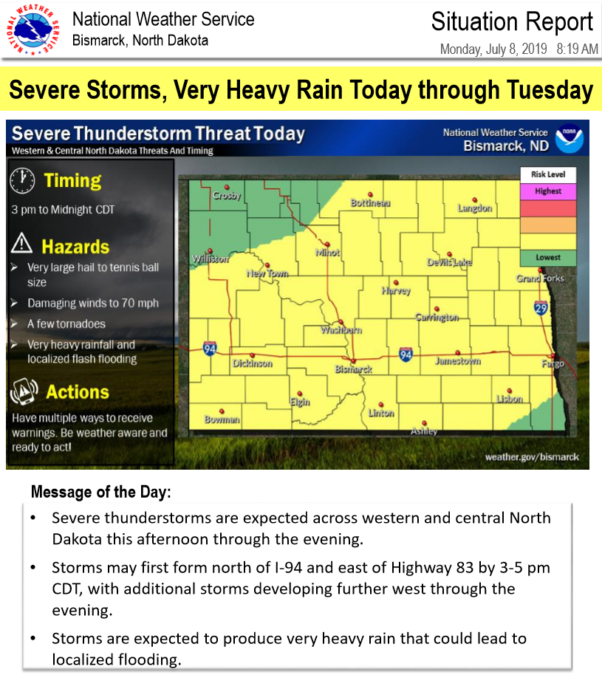
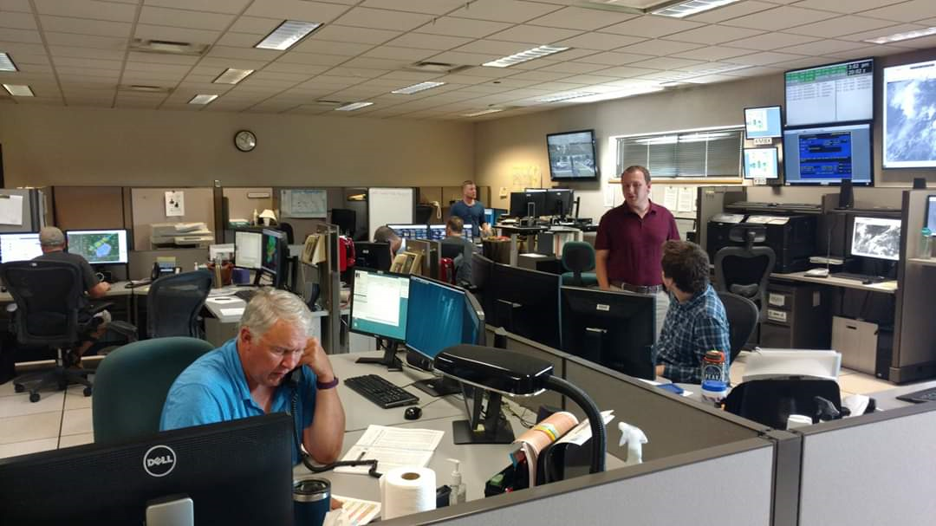
Impact-Based Decision Support Services
WFOs communicate expected hazards, including via warnings

Slide 3
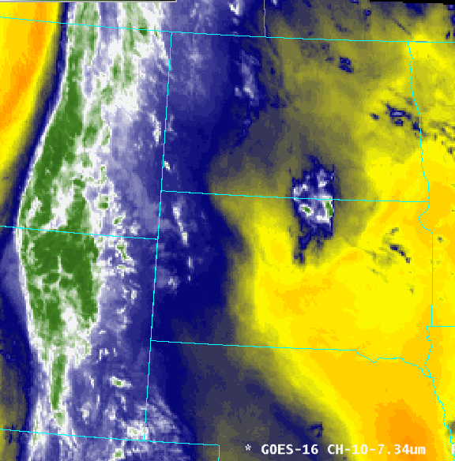
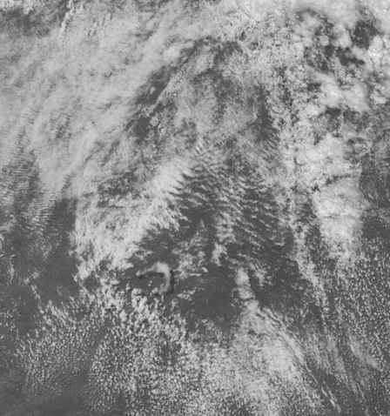
WFO Desired Outcome #1: Assess environmental “preconditioning” to collaborate/message risk
Water Vapor/ALPW Track EML
NUCAPS Confirms Capping
“Billow” Clouds = Higher BL SRH
Operational Challenges: Data availability/integration, balancing with model simulations, identifying features

Slide 4
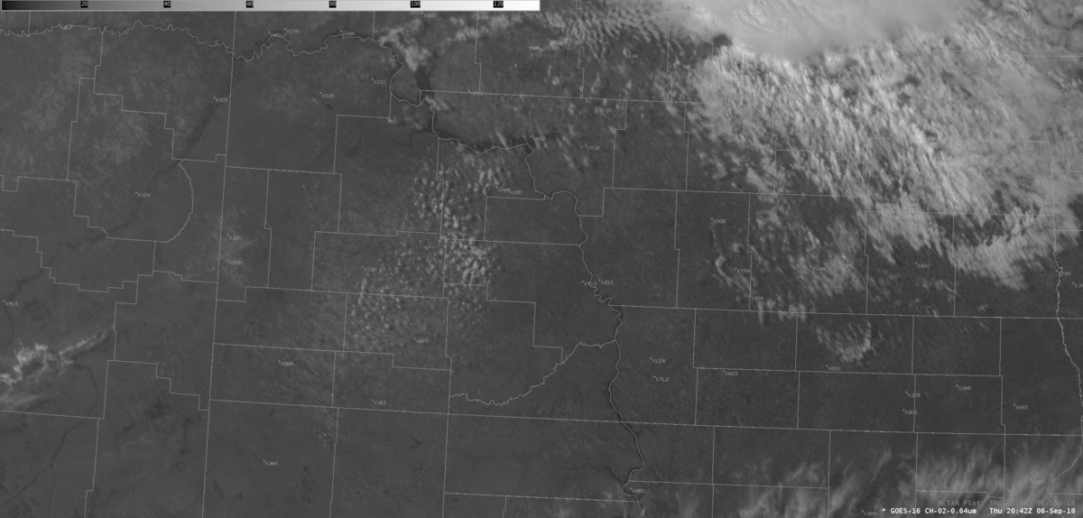
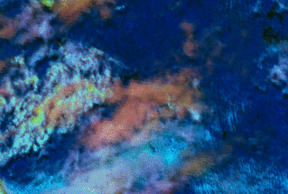
WFO Desired Outcome #2: Anticipate convective initiation at small spatiotemporal scales
Visible band and Day Cloud Phase RGB illuminate initiation elements, including orphan anvils
Operational Challenges: Identifying subtle features, multi-layer dependency, lack of pre-glaciation products

Slide 5
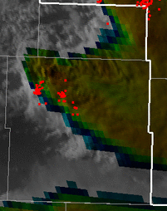
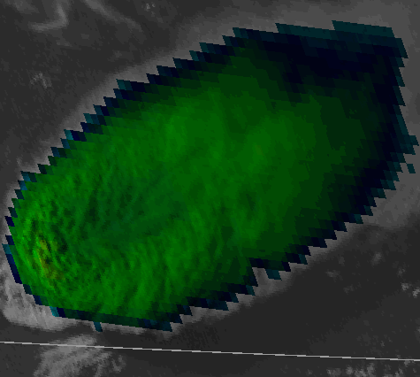
WFO Desired Outcome #3: Issue detailed severe thunderstorm and tornado warnings
Visible/Infrared Sandwich Product for Updraft Strength / Seeing AACPs
GLM for Updraft Strength/Trends
Operational Challenges: Data overload for warning teams, AWIPS memory, lack of trend tools/calibration

Slide 6
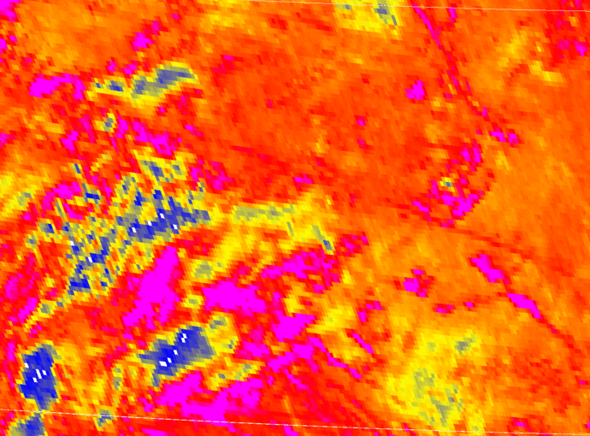
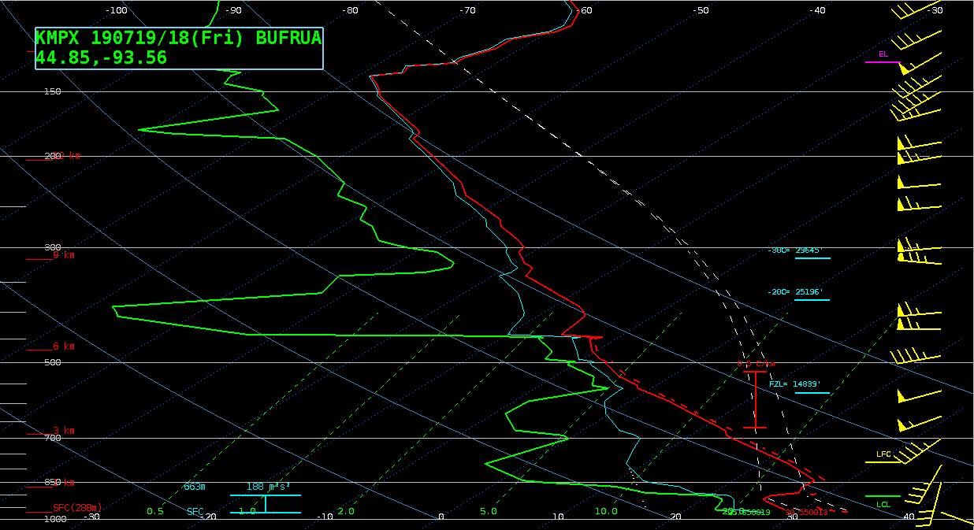
Opportunity: Improved Convective Initiation Tools
NUCAPS Moisture and PBL Sensitivity
Boundary/Forcing Challenges
NUCAPS ~19 UTC
18 UTC KMPX RAOB
Ideas from the field:
Can NUCAPS be paired/blended with RAP PBL data and/or surface observations automatically?
Can GOES-R derived stability indices be improved?
Ideas from the field:
Can a convective initiation algorithm be developed?
Can the split-window product be improved?

Slide 7
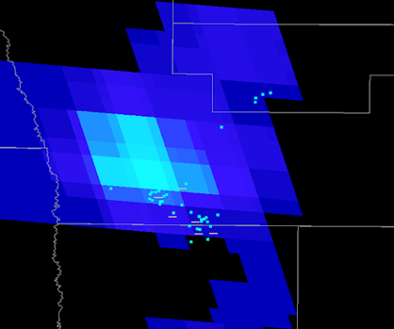
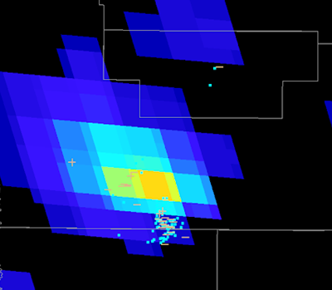
Opportunity: GLM Tool Development
GLM Flash Extent Density Jump with Unwarned EF2 Tornado
T-10 minutes
T+1 minutes
T+6 minutes
Ideas from the field:
Can a calibrated GLM lightning jump algorithm offer situational awareness? Could it be paired with baseline imager and/or RGB products for additional updraft strength/trend identification?
Can GLM be refined/improved (or “bias corrected”) to offer consistent values no matter the storm type and geographic region?

