Slide 1
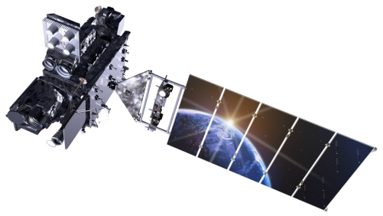
Geostationary Lightning Mapper Update and Applications Scott Rudlosky (NOAA/NESDIS/STAR) GOES-R JPSS Summit (24 February 2020)

Slide 2
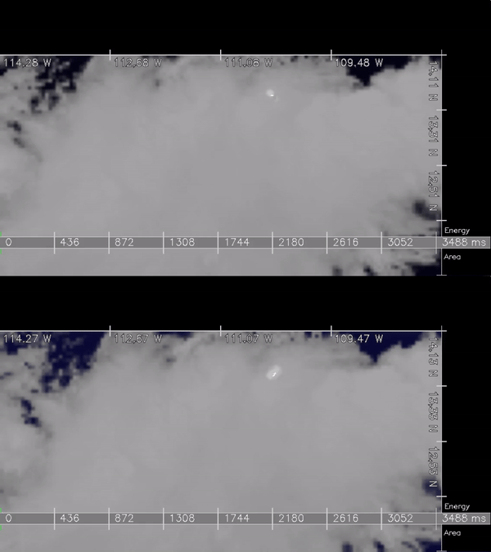
Geostationary Lightning Mapper
First of its kind instrument, discovering new things daily, two product lines
Clearly a lightning imager rather than a detector (very fine temporal resolution)
Have only scratched the surface in terms of instrument capabilities
The TRMM Lightning Imaging Sensor (LIS) could require up to 35 years to sample the diurnal cycle for the equivalent of the 257 days (~9 months) studied by Rudlosky et al. (2019)
GOES-16 GLM
GOES-17 GLM

Slide 3
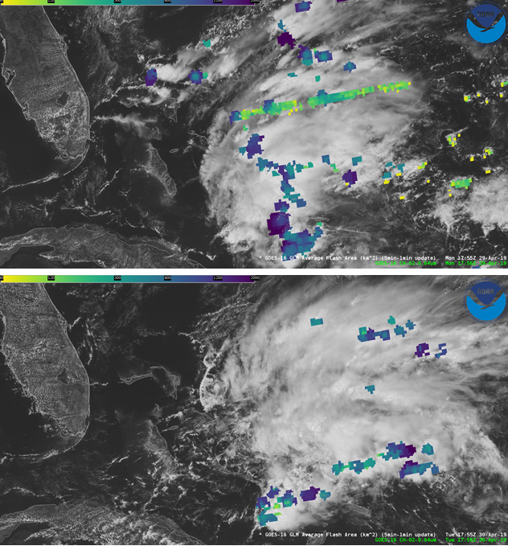
GLM L2 Product Status
https://lightning.umd.edu/documents/GS_Status/
GLM_GS_Status_8_21_19.pdf - lists all known GLM-related changes to the Ground System (GS) software since initial deployment
GOES16_GLM_FullValidation_ProductPerformanceGuide.pdf summarizes key performance metrics and existing issues of the GOES-16 GLM L2 data product found on November 1, 2018
Variable performance still must be better documented, understood, and communicated
With time, as the onboard settings and GS processing evolve
Within the FOV (i.e., diurnal, regional, and storm-scale variability)
Bahama Bar Before and After

Slide 4
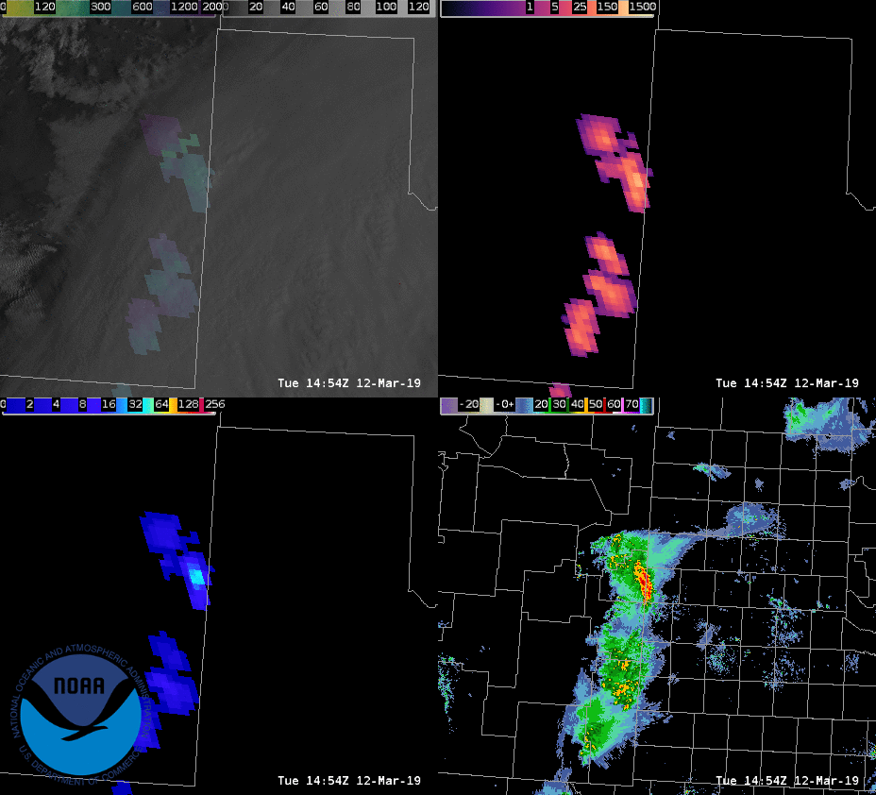
GLM in the National Weather Service
The GLM observations fundamentally differ from the ground-based lightning data most familiar to forecasters
Collaborative effort developed a new suite of gridded GLM products tailored to NWS operations
Gridded products presently produced and distributed via experimental channels (AWC – CRH – Other RHs – WFOs)
Average Flash Area
Total Optical Energy
Flash Extent Density

Slide 5
GLM Path Forward
Experimental distribution results in product downtime (and sub-optimal latency) which discourages operational use
Must accelerate hardening of this product path to encourage forecaster use and best advise deliberations on next generation architecture
Proposed path forward:
Include the x, y, lat, lon, and pixel ID in the L2 data to drastically simplify derivation of the gridded products [FY20]
Develop much simpler image processing codes in the CSPP-GEO to compute official GLM gridded products at each GRB site [FY20]
Transfer CSPP-GEO decoder to the GOES Ground System to broaden availability of the gridded products (e.g., SBN, GEONETCast) [FY21]

Slide 6
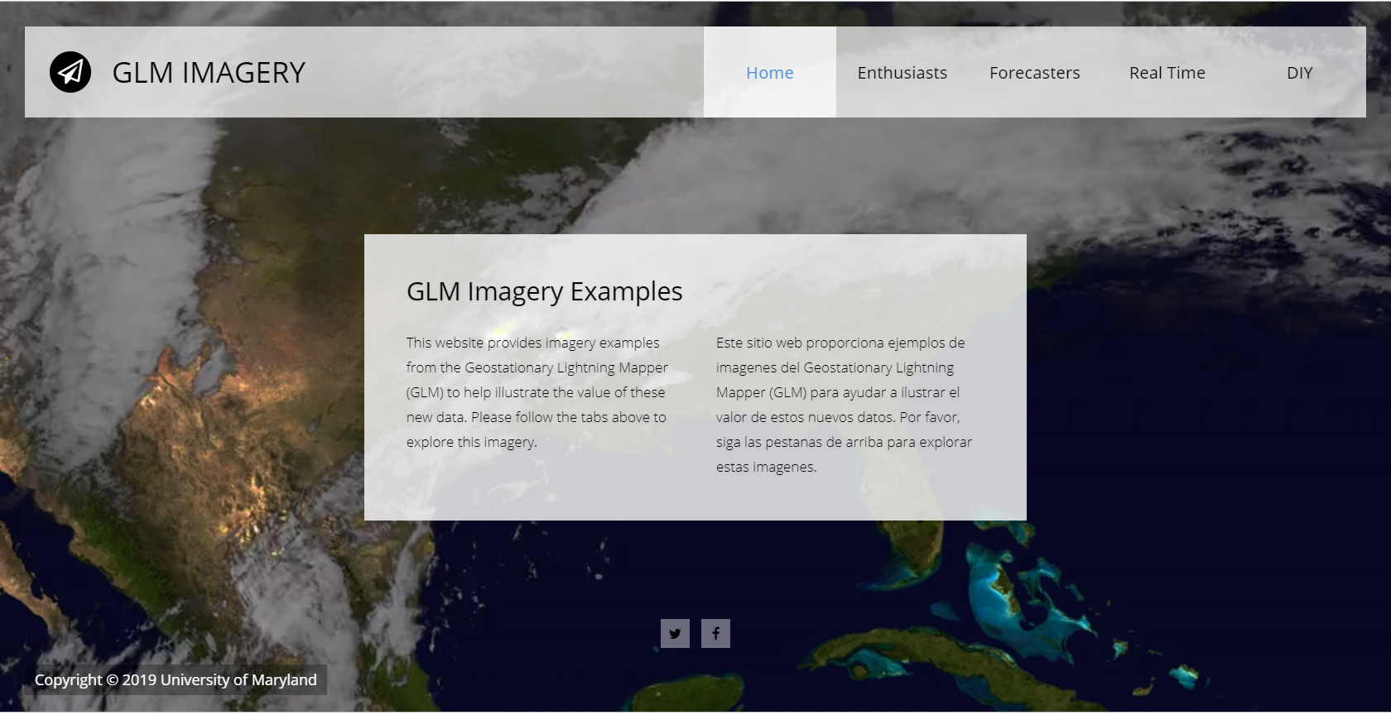
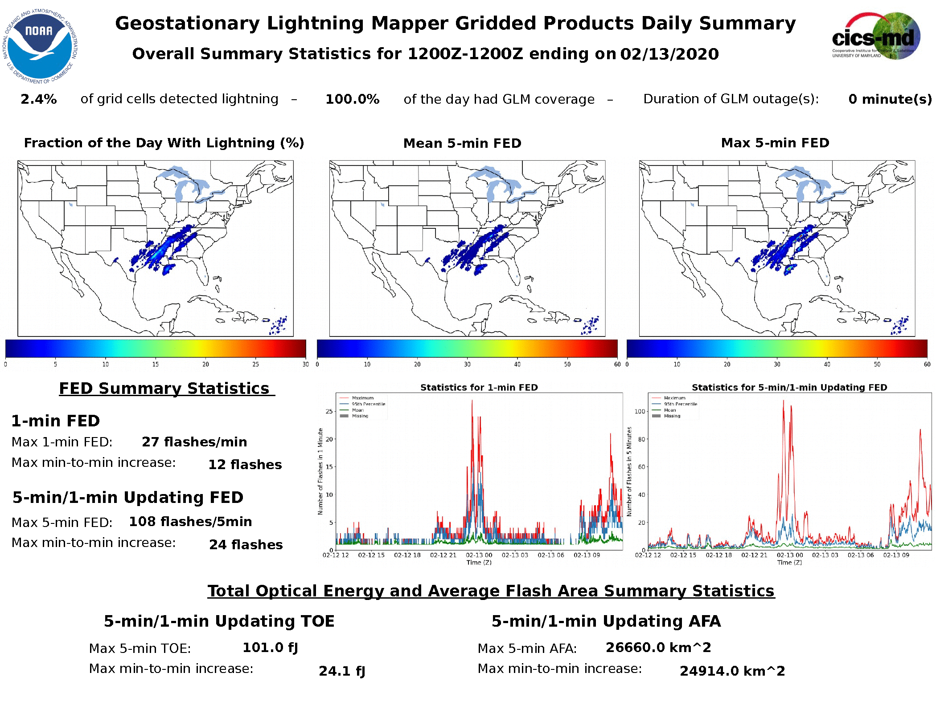
GLM Outreach
Aim to promote proper use and interpretation (e.g., new visualization website)
https://lightning.umd.edu/glm/
NWS VLab Webpage
https://vlab.ncep.noaa.gov/web/geostationary-lightning-mapper

Slide 7
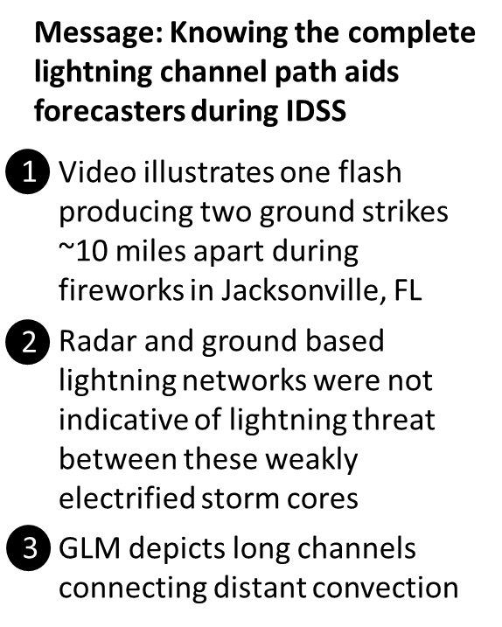
GLM Application
Case contributed by Chad Gravelle (NWS SRH)
Summarized by Scott Rudlosky (NESDIS STAR)

Slide 8
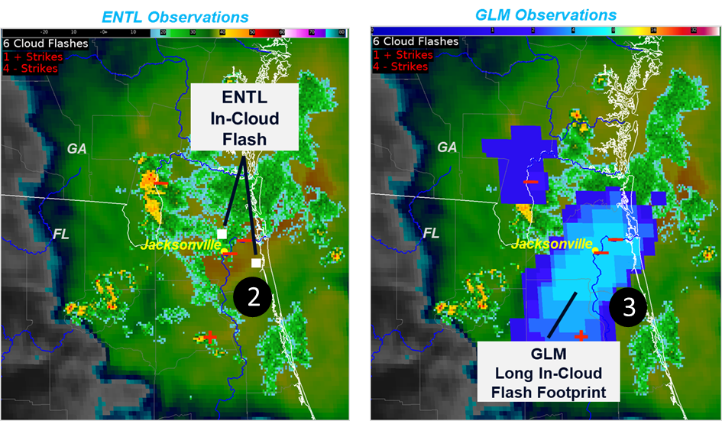
GLM Application
Case contributed by Chad Gravelle (NWS SRH)
Summarized by Scott Rudlosky (NESDIS STAR)

Slide 9
GLM Application
Cases contributed by Chad Gravelle (NWS SRH) and Brian Carcione (NWS/HUN)

Slide 10
GLM Application
Cases contributed by Chad Gravelle (NWS SRH) and Brian Carcione (NWS/HUN)

Slide 11
Thank you for your attention
Experimenting with GLM Storms

