Slide 1
Modeling and Data Assimilation for UFS Applications
JPSS/GOES-R Proving Ground Risk Reduction Summit, 24 February 2020
Vijay Tallapragada
NOAA/NWS/NCEP/EMC

Slide 2
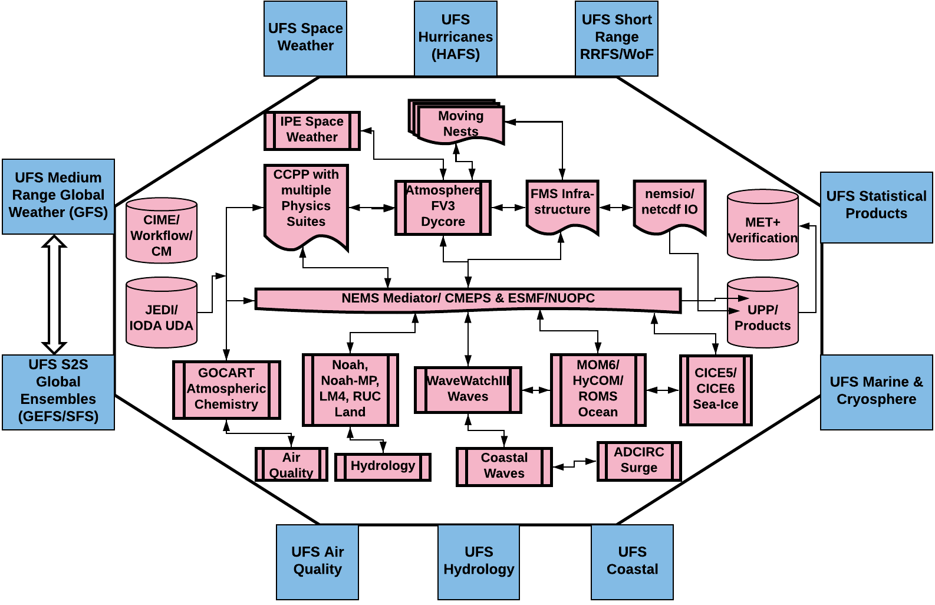
NPS Transitioning to UFS Applications
Conceptual UFS applications in production covering all NPS applications.
Components of UFS are configured to develop distinct applications while maintaining the dependencies between the applications and products

Slide 3
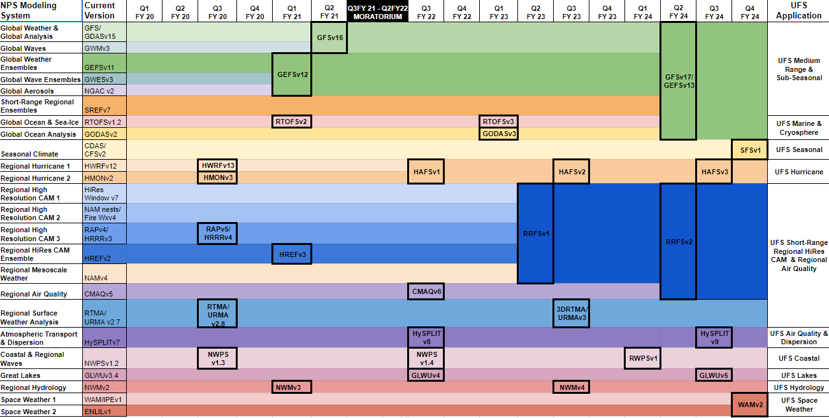
Timelines for transitioning NPS to UFS Applications (planned)
WCOSS Moratorium

Slide 4
Recent and Planned Upgrades to the GFS
GFSv15.1 (June 2019)
Initial implementation of FV3-based GFS
Increase analysis increment & ensemble resolution
No DFI
GFSv15.2 (November 2019)
Observation changes: GOES-17 AMVs, KOMPSAT-5 GPS, METOP-C AMSU-A and MHS
NSST Updates
GFSv15.3 (TBD)
Observation changes: COSMIC-2,
METOP-C GRAS and IASI
GFSv16 (Early 2021)
GSI-based Hybrid 4DEnVar
127 Layers, ~80km model top
Updated physics
Modulated-ensemble LETKF (model space localization)
4D-IAU
Correlated observation errors
VarQC re-design
LDAS

Slide 5
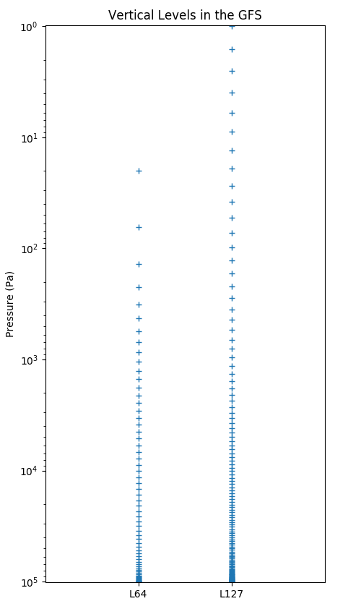
GFSv16 Data Assimilation Upgrades
The GFSv16 will move from 64 layers to 127 layers, raising the model top from 55 km to 80 km.
4D Incremental Analysis Update (IAU)
Replace EnSRF with LETKF (including model space localization and linearized obs operator)
Intra-channel correlated observation errors for radiances
Additional channels (AMSU-A ch14 and ATMS ch15, clear-sky radiances from Meteosat 8 (SEVIRI), Himawari 8 (AHI), GOES-16 ABI)
Variational Quality Control update
New observations
“GLDAS”
Reduced humidity increments in stratosphere
Improved NSST

Slide 6
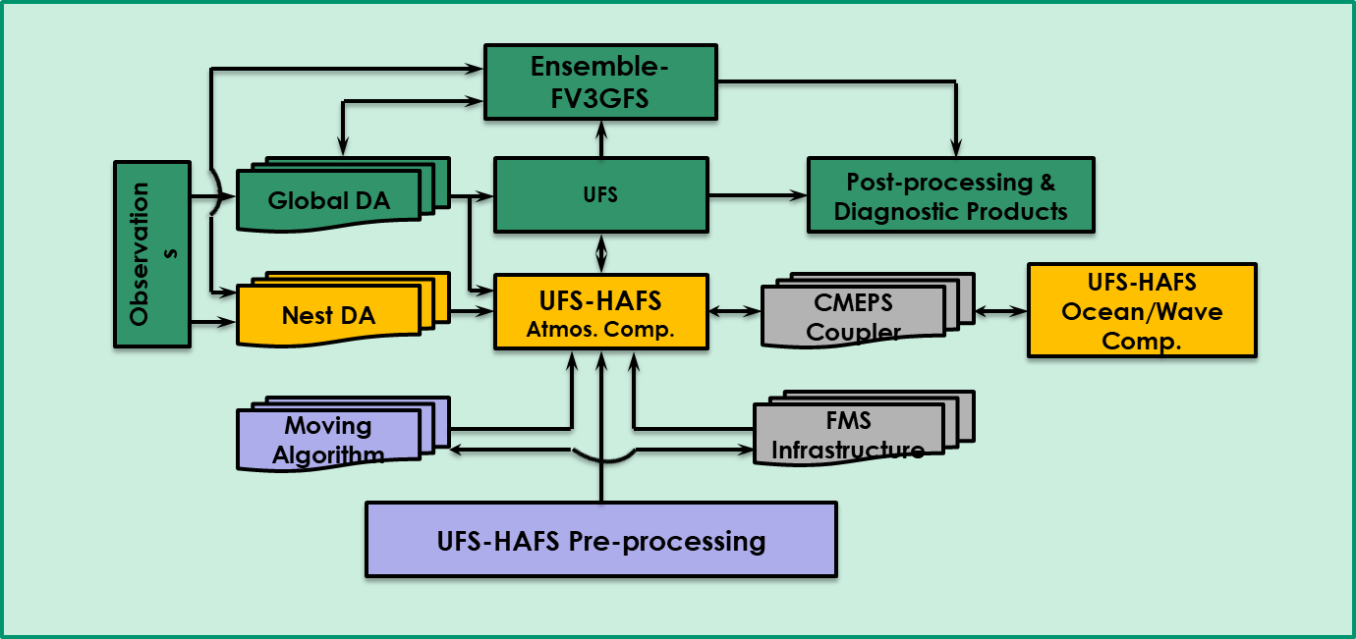
UFS-HAFS Strategic Roadmap

Slide 7
Data Assimilation for Hurricane Models
 |  |  |  | 2011 | 2012 | 2013 | 2014 | 2015 | 2016 | 2017 | 2018 | 2019 | 2020 | 2020+
 | GSI-based DA
 | GSI hybrid
 | P3 Doppler velocity
 | Dropsondes (partial)
 | Global Hawk dropsondes
 | Warm-start HWRF ensemble
 | SLP from TCVitals
 | Satellite radiances/winds (D03)
 | Flight-level obs.
 | Fully-cycled DA (EnKF/GSI)
 | SFMR
 | Dropsondes (all with drift)
 | G-IV Doppler velocity
 | Stochastic physics (DA)
 | Spectral filter for increments
 | Dynamic obs. errors for recon
 | WSR-88D Doppler velocity
 | Clearsky radiance data (more channels)
 | All sky radiance data (inner core)

Slide 8
UFS: Simplification of Regional Model Production Suite
Long Term
GFS/GEFS
to subsume
RAP/NAM/SREF
Global (10-15 km, 4-24/day)
GFS
GEFS
CONUS/OCONUS
CAM (3 km, 2-24/day)
Rapid Refresh
Forecast System
RRFS to subsume
HRRR/NAMnest/HREF
RRFS
What is the RRFS and how do we get there?
Sub-CONUS
CRM (1 km, on-demand)
Warn on Forecast
System
WoFS
*Material courtesy of C. Alexander

Slide 9
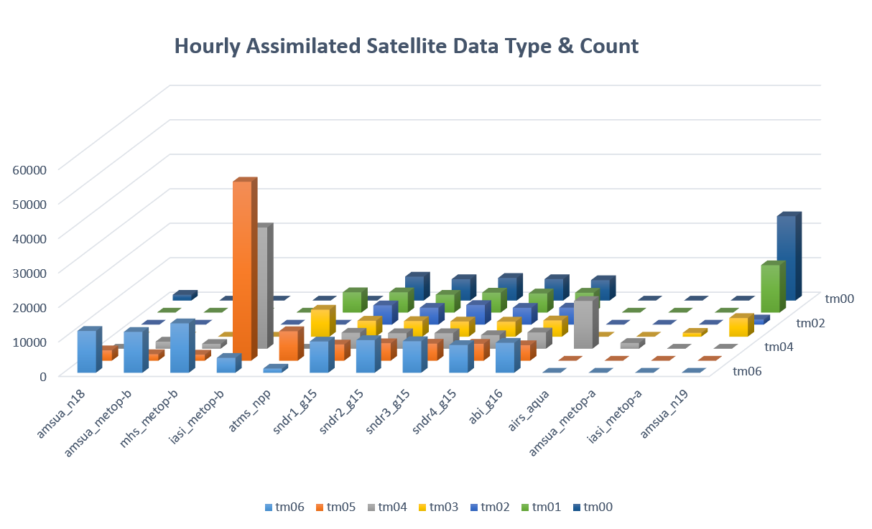
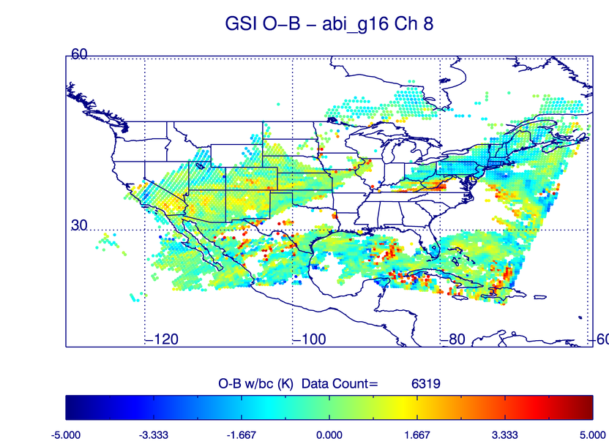
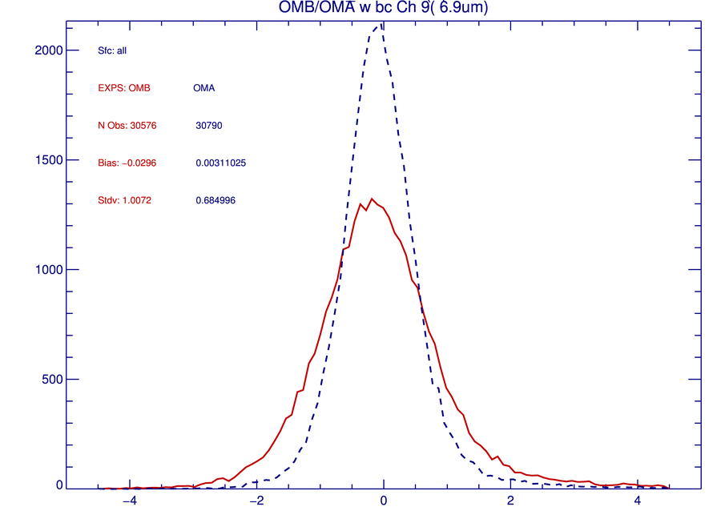
Ongoing Radiance DA Development
Hourly assimilation of radiances
Same data as GFS
Using radiance data through Regional ATOVS Retransmission Service (RARS) to reduce the data latency
Bias corrections for all satellite instruments are estimated within the regional system
Coldstart from GFS
60 hr 3 km forecast
6 hour forecast at 3 km
Hourly hybrid 3DEnVar assimilation
Using global EnKF members
GOES-16 O-Bs and O-As with bias correction
GOES-16 O-Bs
*Material courtesy of X. Zhang

