Slide 1
Improving rapidly-developing storm prediction by assimilating high-resolution GOES-16 ABI Infrared water vapor and cloud sensitive radiances:
issues and challenges
Xuguang Wang, Aaron Johnson
Krishna Chandramouli
Multiscale data Assimilation and Predictability (MAP) laboratory
School of Meteorology, University of Oklahoma
Collaborators:
Jason Otkin (CIMSS, U. Wisconsin)
Thomas Jones (CIMMS, U. Oklahoma)
Jefferey S. Whitaker (NOAA/ESRL/PSD)
Yanqiu Zhu (NCEP/EMC)
24 Feb. 2020
JPSS GOES PGRR summit, College Park, MA
Notes:
Similar instrument as AHI
Focus on initiation of severe convection, and the GSI-based EnKF/EnVar system
Ack coauthors

Slide 2
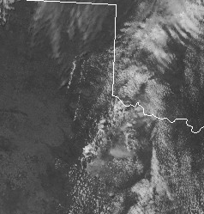
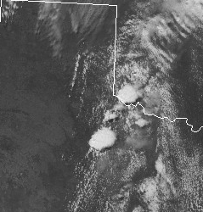
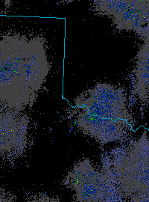
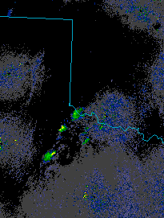
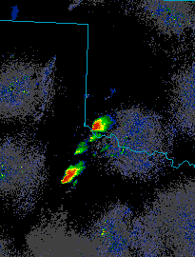
Background and motivation
Direct radar reflectivity assimilation has shown good results for already-initiated storms (e.g., Dowell et al. 2011; Johnson et al. 2015; Wang and Wang 2017).
High resolution ABI obsrvations can be complementary to radar observations and if assimilated can add lead time to NWP of rapidly developing storms (e.g., Cintineo et al. 2016).
Visible satellite
1745 UTC
1815 UTC
Composite Reflectivity
1730 UTC
1800 UTC
1830 UTC
May 18 2017

Slide 3
Challenges of assimilating GOES-16 clear air and cloudy radiances in convection allowing models
Issues of numerical models
Bias (model and obs.) correction
Observation error estimation (operator error, representativeness error, etc.)
Effective assimilation of multiple channels
QC during DA
Data assimilation algorithm advancement to treat nonlinearity and multiscale

Slide 4
Research and Development made so far
We have implemented ABI clear air and cloudy radiance assimilation in GSI-EnKF with various methods to enhance the assimilation.
additive noise inflation to treat model issue
adaptive obs. error estimation
understanding impact of assimilating different ABI channels (channel 9 vs. channel 10)
comparing different bias correction predictors/methods.

Slide 5
GOES-16 products used
Bias correction predictor
Schmit et al. (2017)
Assimilated
Parallax correction
Removal of partial cloudy pixels
Schmit et al. (2017)

Slide 6
Case Overview
May 18 2017
1
1
3
3
2
2
Observed maximum composite reflectivity during 1800-2000 UTC
Observed maximum composite reflectivity during 1800-1830 UTC
Observed maximum composite reflectivity during 1830-1900 UTC
Two long-track supercells were observed in southwestern OK and north-central TX.
Interested in predicting storm scale details and individual convective cells.
Cell 1 initiated first and had the longest track and a tornado.
Cell 2 developed next, and also intensified quickly into a long-lived supercell.
Cell 3 developed last, eventually weakening as it followed the path of cell 1 and ingested cooler air.

Slide 7
Additive Noise Inflation Implementation
Radar and Ch. 10 DA: 1830 UTC cycle
Ensemble based DA cannot add cloud or precipitation hydrometeors to locations where all first guess members predicted zero values of these variables, even if they are implied by the radiance observations.
Zero background error variance for these variables prevents the southern storm(s) (e.g. cell 2) from being produced during ABI DA cycling
Analogous approach to radar reflectivity DA, an additive noise inflation approach is adopted where observations indicate cloud but background indicates clear air.
Cell 2
Cell 3
Cell 1
Ensemble mean background of reflectivity (shaded, potential temperature (red contour), water vapor (green contour), and total cloud (black contour).

Slide 8
Additive Noise Inflation Impact on Channel 10 ABI DA
Verification of time-maximum (using output files every 5 minutes) composite reflectivity during the 1830 to 1900 UTC period.
The implementation of AN allows all storms be well forecast in the 1830 UTC initialization.
The northern storms are able to be forecast with greater lead time. Southern storms captured at 1830 init.
Further optimizations to the AN implementation is still ongoing.
1810 init.
1820 init.
1830 init.
Observation
1
1
1
No AN
3
1
3
2
AN
1
1
1
3
3
2
1830 to 1900 UTC
1830-1900 UTC Forecast time-maximum composite reflectivity

Slide 9
Cross Section Diagnostics on Additive Noise Inflation (Ch10)
Cross sections of DA increment to potential temperature (shaded), water vapor (green contour), and total cloud hydrometeor (black contour)
No Additive noise
Additive noise
Cell 2
Cell 3
Cell 1
Cell 2
Cell 3
Cell 1
1820 UTC
Additive noise allows the increments to produce deeper storms in northern two cells.
Additive noise allows DA to start spinning up the southern storm in the 1820 UTC cycle

Slide 10
Impact of adaptive obs. error estimation
1810 UTC init.
1820 UTC init.
1830 UTC init.
Observation
Ch10
1
3
2
Ch10 adaptive
1830 to 1900 UTC
Ob error estimated from o-b as a function of symmetric cloud amount
The forecasts are generally improved by using adaptive ob error estimation, especially in the southern storm.

Slide 11
Ch9 vs Ch10 ABI DA impact
Observation
Radar & Ch. 9
Radar & Ch. 10
1
1
1
3
3
3
2
4
2
2
4
4
Forecast time-maximum composite reflectivity
Ch10 better captures cell 3 likely because Ch10 can see the early stages of low-level cloud development more clearly than Ch 9.
Ch9 better captures cell 1& 2 likely because of better spun-up ensemble covariance structure

Slide 12
Challenge of bias correction
Channel 9 BT Observation at times from 1710 to 1830 UTC
Channel 9 BT analysis : Observed BT predictor at times from 1710 to 1830 UTC
Channel 9 BT analysis : Simulated BT predictor at times from 1710 to 1830 UTC
k

