Slide 1
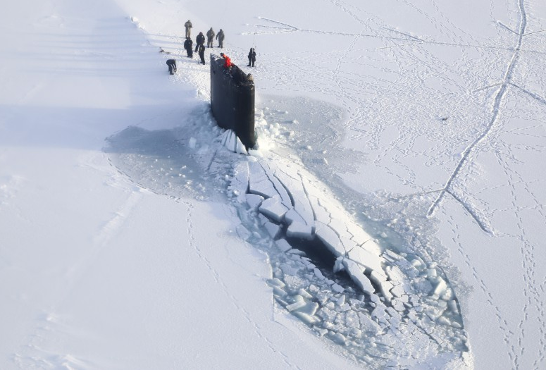
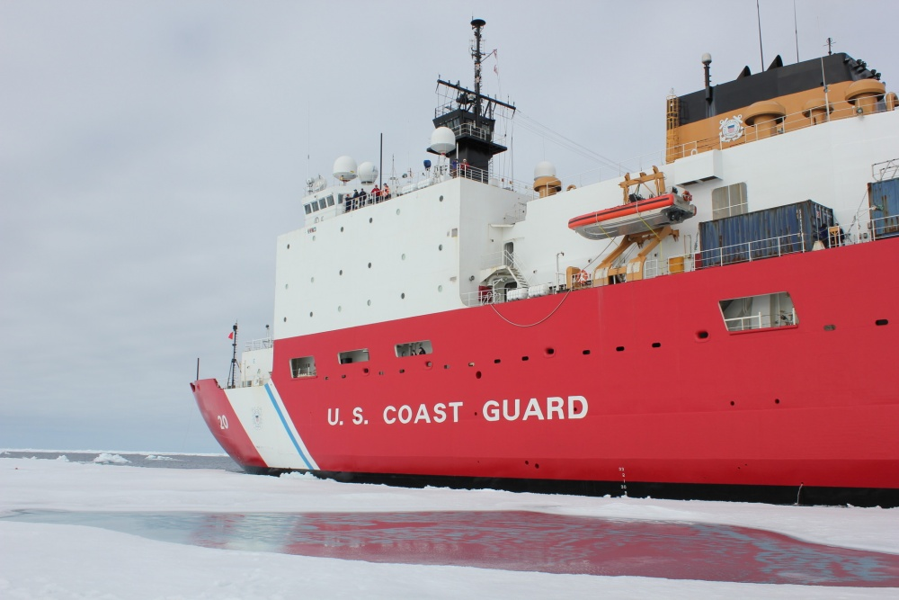
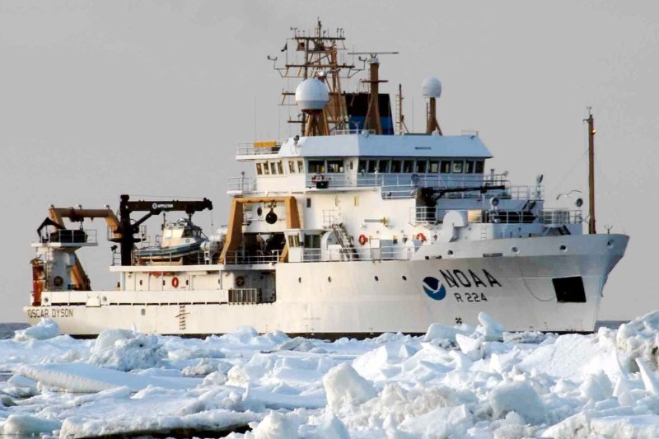
U.S. National Ice Center
Providing Domain Awareness at High Latitudes
USN
USCG
NOAA
Director: CDR Heather Quilenderino, USN
Deputy Director: Mr. Kevin Berberich, NOAA 27 February 2020
JPSS/GOES Joint Proving Ground/Risk Reduction Summit Application Area: Arctic/Cryosphere

Slide 2
Organizational Alignment & Mission
National Weather Service
US Fleet Forces
Asst Commandant for Prevention Policy
National Centers for Environmental Prediction
Commander Naval METOC Command
Naval Information Forces
Director of Marine Transportation Systems
Fleet Weather Center Norfolk
Ocean Prediction Center
Office of Waterways & Ocean Policy
Naval Ice Center
Ice Services Branch
Mobility & Ice Operations Division
Mission: The U.S. National Ice Center provides global to tactical scale ice and snow products, ice forecasting, and related environmental intelligence services for the United States government.

Slide 3
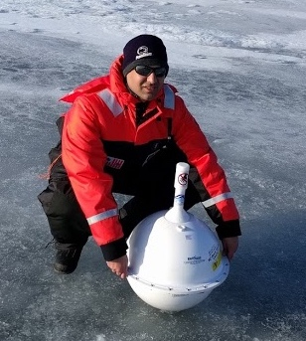
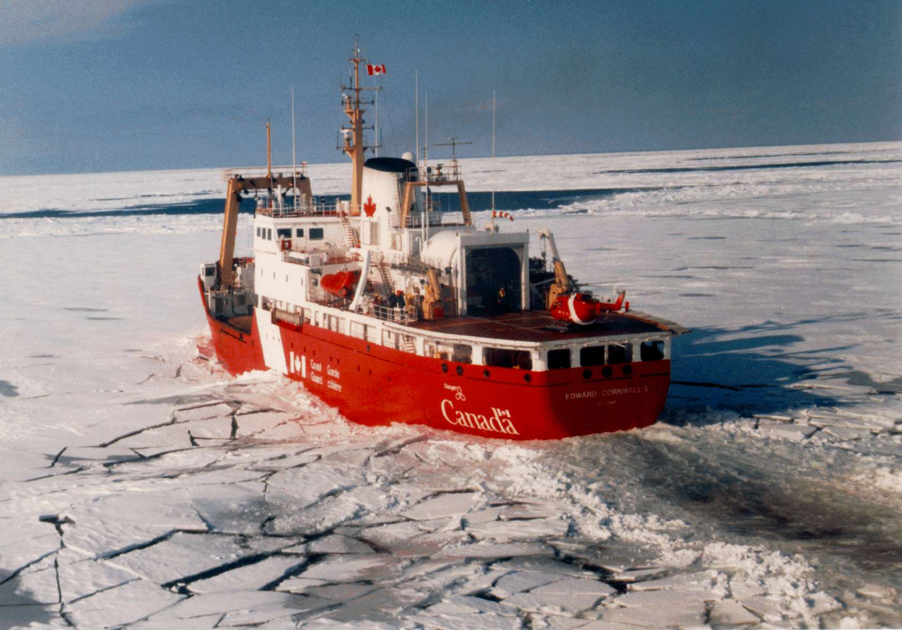
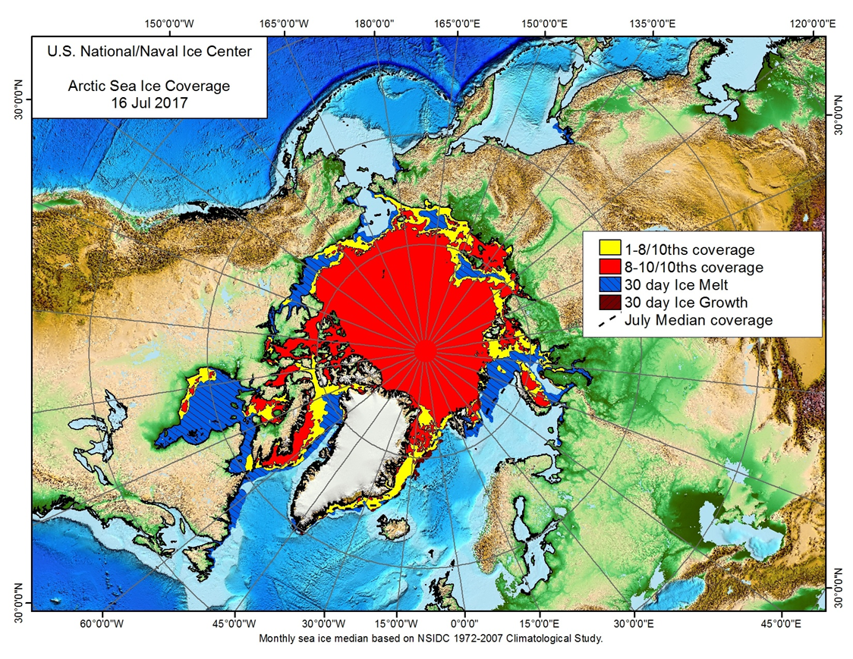
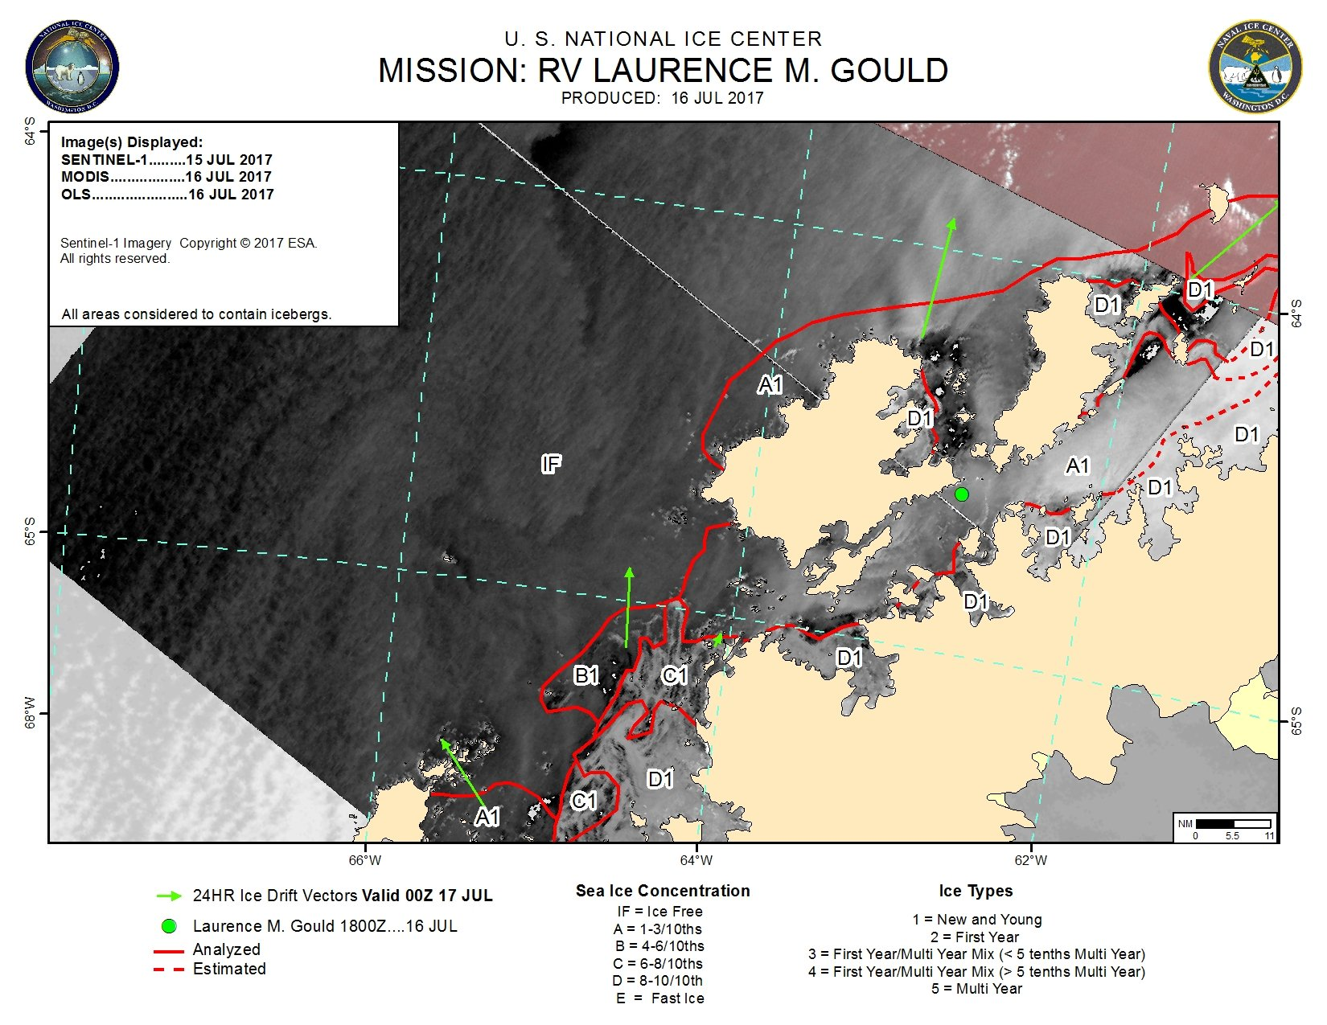
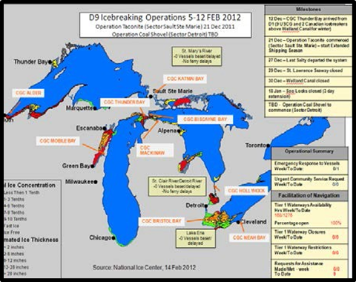
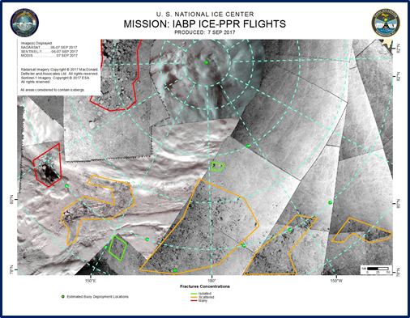
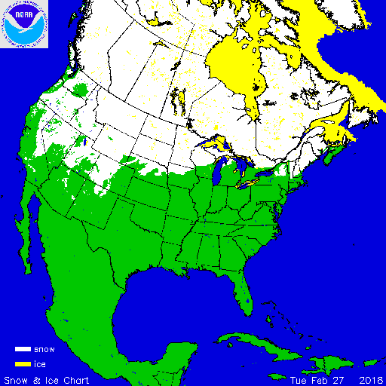
High-Latitude Domain Awareness Global Area of Responsibility
Characterization: Observation, Analysis, and Prediction
Satellites
Buoys
Ship Observations
Aircraft
Webcam
Radar
Surface
Observations
Models
Exploitation: Tailoring and Integration
Weekly Hemispheric
Annotated Imagery
Asset Management
Fractures, Leads
& Polynyas
Daily Snow & Ice Charts
Accurate… Timely… Relevant… Consistent
Notes:
We provide high latitude domain awareness, primarily through interpreting satellite imagery as well as other data sources, and our analysts take that imagery and data and exploit it to create actionable products to meet customer needs.
Annotated imagery is they typical support we provide for government funded vessels and autonomous vehicles to provide ice information for safety of navigation. Asset mgmt. products are geared for Coast Guard customers and will be discussed on a later slide. Fractures, Leads, and Polynyas are all forms of cracks in the ice and is something we provide to submarine operating under the ice. Snow and Ice charts are the products created from the IMS system that will also be shown later.

Slide 4
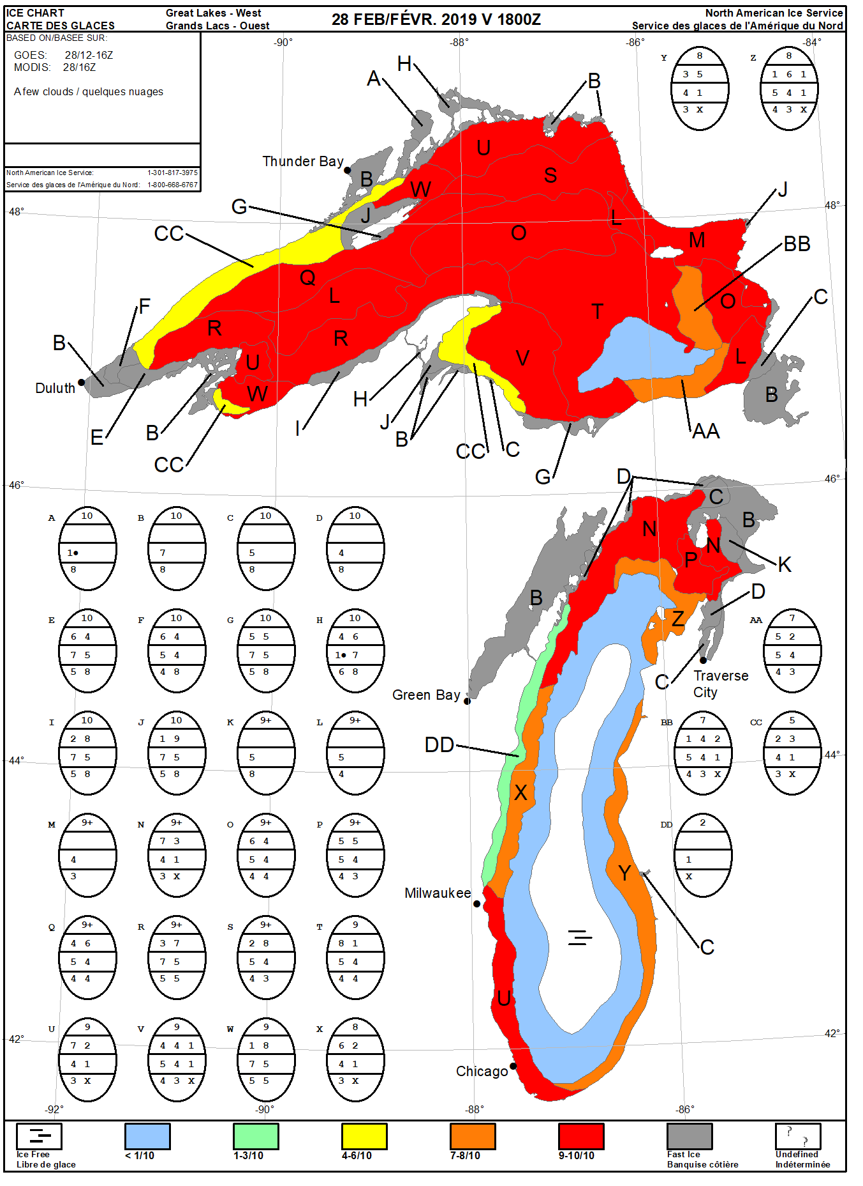
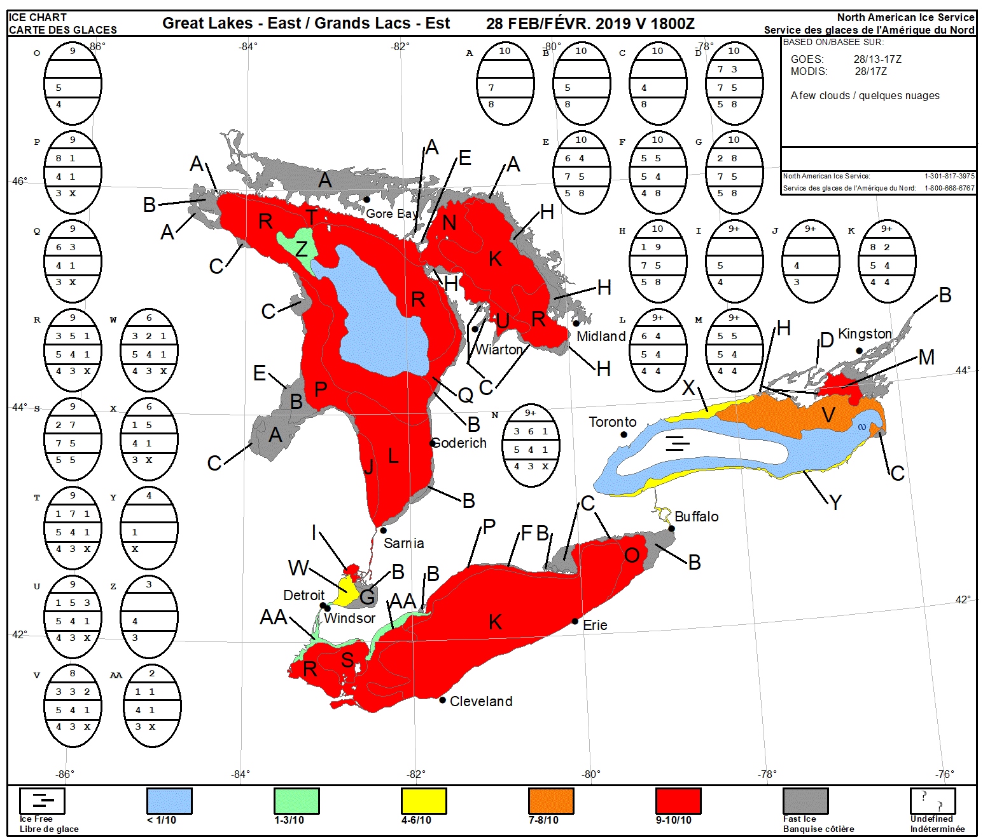
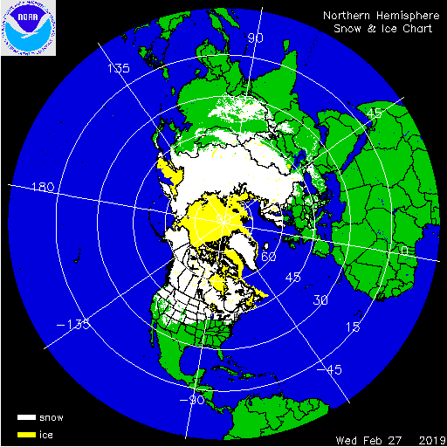
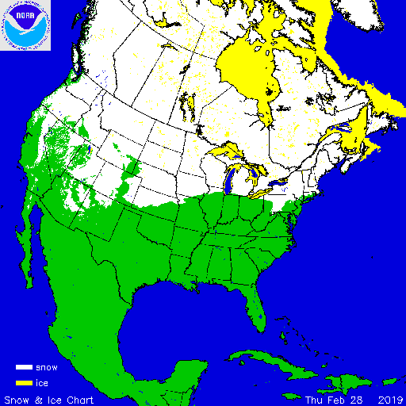
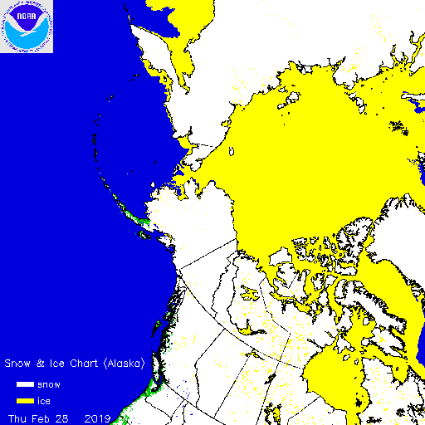
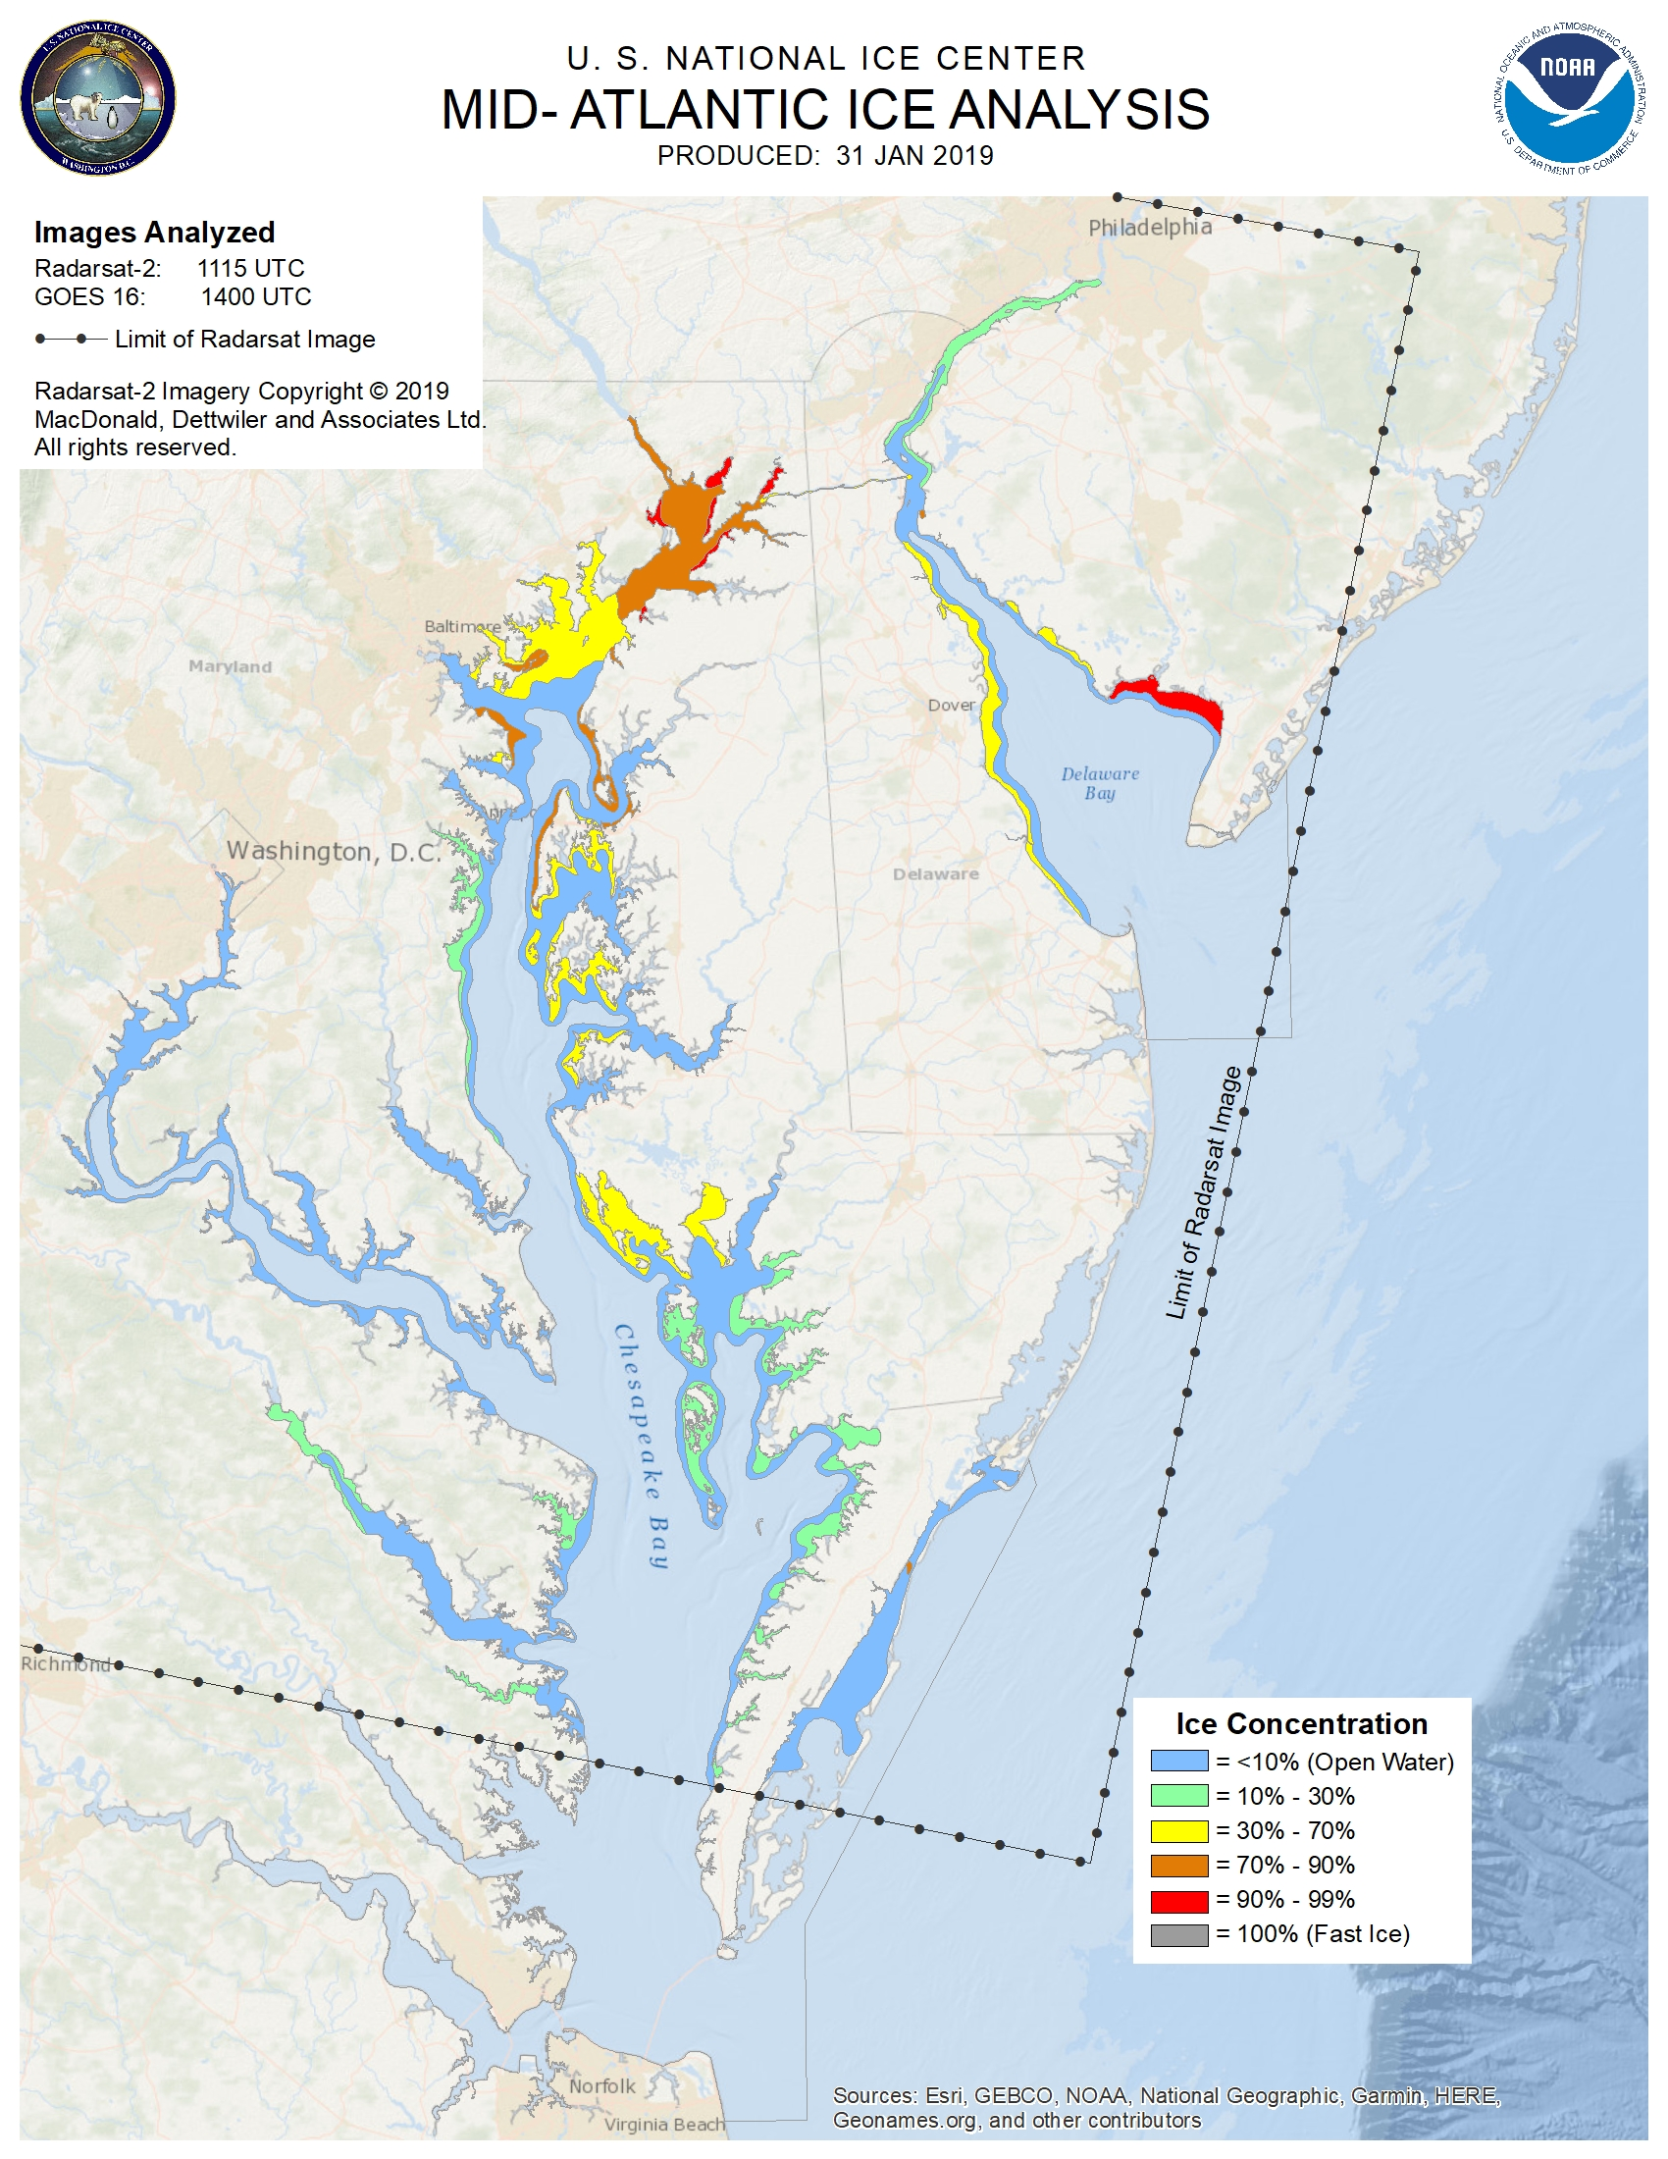
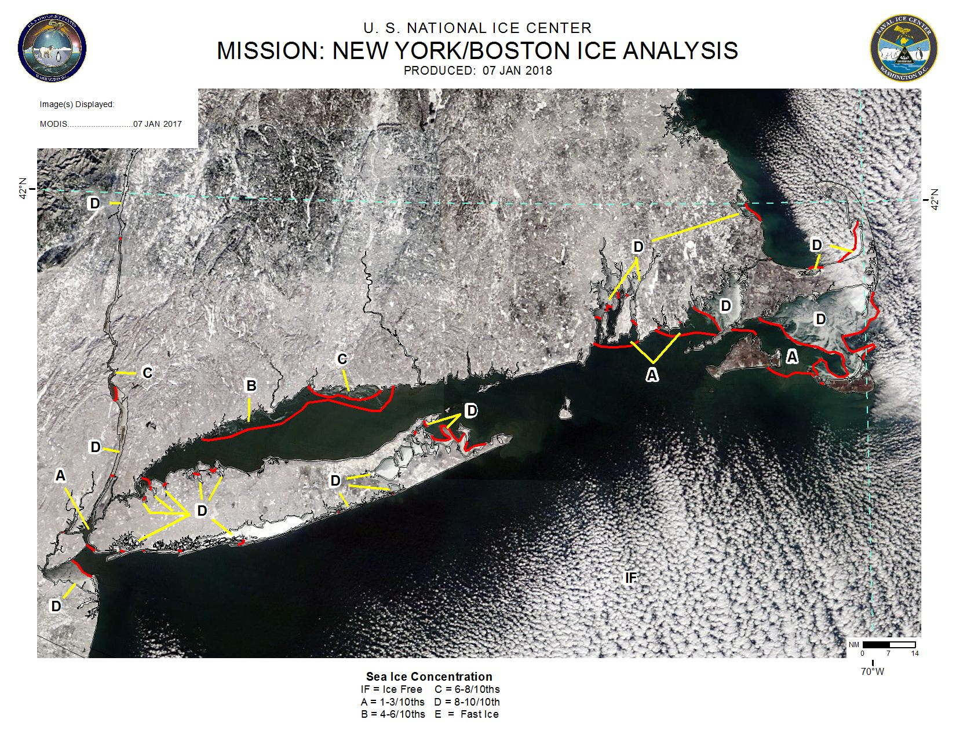
Snow and Ice Operations Sample Products
Interactive Multi-sensor
Snow and Ice Mapping System (IMS)
Great Lakes
Serves as snow and ice initialization for most numerical weather prediction models
Joint US-Canada effort. Charts and forecasts support USCG, NWS, and industry
Chesapeake and Delaware Bay
New England
USNIC forecasts and analyses are considered by the USCG Captain of the Port when making decisions to impose hull restrictions or close regional ports.
Though not as common as ice in the Great Lakes or the mid-Atlantic, USNIC supports operators in the critical hubs of New York City and Boston
Notes:
Done..otd

Slide 5
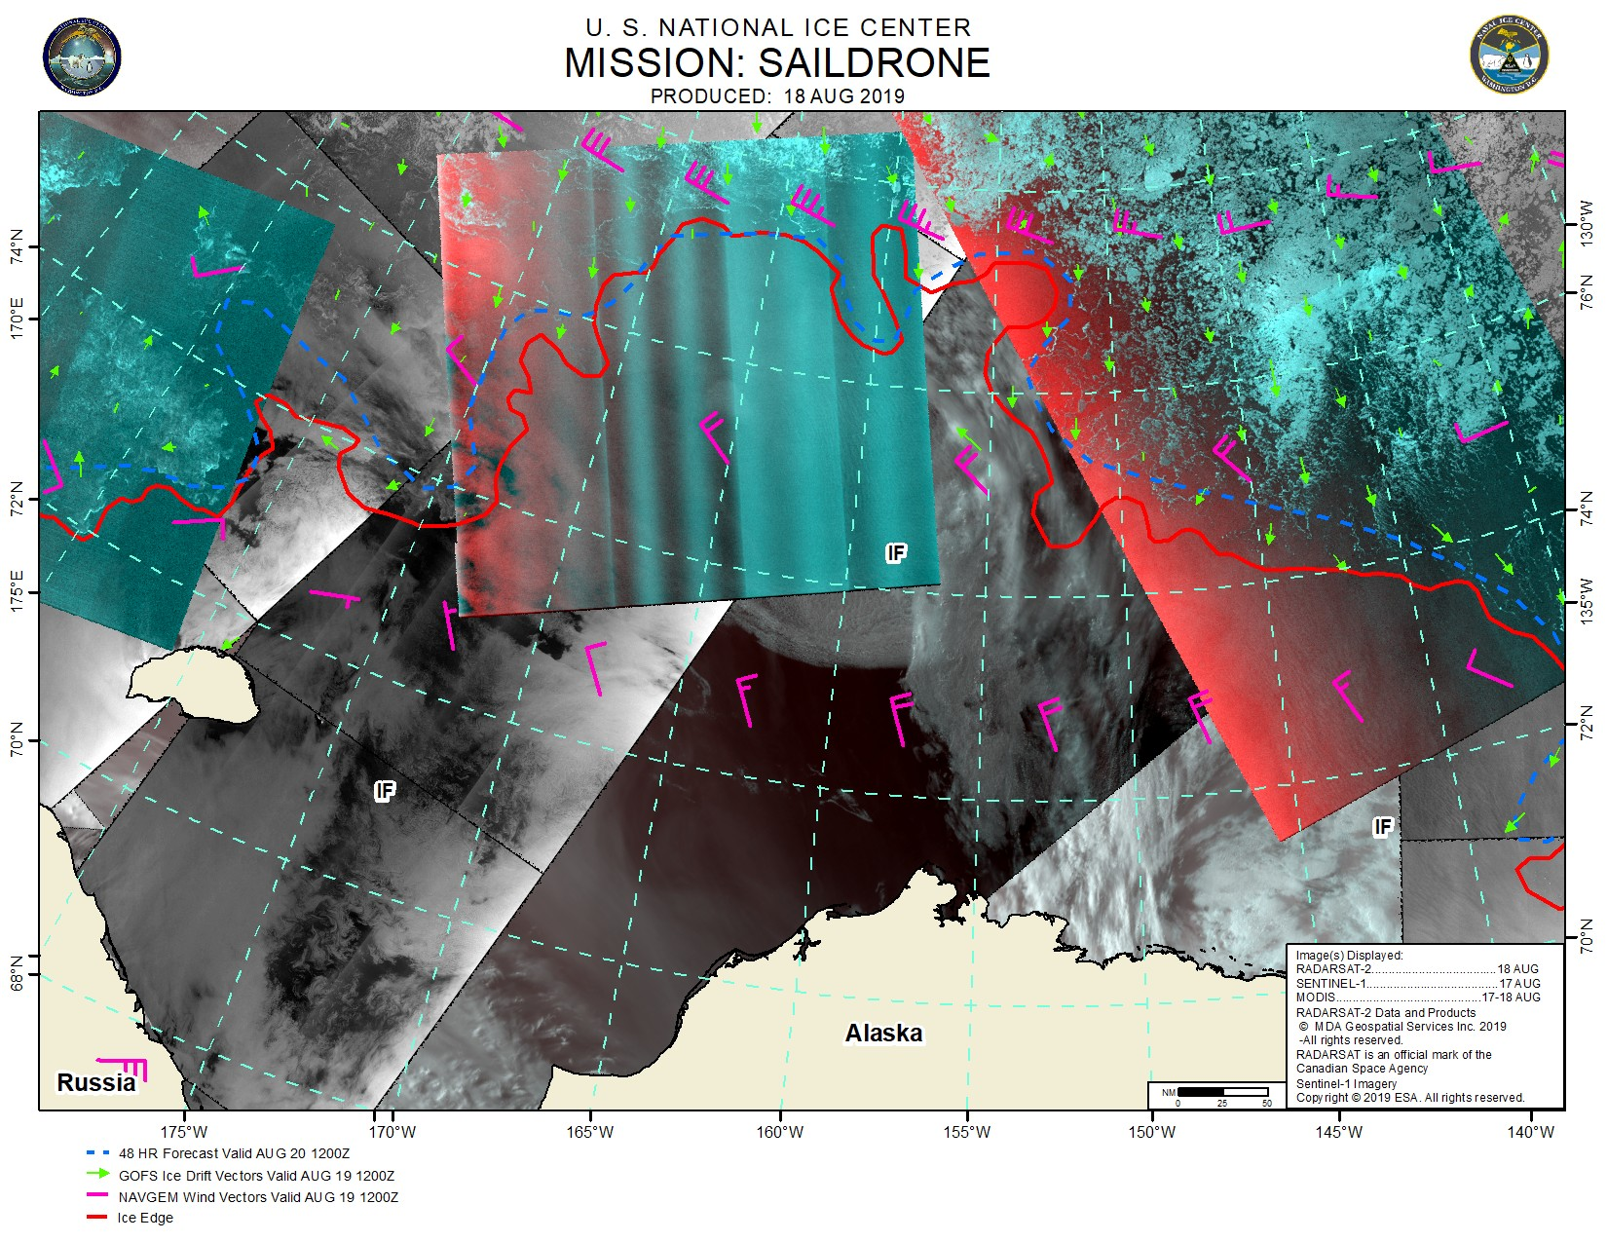
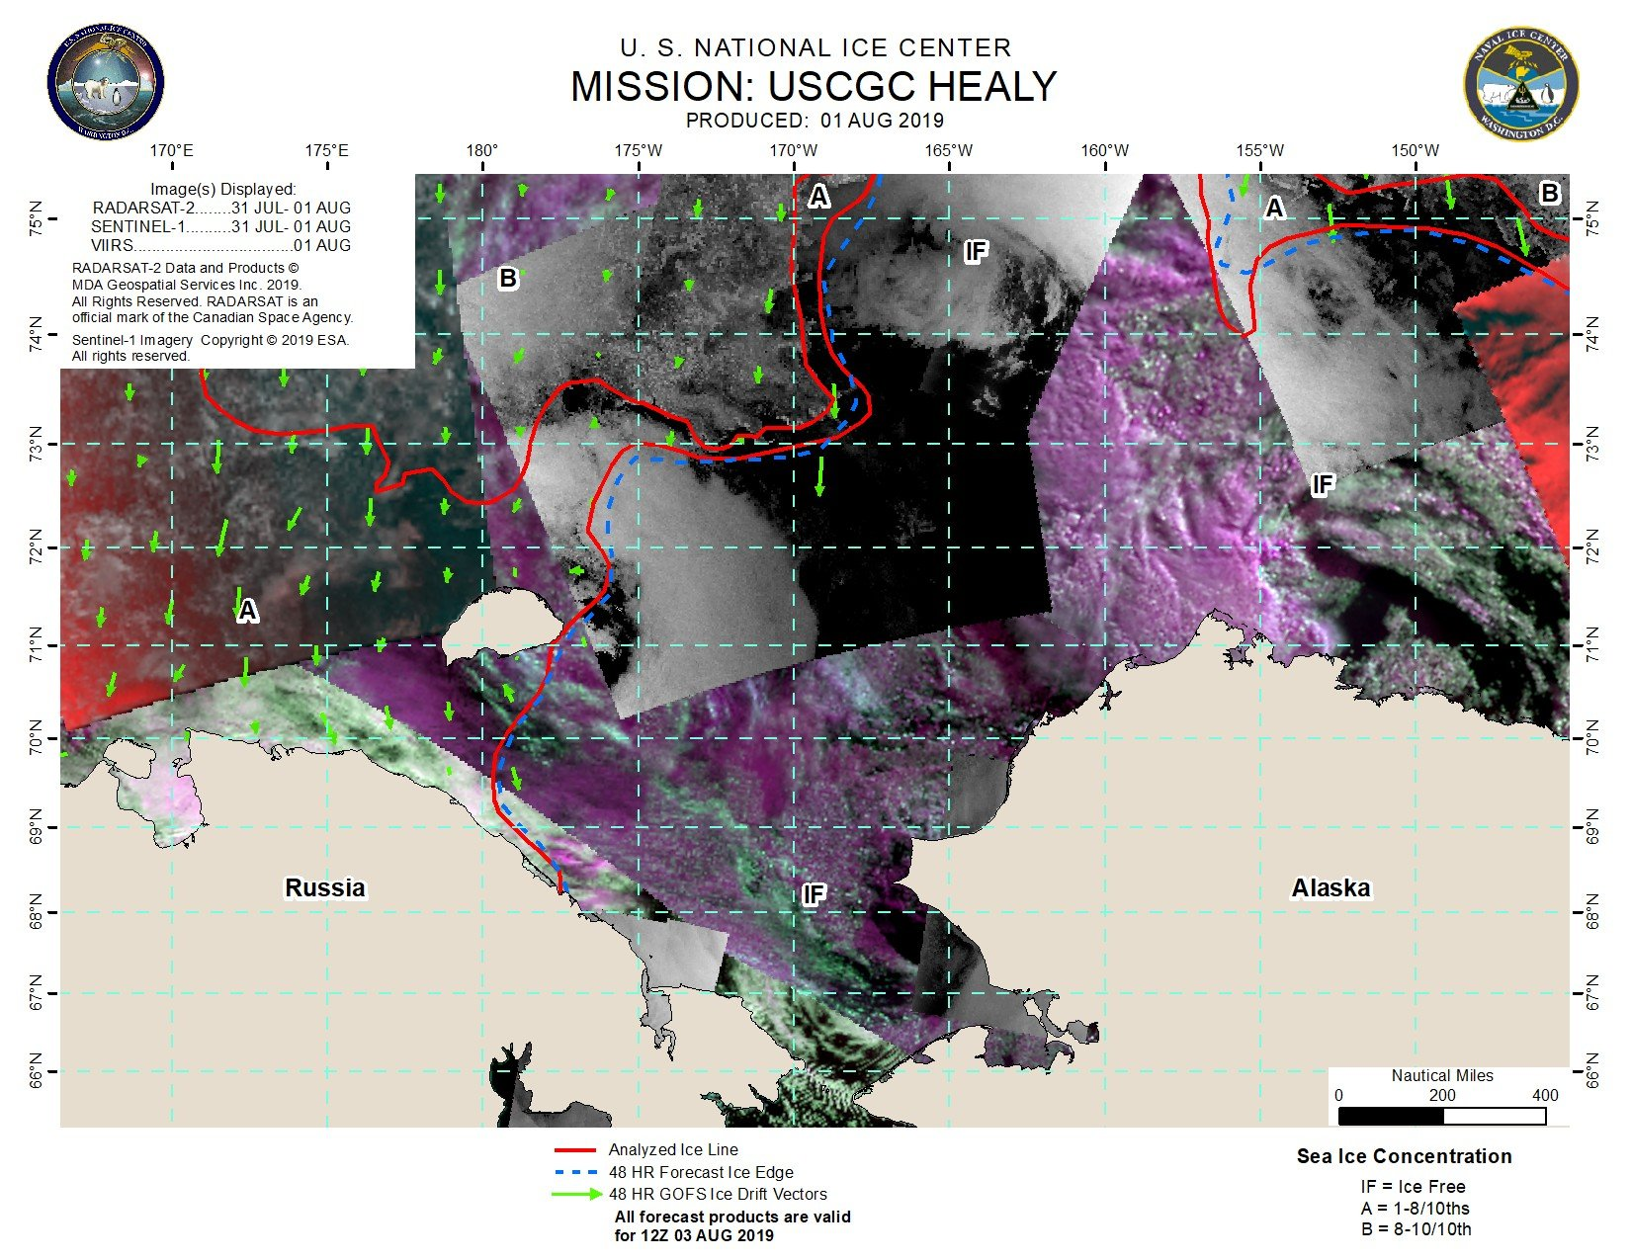
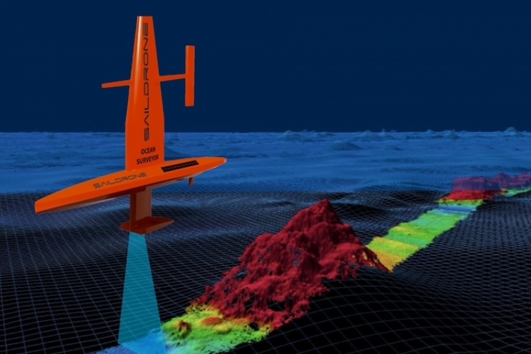
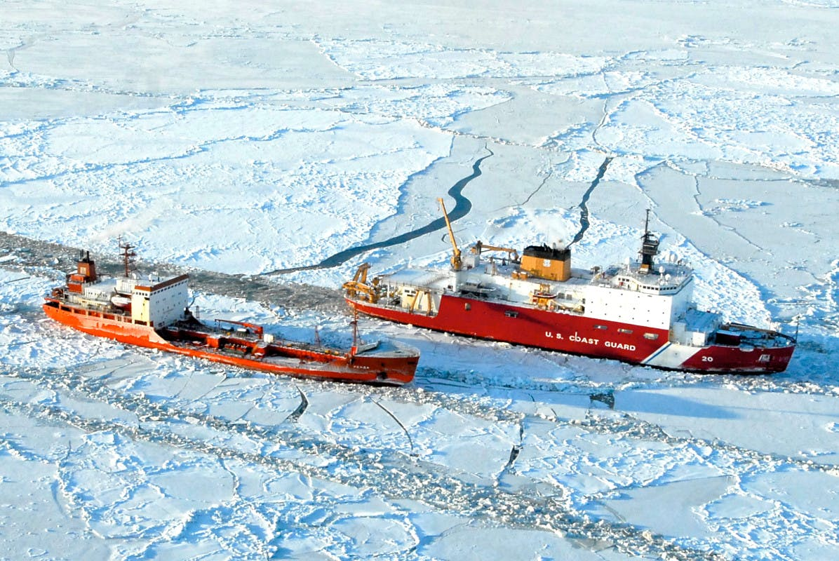
Tailored Support Program
Sample Products
Mission Dates: June – Sep 2019
Agency: NOAA Pacific Marine and Environmental Lab (PMEL)
USNIC supported PMEL’s use of autonomous systems in its development of improved sea ice prediction
Mission Dates: Sep – Oct 2019
Agencies: U.S. Coast Guard, National Science Foundation
USNIC supported USCG maritime awareness and NSF ocean exploration and research efforts
Tailored Support Program provides critical situational awareness to U.S. interests (national defense, resupply, R&D) in or near sea-ice.
Notes:
Both of these are recent examples of USNIC support for entities associated with NOAA’s Blue Economy initiative in the Arctic
Note on Saildrone Pic: Saildrone only recently produced a mapping saildrone. (Tested in GOMEX in AUG2019). The intent is to deploy in the Arctic but this has not yet been done. Up until this point, saildrone in the Arctic has been exclusively looking at the upper water column / at the air-sea interface.
Products: Annotated satellite imagery (model and/or analyst forecasts, sea ice thickness / stage of development, winds, etc overlayed on imagery), products for ingest into ECDIS; other graphic, text, or GIS products as requested by the user
Services: embedded analyst support
2nd Picture: Note use of VIIRS mosaic when RS2 or Sentinel was not sufficient to cover area of interest.

Slide 6
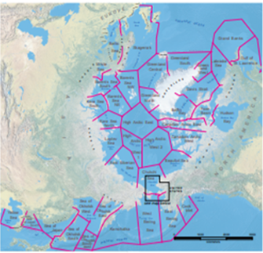
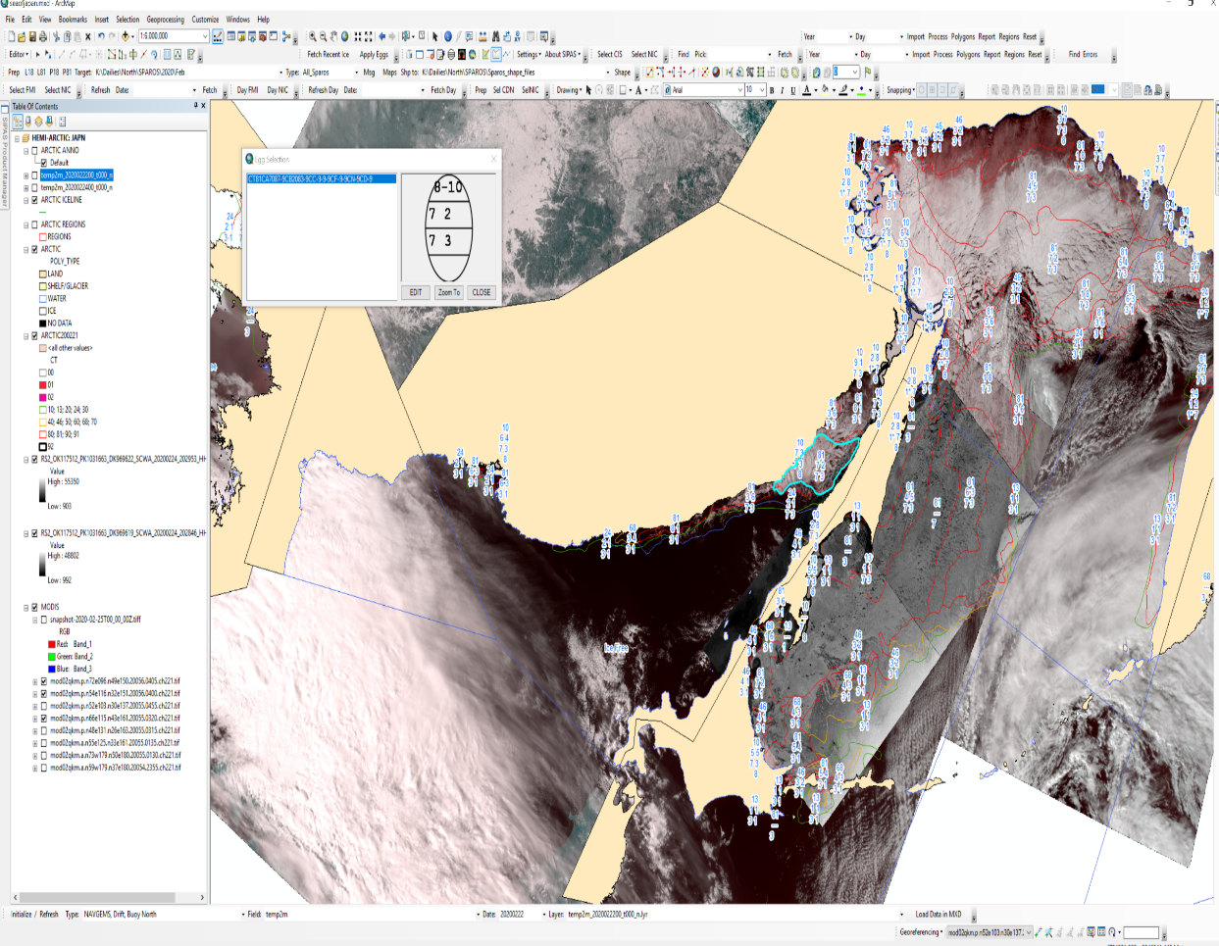
Ice Analysis Process
1) Identify Area of Analysis
Check out region within operational software (Satellite Image Processing and Analysis System – SIPAS)
Northern Hemisphere: 39 Regions
Southern Hemisphere: 13 Regions
2) Import Available Data
Identify and select most recent, highest resolution imagery covering assigned region
Import any ancillary data such as buoy data, weather, models, etc.
3) Perform Ice Analysis
Characterize ice, both concentration and stage of development. Complete task by performing polygon analysis
Use customized tools within SIPAS to assign attributes in WMO global sea ice code standards
4) Perform Quality Control (QC)
QC will check for consistency, correlation with weather factors, degree of ice accretion or melt based on environmental factors, historical ice coverage, ice typing consistent with imagery signature, general pattern as compared to ice drift or other information in area

Slide 7
Process Limitations and Inefficiencies
Data latency to the operations floor
Data formatting
Imagery and derived products - obscuration from clouds
File sizes/system lags
Time to produce daily hemispheric marginal ice zone products
Time to produce weekly hemispheric analysis – Arctic and Antarctic

Slide 8
Illustrations of GOES and JPSS Satellite Data used within USNIC Production Workflow
Notes:
Verify accuracy. Good resource for understanding near constant contrast (NCC)
http://rammb.cira.colostate.edu/training/visit/quick_guides/VIIRS_Near-Constant_Contrast_Quick_Guide_20180709.pdf

Slide 9
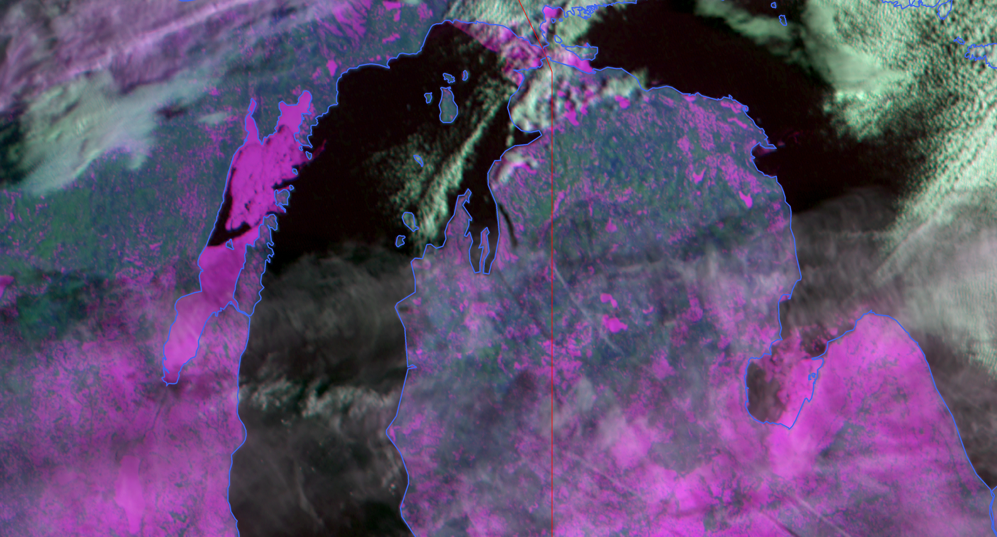
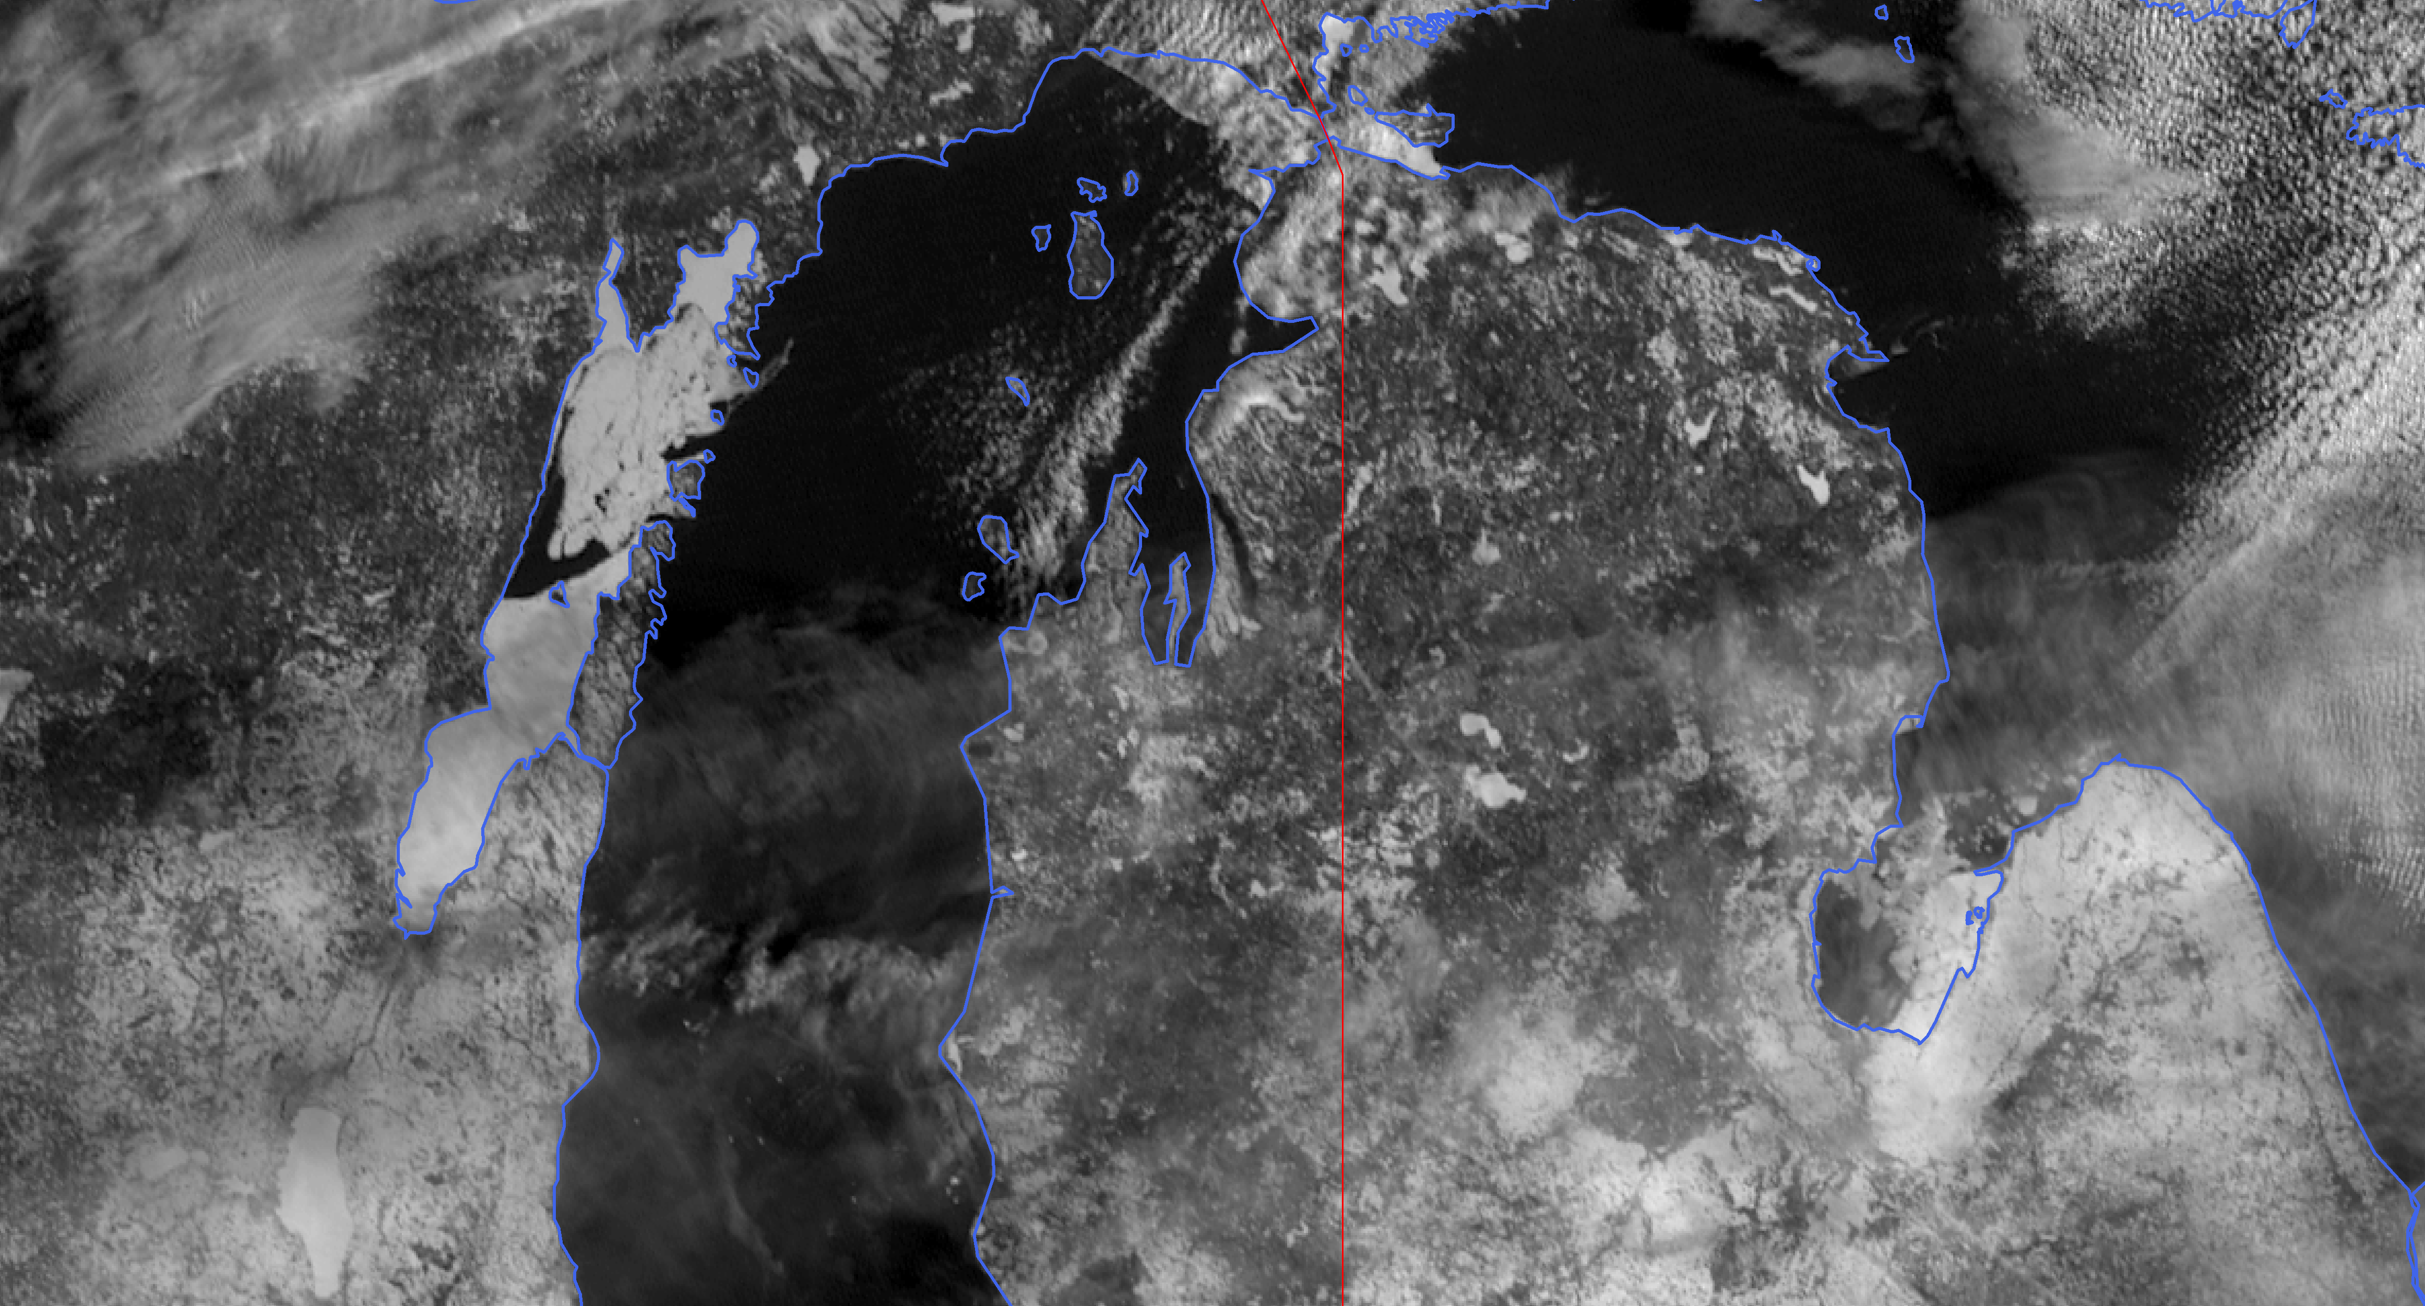
GOES-R Series Satellite Observations Illustrations from USNIC’s SIPAS ice analysis system
Great Lakes, Northern Michigan
Ice
Ice
12 Feb 2020: GOES-16 ABI CH 2
12 Feb 2020: GOES-16 ABI Multiband composite of the Red Band (Band 02), near-IR snow/ice band (Band 05), near-IR 'Veggie' band (Band 03)
Ice
Ice
Notes:
Verify accuracy. Good resource for understanding near constant contrast (NCC)
http://rammb.cira.colostate.edu/training/visit/quick_guides/VIIRS_Near-Constant_Contrast_Quick_Guide_20180709.pdf

Slide 10
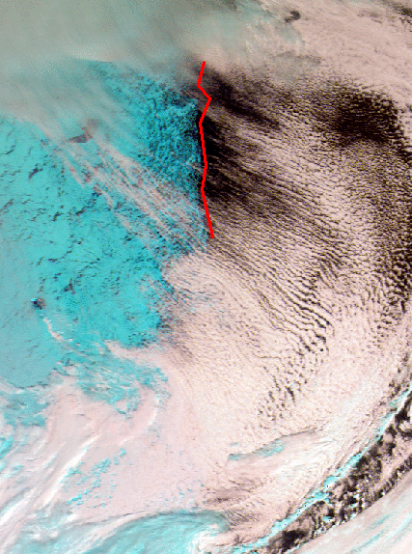
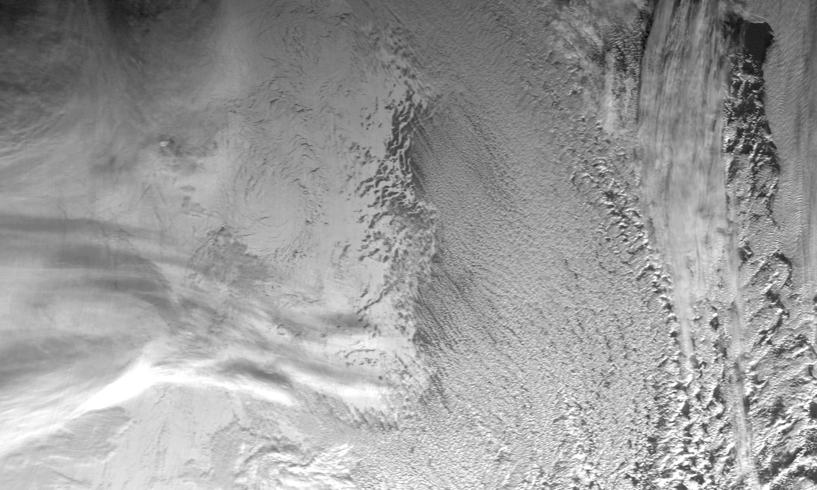
GOES-R Series Satellite Observations Animations of data within SIPAS/ArcGIS environment
GOES-16 ABI channel 2 on Sep 12, 2017 (10hr loop)
GOES-16 ABI Image using channels 5, 3, and 2. The red line traces the overall ice edge not fully seen in any individual still image, demonstrating the utility of time animations not only for ice motion but for the mapping and characterization of sea ice.
Notes:
Increased temporal, spectral and spatial resolution has led to product quality increases at the Center. Animation implemented…

Slide 11
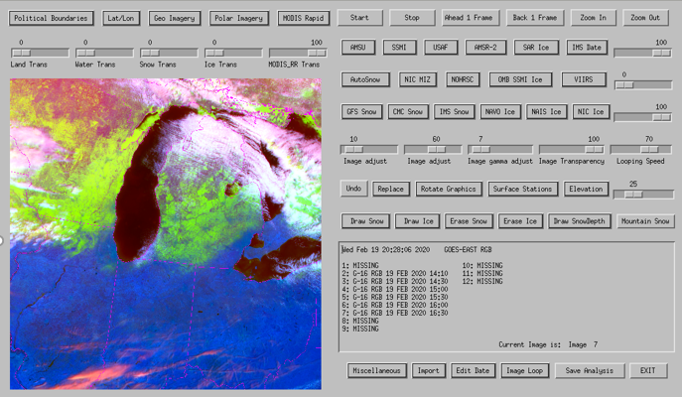
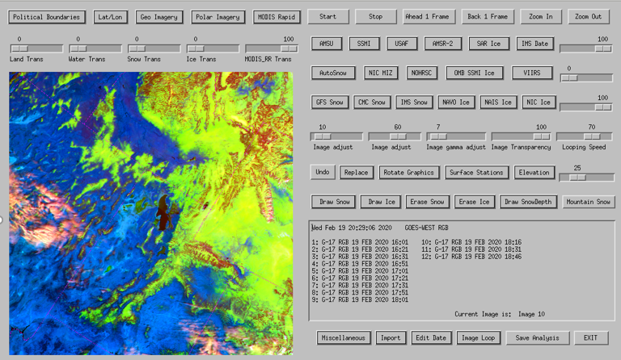
GOES-R Series Satellite Observations Illustrations from USNIC’s IMS snow and ice analysis system
Feb 19th: GOES-16 ABI RGB Multiband composite
Used for Snow/No Snow classification by Analyst
Location: Midwest U.S./Lake Michigan
Feb 19th: GOES-17 ABI RGB Multiband composite
Used for Snow/No Snow classification by Analyst
Location: Western U.S.
Notes:
Verify accuracy. Good resource for understanding near constant contrast (NCC)
http://rammb.cira.colostate.edu/training/visit/quick_guides/VIIRS_Near-Constant_Contrast_Quick_Guide_20180709.pdf

Slide 12
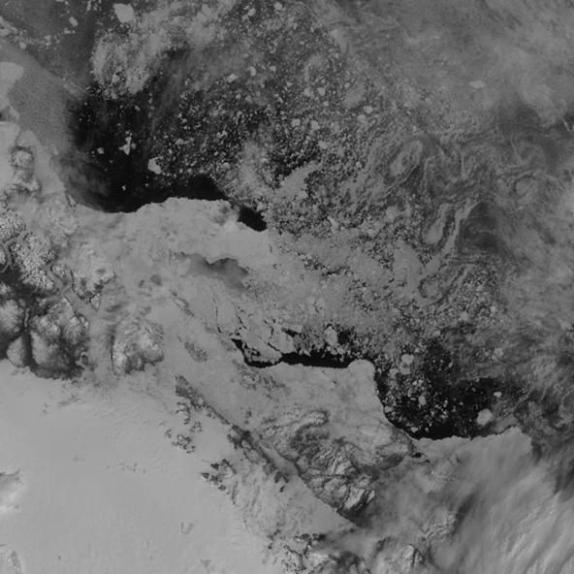
JPSS Satellite Observations Illustrations from USNIC’s IMS snow and ice analysis system
System: IMS NOAA-20 VIIRS Imagery, Band I5
System: IMS
NOAA-20 VIIRS Imagery, Band I1, I2 and I3 Composite Image composite
Notes:
http://rammb.cira.colostate.edu/training/visit/quick_guides/VIIRS_Near-Constant_Contrast_Quick_Guide_20180709.pdf

Slide 13
Ideas for Satellite Data Improvements for Snow and Ice Analysis
Continued timely access to not only NOAA data, but also to non-NOAA datasets (hosting global operations means dependencies on domestic and international data)
Incorporate GOES West animation into operations (will support NWS Alaska Sea Ice Program)
Incorporate VIIRS imagery loops near poles for ice detection
Explore more satellite derived products for operational value/use
Continue to explore use of automation within operations
Exploit and capitalize on recent ice forecast modeling (lots of new science – pros and cons to this from operational perspective)

Slide 14
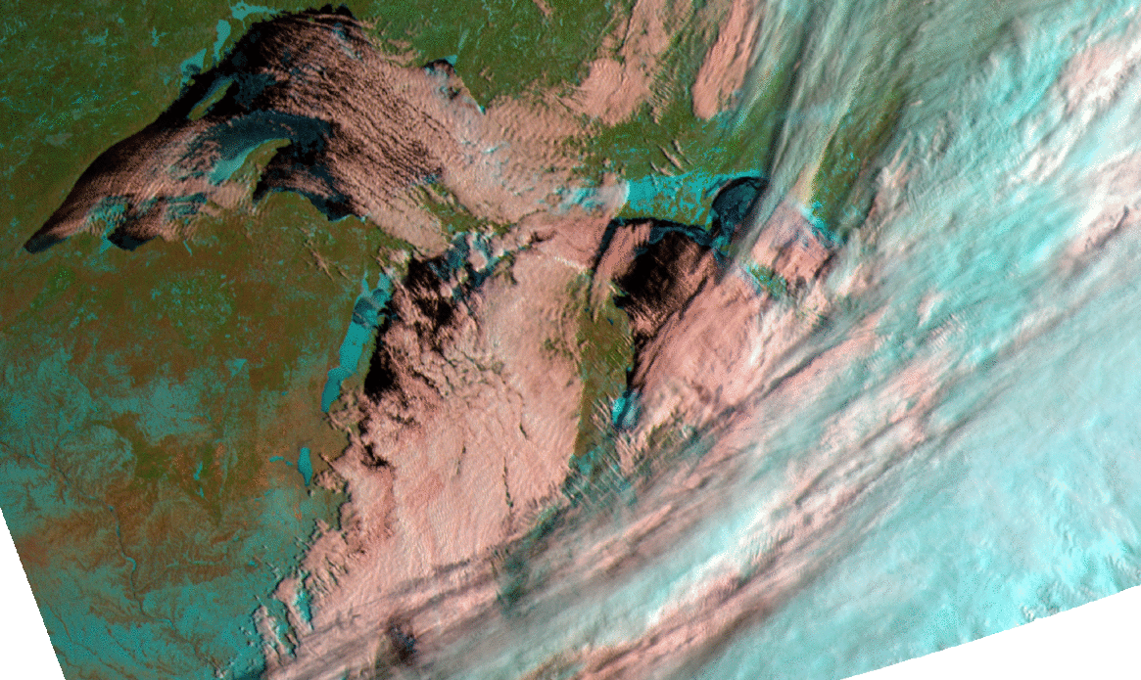
Questions and Comments
Command Duty Officer: nic.cdo@noaa.gov | www.natice.noaa.gov | www.facebook.com/nationalnavalicecenter

Slide 15
Backup

Slide 16
Hierarchy of Satellites/Sensors at USNIC SIPAS Ice Analysis
Satellite | Sensor | Sensor Type | Resolution at Nadir | Swath Width | Received From | Satellite Owner | Orbit Type | Repeat Cycle
RADARSAT-2 | C-Band; 5.405GHz | SAR | 100 - 3m | 500km - 50km | MDA | MDA | Sun-synchronous | 24 days
Sentinel 1A/1B | C-Band; 5.405GHz | SAR | 40 - 5m | 400 - 80km | NOAA/STAR | ESA | Sun-synchronous | 6 days
Terra/Aqua | MODIS | Visible; IR | 500 - 250m | 2330km | NOAA/NESDIS | NASA | Sun-synchronous | 16 days
NOAA-20 (JPSS-1) | VIIRS | Visible; IR | 750 - 375m | 3000km | NOAA/NESDIS | NOAA | Sun-synchronous | 16 days
GOES-E/W | ABI | Visible; IR | 2000 - 500m | 40km | NOAA/NESDIS | NOAA | Geostationary | Cont.
METOP-A/B | AVHRR | Visible; IR | 1090m | 2000km | NOAA/NESDIS | NOAA | Near-polar | 29 days
METOP-A/B | ASCAT | Active microwave | 50 - 25km | 500km | NOAA/NESDIS | EUMETSAT | Sun-synchronous | 29 days
GCOM-W1 | AMSR-2 | Passive microwave | 10 - 5km | 1450km | NOAA/NESDIS | JAXA | Sun-synchronous | 2 days

Slide 17
U.S. National Ice Center Increasing Demand Year Round
Number of Operational Products
21% growth in operational support since 2017

