Slide 1
Science, Technology, and Data Applications for Disaster Operations
2020 JPSS/GOES Proving Ground / Risk Reduction (PGRR) Summit
February 27, 2020
Adam Barker, PhD
Geospatial Analyst
Response Geospatial Office

Slide 2
Geospatial Analysis Informs Decisions throughout the Disaster Lifecycle
Geospatial analysis is typically delivered within days. Conventional approaches (e.g., site inspections) may take months
Expedited rental assistance
Help determine where to deploy Survivor Assistance teams
Help determine where to locate Disaster Recovery Centers
Help to allocate shelter and resource needs
Prioritize and expedite debris removal
May assist in the Presidential declaration process
Force allocations and right-sizing

Slide 3
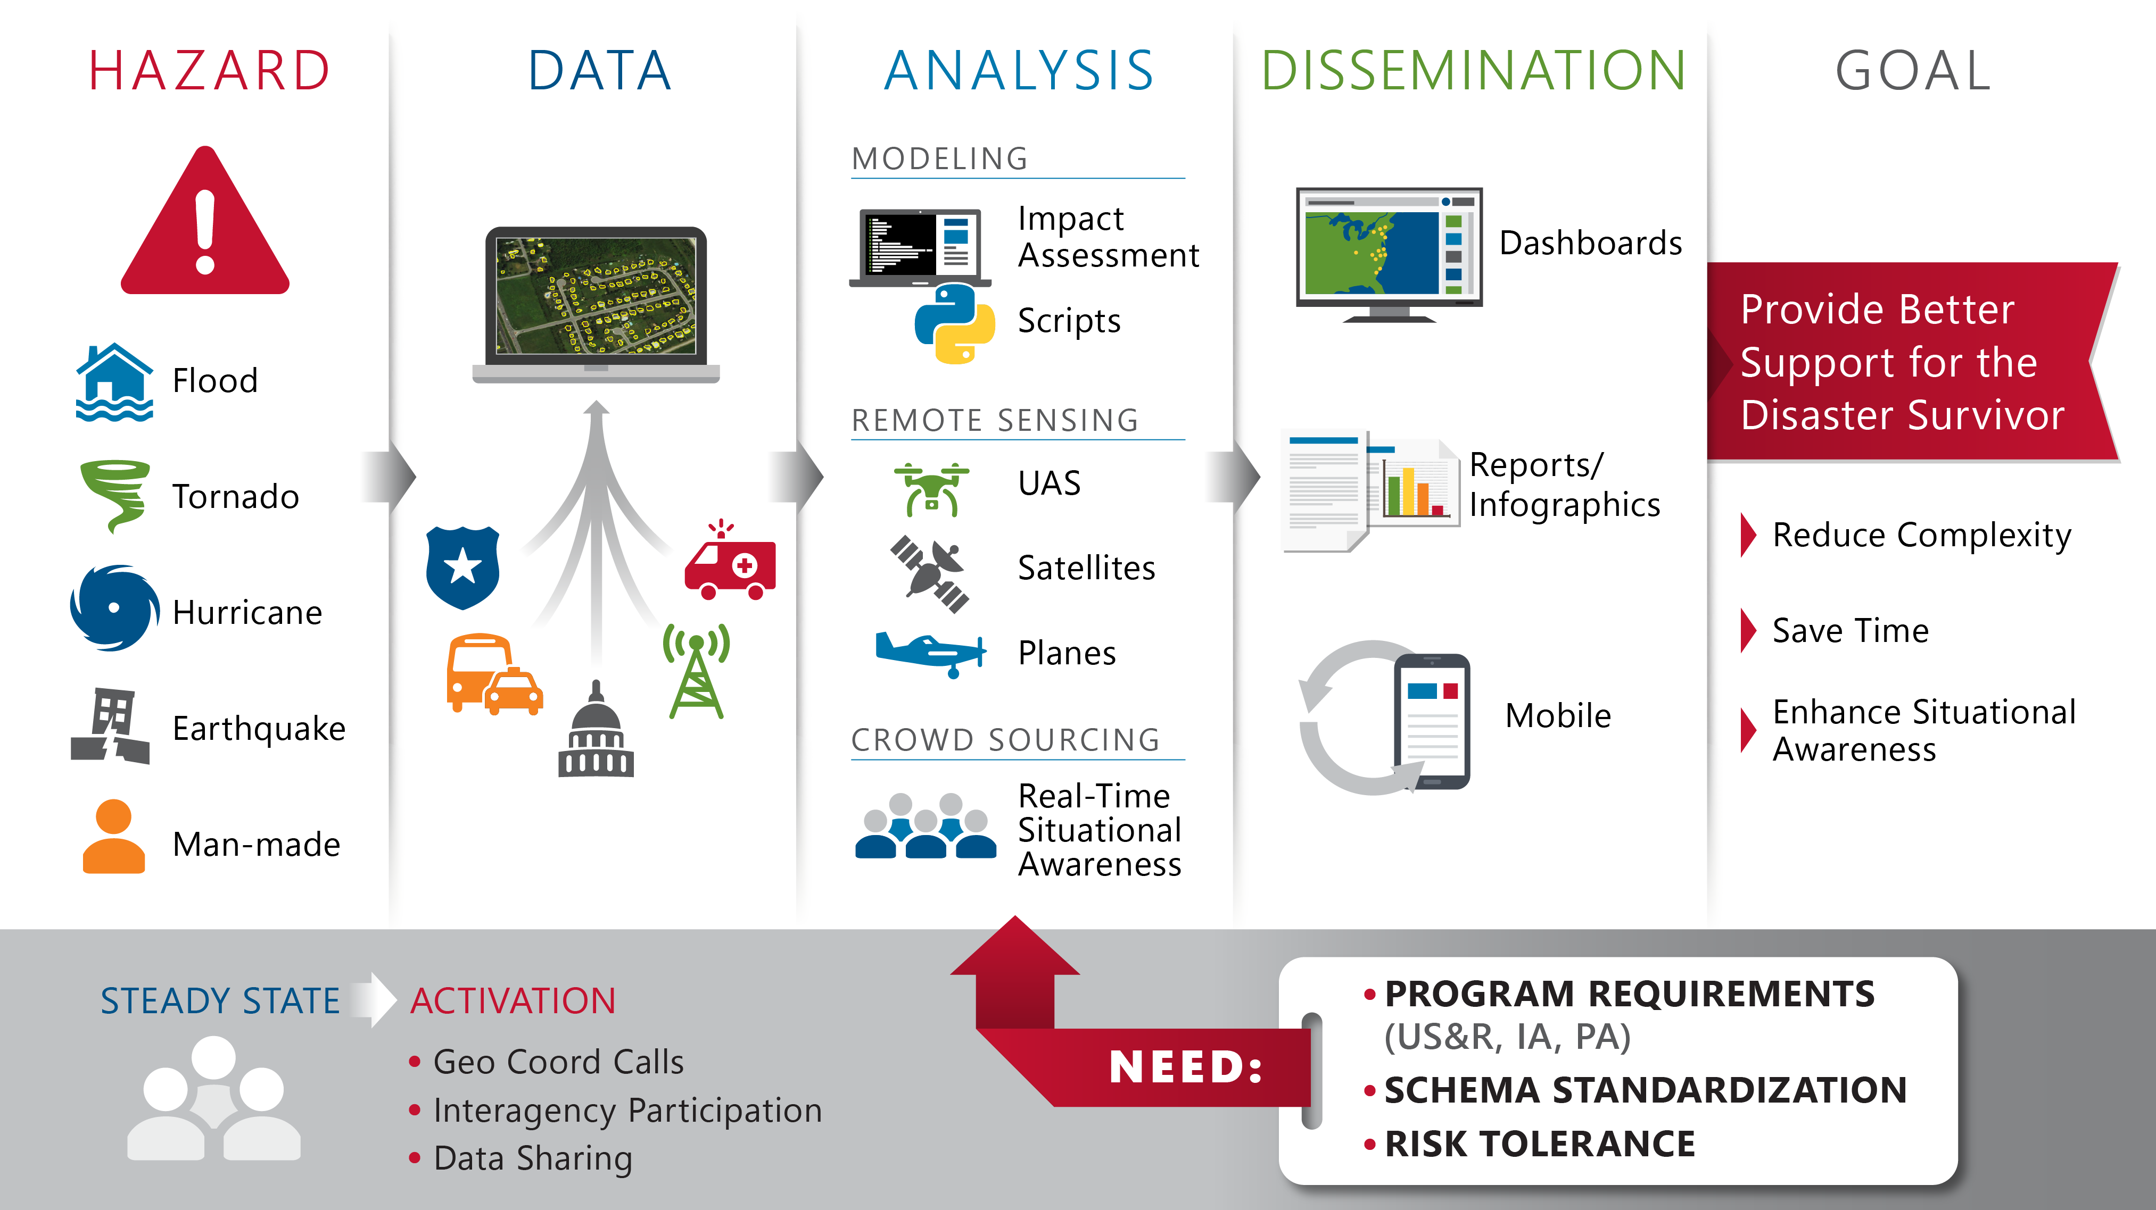

Slide 4
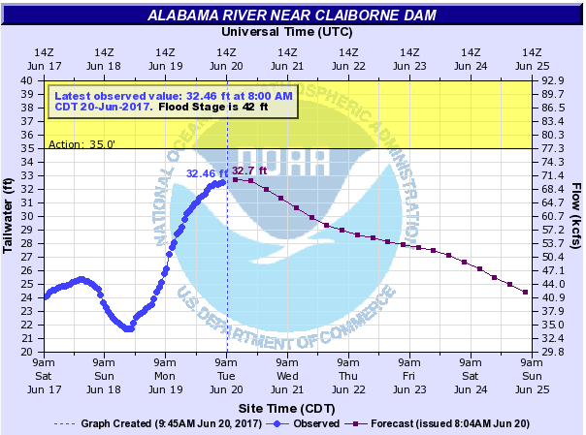
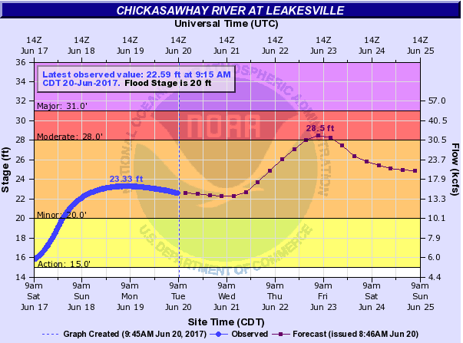
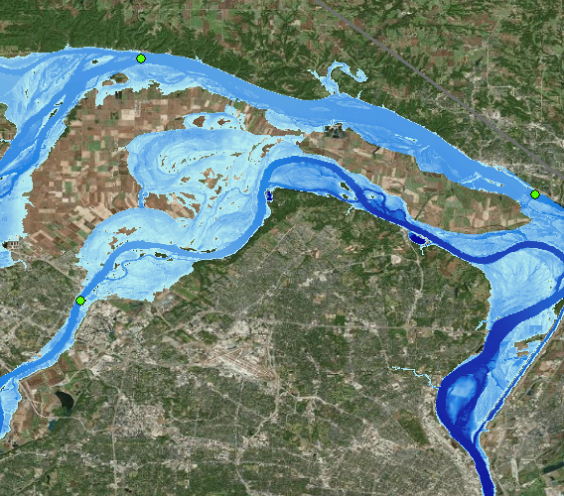
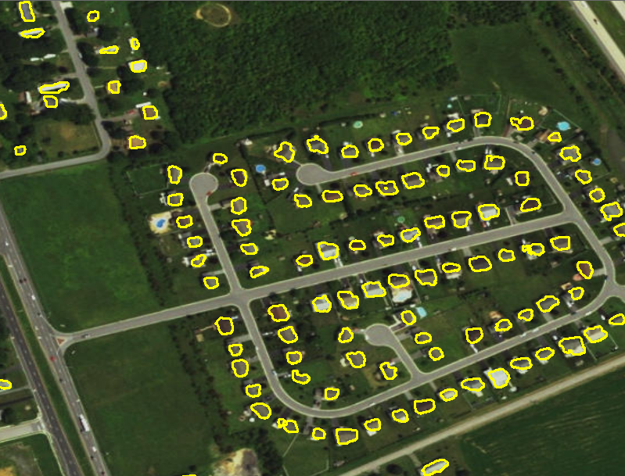
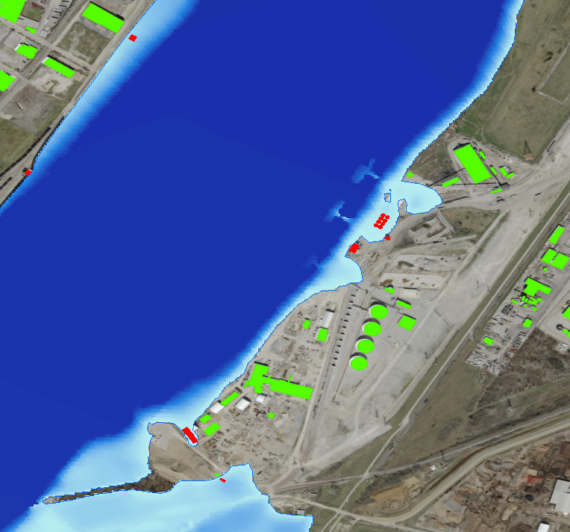
How do we identify damage?
Modeling and imagery helps to determine level of damage
Stream Gauge Data
Remote Sensing Data
Flood Extent / Depth Grid
Structural Dataset
Modeled Impacts
Notes:
Historic Methodology
Structure by structure
Inaccessible analysis (transportation outages, flooding)
Geospatial Damage Assessment Process used in 2017 Hurricanes and Beyond
Uses data to create Flood Depth Grids and rapidly estimate structures impacted and level of damage
Results in significantly reducing the time required to complete damage assessments with a high level of consequence and inform decision making on disaster assistance

Slide 5
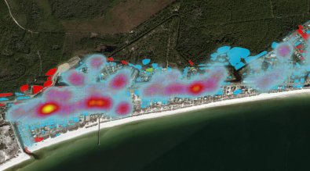
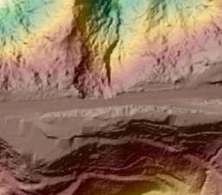
Debris Estimation
REMOTE SENSING | FOCUS AREAS
Transportation Impacts
Damage Assessments

