Slide 1
Proving Ground Summit
February 27, 2020
Eric Holloway - Emergency Services Branch, Alaska Region
Notes:
The May 2013 Galena, Alaska flood event demonstrated the use and value of the products in monitoring river ice and related flooding.
Monitoring ice formation, breakup, melt, and flooding is critical for situational awareness and decision making in protecting property and lives. National Weather Service River Forecast Centers (RFCs) are charged with providing river forecasting, but have few river gauges to help them understand the current state of stream flows. They find out about ice jams often after these jams are already causing water to overflow the river channels.
Satellite ice and flooding products can provide an important capability for observing long stretches of rivers. They can monitor ice movement that is a harbinger of ice jams and possible flooding. Even after the flooding occurs, these products can help determine how quickly flood waters are receding, which helps emergency managers in their planning of recovery efforts.
The value of these satellite capabilities has been proven in Alaska. The state has over 12,000 rivers and thousands more streams and creeks, less than 100 of which are monitored by stream gauges, and even fewer operate when the gauges are affected by ice. Volunteers on the ground and in the air help fill some of the gaps in our knowledge of river states. But vast expanses of Alaska are sparsely populated, and remote areas can be difficult to reach even on fair weather days. Small planes are required to visit most native communities
In 2011, the JPSS Program Office created a Proving Ground and Risk Reduction Program, the goal of which is to facilitate the transfer of advanced VIIRS imaging capabilities from research to operations using data from the Suomi-NPP satellite and future JPSS satellites. The Proving Ground focuses on assisting users in effectively applying JPSS capabilities to their current operations, while the Risk Reduction program evaluates leading edge capabilities to determine their value to operations.
After a particularly severe flooding event in Galena, Alaska in May 2013, the JPSS Program Office proposed to evaluate whether the Risk Reduction River Ice and Flooding Projects could assist in the Alaskan response to the flood. Based on a very positive preliminary evaluation by the Alaska Pacific River Forecast Center, a working group was formed to bring the products into the RFCs operational environment for a more extensive evaluation. The continued success of the products during the Alaska winter of 2013-2014 led to the creation of a formal River Ice and Flooding Products Initiative, the first operational demonstration activity to be conducted under the JPSS Proving Ground and Risk Reduction Project.

Slide 2
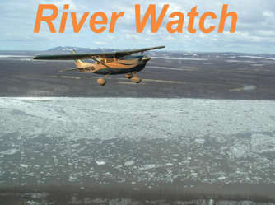
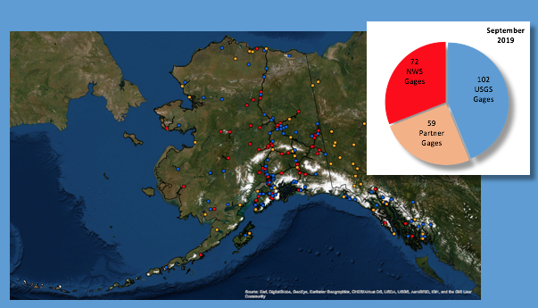
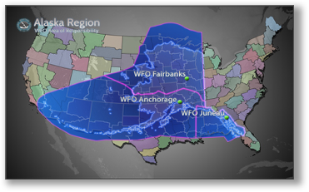
What we have to work with...
Notes:
Alaska Region maintain situational awareness over a very large area. Very challenging to monitor rivers and flooding during spring breakup and really any time of the year.
Roughly 37 WFO’s cover the same HSA territory as the 3 WFO’s and 1 river forecast center up here in Alaska.
General discussion about transportation around the State, small planes are required to visit most native communities
River Watch program...Really got it’s start back in the 60s before IDSS was even a term when we worked very close with the state of Alaska to fly rivers looking for ice jam potential. That partnership continues today by sending trained individuals from the RFC out with folks from the DHS&EM ( Division of Homeland Security and Emergency Management) to fly rivers and report on conditions to city, state, and tribal entities.
River ice, ice jam, and flooding monitoring methods during spring breakup are very limited. Difficult to impossible to know what is occurring on rivers over the large spatial areas of Alaska. Current monitoring methods include:
1. Ground based, point information, from NWS river observers, village officials, or local EM’s. This only provides a VERY localized picture, and is not necessarily representative of what is going on up/down river.
2. River Watch program (two component program). A) The NWS follows the breakup front down the Yukon/Kuskokwim Rivers and provides ice condition, ice jam, flooding information, and decision support to village officials. Spatial coverage is limited though, for example if there are multiple breakup fronts, difficult to monitor all at once. Also, there are many other rivers that experience ice jams and flooding that are not being flown. B) NWS trains scheduled commercial pilots and private pilots how to observe ice conditions. FAA FSS personal are also trained on the same terminology and code the incoming information as remarks in PIREPS, which is flagged by the NWS. The pilots begin reporting during the pre-breakup season as ice begins to melt, which provides information about progress of breakup on rivers. So much larger temporal scale on the breakup process. BUT – all this being said, breakup is dynamic and conditions can change quickly, so data from pilots can get quickly outdated or become obsolete.
3. AK has used satellite imagery for many years to monitor breakup, initially SAR data. The number of passes were limited over AK with large gaps in time and space. The SUOMI satellite data has greatly increased the temporal/spatial availability of remotely sensed data. Of course, there are limitations with the visible imagery (cloud cover, darkness, etc).

Slide 3
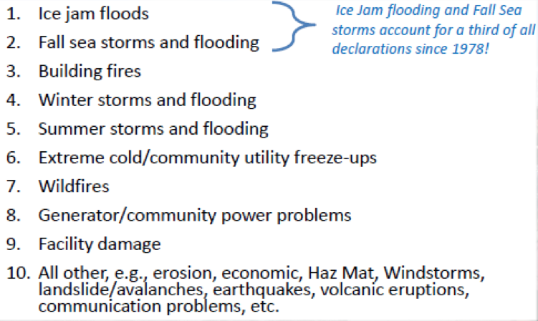
High Impacts from flooding in the state...

Slide 4
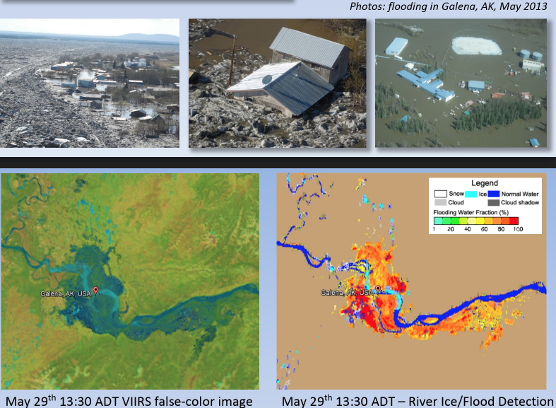
What we have engaged in...
Notes:
A devastating flood in the village of Galena on the Yukon River led to the development of the river ice and flood products using the Suomi NPP VIIRS. The Suomi data has expanded beyond breakup flooding and is also being used for non-ice events as well. This flood was dynamically tracked by SNPP/VIIRS, which showed great advantages of satellite data in near real-time flood detection.
The Alaska RFC and Fairbanks WFO continue to work closely with the JPSS Risk Reduction Project which include GMU and CCNY in effort to provide useable and valuable product that will help in hazardous warning forecast operations.
Derive new products such as high-resolution flood maps,water surface level and flood water depth.
Automatic flood notification to alert forecasters
Cloud shadow issues and solar zenith angle
Continue to use in an operational setting and identify events to improve product
1.The river ice and flood products provide information about the breakup process, where there is open water, where the breakup front is located, ice jams, ice runs coming down the river, and flooding. We never had this type of spatial or temporal resolution in the past.
2.The product gives NWS forecasters a snapshot of the entire CWA (where it is cloud free, of course), keeps staff situationally aware, and helps to identify areas of concern.

Slide 5
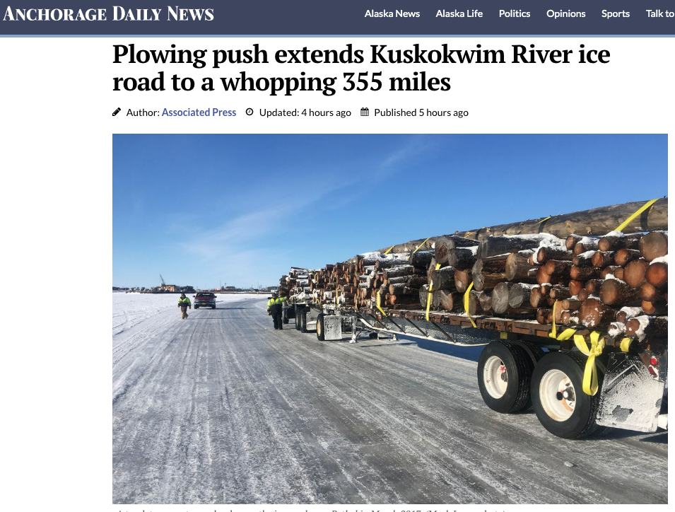
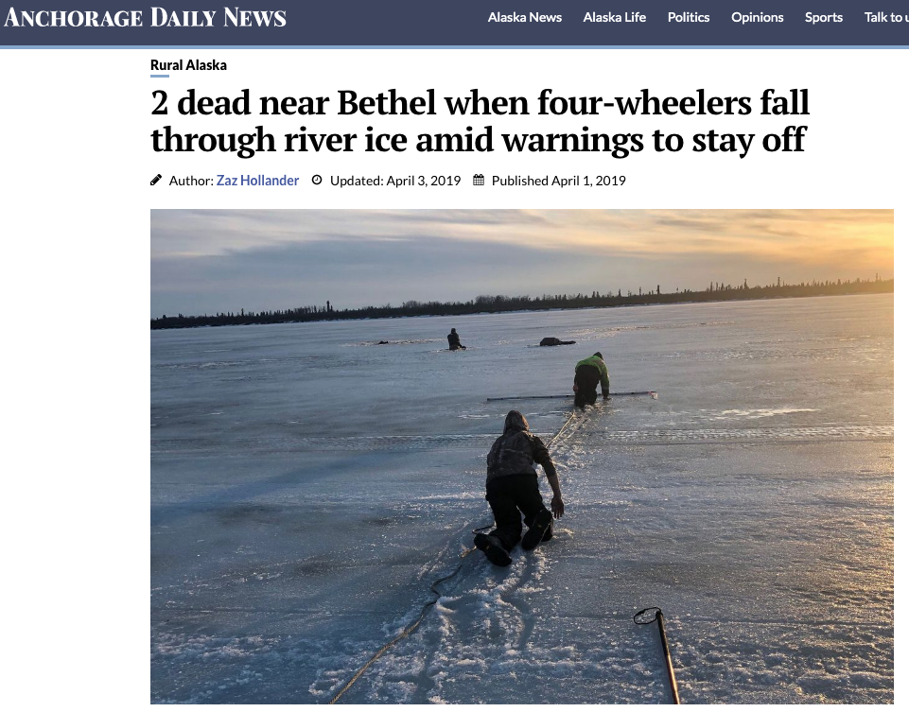
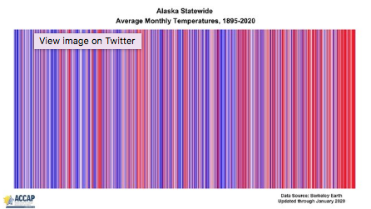
Ice Product...
Notes:
Things are normal in Alaska, both in the climate world and how we do things.
Whether it’s putting in an ice road up the Kuskokwim River so people to visit with friends and family, transport goods and services
Or if you consider last year where 11 people lost their lives due to falling thru the ice because with a changing climate the people are stuck with thinner ice to which to travel and recreate on. This year was more like with and hasn’t been this cold since 2012 and below normal temperature wise.
Bottom line is if we can help people in their decision making whether on not it’s safe to build an ice road yet or like last year, whether or not it’s safe to venture out on the ice yet or not.
Do we want to bring up the developing issue of thin ice in a climate change world and the associated deaths. https://www.nytimes.com/2019/04/10/us/alaska-ice-melting.html

Slide 6
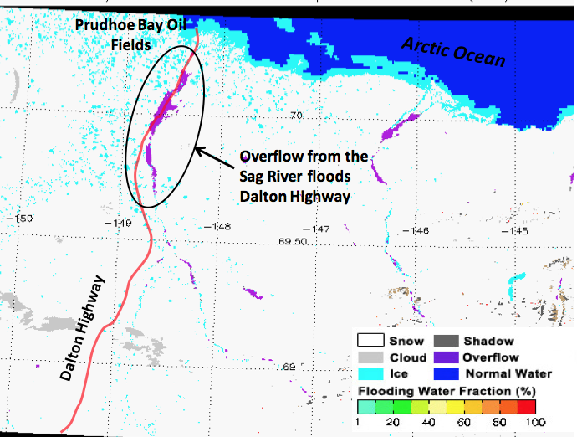
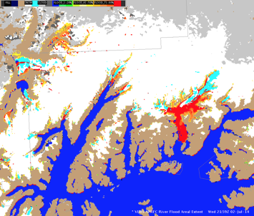
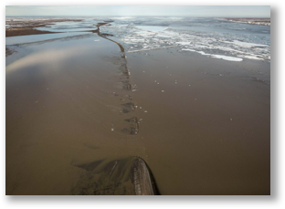
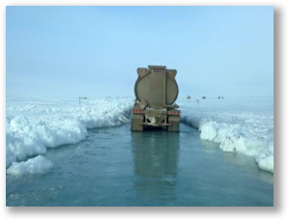
Flood Product...
Notes:
And for the Flood Product it continues to be a work horse for us, and now there is going to be national support by having the NWC monitoring this product.
We have demonstrated the use of this product in event after event. And events we don’t understand.
We will continue to look forward to further improvements to the product and participate in any way that we can in that process.
But again if we continue to provide useable and valuable product that will help in hazardous warning forecast operations in a temporal and spatial resolution that we have never had before then we will continue to win with this product. Keep in mind there are thing that we will never be able to get around, a couple of which are more pronouned in Alaska like Cloud shadow issues and solar zenith angle. Then there is the inability to see thru clouds, but hey beggars can’t be choosers.
And maybe we won’t be able to benefit from some of the newer developments like high-resolution flood maps, water surface level and flood water depth but it’s nice to see others benefit from our early work.
Lastly, i just want to say what a joy it’s been to participate in this R2O project. People like Sanmei and Naira who have been so reponse with questions, and proposed changes. And Bill who continues to steer this project even when interest ebbs and flows.
Event
-During the late winter of 2015, overflow flooding on the Sagavanirktok (Sag) River flooded the Dalton Highway. This resulted in on/off closures to the only road to the Arctic Coast and the Prudhoe Bay oil fields. The road closure had significant impacts and financial costs to the oil fields because goods could not be delivered. In addition, the state of Alaska incurred significant costs due to road maintenance trying to keep the road open, and then during spring breakup when the road was washed out or damaged in many locations.
-The image from April 8, 2015 shows how the river product was used to see the extent of the overflow, which was 30-40 miles or more in length and many miles in width. This information can help forecasters provide DSS to the Alaska DOT and other stakeholders. In collaboration with AK DOT, UAF, USGS, NOAA folks have currently submitted a proposal titled “Understanding the impact of current and future climate states on river flooding on the North Slope of Alaska” to further investigate this flooding and try to increase understanding of these events and improve forecasts for future situations on the North Slope.

