Slide 1
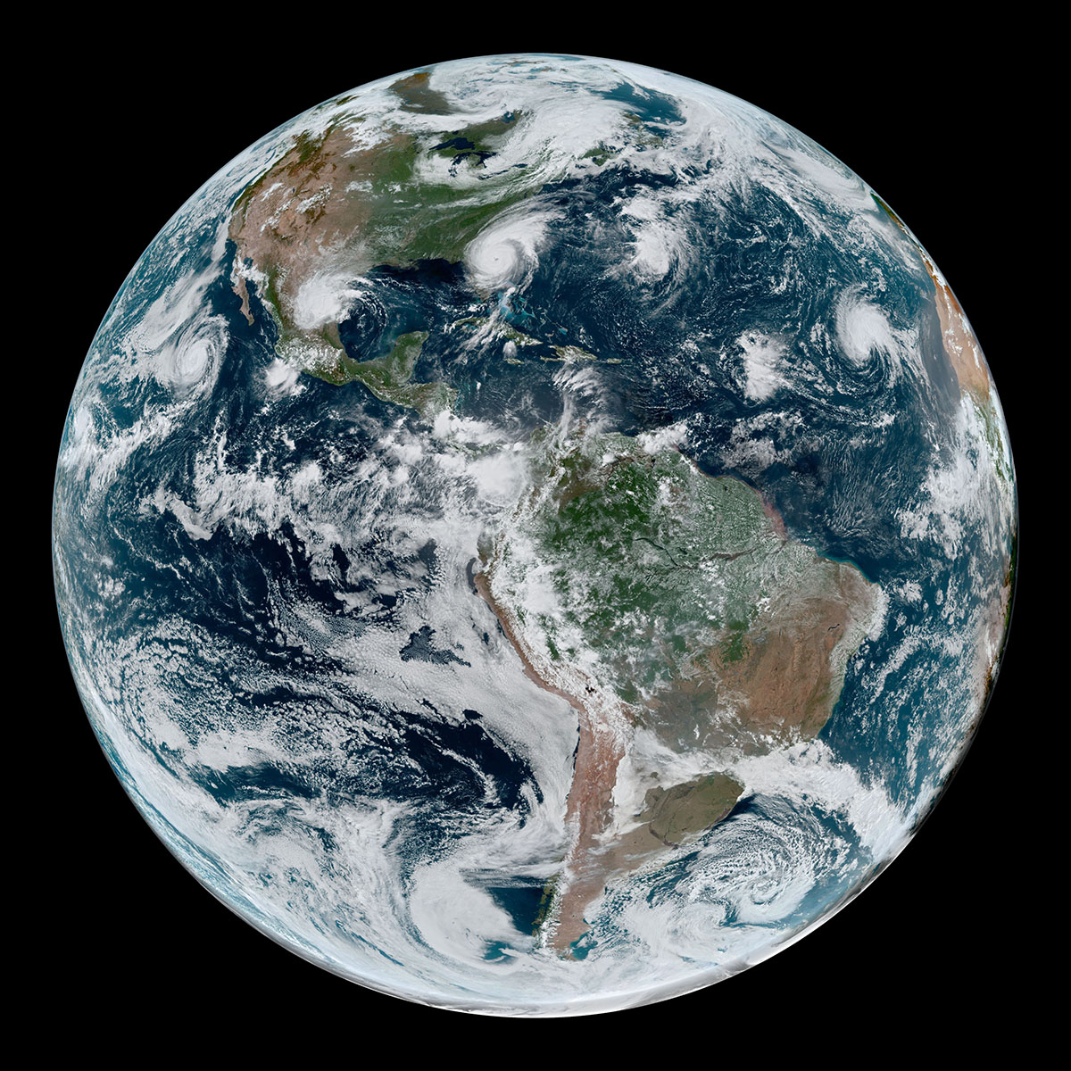
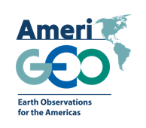
JPSS/GOES-R PG/RR Summit
Angélica Gutiérrez
On behalf of
the Regional GEO – AmeriGEO Amerigeoss.org
GEO-Global Water Sustainability (GEOGloWS)
Advancing the use of Earth Observations in the Americas

Slide 2
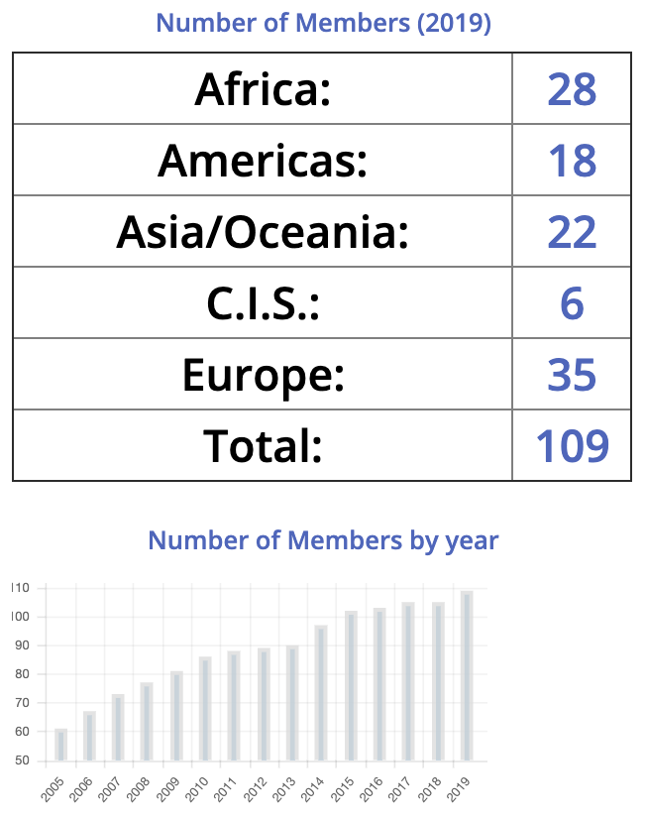
Group on Earth Observations
Notes:
GEO is an intergovernmental partnership that improves the availability, access and use of Earth observations for a sustainable planet.
GEO promotes open, coordinated and sustained data sharing and infrastructure for better research, policy making, decisions and action across many disciplines.

Slide 3
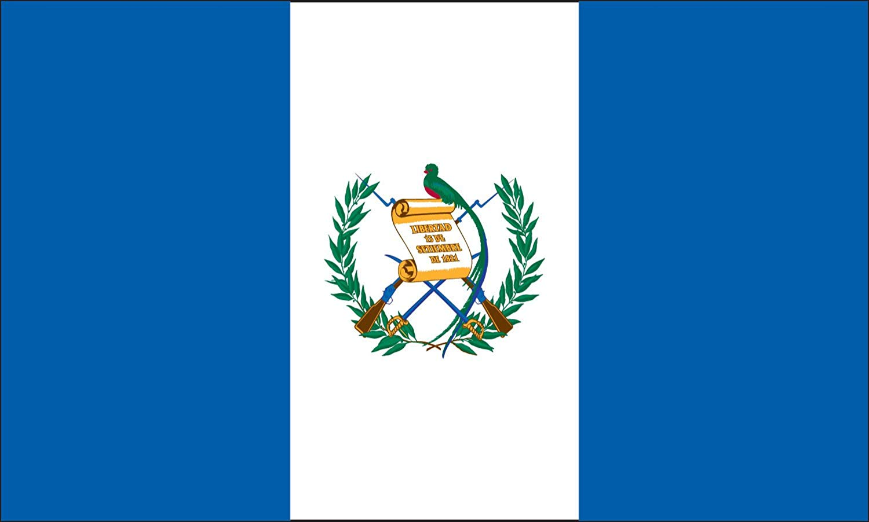
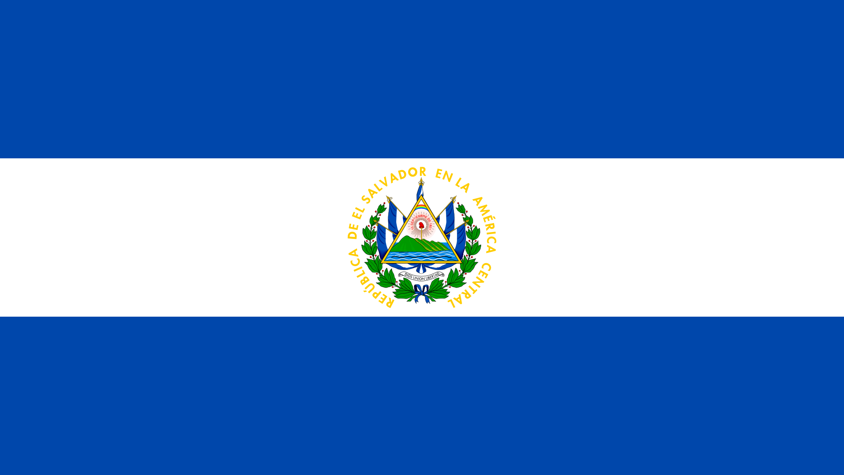
What is AmeriGEO
Conceived in October 2014, launched in November 2015
Is a cooperative effort of the 16 GEO member countries in the Americas that:
Reflects local, national, and regional interests of the GEO country-members for short and long-term planning, development, and implementation aligned with GEO activities.
Is entrenched in the institutional and technical capabilities of its country members and in the resources of other global initiatives available for the benefit of the region.
Seeks to increase institutional and personal capacity and engage experts, stakeholders, and decision makers in the process of decision making.
AmeriGEO Members
Non-AmeriGEO Members
18 Member Countries
Observers: Bolivia, Nicaragua
Notes:
This is an adaptable framework that is leveraged for capacity building.
Includes 18 nations in the Americas
Work with regional and global partners to advance the use of EO data
Develop and leverage member capacities to support stakehoder and decision-maker needs.

Slide 4
What topics does GEO work on?
Community
Decision Makers (National, State, and Local governments)
Academia, NGOs, Commercial
Activities
Thematic (Flagships and Initiatives)
Foundational Activities (GNC-A, others).

Slide 5
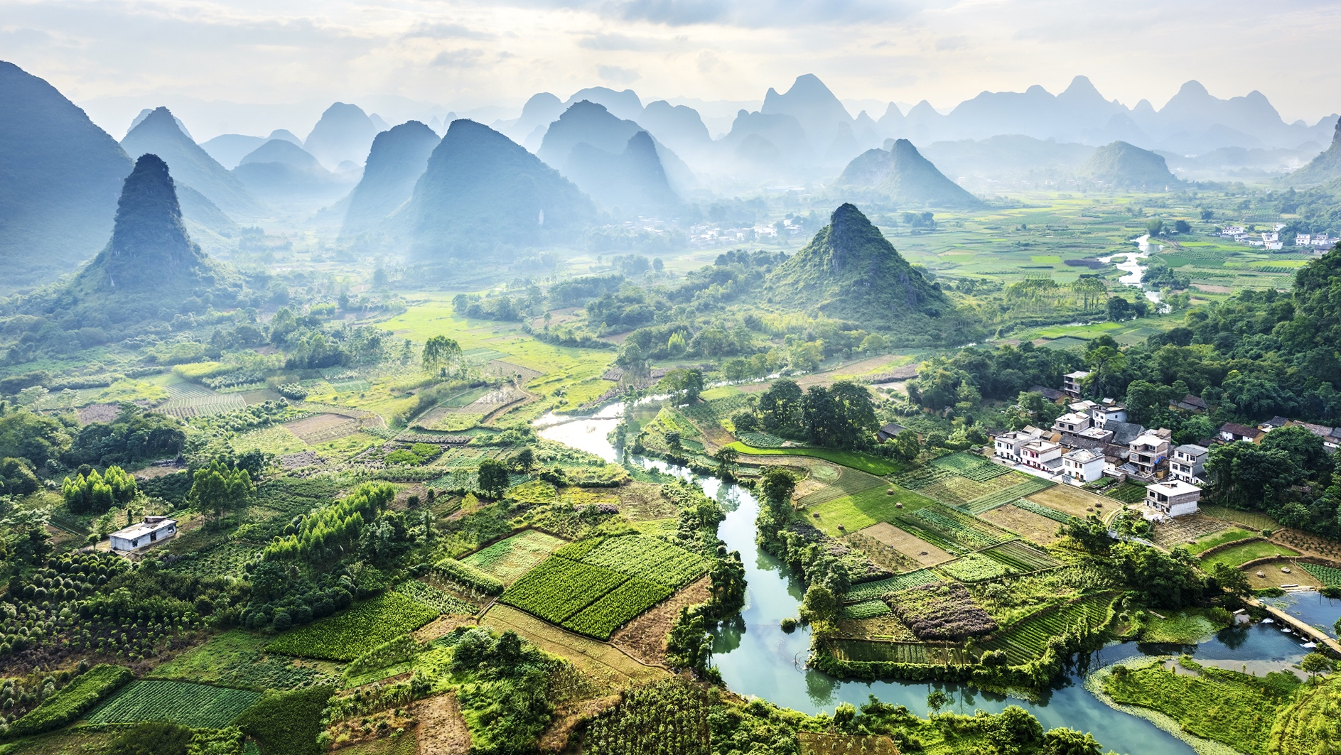
GEO In Action: Revolutionizing Our Understanding of Stream Flow on Every River in the World
GEO Water Activities addressing streamflow and flood risks and forecasting:
Global Flood Awareness System (GloFAS) (JRC EU)
Global Water Sustainability (GEOGloWS) (NOAA – CNES)
Global Flood Risk Monitoring Community (NASA)
Notes:
The GEO Global Water Sustainability Initiative (GEOGLOWS) is working to provide relevant, actionable information about water that promotes the use of earth observations while strengthening observational networks in local operational frameworks.

Slide 6
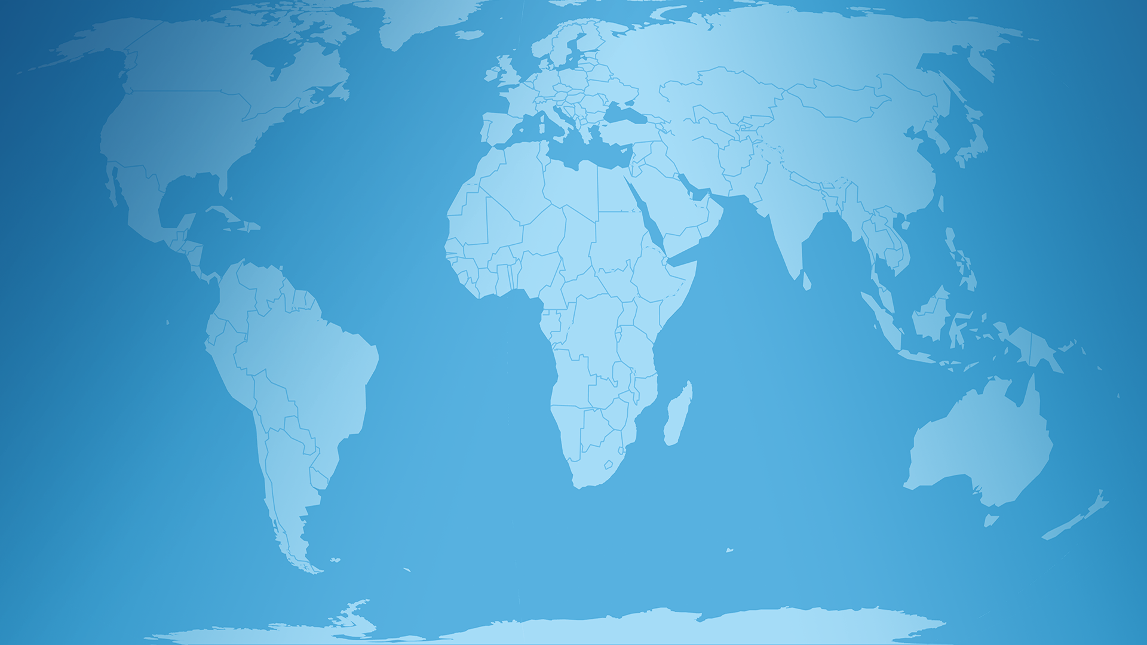
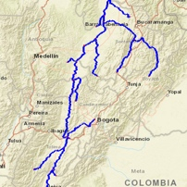
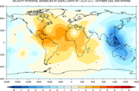
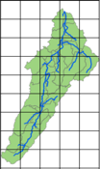
Global Streamflow Services – A Paradigm Shift
PAST – Individual Hydrologic Forecasting
DEM, Land Use, Meteorology
Hydrologic Modeling
HydroMet Services
Global Data
Local Governments
NGO’s and GEO Partners
NOW – Global Hydrologic Forecasting
DEM, Land Use, Meteorology
Hydrologic Modeling
HydroMet Services
Global Services
Local Governments
NGO’s and GEO Partners
Notes:
The global streamflow services completely changes the paradigm for how streamflow information is created and disseminated. Traditionally, each water organization was required to have the expensive infrastructure and capacity to access large global datasets and develop their own models to forecast streamflow useful for decision-makers. Using the GEOGLOWS global streamflow services they no longer have to have their own internal infrastructure for modeling, but instead can access the streamflow forecasts through web services and use them according to their own prioritized needs. This freely provided streamflow information, which leverages the hydrometeorological computational expertise of the GEOGLOWS Partnership, saves millions of dollars and allows national and local agencies to focus precious resources on developing solutions and applications specific to their local water resources management needs.

Slide 7
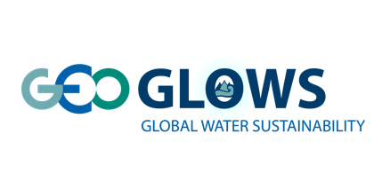
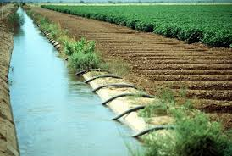
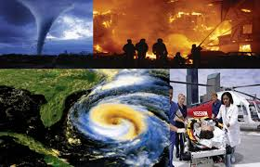
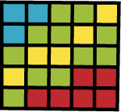
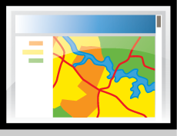
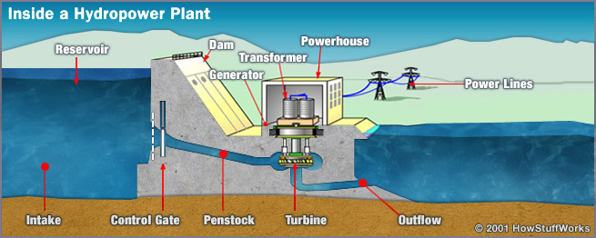
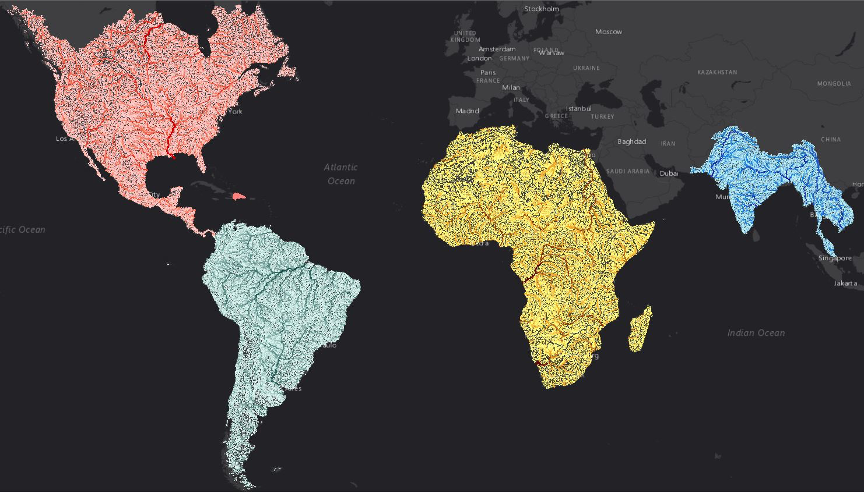
Scaling it up: a global service for local actions through high density forecasts for every river of the world
Spatial
Databases and Tools
Model Files
Scaling tools to global service
Migration of algorithms to ECMWF cyber infrastructure
System to be implemented as quasi-operational service by mid 2020
Custom Python Scripts
Simple Web Interfaces
Engineers, Decision Makers, Advocacy Groups, Public

Slide 8
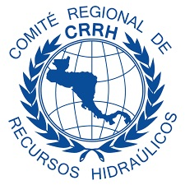
Partnership Global Streamflow Forecast

Slide 9
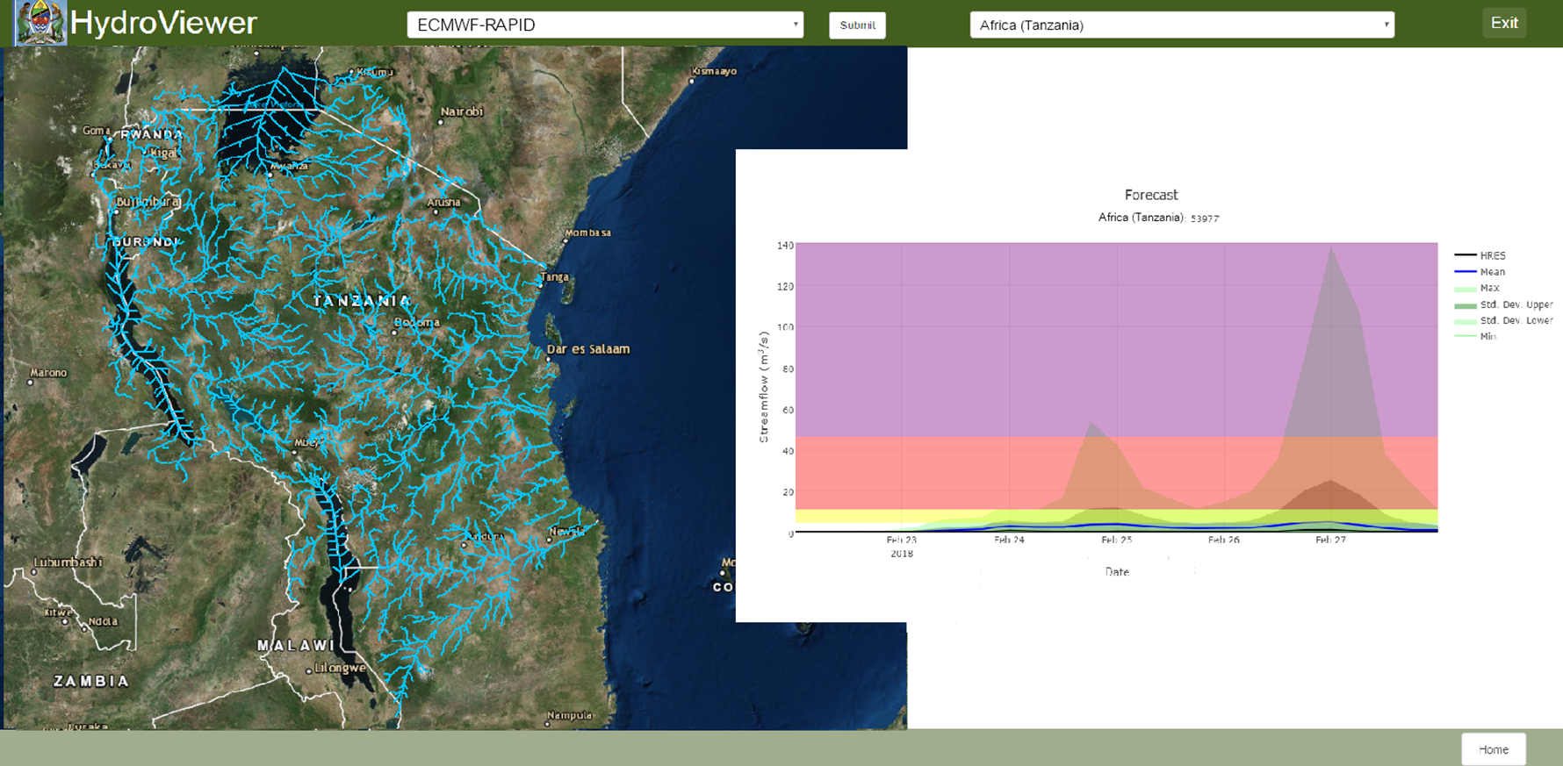
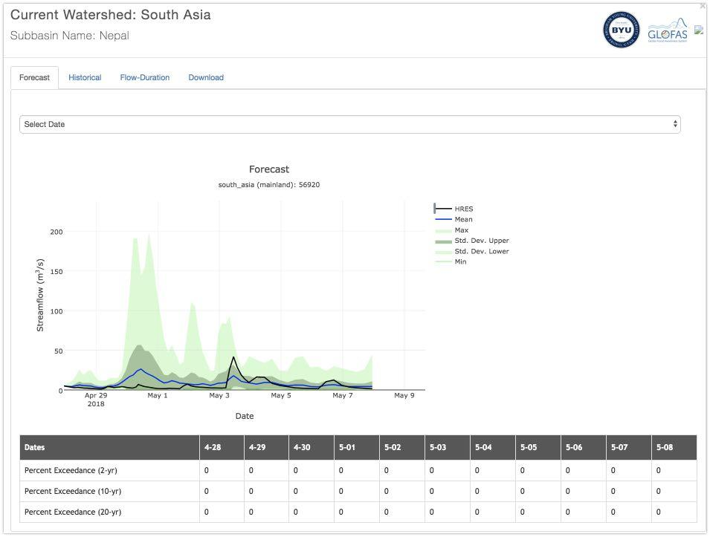
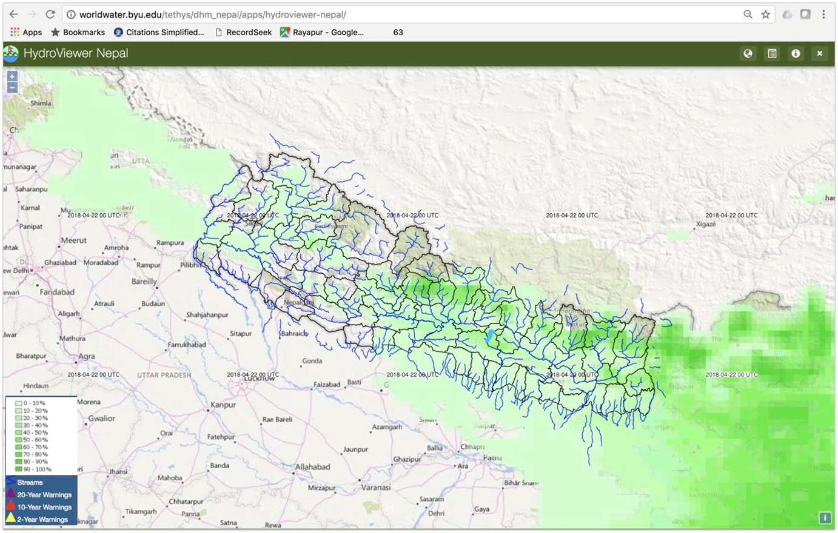
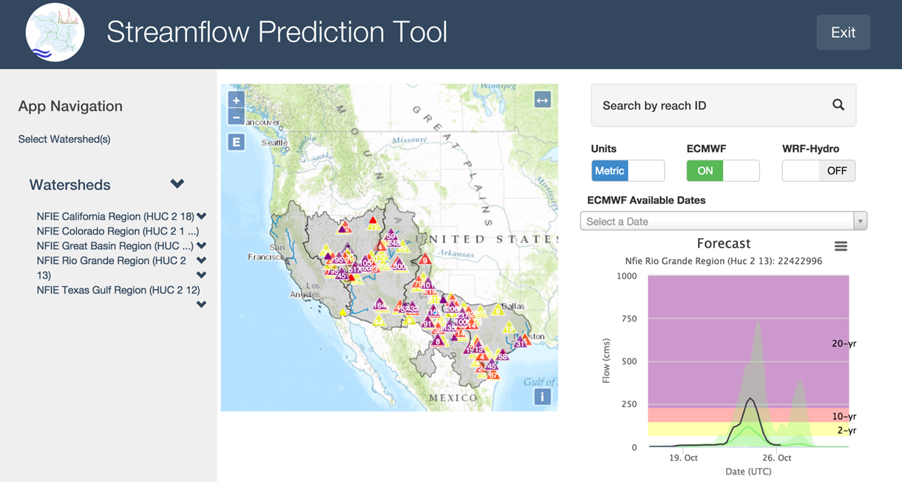
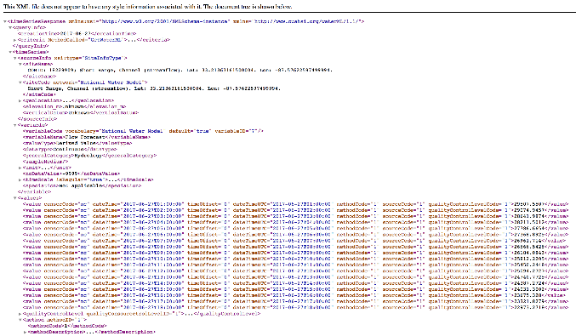
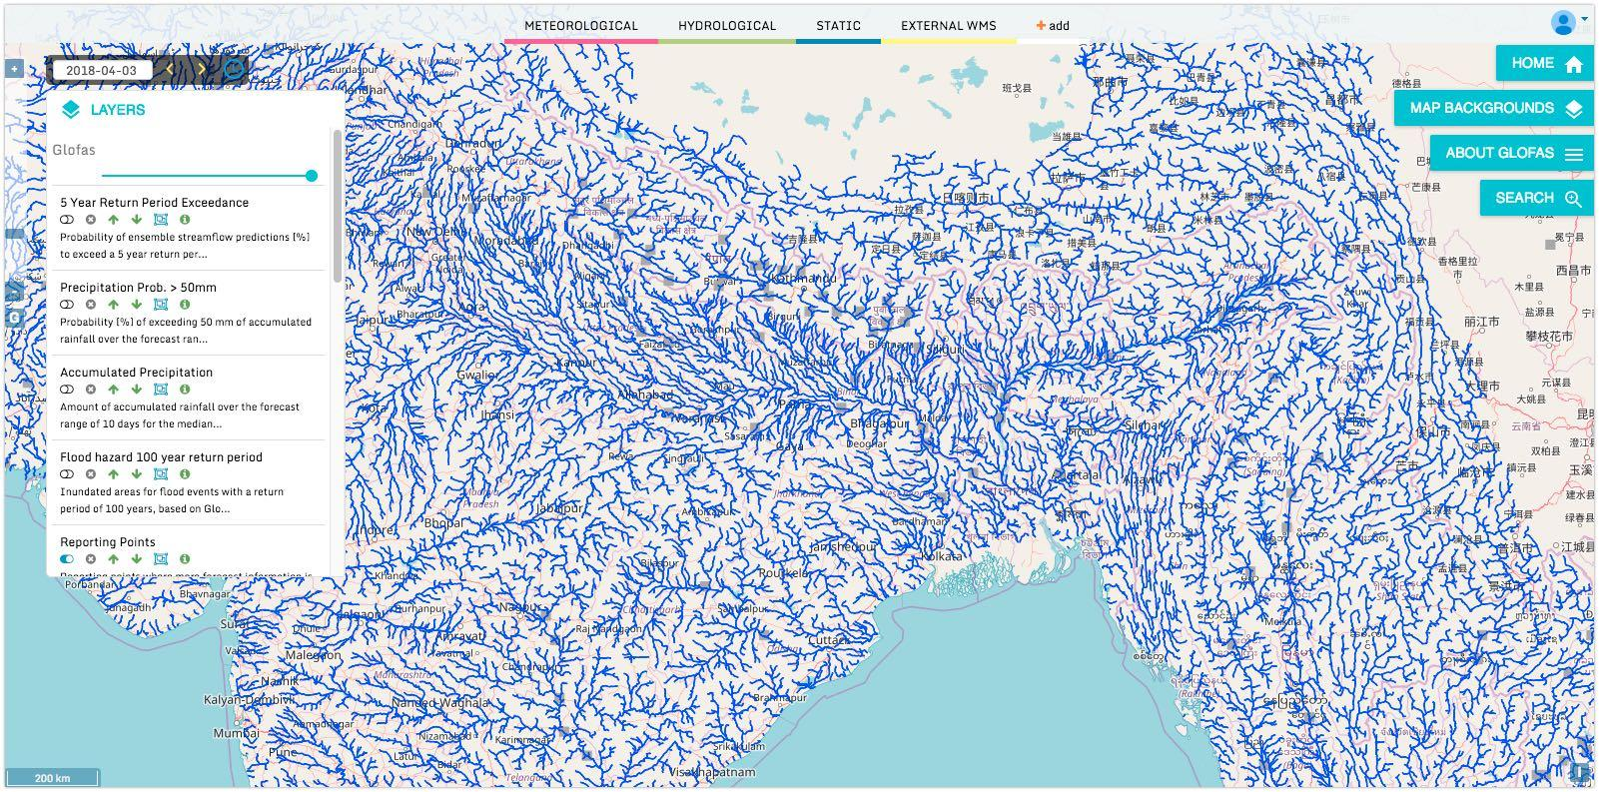
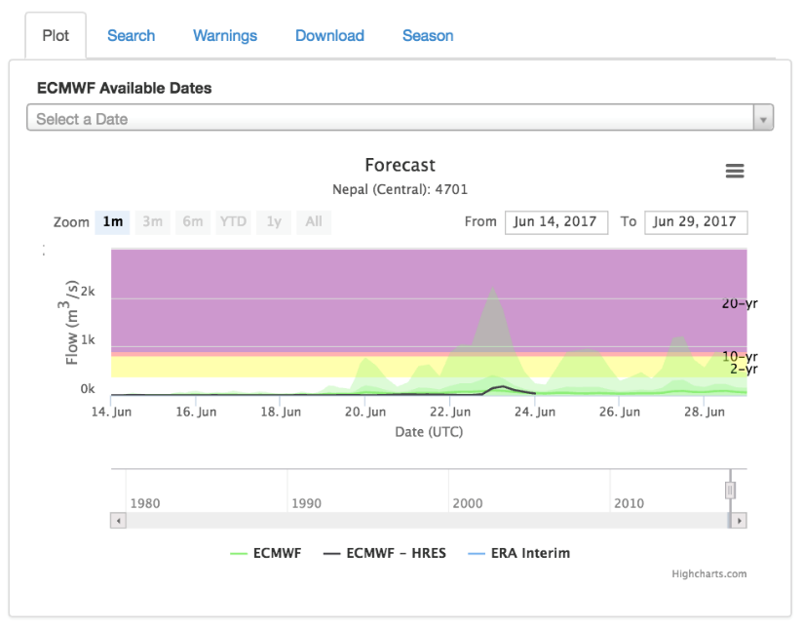
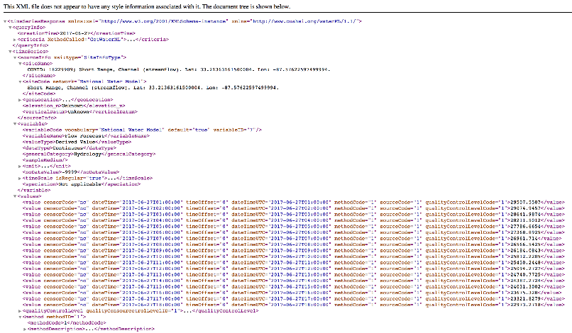
Actionable information
Pilots and Implementation across the world:
USA, Peru, Colombia, Dominican Republic, Brazil, SICA (8 countries in Central América); Ethiopia, Ivory Coast, Somalia, Tanzania; Bangladesh, Nepal, Kazakhstan, Uzbekistan, Kyrgyz Republic, Tajikistan, and Turkmenistan and Afghanistan.
Driven by ECMWF ensemble forecasts
Demonstrated in first pilot in US (2015)
Many national-scale applications
Data served through API access
Custom view using webservices
NO FLOOD VISUALIZATION

Slide 10
NOAA’s Flood Mapping Service from Operational Polar and
Geostationary Orbiting Satellites
https://iac2019-iaf.ipostersessions.com/Default.aspx?s=EC-84-59-56-43-27-07-34-1B-5D-81-4F-81-FB-D4-61
River Ice and Flooding Initiative PRODUCTS:
VIIRS Real time flood maps http://realearth.ssec.wisc.edu/?products=RIVER-FLDglobal
VIIRA Daily Composites https://realearth.ssec.wisc.edu/?products=RIVER-FLDglobal-composite1
VIIRA 5-Day Composites http://realearth.ssec.wisc.edu/?products=RIVER-FLDglobal-composite
ABI Daily Composites http://realearth.ssec.wisc.edu/?products=River-Flood-ABI
AHI Daily Composites http://realearth.ssec.wisc.edu/?products=RIVER-FLD-AHI
Joint VIIRS/ABI http://realearth.ssec.wisc.edu/?products=RIVER-FLD-joint-ABI
Joint VIIRS/AHI http://realearth.ssec.wisc.edu/?products=RIVER-FLD-joint-AHI
The products can also be browse through REALEARTH APP for android and Apple
Notes:
The river ice and flooding products are currently used by the NWS’s River Forecast Centers and other stakeholders in the U.S. They support flood forecasting and mitigation. This has been an excellent capability and services in flood mapping using the LEO and GEO imagery.

Slide 11
A Paradigm Shift is needed to harness the potential of space science and technology in the decision making process
Investment to develop actionable tools and services
Through pilot projects, demonstrate the ability to integrate JPSS/GOES-R PG/RR data with social, economic, environmental data to improve understanding and decision-making
Data integration (Remote sensing and In-situ data, for Social, Economic, Health and Environmental issues)
Higher resolution
More frequent observations to get the accurate time accumulation and lower latency.

Slide 12
JPSS/GOES-R PG/RR Summit
Angélica Gutiérrez
Angelica.gutierrez@noaa.gov
Advancing the use of Earth Observations in the Americas

