Slide 1
WFO Perspective on JPSS/GOES-R Products For Use in Hydrology JPSS/GOES-R Proving Ground/Risk Reduction Summit College Park, MD Feb 24th-28th, 2020
Aaron Jacobs
Senior Service Hydrologist
NOAA/National Weather Service Forecast Office
Juneau, Alaska

Slide 2
WFO’s in Alaska: Forecasters Hydrologic Responsibilities
Maintain a constant weather watch to keep situational awareness of any impactful hydrologic events that could affect their area of responsibility(AOR) with a 7 day time frame.
Issue statements(outlooks,watch,advisory,warning) to provide Impacted Base Decision Support Services (IDSS) to Emergency Management of impending impactful hydrologic events. Including long/short term drought(even in a rainforest)
Send out social media (twitter/facebook) to inform the general public
What is important to the Forecasters:
Total and layered Precipitable Water
How does weather elements compared to normal
Rain Rates/Amounts (In data spare areas)
Snow Water Equivalent on the ground
Integrated Water Vapor Transport

Slide 3
Steps Forecasters Take to Make Decisions & Complete Tasks (Issue Hydrologic Products)
Identify developing atmospheric events that can produce hydrologic impacts
How anomalous is the impending atmospheric event
Assessing current hydrologic conditions
Forecaster’s gain enough confidence from current atmospheric conditions(Sat information) and projected NWP output(QPF,Temp) to issue hydrologic flood products
Notes:
Talk about (stream flows, antecedent conditions, snowpack conditions for #3

Slide 4
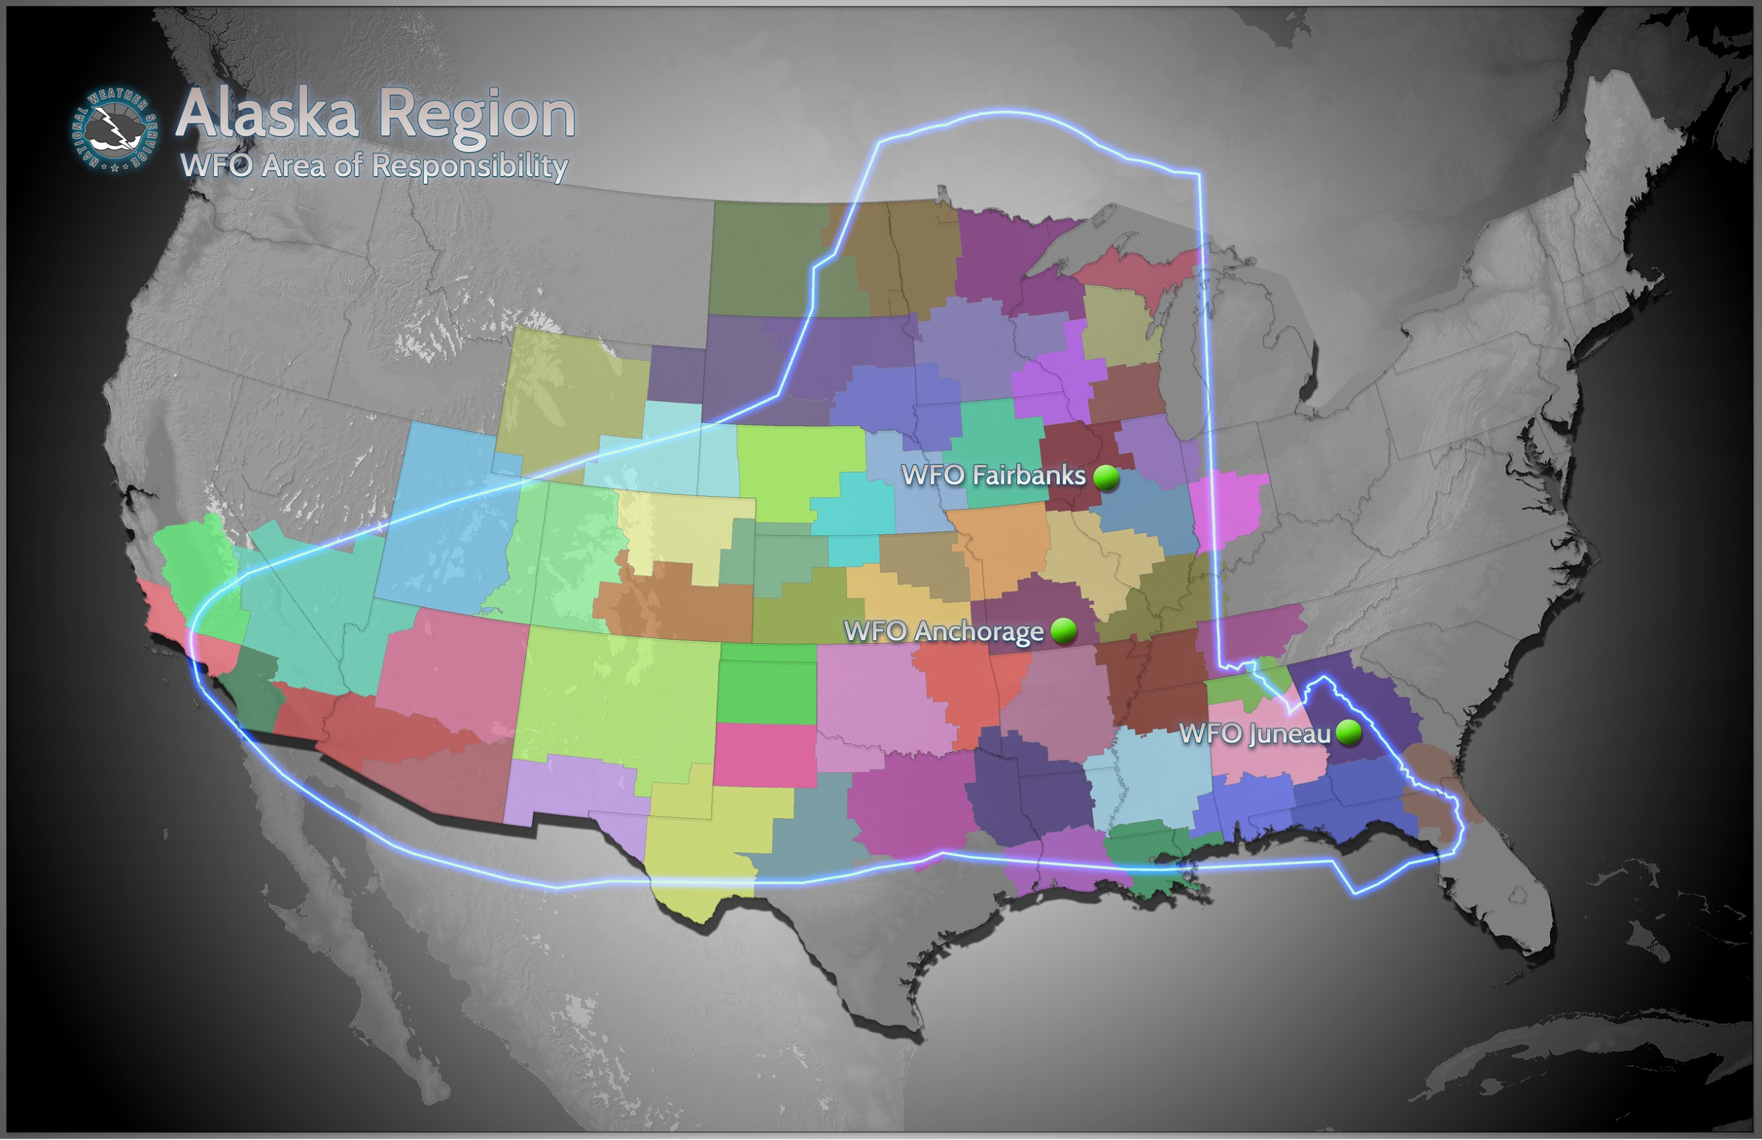
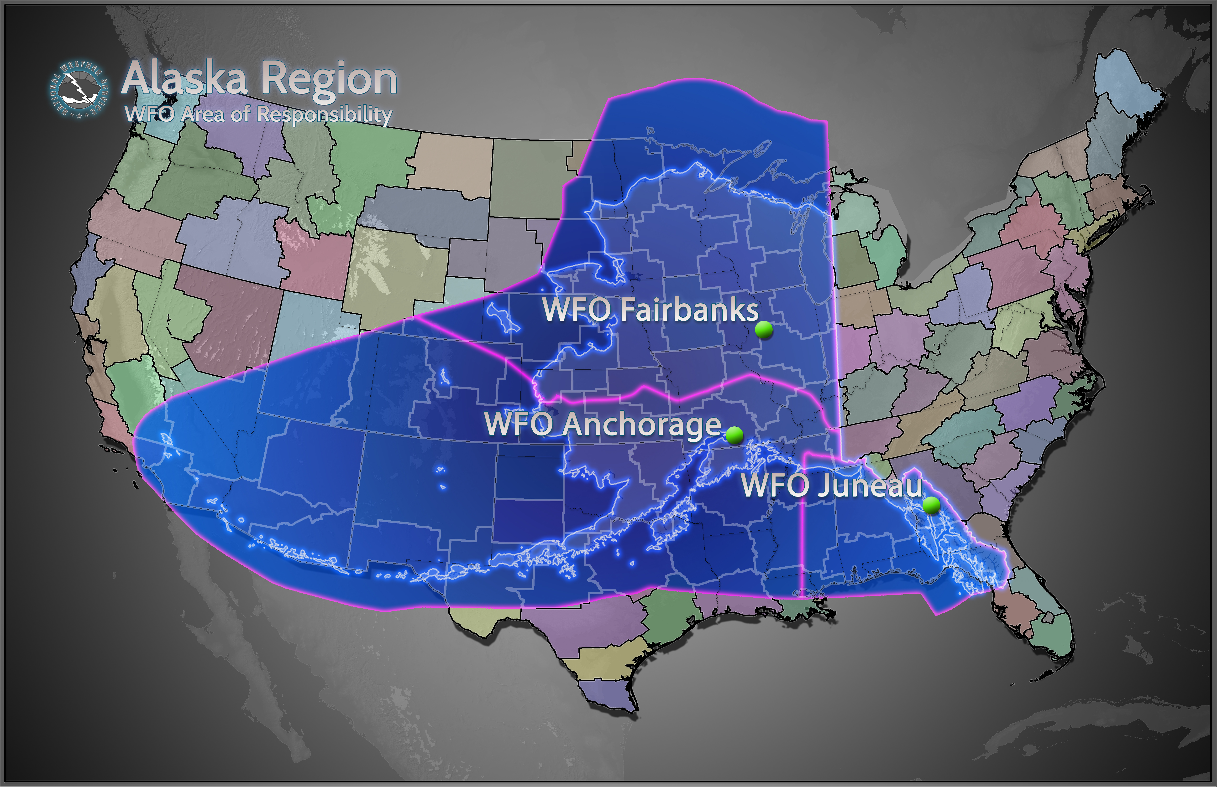
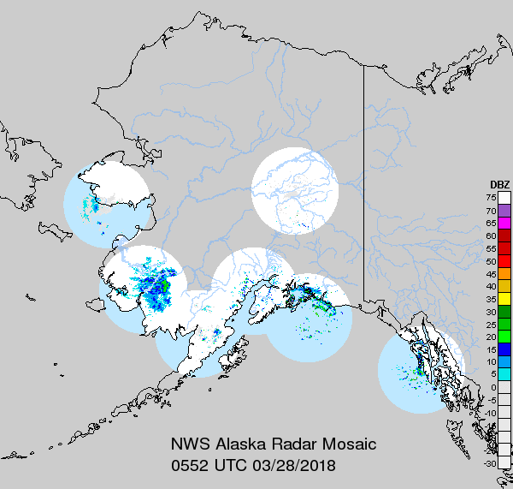
Issues that make tasks time-consuming, unpredictable, or inefficient
Alaska WFOs-Very large area of responsibility most over water
Very complex terrain with little ground truth(lots of data gaps), not much radar coverage
Getting new microwave (MV) derived products in front of the forecasters(security issues within NOAA)
Latency of MV derived products from time of satellite pass
Lack of accurate hi-res current analysis (QPE,SWE, for drought, flood potential)
Notes:
Public / Marine Responsibility
Land: ~185,000 square miles
Water: ~840,000 square miles
~1,025,000 million square miles of responsibility
~475,000 grids [ALU/AER]
22x increase over standard WFO
Standard WFO ~45,000 square miles and ~21,000 grids
68 precip stations for 38,750 sq mi= 1 station per 570 sq mi (stations mostly around cities)
Around 1/2 of stations are poor in winter(non-heated)
LOTS OF GAPS

Slide 5
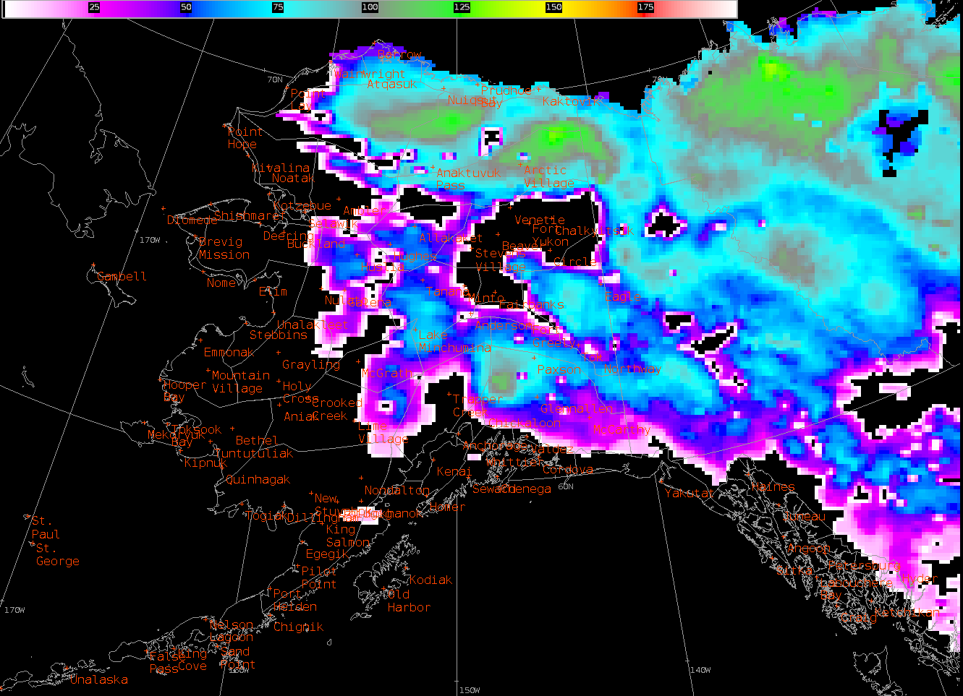
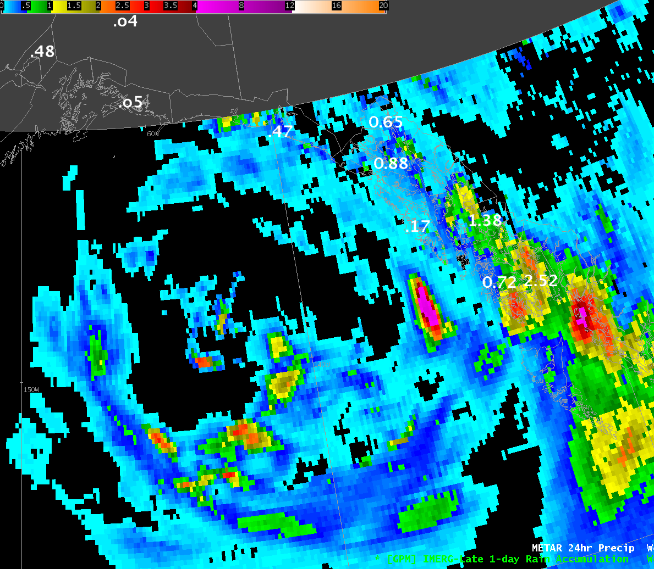
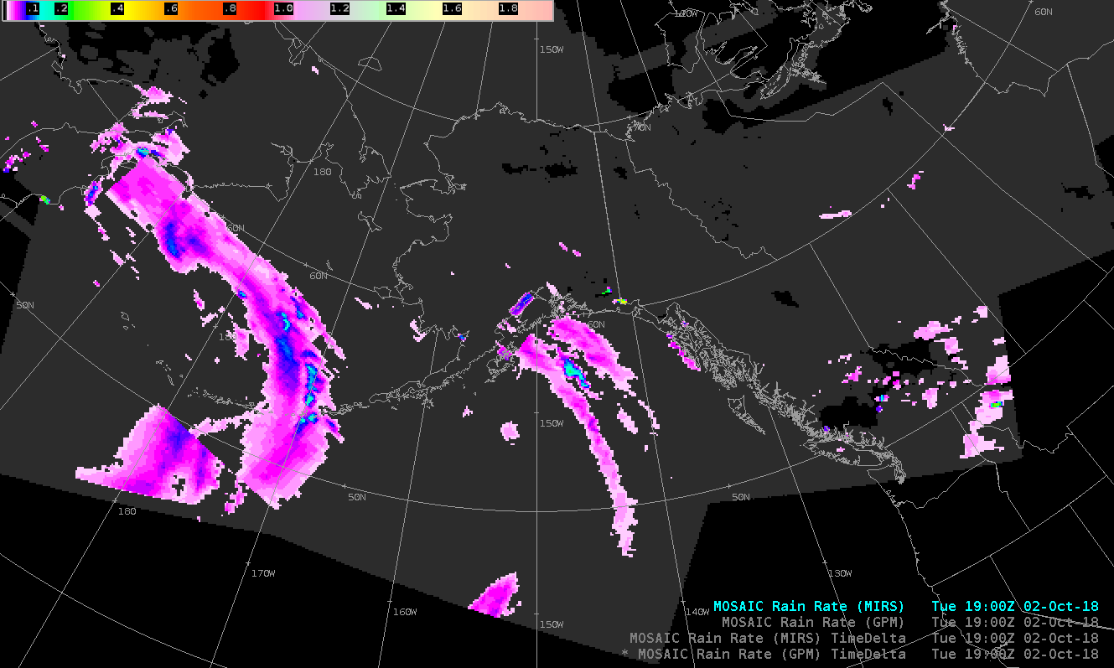
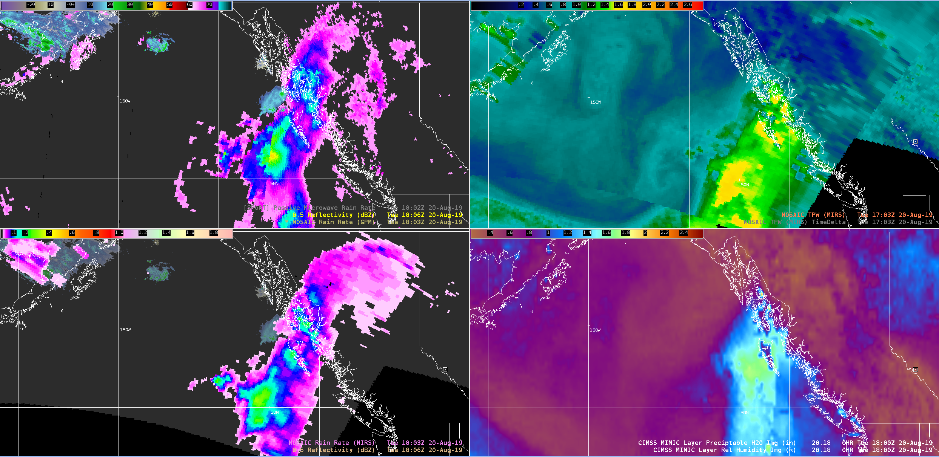
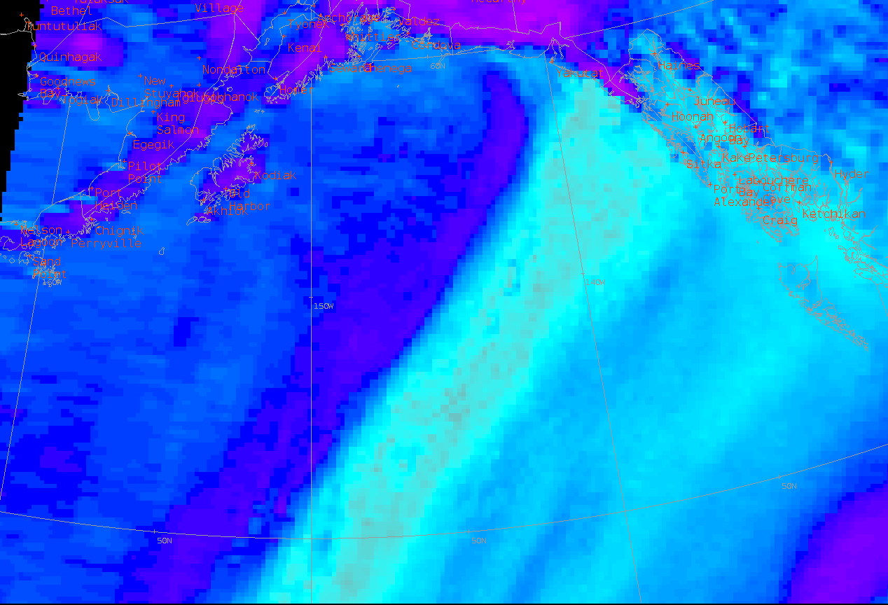
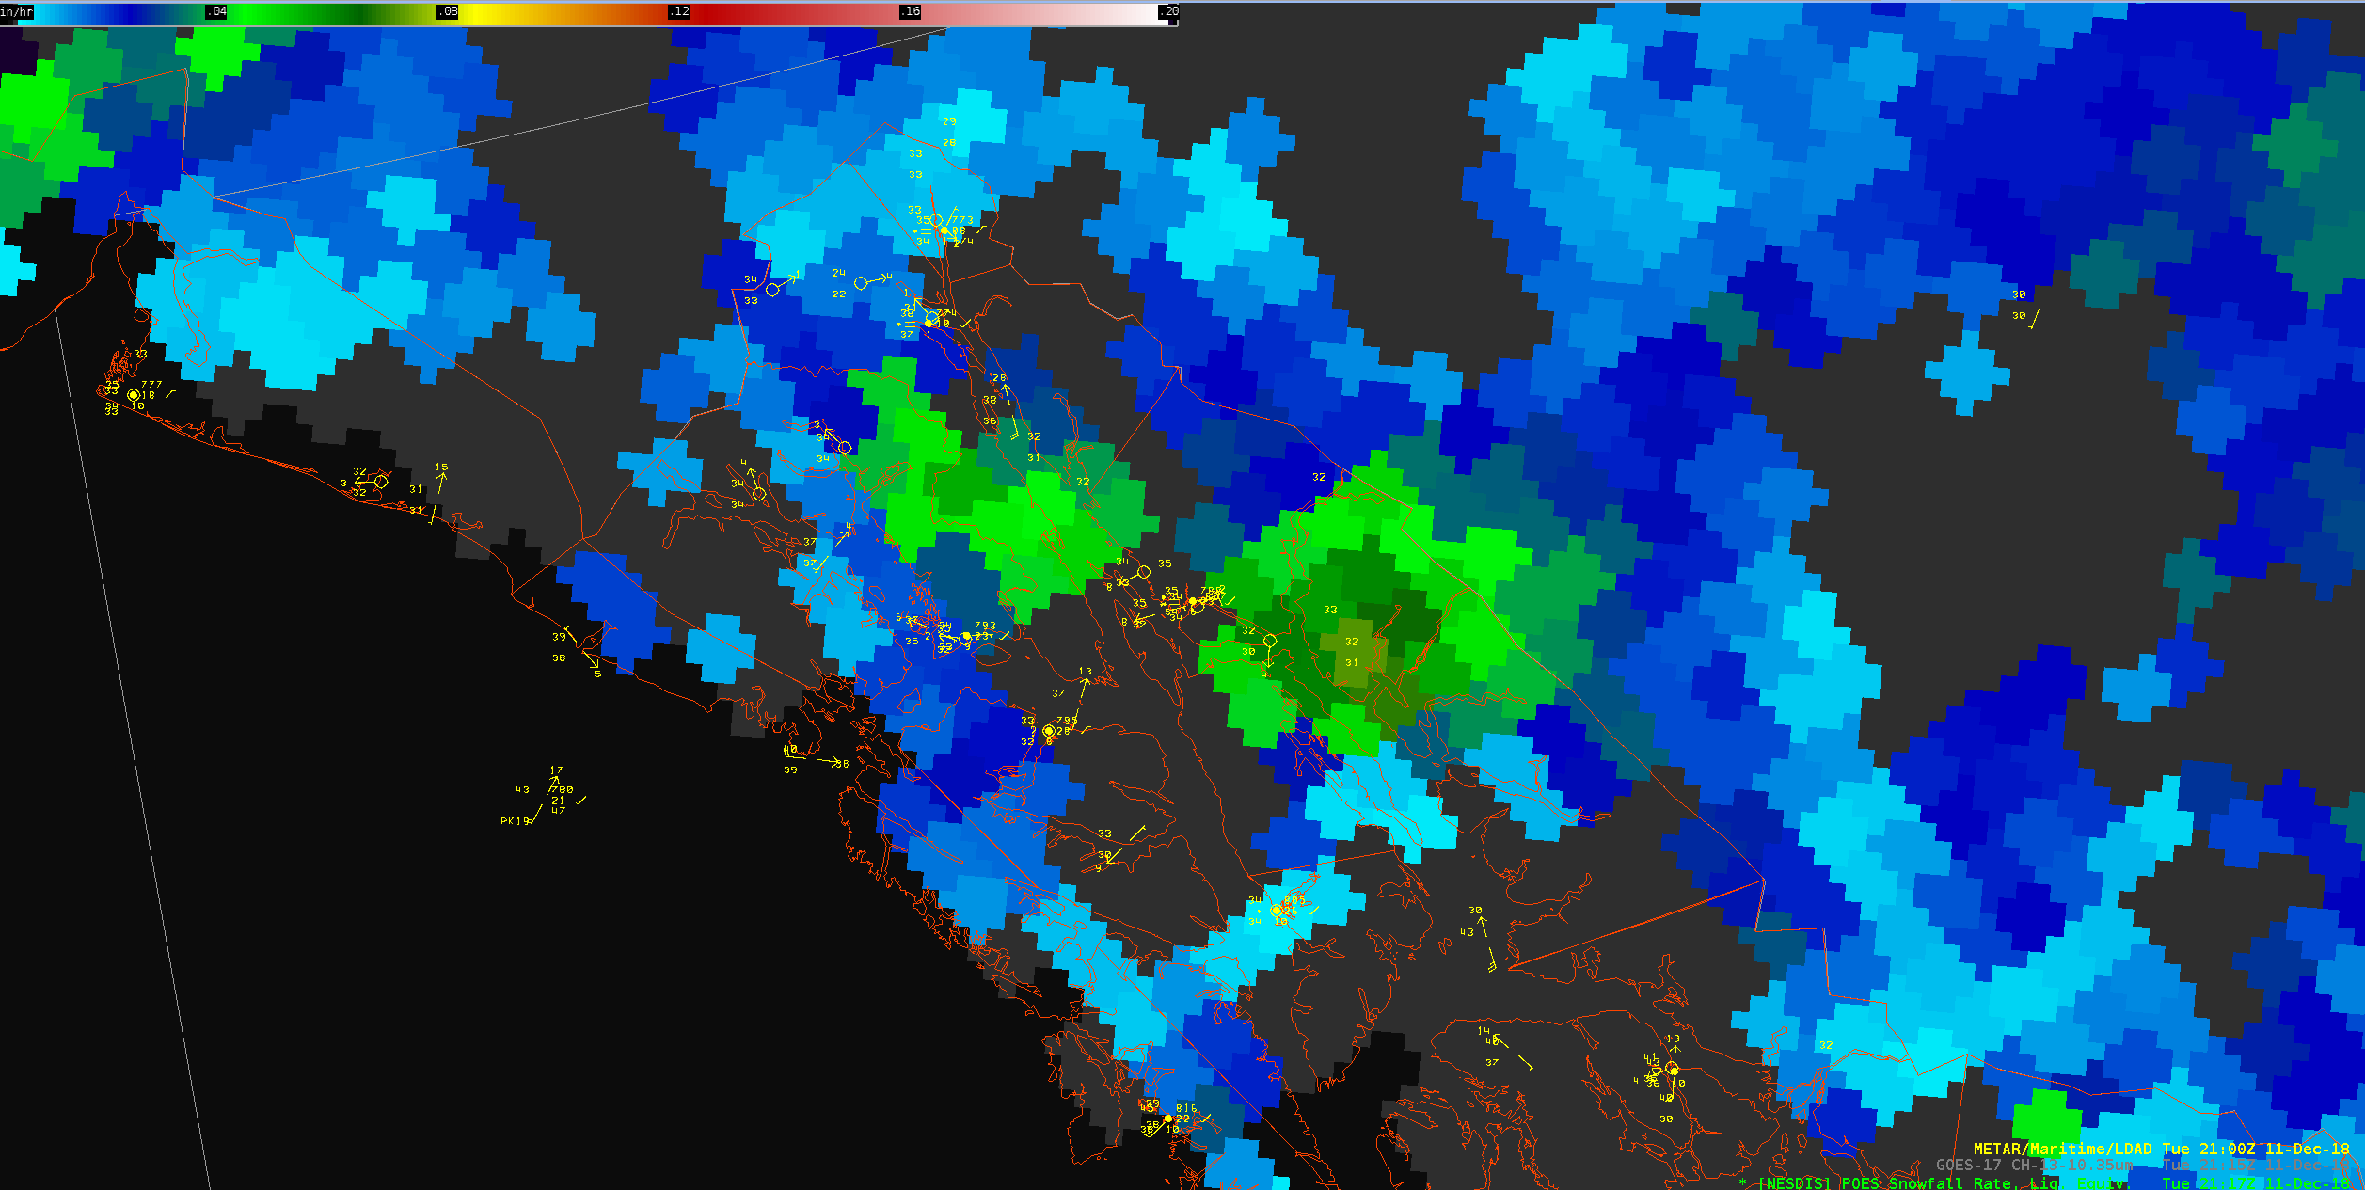
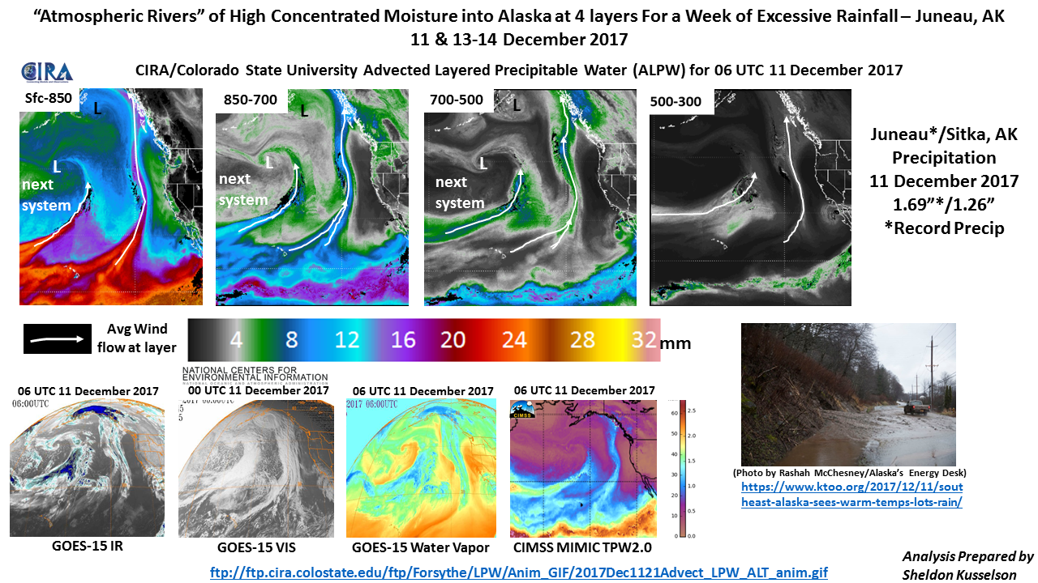
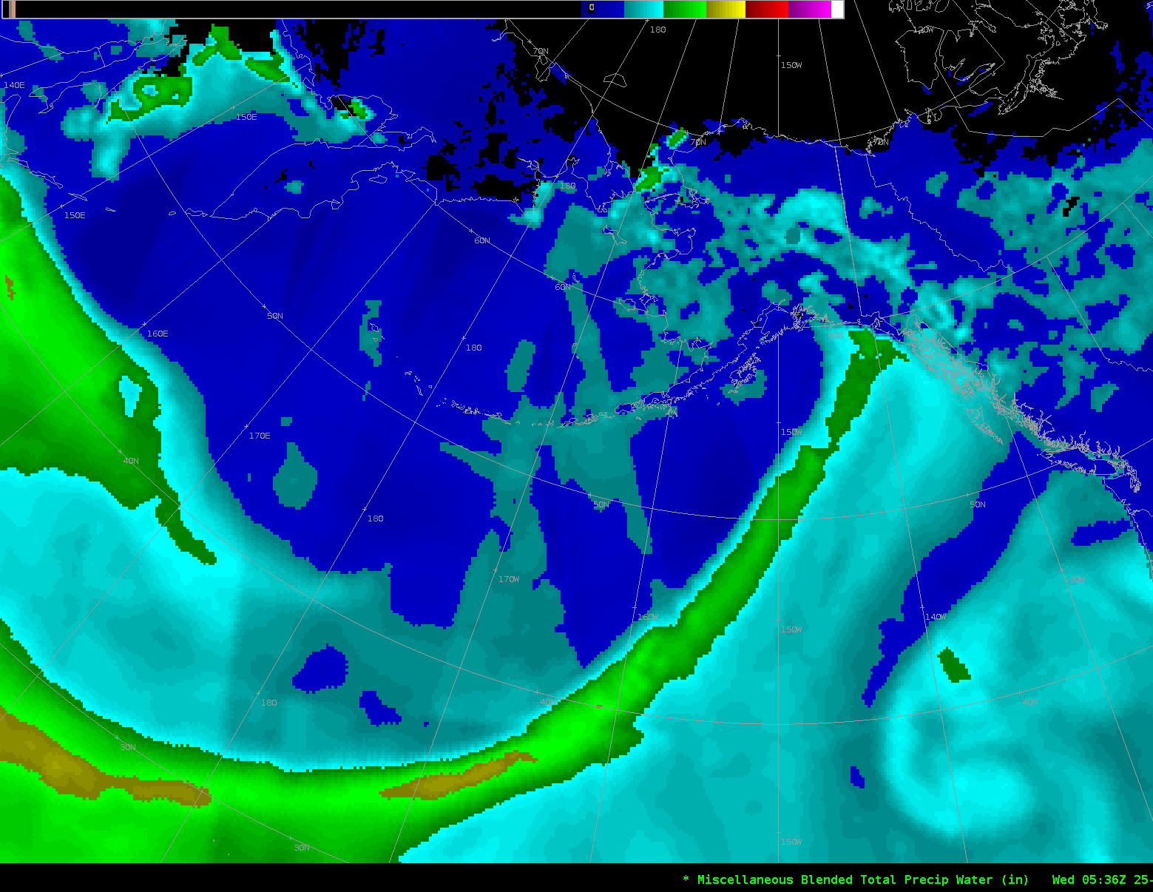
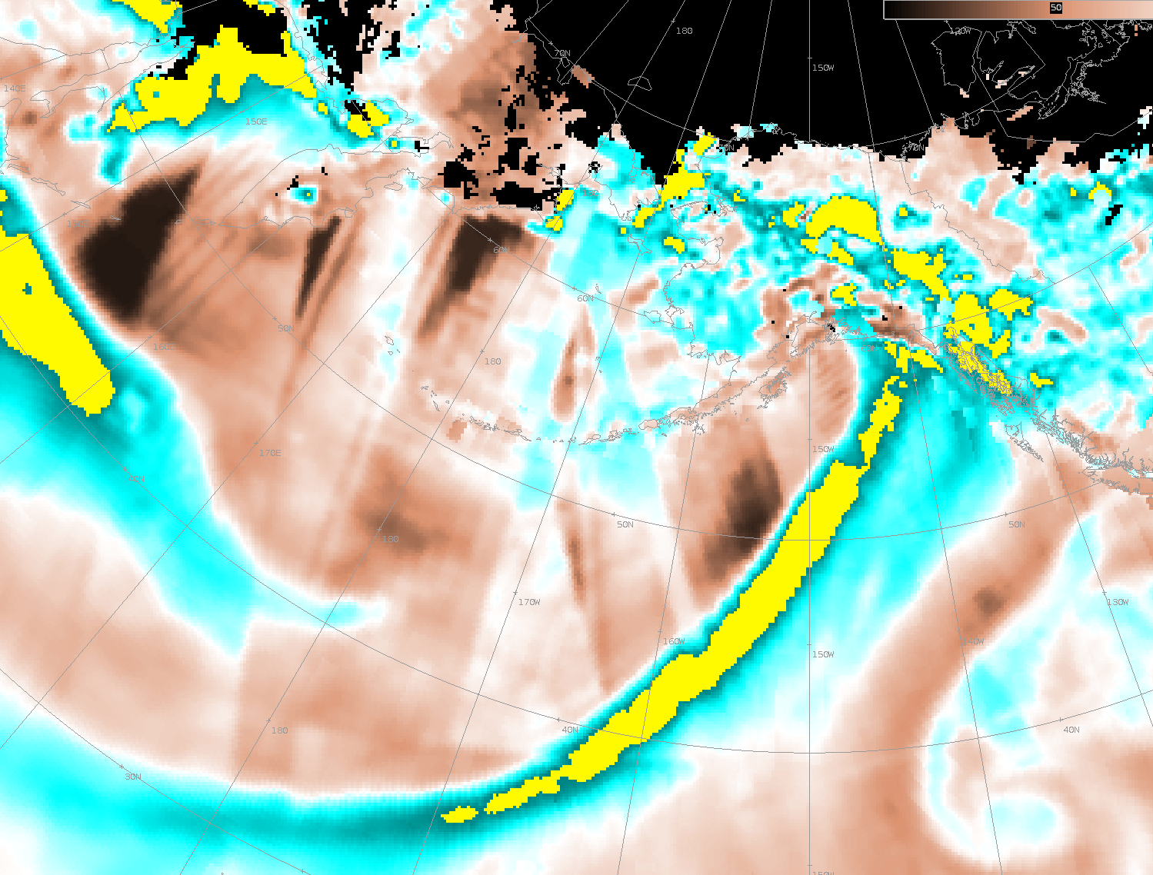
Satellite Data Currently Being Used
MIMIC TPW
Blended Total Precipitable Water(TPW) & % of normal TPW (NESDIS)
TPW (MIRS)
Advected Layer Precipitable Water (ALPW)
Rain Rate products(MIRS & GPM), Blended RainRate(NESDIS)
GPM IMERG QPE (NASA SPoRT)
MIRS SWE and Snowfall Rate Product(SRF)
GOES-17 Rain Rate product (not much)
Combined GEO with LEO products overlay (to limit parallax issues from GEO)
All GOES-17 RGB products and WV bands
Needs From Satellite Data For Use in Hydrology
Continue to decrease latency of products(utilize DB), Streamline getting new products to forecasters in AWIPS!
Get CMORPHv2 to WFOs
Need a LIS for AK (in development) for drought and flood potential
Updated data for % of normal PW, provide POR to forecasters
Provide a composite of GOES-17 and Himawari into AWIPS
Provide near term verification of MV derived products
Gain forecaster confidence in these products
Standardized color scale and units for RR & TPW products
Forecaster Challenges: AWIPS memory issues with all the Sat imagery, data overload, training
Challenge for developers: Develop a satellite IVT product to determine strength of atmospheric river events

