Slide 1
Vegetation Health 1981-2020 APLICATIONS
Felix Kogan, Wei Guo, Wenze Yang
Feb 25, 2020

Slide 2
Vegetation Health COVERAGE
40-year (1981-2018)–Blended AVHRR-VIIRS (4, 16 km)
32-Year (1981-2012) –AVHRR noaa7-19 (4, 16 km)
8-year (2013-2018) -VIIRS s-npp (1, 4 km)
*Next 25-year (2022-2043) –VIIRS noaa21-24
Coverage World
Indices NDVI, BT, VCI, TCI, VHI

Slide 3
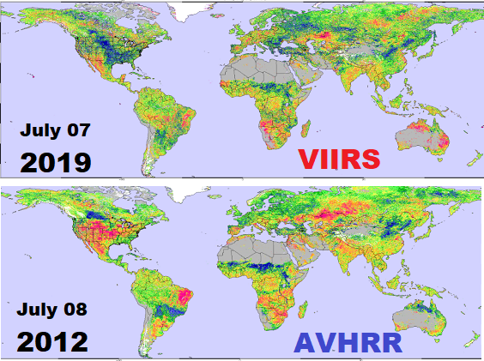
Vegetation Health & Applications
Vegetation Health (VH) is an indicator of toAApplications
Vegetation Health
Drought
Area
Intensity
Duration
Start/End
Impacts
Moisture Stress
Thermal Stress
Healthy veg.
Crop/pasture pr.
Fire Risk
Soil Saturation
Malaria
Land greenness
Landslides
Food security
Climate change

Slide 4
a. World Grain Production-Consumption, 1970-2013
Droughts
2012 – USA
2011 – USA
2010 – Russia, Ukraine, Kazakhstan, Argentina
2007 – Australia, China, Argentina, Brazil, Ukraine
2003 – USA, Europe, Australia, India, China, Ukraine
1996 – USA, Russia, Argentina, Kazakhstan Australia
1988 – USA

Slide 5
Drought Crop Losses in 2014
AUGUST
VCI
Moisture Conditions
TCI
Thermal Conditions

Slide 6
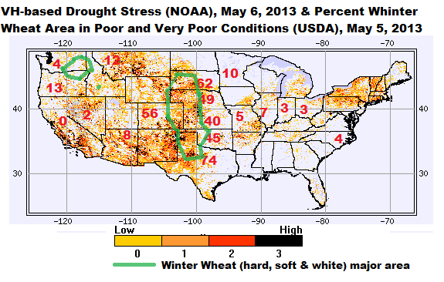
VH-drought stress & USDA pasture & winter wheat condition, May 6, 2013
Pasture
Winter Wheat

Slide 7
VH Applications http://www.orbit.nesdis.noaa.gov/smcd/emb/vci
APPLICATIONS
Moisture & Thermal stress
Drought area
Intensity of vegetation stress
Fire risk
Drought duration
Drought detection/prediction

Slide 8
Nov 25, 2017 Moisture (VCI) and Thermal (TCI) Vegetation Stress
VCI
TCI

Slide 9
Crop Yield Actual and VH-Model Predicted in Kansas

Slide 10
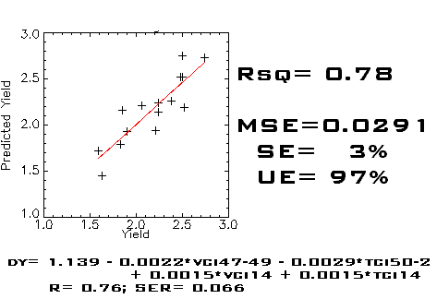
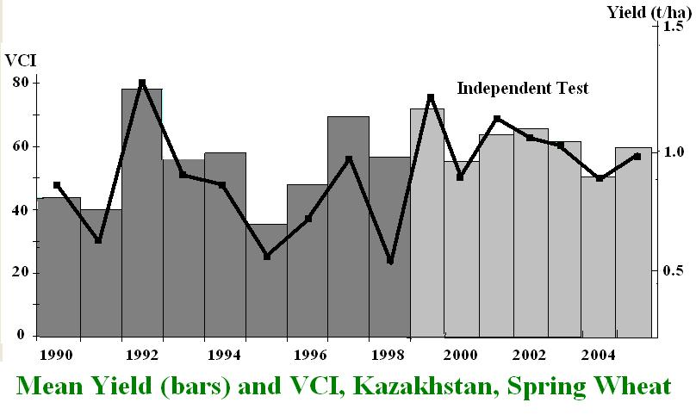
VH Predicted vs Observed Wheat Yield
RUSSIA
INDIA, Rajasthan
KAZAKHSTAN
ARGENTINA

Slide 11
VH-Biomass & Corn Yield Modeling & Prediction
Pasture biomass vs VCI, MONGOLIA
MONGOLIA
Biomass
Corn yield vs VCI, ZIMBABWE
ZIMBABWE
Corn

Slide 12
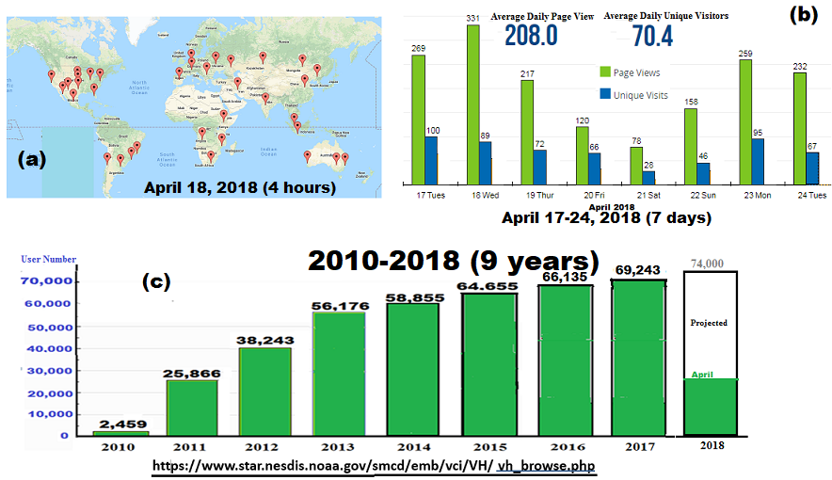
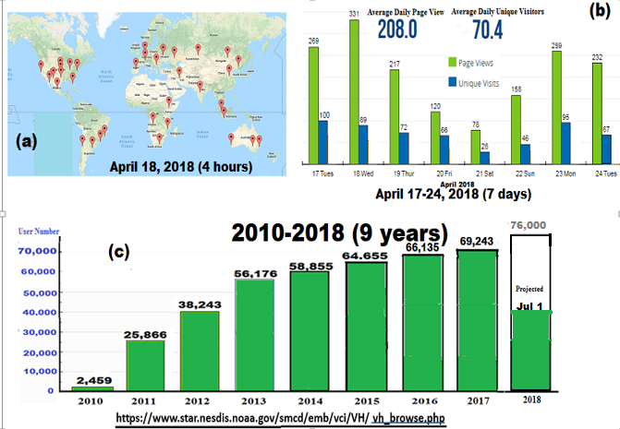
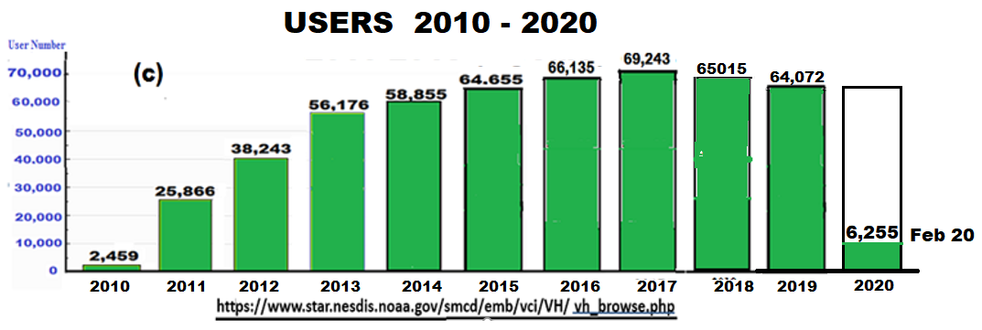
WEB Usage Gl

Slide 13
S-NPP/VIIRS Vegetation Health

Slide 14
0.5 km

Slide 15
Vegetation Health WEB
https://www.star.nesdis.noaa.gov/smcd/emb/vci/VH/vh_browse.php
Every week start counting from January 1

Slide 16
BACK UP

Slide 17
Conclusions
2018 World Population 7.6 bil. Increases with Accelerating Rate; World Grain Production Increases with Decelerating Rate
Grain Supply dropped below Demands (in 2001-2017 - 8 years)
Severe Droughts - Reduces Global Grain Production 4-7% every 3-5 years; Moderate Drought – Reduces Grain 1-3% every 1-3 years
Satellite-based Vegetation Health (VH) Technology Provide Tools for Drought Monitoring & 2-5 Weeks Advance Prediction of its Start/End, Area, Intensity, Duration and Impacts
VH Provide Prediction of Drought-related Crop & Pasture Losses: (a) 1-3 Months in Advance of Harvest, (b) During ENSO years 3-4 months prediction
VH Predicts Food Security Problem 3-5 Months in Advance the Developing Nations Need Assistance
Drought Area & Intensity has not Changed Globally & in USA’s Grain Area during Global Warming since 1981

