Slide 1
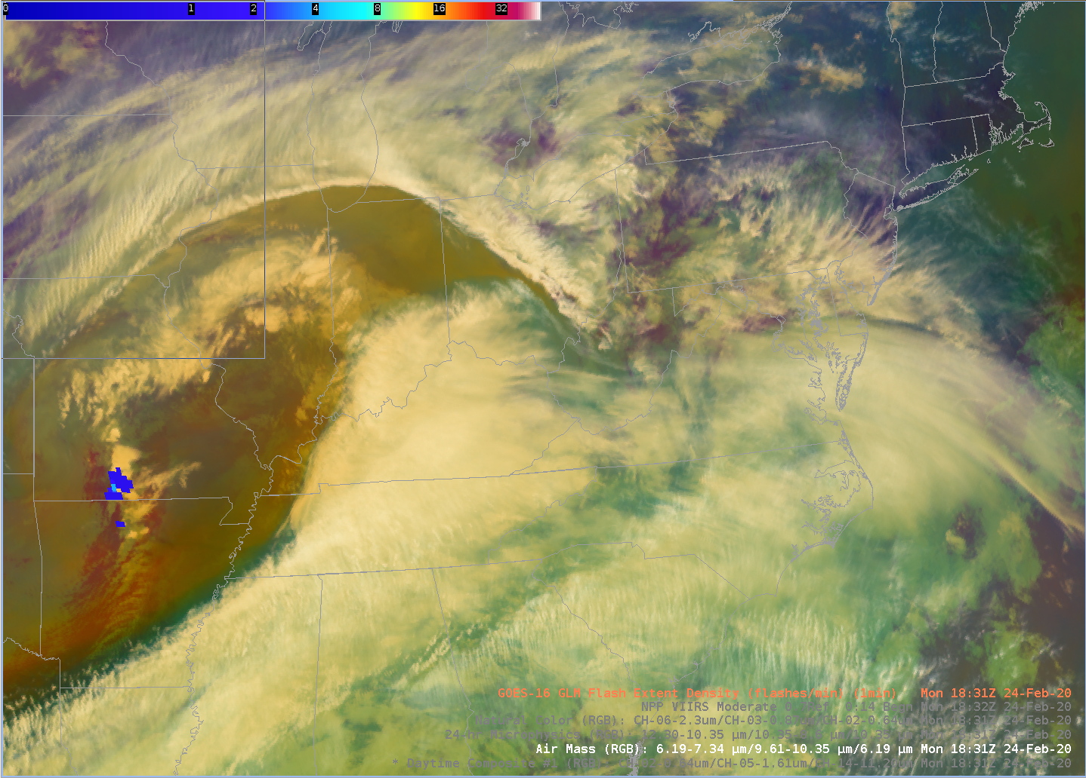
WFO (LWX) Perspective: Satellite Imaging
Steve Zubrick WFO Sterling, VA
For
2020 JPSS/GOES Proving Ground / Risk Reduction (PGRR) Summit
Feb 25, 2020
College Park, MD

Slide 2
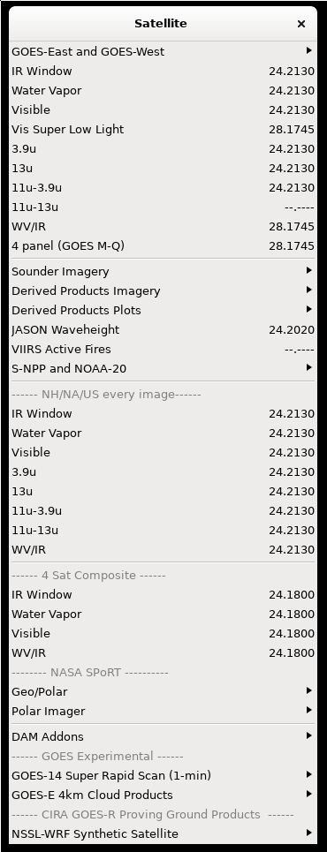
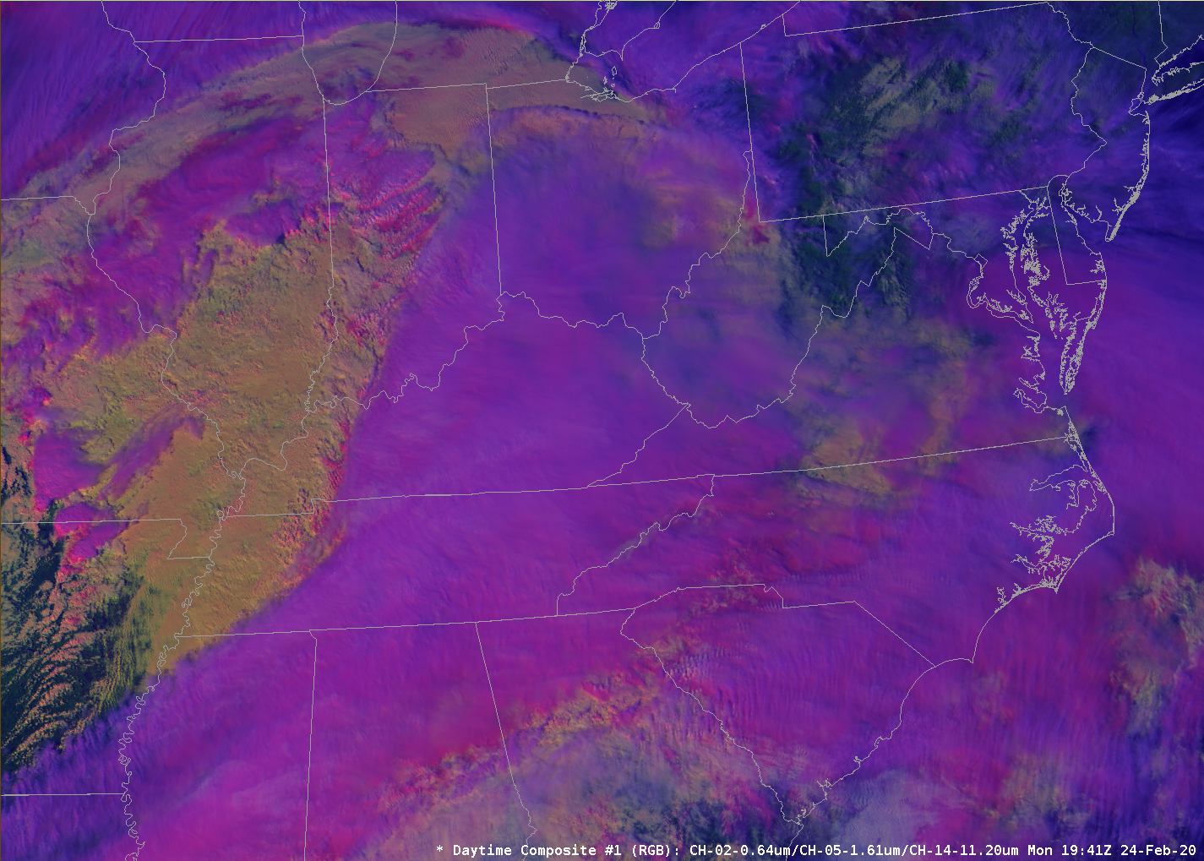
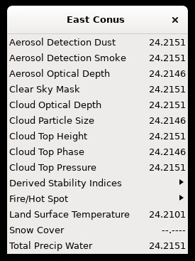
WFO LWX/Sterling – Perspective Steve Zubrick, SOO-LWX

Slide 3
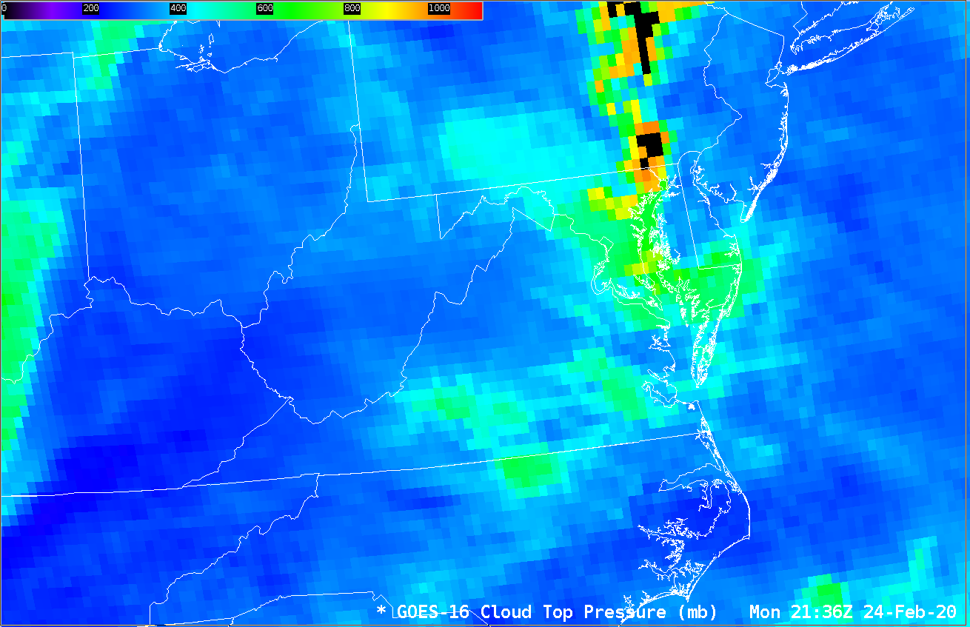
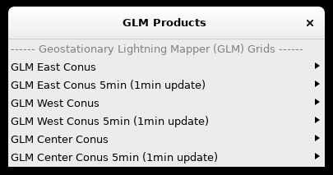
WFO/LWX – Satellite Imaging
GOES/JPSS support local Weather Forecast Office (WFO) mission in a multitude of way
WFO/LWX uses Satellite observations to support all key mission tasks involving warning and forecast operations
Satellite analysis is part of daily forecaster routine

Slide 4
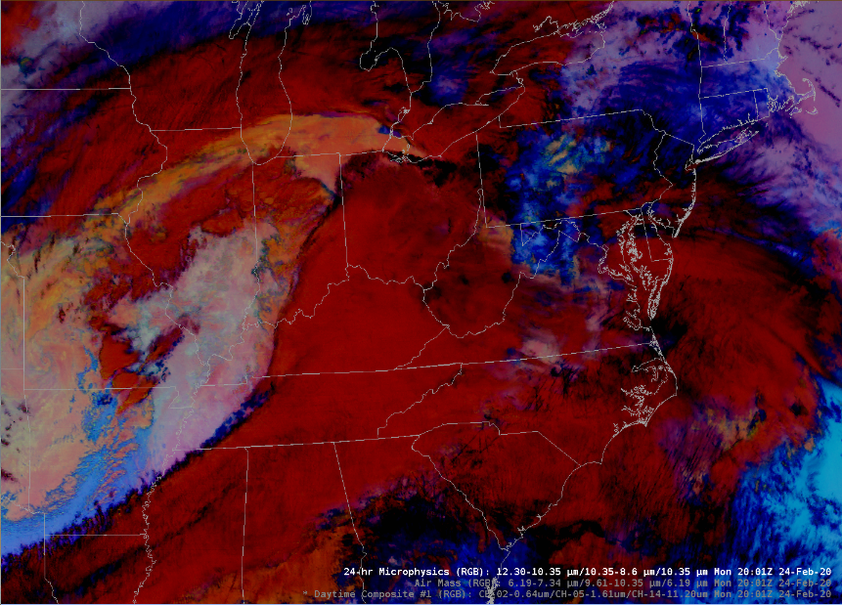
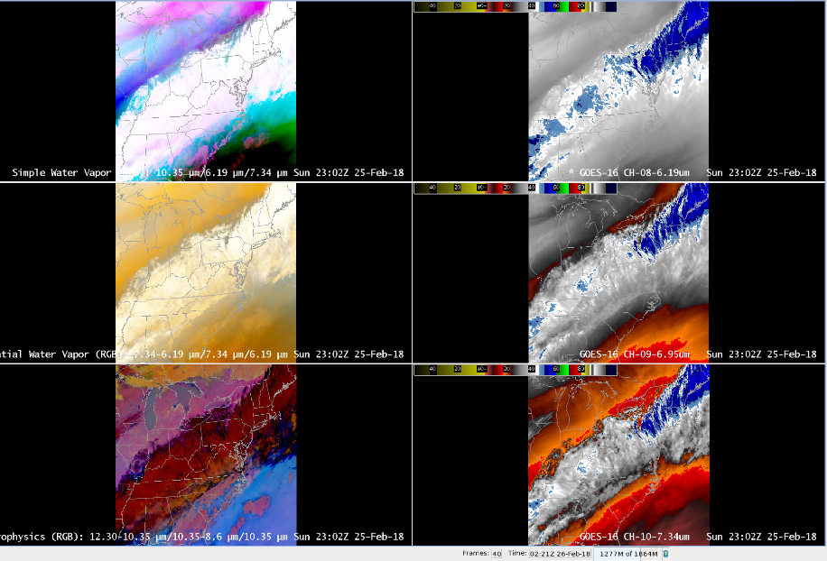
WFO/LWX – Satellite Issues
Training (time for it!)
New hires require lots of training
Slow response (10s sec) in AWIPS plotting complex RGB, derived, and multi-panel satellite products
System lockups do occur requiring reset/reboot

Slide 5
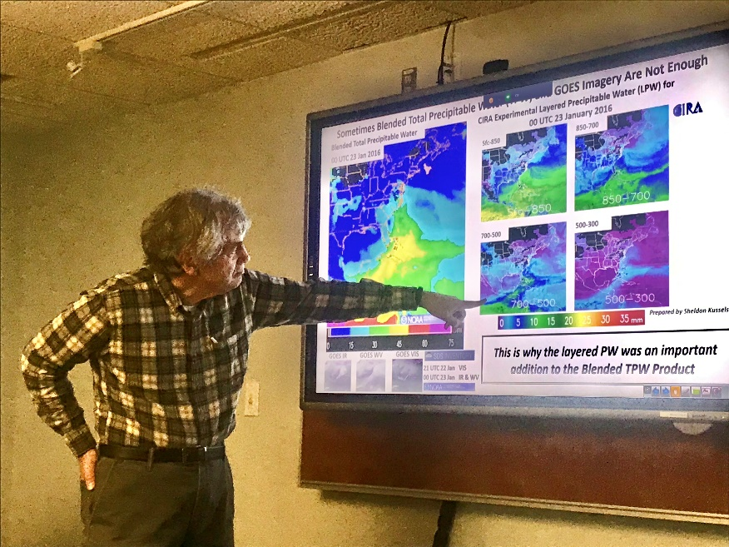
Key Issue – Satellite Training
Satellite training is a continual (and never-ending!) process:
Local in-house training (Satellite Program Leader) and guest experts
Online resources (including CLC/COMET modules, blogs)
Attending conferences/workshops

Slide 6
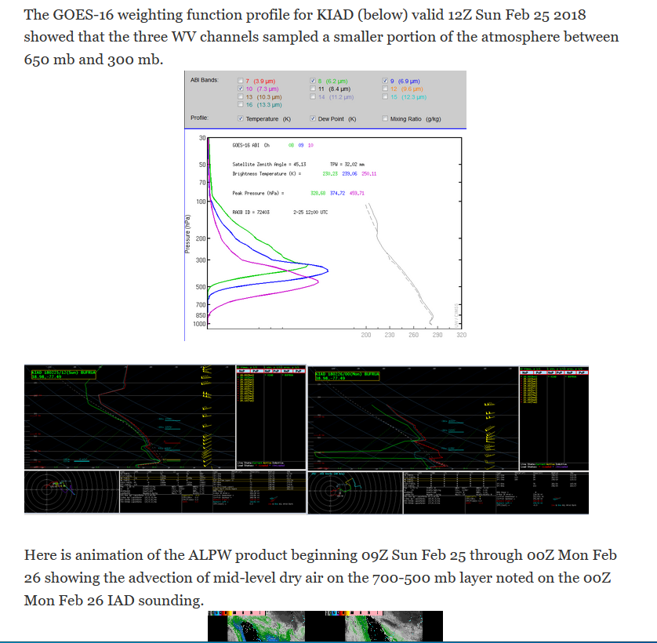
WFO/LWX – Satellite Imaging: Training

Slide 7
WFO/LWX – Satellite Imaging: Training

Slide 8
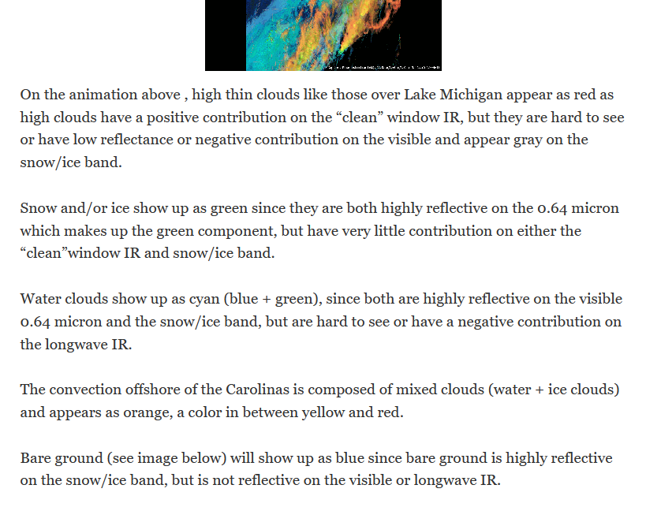
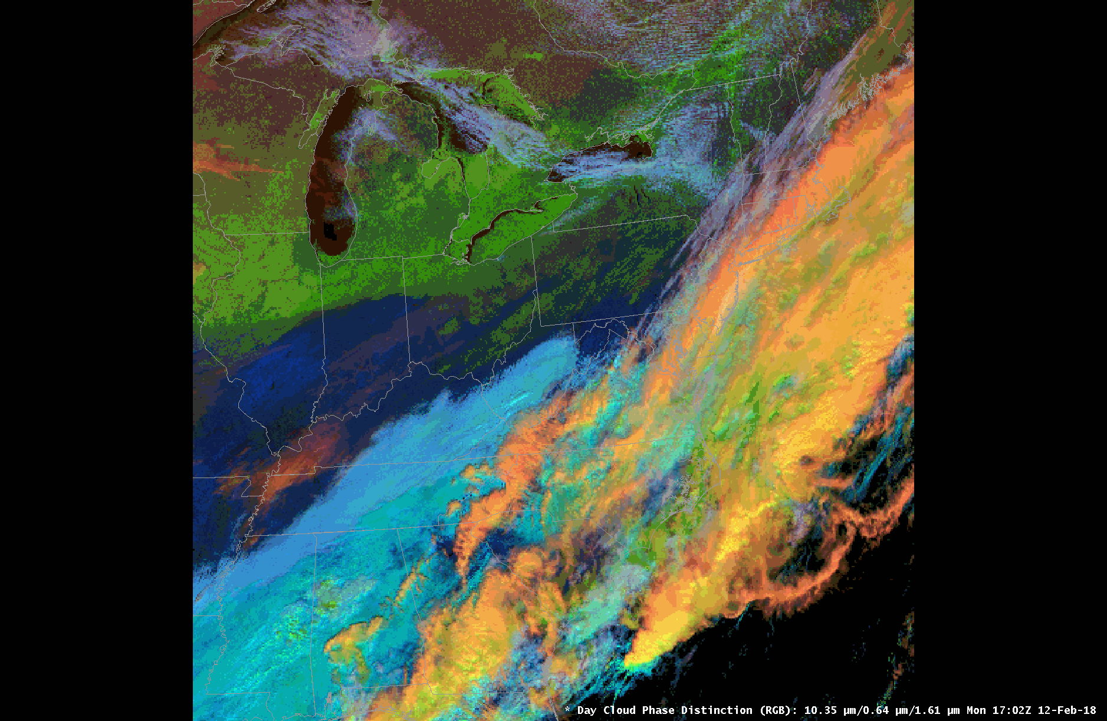
WFO/LWX – Satellite Imaging: Training
Day Cloud
Phase RGB

Slide 9
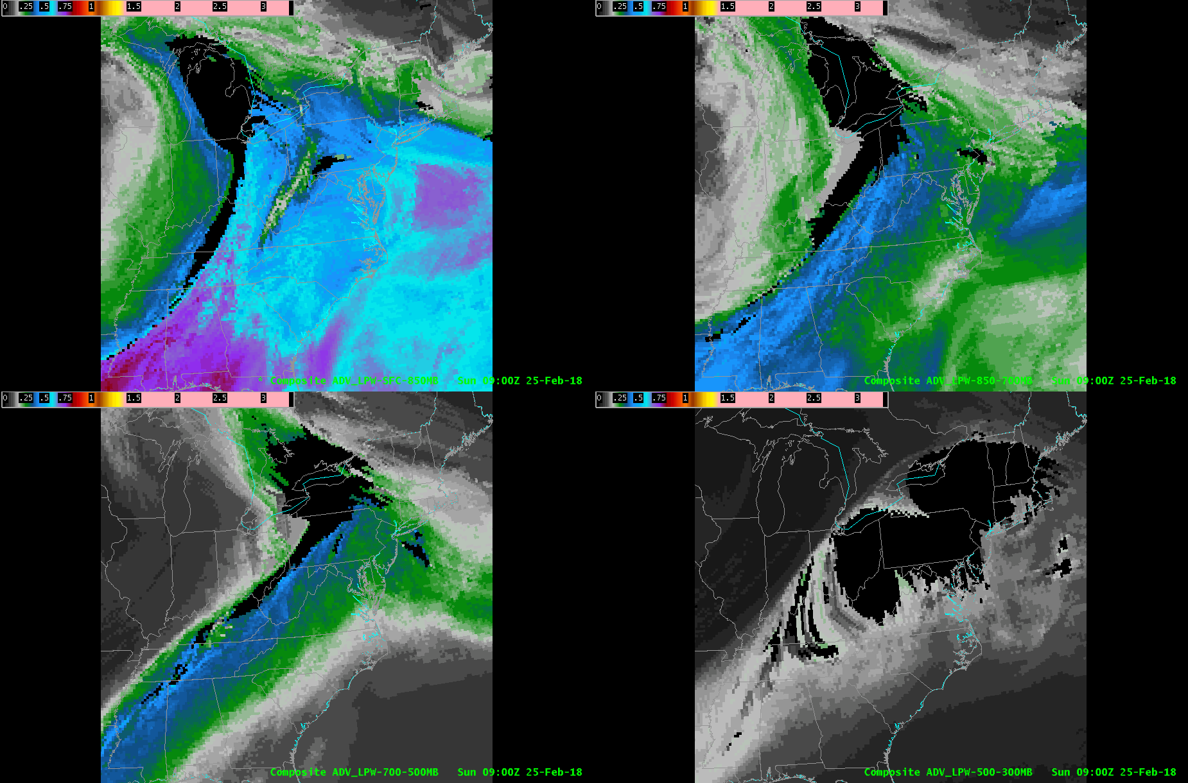
WFO/LWX – Satellite Uses

Slide 10
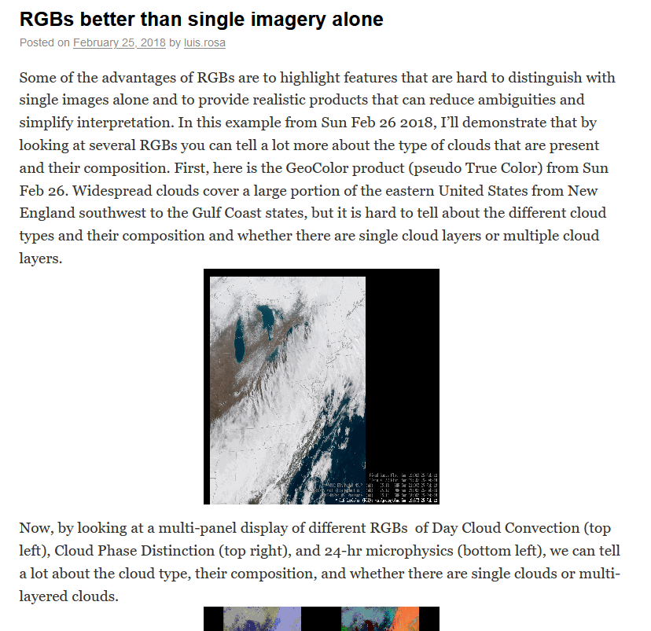
WFO/LWX – Satellite Uses: RGBs

Slide 11
WFO/LWX – Satellite Uses: Rapid Updates
Rapid Updates (1/5 minutes)
Day Cloud
Phase RGB

Slide 12
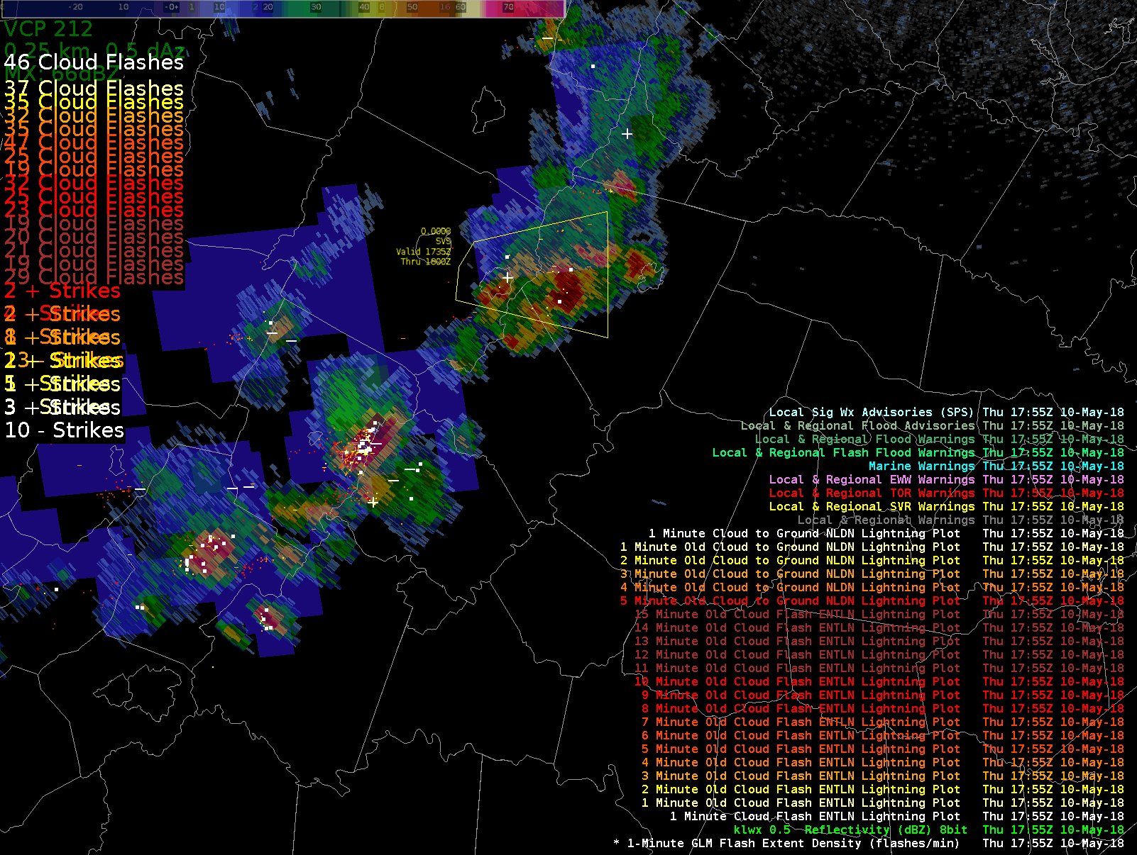
WFO/LWX – Satellite Uses: Convection
Day Cloud
Phase RGB

Slide 13
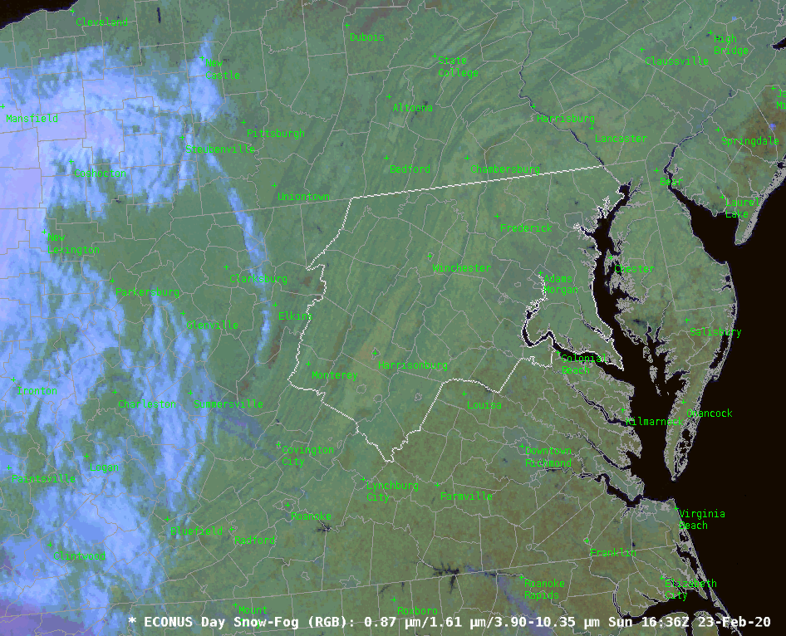
WFO/LWX – Satellite Uses: Social Media
Day Cloud
Phase RGB

Slide 14
WFO/LWX – Satellite Imaging - Examples
RGB and Derived products: Air Mass RGB and GLM FED

Slide 15
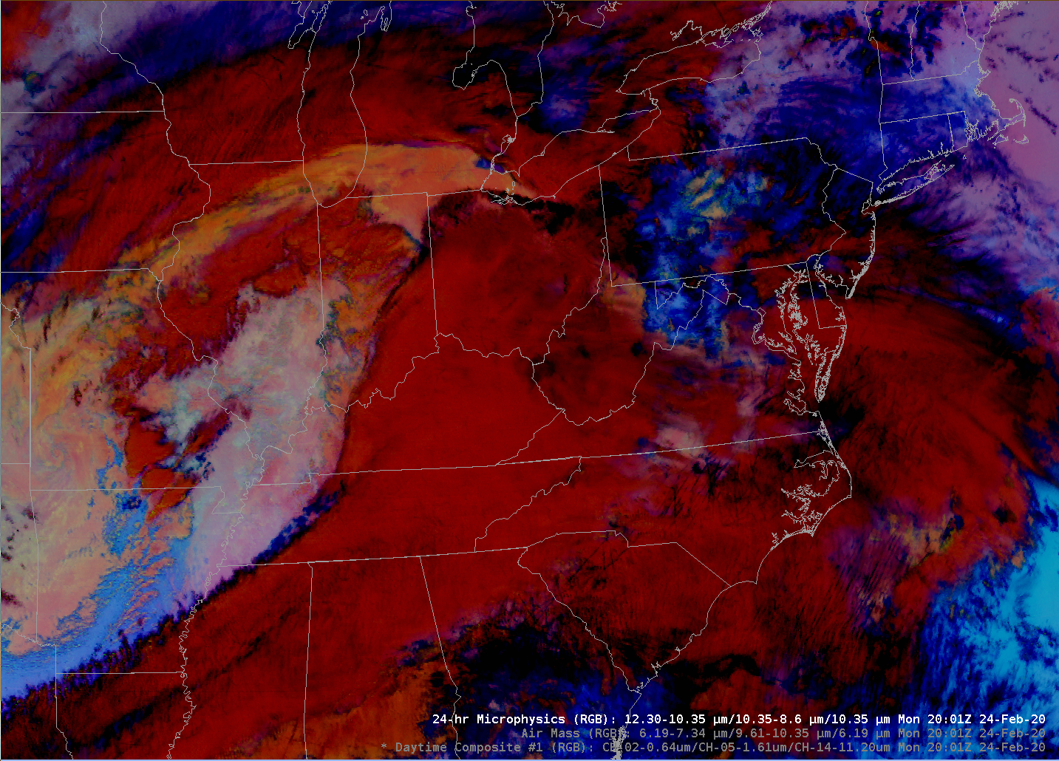
WFO/LWX – Satellite Imaging - Examples
RGB and Derived products: 24-hr Microphysics

Slide 16
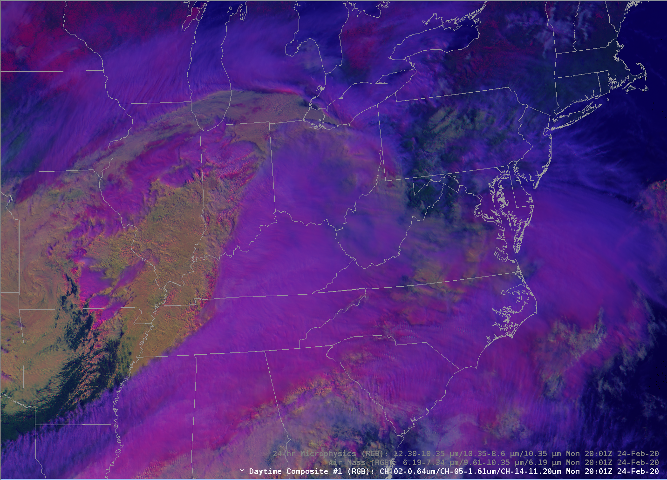
WFO/LWX – Satellite Imaging - Examples
RGB and Derived products: Daytime Composite (#1) RGB

Slide 17
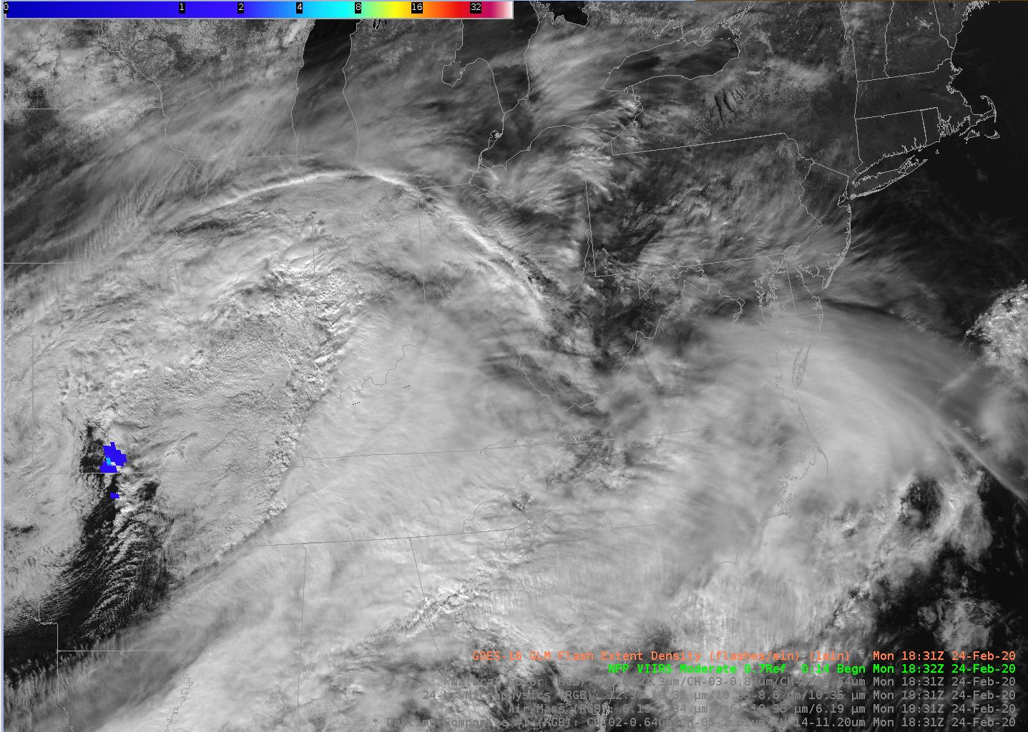
WFO/LWX – Satellite Imaging - Examples
RGB and Derived products: NPP VIIRS Constant Contrast

Slide 18
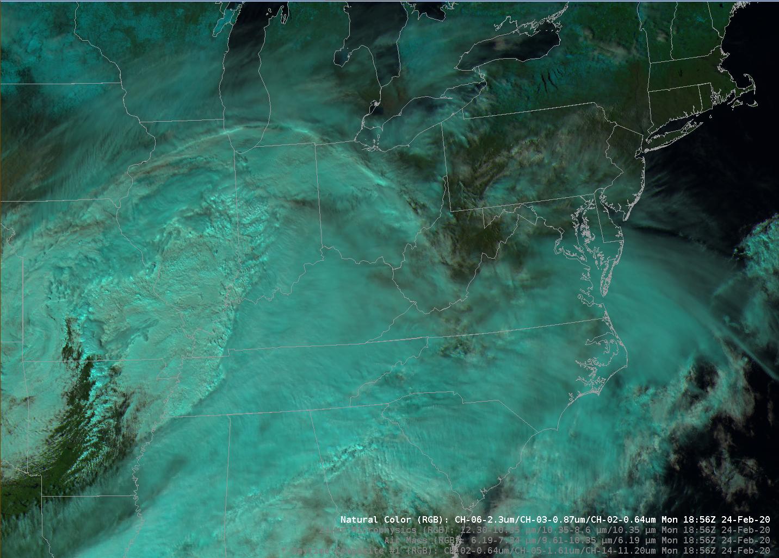
WFO/LWX – Satellite Imaging - Examples
RGB/Derived products: Natural Color RGB (Channels 6/3/2)

Slide 19
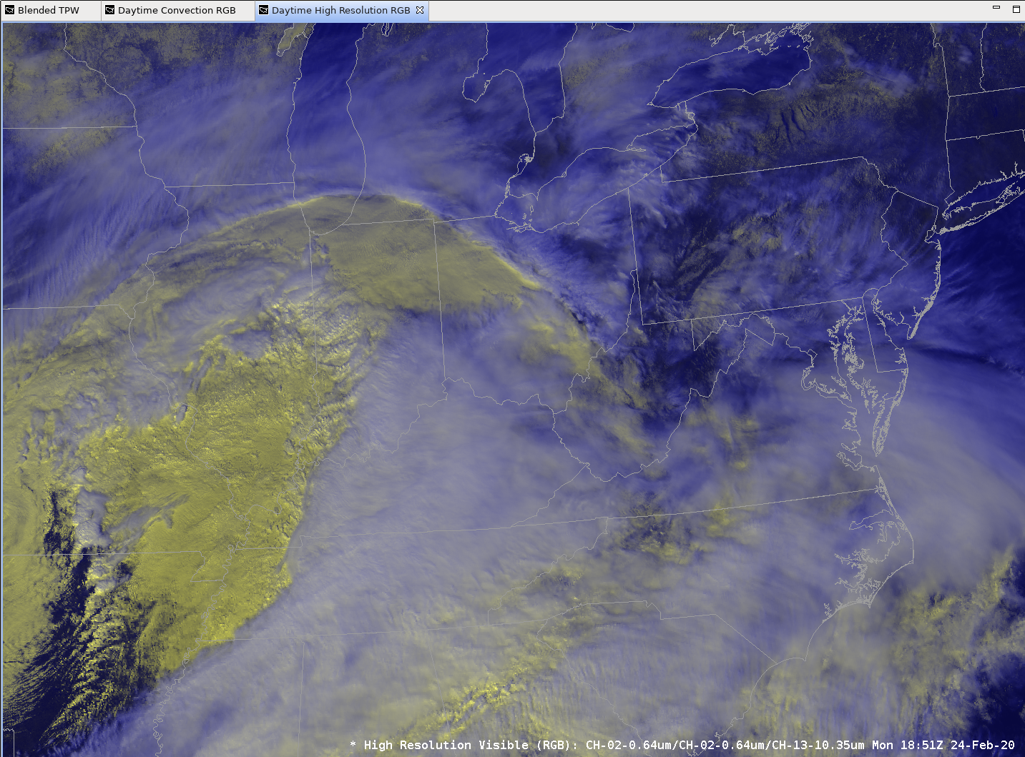
WFO/LWX – Satellite Imaging - Examples
RGB and Derived products: High Res Visible RGB

Slide 20
WFO/LWX – Satellite Use - Summary
Satellite imagery vital to supporting WFO forecast and warning operations
Time for training is a challenge in light of other training needs (e.g., IDSS, Forecast Builder, etc)
Especially for new hires
AWIPS workstation slow response in plotting complex Sat. RGB/derived/multi-panel products needs to be addressed
System lockups also occur requiring reset/reboot

Slide 21
END – WFO/LWX Perspective

