Slide 1
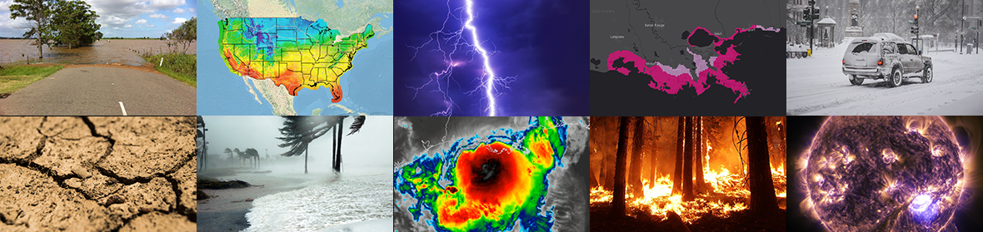
Preliminary Findings from the NWCG Satellite Data Task Team
FEBRUARY 25, 2020 – Satellite Proving Ground Risk Reduction Summit
Presenter: Chad Gravelle, Tech Dev Met, NWS Southern Region HQ

Slide 2
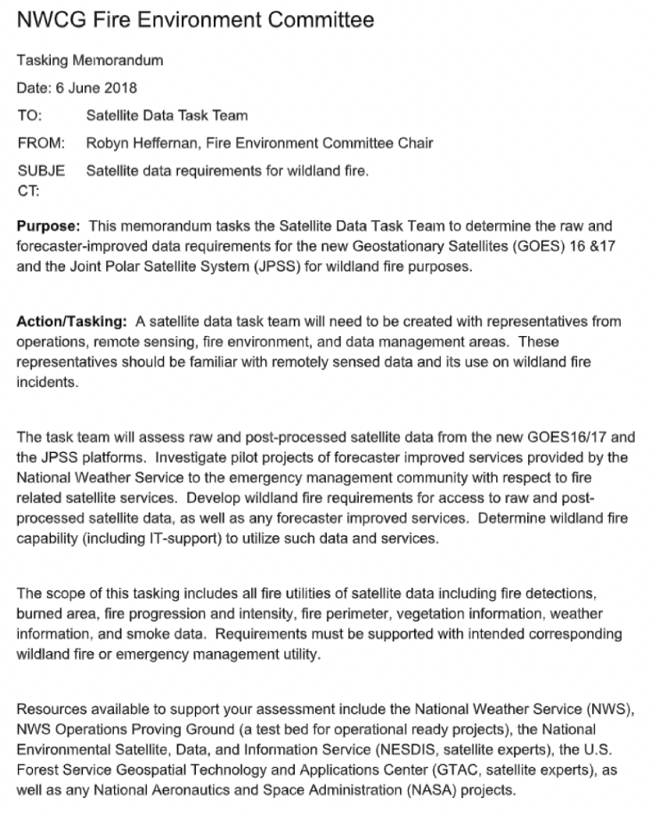
National Wildfire Coordinating Group Task
Todd Lindley (Chair) – NOAA/NWS Norman, OK

Slide 3
National Wildfire Coordinating Group Task
Todd Lindley (Chair) – NOAA/NWS Norman, OK
Drew Daily – Oklahoma Forestry Services
Dr. Chad Gravelle – NOAA/NWS Southern Region HQ
Susan O’Neill – US Forest Service
Sean Triplett – NWCG Geospatial Subcommittee
Cole Belognie – NWCG Data Management Committee
Billy Gardunio – Predictive Services
Craig Thompson – Office of Wildland Fire
Dr. Wilfrid Schroeder – NOAA/NESDIS
Hal Bromley – Bureau of Indian Affairs (recused)

Slide 4
Preliminary Findings
29 Findings and 32 Recommendations that fit broadly into five categories…
Preparedness
Support of Initial Attack
Support of Extended Attack
Smoke/Air Quality
Recovery

Slide 5
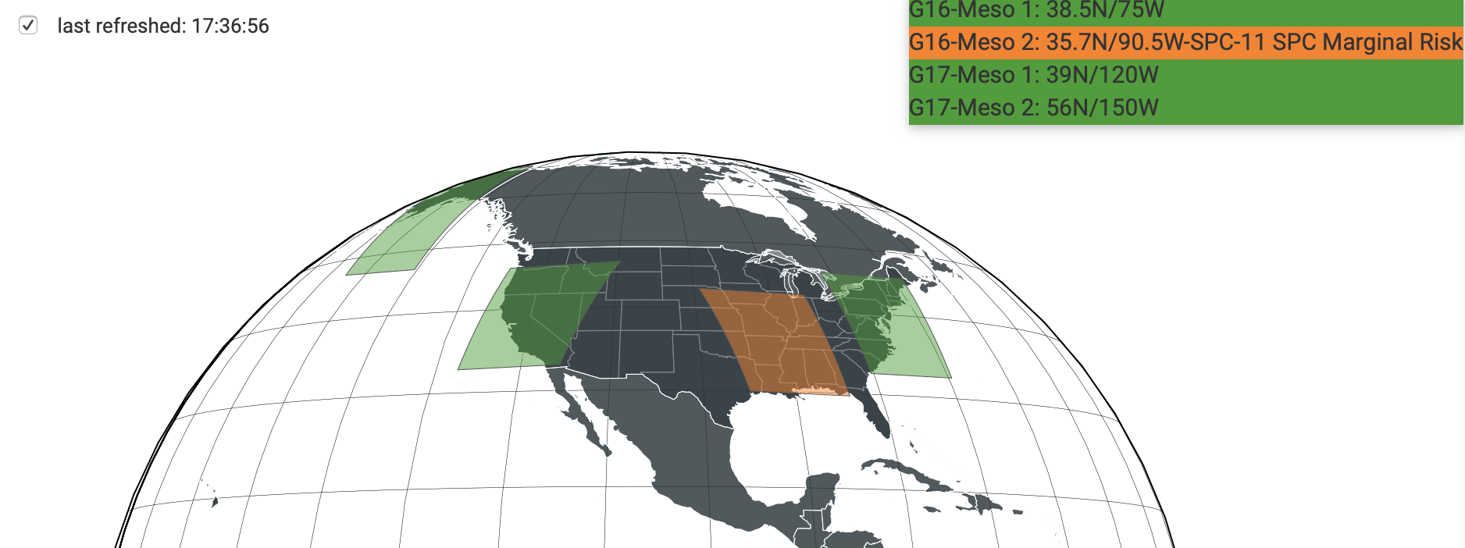
Preparedness
Finding: Applied wildland fire remote sensing research (Lindley et al. 2016) has shown 1-min satellite imagery provides critical information to wildland fire agencies.

Slide 6
Support of Initial Attack
“Fact that never changes: The safest and least costly fires are the ones that receive strong initial attack and are suppressed while still small”....
Dr. Stephen J. Pyne, Between Two Fires

Slide 7
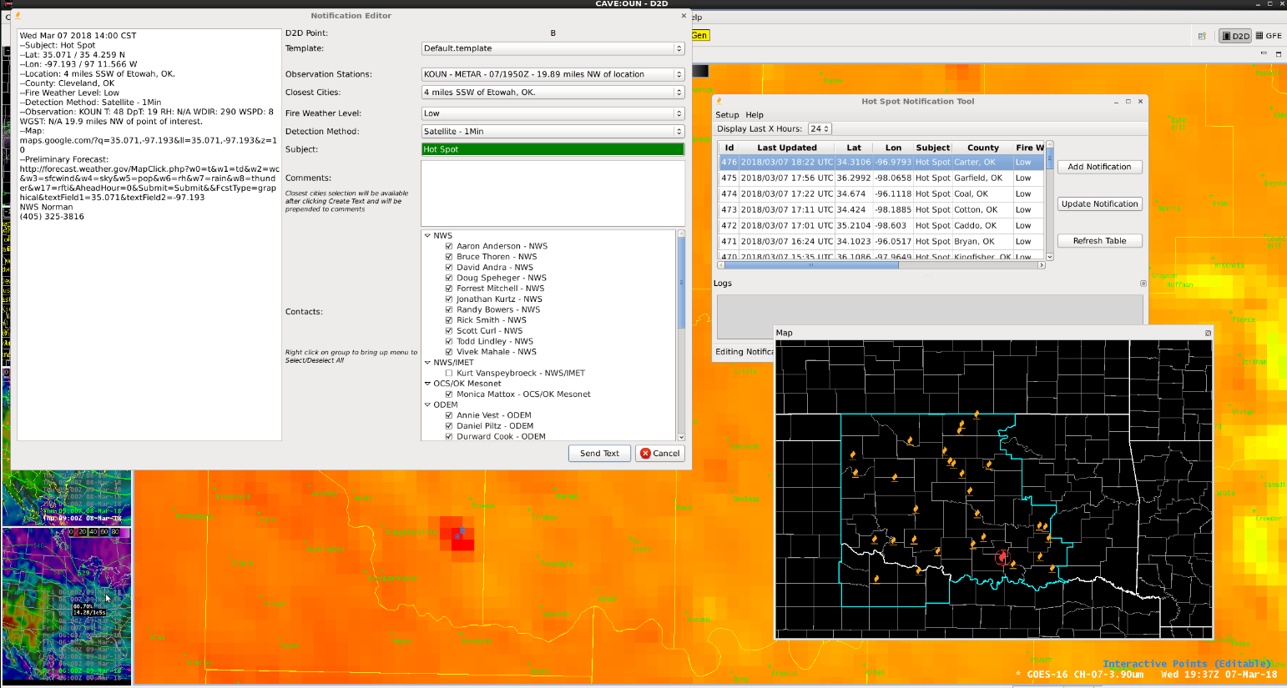
Support of Initial Attack

Slide 8
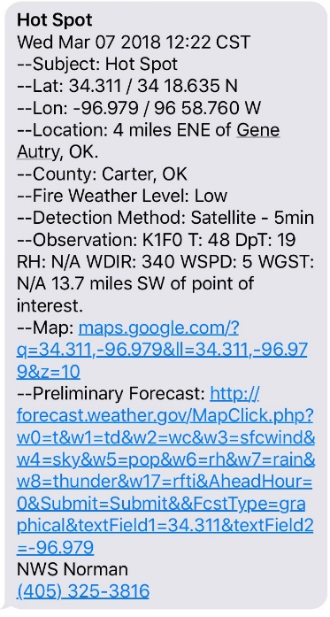
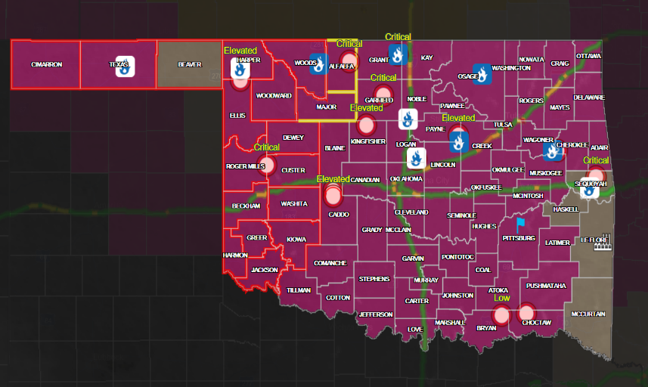
Support of Initial Attack

Slide 9
Support of Initial Attack
How good are NWS forecasters at identifying the locations of these wildfires?

Slide 10
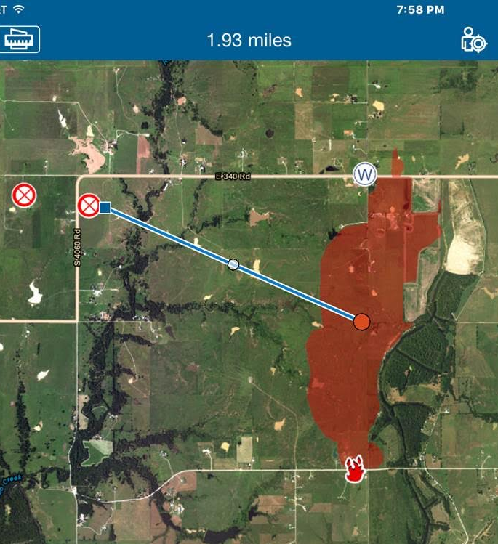
Support of Initial Attack
~1.9 miles
2017

Slide 11
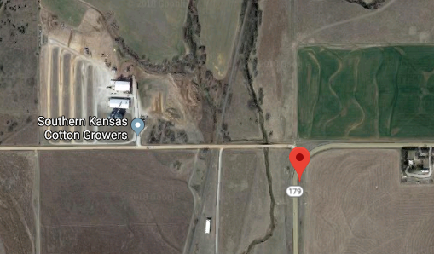
Support of Initial Attack
~1.9 miles
~1600 ft
2017
2018

Slide 12
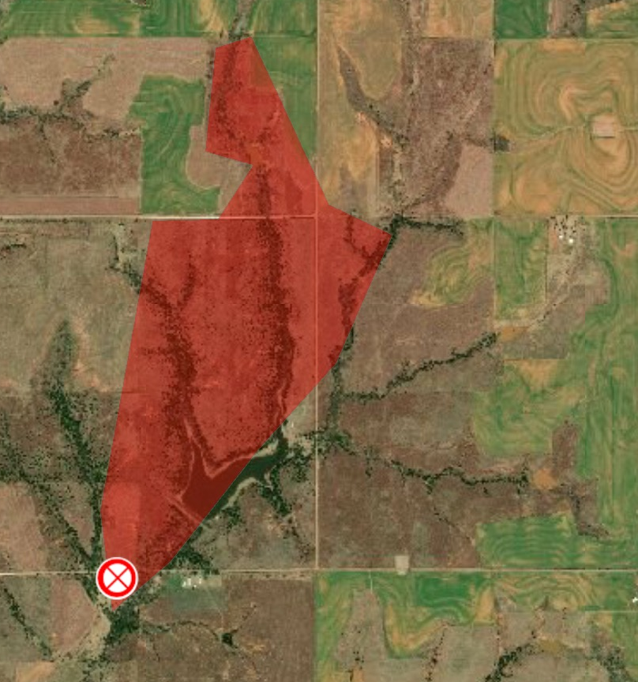
Support of Initial Attack
~1.9 miles
~1600 ft
~215 ft
2017
2018
2019

Slide 13
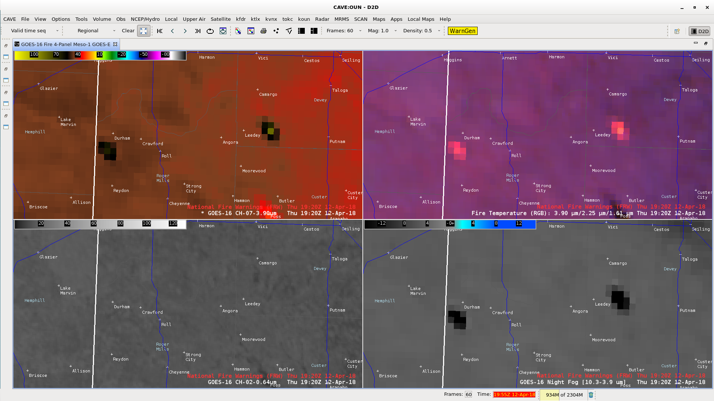
Support of Initial Attack

Slide 14
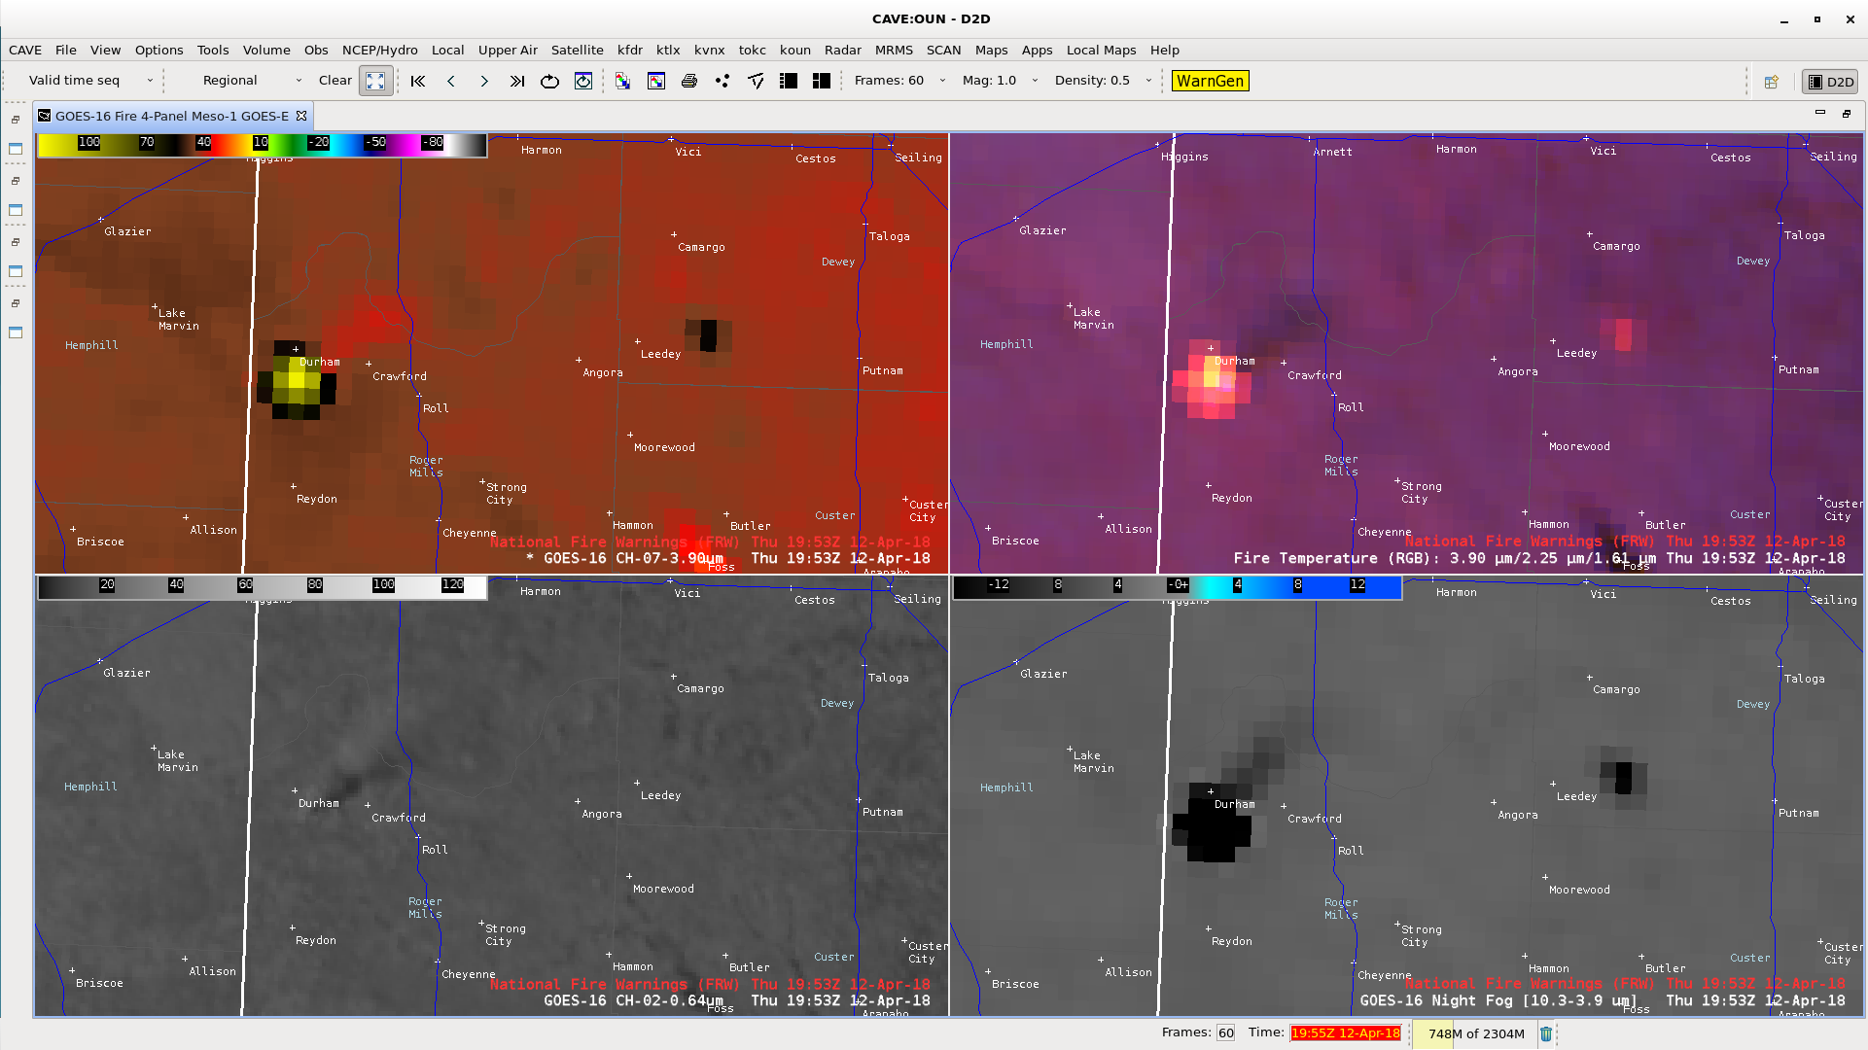
Support of Initial Attack
Finding: A LEO/GEO fused machine learning-based algorithm, analogous to ProbSevere, is needed that provides probabilistic characteristics of wildland fire (e.g., volatility, direction).

Slide 15
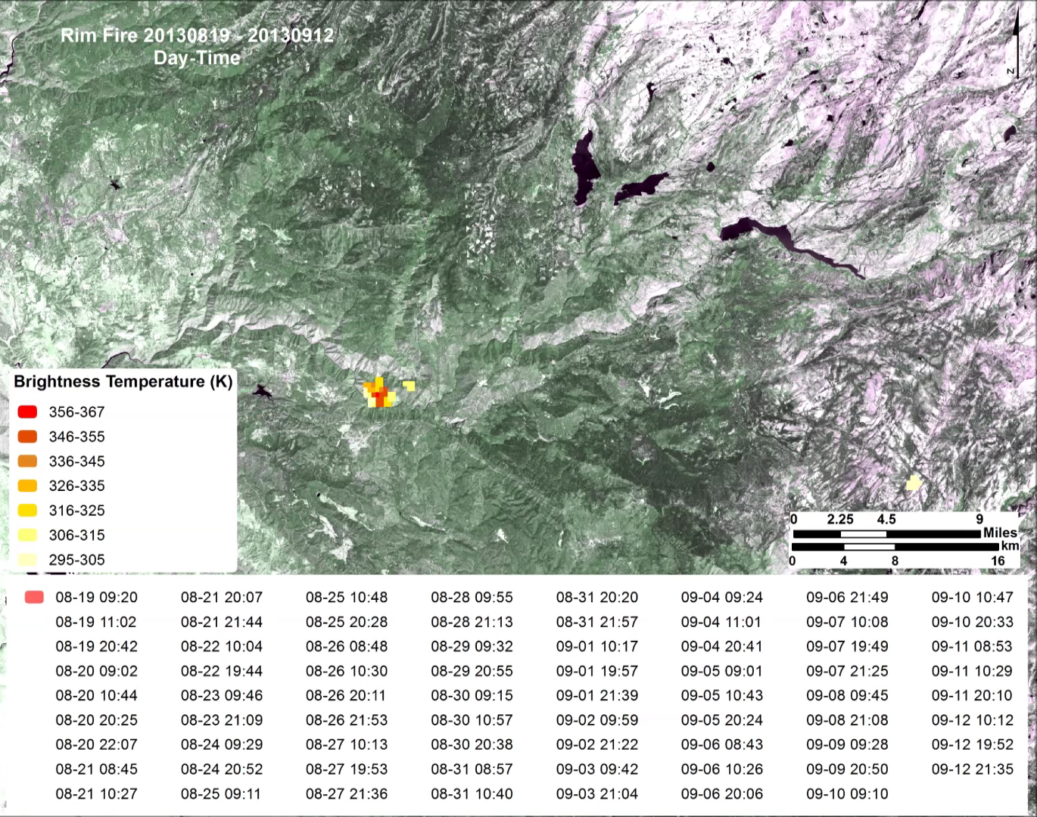
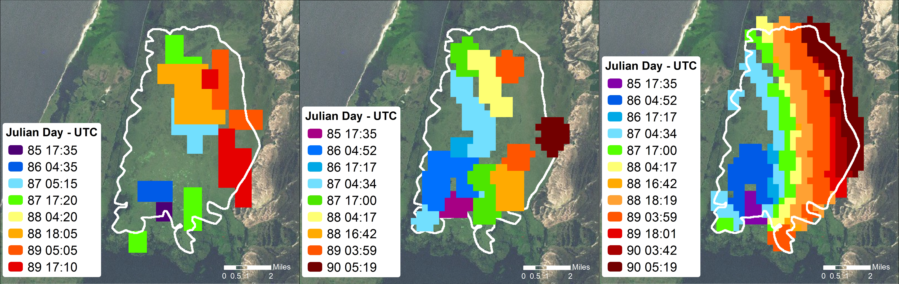
Support of Extended Attack
Finding: Wildland fire behavior intelligence (e.g., rate of spread, burn area, fire radiative power), based on polar orbiters, can provide added information to NIROPS.

Slide 16
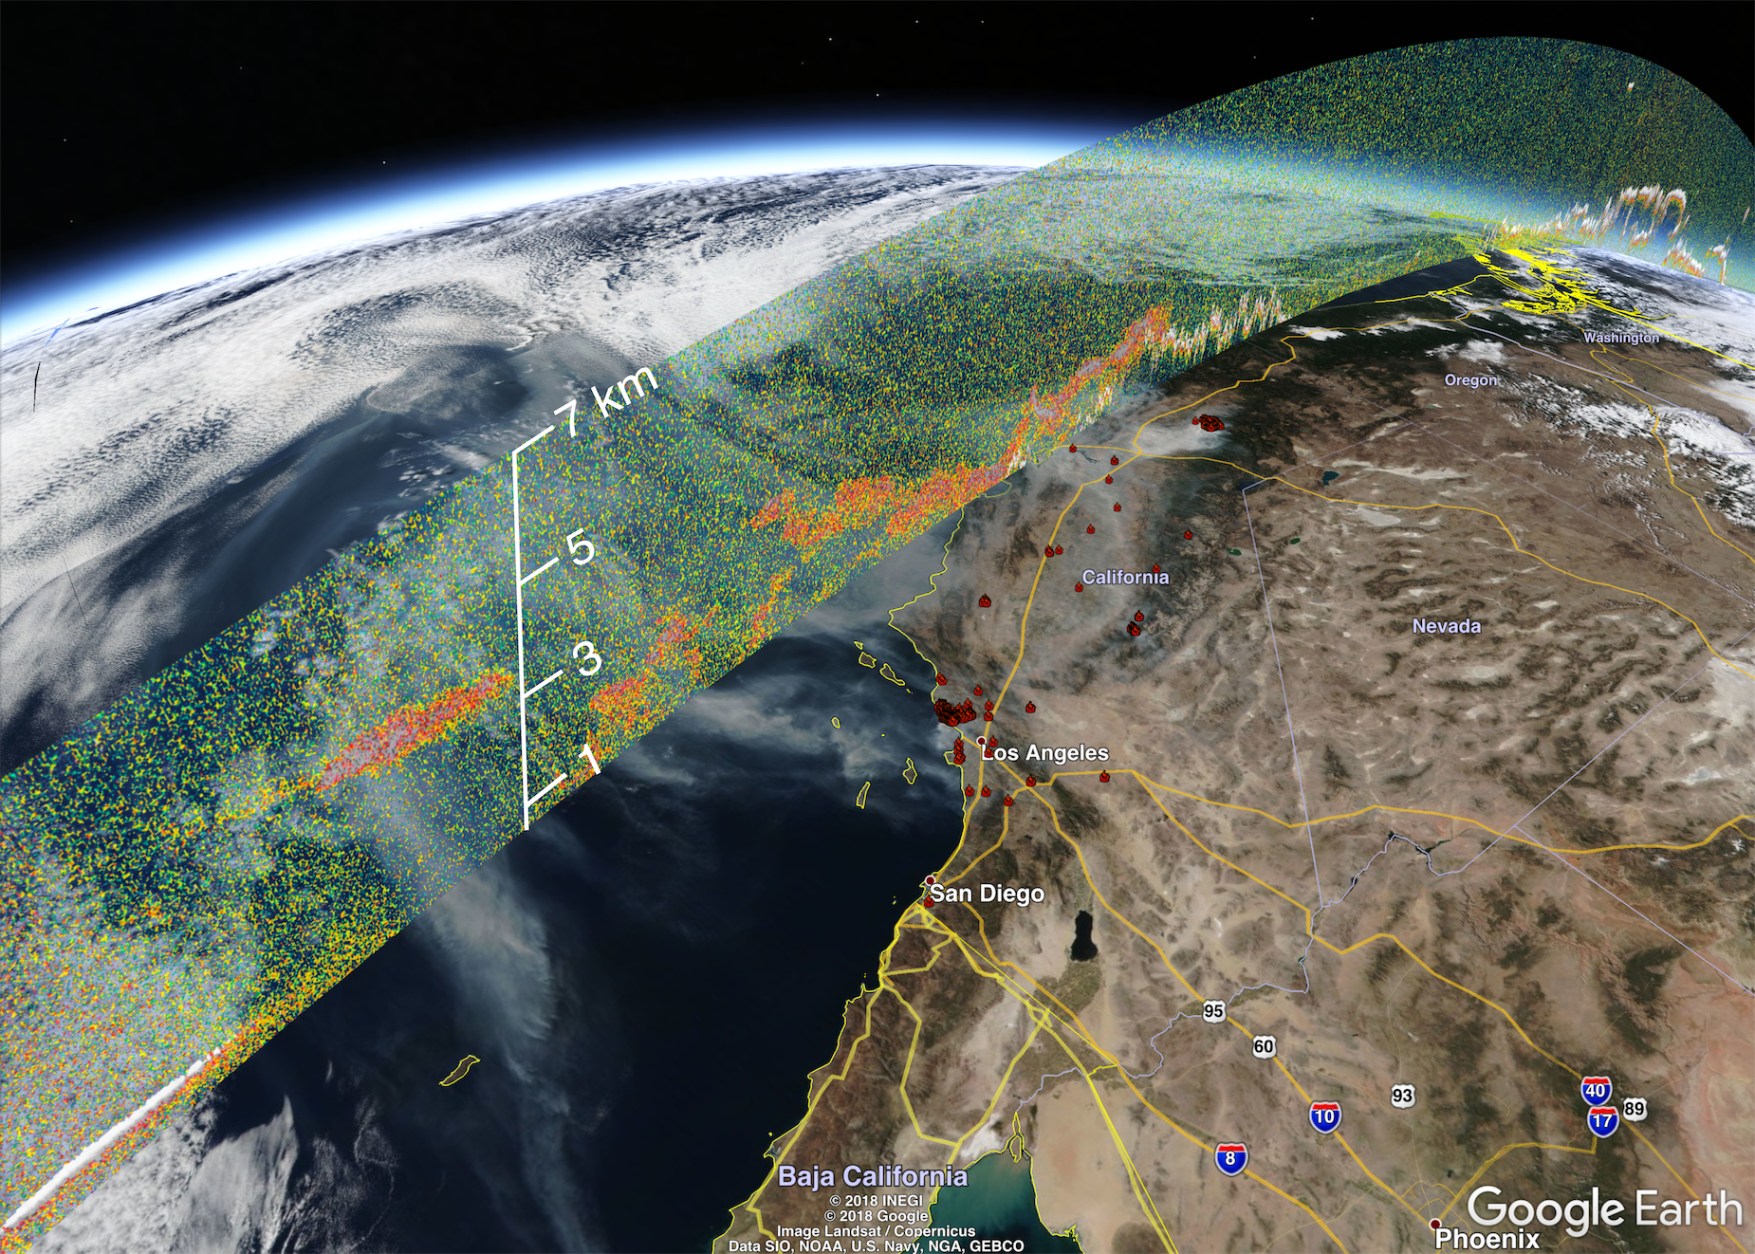
Smoke/Air Quality
J-P. Vernier and Amber Soja, NASA Disaster Response
Finding: Information on the vertical distribution of smoke is unavailable from GEO/LEO satellites.

Slide 17
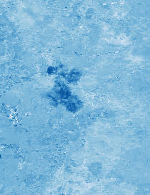
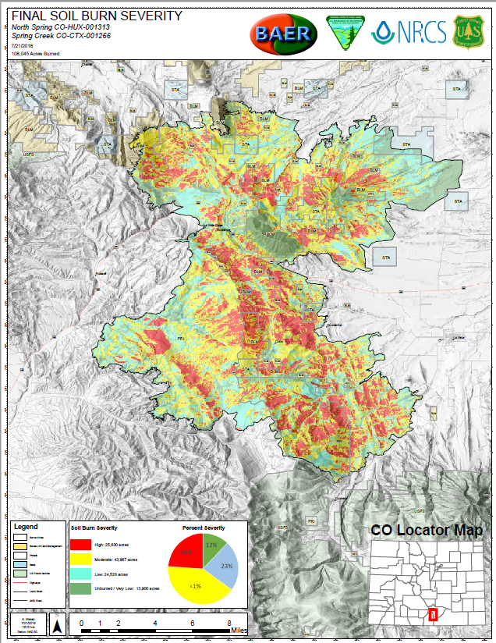
Recovery
BRIDGE Map
18 June 2018 NDVI – 28 July 2018 NDVI
= greater difference
= greater loss of vegetation
Finding: Polar orbiter wildland fire mapping information from the Burn Intensity Delta Greenness Estimate (BRIDGE) is critical for developing an initial burn scar polygon.

Slide 18
chad.gravelle@noaa.gov
NWS Southern Region HQ
Science Technology Services Division
Techniques Development Meteorologist

