Slide 1
JPSS in Western Region
Mike Stavish, SOO, NWS Medford

Slide 2
Question for Western Region Science and Operations Officers (SOOs)
“The ATMS and VIIRS are 2 primary instruments on NOAA-20 we are making use of - ATMS provides the NUCAPS imagery, and VIIRS includes the DNB imagery, SSTs, and Active Fires. How have you or any of your staff been making use of this data?”

Slide 3
“I don't think this gets used much here, especially during the winter. The passes are relatively infrequent, it's like we get a twice per day snap-shot so there's not much use in winter. I know a few will look at NUCAPS for pre-convective initiation soundings in the summer if we get a pass around 18-21z.”
----
“I would say NUCAPS is only used once every blue moon here. We don't use the VIIRS active fires here since GOES East/West works fairly well and being a geostationary satellite is a huge plus. “
----
“We're not using it operationally. We're currently not getting the Active Fires in AWIPS either. We've had some people take a look the DNB imagery and NUCAPS imagery early on, but it hasn't become part of the forecasters repertoire.“

Slide 4
“I think we've used the SSTs for a lake temperature program we use for the Great Salt Lake, but I didn't write the program and the forecaster who did is not in for several days. I have looked at the day-night band for geez-whiz factor but not for anything operational. Otherwise, I don't know of us using it. Our local satellite folks are cc'ed here.”
----
“We are getting the VIIRS active fire data into AWIPS. I can't say it's used a lot. We do use the HRRR Smoke forecasts, from they web and on AWIPS. I have a tool I'm experimenting with to create PotHaze/PotSmoke from HRRR smoke for the short term.”

Slide 5
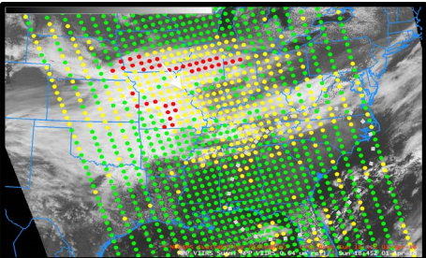
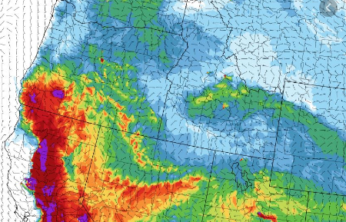
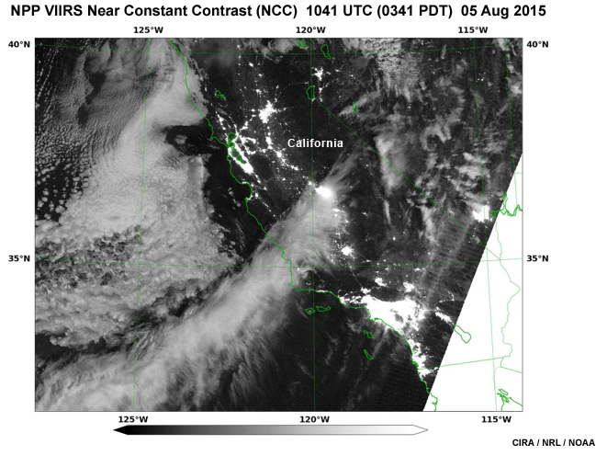
Key Items
How are we using it? ...most common
ATMS
NUCAPS
VIIRS
Day Night Band (DNB) imagery
SSTs
Active Fires

Slide 6
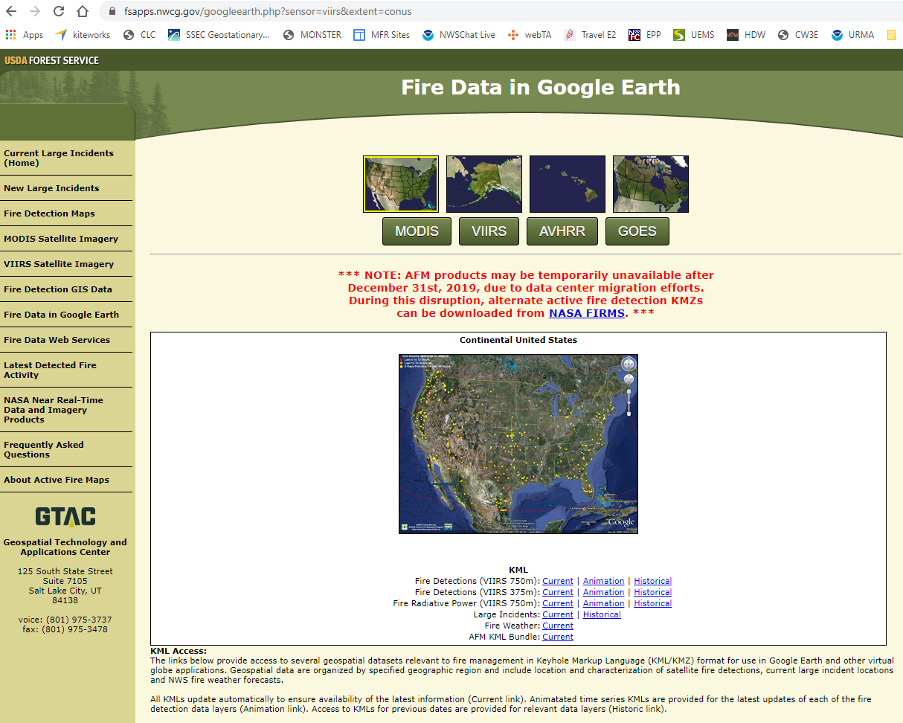
VIIRS Active Fires Online - NWCG
NIROPS IR versus VIIRS for 1st morning update on fire progress
Notes:
Start example of IMET in the field - 1st actions of the day.

Slide 7
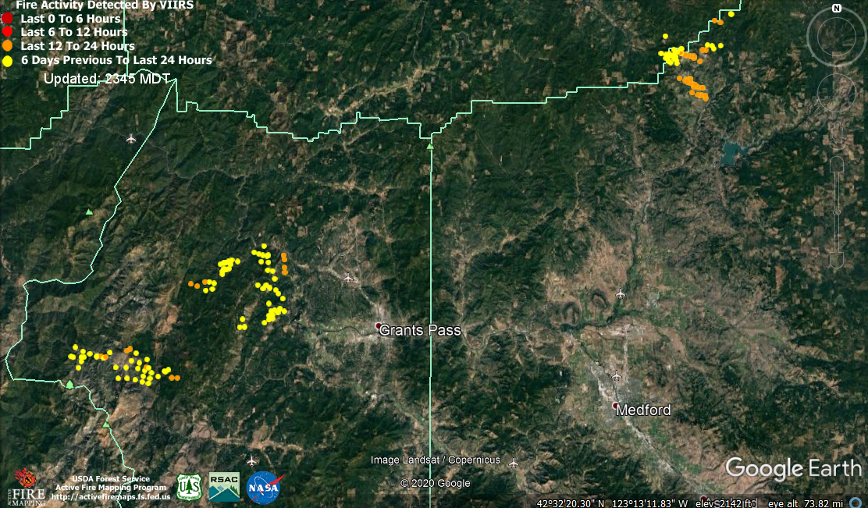
VIIRS Active Fires Online - NWCG
KMZ file download
Dislays in Google Earth
Useful for situational awareness, briefings, social media.
Notes:
Relate the geography. ½ hr from MFR to GP.

Slide 8
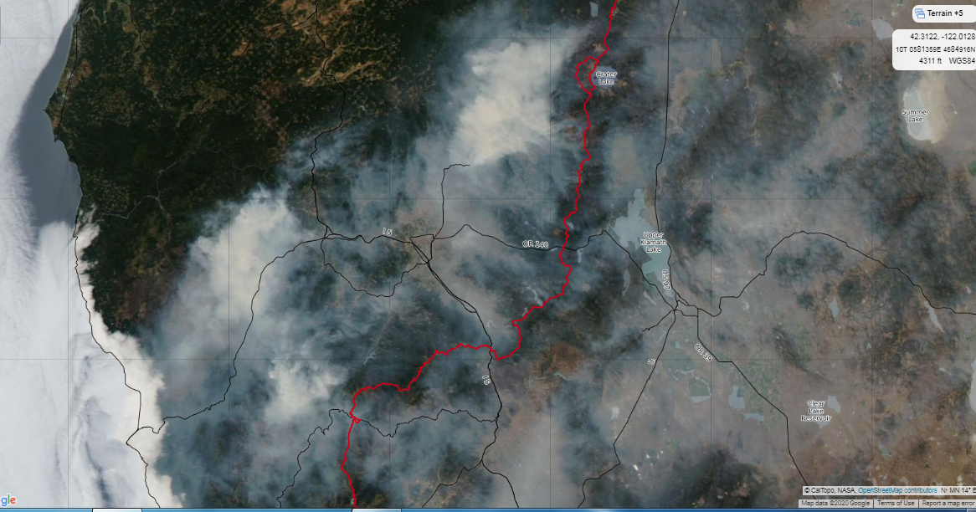
VIIRS Active Fires Online - NWCG
Notes:
High Impact Smoke in Summer 2018

Slide 9
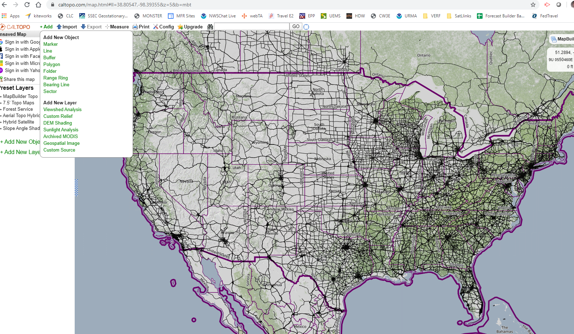
CalTopo
Notes:
This slide answers the question, “What was the R2O problem or challenge that your project team(s) tried to solve?”
- Often training development occurs without intimate field involvement. This STAT team and process facilitated that. This team started before the Myrick SOO–DOH Projects had begin, then became one of the projects.

Slide 10
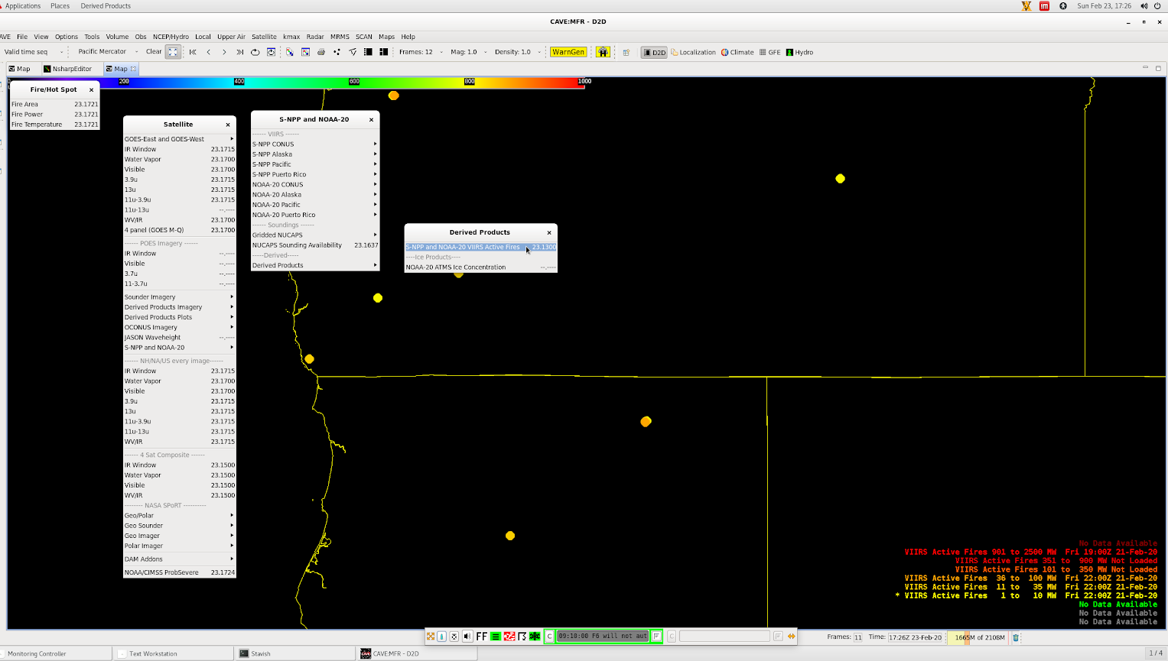
VIIRS Active Fires in AWIPS
Notes:
New Feed - Mention TOWR-S.

Slide 11
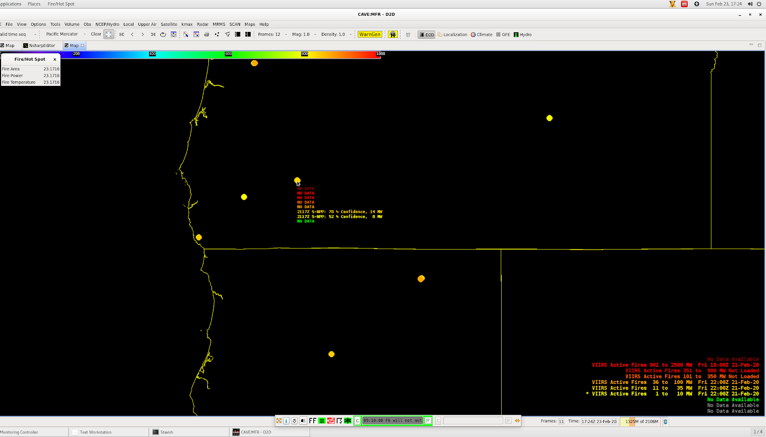
VIIRS Active Fires in AWIPS

Slide 12
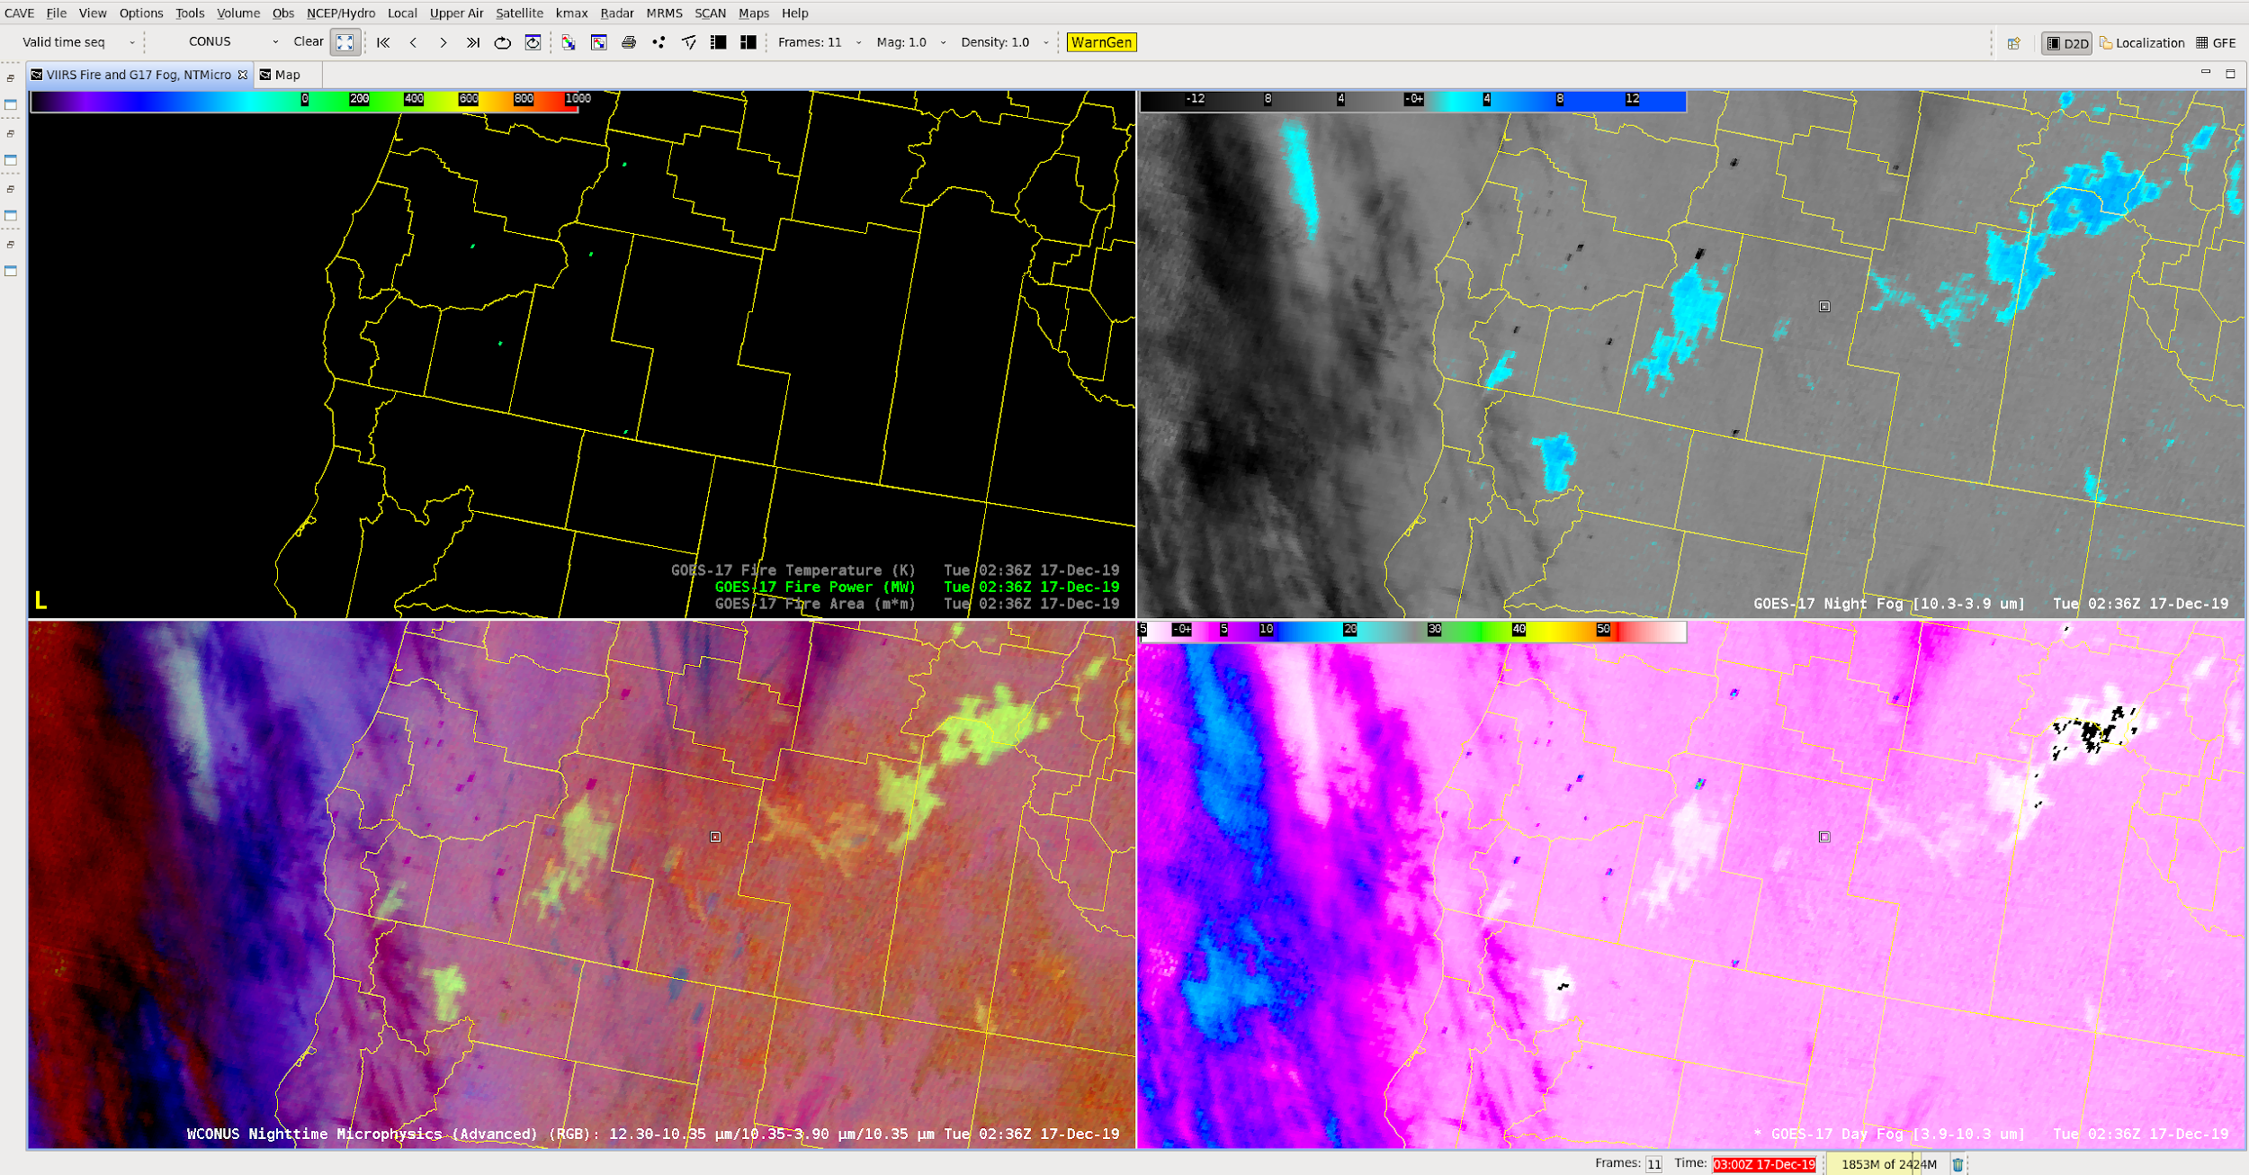
Prescribed Burns - GOES vs. VIIRS
Notes:
Make the point of GOES dtections vs. VIIRS

Slide 13
Prescribed Burns - GOES vs. VIIRS

Slide 14
Prescribed Burns - GOES vs. VIIRS

Slide 15
Prescribed Burns - GOES vs. VIIRS

Slide 16
Prescribed Burns - GOES vs. VIIRS

Slide 17
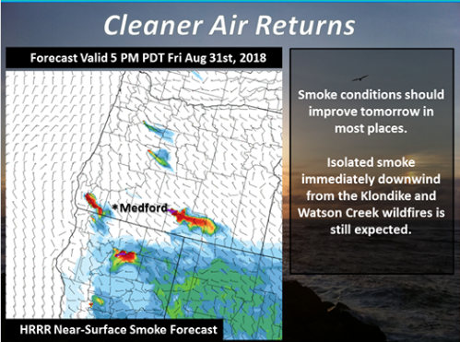
Fire Radiative Power (FRP) in HRRR SMOKE
Notes:
Make the point of the FRP creating point location for the HRRR Smoke - indirect use of the data.

Slide 18
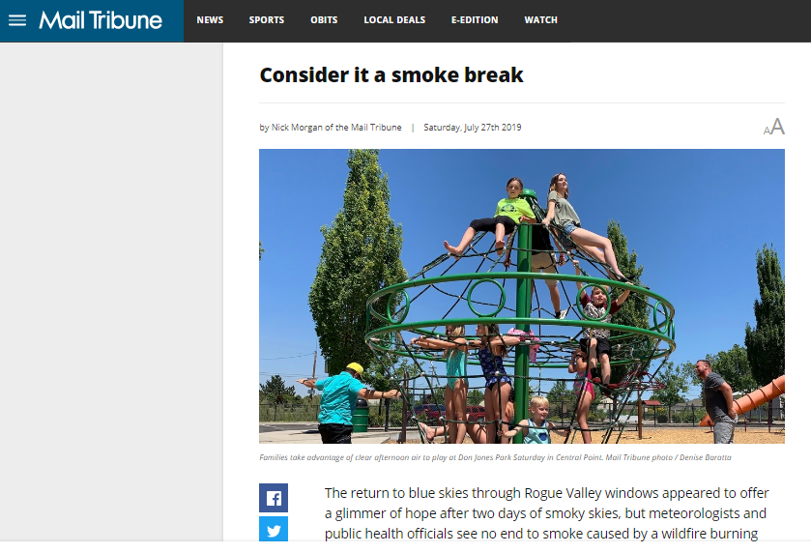
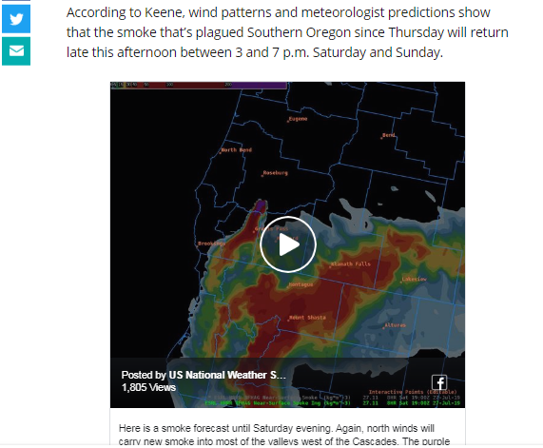
Fire Radiative Power (FRP) in HRRR SMOKE
Notes:
HHRR Smoke assisting in local media and social media post wrt high-impact smoke events.

Slide 19
Sea Surface Temperatures
SST use operationally is variable
The prettier the better
Mariners are savvy and appreciate this type of data
Notes:
High detail in temperatrues off the west coast can reveal currents, upwelling maxima, and other...

Slide 20
Thank You!
Notes:
High detail in temperatrues off the west coast can reveal currents, upwelling maxima, and other...

