Slide 1


A Navy perspective on Tropical Weather Applications and Research
Josh Cossuth
U.S. Naval Research Laboratory
Office of Naval Research
26 February 2020
NOAA JPSS/GOES-R PGRR Summit

Slide 2
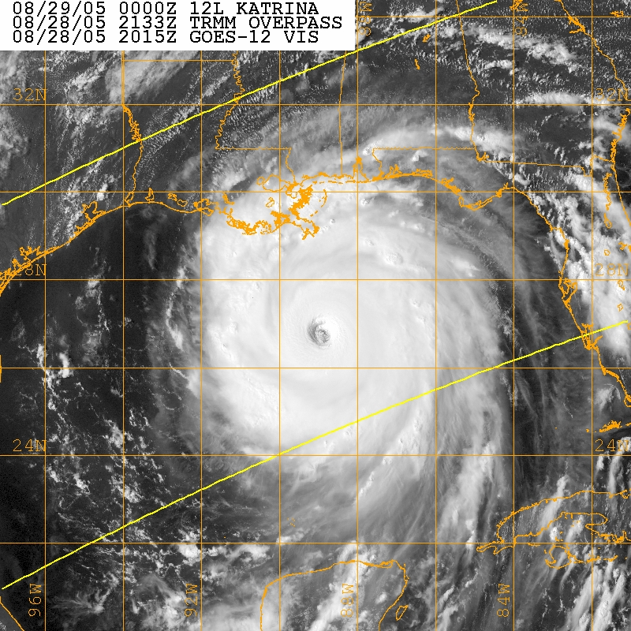
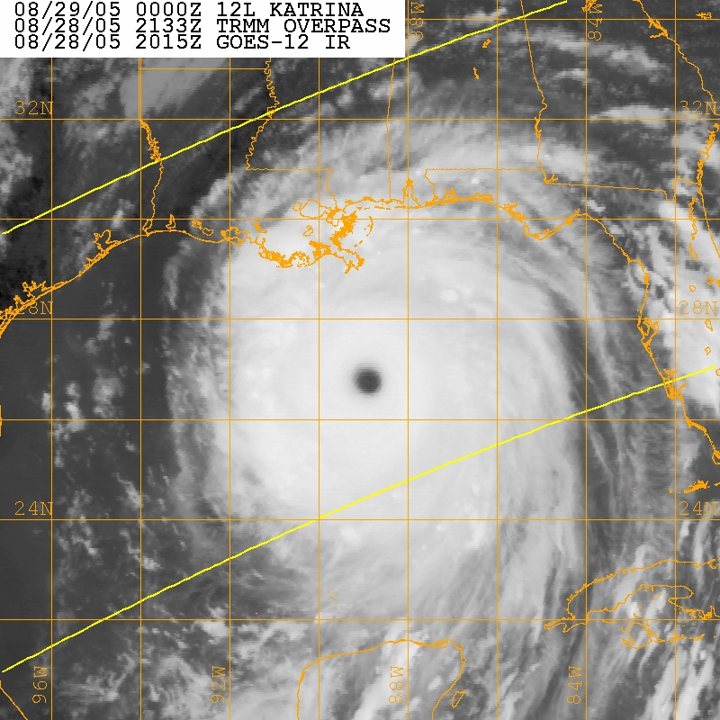
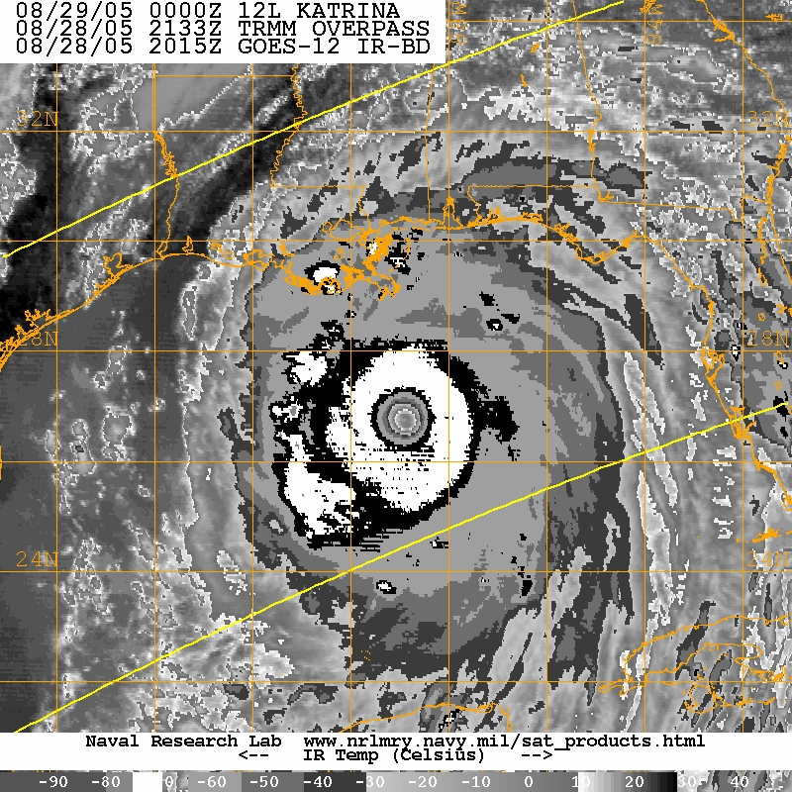
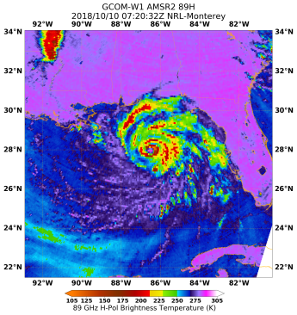
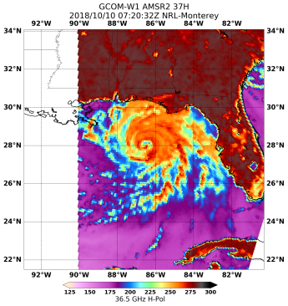
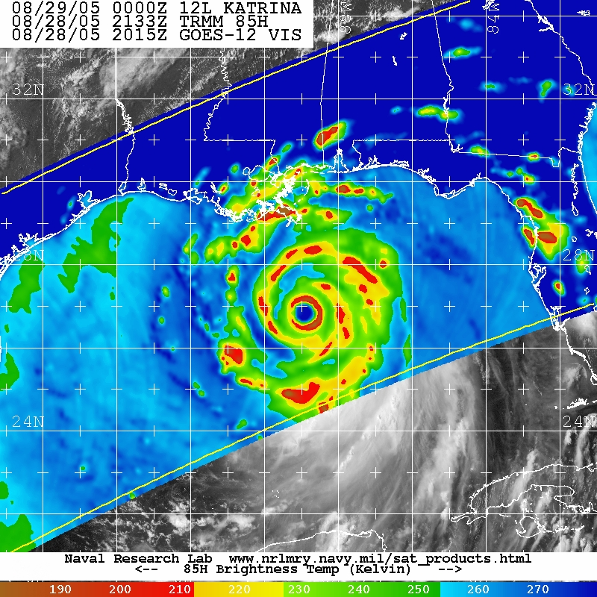
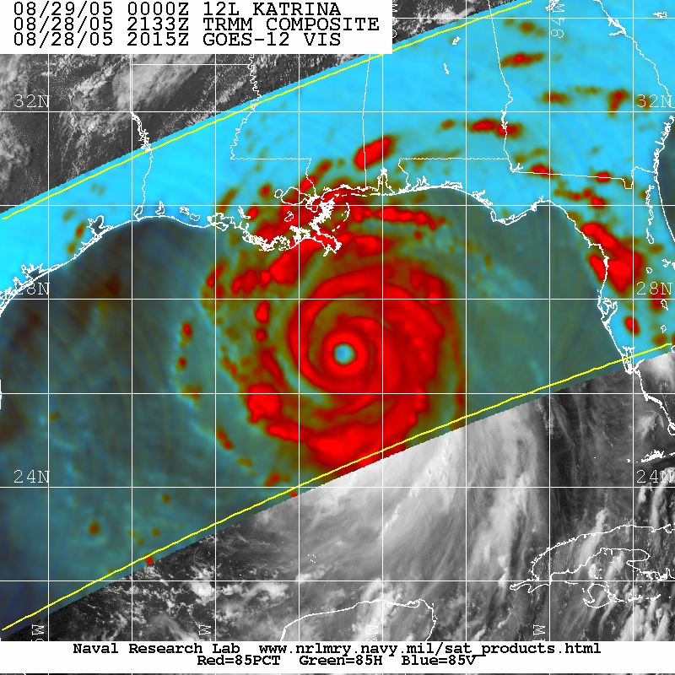
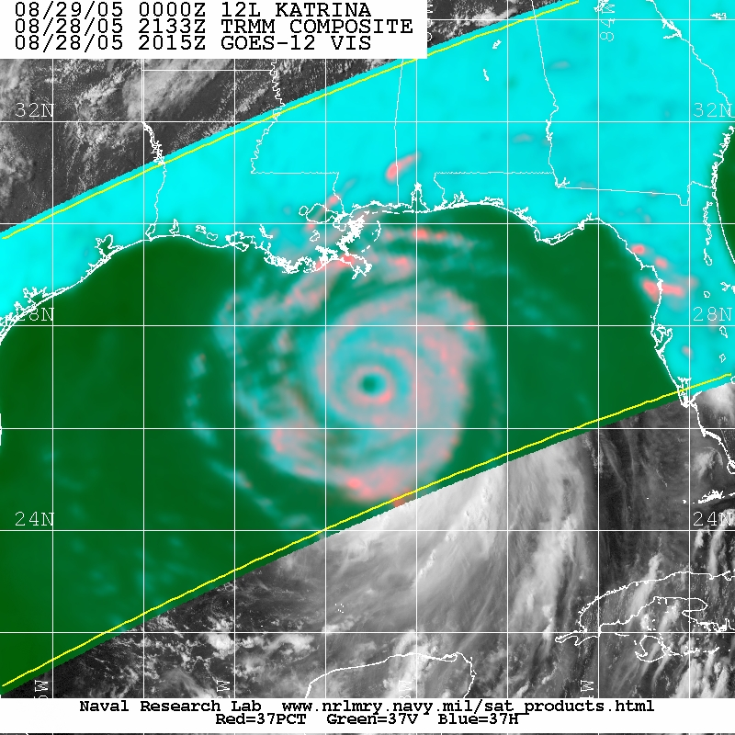
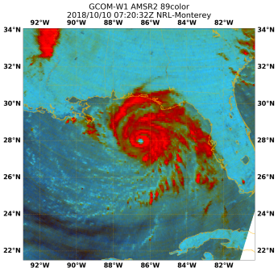
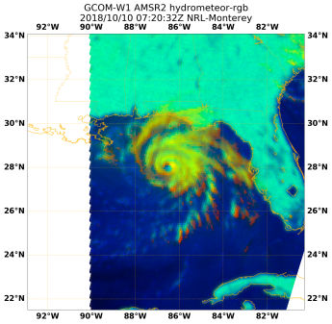
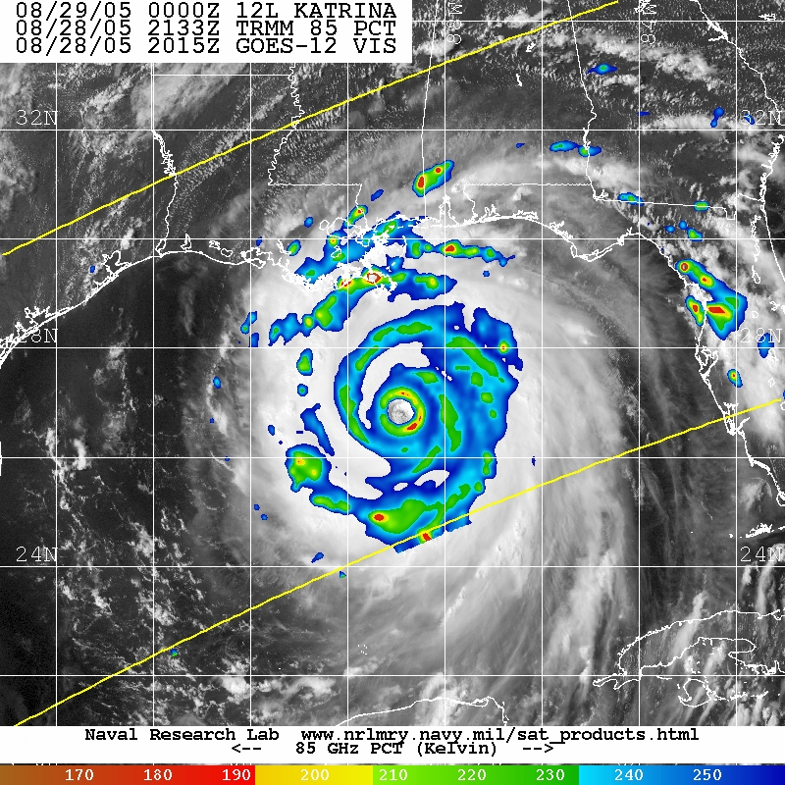
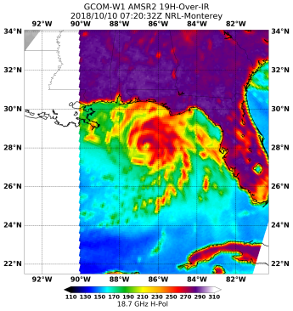
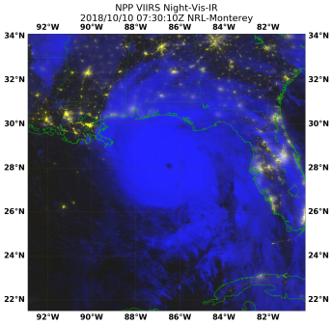
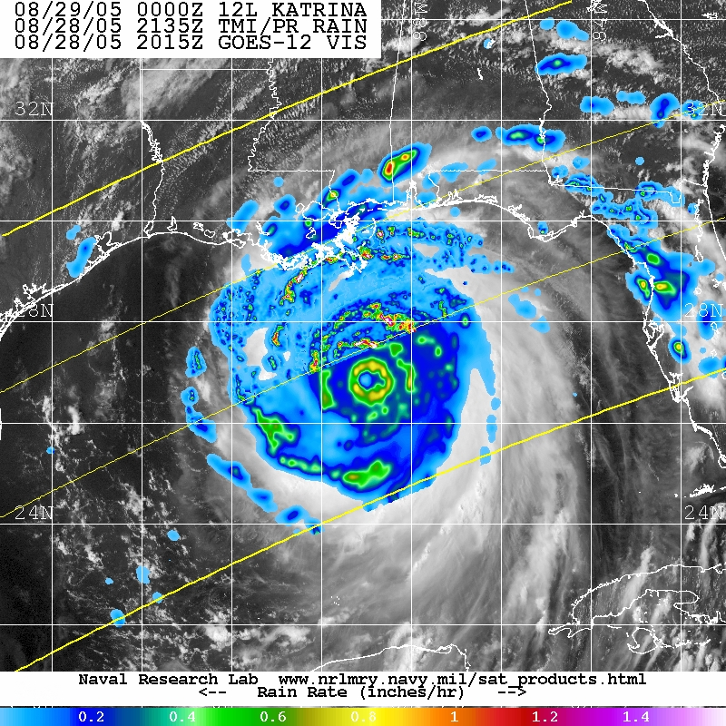
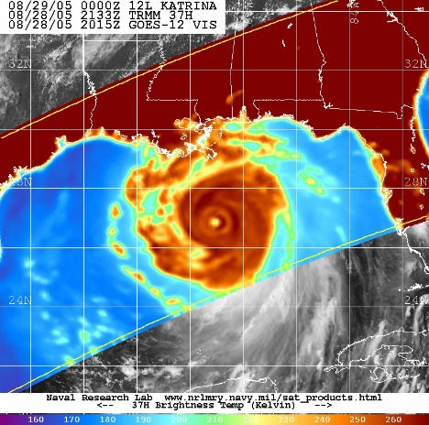
Outline
Current state of Navy tropical weather forecasting
Current NRL satellite research projects and efforts
Related ONR research programs and directions

Slide 3
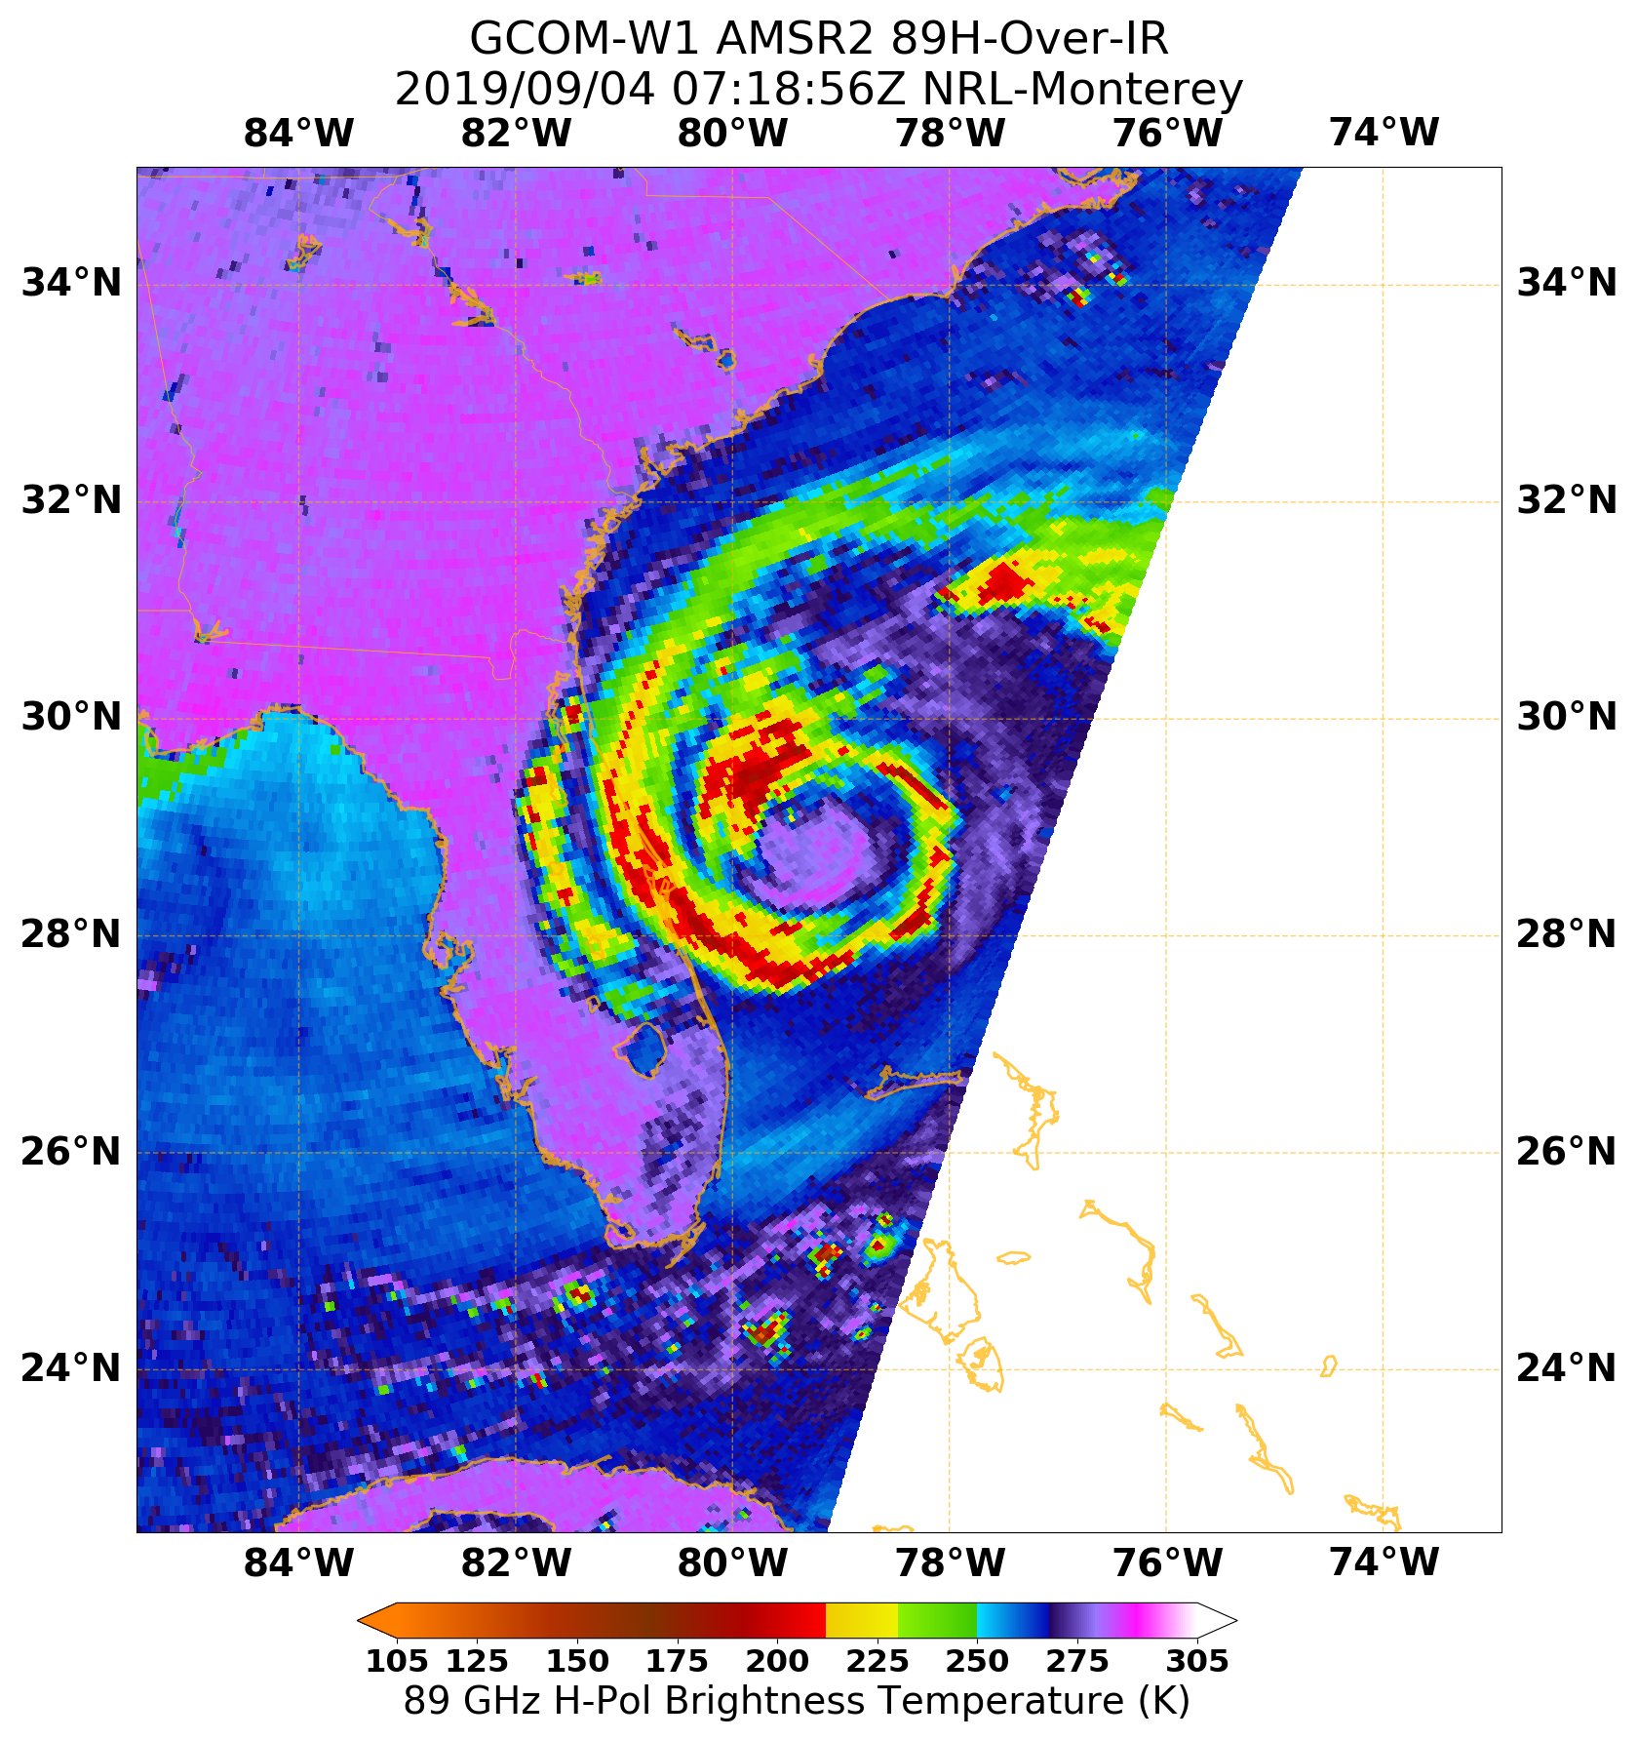
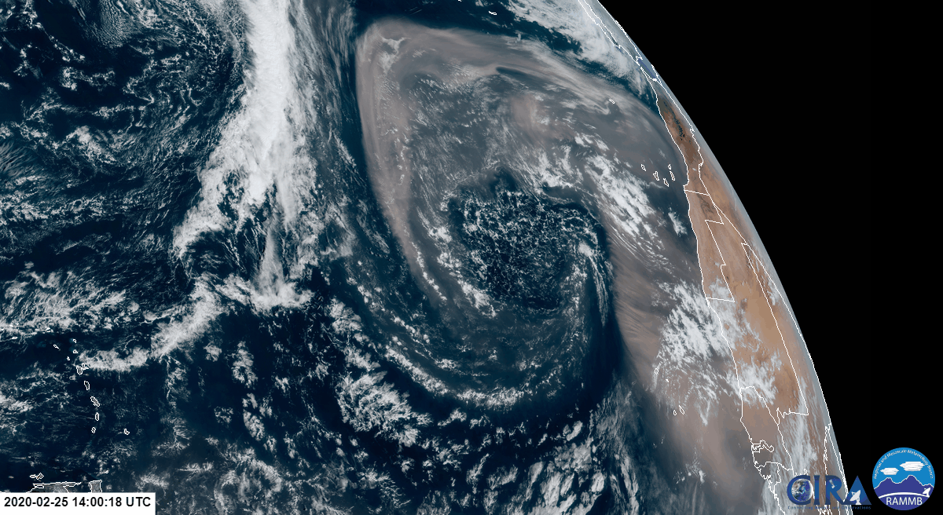
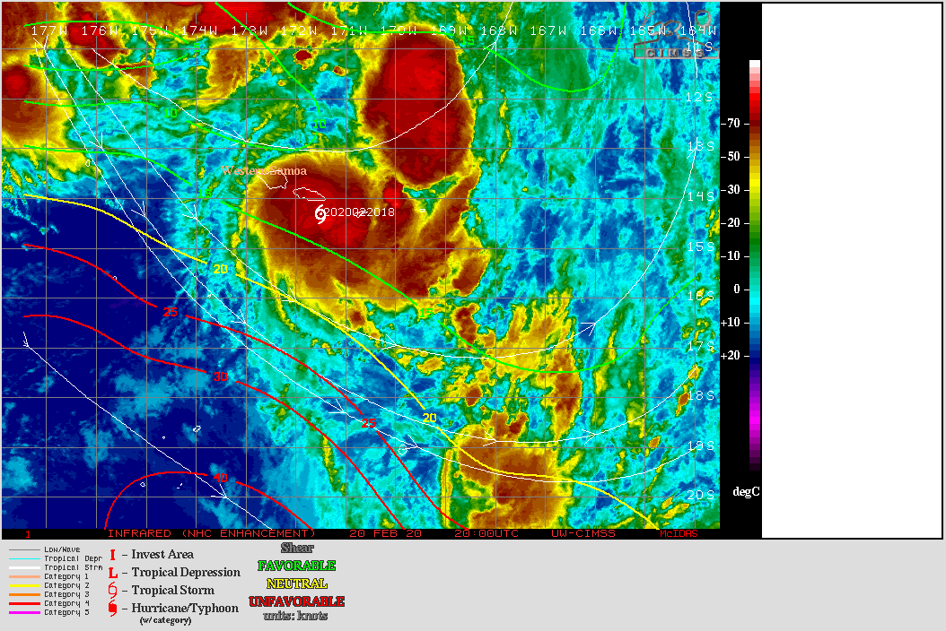
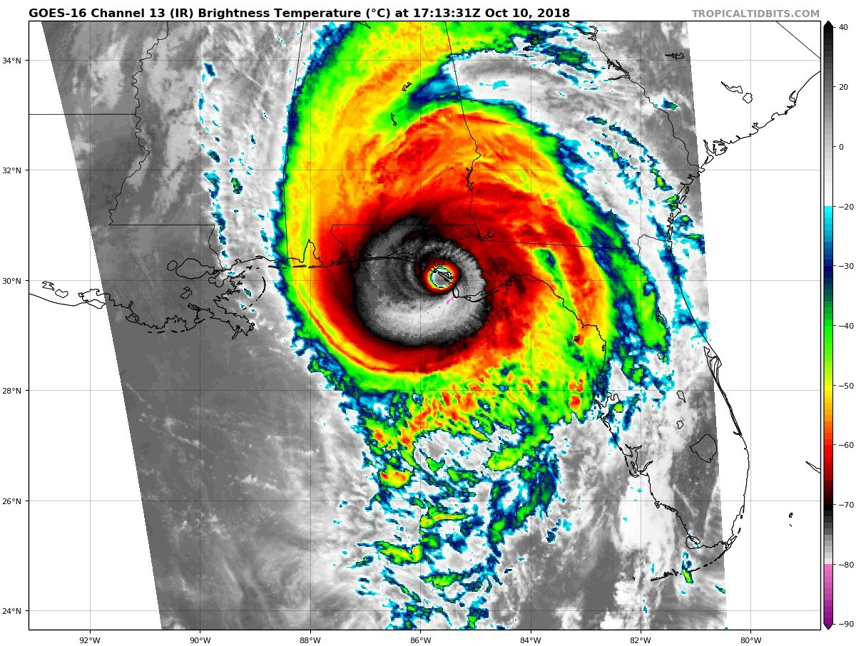
Cutting-edge Product Access?
Navy users of new tropical products (JTWC and FWC forecasters) overwhelmingly use ‘bookmark meteorology’

Slide 4
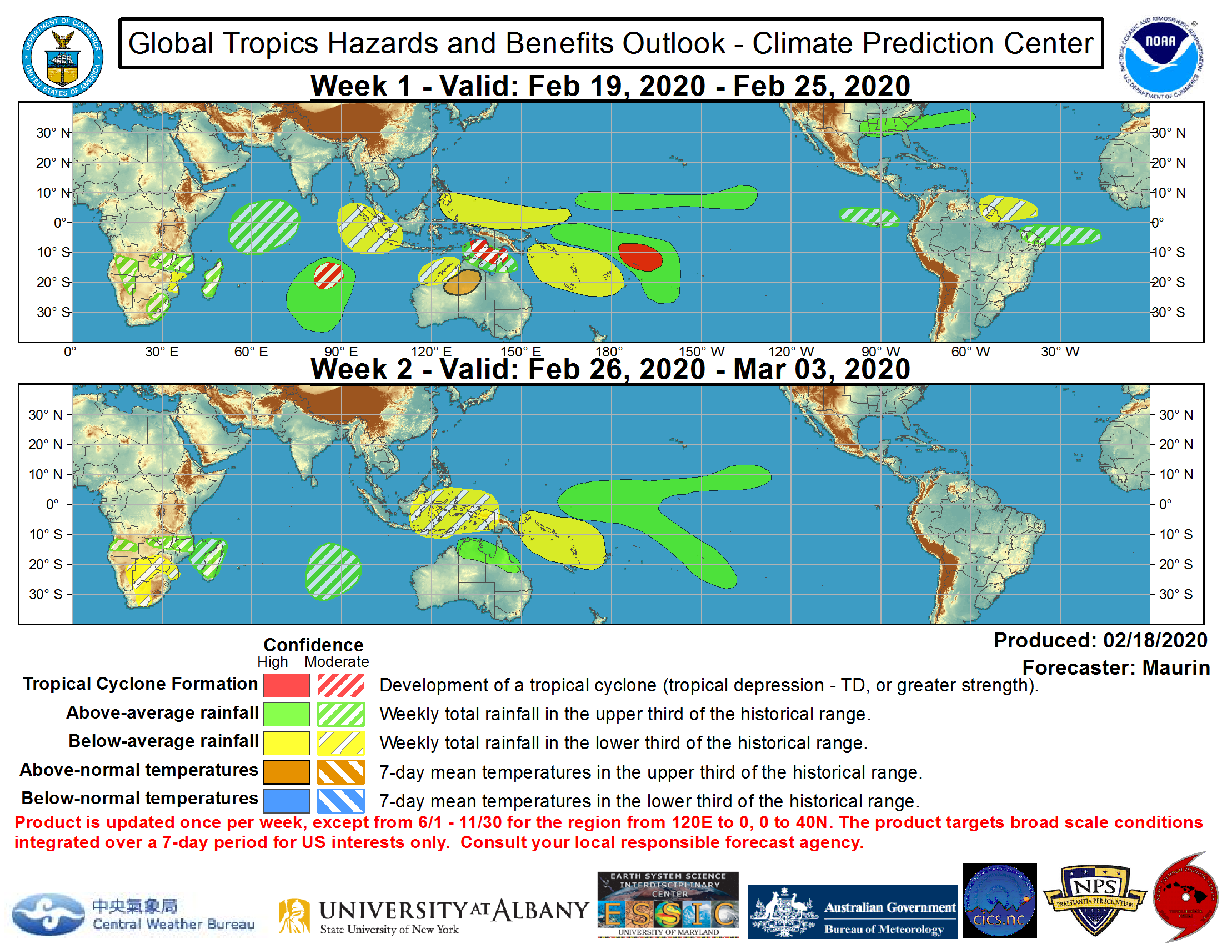
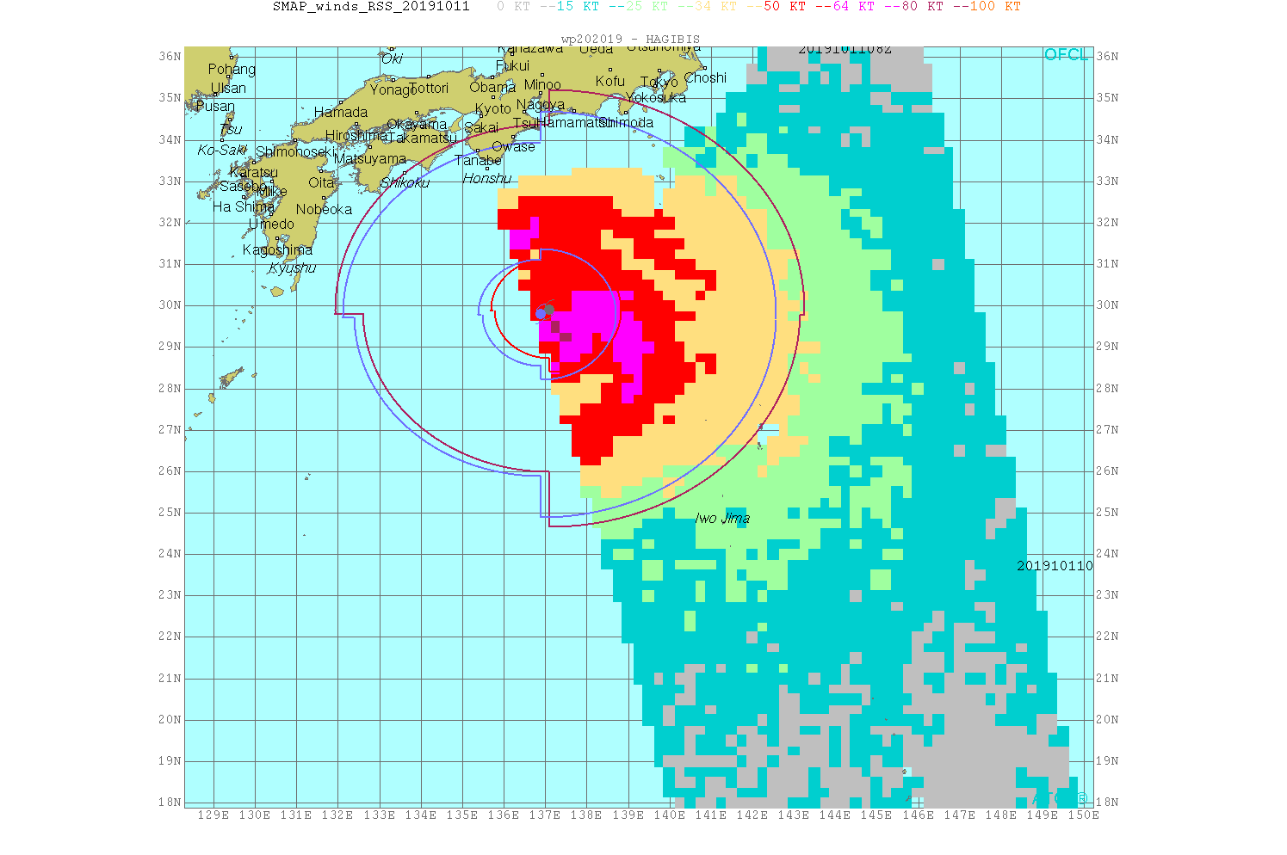
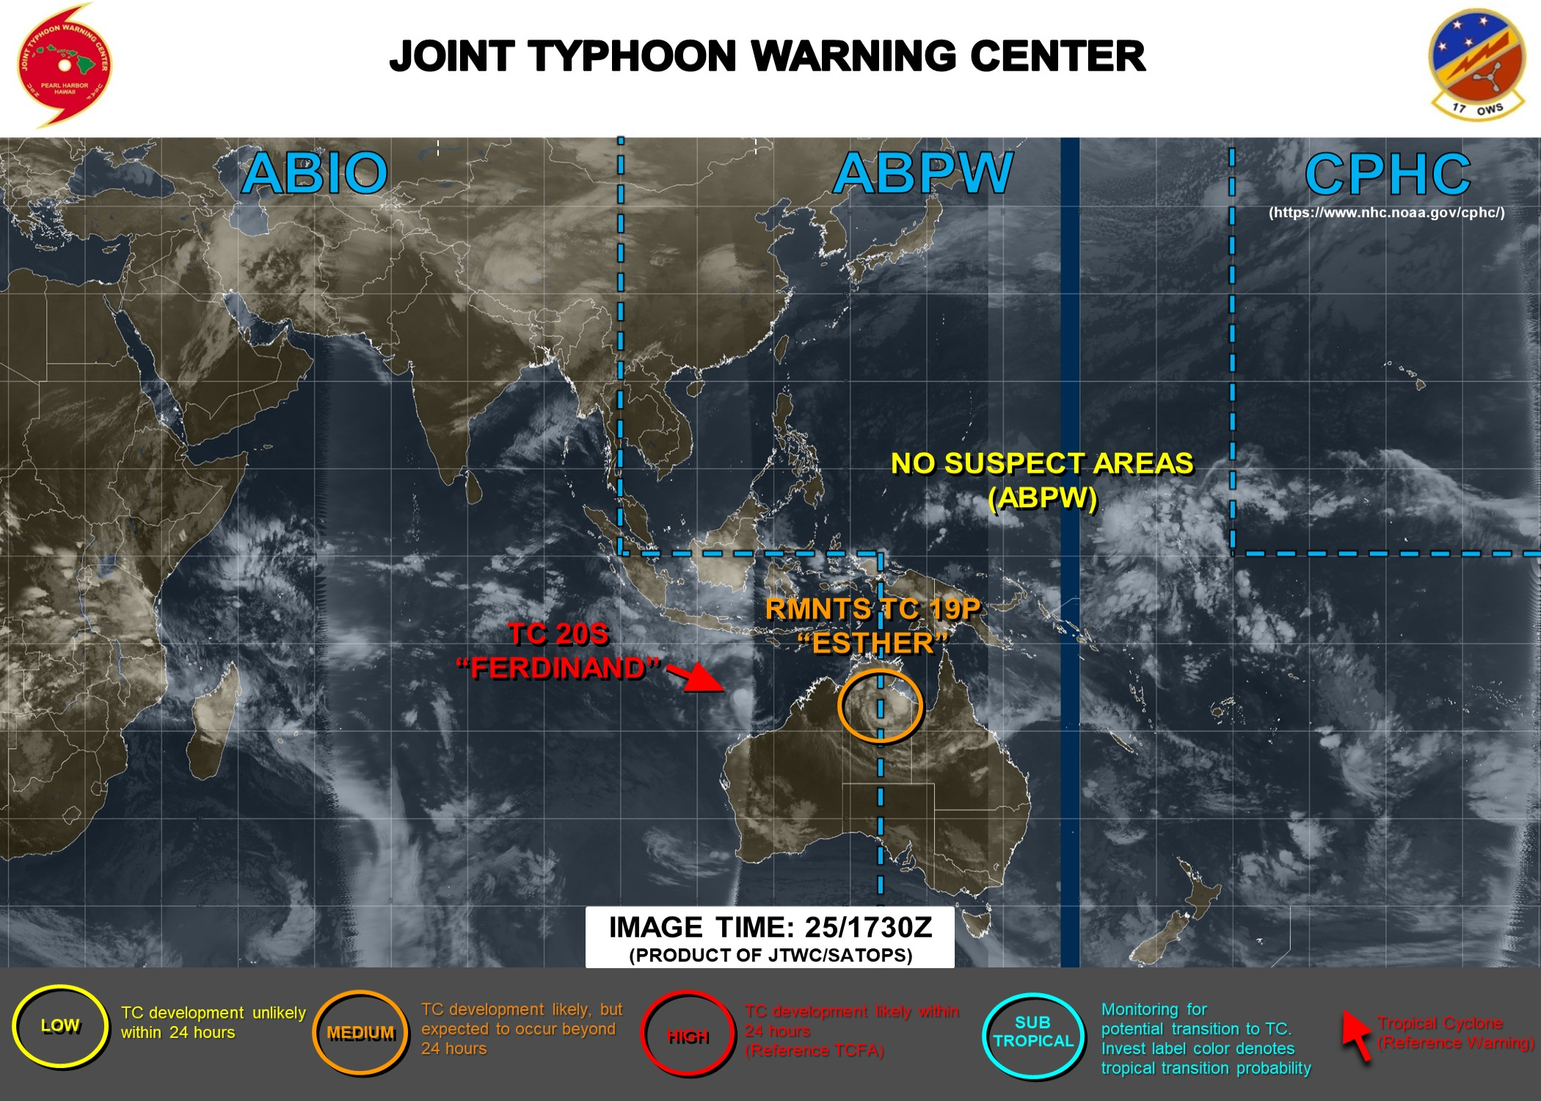
JTWC Forecasting Set-up
Formation:
  Long range: models, MJO, OLR
  Short range: models, visible and infrared Geo
Once formed, most tropical cyclone analysis and forecasting occurs within the Automated Tropical Cyclone Forecasting (ATCF) environment
  Increasing concurrent testing of AWIPS-2
To maximize utility of satellite products, JTWC forecasters need to access to information within the ATCF
While using NRL TC webpage (and CIMSS, CIRA, etc.) helpful, it is not integrated into operations

Slide 5
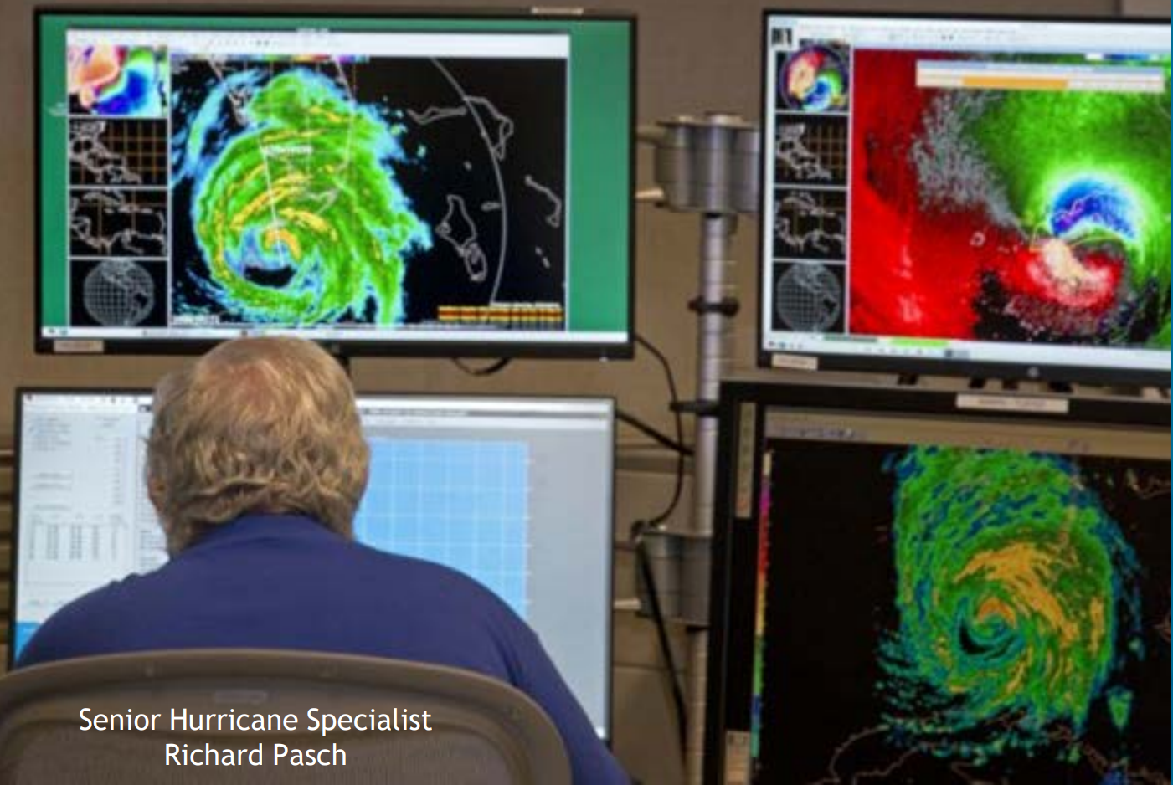
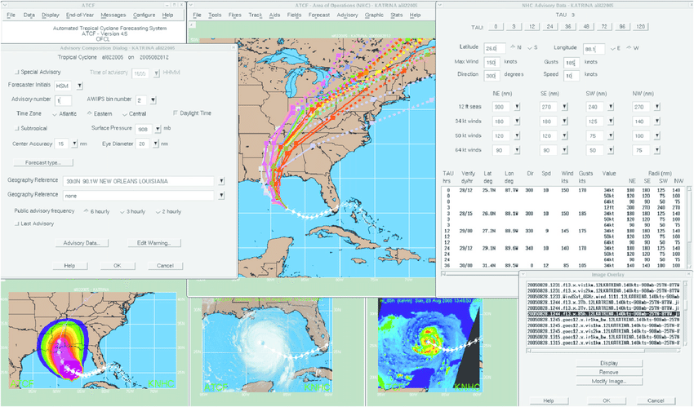
Relevant User Challenges
NOAA satellite data and products are essential toward fulfilling the Navy’s mission
Need better integration of tools and products into decision making systems
  For tropical cyclones, that is ATCF
  Websites are great as proving grounds and prototypes, but useful products should be transitioned into operational software for their potential to be fully realized
For existing products, difficulties occur with:
  Reliance on research tools that have not be operationalized
  High latency (especially for polar orbiters)
  Improper planning for new satellite feeds
  Lack of continuity or training for product replacements

Slide 6
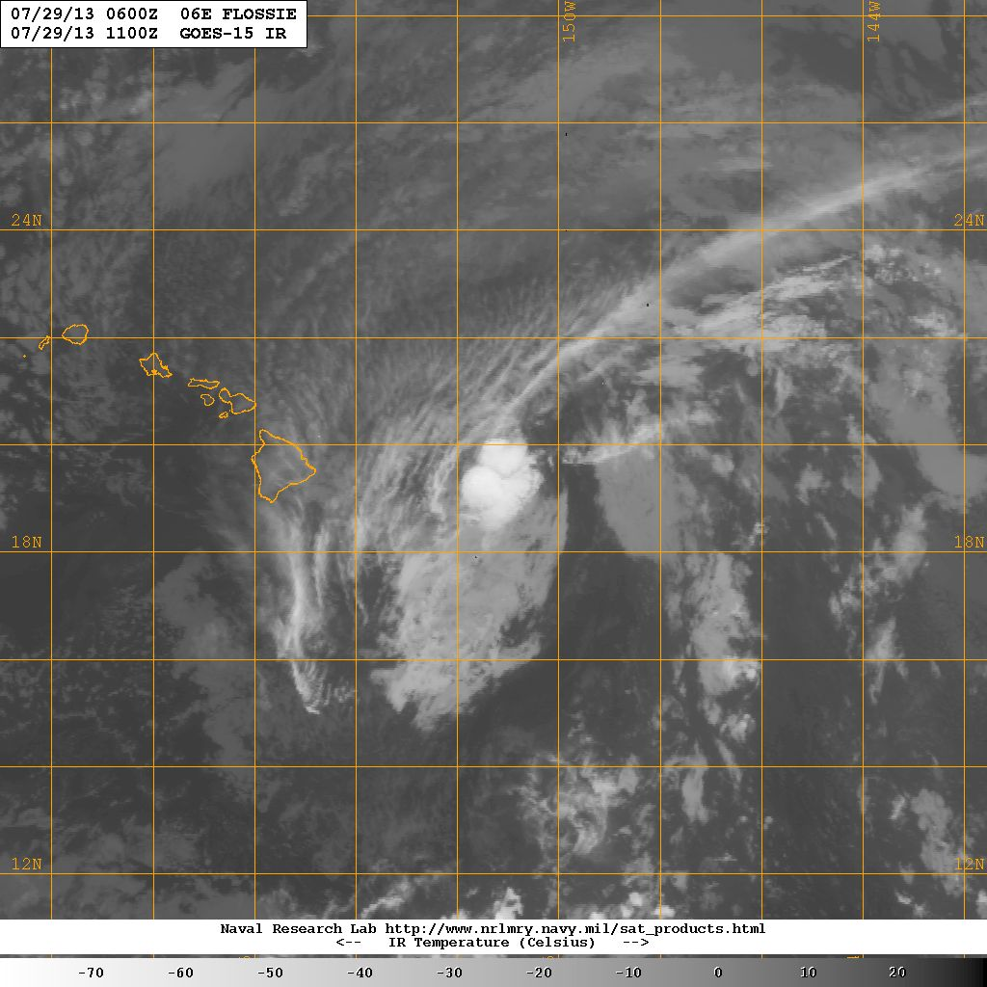
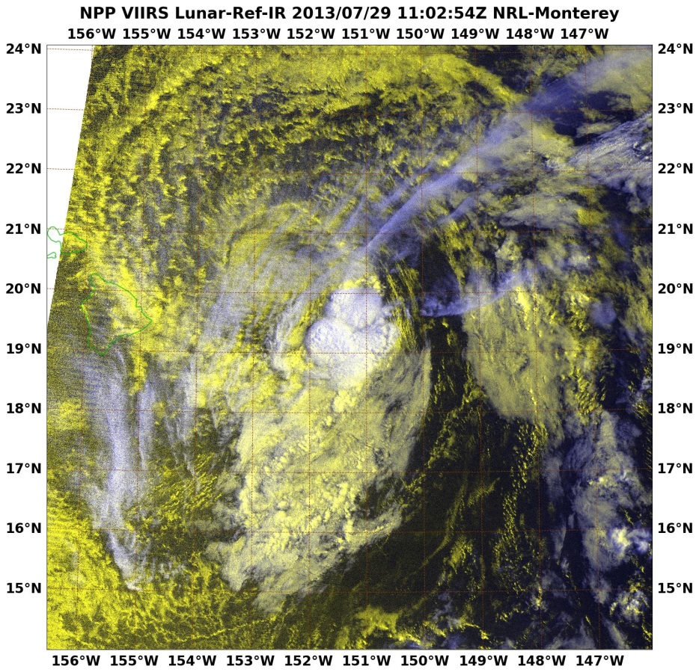
Towards Unified Processing
NRL has been developing a python-based, open source satellite process package – GeoIPS (the Geolocated Information Processing System) to drive near real-time product generation. Goals:
  Share NRL product knowledge with meteorology community
  Leverage new developments back into Navy operations using the same platform for research, development, and operational processing
Base prototype code now available on GitHub:
  https://github.com/USNavalResearchLaboratory/GeoIPS
6

Slide 7
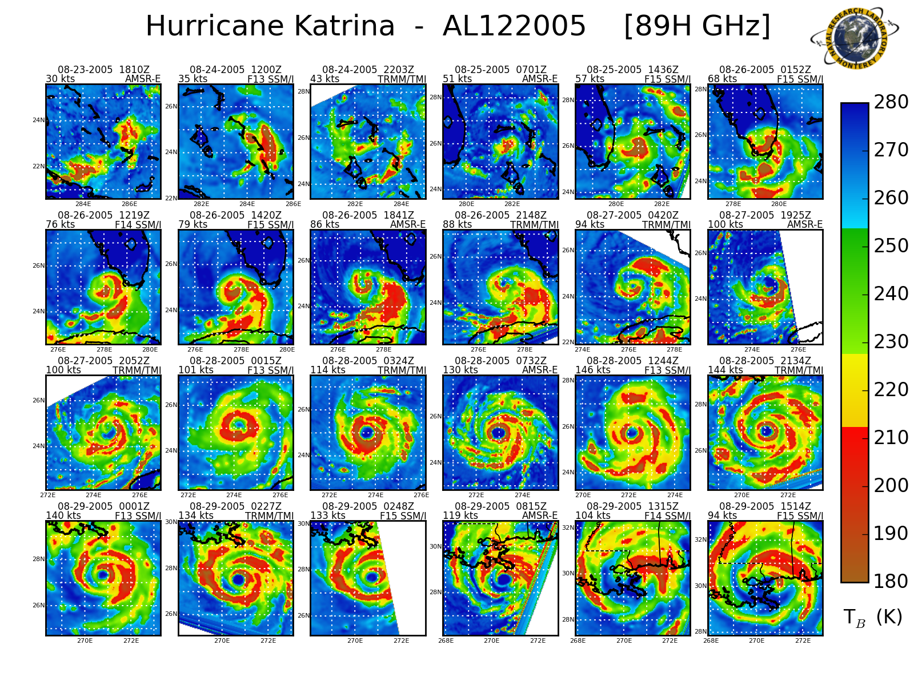
Developer Goal: New products for new needs
Desirable to leverage a developer platform that is shared with the operational system
  Current vision is toward sharing python libraries
Work with users to mitigate largest operational shortfalls and anticipate upcoming needs:
  Need to be agile with available observing constellation
  Get ahead of current capabilities – focusing on storm structure as track and intensity metrics become saturated
Develop and validate new visualizations that describe highly evolving situations

Slide 8
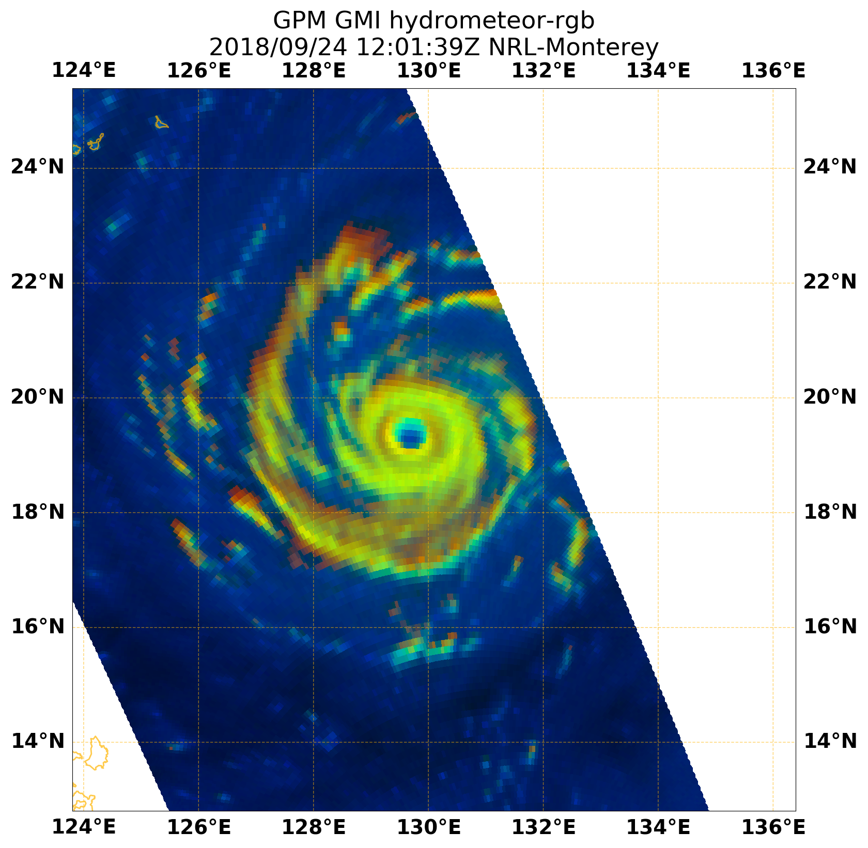
Hydrometeor False Color
Ice scattering and liquid emission signals are combined to provide diagnosis of microphysics
  Used to discriminate vertical convective structure and its symmetry.
In this case:
  Relative shading of yellow/orange indicates vertical alignment of concentric eyewalls and banding
Interpretation:
  Red pixels represent convective ice only
  Green pixels show low level precipitating liquid water and land
  Yellowish/orange pixels show varying combinations of both convective liquid and ice
  Lighter blue to dark blue colors show shallow non-precipitating liquid water/moist air to drier cloud free areas
8

Slide 9
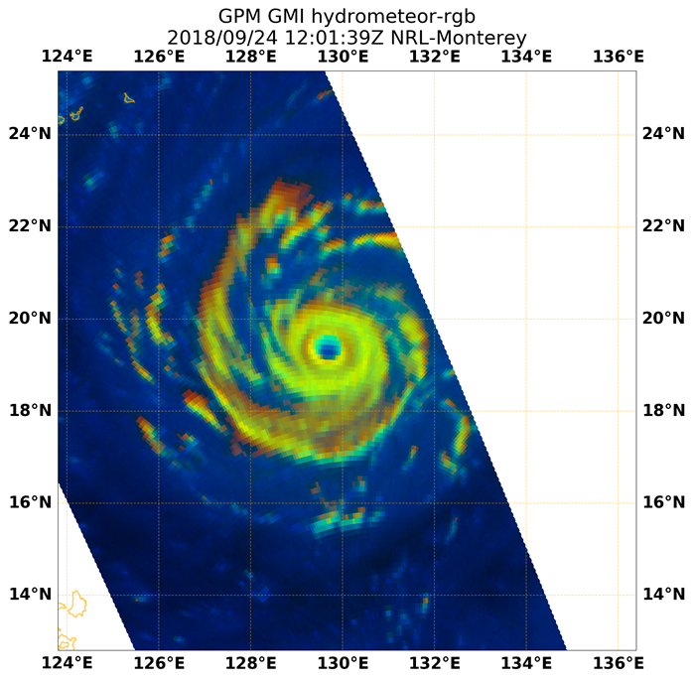
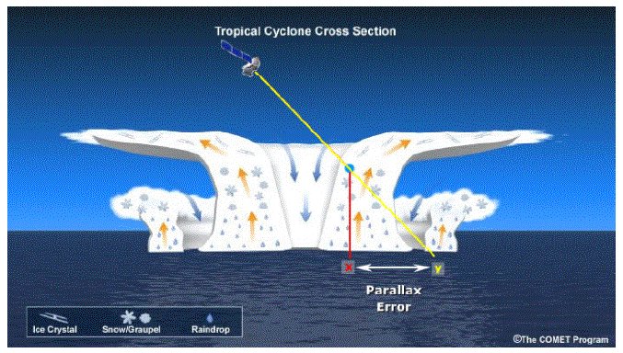
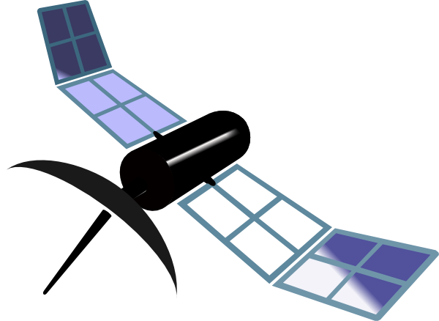
Parallax Analysis
Combining frequencies also demonstrates magnitude of parallax between ice and liquid convective cores
Magnitude of parallax error on the order of position error (~10 km). Needs to be accounted for positioning, structure analysis, etc.

Slide 10
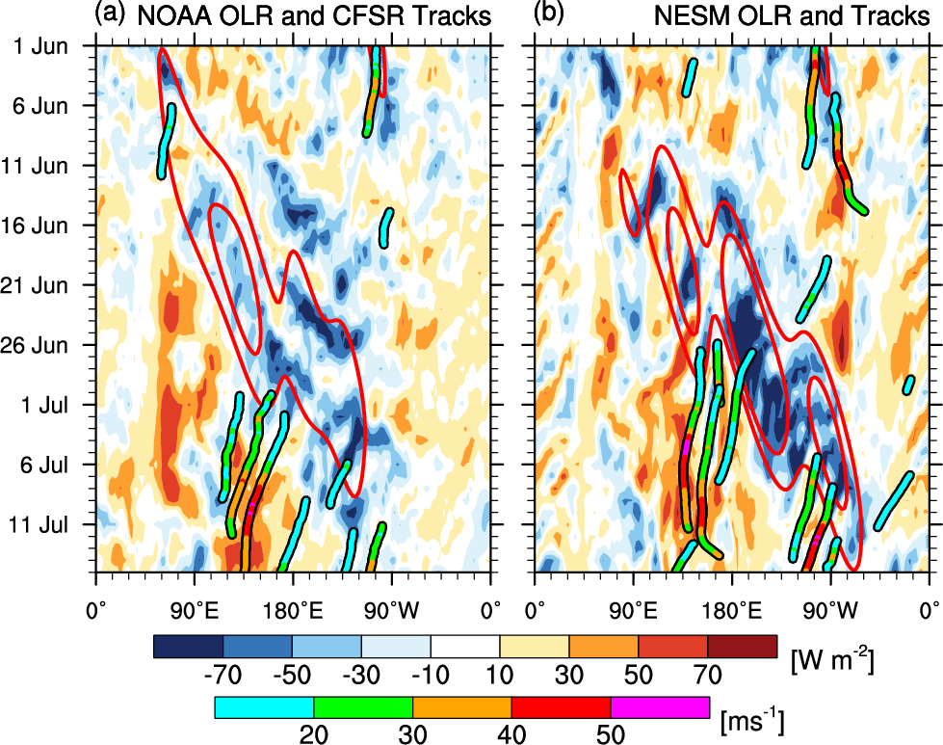
TC Prediction using Navy ESPC
Navy ESPC 45-day forecast from 2015060112
TIME
45-day forecast captures both MJO and elevated TC genesis in this example
TC genesis more common during active MJO phase
0-10°N OLR anomalies shaded from (a) NOAA obs. and (b) 45 d NESM forecast. MJO-filtered OLR anomalies are contoured in red every 15 W m⁻² .
10

Slide 11
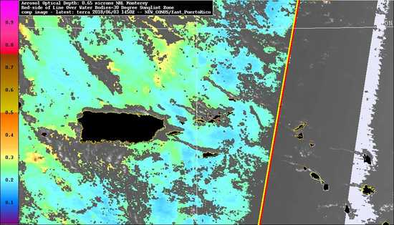
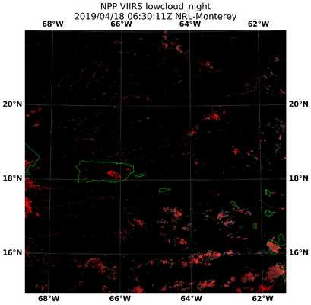
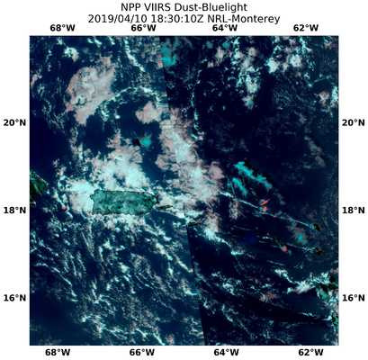
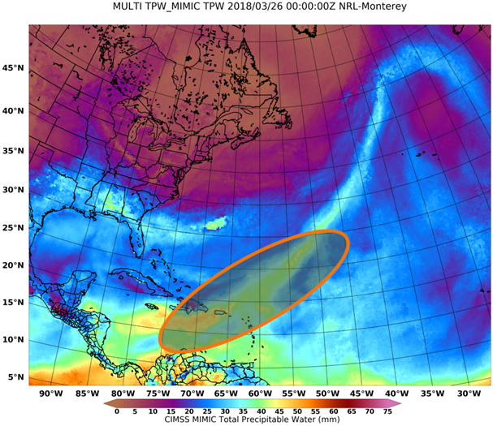
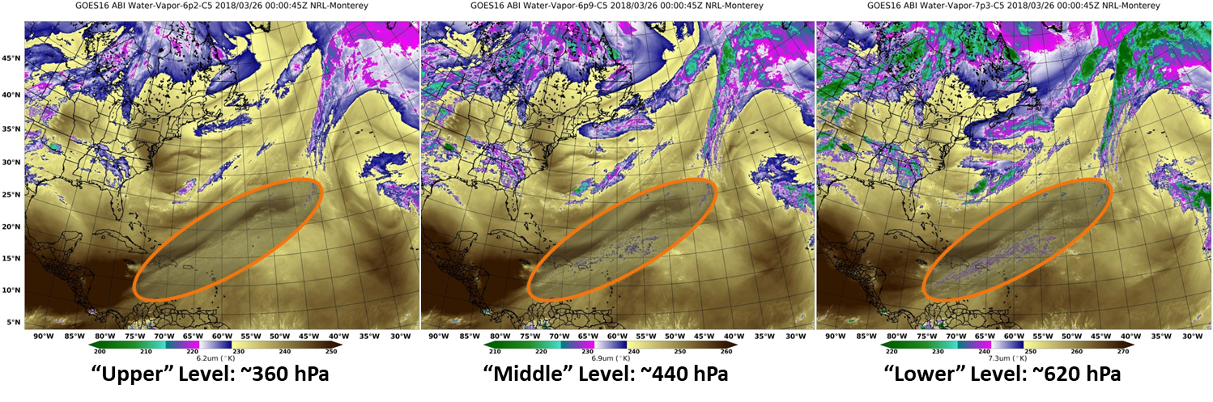
More Tropical Weather Satellite Research at NRL
(Right) NexSat: demonstration website for real-time new product testing with partners and field campaigns
(Below) Atmospheric Rivers: comparing structural signature between TPW and GOES water vapor channels

Slide 12
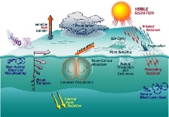
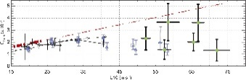
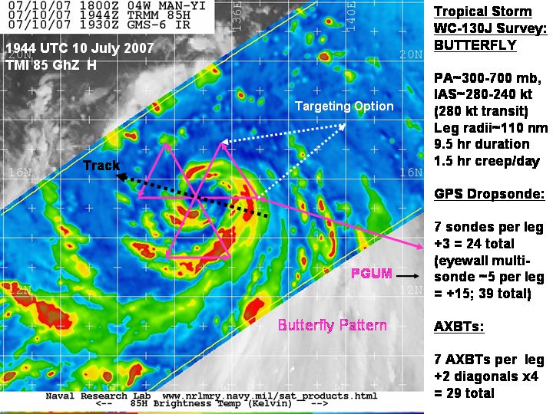
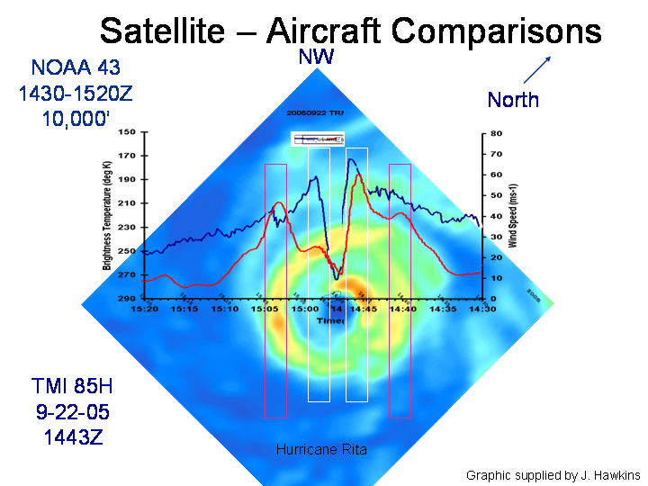
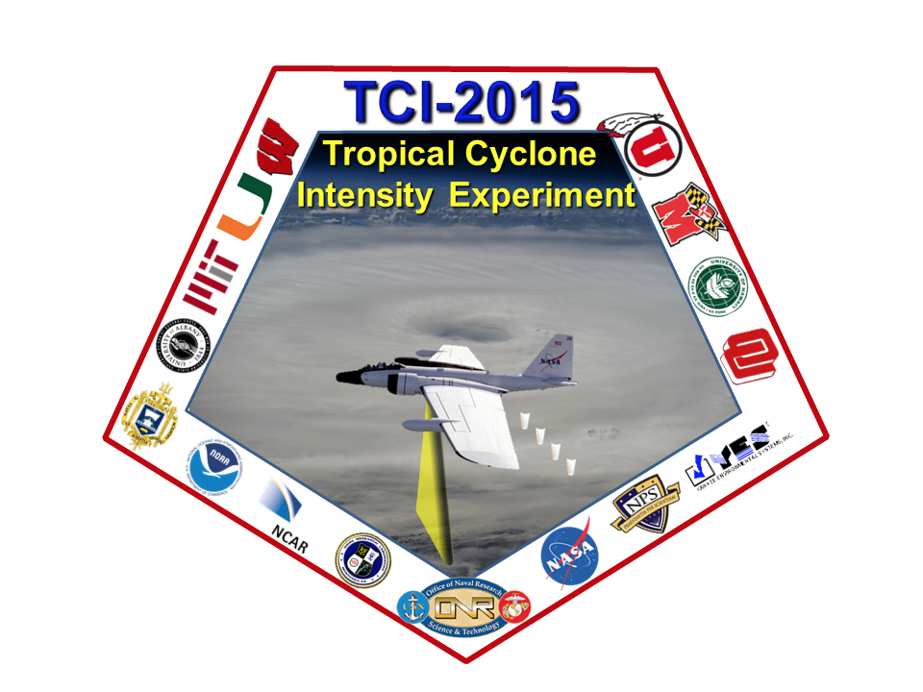
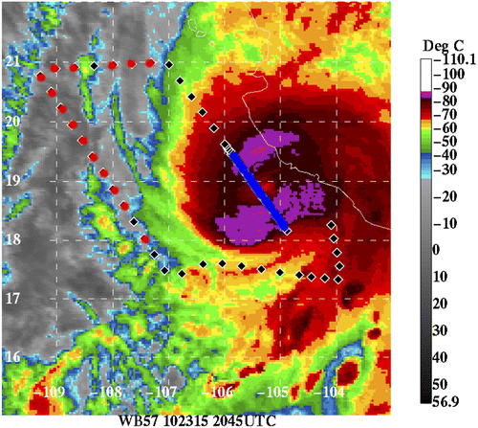
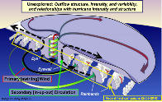
ONR’s Tropical Cyclone Programs
FY00-04: Coupled Boundary Layers/Air-Sea Transfer (CBLAST)
Focused on processes that occur in the oceanic and atmospheric wave boundary layers. Re-examined existing observations of hurricane-ocean boundary layer, wave condition, and hurricane energetics.
FY03: A coordinated field campaign of coincident airborne in situ and remote sensing measurements, together with air-deployed, in-situ measurements using a refinement of observing strategies to better understand the air-sea interfacial boundary layer under high winds and strong shear.
Improved understanding of drag at surface led to first realistic pressure/wind relationship in mesoscale models.
FY07-11: Tropical Cyclone Structure (TCS)
Focused on storm scale processes that produced increasingly reliable intensity and surface wind radii predictions (structure). Applied research (ONR 6.2 core) developed and transitioned COAMPS-TC; first skillful operational mesoscale TC model. Two Field Campaign Years with T-PARC and ITOP.
FY14-18: Understanding and Predicting the Impact of Outflow on
Tropical Cyclone Intensification (TCI)
Focused on enhancing the understanding of dynamics of the upper-level outflow of tropical cyclones (TCs) and its connection to the larger-scale environment.
Improved upper level physics; demonstrated value of in-situ observations for better model initialization and DA; improved the ensemble through initial condition sensitivity
Programmatic Formula: Focused research efforts tying state-of-the-science theory with targeting observing methods can successfully improve numerical representation of tropical cyclones towards more accurate prediction.

Slide 13
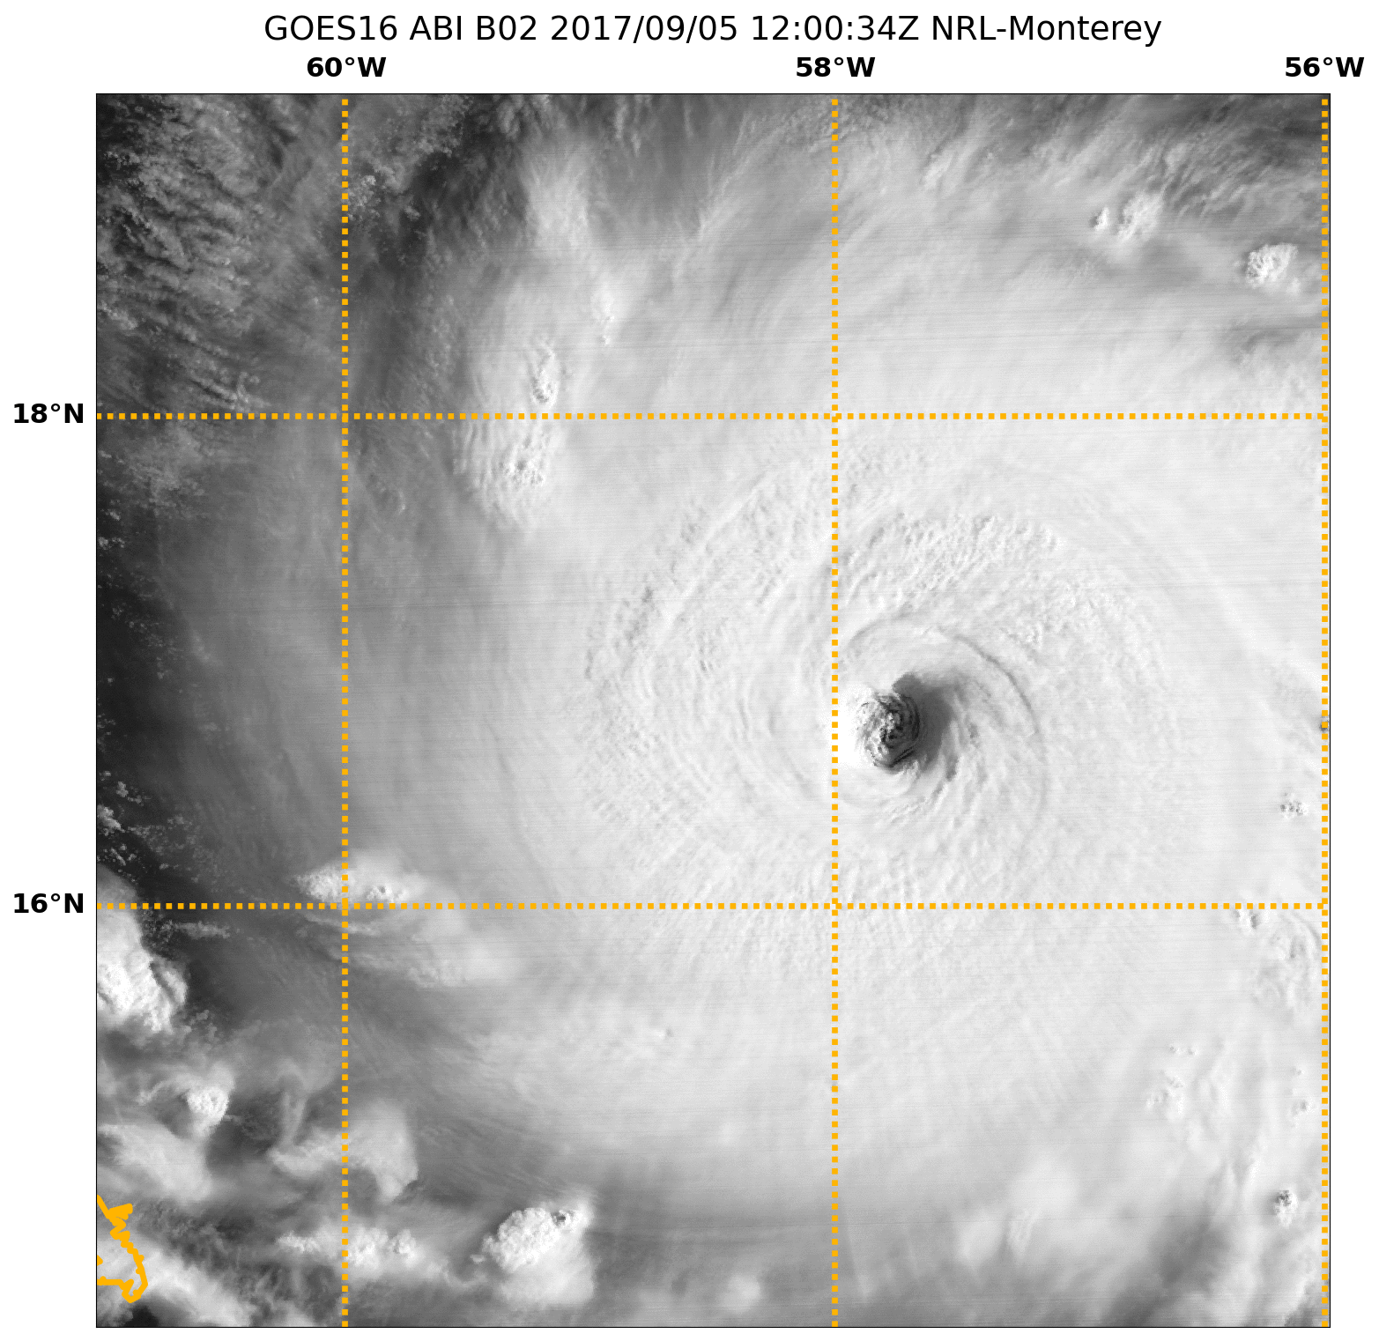
ONR: Toward the Future
Programmatic Goals:
  Tropical Cyclone Rapid Intensification (TCRI) initiative FY20-FY24
    Leverage high resolution models, field campaign, satellite data, and AI for understanding physical processes that modulate intensity change
  Geolocated Information Processing System (GeoIPS)
    Expand initial seed effort by NRL to joint community development with SatPy
    Interface with other community packages and AWIPS-2 visualization systems
    Develop standards for sharing satellite products, algorithms, and accelerating transition into operations

Slide 14
Thanks!

