Slide 1
Why are hurricanes so important to Wisconsin anyway? Developing satellite-based TC applications at CIMSS
Anthony Wimmers, Chris Velden, Tim Olander, Derrick Herndon
Cooperative Institute for Meteorological Satellite Studies (CIMSS)
University of Wisconsin - Madison

Slide 2
GOES-R:
Advanced Dvorak Technique (ADT v9.0)
Hurricane vortex-scale atmospheric motion vectors
JPSS:
ARCHER center-fixing, integration to AWIPS
SATellite CONsensus intensity estimate (SATCON)
Merged TPW
Other:
AI-based TC intensity estimation
Next steps

Slide 3
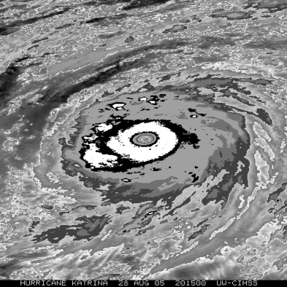
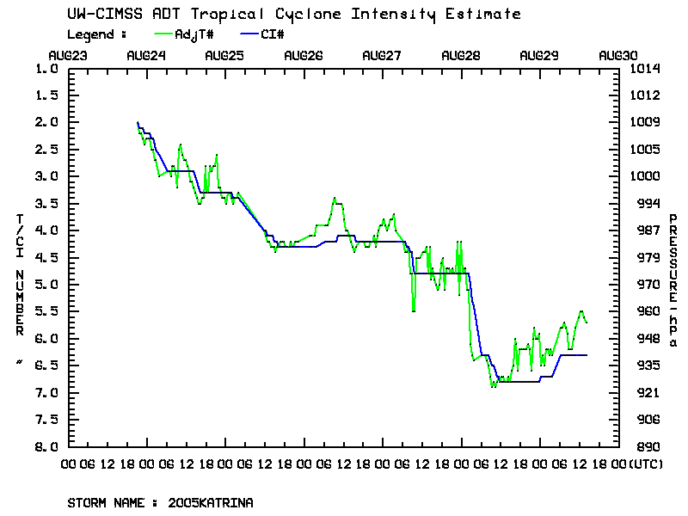
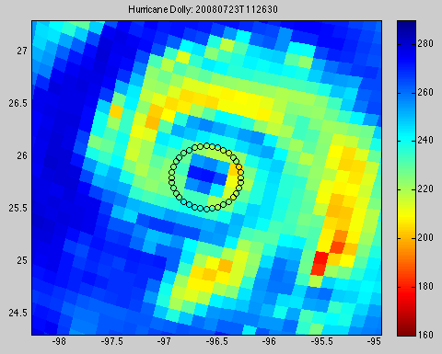
Selected TC Applications-CIMSS: GOES-16/17
Recent Upgrades to the Advanced Dvorak Technique (ADT v9.0)
Product Description: ADT is a computer-based algorithm that provides rapid-refresh objective estimates of TC intensity derived from geostationary satellite IR imagery.
Users: -- Operational TC community: NHC, CPHC, JTWC, RSMCs (WMO Regional TC forecast centers), National TC forecast centers
-- TC Research community: ADT is an archive for studies of TC intensity behavior and long-term trends, and a benchmark for new sat-based methods (SATCON, AI-based methods, etc.)

Slide 4
Selected TC Applications-CIMSS: GOES-16/17
Recent Upgrades to the Advanced Dvorak Technique (ADT v9.0)
Current Development Status: Latest version (9.0) is being transitioned into NESDIS Ops. with the goal to have operational ADT estimates available for the 2020 TC season (GOES-16, Atlantic; GOES-17, East/Cent Pacific): https://www.ssd.noaa.gov/PS/TROP/adt.html
Based on prior user feedback, added functionalities in v9.0 include:
1) ARCHER 2.0 for auto TC center fixing--Employs VIS/IR/SWIR from GEO and 37/85GHz from LEO (SSMIS/AMSR2/GMI) to arrive at best estimate
2) Improved operability on Sub-Tropical systems, and storms undergoing Extratropical Transition (ET)
3) Addition of TC surface wind radii estimates based on Knaff et al. methodology
4) Operability with Himawari and GOES-R series (will function through GOES-17 heat pipe anomaly periods with minimal impacts)
Potential future ADT science upgrades and solutions:
-- Develop a quality indicator for the current intensity estimates
-- Explore AI/Deep Learning approaches to augment the ADT image analysis and retrieval of TC intensity (SSEC2022)

Slide 5
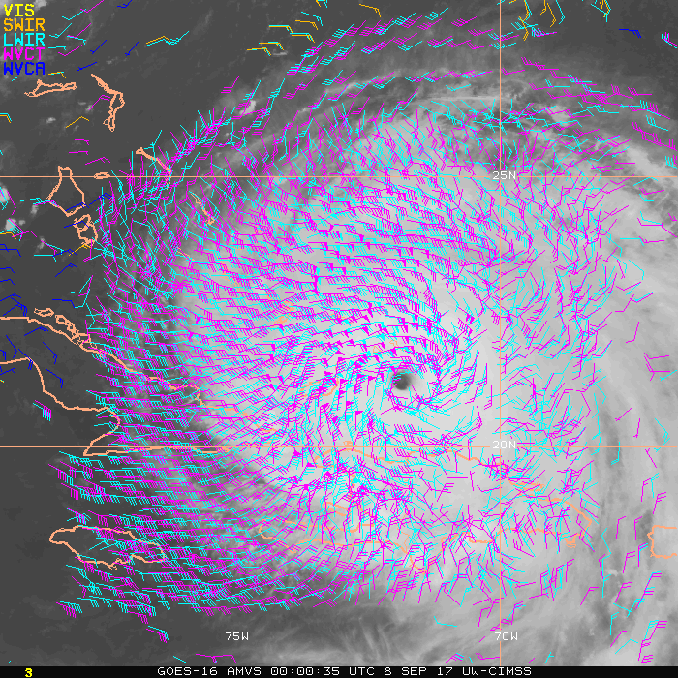
Selected TC Applications-CIMSS: GOES-16/17
Hurricane Vortex-scale Atmospheric Motion Vectors (AMVs)
Enhanced (high spatiotemporal) wind vector estimates around TCs derived from GEO satellite rapid-scan (meso sector) multispectral imagery using the NESDIS operational GOES-R tracking algorithm.

Slide 6
Selected TC Applications-CIMSS: GOES-16/17
Hurricane Vortex-scale Atmospheric Motion Vectors (AMVs)
Users: -- Operational TC community: TC analysis centers (NHC, CPHC, JTWC, RSMCs) and NWP centers (e.g. NCEP/EMC HWRF model, FNMOC/NRL COAMPS-TC model)
-- TC Research community: For studies of TC-env. interactions (e.g. outflow, vertical wind shear), storm-top diagnostics, TC modeling
User Apps: TC analysis--Enhanced wind information to assess TC structure/health
Data assimilation--to better initialize TC NWP models
Current Development Status: Product is in beta testing at UW-CIMSS. Real-time demonstration (GOES-16) planned for the 2020 Atlantic TC season. Proposal is pending to transition the product (in collaboration with NESDIS/STAR) into NESDIS Ops for routine dataset processing and dissemination.

Slide 7
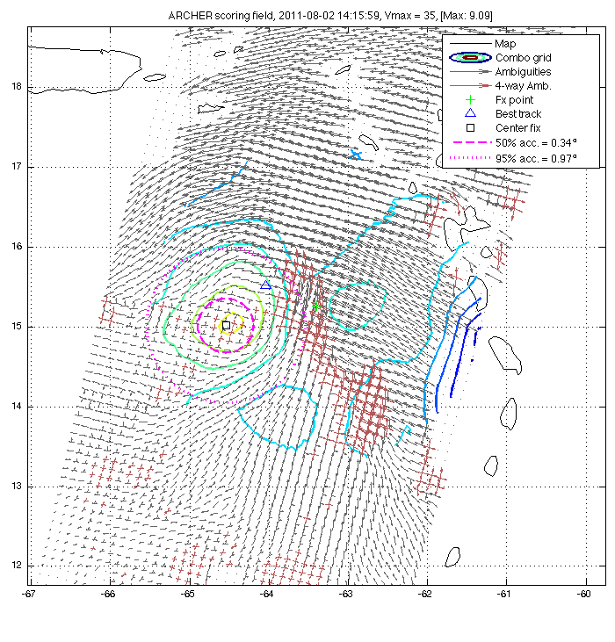
Selected TC Applications-CIMSS: JPSS
ARCHER (rotational center-fixing)
Purpose:
Resolves a TC rotational center automatically from multi-platform satellite imagery (Geo, JPSS, scatt.)
Includes uncertainty estimates
Used as a starting point for many other algorithms
Development in JPSS
Integrate ATMS and VIIRS
Incorporate into the GeoIPS platform, which will bring this product output to AWIPS in an open-source, standardized format.
Geo IR
ASCAT
89GHz MW

Slide 8
Selected TC Applications-CIMSS: JPSS
SATCON (Satellite Consensus TC intensity estimation)
Purpose:
Produces an optimized estimate of TC intensity by incorporating ADT, MW-derived estimates.
Development in JPSS
Incorporate JPSS-1+
Reconfigure to work as a backend on GeoIPS

Slide 9
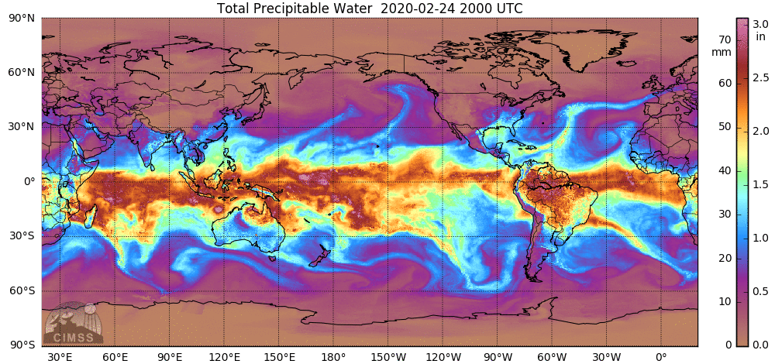
Selected TC Applications-CIMSS/CIRA: Merged TPW
Purpose:
Present tropical weather environment, show critical moisture thresholds for TC growth/decay, atmospheric rivers, stability (layered)
(More in the Hydrology session)
Development in JPSS
Incorporate JPSS-1+
Merge CIMSS’s MIMIC-TPW and CIRA’s Blended TPW, for the best of both worlds

Slide 10
Selected TC Applications-CIMSS: Other
AI-based TC intensity estimation
Model estimate PDF, knots
Truth
37 GHz
89 GHz
Summary:
Demonstrates the ability of AI to produce a probabilistic, near SoTA estimate of TC intensity from PMW imagery (Wimmers et al. 2019).
Future Work:
Supported by ONR for further development to use more complicated inputs and structured results.

Slide 11
Selected TC Applications-CIMSS: Other
Next steps: Managing a crowdsourced AI competition
Purpose:
Use the wisdom of the crowd to determine the best TC intensity ML method
Partnering with Kaggle and NCEI
Details:
NCEI provides a training dataset (HURSAT)
Kaggle members develop ML models to estimate TC intensity
Models are validated with a subsequent TC season
The Kaggle site remains active for years afterwards, for future ML model intercomparison

Slide 12
Extras

Slide 13
Selected TC Applications-CIMSS: GOES-16/17
Hurricane Vortex-scale Atmospheric Motion Vectors (AMVs)
Attributes of the enhanced AMV product for TC apps include:
1) Uses regional (‘MESO’) scans of VIS/IR/WV with 1-min. sampling that can be pointed at targeted regions like hurricanes within view of GOES-16.
2) Tailors the AMV processing to optimize coverage to capture smaller-scale TC flow fields (e.g., use full spatial res imagery, increase target density, relax QC constraints)
3) Employs novel optical-flow tracking methodology to further enhance the TC cold cloud central dense overcast region (CDO--storm top)
4) Datasets can be produced in real time at 15-min intervals for rapid info refresh
Potential future product upgrades and solutions:
-- Document/validate the enhanced vector quality, refine QA procedures/thresholds
-- Explore novel DA methods (dynamic initialization, Hybrid Ens.) to better exploit the increased information content on hurricane scales to improve model predictions

