Slide 1
Tropical Weather A Developer Perspective
J. Knaff, CORP, RAMMB

Slide 2
What Needs Current Products Address?
TC Intensity estimation
TC wind structure estimation
TC intensification
TC Formation
TC environmental monitoring
Forecaster efficiency
Reduce number of products
Outputs go directly into operational workstations

Slide 3
Product | Purpose | Development Inputs | Product Inputs
Hurricane Intensity and Structure Algorithm (HISA) OSPO NDE | 1-min maximum winds 34-, 50-, 64- knot wind radii 2-D winds ATCF FIX | MIRS Retrievals ATMS AMSU Best Tracks Aircraft times | MIRS Retrievals ATMS AMSU TC Location TC intensity (wind radii)
Multi-Platform TC Surface Wind Analysis (MTCSWA) OSPO NDE (ongoing) | 3-hourly 2-D surface winds with TCs Radius of Maximum Winds 34-, 50-, 64- knot wind radii ATCF FIX NetCDF GRAPHIC | IR-based proxy for flight-level winds AMSU/ATMS 2-D winds ASCAT AMVs (global) TC Best Tracks Aircraft for validation | TC intensity (estimated) TC location (estimated)Global Constipation of Geostationary satellites AMSU/ATMS 2-D winds ASCAT AMVs (global)
Rapid Intensification Prediction Aid (RIPA) Operational at JTWC Web for NHC/CPHC | Global forecasts of probabilities associated with Rapid Intensification (various threshold and lead times) Deterministic forecast for Intensity Consensus ATCF AID | SHIPS/LGEM Large-Scale Diagnostics (Developmental) IR-based convective vigor IR-based size | Real-time SHIPS/LGEM Large-Scale Diagnostics (NHC, CPHC, JTWC)
Tropical Cyclone Formation Product (TCFP) OSPO NDE (ongoing) | Global forecasts of probability of TC formation (34-kt) for 0-24h, 24-48h, 0-48h Web | Global Water Vapor Imagery GFS analyses TC Best Tracks | Global Water Vapor Imagery GFS forecasts TC Locations
Proxy Visible CIRA via LDM ISATSS (NHC –AWIPS-2) | Nighttime visible imagery proxy, seamless night-to-day capability IMAGE | VIIRS | ABI

Slide 4
Improvements to existing products
HISA
Create a TC version of MIRS that uses a TC climatology as the first guess
This will result in better convergence in the cloudy scenes near the TC center (i.e., the warm core)
Re-consider deconvolution to arrive at higher resolution
MTCSWA
Add L-Band winds (SMAP, SMOS) to the Analysis
Add C-Band (AMSR2) and Synthetic Aperture Radar (SAR) winds to the analysis
RIPA
Add microwave imagery/products to the mix
Examine additional satellite-based, and aperture independent metrics for size and intensity
Add subjective information, which historically has been/is available in real time.
TCFP
Follow and track suspect disturbances
Extend to 5-days
Utilize model Ensembles
Proxy Visible
Improve the representation of cold/high clouds by using more ABI channels or more advanced statistical methods

Slide 5
Low hanging improvements… big reward
IMPROVE MIRS Retrievals
Operational MIRS
Fails to converge to a solution near the center
Warm core poorly estimated
This is not a systematic error!
MIRS using a COSMIC TC climatology
Convergence in the core
More realistic warm core structure
Better climatologies could be developed

Slide 6
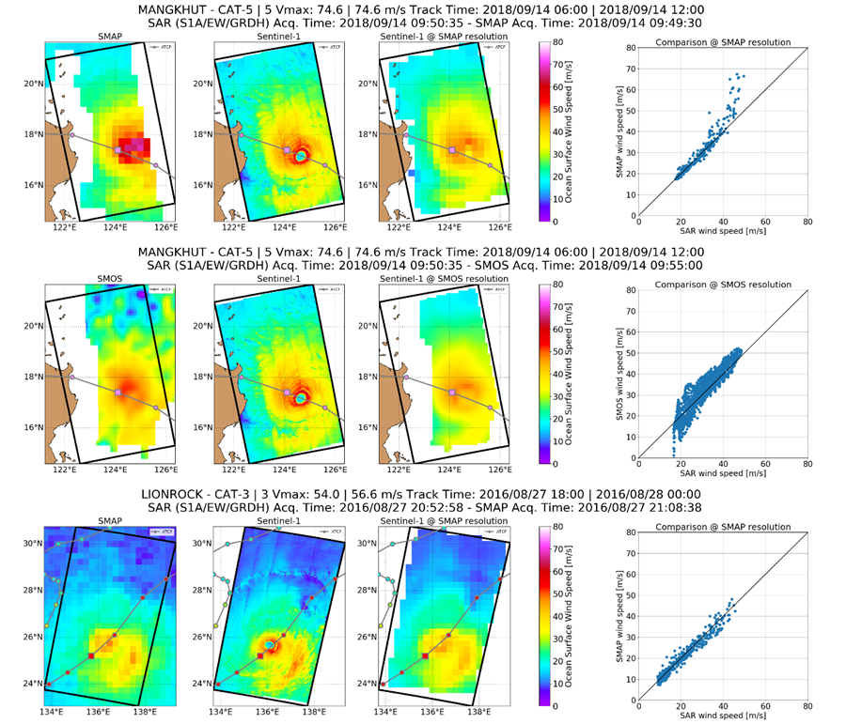
Low hanging improvements… big reward
MTCSWA with SMAP, SMOS, AMSR, SAR winds
Image credit: N. Reul, A. Mouche (IFERMER)

Slide 7
Problems I think should be addressed
Understanding GLM Lightning… what is seen, when, and what it means?
Improving the use of GOES Atmospheric Motion Vectors to monitor the TC environment in the 0 to 8h period when models are still running
Calibrated with model based measures
Using AI/ML to develop ABI-based estimates of LEO imagery/products
Use satellite-data to provide accurate (+/- 100%) estimates of the radius of maximum wind
ABI-based estimates of mid-level moisture and deep layer vertical wind shear
Automatically track weather disturbances (pre-depression, cold lows, squalls etc…)
Start estimating winds associated with all surface cyclones (extra-tropical cyclones, transitioning tropical cyclones, and overland cyclones)
Operational access to relevant LEO data (e.g., 89 GHz & 37 GHz imagery, and SMAP, SMOS, & SAR winds)
AI/ML, DA or data fitting techniques to estimate of 3-D TC winds
For many of these items there is a implicit need for labeled data sets
This is where researchers and forecasters can interact

Slide 8
New Products: Synthetic 89GHz imagery
Provides continuity for forecasters
Provides rapid updates for forecasters
Can be used as input to other products (e.g., precipitation algorithms)
Improves the utilization of ABI
Could be applied to other LEO channels or products
More information during sunlit hours
Image Credit: Chris Slocum

Slide 9
New Products: Radius of Maximum winds
For improved initiation of NWP
For Storm Surge
For wind hazards
Dorian (2019)
Florence (2018)

Slide 10
SAR Winds for TCs is in the works
Collaboratively designed by:
Sean Helfrich’s Group (STAR)
Buck Sampson (NRLMRY)
Alexis Mouche (IFERMER)
John Knaff (STAR)

Slide 11
Extra slides

Slide 12
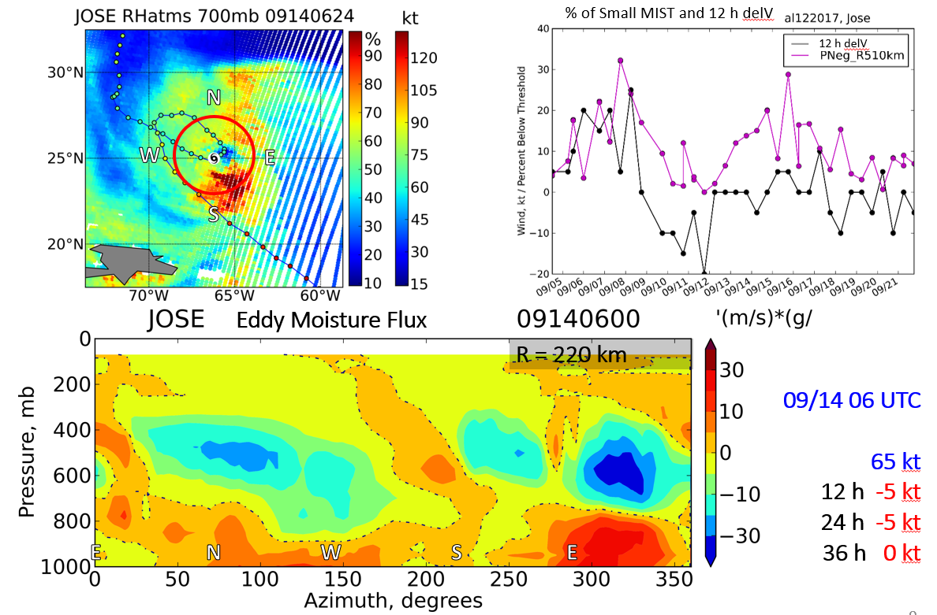
Moisture In-Flux Storm Tool (MIST) (Fall 2019, TC-REALTIME)
Purpose: use ATMS-MiRS SNPP and NOAA-20 data to
develop standalone applications for tracking dry-air intrusions
develop dry-air intrusions quantitative parameters for statistical TC intensity forecast models
Status: work in progress on setting up real-time demo for all TC basins
POC: Galina Chirokova

Slide 13
Develop estimates of the 3-D winds in hurricanes using AI, IR imagery and TC vitals
Justification and Plan
Example from Hurricane DORIAN (HWRF v2014) 12 UTC 29 Aug, 75 knot intensity
Justification:
Improved model initialization
Plan:
Use methods developed with GOES-R risk reduction to estimate the 3-D winds using the method of single field principle component analysis (SFPCA)
Development inputs would be HWRF/HAFS simulated ABI imagery and 3-D winds, storm intensity and motion
In application, observed imagery, storm motion and storm intensity would be used to estimate the winds.
INPUT:
Brightness Temp (first panel)
335 @ 11 knots
75 knot intensity
Winds (barbs)
Rel. Vorticity (contour)

Slide 14
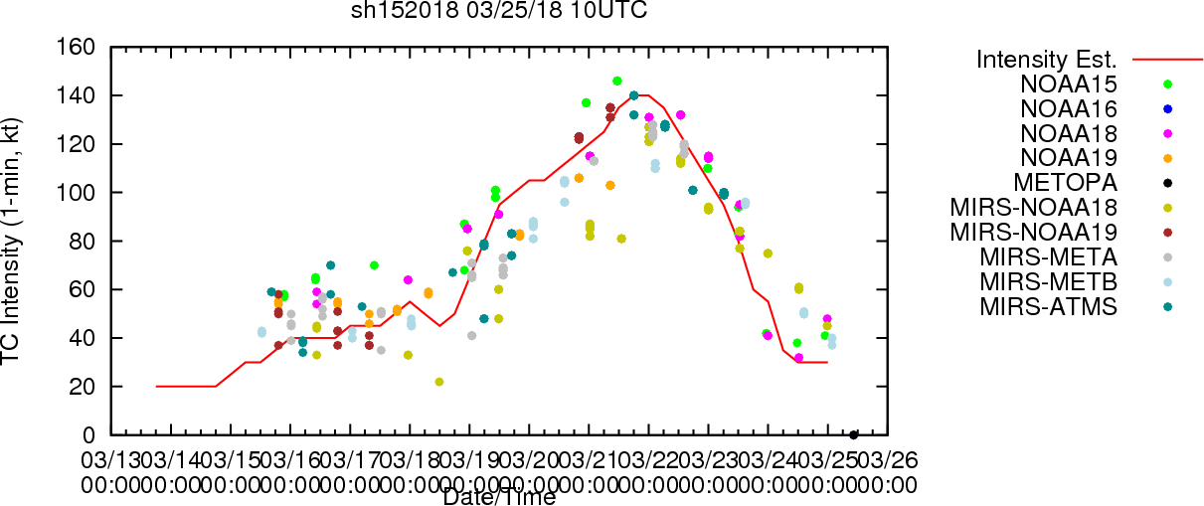
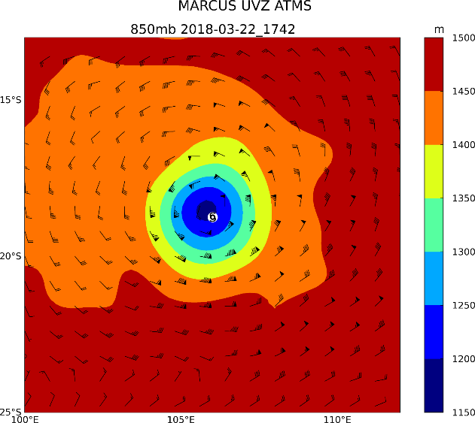
Hurricane Intensity and Structure Algorithm (HISA)
Vmax
HISA provides MW-based TC Intensity estimates:
Global
Objective
Independent of Dvorak
Input:
Temperature profile, CLW from TROPICS-MIRS or statistical retrievals
GFS boundary conditions
ATCF TC track data
Output:
1) Intensity estimates, provided via f-deck
Maximum sustained wind (Vmax, kt)
Minimum Sea Level Pressure (MSLP, hPa)
2) Surface Wind Radii Estimates (nmi), provided via f-deck
R34, R50, R64 for NE, NW, SE, and SW TC quadrants
3) Azimuthally-averaged gradient winds as a function of geopotential height and distance from TC center.
4) Horizontal 2-D balanced winds (kt) for the local TC environment
Operational on ATMS and AMSU on 7 satellites, is upgraded to work with NOAA20 ATMS
Users: NHC, CPHC, JTWC
Results from AMSU and ATMS retrievals
TC Marcus 2018 (SH15)
 | ATMS-MIRS MAE | AMSU-MIRS MAE
Vmax (kts) | 11.1 (1565) | 13.2 (4346)
Pmin (hPa) | 7.0 (1565) | 8.4 (4347)
R34 (nmi) | 20.0 (344) | 24.9 (1044)
R50 (nmi) | 12.0 (215) | 10.6 (601)
R64 (nmi) | 12.0 (134) | 8.9 (336)
TC Marcus 2018 (SH15)
2-D Winds ATMS-MiRS S-NPP
Galina Chirokova (CIRA), John Knaff (NOAA/NESDIS), Scott Longmore (CIRA), Mark DeMaria (NOAA/NWS/NHC), Jack Dostalek (CIRA)

Slide 15
AI/ML to track cold lows in imagery
Justification and Plan
Tracks we would use
Justification:
These features are still poorly forecasted in global NWP and often impact TC track and intensity forecasts.
Plan:
Use an 11 year track (manual) to train AI/ML to automate the tracking using GOES imagery and AMVs

Slide 16
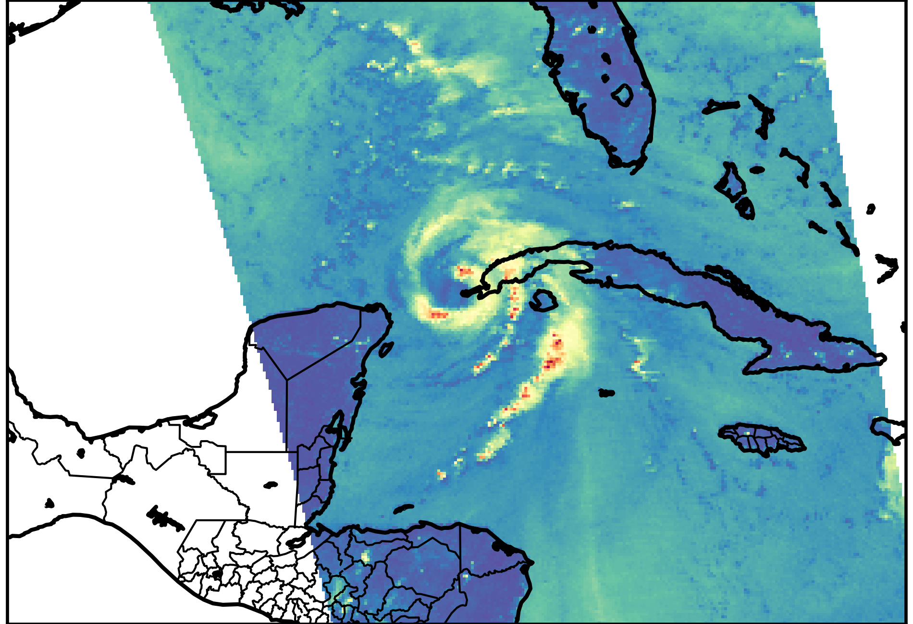
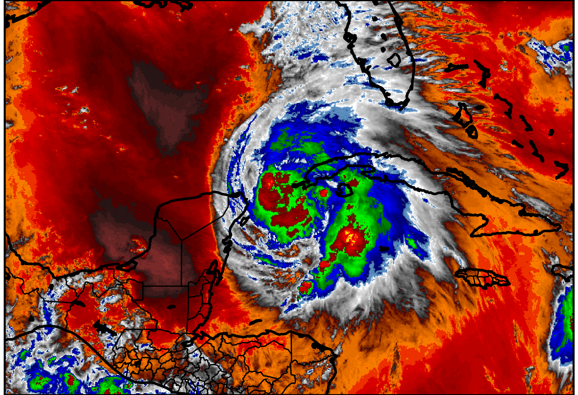
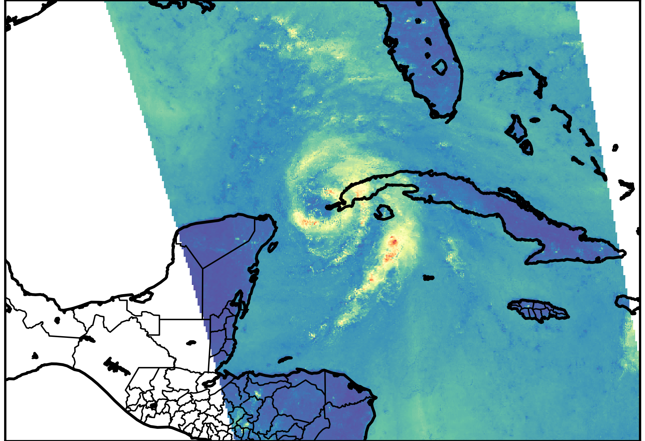
ABI/AHI Synthetic 89-GHz
Purpose:
Provide microwave-like data when polar-orbiting data is missing
How:
Supervised machine learning that is trained on features from GOES-16/17 & Himawari-8/9 L1b & L2 products
AMSR-2 89 GHz
Water vapor
Synthetic from GOES

Slide 17
Tropical Cyclone Formation Product
FY20
Example
This product provides global probabilistic forecasts of 24 and 48 tropical cyclone formation
Update to use all geostationary inputs
Currently degraded
Enable logic/code to access GOES-17/16 data

Slide 18
Improving short-term TC intensity forecasting (Rapid/Unexpected change)
Justification and Plan
Probabilities for Hurricane Dorian (8/29 12 UTC)
Improving forecasts of rapid changes in TC intensity are a high NOAA priority
Currently models have been developed for rapid intensification (RI)
PLAN:
Improve current RI guidance
Develop models for Rapid Weakening, Convective decoupling, and extratropical transition

Slide 19
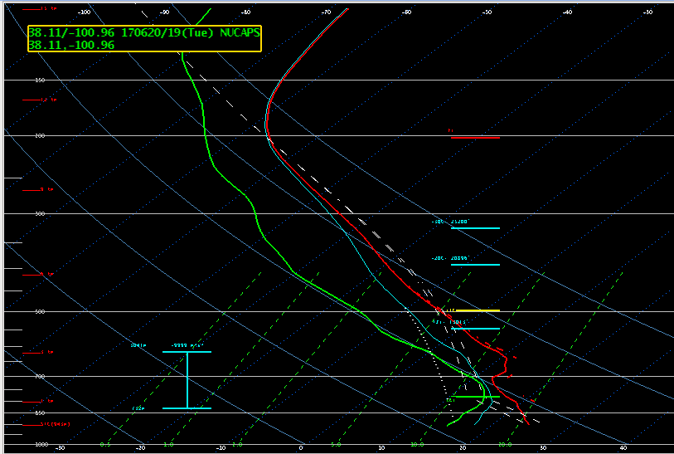
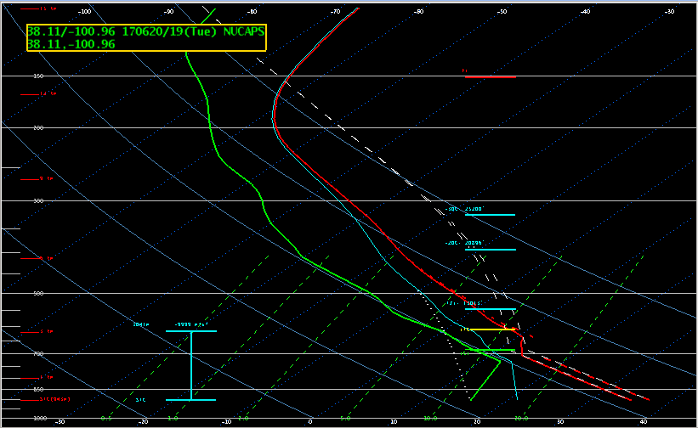
JPSS-PGRR-NUCAPS-DATAFUSION Jack Dostalek, John Haynes
To use NUCAPS retrievals, forecasters often need to modify the surface layer(s) to match observed T and Td
Automated modification using GOES-16 and RTMA data to create surface and boundary layer T and Td
Overall positive feedback from Hazardous Weather Testbed. From blog post: “The modified NUCAPS soundings have shown significant improvement when compared to the operational NUCAPS soundings …”
Example at left from Southwestern Kansas 20 June 2017

Slide 20
3-D hurricane winds via AI/ML
Potential Hurricane Supplemental
Example for Hurricane Edouard (2014)
Motivation:
Use routinely available information to
Improving numerical model initialization
Estimates of tropical cyclone (TC) wind fields.
Proposition:
Given a single Infrared (IR) image, and routinely produced TC advisory information, that a synthetic 3-D vortex could be estimated.
Method:
Use HWRF forecast fields and synthetic imagery (+48h) as training
Use single field principle component analysis (SFPCA) to estimate the winds
In application use the observed TC vitals & observe IR imagery.
Statistical
Estimate
HWRF
Truth

Slide 21
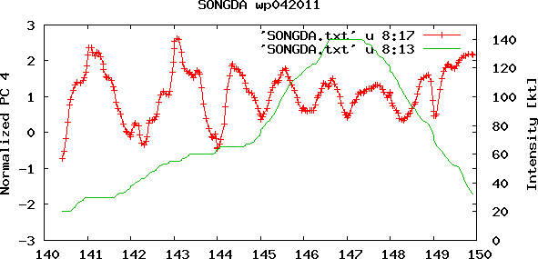
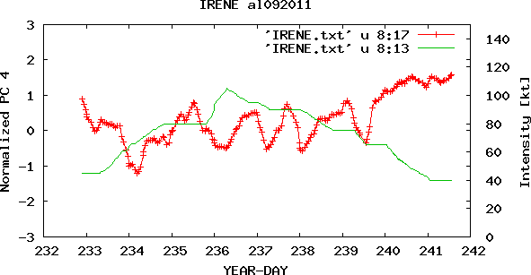
Understand diurnal oscillations of deep convection in TCs
Quantification: IR Imagery
Justification and Plan
Diurnal Oscillations of deep convection in TCs often determine timing of intensification/weakening, effect satellite intensity estimates, and are yet fully understood
Plan:
Use the unique satellite dataset, model analyses, and field campaign data to determine causes and effects of diurnal oscillations
ABI to determine strength of oscillations
COSMIC to examine variation of boundary layer
MIRS, NUCAPS to determine environmental oscillations
Simple models to test hypotheses
Time series of PC4
EOF -4
Pulsing symmetric Variability
8.9% of the variance
GFS used for environmental diagnosis
Knaff, J.A., C.J. Slocum, and K.D. Musgrave, 2019: Quantification and Exploration of Diurnal Oscillations in Tropical Cyclones. Mon. Wea. Rev., in press, https://doi.org/10.1175/MWR-D-18-0379.1

Slide 22
Develop synthetic Microwave imagery using AI and ML
Justification and Plan
Example Hurricane Michael
Justification:
Microwave imagery is often used to estimate TC intensity, location and convective structure
Microwave imagery is a key input to precipitation algorithms
Microwave data are latent and often miss TCs
Geostationary data is not latent and could act as risk reduction as microwave imager/sounders phase out of operations
PLAN:
AI/ML has shown ability to estimate 89GHz during the day
We will expand on this ability to night
We will expand this ability to other microwave frequencies, those most useful for TCs and precipitation estimation
OBSERVED
GMI
Synthetic
GMI

Slide 23
Develop a Monti Carlo TC precipitation exceedance probability product
Justification and Plan
Example of MC-generated track and intensities for Joaquin (2015)
Justification:
TC rainfall, especially inland rainfall, remains a under forecasted hazard where track and intensity errors in deterministic forecasts fail to provide the full range of possibilities
Global model ensembles are under disperse and do not capture the intensities variations of TC
This would improve on Ensemble TRAP
Plan:
Use the track and intensity realizations from the existing Monte Carlo wind probability product (NHC) along with a climatology of rainfall (TC size, TC intensity) to provide probabilities forecasts for rainfall exceedance

Slide 24
Improved utilization of GOES/H8 data for TC environmental monitoring, targeting the 0-6h period between global model runs
Justification and Plan
Details
Justification:
TC NWP is considered late guidance (i.e. the currently available model run is 6h old)
Much can change in the TC environment in this 6h period; effecting intensity forecasts
Plan:
Use GOES AMV’s and ABI water vapor images to develop products specifically targeted to monitor vertical wind shear, upper-level divergence, and mid-level moisture to fill in the 6 to 9h gap in information.
Shear can be calculated from upper-level winds and storm motion; calibration would be needed
Divergence would be calculated using AMVs
Moisture in the 700 to 500 mb layer would be calculated (a quantitative value)using radiative transfer.

Slide 25
Moisture In-Flux Storm Tool (MIST) (Fall 2019, TC-REALTIME)
Purpose: use ATMS-MiRS SNPP and NOAA-20 data to
develop standalone applications for tracking dry-air intrusions
develop dry-air intrusions quantitative parameters for statistical TC intensity forecast models
Status: work in progress on setting up real-time demo for all TC basins
POC: Galina Chirokova

Slide 26
3-D hurricane winds via AI/ML
Potential Hurricane Supplemental
Motivation:
Use routinely available information to
Improving numerical model initialization
Estimates of tropical cyclone (TC) wind fields.
Proposition:
Given a single Infrared (IR) image, and routinely produced TC advisory information, that a synthetic 3-D vortex could be estimated.
Method:
Use HWRF forecast fields and synthetic imagery (+48h) as training
Use single field principle component analysis (SFPCA) to estimate the winds
In application use the observed TC vitals & observe IR imagery.
Statistical
Estimate
HWRF
Truth

Slide 27
Radius of Maximum Winds
Experiments (example Dorian)
Next steps
Microwave imagery
L-Band
SAR
AMSR2

Slide 28
A generalized vertical wind shear metric
$GSHR=4.0 x\sum_{P=850 mb}^{p=200 mb}{w_{p}\sqrt{{(u_{p}−\overline{u})}^{2}+{(v_{p}−\overline{v})}^{2}}}$,
Where
$\overline{u} and \overline{v}$ are the mass weighted deep-layer (850 – 200 mb) flow
And
$w_{p}$are pressure weights
850 to 200 mb
Shear
10 knots
850 to 200 mb
GSHR
20.6 knots
Deep layer
Mean
-1.1knots
Smaller values are favorable for intensification

Slide 29
850-700 mb Temperature advection
Cold air advection is generally disruptive to TCs
Slight warm air advection is typical in TCs
Larger warm air advection helps generate rainfall (upward motion / solenoids) and may lead to intensification
Very large warm air advection is typically associated with extra tropical transition
Z₁ is at 850 mb
Z₂ is at 700 mb
From the model or reanalysis
positive values are favorable for intensification

Slide 30
Normalized R5 (FR5)
R5 is the radius where the tangential wind associated with a TC is nearly equal to the background flow.
It is estimated via infrared imagery following Knaff et al. (2014)
FR5 = R5/R5_{c}, where
R5_{c} is the climatological value of R5 as a function of TC intensity (Knaff et al. 2017)
A combination of R5 and Intensity can be used to estimate wind radii (Knaff et al. 2016).
Figure: (top) Example of the 3-hourly time series of TC size, R5, and normalized TC size FR5, for Hurricane Amanda (2014). (bottom) Daily, color enhanced IR images (8C) corresponding to the estimates of R5 beginning at 0000 UTC 23 May.Ayellow circle is located at a range of 500 km from the TC center, and the color enhancement is provided below the images. (Knaff et al. 2017)
Smaller values are favorable for intensification

Slide 31
Inner core size and recent intensity trends
Radius of minimum Temperature (RMNT)
12-h intensity Tends (capped for ops)
DV≡ The 12-h intensity change [knots]
This upward trends are capped following the concepts/constraints discussed in Dvorak (1984, 1975) ~ 1 to 2 T-numbers per day
𝐷𝑉=𝑚𝑖𝑛(𝑚𝑖𝑛(𝑉𝑀𝐴𝑋∗0.33, 17.5), 𝐷𝑉)
Sometime operations is behind the intensity trend and have to break constraints to catch up this results in a noisy predictor, which is undesirable in development and in operations.
RMNT=28 km
Smaller values are favorable for intensification
larger values are favorable for intensification

Slide 32
Statistical Methods
Linear Discriminant Analysis
Logistic regression
Linear Discriminant Analysis (LDA) is a classification method originally developed in Fisher (1936).
In LDA, a linear combination of variables that best separates two or more groups is developed.
This is formalized as the discriminant function (δ), which is the scalar projection of the data vector (x) in the direction of maximum separation (i.e., Mahalanobis distance), which is called the discriminant vector,(a).
Probabilities are based on prior performance
Logistic regression (LR) is a model where the dependent variable is a defined category (1 or 0).
LRE is a special generalized linear model, where the natural log of the odds ratio based on categorical data is fit to a linear combination of independent predictors (x₁, …, x_{n}) with intercept b_{o} and weights (b₁ ... b_{n}), and p_{e} (event), p_{n} (non-event)
The conditional distribution is a Bernoulli distribution
The LR model predicts probabilities in the form

Slide 33
Deterministic RI Forecasts
Trigger Sensitivity
Rapid Aids (RAPID)
IVCN (CONSENSUS)
IVCN + RAPID (CONSENSUS with Rapid Aids)
Triggered if the consensus probability exceeds 40%
Largest intensity change threshold for each lead time is created
Deterministic forecasts for 24, 36, and 48 h, if triggered are added to the intensity consensus.
Take-Away:
Increasing the threshold improves the consensus with rapid aids (very little) and increases the biases (a lot)
Sampson et al. (2011)

Slide 34
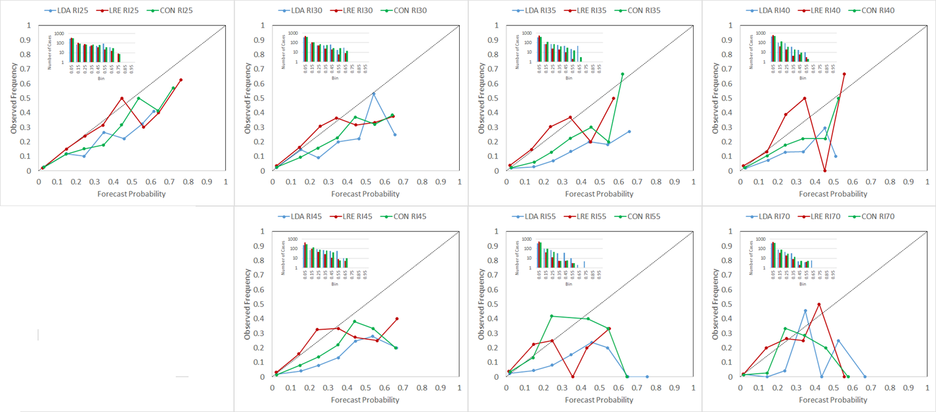
Independent Reliability
RI25
RI30
RI35
RI40
LDA
LRE
CON
RI45
RI55
RI70
Full details are described in Knaff et al. (2018)
Knaff, J. A., C. R. Sampson, and K. D. Musgrave, 2018: An Operational Rapid Intensification Prediction Aid for the Western North Pacific. Wea. Forecasting, 33(3), 799–811, doi: /10.1175/WAF-D-18-0012.1.

Slide 35
Rapid Intensity Guidance (RIPA) –BASED ON 2017 MODEL VERSIONS
Based on synoptic conditions and Infrared imagery
Produces RI guidance when conditions are favorable
Gave solid intensity guidance for RI event, especially early
Not available to NHC forecasters … yet.
Operational at JTWC, more information at:
https://www.nrlmry.navy.mil/atcf_web/docs/pdf/WAF-D-18-0012.pdf
RIPA (40%)
NHC
SHIPS RII (40%)

Slide 36
Updates and improvements (2019)
A second try… going towards the charm…

Slide 37
Engineering fixes
Initial intensity has to be at least 35 kt to trigger deterministic forecasts
Deterministic forecasts truncated at landfall
Probabilities from the various models are forced to be consistent (e.g., RI30 cannot exceed RI25)

Slide 38
Targeted changes
Data and data treatment
Summary of changes
Use developmental data from all JTWC’s basins (2000-2017)
Rectify the predictor co-linearity (Potential intensity vs. current intensity)
Fix issues that showed up in the independent verifications (IR-based predictors)
Use independent verifications from all basins to guide our development
Adding NHC’s thresholds…. 20kt/12h, 55kt/48h, 65kt/72h
-Bigger and more comprehensive dataset
-Cap current intensity at 75 knots… this answers the question of how close to eye formation is the storm?
-Removal of the infrared standard deviations at longer leads
-This concept worked, especially with the examination of infrared predictors and treatment of potential intensity (east Pacific)
-methods still work very well!

Slide 39
New models (weights)
Lda
Logistic regression

Slide 40
Constructing independent forecast
Use the operationally generated SHIPS large-scale diagnostics files
These files will produce what the forecasters would receive in operations
6-hour old GFS forecasts
Real-time track errors
Real-time position and intensity errors (CARQ)
Any other issues with operational data
Verification was conducted using these files during 2018 and 2019 through April.

Slide 41
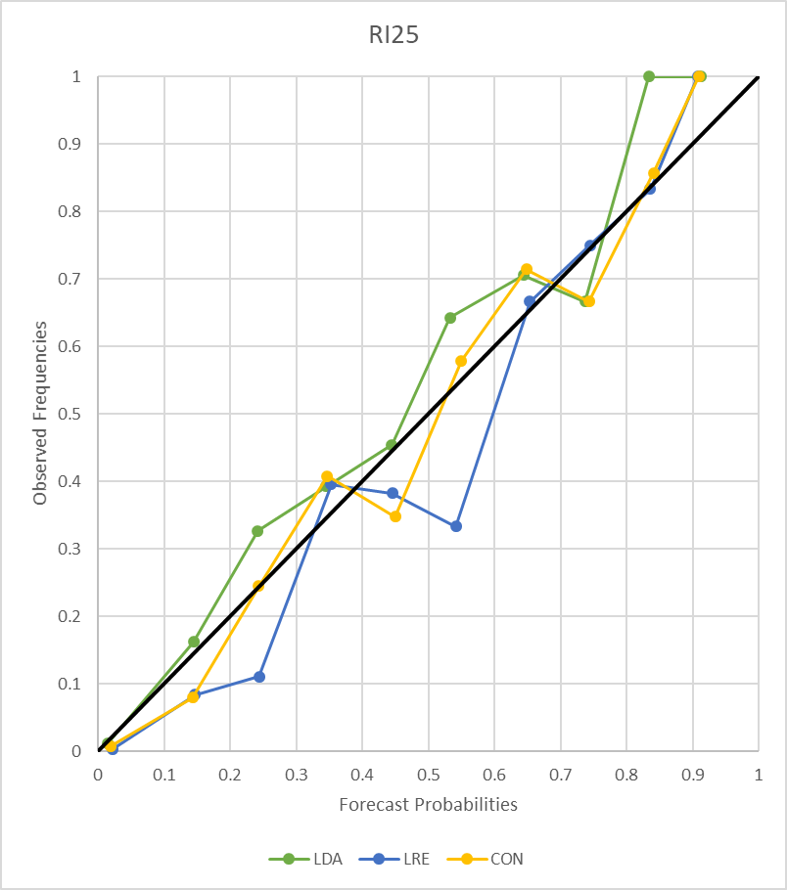
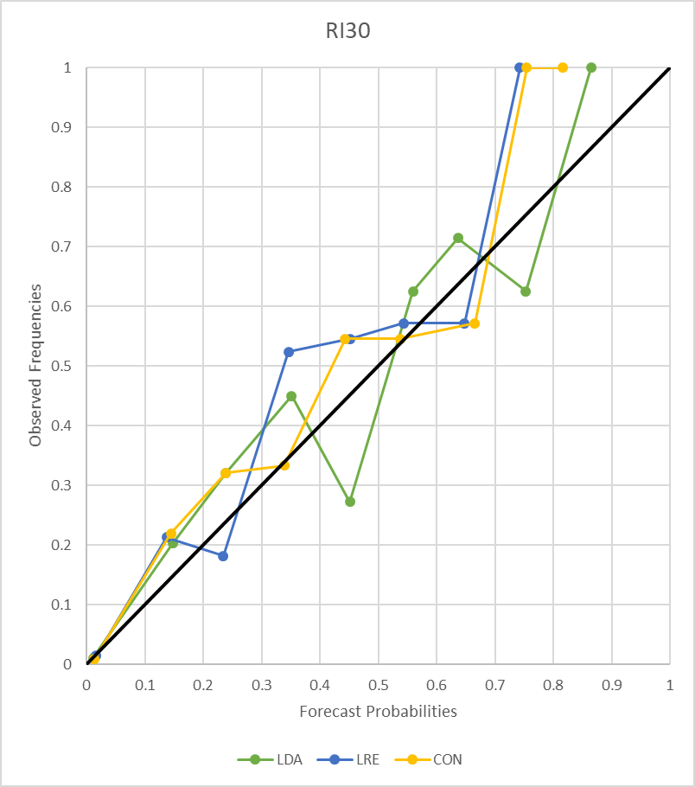
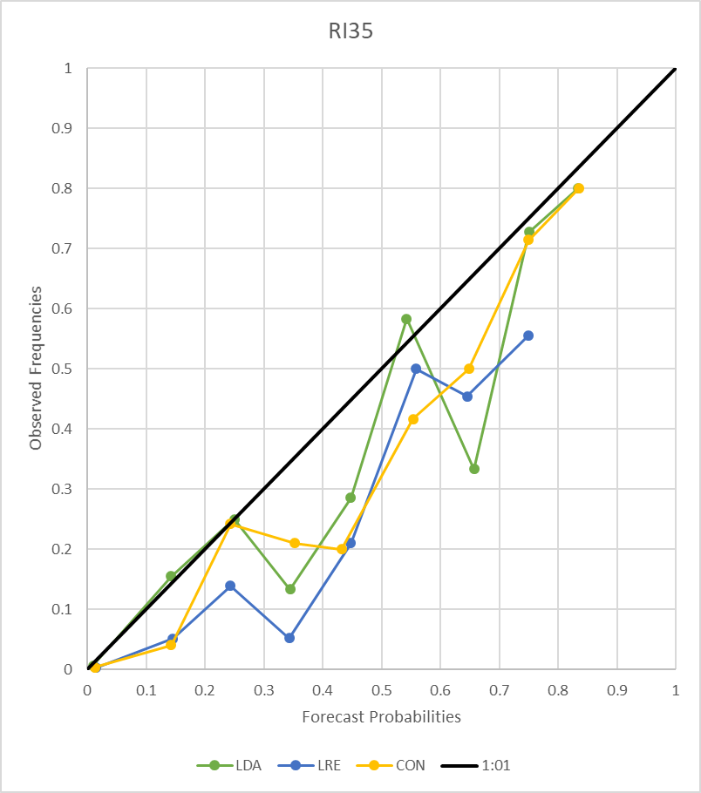
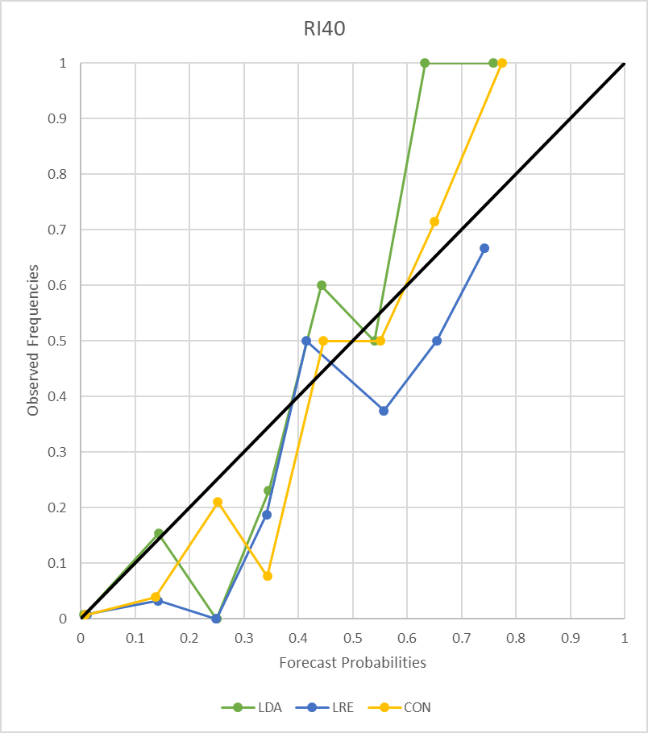
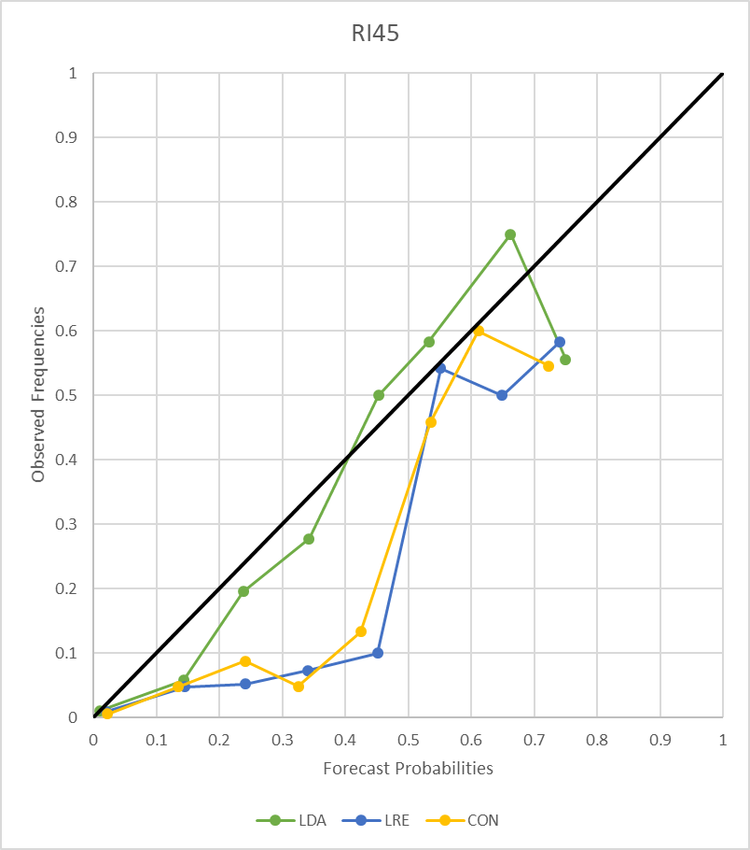
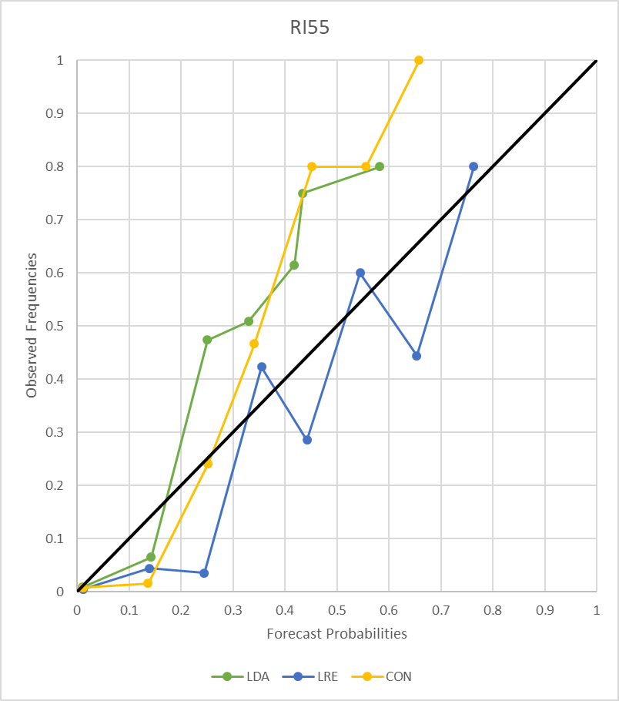
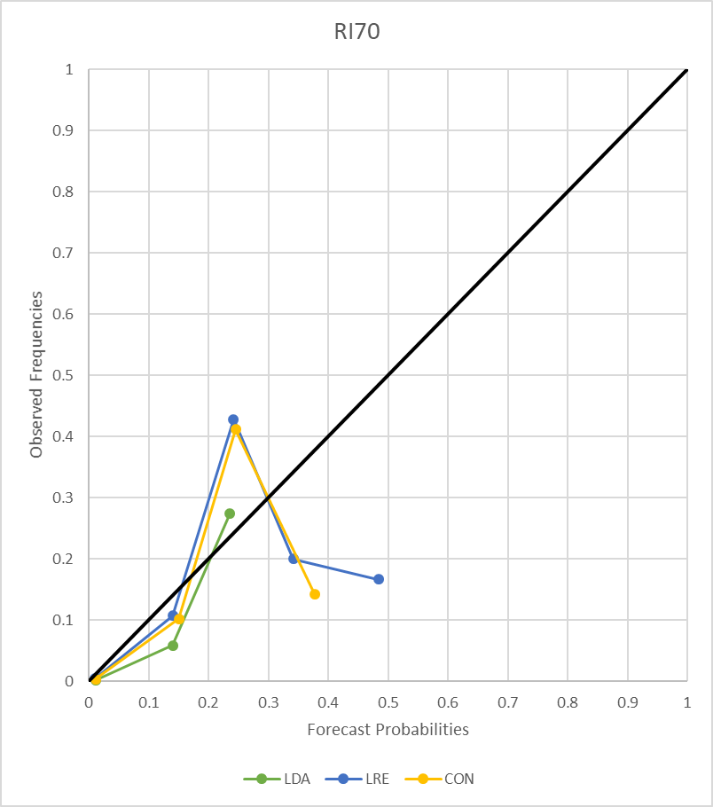
Independent Reliability (this year’s model)
RI25
RI30
RI35
RI40
LDA
LRE
CON
RI45
RI55
RI70

Slide 42
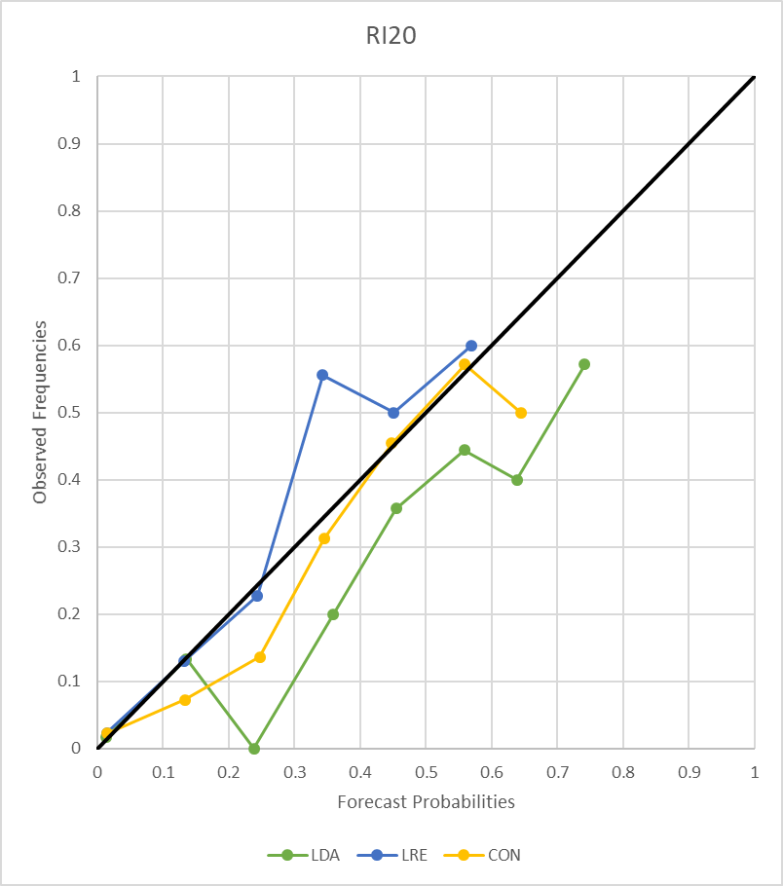
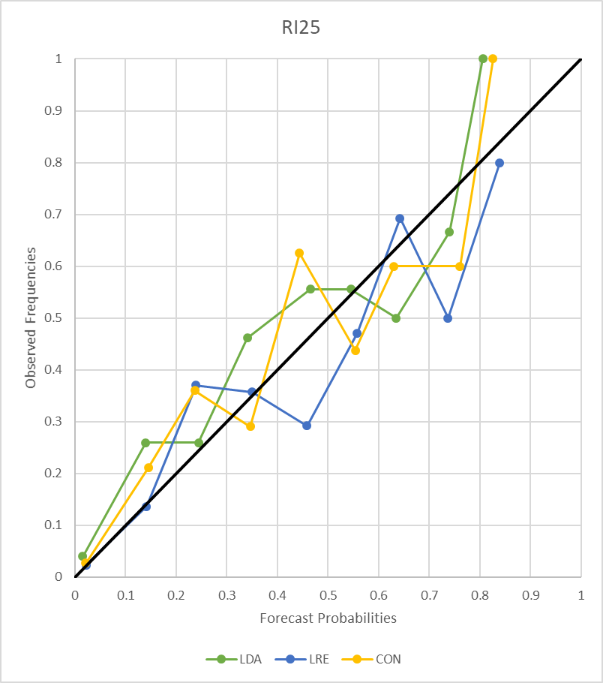
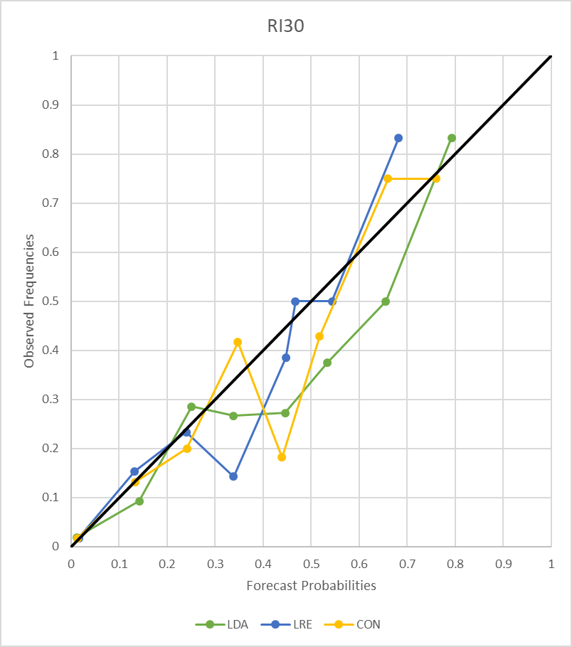
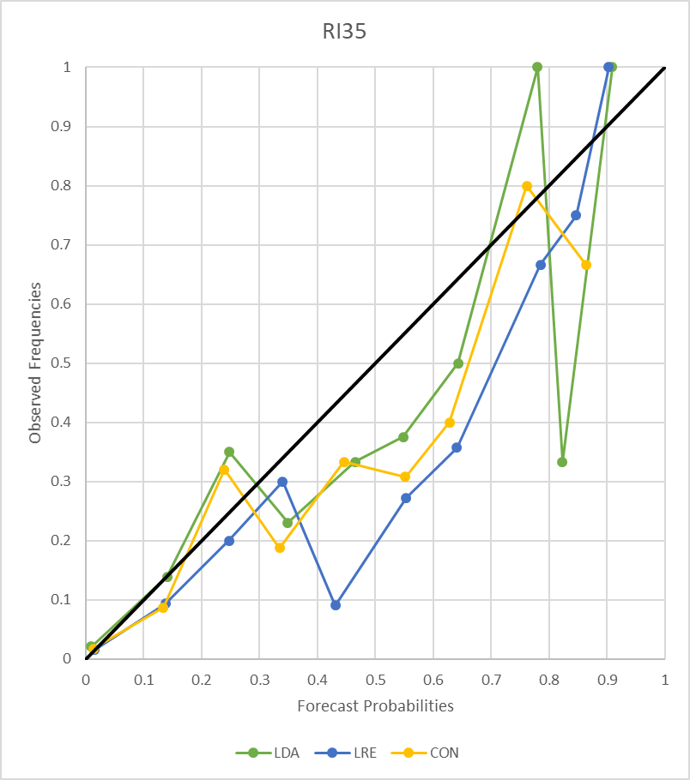
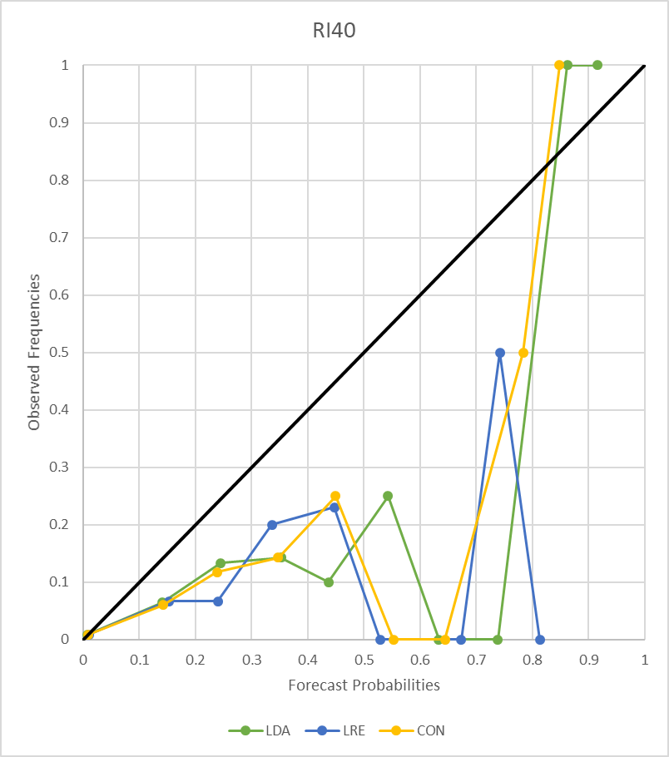
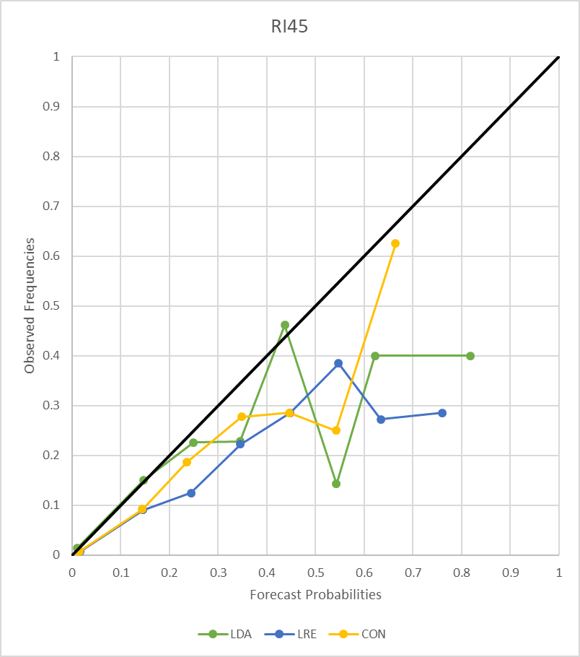
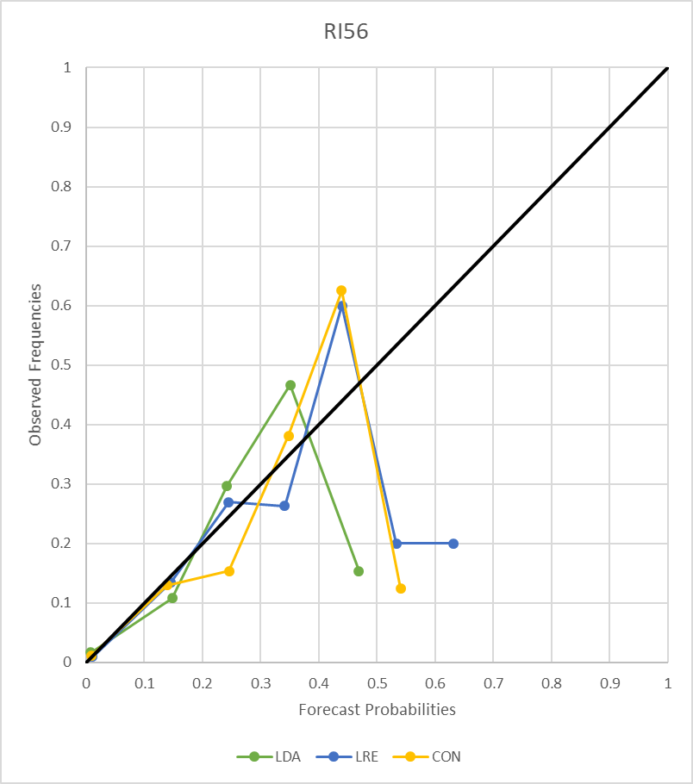
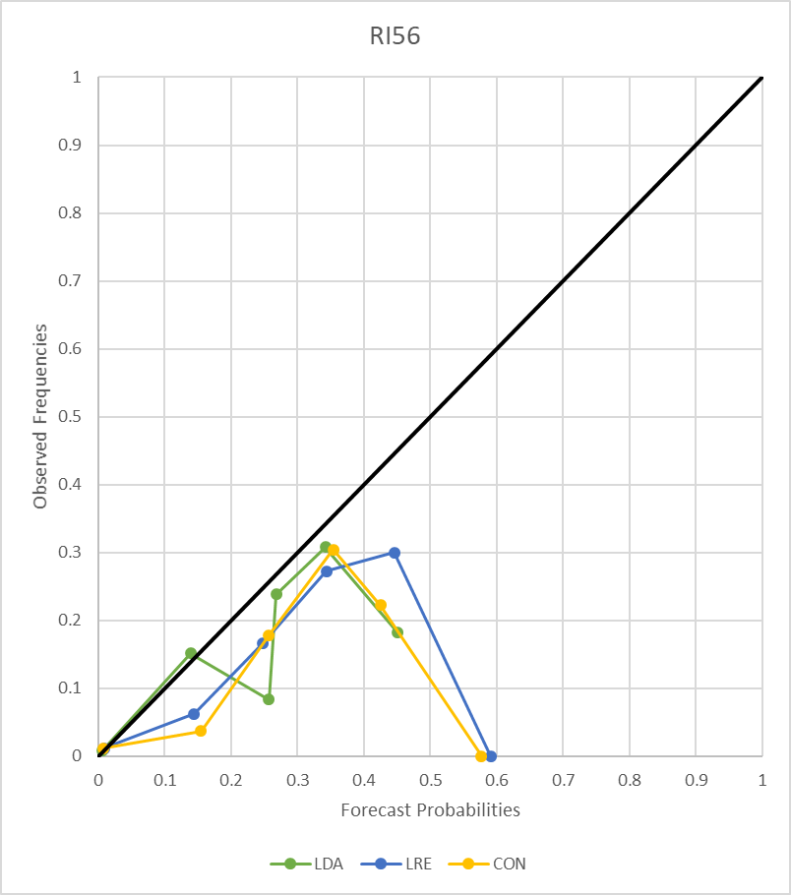
Independent Verification (Atlantic) with NHC’s thresholds
RI20
RI25
RI30
RI35
RI40
RI45
RI55
RI65
in 48 h
in 72 h

