Slide 1
User Engagement from the Cloud Product Team Developers
Andrew Heidinger, NOAA/NESDIS
Cloud Team comprised of NESDIS, CIMSS & CIRA Scientists
PGRR Summit, Feb 22-25, 2020 NCWCP

Slide 2
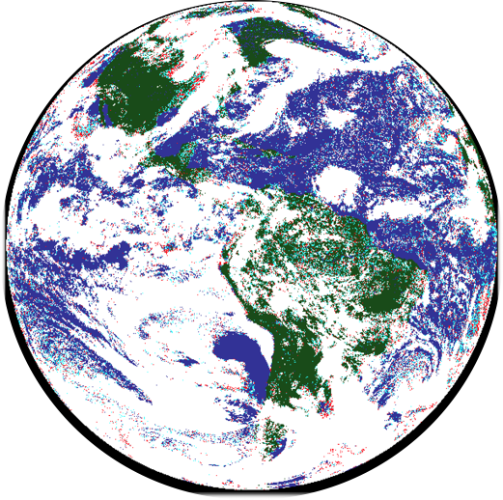
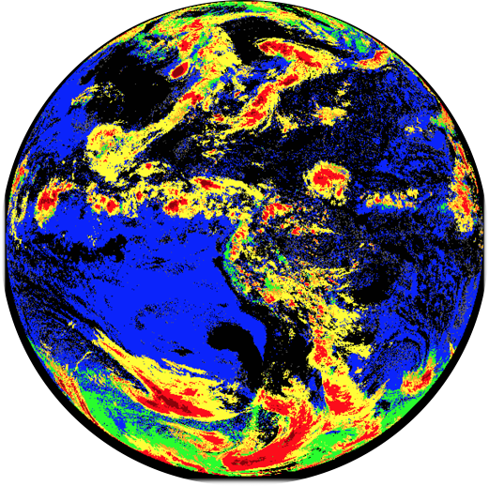
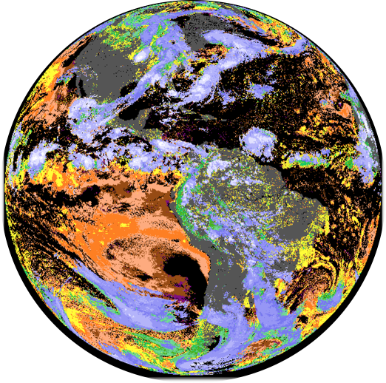
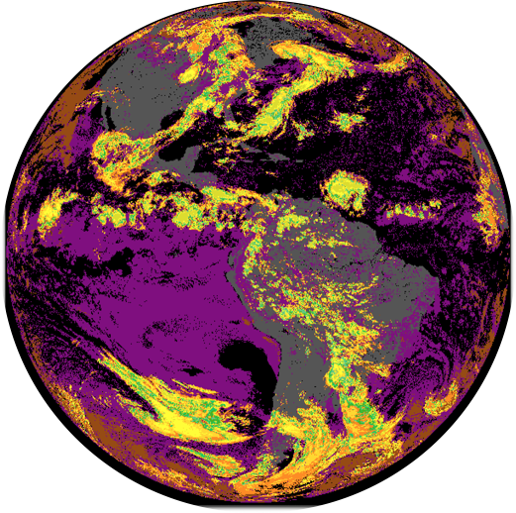
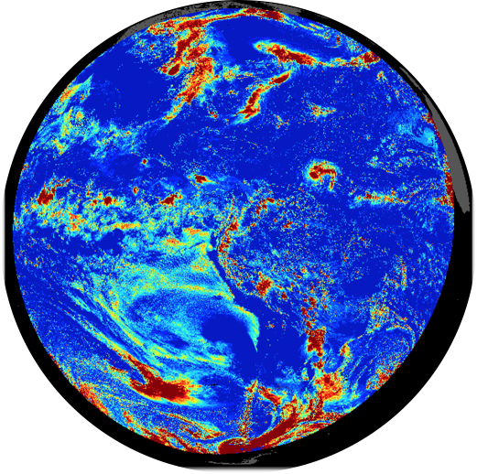
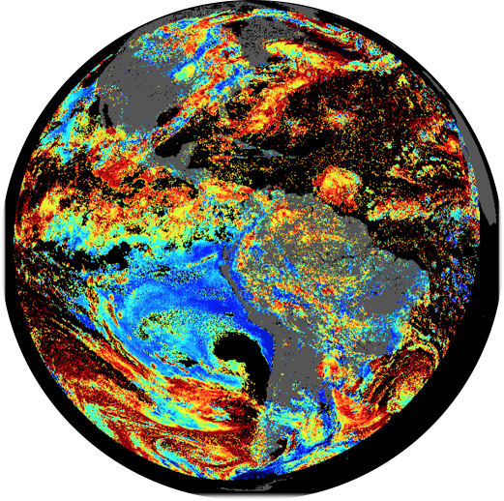
NOAA Enterprise Cloud Products.
Users
Foundational Products
NOAA Users
Internal NESDIS
Applications/Algorithms
Derived Motion Winds
NCEP/All-Sky Radiance Products
Applications
Cross-Sections
ASOS
Sky Cover
Icing
Precipitation
Cloud Presence
Mask
Type
Cloud Vertical Structure
NWP
Top-
Pressure
Non-NOAA Users
Airlines
PGRR Demos
DOE/NREL
NASA SNPP
Taiwan CWB
Geo-
Thickness
Unmet Users
ESRL/HRRR
NWS/AWC
Cloud Optical and Microphysical Properties
Optical Depth
Particle Size

Slide 3
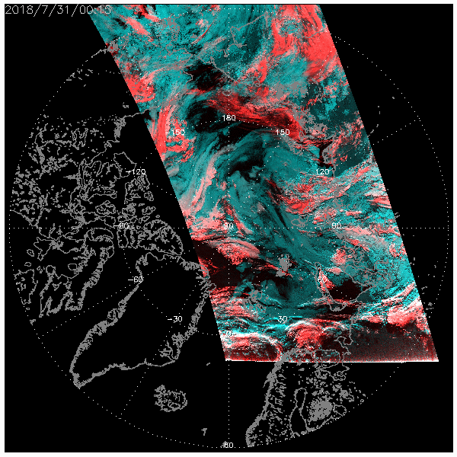
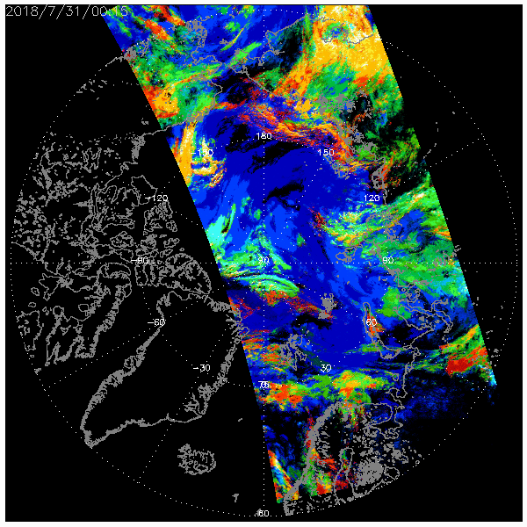
JPSS/VIIRS Example of Cloud Vertical Structure (CVS) Over Arctic
1.38 and 1.6 micron RGB (ice=red,water=blue, clear = black)
RGB made from CVS. (blue = low only, red=high only)
Acknowledge: Jeff Weinrich, Carl Dierking and Jay Cable for the Alaskan Cloud Demo

Slide 4
NESDIS Cloud Product Status (NESDIS/CIMSS/CIRA)
JPSS
NOAA Enterprise Versions 2.1 is operational
Cloud Mask LUT just updated to resolved a snow detection issue
GOES-R LWP versions will be implemented soon.
GOES-R
GOES-R Baseline still operational on GOES-16 and GOES-17
NOAA Enterprise Version modified to handle GOES-17 LHP delivered and moving through ASSISTT into GOES-R GS. Implementation into DE ~March 2020
POES, GOES
Older versions of NOAA Enterprise
EPS-SG
We are starting to evolve NOAA Enterprise for MetImage
Future
Multiple Enterprise algorithms are already employing Machine Learning and more advanced techniques are being explored.
Fusing Sounders and Imagers
Pushing GOES-R/VIIRS clouds to highest spatial resolution possible.
Cloud products are part of AWS Cloud Pilot.

Slide 5
Developmental Path Example (Cloud Mask)
We support:
AVHRR, MODIS, VIIRS, Fy3DI
ABI,AHI,GOES-I/P,MSG,MTSAT,COMS, Fy4A
Source and ground system agnostic
POES/GOES Operational
2000
GOES-R Baseline
2006
NOAA Enterprise
Machine Learning
NOAA Enterprise
Deeper Machine Learning
our goal has always been to stay as close as we can to state of the art while remaining fast enough for real-time generation
2011
NOAA Enterprise
Arti. Intell (AI)
2020
Roughly new version every 5 years but development is continual and driven by user feedback
2020+

Slide 6
Cloud Product User Examples That Fall Outside This Panel

Slide 7
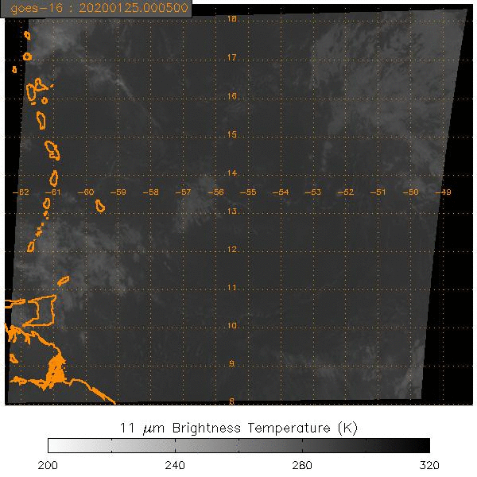
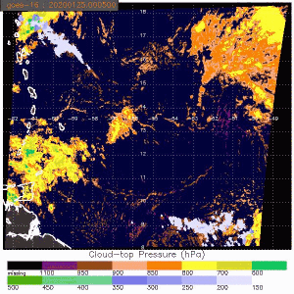
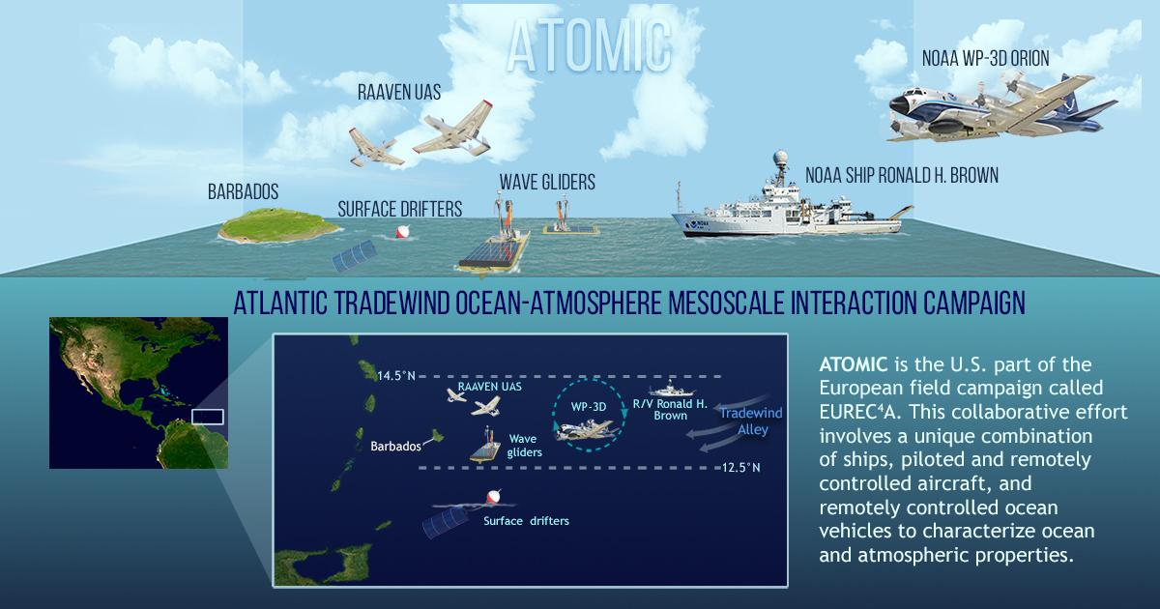
Field Campaign Support
The Cloud Team participates regularly in provided satellite cloud products to Field Campaigns.
We just finished supporting the NOAA/OAR ATOMIC mission centered over Barbados.
We benefit for exposing researchers to our latest algorithms.
We need to run these ourselves to provide highest resolution.
Support for this comes from leveraging the AWG and JPSS projects.

Slide 8
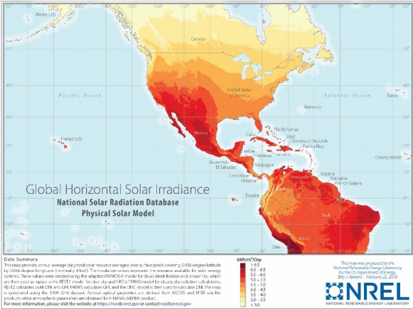
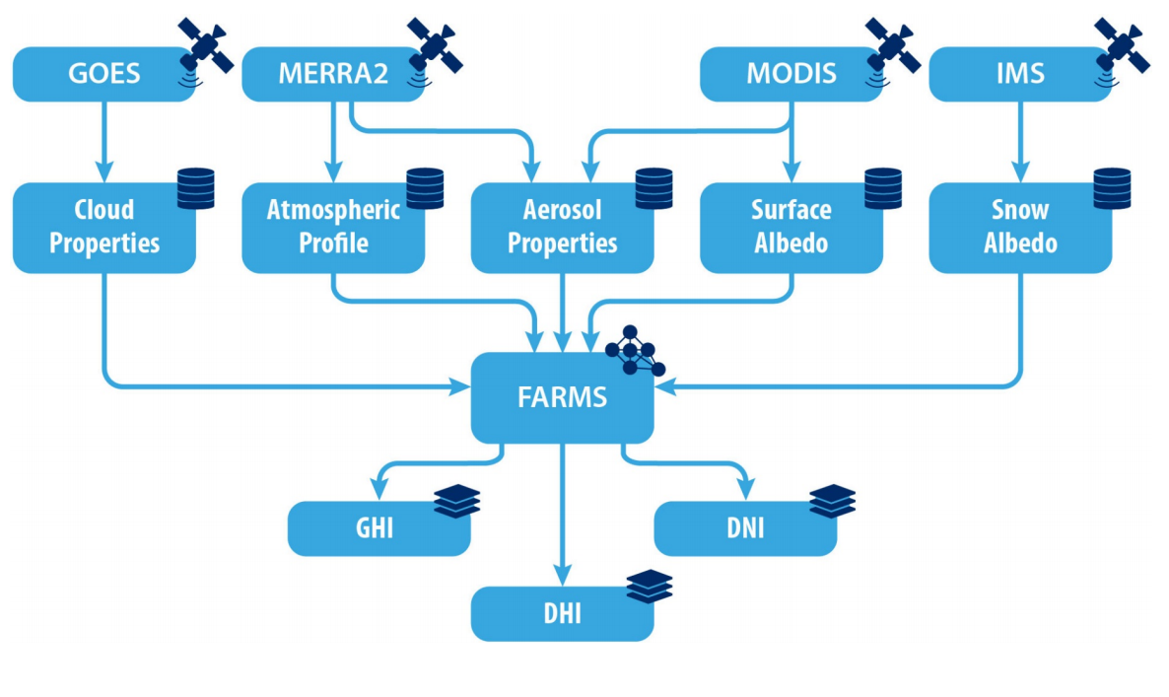
User Example: National Solar Radiation Database
DOE/NREL uses GOES-16/17 Cloud Optical Properties as an input to their National Solar Radiation Database.
NSRDB has 60,000 users per year. GOES-R GS Cloud Optical Depth is too coarse spatially (4km FD).
Should we migrate them to GOESR-GS? Is it ok to serve data like this long-term? More than PGRR.
NOAA Enterprise Algorithms/
in CLAVR-x

Slide 9
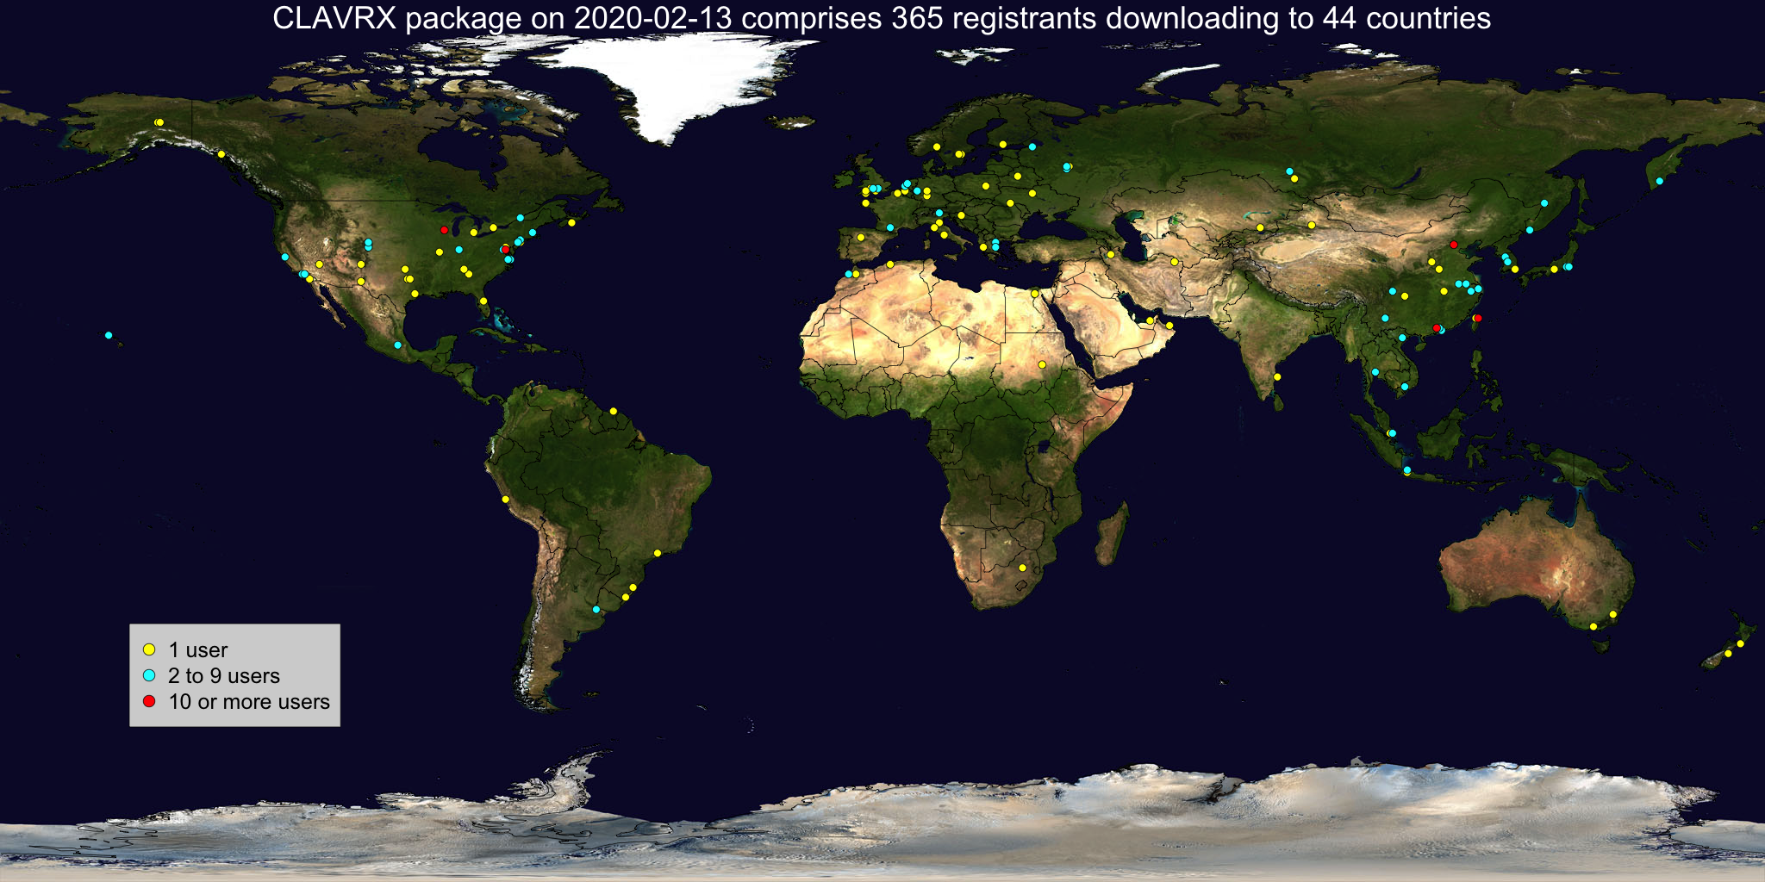
Direct Broadcast Users
GOES-R and JPSS Support for Direct Broadcast has been successful in getting NOAA Cloud Algorithms into a global and diverse community.
Developers receive no specific support for this.
We have benefited from these interactions - no formal or funded interactions.
Example of a Russian Modification of NOAA Enterprise Cloud Properties using CSPP/LEO. (Met. Cloud Types)

Slide 10
Conclusions
Cloud team makes many foundational products and several applications.
We have many users outside of NOAA including the research community.
We place a large priority on our impact on Winds and the All-Sky Radiance Products since the impact NWP.
We very much want to build on this with use of cloud properties by users such as ESRL and the Aviation Weather Center.

Slide 11
Thank you

Slide 12
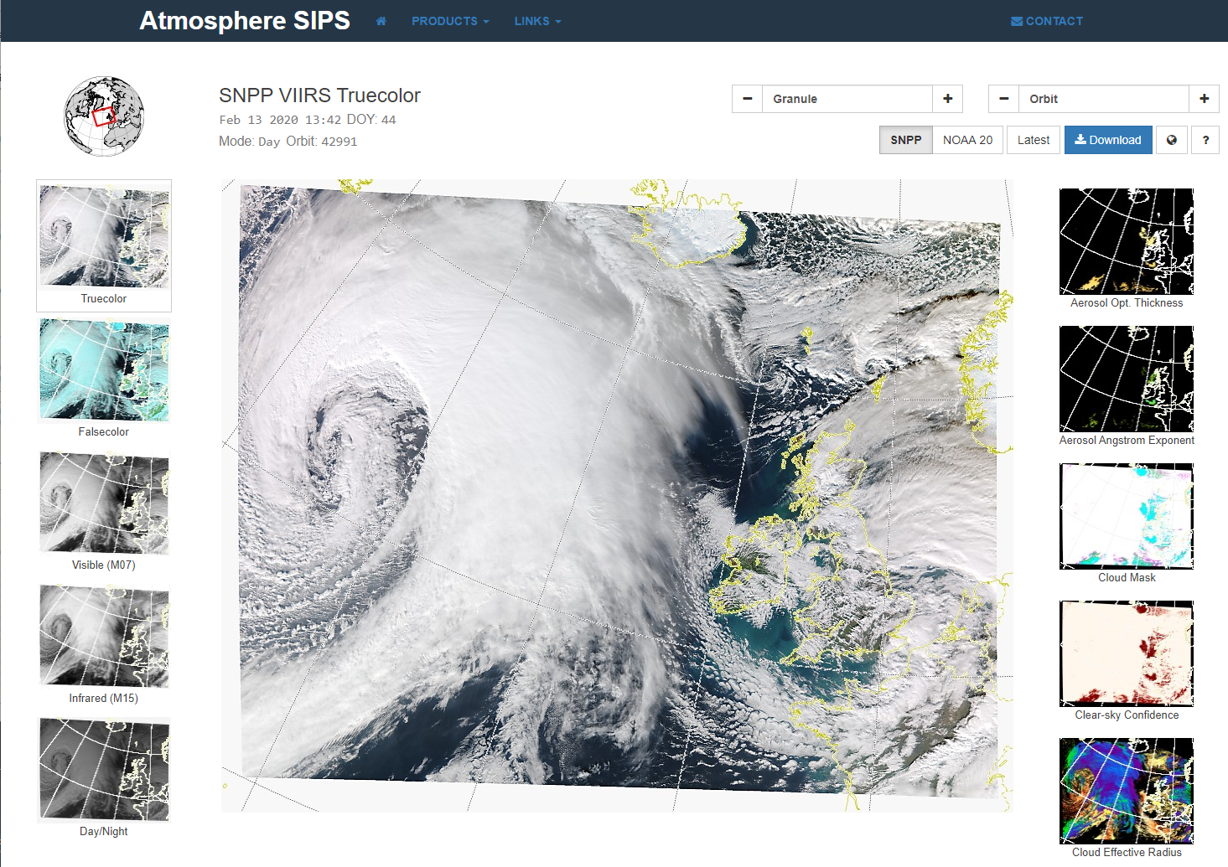
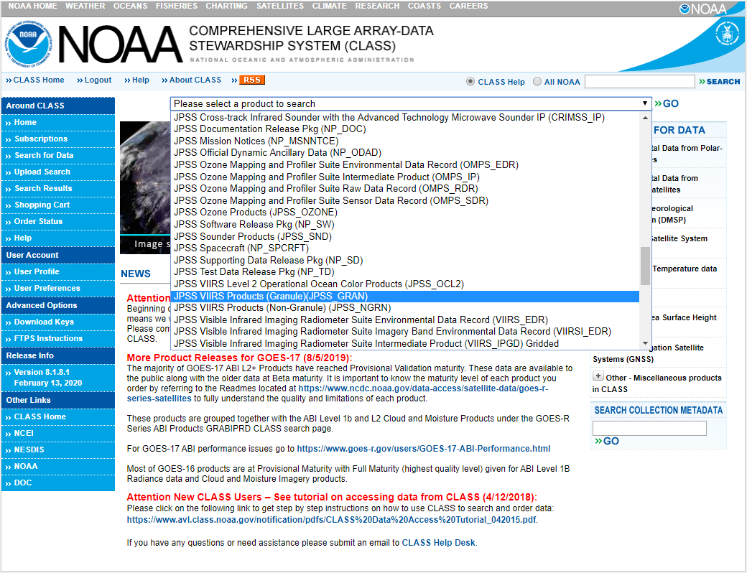
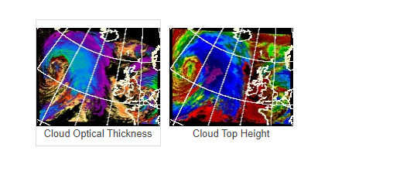
User Interfaces (NOAA versus NASA)
There is benefit to having an easy and appealing interface to the public.
NASA invests a lot of funds for this and benefits from increased public usage.
NOAA should consider a new front-end to CLASS that is more appealing and straightforward.
JPSS products (JPSS_Gran) are #80 out of 112 in the drop-down menu.
NASA interface allows viewing of imagery and products and direct download.

Slide 13
WMO CGMS High Level Priority Plan (HLPP 2019 - 2023)
High Level Priority Tasks
4.3 - Foster the continuous improvement of products through validation and inter-comparison through international working groups and SCOPE-type mechanisms.
Continuous improvement of products is achieved via the ICWG inter-comparisons.
SCOPE-CM is set up to facilitate international activities to generate Climate Data Records.
NOAA is under-represented in this community.
SEP 14 Meeting (7-8 February 2019) [Most recent meeting]
SCOPE-CM #10 - AMV and CSR/ASR
Partners include NOAA/CIMSS
Project lead is JMA, but never contacted NOAA or CIMSS for input.

Slide 14
Cloud Climate Users
In terms of numbers, the climate community is very large.
NOAA Enterprise Cloud Algorithms have two climate activities
The Pathfinder Atmospheres Extended (PATMOS-x) on AVHRR (40+ years).
The NASA SNPP MODIS/VIIRS Continuity Project uses the NOAA Enterprise Cloud Height Suite of Products.
NASA is also developing climate-centric products for the advanced Geostationary Imagers.
What is the NOAA role? We can’t compete with their reprocessing infrastructure.
The International Satellite Cloud Climatology Project (ISCCP) is being reimagined on the new advanced geostationary imagers. This will bring together research and space agencies.
I expect Reanalysis and Climate Users will gravitate to this for clouds and maybe aerosol climate products.

Slide 15
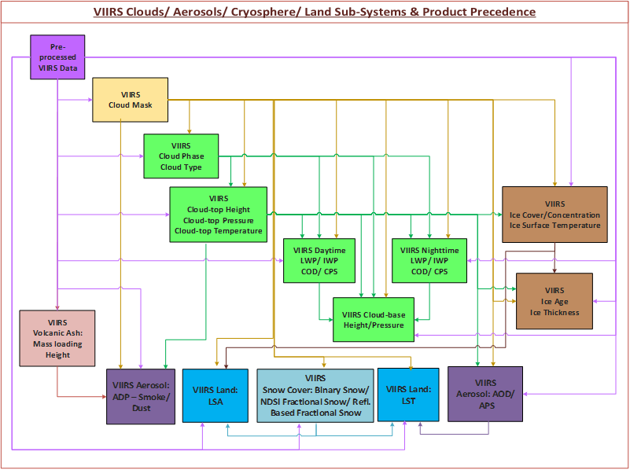
Cloud Algorithm Dependency
“The first algorithms in the chain”
Users of VIIRS Cloud Products outside of processing system
NCEP (ECM)
VIIRS Polar Winds (ACHA)
USAF (ECM, indirectly via snow cover)
GINA/NWS (ACHA, CCL)
Field Campaigns
Any downstream users of algorithms dependent on the cloud products

