Slide 1
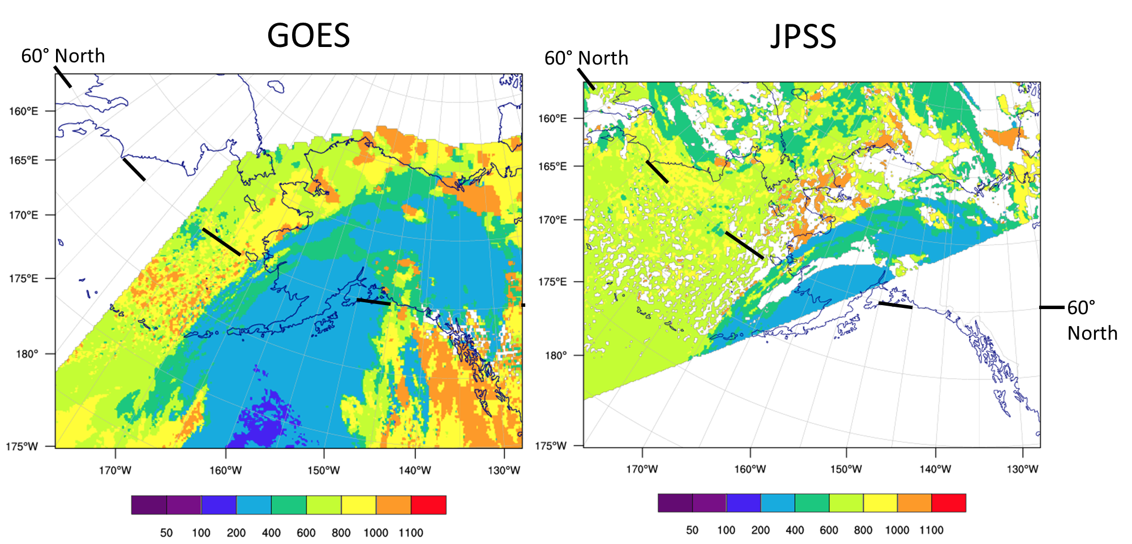
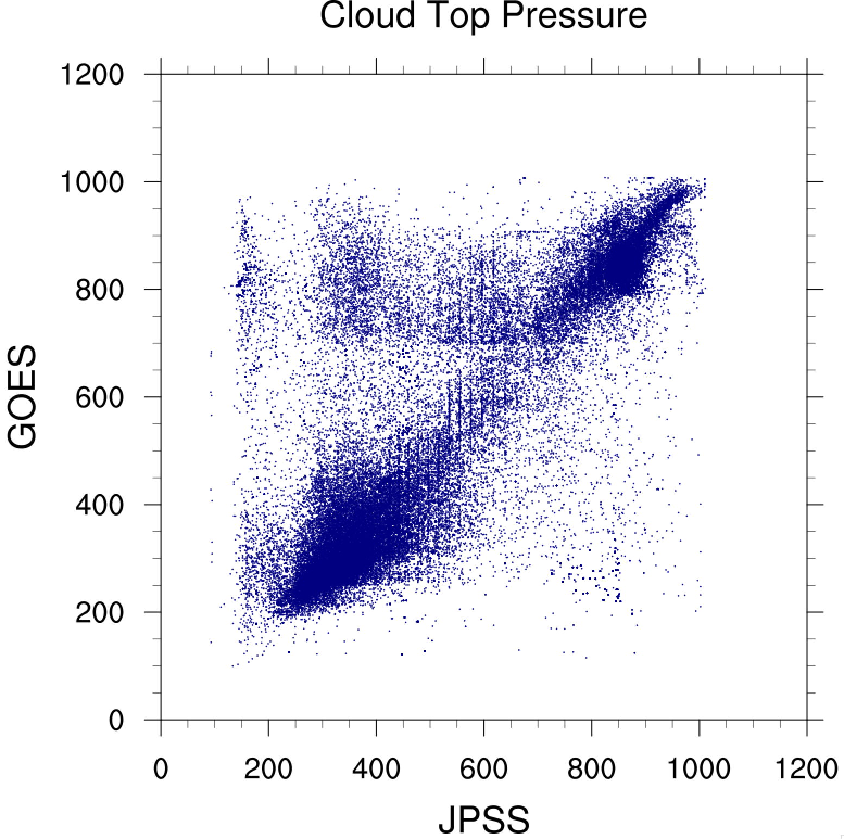
Assimilation of satellite clouds and winds in rapidly updating regional models
GOES
Cloud-top pressures
JPSS
Cloud analysis products for RAP/HRRR
GOES cloud-top pres/temp
(from NESDIS and Langley)
METAR ceilometers, RVR (fog building)
Polar orbiter cloud products (for RRFS)
Related surface assimilation products
VIIRS Green Vegetation Fractions
IMS snow cover product
Comparison GOES vs. JPSS
Cloud-top Pressures
Impact from adding GOES-16 AMVs*
(CNTL=all conv. obs. w/ other AMVs)
from Hongli Wang
High
w/ G16 AMVs
CNTL
200
400
600
800
1000
Products based on time evolution
Atmospheric Motion Vectors
Cloud-top cooling rate
GOES pressure
Low
1000 800 600 400 200
RAP/HRRR cloud analysis group members:
Terra Ladwig, Stan Benjamin, Eric James
JPSS pressure
Steve Weygandt, NOAA/ESRL – Amanda Back, NOAA/ESRL, CIRA

Slide 2
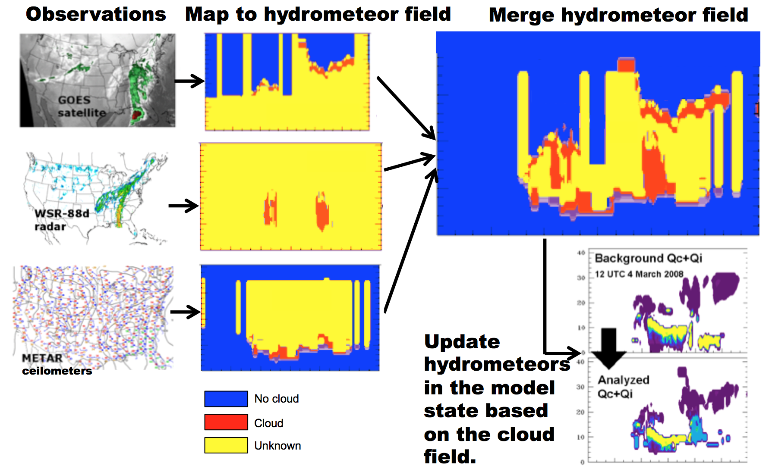
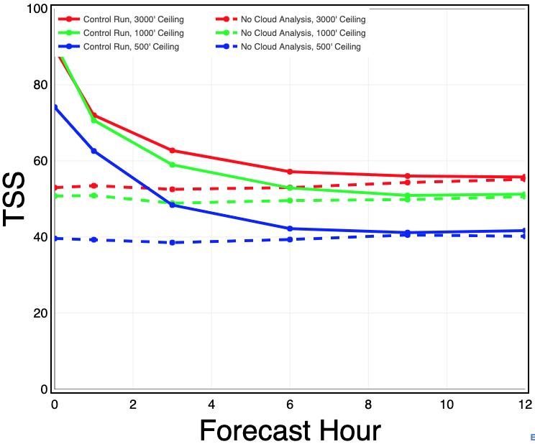
Assimilation of satellite clouds and winds in rapidly updating regional models
Cloud building / clearing using satellite products
Current RAP / HRRR / 3D-RTMA* uses
non-variational cloud “specification” method
to modify cycled cloud hydrometeors
🡺 Work to extend RAP/HRRR cloud analysis
to variational / ensemble framework (T. Ladwig)
Significant positive impact for short-range
cloud forecasts (ceiling and visibility)
🡪 Key for aviation applications, including HRRR-AK
Sub-grid cloud faction included for RAPv5/HRRRv4
🡪 Work to project cloud DA onto cloud fraction
* real-time
experimental
Benjamin et al. 2020
Skill for HRRR forecast ceiling
SUMMER (15-25 Jul 2018)
3000’ ceiling
1000’ ceiling
500’ ceiling
with cloud DA
- - - - without cloud DA

Slide 3
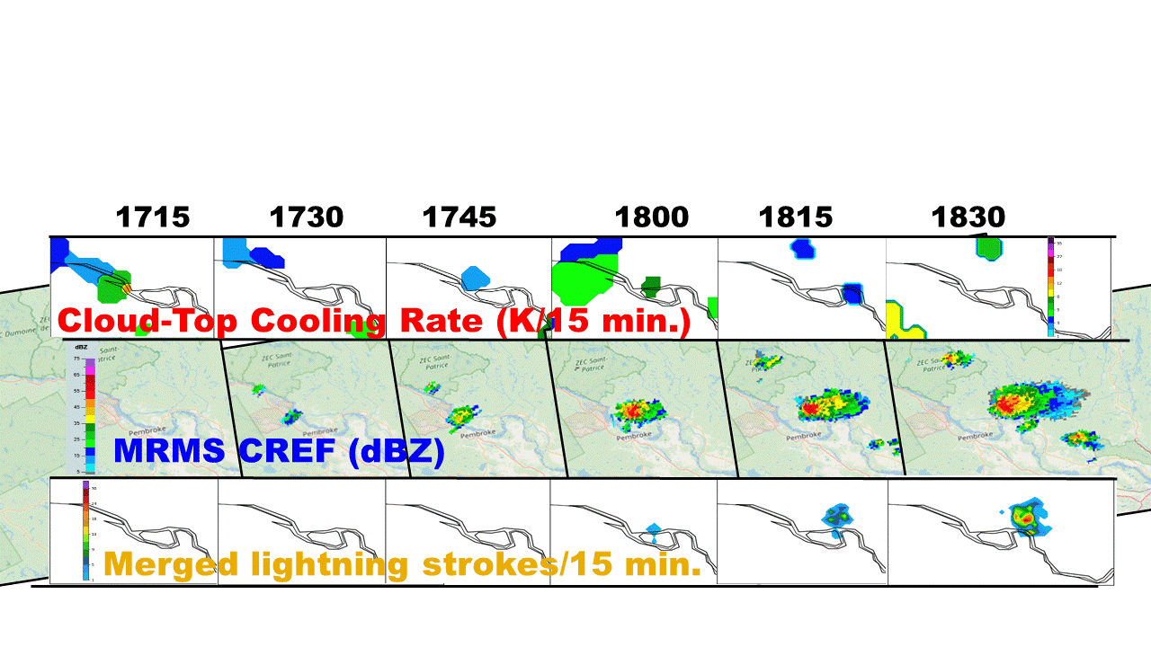
Assimilation of satellite clouds and winds in rapidly updating regional models
Avg. HOURLY RAP/HRRR AMV obs counts
1596 GOES-15 IR long-wave cloud (245) 3076 GOES-16 IR long-wave cloud (245)
872 GOES-15 deep layer cloud top (246)
1308 GOES-16 deep layer cloud top (246)
586 GOES-15 deep layer wat vap (247)
667 GOES-16 deep layer wat vap (247)
1600 EUMETSAT total (243+253)
1503 JMA total (242+250+252+254)
AMVs and Cloud-top Cooling Rates
GOES-16 AMVs being assimilated into RAPv5/HRRRv4
(large total # of AMVS 🡪 important hourly obs source)
Cloud-top cooling rate data (CTCR) complements
reflectivity and merged lightning data for capturing
convective initiation part of storm evolution
Comparison of different convection indicators including
11208 Average Total AMV obs. per hour
Assimilating CTCR during pre-forecast hour crucial for ability of 18z init HRRR to capture storm initiation
18z init + 3h fcst
Valid
21z
CTCR for
17-18z
1900
2000
21z MRMS obs
from Amanda Back

Slide 4
Assimilation of satellite clouds and winds in rapidly updating regional models
Science / Tech for Clouds
Variational / ensemble cloud DA
Using cloud depth information
Cloud DA: balance / retention
Building multiple cloud layers
Merging GOES/JPSS products,
using cloud products for radiance DA
Science / Tech for AMVs
Cloud height assignments
QC and quality flags
Further impact evaluation
(AMV category / level,
regional vs. global,
land vs. ocean)
Evolving / future needs for satellite clouds &
AMVs
Flight Category | Ceiling threshold (feet) | Visibility threshold (miles)
LIFR | < 500 | < 1
IFR | 500 - 1000 | 1 - 3
MVFR | 1000 - 3000 | 3 - 5
VFR | > 3000 | > 5
Accurate cloud analysis
is crucial for improving
ceiling and visibility
forecast skill, which is very important for aviation weather
Use of time evolution
Further testing of cloud-top
cooling rate assimilation
Consider assimilation of storm-top divergence, other information from time series of images

