Slide 1
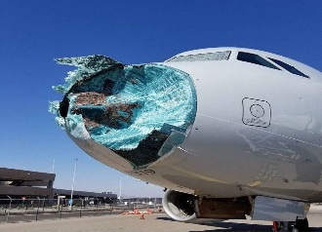
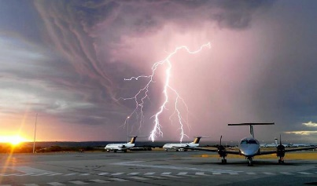
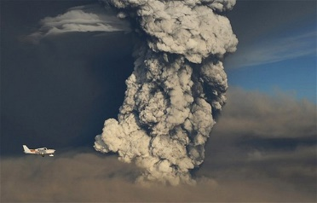
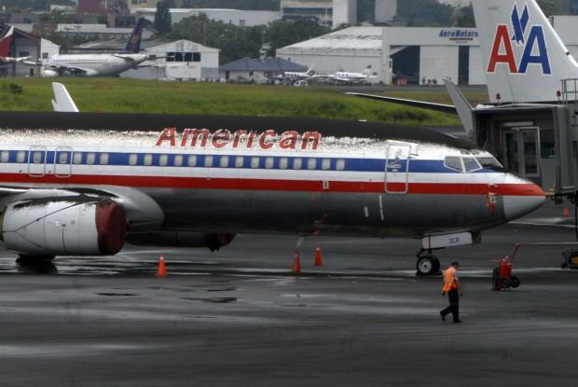
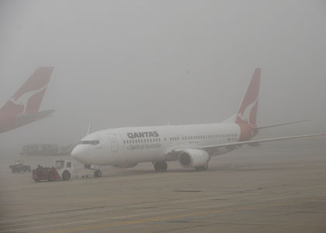
Product and Application Development in Support of Aviation
Aviation Herald
Will Mallinson
Michael Pavolonis (NOAA/NESDIS)
UW-CIMSS: Corey Calvert, John Cintineo, Dave Hyman, and Justin Sieglaff
NOAA/OAR: Alice Crawford, Allison Ring, and Barbara Stunder
Notes:
-Mostly AI type capabilities
-Major themes: data fusion, task automation in response to data overload, application development instead of traditional products
-FLS: product summary, GOES-16 R2O, GOES-17 R2O, potential future work (1 slide)
-Convection: ProbSevere R2O, current deep learning applications, potential future work (1 slide)
-VOLCAT: changing ICAO requirements, VOLCAT highlights (pre-eruptive/co-eruptive situational awareness: thermal time series, timely detection: alerts and event dashboard, quantifying volcanic cloud hazards: automated tracking and characterization, forecasting volcanic clouds) (3 slides)

Slide 2
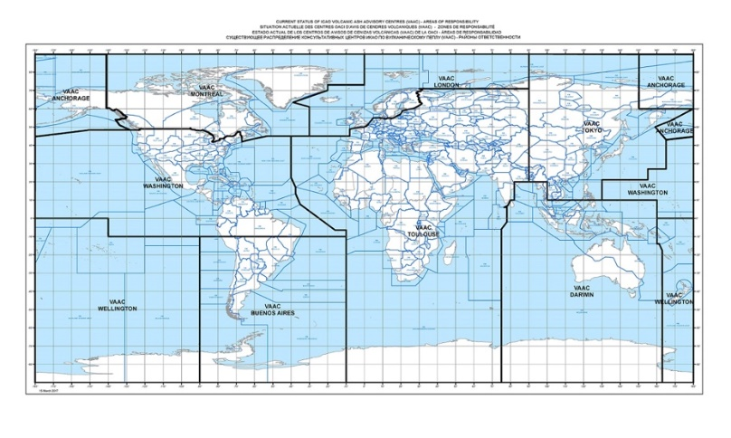
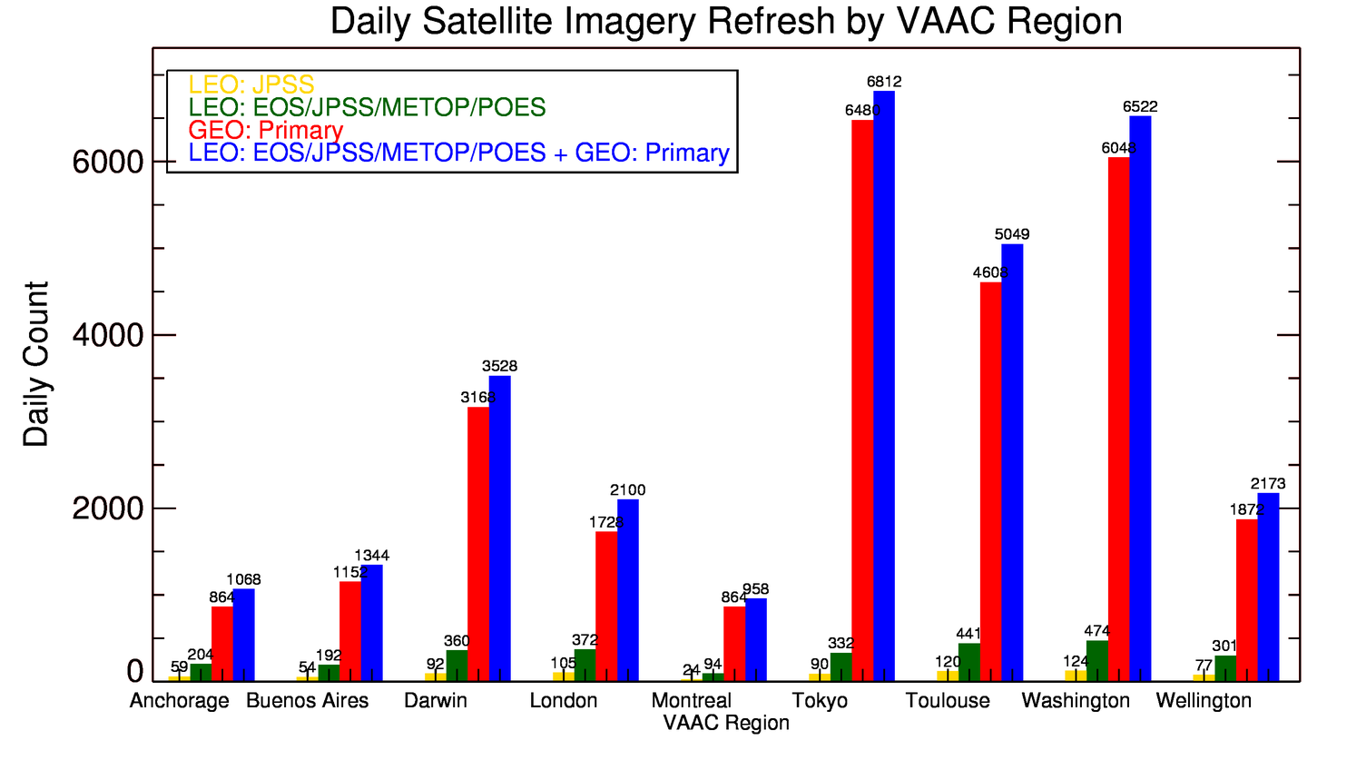
Volcanic Clouds
Minimum human work load (@W-VAAC) for “complete” monitoring: 1 satellite image every 15 seconds
Overarching Challenges:
Data overload
Changing ICAO requirements
Overarching Challenges:
Data overload
Changing ICAO requirements
Minimum human work load (@A-VAAC) for “complete” monitoring: 1 satellite image every 1 minute

Slide 3
VOLCAT event dashboard – automatically captures new volcanic events in NRT
Notes:
-Introduce VOLCAT
-automatically extracts the small subset of satellite images pertinent to volcano monitoring

Slide 4
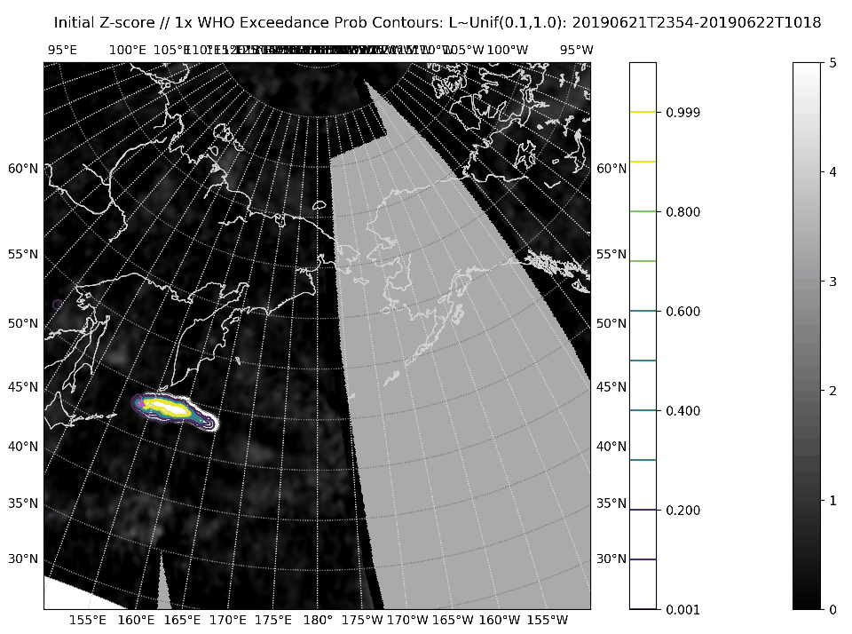
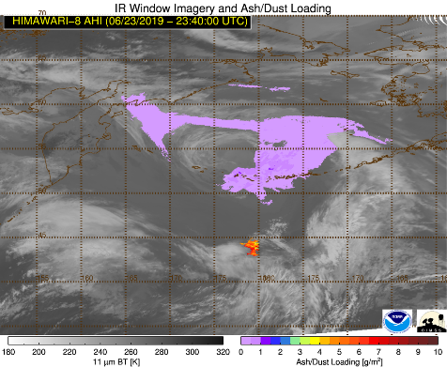
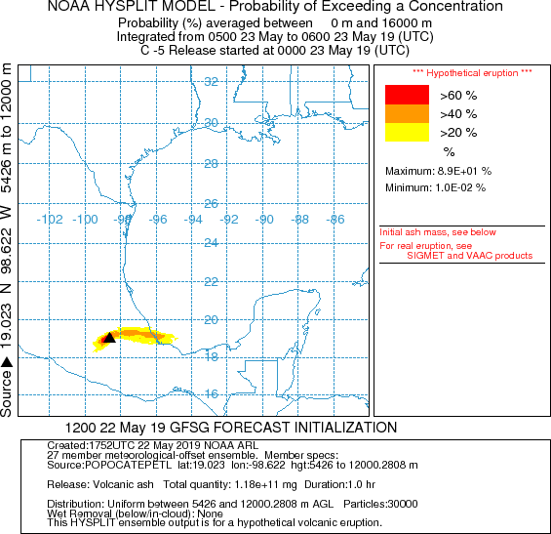
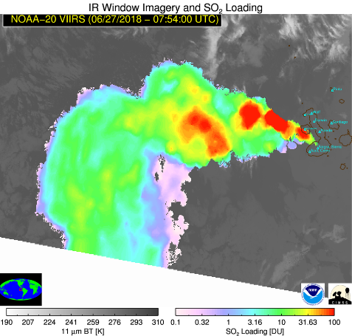
Volcanic Clouds
Overarching Challenges:
Data overload
Changing ICAO requirements
Overarching Challenges:
Data overload
Changing ICAO requirements → quantitative ash forecasts; SO₂ health hazard
P(SO₂ > World Health Organization Threshold)
Satellite Info
HYSPLIT - Forecasts
Notes:
Ongoing/future

Slide 5
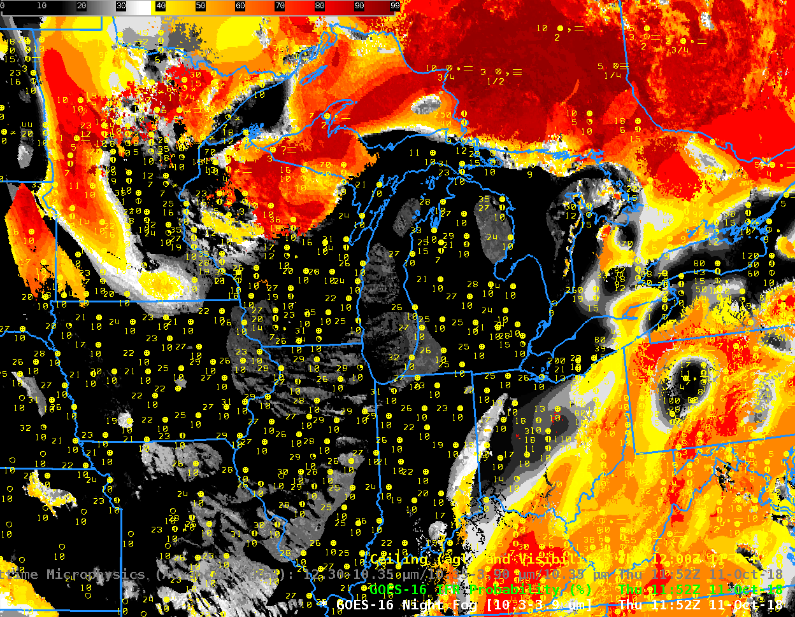
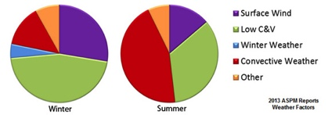
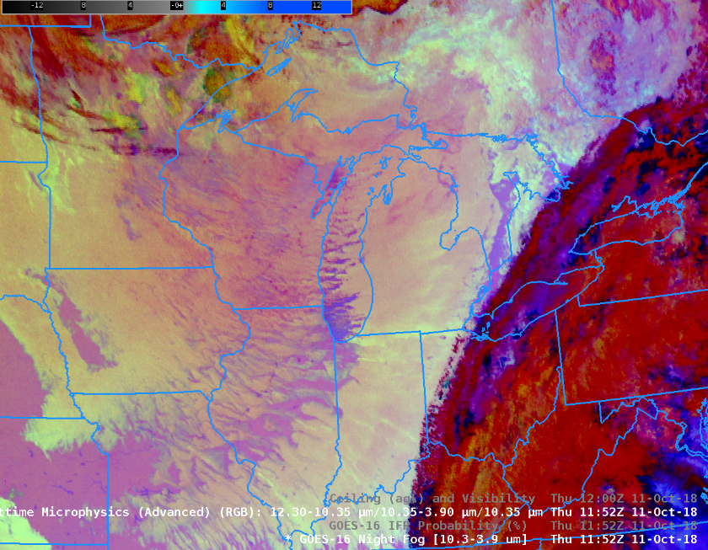
Low Ceiling and Visibility
Low C&V
Low C&V
Current value: more efficient air traffic management
Future possibilities: AI-based super res and fog/low stratus nowcasting tools for improved resiliency to ceiling/visibility related disruptions
Notes:
-R2O schedule
-Worth mentioning ceiling and visibility as it is one of the most common weather related causes of delays
-FLS products: added value over imagery alone
Now: management of air traffic (everyday tool for AWC and NAM at FAA Air Traffic Control System Command Center); also usage at WFOs
Future: AI for super res and fog formation/dissipation nowcasting (challenging problem for dynamical models)

Slide 6
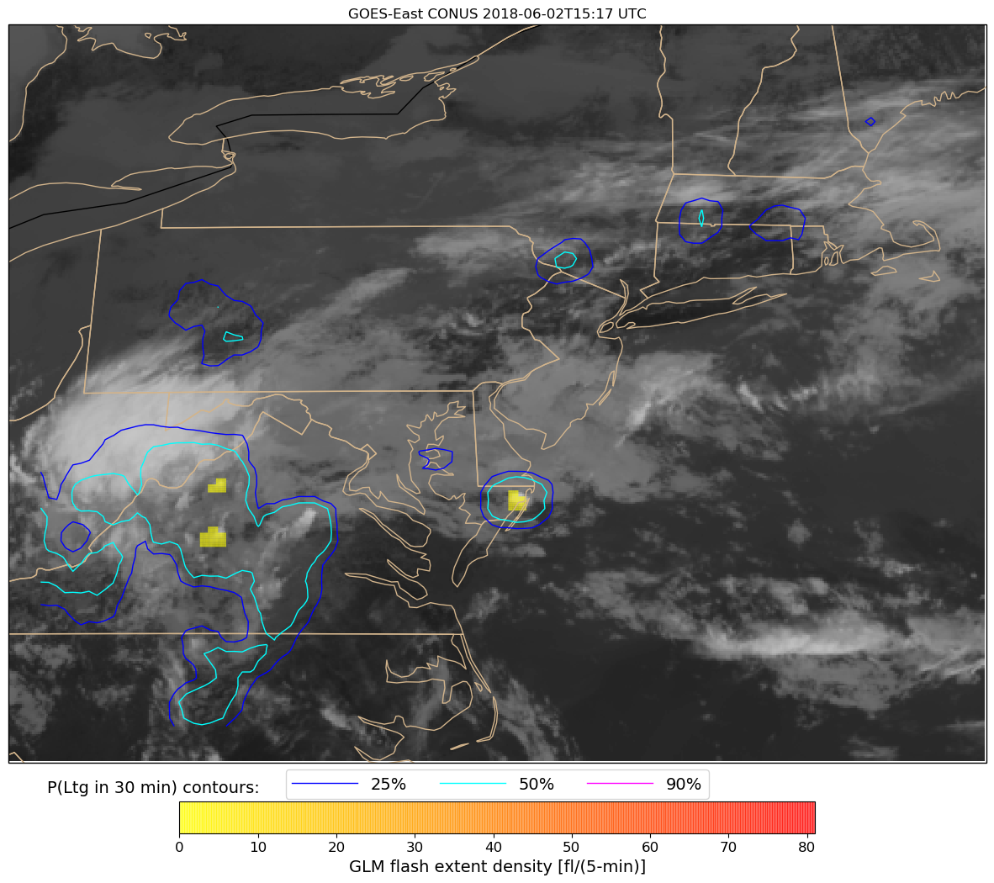
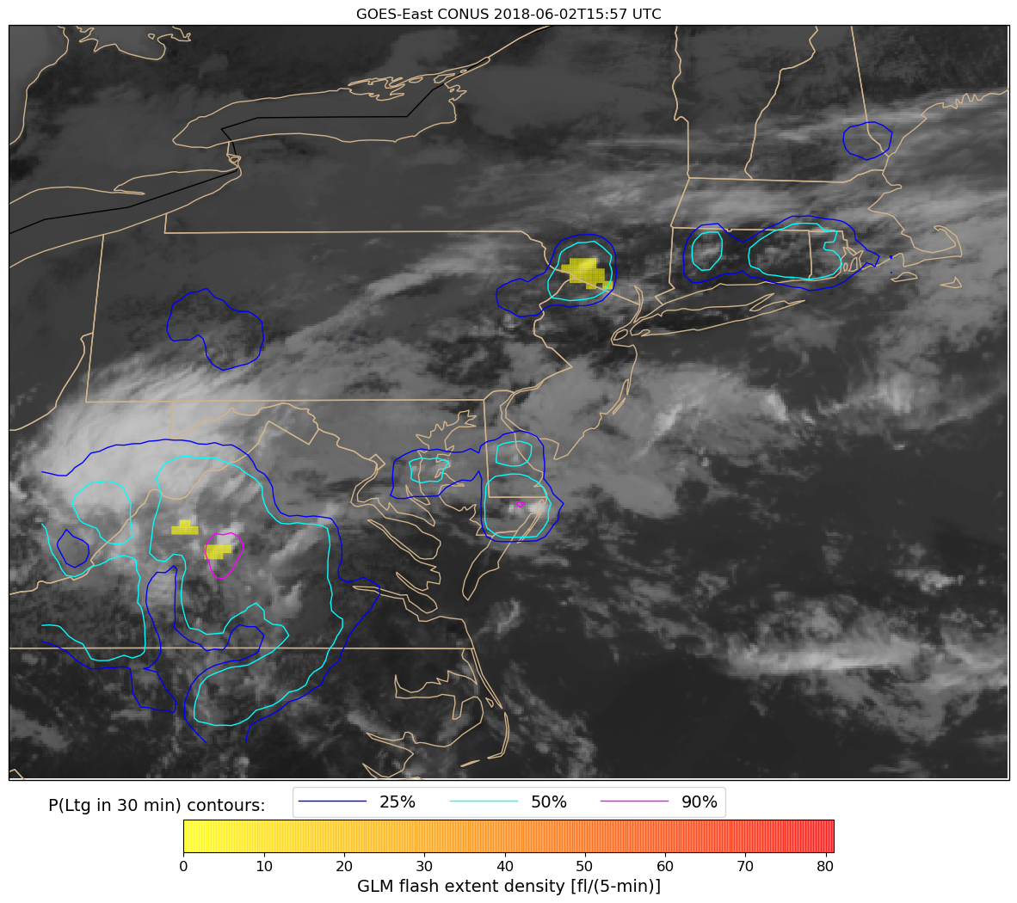
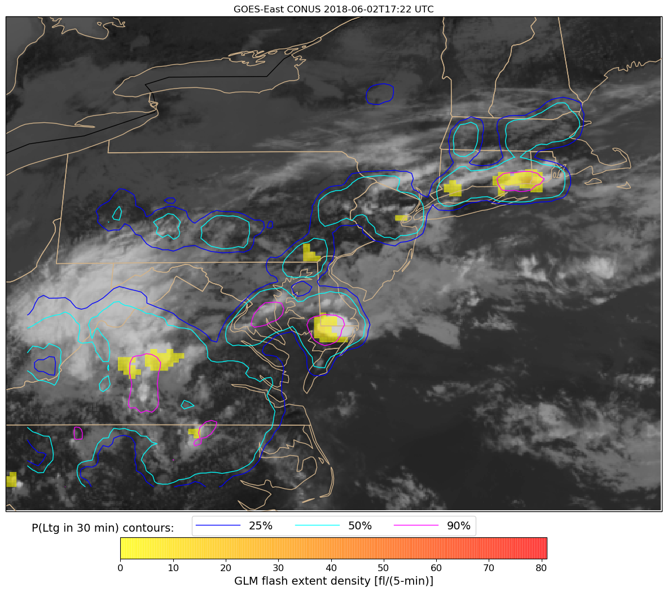
Convection Nowcasting – ProbSevere AI Tools
Probability of Lightning (10-60 min nowcast)
15:17 UTC
Enhanced probability of lightning initiation upstream of NYC @ 15:17 UTC
15:57 UTC
Lightning initiation (40 min later)
17:22 UTC
Lightning observed in NYC region @ 17:22 UTC
Notes:
-Convection is another major disruptor
-ICP, which will be integrated into ProbSevere, can be used over OCONUS as well (good for aviation)

Slide 7
Aviation: Overarching Emerging Needs
Data Overload and Information Demand
Aviation Trends
International Air Transport Association: near doubling of passengers to 8.2 billion by 2037
Increased need for efficiency (environmental and business model sustainability)
Notes:
-The number of earth observations generated by operational meteorological satellites each day, now exceeds 1 trillion which is about 6.5 times greater than it was less than 5 years ago

