Slide 1
Satellite Products for Aviation Remote Sensing Needs in the High Latitudes
JPSS/GOES-R PG/RR Summit
Carl Dierking
UAF/GINA

Slide 2
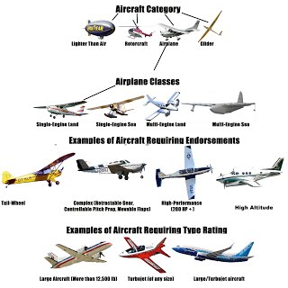
Beyond METARs
Needs vary with equipment:
Commercial vs Private
IFR vs VFR
Floats, skis, wheels, helipads, etc.
Common Data expectations:
Extremely timely and highly detailed
Life threatening impacts
Observations preferred
Information enroute not always available.
Notes:
I work for the Geographic Information Network of AK… which is a DB data provider, but in my role as a satellite liaison I have a feel for how this type of data is meeting the needs of the aviation community, so I’ll try my best to represent their interest.
First of all… In terms of aviation guidance, there are some common themes, and disparate ones…
Extremely timely and highly detailed
Life threatening impacts
Affinity for observations
Information enroute often missing
Needs vary with equipment:
Commercial vs Private
IFR vs VFR
Floats, skis, wheels, helipads, etc.

Slide 3
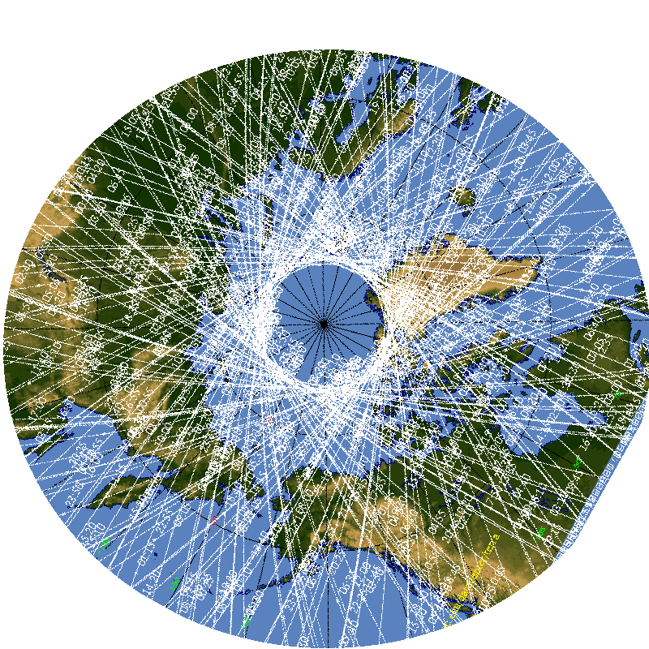
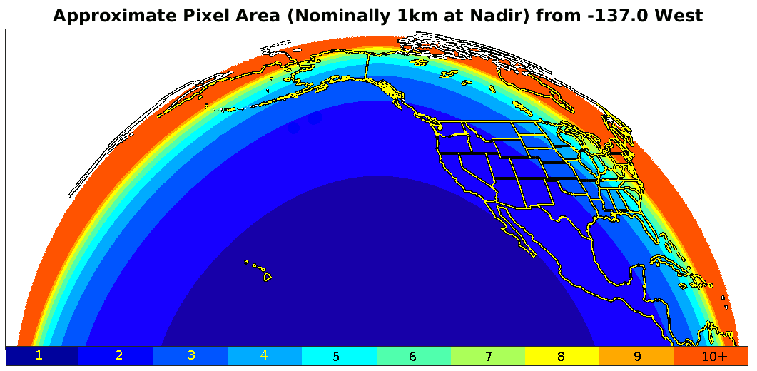
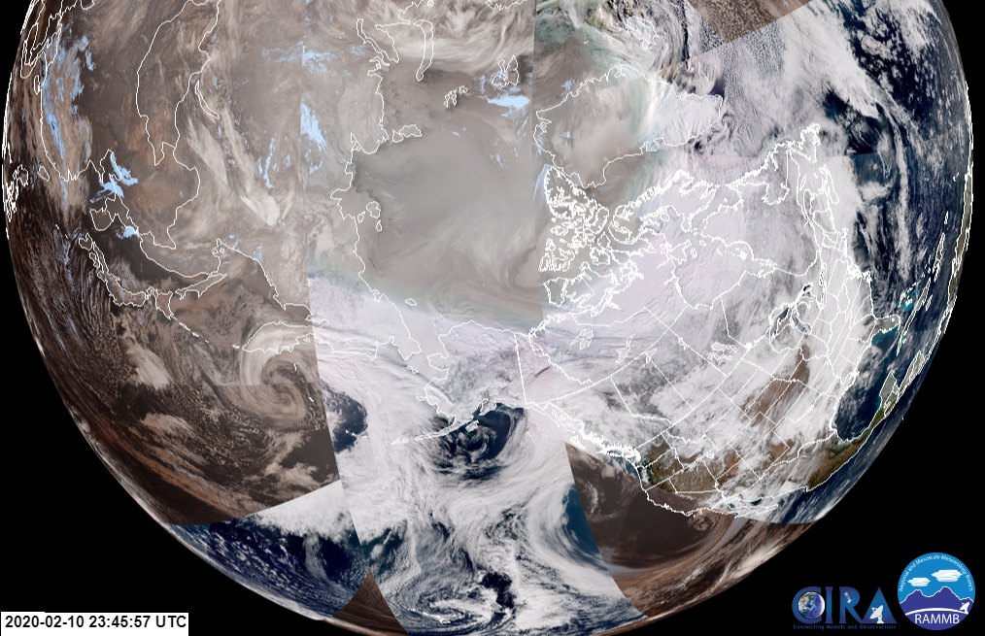
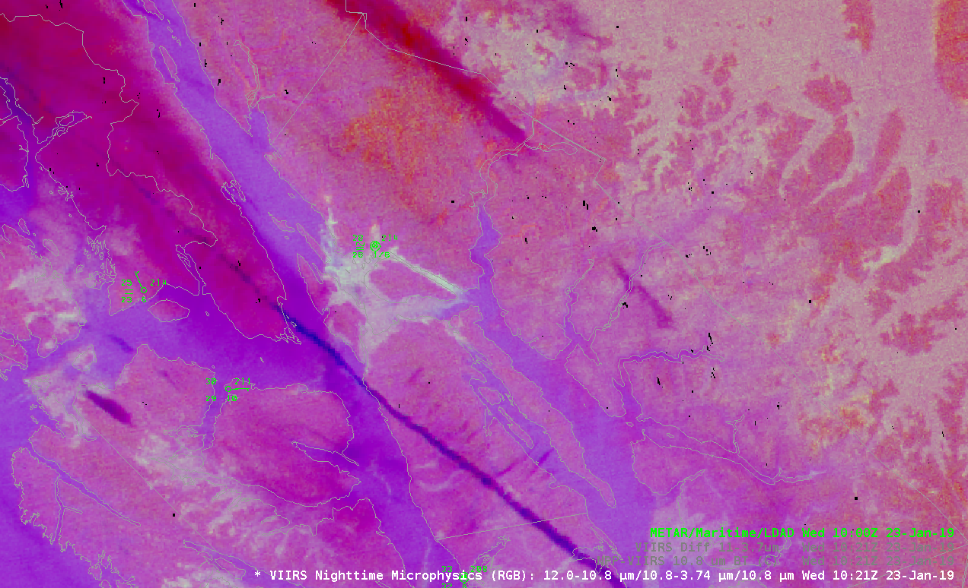
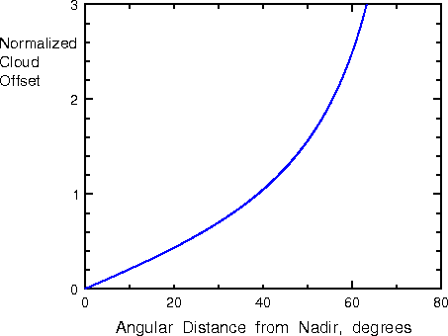
Northern Latitudes need LEO and GEO
GEO – Pacific Circulations/Systems
Good resolution in mid latitudes
Exponential parallax displacement
High frequency updates
One satellite for hemisphere
LEO - Polar Circulations/Systems
Very high resolution (375m – 1km)
Minimal parallax
Frequent updates near poles (~ hourly)
Multiple polar-orbiting satellites
Notes:
Coming from AK, I’m naturally inclined to talk about the high latitudes, but some of theseH issues are not so unique.
The use of satellite data in the far north that requires a dual perspective, both GEO and LEO. As these images from CIRA’s slider app show, systems moving north from the Pacific are well handled with GEO, while Arctic circulations are best handled with LEO. Aviation weather analysis and forecasting requires extremely timely and highly detailed information. For the most part, in the mid-latitudes the GOES-R generation of geostationary meets that objective,
however resolution degradation and parallax displacement increases exponentially near the limb. As a result northern latitudes have to utilize both GEO & LEO. GEO for system propagation and evolution…
and LEO for detail.
Fortunately LEO satellite orbital paths frequently cross the poles and there are an increasing number of LEO satellites to exploit. Although not as frequent as GEO, LEO coverage north of the Arctic circle is at least hourly most of the day. One difficulty with this multi-platform approach is calibrating or normalizing all the different LEO sensors, while GEO is primarily one instrument. So high latitudes have this split perspective from the GEO view to the LEO view. Algorithms or products that can blend the best of both perspectives would be very desirable.

Slide 4
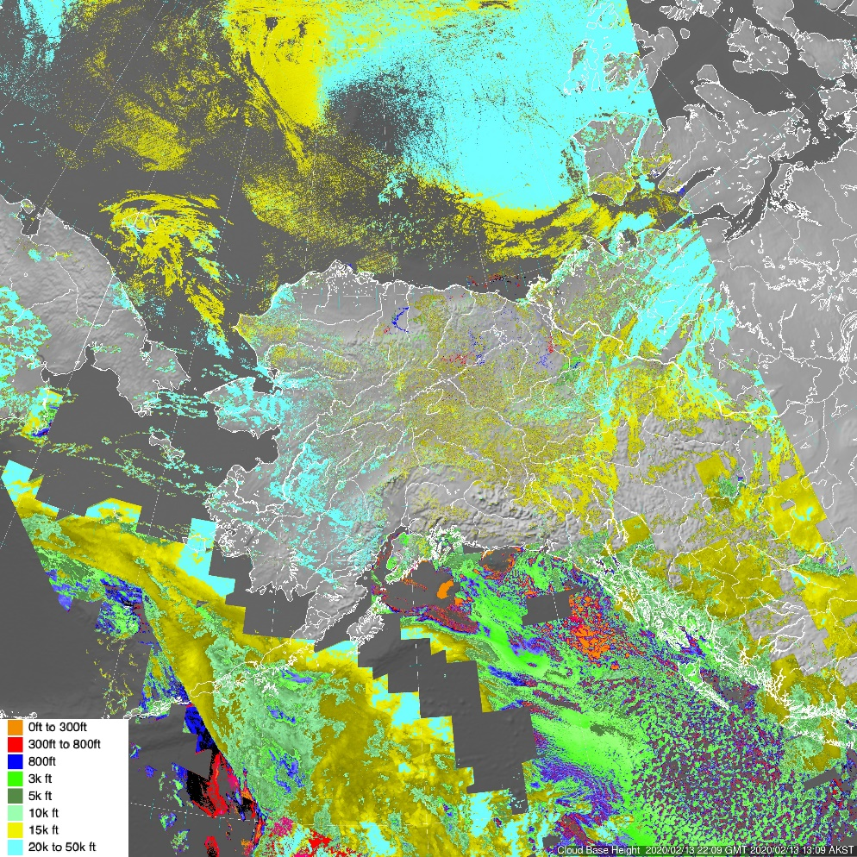
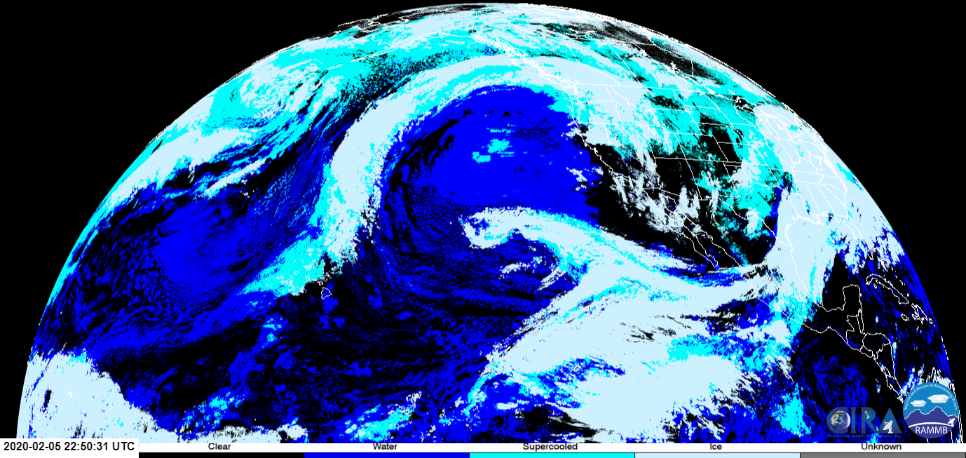
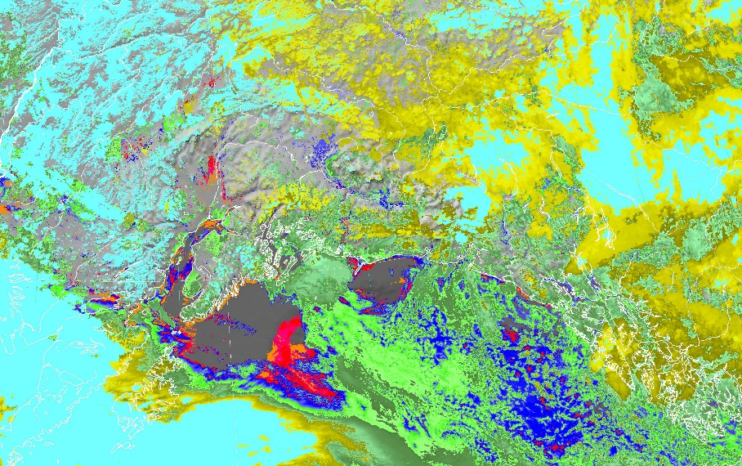
Strong Interest in Cloud Products (GEO & LEO)
CLAVR-x Products
Cloud Top Height
Cloud Base Height
Cloud Phase
Cloud Type
Cloud Top Temperature
How much “interpretation” should be expected of pilots?
Cloud Top Height
Cloud Phase (CIRA Slider)
Cloud Base Height
Notes:
The JPSS Aviation Initiative has been evaluating a number of CLAVR-x cloud products for flight planning purposes, mainly focusing on Alaska and LEO version… however there are also GEO versions. The image shown is a GEO CLAVR-x cloud phase product. As mentioned in the previous slide, the GEO perspective degrades toward the poles but since the height of clouds is inherent in the algorithm, parallax corrections can be made with either GEO or LEO perspectives.
Here are a couple of LEO cloud products… cloud top height and cloud base height.
As mentioned before the LEO version provides a significant advantage on the ability to identify cloud features, especially in the far north.
And here is a LEO CLAVR-x version of cloud top heights and cloud base heights

Slide 5
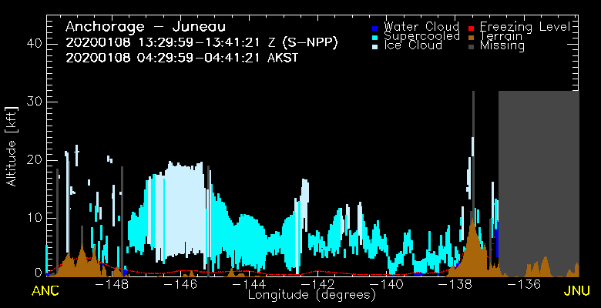
Aircraft Operator Feedback
“The work to date by the JPSS team shows considerable promise … significant work is needed to craft the visualization of these products, to make them interpretable for the aviation community.”
“One problem that has to be overcome is how to deal with the limits of swath data from polar orbiting satellites, where coverage may be hit or miss along the route a pilots is evaluating for cross-country flight.”
Tom George, Aircraft Owners & Pilots Assn
“Bandwidth and area coverage are two of Alaska’s biggest challenges regarding digital data. Improved satellite communications infrastructure, on the ground and in the air, could solve both problems.”
“The fusion of geo-stationary and polar-orbiter satellite data will be a step forward, but we also need more polar-orbiting satellites providing near-real-time imagery and observations in order to achieve weather data parity with the rest of the country.”
Andrew McClure, FAA
Cloud Cross-section ANC-JNU (Yoo-Jeong Noh - CIRA)
Notes:
One of the “improved visualization” methods that generated a lot of interest among Alaskan aircraft operators are Flight Route Cross-sections. They are generated from CLAVR-x output but currently only work for preset routes. Feedback suggests a more dynamic route selection would be preferred.
The grey area on the right (outlined in red) shows the problem with LEO data. At times a portion of the route may be missing. Blending GEO cloud products could potentially fill in these data voids.

Slide 6
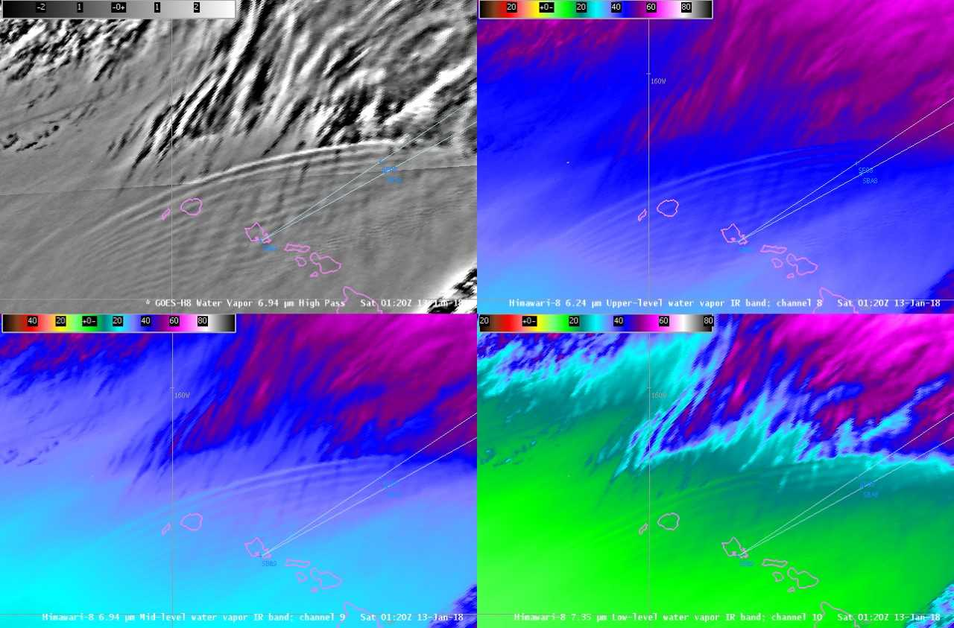
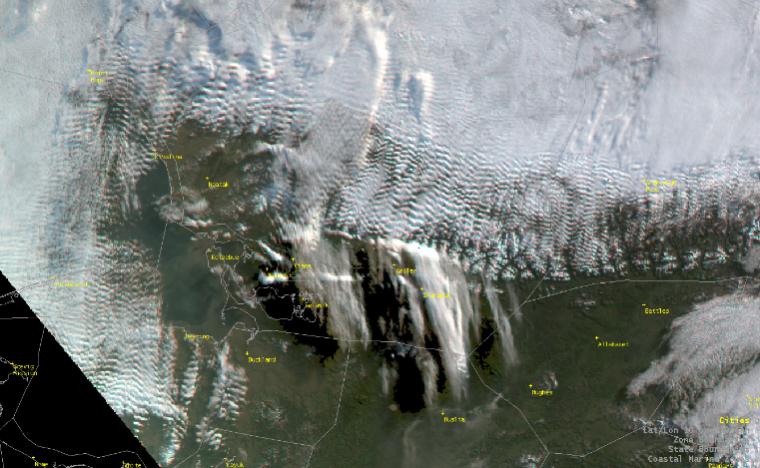
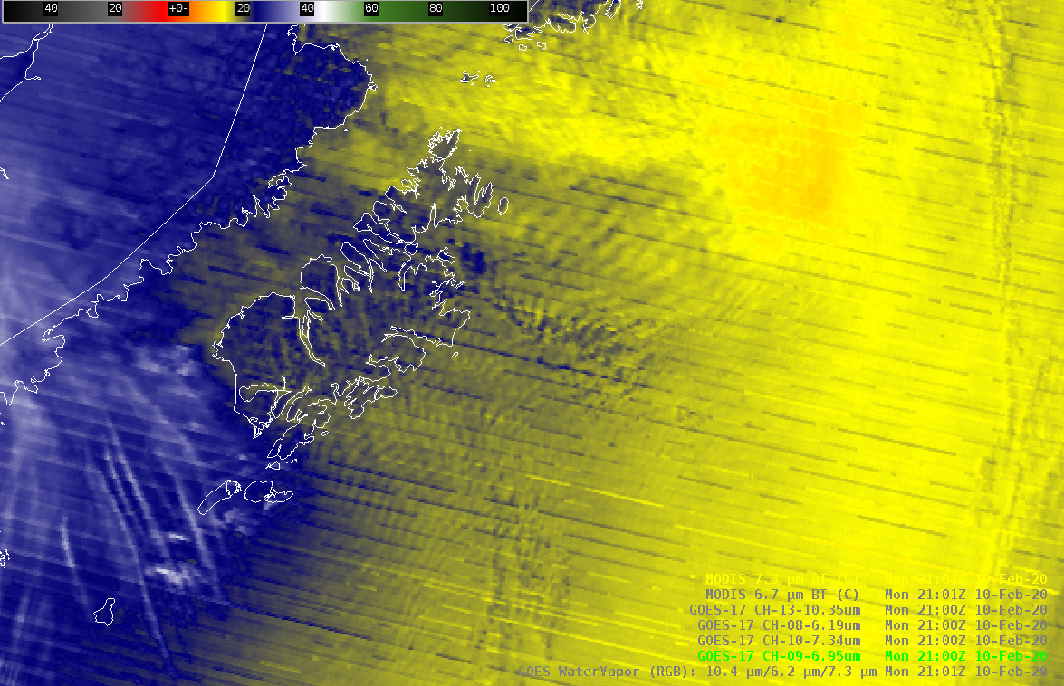
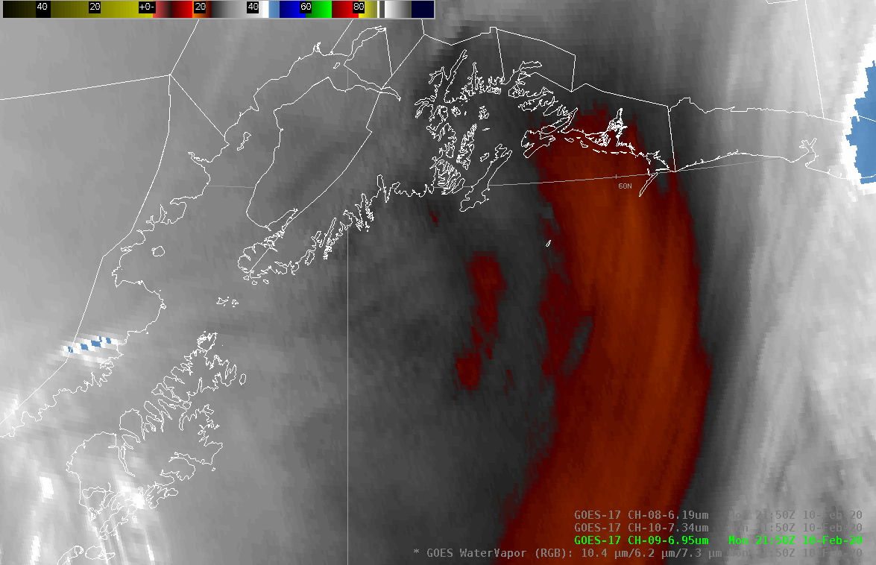
Gravity Waves and Turbulence
VIIRS True Color (Nrn AK)
MODIS 7.3 um WV
Best High Pass Filters?
How do impacts vary with Aircraft Type?
How can machine learning techniques assist?
Severe Turbulence over Hawaii (Scott Bachmeier – Jan 12, 2018)
https://cimss.ssec.wisc.edu/satellite-blog/archives/26745
“We're still figuring out which filters (we have 4), which of the 3 bands to use (though generally the top), and what signatures are turbulent. However, Tony (Wimmers) is using AI to find the patterns and suggests it's quite good at doing so.” - Nate Eckstein, NWS
GOES 17 – 6.95um WV
Notes:
As satellites improve gravity waves are being observed more abundantly, but more work is needed to quantify the severity wave patterns on aircraft. Aircraft speed, trajectory, and size are all factors that determine the impacts of waves at specific frequencies. Can more objective criteria and possibly AI techniques help to classify the severity of observed waves?

Slide 7
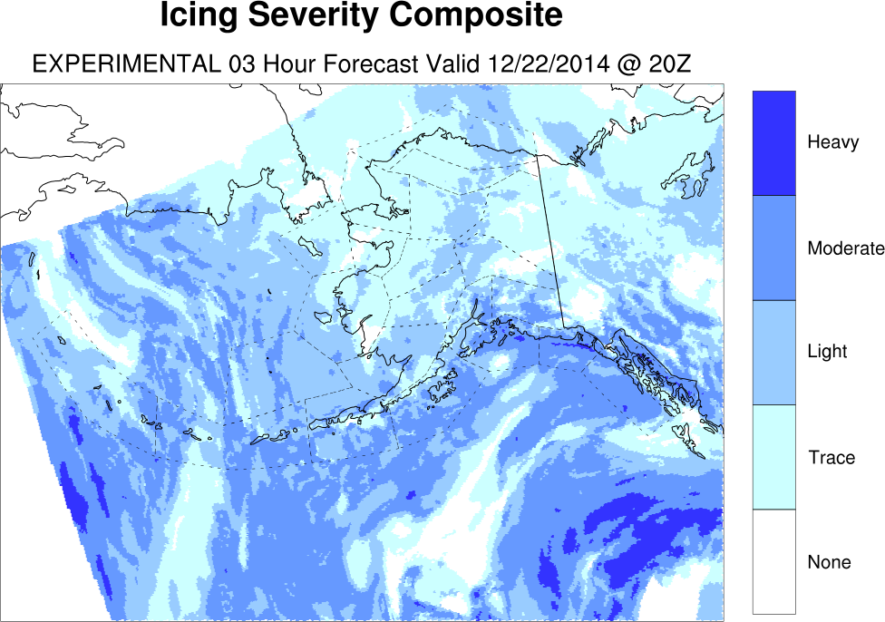
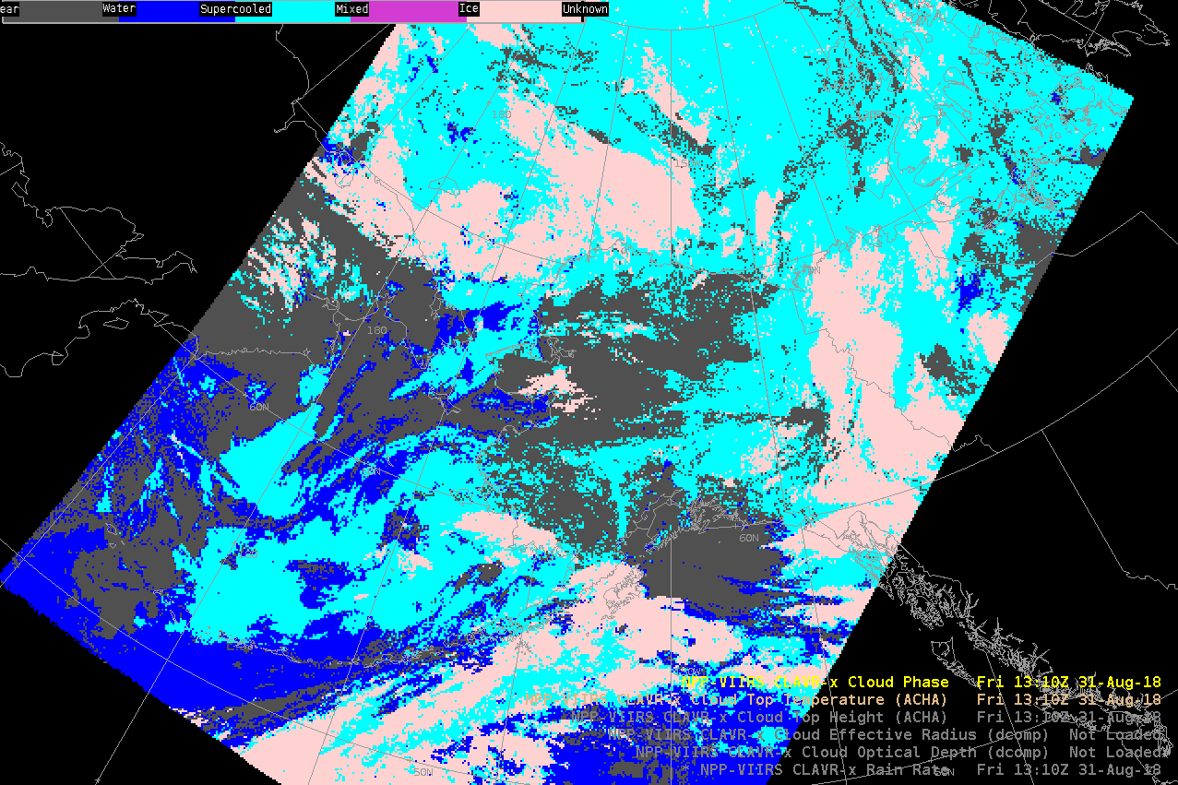
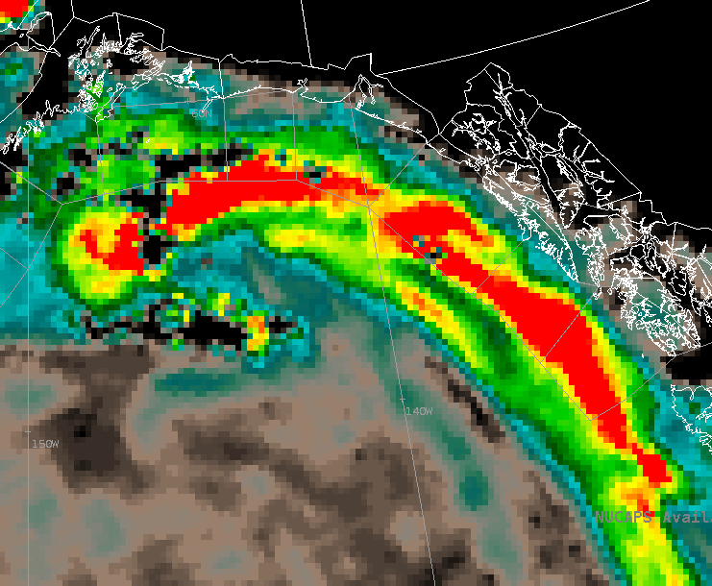
Experimental Icing Products
CLAVR-x Cloud Phase
MIRS Cloud Liquid Water
Icing Product Alaska (NCAR)
We're mainly using Icing Product Alaska (IPA), developed by NCAR through FAA- AWRP (Avn Wx Research Program). We supplement that guidance with BUFKIT, but over the whole state that's a lot to sort through all the soundings. NUCAPS or Gridded NUCAPS might assist with an analysis, but we also use satellite imagery to look at the cloud top phase, temperature. – Nate Eckstein (AAWU)
Notes:
-We're mainly using Icing Product Alaska (IPA), developed by NCAR through FAA- AWRP (Avn Wx Research Program). We supplement that guidance with BUFKIT, but over the whole state that's a lot to sort through all the soundings. NUCAPS or Gridded NUCAPS might assist with an analysis, but we also use satellite imagery to look at the cloud top phase, temperature. – Nate Eckstein (AAWU)

Slide 8
Challenges and Questions…
How can GEO and LEO perspectives for aviation products be merged to take advantage of the strengths of each?
How should the impact of aviation hazards identified by satellite (such as gravity waves) be calibrated for aircraft size, speed, and direction?
How can objective methods be developed (such as AI) to alert on aviation hazards turbulence, icing, volcanic ash, etc?
Notes:
- Can GEO and LEO perspectives for aviation products be merged to take advantage of the strengths of each?
- How should the impact of aviation hazards identified by satellite (such as gravity waves) be calibrated for aircraft size, speed, and direction?
- Can objective methods be developed (such as AI) to alert on aviation hazards turbulence, icing, volcanic ash, etc?

