Slide 1
Cloud Research and Satellite R20 at
the Aviation Weather Center
Ty Higginbotham
CIRA, CSU, NOAA, NWS, AWC
February 26, 2020

Slide 2
Outline
Introduction to AWC
GFA, sky cover research, and cloud layer research
RGB Operational Use Case
GLM Operational Use Case
AWC Forecaster Feedback
Possible Implementations and Future Research

Slide 3
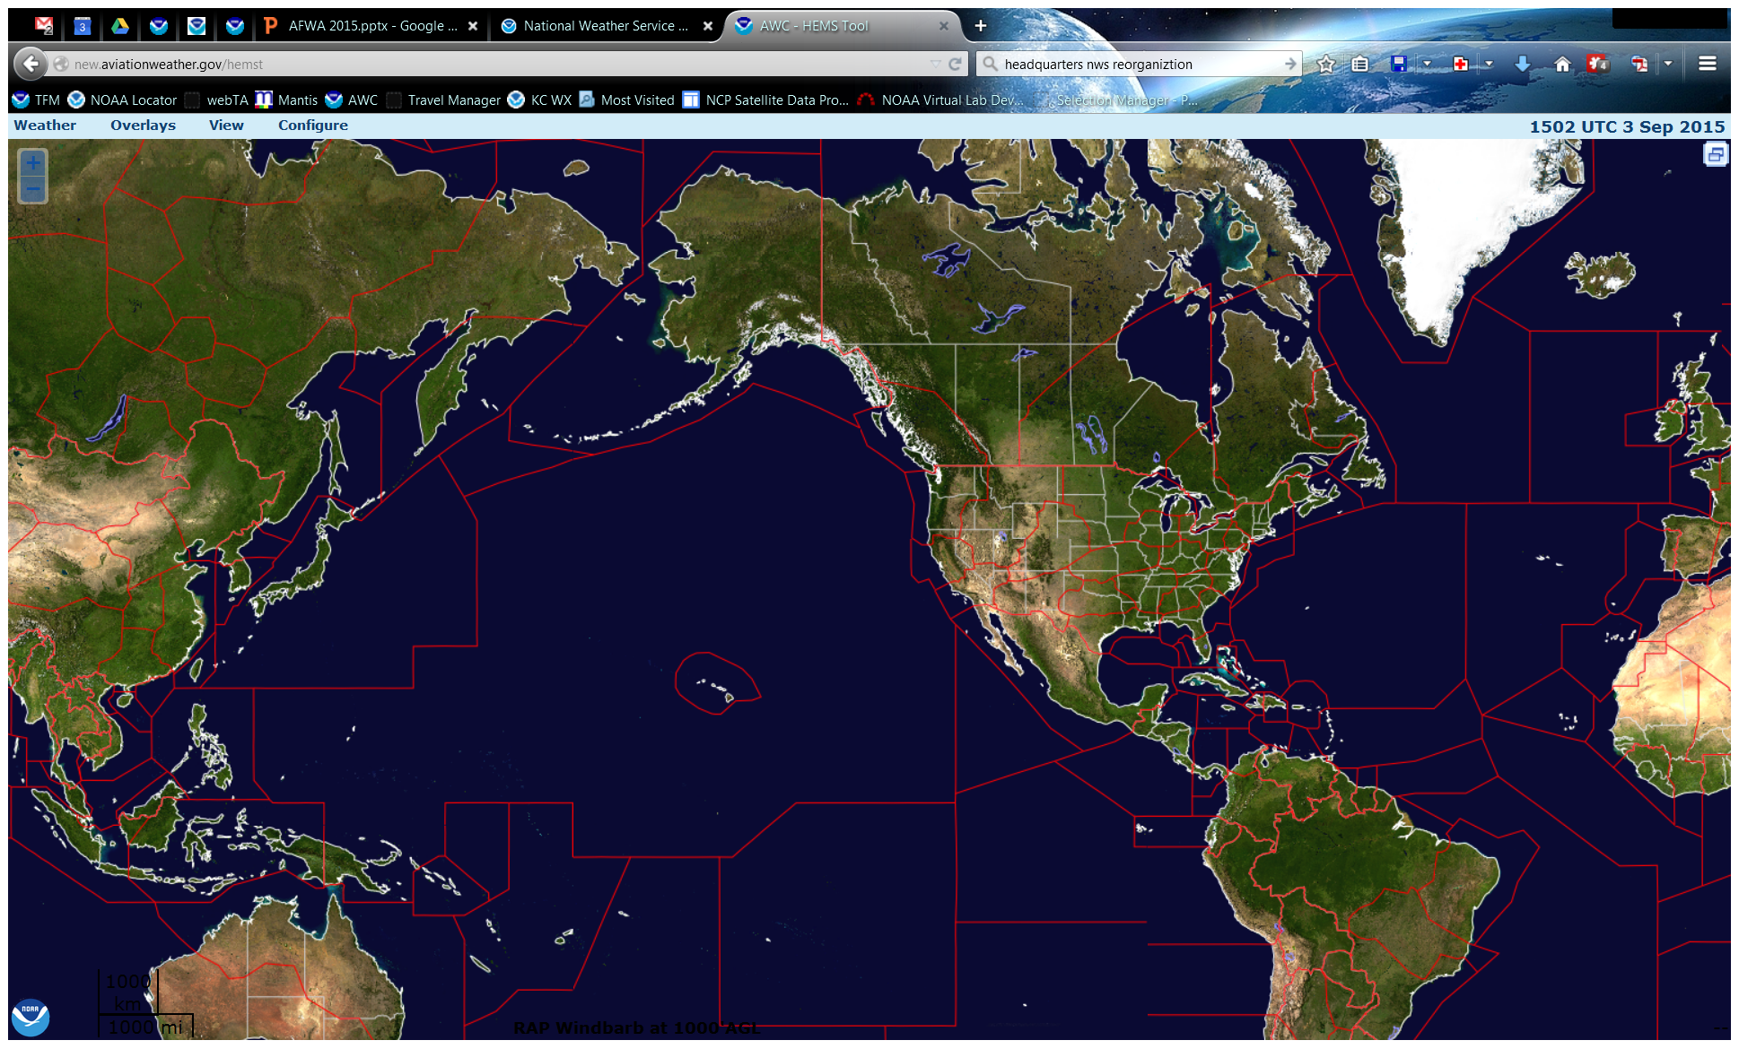
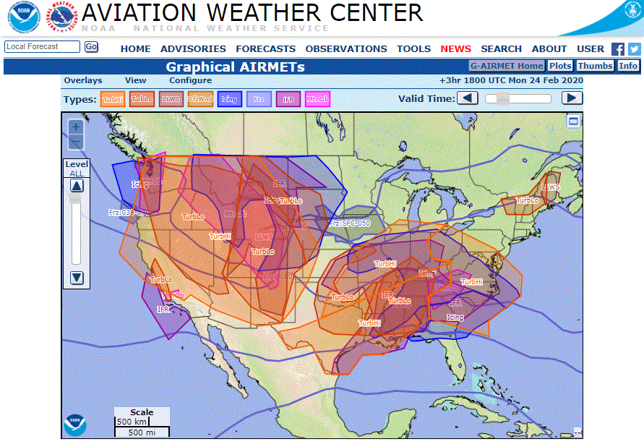
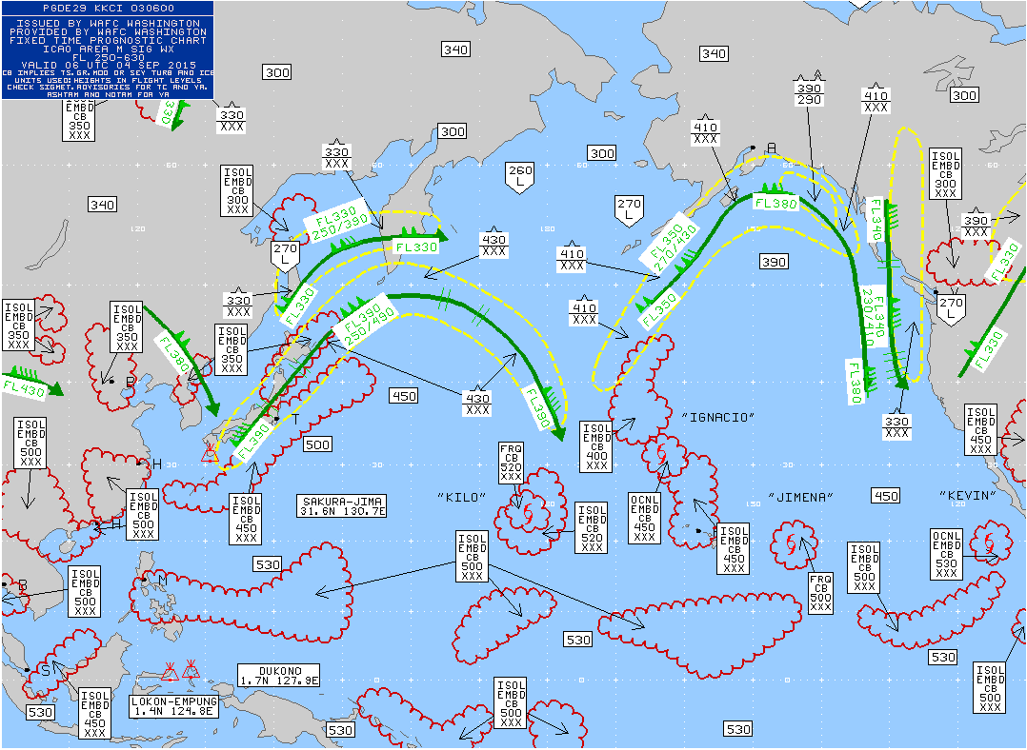
The Aviation Weather Center
One of the nine NWS National Centers
Domestic and International Aviation Forecasts and Warnings
www.AviationWeather.gov
Notes:
The Aviation Weather Center delivers consistent, timely and accurate weather information for the world airspace system. We are a team of highly skilled people dedicated to working with customers and partners to enhance safe and efficient flight.
We issue C&V products for IFR/LIFR, etc. conditions. Current model ceiling forecasts either need improvement or aren't exactly what we're looking for, so we've been doing a lot of research in recent years to see what we can do to make them better or build other tools to meet our needs.

Slide 4
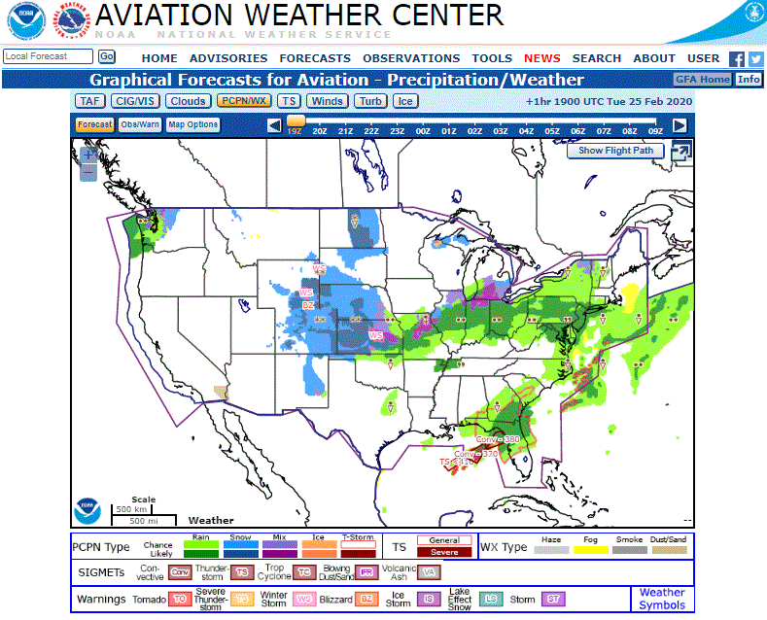
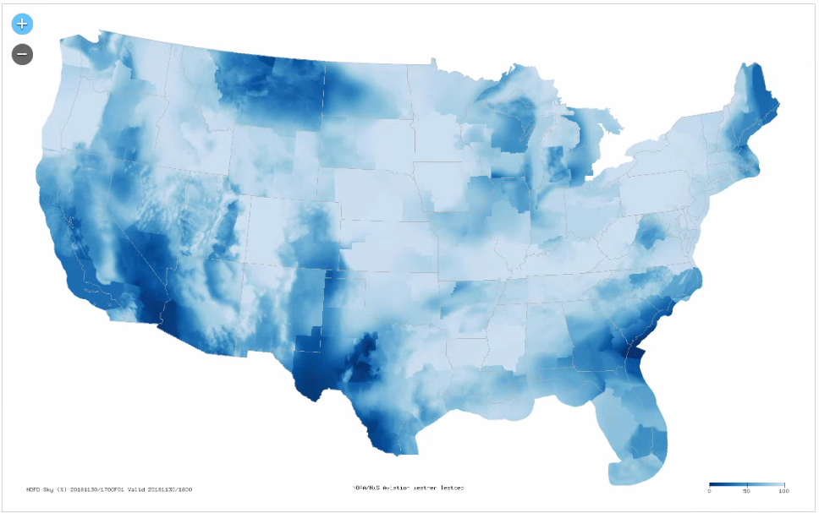
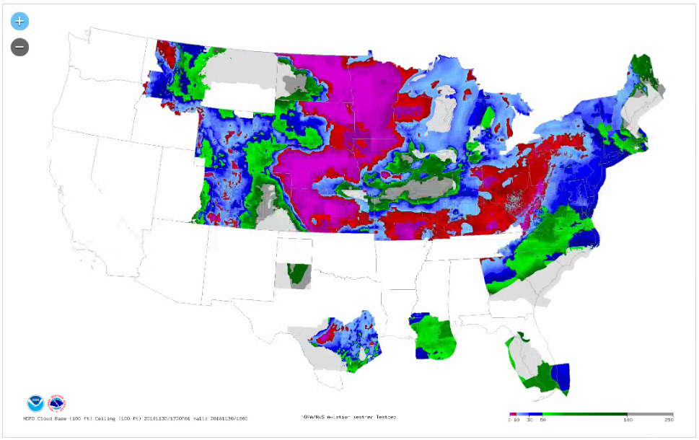
Graphical Forecasts for Aviation (GFA)
How do we create one common operating picture that meets the needs of all aviation users?
Possible Future Collaborative Forecast Process Steps:
AWC would derive first guess grids of Primary, Secondary, and Tertiary cloud base and corresponding sky cover
These grids would be edited by local WFOs through the DAS paradigm to derive a TAF that can include up to three cloud layers
The final edited grids would be used to derive needed cloud variables for the GFA (cloud bases, tops, coverage, presence of layers, cirrus) at AWC
This would allow for a consistent depiction of clouds across all levels; from local to national
Notes:
Graphical Forecasts for Aviation (GFA) replaced text Area Forecast products
Requirements include indicating presence of layered clouds, cloud tops and cloud bases, which are not provided by the current DAS paradigm
Need to allow for up to three cloud bases to resolve full TAF cloud information
In addition to cloud bases, also need to indicate corresponding coverage for each layer
This allows for more accurate TAFs and all coverage possibilities
AWC developed a method to create Primary, Secondary, and Tertiary layers from model derived fractional cloud cover to support DAS and GFA
Designation of layers depends on height of base and max fractional coverage of the layer
Middle left image - Cloud cover from the NWS NDFD Sky grid. All WFOs currently produce this as part of their forecasting suite of grids.
Middle right image - WFOs participating in Digital Aviation Services (DAS) currently edit grids of Cloud Base Primary, often derived from relative humidity provided by models, to represent clouds in a TAF. Together with the Sky grid, a resultant grid of Ceiling (seen here) is produced.

Slide 5
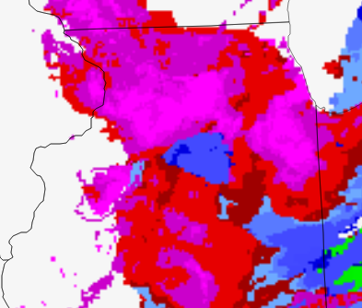
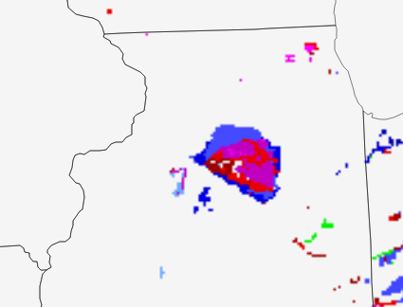
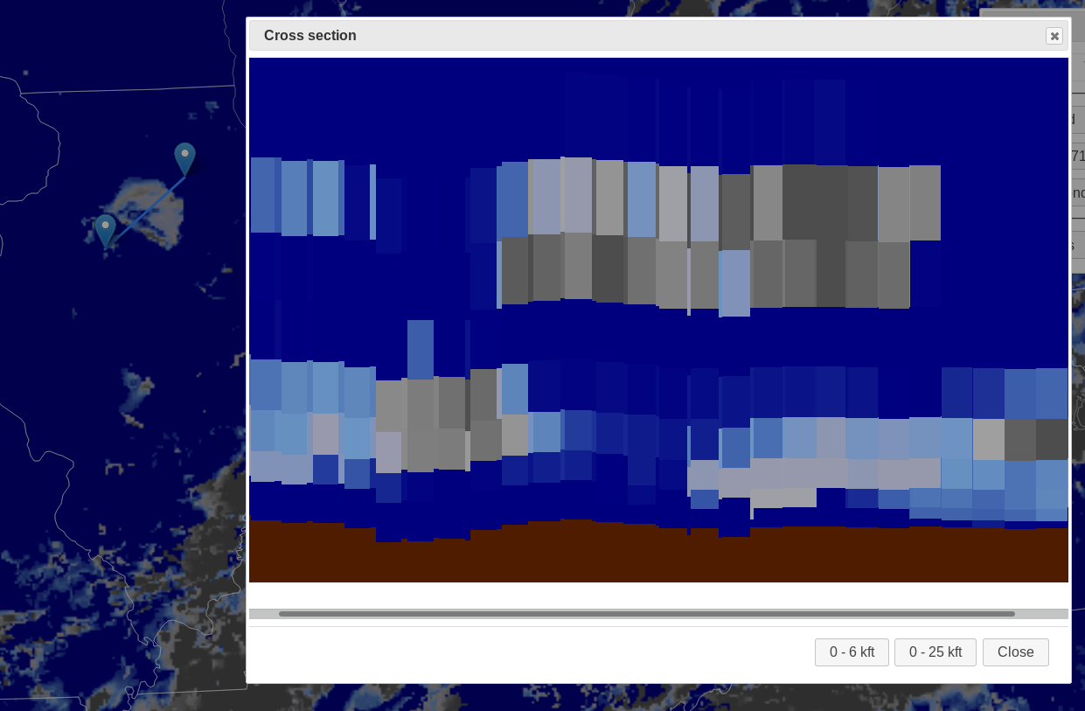
Cloud Coverage and Cloud Layers
The Primary layer with higher cloud base and fractional coverage
The Secondary layer with lower cloud base and fractional coverage
Notes:
Top left image - In this plan view of AWC derived Primary Cloud Base, an area of higher bases are depicted in a region with predominantly lower cloud bases.
Middle left image - Looking at the corresponding Secondary Cloud Base, a lower layer does exist, and the corresponding sky cover (seen at right) indicates lower cloud fractional coverage.
Bottom middle image - A cross section of the 3D cloud fraction taken through this area better illustrates what the model is depicting. The Secondary layer with lower fractional coverage and base height is clearly seen below the upper Primary layer with higher fractional cloud coverage.

Slide 6
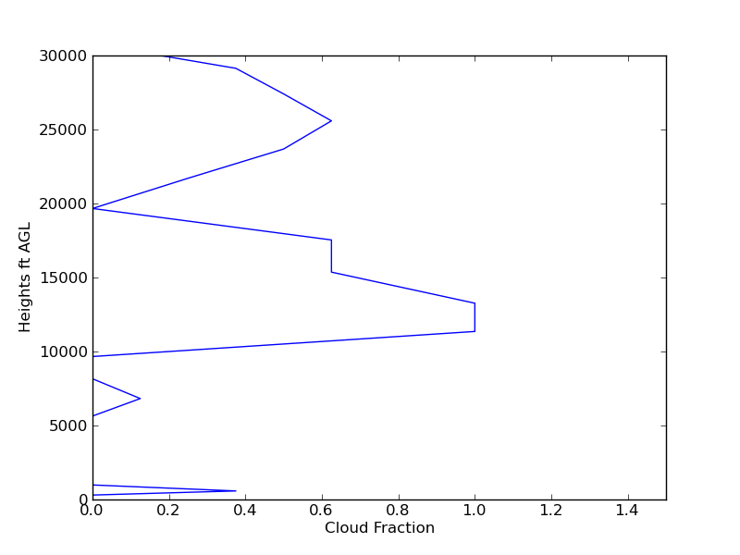
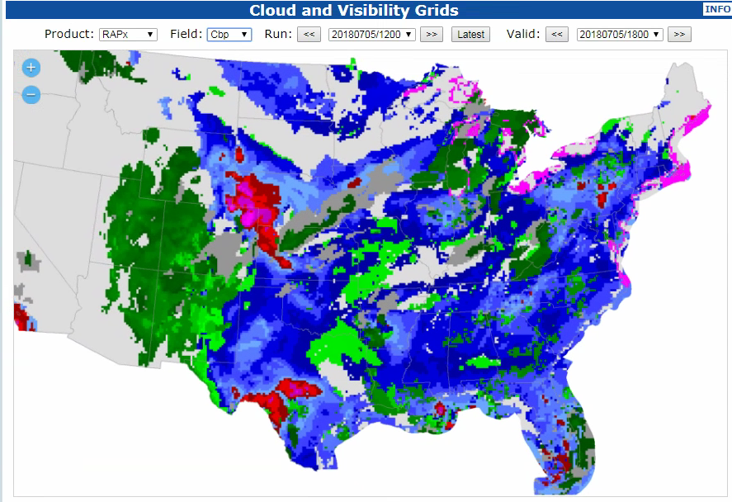
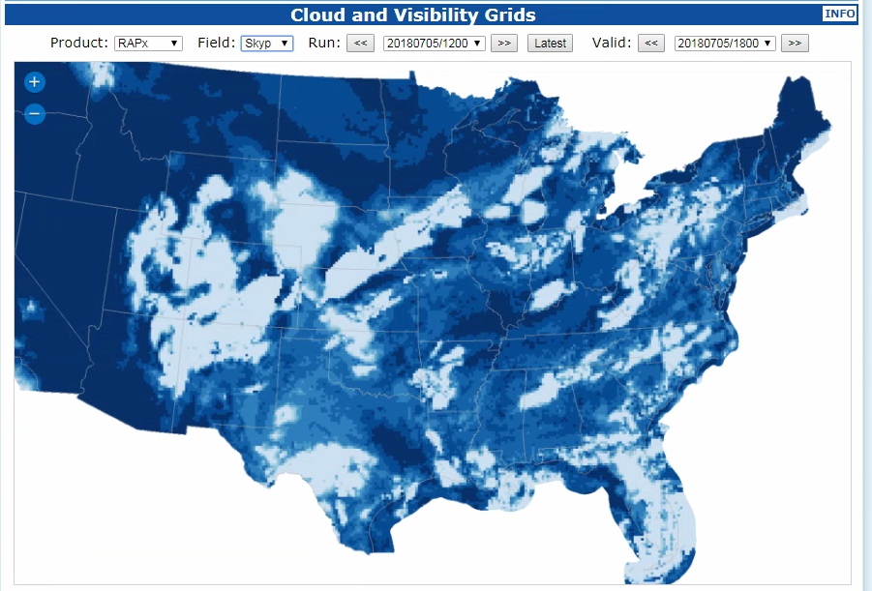
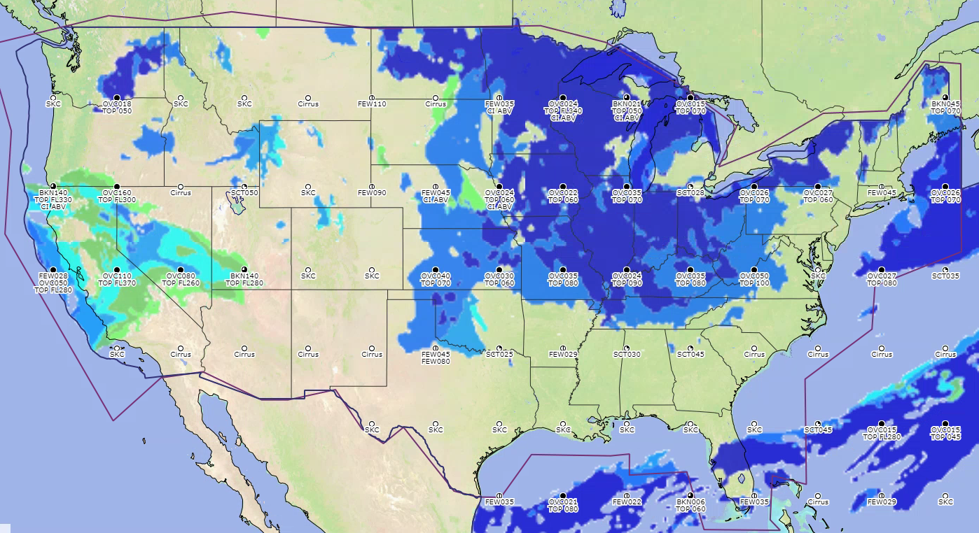
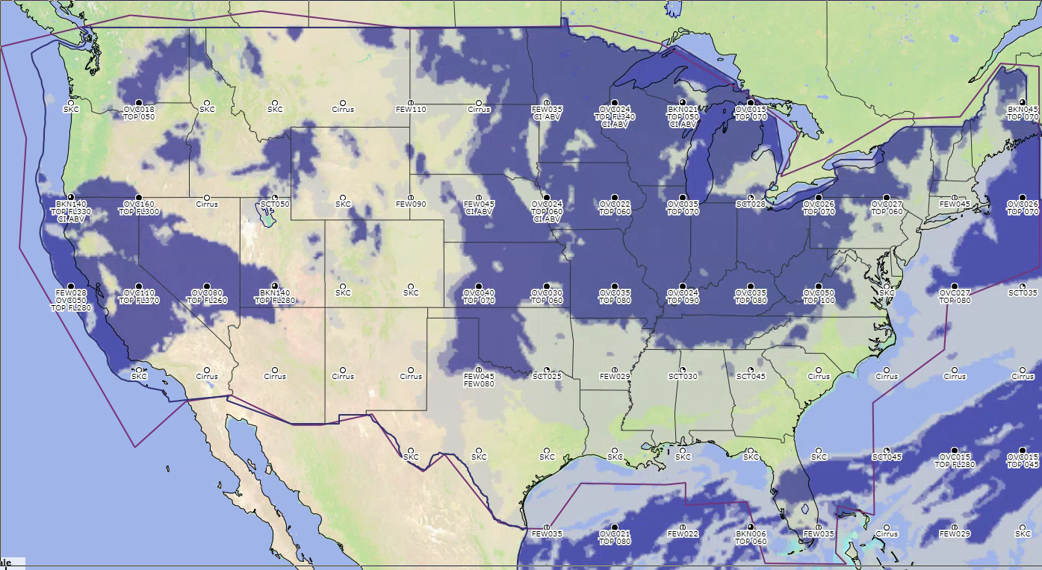
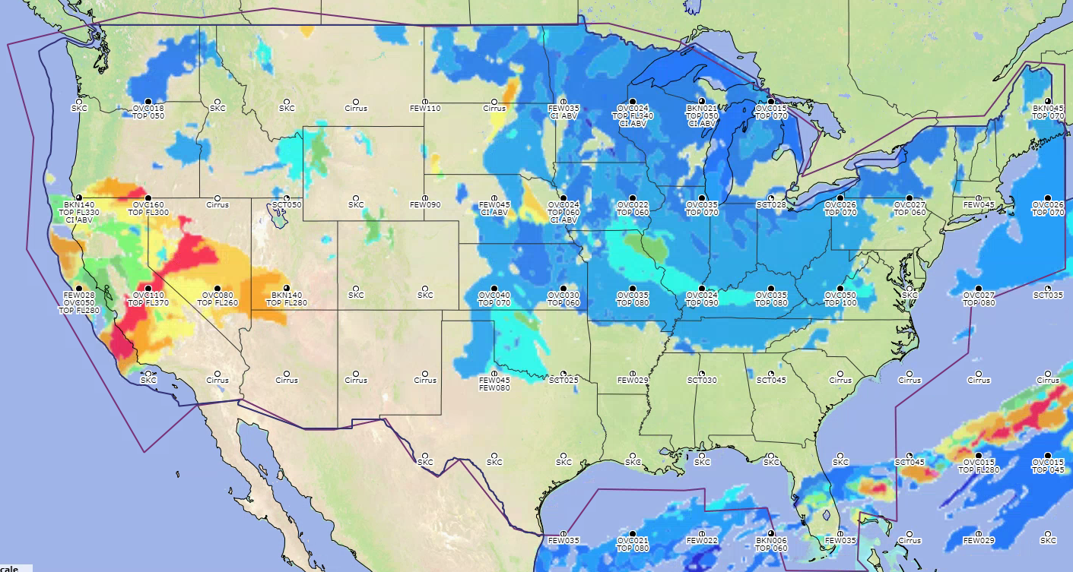
Cloud Coverage and Cloud Layers
This is our Secondary layer, the lowest SCT layer
Primary Cloud Base
& Primary Sky cover
This is the Primary layer It is the lowest >= BKN cloud
This layer is not added to a grid
This layer is our Tertiary layer, lowest FEW cloud after SCT and BKN layers defined
GFA Cloud Bases
GFA Cloud Coverage
GFA Cloud tops
Notes:
Top left image - 3-D cloud fraction from high-resolution models allows us to derive cloud tops, bottoms, and fractional coverage.
Top right images - Sky coverage represents the max cloud fraction in the layer that corresponds to Primary Cloud Base
Bottom image - Layers derived for DAS are converted into MSL, and those with bases below 18,000ft are used to determine the gridded cloud bases, coverage and, tops. Values of base and top with corresponding coverage >= broken are displayed. Text is output to indicate cloud layers with bases and coverage, tops of broken or overcast layer, and existence of cirrus above 18,000ft.

Slide 7
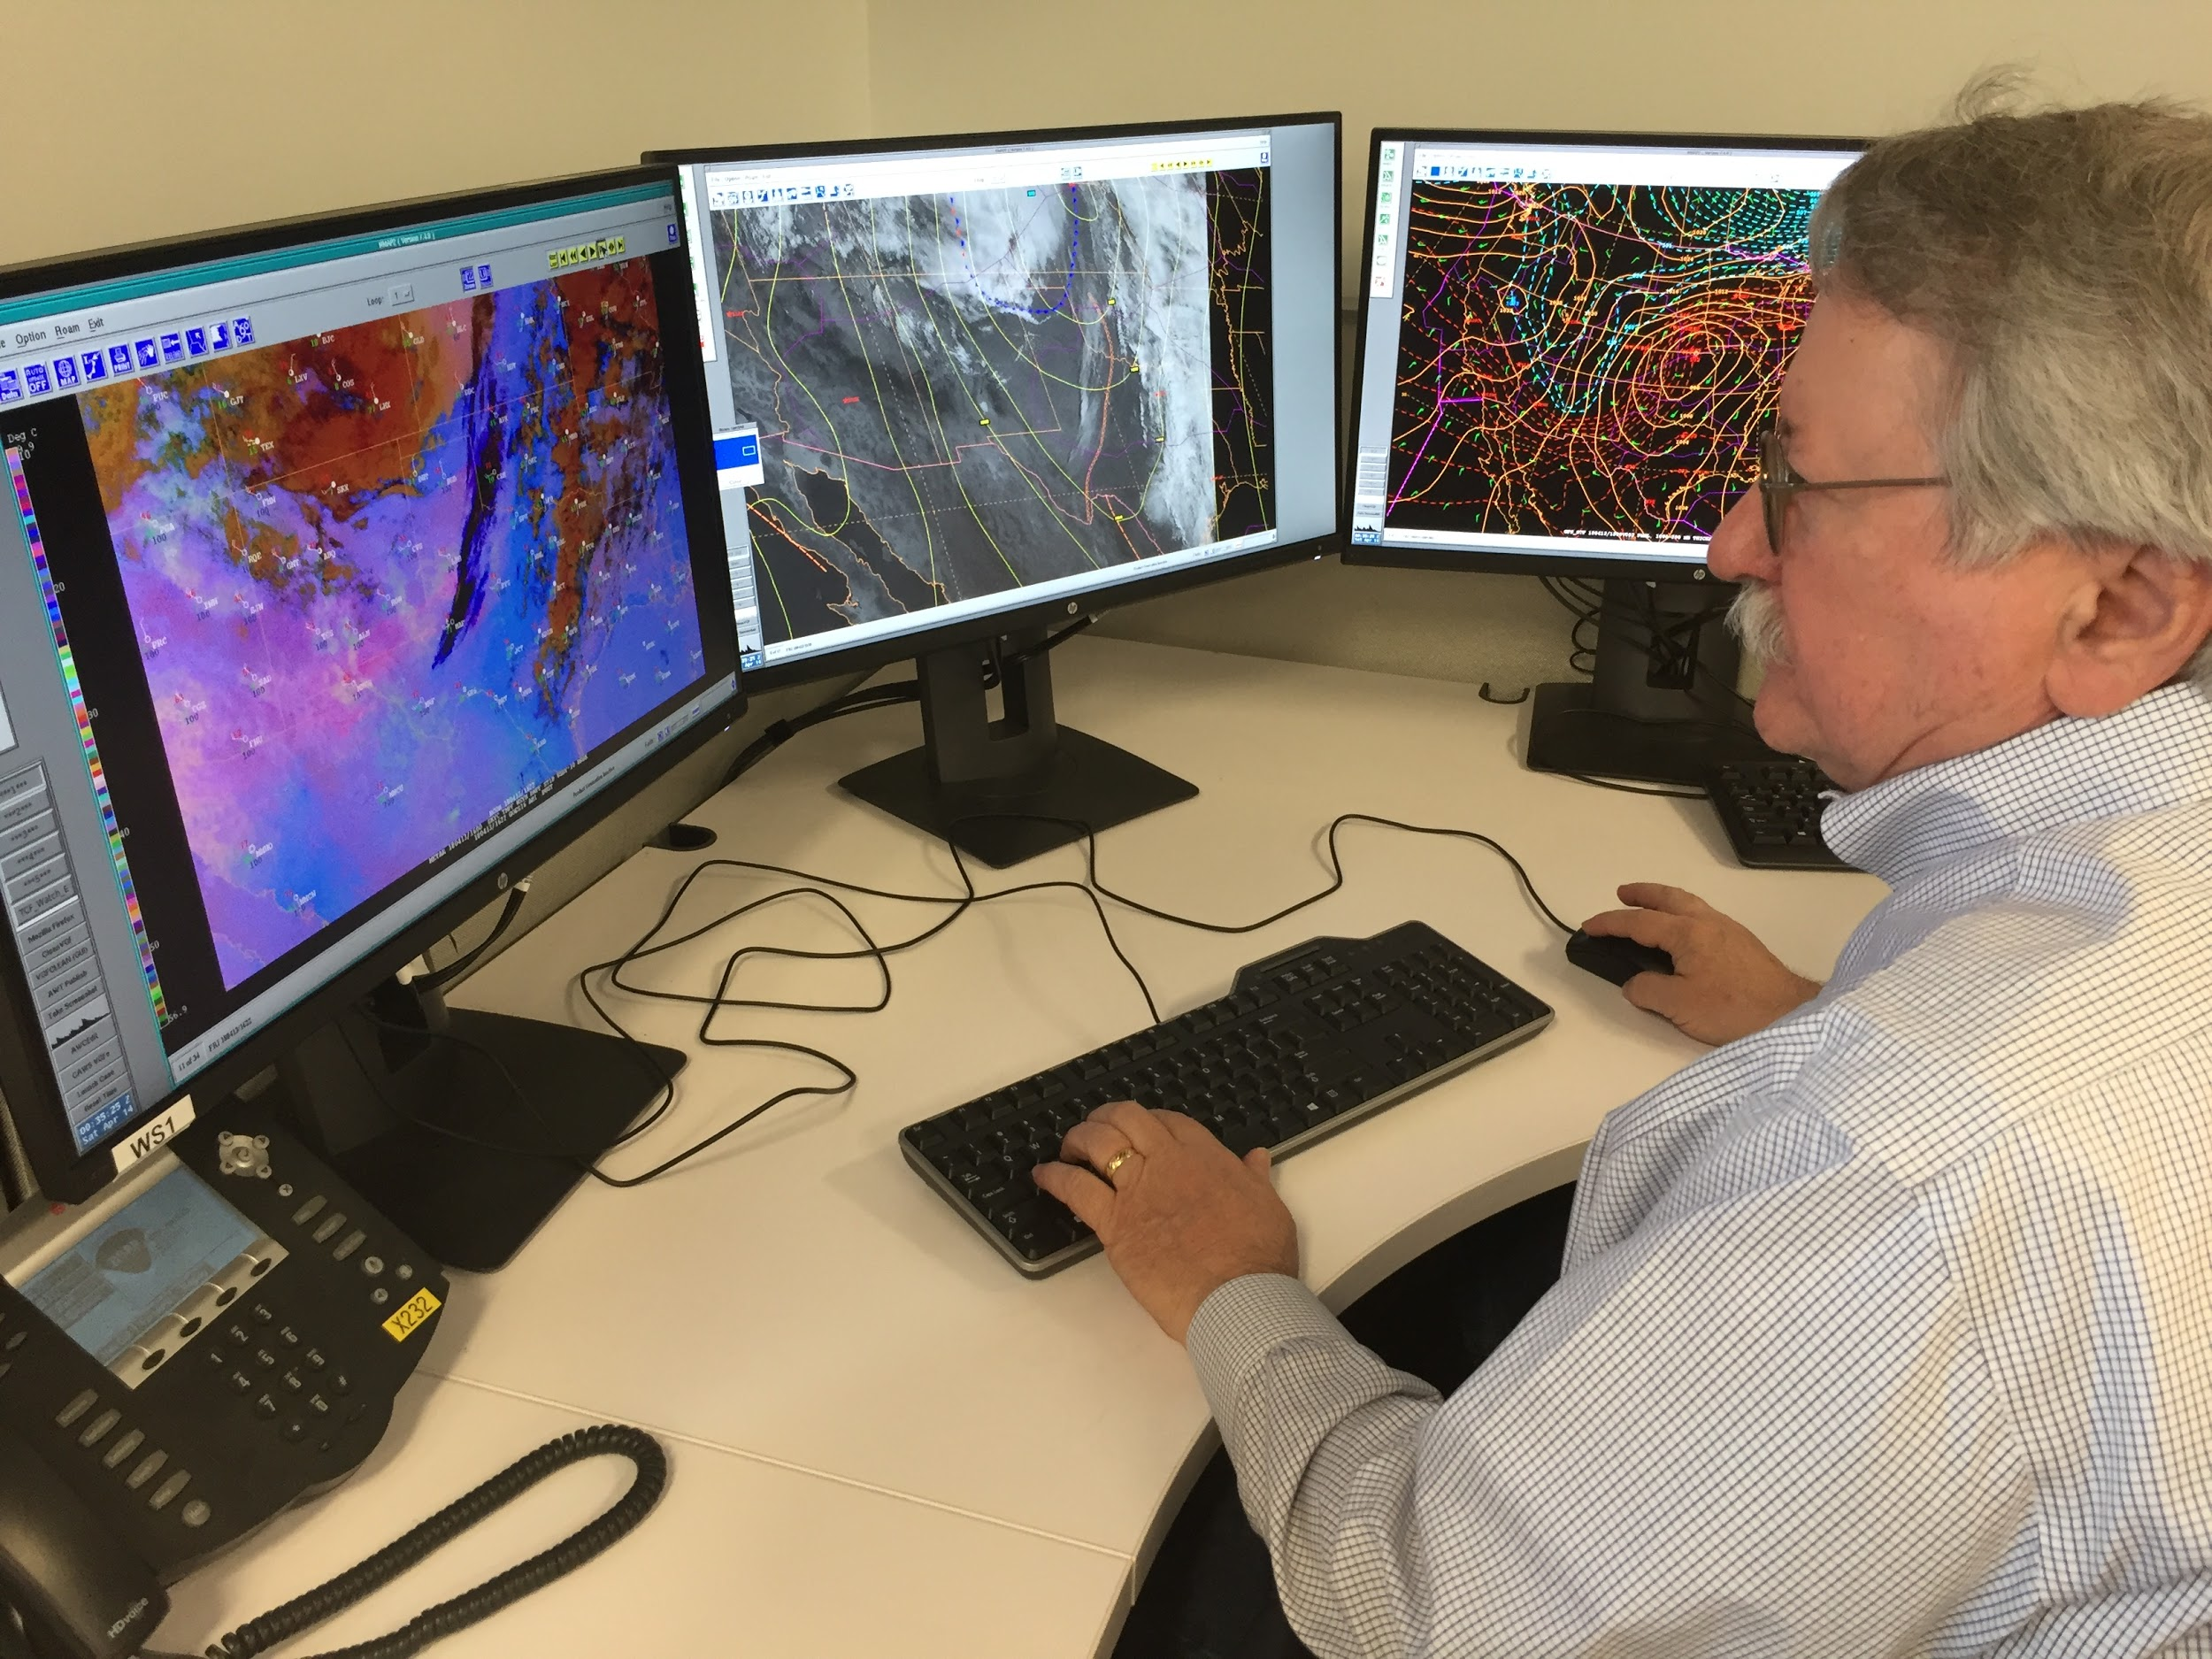
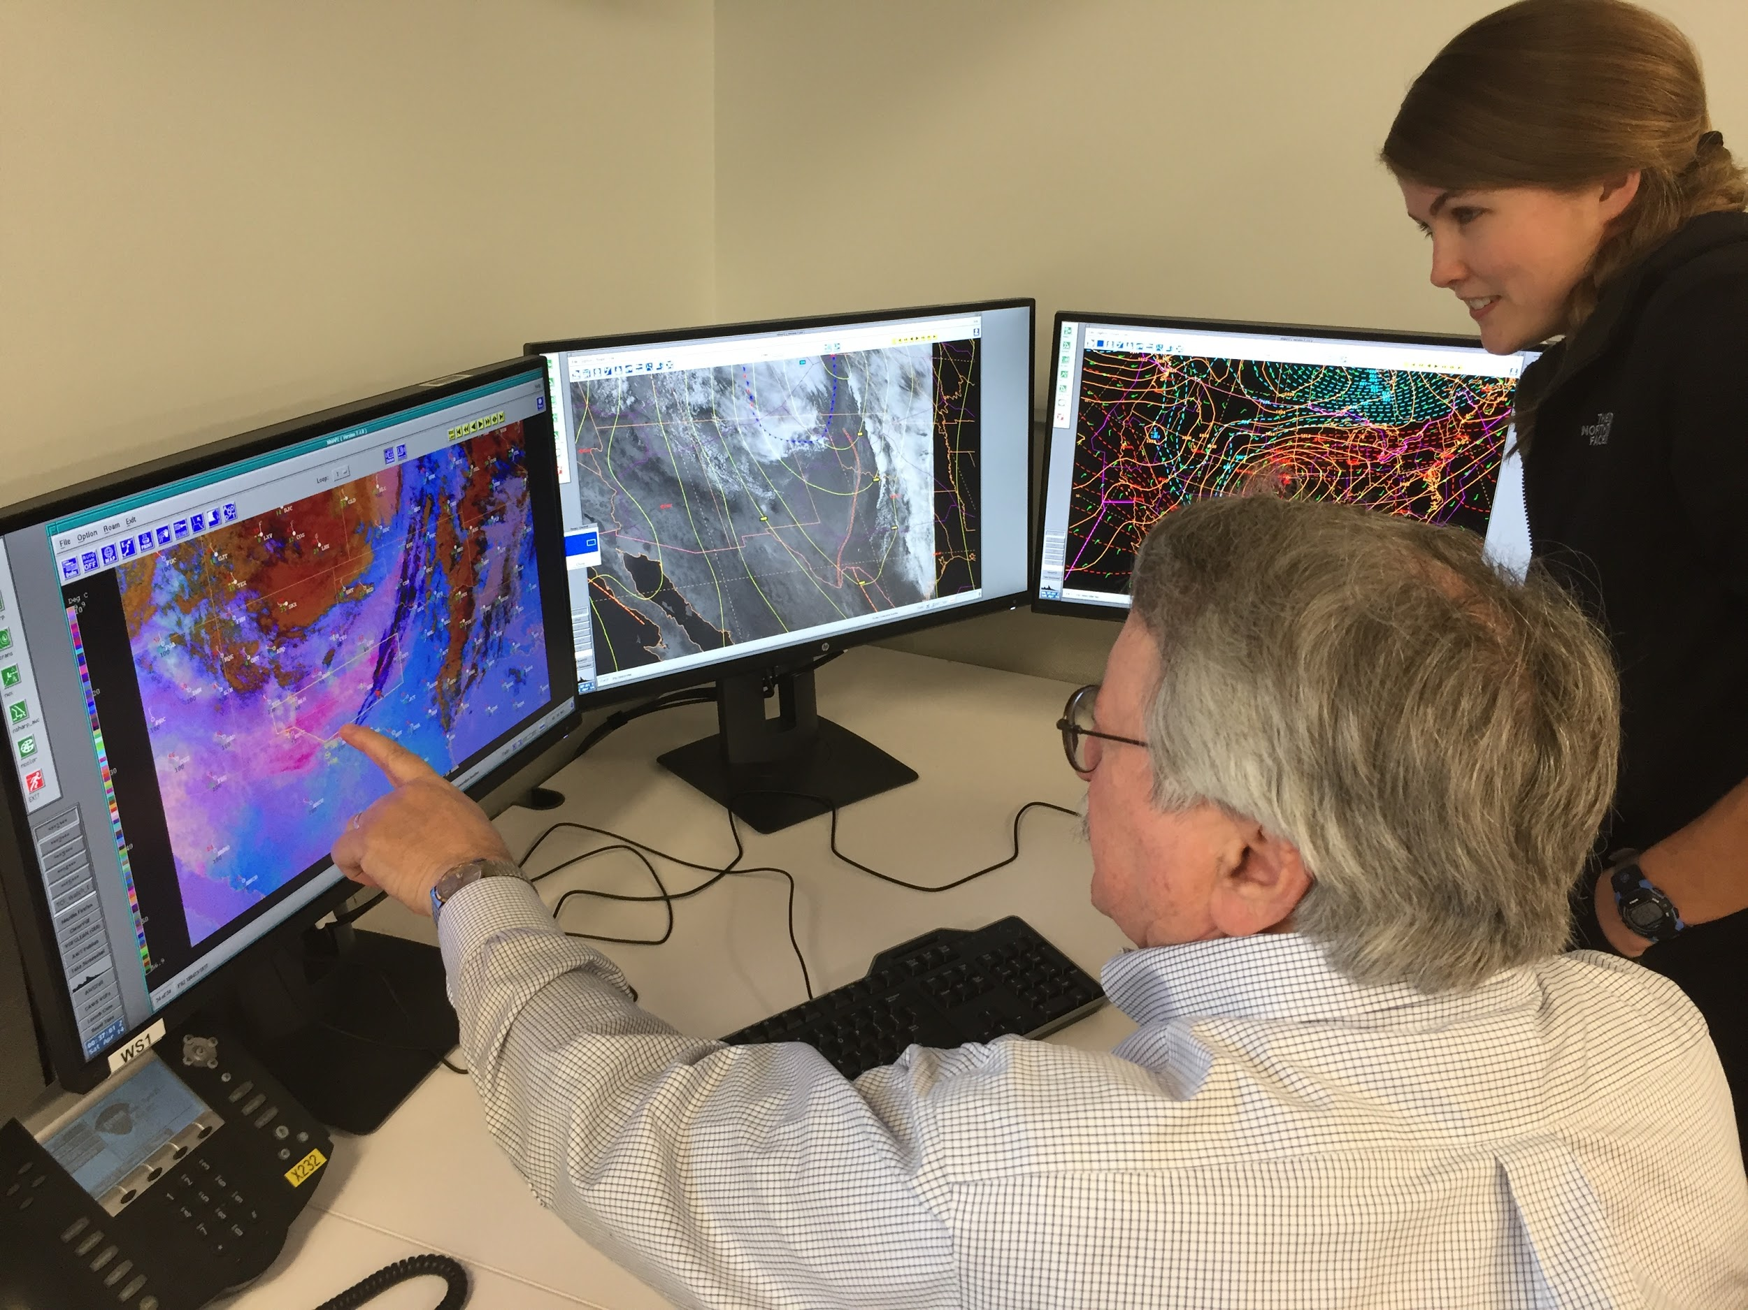
Blowing Dust
“This imagery worked to perfection today as I was able to get the jump on a blowing dust SIGMET over southern NM and western TX based on the darkening pink area. It also showed movement of the area which helped in determining what points to use for the SIGMET.”
Senior Aviation Meteorologist Pete Reynolds confers with CIRA Satellite Meteorologist Amanda Terborg on an area of blowing dust in western Texas on April 13, 2018.
Blowing dust SIGMET issued by Senior Aviation Meteorologist Pete Reynolds at 1640 UTC overlaid with the 1642 GOES-16 Dust RGB imagery. The dark magenta coloring clearly identifies the blowing dust.
Notes:
Aviation Weather Center Uses Advanced Satellite Imagery to Improve Lead Time on Blowing Dust Warning
Meteorologists at the Aviation Weather Center monitor the potential for dust storms closely. Aside from flight delays, diversions and cancellations due to decreased visibility, dust can also cause serious mechanical problems that can lead to false flight speed readings, reduced engine performance, and potential engine flame-out.
Ironically, the same dust storms that are impossible to overlook by pilots and air traffic controllers are extremely difficult to observe using legacy satellites. The six channels on the legacy Geostationary Operational Environmental Satellite (GOES) satellites were designed to view clouds through visible, infrared, and water vapor channels. Neither the infrared nor water vapor channels are sensitive to the unique composition of dust particles, making them essentially invisible at those wavelengths. Dust is also difficult to detect with visible channels due to its similarity in color to the surrounding arid ground of the desert.
Fortunately, scientists and engineers have solved this problem with the Advanced Baseline Imager (ABI) satellite sensor aboard the new generation of GOES weather satellites. The ABI was first launched onboard GOES-16 and became officially operational in December 2017. It was designed with a higher spectral resolution, increasing the number of channels from 6 to 16 compared to the legacy satellites. Not only do the extra channels broaden the scope of meteorological phenomena that can be detected, but meteorologists have discovered great utility in combining these channels into composites called “Red-Green-Blue” composites (RGBs), which take advantage of multiple channels to help distinguish a specific feature (such as dust) from other clouds or surfaces.
On April 13, 2018, Senior Aviation Meteorologist Pete Reynolds took advantage of the new GOES-16 Dust RGB imagery to monitor blowing dust in western Texas. Pete knew that high winds and lofted dust were expected across portions of New Mexico and Texas. The RGB imagery clearly showed the first indications of dust around 1630 UTC and Pete issued a SIGMET (aviation jargon for a warning) for blowing dust shortly thereafter at 1640 UTC. By 1700 UTC, there were three METAR reports of IFR visibility within the SIGMET area.
Pete said the ability to clearly see the dust right at onset served as a critical decision aid, and resulted in extra lead time for a potentially impactful aviation hazard: (read statement on slide)
The Dust RGB imagery was utilized throughout the rest of the event as well, particularly when the movement of the dust warranted a reissuance of the SIGMET further east around 2000 UTC. The RGB clearly showed the direction the lofted dust was moving, and guided the points for the new SIGMET area.

Slide 8
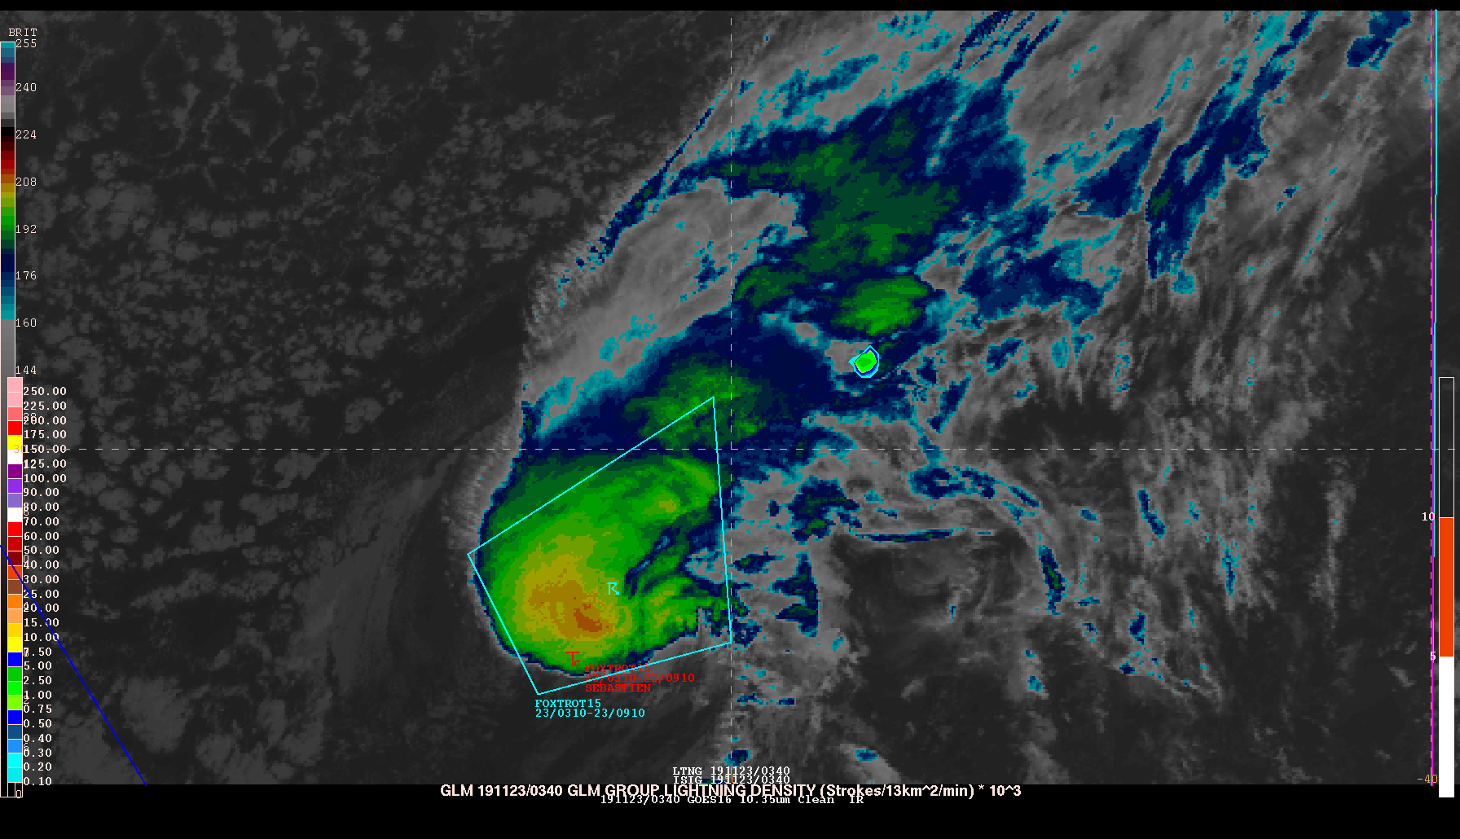
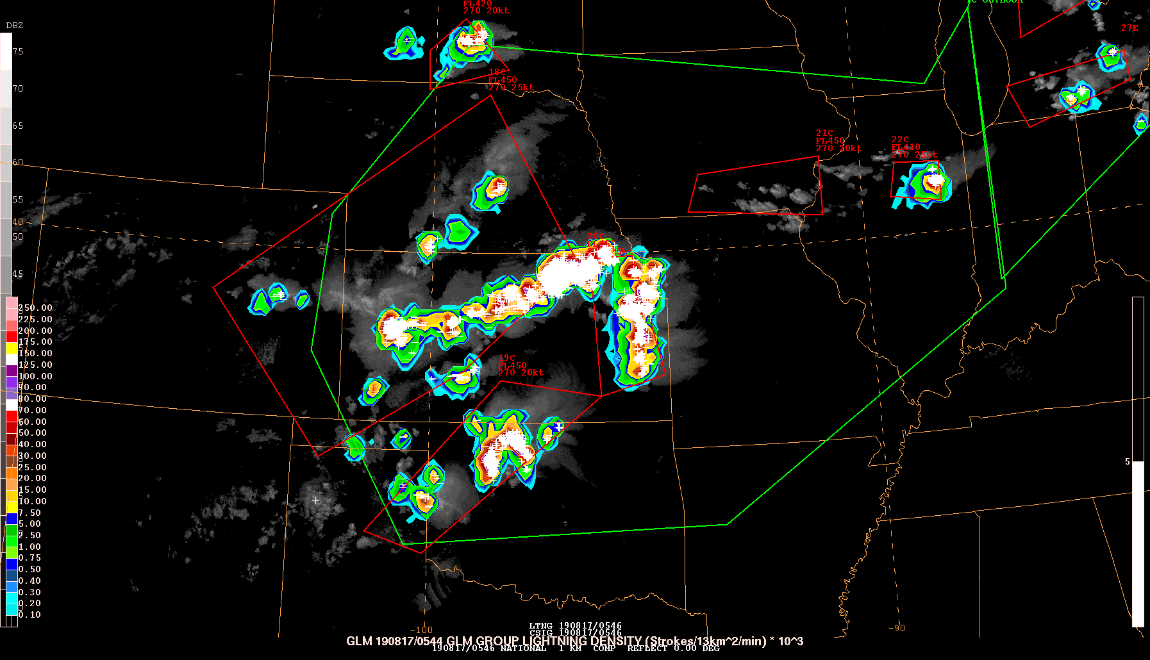
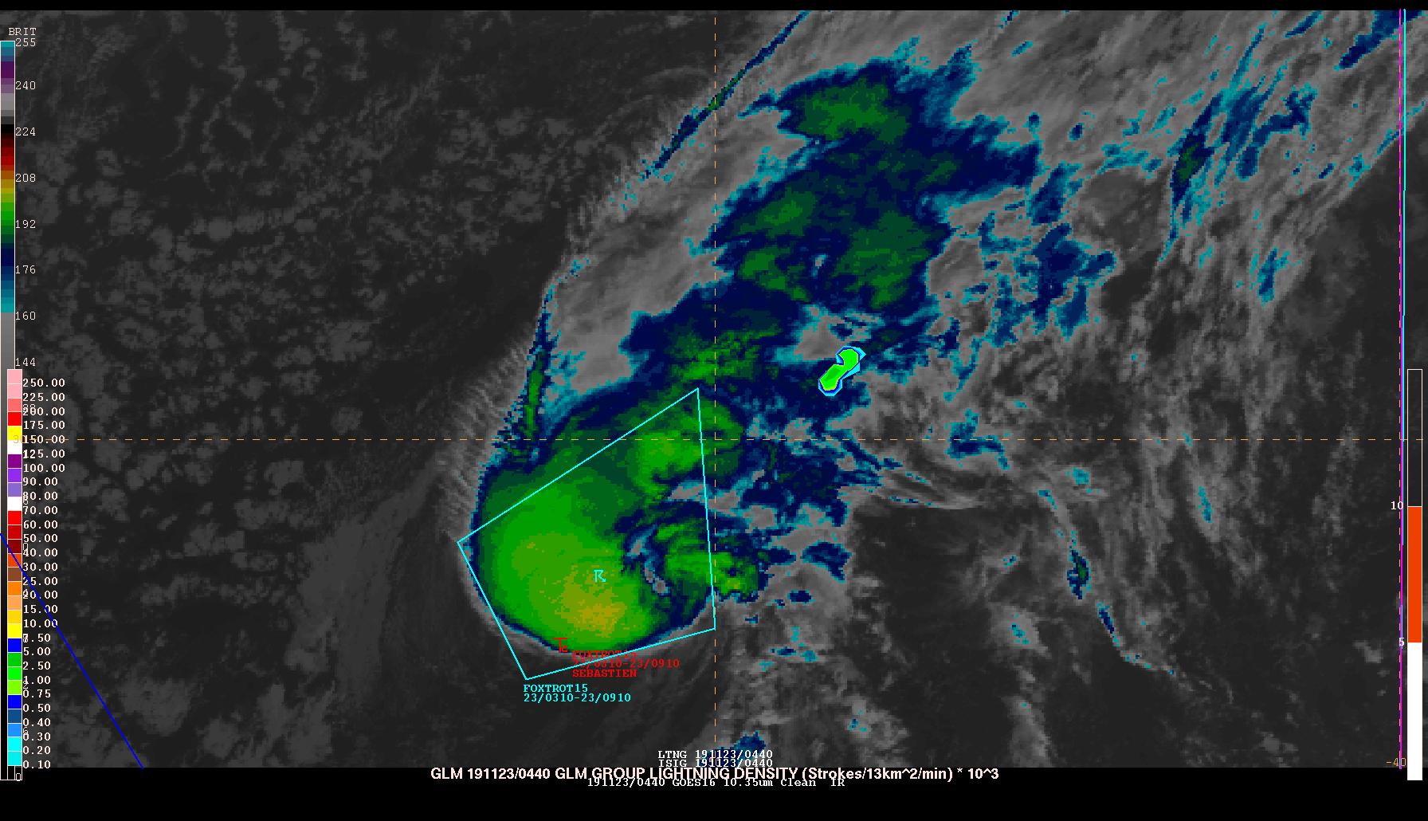
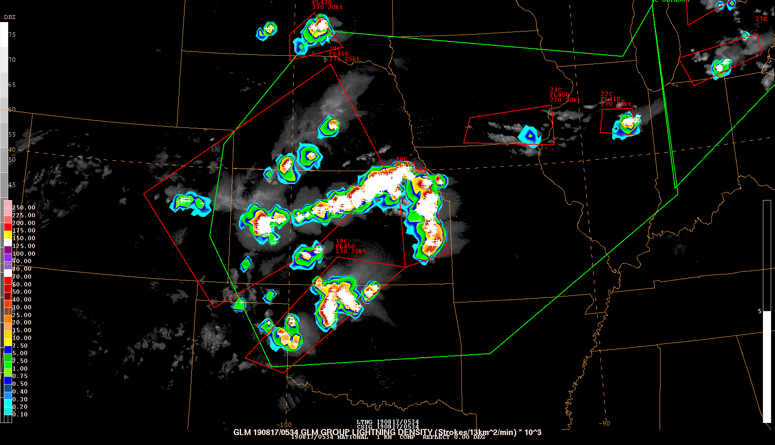
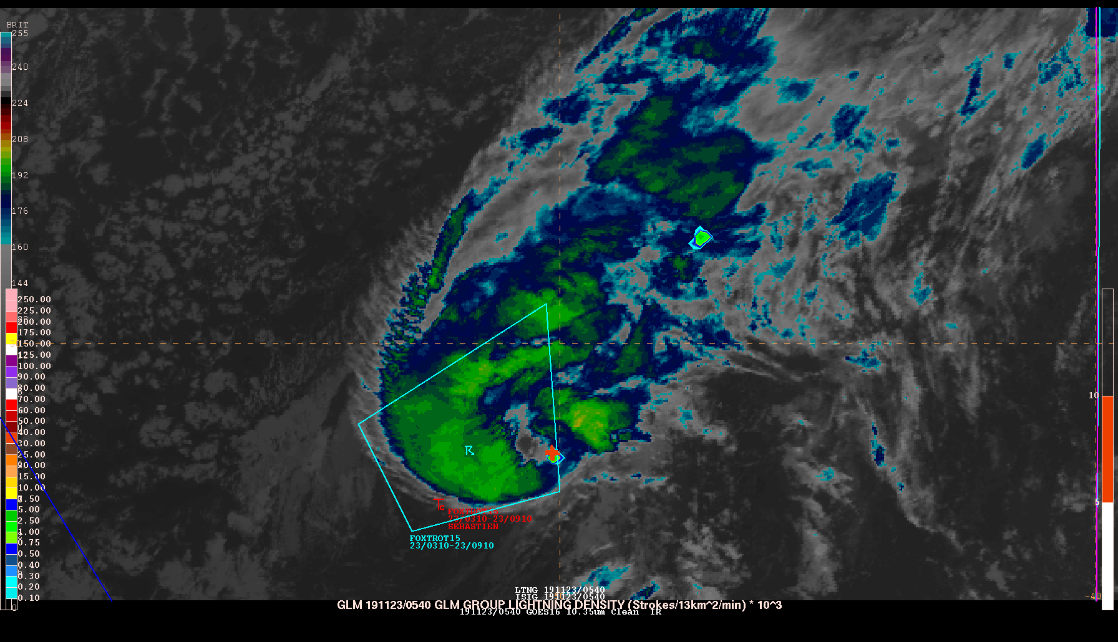
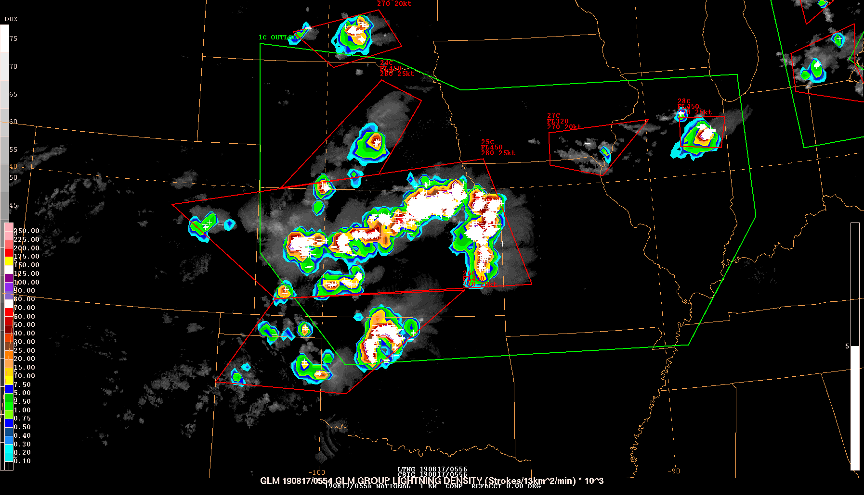
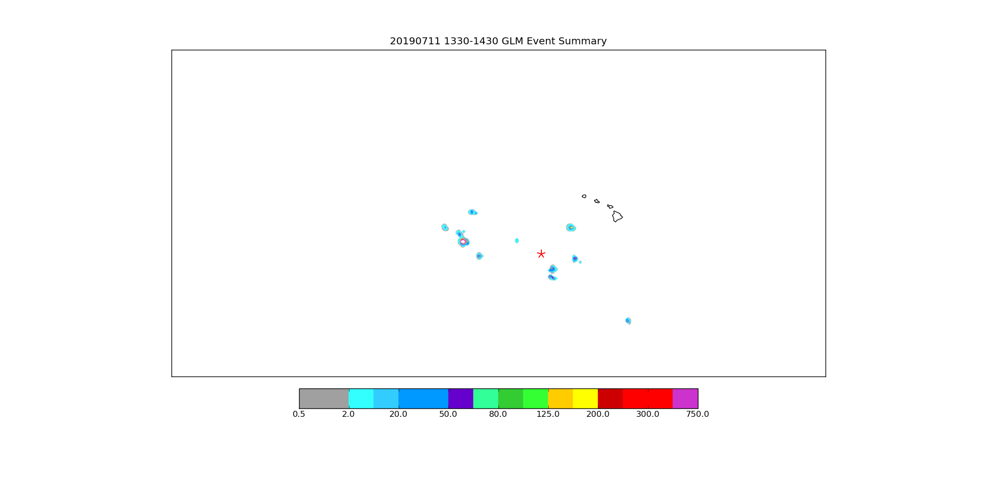
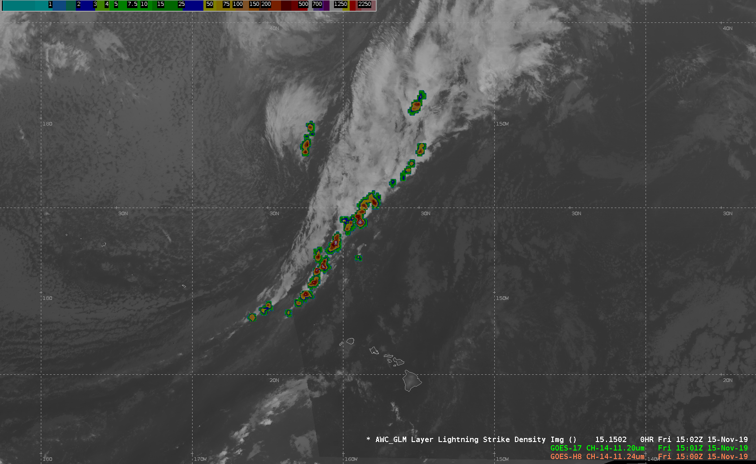
Operational Case Using GLM
Oceanic Coverage
Improved Lead Time
The Aviation Weather Center has been using gridded data from the GOES GLM since the Summer of 2018.
Forecasting convective SIGMETs where there are no observations is already hard enough, but adding in GLM has allowed forecasters to use the data to support Meteorological Watch Offices (MWOs) with Impact-based Decision Support Services (IDSS).
a)
b)‏
IDSS
Transition to AWIPS
Notes:
The Aviation Weather Center has been using gridded data from the GOES GLM since the Summer of 2018.
Forecasting convective SIGMETs where there are no observations is already hard enough, but adding in GLM has allowed forecasters to use the data to support Meteorological Watch Offices (MWOs) with Impact-based Decision Support Services (IDSS).
Here are some examples of how GLM is used to enhance both domestic and international forecast and warning operations at the AWC along with a continued evaluation of its performance.
OCEANIC COVERAGE
The GLM provides AWC forecasters with convective observations beyond the extent of radar data. The above images are IR snapshots from tropical storm Sebastien from 0340-0540 UTC on 23 November 2019 in the central Atlantic Ocean. Notice the embedded convection captured by GOES-16 GLM outside of the Tropical SIGMET region. This additional information can lead to improved convective awareness in IDSS.
IMPROVED LEAD TIME
Active Convective SIGMETs from 17 August 2019. Top left is 0534 UTC showing current SIGMETs with active lightning scattered across Kansas. GLM indicates lightning activity generating between SIGMETs in the Oklahoma Panhandle. By 0545 UTC (top right), only single NLDN is observed in same region. By 0556 UTC, Convective SIGMET has been modified to cover GLM signatures.
TRANSITION TO AWIPS
Combined GLM grids from GOES-16/17 have been adapted at AWC to work with the AWIPS Production system. Above is a snapshot of GOES-17 GLM over Hawaii combined with merged Himawari and GOES-17 IR imagery.
IDSS
The red star shows the location of an aircraft on 11 July 2019 that encountered severe turbulence southwest of Hawaii. The turbulence is believed to be associated with a convective cell. While forecasts yielded little insight to the presence of turbulence, the GLM indicated the presence of numerous rapidly developing and dissipating isolated convective cells.

Slide 9
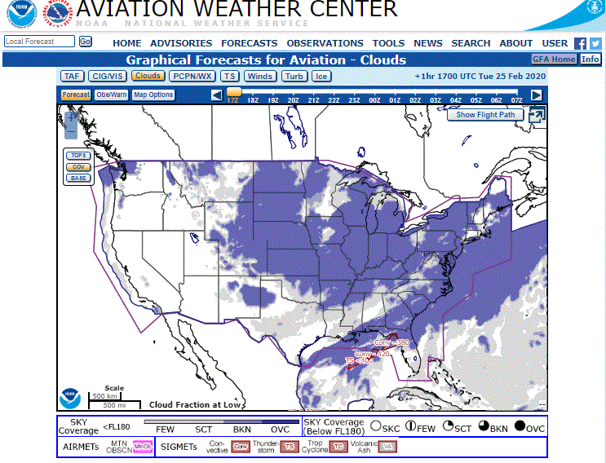
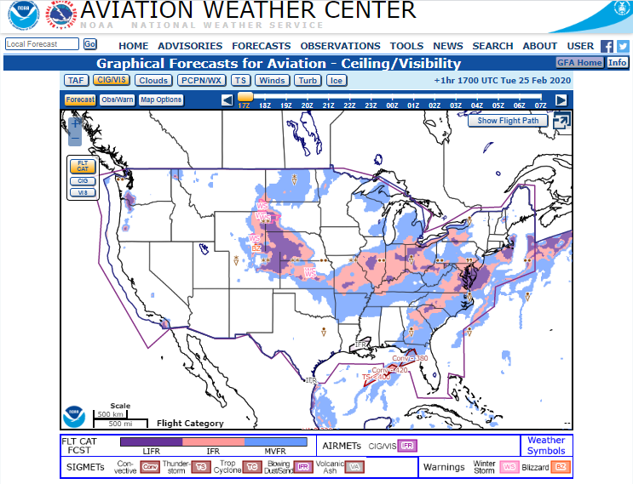
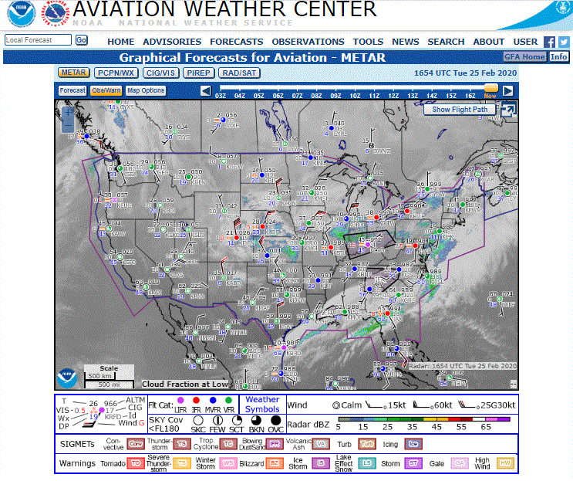
Forecaster Satellite Use Feedback
Ceiling and Visibility Desk
Use Vis/Fog product the most
Vis during the day and Vis/Fog at night
Satellite helps see the trend of fog dissipating or low stratus building
Drawing AIRMETS, or making an amendment…
Satellite is used to determine cloud extent
Very critical for situational awareness of current conditions for low clouds and fog
From the RGB suite, great for seeing smoke
Only tool for seeing blowing dust
Notes:
Ceiling and visibility is one of the most leading causes of delays among air travel

Slide 10
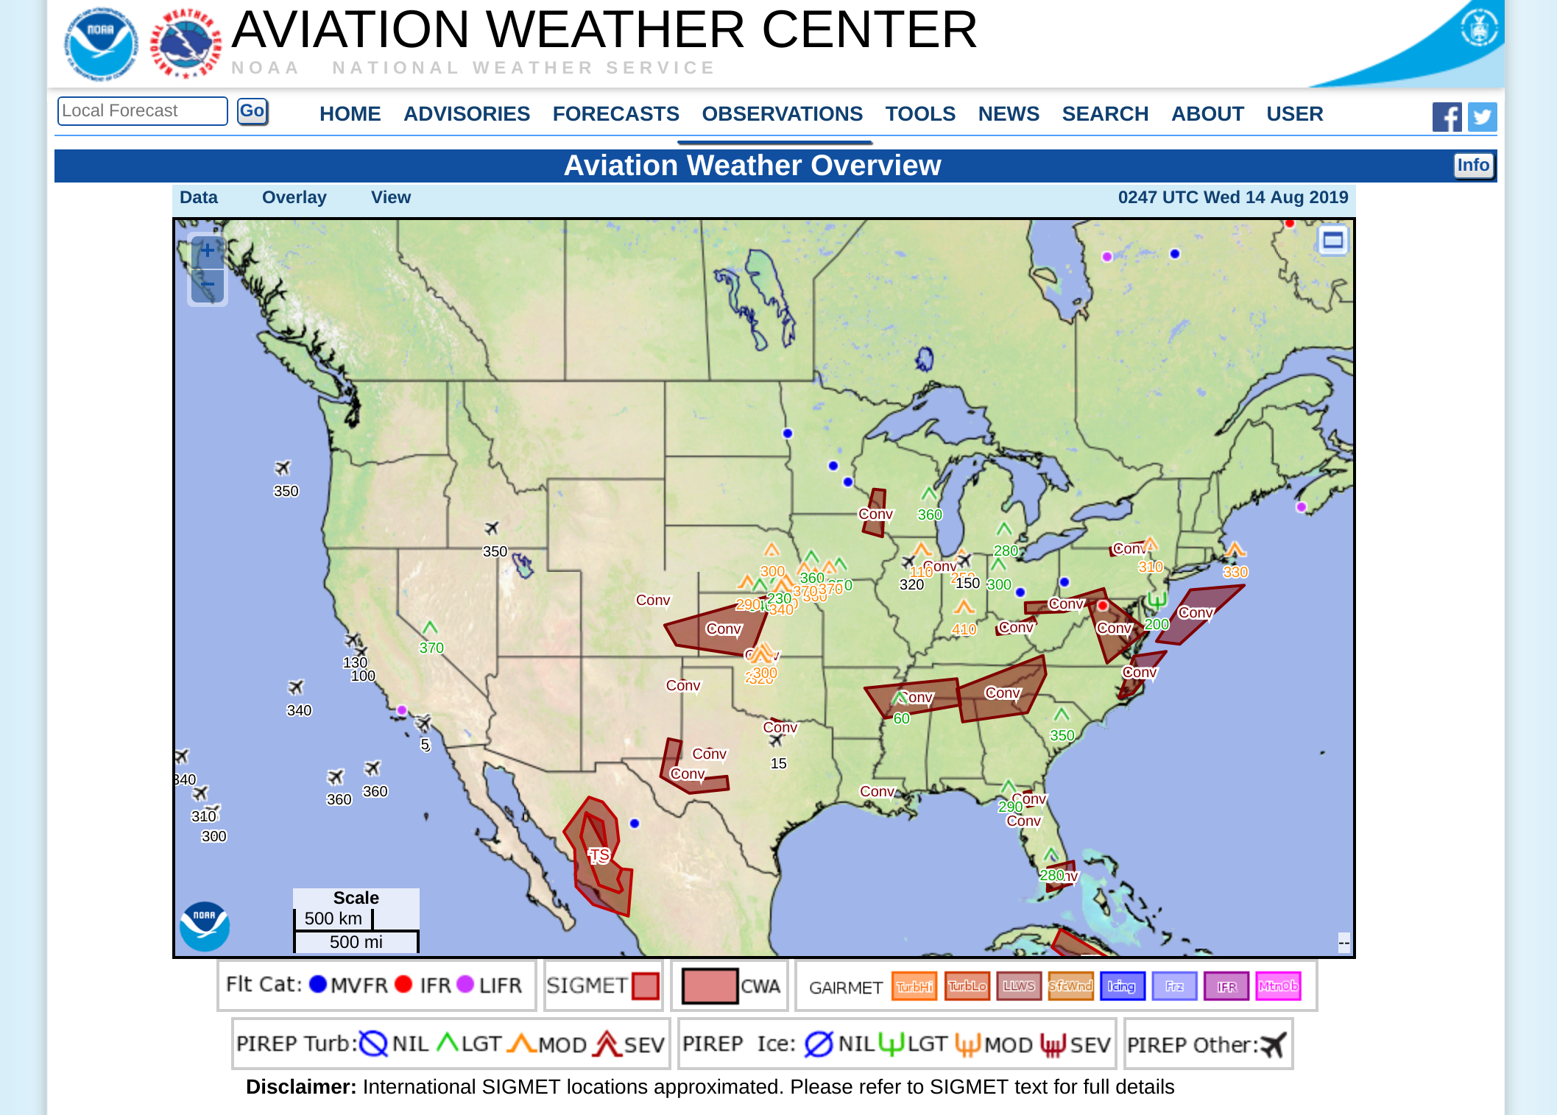
Forecaster Satellite Use Feedback
Convective Desk
Satellite is critical when issuing CSIGs. GOES-16/17 and GLM have vastly improved CSIG coverage and led to greater lead time for developing areas of TS. The availability of CONUS scans every 5 minutes is extremely valuable. In fact, given the shortfalls of radar coverage over the West, CSIG forecasters can rely heavily on GOES-17 and GLM for issuance.
Anticipating convection. CSIGs are hourly products and so much can evolve with convection in between those issuances. Use visible satellite imagery (including the 1-min loop when available) to look for towering cumulus and signs of new development.
IR imagery to help shape CSIG areas. When there is a well developmed MCS, convectively induced severe turbulence can be found many miles away from the apparent system i the cold cloud shield. Make sure area is covered by CSIG.
Cloud height tool for a second confirmation on storm tops.

Slide 11
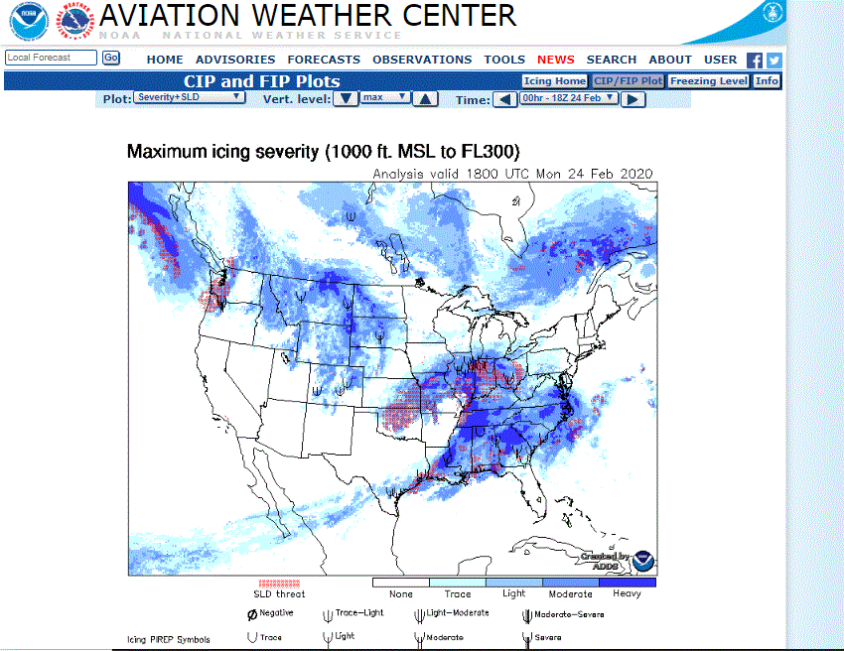
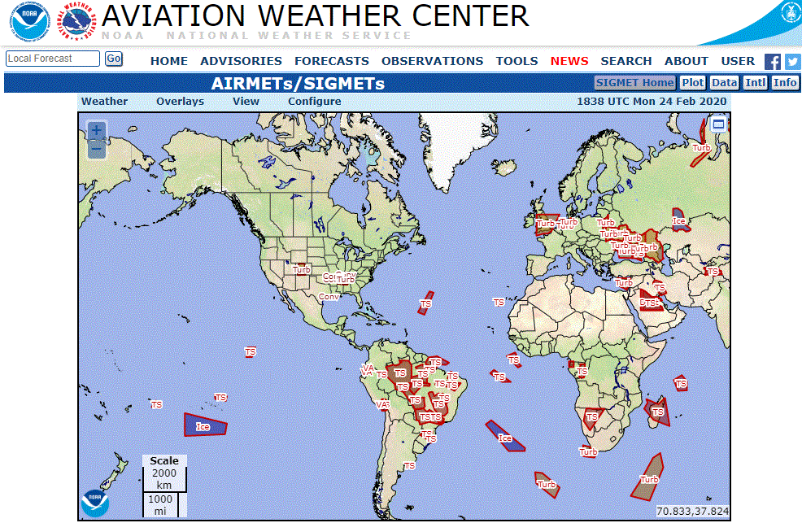
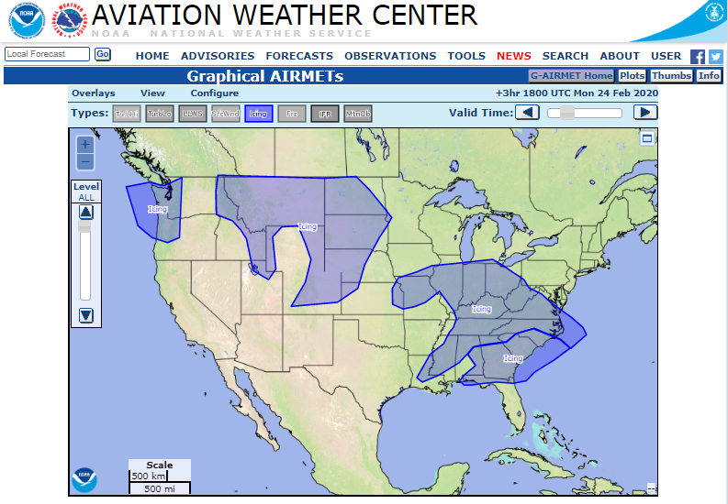
Forecaster Satellite Use Feedback
Tropical and Icing Desk
The main issue with JPSS -> Images take a long time to process and have a large temporal disparity.
GOES -> Getting the ABI cooling problem fixed.
Get the next version of Himawari with GLM capability in space. GLM = Good!
Shortwave IR imagery, with a color table set up to emphasize cloud tops with temperatures in the 0°C to -15°C range.
Indicates the presence of super-cooled liquid water droplets, which is the primary concern of the icing desk.
Anything colder is likely to be glaciated and contain mainly ice crystals, while warmer is too warm for ice.
Notes:
Possible Future Collaborative Forecast Process Steps:
AWC would derive first guess grids of Primary, Secondary, and Tertiary cloud base and corresponding sky cover
These grids would be edited by local WFOs through the DAS paradigm to derive a TAF that can include up to three cloud layers
The final edited grids would be used to derive needed cloud variables for the GFA (cloud bases, tops, coverage, presence of layers, cirrus) at AWC
This would allow for a consistent depiction of clouds across all levels; from local to national.

Slide 12
How the Satellite Community Can Help Collaborate on Future Interests
Any increase in resolution or scans would be helpful.
Use improvements when it comes to latency with getting scans into our workstations.
There is typically a 4-5 minute delay with getting the data, which has an impact at issuance time if additional areas of convection develop.
One of the problems is when you have multiple cloud layers
Only getting cloud top temperatures from the top layer. Could have an icing layer being obscured.
Having a way to view cloud top temperatures for multiple layers.
Possible Future Collaborative Forecast Process Steps:
AWC would derive first guess grids of Primary, Secondary, and Tertiary cloud base and corresponding sky cover
These grids would be edited by local WFOs through the DAS paradigm to derive a TAF that can include up to three cloud layers
The final edited grids would be used to derive needed cloud variables for the GFA (cloud bases, tops, coverage, presence of layers, cirrus) at AWC
This would allow for a consistent depiction of clouds across all levels; from local to national.

