Slide 1
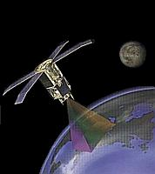
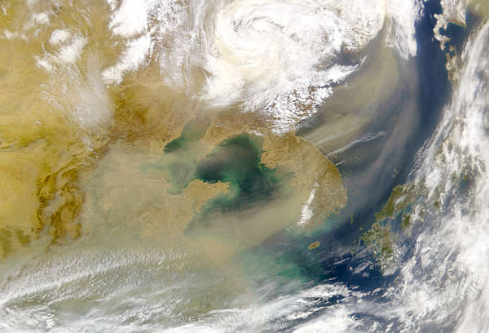
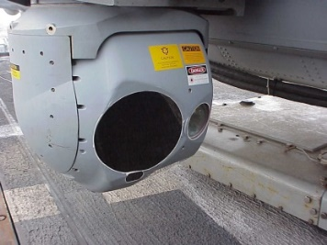
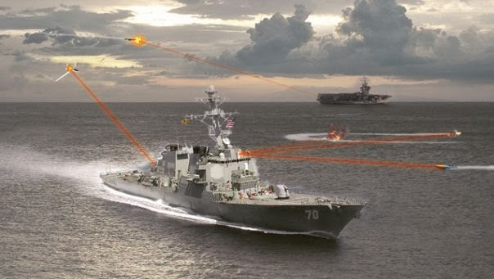
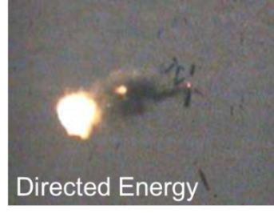
Motivation – Navy Requirements for EO/Aerosol Research
Atmospheric environment (aerosols, clouds) can have a significant impact on visibility and EO conditions:
Passive sensors: Visibility for operations; EO/IR sensors, satellite sensors
Active sensors: Directed energy; laser communications; laser radar; precision guided munitions illumination
Low visibility
Satellite
FLIR
Night Vision
Laser Designators/DE
Goal: Measure, model, and predict the impact of the environment on naval operations, and EO/IR sensors and weapon systems
Notes:
Notes: Two sheets in the embedded EXCEL spreadsheet for funding. One for slide (shown above) and one with details including PE/CLI combination.

Slide 2
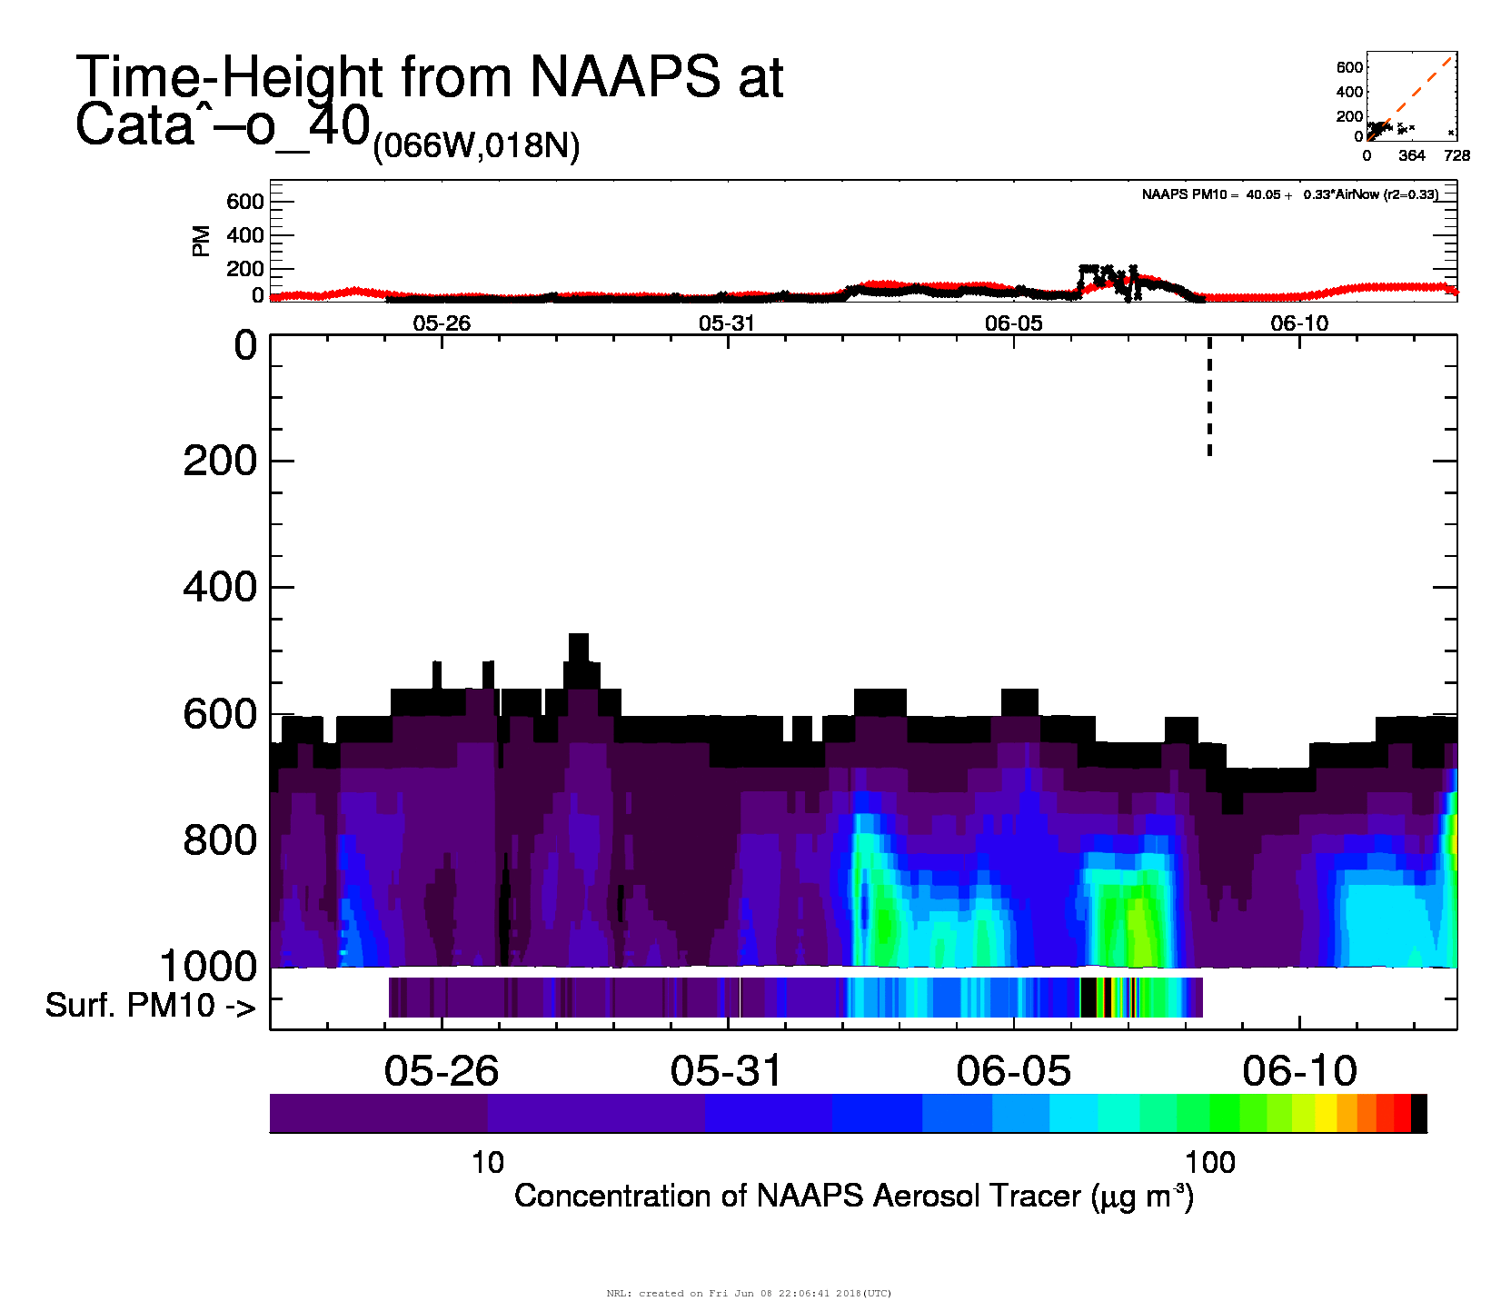
Predicting Large PM Events: Puerto Rico June 2018
Black Line / Stripe at bottom: EPA AirNow PM2.5, Cataño, Puerto Rico
Red Line / Curtain: Navy Aerosol Analysis and Prediction System
Large surface PM event 6/1-6/8 captured in the model
Model Predicts high PM on 6/12
How’d the model do?

Slide 3
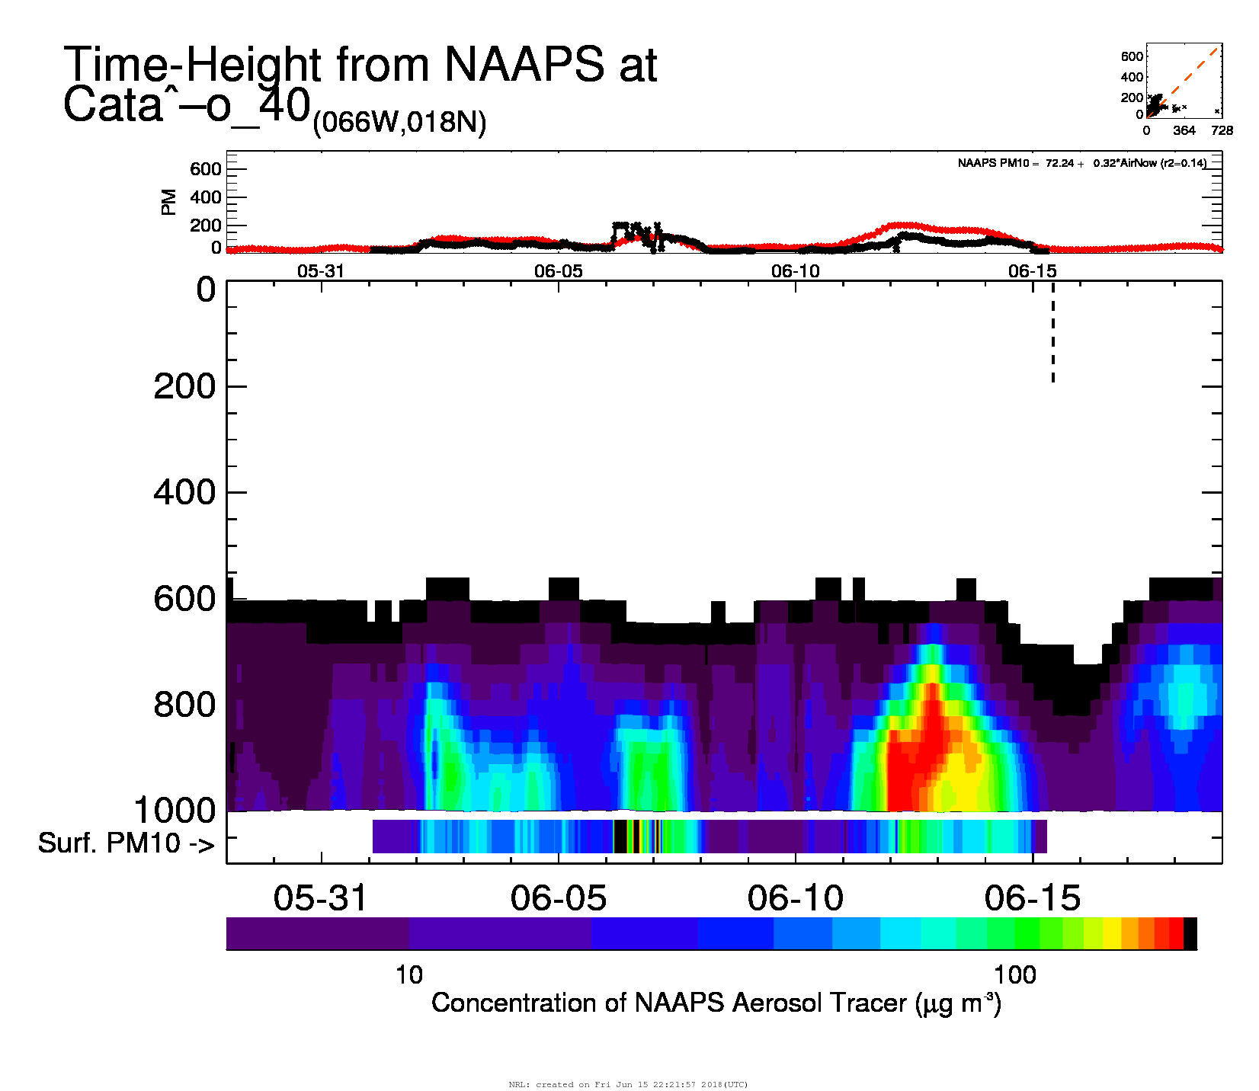
Predicting Large PM Events: Puerto Rico June 2018
Black Line / Stripe at bottom: EPA AirNow PM2.5, Cataño, Puerto Rico
Red Line / Curtain: Navy Aerosol Analysis and Prediction System
6/12: Surface PM >100ug/m3
NAAPS overpredicts but captures timing
So, the model can predict long-range PM2.5 events at this location?

Slide 4
Predicting Large PM Events: Puerto Rico September 2018
Left: Evolution of NAAPS forecast AOD
Right: Verification vs AirNow PM2.5
At PR, event was predicted multiple days ahead
Shape of forecast event changed drastically
16/09/2018 18:00 UTC 138-Hour Forecast 17/09/2018 18:00 UTC 114-Hour Forecast
a)
19 Sep 2018
PM10 Observations
Significant Dust
Event in Forecast
18/09/2018 18:00 UTC 90-Hour Forecast
19/09/2018 18:00 UTC 66-Hour Forecast
b)
24 Sep 2018
Observed spike in PM10
The four panels above show the 16/09/2018 18UTC, 17/09/2018 18UTC, 18/09/2018 18UTC, and 19/09/2018 18UTC NAAPS forecasts for 22/09/2018 at 12:00 UTC. These maps show the modeled aerosol optical depth (AOD) near the end of the observed event. The Ponce site is marked by the red arrow. The time-height curtains to the right show the NAAPS TPM forecast (a) and analysis (b) compared to the observed PM10, as well as the vertical extent of the plume. While the magnitude of the event remained similar between each forecast, the 16/09/2018 18UTC 138-hour forecast showed the dust plume had a broad spatial extent, and covered all of Puerto Rico. In subsequent runs, the plume was forecast as more elongated and westward of Puerto Rico.
Camacho et al., AGU 2018

Slide 5
Predicting Large PM Events: Puerto Rico September 2018
Black: observed PM2.5 from AirNow
Early forecasts (blue, yellow) show surface event but lagged start
Starting with 2-day forecast, timing matches observed event well
Magnitude rapidly converges to a value that’s too high
Does this indicate a problem with the AOD-to-mass conversion? Or is it something else?
PM10 Start PM2.5 Start
PM10 End PM2.5 End
End of NAAPS Forecast

Slide 6
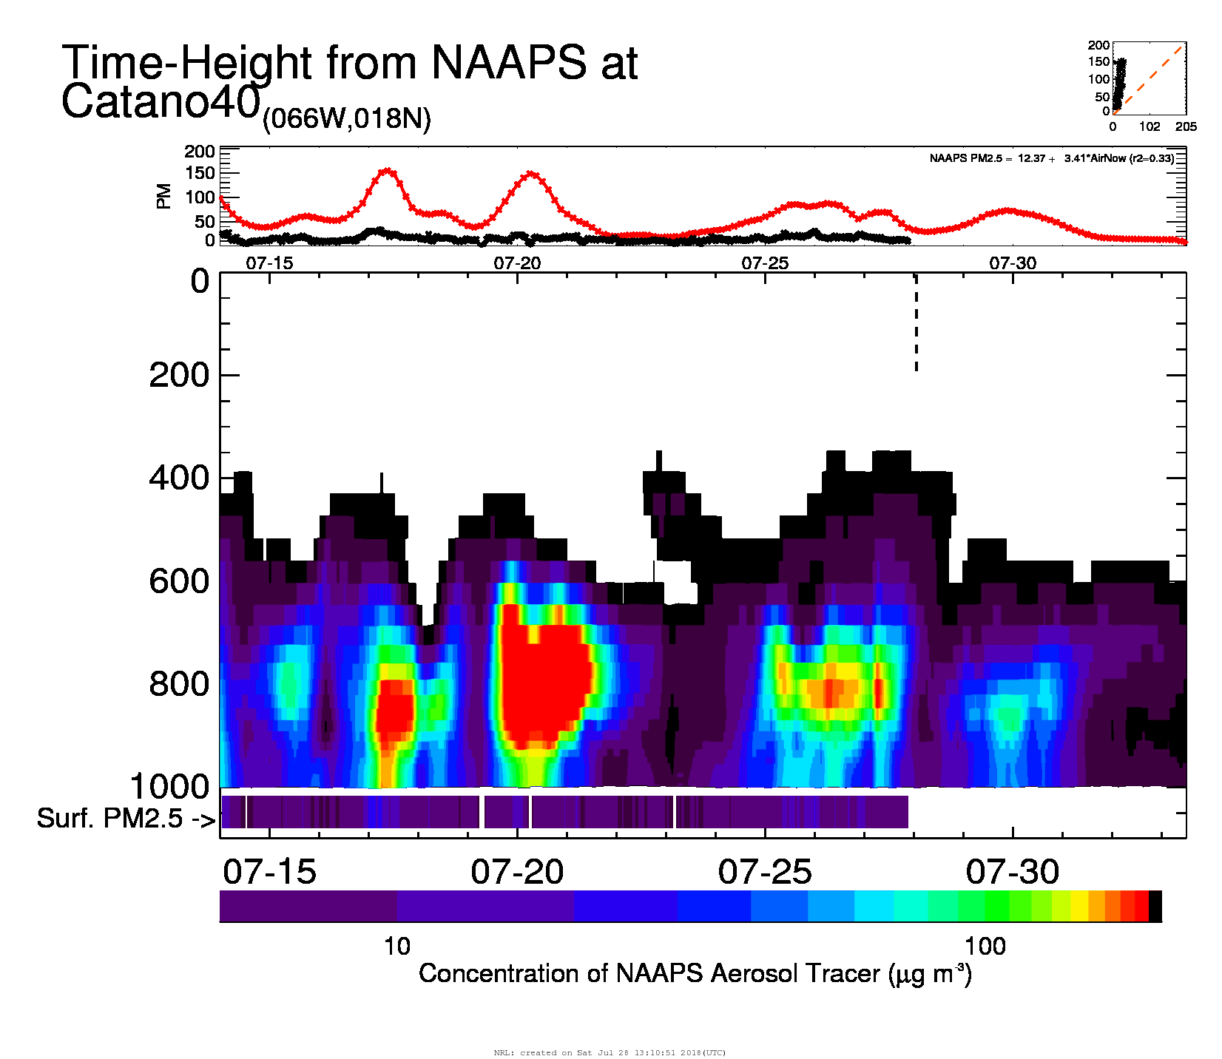
Predicting Large PM Events: Puerto Rico July 2018
Black Line / Stripe at bottom: EPA AirNow PM2.5, Cataño, Puerto Rico
Red Line / Curtain: Navy Aerosol Analysis and Prediction System
July events severely overpredicted by NAAPS
In this case, numerical diffusion is at fault (aerosol was aloft, model erroneously mixed to surface)

Slide 7
Final Slide
Model constrained by AOD used to predict PM2.5
Very sensitive to mass conversion
Mass extinction efficiency
Particle size distribution
Very sensitive to vertical mixing
Model PBL
Numerical Diffusion
AOD to PM: It works, where and when it works
THANK YOU!

