Slide 1
An ESPA-Grande-compatible free-flyer wind lidar mission design for aerosol and/or molecular winds
Sara Tucker, Brooke Walters, Jeff Applegate, Carl Weimer
Ball Aerospace, stucker@ball.com
With special thanks to the Ball Aerospace OAWL development team &
partners, including Mike Hardesty and Sunil Baidar of CU-CIRES/NOAA

Slide 2

Optical Autocovariance Wind Lidar (OAWL): Field-Widened, Dual-Wavelength-demonstrated, Quadrature Mach Zehnder Interferometer (QMZI)
Demonstrated OAWL SYSTEMS Year & Name | Wavelength(s)* |  | Aerosol | Molecular | Ground | HSRL | Airborne | #Looks
 | 355 nm | 532 nm
2011, OAWL-P IIP | X |  | X |  | X | X | X | 1
2013, HOAWL | X | X | X |  | X | X |  | 1
2016, GrOAWL |  | X | X |  | X | X | X | 2
2017, HAWC-OAWL | X | X | X |  | X | X | O | 2
2018, StratOAWL | X |  | X | X |  |  | X | 1#
2020+, Nested OAWL | X | X | X | X | X | X |  | 2
*Reflective cat-eye approach provides wavelength flexibility. 1064 nm concept also considered for high aerosol applications. # Balloon-based on scanning gondola
Quarter wave plate (QWP) + polarizing beam splitters (PBS) provide four relative phase interference points.
Field-widened using all-reflective cat-eye design
π/2
QWP = π/2
PBS
π
Non-Polarizing beamsplitter
OPD = optical path
difference
PBS
0 (2π)
3π/2
$Δ$φ
A
A
Interferometer field-widening enables use of larger system field of view (like CALIPSO), reduces telescope requirements, and enables modularity
O
0
π/2
π
π/4

Slide 3
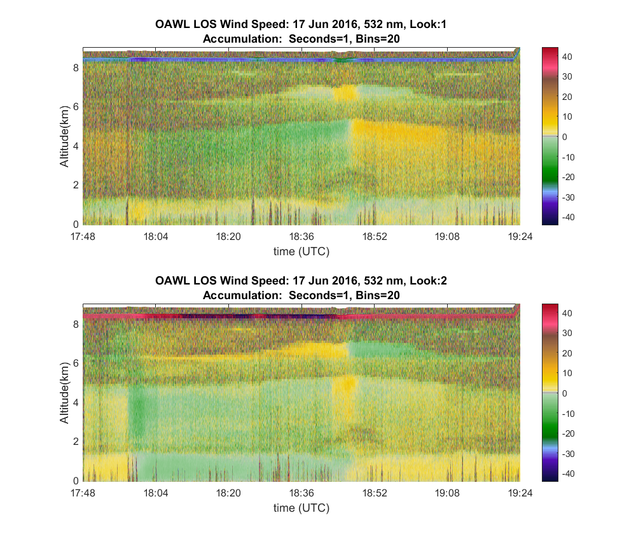
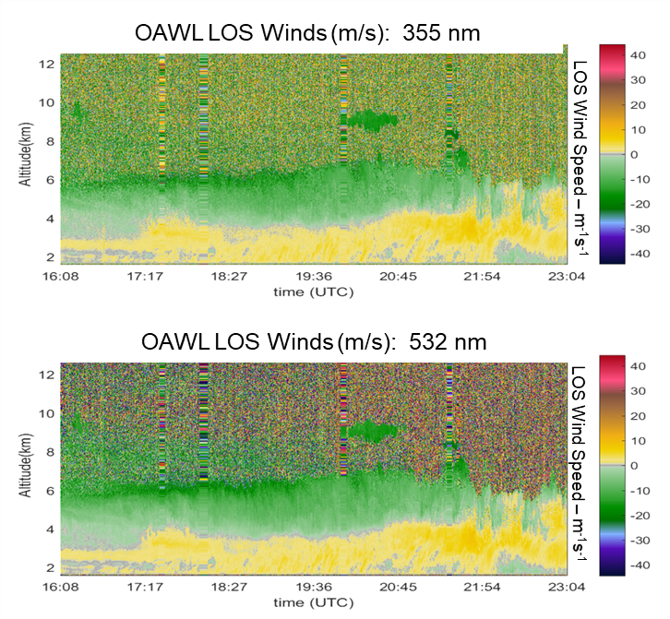
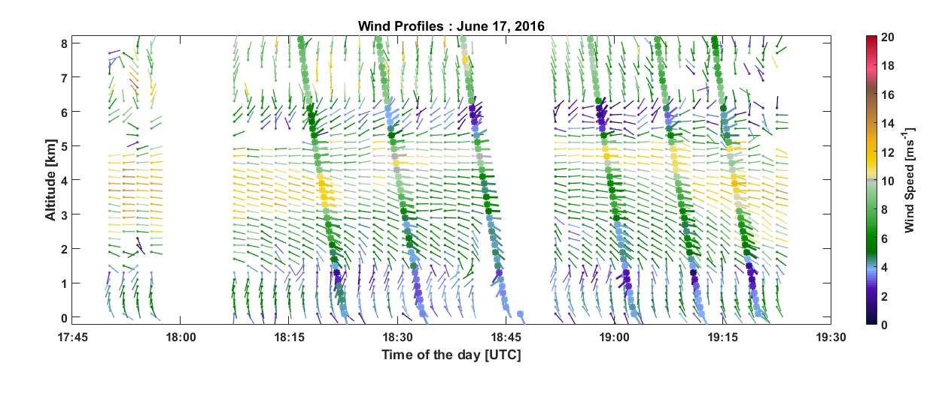
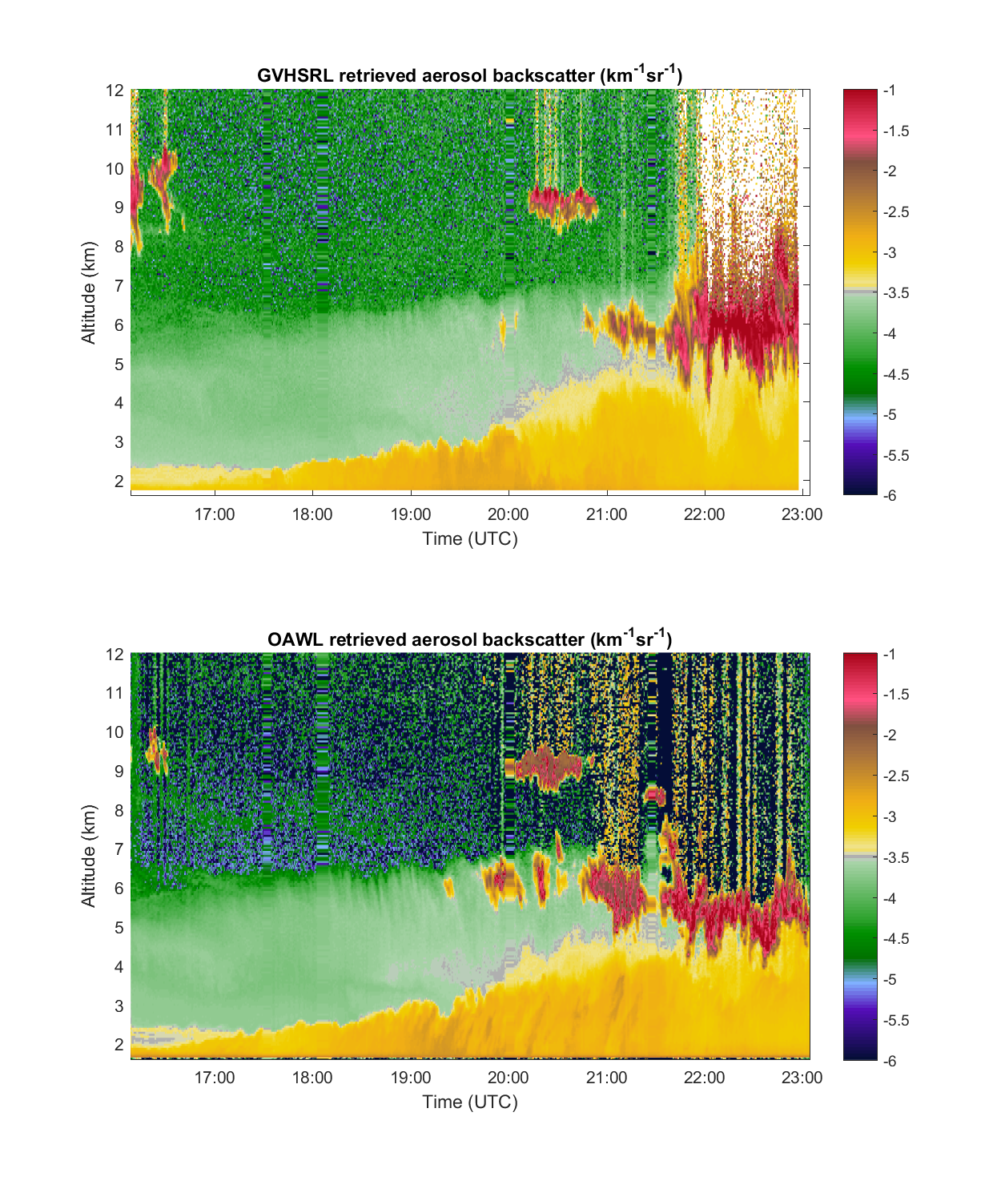


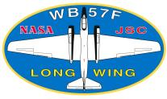


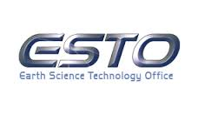



Airborne OAWL Configurations & Demonstrations Ground-Based
17 June 2016: Forward look, 1s profiles,
<1.5 mJ/pulse (0.3 W), 532 nm
Green OAWL (“GrOAWL”)
Airborne demonstrator for 532 nm Aerosol winds: (flown on WB-57)
Dual 45° Line-of-Sight (LoS) wind speed data – can combine to get speed & direction
Tucker et al., 2018 & Baidar et al., 2018, J. Atmos. & Ocean. Tech,
Variable wind speed processing
parameters: 0.5-20 s accumulation,
8.5 m to 1 km range gates
based on aerosol loading
HAWC-OAWL
Dual wavelength (355 nm
& 532 nm) OAWL aerosol winds
(could build for 1064 nm too…)
Concurrent dual wavelength
HSRL (no crosstalk) for aerosol backscatter coefficients
Ground-based observations
Pointing 30° El, ~270° Az.
LOS Wind Speed, m/s
Aft look, 1s profiles
LOS Wind Speed, m/s
OAWL 532 nm aerosol backscatter coefficient
Backscatter - km⁻¹sr⁻¹

Slide 4
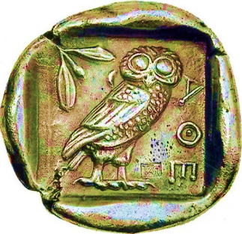
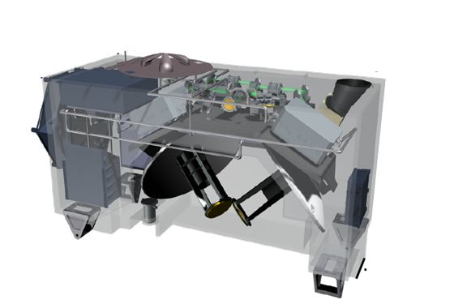
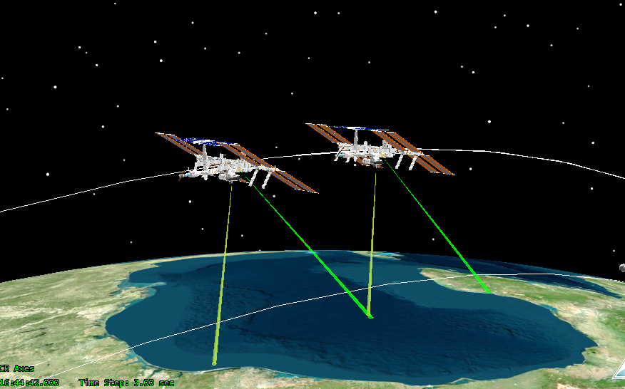
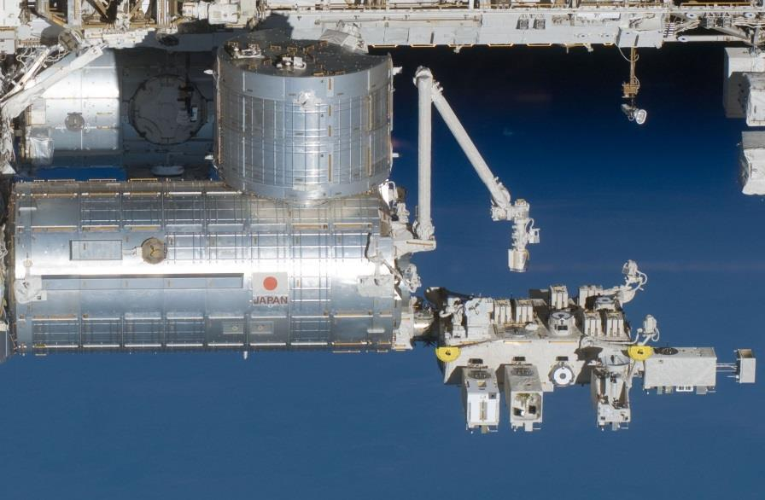
ATHENA-OAWL Earth Venture Instrument (EVI) proposal for ISS
ATHENA-OAWL: Aerosol Transport, Hurricanes, and Extra-tropical Numerical weAther using OAWL.
Path-finding science for next-generation global weather prediction and climate analysis: co-located wind and aerosol (HSRL) profiles to address multiple dynamics and aerosol science questions
Design-to-cost approach to NASA EVI based on heritage systems (i.e., CALIPSO) & International Space Station
Proposed in 2013 (Cat 3) and Re-proposed in 2016. Rated Category 2 in 2018 (Selectable), not selected → Aeolus launched August 2018.
Designed for Japanese Experimental Module: JEM-EF
  Provides large margins on mass, power, cooling availability
  Limited slot availability
ISS not an option for Earth Venture proposals since 2018
RAM direction
ISS Ground
Track
Notes:
Objectives: Co-located wind and aerosol profiles to provide:
better understanding of relationships between aerosol radiative forcing, atmospheric dynamics and the genesis and lifecycle of tropical cyclones
understanding of the impacts of long-range dust and aerosol transport on global energy and water cycles, air quality, and climate.
breakthroughs in modeling and prediction of low and mid-latitude weather and climate.

Slide 5
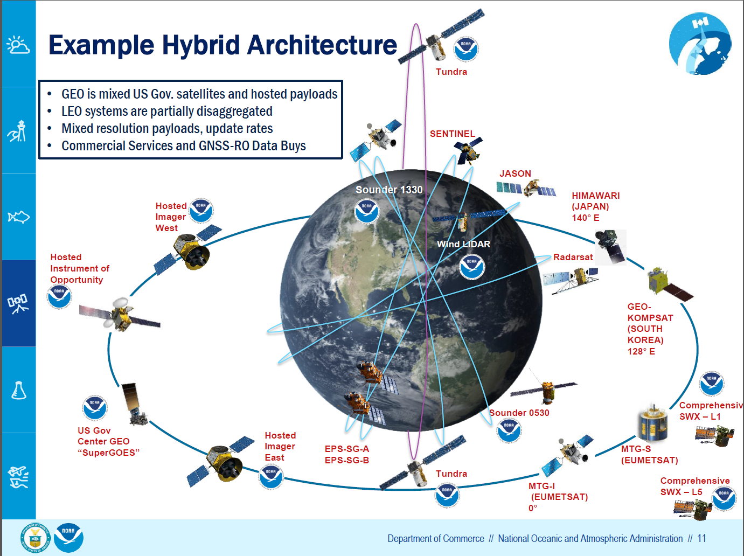
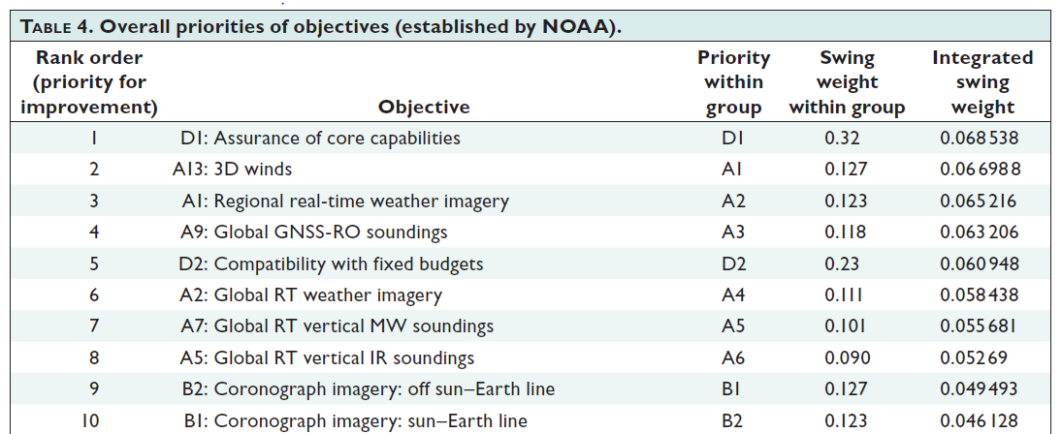
Internal Free-Flyer study in support of Next Generation Weather Architecture
Free-flyer OAWL studies to support future NOAA LEO portfolio and NASA Earth Explorer concepts
Objective – provide a valuable wind observation in a low-cost mission concept
Approach: take advantage of the following:
  Growth in launch and spacecraft technology markets
  OAWL design modularity and optical throughput efficiency
  High TRL components from the CALIPSO lidar, etc.
Focused on a smallsat solution to optimize performance and cost
Notional instrument concept chosen based on ATHENA-OAWL design for ISS – with option for 355 nm.
Single line of sight (LOS), ESPA-Grande-compatible concept (for potential rideshare)
  2016: Demonstrated the dual LoS OAWL system in remote aircraft testing – 2 looks still an option for future missions.
  Two spacecraft, each with single LoS, provide more information than 1 spacecraft with dual LoS. - like the “Dual Tandem” approach discussed by Stoffelen
  Also see Horanyi et al., and presentations at Aeolus CalVal meeting.

Slide 6
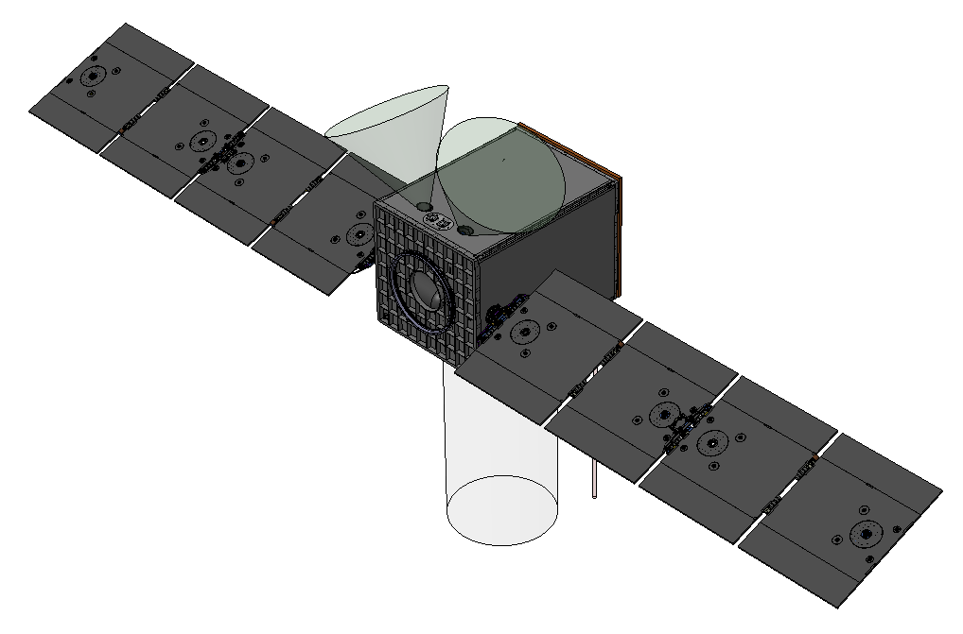
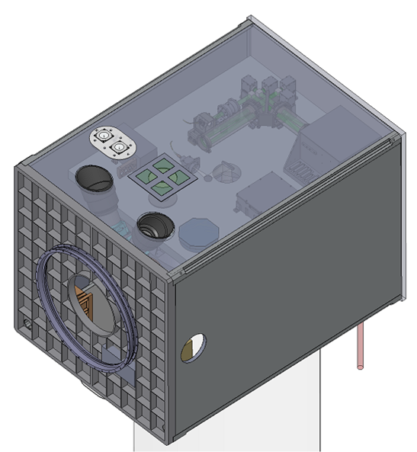
Free Flyer OAWL – Internal Study
Baselined a “sensorcraft” approach, starting with Ball small spacecraft (e.g. STPSat) components, avionics, etc. in an “ESPA-Grande” volume
  Fit a single-look (single laser line of sight) system - like Aeolus, but smaller.
  Concept maximizes science return given requirements and constraints
  Supports 300 – 500 km altitude
  Minimum 5 years consumable life for spacecraft resources.
Considered wide range of mission factors:
  Orbit – power/eclipses, battery sizing, cooling capability, required fuel, etc.
  Spacecraft volume/compatibility, pointing, drag, etc.
Optimized power-aperture product based on spacecraft volume, desired sun-sync orbit, and laser TRL
Bus and payload packaged around an 85 cm diameter telescope & 500W wallplug laser (with required cooling in desired orbit) – and room for small IR sounder
Looking into rideshare vs. dedicated launch options to enable mission within budget concepts
Increasingly lower launch and spacecraft costs enable a wind lidar + sounder concept for a future Earth Explorer mission.
This design is compatible with the various flexible OAWL configurations…
  Radiometric performance results available for various orbits & power levels for each modular configuration.

Slide 7
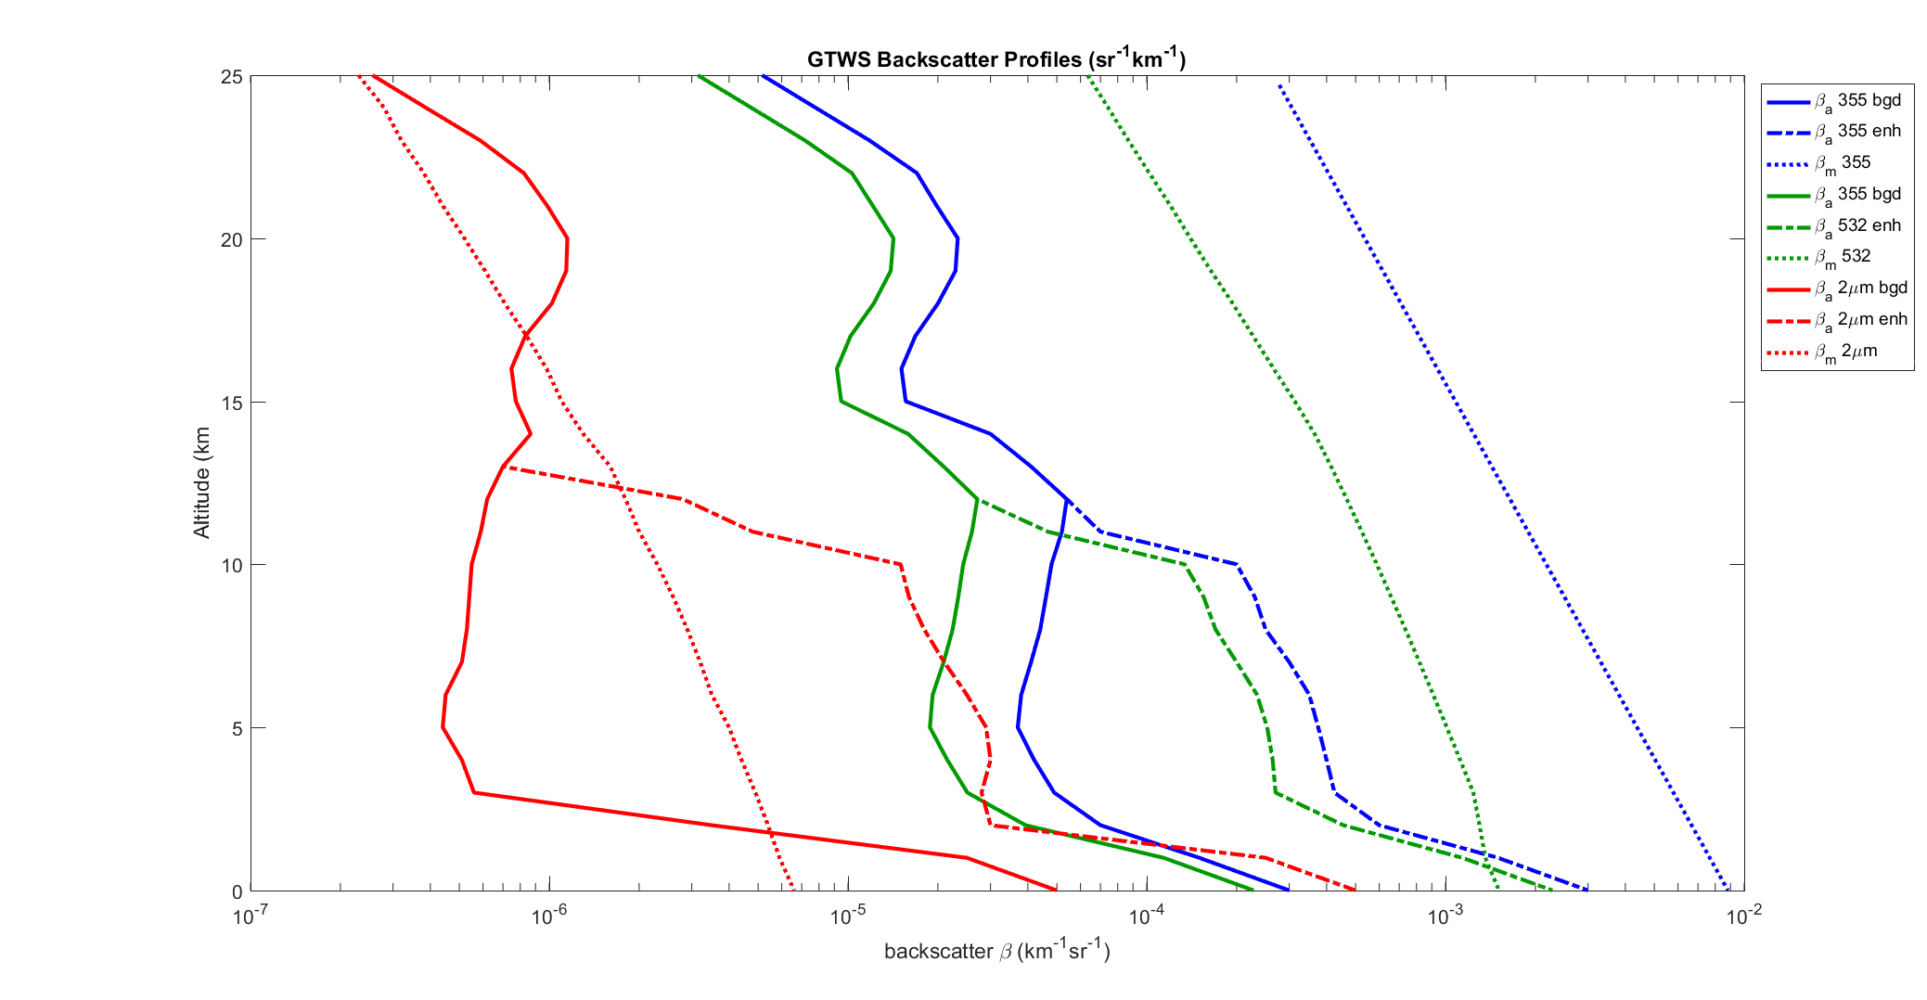
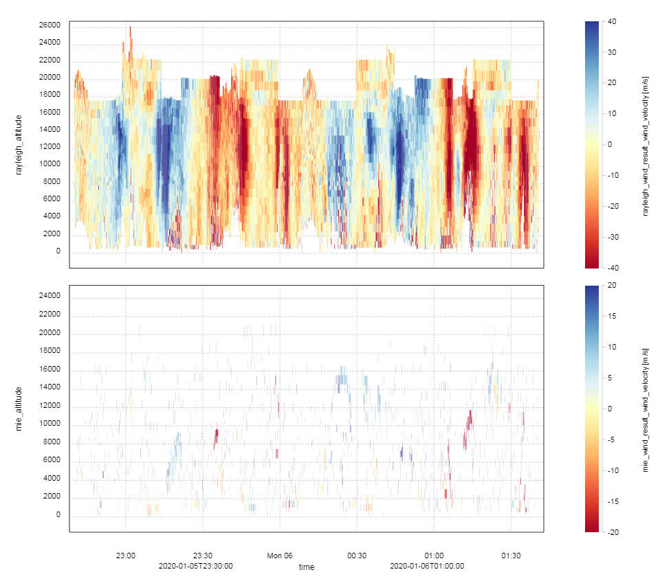




OAWL Developments: a molecular channel for UTLS winds
Why? Coverage (esp. in UTLS)
Aeolus impact, previous OSSE’s
OAWL/QMZI approach has been demonstrated for aerosol winds
We can also use QMZI make wind measurements from molecular returns
  with or without knowledge of aerosol returns
  No aerosol contamination of molecular (Rayleigh) channel
From http://www.swa.com/
target-atmosphere-profiles
These properties factor strongly into which lidars are best for a given application
“Direct” Detection
Double-Edge
Fringe Imaging
Mach Zehnder
Lidar returns increase at cloud layers, with reduced returns after the cloud
returns
M
A
1064 nm, 532 nm (CALIPSO) & 355 nm (Aeolus)
Aeolus Molecular (Rayleigh)
A
Heterodyne
Detection
A
~2 μm, (1.6 μm, ~10 μm)
Aeolus data images: ESA & ECMWF
Aeolus Aerosol (“Mie”)
A
A

Slide 8
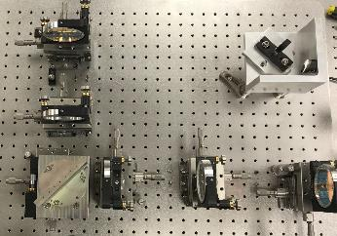
Path(s) to Full Atmospheric Wind Profiles
Aeolus - all 355 nm wavelength
    Molecular (Rayleigh): Double-edge Fabry-Perot etalon
    Aerosol/Cloud (Mie): Fizeau etalon spectrometer
OAWL field-widened QMZIs
  Two 355-nm wavelength QMZIs
    Molecular: Compact, short (~3-4 cm) OPD QMZI -
      StratOAWL - on stratospheric balloon under a DARPA program
    Aerosol: Long (90 cm) OPD QMZI (original OAWL configuration)
      Demonstrated under NASA IIPs (dual wavelength aerosol winds)
      Alternative: Fizeau spectrometer like on Aeolus
  355 nm & 532 nm: The Nested-OAWL interferometer
    Aerosol winds @ 532 nm (long OPD – like previous OAWLs)
    Molecular & aerosol winds @ 355 nm (new short OPD)
    Same laser used on HAWC-OAWL and GrOAWL
    Interferometer & laser frequency stabilization not required
    Internal breadboard build & demonstrations: 2019-2020
Short-OPD, 355-nm QMZI OAWL
Long-OPD, 355-nm QMZI OAWL – or Fizeau
Nested short (355 nm) and long (532 nm) OPD QMZIs
Notes:
Short (molecular) OPD is “nested” inside the long (aerosol) OPD: “Nested OAWLs”
Same detectors as used for the dual wavelength OAWL
2018 IRAD for demonstration is underway

Slide 9
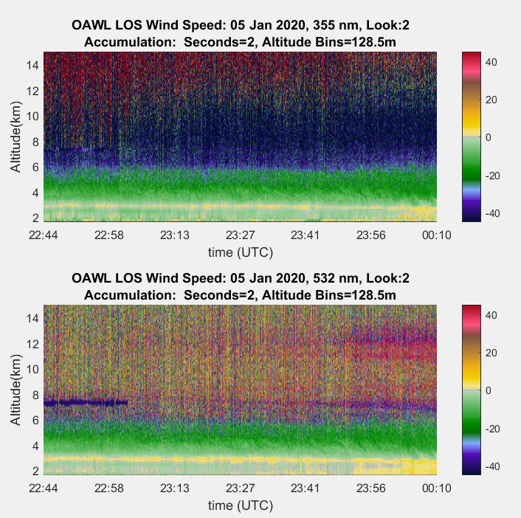
Nested-OAWL demonstration: 05 January 2020
Molecular + Aerosol winds
Ground based operation in
Boulder (1.6 km altitude)
LOS: ~275° azimuth, ~30° elevation
using a turning mirror below the system
Maximum sampling range of ~34 km
(~19 km altitude @ 30 ° elevation )
355 nm (top panel)
  Short (0.04m) OPD molecular + aerosol channel
  large FSR → no wrapping but higher uncertainty
  ~11 mJ/pulse, 200 Hz, (effective ~4.5 mJ/pulse from turning mirror R=0.65² @ 355)
532 nm (bottom panel)
  Long (0.9m) OPD aerosol (“Mie”) channel
  Small FSR - lower uncertainty
    if/when aerosols are present
    Proven 532 nm channel provides validation for 355 nm molecular channel
  ~1 mJ/pulse, 200 Hz.
  Wind estimates outside the FSR wrap 2π, but can typically be unwrapped → they are not lost (like in heterodyne & filter-based approaches)
Preliminary data – algorithm development (incl. ML) in progress
Speed (m/s)
Aerosol only winds
Speed (m/s)

Slide 10
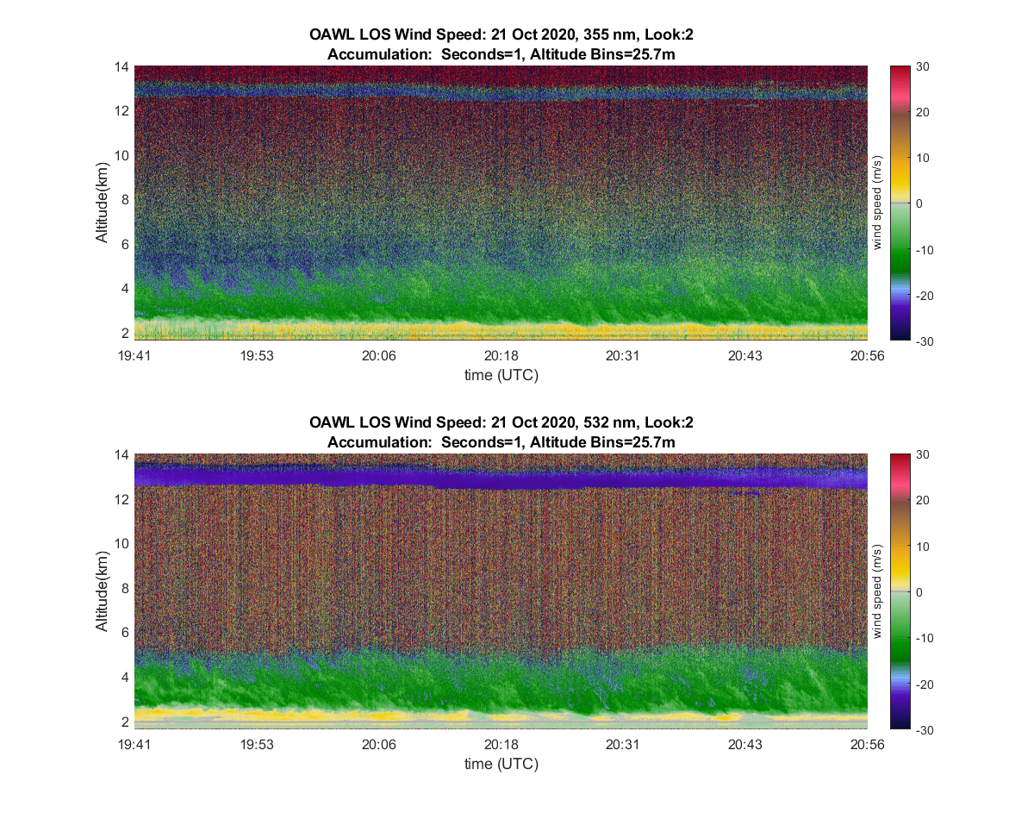
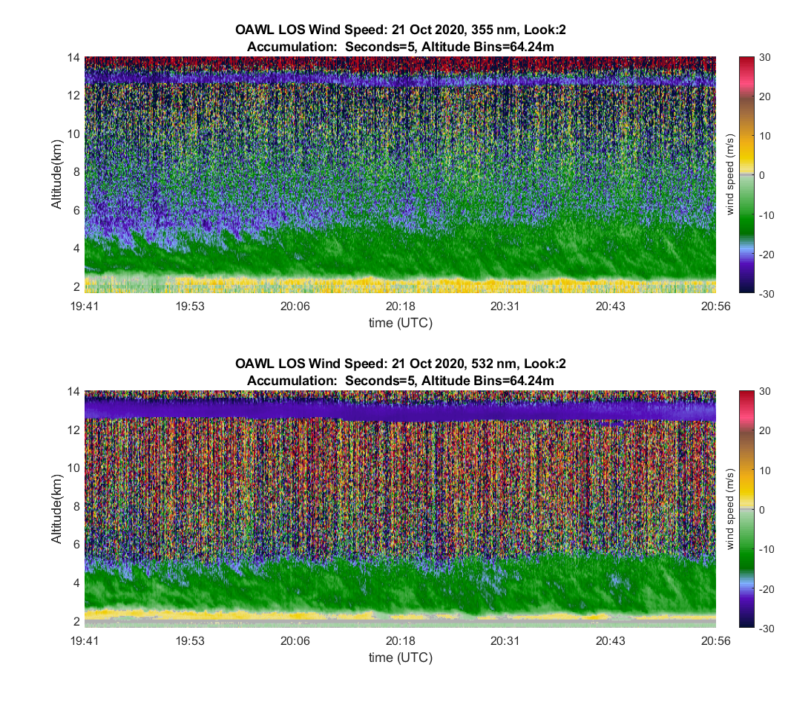
Nested-OAWL: 21 October 2020 (smoke layer)
1s, 26m
5s, 64m
Molecular + Aerosol winds
Aerosol only winds
355 extinction dominates by ~12 km AGL → A downward-looking (airborne, space-based) system would balance extinction with increasing molecular backscatter vs. range

Slide 11
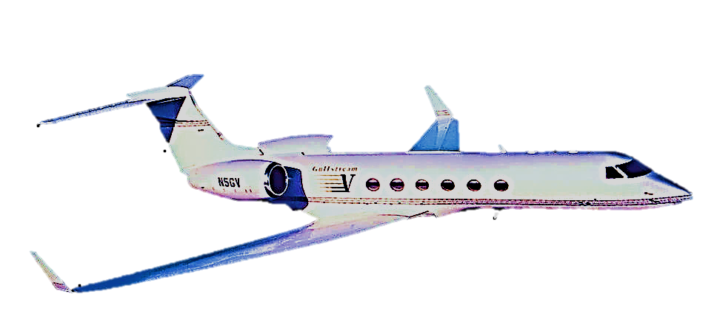
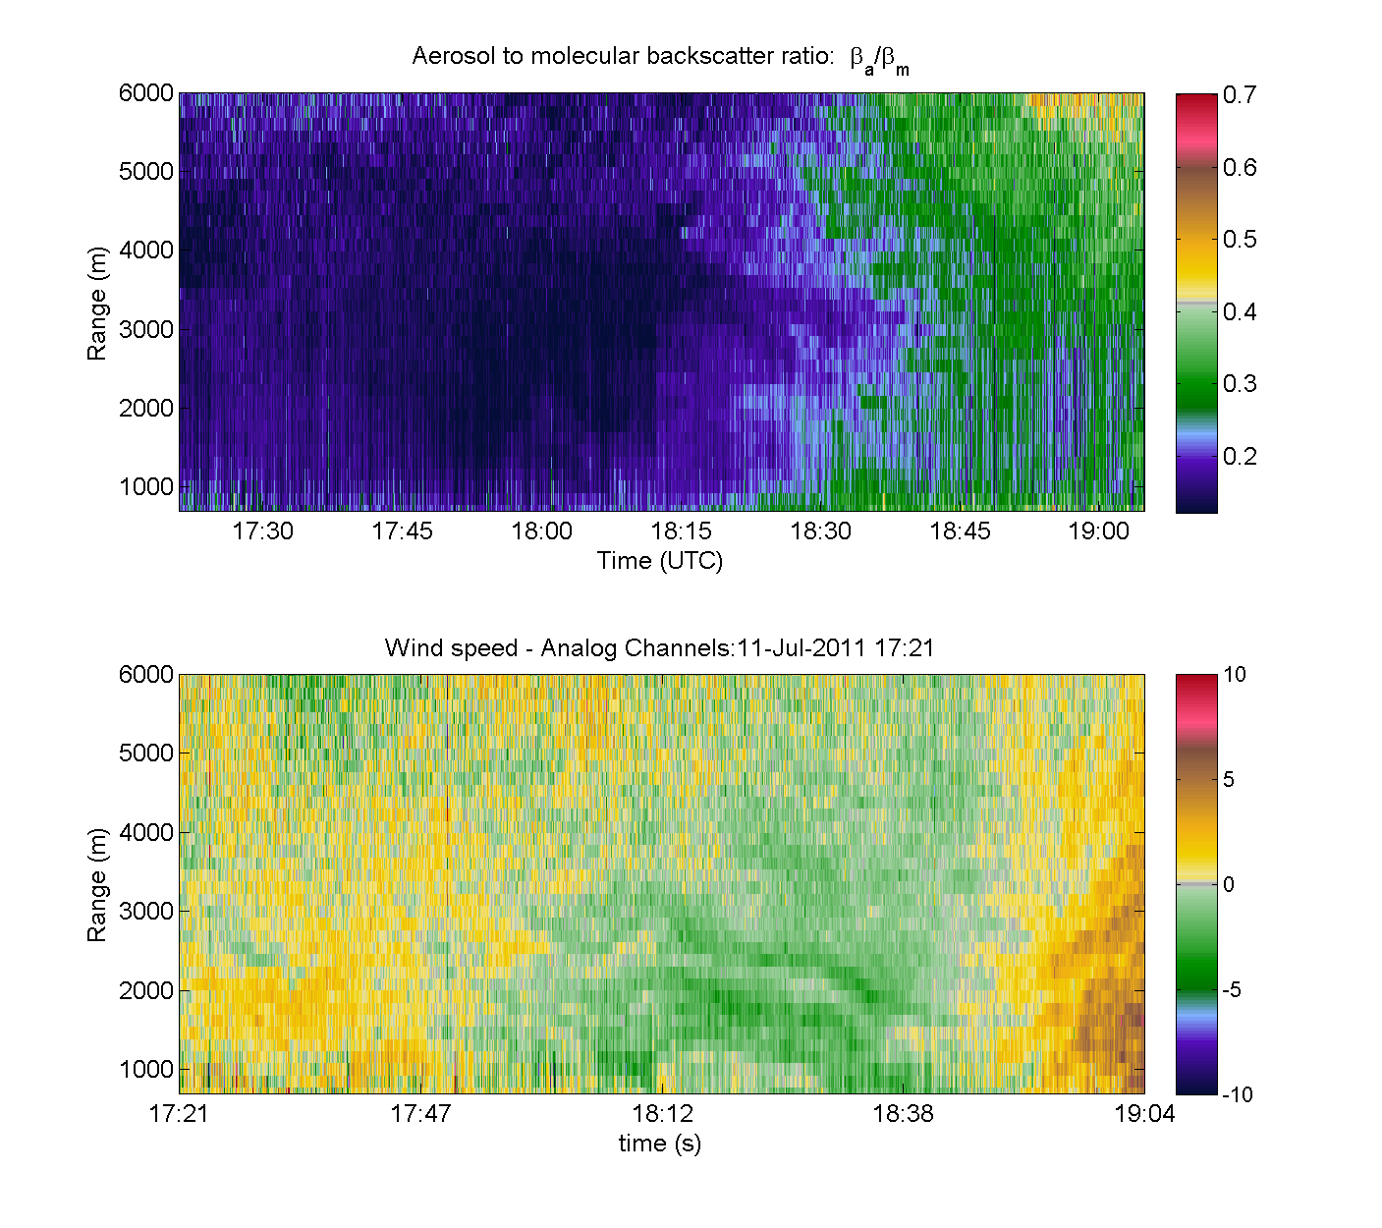
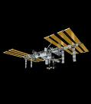
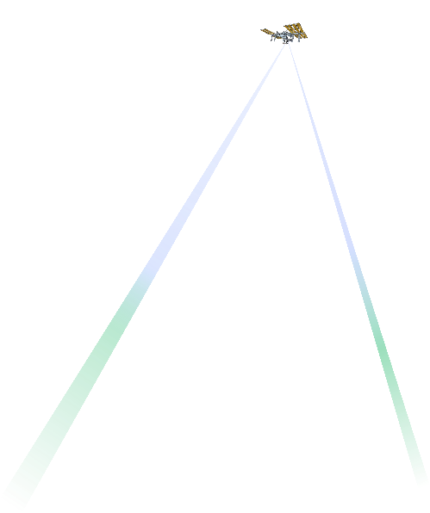
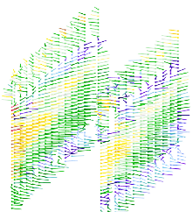

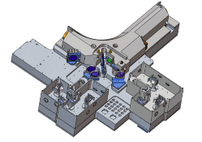

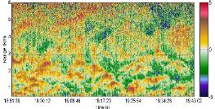
GOING BEYOND: NASA/Ball CALIPSO Lidar >14 Years on orbit!
Ball Aerospace’s Optical Autocovariance
Wind Lidar (OAWL) - Aerosol & Molecular
ESA’s ADM Aeolus (single look – 355 nm Aerosol & Molecular)
*NASA ESTO funded grants (no profit)
Ball funded (IRAD, studies, etc.)
Global 3D winds
NSOSA study
ESDS
 |  |  |  |  |  |  |  |  |  |  |  |  |  |  |  |  |  |  |  |  | ‘30
 |  |  |  |  |  |  |  |  |  |  |  |  |  |  |  |  |  |  |  | ‘29
 |  |  |  |  |  |  |  |  |  |  |  |  |  |  |  |  |  |  | ‘28
 |  |  |  |  |  |  |  |  |  |  |  |  |  |  |  |  |  | ‘27
 |  |  |  |  |  |  |  |  |  |  |  |  |  |  |  |  | ‘26
 |  |  |  |  |  |  |  |  |  |  |  |  |  |  |  | ’25
 |  |  |  |  |  |  |  |  |  |  |  |  |  |  | ‘24
 |  |  |  |  |  |  |  |  |  |  |  |  |  | ‘23
 |  |  |  |  |  |  |  |  |  |  |  |  | ‘22
 |  |  |  |  |  |  |  |  |  |  |  | ‘21
 |  |  |  |  |  |  |  |  |  |  | ‘20
 |  |  |  |  |  |  |  |  |  | ‘19
 |  |  |  |  |  |  |  |  | ‘18
 |  |  |  |  |  |  |  | ‘17
 |  |  |  |  |  |  | ‘16
 |  |  |  |  |  | ‘15
 |  |  |  |  | ‘14
 |  |  |  | ’13
 |  |  | ‘12
 |  | ’11
 | ’10
’09
Operational Airborne mission development
EVI-4 ATHENA-OAWL 532 nm Aerosol winds ISS Mission concept (TMCO rated Selectable)
Full
tropospheric
operational wind lidar
aerosols
Nested OAWL
full troposphere
demonstration
winds
ESA’s
Aeolus
Launch
22/08/18
On-orbit Operational Demonstration
OAWL Mission
concepts
Operational Space Demonstration Flight build
OA Laboratory
Prototype
*HAWC-OAWL IIP
Aeolus
CalVal studies
OAWL provides the highest US TRL
for a Doppler Wind Lidar mission
*GrOAWL
2016 demo
Free Flyer OAWL: ESPA-class wind lidar Mission Concept Study
*OAWL-ACTs
*OAWL-IIP
2011 demo
Notes:
OAWL IIP – First demonstration 2011
GrOAWL: the 2 LOS ATHENA Airborne Demonstrator built, flown, validated, and scaled to space
2 pubs: Journal of Atmospheric & Oceanic Technology: Tucker et al., 2018 & Baidar et al., 2018
ATHENA-OAWL: EVI-2,4 proposals
Aerosol Transport, Hurricanes, and Extra-tropical Numerical weAther using OAWL.
Mission Systems Architecture: Design-to-cost approach: based on heritage systems (CALIPSO) and
ISS hosting
EVI-4, rated Category 2 (TMCO rated Selectable
– but not selected).
HAWC-OAWL: Ground-based demonstrations of dual-wavelength wind and aerosol backscatter coefficient measurements
ESTO managed competitive grants: NO profit

Slide 12
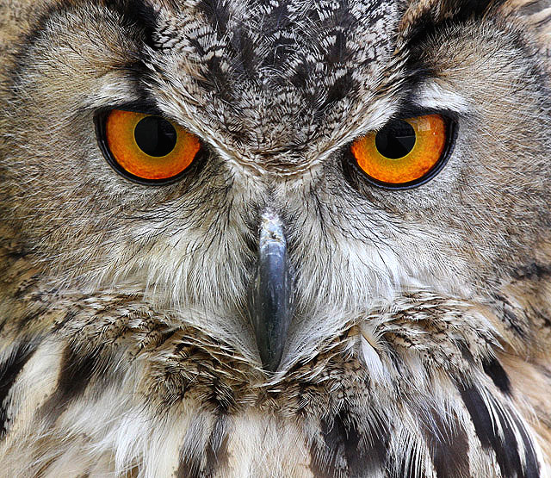
Summary & Conclusions
ESA-Aeolus’ successes and lessons benefit the whole community
  Lidars can provide direct winds measurements from space; the technology is available.
  Aeolus is demonstrating the impact of full tropospheric wind measurements
And yet, we (the whole community) can do more, right away – starting with ongoing Aeolus tests, then Aeolus follow-on, then US missions
The OAWL QMZI technology provides a demonstrated, high TRL, low risk approach to a US aerosol wind lidar mission
A 3D-winds mission can also include sounders, and lidar will provide innovation
OAWL QMZI technical benefits include:
  High throughput/optical efficiency to optimize mission size, weight, and power
  Flexibility to provide Winds + HSRL at various wavelengths (1064, 532, 355)
  Demonstrated options for including a 355 nm molecular channel (like Aeolus) for UTLS observations
Ball continues to invest in OAWL to provide wind observations through the full troposphere and to be a mission partner, supporting future 3D winds missions.
Thank you for listening
Notes:
Since 2017, NASA is only investing in coherent (2 micron) lidar systems. 2 micron system TRLs are low and still require significant development.
No NASA investment in molecular wind lidar systems since 2014

Slide 13
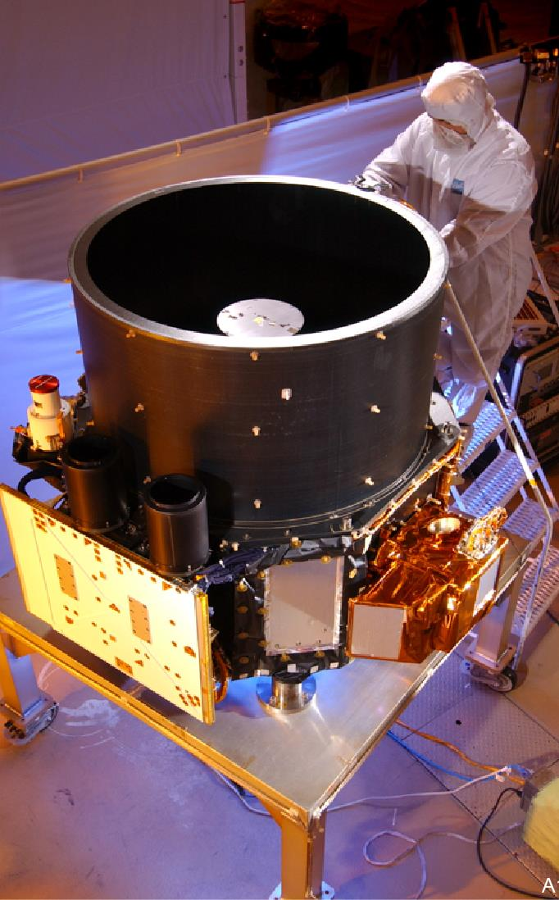
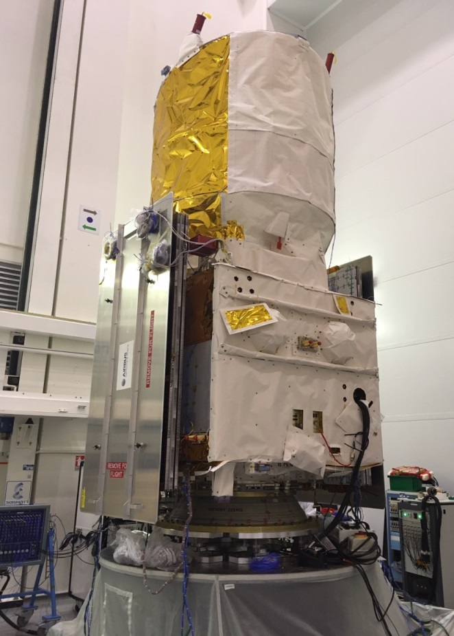
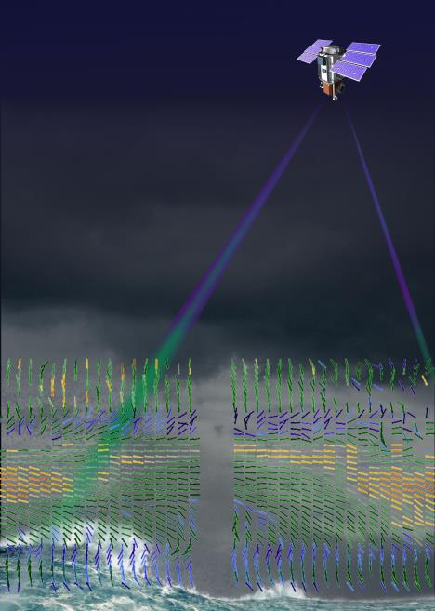
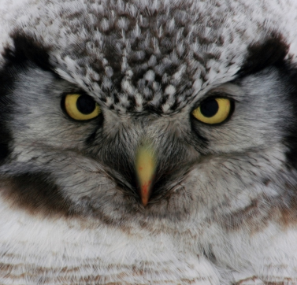
NASA/Ball
CALIPSO
Aerosol
Lidar
2006
ESA’s Aeolus
Wind
Lidar
2018
OAWL: Full tropospheric wind & aerosol observations

Slide 14
EXTRA, EXTRA!

Slide 15


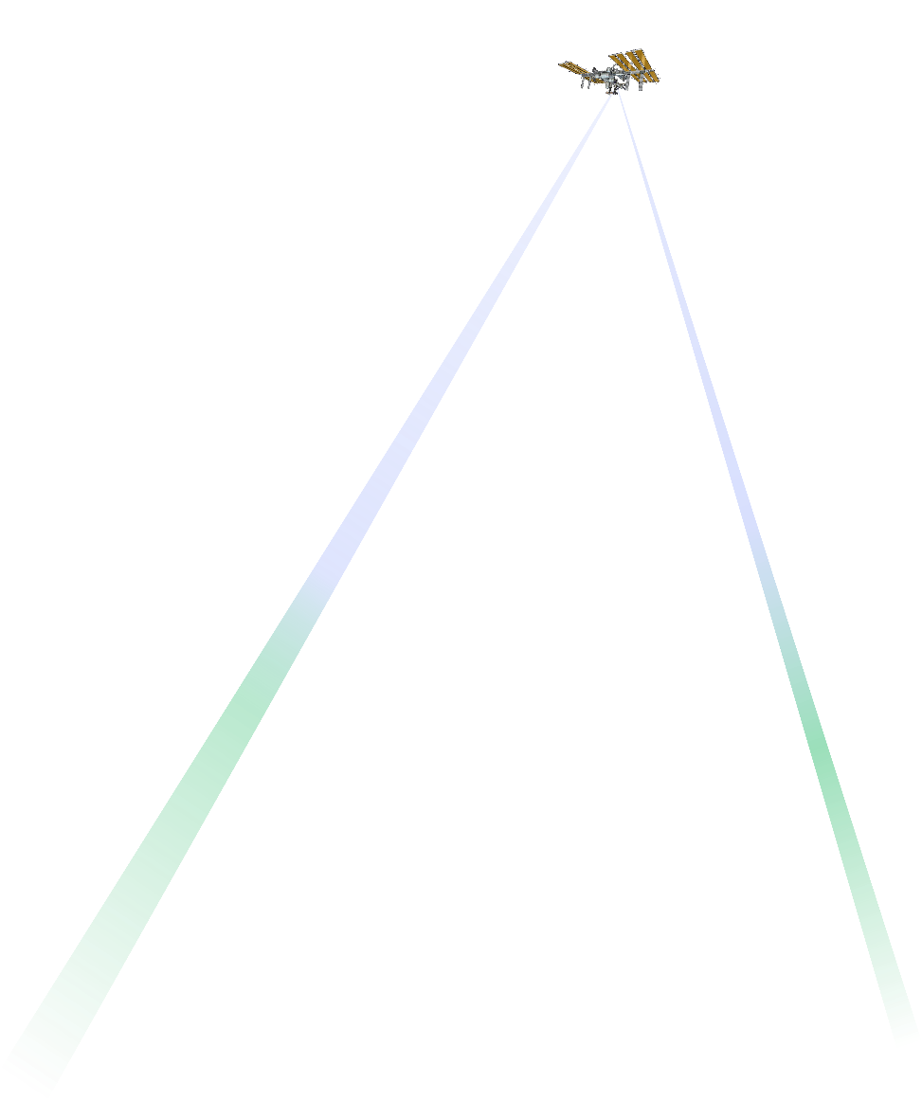
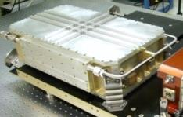
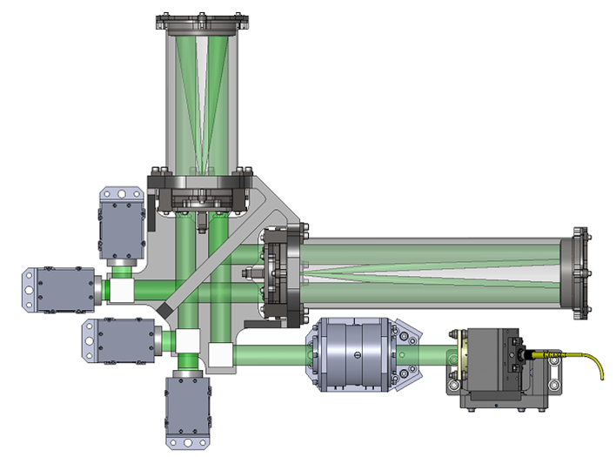

OAWL builds on Aeolus & CALIPSO – and relaxes technical requirements
Wrapping fringes
for removal of platform-motion-induced Doppler offsets or high speed winds in processing without signal loss
Laser - Nd:YAG: doubled (like CALIPSO) and/or tripled (like AEOLUS)
OAWL detectors & real-time processors increase flexibility in processing parameters, altitude
gate size, etc.
OAWL QMZI high throughput efficiency optimizes lidar power-aperture design
Wrapping fringes eliminate need to lock QMZI to laser frequency
OAWL QMZI configurations for aerosol & molecular channels: no cross calibration required & no Mie contamination
Field widened interferometer (~10 mrad+) mitigates biases from changing field angles, provides Tx/Rx overlap margin, and enables use of lower cost (not diffraction limited) telescopes
Like Aeolus, OAWL offers a path to full atmospheric lidar wind profiles

Slide 16
Observing Atmospheric Winds from Space
M
Molecular: UT/LS
Measure 3D Winds
A
Aerosol: LT/clouds
A
W
W
Water Vapor Features
Passive (Motion Vector, sea-state, etc.) Sounders and Imagers
Active
μ-wave
IR
MWIR
visible
Microwave
Optical Doppler Lidar
Optical (feature tracking lidar)
A
Lower troposphere/ aerosol scattering
A
Full-Troposphere & Lower Stratosphere (aerosol + molecular)
M
“Coherent” Heterodyne Detection
“Direct” Detection
1064 nm, 532 nm (CALIPSO) & 355 nm
~2 μm, (1.6 μm, ~10 μm)
LaRC
DAWN
A
Double-Edge
Fringe Imaging
Mach Zehnder
GSFC?
NOAA CSD, NOAA P-3, Halo, Leosphere,
A
M
A
M
M
A
ESA’s
Aeolus
UPMC (France)
ATHENA OAWL
Nested OAWL
Notes:
Plenty of solutions – the challenge is asking the right questions
~40 years of NASA investments in wind lidar technology
Multiple technology investments from NASA ESTO.
NASA/NOAA Working Group on Space-Based Wind Lidar (“LWG”, formerly the LAWS science team, 1989)

Slide 17
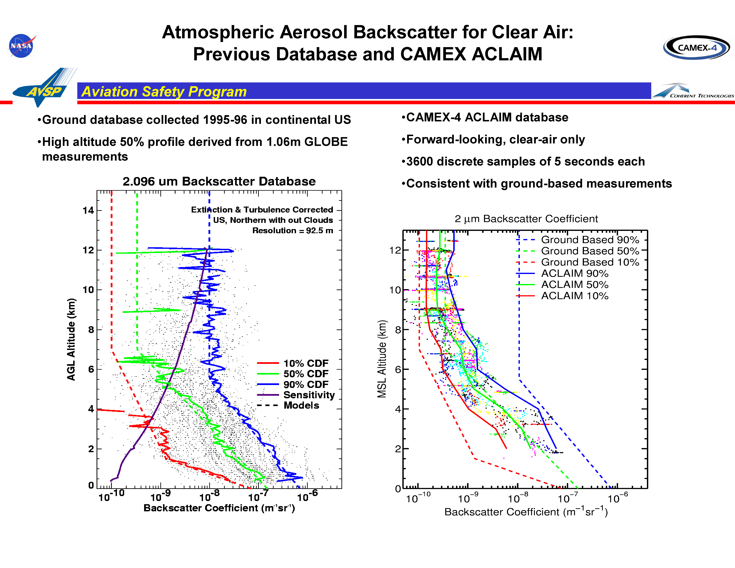
Courtesy - Ivan Clark, NASA

Slide 18
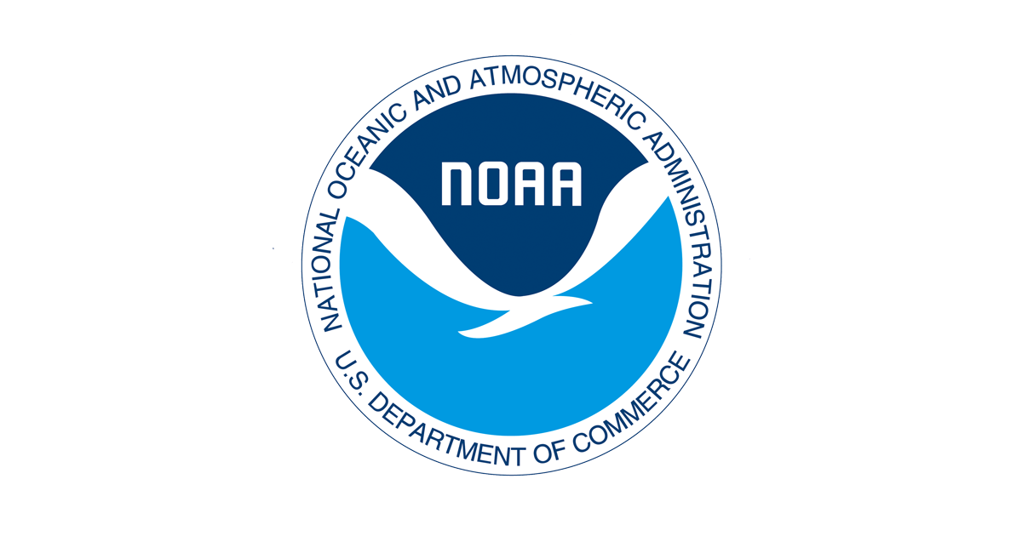
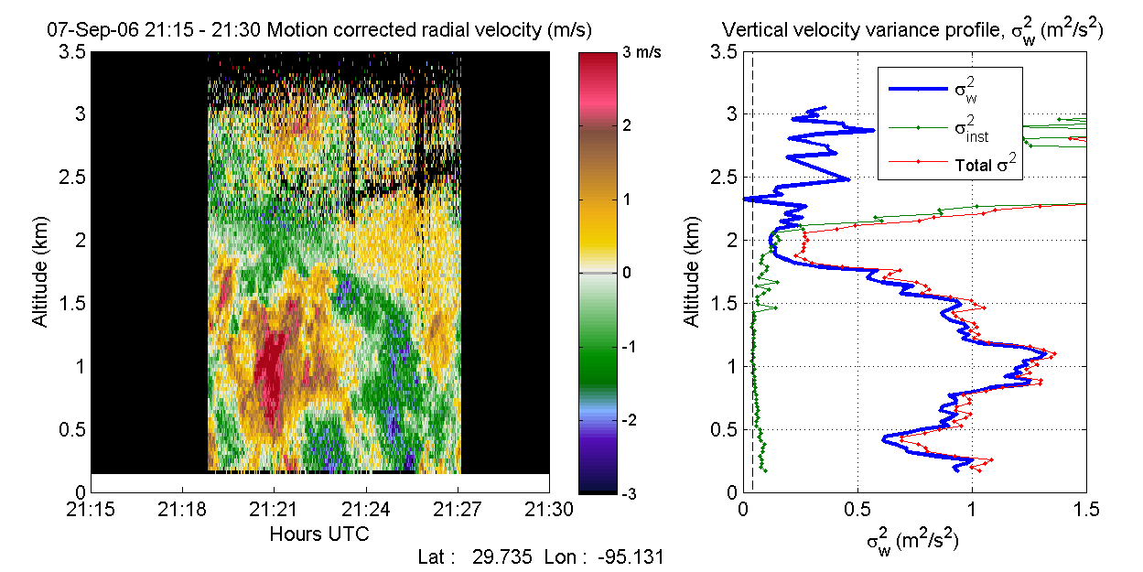
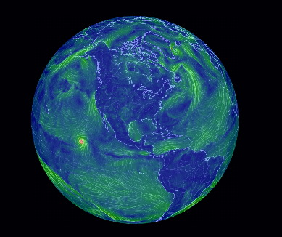
Mission motives – really-simplified
NOAA Requirements: focus on improving NWP, Protecting Lives and Property
NASA Requirements: Science. Processes, Modeling, Pre-operational
Global initialization of forecast models that use tested model physics
  Global coverage
  Variable scales
  (model grids)
Research on model
physics
Research to update model physics
  Focused coverage
  Variable scales
  PBL emphasis
  ESDS driven science
A well-planned mission can provide something for everyone

Slide 19
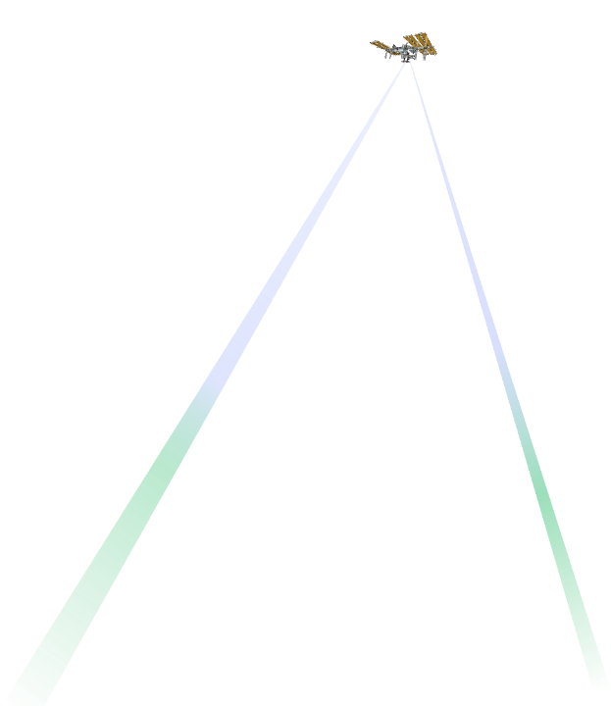

To think about: Shaping a future US wind lidar mission starts now
What does NOAA and, specifically, NESDIS & the NWP community hope to get out of a winds mission?
  Full troposphere vs. certain parts?
  Large scale global winds from orbit?
  Detailed PBL studies (from aircraft/surface obs)?
What is the maximum resolution (horizontal-along track, and vertical) that supports an operational demonstration?
  Is Aeolus resolution & performance good enough?
  What data/science improvements are desired over Aeolus?
  What are we willing to trade to keep costs down? Resolution? Duty cycle? Vertical coverage? Horizontal coverage?
How many look-angles or lines-of-sight?
  Aeolus finding (Horanyi et al. 2014): Single LOS provides 60%-70% the impact of dual-LOS on same satellite.
  Assimilation: LOS winds provides more impact than horizontal winds
  Two looks on same satellite, or two smaller satellites for double coverage?
How would you take advantage of variable/flexible sampling/processing?

Slide 20
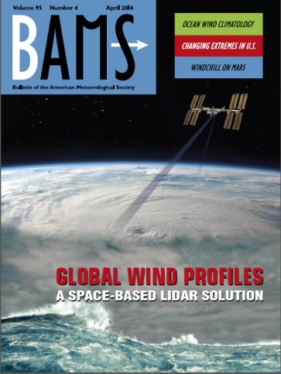
CCOPE/ADLS
(Airborne)
LAWS Panel
NOAA
Mini-MOPA
DAWN 1 IIP
DAWN SP
NOAA TeaCO
LAWS Team
NOAA HRDL
VALIDAR
DAWN 2 IIP
SPARCLE
←← DAWN Flights →→
CO2
Solid State Heterodyne
84 | 85 | 86 | 87 | 88 | 89 | 90 | 91 | 92 | 93 | 94 | 95 | 96 | 97 | 98 | 99 | 00 | 01 | 02 | 03 | 04 | 05 | 06 | 07 | 08 | 09 | 10 | 11 | 12 | 13 | 14 | 15 | 16 | 17 | 18 | 19 | 20 | 21 | 22
Direct Detection
← TWiLiTE Flights.
Zephyr
TWiLiTE IIP
Edge Technique
GroundWinds
A2D Airborne
TWiLiTE AITT
Fringe Imaging HRDI
Fringe Imaging Lidar
GLOW Double Edge
Optical Autocovariance
Aeolus Launch
Decadal Survey
3D-Winds Hybrid
GTWS
GWOS
WISSCR
ESA’s ADM Aeolus (single look – 355 nm Aerosol & Molecular)
Optical Autocovariance (OA) Wind Lidar
ATHENA-OAWL
History: A partial (38 year) timeline of space-based Doppler wind lidar
Notes:
~40 years of NASA investments in wind lidar technology
Multiple technology investments from NASA ESTO.
NASA/NOAA Working Group on Space-Based Wind Lidar (“LWG”, formerly the LAWS science team, 1989)
2007 NRC Decadal Survey “3D-Winds” mission (Tier 3): defined as a hybrid of two separate lidar systems, with two different lasers, on one spacecraft.
The past decade:
Risk tolerance at NASA has decreased significantly
Budgets have decreased as well: NASA asked to do more and more
Industry technology investments help to make missions possible
Contractor efforts are increasingly scrutinized/audited (DCAA)

Slide 21
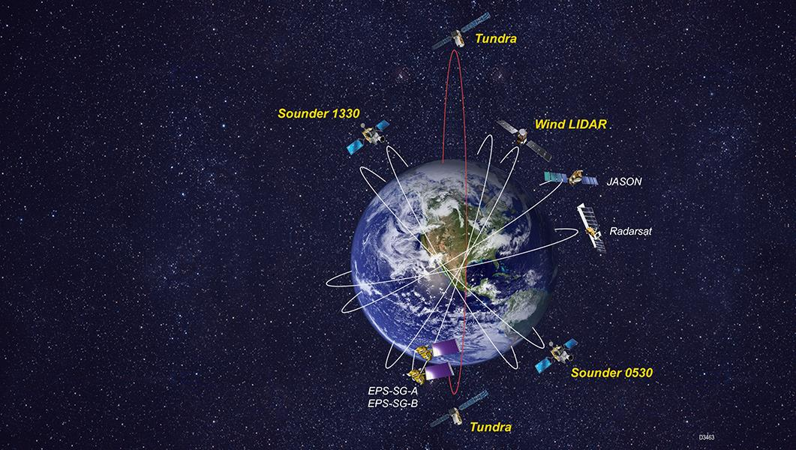

Next Generation Operational LEO Weather Architecture
Based on NOAA’s Satellite Observing System Architecture (NSOSA) Study

Slide 22
