Slide 1
Emerging technology for a SmallSat coherent wind lidar space mission with lower cost and risk
Michael J. Kavaya, J. Yu, J. Marketon, K. Bedka (NASA Langley)
S. Henderson (Beyond Photonics), D. Emmitt (Simpson Weather Assoc.)
Working Group on Space-Based Lidar Winds
17-19 November 2020
Sponsored by NASA Science Mission Directorate Earth Science Division
& SMD ESD Earth Science Technology Office

Slide 2
Purpose and Space Mission Goals
Vision
Sammy just showed that Wind-SP is a viable architecture for space. Aircraft flight and space qual. are the next steps
We are also considering technology developments and mission concepts for a SmallSat mission
Size, risk, and cost reduction are all beneficial to enable a SmallSat mission in the current budget environment
We desire to achieve high spatial & vertical detail, and high precision winds from a SmallSat with comparable performance to our airborne instrument DAWN, which would reduce the cost per satellite and allow for frequent revisits suggested by the Decadal Survey
Mission Goals
Meet NASA’s goals of improved understanding of atmospheric processes and contributing to NWP forecast improvement
More affordable to enable constellation of satellite wind lidars
Lower risk
Two collocated lines of sight for horizontal vector winds
Significant wind measurement above PBL
High photon efficiency for smaller telescope & laser ü
Very accurate winds ü
High horizontal and vertical resolution for seeing detailed processes ü
Equal day/night performance ü
Multiple data processing options for same data; optimize science given conditions ü
Wind turbulence profiles (second moment) also measured ü
No calibration-intensive optical intensity measurements needed, only frequencies ü
Coherent
Detection
Features

Slide 3
Space-Based Coherent Wind Lidar Optical Components
Sammy showed components developed during Wind-SP
We show here emerging technology to address the following:
Typically Large:
Two telescopes
Lidar Transceiver
Typically Considered High Risk:
Oscillator laser resonator length

Slide 4
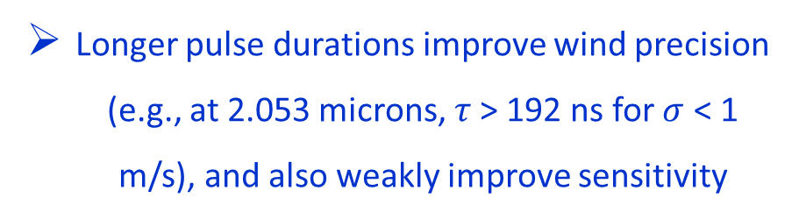
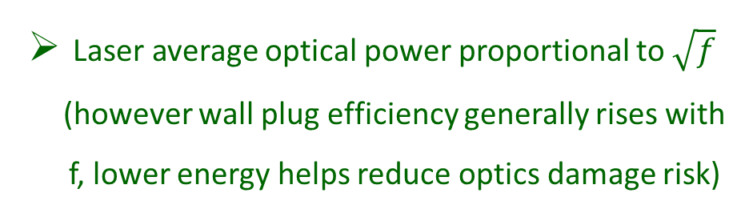
Pulsed Coherent-Detection Wind Lidar
Specialized Laser Requirements
Pulse energy U preferred over pulse rate f
Good laser beam quality
𝑀² is critical, goal < 1.1
Laser Figure of Merit (FOM) different than direct detection: energy U x sqrt(rate f)
Laser average optical power proportional to $\sqrt{f}$ (however wall plug efficiency generally rises with f, lower energy helps reduce optics damage risk)
Longer pulse durations improve wind precision (e.g., at 2.053 microns, $τ$> 192 ns for $σ$ < 1 m/s), and also weakly improve sensitivity

Slide 5
Compact Power Amplifier for Hybrid Fiber-Bulk Wind Lidar Transmitters
Beyond Photonics 2020 SBIR Phase I, 8/31/20 – 3/1/21
Subject of this SBIR
Significant Simplification and Risk Reduction
Transmit Laser is a Fiber Amplifier followed by a Compact Crystal Amplifier + T/R Module
Completely eliminate oscillator laser resonator
Fiber amplifier requirement only 0.5 mJ/400 Hz
Bulk crystal amplifiers boost pulse energy to 40 mJ at 400 Hz matching the laser figure of merit of the Wind-SP system
Compact packaging of bulk crystal amplifiers results in robust environmentally insensitive module
Utilizes Wind-SP crystal amplifier development
500 ns pulse duration for very low LOS wind error contribution
Phase I – Preliminary Design; Phase II – Prototype
Fiber Amplifier/Pulse Forming proposed by Beyond Photonics in outstanding NASA ACT proposal

Slide 6
High-Efficiency Wide-Bandwidth Balanced Detector-Preamplifier at 2-micron Wavelength
Beyond Photonics 2020 SBIR Phase I, 8/31/20 – 3/1/21
Goal: Receiver capable of capturing ±4.2 GHz Doppler shifts from satellite & equatorial velocities
Significant Simplification, Reduced Parts Count, and Risk Reduction
  Eliminates two wideband tunable, controllable CW lasers
  Eliminates accompanying frequency difference feedback loops and controlling software
  Compatible with other BP SBIR Phase I on previous slide
  BP is partnering with Discovery Semiconductor/Abhay Joshi
  Discovery Semiconductor has demonstrated 8.8 GHz BW with QE ~ 70%; space qualified
  Phase I – two prototypes with testing; Phase II – delivered receiver, 3dB BW > 5 GHz, QE > 90%

Slide 7
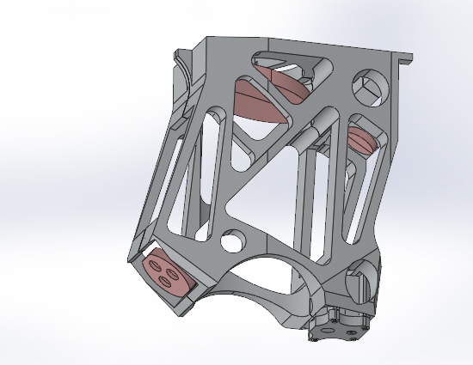
Compact Telescope/Beam Expander (BEx) for Space
Compact BEx designed at NASA Langley
  Modified Cassegrain, off-axis (afocal) with free-form corrector optic
  Folded design reduces BEx length
  Airborne design (15 cm) scalable for space (60 cm)
Rocky Mountain Instruments
  Design and build athermal Langley BEx structure for airborne use
  Design & build optic elements and coatings for Langley BEx
Voxtel
  2019 SBIR Phase I demonstrated feasibility of freeform GRIN phase corrector plate in Langley BEx design
  2019 SBIR Phase II awarded to implement Langley BEx with PCP
Figure 2 - RMI BEx SolidWorks CAD Model

Slide 8
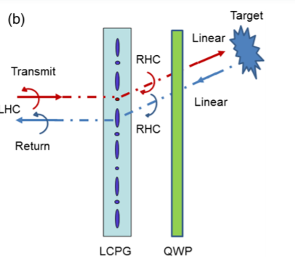
Solid-State Beam Steering with Liquid Crystal Polarization Gratings (LCPGs)
Space mission beam steering with optical wedge(s) is not viable
Rotating telescope was thoroughly investigated in NASA LAWS project
Boulder Nonlinear Systems
  2016 Phase II Air Force
  2017 SBIR Phase II NASA Langley
  2018 SBIR Phase I Air Force
  Electro-Optical Technology Development In Liquid Crystal Beam Steering (E-OpTICS), Dr. Devin Pugh-Thomas, NASA Langley, 5 cm + 8 directions + T > 90% at 1.5 microns
Solid-state beam director
Cascading n stacks gives 2^{n} directions
Multiple directions & 13 cm demonstrated
Monostatic coherent lidar requires quarter wave plate (QWP) for transmit/receive (T/R) separation
Potential for multiple LOS with 1 telescope

Slide 9
Other Emerging Technologies
AdValue 2020 SBIR Phase I – fiber amplifier > 30 mJ; more transmit laser options
Aqwest 2020 SBIR Phase I – Tm-ceramic 2-micron laser for improved efficiency; less prime power
NanoVox 2020 SBIR Phase I – free form variable index of refraction optics to correct telescope aberrations; more aberration correction options
Pending Beyond Photonics ACT proposal for fiber-crystal amplifier fiber front end & pulse shaping
Pending Langley ACT proposal for coherent lidar photonic integrated circuit (PIC); increased ruggedness (fewer alignment points), & reduced size

Slide 10
Computer Simulated Performance Assumptions
Transmit laser
2052.92 nm, 40 mJ, 400 Hz, 500 ns FDHM, TX M² = 1.1 (FOM = 4.3) (Wind-SP = 3.1)
Geometry
300 km, 30° nadir
Lidar
D = 60 cm; lidar system efficiency = 35%, Budgeted SNR down 5% due to residual angle misalignment
Atmosphere
Extinction included (optimum wavelength = 2052 nm would have less extinction)
No wind shear, wind turbulence, clouds
Science
Vertical resolution 100 m; Horizontal resolution 10 km; Percentage of Outlier Estimates 10%
Horizontal wind full search bandwidth, last pass through data, = 40 m/s
Theory
R. G. Frehlich, “Velocity Error for Coherent Doppler Lidar with Pulse Accumulation,” J. Atmos. Oceanic Technol. 21, 905 (2004); with published & unpublished errata corrected
To capture data from -5 to 35 km with no
pulse confusion, maximum PRF ~ 3.1 kHz

Slide 11
Base Case Aerosol Sensitivity
Many winds above PBL
PBL winds measured with very good science parameters
Figure Courtesy:
J. Rothermel
D. Bowdle
D. Emmitt

Slide 12
Improved Coverage Through Relaxed Science Requirements
Science Changes
Vertical resolution 100 → 200 m
Horizontal resolution 10 → 20 km
Percentage of Outlier Estimates 10 → 20%
Horizontal wind full search bandwidth, last pass through data, 40 → 30 m/s
Base Case Aerosol Sensitivity
Enhanced aerosols above PBL now completely covered
More subvisual cirrus covered

Slide 13
Improved Coverage Through Relaxed Science Requirements & Larger Diameter
Science Changes
Vertical resolution 100 → 200 m
Horizontal resolution 10 → 20 km
Percentage of Outlier Estimates 10 → 20%
Horizontal wind full search bandwidth, last pass through data, 40 → 30 m/s
Lidar Changes
D = 60 → 80 cm
Base Case Aerosol Sensitivity
Starting to measure background and volcanic aerosols

Slide 14
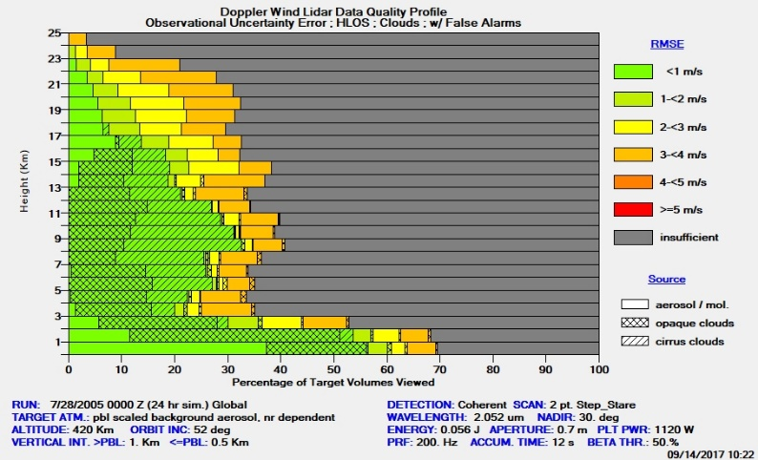
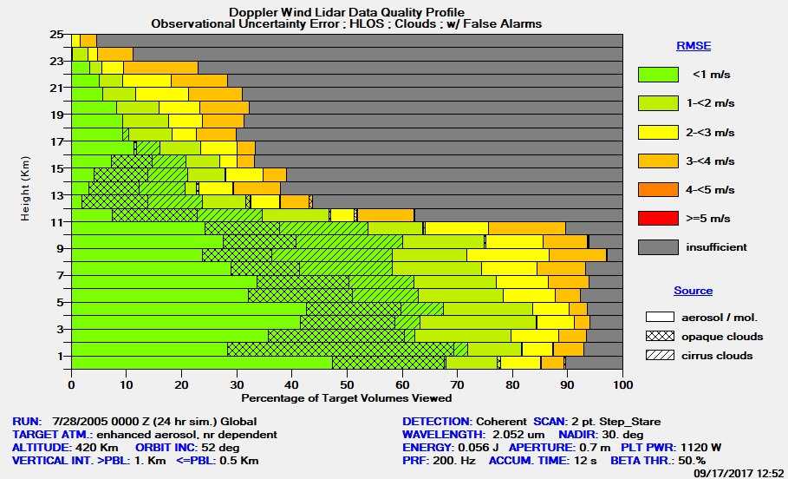
Examples of Simulated Space Performance with Wind-SP or Fiber-Crystal Laser
GTWS Background Aerosol Model
GTWS Enhanced Aerosol Model
420 km
56 mJ, 200 Hz (Wind-SP)
70 cm telescope
1 km dz, 92 km dh
Clouds included
Courtesy David Emmitt

Slide 15
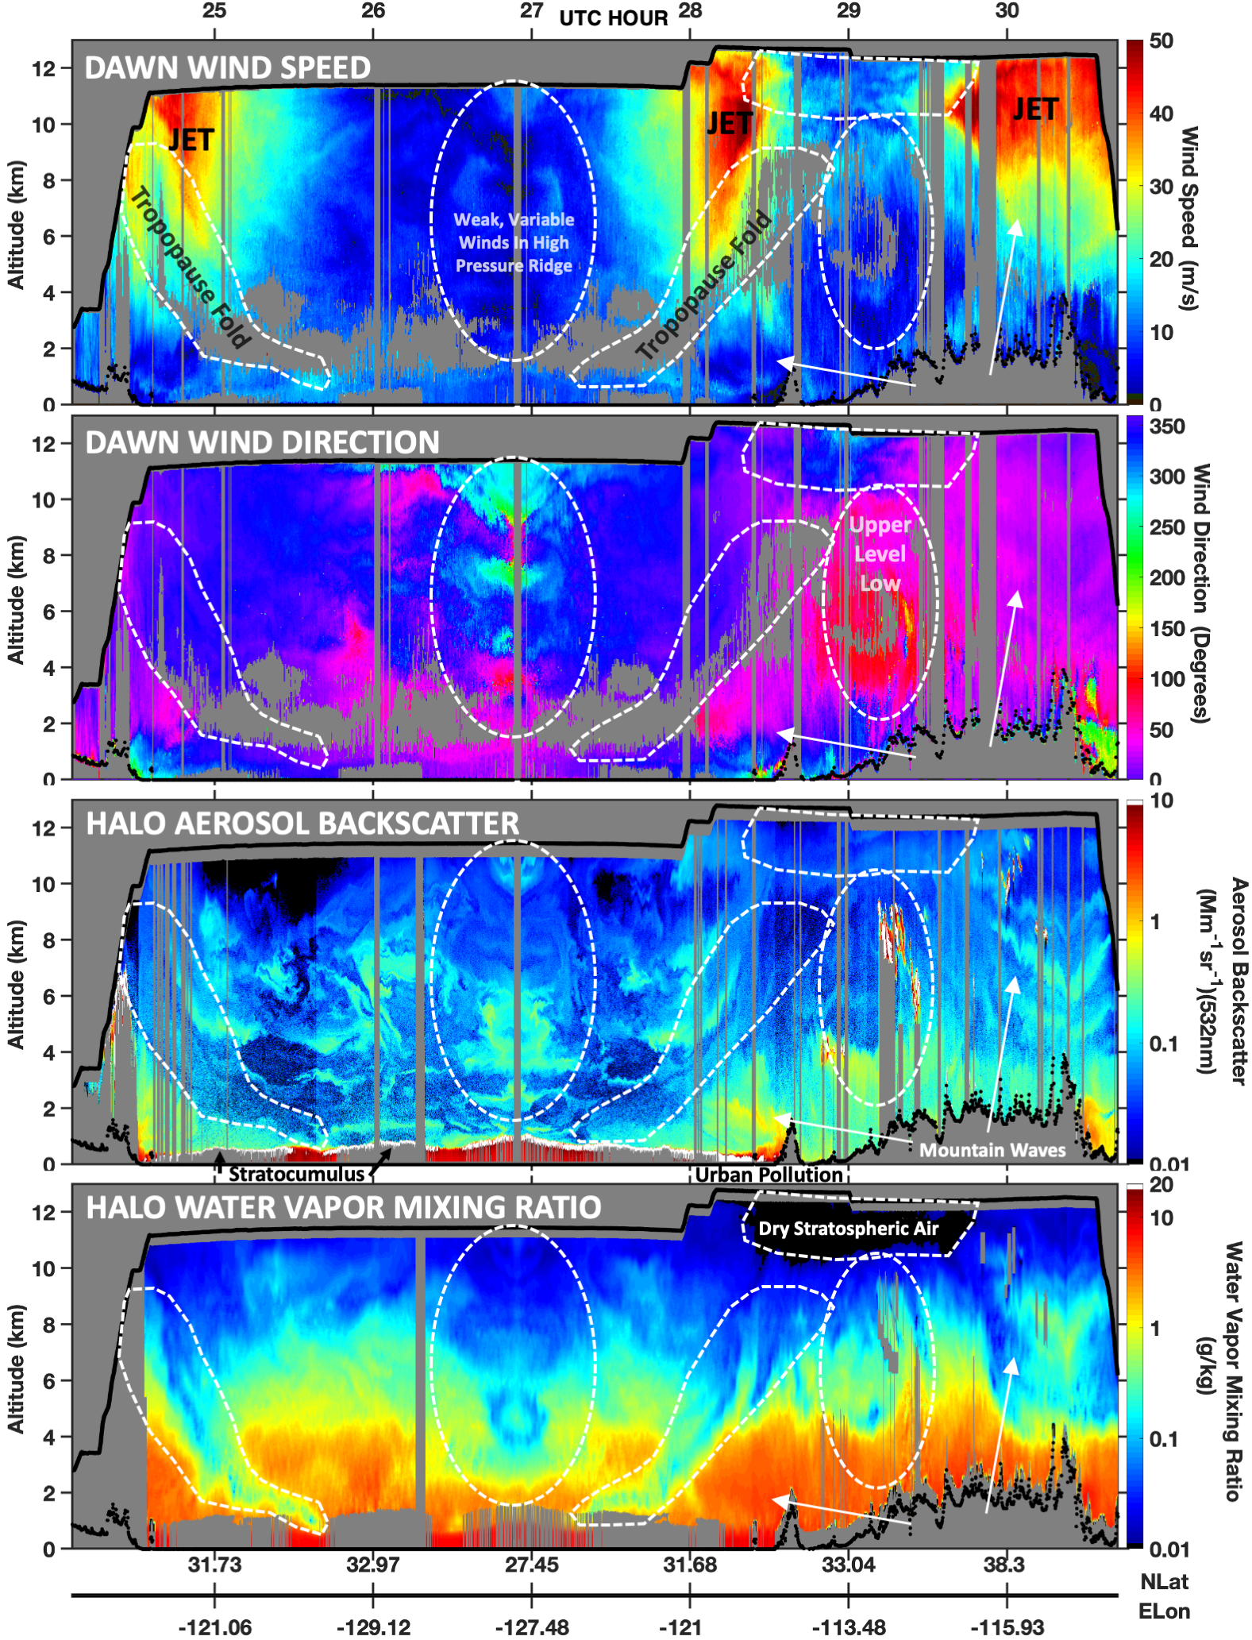
DAWN and HALO 2019 Airborne Performance
DAWN Wind Speed (0 – 50 m/s)
12 km altitude lines
DAWN Wind Direction
HALO 532 nm Aerosol Backscatter (0.01 – 10 1/Mm-sr)
HALO Water Vapor Mixing Ratio (0.01 – 10 g/kg)
Courtesy Kris Bedka & Amin Nehrir

Slide 16
Summary
The Wind-SP lidar will be flown on the P-3 and is on the path to space
We are also watching emerging technologies for opportunities to save mission cost and risk
Coherent detection offers several benefits of wind accuracy, high resolution, smaller telescopes and prime power, equal day/night performance, and data processing flexibilities
Airborne data has validated the coherent detection wind measurement technique by many groups
Considerable wind measurements above the PBL have been obtained with the DAWN lidar
Simulations of Wind-SP or the Fiber-Crystal Laser space performance indicate significant contributions to improved PBL processes understanding, and also frequent wind measurements above the PBL

Slide 17
Thank you

