Slide 1
Updates on the Designs of Lasers for Space-Based Wind, Aerosol, and Cloud Measurements
November 19, 2020
Fran Fitzpatrick, Joe Rudd, Michael Albert, Kent Puffenburger,
Tom Schum, Slava Litvinovitch, Darrell Jones, Floyd Hovis
Contacts: Fran Fitzpatrick ffitzpatrick@fibertek.com
Floyd Hovis fhovis@fibertek.com

Slide 2
Outline
Review of the High Energy UV Demonstrator (HEUVD) design & testing
Updates to HEUVD for space-based winds, aerosol, & cloud lidars
  Higher efficiency, lower weight gain modules
  Diode lifetime testing
  Modify design to support a 532/1064 nm laser for 2λ HSRL Aerosol, Cloud, Convection, & Precipitation (ACCP) or Optical Autocovariance Wind Lidar (OAWL) missions
Concept for updated at about 355/532 nm lasers for UV OAWL or 3λ HSRL for to the Aerosol, Cloud, Convection, & Precipitation mission

Slide 3
HEUVD Initial vs. Final Goals & Objectives
ESTO funded program goals
  355 nm laser design that could meet the lifetime requirements for a 3-year space-based mission
  Purely conductively cooled Laser Optics Module (LOM) design
  Extended life testing of the laser transmitter to assess UV lifetime
  Environmental testing to advance the design from TRL 4 to TRL 6
The HEUVD optical design was based on the original goal of a 50 Hz, 350 mJ, 355 nm laser
Performance Goals vs Performance
 | Repetition rate (Hz) | Total Energy (mJ) | 355 nm Energy (mJ) | 355 nm M² | 355 nm Lifetime (10⁹ shots)
Original goal | 50 | 750 | 350 | ≤ 4 | >1
Final goal | 150 | 250 | 100 | ≤ 4 | 14
Performance | 150 | >250 | >100 | 3.3 | >2.8*
*>4 billion demonstrated at 1064 nm
The final program objective was the design, build, and characterization of a 100 mJ, 355 nm laser operating at 150 Hz

Slide 4
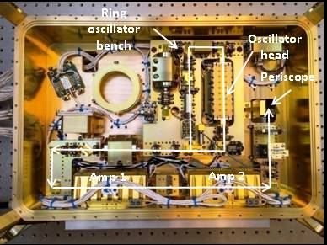
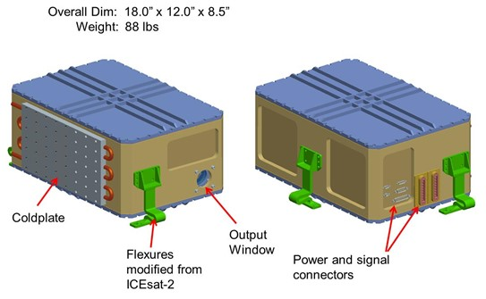
HEUVD Transmitter Design Validated by Performance and Lifetime Testing
Sealed , dual compartment design
Stringent contamination control
Pure conductive cooling to a single external thermal interface
Flexure mounted for high launch vibration levels
Full power 532 nm lifetime successfully completed
  1.2 billion shots
Half power (50 mJ/150 Hz) UV lifetime test successfully completed
  1.5 billion shots
Full power (100 mJ/150 Hz) UV lifetime test successfully completed
  1.35 billion shots
Resonator & preamplifier compartment
A key accomplishment was the demonstration of 2.8 billion shot UV lifetime with negligible optical degradation
Power amplifier & nonlinear conversion compartment

Slide 5
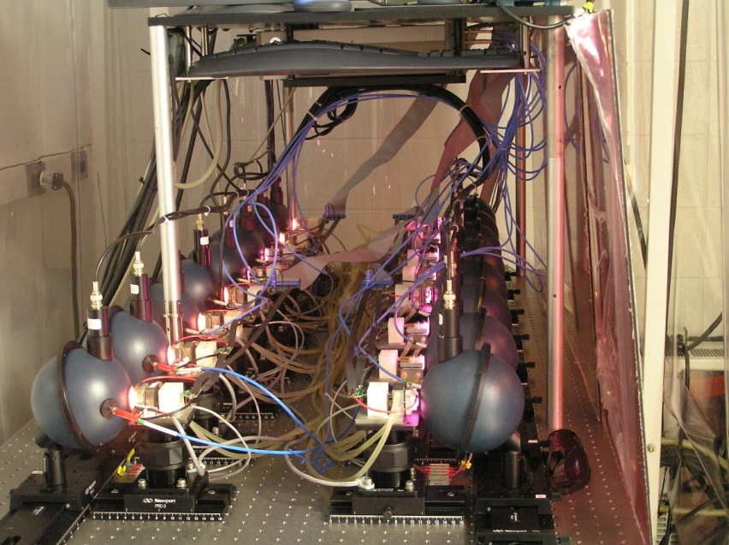
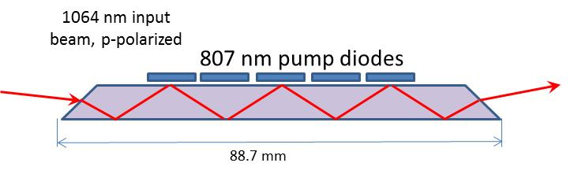
HEUVD Path Forward
Diode lifetime testing
  Faster than expected diode decay surfaced HEUVD lifetime testing
  ACCP funding is supporting lifetime testing of diodes from two vendors
    Test is set up and ready to start at LaRC
Upgrades to HEUVD preamp and power amplifier design
  New preamp is a compact, high efficiency design developed with DoD funding
  Original power amp design for 750 mJ not appropriate for final 250 mJ operation
    New design developed and validated with ACCP mission funding
  Update gain modules to incorporate newer 200 W bar stacks that are being life tested and that will be used in the next laser systems
    200 W bar stacks enable smaller and higher efficiency modules
Develop an updated laser module design suitable for 2λ HSRL or OAWL systems
  Being supported with ACCP mission funding
Diode lifetest facility at LaRC
Updated power amp design

Slide 6

NASA Langley Lifetime Test Facility
Joint Fibertek/NASA Langley trade study identified and procured diodes from two vendors capable of supplying space-qualified QCW pump diodes
Diodes from both vendors will be tested at full 200 W/bar and derated 150 W/bar to validate lifetime impact of derating
Start of lifetime testing has been delated due to COVID-19
Fully-automated testing will run 24/7
Slab
Slab

Slide 7
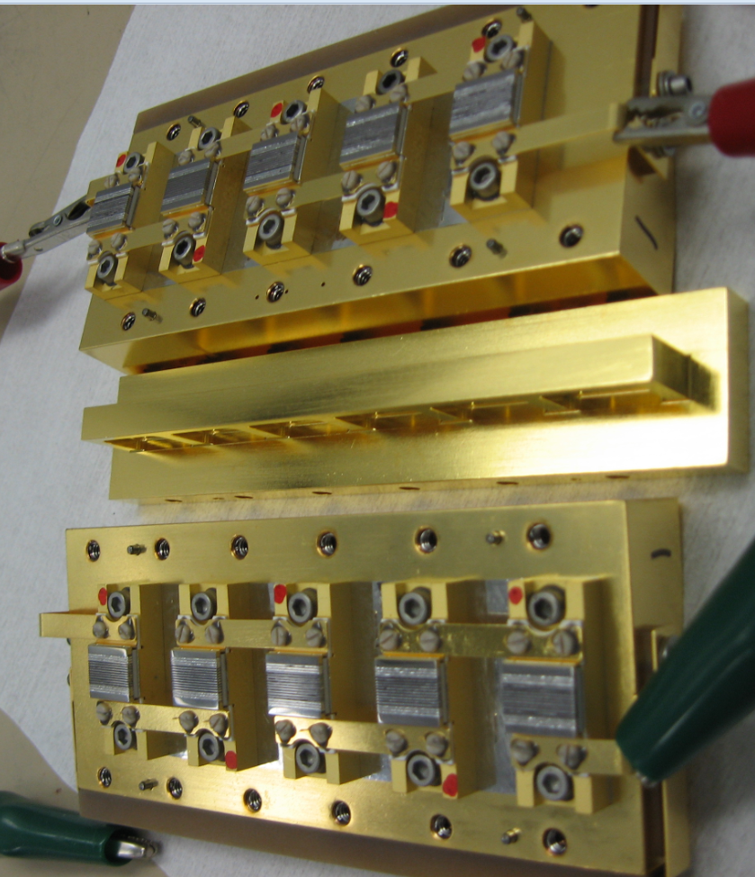
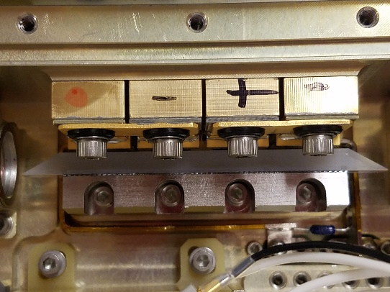
Original HEUVD vs. New Preamplifier Head Mechanical Design Comparisons
Original OAWL-2 preamplifier head weighs 4.82 lbs
  Complex 2-sided cooling and pumping assembly
  Based on older 100 W bar stacks
Updated preamplifier head weighs 0.47 lbs
  1-sided cooling and pumping assembly
  Takes advantage of newer 200 W bar stacks
  Highly optimized pump on bounce design
90 mm
Diodes
45 mm
Slab
HEUVD preamplifier gain head components minus top
Updated preamplifier gain head

Slide 8
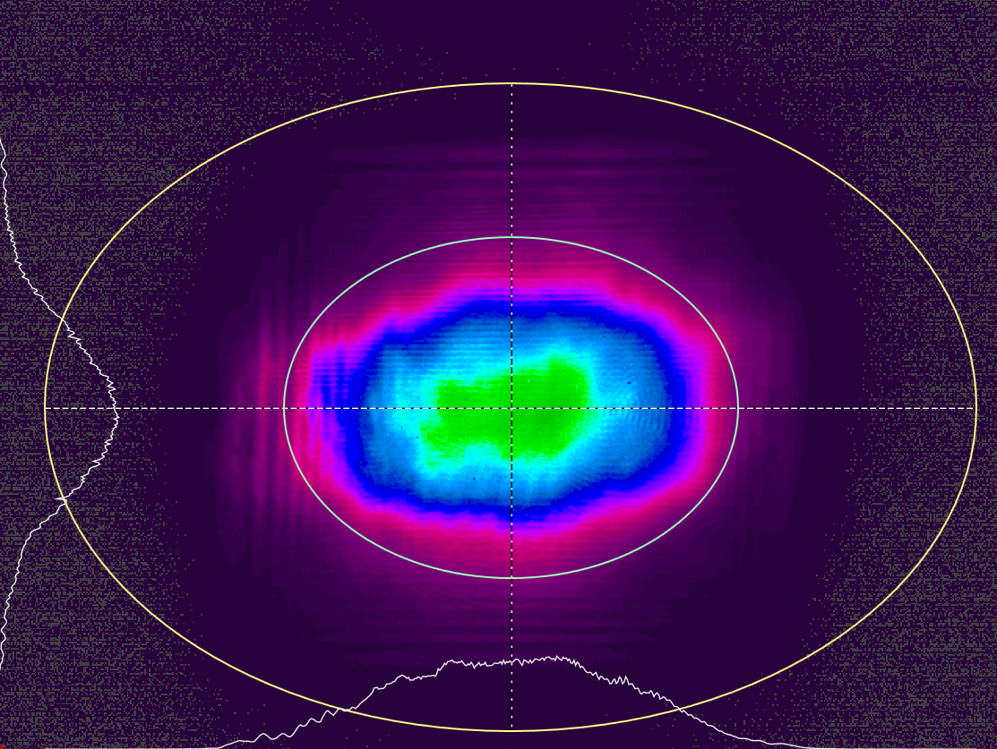
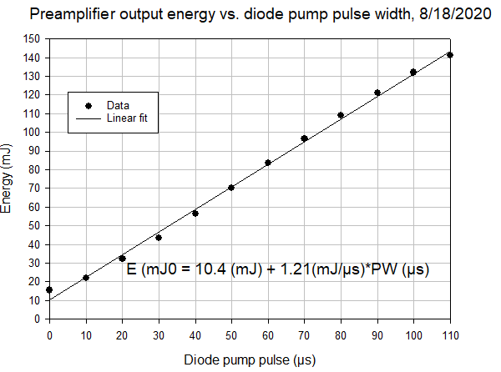
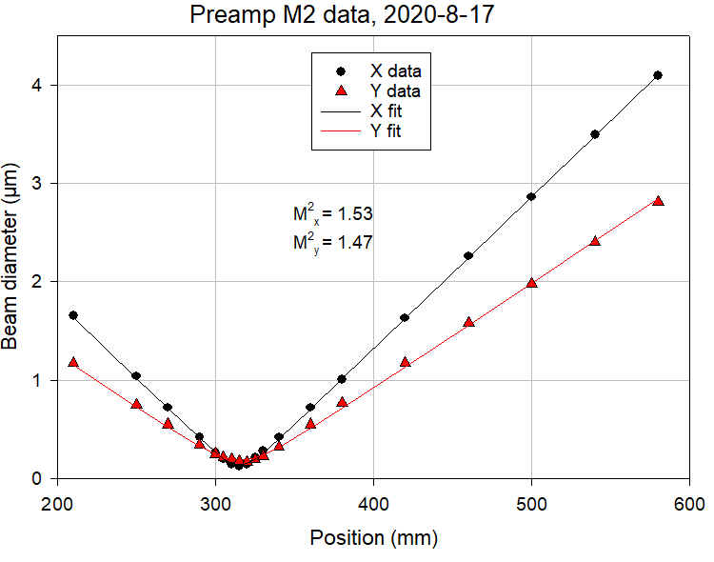
Updated Preamplifier 20 Hz Test Results
16 mJ input from ring oscillator
  130 A (141 W/bar), 76 µs diode pump pulses for the 21 oscillator diodes
20°C chiller temperature for both oscillator and preamplifier
150 A (154 W/bar) and variable pump pulse width for the 28 preamplifier diodes
Preamplifier optical to optical efficiency at 141 mJ output is 26%
Near field profile
X diameter = 2.95 mm
Y diameter = 2.04 mm

Slide 9
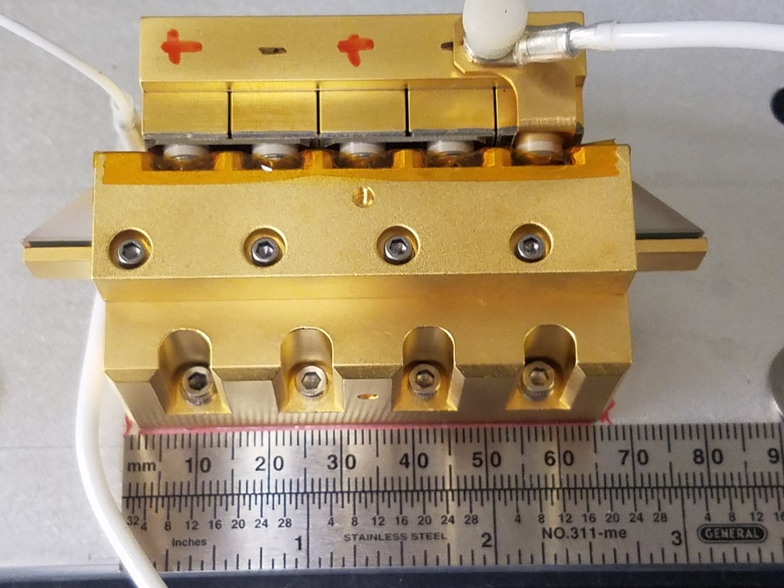
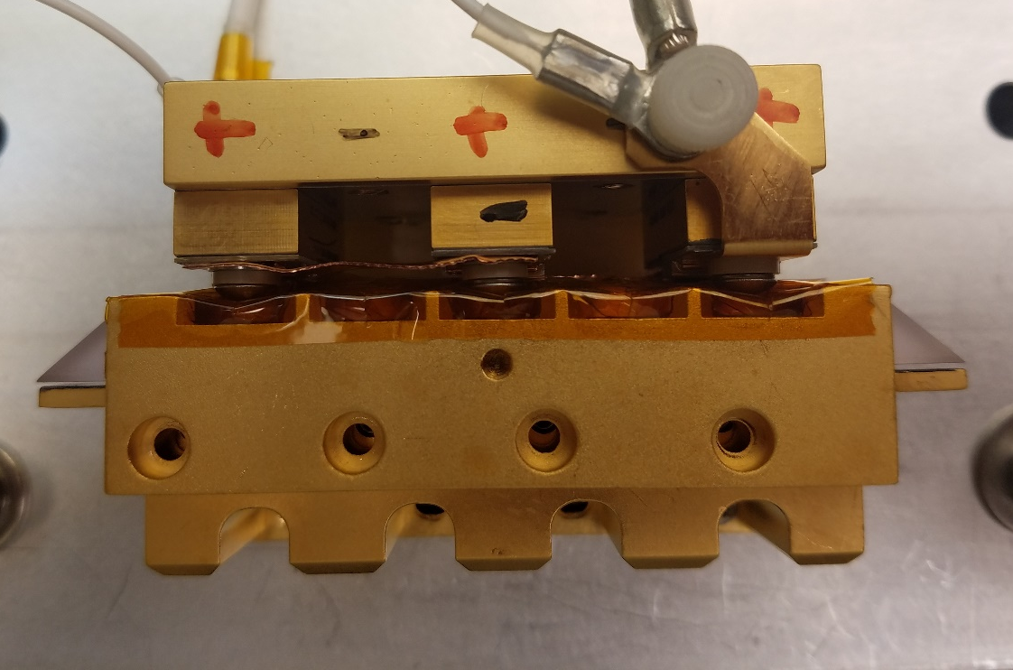
Updated Power Amp Design Overview
The power amplifier was originally designed as the new power amplifier for HEUVD and was also used in the dual-pulse SBIR
  Incorporates either 5 (for flood fill) or 3 (for pump on bounce) 10-bar, 400 µm pitch stacks in the laser head
  Off-axis design allows use of a 5 mm diameter input beam without overfilling the diode stack footprint
Diodes
Diodes
Pump on bounce configuration with 3 diode stacks
Flood fill configuration with 5 diode stacks

Slide 10
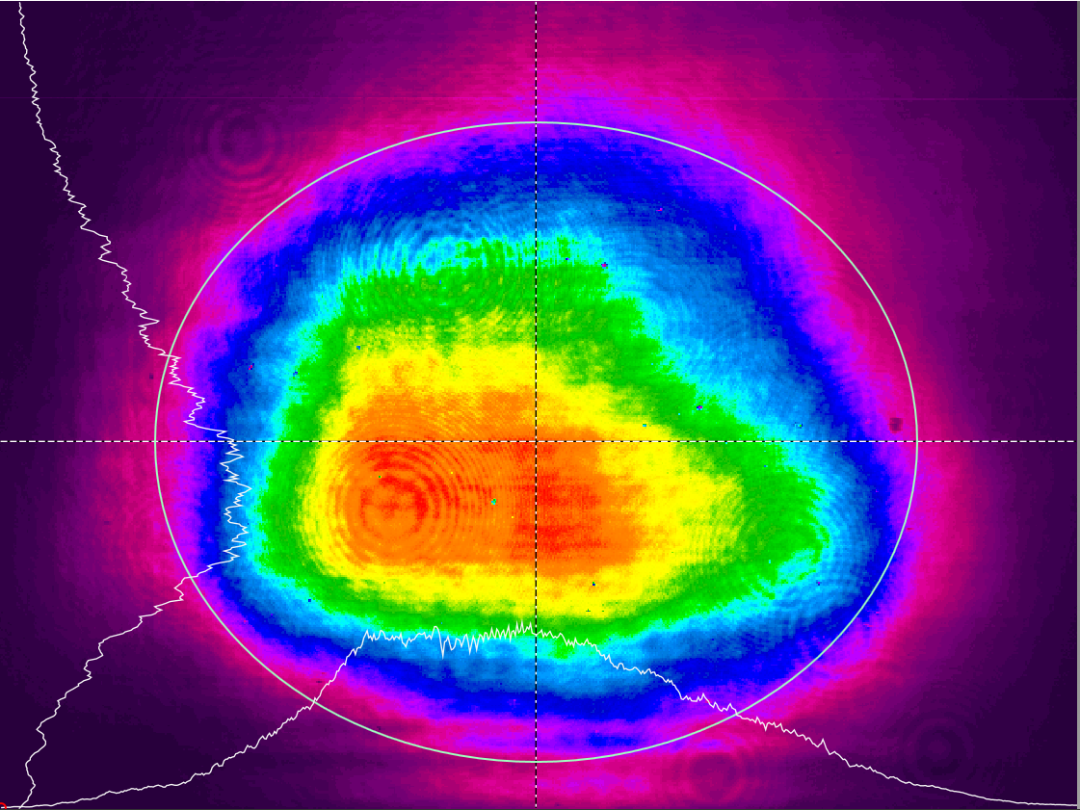
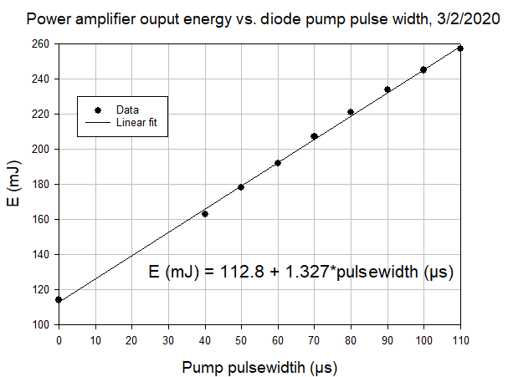
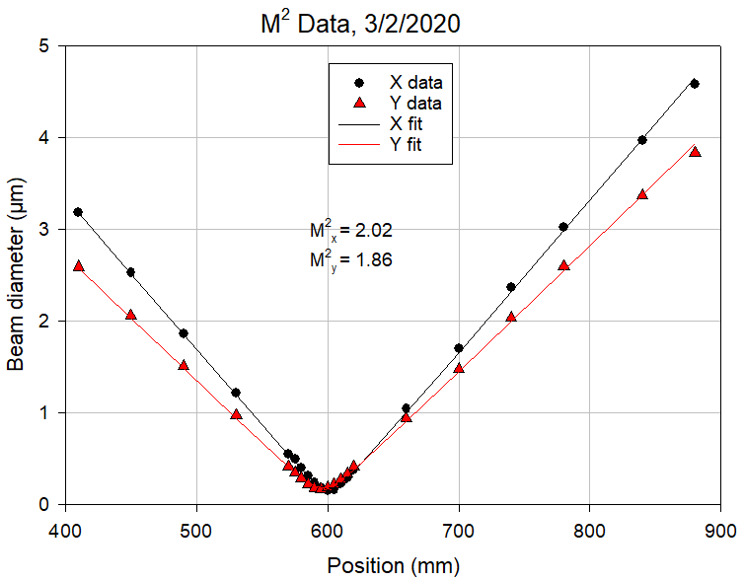
Power Amplifier 20 Hz Test Results With 3 Stack Pump on Bounce Configuration
114 mJ input from preamplifier
20°C chiller temperature for both oscillator and preamplifier
48°C chiller temperature for the power amplifier
165 A (200 W/bar) for the three 10-bar power amplifier diode pumps
Measured output energy vs. diode pump pulse width
Power amplifier optical to optical efficiency at 260 mJ output is 22%
Near field profile
X diameter = 4.58 mm
Y diameter = 3.81mm

Slide 11
Transmitter Performance Requirements for Space-Based 2λ ACCP
The ACCP requirements should meet most of the 2λ OAWL requirements except for linewidth
  Expected OAWL 532 nm linewidth requirement will be < 30 MHz
Current Top-Level Laser Requirements
Parameter | Specification 1064 nm 532 nm
Repetition rate | 70 Hz | 70 Hz
Pulse energy | 125 mJ | 125 mJ
Spectral width | < 100 MHz | < 100 MHz
Polarization | Linear | Linear
Divergence | 150 µrad | 150 µrad
Divergence ellipticity | ≥0.75 | ≥0.75
Heat transfer | Conductive | Conductive
Wall plug efficiency | Projected to be > 4.4%
Environmental | GEVS Verification

Slide 12
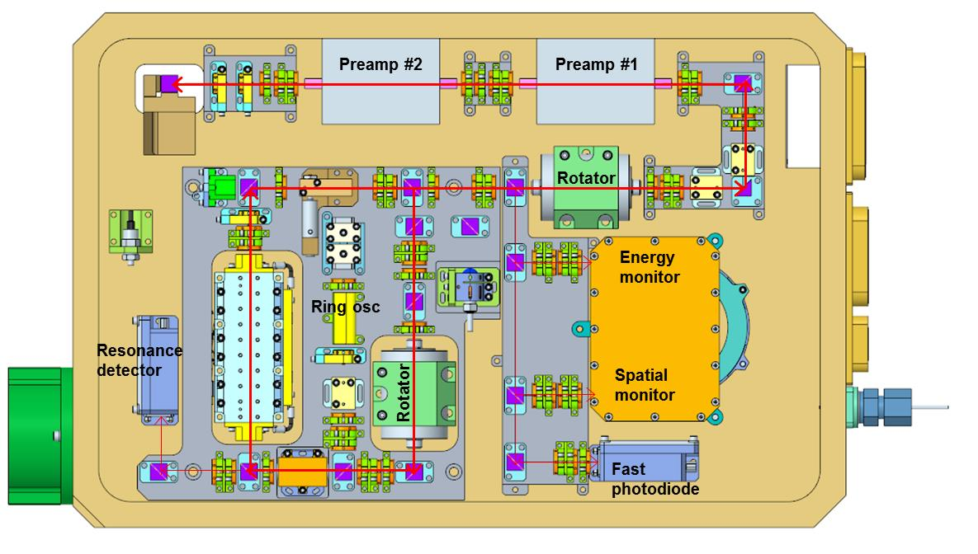
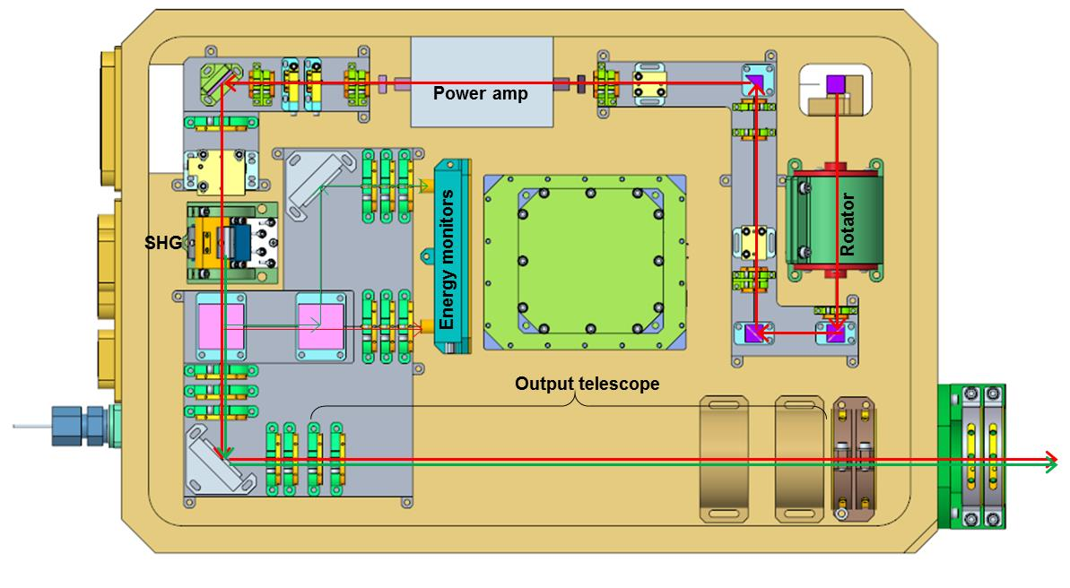
HEUVD Design Updates for 2λ HSRL or OAWL Operation
Incorporate 200 W bar stacks into the preamplifier design
  40% reduction in size and weight
Updated resonator beam diagnostics
  Energy
  Spatial mode
  5 GHz time profiles
Updated power amplifier design
  Reduced size
  Higher efficiency
Output energy monitors at both 1064 nm and 532 nm
Output optics to provide equal divergences at 1064 and 532 nm
Oscillator/preamp compartment
Power amp/ output optics compartment

Slide 13
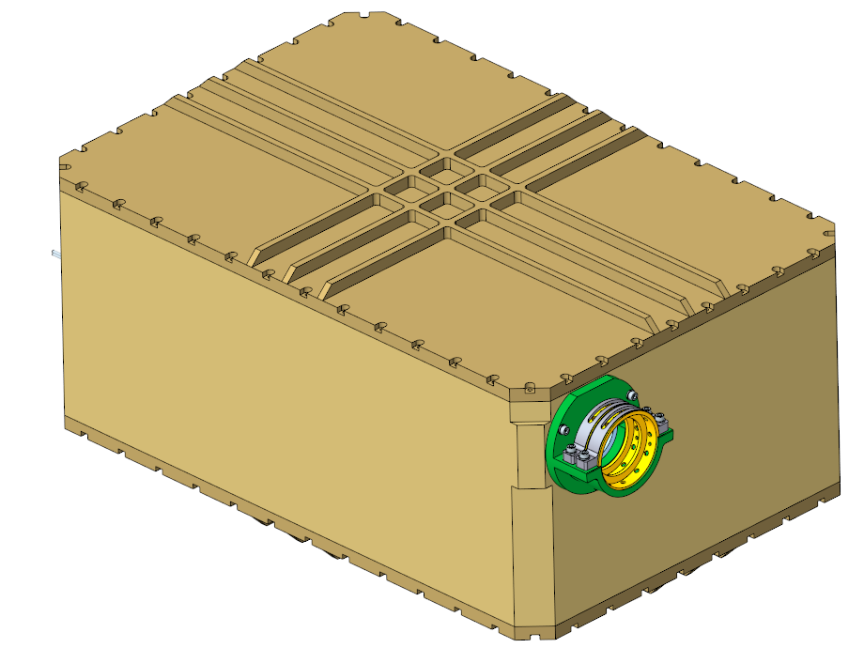
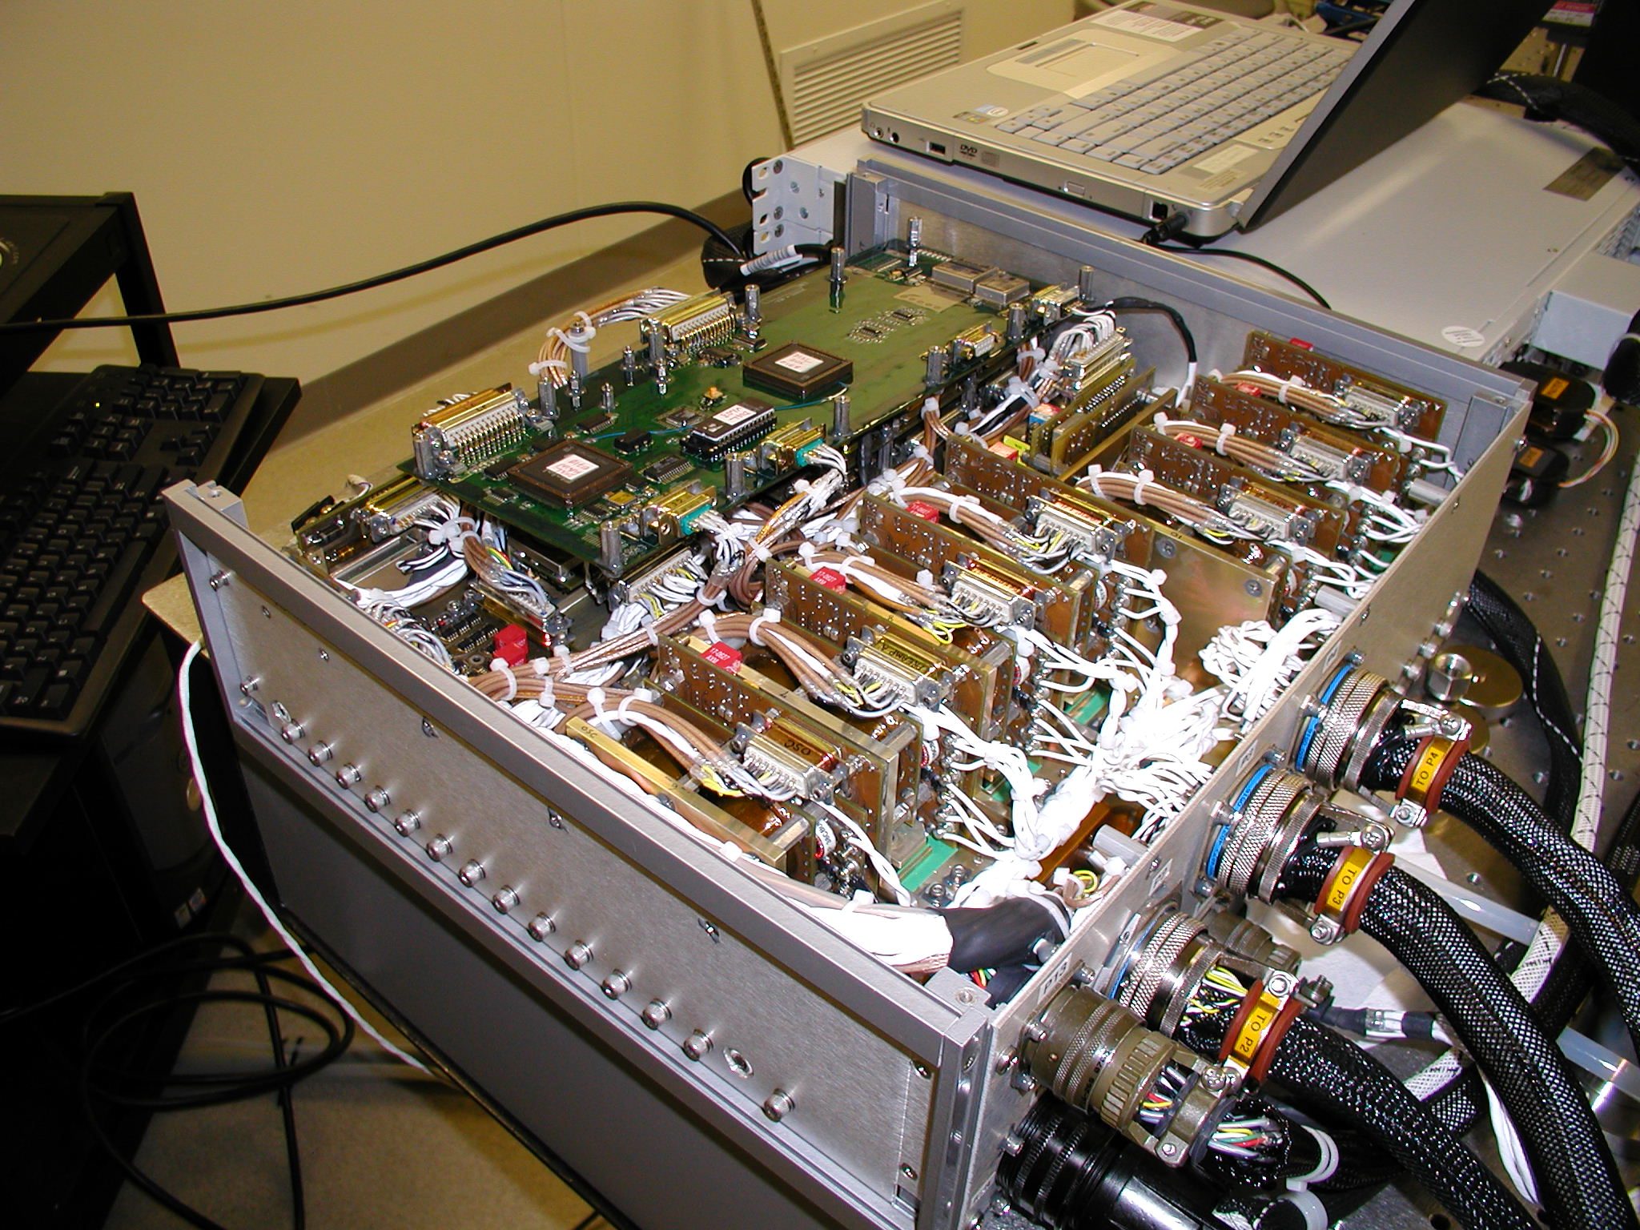
2λ Size, Weight, and Power Estimate
Laser Optics Module
Laser Electronics Module
ACCP LEM mass estimates scaled from the rack mounted HSRL-2 LEM
  Electronics alone estimated at 16 kg
  Vented housing estimated to be 10 kg
  Total mass estimated to be 26 kg
Dissipated power estimated to be 160 W
30 cm
46 cm
19 cm
Output Risleys
Volume – 26 l
Mass – 32 kg
Dissipated power – 240 W
ACCP support will allow development of a PDR level laser module design and concept level electronics design for the flight laser

Slide 14
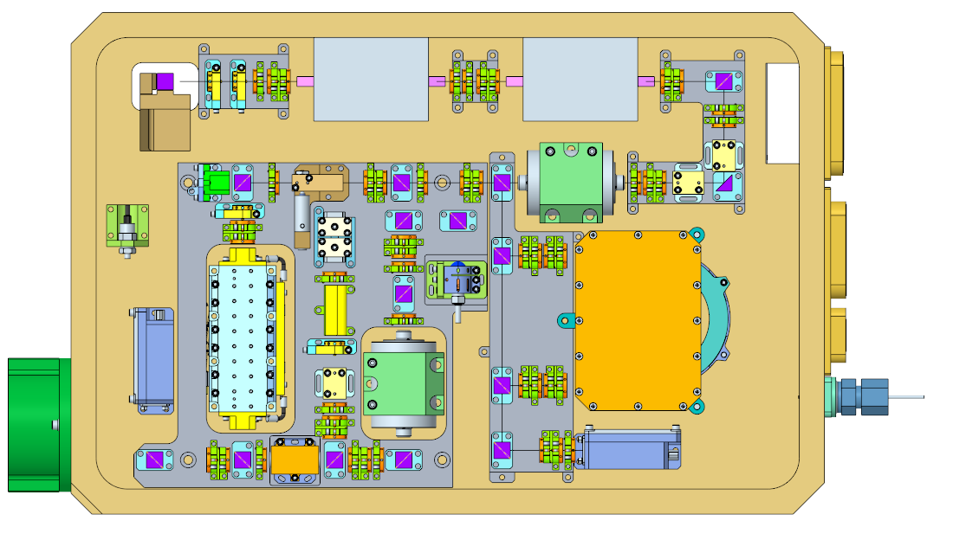
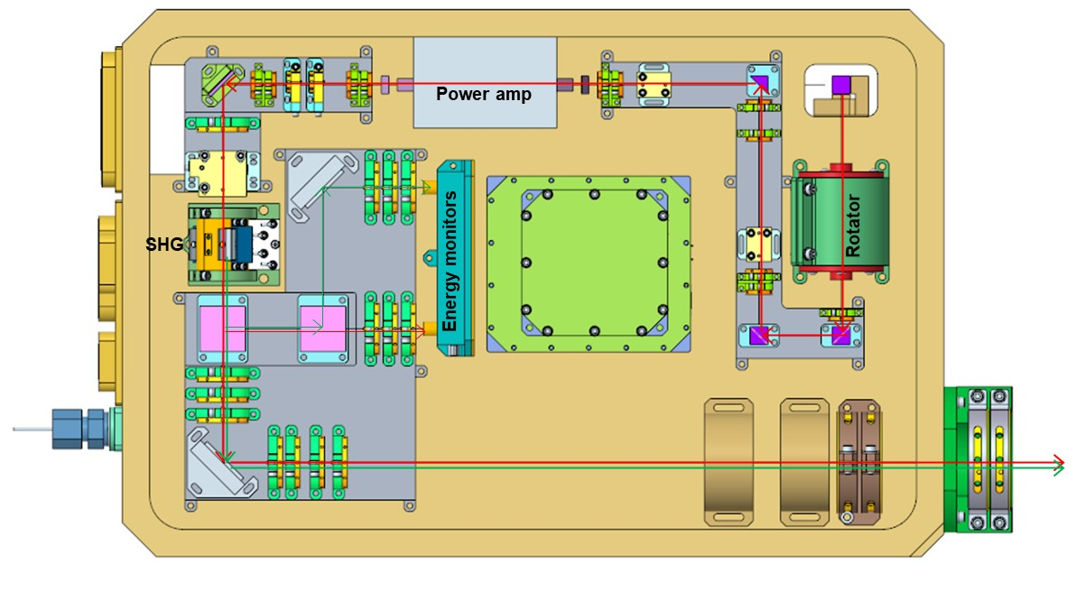
Conceptual Approach to a 3λ Laser
1064 nm, 532 nm, 355 nm
Maintain same LOM module size
  Oscillator/preamp compartment would be unchanged
  Power amp compartment could be maintained through the SHG
    The output telescope would be replaced by separately sealed compartment containing the THG and a simple 2X expansion scope
    Final beam shaping would be done external to the LOM
Electronics updates would be minimal
Preamp #2
Preamp #1
Energy monitor
Ring osc
Resonance detector
Spatial monitor
THG clean box with a 3rd harmonic crystal, 2X expansion scope, and UV energy monitor
Fast photodiode

