Slide 1
Latest Progress and Results in LEO-GEO and GEO-GEO stereo AMVs
Dong L. Wu¹
James L. Carr², Jaime Daniels³ , Mariel D. Friberg ^{1,4} , Wayne Bresky⁵,
Houria Madani², Robert E. Wolfe¹, Guoqing (Gary) Lin^{1,6}, Bin Tan^{1,6},
Michael A. Kelly⁷ and Jie Gong⁸
NASA Goddard Space Flight Center, Greenbelt, MD;
Carr Astronautics, Greenbelt, MD;
NOAA/NESDIS Center for Satellite Applications and Research, College Park, MD;
Universities Space Research Association, Columbia, MD
5) I.M. Systems Group (IMSG), Rockville, MD;
Science Systems and Applications, Inc., Lanham, MD;
Johns Hopkins Applied Physics Laboratory, Laurel, MD;
GESTAR, Universities Space Research Association, Columbia, MD

Slide 2
GEO-GEO Stereo: 10-min refresh, single-single view, full diurnal
Carr, J.L.; Wu, D.L.; Daniels, J.; Friberg, M.D.; Bresky, W.; Madani, H. GEO-GEO Stereo-Tracking of Atmospheric Motion Vectors (AMVs) from the Geostationary Ring. Preprints 2020, 2020090629 (doi: 10.20944/preprints202009.0629.v1).
MODIS-GEO Stereo: Snapshot, single-single view, twice daily
Carr, J.L., D.L. Wu, R.E. Wolfe, H. Madani, G. Lin, B. Tan, “Joint 3D-Wind Retrievals with Stereoscopic Views from
MODIS and GOES”, Remote Sensing, 2019, Satellite Winds Special Issue
https://doi.org/10.3390/rs11182100
MISR-GEO Stereo: Snapshot, multi-single view, daytime only
Carr, J.L., D.L. Wu, M.A. Kelly, and J. Gong, “MISR-GOES 3D Winds: Implications for Future LEO-GEO and LEO-LEO Winds”, Remote Sensing, 2018, MISR Special Issue
https://www.mdpi.com/2072-4292/10/12/1885

Slide 3
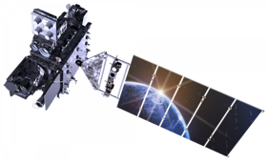
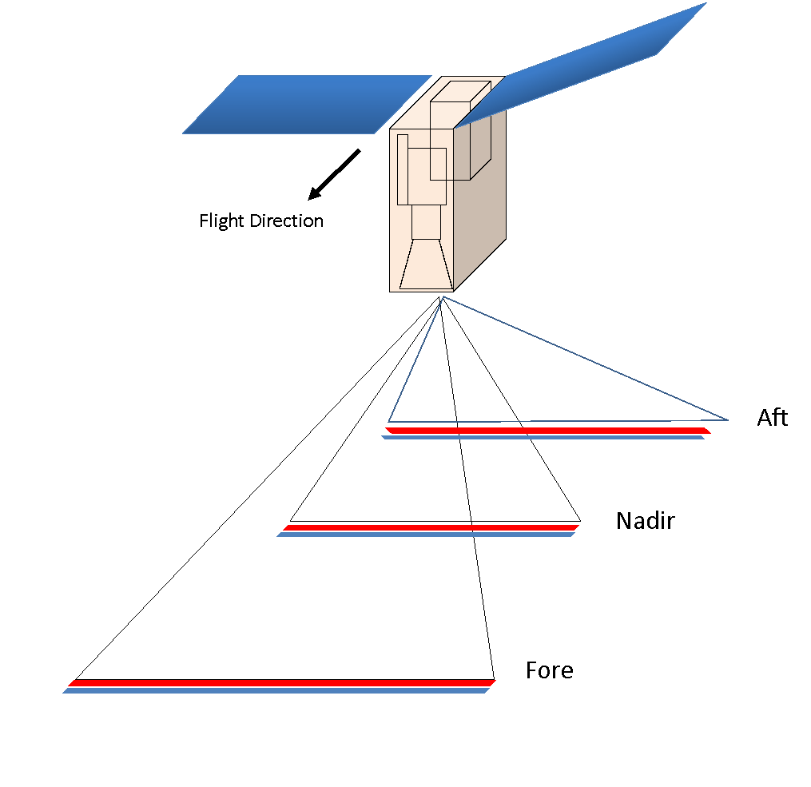
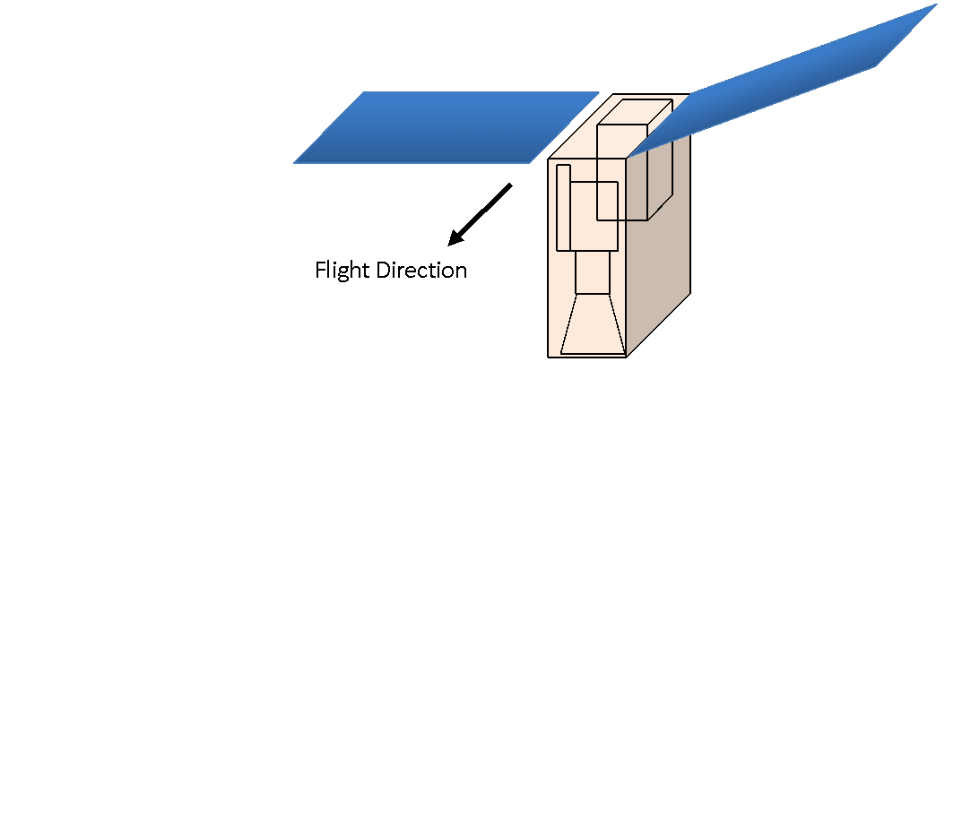
G16
G16
GEO
GEO
G16-G17 (done)
G17-H8 (done)
G13-G16 (done)
G16-MSG (soon)
G16-MTG (coming)
MODIS (done)
VIIRS (soon)
MISR (done)

Slide 4
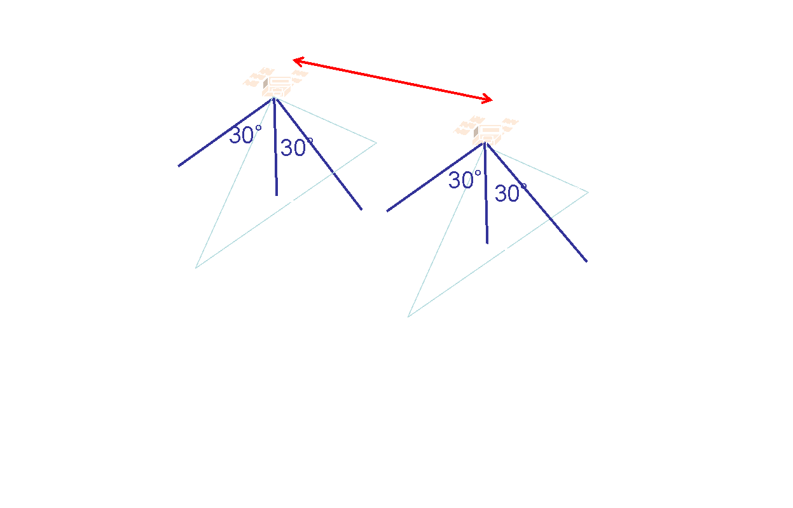
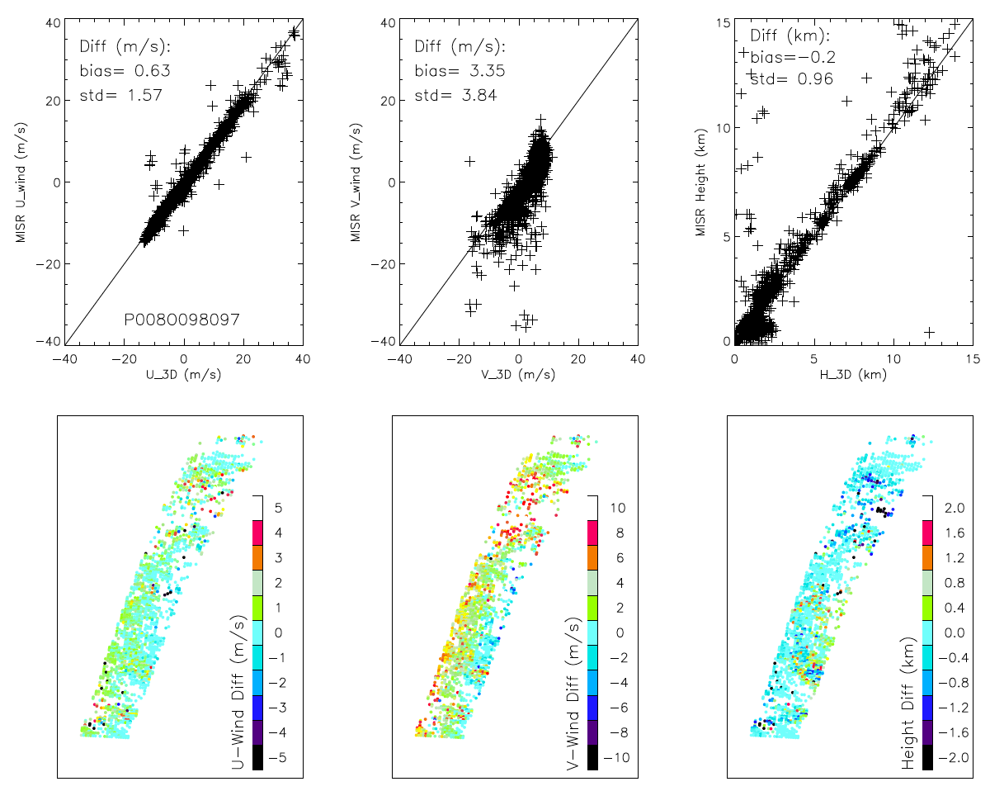
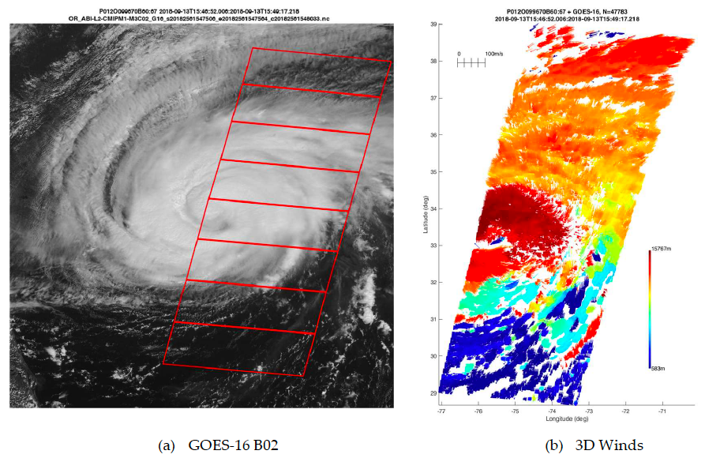
MISR-GOES Stereo Winds
Carr et al. (2018)

Slide 5
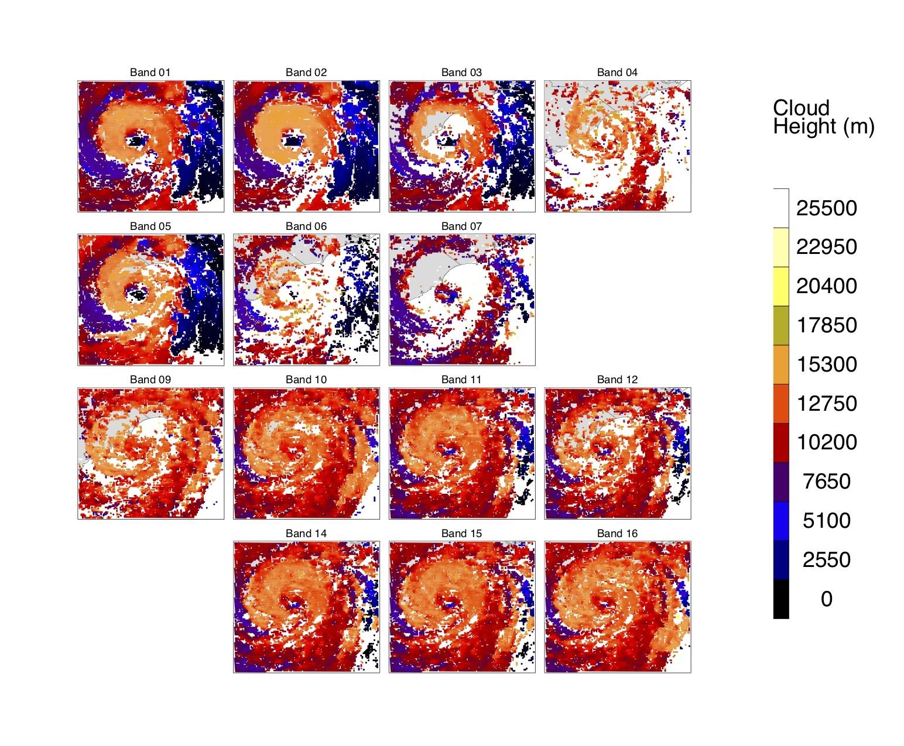
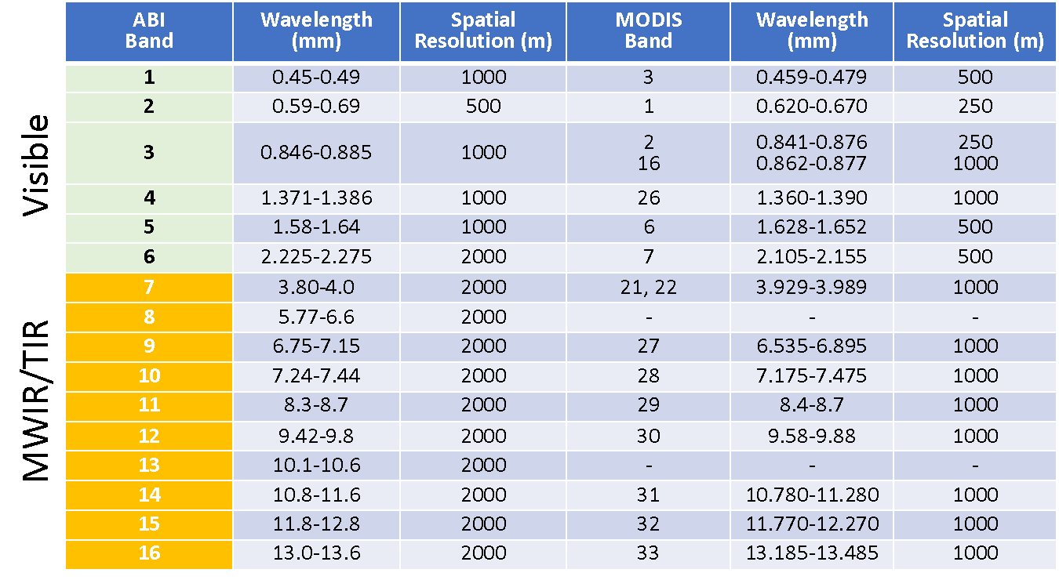
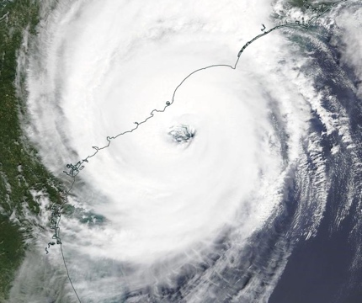
MODIS-GOES Stereo Winds
Hurricane Dorian (Sep 5, 2019)
No synchronization required for LEO and GEO images
Accuracy (except at singularity) Height ~200 m
Wind < 0.5 m/s
Carr et al. (2019)
Self-consistent AMV height assignment within each spectral band

Slide 6
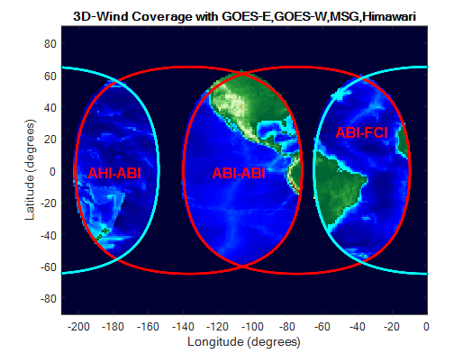
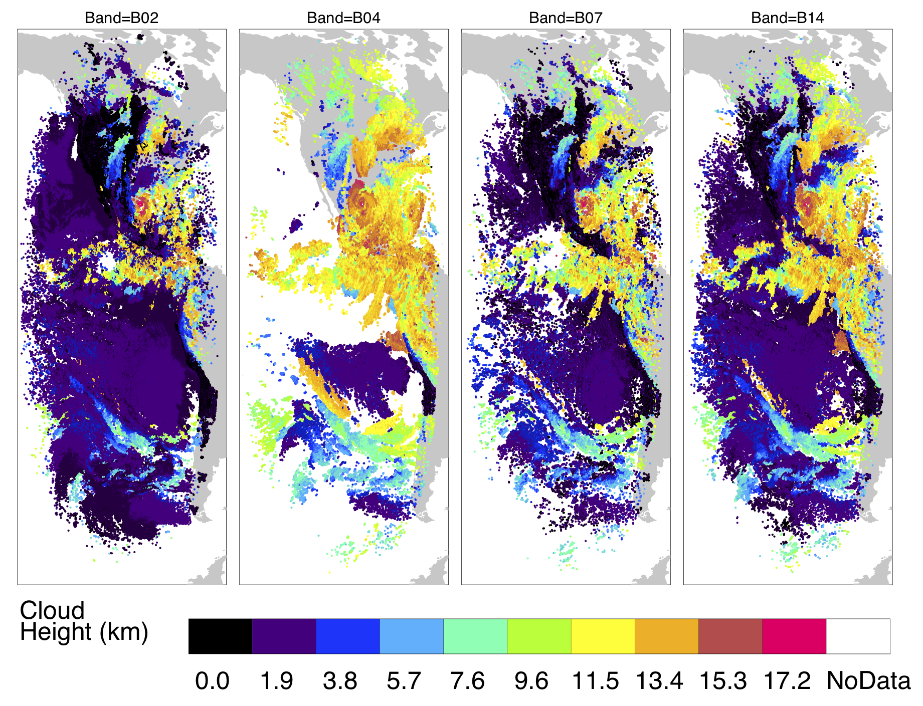
GEO-GEO Stereo Winds
G16-G17 Stereo Winds
Visible
Shortwave IR
Midwave IR
Longwave IR
No synchronization required for GEO and GEO images
Accuracy Height ~300 m
Wind < 0.5 m/s
Figure 11

Slide 7
Applications
Deep Convective Systems
Tropical storms and hurricane diurnal cycle
Severe weather
PBL
Cold air outbreak
Stratocumulus-to-cumulus transition
Orographic clouds
Wildfire plume and Air Quality
Pyrocumulonimbus (pyroCb) cloud
Plume evaluation

Slide 8
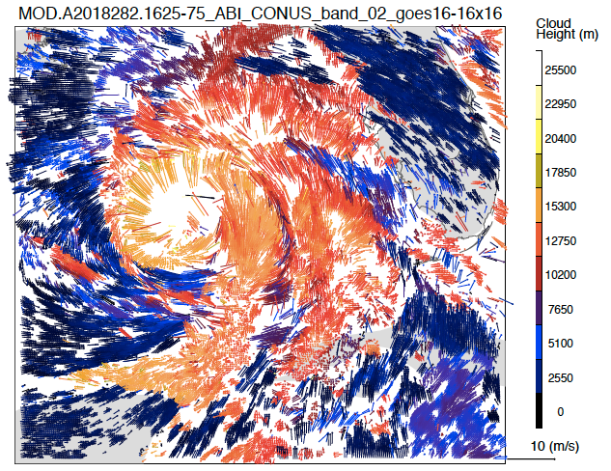
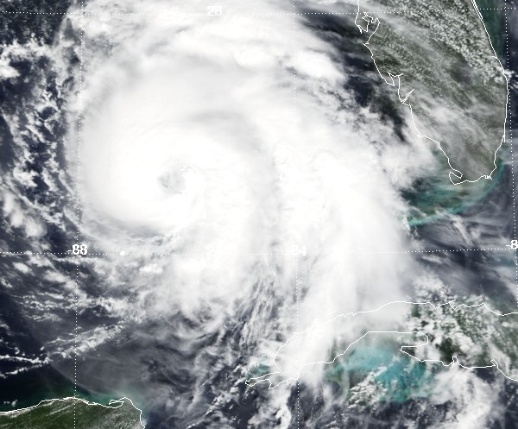
MODIS-GOES Stereo Winds
Carr et al. (2019)
Hurricane Michael (October 9, 2018)

Slide 9
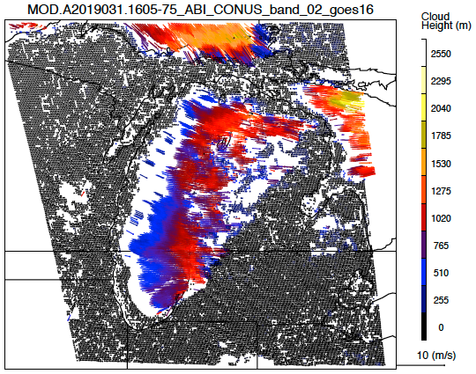
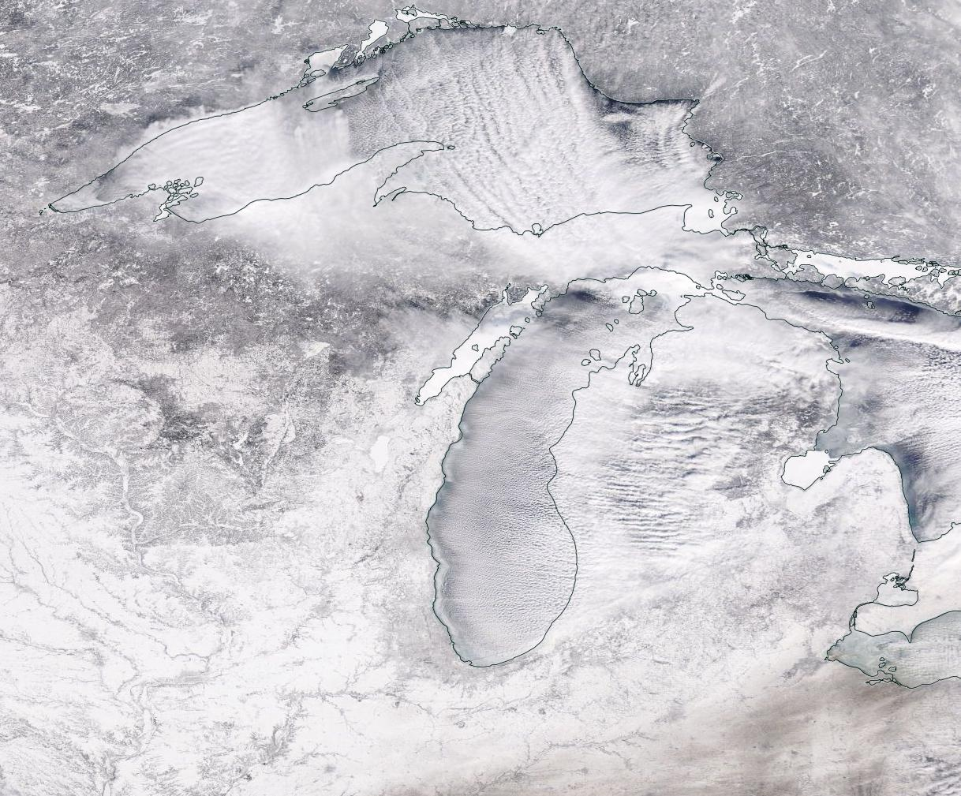
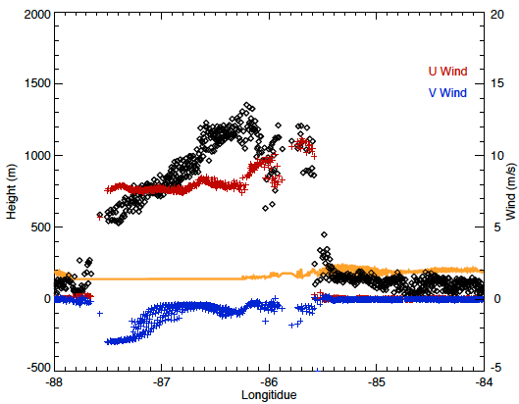
MODIS-GOES Stereo Winds
Carr et al. (2019)
Lake Superior
43ºN
Michigan
43ºN
height
Lake Michigan
Severe Weather:
Lake-Effect Snowfall
(Jan 31, 2019)

Slide 10
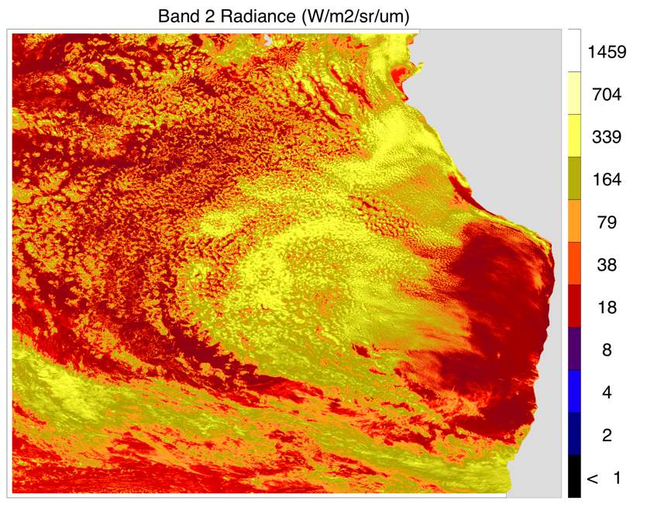
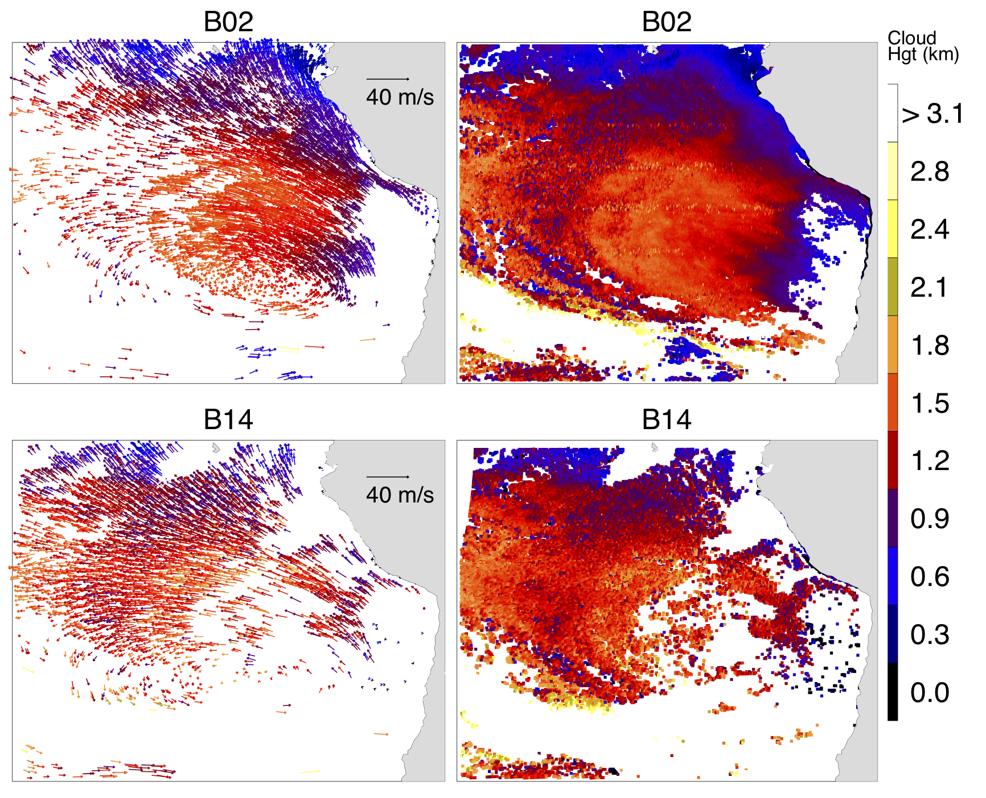
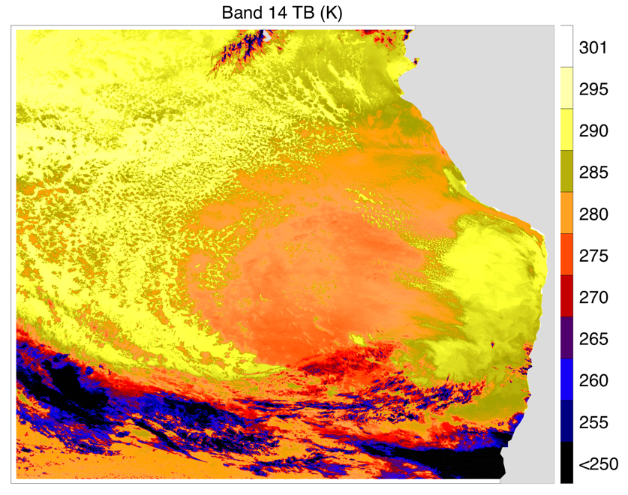
G16-G17 Stereo Winds and Height
Stratocumulus-to-cumulus transition
Dynamic maritime PBL variations
Carr et al. (2020)
VIS
IR

Slide 11
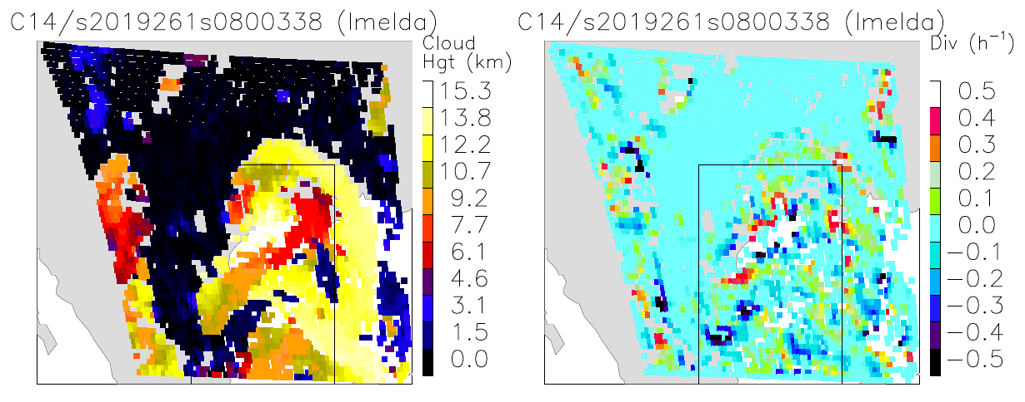
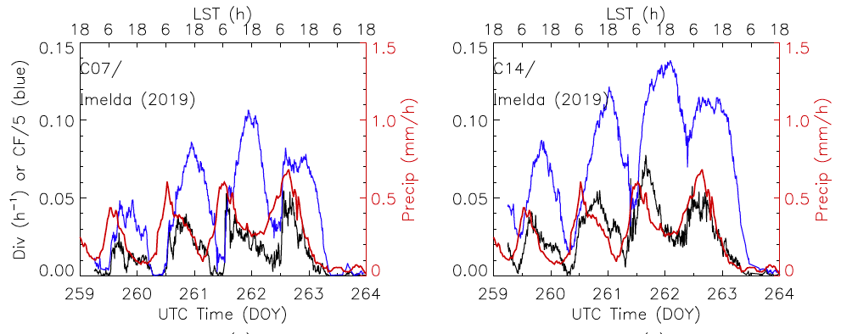
G16-G17 Stereo Winds and Height
Tropical Storm Imelda (2019)
Carr et al. (2020)
Dense wind measurements to derive cloud top divergence at z >11 km
Strong diurnal cycles in upper-level cloudiness and divergence, and in precipitation
Precipitation leads upper-level divergence by ~6 hours
Divergence
Cloud fraction
IMEG Precipitation

Slide 12
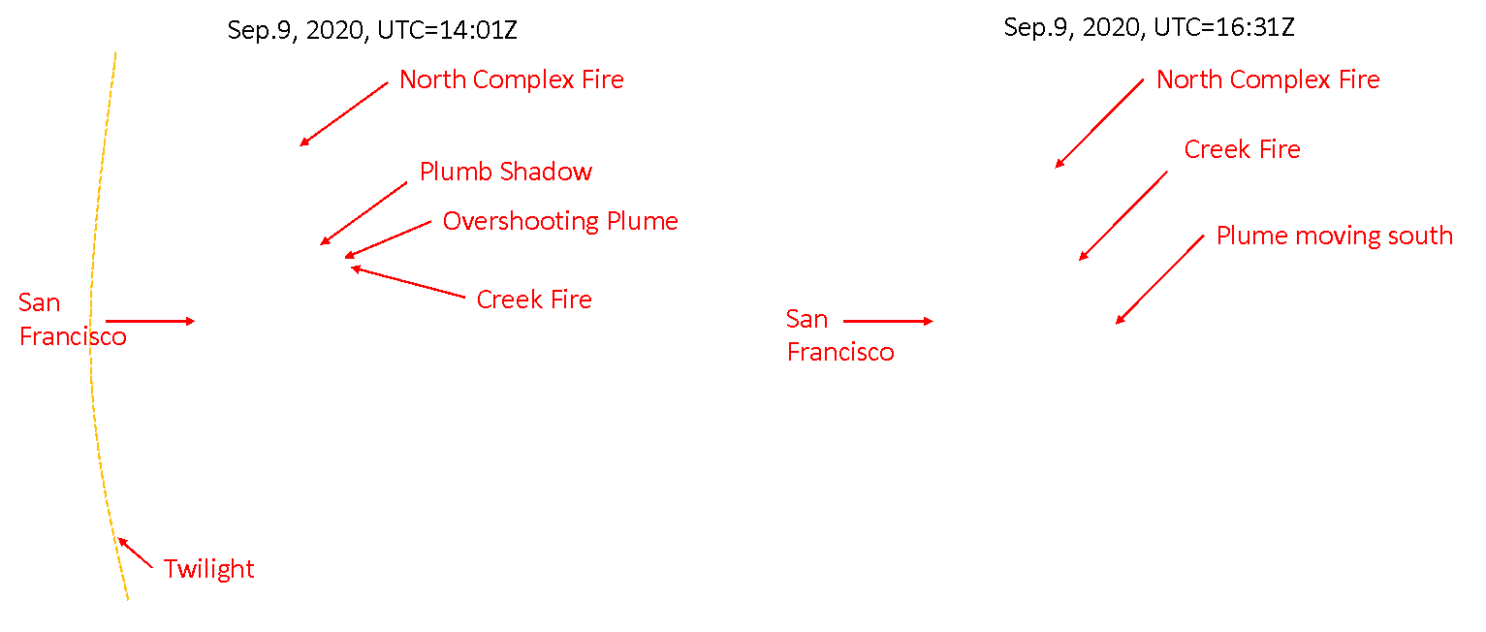
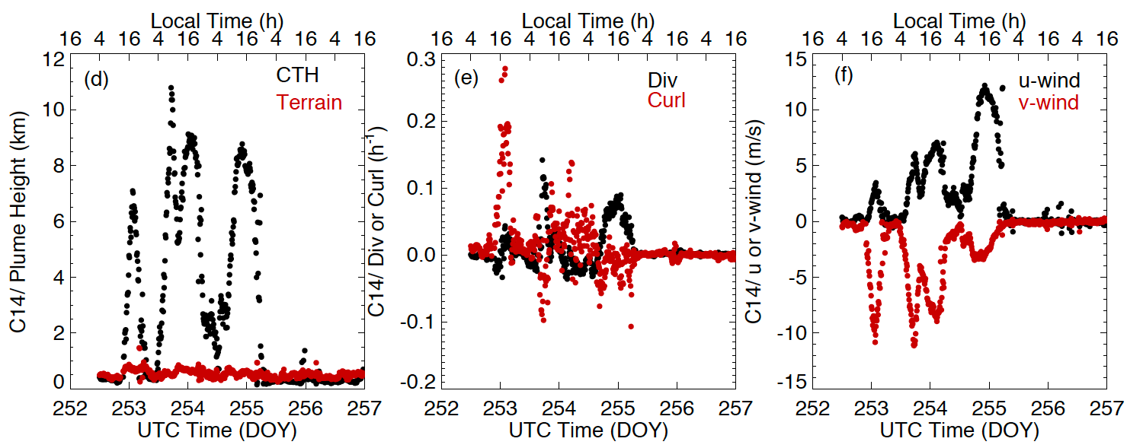
California Creek Fire (Sep 2020)
G16-G17 Stereo Plume Height
Carr et al. (2020)
Intense and deadly wildfire season in the West Coast in 2020
Strong diurnal cycles in plume height and winds
Wide spread of fire plume and poor air quality
pyroCb retrieved from stereo plume height
pyroCb

Slide 13
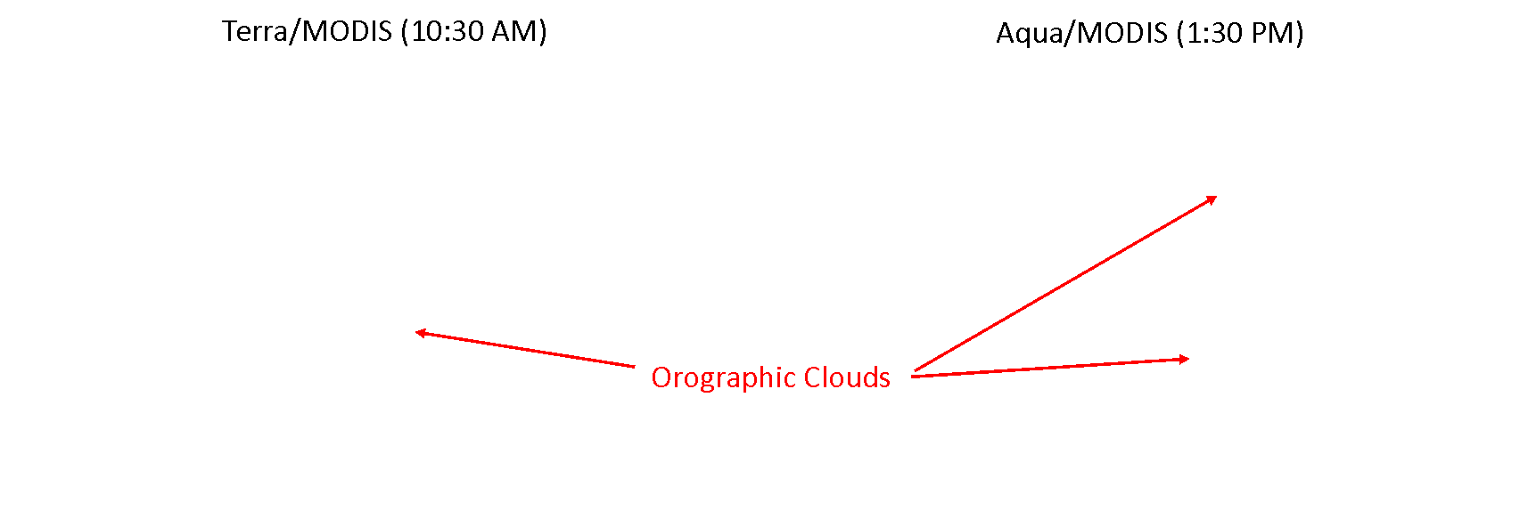
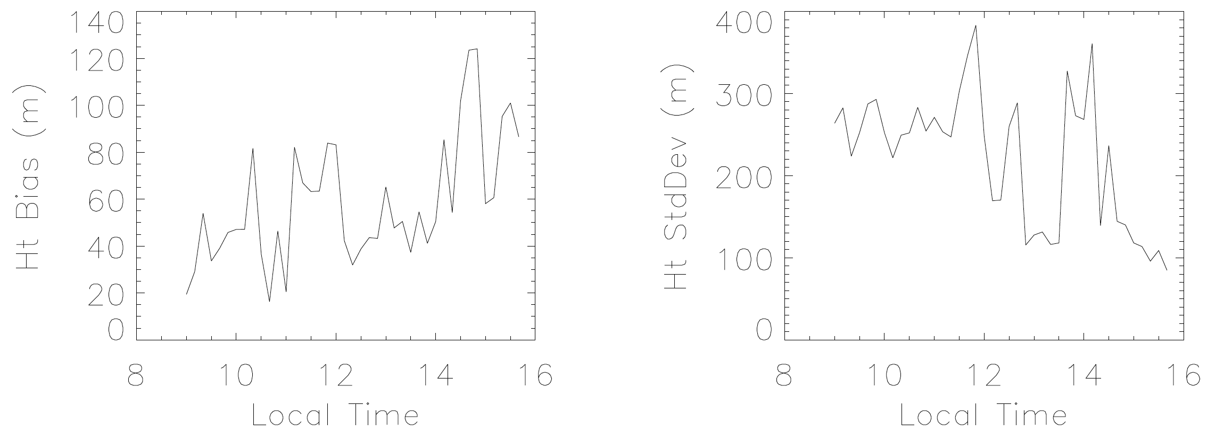
Orographic Clouds and PBL Variations
G16-G17 Stereo Height
Carr et al. (2020)
High precision of advanced Image Navigation and Registration (INR) enables to track small changes in stereo height
Growth of orographic clouds is sensitive to PBL and surface properties
Signature of height growth near surface indicates rising orographic clouds during daytime
Height Above Terrain (m)

Slide 14
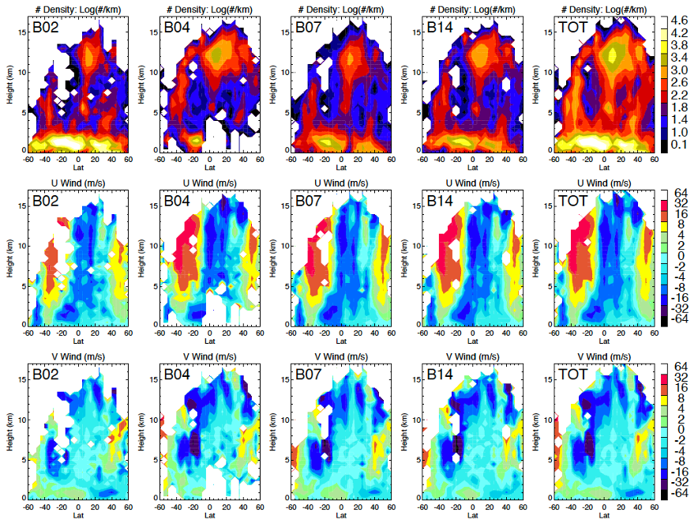
Why Stereo Wind/Height (1/2) ?
More accurate height assignment for atmospheric motion vectors (AMVs)
AMVs are one of the key inputs to data assimilation and numerical prediction systems
Mature technique and cost-effective constellation for global spatiotemporal coverage

Slide 15
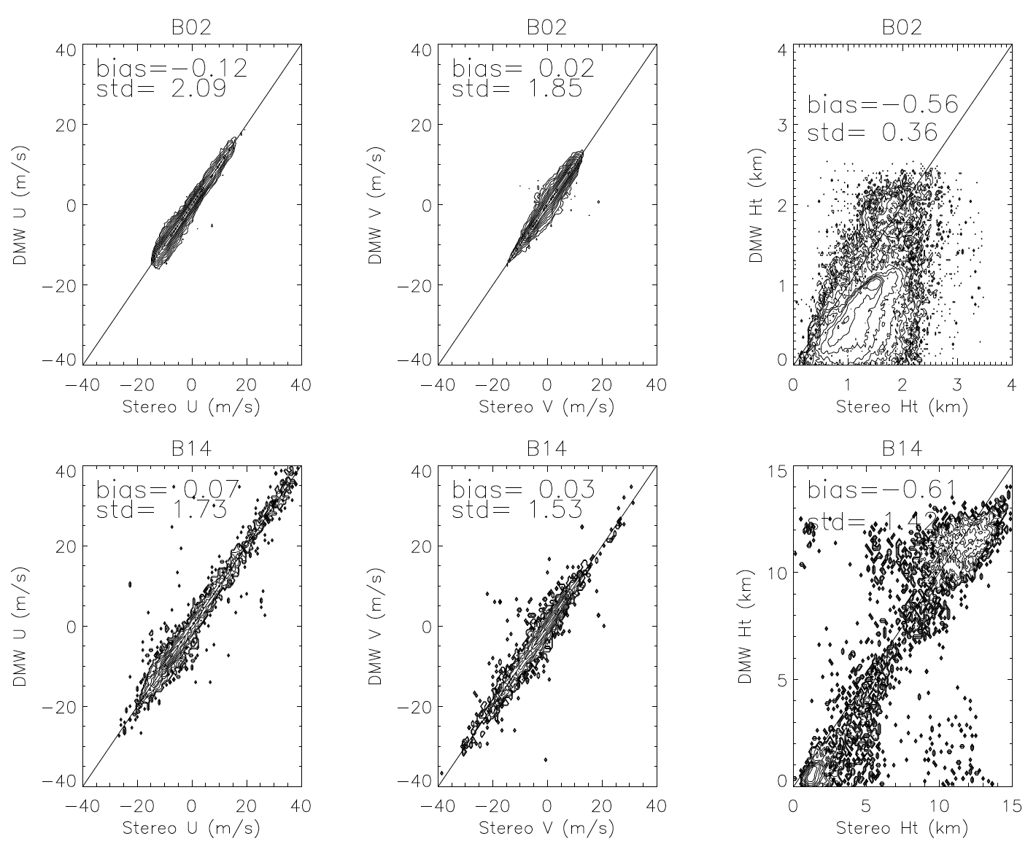
Why Stereo Wind/Height (2/2) ?
Good 1:1 correlation between operational and stereo AMVs (U and V)
Conventional AMV errors are largely associated with height registration uncertainty
Systematic biases for PBL heights
Problems for multi-layer clouds
Vis
Vis
Vis
Height
U-wind
V-wind
Operational AMVs
IR
Height
IR
IR
V-wind
U-wind
Stereo AMVs/Height

Slide 16
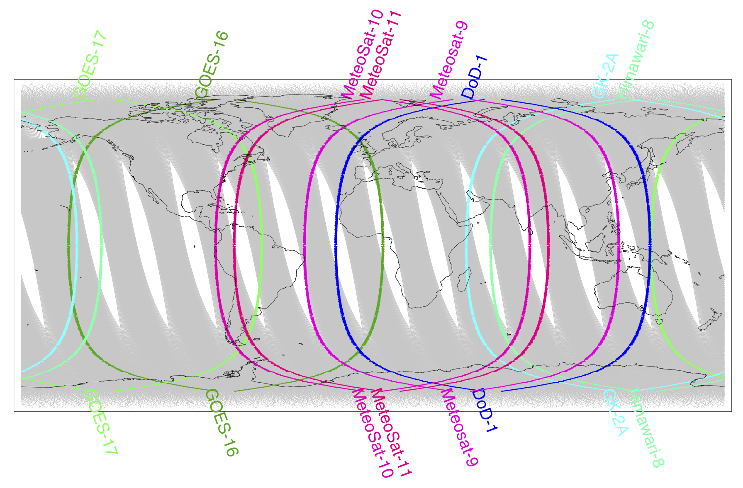
Future 3D-Winds
Program of Record (GEO-Ring, LEOs) and New LEO Sensors (Lidar, Imager)
GOES-13 => DoD-1

