Slide 1
Current Status of the ESA Aeolus Follow-On Mission
Aeolus Follow-On team
D. Wernham, A. Heliere (ESA)
17-19 Nov. 2020,
NOAA-NASA Working Group on Space-based Lidar Winds

Slide 2
Preamble
Based upon the success of the Aeolus satellite…
The EUMETSAT Council expressed interest for a future operational Doppler Wind Lidar mission and proposed to ESA to prepare for a joint preparatory roadmap for a potential future operational mission.
EUMETSAT defined preliminary top-level inputs for the Aeolus Follow-On Mission.
ESA defined lessons learned from the Aeolus development and in-orbit operations and formulated provisional requirements for an Aeolus Follow-On mission.
The Aeolus Scientific Advisory Group proposed the performance needs for a future Wind Lidar mission.
4 Key pre-development activities were identified by ESA taking account of the above, namely:
  An Instrument Consolidation Study;
  2 x Laser Transmitter Pre-developments;
  A Detector Pre-development.

Slide 3
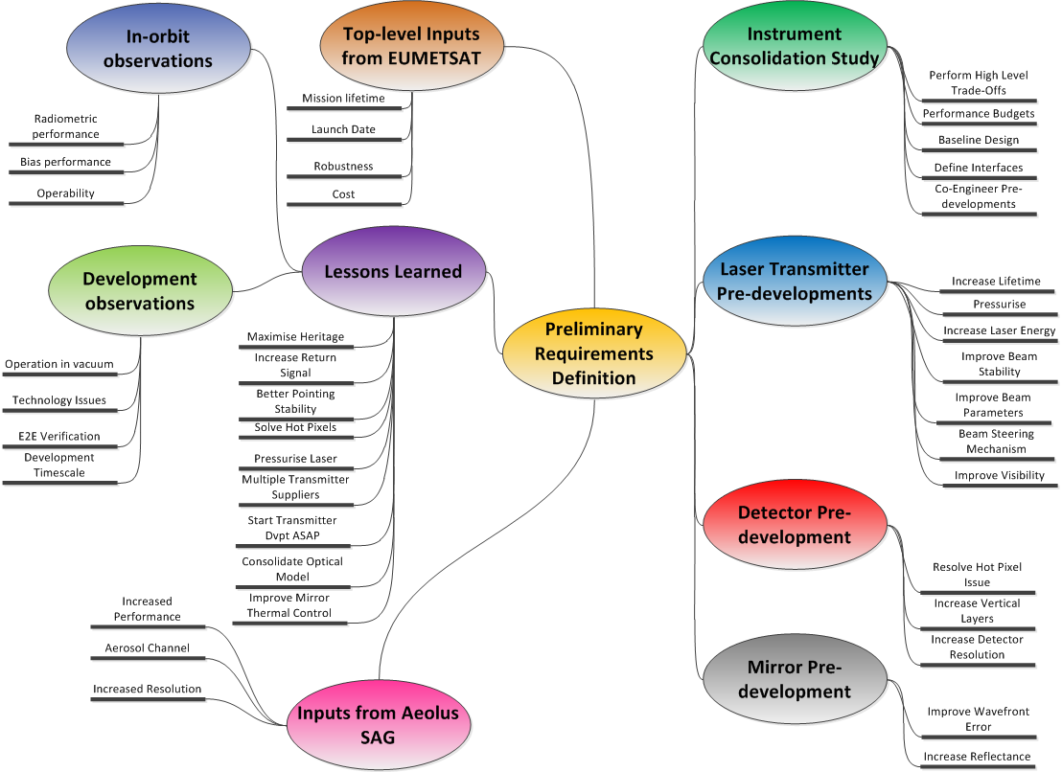
Instrument Pre-development Activities Definition
The pre-development activities definition process resulted in the following needs:
An instrument consolidation study, performing trade-offs, in order to baseline the instrument sizing and design for the Aeolus Follow-On;
2 x transmitter developments in order to improve the laser performance and to mitigate schedule risk;
A detector development in order to resolve the hot pixel issue and increase the number of vertical samples;
A mirror development is still being considered to improve the radiometric throughput and thermal control but currently not funded.

Slide 4
Instrument Pre-development Activities Definition
Main evolutions from Aladin:
Significant increase in lifetime (3yrs to >5-7yrs)
Significant increase in vertical bins and resolution
In addition:
Higher altitude needed to meet lifetime → lower signal
goal requirements (Trop.) are factor x2 in Hor. and x2 Ver. resolution leading to x4 higher signal need
Possible addition of aerosols cross polar channel
Issues to be resolved:
Aladin not meeting the original requirements for random and systematic errors
Higher laser energy and transmission through the FS needed

Slide 5
Instrument Consolidation Study – Airbus D&S (1/3)
  Study logic overtime
  05/2020 Study proposal
  09/2020 Study KO : study work-plan, main tradeoff presentation, and preliminary model simulations
  12/2020 PM#1: orbit altitude trade-off , lessons learnt and obsolescence, simulation model 1st delivery, trade-off status
  02/2021 Preliminary baseline review: presentation of trade-off results and proposed baseline
  06/2021 Mid-Term Review: instrument ICD issues, inputs for P/F, requirement specification for sub units
  02/2022 Final Review : convergence on design, requirement specs, development plan
  Design improvement
  Critical objective is to go for operational mission, which means increase robustness, lifetime, reliability, but to keep heritage from past ALADIN or ATLID or MERLIN Lidar to minimize development duration.
  On the other hand, new requirements are defined from SAG recommendation for matching 2030-2040 timeframe expectations
    Threshold requirements are close to ALADIN one, with request of higher vertical sampling layers 66 instead of 24
    Goal requirements are factor x2 in Hor. and x2 Ver. resolution leading to x4 higher signal need. (in troposphere)
    Additional requirement evaluation: aerosols cross polar channel added

Slide 6
Instrument Consolidation Study – Airbus D&S (2/3)
  Main trade-offs to be concluded for Preliminary Baseline Review:
  Bi-static or Mono-static architecture
    A bi-static preliminary baseline is elaborated to be traded compared to existing ALADIN monostatic
      Main advantage of bi-static: transmitter path reliability increase, contamination control, LoS misalignment control
      Main disadvantage of bi-static: ALADIN heritage modification, no internal path direct calibration, higher instabilities on LoS at spectrometer input leading to new random error contributor.
  Laser Pulse repetition frequency increase above 50Hz
    Set-point to be optimized based on acceptable laser dissipation increase, on detection read out scheme, on optimum baseline review
  Altitude trade off
    Outcome shows a possible altitude at 340km for 7 year lifetime including worst case solar activity assumption. A mix of electrical propulsion and chemical propellant is a possible solution.
  Subunits interface and requirements
    Laser head volume and shape definition in review to verify accommodation solutions
    Laser dissipation and laser cooling system solutions identifications
    Detector pixels architecture analysis and temperature control upgraded solution verifications

Slide 7
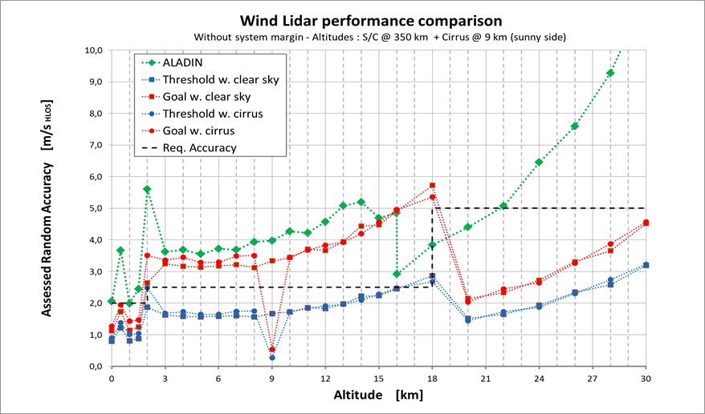
Instrument Consolidation Study – Airbus D&S (3/3)
Model simulations
ALADIN model has been extended to higher atmosphere layers, keeping same processing.
Preliminary results using same ALADIN model, and with assuming 125mJ laser energy, 350km altitude and assuming solving Rx energy loss anomaly:
  threshold requirements are achievable, and there is strong improvement vs ALADIN performance by a factor x2.
  goal requirements are not met especially in the range 10km to 18km in troposphere, and would need x4 signal increase.
  The study will review performance allocation with aim to solve the link anomaly and check where further improvement can be seen while keeping ALADIN heritage.
Predicted performance of Aeolus Follow-On assuming that the atmospheric signal loss observed at start of Aladin operations is resolved, laser energy is 125mJ and an orbital altitude of 350km. The green curve represents the Aladin performance in-orbit. Note that this assumes that there are no further improvements to the radiometric link budget.

Slide 8
Pre-development Activities
Pre-developments of an Engineering Model of the Laser Transmitter (x2)
  These are currently being negotiated with Leonardo (Aladin/Atlid heritage) and the Institute of Laser Technology (FULAS/MERLIN heritage). Kick-off planned early December.
  Critical aspect is the increased lifetime (>5 years) and the increased robustness
  Targeting increased Energy level 150mJ in UV (125mJ EOL)
Pre-development of an Engineering Model of a wind lidar Detector
  This is in the tendering stage with Teledyne e2V
  Heritage from both ALADIN ACCD and ATLID MCCD
  Required higher number of vertical samples (54 to 66)
  Resolve hot pixels issue

Slide 9
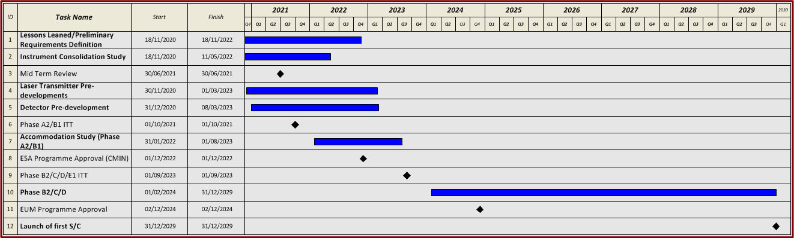
Aeolus Follow-On Roadmap
Key durations/dates:
Instrument Consolidation Study (Q3 2020;18 months)
Laser Transmitter Pre-developments (Q4 2020; 30 months)
Detector Pre-development (Q4 2020; 27 months)
Phase A2/B1 (Q1 2022; ~18 months)
Phase B2/C/D (Q2 2024; ~6 years)

Slide 10
Aeolus Follow-On Major Open Points
Requirement consolidation before end 2020:
  this is a key input for the instrument consolidation and pre-developments.
Number of satellites versus affordability:
  may drive the satellite design e.g. number of transmitters per instrument;
  this may result in reduction of mission lifetime from 15 to 10yrs.
Resolution of the Aeolus signal return anomaly:
  Key to achieving performance
Potential aerosol channel:
  this is a recommendation from the Aeolus SAG (currently not assumed to be a core mission requirement but integrated into the Instrument Consolidation Study).

