Slide 1
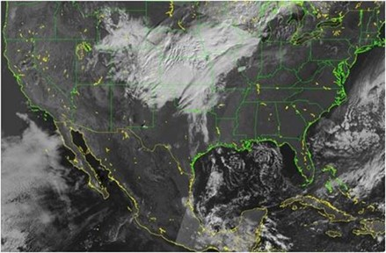
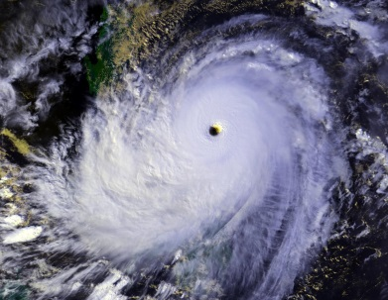
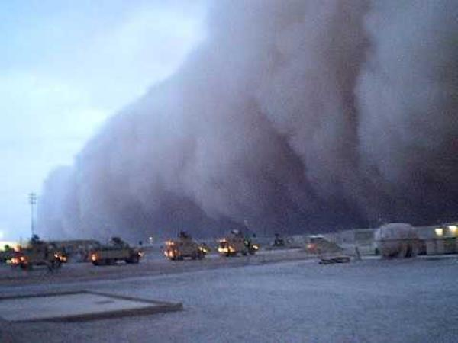
An Industry Perspective on Strategies Needed to Field a U.S. Winds Mission
November 19, 2020
Cory Springer
Director, Weather & Environment

Slide 2
BLUF (Bottom Line Up Front)
NOAA stated goal, via the NSOSA, is to field an operational 3D winds mission by 2030 (a “high priority”);
AEOLUS has demonstrated that the impact of a wind lidar system is profound;
Through significant NASA and private sector technology investments, the U.S. is ready to go to space;
Such a system will not require a $1B investment;
The private sector should be part of the solution;
This WG can play a leading role in fielding a space-based U.S. wind lidar system by 2030

Slide 3
Agenda
Observations & Assessment
What can be done
Where to start
Recommendations

Slide 4
Observations & Assessment
A more focused, common WG goal could be valuable to the agencies as they develop programs and budgets;
There seems to be a subconscious, self-inflicted constraint within the WG that any U.S. wind lidar system must meet both operational WX and NASA science (PBL, small-scale processes) needs;
One possible near-term goal: provide technical and programmatic recommendations for fielding an operational U.S. wind lidar mission by 2030;
Developing an operational wind lidar mission will be a team sport between public and private sectors;

Slide 5
What Can Be Done
Provide “actionable” recommendations to agency leaders to support programmatic planning activities;
Initial priority: come to a consensus on technical approach – recommend focus on a system or set of systems that can be fielded by 2030 to meet NOAA’s operational requirements;
Leverage investments made to date – and provide recommendations for future agency investments supporting a 2030 mission;
Follow-on priority: recommend technical approach for a synergistic/complimentary science-focused mission for a future NASA Explorer mission to support NASA Atmospheric Winds/PBL science needs;

Slide 6
Where to Start
We are in a great place!
What do we know?
Technology is mature/ready to go to space (AEOLUS, OAWL);
It’s not a $1B mission (AEOLUS, ATHENA OAWL);
It builds on previous work (CALIPSO, AEOLUS, OAWLs, DLR Falcon lidars, DAWN);
We know the technology is ready to go to space – thanks ESA for leading the way!
Ball’s space-based OAWL design continues to advance and has been deemed “acceptable risk & selectable” by NASA Technical, Management, Cost, and Other (TMCO);
CALIPSO is still operating after 14 years and > 8 billion lasers shots!

Slide 7
Recommendations for WG
Come to consensus on a common goal;
Near-term priority should be supporting NOAA since they are in the middle of defining their nextgen architecture;
Develop a roadmap to a 2030 operational system launch;
Recommend technical solution (optimized for performance and cost) to provide maximum bang-for-the-buck;
Solution should recognize complimentary contributions of partner nations, passive AMVs and airborne obs – how would one design a combined wind lidar, passive IR sounder mission, augmented by and airborne obs?
Solution should also recognize “boundary conditions” (i.e., budgetary realism - thus NOAA’s desire for smallsat solutions - 2030 on-orbit goal, etc.);

Slide 8
Questions / Comments
… or better yet, group discussion

