Slide 1
NOAA’s Perspective on 3-D Winds
Vanessa Griffin
Director, Office of Systems Architecture and Advanced Planning
NOAA National Environmental Satellite, Data, and Information Service
Nov. 17, 2020

Slide 2
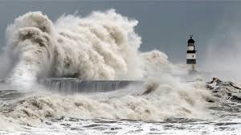
Agenda:
Importance of Satellite Wind Observations to NOAA
NOAA’s History of Measuring Winds
NSOSA Study Findings
Developing Our Next-Gen Earth Observation Architecture
Next Steps: Working With Our Users to Shape Program Requirements

Slide 3
Importance of Satellite Wind Observations to NOAA
Satellite Derived Winds: Key Component of Global Observing System (GOS)
Enhanced understanding of 3-D Winds: operational forecasts, fire weather, environmental modeling, environmental prediction, seasonal outlooks (including hurricanes)
Provide vital tropospheric wind over regions devoid of in-situ wind observations: oceans, polar regions, and Southern Hemisphere land masses
Key wind observations demonstrated to improve NWP forecasts including tropical cyclones
Improved guidance for NWS field forecasters
Global Radiosonde Network
Department of Commerce // National Oceanic and Atmospheric Administration // ‹#›

Slide 4
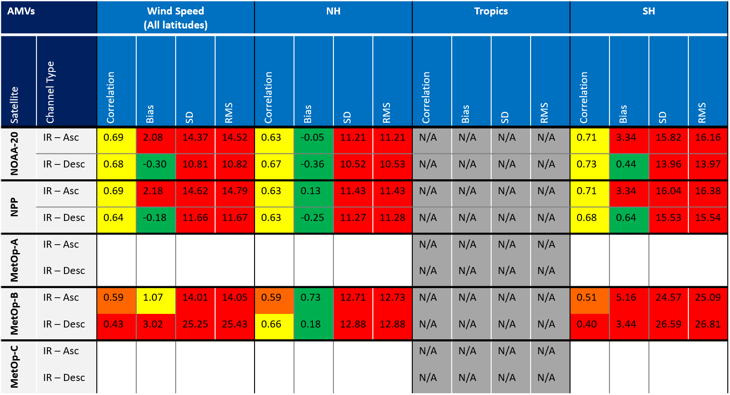
NOAA’s History of Measuring Winds:
Global horizontal wind measurement is a long-established requirement for NWP
NOAA participation dates back 40 years:
Laser Atmospheric Wind Sounder (LAWS) science team with NASA, 1980s-early 1990s
In the 1990s this morphed into the NASA/NOAA Lidar Working Group
NOAA funded GroundWinds and Balloon Winds projects in the early 2000’s
NOAA continues supporting the NOAA-NASA Working Group on Space-based Lidar Winds since it’s inception in the early 1990’s
3D Wind projects funded by the OPPA Technology Maturation Program (TMP) since it was established in 2018
TMP Project Results: Overview of comparison statistics between Aeolus Rayleigh-clear winds and LEO AMVs based on AMV channel type, latitude region, Aeolus ascending/descending orbit.
Overall, IR AMVs from LEO satellites exhibit similar comparisons with Aeolus Rayleigh-clear winds. Winds have smallest bias in NH.
Notes:
3D Wind projects funded by the Technology Maturation Program (TMP) since it was established in 2018 … TMP 3-D Winds team participants: STAR, AOML, CIMAS, CIRA, UWISC-CIMSS: Wind, UWISC-CIMSS: OSSE …you will hear from a number of these team members over the next few days …… including Mike Hardesty and Kevin Garrett -- Co-chairs, U. S. Working Group on Space-based Lidar Winds

Slide 5
NOAA’s History of Measuring Winds (cont):
3-D Winds (AMV’s) currently derived from these satellites/instruments:
GOES-R ABI Measurements
EOS TERRA/AQUA MODIS
JPSS VIIRS
METOP-A, -B
Meteosat/SERVIRI
Himawari-8 AHI
Notes:
IMPORTANCE OF SATELLITE WIND OBSERVATIONS:
Satellite Derived Winds are a Key Component of the Global Observing System (GOS)
Provide vital tropospheric wind information over expansive regions of the earth that are devoid of in-situ wind observations that include oceans, polar regions, and Southern Hemisphere land masses.
Provide key wind observations to operational NWP data assimilation systems where their use has been demonstrated to improved numerical weather prediction forecasts including tropical cyclones
Provide improved guidance for NWS field forecasters

Slide 6
NOAA Satellite Observing System Architecture (NSOSA) Study Findings
Notes:
IMPORTANCE OF SATELLITE WIND OBSERVATIONS:
Satellite Derived Winds are a Key Component of the Global Observing System (GOS)
Provide vital tropospheric wind information over expansive regions of the earth that are devoid of in-situ wind observations that include oceans, polar regions, and Southern Hemisphere land masses.
Provide key wind observations to operational NWP data assimilation systems where their use has been demonstrated to improved numerical weather prediction forecasts including tropical cyclones
Provide improved guidance for NWS field forecasters

Slide 7
NSOSA Study Architecture Analysis:
Considered future observing capabilities, partner observations, user requirements, instrument technologies, and commercial interests
Provided discriminating choices and opportunities about the next generation, and establishes a robust analytic capability to evaluate and iterate opportunities
Observational Objectives
Model Costs
Strategic Objectives
Develop Constellation Concepts
Score Against Requirements and Strategic Priorities
Available Technology
Cost/Benefit
Inform and Refine
Performance Score
Relative Cost
Notes:
On "available technologies" say developed instrument catalog with over 100 instrument concepts of current and projected future capabilities
On "developed constellation concepts" talk about the broad range of options examined, from legacy continuation to radical alternatives
Reinforce that legacy constellation options are not specific to sensors, services, etc. of the companies in the room

Slide 8
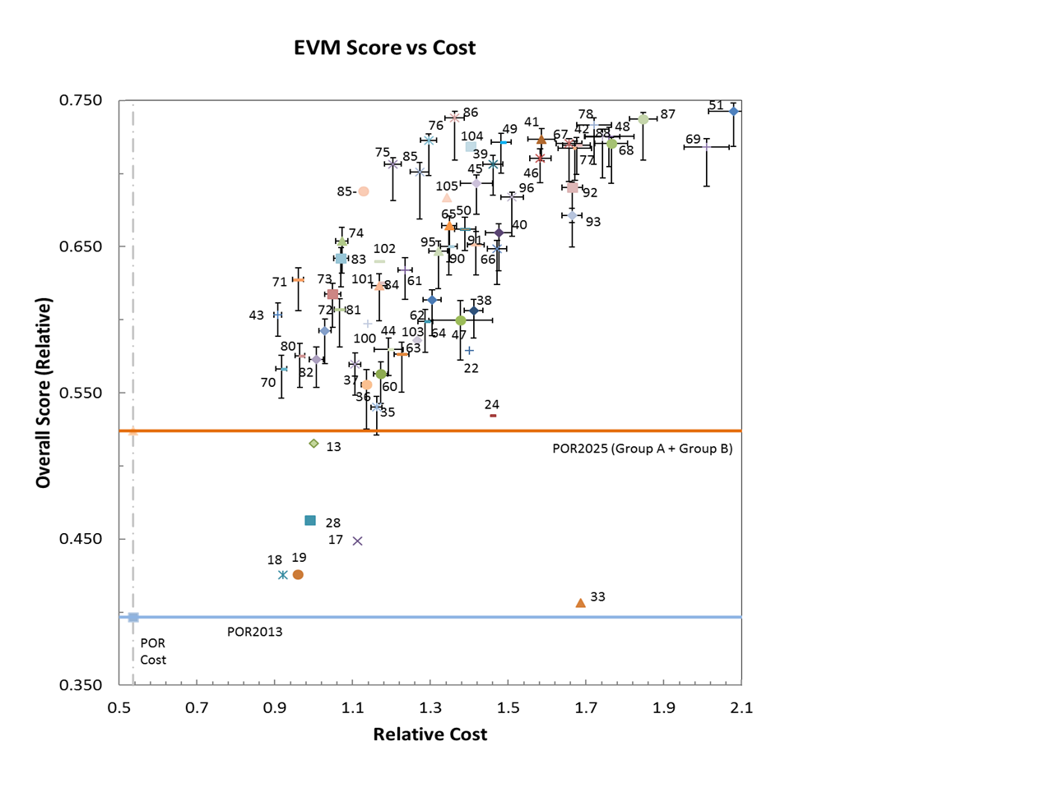
NSOSA: New & More Capability for Same Cost
The value difference between Hybrid and Legacy shows that additional capabilities of the Hybrid architecture are possible at the same cost as the Legacy architecture
Relative Performance Score
Near-Space Atmospheric Measurements
Real Time Imagery
Hybrid
Legacy Continuation
3D winds
Notes:
Note that nearly half of the gain in value is by the addition of a 3D wind capability.

Slide 9
How NSOSA Scored 3-D Winds:
The NOAA Space Platform Requirements Working Group (SPRWG) ranked 3-D Winds as their #1 objective for improvement over current capabilities
SPRWG ranked 3D Winds “High value, relatively high risk, relatively high cost, with potential exploitation of rapid pace of SmallSat capabilities for a distributed wind architecture.”
SPRWG identified 3-D Winds as the “Holy Grail” of NWP
NOAA is interested in 3-D Winds, but not necessarily only lidar technology
- NOAA is currently laying out a plan to obtain 3-D Winds (exploring active or passive solutions)
Notes:
"This objective is essentially the “Holy Grail” of NWP, and not well provided now..." can be attributed to Bob Atlas, Chris Velden, James Yoe, and Rick Anthes, who were the authors of Objective A13 of the SPRWG report. The overall primary author of the SPRWG report was Rick Anthes.
A ground rule of the NSOSA process is that all objectives will be included in any architecture to at least the ST level. Thus the rank order gives priorities for moving from ST to ME levels—the priorities in improving the capability above the ST levels, not absolute priorities. Highest priority is therefore given to objectives that are both very important to NOAA operationally and have a relatively low level of capability at the ST level (see Fig. 1). Highest priority for NOAA operations is assumed to be saving lives and property; therefore Nowcasting (severe weather) and NWP are the highest priorities in general for improvement.
2) Follow the indicated 3D Wind roadmap (see Section 8.6) leading nominally to an operational
3D Wind Doppler lidar system. The roadmap specifies analysis of experimental wind lidar
data, technology development, and consideration of alternative approaches to 3D vertical
wind measurements prior to selection of the operational approach. The nominal approach
should consist of one orbit of guaranteed coverage and another orbit available as residual
satellites exceed their design lives. The nominal approach was what was analyzed for cost
and effectiveness in the NSOSA study.

Slide 10
Developing Our Next-Gen Earth Observation Architecture
Notes:
IMPORTANCE OF SATELLITE WIND OBSERVATIONS:
Satellite Derived Winds are a Key Component of the Global Observing System (GOS)
Provide vital tropospheric wind information over expansive regions of the earth that are devoid of in-situ wind observations that include oceans, polar regions, and Southern Hemisphere land masses.
Provide key wind observations to operational NWP data assimilation systems where their use has been demonstrated to improved numerical weather prediction forecasts including tropical cyclones
Provide improved guidance for NWS field forecasters

Slide 11
Four Pillars of NSOSA Implementation
Integrated, Adaptable, and Affordable: Orbits, Instruments & Systems
Miniaturized instruments on small, affordable, and proliferated satellites and partner data improving forecasts through better and additional data. Better precipitation forecasts, wave height predictions, ocean currents, and more.
Continuous real-time observations supporting warnings and watches of severe weather and hour-by-hour changes. High-inclination orbits to observe northern latitude & polar regions.
Reliably monitoring coronal mass ejections from L1, GEO, and LEO can protect the nation’s valuable, vulnerable infrastructure. New capabilities at L5 and high earth orbit can provide additional insight and improve forecasts.
LEO
GEO
Space Weather
Secure ingest of data in different formats from different partners requires a flexible, scalable platform. Common Services approach integrates cloud, AI, and machine-learning capabilities to verify, calibrate, and fuse data into new and better products and services.
Common Ground Services
Notes:
Evolving to a more mission-effective, integrated, adaptable, and affordable portfolio
Responding to changing technology, emerging partnerships and evolving observation requirements
Why start now?
10-15+ year development timeline for space assets
Current constellation (GOES-R/S/T/U and JPSS-1/2/3/4) fly-outs 2026-2035

Slide 12
Commercial Partnerships:
NESDIS is engaging the commercial sector in a number of ways to leverage ongoing and emerging capabilities.
Broad Agency Announcements (BAA): NESDIS is executing 32 studies to assess new concepts for instruments, spacecraft, business models, and mission elements in GEO and extended orbits, LEO small sounder satellites, and Space Weather.
Commercial Weather Data Pilot (CWDP): CWDP Round 2 completed spring 2020: demonstrated readiness of commercial sector to provide RO data operationally.
Commercial Weather Data: NESDIS is currently pursuing the first operational commercial Radio Occultation (RO) data purchase.
II ‹#›

Slide 13
From NSOSA to Now, and What Comes Next: Examining Capabilities in LEO, GEO-XO
2018:
NSOSA Analysis Completed, Reference Architecture Identified
2019-2020:
Broad Agency Announcements, Industry Concept Study Cycles for GEO-XO and LEO Capabilities, Missions & Instruments
2020’s:
Ongoing Industry Concept Study Cycles, Ongoing Joint Ventures, NGES Underway, Demonstration Flights Begin
2026-2029:
Continued Evolution of the Next-Gen Ground Architecture, SounderSat1 & 2 Launches*
~2030:
Transition Underway to Next-Gen Ground, GEO-XO1 Launch*
*Notional launch dates, dependent on out-year funding

Slide 14
NOAA’S Next-Gen Observation & Data Information Systems: How We Get There
New business models – joint venture, other transactional authority, data buys
Opportunity – rapid pace of commercial development, cheaper launch capability, more satellites
Ground & data system to match space capability – DACS, NCCF & NGES
Partnerships w/ private industry, other agencies
& strategic partners – obtaining global data
Engaging our users – user needs are evolving as quickly as the climate changes

Slide 15
How We're Doing This: Joint Venture Leverages Capabilities Through Partnerships
NOAA develops new technology and capabilities with NASA, DoD and industry through Joint Venture.

Slide 16
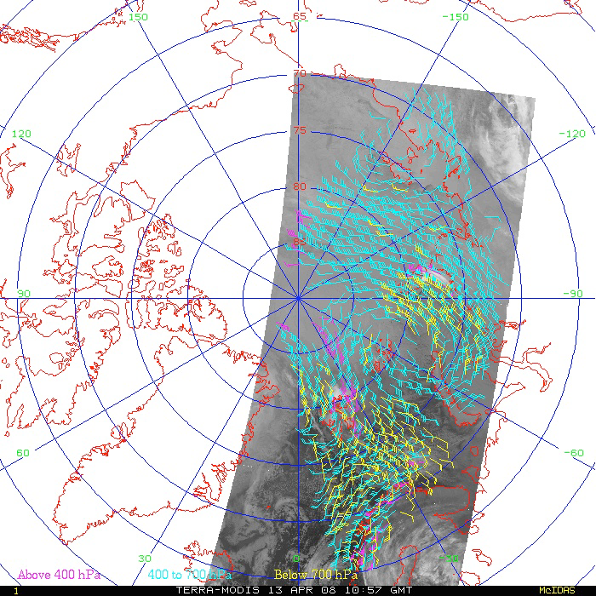
How do 3-D Winds fit into the picture?
GEO & LEO BAA studies are currently finishing up
3-D Winds are a high priority for NOAA: further inquiry in next round of GEO and LEO studies
NOAA will further explore potential solution spaces to obtain 3-D Winds -- Hyperspectral sounding (AMV Winds) in GEO and/or proliferated infrared and microwave sounders in LEO
Single-satellite winds are derived from the Moderate Resolution Imaging Spectroradiometer (MODIS), the Advanced Very High Resolution Radiometer (AVHRR), and the Visible Infrared Imaging Radiometer Suite (VIIRS)
Department of Commerce // National Oceanic and Atmospheric Administration // ‹#›

Slide 17
Next Steps: Working With Our Users to Shape Program Requirements
Notes:
IMPORTANCE OF SATELLITE WIND OBSERVATIONS:
Satellite Derived Winds are a Key Component of the Global Observing System (GOS)
Provide vital tropospheric wind information over expansive regions of the earth that are devoid of in-situ wind observations that include oceans, polar regions, and Southern Hemisphere land masses.
Provide key wind observations to operational NWP data assimilation systems where their use has been demonstrated to improved numerical weather prediction forecasts including tropical cyclones
Provide improved guidance for NWS field forecasters

Slide 18
User Engagement Shapes our Program
NOAA Mission
User Needs
NESDIS Strategic Objectives
USG Agreements, Policies, Laws
NESDIS Level Requirements
FEEDBACK LOOP
NESDIS Project/Program
Requirements
Objectives
Primary Mission Essential Functions (PMEF’s)
PLAN
Implementing NOAA’s mission of Science, Service, and Stewardship
NESDIS Level Requirements are developed from User Needs
NESDIS Program/Project requirements are derived from the NESDIS Level Requirements, guided by the NESDIS Strategic Objectives

Slide 19
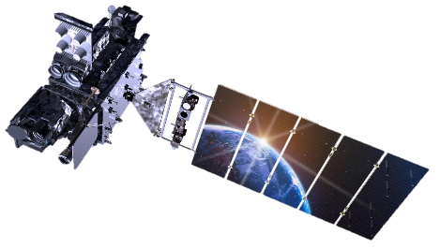
Next Steps: Maintaining the Dialogue with NOAA’s Users
Users Help Determine NOAA’s Program Requirements
User Engagement is critical
Working With our Partners on Tech Maturation
Joint Venture with NASA , DoD, Commercial Sector
NOAA’s Next-Gen Architecture
Agile, disaggregated constellations
Opportunity for earlier on-boarding of emerging technology
NOAA is actively pursuing a 3-D Winds Solutions!

