Slide 1
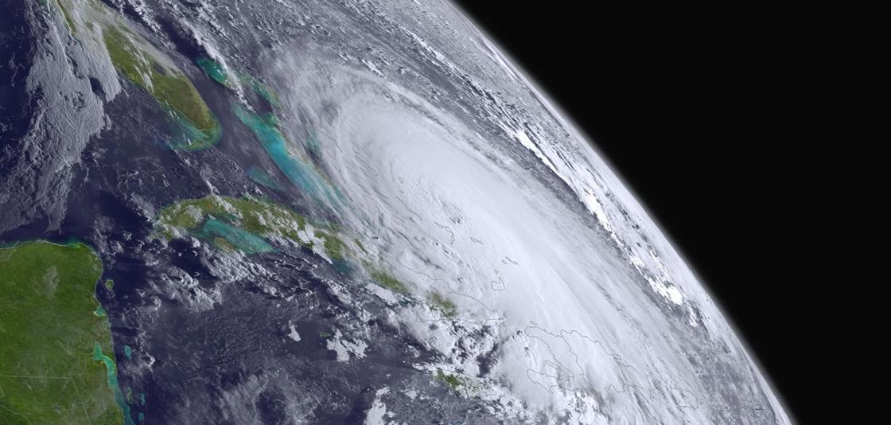
Global Winds to Support Future Weather Forecasting
November 17, 2020
Jim Yoe
National Centers for Environmental Prediction

Slide 2
Overview
Global Wind Data Shortfall and Impacts
NOAA’s Operational NWP Model Suite
  Current
  Future
Summary
Questions
2

Slide 3
Overview
Global Wind Data Shortfall and Impacts
NOAA’s Operational NWP Model Suite
  Current
  Future
    Community Development
      Unified Forecast System
      Joint Environment for Data assimilation Integration (JEDI)
      Implications for Observations
Summary
Questions
3

Slide 4
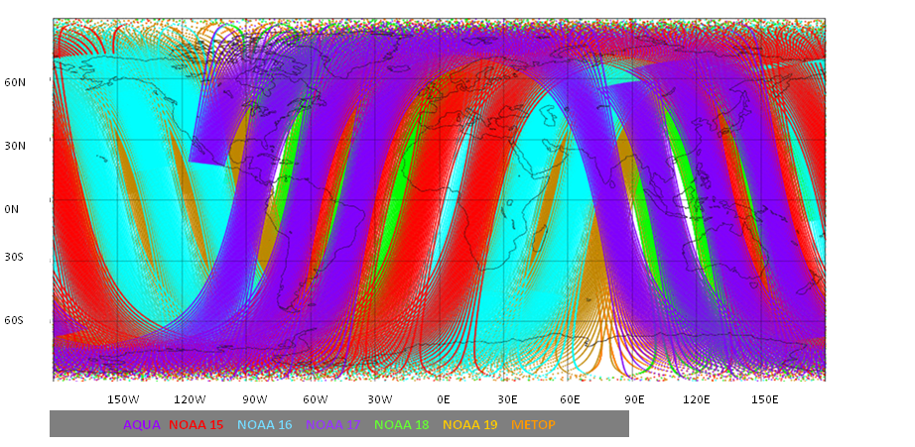
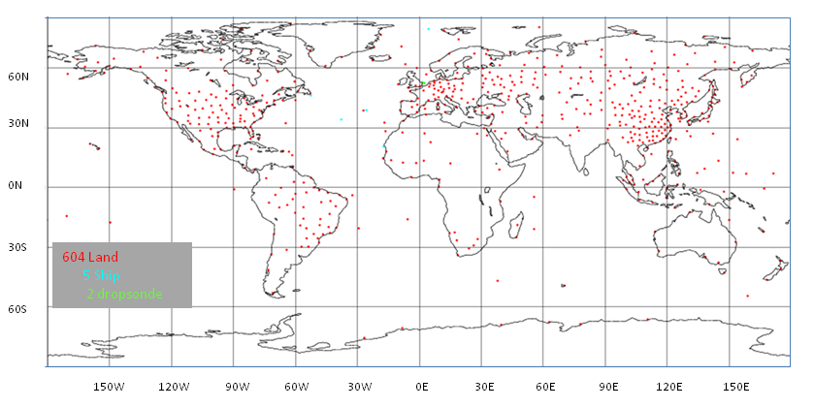
Global Vertically Resolved Observations for NWP
Mass Field Information from Polar-orbiting environmental satellites
Satellite winds (AMVs) globally available (previous talk) but vertically challenged
“Conventional” Information
Land, ship, AC – based sondes – mass (T, Q) and wind field observations
Figures from Baker et al BAMS 2014 (“Missing Link” Paper)

Slide 5
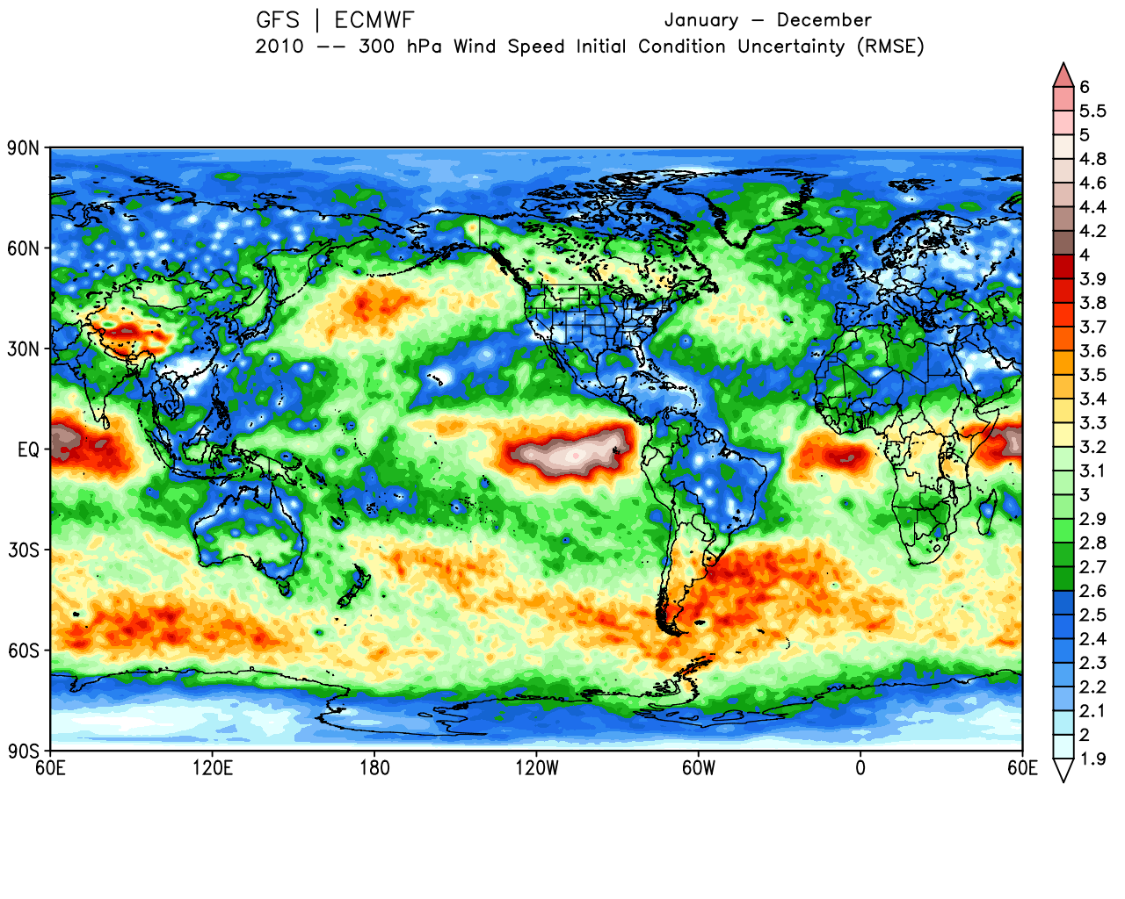
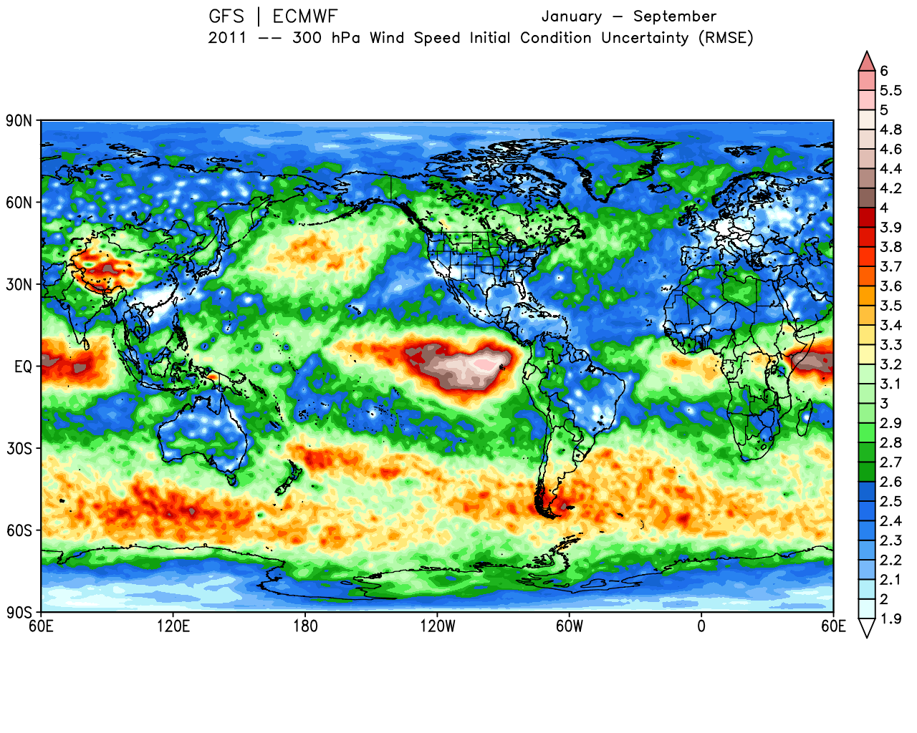
RMS Analysis Diff. ECMWF-GFS for 300 hPa Wind
2010
From Baker et al 2014
2011
Note Persistent Uncertainty

Slide 6
Impact of Mass and Wind Field Observations
Baker et al 2014 (originally provided by C. Cardinali)

Slide 7
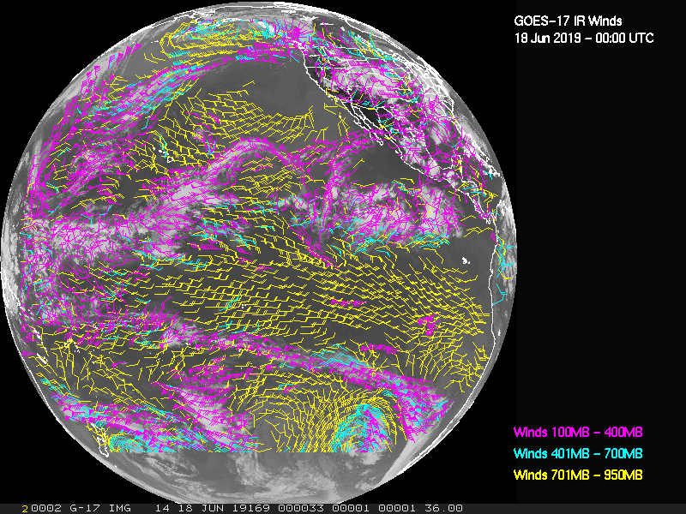
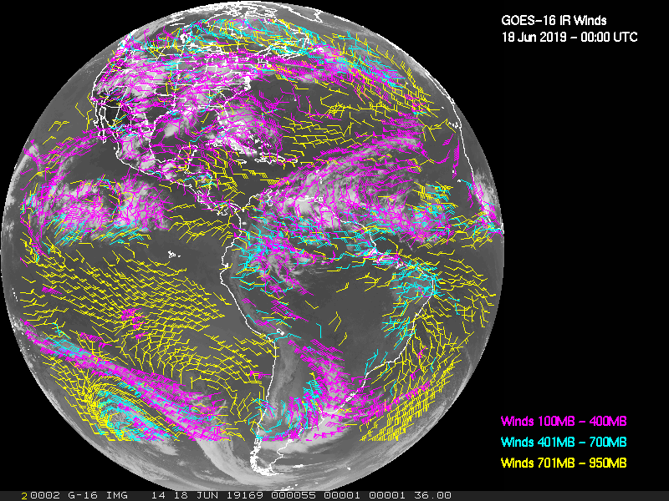
Current GOES W/E AMVs using ABI
GOES-17 (West)
GOES-16 (East)
Also Himawari, w/higher spatial resolution than GOES NOP series, but still lacking full vertical coverage and resolution

Slide 8
Observation System Simulation Experiments
( Summary from Atlas et al, QOSAP 2015)
OSSEs to date have shown significant potential for wind profile observations from space to improve large scale numerical weather prediction.
New OSSEs are needed to evaluate the both the potential impact of passive wind measurements (with realistically simulated errors) and the synergies between passive and active measurements.
Regional hurricane OSSEs have shown that having adequate coverage over the hurricane circulation and correctly representing the interaction of the hurricane with its environment are needed.

Slide 9
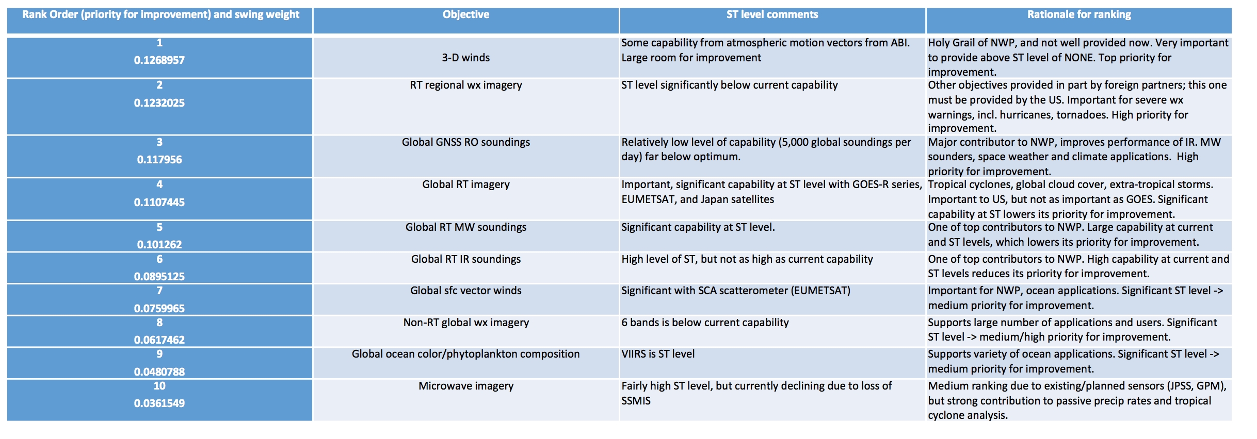
Rank Order of Objectives 1-10 in Group A
Ranked in order of improvement from ST to ME.
(from Gallagher to LWG 2018, NSOSA)

Slide 10
Overview
Global Wind Data Shortfall and Impacts
NOAA’s Operational NWP Model Suite
  Current
  Future
Summary
Questions
10

Slide 11
NOAA’s Operational Numerical Model Guidance Suite - Current
Climate Forecast
System (CFSv2)
Regional Hurricane HMONv3,
HWRFv13
Global Waves (GWMv3)
WaveWatch III
Nearshore Waters
SURGE: SLOSH
ESTOFS: ADCIRC
NWPS1.3:
SWAN
Great Lakes v3.4
WaveWatchIII
Ecosystem
EwE
3D-Var DA (CDAS)
4D-EnVar DA
GFS, MOM4, GODAS, GLDAS/Noah Land, KISS Sea Ice
Ocean (RTOFSv2)
HYCOM, CICE4
Regional Bays
Great Lakes (POM)
N Gulf of Mexico (FVCOM)
Columbia R. (SELFE)
Chesapeake (ROMS)
Tampa (ROMS)
Delaware (ROMS)
3D-Var DA
Global Forecast System (GFSv15)
4D-En-Var
DA (GDAS)
Regional NAMv4
w/NAM-nests
NMMB, Noah land model, includes Fire Wx
FV3 Dynamics
Noah Land model
3D-Hybrid-VAR DA
Dispersion
HYSPLITv7
Global Ensemble Forecast System (GEFSv12)
Short-Range Ensemble Forecast (SREFv7) 26 members
31 GFS Members coupled to Waves (GWES) and Aerosols
High Res Ensemble Forecast (HREFv3)
Air Quality
WRF-ARW & NMMB
13 members each
CMAQv5
North American Ensemble Forecast System (NAEFS)
WRF-ARW, NMMB, FV3 CAM
High Res Window v7
Rapid Refresh RAPv5
3D-VAR
DA
GEFS, Canadian Global Model Ensembles
WRF-ARW & NMMB
WRF ARW
North American Land Surface Data Assimilation System
Regional Climate Data Assimil. Syst.
National Water Model
Space Weather
Space
Weather
High-Res RR (HRRRv4)
WRF ARW
Ens DA (HRRDAS)
3D-Var DA
GSM WAM
ENLIL
Noah Land Surface Model
Eta-32/NARR
Noah-MP
11
Notes:
11

Slide 12
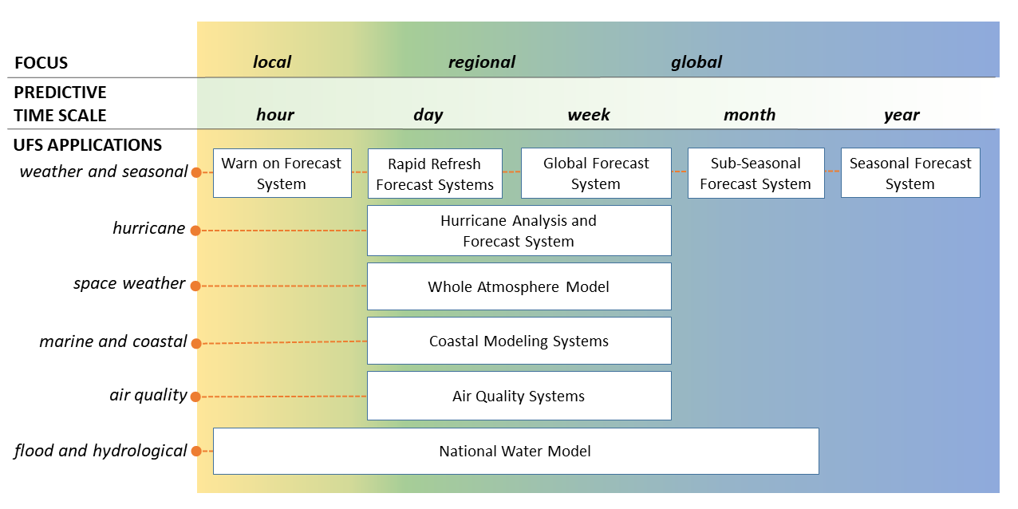
NPS Transitioning to UFS Applications
12

Slide 13
Key Features of the UFS
Shared codes to enable academic & industry researchers help NOAA accelerate the transition of research innovations into operations.
UFS code developed by a broad community and is openly available to the public, with documentation and support for users
  Link to EPIC and JEDI
Enables NOAA to simplify its production suite of forecasting models from many independent systems, each of which has to be improved and maintained separately, to a single seamless modeling system with fewer, more comprehensive applications.
UFS applications, which each provide guidance for a particular forecast, span local to global domains and predictive time scales from sub-hourly analyses to seasonal predictions

Slide 14
Summary
There is imbalance between vertically resolved mass and wind field observations for global NWP
Lack of wind information results in demonstrated analysis and prediction shortcomings
  OSSEs continue to indicate large potential for improvement globally and situationally
  Need to refine requirements to define best solution
  Future coupled NWP and DA with community access a key to maximizing impact of future 3-D wind observations.
14

Slide 15
Thank you!
Questions?
Additional questions can be addressed to james.g.yoe@noaa.gov

