Slide 1
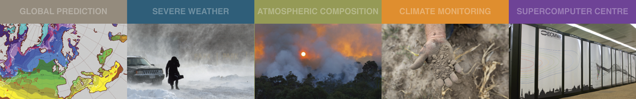
European Perspective on High Impact Observations today and in the future
Lars Isaksen, ECMWF
With contributions from many scientists at ECMWF
Lars.Isaksen@ecmwf.int

Slide 2
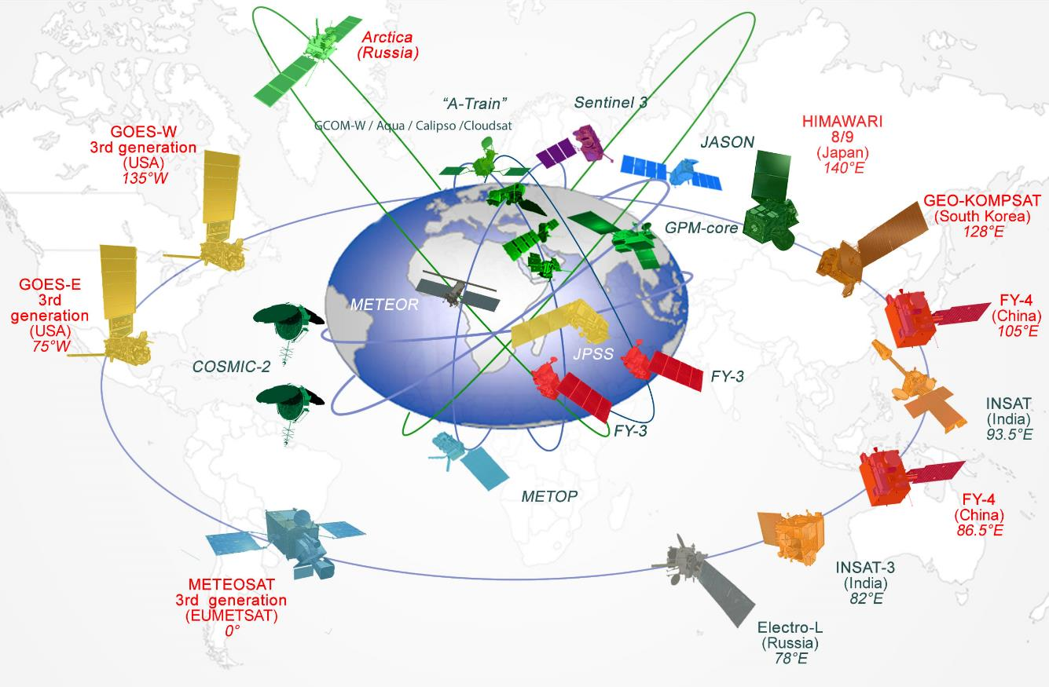
WIGOS: WMO Integrated Global Observing System
In 2020 there are 190 active satellites supporting weather, climate, earth system and space weather

Slide 3
2000
70% American
20% European
10% Asian
2020
30% American
45% European
25% Asian
~10 satellites
~12 instruments
~0.35B obs/day
~50 satellites
~95 instruments
~40.0B obs/day
COSMIC-2
CMA LEO
EUMETSAT LEO
NOAA LEO

Slide 4
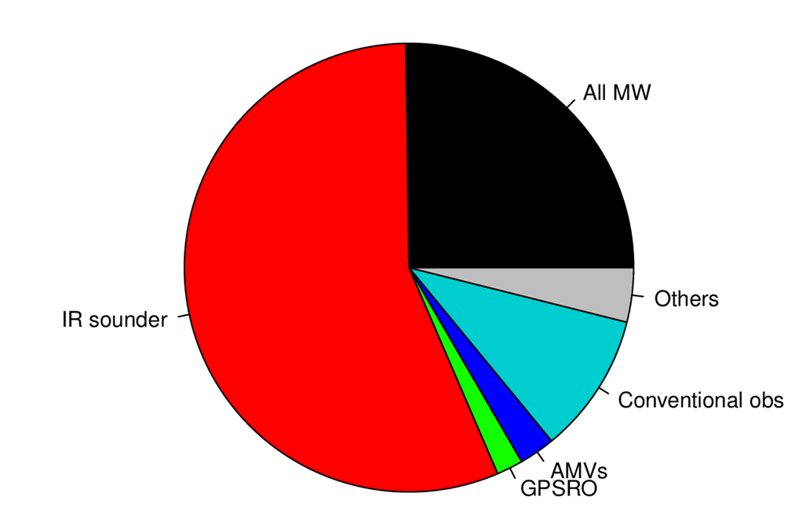
With millions of observations assimilated every analysis cycle, how do we quantify the value provided by all these data?
Proportion of assimilated observations
(Total number used: ~ 50 Million per 24 h)

Slide 5
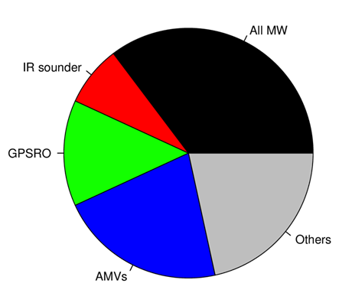
Observing System Experiments – the expensive gold standard
OSEs are performed regularly at ECMWF (e.g., Bormann et al., 2019; McNally, 2014; Radnoti et al., 2010; Kelly et al., 2004), but because of their expense usually involve a limited number of experiments, each considering relatively large subsets of observations.
To assess and understand the relative contribution of each component of the observing network to the overall health of the forecasting system
Denial experiments compared to a full system for (Bormann et al., 2019):
All conventional observations
MW radiances
IR sounder radiances
AMVs
GPSRO
Periods:
  1 June – 30 September 2016;
  1 December 2017 – 31 March 2018;
2 IASI,
1 CrIS,
1 AIRS
6 AMSU-A, 1 ATMS,
4 MHS, 1 MWHS,
1 MWHS-2, 2 SSMI/S,
1 SAPHIR, 1 GMI, 1 AMSR-2
Up to 9
instruments
Including WV
radiances from 5
geostationary
satellites;
scatterometers,
etc
5 geostationary
satellites,
7 polar satellites

Slide 6
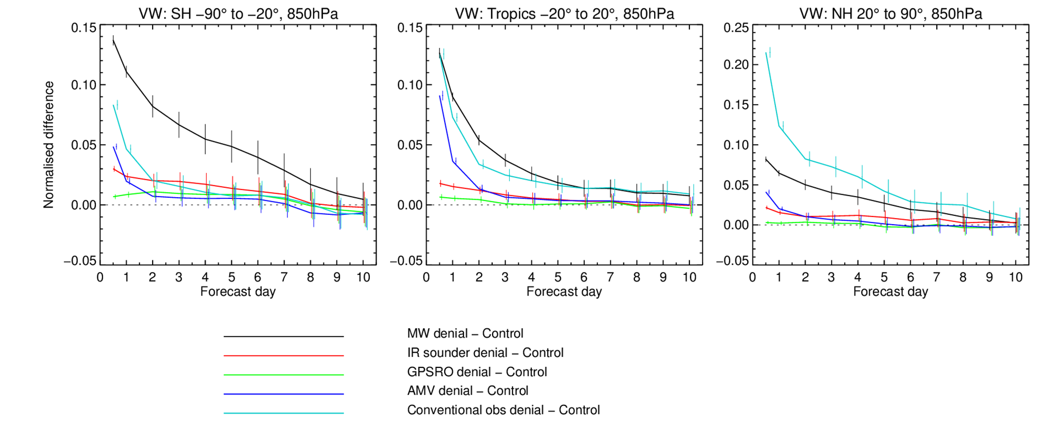

Current impact of various observing systems: Wind at 850 hPa
Southern Hemisphere
Tropics
Northern Hemisphere
The results confirm the complementarity of the global observing system:
  Microwave observations and conventional (in situ) observations are most important for global NWP
  Atmospheric Motion Vectors add benefits for tropospheric wind, particularly in the tropics and at the short range
  GPSRO shows significant impact in the upper troposphere/lower stratosphere, particularly temperature (not shown)
  Similar impact for geopotential height at 500 hPa in the extra-tropics (not shown)

Slide 7
Forecast Sensitivity Observation Impact (FSOI) measure
Cardinali (2009) following Langland and Baker (2004))
Estimates of observation impact using the adjoint (transpose) of the data assimilation system have become increasingly popular as an alternative/complement to traditional OSEs.
  Enable a simultaneous estimate of forecast impact for any and all observations assimilated.
  Impact assessed without denial - FSOI measures the impact of observations when the entire observation dataset is present in the assimilation system
  Used at several centres now for routine monitoring or experimentation: ECMWF, Met Office, Météo-France, JMA, NRL, GMAO, …
FSOI Forecast Sensitivity Observation Impact OSE Observing System Experiment

Slide 8
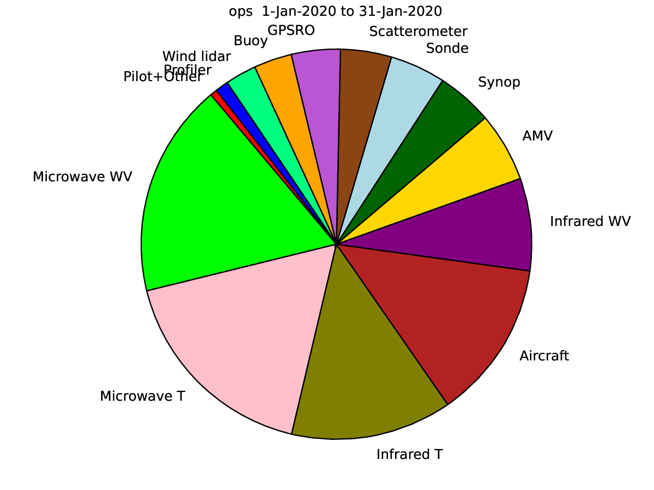
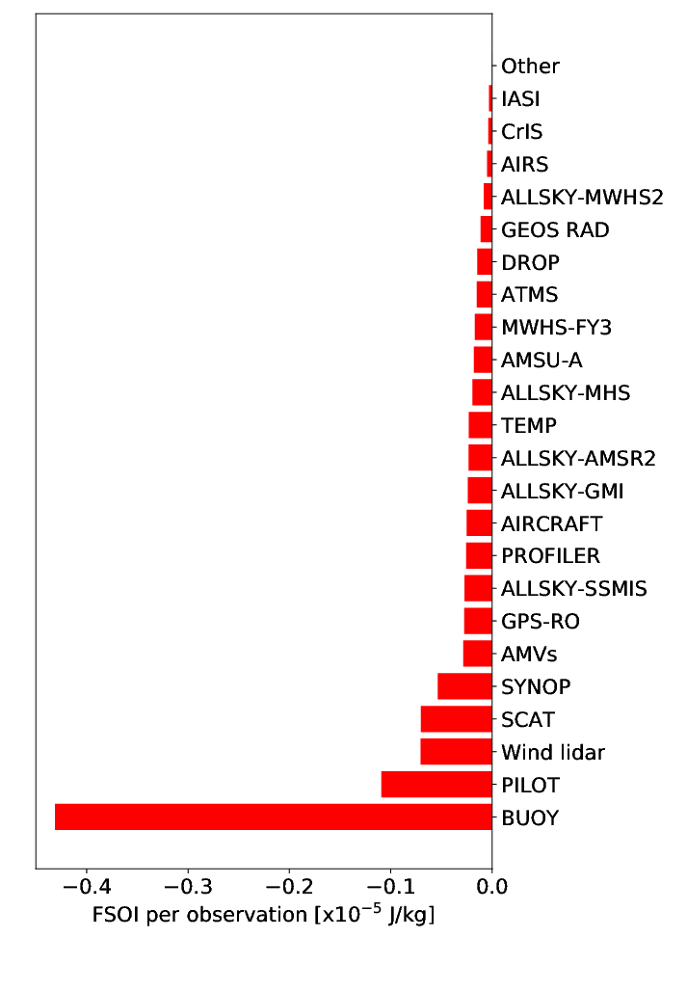
FSOI of observing systems at ECMWF, January 2020
100% = full operational observing system
Impact per observation

Slide 9
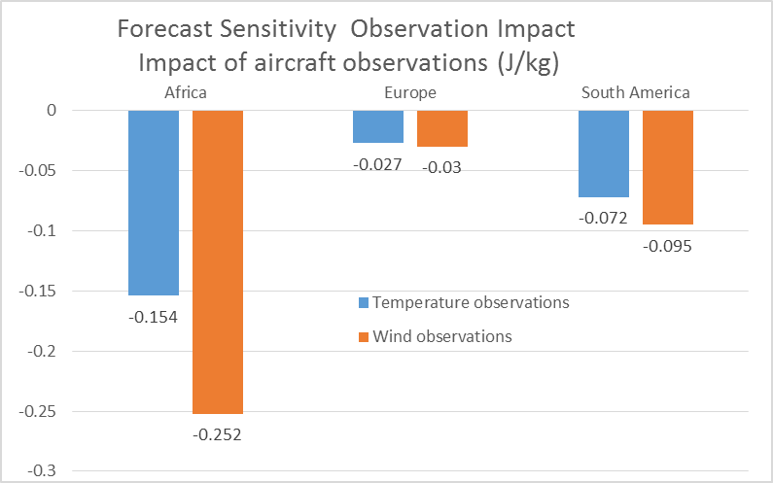
FSOI – 24-hour ECMWF forecast sensitivity to aircraft observations
Average FSOI per observation of aircraft temperature and wind observations from February-October 2017
Africa impact per obs compared to Europe:
5.7 times bigger for temperature observations
8.4 times bigger for wind observations
South America impact per obs compared to Europe:
2.7 times bigger for temperature observations
3.2 times bigger for wind observations
Africa: (35S-20N,20W-35E) 4.1M obs. Europe: (35N-70N,10W-30E) 26.4M obs. South America: 14.4M obs.

Slide 10
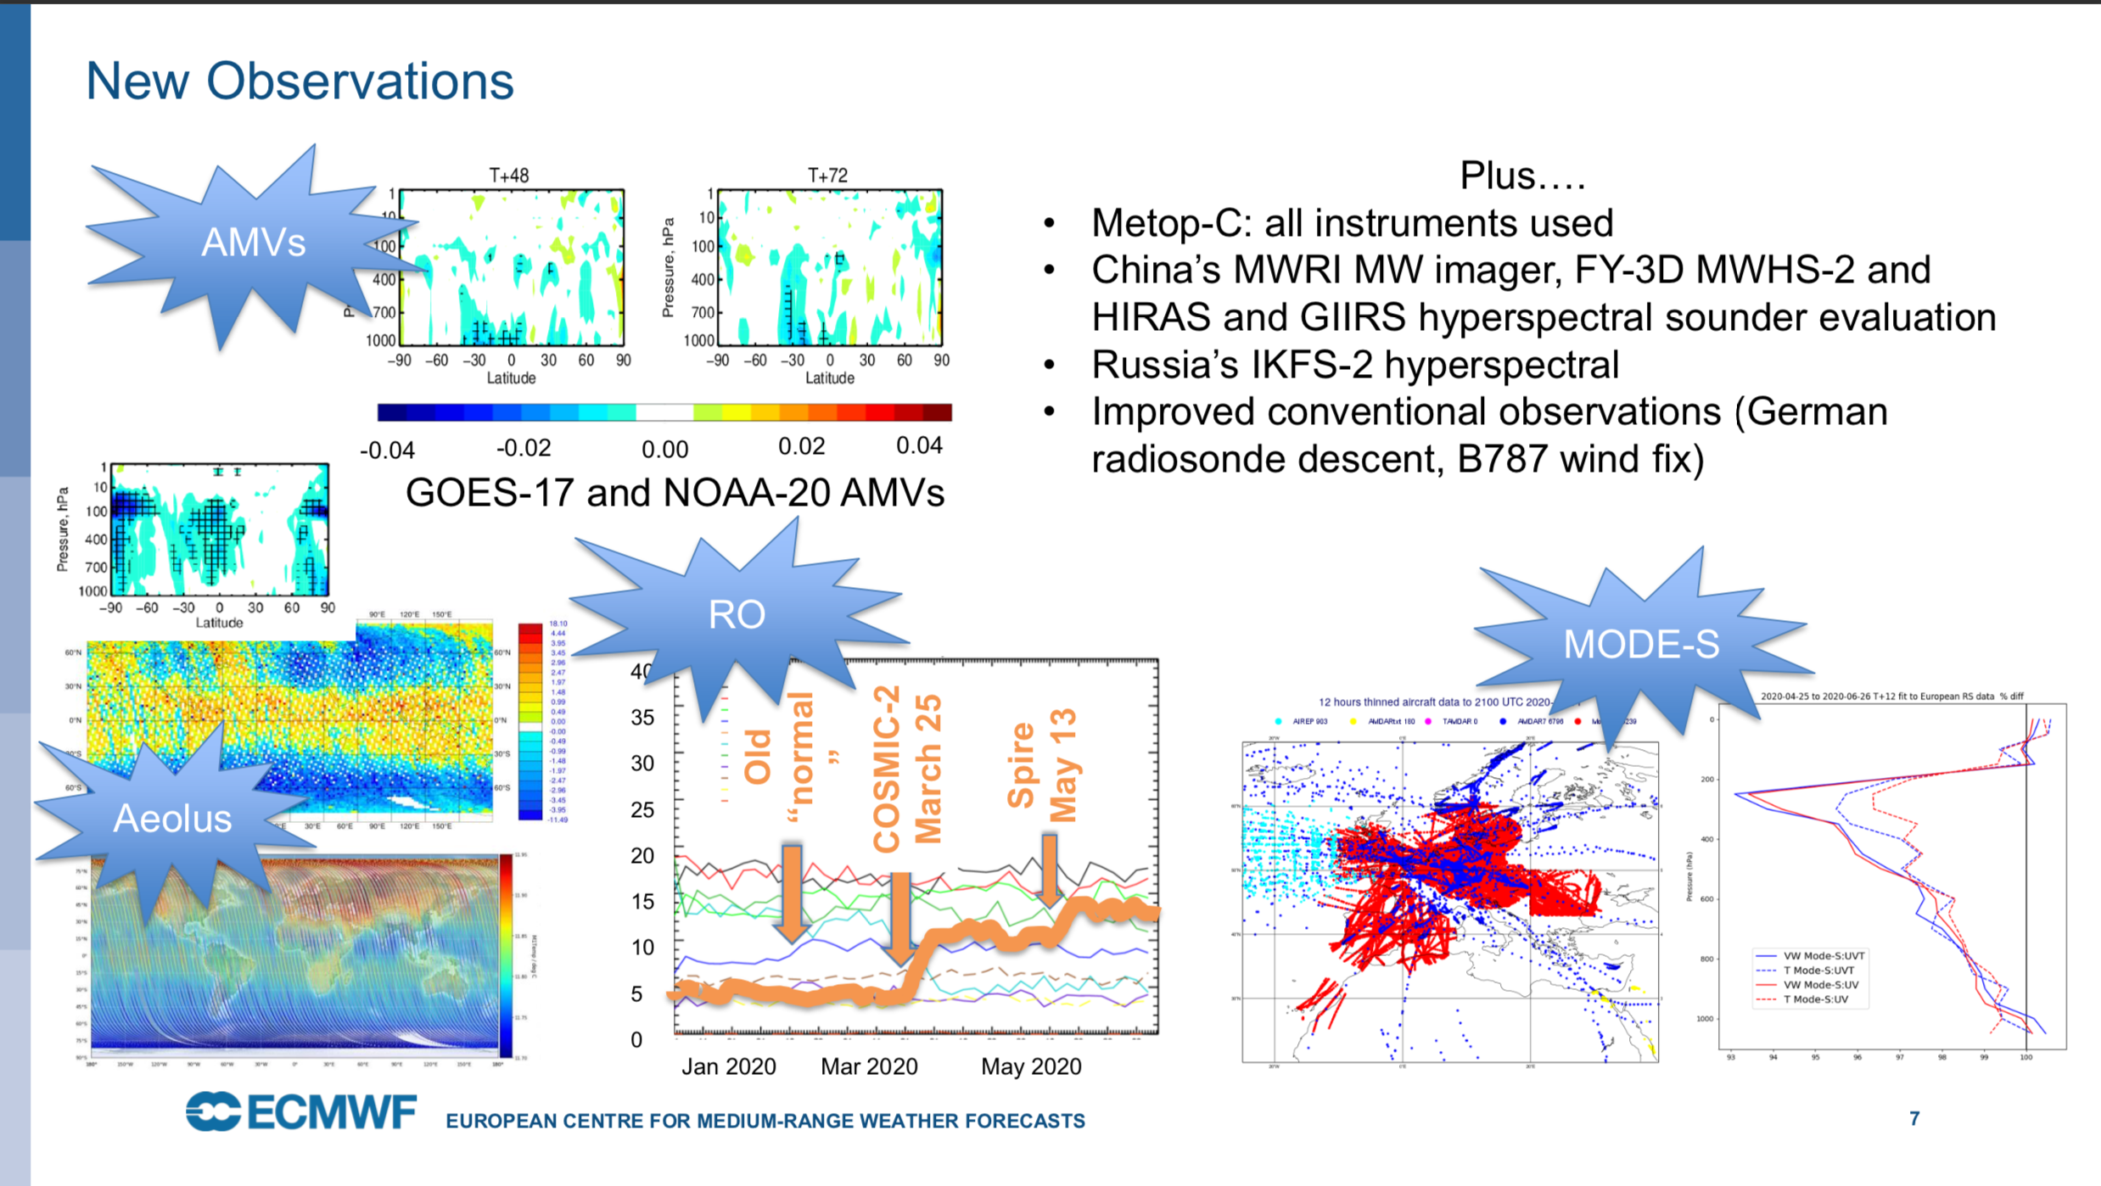

Slide 11
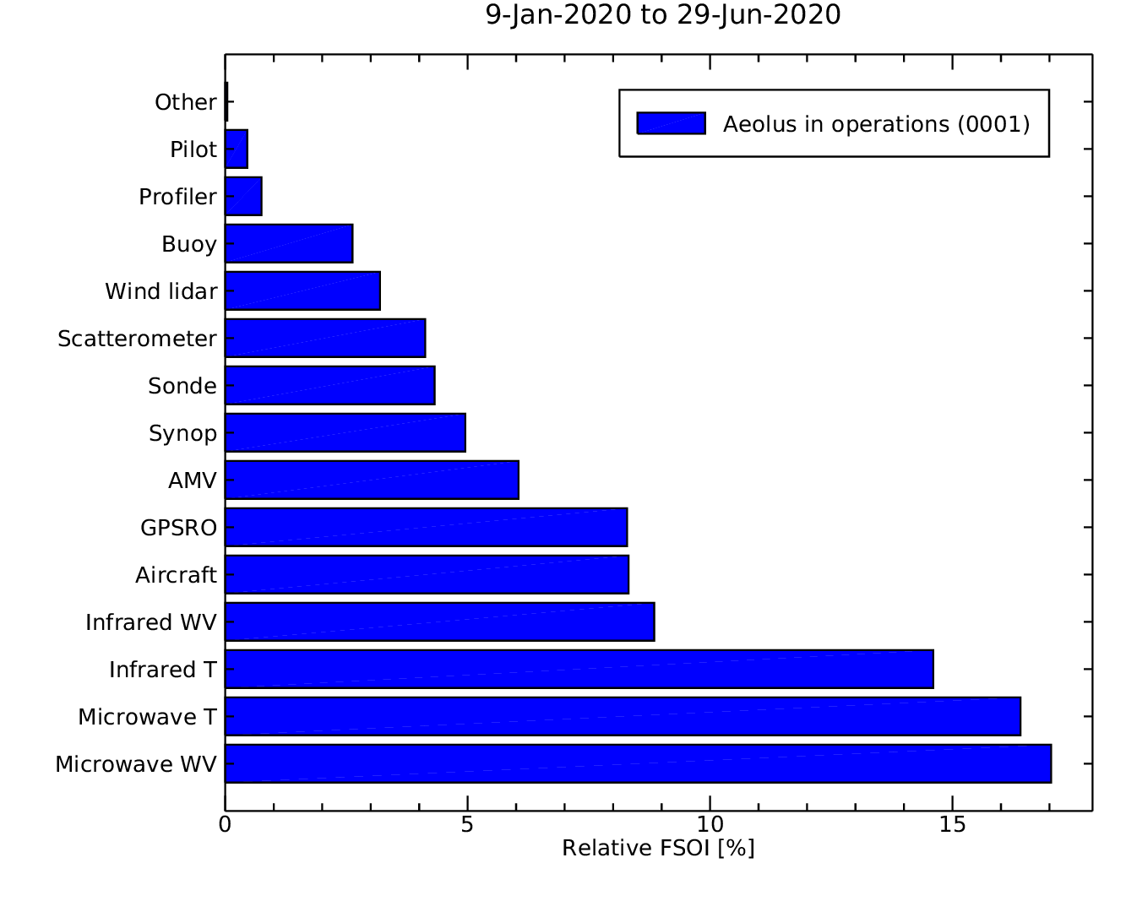
Aeolus FSOI compared to other observing systems
(CY46R1 only)
Aeolus (1 instrument)
Aeolus has a very good impact for one satellite-based instrument
Aeolus operational at ECMWF since January 9, 2020
3 instruments
15 instruments
15 instruments
10 instruments
6 instruments
9 instruments
14 instruments

Slide 12
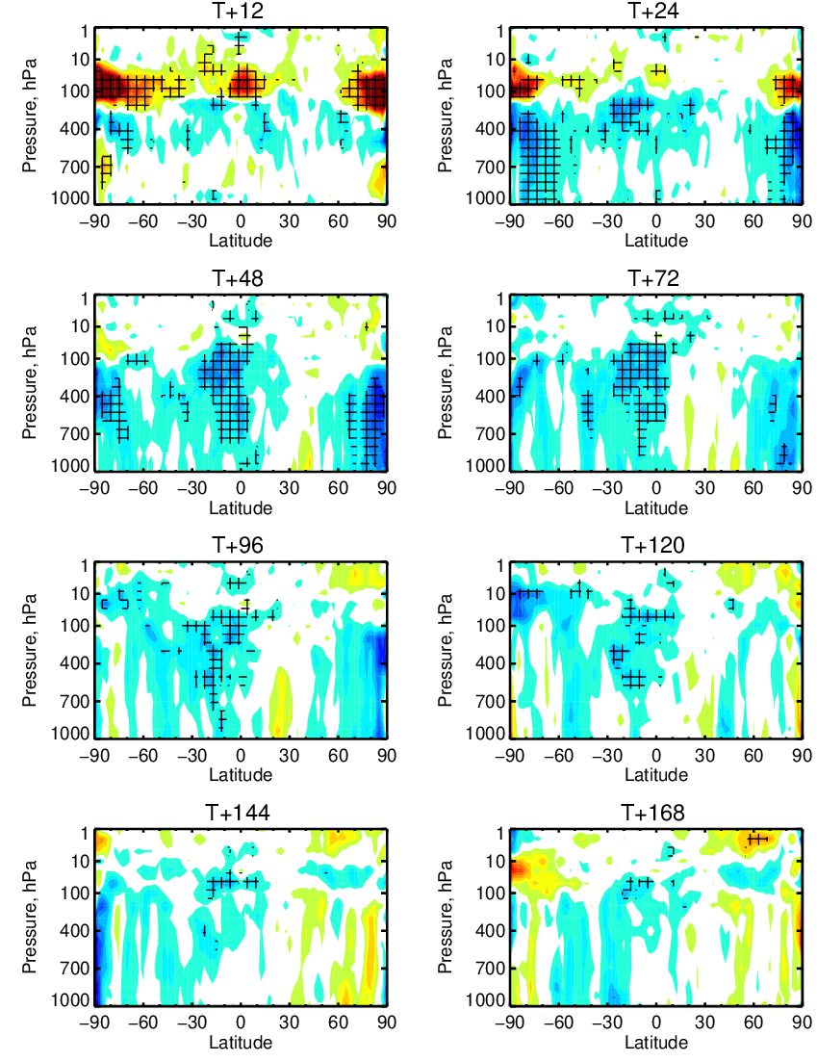
Vector wind root mean square error change due to Aeolus (Rayleigh-clear + Mie-cloudy) – early FM-B OSE
+4%
Verification against ECMWF operational analysis
Good positive impact in tropical troposphere and lower stratosphere
  Throughout forecast range in lower stratosphere
Good positive impact in polar troposphere
  Up to 4 day range
Similar patterns of impact for temperature and humidity forecasts (not shown)
Much more detail in Mike Rennie’s Aeolus NWP Impact talk tomorrow!
hours
~16 km
Better with Aeolus
-4%

Slide 13
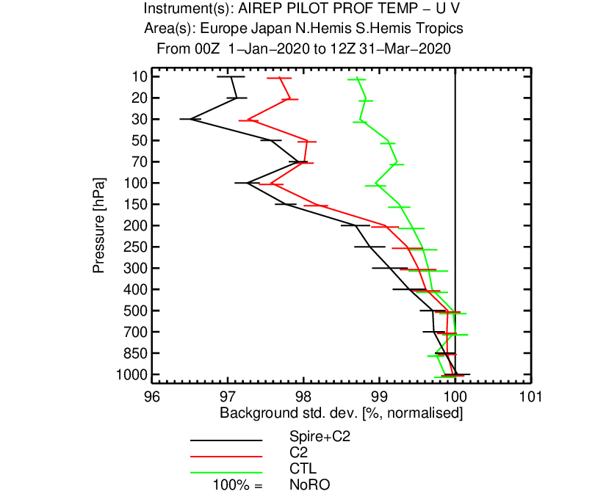
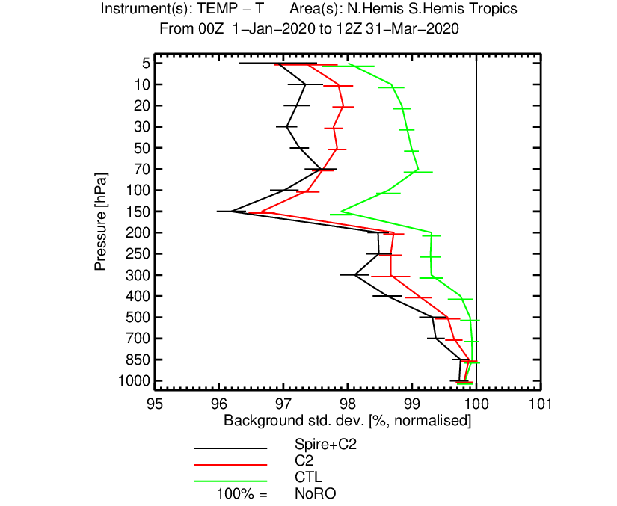
GPS (GNSS)-RO progress
COSMIC-2 operational March 25, 2020
  First sight of the COSMIC-2 at ROM-SAF – IROWG workshop (Sept 19-25, 2019)
  4000-5000 profiles per day in ± 40 degree latitude band
  Significantly improved fit to radiosonde and aircraft temperatures, wind and humidity
Spire operational May 13, 2020 provided additional benefit
Improved wind fit
Improved Temperature fit

Slide 14

ECMWF is developing a coupled data assimilation system
For enhanced predictability with special emphasis on medium-range and extended range
More realism coupling, e.g. to improve water and energy budgets
Atmosphere
Sea Ice
Land
Ocean
Waves
Notes:
Synergies not only to improve all components, but to develop infrastructures, data production and distribution in a new way

Slide 15
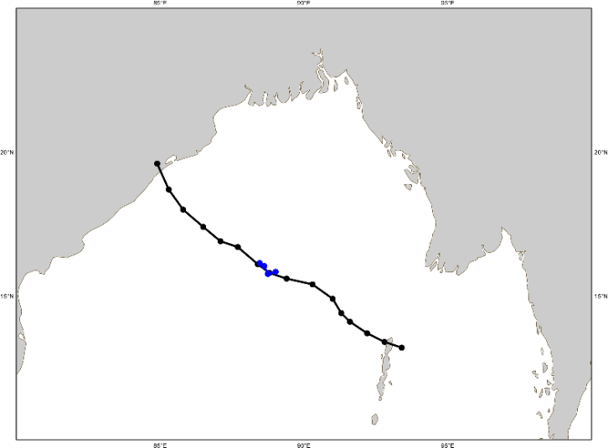
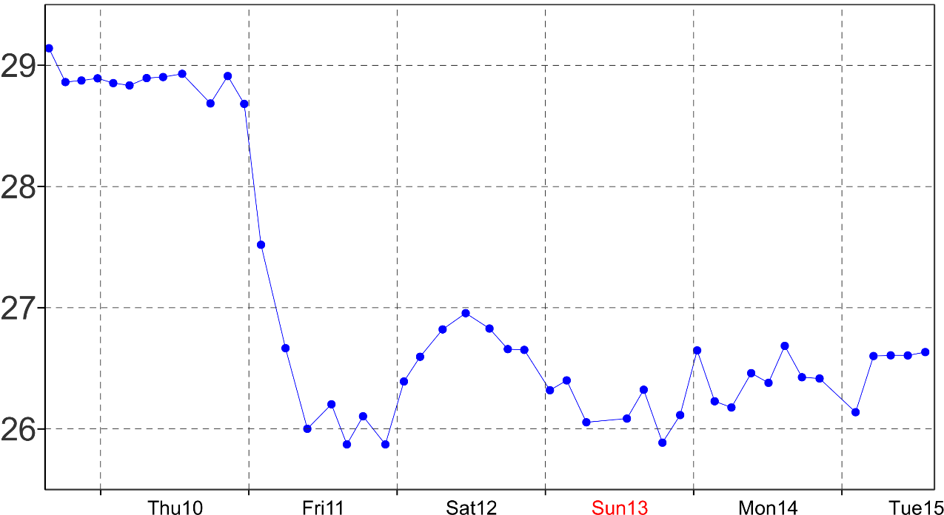
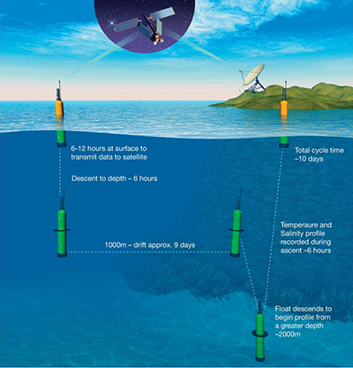
Impact of scatterometer winds …on the ocean parameters
Coupled Data Assimilation (CDA)
Focus on a specific weather event:
TC Phailin
Bay of Bengal
formed on the 4th October 2013
Argo probe with high-frequency measurements
Temperature measurements at 40-meter depth
Impact of scatterometer surface wind data in the ECMWF coupled assimilation system
P. Laloyaux, J-N Thépaut and D. Dee. MWR, 2016

Slide 16
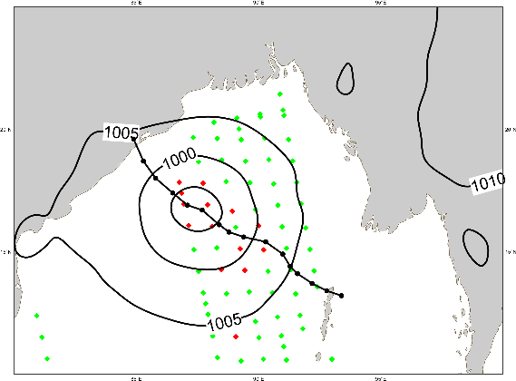
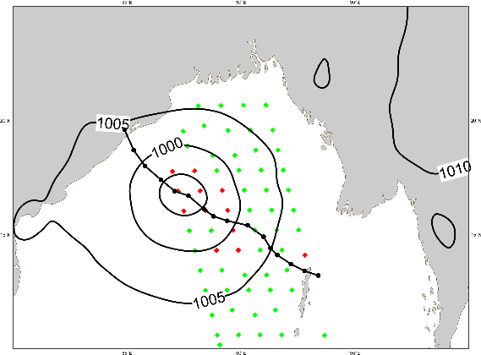
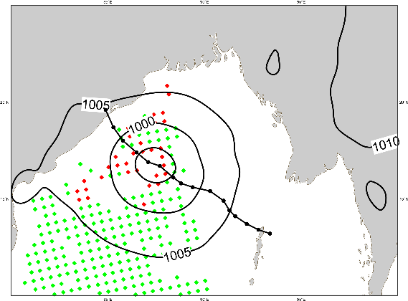
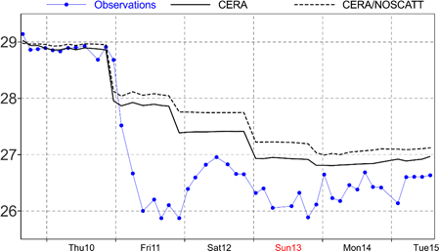
TC Phailin
Impact of scatterometer winds …on the ocean parameters
Wind measurements from scatterometers (11 October 2013)
ASCAT-A
ASCAT-B
OSCAT
Ocean temperature analysis at 40-meter depth (scatterometer data are assimilated)
Coupled analysis with Scatterometer winds is closer to the observations with a stronger cold wake

Slide 17
Clear-sky assimilation
Model | Observations
✓
×
×
✓?

Slide 18
All-sky assimilation
Model | Observations
✓
✓
✓
✓

Slide 19

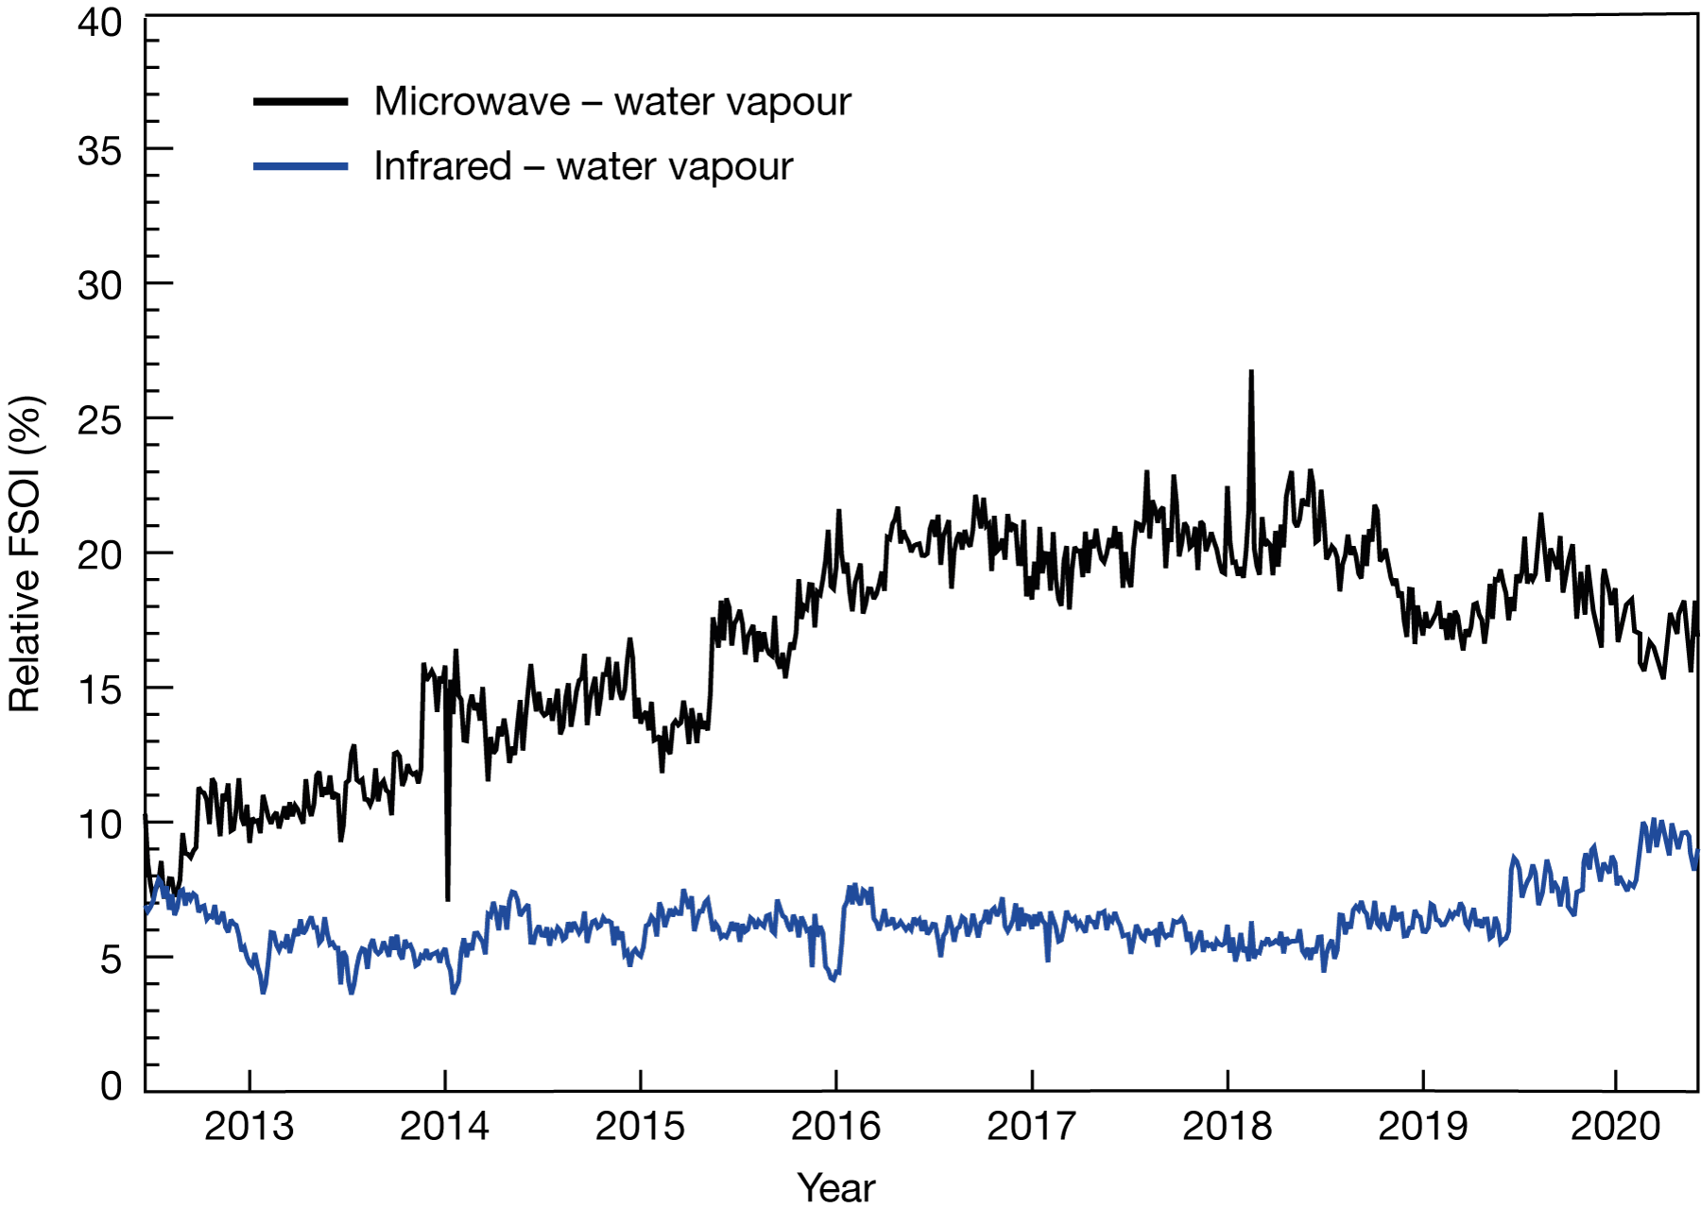
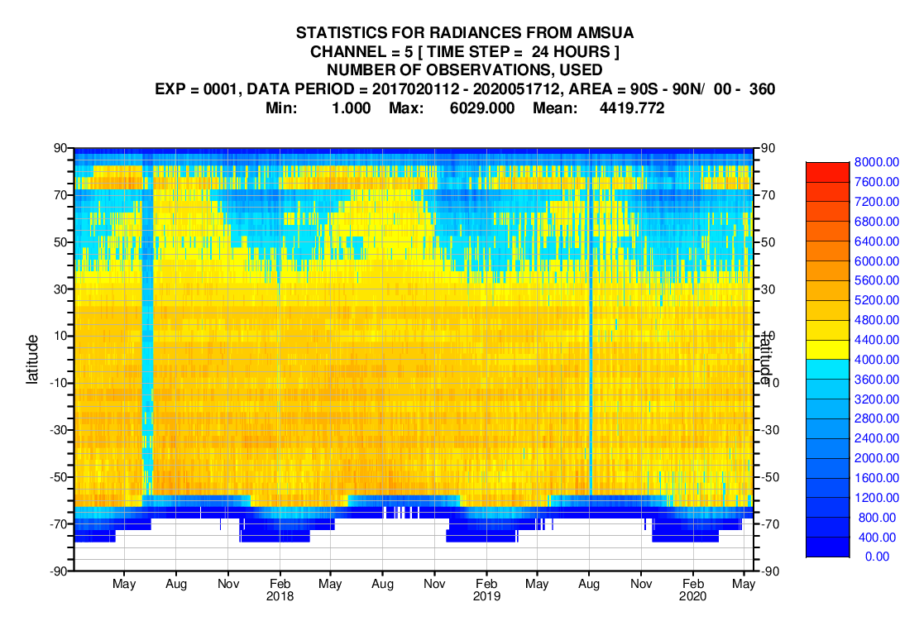
From all-sky to all-sky and all surface: tackling the frontier challenges in NWP
Huge success of all-sky.........
……..huge potential of all-surface
AMSU-A Channel 5 data usage
Notes:
Satellite data hugely important source of data for NWP – but very hard to use.
• Initially used just subset of data in clear sky conditions
• ECMWF led the global NWP community in developing techniques to use microwave data in
all sky conditions – sustained research investment over many years with huge pay-off (plot
on left shows relative contribution of microwave water vapour channels – increased
dramatically value obtained from this data – little more than 5% to approaching 20%
• But still much further to go in extracting as much value as we can from your investments in
observations
• Plot shows that in northern latitudes we manage to assimilate far less amsu data at high
latitudes in winter than summer – not able to use it over ‘difficult surfaces’ like snow and ice
• Huge potential to make another step analagous that made when we went to all-sky
satellite use to go to ‘all surface’. Will be very challenging – but just the sort of cutting
edge work ecmwf should be doing.

Slide 20
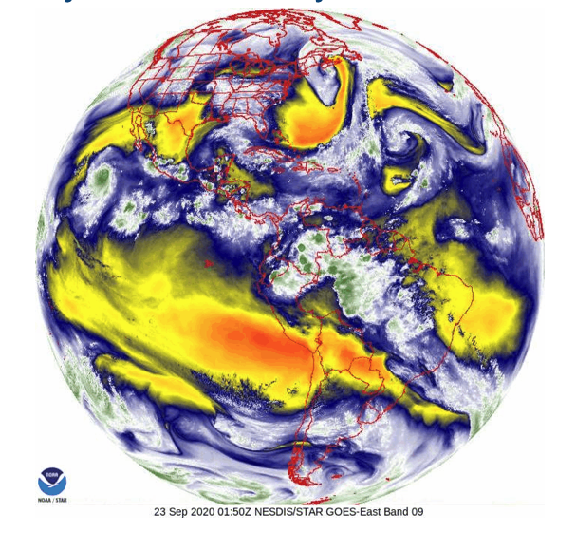
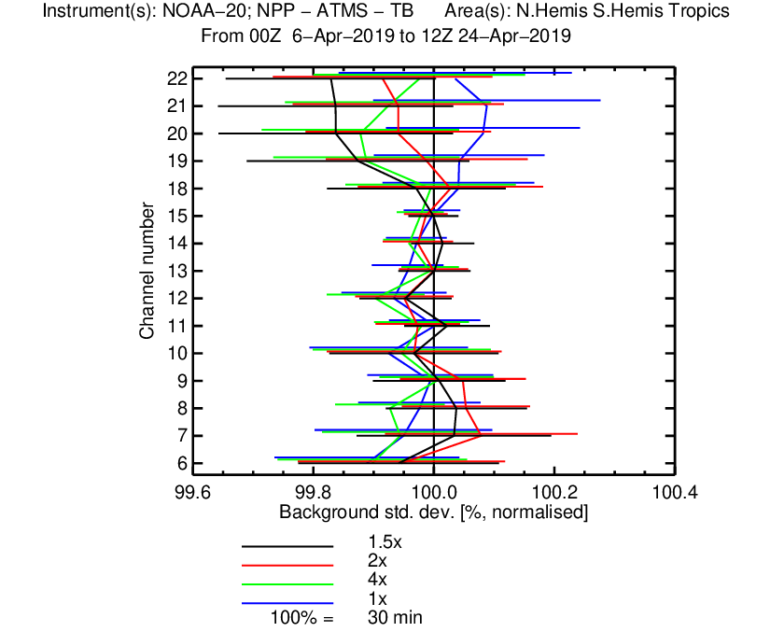

GOES-16 provides full-disk clear sky radiances every 10 minutes
Increase temporal data usage beneficial when observation errors are inflated.

Slide 21
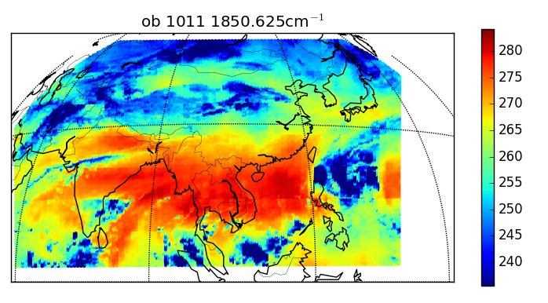
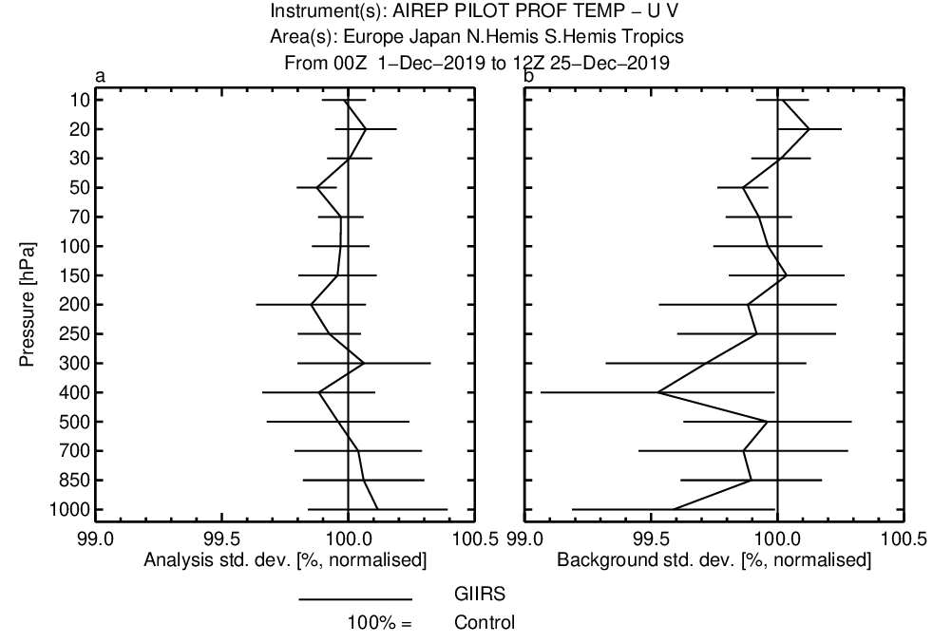
GIIRS – hyperspectral IR sounder on Chinese satellite FY-4A
This is the first GEO with a hyperspectral sounder. Good practice for MTG-IRS.
This coverage every 2 hours
Fit to radiosonde winds improved

Slide 22
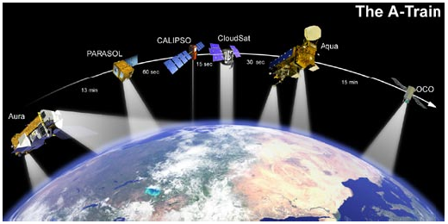
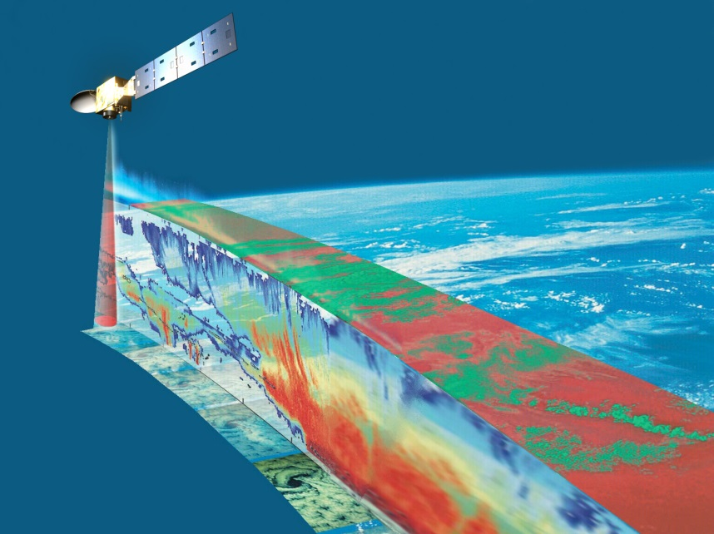
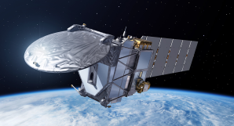
EarthCARE: cloud radar and lidar – strong ECMWF involvement
EarthCare
ThA-Train
  Launched 2006
  NASA
  700-km orbit
  CloudSat 94-GHz radar
  CALIPSO 532/1064-nm lidar
  MODIS, CERES and AMSR-E radiometers
EarthCARE
  Expected launch c. 2022 or 2023
  ESA+JAXA
  400-km orbit (more sensitive)
  CPR: 94-GHz Doppler radar
  ATLID: 355-nm lidar
  MSI and BBR radiometers

Slide 23
Crowdsourced observations – potential for use in NWP
Three main categories:
Private sector and Third-party public organisations: Great potential for use in NWP
Automated amateur weather stations: Huge increase in recent years. Large diversity in types and operating environments. Potential for use in NWP, if good collaboration is pursued.
Smart devices: Mass availability of meteorological parameters from internet connected smart devices: smartphones and I-o-T. Privacy issues. Very challenging to use for NWP due to diversity and quality issues.
Advanced quality control essential for the use crowdsourced observations in NWP

Slide 24
Harnessing the potential of Machine Learning and Artificial Intelligence
Machine learning will have
no long-term effect
Machine learning will replace
conventional models
Simple post-processing
applications
Feature detection in
model output
Observation screening
Emulation of
parametrisation schemes
Bias correction in 4DVar
Learn model components
from observations
Learn equations of motion
Notes:
AI. Slide from Peter Deuben’s council presentation. Potential for AI to play a significant role
on all parts of our activities – observational handling, data assimilation, model, postprocessing.
For example, already exciting new avenues being investigated in data assimilation,
using AI techniques to look to improve model error estimation
Niche for us – bringing together optimal blend of domain knowledge with AI
techniques. Very surprised if we don’t make very significant use of AI techniques
on timespan of this strategy.

Slide 25
European Perspective on High Impact Observations today and in the future
Lars Isaksen, ECMWF
With contributions from many scientists at ECMWF
Thank you for your attention.
Lars.Isaksen@ecmwf.int

