Slide 1
Assessing the Impact of Cutting
Edge and Future Spaceborne Wind Observations at NASA
Will McCarty
Global Modeling and Assimilation Office
NASA Goddard Space Flight Center
NOAA-NASA Working Group on Space-based Lidar Winds
17 November 2020

Slide 2
Spaceborne Winds from the GMAO Perspective
With Atmospheric Winds as a NASEM ESAS Decadal Survey explorer-class observable, the GMAO has performed a number of studies in the last handful of years investigating new and future approaches
  Utilized GMAO OSSE framework and JCSDA for Aeolus preparation ~ 2010
  Evolved into a combination of leveraging real prototype data OSEs and simulated OSSEs
  Both active and passive (atmospheric motion vector, AMV) approaches
At the Global Modeling and Assimilation Office, it isn’t just forecast skill!
  The GMAO’s path forward continues to evolve as an earth system modeling and analysis capability in Goddard Earth Observing System (GEOS)
  Our future science depends on winds for transport and coupling
  Forecast metrics are still our most robust validation
    A good forecast leads to better earth system analysis
This talk will serve as a synopsis of some of the recent work at the GMAO focusing on spaceborne winds

Slide 3
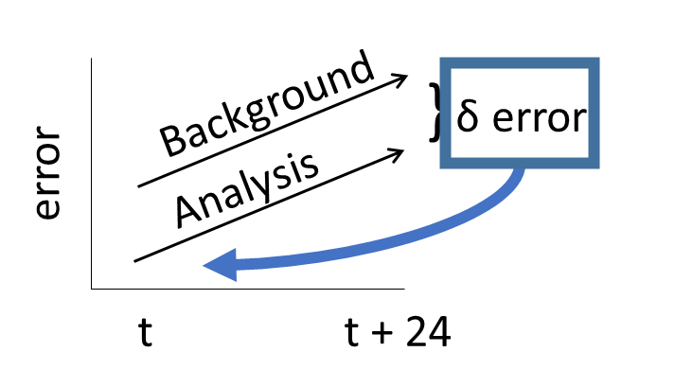
Spaceborne Winds from the GMAO Perspective
The results of this talk will focus on the FSOI metric to provide a commonality across experimentation
FSOI is a measure of 24 hour forecast error reduction projected into observation space
  Each assimilated observation has its own impact metric
  Allows for the aggregation of the metric in different ways
    per instrument, channel, footprint, etc.
A negative value equates a reduction in error, so NEGATIVE = GOOD

Slide 4
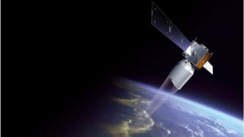
Aeolus Wind Retrieval Assimilation
The GMAO has been involved in Aeolus for over a decade
  In 2009, Aeolus preparadness was performed under auspices of Joint Center for Satellite Data Assimilation
    Then the satellite was delayed indefinitely, and I focused elsewhere
  Accepted as a member of the ESA Aeolus Cal/Val Team to help validate the observations before wide-release
Initial implementation was coordinated with NOAA through direct EMC collaborations and NESDIS TMP program
Initial tests:
  First laser, Rayleigh-Clear and Mie-Cloudy
  QC implementation built on M. Rennie/ECMWF QC document
  In-house bias correction scheme and error model applied
    BC = f(type,z,node)

Slide 5
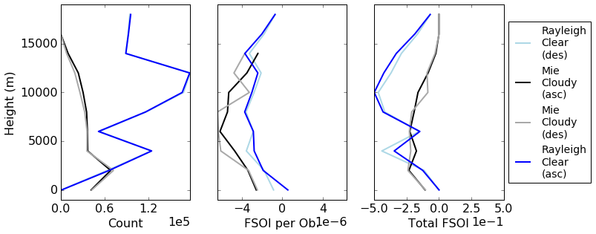
Aeolus FSOI
FSOI as a function of height
  Total impact is the sum over all observations, so there is some expectation that the impact scales with observation count
    Rayleigh FSOI minimum corresponds to the observation count maximum
  Per observation, both the Mie and Rayleigh show signs of most impact in the middle troposphere
    Consistent in that AMVs are generally located in the upper and lower troposphere – the middle troposphere is a relative data void!

Slide 6
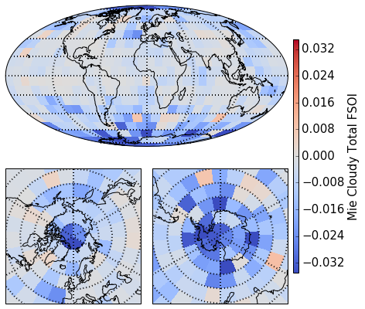
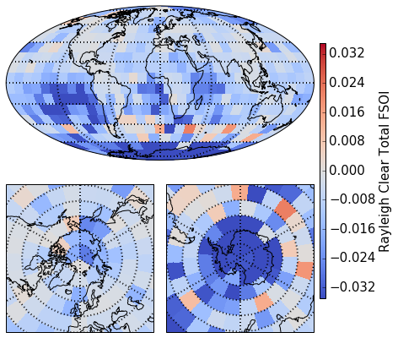
Aeolus Spatial FSOI
Spatial Distribution of Total FSOI
  Both show largest impacts in Southern Hemisphere – consistent with forecast skills
    This period still had longitunal biases in the NH that were not accounted for in Bias Correction
  Both show benefit over Antarctica
  Minimal impact in southern storm track
  Rayleigh benefit in subtropics that is not as apparent in Mie
    Clear sky observation!
    Difficult to get AMVs from imagers above clouds due to lack of spectral information
    Filling a data void?

Slide 7
AMVs from Sounding
Multiple proposed approaches are build upon the idea of performing feature tracking on retrieved atmospheric profiles
  AMVs on instruments with imager spatial resolution and sounder spectral resolution
We can demonstrate this method using real observations, with caveats
  AIRS has the spectral coverage needed for this method, but…
  AIRS has a 15 km spatial footprint
  AIRS has poor temporal sampling
    AIRS orbits only overlap at the poles
    Successive orbits are 100 minutes apart
    Three views are needed for AMV feature tracking
Via D. Santek (UWisc/SSEC)

Slide 8
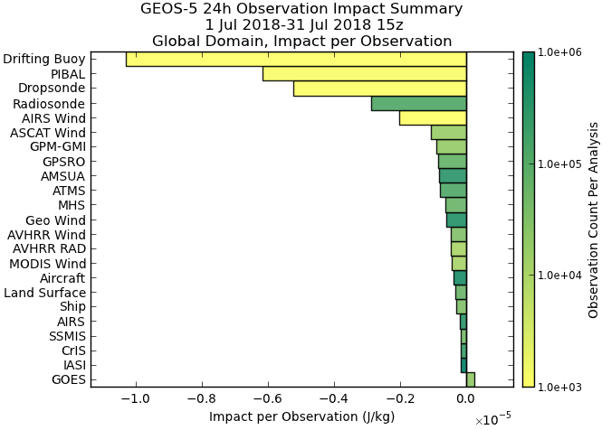
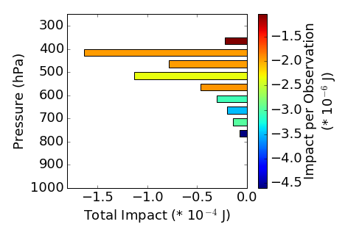
AIRS AMV FSOI
The premise of these winds is filling a data void in the mid-troposphere
  While the total counts are low, they rank near the top in FSOI per-observation
  The vertical distribution shows that the total impact comes from ~300-500 hPa
    Particularly aloft, MODIS winds also measure these levels
  The largest FSOI per observation are seen below 500 hPa

Slide 9
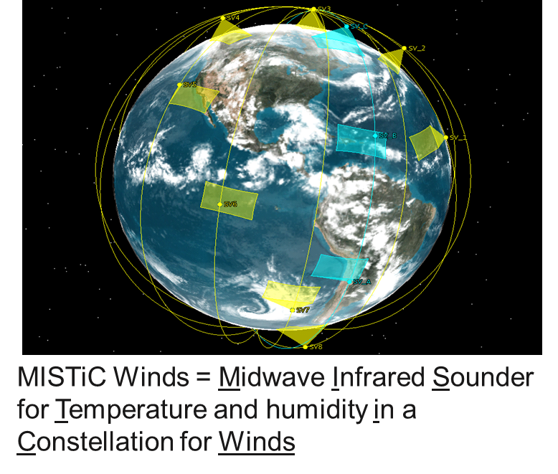
AMVs from a LEO Infrared Sounder Constellation
MISTiC™ Winds provide High Spatial/Temporal Resolution Temperature and Humidity Soundings of the Troposphere
  The observing strategy is to retrieve atmospheric state and motion via LEO Constellation of MicroSats
    Infrared spectrometer sampling the midwave
    With the constellation approach, temporally subsequent sets of retrievals can then be used to perform feature tracking and retrieve atmospheric motion vectors (AMVs)
  Main goal of the study is to investigate the potential impact of these observations of both the wind and radiance information from the constellation

Slide 10
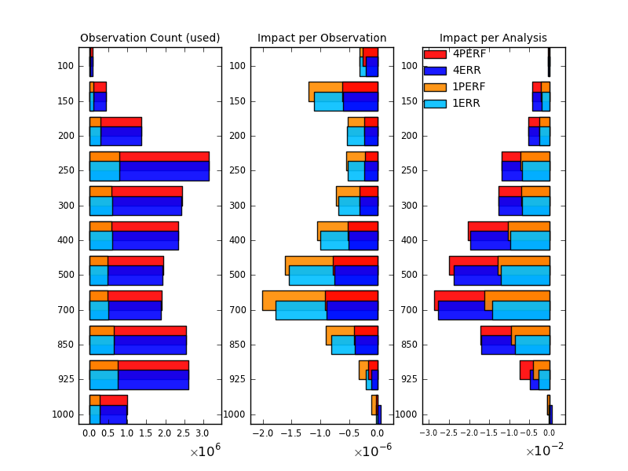
LEO Infrared Sounder Constellation AMV FSOI
Simulated AMVs showed that largest FSOI was seen in the mid-troposphere
  Filling a data void that is sparsely observed by the baseline geostationary imagers
A key unanswered question to this effort is what requires feature detection/AMV retrieval, and what can be solved in a 4D assimilation method?
  These results were 3D-Var
  Current GMAO 4D-EnVar assumes hourly binning of observations, coarser than proposed constellation approaches
  Otherwise, what wind is inferred from “tracer effect”
    Where motions in radiances in assimilation solution are translated into wind responses

Slide 11
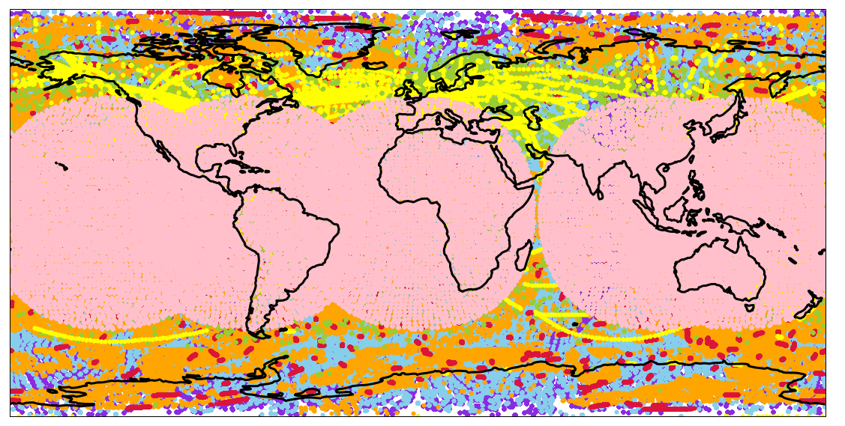
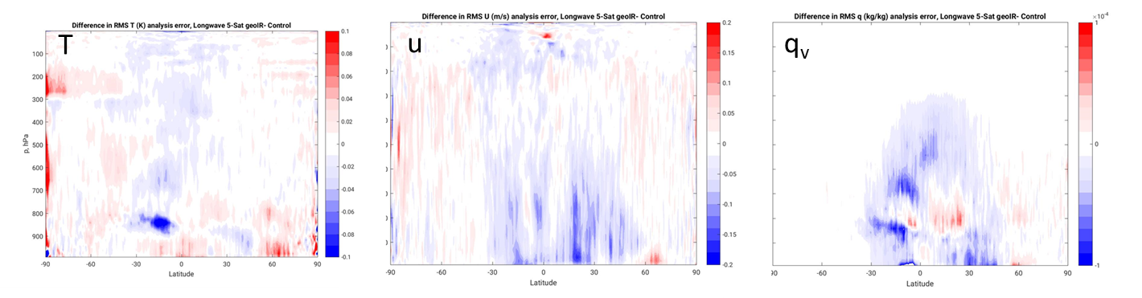
Investigating the Utility of Geostationary Infrared Sounders
A set of OSSEs considering the impact of a constellation of hyperspectral IR sounder from GEO were performed
  Considered MTG-S-like instrument (SRF, temporal sampling)
  No sounder AMVs; only radiances!
  Analysis error reductions show that the most coherent signals were in wind and water vapor
Considering the existing polar fleet of IR sounders, the new information content is temporal
  Validation of the ‘tracer effect’, the 4D analysis procedure extracts wind information from the sequential temporal sampling
Error Reduction
Good Bad

Slide 12
Parting Thoughts
Winds are still a data void!
  Active approaches like Aeolus have apparent impact, particularly in the clear-sky
    From a global DA perspective, there is a Rayleigh and/or Mie consideration
    Strengths of low-wind speeds?
    Lack of spatial information
  Will the passive approaches be able to fill that void?
    Feature tracking needs moving features!
    AMVs to resolve mesoscale, spatially varying motions?
  The information content is likely complementary
    Active w/ improved vertical representation; passive w/ improved spatial representation
Other spaceborne wind considerations @ GMAO
  Collaboration w/ JPL on MISR winds showed promise (w/ K. Mueller), but implementation testing never fully matured
  Investigation of wind measurements via Optical Flow methods versus traditional feature tracking (w/ TJ Vandal, NASA Ames BAERI)
  Reprocessing historical AMV records from U. Wisc./SSEC, JMA, and EUMETSAT for next reanalysis
  Importance of surface roughness/winds in future Atm/Ocean Coupled analyses

