Slide 1





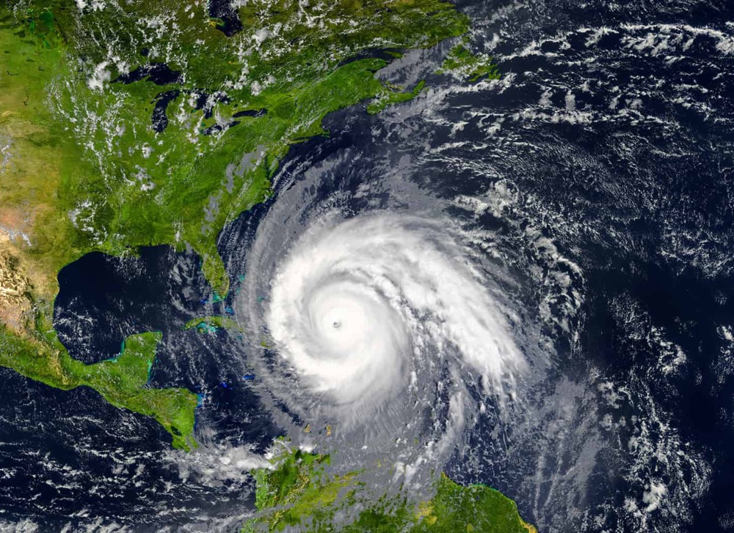


The role of winds from space as part of the OSSE support for the next generation of NOAA environmental satellites
Lidia Cucurull
Deputy Director and Chief Scientist
Quantitative Observing System Assessment Program (QOSAP)
National Oceanic and Atmospheric Administration (NOAA)
With contributions from NESDIS/OSAAP and NESDIS/OPPA
November 17, 2020

Slide 2
NOAA QOSAP Program
Maintain/develop/update NOAA “OSSE/OSE ready” capabilities for environmental (atmospheric, oceanic, etc.), and other impact assessment techniques (e.g. E/FSOI).
  Validation of nature runs
  Simulation of perfect and error-added observations for current and proposed observing systems
  Data assimilation strategies for different observing technologies
  Calibration of OSSE systems
  Development of verification metrics
Coordinate and provide guidance and support to NOAA teams conducting OSE/OSSEs, as needed.
Help NOAA Line Offices conducting OSE/OSSEs to follow the NOSC Impact Assessment Framework Memo “Guidance on the Process to Define, Design, Execute, Review & Report on Observing Systems Value and Impact Assessments” of March 22, 2018.

Slide 3
NOAA QOSAP Program (cont’d)
In coordination with the OSC/NOSC, conduct comprehensive assessments (OSSEs, OSEs, etc.) as requested by the different Line Offices through funded projects after a case-by-case consideration (e.g. availability of personnel and HPC resources).
Execute OSSE/OSE studies as requested by the NOSC.
Provide recommendations to the OSC/NOSC for changes to the configuration of NOAA’s observing systems and overall portfolio to maximize the benefit to NOAA and its constituents.
Coordinate with NOAA’s Technology, Planning and Integration for Observations (TPIO) to help maintain, improve and assess NOAA’s observing systems.
Collaborate with JCSDA and EPIC concerning activities and results of quantitative assessments conducted through QOSAP.

Slide 4


Why OSSEs?
Costs of developing, deploying and maintaining new space-based architectures typically exceed $100-500 million/instrument.
Provide quantitative information on the impact of new observing systems.
Evaluate the impact of alternative mix of current and/or proposed instruments.
Optimize data assimilation strategies.
Perform cost-benefit analysis for better planning and decision making.
Trade-off studies in the design and configuration of proposed observing systems (i.e. coverage, resolution accuracy, and data redundancy).
Requirement from the Weather Research and Forecasting Innovation Act of 2017 for observing systems with a cost of more than $500 million.

Slide 5
Real vs Simulated worlds
5
Notes:
Requirements for an OSSE system:
A long atmospheric model integration using a “state of the art” numerical model to provide a complete record of the assumed true state of the atmosphere, usually referred to as the nature run. The nature run should represent the main characteristics of the real atmosphere, e.g. right climatology, general patterns of storm tracks, etc.
Simulated existing conventional and satellite observations from the nature run. These synthetic observations need to be simulated with the same spatial and temporal coverage, resolution, and accuracy as in the real world.
Generation of new proposed observations from the nature run with realistic coverage and accuracy.
An assimilation system, where the synthetic observations from both the current and proposed instruments will be assimilated and evaluated. This assimilation system should be of lower resolution than the nature run. Realistic differences between the nature run and the model used for assimilation and forecasting should exist, and ideally they should approximate the differences between a state-of-the art assimilation system and the real atmosphere.
Calibration of the entire OSSE system to ensure that the accuracy of analyses and forecasts, and the impact of existing observing systems in the OSSE environment are comparable to the accuracies and impacts of the same observing systems in the real world.
The benefits of a proposed observing system are quantified by comparing the forecasts with and without the proposed observing system against the nature run.

Slide 6
Key aspects of a credible OSSE
Will the study be completed in time to be useful?
Is the Nature Run (NR) and the difference between the NR and forecast models realistic?
Are the coverages and error characteristics of simulated observations realistic?
Are the forecast accuracy and impacts of existing observing systems in the OSSE comparable to the real world?
Have the limitations of the OSSE system been determined? (Conclusions should not be drawn that go beyond these limitations.)
6

Slide 7
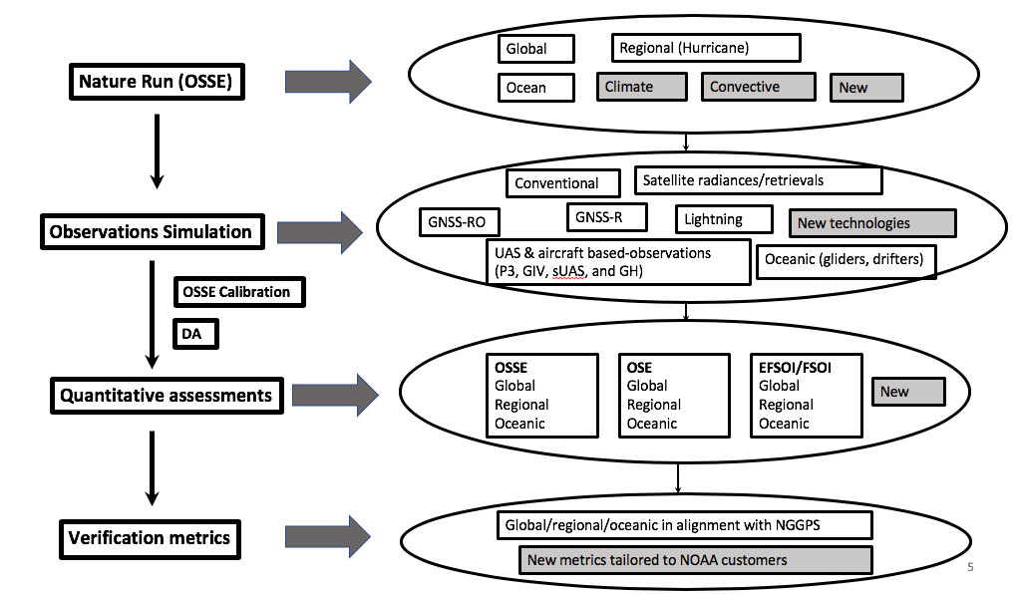
7

Slide 8
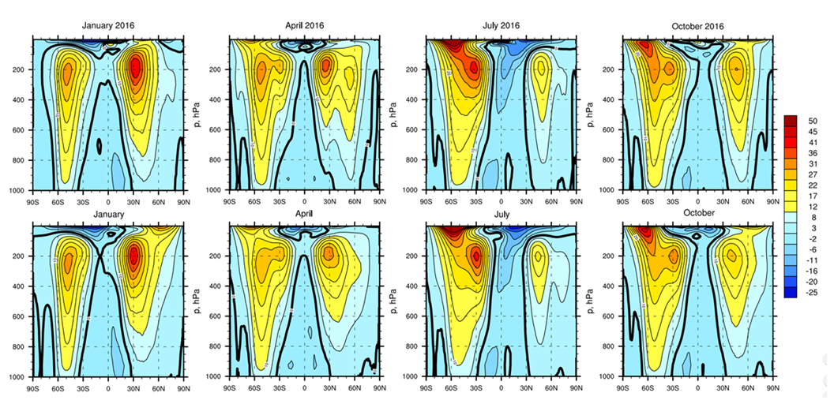
Validation of the ECO1280 nature run
ERA5 ECO1280
Figure: Time mean zonal mean of the zonal wind (color contours, ms⁻¹, black contour, zeroth contour line) in the ECNR (top) and in the ECMWF ERA5 Reanalysis from 1979-2014 (bottom).
8

Slide 9
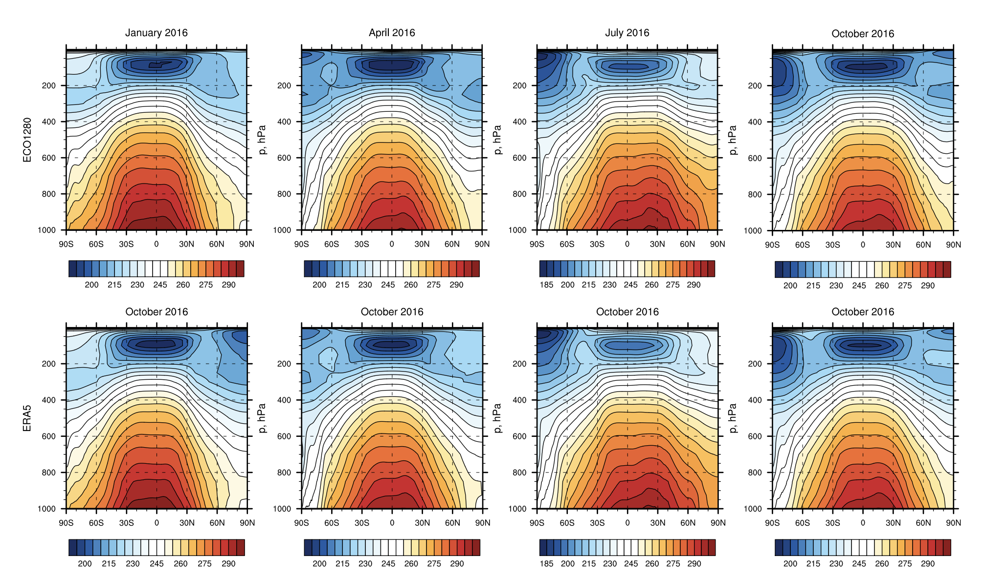
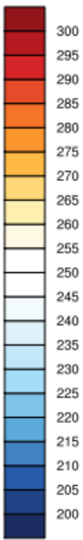
Validation of the ECO1280 nature run
Time mean, zonal mean of the ECNR for Temperature (K) in the ECNR (top) and the ERA5 (bottom) from 1979-2014.
9

Slide 10
Consolidated Observing Systems Simulator (COSS)
Process Input Data
COSS
Conventional Observations
Aircraft Observations
GNSS-RO
Aircraft Reports
Refractivity
Bending Angle
Radiances
CRTM
ECO1280
G5NR
ECO1280
G5NR
ECO1280
G5NR
ECO1280
G5NR
ECO1280 (cloudy)
G5NR
FV3GFS Global OSSE system calibrated with
two different NR (G5NR and ECO1280)
HWRF Hurricane OSSE system under
development
10

Slide 11
Next-Generation of NOAA satellites
NOAA conducted a study to plan for the next generation of weather satellites – NOAA Satellite Observing System Architecture (NSOSA).
Outlined new capabilities and architectures which NOAA should invest in.
Generated architectural questions that could be addressed by observing system simulation experiments (OSSEs).
Benefits from existing observing systems to be combined with potential enhancements from non-yet-existing capabilities.
Follow the guidance from the NOSC Impact Assessment Framework Memorandum on the process to define, design, execute, review, and report on impact assessments.

Slide 12
Key questions to address
Relative value of sounding quality and quantity for global NWP – to support decision making on sounder performance versus satellite numbers.
Value of global wind observations and their value relative to enhanced sounding, relative value of different approaches to global wind observations (active versus passive).
Value of regional real-time sounding observations.
Sounders in geostationary orbit (GEO-XO).

Slide 13
Ongoing efforts
Calibration of the FV3GFS/ECO1280 global OSSE system.
  Validation of the ECO1280 nature run.
  Simulation of conventional, GNSS RO and cloudy satellite radiances.
  Errors added to the observations.
Finalize experiment design and start running experiments to answer key questions on observing capabilities/impacts.
  Global control with FV3/GFS (different levels of performance) and a regional control.
  Quantity (soundings per day or update rate) versus quality (spatial resolution, temperature/humidity accuracy) trades.
  Global winds with different technologies.
  Regional real-time sounding evaluation (GEO-XO).

Slide 14
Questions?

