Slide 1
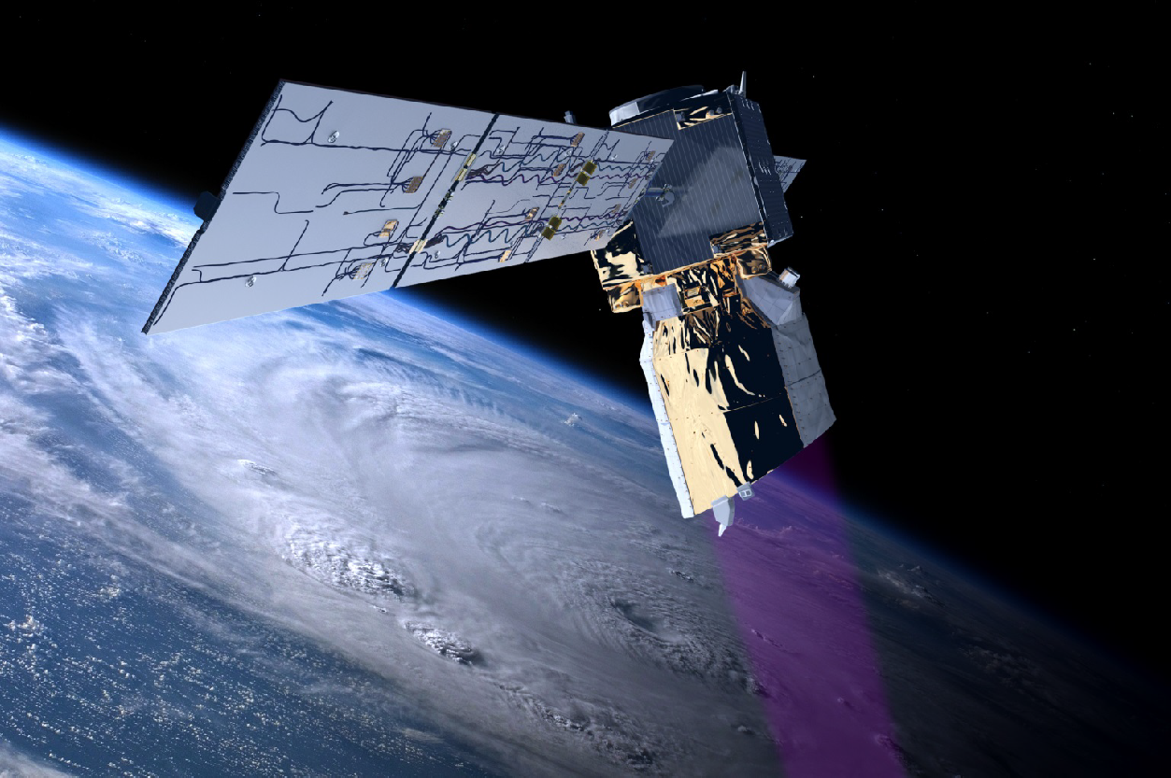
The needs for satellite winds and an Aeolus follow-on
Aeolus © ESA
Ad.Stoffelen@knmi.nl, Anne Grete Straume (ESA), Gert-Jan Marseille (KNMI), Oliver Reitebuch (DLR), Régis Borde (EUMETSAT), Tommaso Parrinello (ESA)
& Aeolus SAG

Slide 2
Wind profile satellite observation requirements and capabilities
Ad Stoffelen, Angela Benedetti, Régis Borde, Alain Dabas,
Pierre Flamant, Mary Forsythe, R. Michael Hardesty, Lars Isaksen,
Erland Källén, Heiner Körnich, Tsengdar Lee, Oliver Reitebuch, Michael Rennie,
Lars-Peter Riishøjgaard, Harald Schyberg, Anne Grete Straume,
Michael Vaughan
Published in the Bulletin of the American Meteorological Society
Following Aeolus success, looks forward to future vertical wind profiling capability in operational meteorology.
Addresses the need for high-quality wind and profile information to capture and initialize small-amplitude, fast-evolving and mesoscale dynamical structures, as the resolution of global NWP improved well into the 3D turbulence regime on horizontal scales smaller than 500 km.
Recognizes the transport and dispersion of atmospheric constituents and improved depiction of circulation on climate scales.
Direct wind profile observations over the oceans, tropics and Southern Hemisphere are not provided by the current global observing system. Looking to the future most other wind observation techniques rely on cloud or regions of water vapour and are necessarily restricted in coverage. Therefore, after its full demonstration, an operational Aeolus-like follow-on mission obtaining globally-distributed wind profiles in clear air by exploiting molecular scattering remains unique.

Slide 3
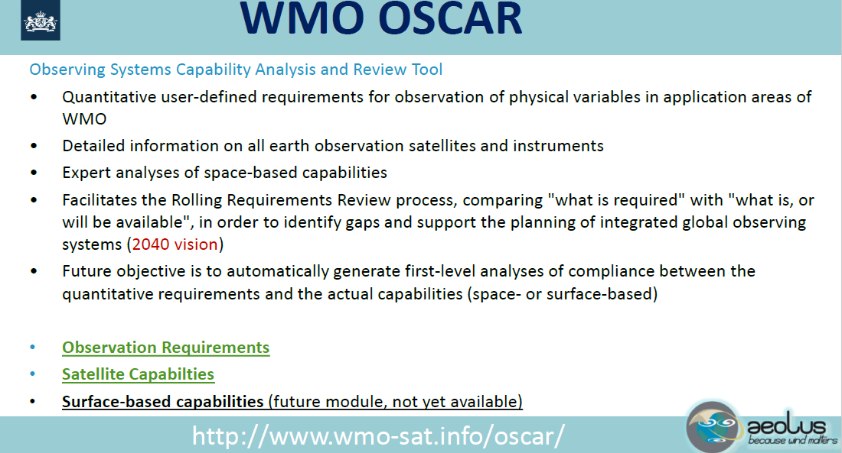

Slide 4
PIEW – Final presentation
Prediction Improvement for Extreme Weather
ESTEC, 25-10-2005
Gert-Jan Marseille
Ad Stoffelen
Jan Barkmeijer
Notes:
The following peer-reviewed publications document the ESA project PIEW:
MARSEILLE, G.J., A. STOFFELEN and J. BARKMEIJER, 2008, A CYCLED SENSITIVITY OBSERVING SYSTEM EXPERIMENT ON SIMULATED DOPPLER WIND LIDAR DATA DURING THE 1999 CHRISTMAS STORM, Tellus A 60 (2), 2008., pp. 216-233.
MARSEILLE, G.J., A. STOFFELEN and J. BARKMEIJER, 2008, IMPACT ASSESSMENT OF PROSPECTIVE SPACE-BORNE DOPPLER WIND LIDAR OBSERVATION SCENARIOS, Tellus A 60 (2), 2008., pp. 234-248.
MARSEILLE, G.J., A. STOFFELEN and J. BARKMEIJER, 2008, Sensitivity Observing System Experiment (SOSE) - A New Effective NWP-based Tool in Designing the Global Observing System, Tellus A 60 (2), 2008., pp. 249-260.
PIEW is based on earlier simulation and impact assessment work:
STOFFELEN, A., G.J. MARSEILLE, F. BOUTTIER, D. VASILJEVIC, S. de HAAN and C. CARDINALI, 2006, Doppler Wind Lidar Observation System Simulation Experiment, Quart. J. Royal Meteor. Soc., 132, 1927-1947.

Slide 5
Conclusions
SOSEs have been applied to ADM-Aeolus and various candidate follow-on scenarios for a database of cases with bad ECMWF 2-day forecasts
Aeolus is capable to resolve part of the analysis error structures in data sparse areas
Measuring wind vector profiles instead of LOS components over the Northern Hemisphere oceans gives “only” a 50% forecast improvement
A larger improvement of 70% is achieved by a more uniform distribution of LOS wind observations
This may be achieved by two Aeolus in orbit (tandem)
A third Aeolus in orbit gives still a significant improvement over the North Atlantic
Storm track targeting over the Atlantic by dual-inclination works
(but elsewhere its value is limited)
Limited to dawn-dusk times of day!
Notes:
Note that we only investigated Aeolus missions in dawn-dusk orbit, i.e., overpassing at about 6:00 and 18:00 Local Solar Time (LST). In this scenario, tandem and trio DWLs deliver spatial filling in of DWL curtains within a time window of 45 minutes, i.e., sampling almost the same large-scale wind field over distances of 500-2000 km. Wind profile voids over the oceans, tropics and southern hemisphere are usually much larger than this and indications exist of persistent large-scale circulation problems in NWP models, e.g., Belmonte and Stoffelen, https://www.ocean-sci.net/15/831/2019/ .
While dawn-dusk orbits have their advantages for a UV DWL, the temporal coverage gap is not addressed in PIEW. From scatterometer studies we know that wind instruments separated by 2.5 hours in LST overpass, provide independent NWP impact. Hence, DWL constellations at 9:00 LST, 12:00 LST and 15:00 LST would be very useful too for NWP. E.g., Stoffelen et al., https://www.knmi.nl/kennis-en-datacentrum/publicatie/research-and-development-in-europe-on-global-application-of-the-oceansat-2-scatterometer-winds .

Slide 6
SOSE - summary - flowchart
Ana-
ly-
sis
Model State
t = 0
Forecast Run
t = 0 → 48 h
Analysis is used as
pseudo-truth to
simulate DWL
Forecast
t = 48 h
Key Errors
t = 0
Sensitivity Computation
t = 48 h → 0 h
Forecast Error
t = 48 h
Analysis
t = 48 h
Forecast Run
t = 0 → 48 h
Updated State
t = 0
Ana-
ly-
sis
Better Forecast
t = 48 h
Ana-
ly-
sis
Notes:
The SOSE method back-propagates 24-hour forecast errors to the analysis time, while preserving the consistency with the observations (24 hours earlier). Subsequently, these analysis improvements are sampled by a DWL, resulting in simulated DWL profiles, which are subsequently assimilated. For details see:
MARSEILLE, G.J., A. STOFFELEN and J. BARKMEIJER, 2008, Sensitivity Observing System Experiment (SOSE) - A New Effective NWP-based Tool in Designing the Global Observing System, Tellus A 60 (2), 2008., pp. 249-260.

Slide 7
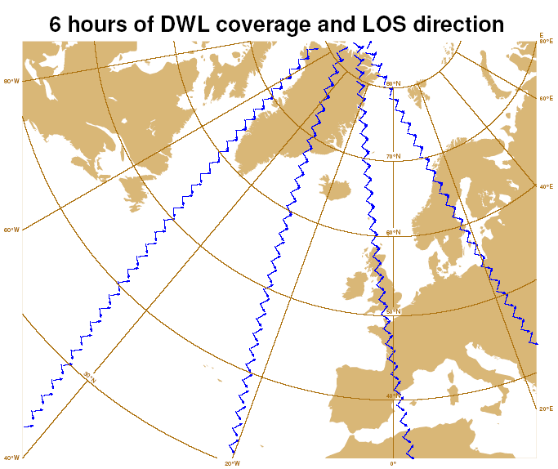
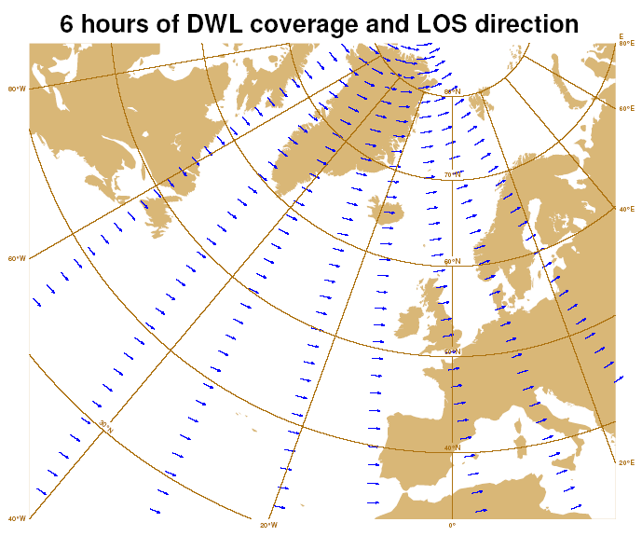
ADM follow-on candidates
Dual perspective
Tandem-Aeolus
information content single LOS vs. dual-perspective
Notes:
Dual perspective provides both zonal and meridional information.
Tandem-Aeolus, on the other hand, provides increased zonal coverage.

Slide 8
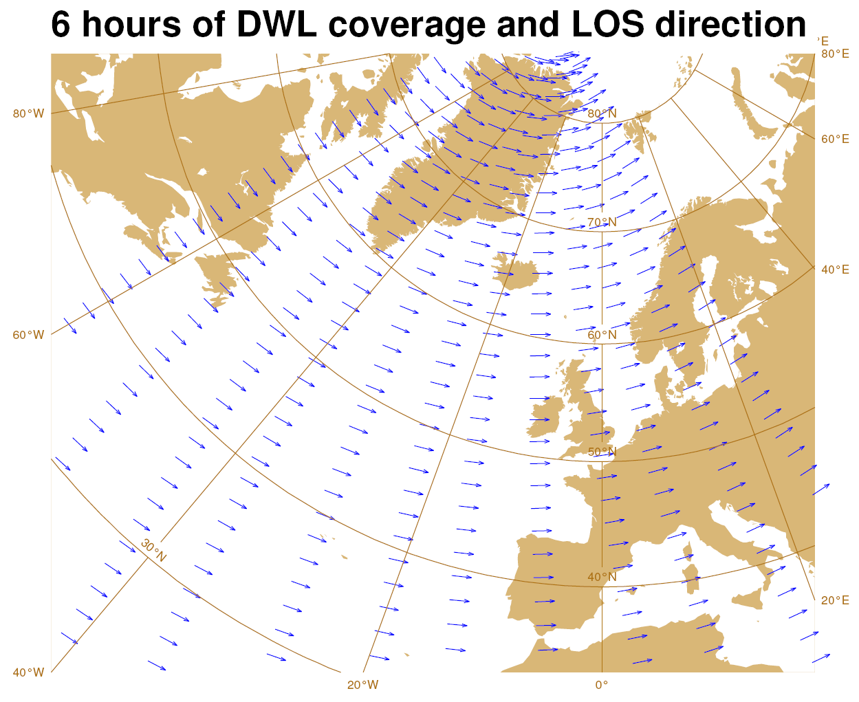
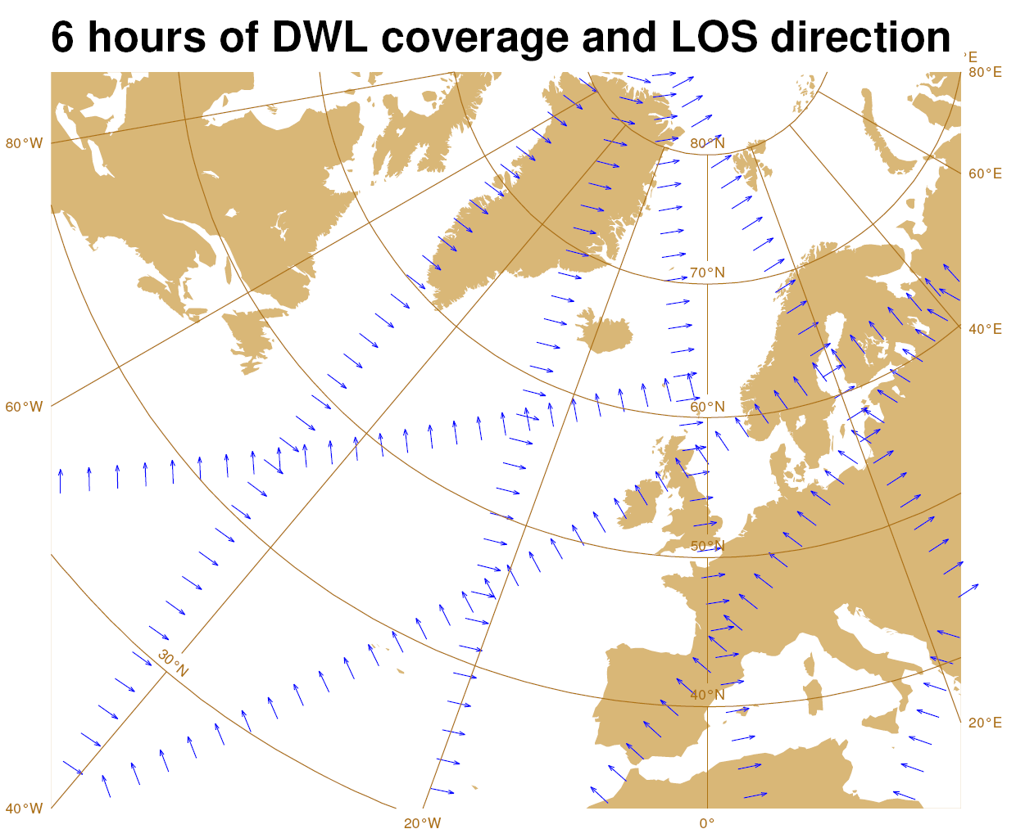
Additional ADM follow-on scenarios
Triple-Aeolus
Dual-inclination (“alternative” dual-perspective)
Storm track targetting
Notes:
Triple Aeolus provides even better zonal coverage than Tandem Aeolus.
In dual inclination the storm track region, i.e., the location where most test bad forecasts occurred, both coverage and meridional perspective is added.

Slide 9
DWL forecast impact – 500 hPa geop. height
(%) | N.Hemis | N.Atlantic | Europe | N.Pacific | N.America | N.Pole
Aeolus | 4.9 | 2.9 | 2.8 | 6.6 | 5.4 | 9.9
Dual-perspective | 7.3 | 3.9 | 3.8 | 9.8 | 8.5 | 14.1
Tandem-Aeolus | 8.0 | 5.0 | 5.3 | 11.1 | 7.4 | 15.8
Dual-inclination | 6.6 | 4.4 | 4.7 | 8.5 | 5.8 | 10.8
Triple-Aeolus | 9.8 | 6.4 | 8.0 | 13.1 | 8.8 | 18.3
Added value of Triple-Aeolus largest for Europe
  Europe: Forecast improvement linear with # Aeolus’
Notes:
At 6:00/18:00 LST a large potential exists for improved profiling of the zonal wind.

Slide 10
Recommendations
Adopt SOSE approach, e.g. to test ADM vertical sampling modes
SOSE cycling for series of pseudo-truth / long-loop 4D-Var?
Besides sampling of 12UTC window, also test sampling in the other 6-hour windows, in particular for dual-inclination impact assessment
Test Aeolus follow-up missions in tropical region (Nedjeljka)
Just fly more Aeolus-type instruments!
Marseille, Stoffelen & Barkmeijer, 2008:
https://doi.org/10.1111/j.1600-0870.2007.00288.x
https://doi.org/10.1111/j.1600-0870.2007.00289.x
https://doi.org/10.1111/j.1600-0870.2007.00290.x
Žagar et al., 2008: https://doi.org/10.1175/2007MWR2335.1
Limited to dawn-dusk times of day!
Notes:
Tropical regions have been evaluted by Zagar et al. (2008), where the meridional wind plays a more independent role and is needed for a more complete analysis of the tropical circulation:
Žagar, Nedjeljka, Ad Stoffelen, Gert-Jan Marseille, Christophe Accadia and Peter Schlüssel, 2008, Impact Assessment of Simulated Doppler Wind Lidars with a Multivariate Variational Assimilation in the Tropics, Monthly Weather Review, 2443--2460, https://doi.org/10.1175/2007MWR2335.1.

Slide 11
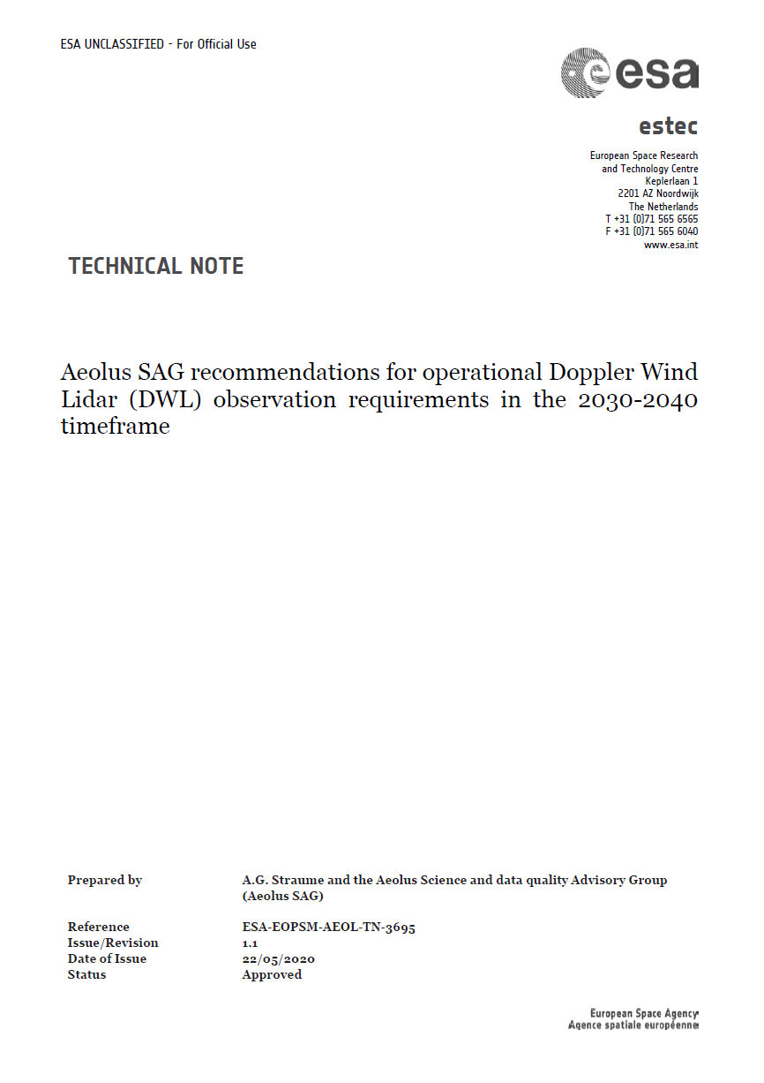
Technical Note summarizing SAG assessment
Aeolus SAG convenors:
Jonas von Bismarck (ESA-ESRIN)
Anne Grete Straume (ESA-ESTEC)
Aeolus Mission Manager:
Tommaso Parrinello (ESA-ESRIN)
Aeolus SAG members:
Vassilis Amiridis, NOA, Greece
Roohollah Azad, Norwegian Meteorological Institute, Norway
Holger Baars, TROPOS, Germany
Angela Benedetti, ECMWF, United Kingdom
Régis Borde, EUMETSAT, Germany
Alexander Cress, DWD, Germany
Alain Dabas, Météo-France, France
Mary Forsythe, UK Met office, United Kingdom
Michael Hardesty, NOAA, USA
Lars Isaksen, ECMWF, United Kingdom
Shoken Ishii, TMU, Japan
Ioanna Karagali, DTU, Denmark
Jean-Francois Mahfouf, Météo-France, France
Oliver Reitebuch, DLR, Germany
Michael Rennie, ECMWF, United Kingdom
Gail Skrofronick Jackson, NASA, USA
Ad Stoffelen, KNMI, The Netherlands
Michael Vaughan, OLA, United Kingdom
Martin Weissmann, University of Vienna, Austria
Nedjeljka Žagar, University of Hamburg, Germany
available in Friday Aeolus Workshop folder:
https://www.aeolus.esa.int/confluence/display/ACVWS2020/13+-+Friday+-+Aeolus+Follow-on+studies
Notes:
AGS, NWP, Impact 17 June 2020
Refine Aeolus requirements to ensure impact in 2030-2040 timeframe
Assess improvement of aerosol and cloud sensing which comes as a spin-off product of DWLs
Assessment of how Aeolus Mission Requirements are met performed regularly:
Random errors higher then requirements
Bias slightly higher than requirements
Most other requirements met or to be assessed at the end of the mission

Slide 12
SAG assessment for mission requirements for future DWL´s (1) Requirements for instrument performance
red circles indicate main changes wrt. Aeolus requirements
threshold, breakthrough, goal according to WMO definition
Fill requirements space with thresholds and breakthroughs
This provides a requirements box wherein Aeolus FO trade-offs occur
Move Aeolus FO as close as possible to breakthrough points
It is generally cost-effective to move to breakthrough points
While such movement increases cost generally
Notes:
AGS, NWP, Impact 17 June 2020
Significant impact to be ensured in 2030-2040 timeframe
Important to ensure sufficient data quality (random and systematic errors), adequate geographical and vertical coverage and spatial and temporal sampling (single LOS, single parameter)
WMO break-through requirements - typical baseline
Address needs of global and regional NWP as far as possible

Slide 13
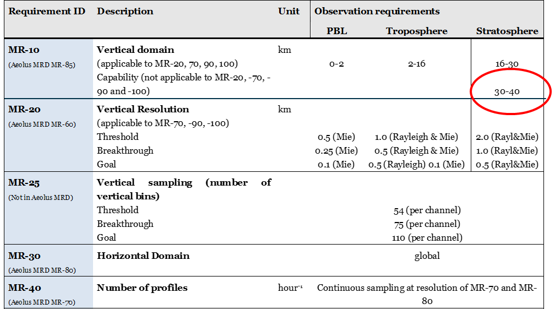
SAG assessment for mission requirements for future DWL´s (2)
Requirements for instrument performance
red circles indicate main changes wrt. Aeolus requirements
relaxed requirement wrt. Aeolus

Slide 14
SAG assessment for mission requirements for future DWL´s (3)
Requirements for aerosol sensing capabilities
Requirement ID | Description | Unit | Observation Requirement
MR-210 | Minimum detectable particle backscatter coefficient (i.e. lidar sensitivity) at top of atmosphere for 10 km horizontal and 100 m vertical resolution | m⁻¹ sr⁻¹ | 8x10⁻⁷ (± 50%)
MR-220 | Minimum detectable particle backscatter coefficient (i.e. lidar sensitivity) of a co-polar channel for 10 km horizontal and 100 m vertical resolution | m⁻¹ sr⁻¹ | 2.6 x10⁻⁶ (± 50%)
MR-230 | Minimum detectable particle backscatter coefficient (i.e. lidar sensitivity) of a cross-polar channel for 10 km horizontal and 100 m vertical resolution | m⁻¹ sr⁻¹ | 2.6 x10⁻⁶ (± 50%)
Improved aerosol and cloud sensing with respect to Aeolus would require depolarization measurements
Requires change in current Aeolus design: trade-off investigation requested by ASAG

Slide 15
Summary
We started early to think about Aeolus FO
More Aeolus satellites with zonal perspective appear clearly beneficial
Besides dawn-dusk, other times of day will be beneficial too
Aeolus demonstrated impact in NWP, AMV validation and showing model biases
Wind performance has not been fully demonstrated
We learned many invaluable lessons for Aeolus FO
Increased wind performance will provide much additional benefits, particularly for molecular winds
Beyond Aeolus, requirements on a depol. channel and meridional winds have been expressed
A trade-off requirements space has been defined with threshold and breakthrough quality values

Slide 16
Aeolus science outreach
Aeolus data and their application | Special Issue
Copernicus AMT/ACP/WCD inter-journal SI
EGU2021 AS1.28: Aeolus data and its application
IGARSS’21, Brussels, Belgium,
Aeolus and Aeolus follow-on

Slide 17
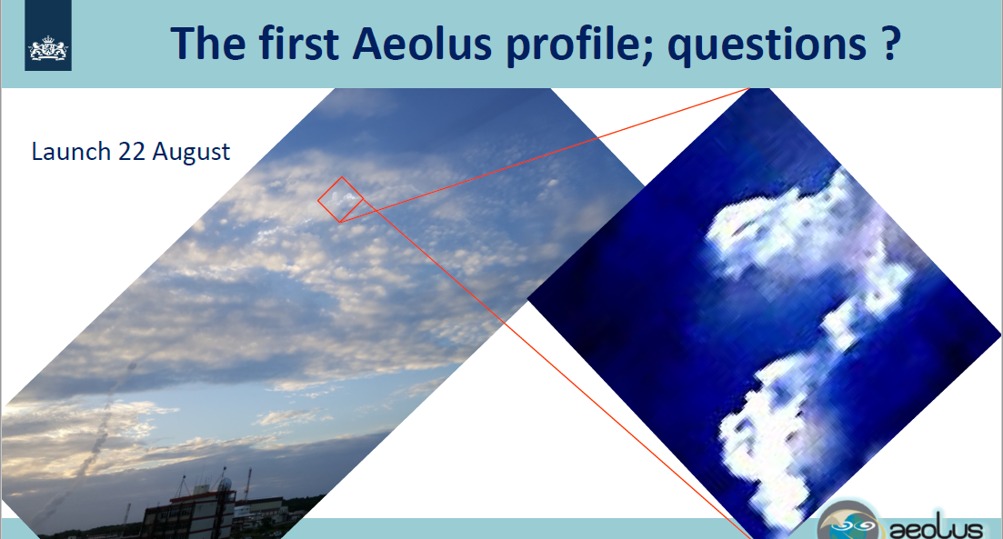
Notes:
If you look carefully, you see the curling Aeolus rocket launch track behind the clouds. This is caused by the intermittent shear of the QBO, blowing the track in different directions at different heights.

Slide 18
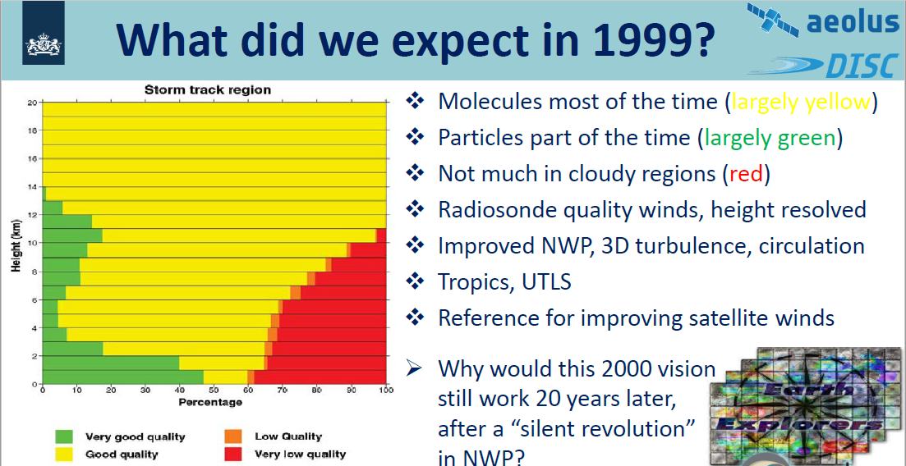
Stoffelen and Marseille, 1998
Notes:
The breakthrough in DWL concepts was the ability to measure in clear air, i.e., without aerosol and clouds (yellow region). Satellites were not yet much used in NWP, but we knew that radiosonde winds are key for NWP. Hence, the observation errors assigned in NWP (mainly spatial representation error) of 2-3 m/s for radiosondes, Aeolus would almost certainly provide impact in NWP, due to its more uniform global coverage than radiosondes.
Where the impact of satellites was negligible in 1999, today satellites determine the majority of NWP impact, which is part of an evolution in NWP that has been called “silent revolution”. However, the lack of wind profiles has not been remedied over the past 20 years.

Slide 19

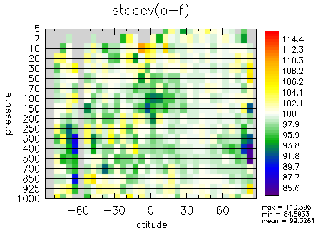
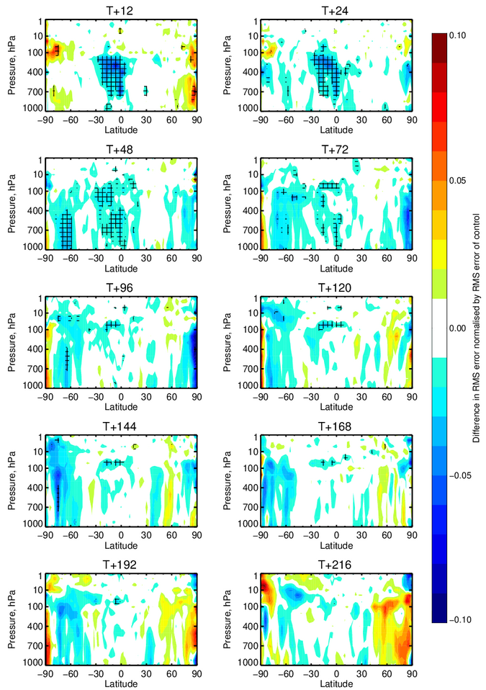
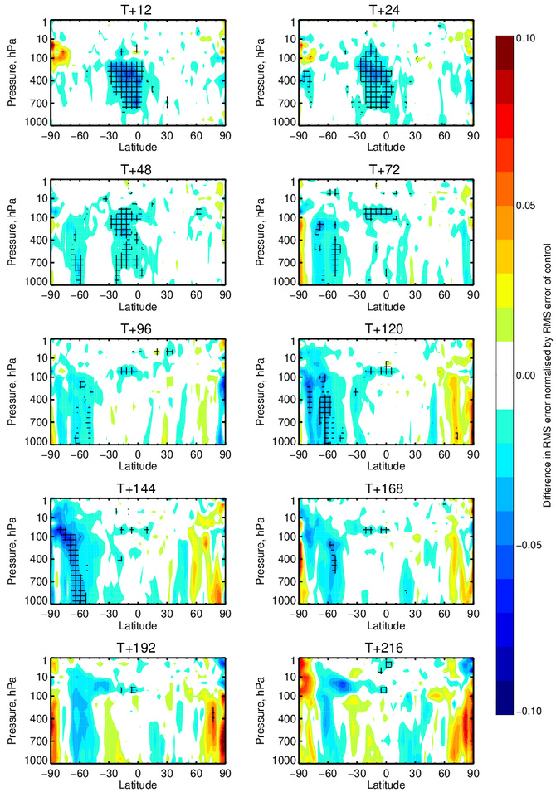
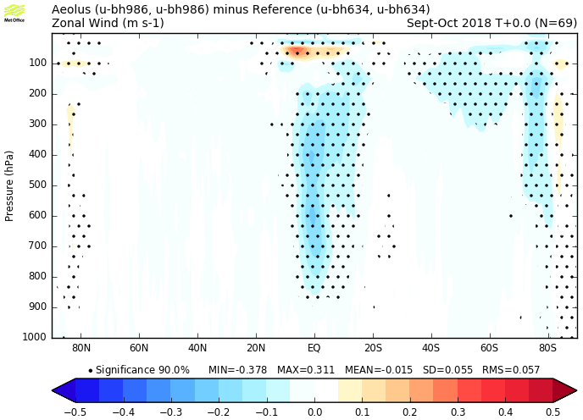
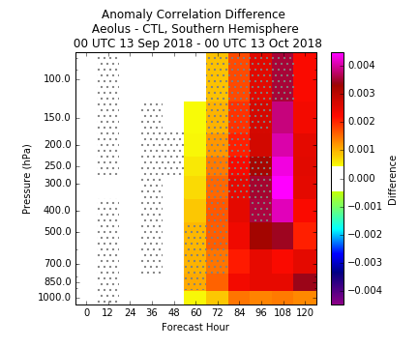
Very positive results on the use of Aeolus in NWP was presented at the September 2019 NWP Impact Assessment Working Meeting
Even noisy Aeolus data demonstrates its value
Impact will double when noise error SD is
reduced by a factor 2
10%
better
15%
better
ECMWF wind impact 72-hour forecast
UK Metoffice zonal wind analysis improve when Aeolus is assimilated. Blue colors imply improvements.
Deutscher Wetterdienst comparison against radiosondes show large improvement.
NASA GMAO height forecasts improved, especially for Southern Hemisphere 48-120 hour forecasts. Red colors mean improved forecasts.
NOAA also presented very positive tropical and Southern Hemisphere forecast impact (not shown).
Notes:
See also the EGU uploads by Parinelli et al., Kirch et al., Rennie and Isaksen and several others in this Aeolus session. Furthermore:
https://www.ecmwf.int/en/about/media-centre/news/2020/ecmwf-starts-assimilating-aeolus-wind-data
https://www.esa.int/Applications/Observing_the_Earth/Aeolus/COVID-19_Aeolus_and_weather_forecasts

Slide 20
Summary and Conclusions
Requirement for upper air wind profiles remains strong for all WMO weather and climate application areas;
Radiosonde observation show the highest impact of all (non-satellite radiance) observations, and the highest impact of all on a per observation basis;
  Network is difficult to expand (difficult even to maintain as is);
Aircraft observations provide a very valuable complement to the radiosonde network;
  Coverage is driven by operational and commercial constraints of airline traffic, not by WMO requirements;
A constellation of space-based wind lidars could provide an excellent combination of horizontal, vertical and temporal resolution meeting key WMO requirements;
We look forward to seeing the results from Aeolus/ADM!
WMO, Lars-Peter Riishojgaard, EUMETSAT, 29/5/’18
Notes:
The WMO OSCAR provides the rolling requirements review for atmospheric variables, including horizontal winds:
https://www.wmo-sat.info/oscar/variables/view/179
This includes a gap analysis of the WIGOS, informing meteorological satellite operators on the evolution of their space instrumentation:
https://www.wmo.int/pages/prog/www/WIGOS-WIS/meetings/WIGOS-VisionSurface-2040/WIGOS-Surface-2040-Space-Vision.pptx

Slide 21
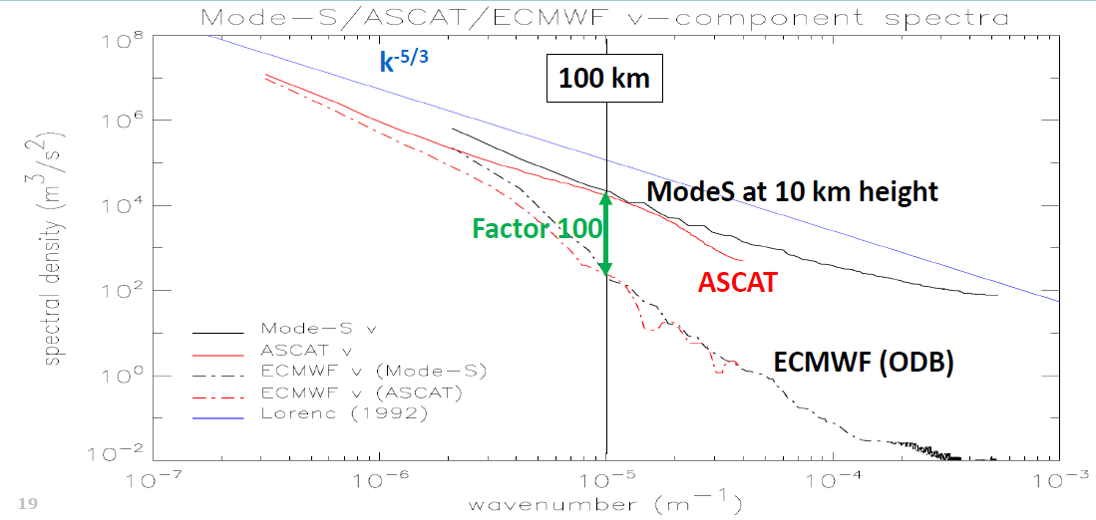
Grid distance 9 km, resolved scales ~150 km
H/V aspect ratio ~100
Notes:
To determine the resolution of NWP models collocated NWP and observation data are needed, since spectral amplitudes vary from one case to another by typically one order of magnitude. Here, collocated spectra are given in data void regions with only weak surface forcing. These are for ASCAT over the oceans and for Mode-S airplane tracks at 10 km height. The similarity of the spectral deficit in wind variance in the NWP model, due to lack of observations (and forcing) is remarkable.

Slide 22
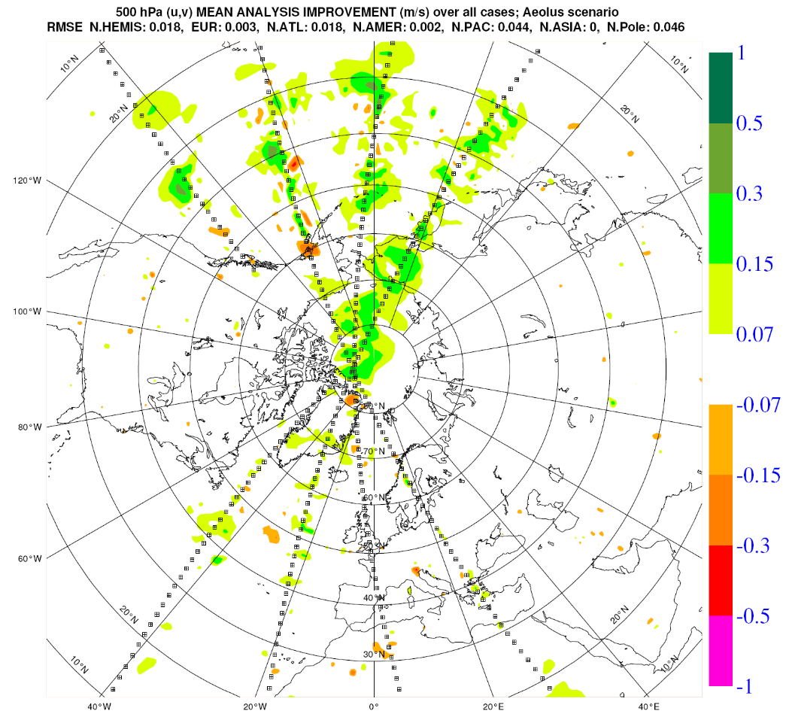
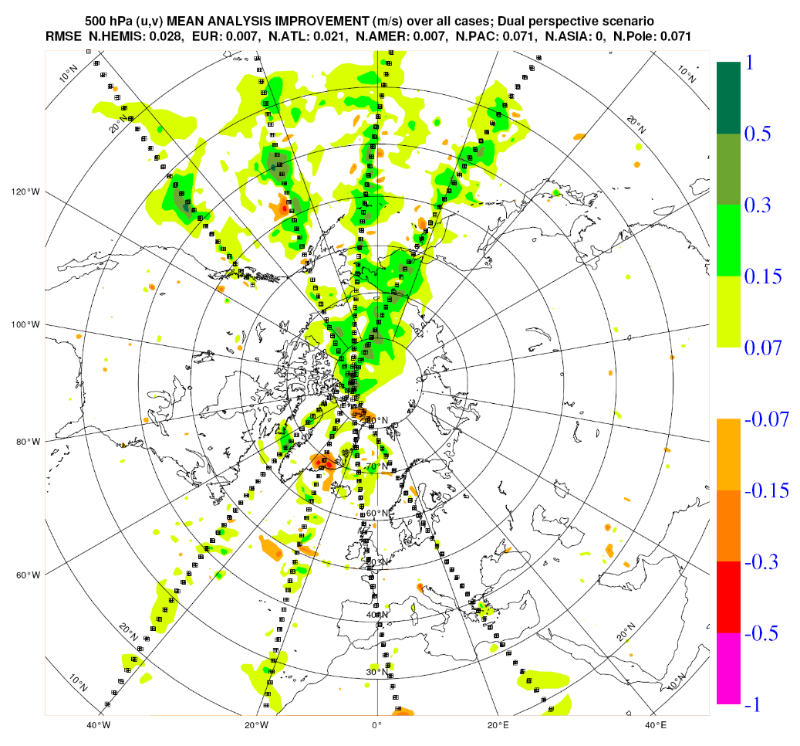
DWL analysis impact - 500 hPa wind
Aeolus
Dual-Persp.
Dual-perspective better than single LOS (Aeolus)
Notes:
However, improvements reside close to the DWL observation track generally in a single step analysis. Here the same sampling is tested over many different analysis cases.

Slide 23
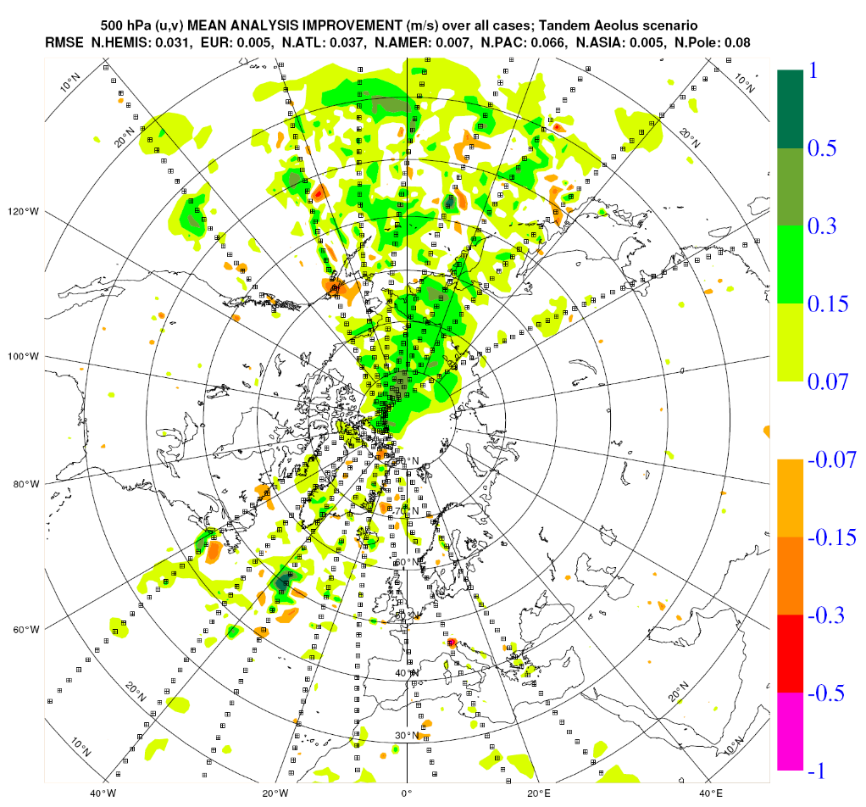
DWL analysis impact – 500 hPa wind
Aeolus
Tandem
Tandem-Aeolus scenario recovers large scale structures
Notes:
Tandem-Aeolus provides more larger-scale improvements than dual-perspective. Note that the number of independent observations is identical in both scenarios.

Slide 24
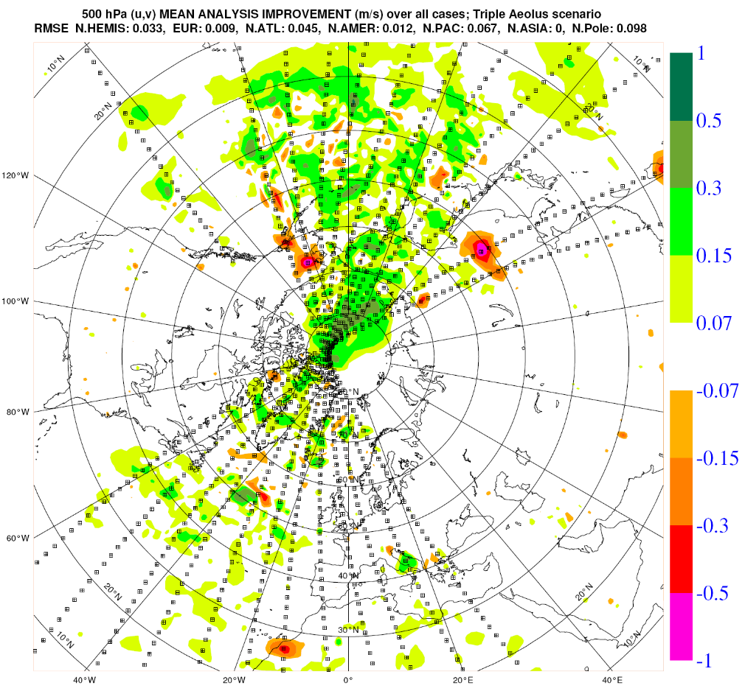
DWL analysis impact – 500 hPa wind
Tandem
Triple
triple-Aeolus has added value over the Atlantic
Notes:
A seemingly relatively large benefit is seen going from 2 to 3 DWL.
On the other hand, some detrimental impacts are observed over land masses, probably due overfitting issues.

Slide 25
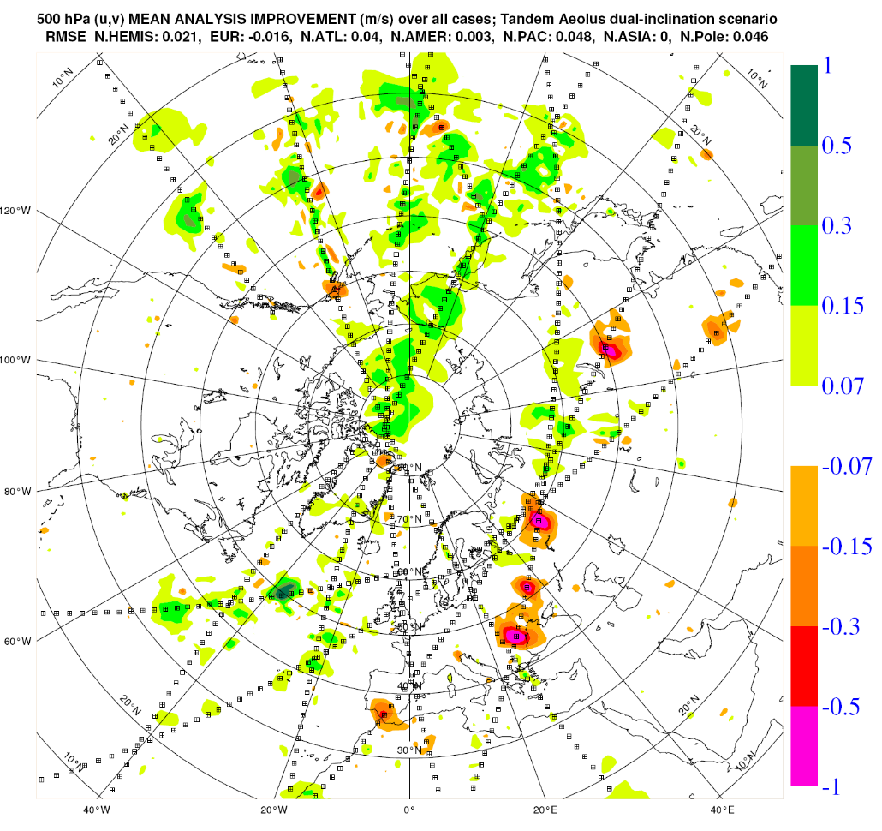
DWL analysis impact – 500 hPa wind
Tandem
Dual-incl
Dual-inclination scenario better samples the storm-track region over the Atlantic
Dual-inclination scenario has many observations over data dense continents
Notes:
Dual inclination suffers from the land-based observations, which appear not very beneficial over all.
Nevertheless, it missed beneficial polar impacts and some tandem ocean benefits too.

Slide 26
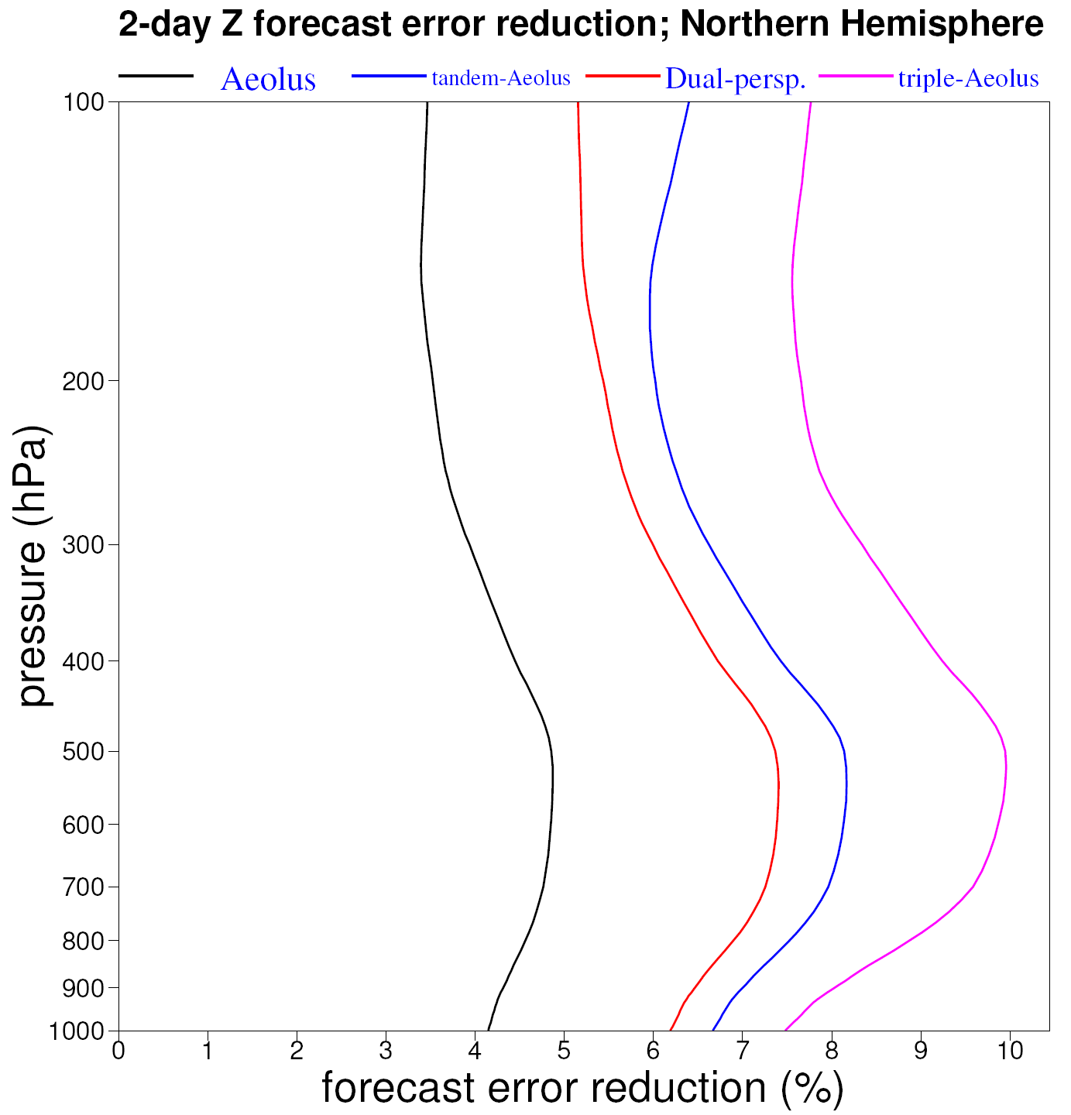
DWL forecast impact – 500 hPa geop. height
Result very consistent in the vertical
Aeolus
Dual-pers.
Tandem
Triple

Slide 27
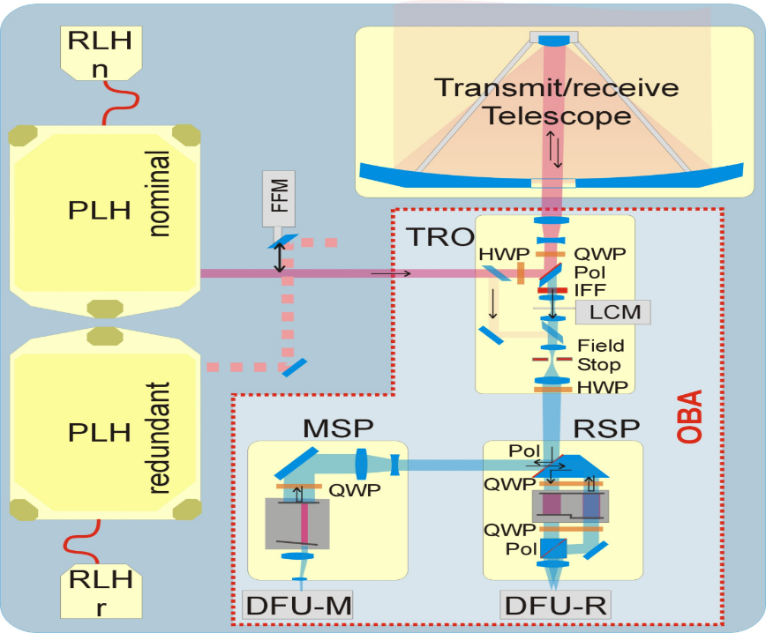
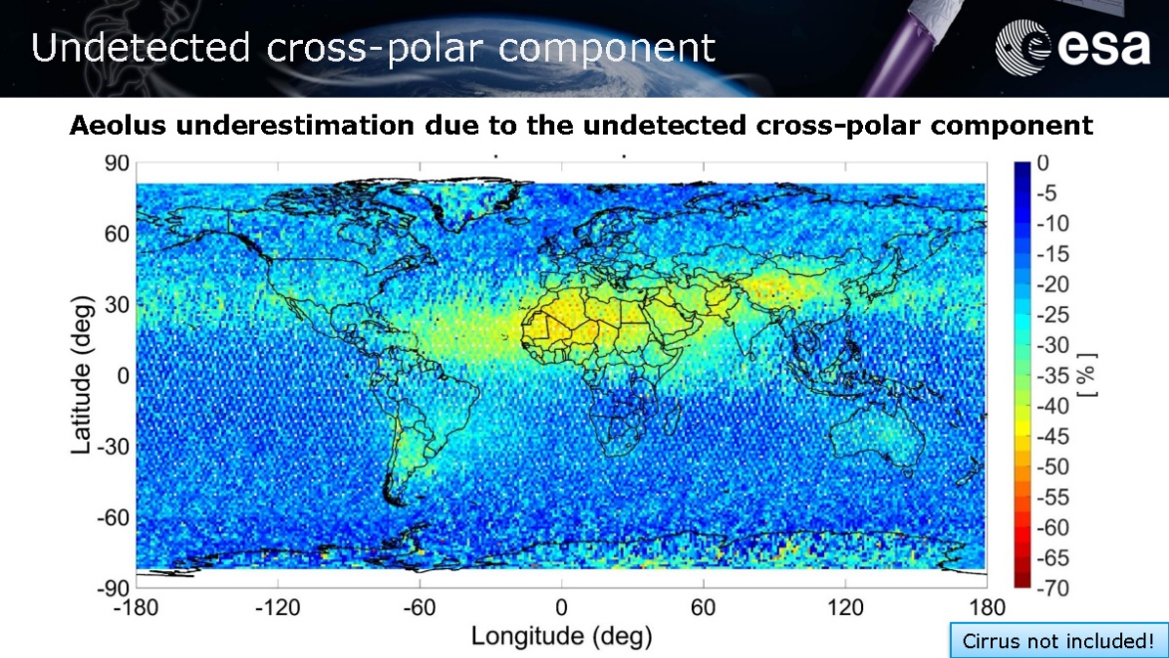
Possibility to enhance aerosol sensing capability of ALADIN
Missing depolarization signal (per design) for aerosol classification, discrimination aerosol/clouds and significant loss of Mie signal (up to 50%) in depolarizing scenes (e.g. global desert dust belt)
Increase capability for vertical resolution in raw data (100 m) and significantly increase number of range gates and possibly altitude range up to 40 km
De-pol signal
V. Amiridis (2019), Cal-Val WS
ESA (2008): Aeolus Science Report

Slide 28
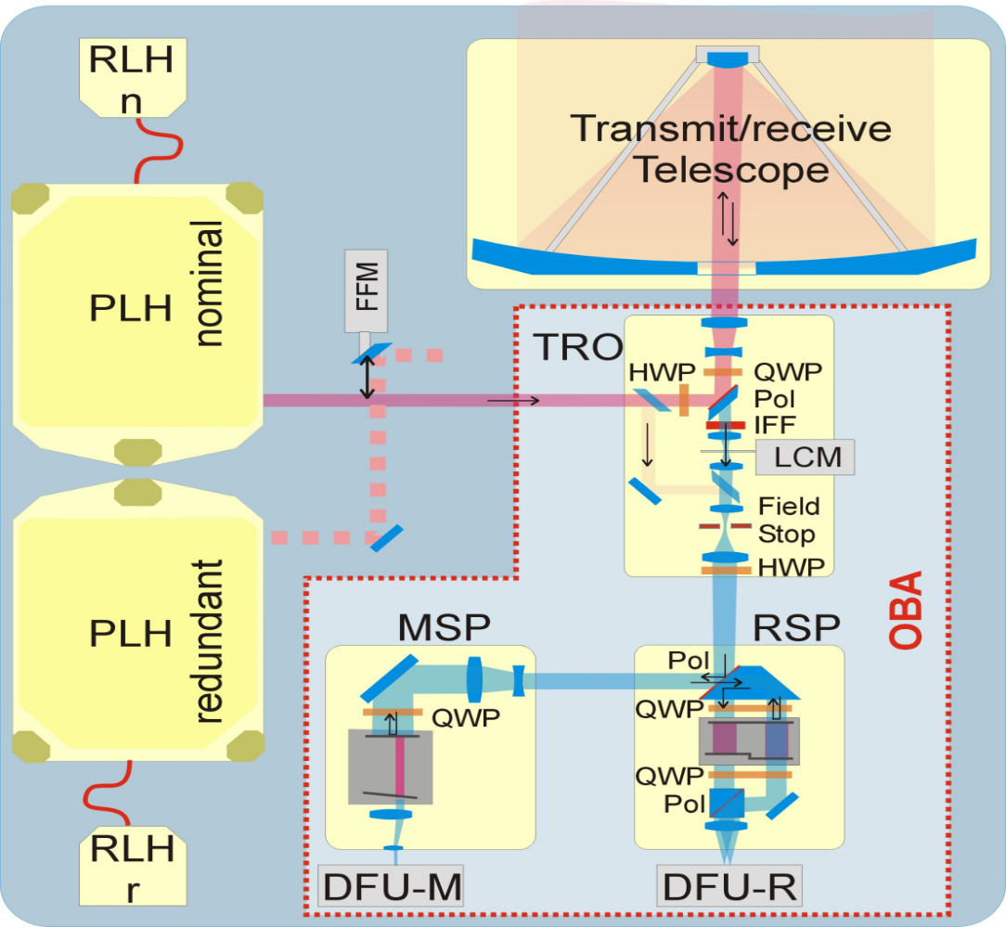
Main limitations of the ALADIN instrument
Overall optical throughput: factor 2-3 missing
in Rayleigh signal compared to pre-launch simulations (actual factor 4-6 missing) => enhanced Rayleigh random errors => better match of actual laser performance (energy and beam divergence) with optical receiver design (field stop for field-of-view FOV, M1 mirror): increase field stop size with sufficient margins
Thermal-mechanical stability of laser beam (divergence, LOS pointing) and transmit-receive path (including internal reference) => drifts of constant bias contributor for Rayleigh winds
Telescope primary mirror optical quality (WFE) and thermal stabilization => Rayleigh (and Mie) bias and signal levels as a function of orbit phase (argument of latitude) and longitude induced by actual TOA radiation
WFE
laser
divergence
FOV
ESA (2008): Aeolus Science Report

Slide 29
SAG assessment for mission requirements for future DWL´s 3/4
Requirements for timeliness and lifetime

Slide 30
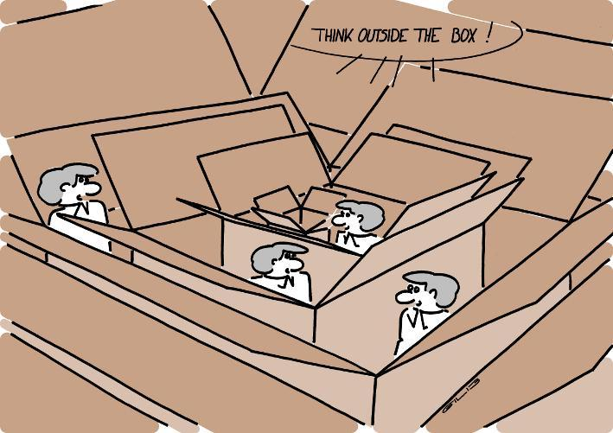
Summary and Conclusion
A large number of recommendations / lessons learnt could be
derived from on-going Aeolus mission wrt. mission and system
requirements, instrument specifications, design, alignment, operation,
and ground-testing with >15 yr expertise on DISC side to support FO
= > end-of-life mission phase could be used to perform additional
sensitivity tests on the instrument in order to support FO process
ASAG recommends to perform a trade-off within the instrument
consolidation study for implementation of an additional de-pol detector
ASAG highlights the benefit of the ALADIN airborne demonstrator A2D
during all phases of Aeolus
Space laser technology evolved significantly since early ALADIN development phases, e.g. ATLID, MERLIN and ESA study FULAS; laser pre-development activities for Aeolus FO should allow to achieve better performance than for Aeolus FO (basically to achieve a factor 2-4 higher vert/hor. resolution assuming an orbit altitude of 320 km)
Better performance need improvements also in the optical receive path, mainly optical quality of the telescope and its thermal stabilization, matching FOV to laser divergence, and thermal stability to lower drifts in illumination of spectrometers
https://gilscow.wordpress.com

