Slide 1
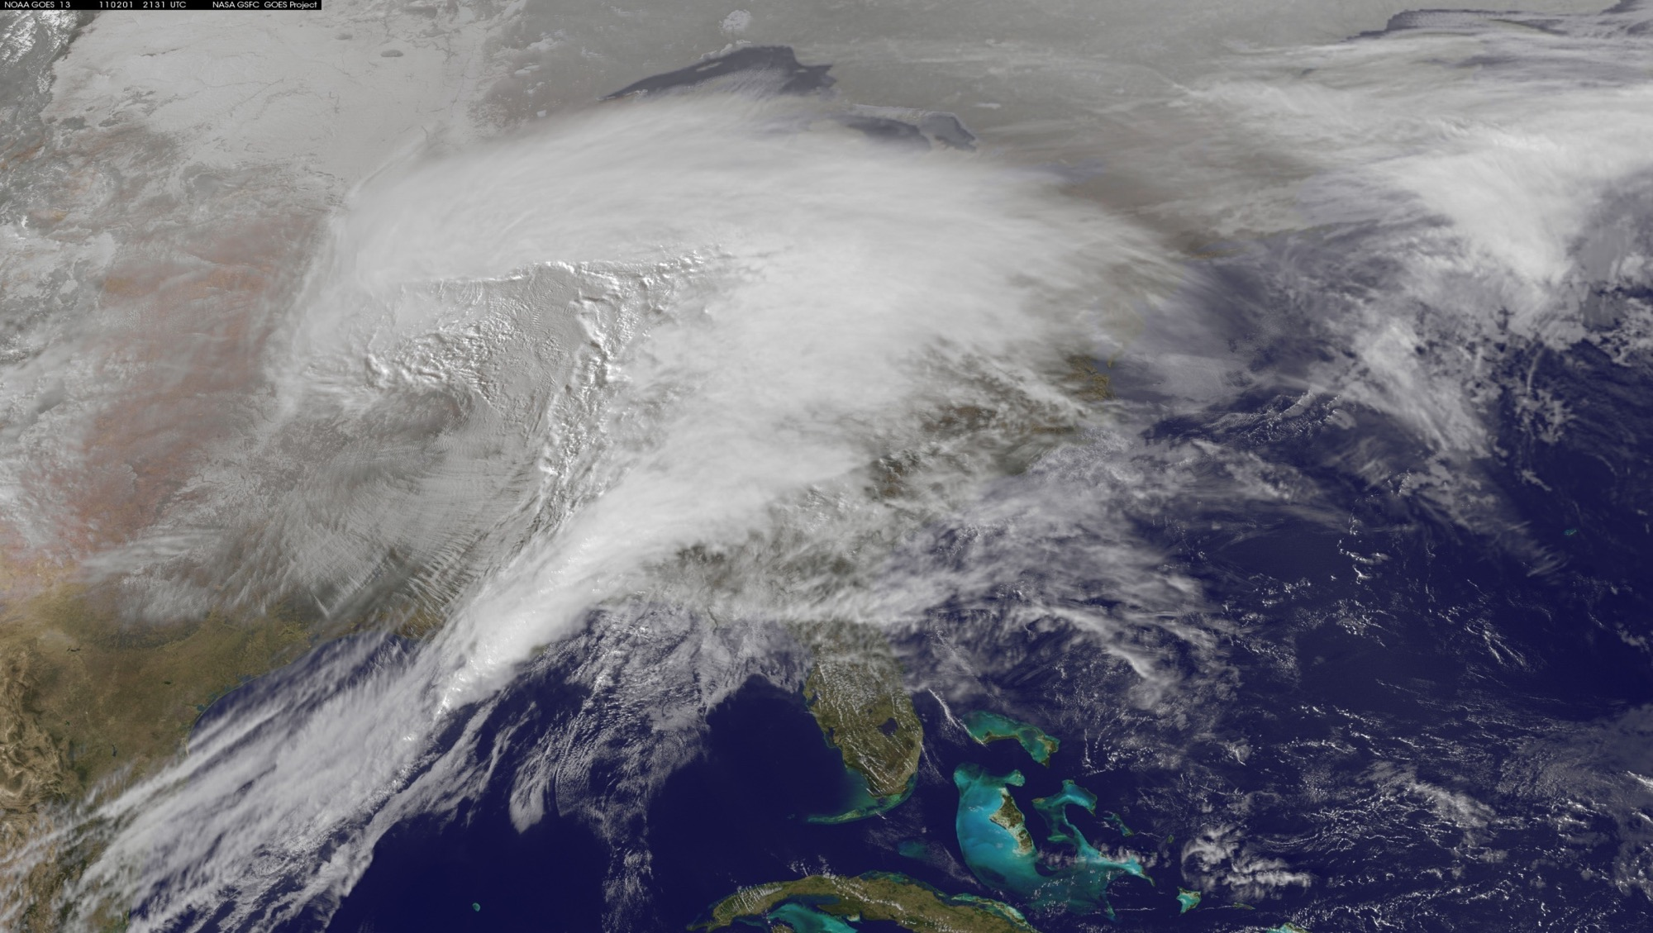

3D Winds from Atmospheric Motion Vectors: Information Content, Uncertainty, and Complementarity
Derek J. Posselt¹
Hui Su¹, Longtao Wu¹,
Hai Nguyen¹, Kevin Mueller¹, Joaquim Teixeira¹,
Chris Wilson¹, Trinh Vo¹, Fei He², William McCarty³
¹Jet Propulsion Laboratory, California Institute of Technology, Pasadena, CA
²NOAA-NESDIS, Silver Spring, MD
³NASA Goddard Space Flight Center, Greenbelt, MD
©2020. All rights reserved. A portion of this research was carried out at the Jet Propulsion Laboratory,
California Institute of Technology, under a contract with the National Aeronautics and Space Administration.

Slide 2
Atmospheric Winds
Complementary approaches for space based observation of atmospheric winds
  Lidar: high accuracy, limited sampling in space and time
  AMVs (or other approaches): lower accuracy, broader coverage, possibility of rapid revisit
Key questions:
  What are the uncertainties in AMVs, and how does representation of uncertainty affect the outcome of an OSSE?
  What impact do (clear air water vapor) AMVs have on NWP forecasts, relative to other observations?
  What are the relative strengths / drawbacks of AMVs as a component of a global 3D winds observing system?
Complementary approaches for space based observation of atmospheric winds
  Lidar: high accuracy, limited sampling in space and time
  AMVs (or other approaches): lower accuracy, broader coverage, possibility of rapid revisit
Key questions:
  What are the uncertainties in AMVs, and how does representation of uncertainty affect the outcome of an OSSE?
  What impact do (clear air water vapor) AMVs have on NWP forecasts, relative to other observations?
  What are the relative strengths / drawbacks of AMVs as a component of a global 3D winds observing system?
Notes:
Measurements of 3D winds have been called out as important for 10+ years. Much of the focus has been on Doppler wind lidar, and we anticipate this will be a key component in a future winds mission. However, lidar has spatial and temporal sampling issues (infrequent sampling, and limited swath). We are exploring the efficacy of lower-accuracy, but more frequent and spatially dense observations from feature-tracked water vapor and clouds.

Slide 3
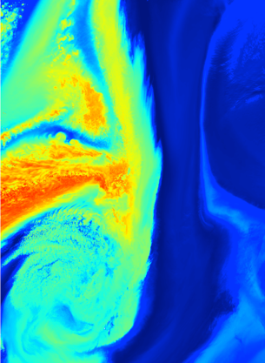
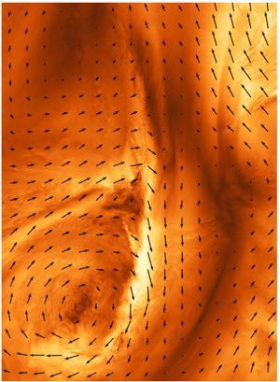

Atmospheric Motion Vectors
Use of image processing (and other) techniques to track atmospheric motion from sequences of images
Heritage in tracking clouds and water vapor
Known to be uncertain, and to contain ambiguities
Motivation to systematically explore the potential efficacy of AMVs, and quantify their uncertainties
  More effective use in DA/OSSEs
  Evaluation of various AMV measurement concepts
  Potential synergy with other wind measurements
Information and uncertainty experiments:
  Track sequences of water vapor fields from a nature run
  Compare synthetic AMVs with nature run winds
Model Water Vapor
Model Wind Speed and Direction

Slide 4
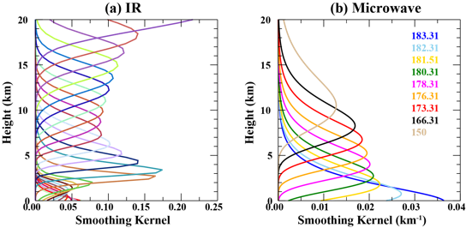
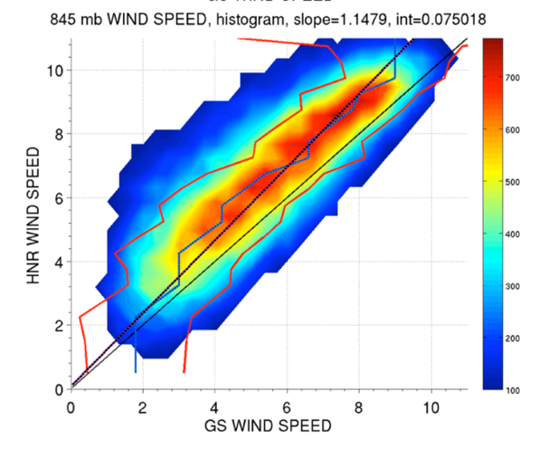
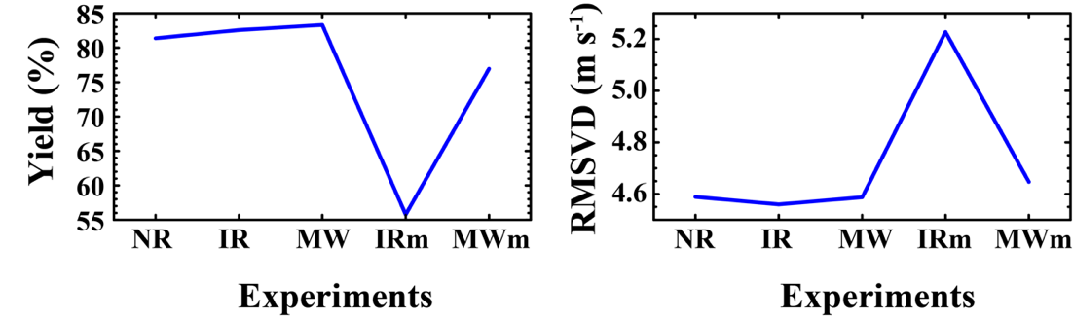
AMVs from IR vs MW Sounders
Posselt et al. (2019, JAMC)
Nature run winds and water vapor = reference
Blur nature run water vapor using MW and IR vertical weighting functions
Produce AMVs by tracking sequences of
blurred nature run water vapor images
Compare with nature run winds
Examine yield and RMSVD
Geostationary Microwave
Lambrigtsen et al. (2018; IEEE)

Slide 5
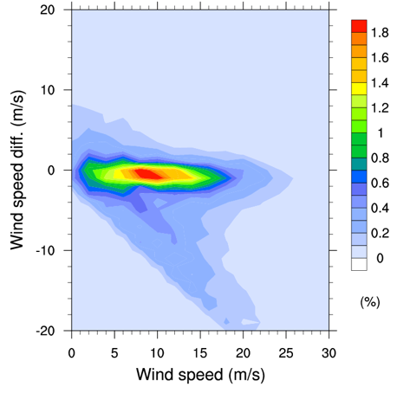
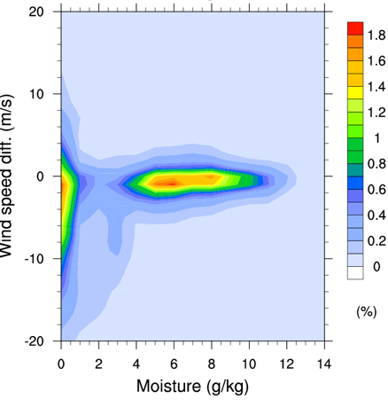
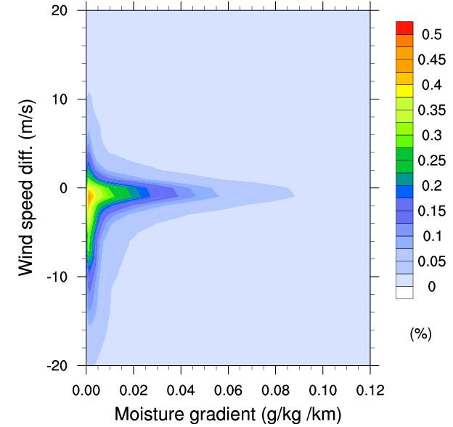
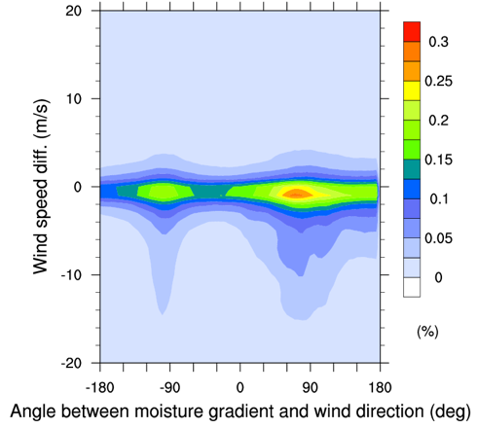
State Dependent AMV Errors
Posselt et al. (2019, JAMC); Teixeira et al. (2020, AMT)
Retrieval errors are generally within ±2 m/s.
Large errors: low moisture content or wind direction perpendicular to moisture gradient
Have developed an error emulator to apply these uncertainties to forecast OSSEs
(Teixeira et al. 2020; AMT)
Angle Between
Wind Direction & Vapor Gradient
Wind Speed
Vapor Content
Vapor Gradient
Y-axis: Difference between retrieved AMV wind speed and nature run.
Notes:
These plots show the wind speed error, as measured by the difference between winds in the nature run, and retrieved winds, as a function of (from left to right): wind speed, water vapor content, water vapor gradient, and angle between vapor gradient and (true) wind.
The results show that there is a low bias in the retrieved winds, reflecting the inability to retrieve winds where the gradient is weak or perpendicular to the flow. Errors are largest at low water vapor contents, small gradients, and for flows perpendicular to water vapor gradient.

Slide 6
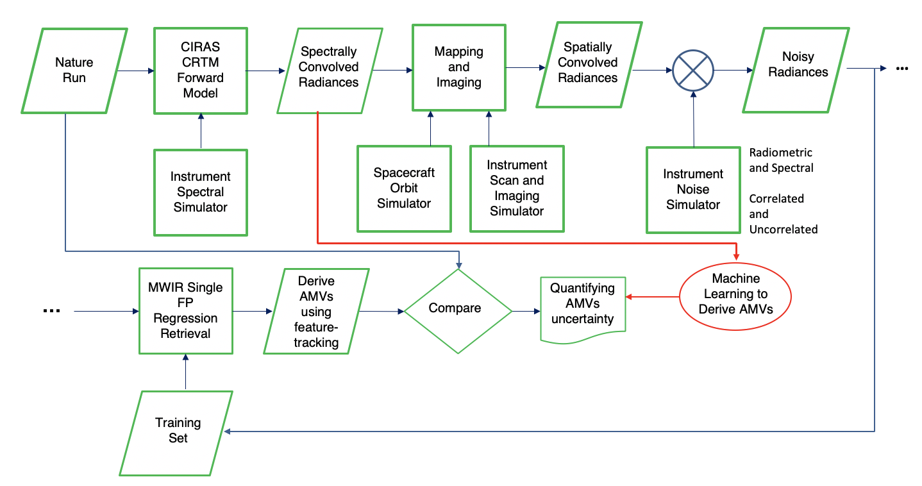
IR Sounder Constellation (CIRAS)
End-to-End Observing System Simulation Framework
(Tom Pagano, Chris Wilson, Hai Nguyen, Trinh Vo, Longtao Wu, Hui Su)
Previous results tracked synthetic water vapor
  Simplified treatment of retrieval error
  Does not track radiances
New research: end-to-end observing system simulation framework
  Forward simulate hyperspectral radiances
  Retrieve temperature and water vapor profiles
CIRAS 3D AMV Flow Chart

Slide 7
IR Sounder Constellation (CIRAS)
End-to-End Observing System Simulation Framework
(Tom Pagano, Chris Wilson, Hai Nguyen, Trinh Vo, Longtao Wu, Hui Su)
Previous results tracked synthetic water vapor
  Simplified treatment of retrieval error
  Does not track radiances
New research: end-to-end observing system simulation framework
  Forward simulate hyperspectral radiances
  Retrieve temperature and water vapor profiles
  Track retrieved water vapor
  Compare AMVs vs. nature run
CIRAS 3D AMV Flow Chart

Slide 8
IR Sounder Constellation (CIRAS)
End-to-End Observing System Simulation Framework
(Tom Pagano, Chris Wilson, Hai Nguyen, Trinh Vo, Longtao Wu, Hui Su)
Previous results tracked synthetic water vapor
  Simplified treatment of retrieval error
  Does not track radiances
New research: end-to-end observing system simulation framework
  Forward simulate hyperspectral radiances
  Retrieve temperature and water vapor profiles
  Track radiances using ML
  Compare AMVs vs. nature run
CIRAS 3D AMV Flow Chart

Slide 9
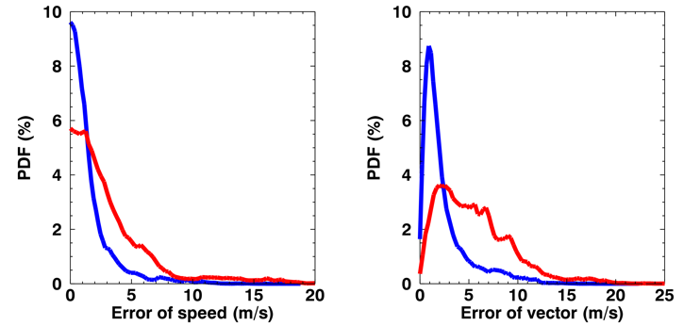
Cubesat IR Atmospheric Sounder (CIRAS) AMV Retrieval Using Water Vapor Feature Tracking
(Tom Pagano, Chris Wilson, Hai Nguyen, Trinh Vo, Longtao Wu, Hui Su)
CIRAS retrieved water vapor feature tracking
  wind speed RMSE ~5.5 m/s
  wind vector RMSE ~ 8.5 m/s
Additional QC and/or advanced tracking algorithms would provide smaller errors
 | Wind speed RMSE | Wind vector RMSE
CIRAS Retrieval | 5.48 | 8.52
CIRAS Retrieval Qv > 6 g/kg | 4.80 | 6.81
Nature run AMVs
CIRAS AMVs
Peak density < 2 m/s
Peak density ~3 m/s
AMV measurements w/in ~5 m/s of the background made positive impacts on NWP.

Slide 10
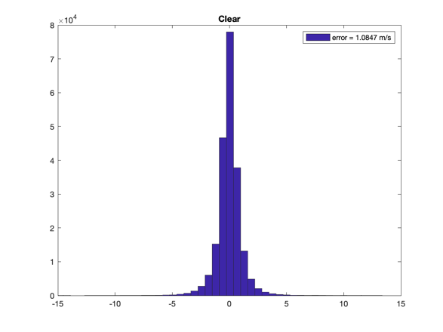
AMV Retrieval from Radiances
Using Convolutional Neural Network
(Tom Pagano, Chris Wilson, Hai Nguyen, Trinh Vo, Longtao Wu, Hui Su)
Alternate retrieval of winds: direct use of hyperspectral radiances to produce feature tracked winds
  Add noise to synthetic radiances
  De-noise and dimension reduce using PCA
  Train a CNN using radiance PCs and nature run winds
  Loss function is the mean squared error on wind speed (u and v)
Test and train on a single case: RMSE is ~ 1 m/s
RMSE=1.08 m/s
Frequency
-15
-10
-5
0
5
10
15
900 hPa Clear-Air Wind Error

Slide 11
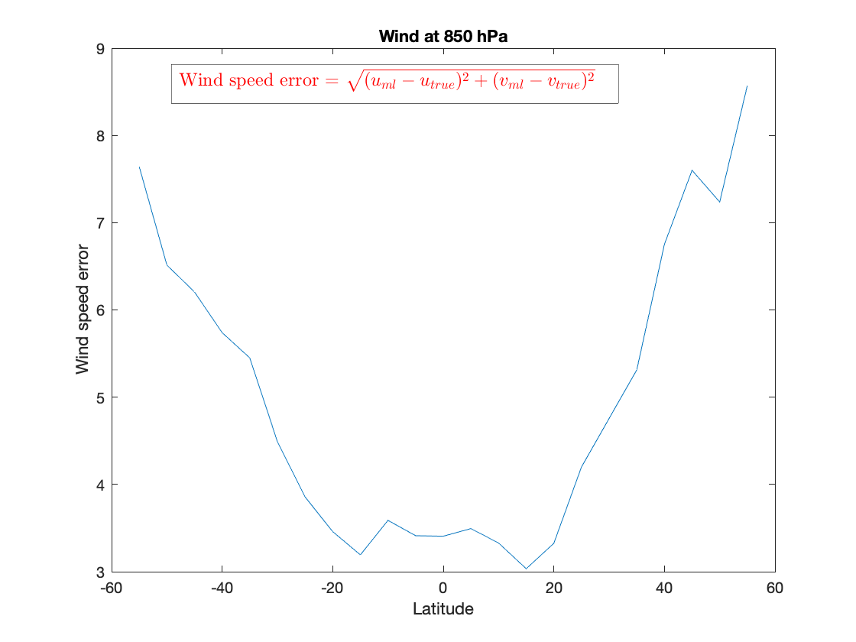
AMV Retrieval from Radiances
Using Convolutional Neural Network
(Tom Pagano, Chris Wilson, Hai Nguyen, Trinh Vo, Longtao Wu, Hui Su)
Alternate retrieval of winds: direct use of hyperspectral radiances to produce feature tracked winds
  Add noise to synthetic radiances
  De-noise and dimension reduce using PCA
  Train a CNN using radiance PCs and nature run winds
  Loss function is the mean squared error on wind speed (u and v)
Test and train on global data: RMSE is ~5 m/s (~3 m/s tropics)
Global Wind at 850 hPa
9
8
7
Wind Speed Error (m/s)
6
5
4
3
-60
-40
-20
0
20
40
60
Latitude
850 hPa Clear-Air Wind RMSE

Slide 12
Forecast OSSEs with GMAO System
(Will McCarty, Longtao Wu, Masashi Minamide, Hai Nguyen, Joaquim Teixeira)
Conducted a forecast OSSE to assess impact of AMVs from
  Constellation of IR sounders on small sats (W. McCarty)
  Geostationary microwave sounder (single s/c at 90 deg. W; 5000 km FOV)
Leo IR Sounders
Geo MW Sounder, Global Impact
Geo MW Sounder, Regional Impact

Slide 13
AMV Pros/Cons and Complementarity
  Lidar: (+) high vertical resolution, no height assignment error,
  no reliance on a tracking algorithm
  (-) requires long averaging length, only available on a narrow track,
  line of sight (single wind component) not available under clouds
  AMVs: Diverse, flexible (GEO, LEO, small-sat convoy), potentially low cost.
  Geo offers high temporal resolution, high impact for hazardous weather
  Vis/IR Cloud AMVs:
  (+) ubiquitous, proven, reliable
  (-) height assignment error
  IR vapor AMVs:
  (+) higher vertical resolution than MW, includes T,q_{v} soundings
  (-) not available under clouds (clear-air only)
  MW vapor AMVs:
  (+) available in and under clouds (all-weather), includes T,q_{v} soundings
  (-) lower vertical resolution than lidar and IR

