Slide 1
Current activity for future Space-Based Doppler Wind Lidar in Japan
Working Group Meeting on Space‐based Lidar Winds 2020
(17 November 2020, Virtual Meeting)
S. Ishii¹, K. Okamoto², K. Fujihira³, A. Matsumoto⁴,
T. Kubota³, T. Imai³, D. Sakaizawa³, S. Imamura³, N. Tomii³,
I. Okabe² , S. Yamanaka¹, R. Oki³, M. Satoh ⁵, and T. Iwasaki⁶
¹TMU, ²JMA/MRI, ³JAXA, ⁴ANA HOLDINGS INC.,
⁵AORI, University of Tokyo, ⁶Tohoku University

Slide 2
Outline
Future space-based LiDAR in Japan
Background
Feasibility study on future space-based Coherent Doppler Wind LiDAR
Milestone to next step
Summary

Slide 3
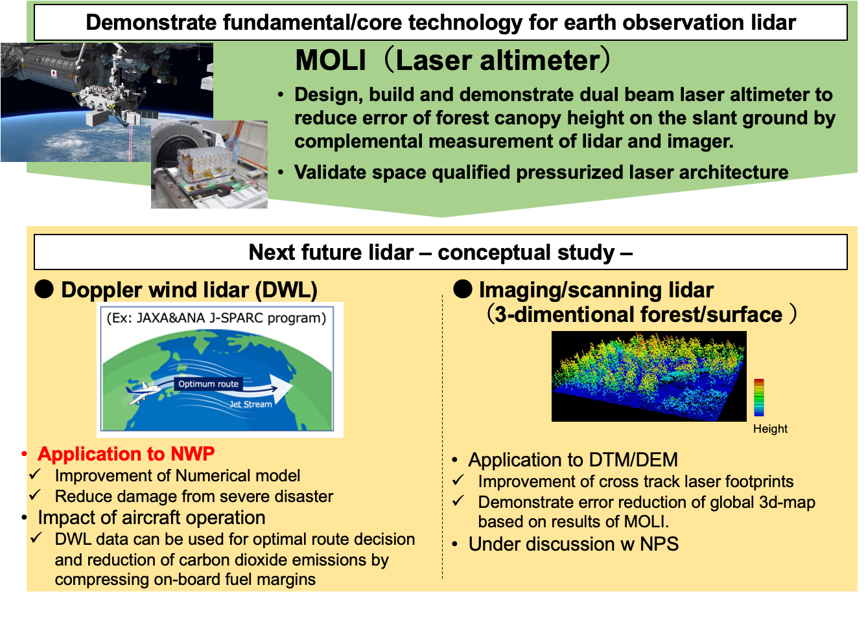
Future space-based LiDAR in Japan
( International collaboration? )

Slide 4
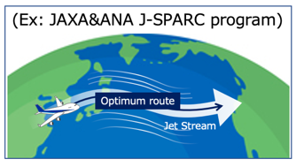
Background
Space-based DWL Wind observation improves the accuracy of numerical forecasts
The flight plan is based on predicted 3D wind speed data to calculate the optimal flight path and altitude.
Transmitting wind information to an airplane in flight is expected to improve fuel efficiency.
It is expected to contribute to economic benefits by improving fuel efficiency and CO₂ reduction.
Space-based DWL
©JAXA
Collecting 3D wind speed data at any time
http://www.cao.go.jp/minister/1708_m_matsuyama/photo/2017-028.html

Slide 5
Objective
Objectives of future space-based DWL observation are to contribute to various issues:
Improvement of prediction accuracy (NWP),
Through deeper understanding of convection – atmospheric dynamics interaction,
Improvements of cloud structure scheme and water cycle
Improvements of reanalysis data sets and discrepancy between the various reanalysis data sets
Formation and dissipation of typhoon (location, intensity, size)
Improvement of atmospheric transport model (aerosols. radioactive materials, air pollutant, dust) and radiation budget
Validation and accuracy improvement of AMV
Space-based Doppler Wind Lidar is attractive for global wind profiling observation.

Slide 6
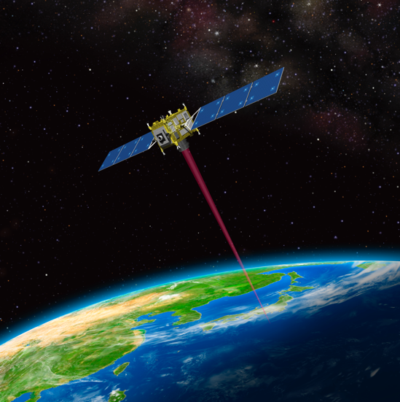
Concept of future space-based Coherent Doppler Wind Lidar (2020)
 | Space-based CDWL
Orbital altitude Orbit | <300 km / Polar
Transmitter | Plan 1：1.5-µm, >70 mJ, 150 Hz Plan 2：2.-µm, 90 mJ, 30 HzX2
Receiver | 0.4 - 0.6 m / 1 look
Target horizontal resolution | <100 km
Target vertical resolution | Altitude 0-2 km: 0.5 km Altitude 2-12 km: 1 km Altitude 12-20 km: 2 km
Nadir angle | 35 degree
Looking angle | 90 degree
Target horizontal wind speed | -150 ~ 150 m/sec
©JAXA
A candidate launch vehicle is “Epsilon rocket” developed by JAXA.
Requirement of wind measurement
Altitude (km) | Vertical resolution (km) | Wind speed error (m/s)
12-20 | 2 | <4
2-12 | 1 | <1
0-2 | 0.5 | <1

Slide 7
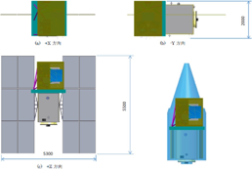
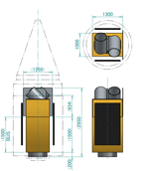
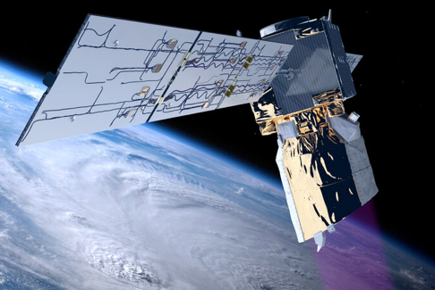
Feasibility study on future space-based Doppler Wind Lidar (2019)
 | Aeolus | Plan 1 | Plan 2
Orbital altitude (km) | 320 | 300 | 35
Wavelength (µm) | 0.355 | 1.55 | 2.05
Target | Molecular and Aerosol | Aerosol and Cloud
Weight (kg) | 500 | 335 | 430
Mission size (m³) | 4.6 x 1.9 x 2.0 | 1.8×1.8×2.0 | 1.4×1.5×1.7
Telescope diameter (m) | 1.5 | 0.58 (2 looks) | 0.6 (2 looks)
Pulse energy (mJ) | 65 | 50 | 90
PRF* (Hz) | 50 | 150 | 30×2
Power required for mission (W) | 840 | 1070 | 563
Cooling system |  | None | -55℃
* PRF: Pulse Repetition Frequency
Plan 1
Plan 2

Slide 8
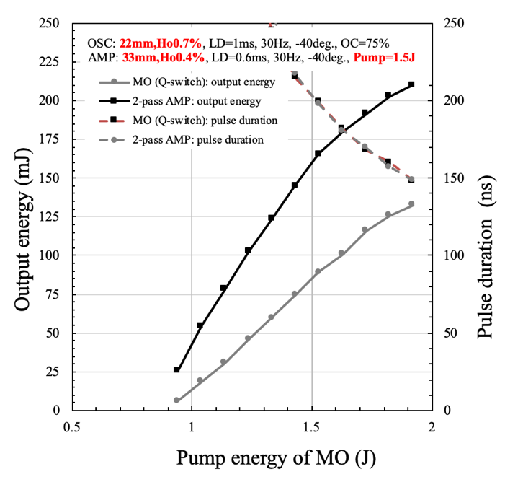
Characteristics of single-longitudinal high pulse-energy conductively-cooled 2-µm laser for space-based DWL developed at NICT
 | Single pulse system | Double pulse system
Power | ○ 3.81 W | ○ 4.80 W
Pulse energy | 〇 127 mJ | 〇 160 (80×2) mJ
PRF ※ | ○ 30 Hz | ○ 30 Hz
Pulse width | ○ 130 ns | ○ 205 ns
Wavelength | ○ 2051.250 nm | ○ 2051.250 nm
M^{2 ※※} | ○ < 1.2 | ○ < 1.2
Wall-Plug efficiency | ○ 1.6 % | ○ 2.0%
Temperature (Laser medium) | ○ -38℃ | ○ -38℃
Power consumption (Sensor) | 300 W = 240 W (laser) + 60 W (Other things) | 300 W = 240 W (laser) + 60 W (Other things)
FOM※※※ | 0.06 | 0.07
Remarks | Size: 0.8×0.6×0.2m Telescope: φ40cm | Size: 0.8×0.6×0.2m Telescope: φ44cm
※ PRF: Pulse repetition frequency
※※ M²: Beam propagation factor (perfect Gaussian Beam with M² =1)
※ ※ ※: FOM = Pulse energy × PRF × Telescope Area

Slide 9
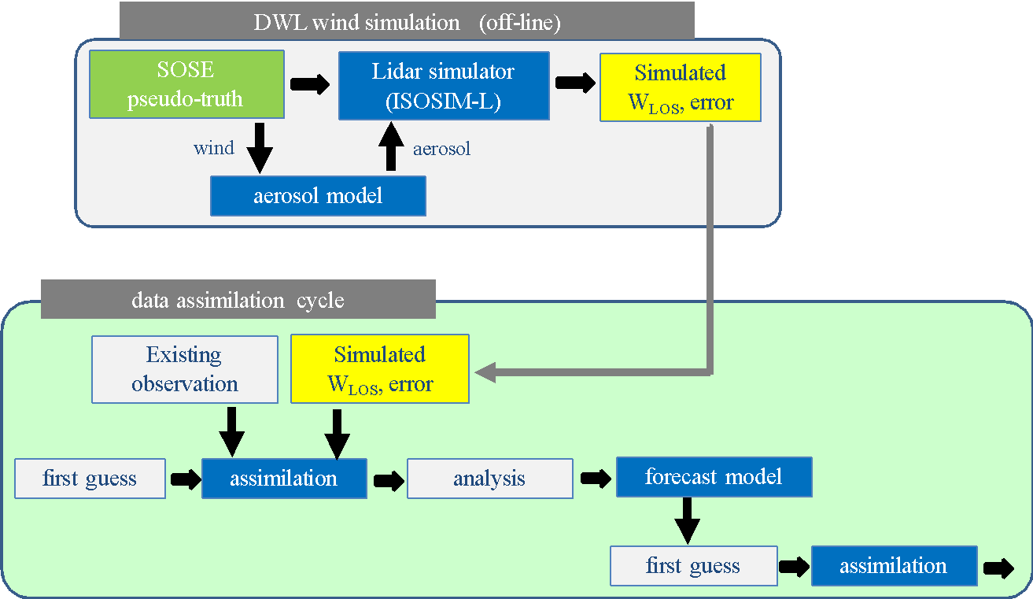
Observing System Simulation Experiment (OSSE)
Sensitivity Observing System Experiment (Marseille et al. 2008)
Pseudo-truth (PT) field is created by correcting first-guess based on adjoint sensitivity and assimilating real observations
PT field is consistent with obs and reduces forecast-errors
Simulation of existing observations is not necessary, unlike Nature-Run OSSE
Okamoto et al. (2018)
Hourly aerosol field generated with global aerosol model (MASINGAR) constrained by PT winds

Slide 10
Performance simulation for future space-based CDWL
Simulated atmospheric data (SOSE)
January and August 2018 , 00Z , 06Z , 12Z , 18Z
P, U, V
Aerosol model
40 layers, 0.6deg (640 pts) x 0.6deg gird
Composition: sulfate, sea salt, dust, carbon, organic aerosol
Backscattering coefficients calculated using Mie theory
Cloud model
100 layers, 0.6deg (640 pts) x 0.6deg gird
Type: cumulous cloud, stratus cloud
Cloud coverage, Cloud Water Content
Orbit / Altitude
Sun-synchronous LEO orbits at an altitude of about 300 km and polar inclination.
Output
1 shot data： time, Altitude, Latitude, Longitude, LOS wind speed, wind error, Power, SNR
6.4- and 12.8-sec averaged data: time. Altitude, Latitude, Longitude, LOS wind speed, wind error, SNR
Altitude (km) : -0.5, 0.1, 0.5, 1, 1.5, 2, 3, 4, 5, 6, 7, 8, 9, 10, 11, 12, 14, 16, 18, 20
7.73 km/s
Φ=35°
Satellite ground track
200−300 km
θ=90°
36.4°
147-221 km
Laser foot-print track

Slide 11
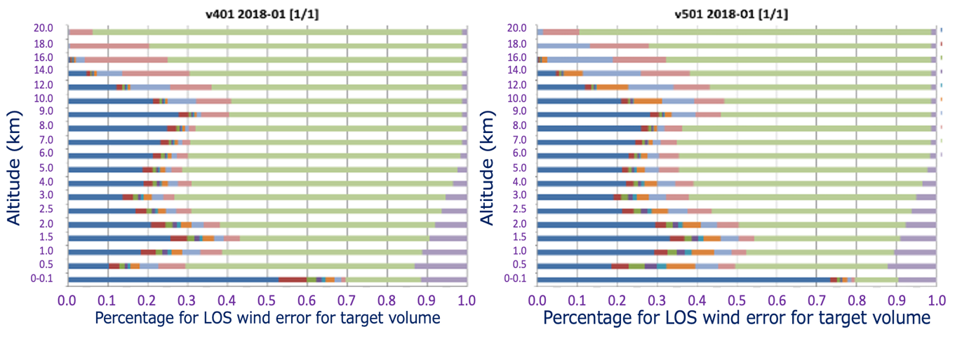
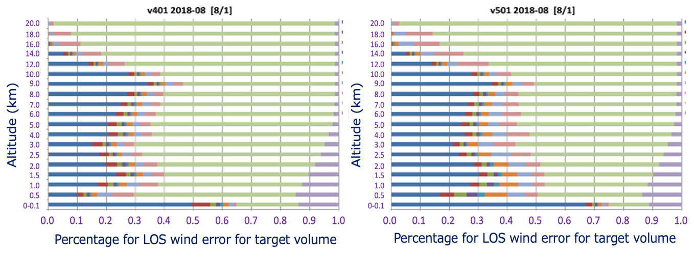
Percentage performance profile
2-µm DWL（January 2018）
1.5-µm DWL（January 2018）
19.
2-µm DWL（August 2018）
1.5-µm DWL（August 2018）

Slide 12
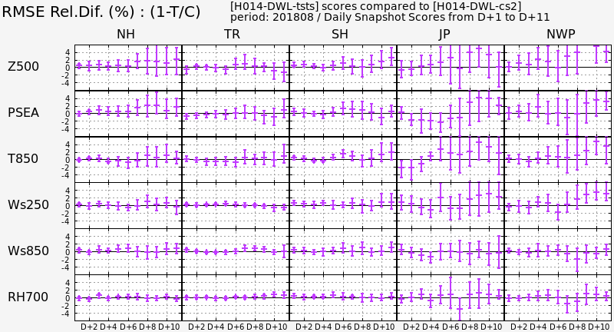
Preliminary results of OSSE with DWL data: August 2018
Data: DWL pseudo data provided by DWL simulator (Baron et al. 2017, Ishii et al. 2017, JMSJ)
Experiment Configuration:
CNTL experiment is equivalent to JMA’s global spectral model (GSM) as of 2018.
TEST experiment is as same as CNTL excepting DWL data assimilated.
Quality control (QC) method: ref. Okamoto et al. (2018, JMSJ)
Term: one month in both summer (Aug. 2018) and winter (Jan. 2018).
Degrade
Forecast hours (240h)
Improve

Slide 13
Milestone to Next Step
 | FY 2019 | FY 2020 (Feasibility study) |  |  |  | FY 2021
Lidar Team
Science Team
JAXA ANA
Discussions of feasible DWL system
OSSE
Review of science requirements
Advanced mission program
Preparation of Documents
Proposal for mission
Discussions and review on co-creation for space business
Review of OSSE results
① Review of mission requirements
② Review of OSSE results

Slide 14
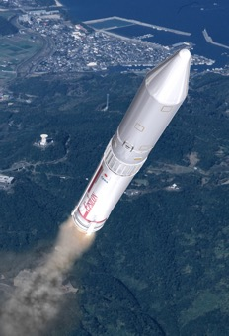
Summary
We implemented the feasibility study on the future space-based CDWL in 2019 and updated its attributions. We conduct the further feasibility study in 2020.
The satellite system is based on the design of an advanced super low altitude satellite (less than an altitude of 300 km), and the future space-based CDWL is under investigation.
We are investigating a 1 LOS dawn-dusk orbit DWL in super low altitude satellite.
Candidate laser system: 1.5-µm / 2-µm
JAXA and ANA Holdings discuss on co-creation for new space business.
Future plan
Assessment of results obtained by OSSE experiments
Review of technical mission requirements
Review of scientific and other user requirements
Preparation for Mission Definition Review

