Slide 1
Aeolus, ESA’s wind mission Status and future outlook Tommaso Parrinello on behalf of the Aeolus Team
NOAA-NASA Working Group
on Space-based Lidar Winds
17-19 November 2020

Slide 2
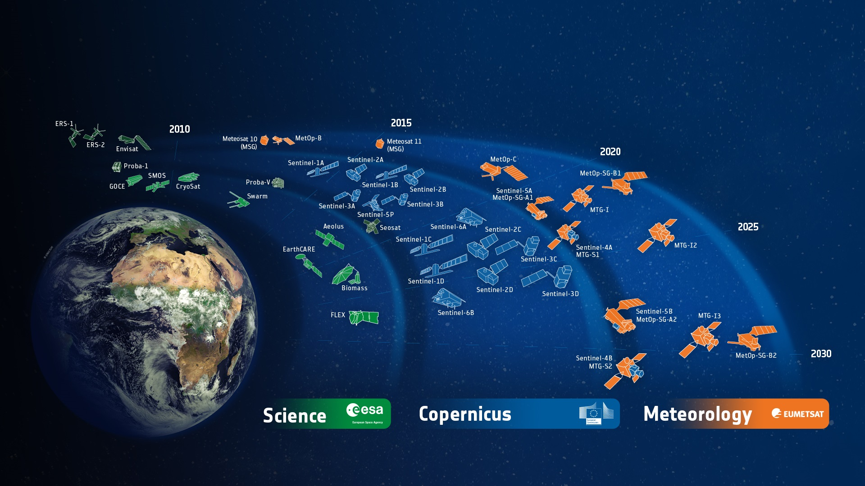
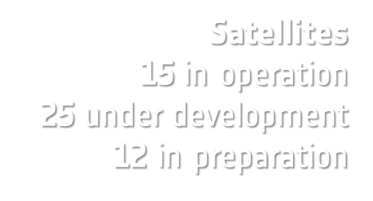
A successful Track-Record
ESA-Developed Earth Observation Missions
ESA UNCLASSIFIED – For Official Use
European Space Agency
Notes:
D/EOP has three main lines of activities: Earth Science, Copernicus and Meteorology
Since the latest launch of Aeolus on 22 Aug. 2017, we have 25 satellites in development and 15 satellites in operation.

Slide 3
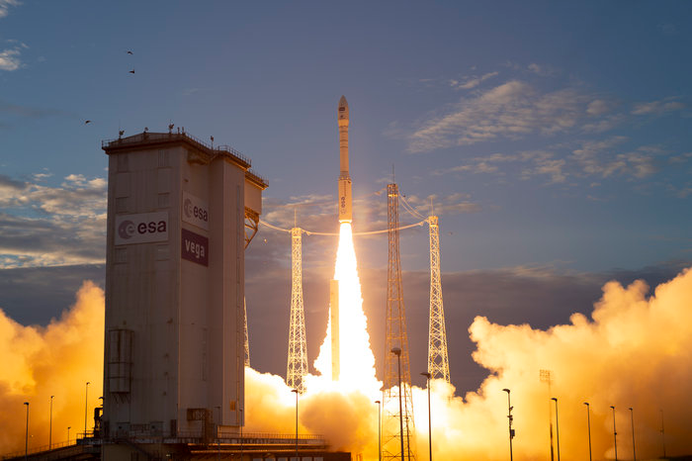
Aeolus, European Space Agency’s Wind Mission
Launched: 22 August 2018, Kourou
Launcher: Vega
Main Payload: ALADIN - DWL @355 nm
Orbit: Altitude of 320 km, inclination of 97, sun-synchronous, Dawn-Dusk, 7d repeat cycle
Mission Control: ESA/ESOC (DE)
Ground Station: Kiruna (SWE), Svalbard (NOR) and Troll (Antarctica)
Data Processing: Tromsø, (NOR), ECMWF (Reading, UK), ESA/ESRIN (IT)
Mission Management: ESA/ESRIN (ITA)
Mission Life: 3 years

Slide 4
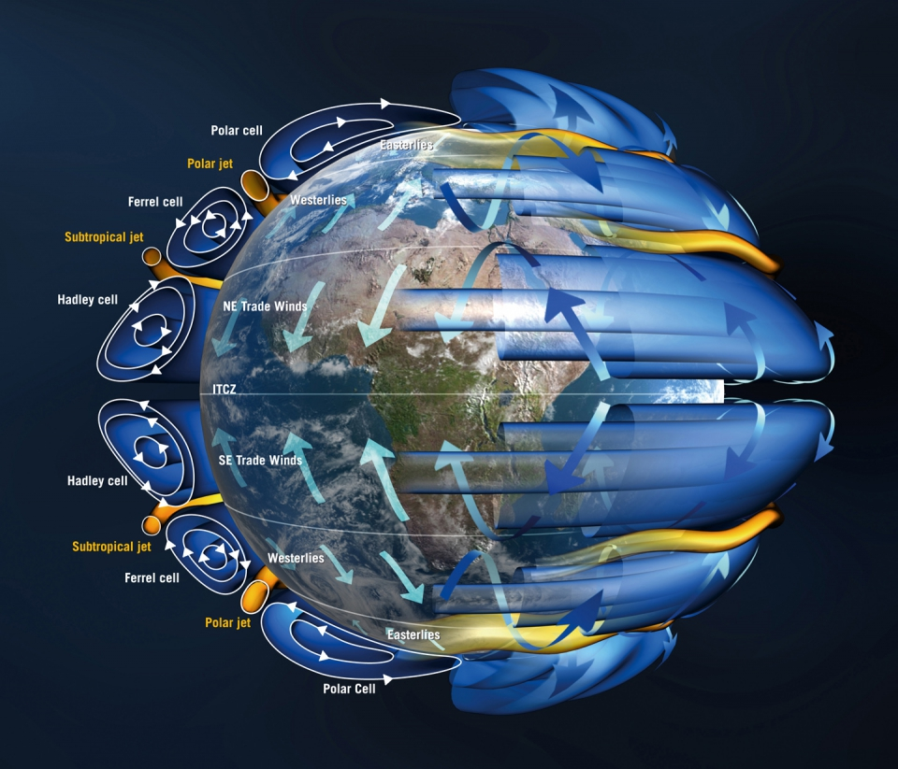
AEOLUS MISSION OBJECTIVES
Scientific Objectives
To improve the quality of weather forecasts by providing global measurements of horizontal wind profiles in the troposphere and lower stratosphere
To advance our understanding of atmospheric dynamics and climate processes
Long-term goal
Demonstrate space-based Doppler Wind LIDARs capability for operational use

Slide 5
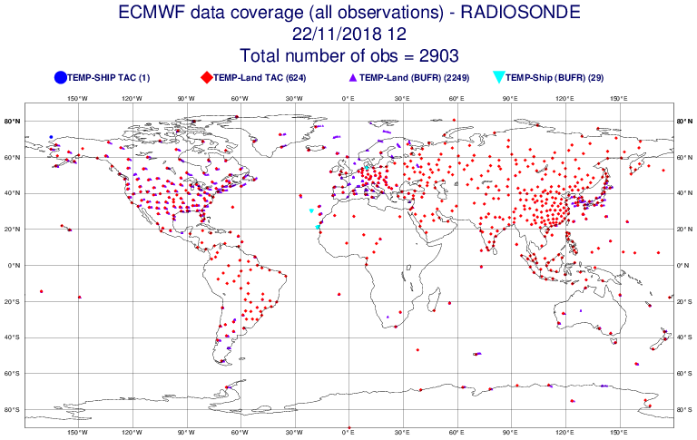
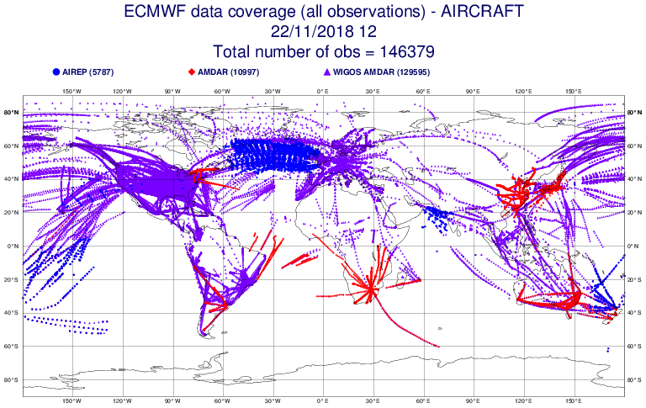
Aeolus, European Space Agency’s Wind Mission
Motivation
Wind observations are scarce in the present Global Observation Systems which limit our ability to predict weather especially in the tropics where atmospheric motions on all scales are dominated by the wind field …. …and expect to obtain information on aerosol and cloud properties
(Aeolus Science Report)
Example of Direct wind observations in the GOS: radiosondes, surface (conventional, scatterometers), airplanes, AMVs
Notes:
Motivation: lack of winds in the GOS
Direct wind observations in the GOS:
radiosondes, surface (conventional, scatterometers), aireps, AMVs
Aeolus observations per day:
~0.2% of the 40 million
but significant forecast improvement still expected and seen

Slide 6
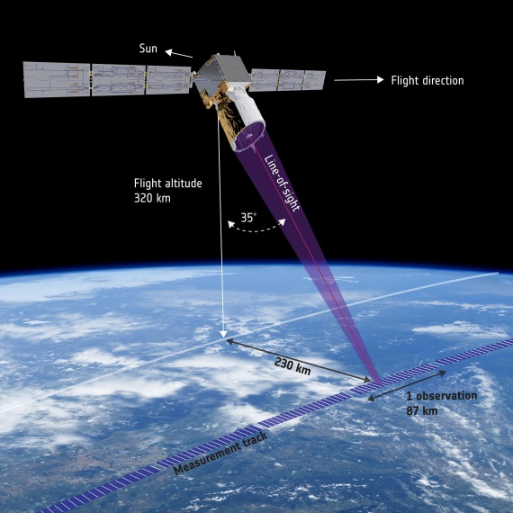
MEASUREMENT PRINCIPLE
The line-of-sight (LOS) points 35º from nadir to capture profiles of single component horizontal wind (LOS wind is projected to HLOS)
Direct detection UV Doppler Wind Lidar (355 nm) on two receiver channels: Rayleigh to determine winds from molecular backscatter and Mie to determine winds from aerosol & cloud backscatter
Weekly calibration to monitor instrument drifts and ground returns for attitude correction are used for instrument calibration (bias correction).
Vertical wind resolution: 24 vertical bins per channel, 250m-2km
Horizontal wind resolution: 87 km for Rayleigh, 10 km for Mie
Notes:
Direct detection UV Doppler Wind Lidar (355 nm) on Two receiver channels: Mie receiver to determine winds from aerosol & cloud backscatter (Fizeau) & Rayleigh receiver to determine winds from molecular backscatter (Double edge Fabry-Perrot)
Horizontal resolution: Horizontal wind resolution (87 km for Rayleigh, 10 km for Mie). Can be optimised. L2A is currenrly given at 87 km
24 vertical bins per channel (old technology, much better resolution can be achieved now!)
Vertical sampling: 250m – 2 km, steps of ≥250m
Sampling optimized to climate zone (max 8 times per orbit)

Slide 7
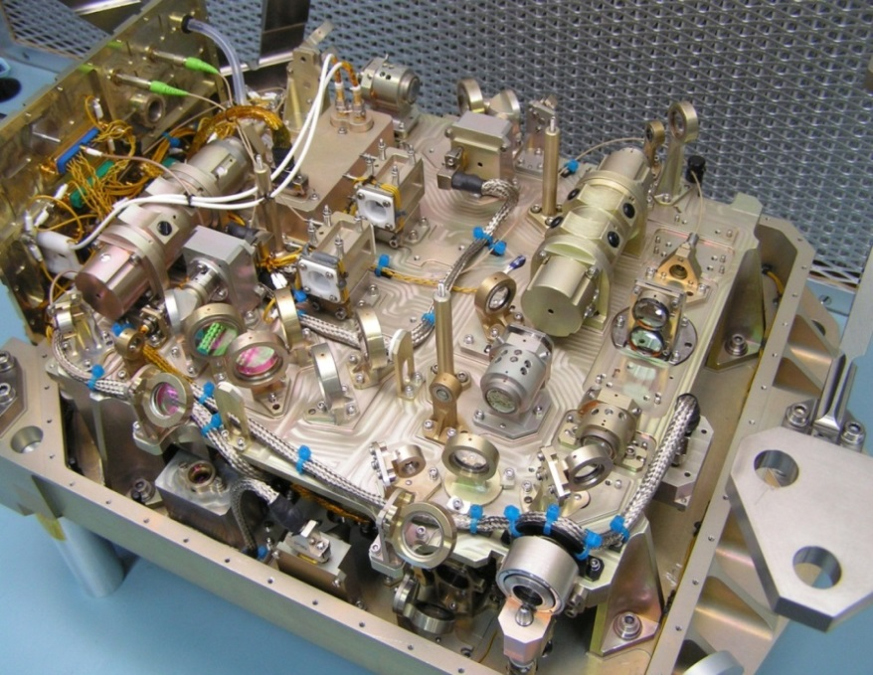
ALADIN: A TECHNOLOGICAL CHALLANGE
One of the most sophisticated instruments ever to be put in orbit
High-power ultraviolet (UV) laser transmitter containing ~80 optical functions and different wavelength conversion
Extreme backscatter sensitivity via 1.5m telescope, 80 microns field stop and etalon spectrometers
Doppler Wind Lidar principle
𝚫f = 2*f_{o}*V_{LOS}/C
V_{LOS}=1 m/s
𝚫f = 5.64 MHz - 𝚫f /f_{o} = 6.7 10⁻⁹
𝚫λ= 2.4 10⁻¹⁵ m (H⁺ ≈ 1.7 10⁻¹⁵ m)

Slide 8
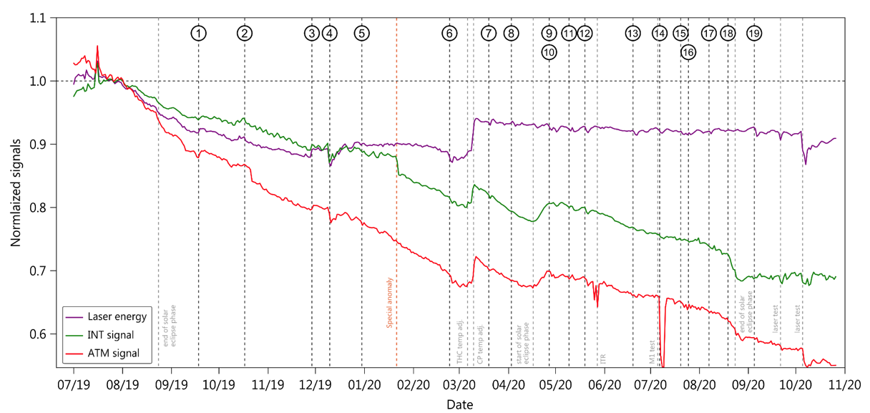
SPACE SEGMENT
The performance of the mission is very good
It is performing well and any sign of degradation, including consumables and life limiting elements, are within the specifications. Special operations tasks exceed any explorer missions
FM-B continues to perform well in terms of UV output energy (i.e. around 61mJ) and stable since March 2020.
The most critical problem remains the decrease of the return signal. Very close to FM-A swap but less impact on data quality
Investigations with ESA, industry and external expert teams are taking place incessantly. An overall roadmap to recapture the energy has has been defined and it constantly and dynamically amended
The fully recovery is probably not realistic but different solutions and mitigations actions are taking place (e.g. M1 thermal optimisation) including also options like returning to FM-A and/or to lower the orbit.
Output UV Energy
Mission extended to end of 2022
INT Signal
ATM Signal
Courtesy O. Lux (DISC)
Notes:
MENTION the sensitivity of the return energy to thermal environment in particular to the eclipse season
LID---> Laser Induced Damage (in the optics)
LIC-→ Laser Induced Contamination (in the optics)
The option to return to FM-A is based on the idea that the laser beam drift might be linked to the FM-B transmitter (rigid body motion) or loss of alignment. This behavior was not present in FM-A where the decrease of energy followed exactly the same loss of output energy.

Slide 9
GROUND SEGMENT
Constantly monitoring, improving and managing the Aeolus data acquisition, production, reprocessing and distribution to user community (e.g. ~98.0% L2B products are available to users in NRT)
Weekly ALADIN instrument Mission Planning operating in accordance to mission objectives, wind observation requirements, instrument maintenance and calibration activities like the recent IRONIC
VirES for Aeolus (interactive data visualization and retrieval platform) https://aeolus.services/ now allows self-registration for public users. Roadmap for future evolution into a Virtual Collaborative Environment is under implementation
Svalbard Station

Slide 10
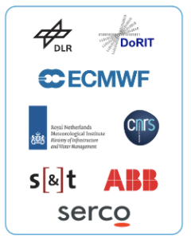
QUALITY AND DATA EVOLUTION
Constant monitoring and improving of Aeolus data quality (random and systematic errors) allowing for quick reaction to performance issues.
Random errors are not improving because primarily affected by reduced return atmospheric signal and lower UV emitted energy. Biases have improved significantly
Adopting rapid six-month major update cycles of ground processors, allowing swift adaption to lessons learnt and operational/scientific needs, has been successful.
The reprocessing strategy is quite stable but always open to feedback
New evolution are taking into consideration the outcome of the ongoing investigations, reprocessing strategy and synergies with other Mission (e.g. ATLID EarthCARE algorithms for L2A Aeolus products)
Mission Requirements
April - June 2020

Slide 11
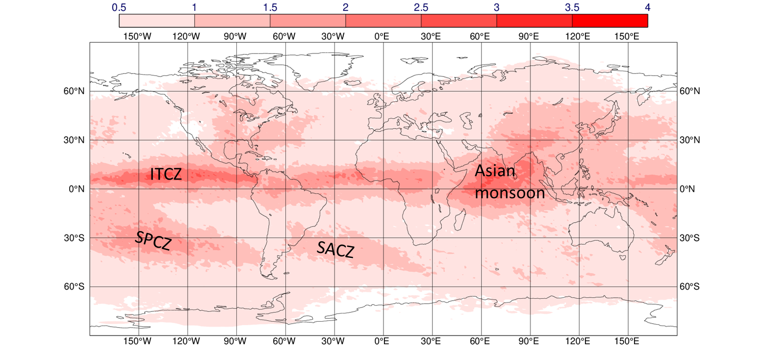
SCIENCE
ECMWF, DWD and Météo-France assimilating Aeolus data. UK MetOffice by end of 2020. NCMRW by Feb. 2021
Impact of Aeolus on NWP and on other scientific exploitation (i.e. aerosol, gravity waves, hurricane tracking, atmosphere dynamics) confirmed at the recent Aeolus Cal/val & Science Workshop
Aeolus+ Innovation studies under negotiation
Aeolus scientific study (i.e. prediction on extreme weather events and regional model) under preparation
Aeolus optical products L2A are becoming more mature and ready to be released in spring 2021
Standard deviation of change in zonal wind analysis (m/s) at ~10 km in the ECMWF model when assimilating Aeolus Rayleigh – clear + Mie-cloudy winds from 4 April to 19 August 2020, courtesy M. Rennie ECMWF
Notes:
Indian National Centre for Medium Range Weather Forecasting (NCMRW) will by February 2021

Slide 12
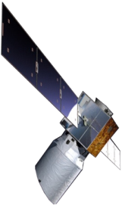
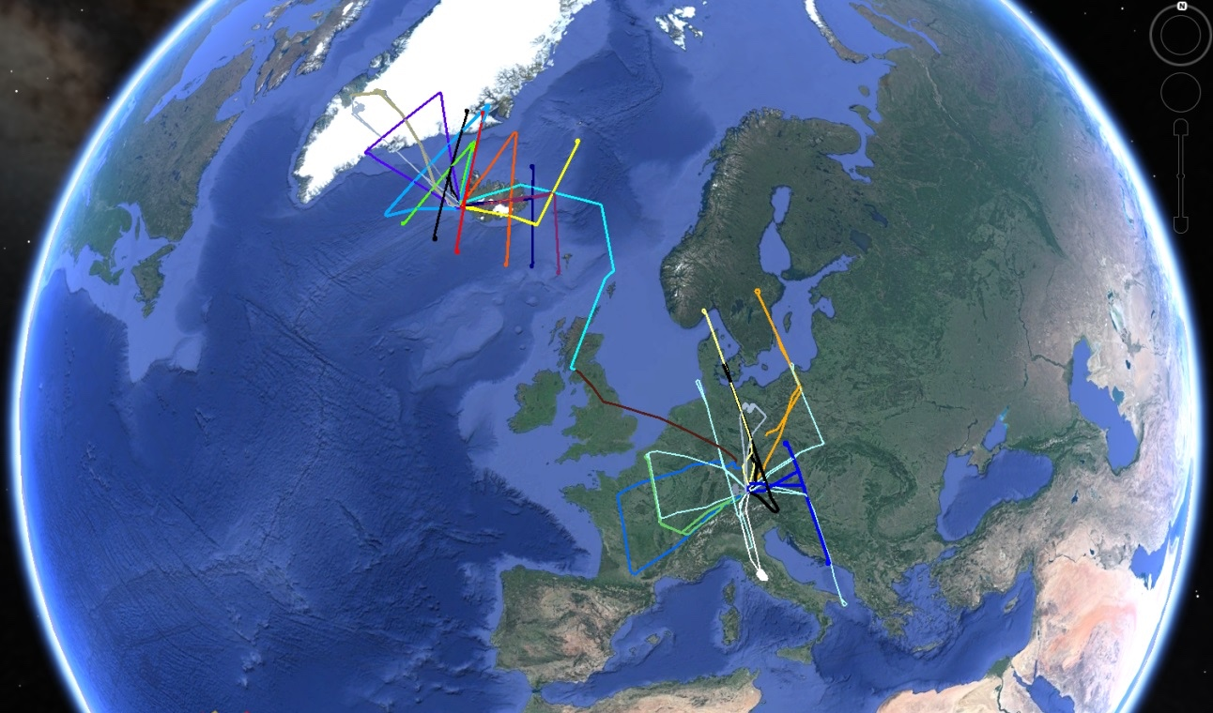
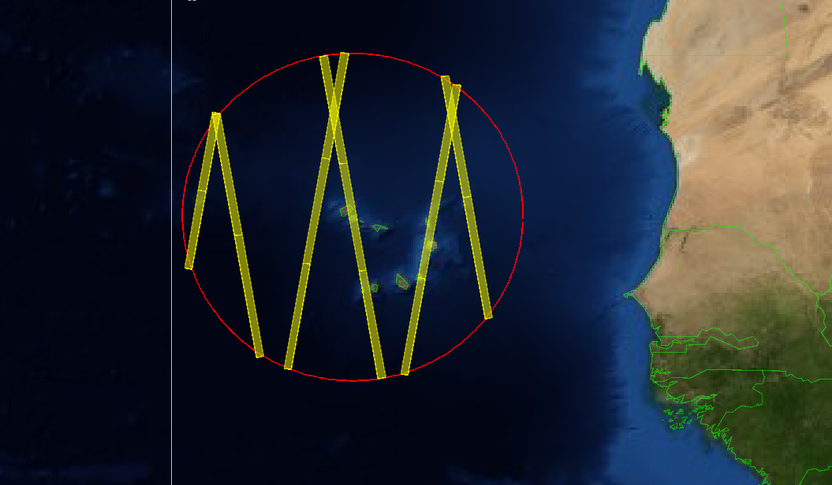
Aeolus Airborne Campaigns (2018-2021)
AEOLUS AIRBORNE CAMPAIGNS (2018-2021)
WindVal III (Central Europe, Nov 2018) Successfully completed
AVATARE (Central Europe, May 2019) Successfully completed
AVATARI (Iceland Arctic, September 2019) Successfully completed
STRATEOLE2 (Seychelles, Nov. 2019 - Feb. 2020) Successfully completed
TROPICAL (Cape Verde/Tropics, Summer 2020) Re-planned to Summer 2021 due to Covid-19

Slide 13
Mission Timeline (2020-2022+)
Signal Recovery
Fall-Winter 20/21
Major Baseline
Spring 2021
FM-B Reprocessed #2
Spring 2021
Major Baseline
Fall 2021
End nominal life-time
December 2021
Major Baseline
Spring 2022
Major Baseline
Fall 2022
End Extension
December 2022
FM-B Reprocessed #1
Fall 2020
Release L2A
Spring 2021
2.0 ANX
Spring 2021
Tropical Campaign
Summer 2021
FM-A Reprocessed #1
Fall 2021
PB-EO ME
Spring 2022
Full Reprocessed
Fall 2022
CaV& Science Workshop
NWP/L2A WS
Science & CV Workshop
Science & CV Workshop
SAG#5
NWP/L2A WS
SAG #2
SAG#3
EGU 2021
SAG#4
EGU 2022
SAG#6
SAG #2
2020
2021
2022
Mission Extension Beyond 2022
OL (or FM-A)
TBC
OL (or FM-A )
TBC
PB-EO Decision
Mission Extension
September 2020
Orbit decay/FM-A on
Orbit decay/FM-A on
GO-NO for
Next steps (OL, FM-A, etc)
Spring 2021
Aeolus re-enters

Slide 14
SYNOPSIS
The overall performance of the mission is good. After the switch to FM-B, a number of critical issues remain challenging with the instrument and will drive the timeline and operations in the following months.
Aeolus has been providing global measurements of horizontal wind profiles for more than 25 months (>3B shots). Main bias variations have been corrected. Improvement of Random Error to meet Mission Requirement remains challenging
The recent workshop has confirmed the impact of Aeolus L2B winds is consistent in several global models with largest effects in the upper troposphere and lower stratosphere, in the TR and SH. Further scientific exploitation of the data is showing significant results
Several met centers are assimilating (or about to assimilate) Aeolus data into their operational forecasting systems.
The mission has been extended until end of 2022. Our main objective is to reach that target with the best possible performance and in support of the follow-on development

