Slide 1


An Assessment of the Impact of Aeolus Doppler Wind Lidar Observations for Use in Numerical Weather Prediction at ECMWF
by M. Rennie and L. Isaksen
Acknowledgements: Aeolus DISC and ESA
NOAA-NASA Working Group on Space-based Lidar Winds, 17-19 Nov 2020

Slide 2
Assessment of Aeolus winds NWP impact at ECMWF
Observing System Experiments (4 periods tested)
  Presented in earlier meetings (so not shown):
    Early FM-A (first laser): 12 September to 16 October 2018
    Late FM-A: April to June 2019
  Will present today:
    Early FM-B (second laser): 2 August to 31 December 2019
    Mid-2020 FM-B: 4 April 2020 to 20 September 2020 N.B. 10 days excluded for special operations tests
Forecast Sensitivity Observation Impact since 9 Jan 2020 (operational assimilation started at ECMWF)

Slide 3
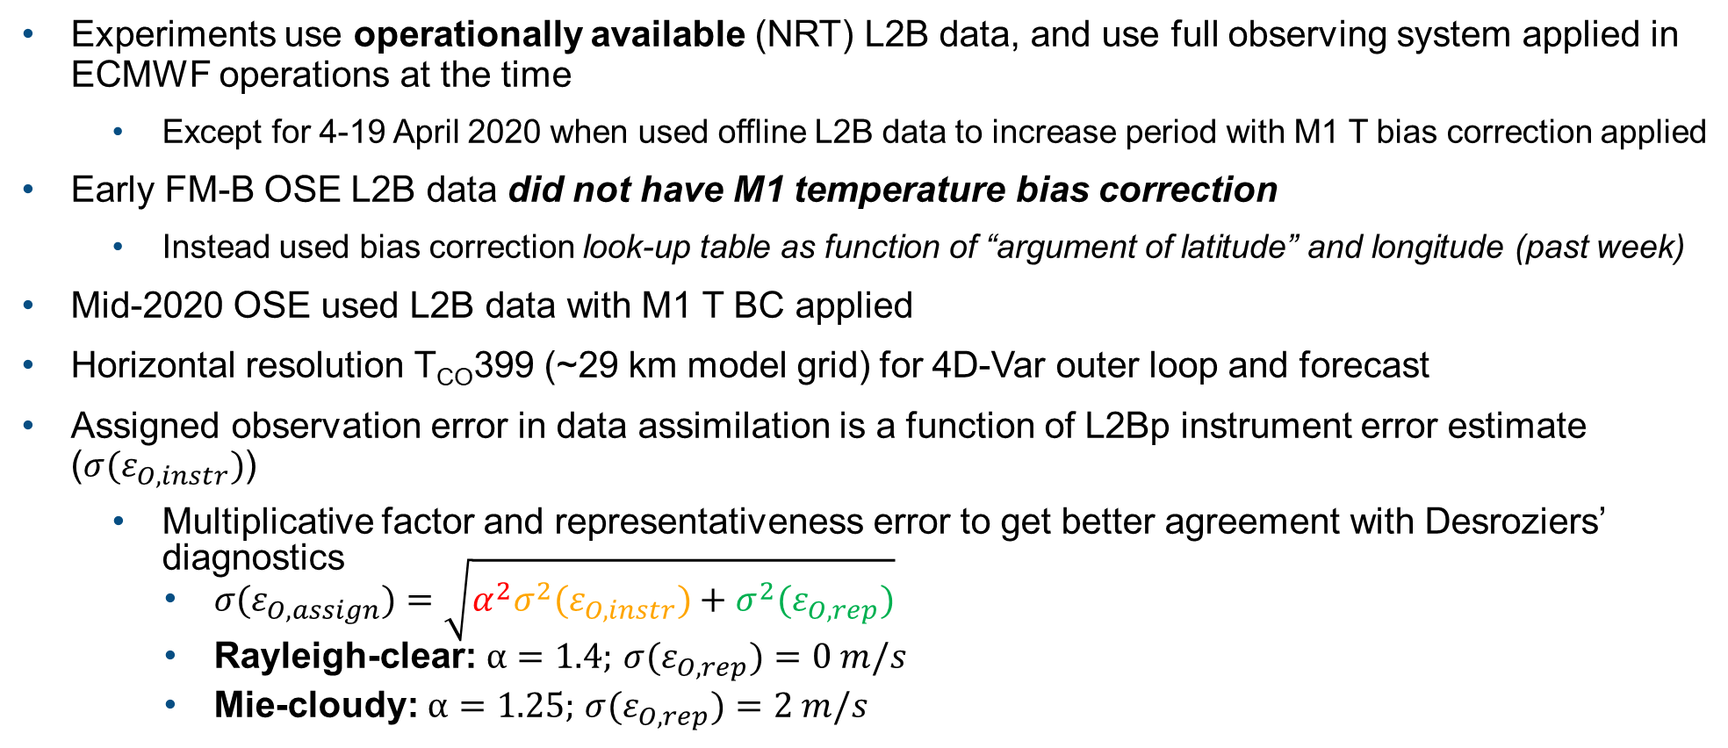
OSEs for assessing NWP impact of Aeolus
Experiments use operationally available (NRT) L2B data, and use full observing system applied in ECMWF operations at the time
  Except for 4-19 April 2020 when used offline L2B data to increase period with M1 T bias correction applied
Early FM-B OSE L2B data did not have M1 temperature bias correction
  Instead used bias correction look-up table as function of “argument of latitude” and longitude (past week)
Mid-2020 OSE used L2B data with M1 T BC applied
Horizontal resolution T_{CO}399 (~29 km model grid) for 4D-Var outer loop and forecast
Assigned observation error in data assimilation is a function of L2Bp instrument error estimate (${σ(ε}_{O,instr})$)
  Multiplicative factor and representativeness error to get better agreement with Desroziers’ diagnostics
    $σ(ε_{O,assign})=\sqrt{α^{2}σ^{2}(ε_{O,instr})+σ^{2}(ε_{O,rep})}$
    Rayleigh-clear: $α=1.4;$ ${σ(ε}_{O,rep})=0 m/s$
    Mie-cloudy: $α=1.25;$ ${σ(ε}_{O,rep})=2 m/s$

Slide 4
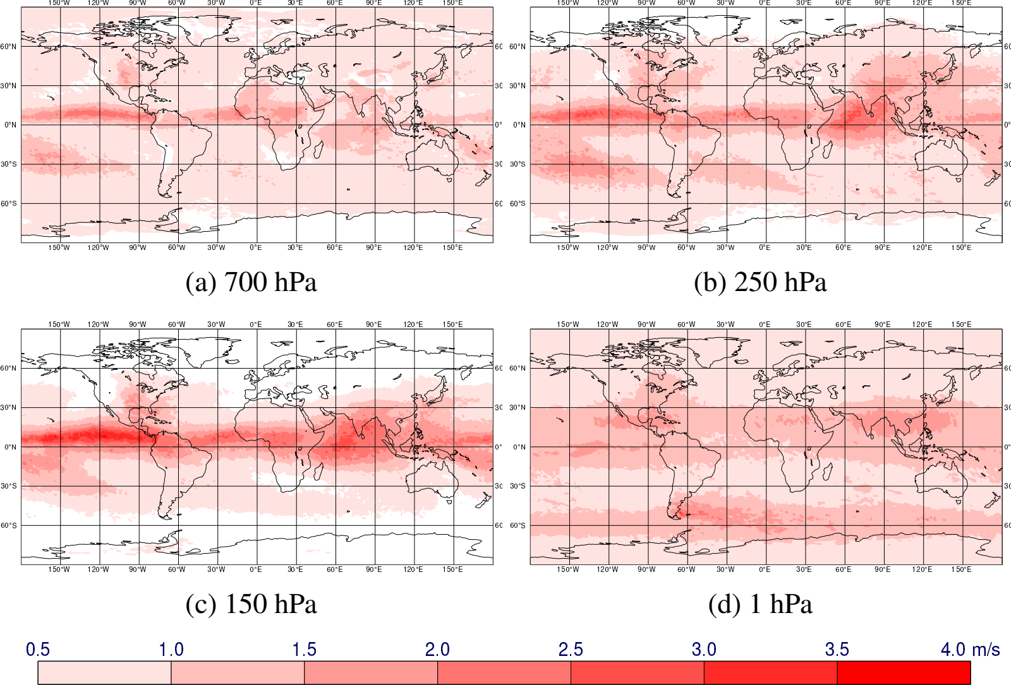
Standard deviation of zonal wind analysis differences due to assimilating Aeolus
ITCZ
Asian monsoon
SPCZ
SACZ
Mid-2020 OSE: Period 4 April to 19 August 2020
(~3 km)
(~10 km)
(~13-14 km)
(~48 km)
Largest changes made to tropical upper troposphere and SH extratropics – in climatological convergence zones; model outflow from convection not quite right?
Similar patterns also in early FM-B period

Slide 5
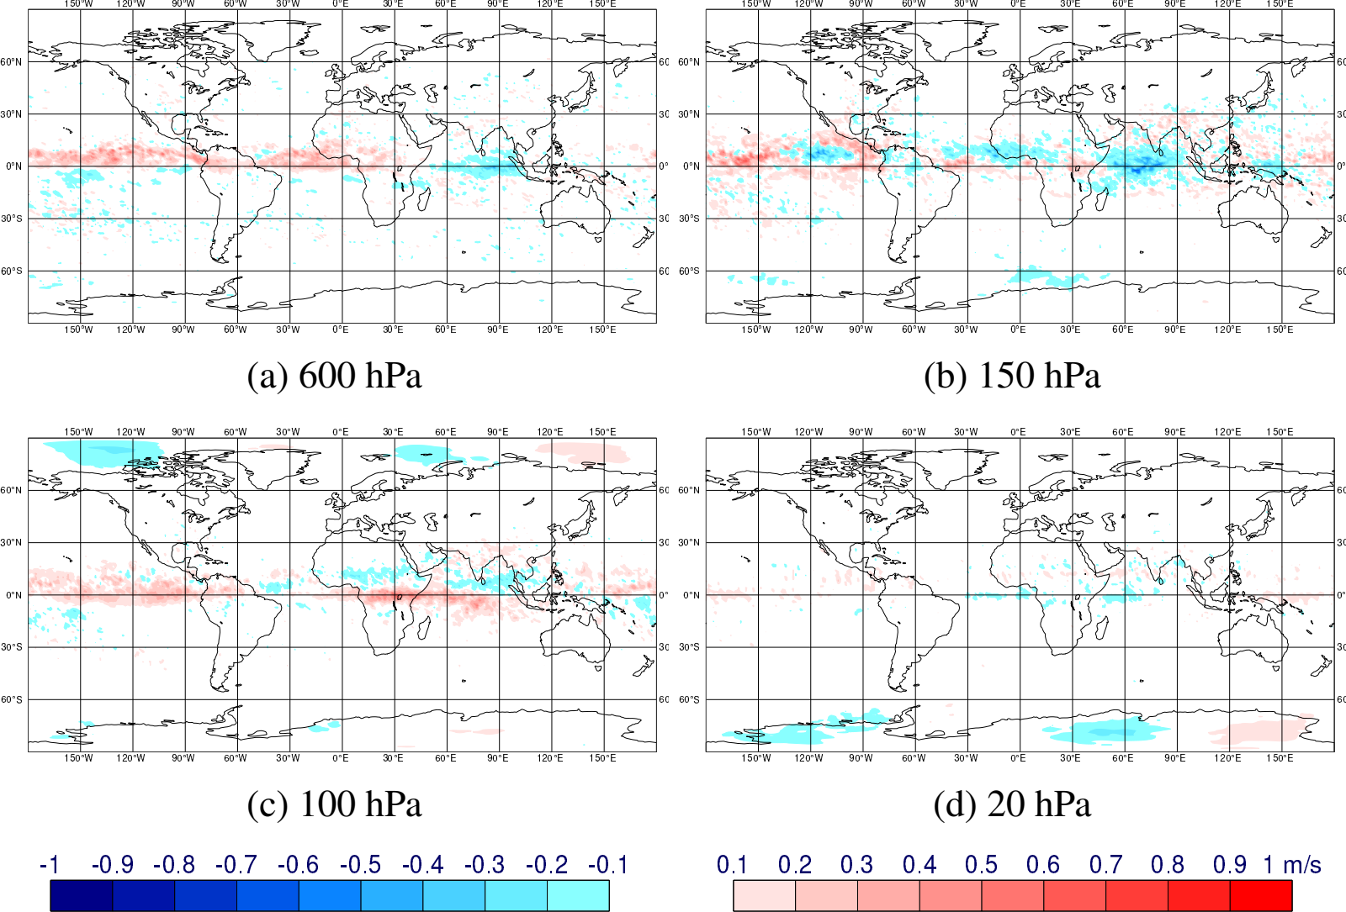
Mean of zonal wind analysis differences due to assimilating Aeolus
Mean change in u-wind (exp - control)
Tropics strongly affected – suggests model zonal wind biases exist
Also some systematic changes in polar stratosphere
Mean u-wind of the control at 100 hPa
(~4 km)
(~13-14 km)
m/s
(~16 km)
(~26 km)
Aeolus is making systematic adjustments to the position of the Tropical Easterly Jet associated with the Asian Monsoon

Slide 6
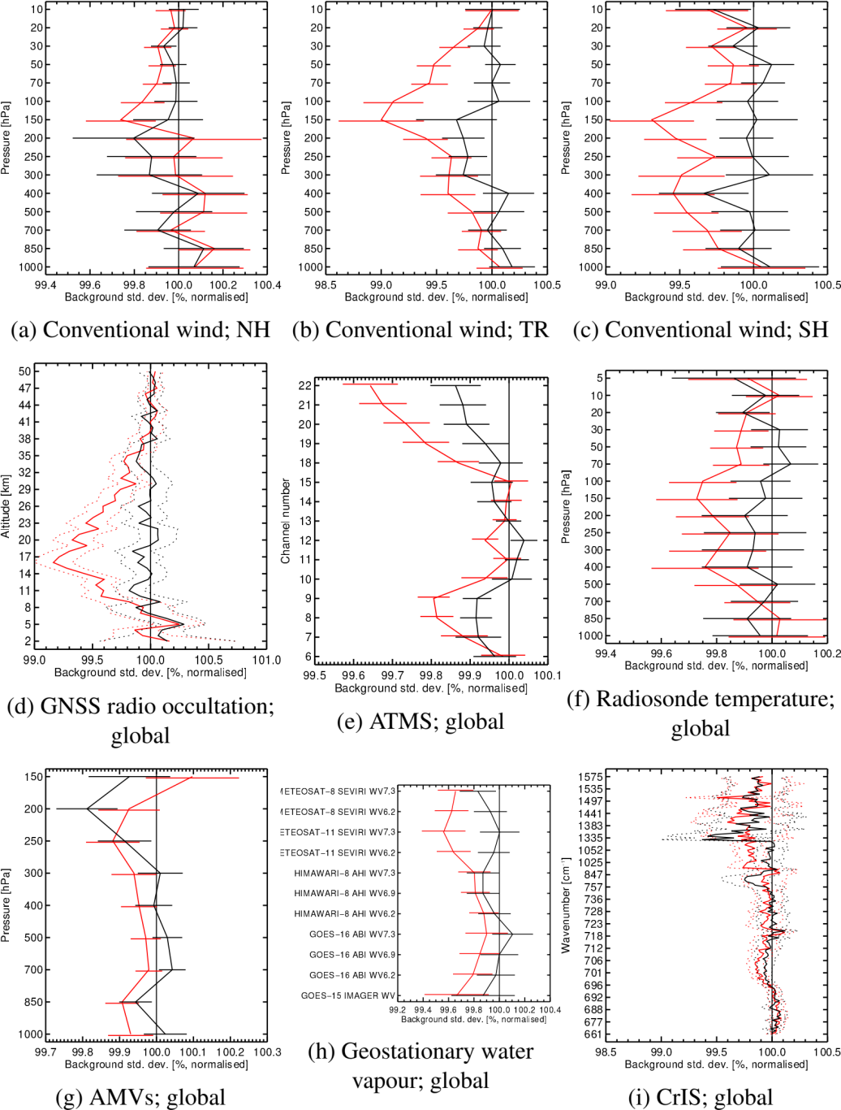
Short-range forecast fit (O-B) to other observations when assimilating Aeolus – results of early FM-B OSE
<100 % means Aeolus improves the forecast
Aeolus improves wind, temperature and humidity, most strongly in upper troposphere and lower stratosphere
Greatest impact in tropical upper troposphere
Both Mie-cloudy and Rayleigh-clear give positive impact
  But Rayleigh-clear typically gives larger impact than Mie-cloudy
– Rayleigh-clear and Mie-cloudy both assimilated
– Mie-cloudy only assimilated

Slide 7
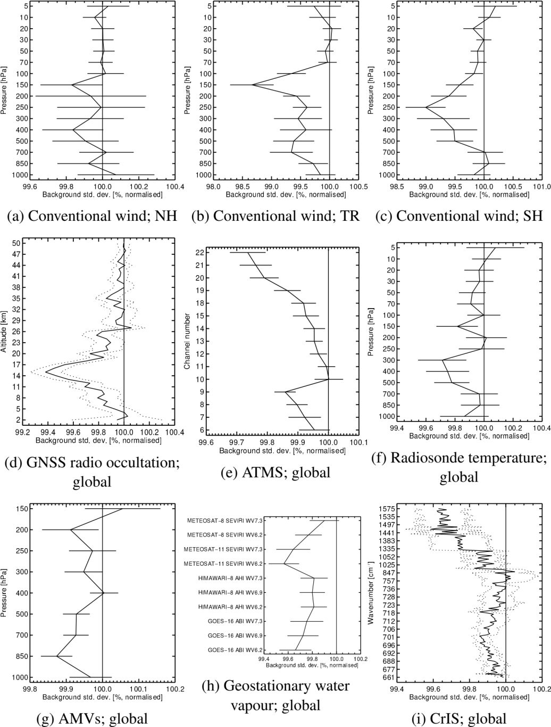
Short-range forecast fit (O-B) to other observations when assimilating Aeolus – results of mid-2020 FM-B OSE
Similar picture to early FM-B OSE i.e. Aeolus improving wind, temperature and humidity short-range forecasts
– Rayleigh-clear and Mie-cloudy both assimilated

Slide 8
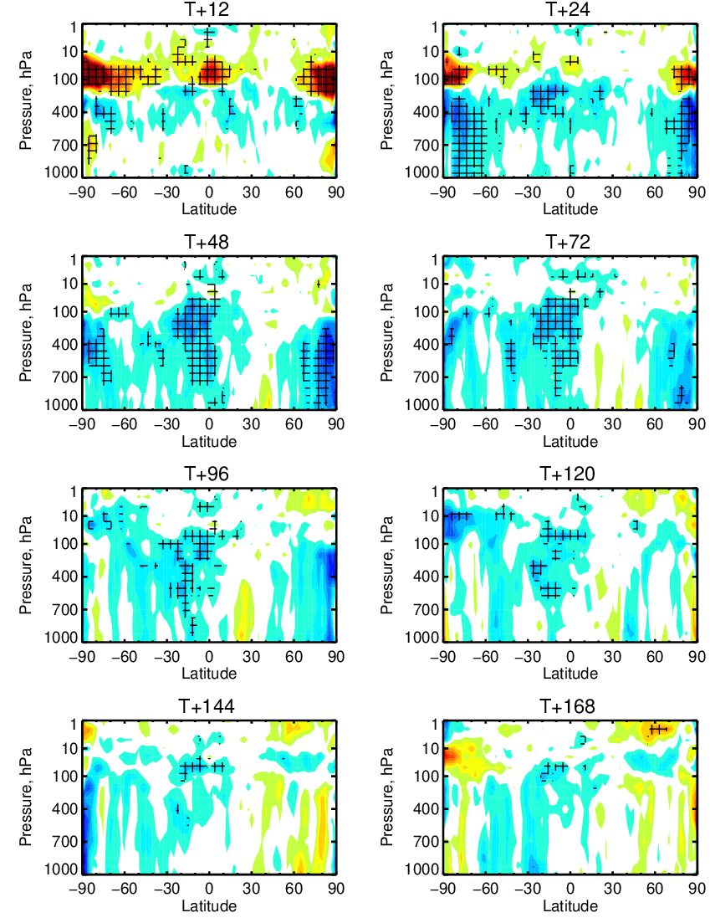
Vector wind root mean square error change due to Aeolus (Rayleigh-clear + Mie-cloudy) – early FM-B OSE
+4%
Verification against ECMWF operational analysis
Good positive impact in tropical troposphere and lower stratosphere
  Throughout forecast range in LS
Good positive impact in polar troposphere
  Up to 4 day range
Similar patterns of impact for temperature and humidity forecasts (not shown)
hours
~16 km
Better with Aeolus
-4%

Slide 9
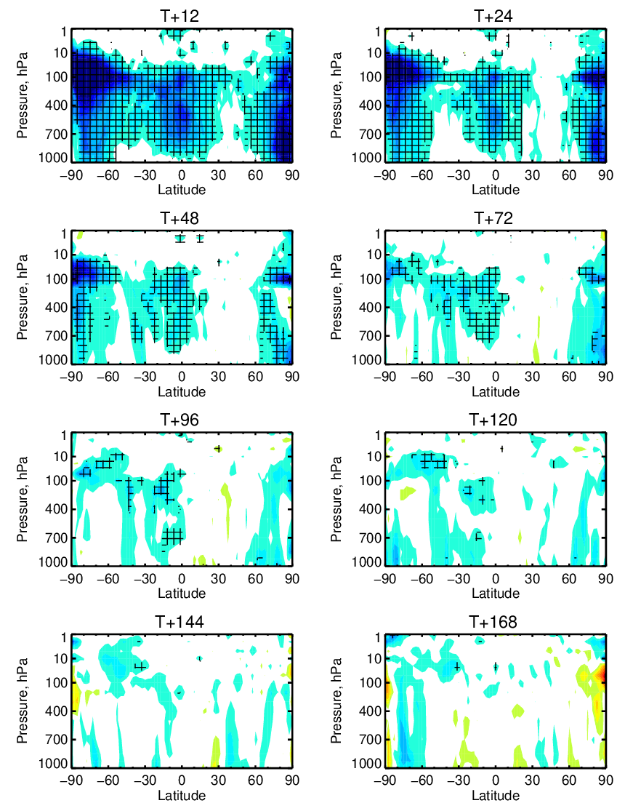
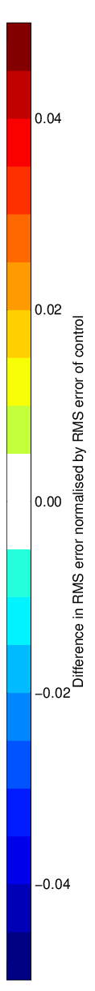
Vector wind root mean square error change due to Aeolus (Rayleigh-clear + Mie-cloudy)
– mid-2020 FM-B OSE
Verification against ECMWF operational analysis (so first day or so is misleading, with Aeolus assimilated operationally)
Good positive impact in tropical troposphere and polar regions; at day 2-5 forecast range
Similar spatial patterns of impact seen for temperature and humidity forecasts (not shown)
Similar pattern to early FM-B period, but smaller magnitude smaller in tropics
  Assumed to be because of noisier Rayleigh winds
+5%
hours
~16 km
Better with Aeolus
-5%

Slide 10
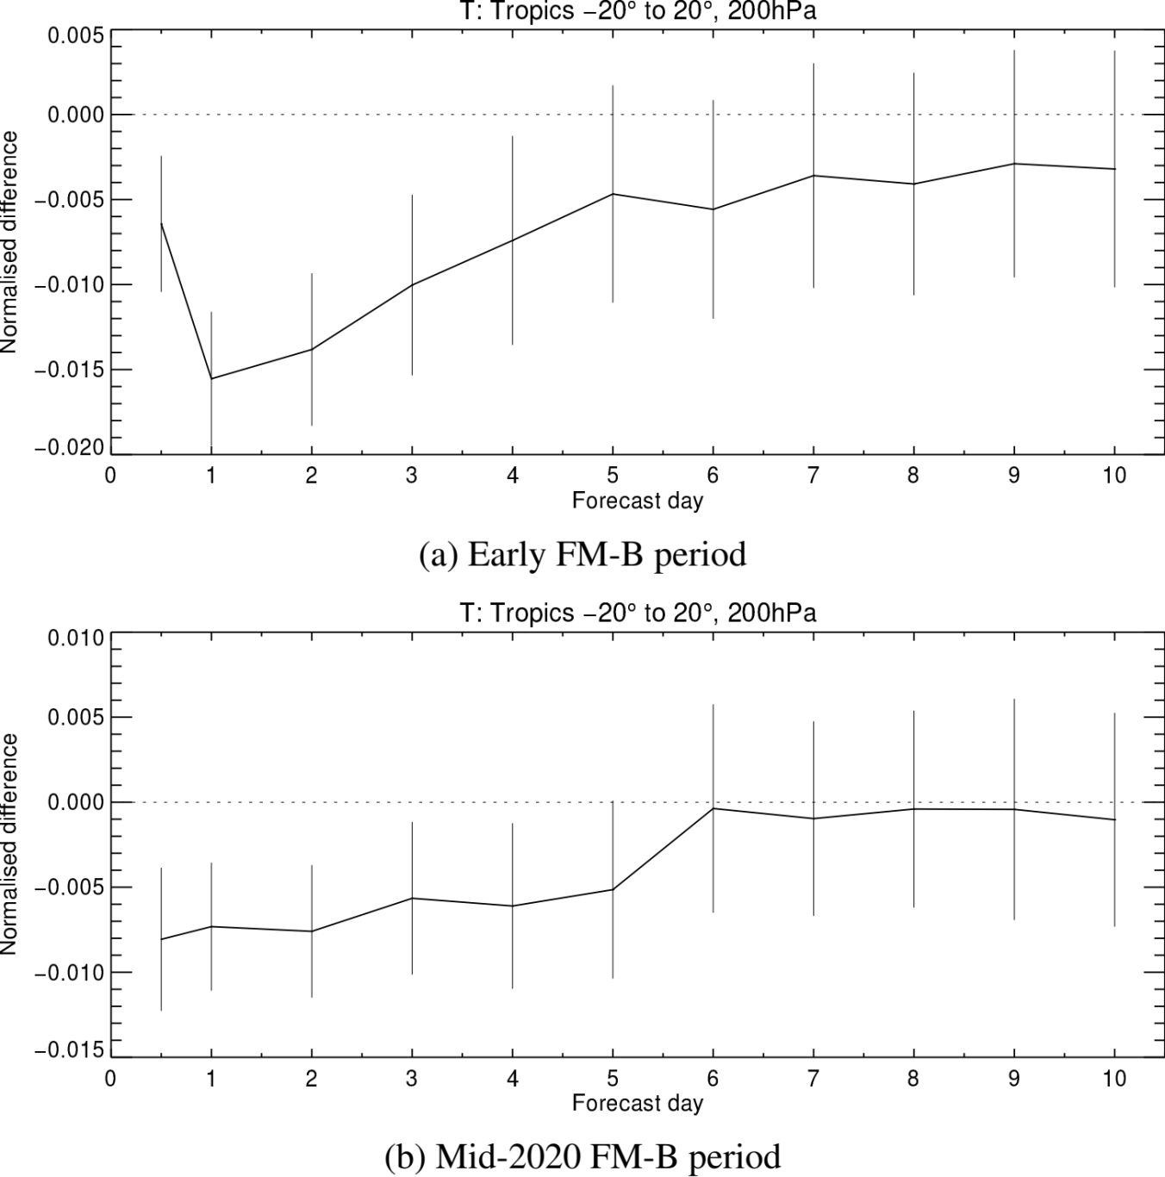
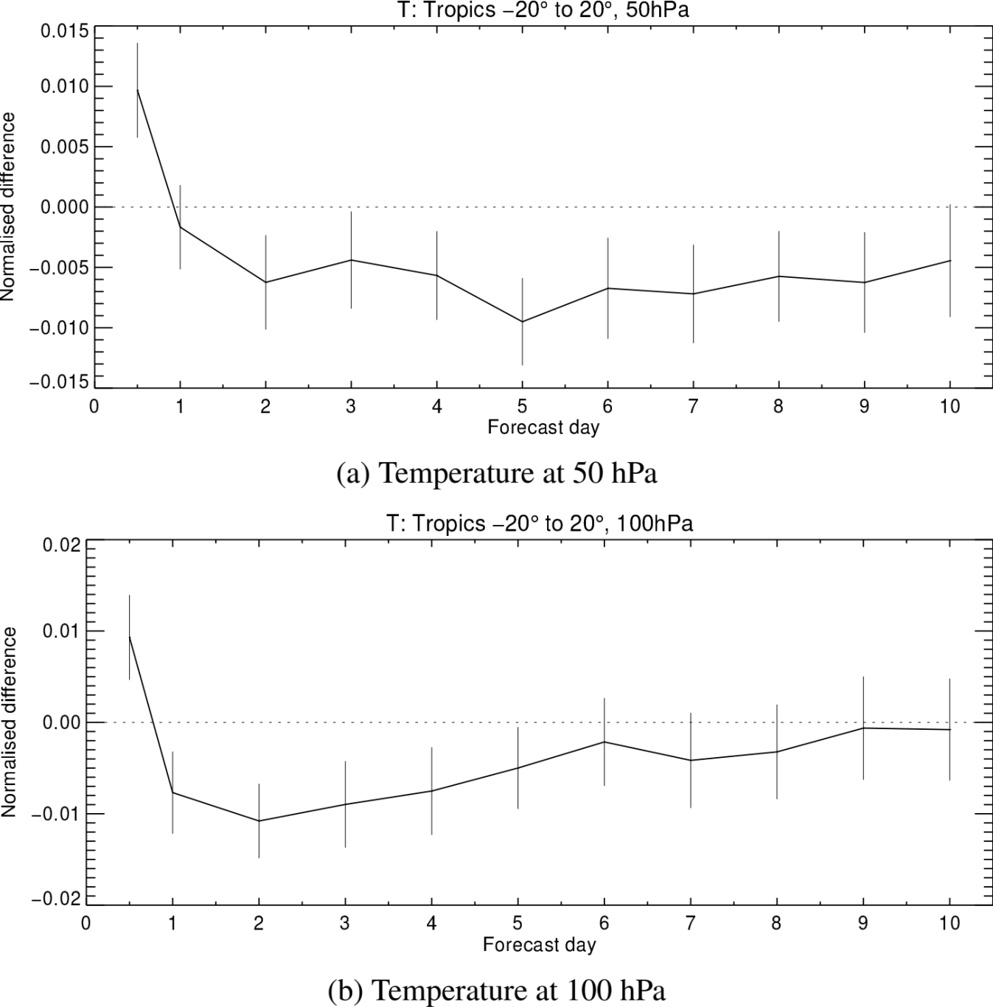
Largest impact from Aeolus found in tropical UTLS
Both OSE periods show good impact in tropical 200 hPa temperature (RMS error)
Early FM-B period showed good impact at tropical tropopause and lower stratosphere (out to day 10)
Better with Aeolus

Slide 11
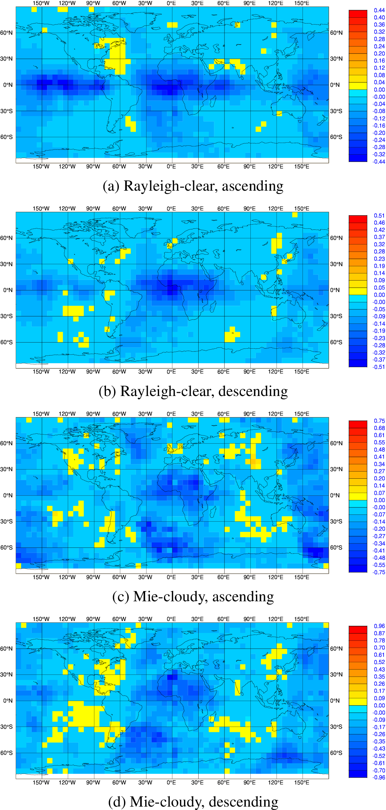
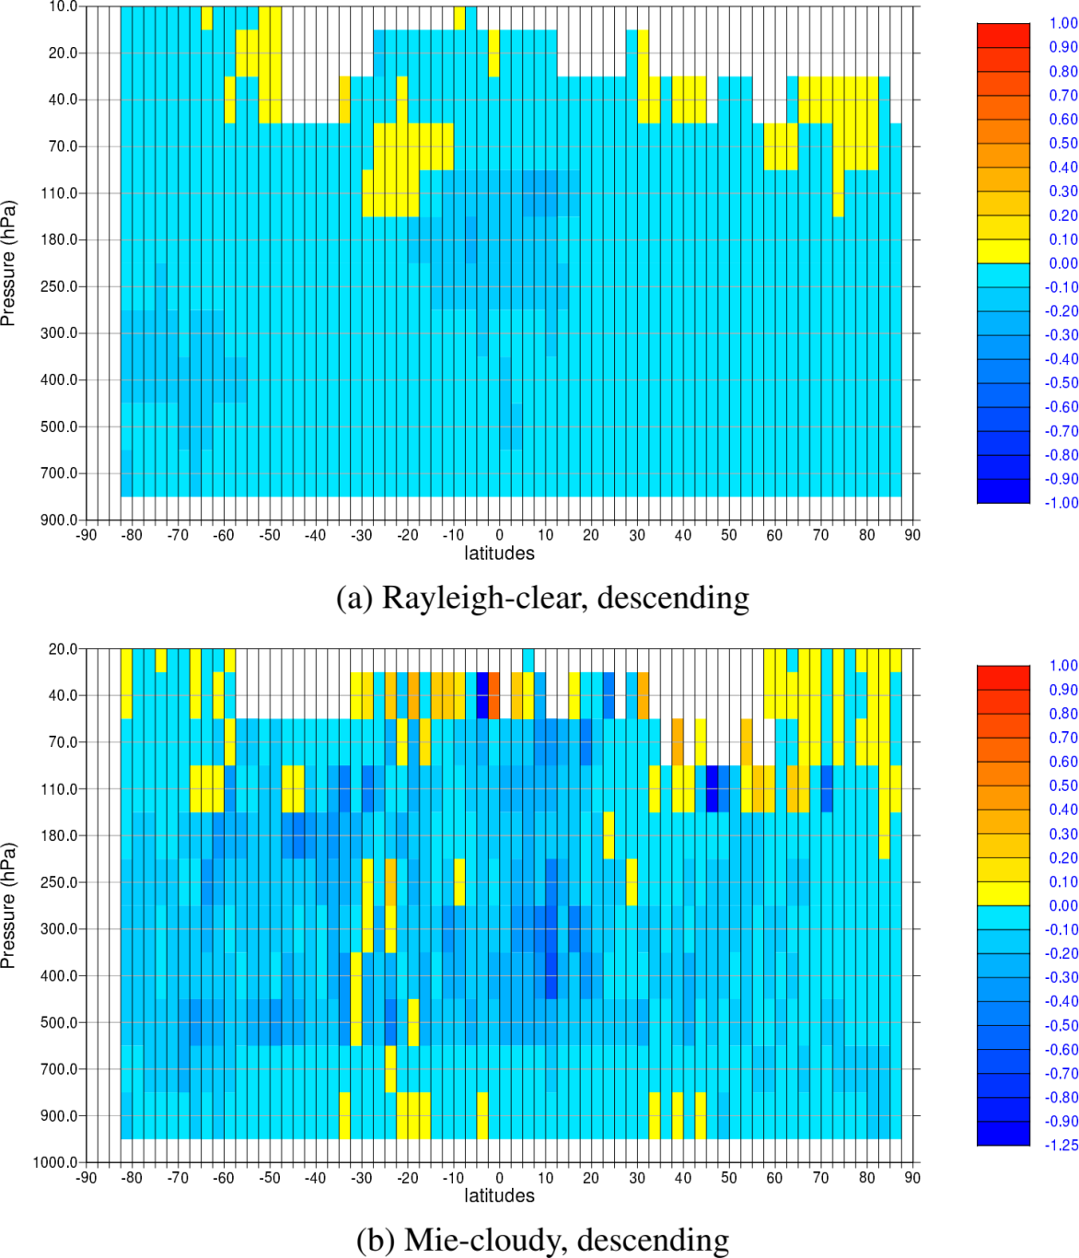
Mean FSOI per Aeolus observation for period 9 January to 1 September 2020
Profile average mean FSOI per observation
Zonal average mean FSOI per observation
Better with Aeolus
Positive impact:
Larger impact in tropics and ocean areas
Particularly large in South Atlantic Convergence Zone
Rayleigh impact peaking in tropical upper troposphere
FSOI impact per ob of Mie is twice that of Rayleigh
Impact reduced in certain longitude bands – due to being at start of ECMWF’s 12 hour 4D-Var window

Slide 12
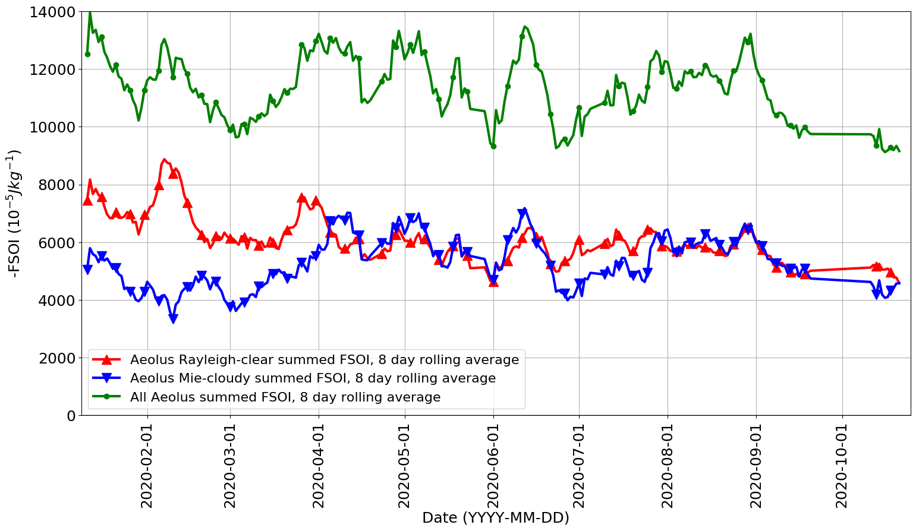
Time series of summed FSOI for Mie-cloudy, Rayleigh-clear and combined – from ECMWF operational data assimilation
Since April Rayleigh and Mie have similar total FSOI
Rayleigh impact is probably dropping with time – as would be expected given the increasing noise
But we still have a positive impact

Slide 13
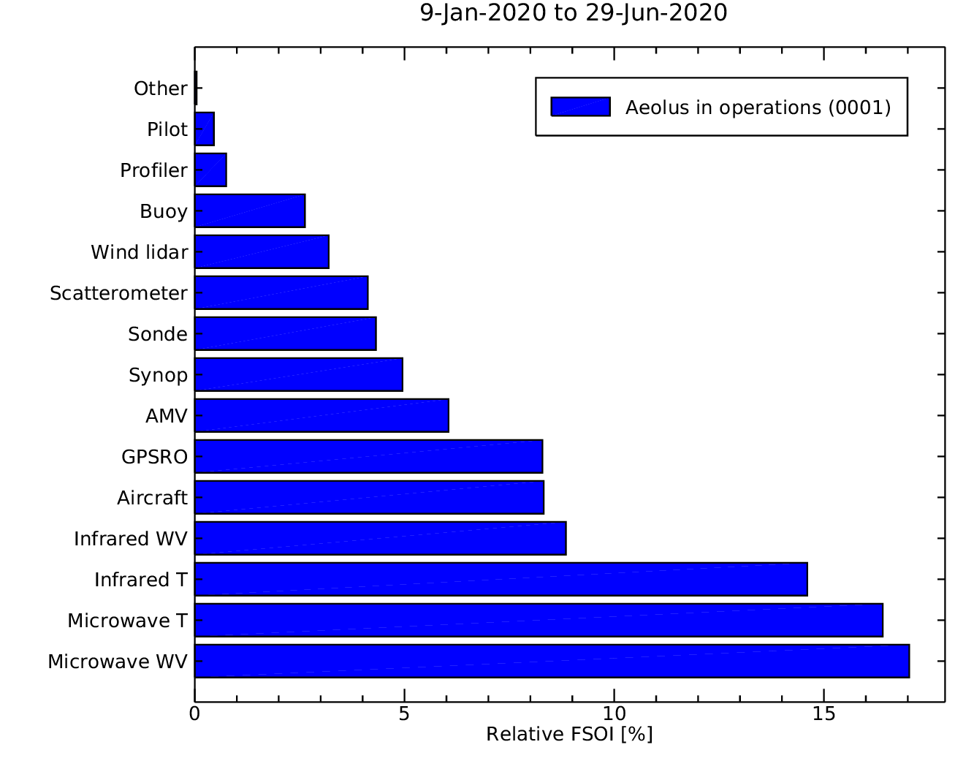
Aeolus FSOI compared to other observing systems
(CY46R1 only)
Aeolus (1 instrument)
Aeolus has a very good impact for one satellite-based instrument
3 instruments
15 instruments
15 instruments
10 instruments
6 instruments
9 instruments
14 instruments

Slide 14
Summary of Aeolus NWP impact assessment at ECMWF
OSEs for early and mid-2020 FM-B periods show Aeolus gives statistically significant and good magnitude positive impact on forecasts in tropics (up to 10 days) and polar regions (up to 4 days)
  Rayleigh winds provide most of tropical impact, but Mie impact is good in extratropics
FSOI also corroborates the OSE positive impact
  Rayleigh and Mie have similar global impact in 2020
  Mie FSOI impact per ob is double that of Rayleigh (thanks to lower noise)
  Average FSOI per ob is very good compared to other satellite data, second only to scatterometer
Aeolus provides only <1% by number of obs assimilated; its strong impact demonstrates the importance of global wind profiles
See indications of a reduction of Rayleigh-clear impact with time as it gets noisier
Still potential to improve impact: by mitigating radiometric performance issues, processing chain improvements and in data assimilation method improvements

Slide 15
Thanks, any questions?

Slide 16
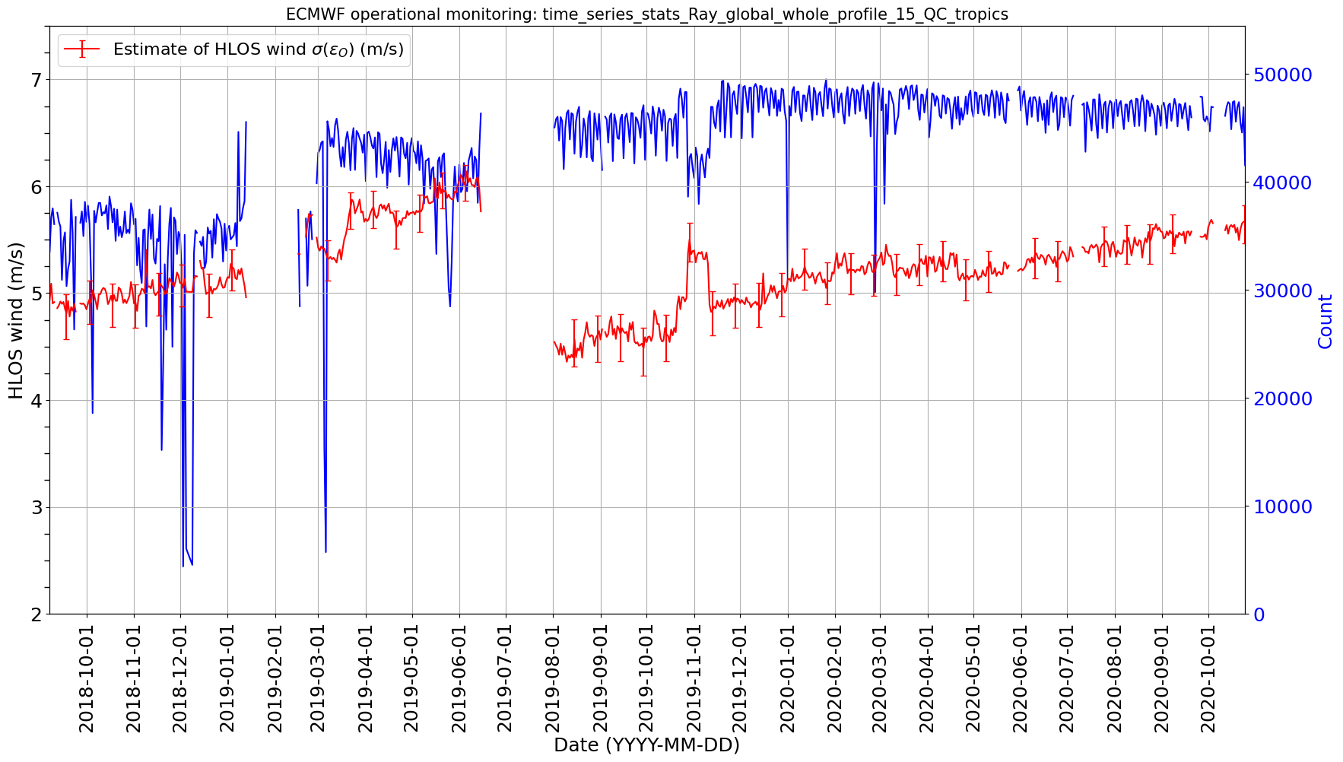
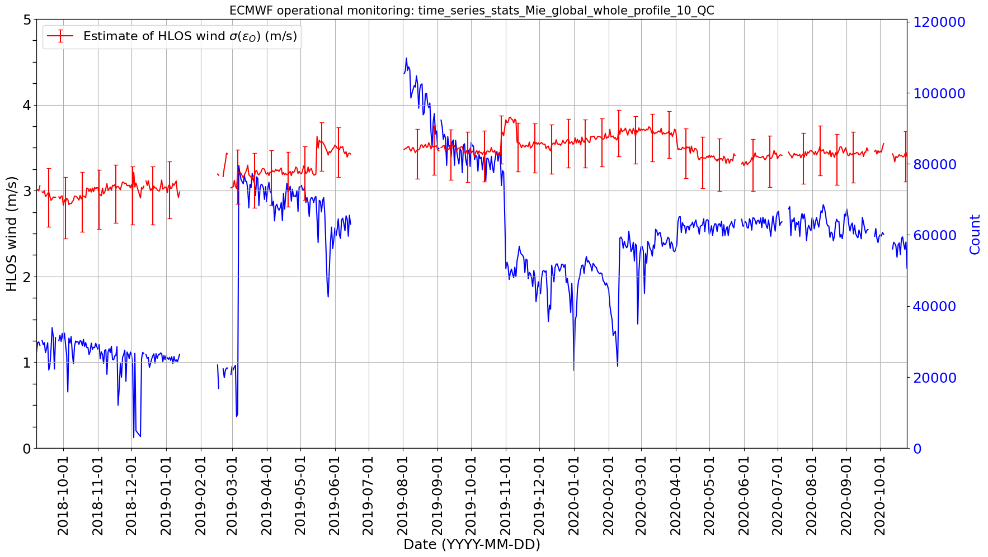


L2B HLOS wind random errors – relevant to impact size
Rayleigh-clear, tropics only (to minimise solar background noise seasonal variations)
Mie-cloudy, global
$$QC:abs\left(O−B\right)<15 m/s$$
$$QC:abs\left(O−B\right)<10 m/s$$
Rayleigh-clear noise increasing for FM-B
  ~1-1.5 m/s noisier than early FM-B
Similar now to late FM-A (NRT data)
Current Mie-cloudy random errors are similar to early FM-B

Slide 17
Benefit of M1 T bias corrected data compared to ECMWF look-up table bias correction
For short period: 4 to 19 April 2020 – during testing of M1 T bias correction
Verified with global ATMS microwave radiance background departures
Data with M1 T bias correction shows positive impact
It’s unclear why the look-up table BC method did not work so well for this short period
OSEs in the following slides focus on use of only M1 T bias corrected L2B data, with Mie assigned error using rep. error
With M1 T bias correction
With ECMWF’s own arg_lat vs long. look-up table bias correction

Slide 18
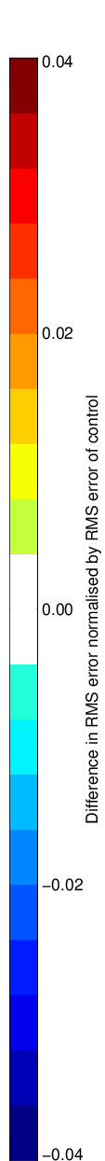
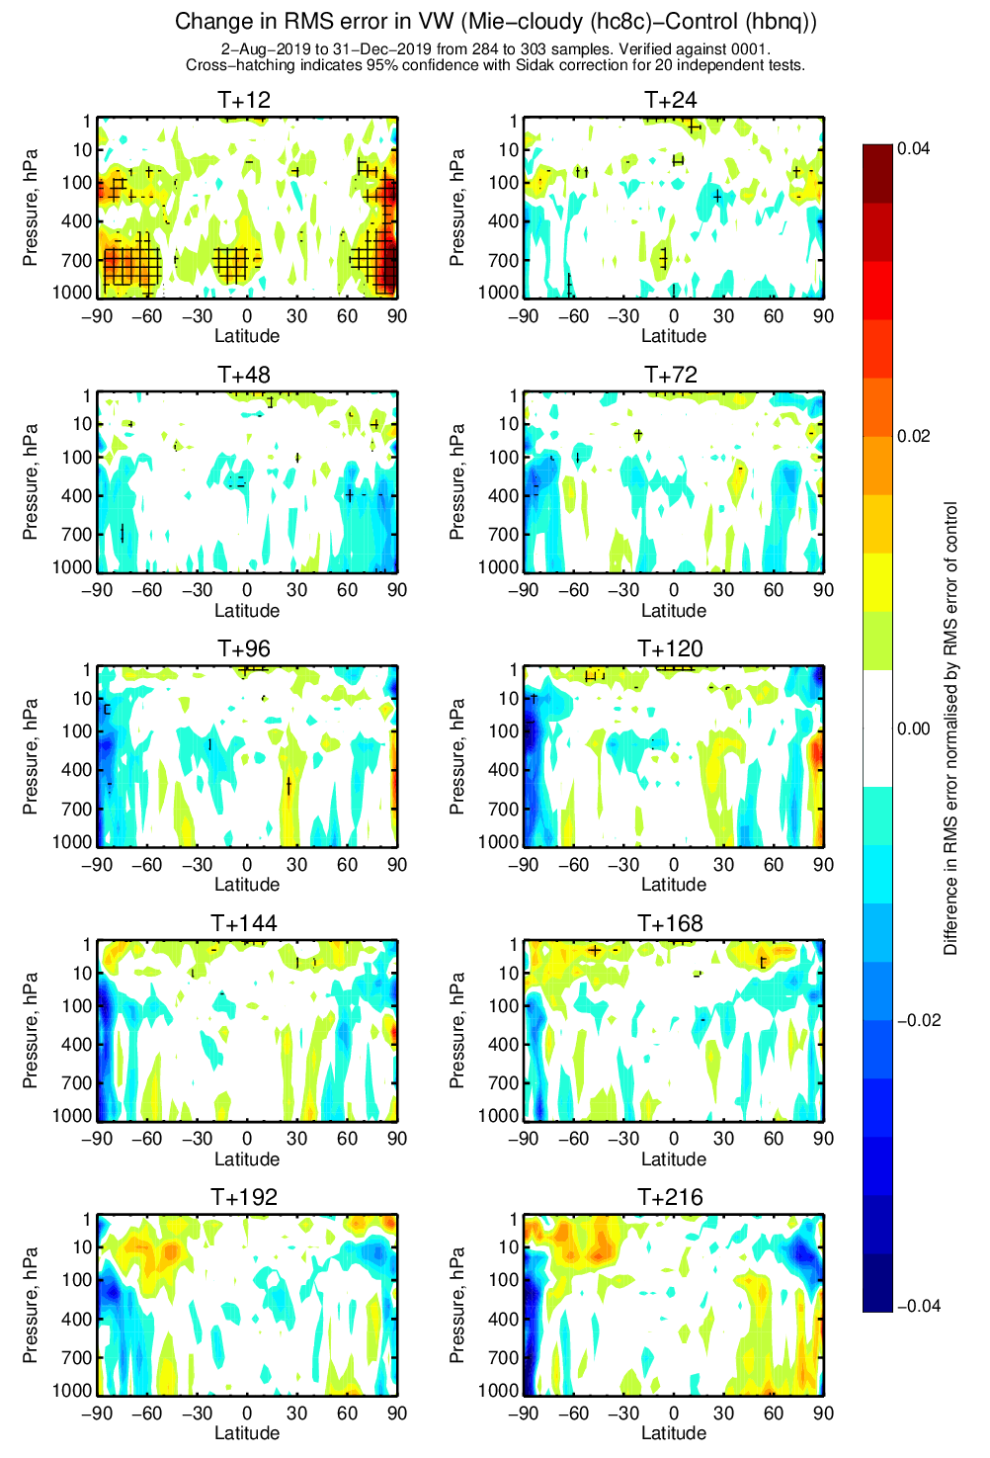
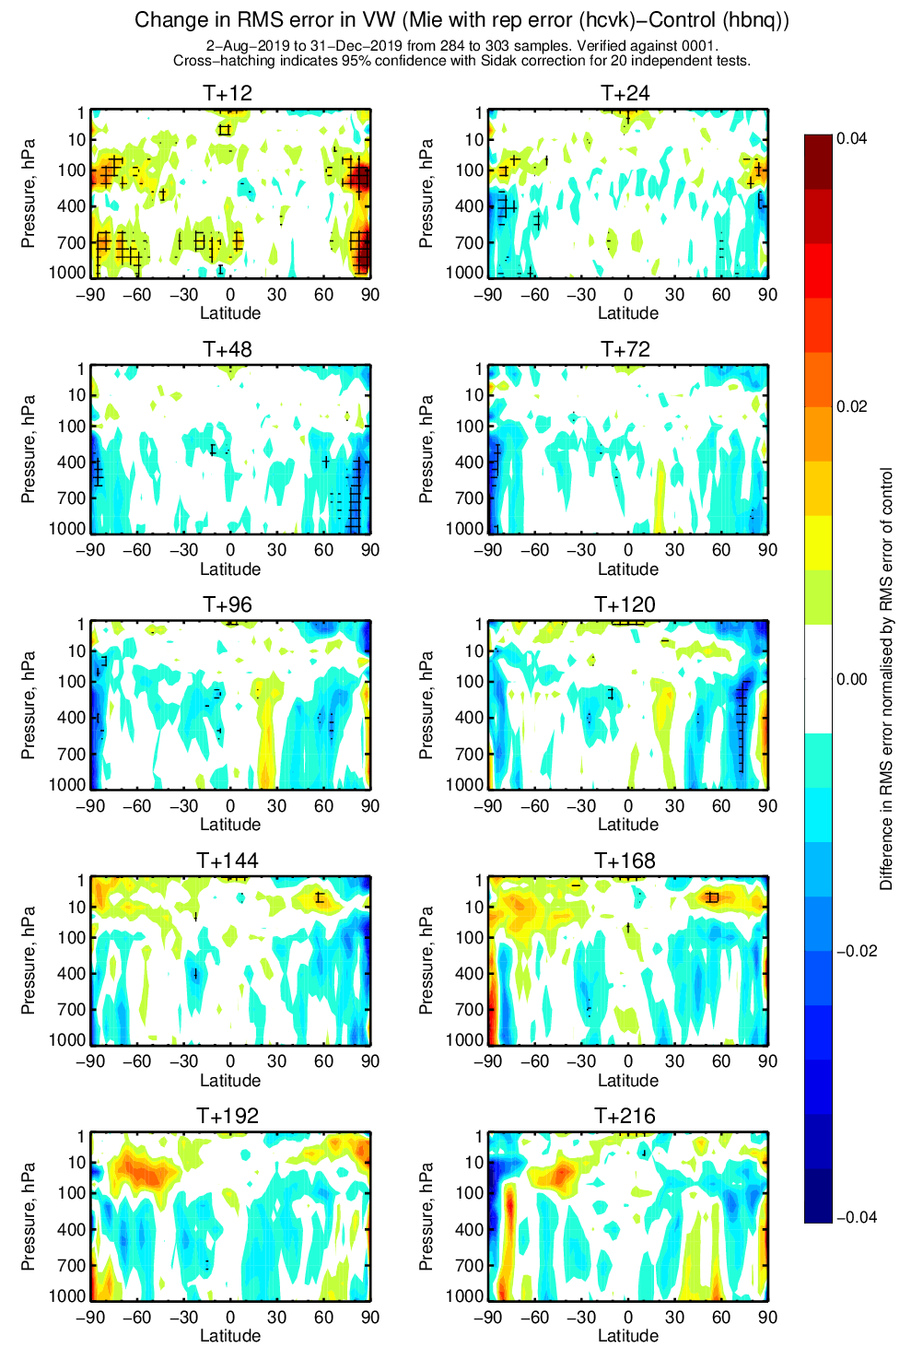
Improving Aeolus impact: Mie-cloudy wind impact is increased with refinement of assigned observation error
+4%
Mie-only impact on vector wind for early FM-B period
Improved Mie observation error model; including representativeness error
Simple observation error model
Better with Mie
-4%

Slide 19
A hint of positive impact at 500 hPa from assimilating only Rayleigh-cloudy winds in the tropics for early FM-B period
Hope for more impact when we potentially improve Rayleigh-cloudy calibration in L2Bp

Slide 20
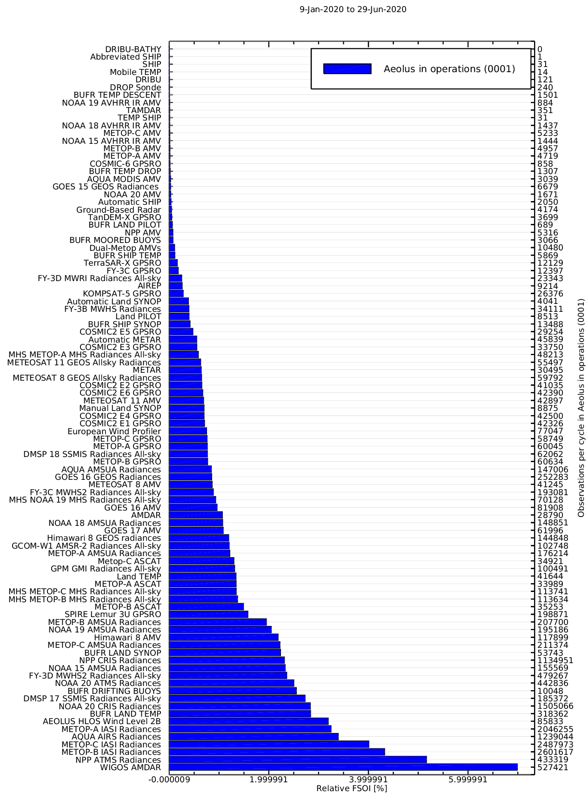
Aeolus FSOI compared to other observation types

Slide 21
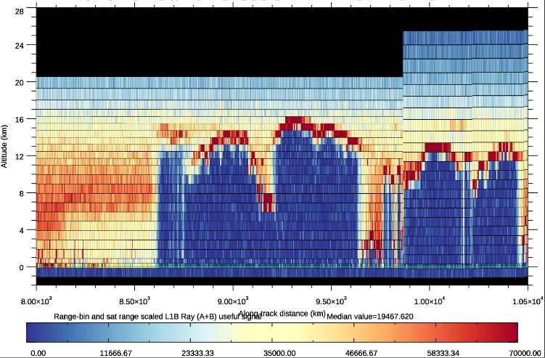
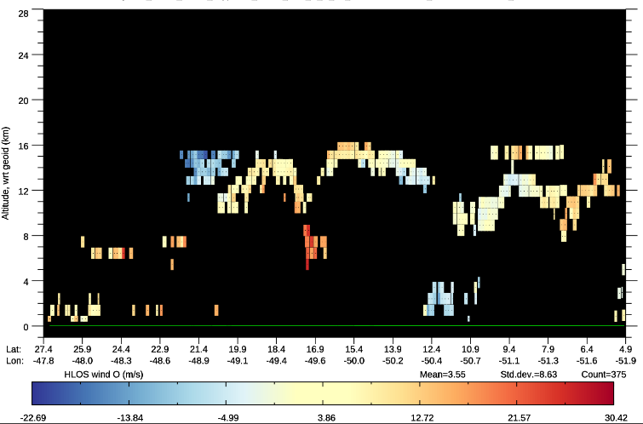
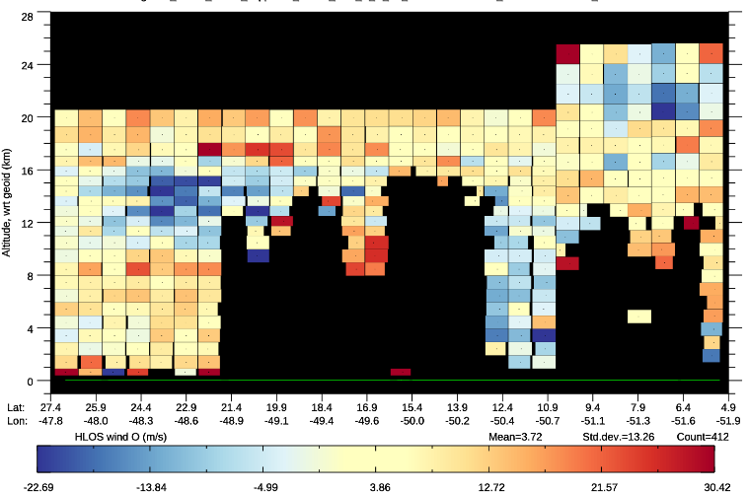
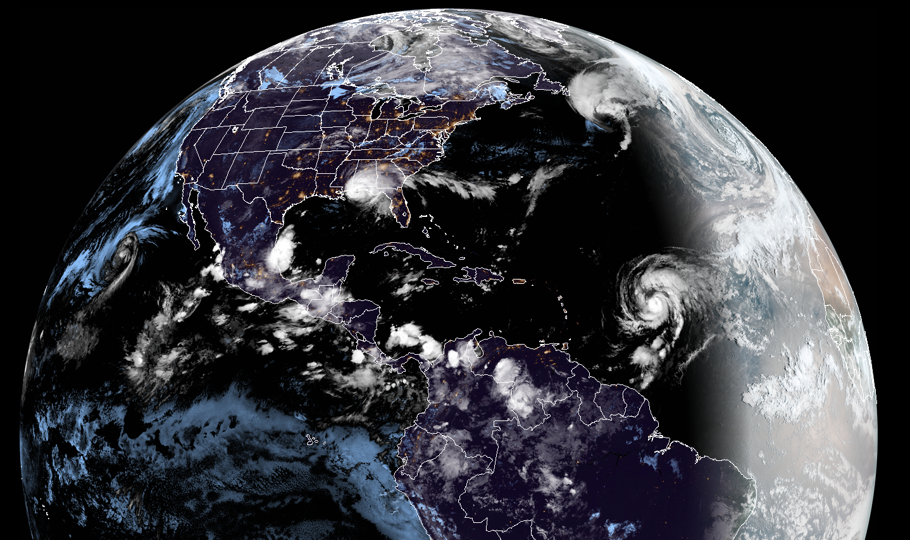
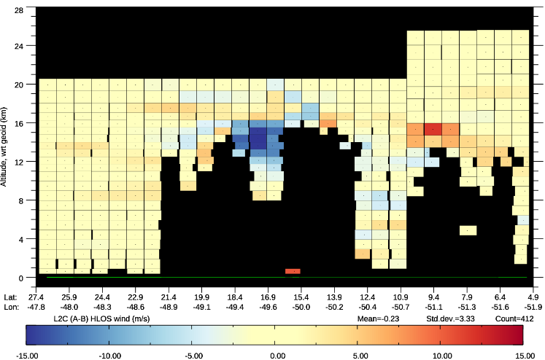
An example of L2B winds in operational NWP:
Some rather large wind increments with Aeolus near Hurricane Teddy (16 September 2020)
L1B meas. useful signal
Hurricane Teddy
L2B Mie-cloudy wind
L2B Rayleigh-clear wind
Rayleigh-clear HLOS wind analysis increments
Level-2C data
This was seen to occur for several days, with Aeolus hits
<-15 m/s!

