Slide 1
Impact assessment of Aeolus HLOS winds on NOAA global forecasts
Kevin Garrett
NOAA/NESDIS Center for Satellite Applications and Research
Hui Liu, Kayo Ide, Katherine Lukens, Ross Hoffman (University of Maryland/CISESS)
Lidia Cucurull (NOAA/OAR/AOML)
Karina Apodaca (CIRA)
Mike Hardesty (CIRES)
Acknowledgements: Trish Weir (NESDIS), Iliana Genkova (IMSG@NCEP/EMC), Dave Santek, Brett Hoover, Agnes Lim (CIMSS), Peter Marinescu (CIRA), Lisa Bucci (AOML)
Satellite and Information Service
18 Nov 2020

Slide 2
Topics
Scope of Aeolus activities
Data assimilation integration
Data assimilation impact studies
Ongoing efforts
Summary

Slide 3
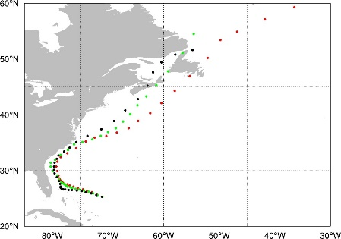
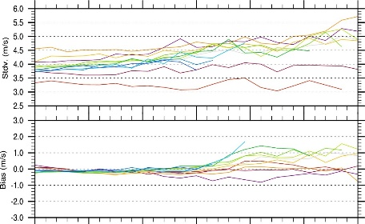
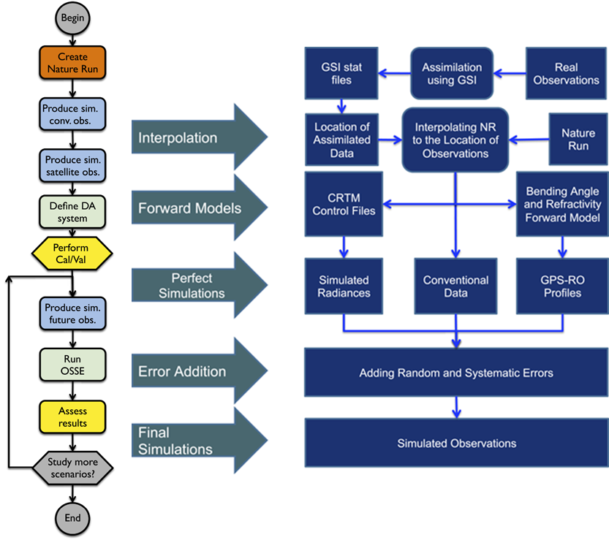
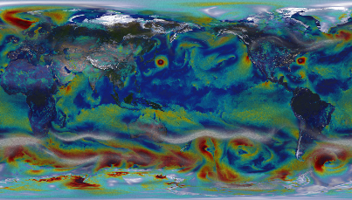
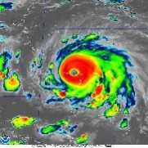
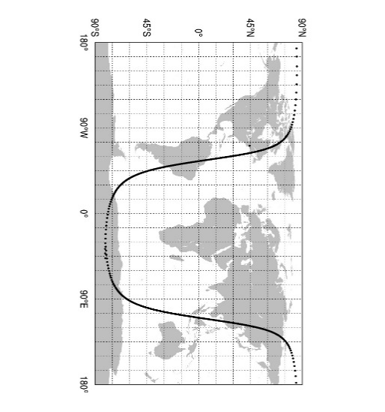
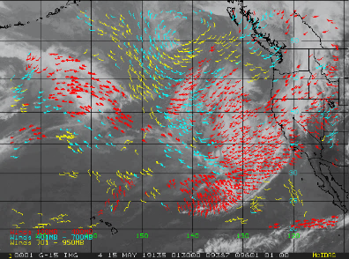
Scope of Aeolus activities
Assess 3D-winds impacts on NOAA numerical weather prediction supporting NESDIS Technology Maturation Program (TMP) and next generation satellite architecture planning.
Integrate and assess impact on NOAA global NWP
Use Aeolus to improve NWP impact of other data (e.g. AMV)
Compare Aeolus measurements to TC reconnaissance observations
Data evaluation
Global DA
Field Studies
Hurricane DA
Synergies
OSSEs
Characterization of random/systematic errors
Comparison to other wind data sources
Optimize use in global and hurricane NWP to assess impact on TC forecasts
Assess impact of active and passive 3D winds through a global OSSE

Slide 4
Overview of data assimilation system
Observing System Experiments
Observing System Experiment Setup
NOAA FV3GFS v15.2
4DEnVar, 80 member ensemble
Experiments run at C384/C192/L64 resolution (25 km Analysis/Forecast)
Assimilation of Aeolus HLOS (L2B) wind (Rayleigh clear/Mie cloudy)
FM-A period: 12 Sep – 16 Oct 2018
FM-B period: 2 Aug – 30 Sep 2019
FM-B period 2: 2 Aug – 30 Sep 2019
Verification shown against ECMWF
 | Control run | Aeolus Experiment
All operationally assimilated observations | Yes | Yes
Aeolus L2B HLOS | No | Yes (Rayleigh clear + Mie cloudy winds)

Slide 5
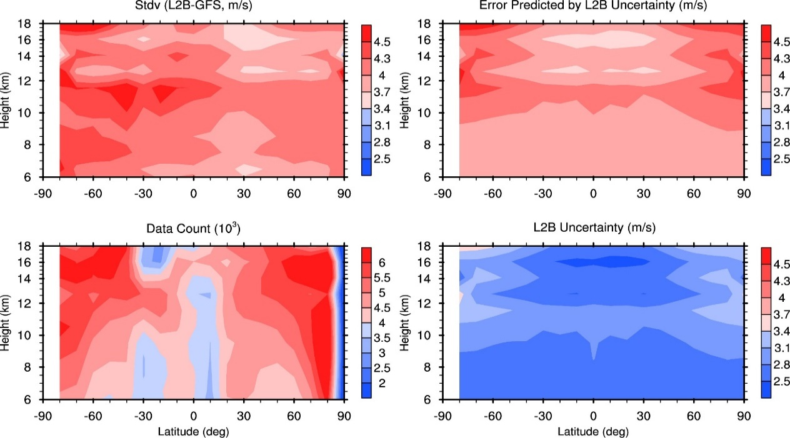
Aeolus evaluation and integration FM-A period (Sep 12-Oct 16, 2018)
Offline bias correction for Rayleigh. B(lat,z,t,phase)
Assess “clean” record of FM-A
Static bias to handle dependencies
Dynamic observation errors based on L2B uncertainty
Dynamic Observation Errors
Stdv
Bias

Slide 6
Aeolus summary impacts FM-A period (Sep 12-Oct 16, 2018)
Zonal Mean Analysis/Difference
Summary Assessment Metrics
Aeolus
Aeolus-CTL
Region
95% CI
CTL
Aeolus
Better
u
Worse
NH SH TRO
Parameter
Better
Worse
v
Z T Wind RH
Level
Better
Analysis impact: SH/TRO above mid-troposphere (u)
Forecast impact: Significant positive impact in SH, positive impact on Wind and Temperature, above 700 hPa
Worse
250 500 700 850 1000
hPa

Slide 7
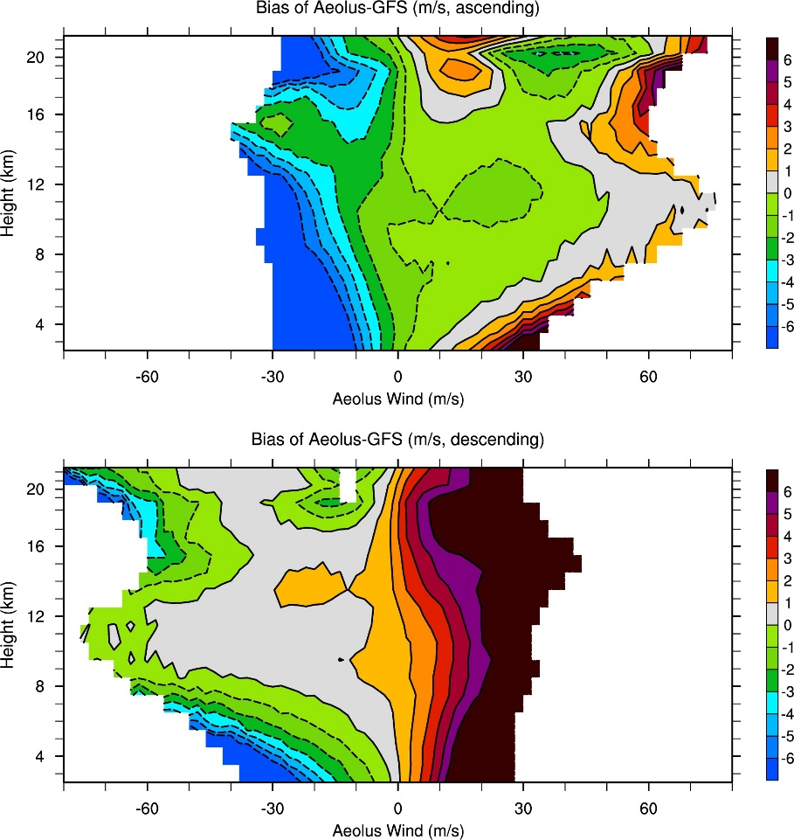
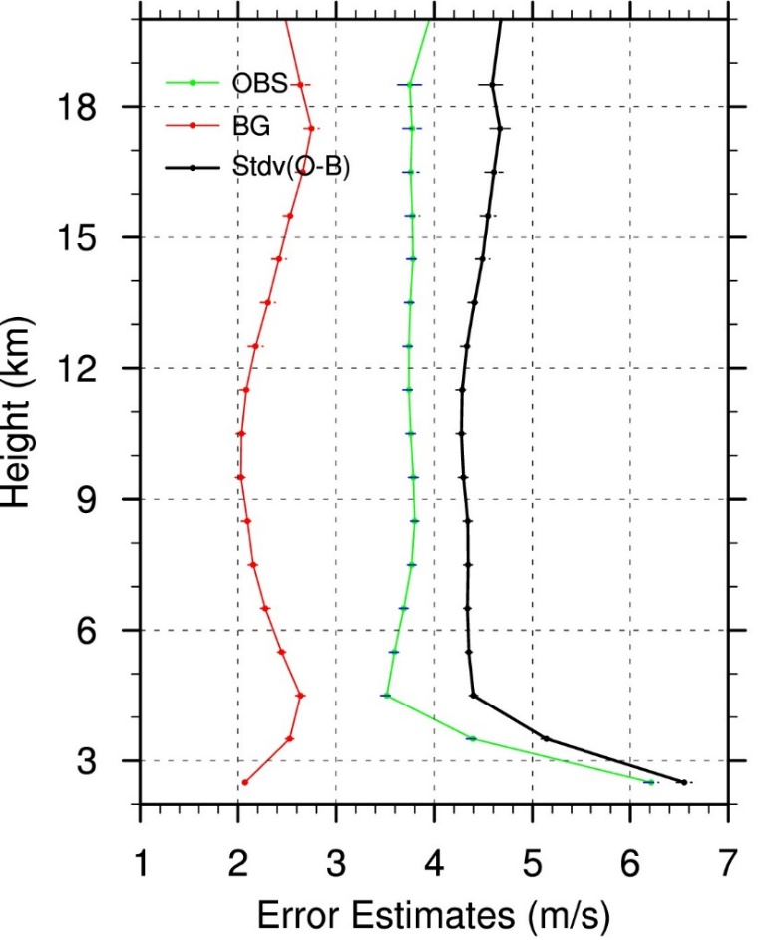
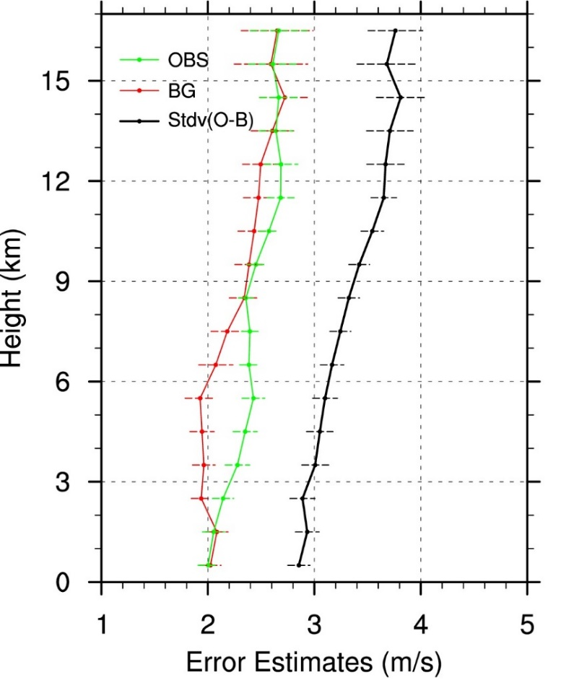
Aeolus evaluation and integration FM-B period (Aug 2-Sep 30, 2019)
O-B Bias (descending)
FV3GFS wind observation errors
From Jung et al.
https://www.weather.gov/media/sti/nggps/09%20Jung_nggps_Aug_2016.pdf
Observation errors using HL method
Aeolus Rayleigh winds have dependence on latitude (l), layer (p), orbit (n), and wind speed (w)
Use linear fit of (O-B) to Aeolus winds (w) to determine coefficients c_{0(l,p,n)} and c_{1(l,p,n)}
BC_{(l,p,n)} = c_{0(l,p,n)} + c_{1(l,p,n)} w
Mie error is, ~2-3 m/s, close to GFS background error
Rayleigh error is ~ 4 m/s

Slide 8
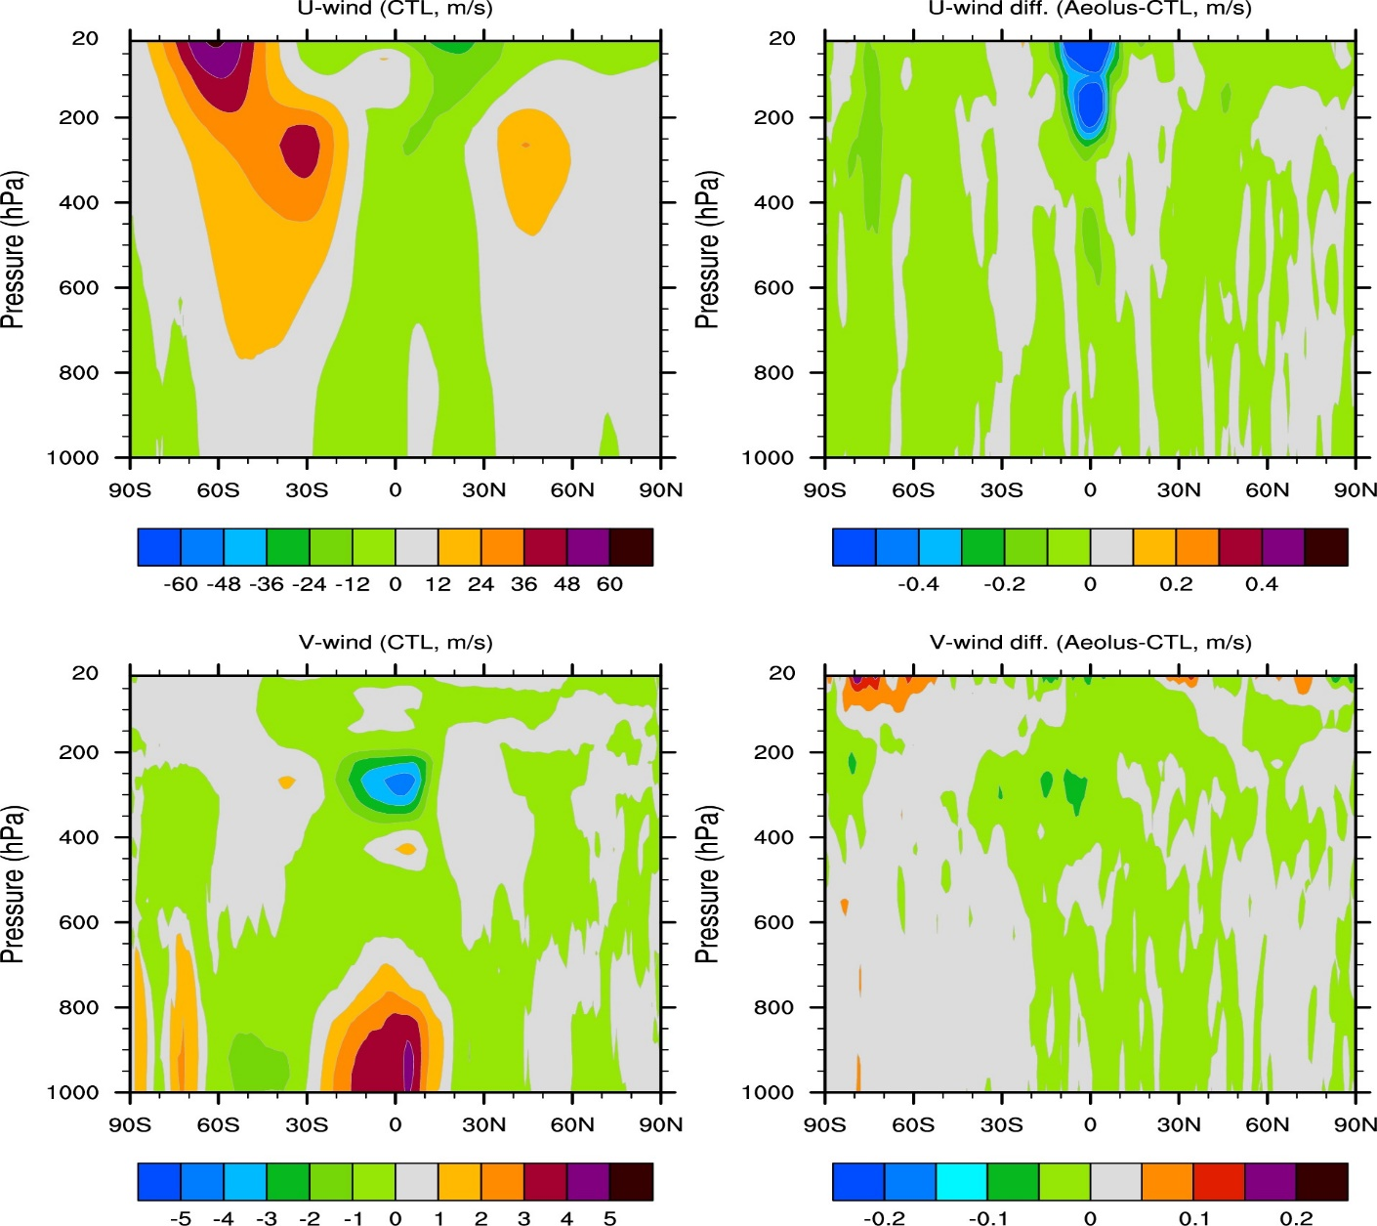
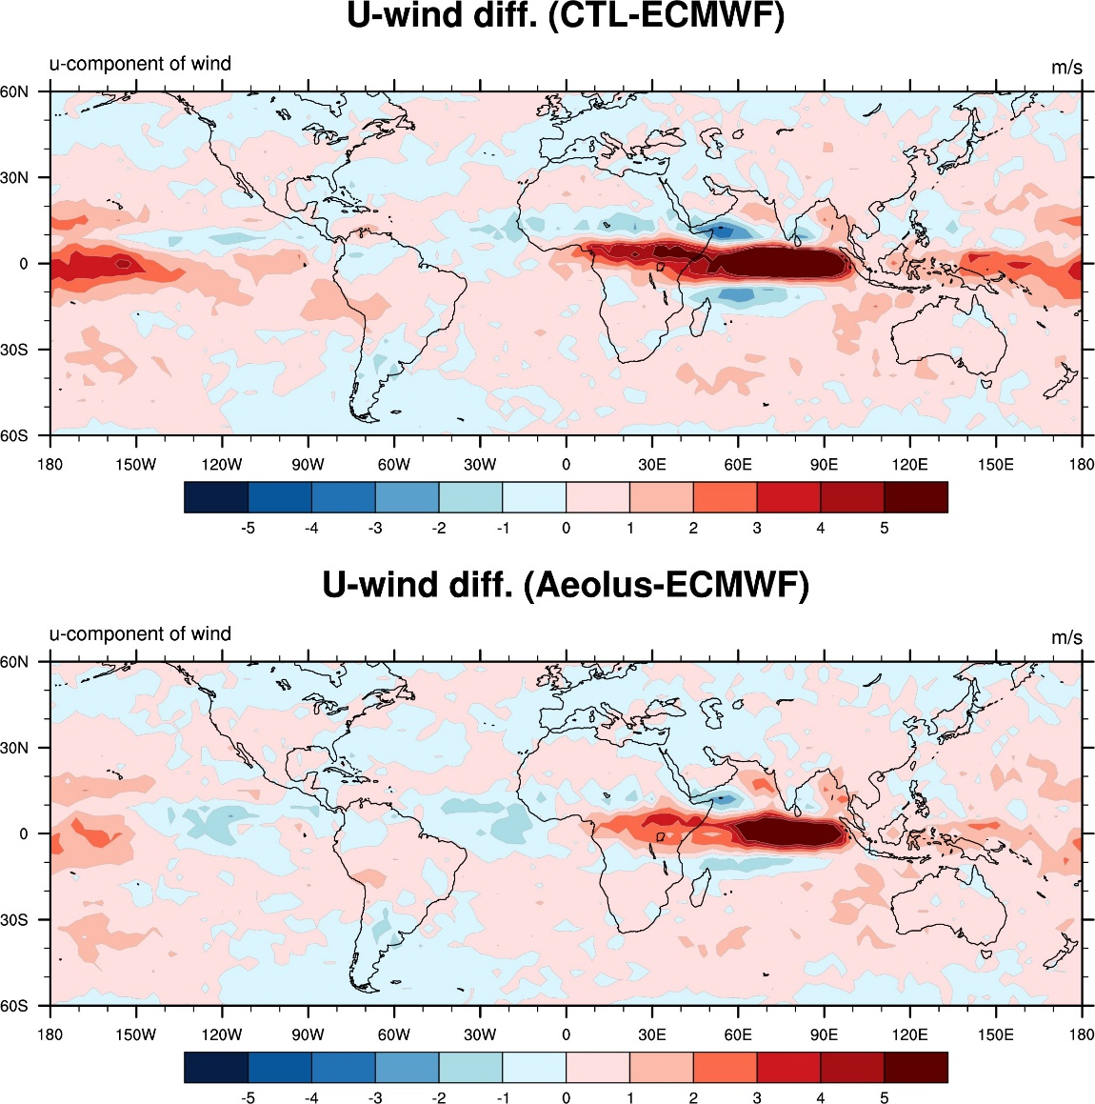
Aeolus analysis impacts FM-B period (Aug 2-Sep 30, 2019)
U-wind CTL
U-wind Aeolus-CTL
100 hPa
V-wind CTL
V-wind Aeolus-CTL
Larger impact on Tropical Easterly Jet
Improvement in Easterly Tropical Jet

Slide 9
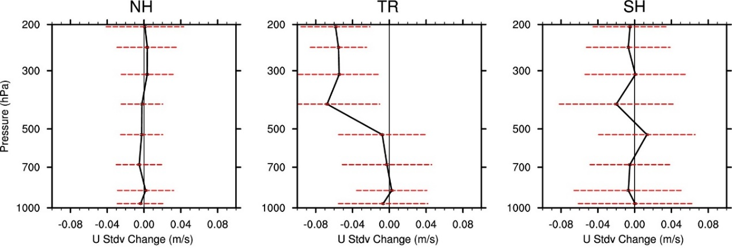
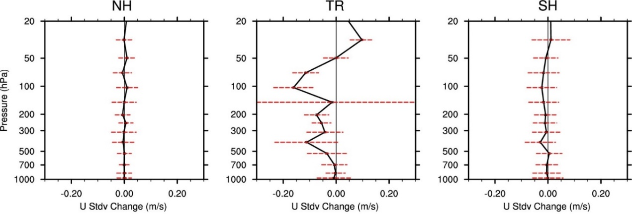
Aeolus forecast impacts FM-B period (Aug 2-Sep 30, 2019)
Improvement of background fits in Tropics, mostly for u component
Better
Worse
0
U wind Background vs. Aircraft (Aeolus – CTL)
U wind Background vs. Radiosonde (Aeolus – CTL)

Slide 10
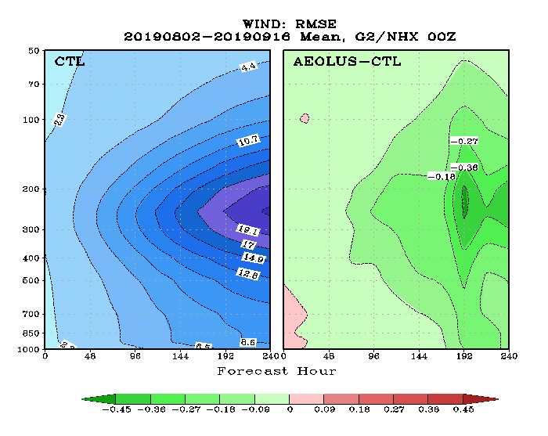
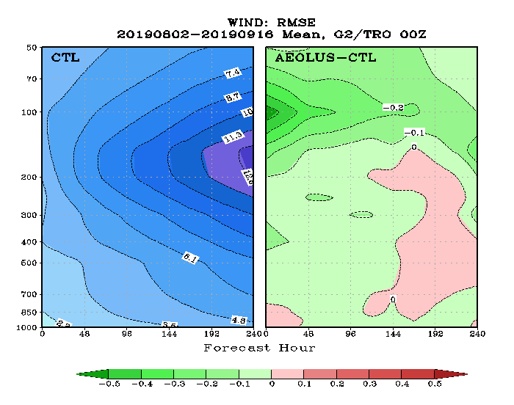
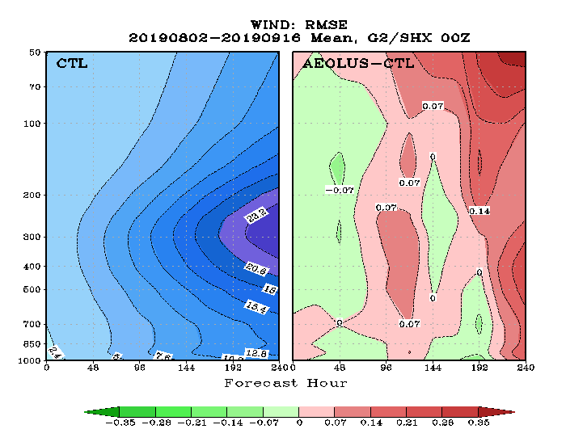
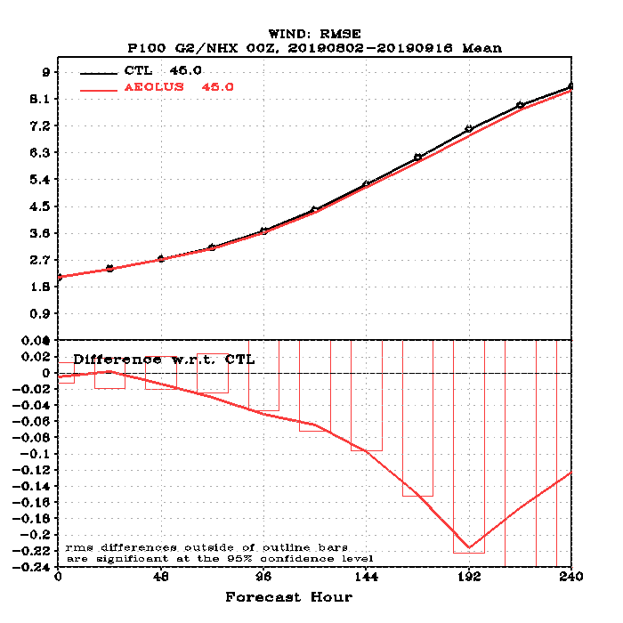
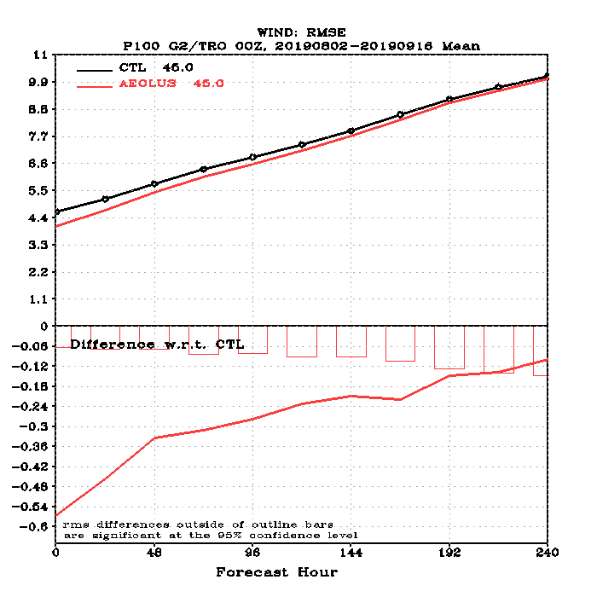
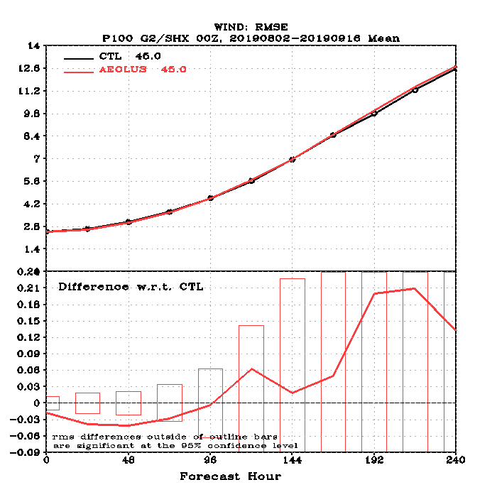
Aeolus forecast impacts FM-B period (Aug 2-Sep 30, 2019)
NH Wind RMSE
TRO Wind RMSE
SH Wind RMSE
CTL
Aeolus-CTL
CTL
Aeolus-CTL
CTL
Aeolus-CTL
100 hPa Wind RMSE
Difference (Aeolus-CTL)
Marginal RMSE reduction Significant RMSE reduction Significant RMSE reduction < Day-3

Slide 11
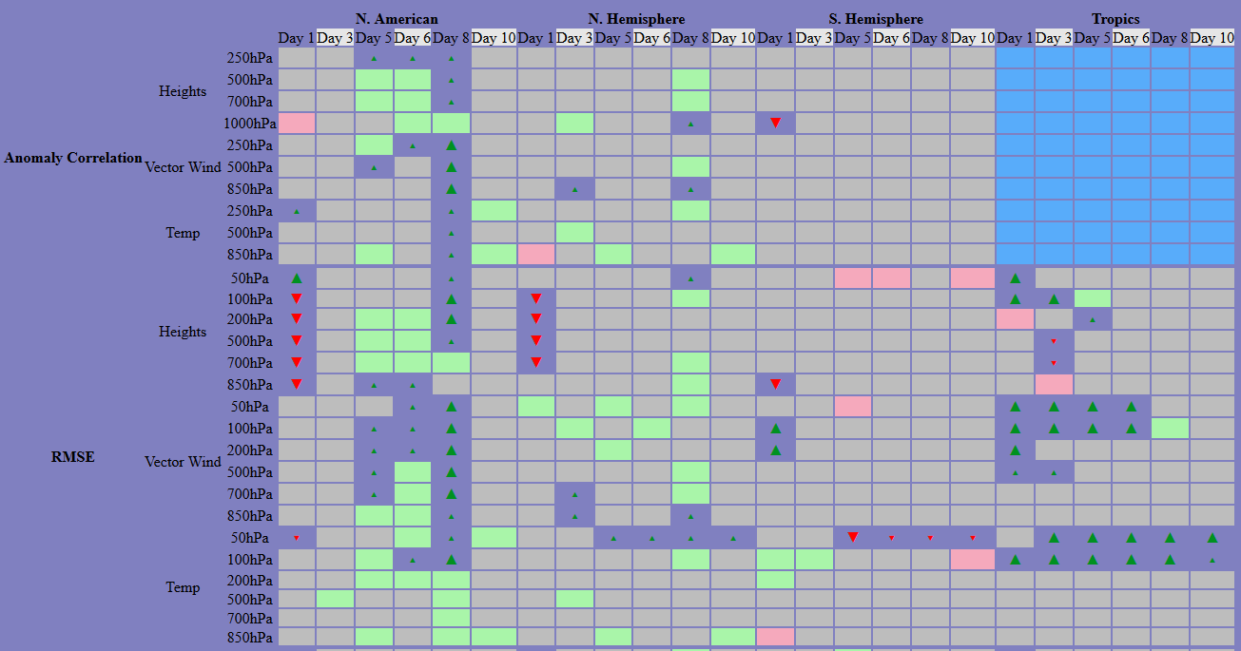
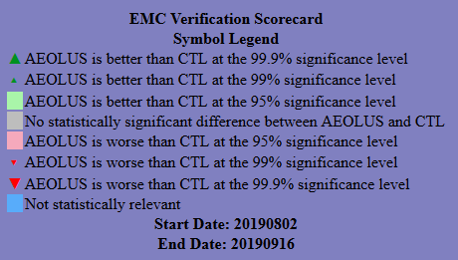
Aeolus forecast impacts FM-B period (Aug 2-Sep 30, 2019)
Mostly positive impact, significant in N. America and Tropics
NCEP Scorecard for Aeolus vs. CTL verified against ECMWF analysis

Slide 12
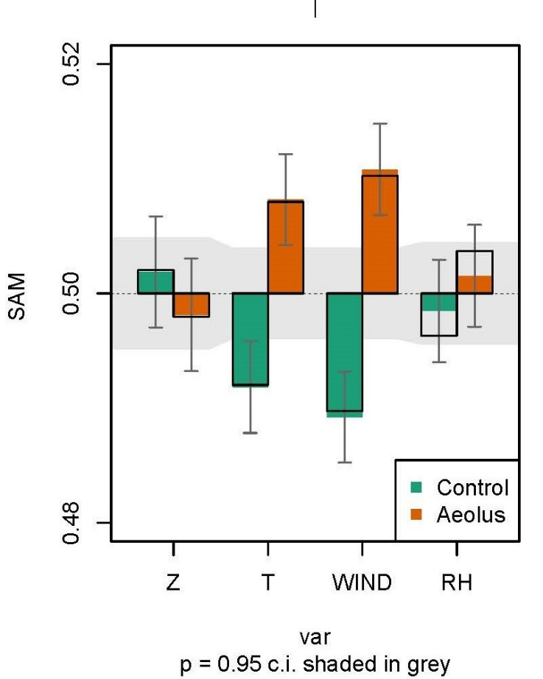
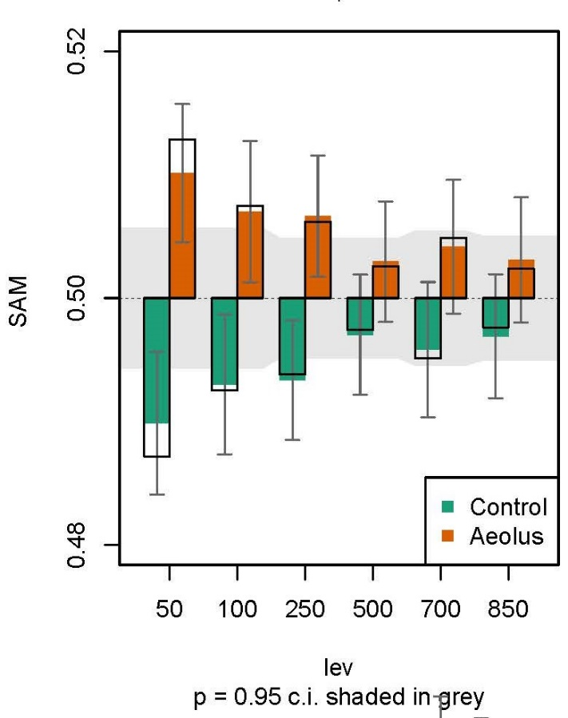
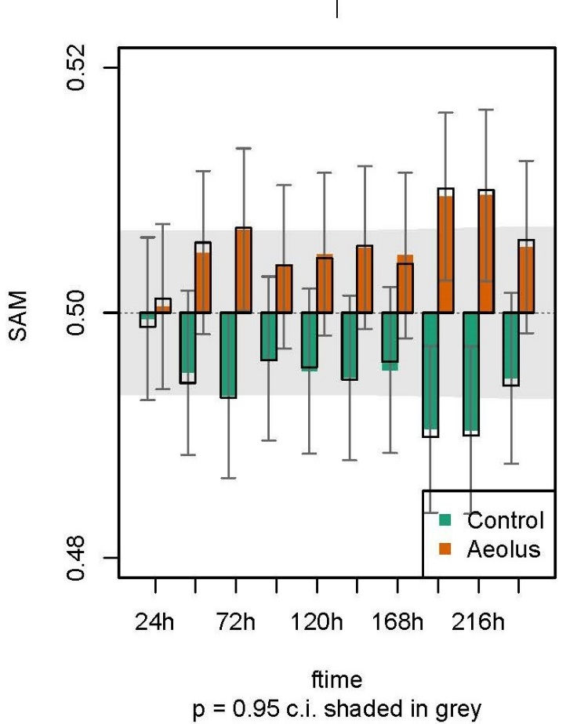
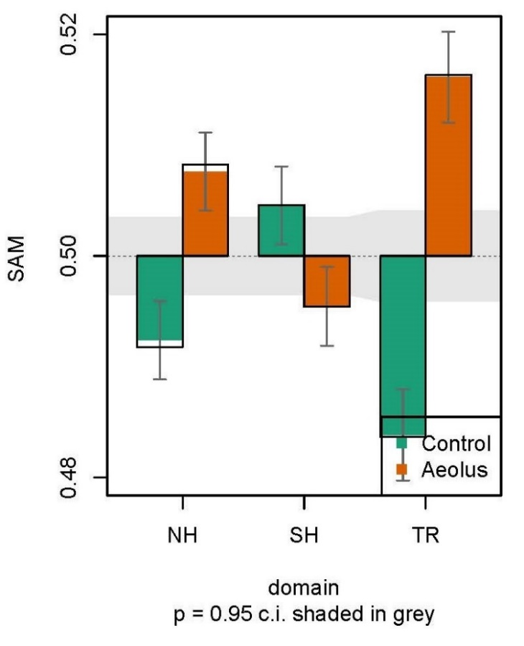
Aeolus forecast impacts FM-B period (Aug 2-Sep 30, 2019)
Distributions of SAMs with mean > 0.5 demonstrate positive impact; < 0.5 demonstrate negative impact
Region
Better
Parameter
Better
Worse
Worse
Level
Positive Impact | NH, TRO | T, Wind | Above 250 hPa | Day 3, 8, 9
Negative Impact | SH

Slide 13
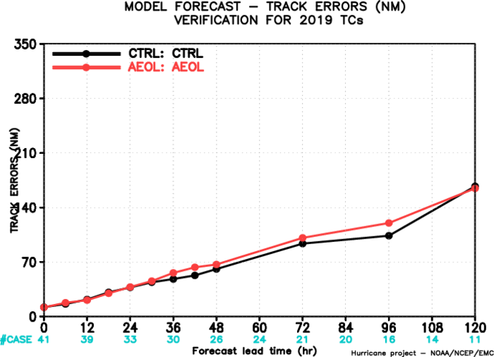
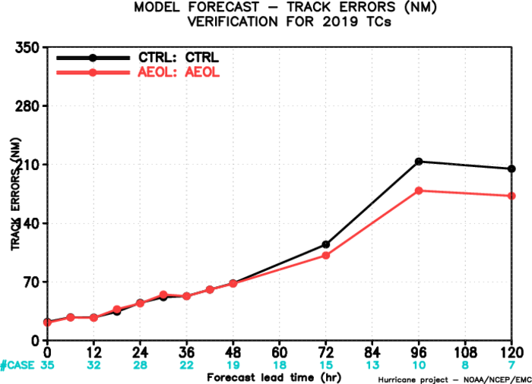
Aeolus forecast impacts FM-B period (Aug 2-Sep 30, 2019)
250 hPa u/v wind anl differences
Aeolus impact in Tropical Jet region in East Pacific is having a positive impact on EP track forecasts.
Neutral impact on winds around the AL basin result in small negative impact on AL track forecasts.
AL Basin Track Error
EP Basin Track Error

Slide 14
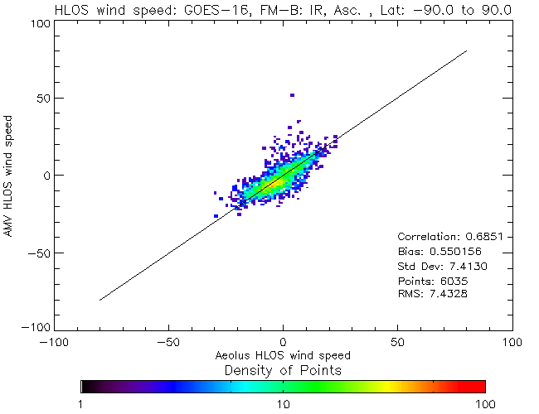
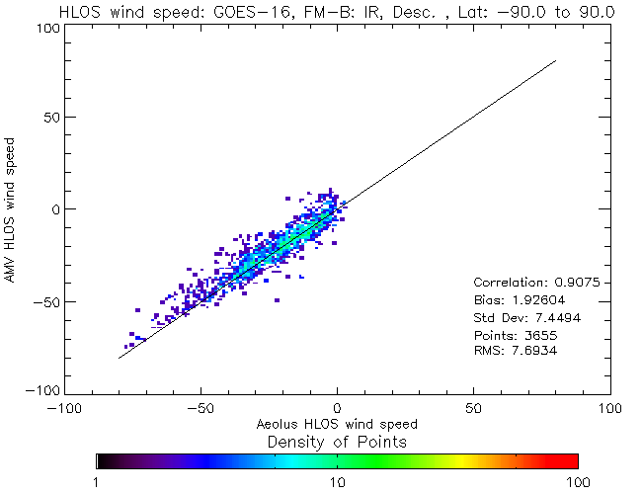
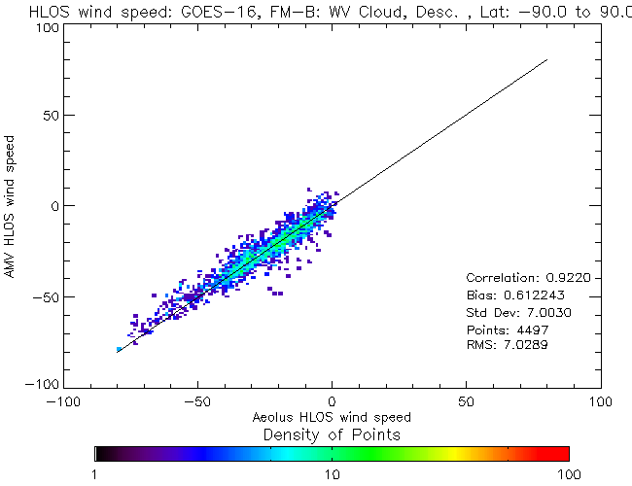
Can Aeolus improve AMV NWP impact?
Aeolus vs GOES-16 AMVs FM-B period
Produce dataset of collocated Aeolus to AMV (GEO, polar, all types)
Develop variational feature track correction (varFTC)
Minimize cost function to determine optimal shift in height assignment; possibly stratified into regimes
Initial results of this technique are promising
ASC
IR
ASC
WV-cloudy
DESC
IR
DESC
WV-cloudy

Slide 15
Assess impacts using M1 corrected data
Before M1 Correction (Aug-Sep 2019)
Days since August 2, 2019
Days since August 2, 2019
With M1 Correction (April-May 2020)
Days since April 21, 2020
Days since April 21, 2020

Slide 16
Summary
Aeolus HLOS data assimilation continues to demonstrate positive impact on NOAA global NWP
Analysis/Forecast impact with optimizations similar to previous results: impact on upper troposphere/stratospheric winds
Good consistency in results, even with different lasers, different QC, bias correction, obs errors, etc!
Refinement of assimilation with each improvement to data (FM-A, FM-B, FM-B w/M1 correction)
Refinement of DA for initial FM-B period improves forecast skill
Studies commencing using M1 corrected L2B data, and NOAA processed L2B data
Effort started to assess synergies between Aeolus and AMV (correct height assignment/wind biases of AMV)
Effort has started to conduct active/passive 3D-winds OSSEs
This work has been supported by the NOAA/NESDIS/OPPA Technology Maturation Program

