Slide 1
Comparison and validation of Aeolus winds to AIRS 3D winds, rawinsondes, and reanalyses
David Santek, Brett Hoover, Hong Zhang
University of Wisconsin-Madison
Space Science and Engineering Center (SSEC)
Cooperative Institute for Meteorological Satellite Studies (CIMSS)
NOAA NA15NES4320001
NASA ROSES 80NSSC18K0984

Slide 2
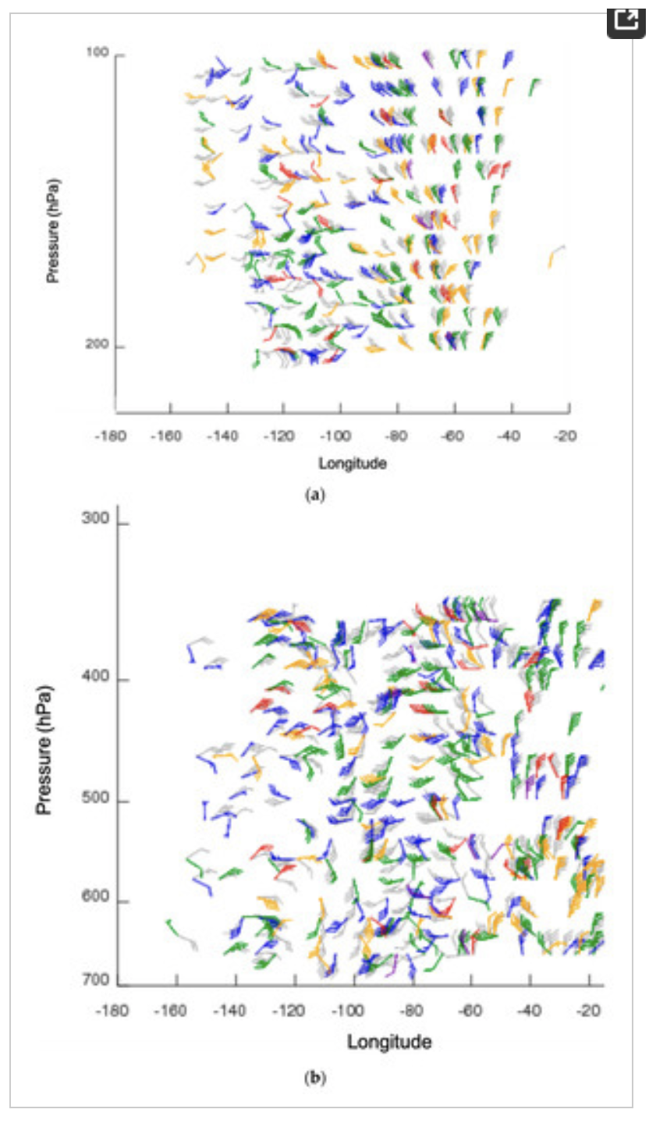
What are 3D winds?
Vertical distribution of wind information in the troposphere and stratosphere. Considering two methods:
Direct measurement using Lidar (Aeolus)
Tracking moisture and ozone features on pressure surfaces (Aqua AIRS retrievals)

Slide 3
Why compare AIRS 3D winds to Aeolus winds?
Motivation
Decadal Survey recommends a 3D tropospheric wind mission Using a space-based LIDAR instrument and/or the use of hyperspectral infrared measurements
The combination of lidar winds and AMV winds might also provide some advantages where one is used to calibrate the other.
Validation
They both provide a vertical distribution of winds throughout the troposphere and stratosphere in clear sky and above cloud

Slide 4
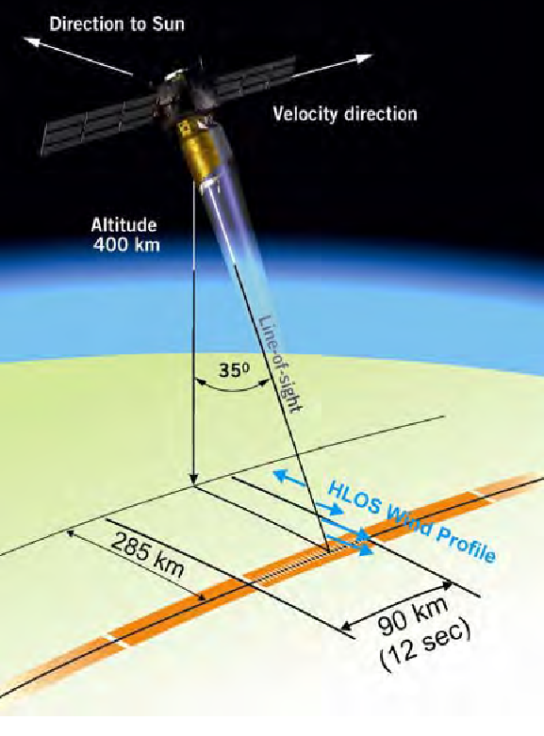
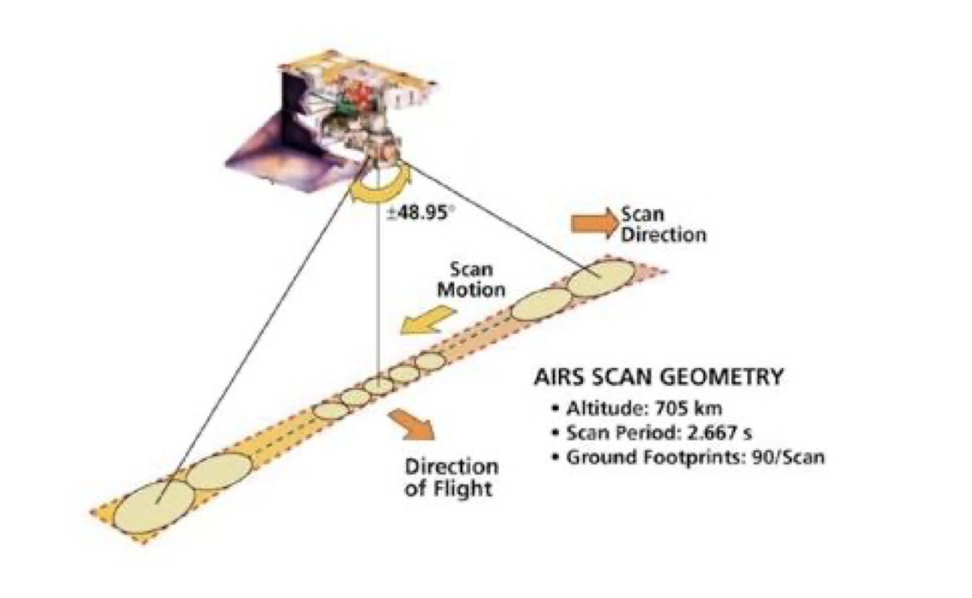
Aeolus vs AIRS
Atmospheric Infrared Sounder (AIRS)
Hyperspectral Infrared instrument
2378 Channels
Results in vertical profiles of temperature, humidity, ozone in the troposphere and stratosphere
Aeolus
AIRS
NOAA-NASA Working Group on Space-based Lidar Winds 2020
4

Slide 5
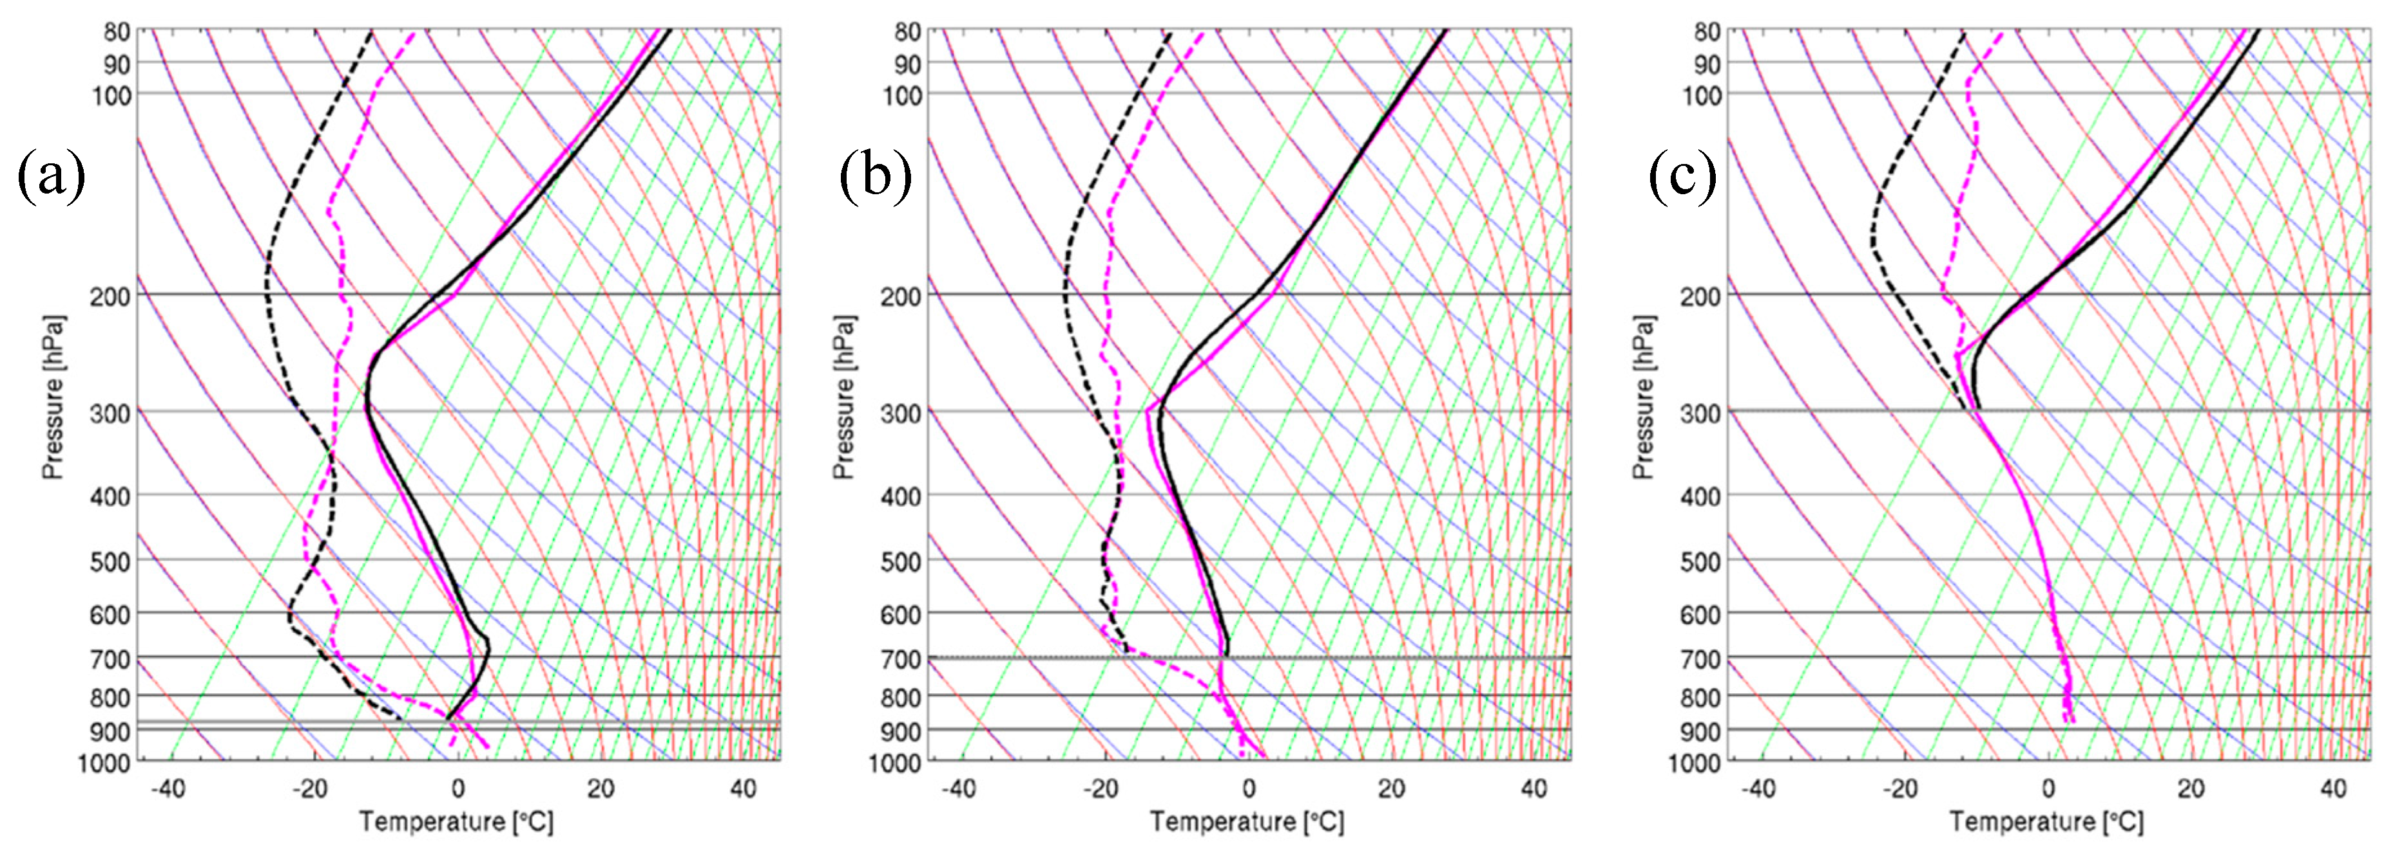
Aeolus vs AIRS Retrieval Winds
Aeolus: Doppler wind lidar (DWL) instrument. Single line-of-sight instrument, which results in the Horizontal Line of Sight (HLOS) component of the wind.
Mie: Particle (aerosols and clouds) Rayleigh: Molecular (cloud free)
AIRS 3D winds: Winds derived from tracking moisture features (troposphere) and ozone gradients (stratosphere) on pressure surfaces from AIRS retrieved vertical profiles of temperature, humidity, and ozone in clear-sky and above cloud.
Example temperature and dewpoint profiles for clear sky (a), above low cloud (b), above high cloud (c) as compared to the model background. Retrievals (black) and NCEP/GFS (magenta).

Slide 6
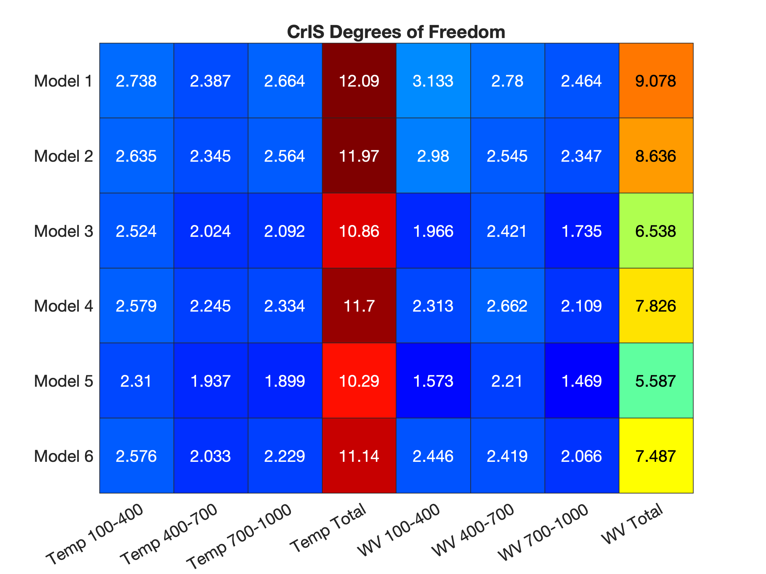
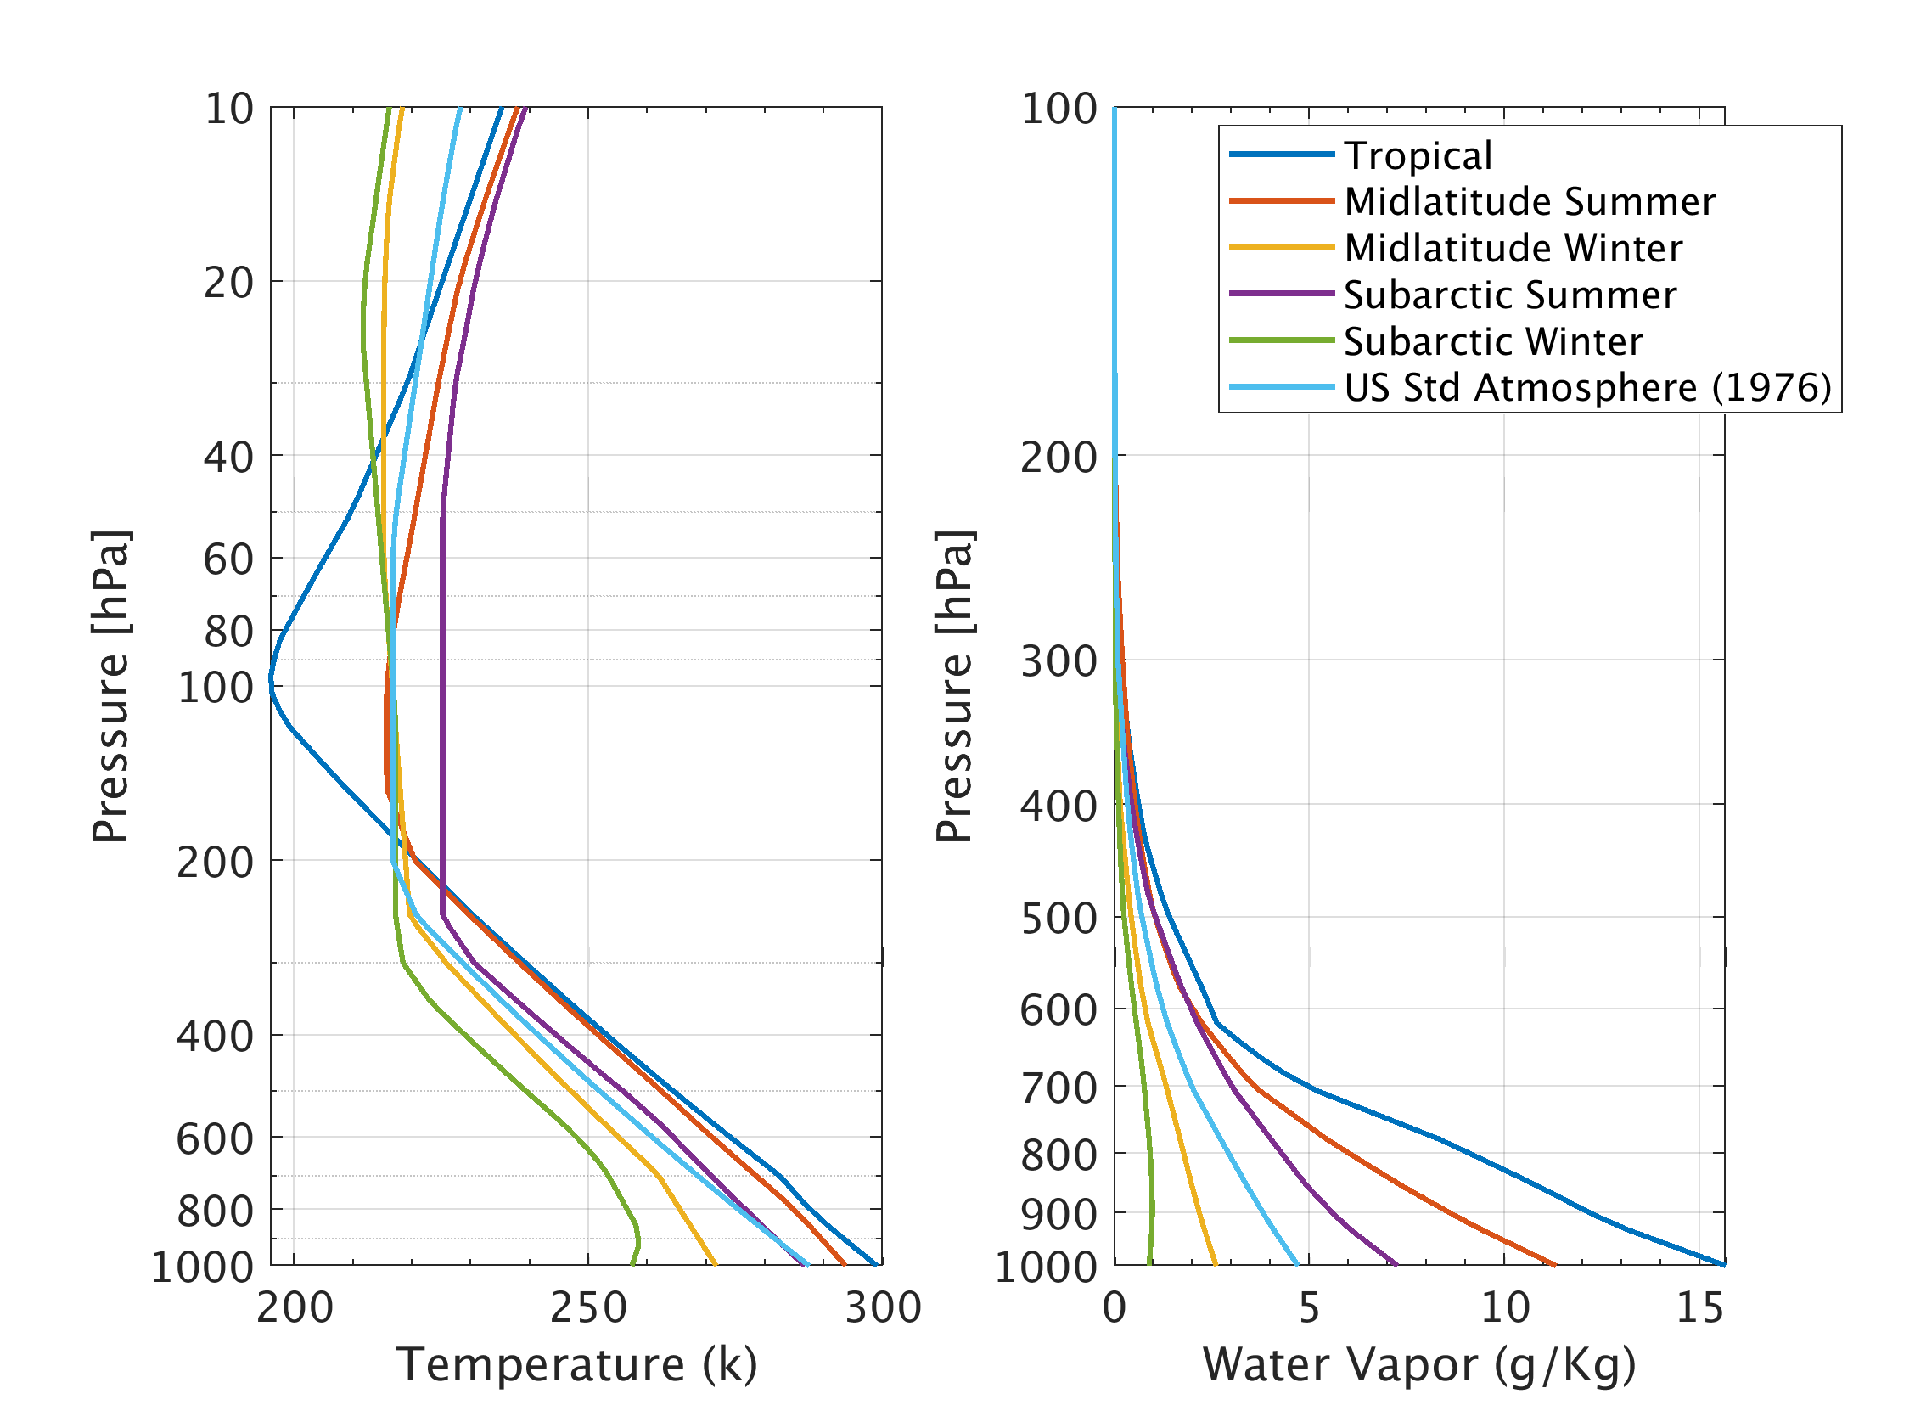
Hyperspectral IR Retrievals Temperature and humidity Degrees of Freedom
Six Model Atmospheres Temperature and Water Vapor Profiles
Retrievals of moisture from hyperspectral IR radiances resolve onto 5 to 8 independent pressure levels from 100 to 1000 hPa
Tropical
Mid-lat summer
Mid-lat winter
Subarctic summer
Subarctic winter
Standard Atmosphere
Degrees of Freedom (DOF)
Independent pieces of information (shown in pressure layers)
The Totals are from surface to TOA
NOAA-NASA Working Group on Space-based Lidar Winds 2020
6

Slide 7
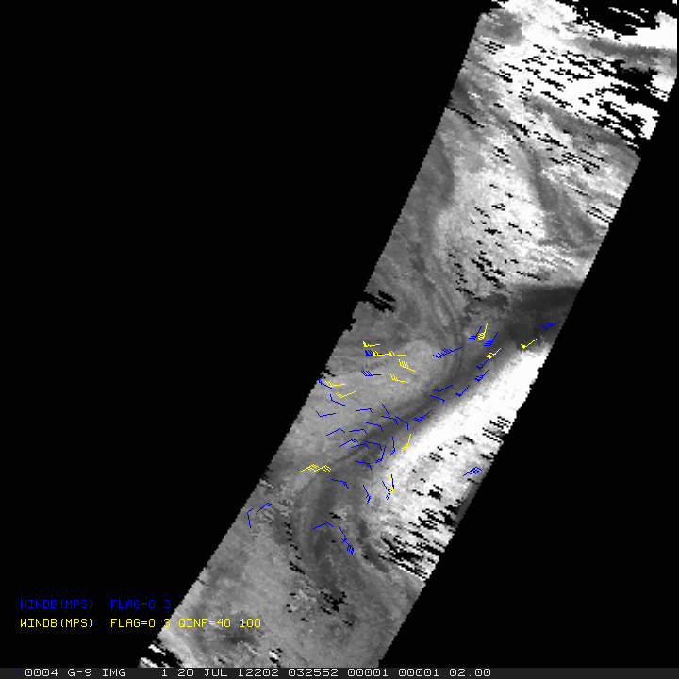
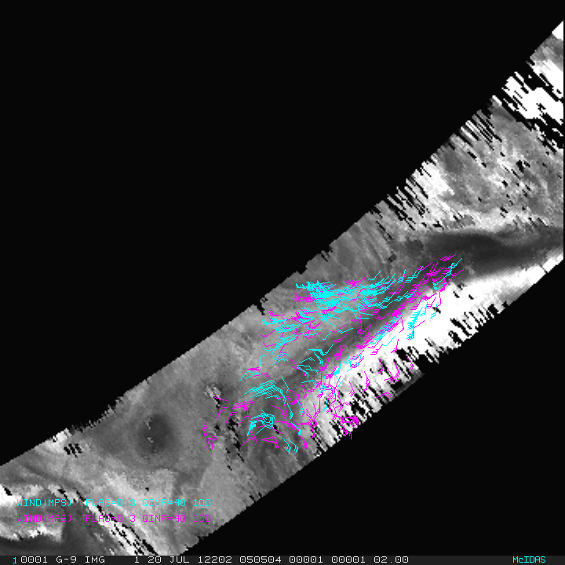
AIRS 3D Winds Atmospheric Motion Vectors (AMVs)
20 July 2012: 0325, 0505, 0643 UTC
AIRS 20 July 2012 0505 UTC
Ozone (magenta): 103 to 201 hPa Humidity (cyan): 359 to 616 hPa
Wind vectors on 400 hPa pressure surface centered on North Pole
Blue: All winds Yellow: Quality controlled
https://www.mdpi.com/2072-4292/11/22/2597

Slide 8
Aeolus vs AIRS winds
AIRS retrieval winds | Aeolus Rayleigh clear-sky
Humidity feature tracking | Molecular motion using Doppler Lidar
Total wind | Horizontal Line of Sight (HLOS) wind component
Better spatial coverage | Better vertical resolution
Average motion spanning 200 minutes | Near instantaneous
Comparisons
August through September 2019
Only polar regions
Intercomparison
Each compared to rawinsondes
Co-located compared to ERA5 reanalysis
Account for differences
Total wind from AIRS AMVs was adjusted to equivalent HLOS wind (used viewing angle from co-located Aeolus winds)
For each AIRS AMV, co-located Aeolus winds were super-obbed in space and time
Co-location
Within 100 km (150 km for rawinsondes)
+/- 90 minutes (+/- 60 min. for rawinsondes)
+/- .04 difference in log10 pressures (approx. height)
+/- 60 hPa at 700 hPa
+/- 20 hPa at 200 hPa

Slide 9
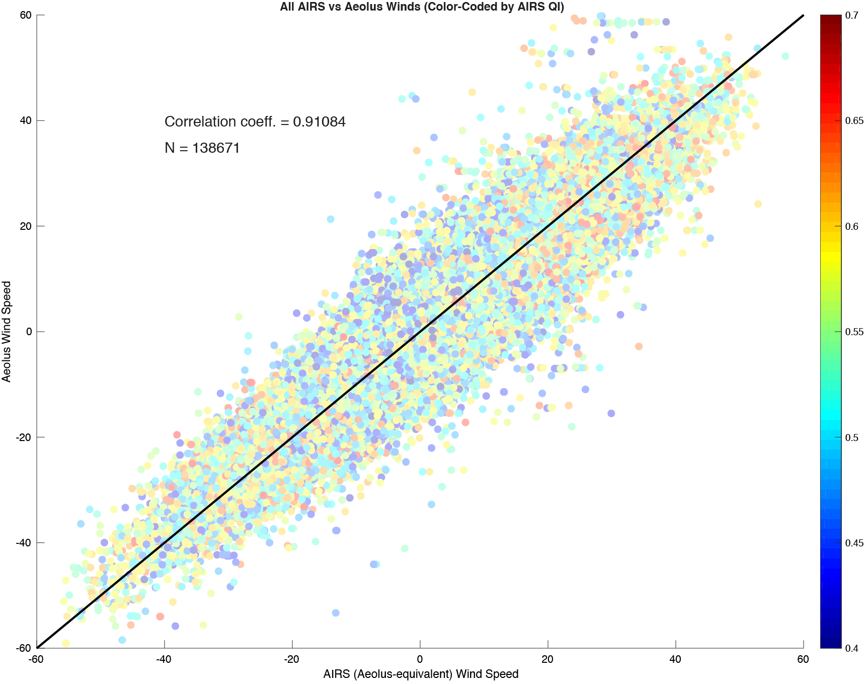
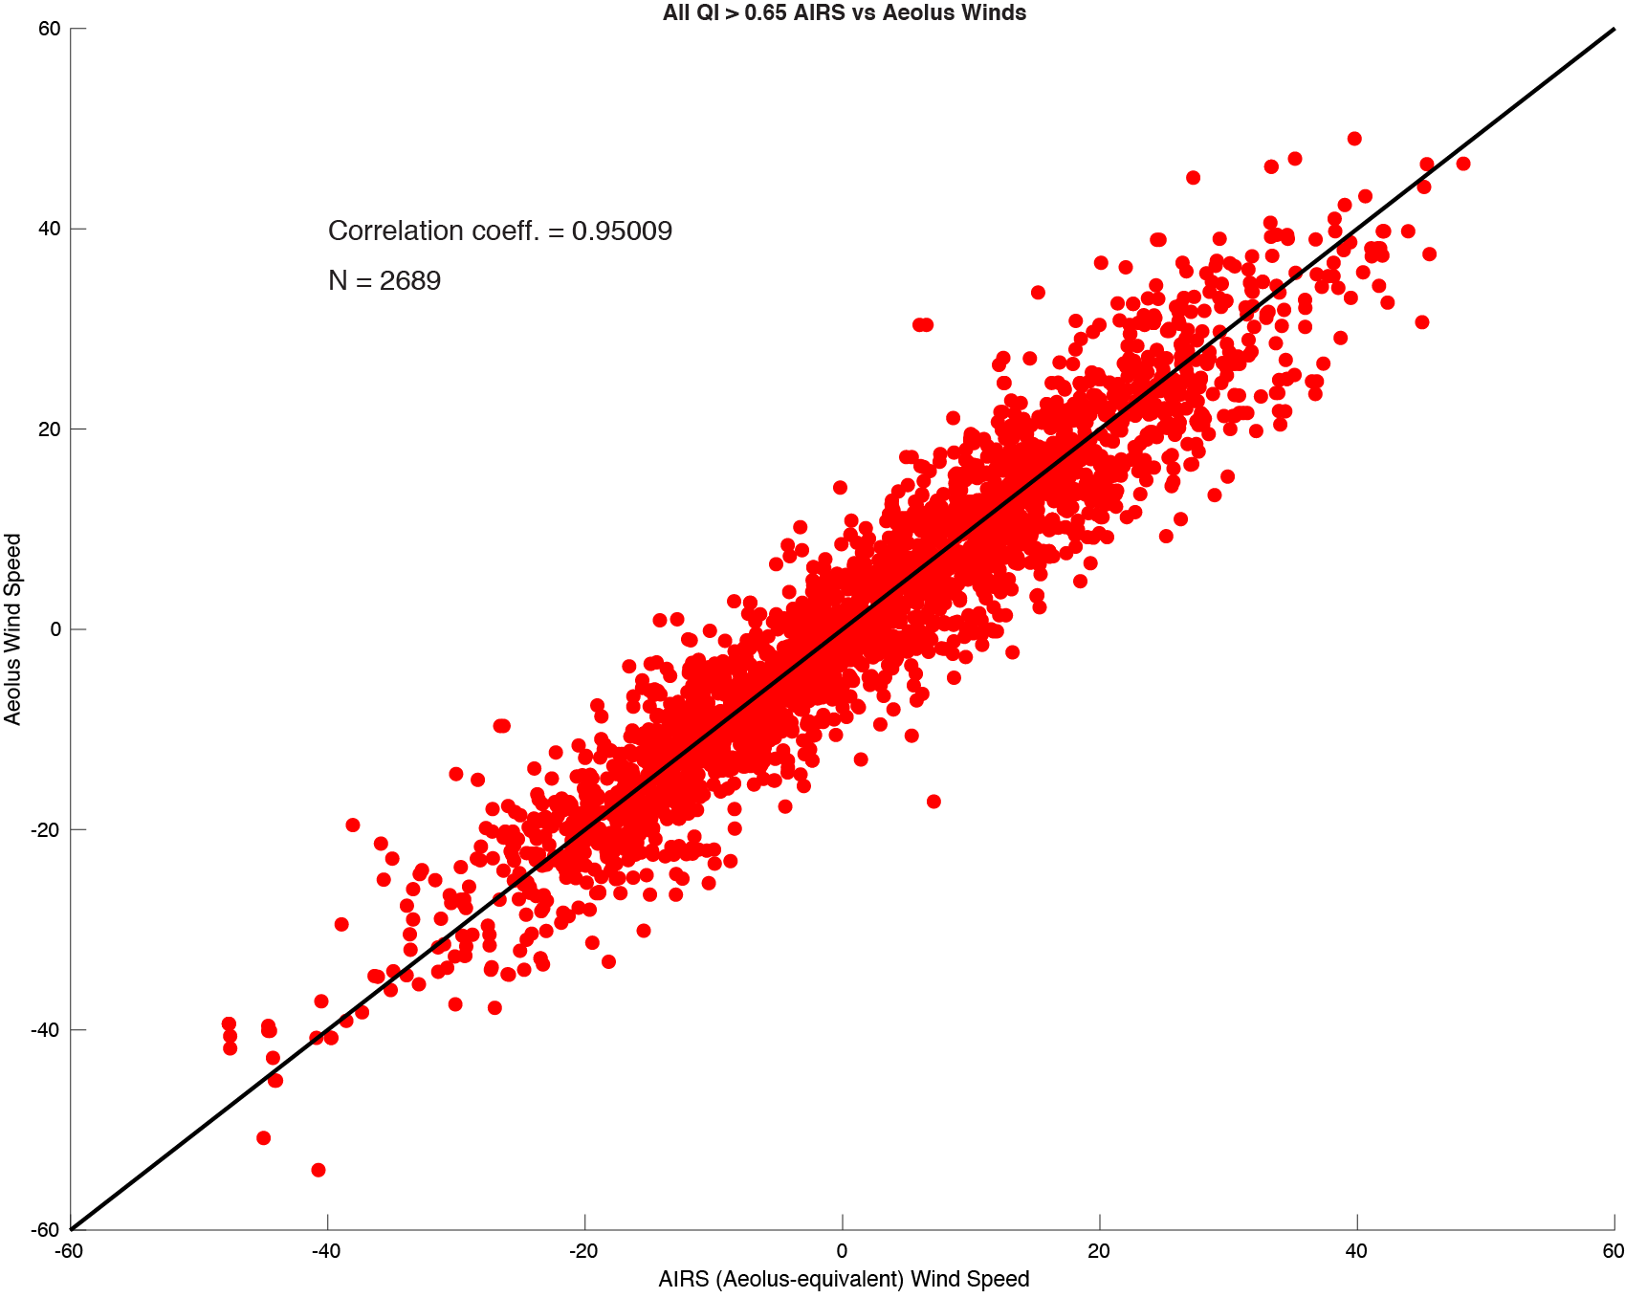
Aeolus vs AIRS Winds
HLOS Wind Speed
N = 138,671
r = 0.91
N = 2,689
r = 0.95
All winds color-coded by AIRS quality; polar region
Highest quality AIRS winds; polar region

Slide 10
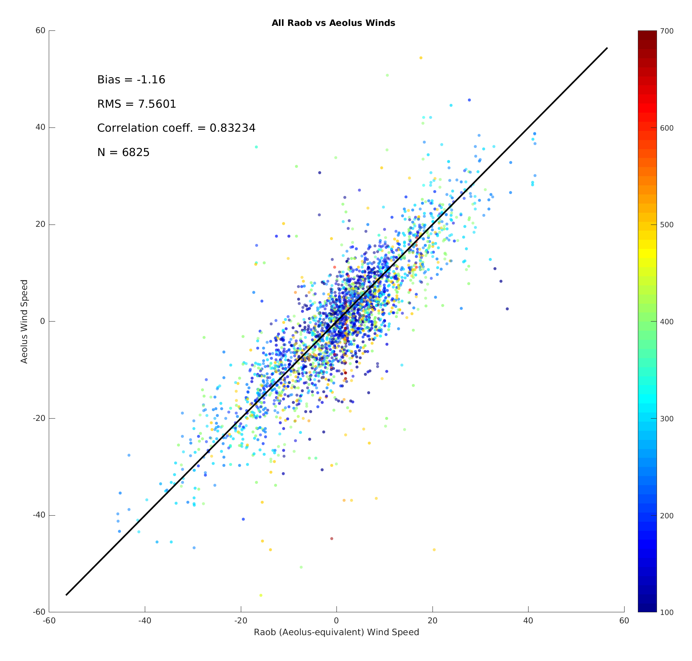
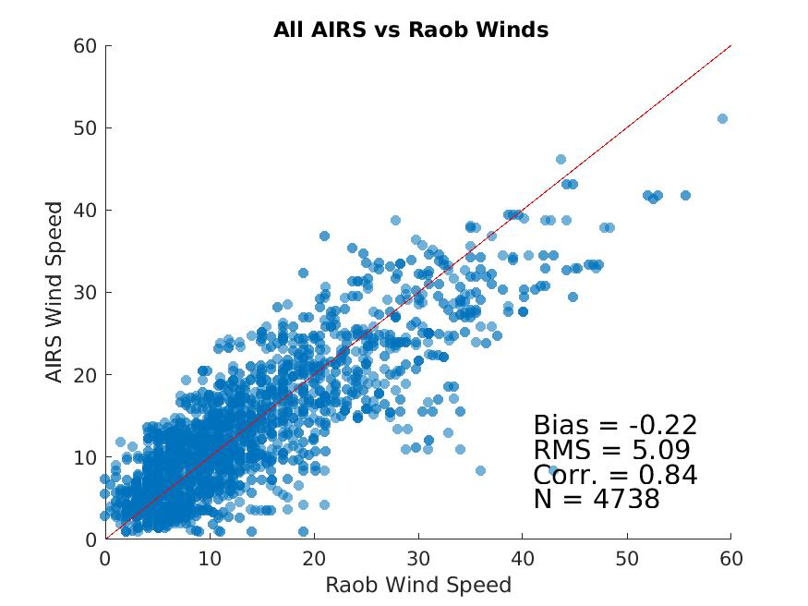
Aeolus and AIRS Winds Compared to Rawinsondes
Wind speed
N = 6,825
Bias = +0.83 ms⁻¹
RMSD = 7.56 ms⁻¹
r = 0.83
N = 4,738
Bias = -0.22 ms⁻¹
RMSD = 5.09 ms⁻¹
r = 0.84
Aeolus HLOS wind speed color-coded by pressure; polar region
All AIRS winds (total wind); polar region

Slide 11
Comparisons to ERA5
Aeolus Rayleigh and AIRS 3D winds compared to ERA5 for 10 days in August and September 2019
~36,000 AIRS/Aeolus co-locations
 | AIRS vs ERA5 | Aeolus vs ERA5
Bias | +0.015 ms⁻¹ | -0.265 ms⁻¹
RMSE | 4.61 ms⁻¹ | 5.49 ms⁻¹
Correlation | 0.94 | 0.92
Differences in bias are statistically significant at 95% confidence using a 2-sided student's t-test
NOAA-NASA Working Group on Space-based Lidar Winds 2020

Slide 12
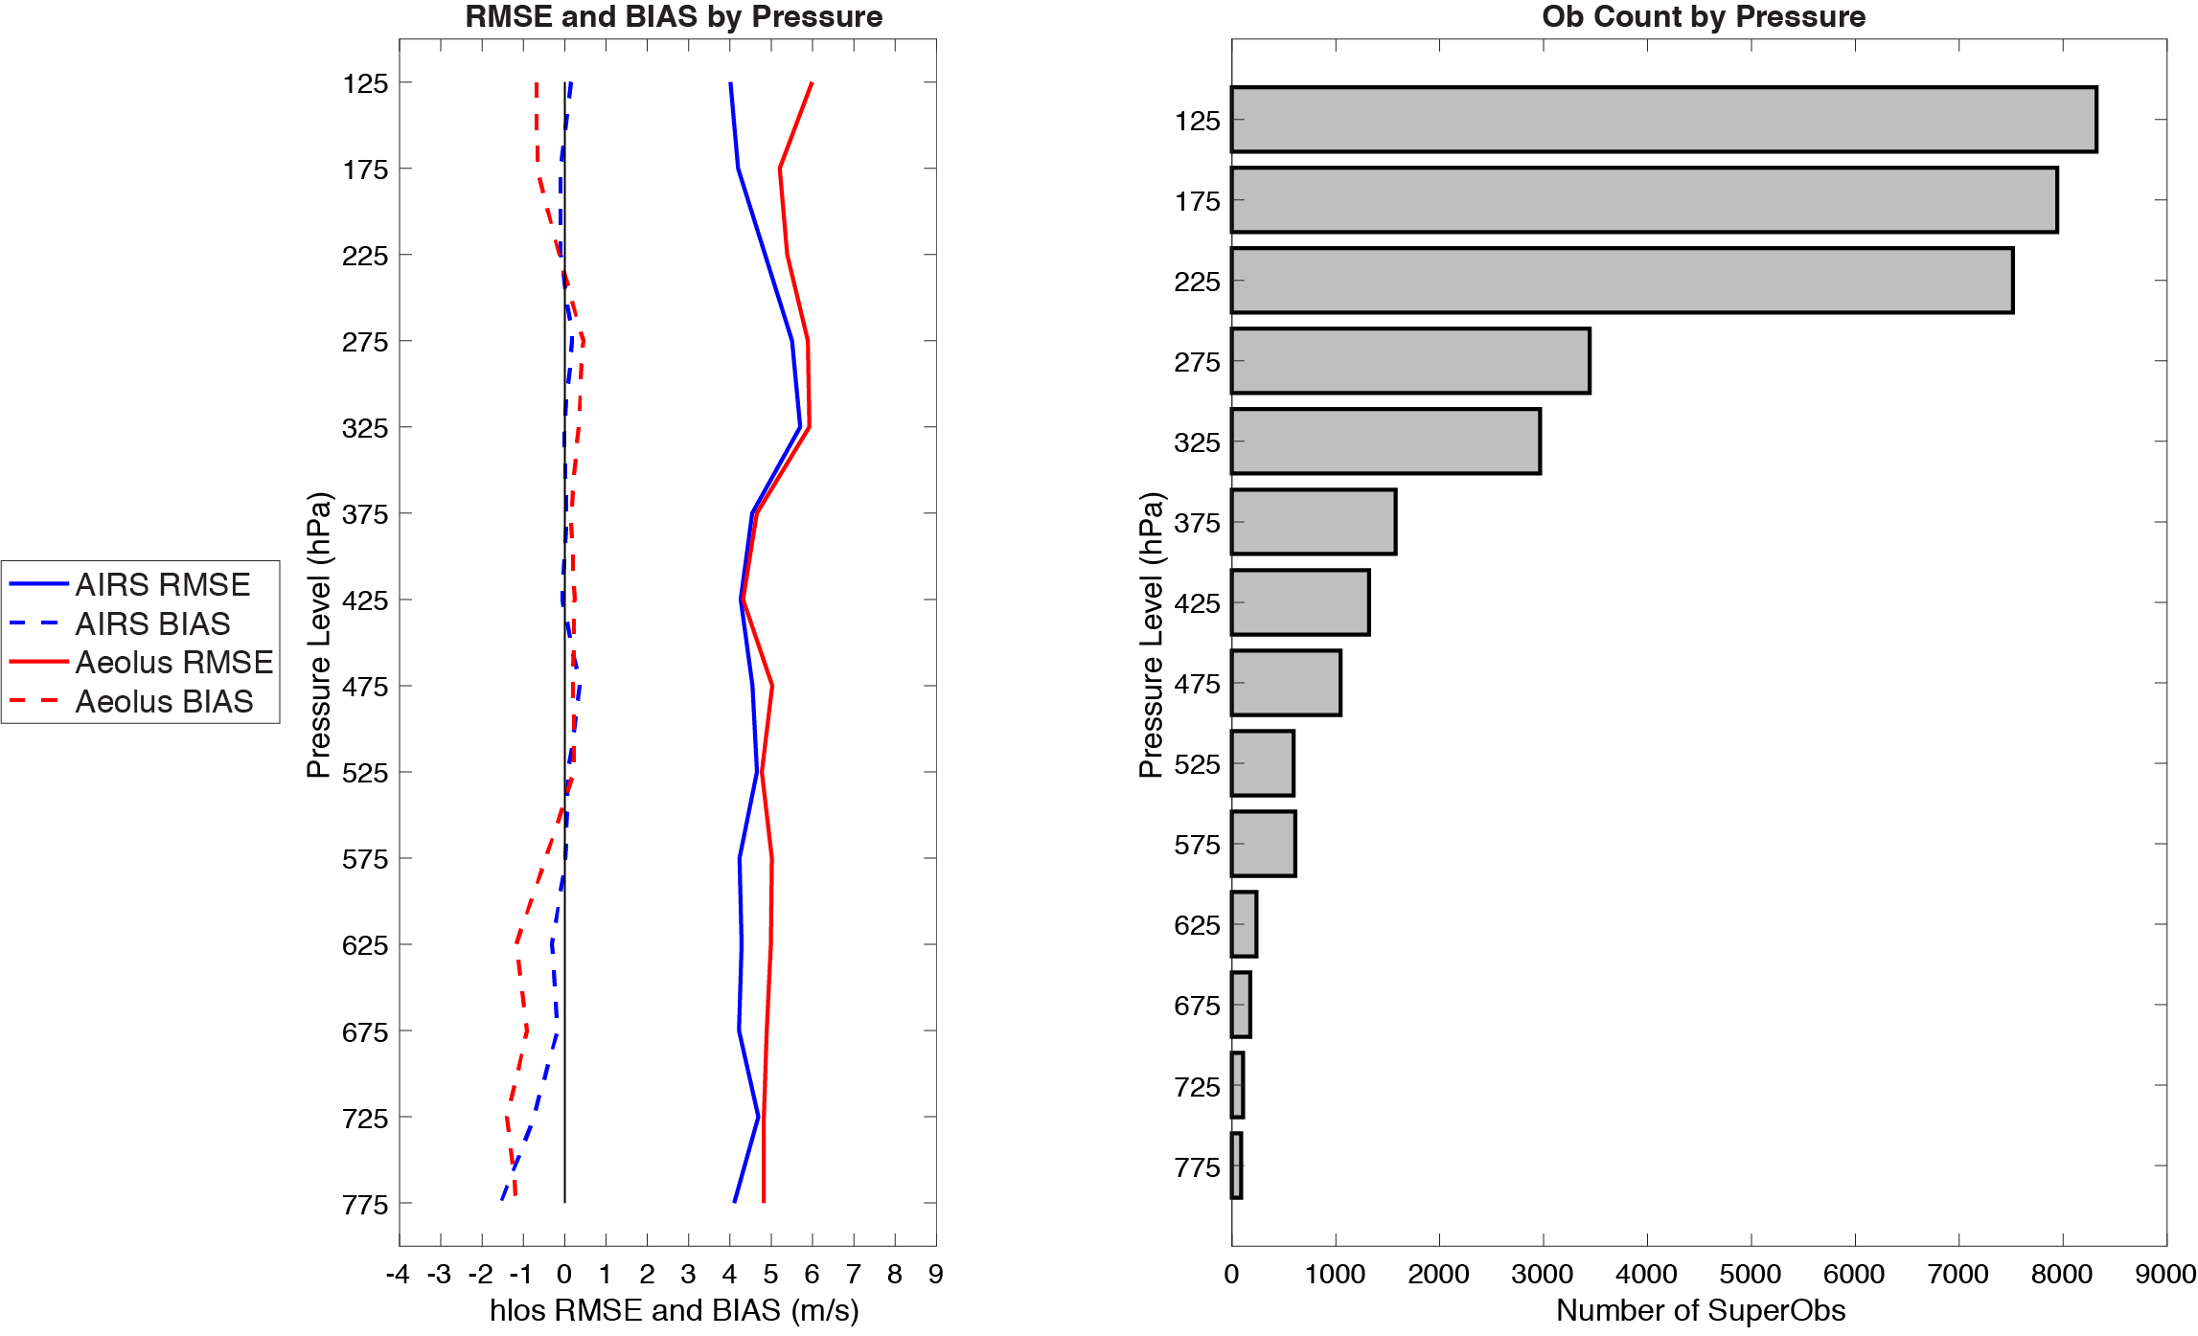
Comparisons to ERA5
AIRS and Aeolus have similar bias and RMSE throughout mid- and upper-troposphere
Largest differences are in the lower troposphere and the stratosphere: AIRS 3D winds compare more closely
AIRS and Aeolus wind speed bias (dashed) and RMSD (solid) compared to ERA5
NOAA-NASA Working Group on Space-based Lidar Winds 2020

Slide 13
Summary
Since there are several inherent differences in the spatial coverage, temporal sampling, and wind measurement this high correlation indicates these two sources of 3D winds may be complementary, with similar quality.
Aeolus vs AIRS HLOS-equivalent wind speed
This helps to justify a combined mission of a DWL with a hyperspectral IR instrument:
DWL gives high-quality 3D profiles of HLOS winds along a path
Hyperspectral IR will provide potentially similar quality total wind with improved horizontal spatial coverage (reduced vertical resolution). Note: Higher resolution hyperspectral instrument needed.
NOAA-NASA Working Group on Space-based Lidar Winds 2020

