Slide 1
The role of ADWLs in the design, performance simulations, trade studies and cal/val of space-based wind observing systems
G. D. Emmitt, S. Greco and S. A. Wood
Simpson Weather Associates
M. J. Kavaya and K. M. Bedka
NASA/LaRC
NOAA-NASA Working Group on Space-based Lidar Winds
Virtual meeting
17-19 November, 2020

Slide 2
ADWLs available for wind observations, especially over oceans
TODWL (ONR, Naval Postgraduate School)
P3DWL (Army Research Laboratory/NOAA )
DAWN (NASA, LaRC)
DLR A2D and 2um coherent system (DLR)
Near future
AWP (NASA/LaRC)
OAWL (Ball Aerospace)

Slide 3
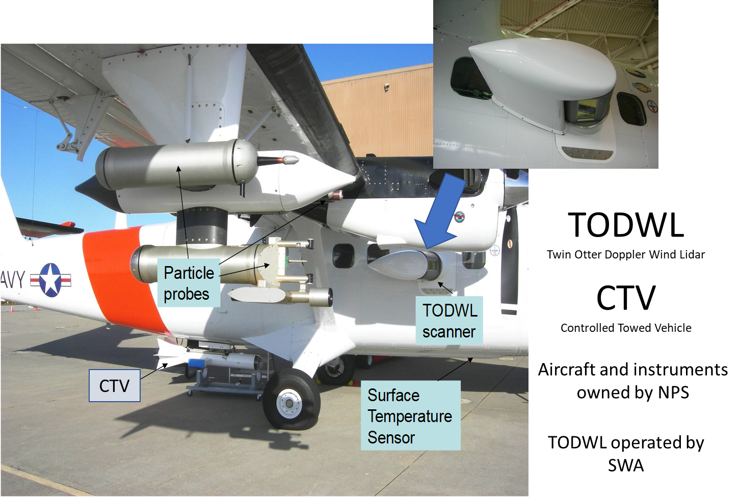
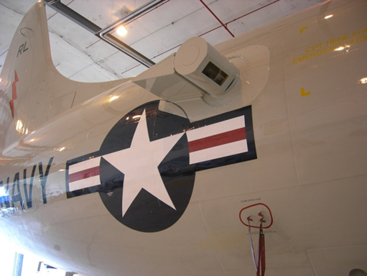
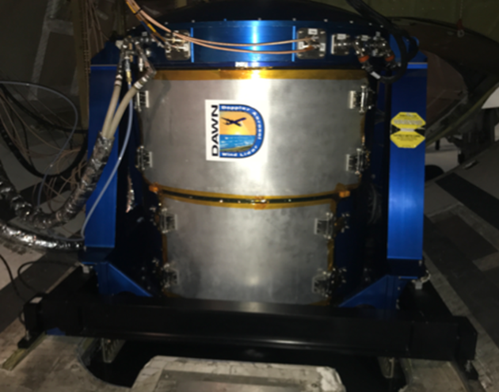
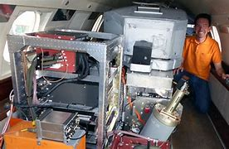
P3DWL
DLR DWLs
DAWN

Slide 4
Papers relevant to this presentation (last 3 years) (TODWL, P3DWL and DAWN)
Bucci, L., S. Majumdar, R. Atlas, B. Dahl, G.D. Emmitt and S.A. Wood, 2020: Impacts of Assimilating Airborne Doppler Wind Lidar data into NOAA’s Hurricane Weather Research and Forecasting (HWRF) System. 34th Conference on Hurricanes and Tropical Meteorology, New Orleans, LA, May. 12
Cui, Z., Z. Pu, G.D. Emmitt and S. Greco, 2020: The Impact of Airborne Doppler Aerosol WiNd lidar (DAWN) Wind Profiles on Numerical Simulations of Tropical Convective Systems during the NASA Convective Processes Experiment (CPEX). Journal of Atmospheric and Oceanic Technology, Accepted for publication, February 28, 2020.
Emmitt, G.D. and S. Greco, 2020: Using an Airborne Doppler Wind Lidar to Evaluate Sampling and Data Processing Strategies Relevant to PBL Research and a Future Space-based System. Amer. Meteor. Soc. 100th Ann. Meeting, , 10th Symposium on Lidar Atmospheric Applications Poster Session, Boston, MA, Jan. 13.
Greco, S., G.D. Emmitt, S. Wood, K. Bedka and S. Rodier, 2020: Comparison of DAWN, Dropsonde and Aeolus Wind Observations during the April 2019 NASA Aeolus Cal/Val Test Flight Campaign. Amer. Meteor. Soc. 100th Ann. Meeting, 16th Annual Symposium on New Generation Operational Environmental Satellite Systems, Boston, MA, Jan. 16.
Greco, S., G.D. Emmitt, S. Wood and M. Kavaya, 2019: Potential ABL wind measurements and derived parameters from a space-based coherent Doppler Wind Lidar. AGU 100th Fall Meeting, A11T – Observing the Boundary Layer from Space II Poster Session, San Francisco, CA, Dec. 9.periments (OSSEs)—Part II, Phoenix Az., January 8
Emmitt, G. D., M. Kavaya and U. Singh, 2017: Integrating a Doppler wind lidar into a network of wind observing systems: Capitalizing on synergisms with a high precision, cloud scene penetrating lidar. 2017 IEEE International Geoscience and Remote Sensing Symposium (IGARSS), Fort Worth, TX, USA,23-28 July 2017.

Slide 5
Papers/presentations relevant to this presentation (most co-authored with NASA and NOAA researchers)
Decade | OSSEs | Data Assimilation | Instrument design/trade studies | Cal/Val
2011-2020 | 21 | 15 | 10 | 9
2001-2010 | 52 | 8 | 21 | 5
1991-1999 | 17 |  | 16
Source: http://www.swa.com/research-library/eld-library

Slide 6
Space-based wind observing system (s): mission phases
Requirements
Concept construction (OSSEs)
DWL instrument error (random and bias) can be traced to ADWL observations
Detailed design and trade studies (OSSEs)
Airborne demonstrations of the technology
DWL data processing and product generation
Developed with airborne DWL data
Post launch cal/val
ADWLs able to cover significant expanses of ocean
Post launch product improvement
ADWLs plus companion sensors (e.g. HALO, dropsondes) can provide oversampling with precise wind and aerosol measurements

Slide 7
Requirements for space-based wind observations
Science/application justification
Global weather forecasting
Global PBL research
Global full tropospheric/stratospheric research
Precision
Coverage
Temporal
Spatial
Latency
Data management

Slide 8
Space-based DWL concept development
Instrument feasibility/trade studies (built upon ADWL experience)
Single/hybrid technology
Aeolus approach; Direct Mie and Rayleigh
Coherent Mie; Direct Rayleigh
Synergistic technologies
Active lidar and passive AMVs
Multi parameter missions
DIAL plus DWL

Slide 9
ADWL support for simulations for OSSEs
Coherent or Direct
Passive AMVs
Emphasis in simulating optical remote sensing of winds for OSSEs has been clouds and turbulence/shear.
Characterization of instrument measurement errors based upon ADWL downward looking perspective (clouds, aerosols, surface reflections)
Random errors
Bias (more important)
Sampling errors derived from sub-sampling high quality/high density ADWL observations.
Representativeness
Situational bias (e.g. clouds permitting)

Slide 10
Other space-based DWL simulations
LAWS (EOS proposal); 1989-1993
GTWS (NPOESS and data buy); 1996 -1998
SPARCLE (NASA Shuttle); 1997-2001
DD/Hybrid (Gentry at GSFC); 1999-2001
Tech neutral DWL OSSEs (NCEP); 2000-2003
JEMCDL (Japan); 2001-2003
GeoWinds (NASA); 2001
ALADIN (ESA); 2008
GWOS (NOPESS); 2008-2012
WISSCR (a Coherent DWL for ISS); 2011-2012
OAWL (free flyer); 2011-2015
OAWL (ISS); 2014-2015
WINDSP (under development); 2017 - present

Slide 11
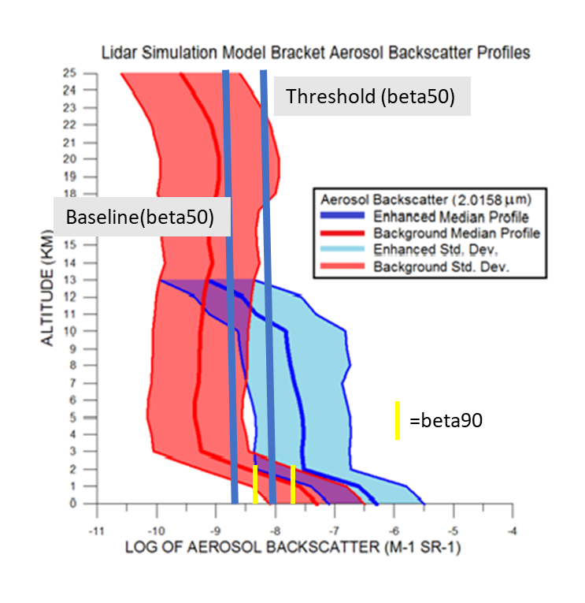
These beta profiles are
based upon data
collected during
NASA and European
airborne campaigns
in addition to verification
by ground based lidars
with coherent detection
Some data bases support
1-2 orders of magnitude
higher backscatter in the
near surface than
we have been using in
our simulations.
MODTRAN PBL VALUES
http://www.swa.com/images/LidarSpaceBased/Design%20atmospheres%20for%20GTWS.pdf

Slide 12
Simulated potential WIND-SP vertical coverage
NO CLOUD
W/CLOUDS
BACKGROUND
AEROSOLS
(e.g. SH, ARCTIC)
Remember the 90/10 rule
ENHANCED
AEROSOLS
(e.g. Anthro, deserts,
fires, thin clouds

Slide 13
Data processing and product generation practice using ADWL data before launch
Adaptive Integration Algorithm (AIA)
Supervised Search Algorithm (SSA)
Multi-pass Micro Slides (MMS)
Multiscale Turbulence Metric (MTM)
Sea Spray and Foam Detection Algorithm (SSFDA)
Wave State Metric (WSM)

Slide 14
Identifying MABL properties observable from space using ADWL based algorithms
Profiles of the horizontal wind vector using two perspectives
Maximum vertical resolution ~ 33m in high backscatter situations
Nominal horizontal resolution ~500m in high backscatter situations
Depth of the MABL defined by backscatter gradients
Vertical resolution using sliding gates ~ 10-25m for well defined ABL tops
Depth of the mixed layer using the spectral width
Limited to cases where TKE > 1.0 m^2/s^2 near top of PBL
Shear within the MABL
Presence of LLJs which have a significant impact on estimating air/sea exchanges
Presence of rolls within the MABL
Allows for selection of appropriate parametrization of the ABL fluxes
Depth of sea spray layer and presence of foam
Large impact on air/sea fluxes; spray enhances fluxes while foam reduces fluxes
Additional observations of surface currents and waves in high impact situations

Slide 15
ADWL data Processing Package for the mABL (AP³BL)
PBL heights derived from aerosols and turbulence
PBL turbulence intensities used with other space-based observables to estimate fluxes
Detection of the presence of LLJs and OLEs within the MABL
Sea State (waves, foam, currents)
LAS (Layer Adjacent to the Surface) aerosol gradients and structures

Slide 16
Detailed design stage for DWL instrument
ADWL data and experience are critical to optimizing instrument design to verifiable performance expectations
Sampling patterns and integrated shot density
Observation precision vs coverage
Vertical resolution vs. PODs
Derived quantities based upon ADWL experience
Cloud top/bottom
PBL depth
Aerosols
Turbulence
Ocean surface properties (waves, foam, currents)

Slide 17
Using airborne DAWN to simulate space-based DWL sampling and representativeness
For example, WIND-SP design evolves from the DAWN instrument
Data quality expectations are based upon proven DAWN performance
Ongoing analyses of DAWN data taken during CPEX (2017) and the AEOLUS cal/val preparatory flights (2019) has a WIND-SP focus
DAWN’s optical power allows for single shot processing from 10 km and thus provides an excellent high spatial representation of the winds over planned WIND-SP 10km flight segments.
Using only 2 of the 5 looks by DAWN during the CPEX allows for evaluation of the 2 looks (or single look) data products WIND-SP.

Slide 18
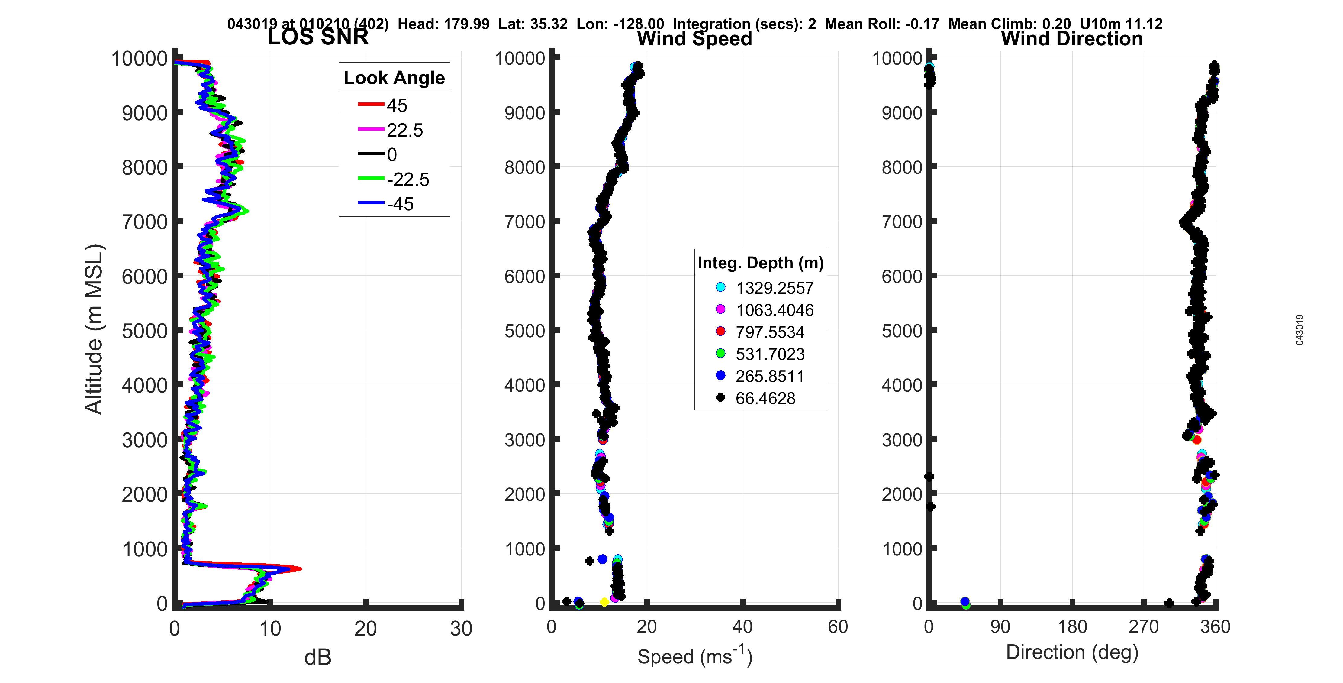
DAWN wind profile from Flight Level 10km using 2 second stares and 32m range gates

Slide 19
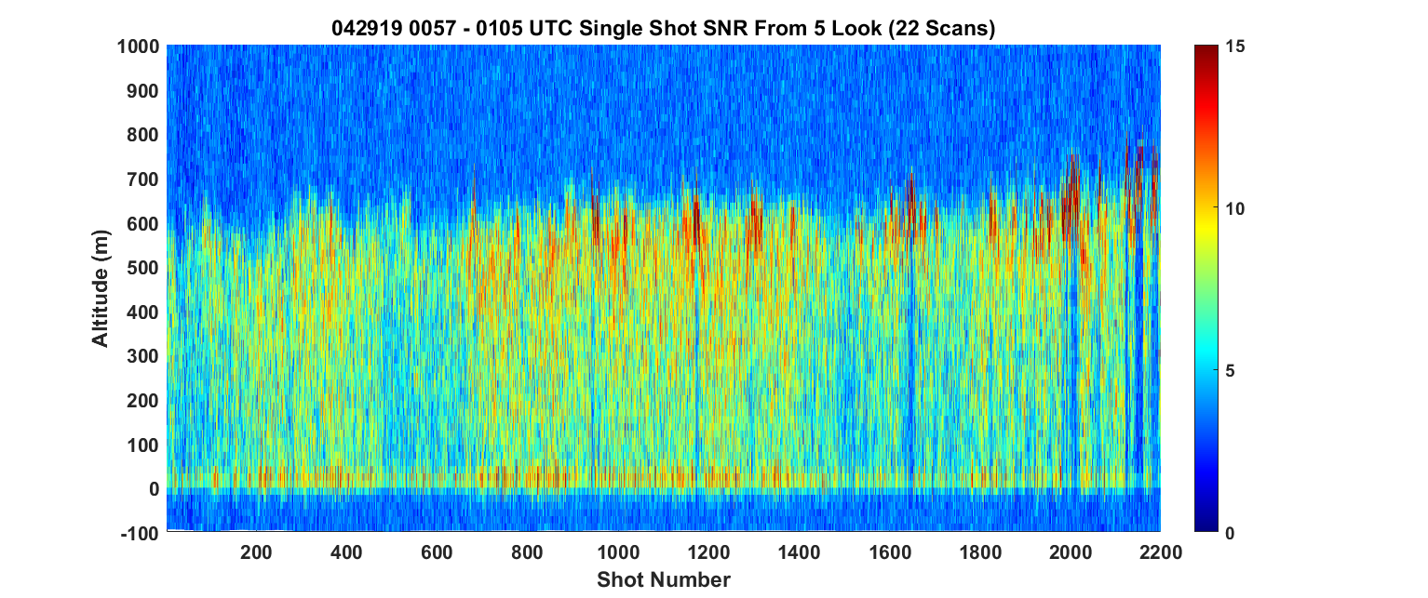
Example of a 200HZ space-based DWL sample density overlaid on ~ 100km of DAWN single shot data during Aeolus cal/val
~100 km
10 km
Cloud

Slide 20
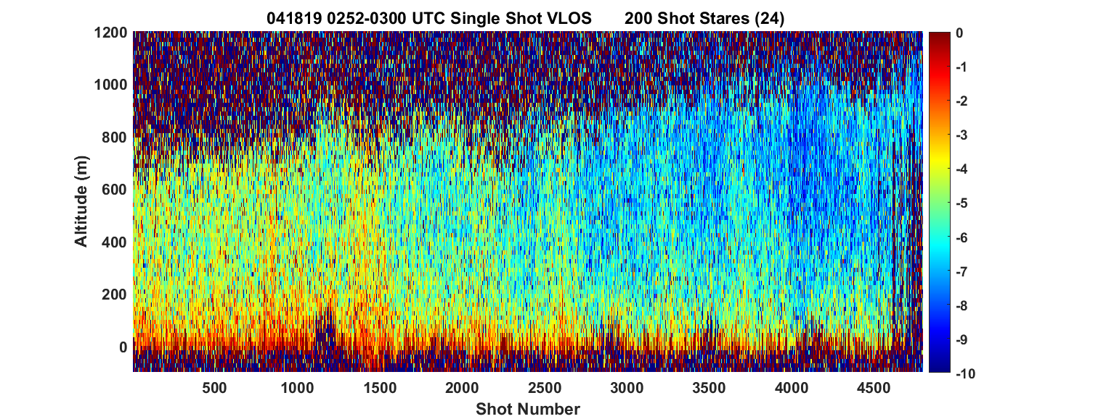
DAWN 100 km stare along Aeolus observation plane: VLOS (m/s)

Slide 21
Post launch cal/val & post launch product improvements

Slide 22
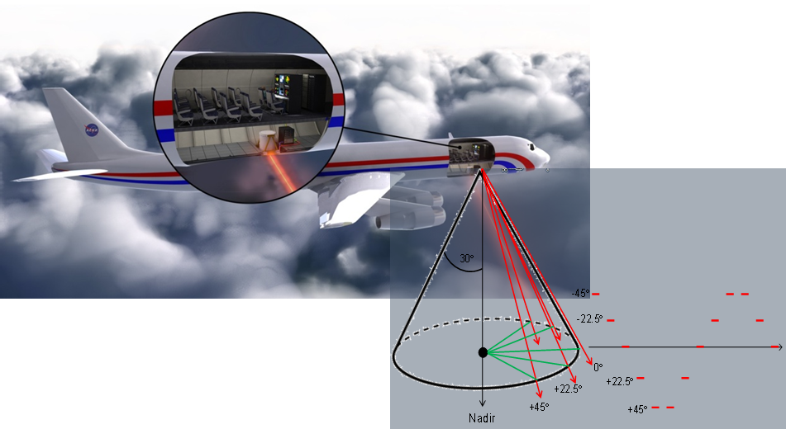
DAWN, Dropsonde and Aeolus Wind Comparisons from April 2019 NASA Aeolus Cal/Val Test Flight Campaign
NASA Airborne DAWN and HALO underflights of Aeolus
April 17-30, 2019 based out of Palmdale, CA
Airborne DAWN, HALO and YES Dropsondes aboard NASA DC-8
5 underpasses of Aeolus
Over the eastern Pacific Ocean
- Two transects between US west coast and Hawaii
- Three missions off west coast of US (30 – 50 N)
- Mostly clear to partly cloudy conditions
- Low and high aerosol segments
DAWN profiles every ~5km ; 128 DAWN profiles along 600km track
7 AEOLUS profiles along DAWN under-flight track
7 DAWN “Integrated” profiles utilizing 17 individual DAWN profiles
G. D. Emmitt and S. Greco
Simpson Weather Associates
M. Kavaya and K. Bedka
NASA/LaRC
Aeolus Cal/Val and Science Workshop
2-6 November 2020

Slide 23
Coherent DWL DAWN prepping for Aeolus underflights planned for summer 2021
DAWN- dropsonde comparisons during April 2019 Aeolus underflights
Date | # of U Samples | Mean ∆z (m) | Bias (m/s) | RMSD (m/s)
ALL | 4327 | 3.06 | -.13 | 1.01
0422-23 | 1453 | 3.33 | .04 | 0.88
0425-26 | 476 | 2.65 | -.01 | 1.00
0427-28 | 702 | 2.93 | -.61 | 1.19
0429-30 | 1697 | 3.00 | -.11 | 0.97
Date | # of V Samples | Mean ∆z (m) | Bias (m/s) | RMSD (m/s)
All | 4327 | 3.06 | -.18 | 0.90
0422-23 | 1452 | 3.33 | -.20 | .78
0425-26 | 476 | 2.65 | -.53 | 1.01
0427-28 | 702 | 2.93 | .01 | 1.11
0429-30 | 1697 | 3.00 | -.15 | 0.83
DAWN- dropsonde comparisons during 2017 CPEX
Date | # of U Samples | Mean ∆z (m) | Bias (m/s) | RMSD (m/s)
ALL | 16207 | 3.11 | .08 | 1.59
Date | # of V Samples | Mean ∆z (m) | Bias (m/s) | RMSD (m/s)
All | 16207 | 3.11 | .19 | 1.61

Slide 24
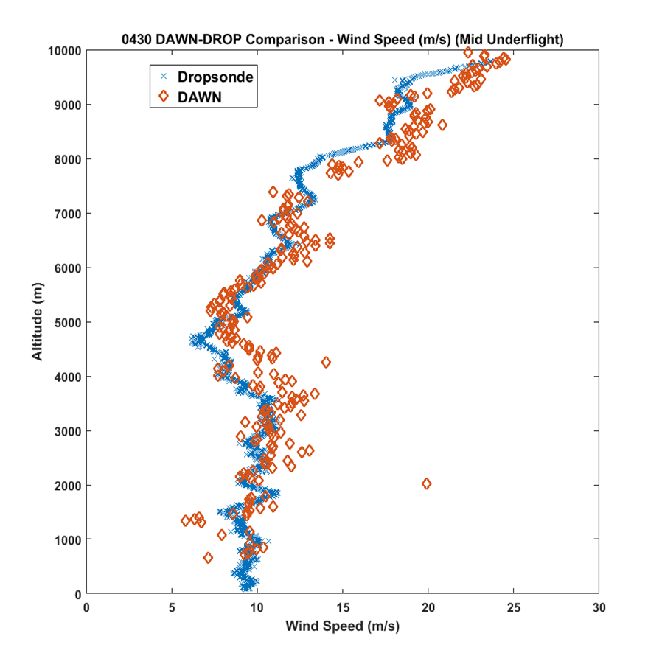
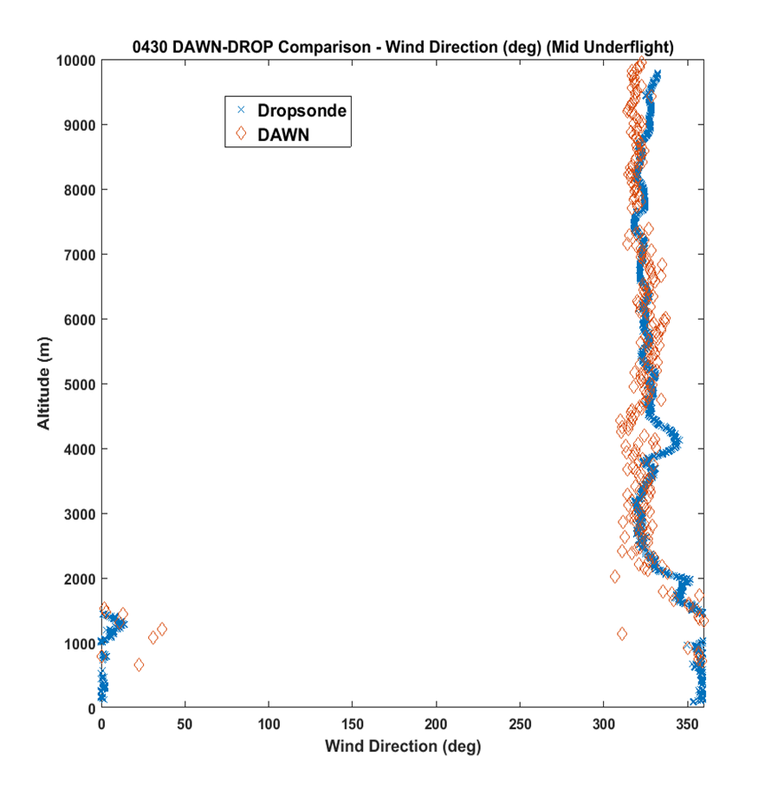
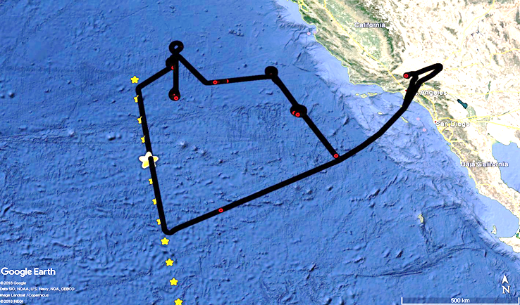
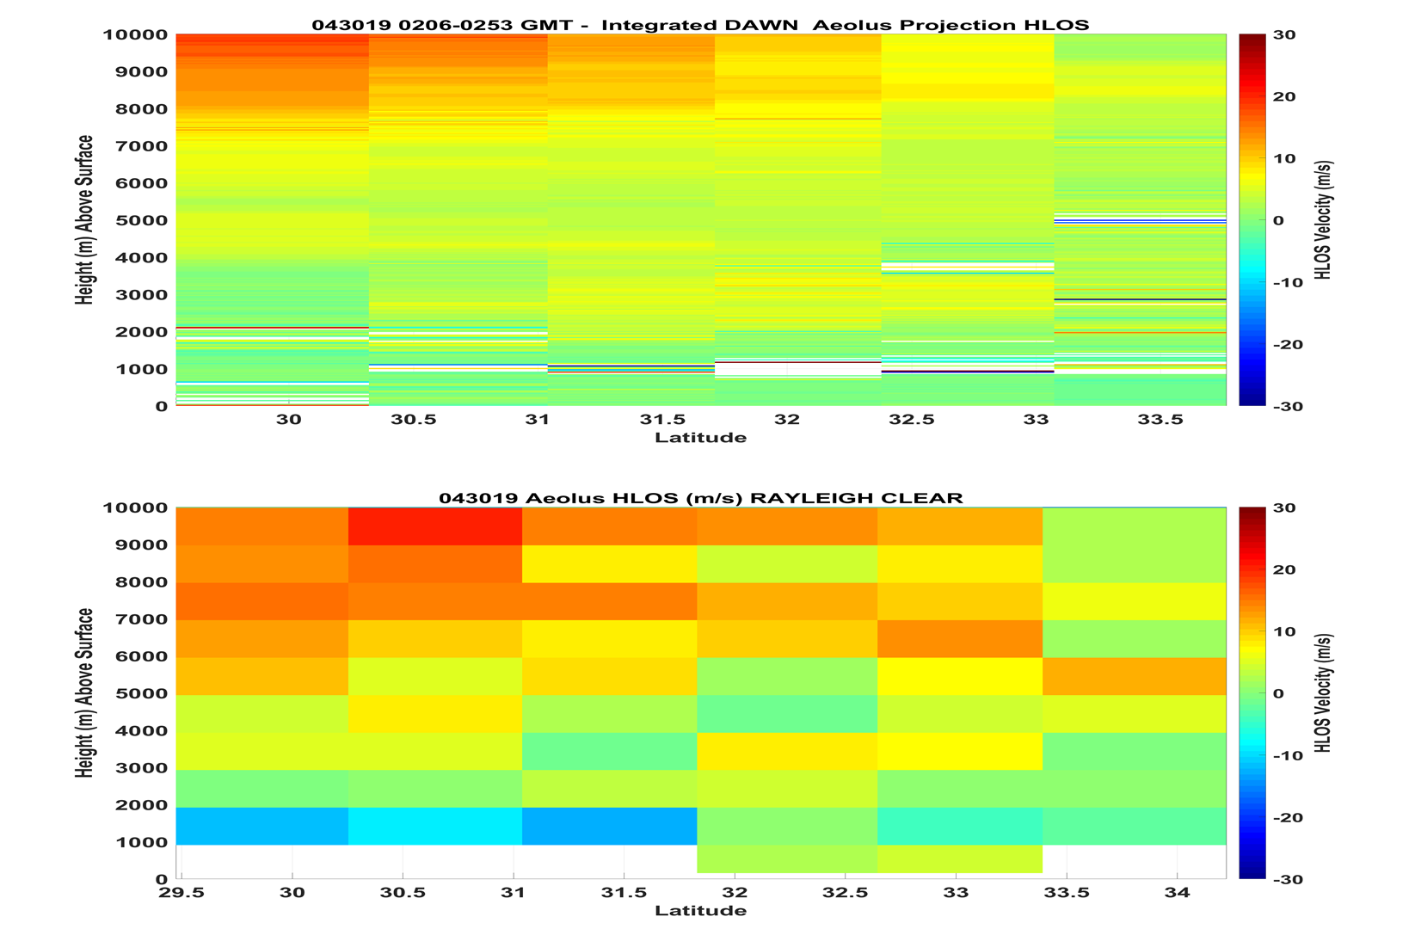
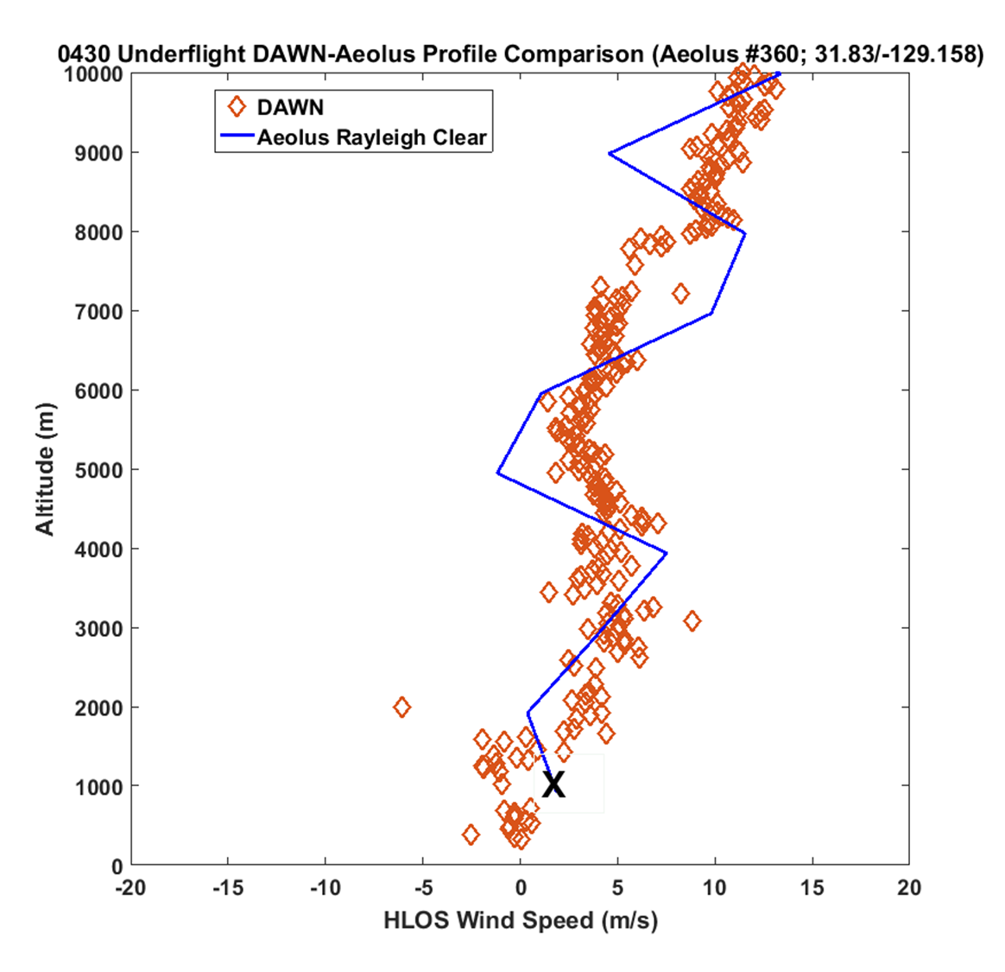
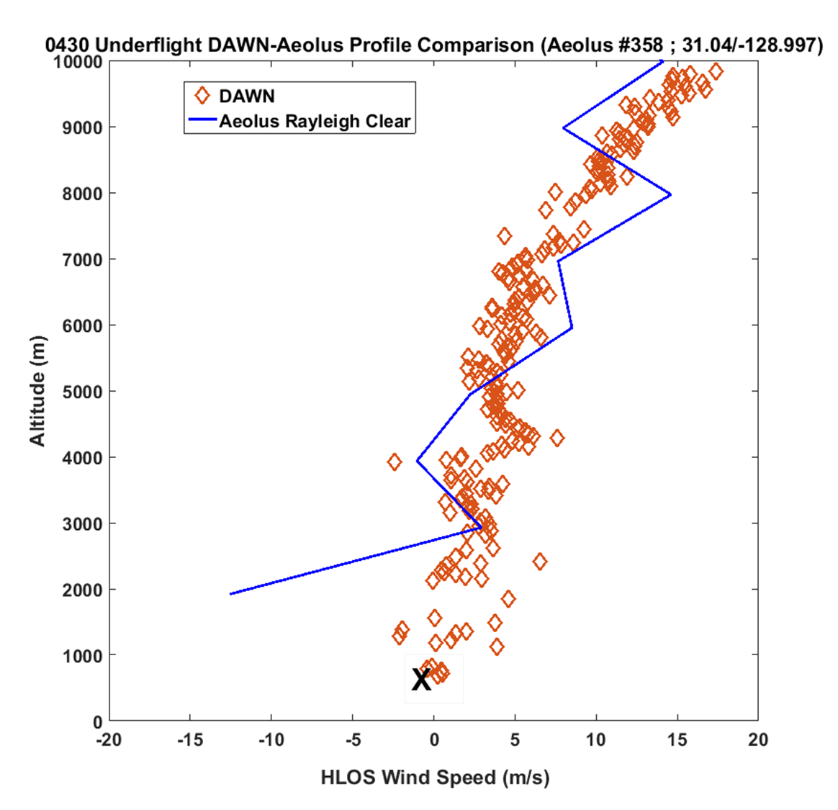
30 April 2019 Aeolus underflight
10 km
DAWN vs. Dropsondes
DAWN vs. Aeolus

Slide 25
Conclusion
Airborne Doppler Wind Lidars, especially currently available
coherent detection systems, are meeting the challenge of
providing higher precision, higher vertical resolution and
higher horizontal resolution for space-based instrument and
mission design, data product algorithm development or
cal/val of space-based wind observing systems that
traditionally have lower precision or sample densities,
regardless of the orbiting technology. This is especially true
for cal/val over the oceans.

Slide 26
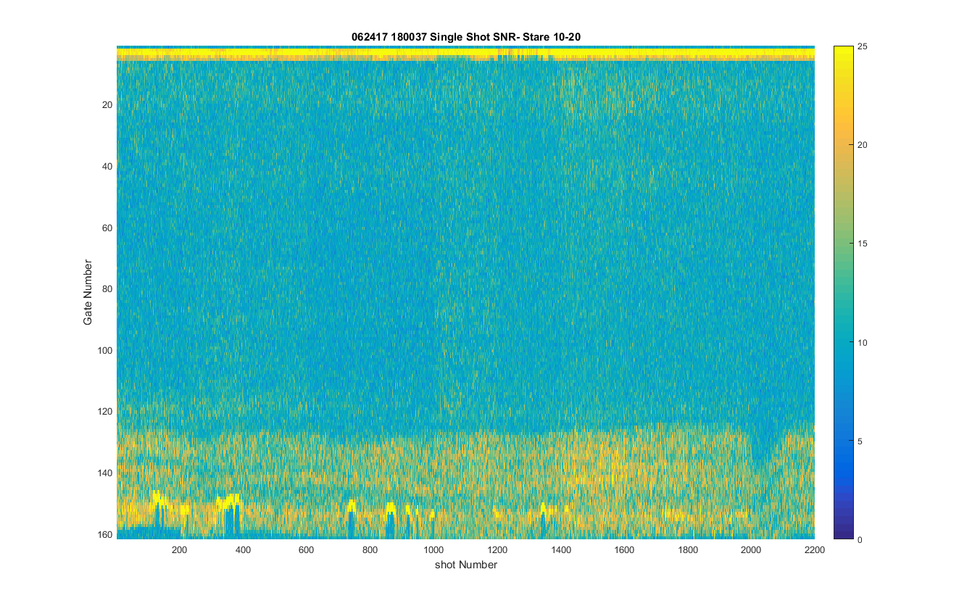
Example of DAWN’s mapping the ABL from 10km FL
12 second (~84 km) WIND-SP orbit segment
Height (km)
0 1 2 3 4 5 6 7 8 9 10
Signal Strength (dB)

Slide 27
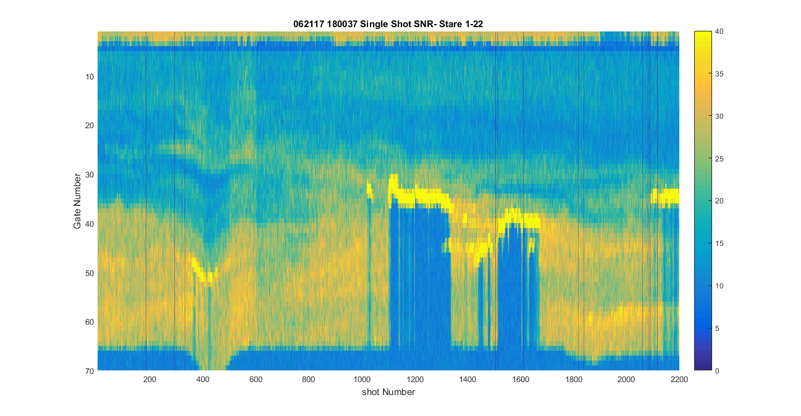
Example of Single Shot Returns from DAWN during CPEX (~22m between shots; ~60m vertical resolution)
~85 km
10 km
Cloud
Height (km)
0 1 2 3 4 5
Small A/C roll
Signal Strength (dB)

