Slide 1
Assimilation of Airborne Doppler Wind Lidar Collected in Tropical Cyclones
Lisa Bucci¹
S. Majumdar², R. Atlas³, B. Dahl², K. Sellwood², G. D. Emmitt⁴, S. Wood⁴
¹NOAA/AOML ²University of Miami ³University of Maryland ⁴Simpson Weather Associates
NOAA-NASA Working Group on Space-based Lidar Winds November 18, 2020

Slide 2
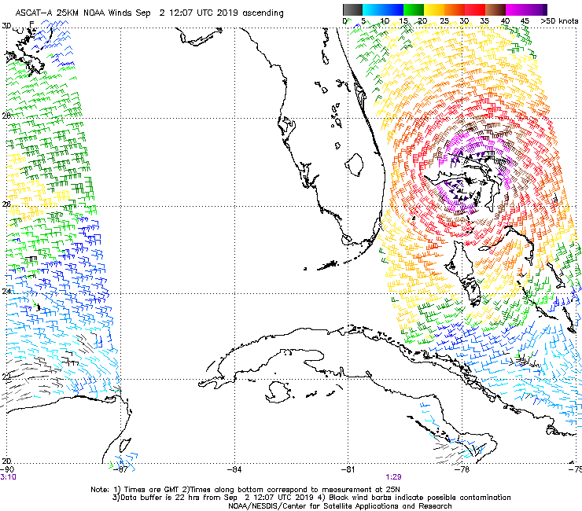
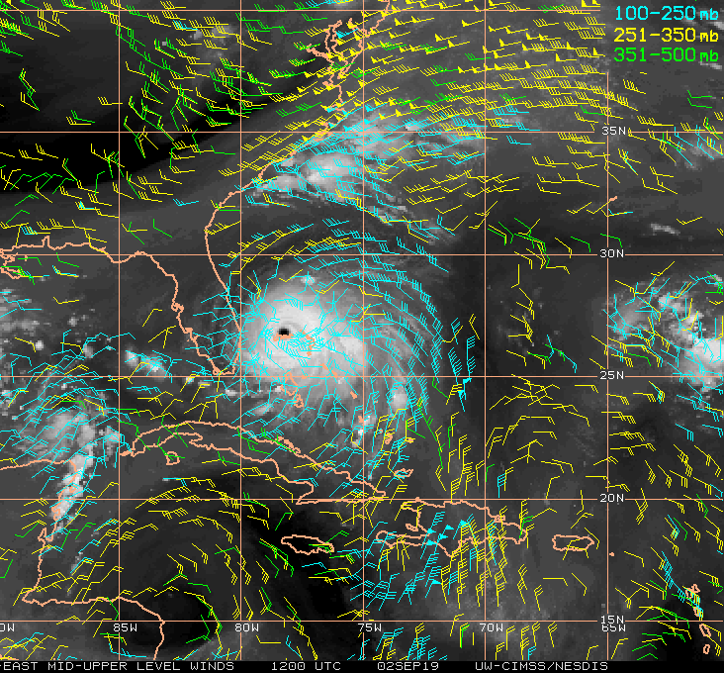
Motivation: Observation Gap
Winds in and near a tropical cyclone (TC) are often limited
Atmospheric Motion Vectors (AMVs) collect winds through feature tracking
Layer of winds
1-2 layers depending on TC
Scatterometers provide coarse (25 km) snapshot of surface winds
Serendipitous
Rain-contaminated
ASCAT-A for Hurricane Dorian (2019)
CIMSS AMVs for Hurricane Dorian (2019)
Assimilation of Airborne Doppler Wind Lidar Collected in Tropical Cyclones
November 18, 2020
Notes:
One feature of great interest are tropical cyclones (an all-encompassing term for hurricanes, typhoons, tropical storms, tropical depressions) which we know form over the global tropical oceans. Remotely-sensed winds observations near these potentially high-impact weather events are even scarcer. We can track features on visible, infrared, and water vapor satellite imagery which are known as atmospheric motion wind vectors-- but these measurements represents a winds through a layer and it is difficult to know what altitude that feature occurs. If you’re lucky you might also have a scatterometer pass over the storm which provide a 25 km horizontal resolution snapshot of surface wind, but heavy rains can cause errors in both the speed and direction of those winds.

Slide 3
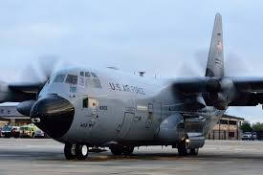
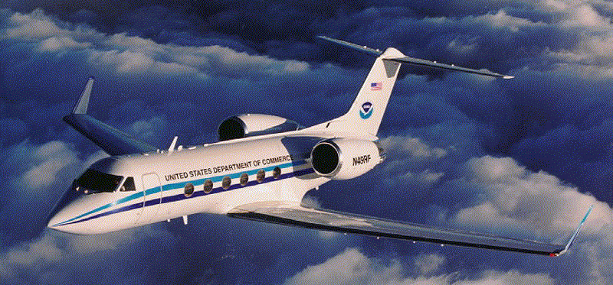
Motivation: Observation Gap
Inner core observations
Near-storm/environmental
observations
Air Force C-130s
NOAA P-3s
NOAA G-IV
Pros
Cons
Dropsondes: Accuracy, vertical resolution, all variables Discrete profile, flight altitude
Flight-level probes: Accuracy, along-track resolution, all variables 1 vertical level
Stepped Frequency Microwave Radiometer (SFMR):
Tail Doppler Radar (TDR):
Pros
Cons
Pros
Cons
- Along-track resolution
- Desirable region (surface)
- Only wind speed
- 1 vertical level
- Largest winds dataset
- 2-km (0.5-km) horizontal (vertical)
- Needs rain/ice
- No lowest BL
Assimilation of Airborne Doppler Wind Lidar Collected in Tropical Cyclones
November 18, 2020
Notes:
So the best way to collect winds in a tropical cyclone is to use aircraft reconnaissance like the National Oceanic and Atmospheric Administration (NOAA) P-3. This aircraft flies into tropical cyclones every year and come equipped with multiple wind-observing instruments.

Slide 4
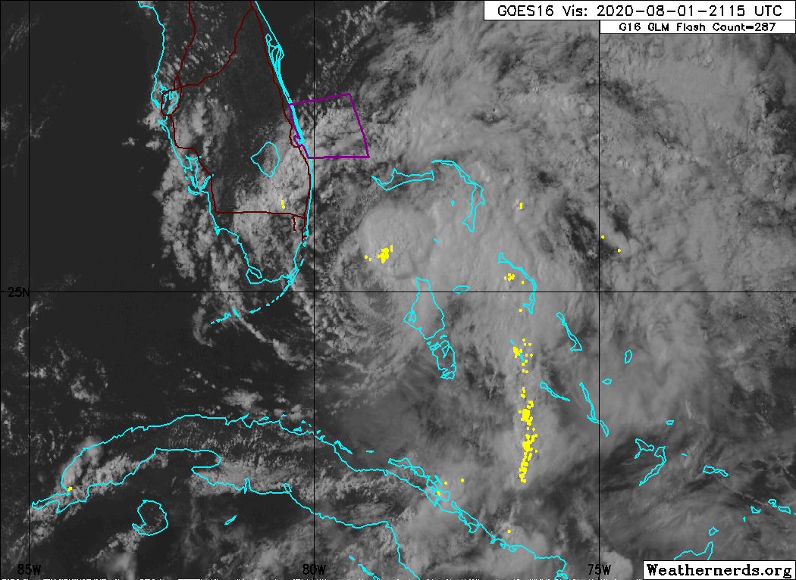
Motivation: Observation Gap
Even with hurricane reconnaissance aircraft, important areas of the TC are largely under-observed
Boundary layer (especially near surface)
Moat regions between rain bands
Precipitation-free regions (genesis, asymmetric TCs)
Exposed up-shear portion of circulation in Isaias (2020)
Assimilation of Airborne Doppler Wind Lidar Collected in Tropical Cyclones
November 18, 2020
Notes:
So the combination of these wind-observing instruments still leaves gaps in some key regions in tropical cyclones. These regions included places the boundary layer, a place where fluxes from the ocean play a key role in regulating TC intensity. We also don’t get many observations in preciptation-free regions-- like in developing tropical cyclones that often have asymmetric distributions of precipitation or even in moat regions between rainbands or the eyewall in storm TCs. These gaps give the doppler wind lidar (DWL) the opportunity to measure in some of these under-observed regions and possibly fill the observation gap.

Slide 5
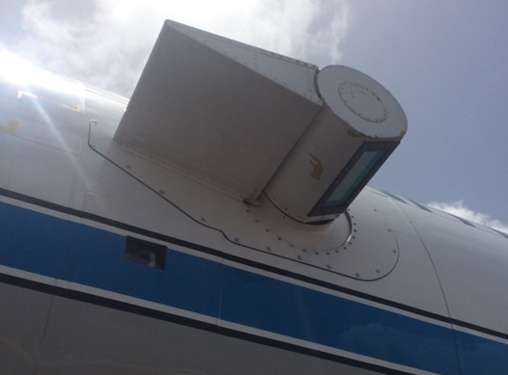
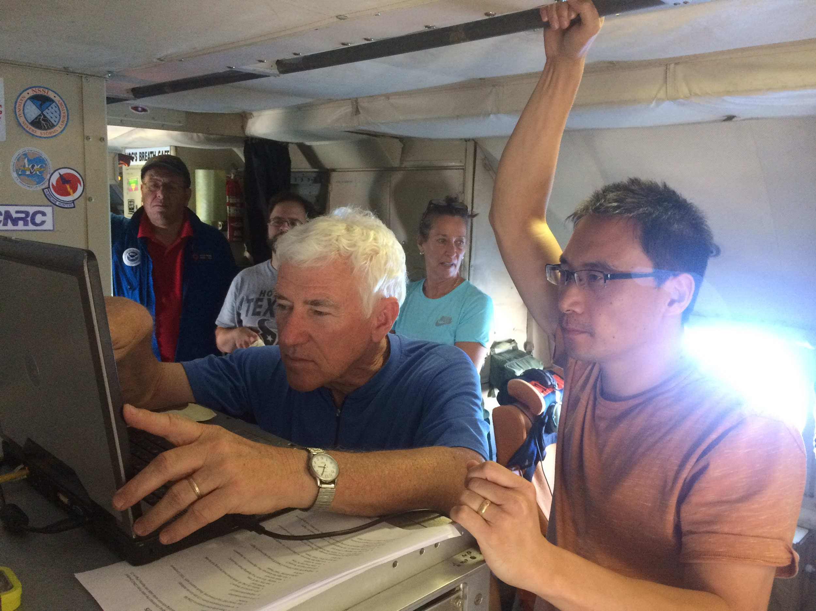
Validation of an Airborne DWL in Tropical Cyclones
Bucci et al. 2018
Is the airborne Doppler Wind Lidar (ADWL) capable of collecting wind profiles in a TC environment?
Are the wind observations reliable?
12 step-and-stare conical scan
Unique scanner allows for looks above or below aircraft
Coherent DWL needs aerosols 1.6μm and larger
Horizontal: ~3 km Vertical: 50 m
Pew Pew
ADWL Scanner outside of the port window of the NOAA P-3
G. D. Emmitt training ADWL operators on a test and calibration flight
Assimilation of Airborne Doppler Wind Lidar Collected in Tropical Cyclones
November 18, 2020

Slide 6
Validation of an Airborne DWL in Tropical Cyclones
ADWL Retrieval Minus Dropsonde
ADWL (5+ LOS) versus Dropsondes
x
Wind Difference
RMS
Bias
S_{ADWL} = 1.0026(S_{DROP}) − 0.0202
corr=0.9586
N=2056
Non-center
+
Center
Assimilation of Airborne Doppler Wind Lidar Collected in Tropical Cyclones
November 18, 2020
Notes:
First we compare the wind speeds from the DWL dropsonde, so on the left figure, you’re looking at the number of looks that went into making a DWL wind profile on the x-axis and on the y-axis you’re seeing the difference between the DWL profile and the collocated dropsonde. You can see that when you have 5 shots (or line-of-sights) or more your errors become more consistent. There a jump due to outlier in the 12 shots category and this is likely due to a dropsonde drifting from a low wind regime into a high one (like drifting from within the eyewall into the eyewall). So these difference are probably due to the difference in the nature of the measurement-- DWL wind profile is a volumetric average at many levels and the dropsonde is a discrete advected point measurement.

Slide 7
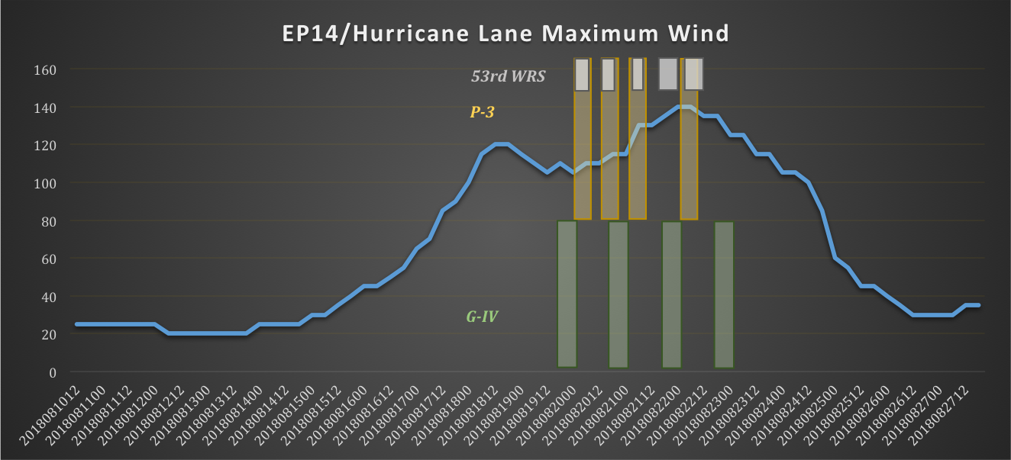
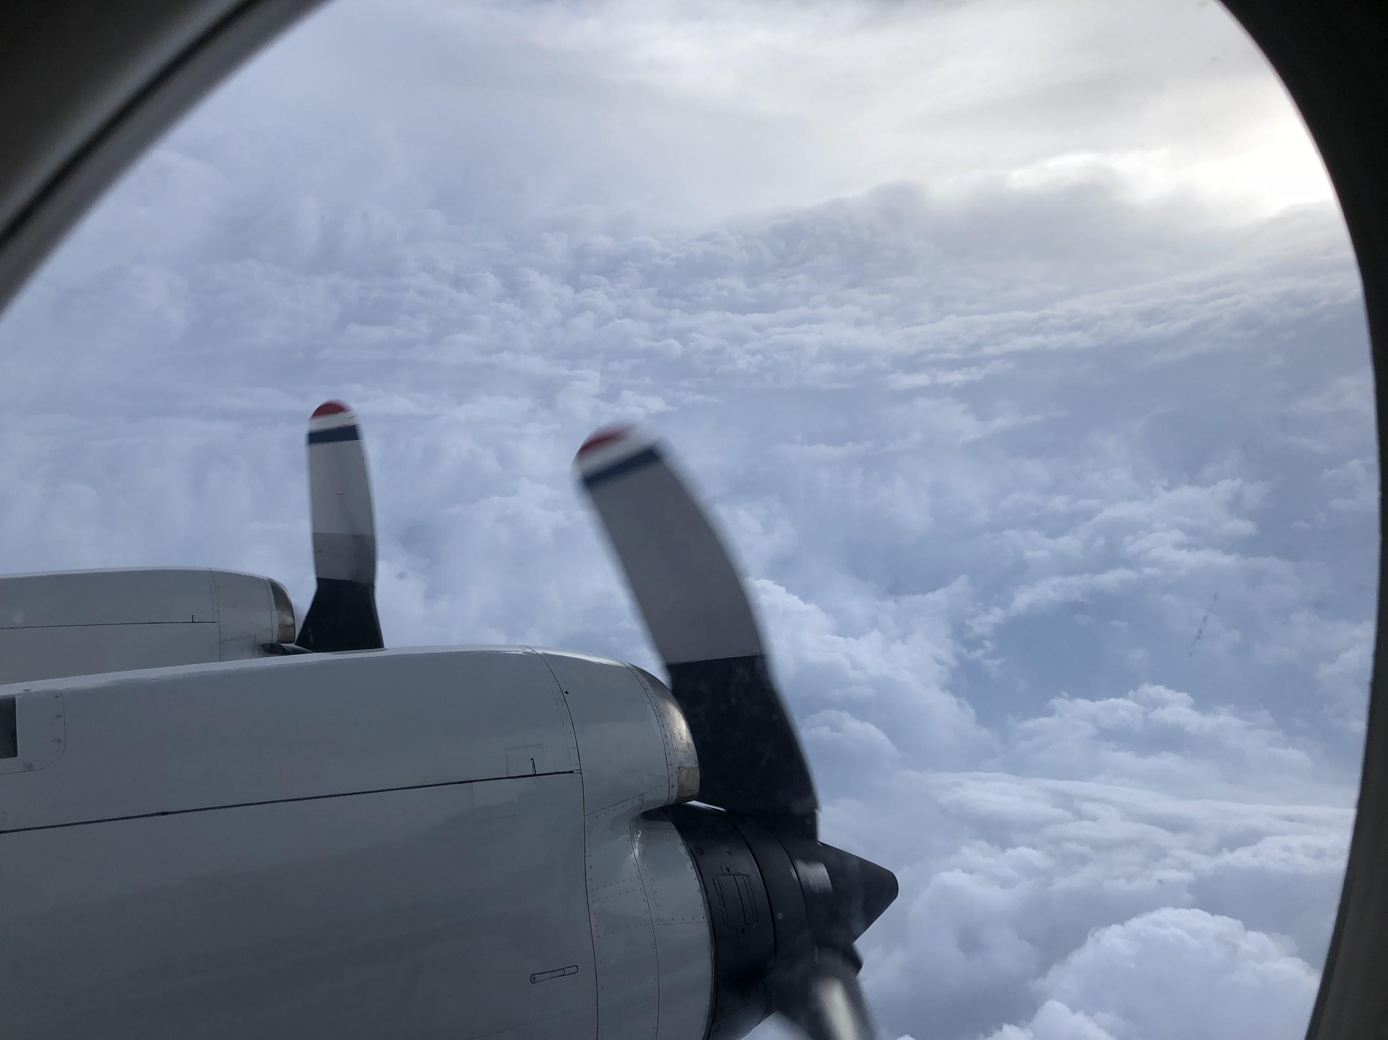
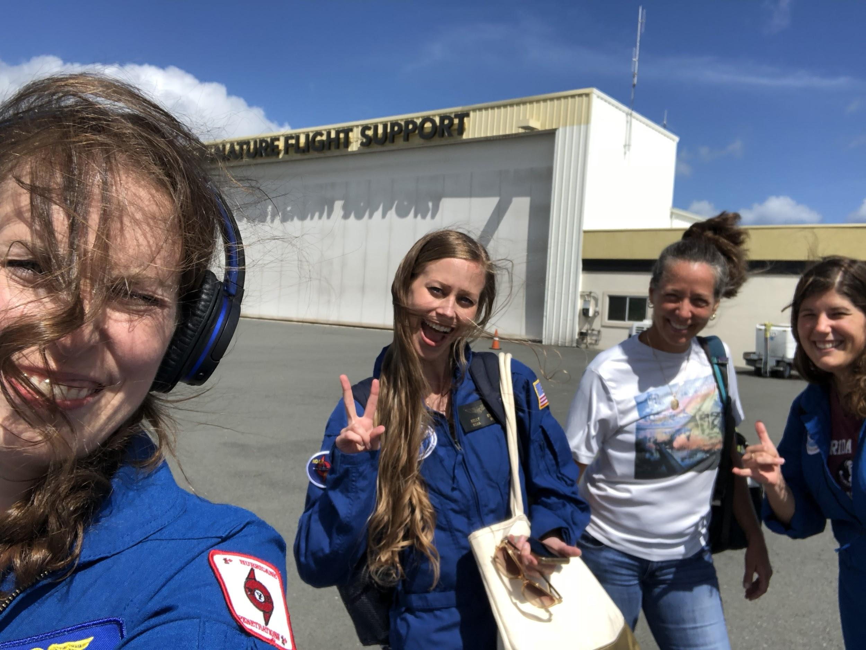
Assimilation of ADWL Observations Collected in Hurricane Lane (2018)
Hurricane Lane (2018)
Formed in the eastern Pacific on August 15, 2018
Track took it into the central Pacific close to Hawaii
Intensified to a category 5 hurricane on August 22, 2018
Strongest hurricane measured ever by an ADWL
Credit: J. Zawislak
Assimilation of Airborne Doppler Wind Lidar Collected in Tropical Cyclones
November 18, 2020
Notes:
Do increased observations in the boundary layer modify initial TC structural representation?
Does the modified BL structure translate to improved analyses and forecasts of TC intensity?

Slide 8
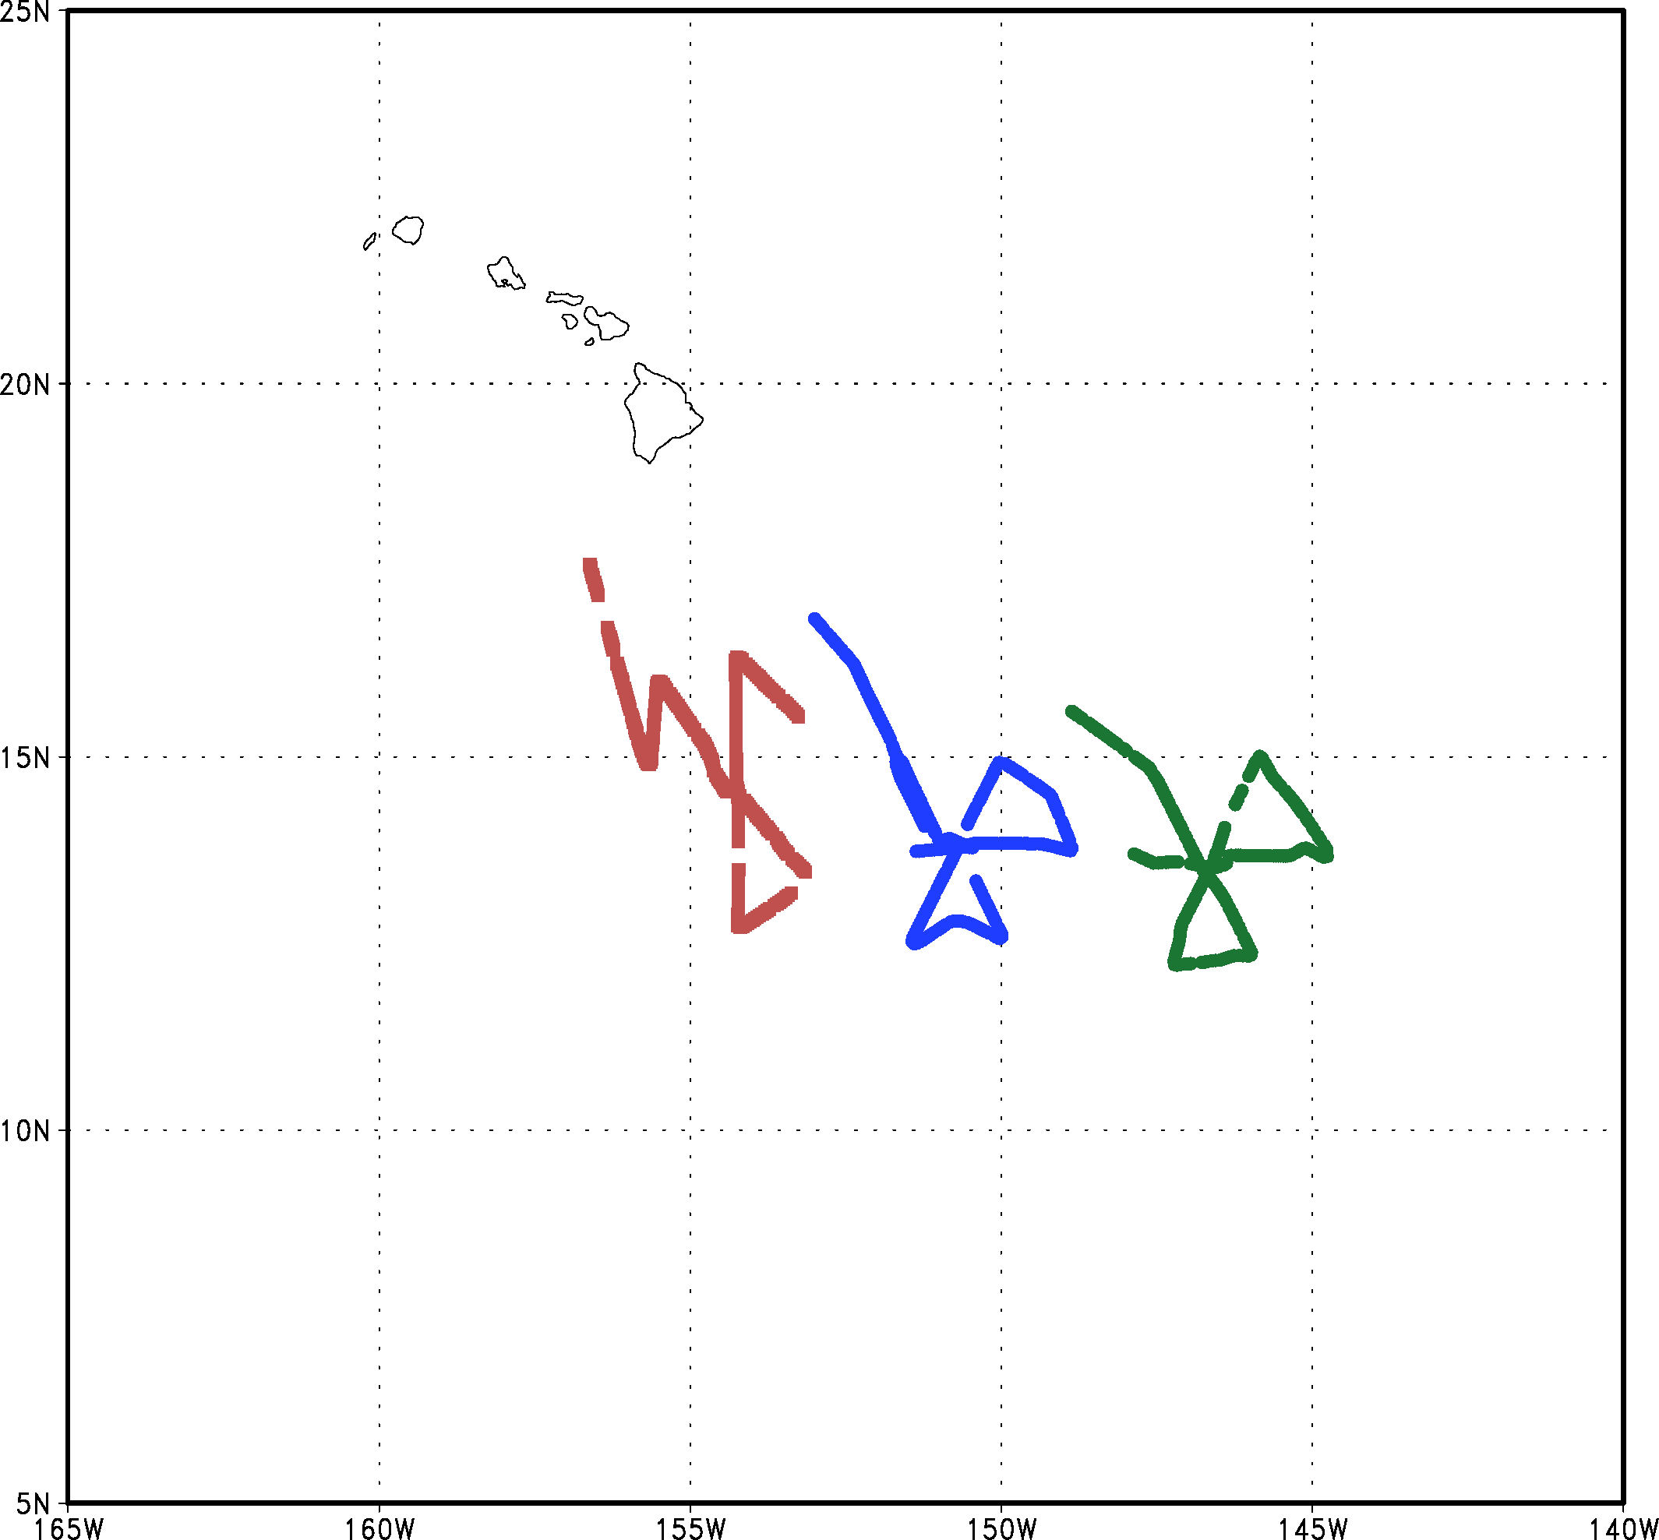
Assimilation of ADWL Observations Collected in Hurricane Lane (2018)
ADWL Data Basics
No horizontal/vertical thinning (for now)
Data available every 25 m
Observations considered independent every 50 m
Models levels (in boundary layer) spaced every ~150 m
Cycle | Intensity (kts) | Total DWL Retrievals | Profiles |  | 5+ LOS | Sondes
 |  |  | Up | Down
0600 UTC Aug 20 | 110 | 20887 | 89 | 166 | 6580 | 15
0600 UTC Aug 21 | 130 | 37510 | 0 | 340 | 13018 | 21
0600 UTC Aug 22 | 135 | 28988 | 48 | 236 | 12963 | 27

Slide 9
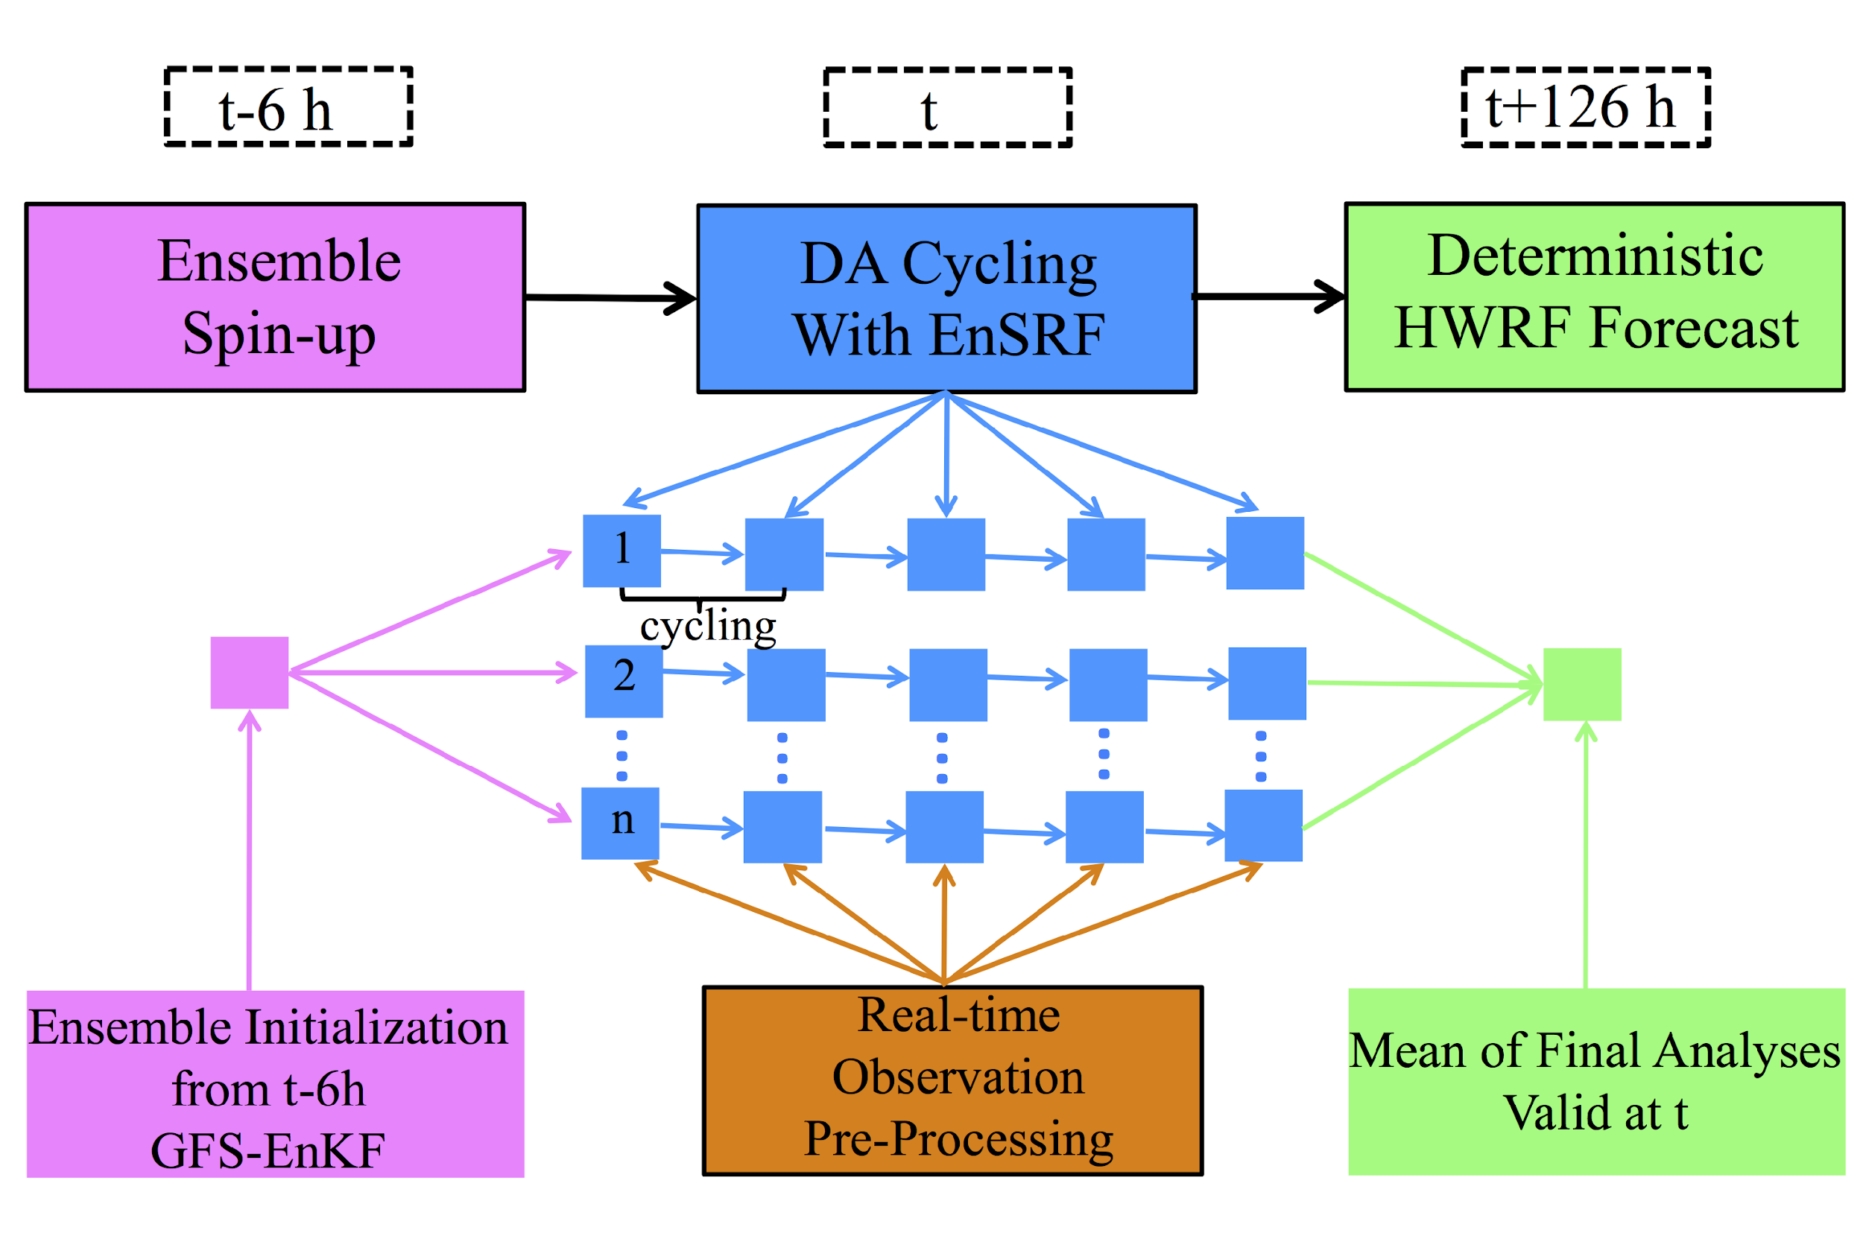
Assimilation of ADWL Observations Collected in Hurricane Lane (2018)
Hurricane Ensemble Data Assimilation System (HEDAS)
Ensemble square-root Kalman filter (Whitaker and Hamill 2002)
Storm-relative processing capability (Aksoy 2013)
HWRF modeling system
Hurricane inner-core data assimilation for high-resolution vortex initialization
Assimilation of Airborne Doppler Wind Lidar Collected in Tropical Cyclones
November 18, 2020
Notes:
This is the data assimilation system that was used for this study. For those that are not familiar with data assimilation-- just think of it as a way for us to blend observations with model fields. For those of you who are familiar with DA, I used a standard ensemble square-root filter. This isn’t a traditional cycled EnKF system-- instead 30 members are spun from the GFS ensemble for 6 hours. Data is processed in a storm-relative framework which is assimilated in a series of 15-30 minute time windows that produce a final mean analysis which is used for a single deterministic forecast. System is a nice research tool specifically built to study the assimilation of inner-core observations.

Slide 10
Assimilation of ADWL Observations Collected in Hurricane Lane (2018)
Experiment Descriptions
Experiment Name | Instrument Type Assimilated | Cycling Frequency (minutes)
All | TDR, ADWL, Control | 15
NoADWL | TDR, Control
NoTDR | ADWL, Control | 30
NoTDR_NoADWL | Control
Control = Flight-level (winds, temperature, moisture),
Dropsondes (winds, temperature, moisture),
SFMR (surface wind speed)
Assimilation of Airborne Doppler Wind Lidar Collected in Tropical Cyclones
November 18, 2020

Slide 11
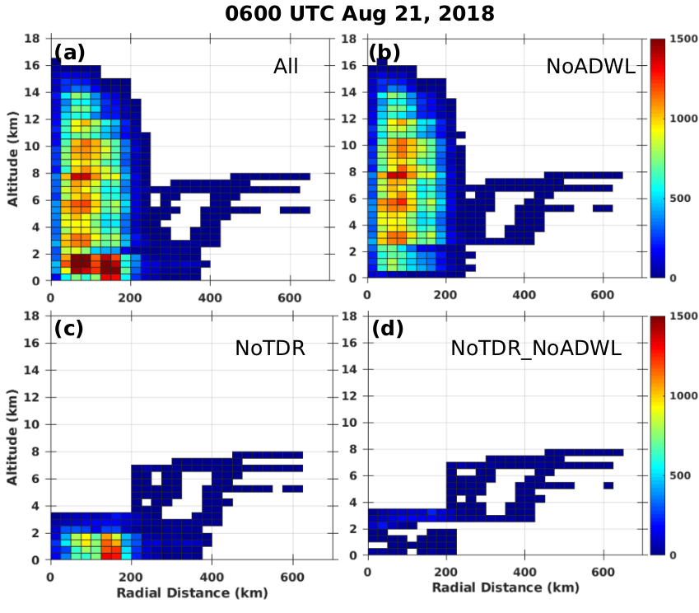
Assimilation of ADWL Observations Collected in Hurricane Lane (2018)
Total assimilated wind observations binned by radius (every 25 km) and altitude (every 0.5 km)
With TDR data
ADWL increases wind observations radially and in the boundary layer
Without TDR data
With ADWL data
Without ADWL data
Assimilation of Airborne Doppler Wind Lidar Collected in Tropical Cyclones
November 18, 2020

Slide 12
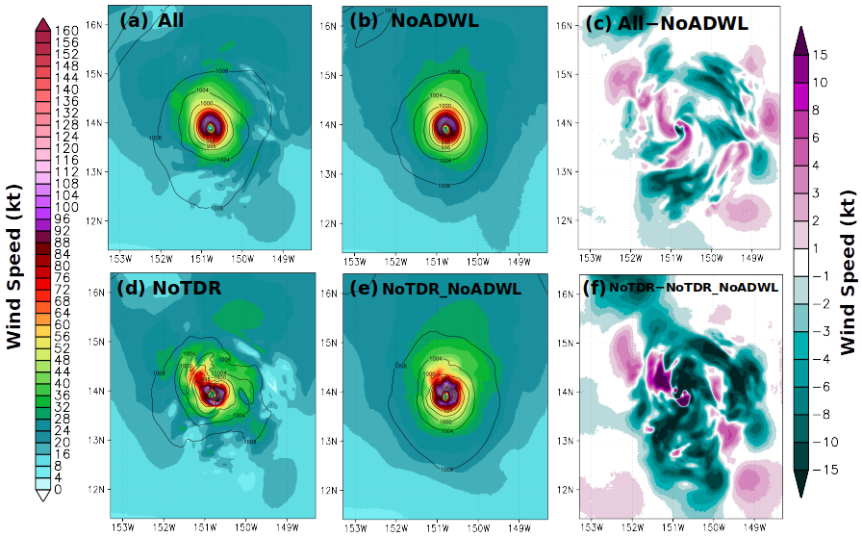
Assimilation of ADWL Observations Collected in Hurricane Lane (2018)
10m Wind Speeds and Differences
ADWL shifts center position and generally decreases surface wind speeds
Assimilation of Airborne Doppler Wind Lidar Collected in Tropical Cyclones
November 18, 2020
Notes:
Remove?

Slide 13
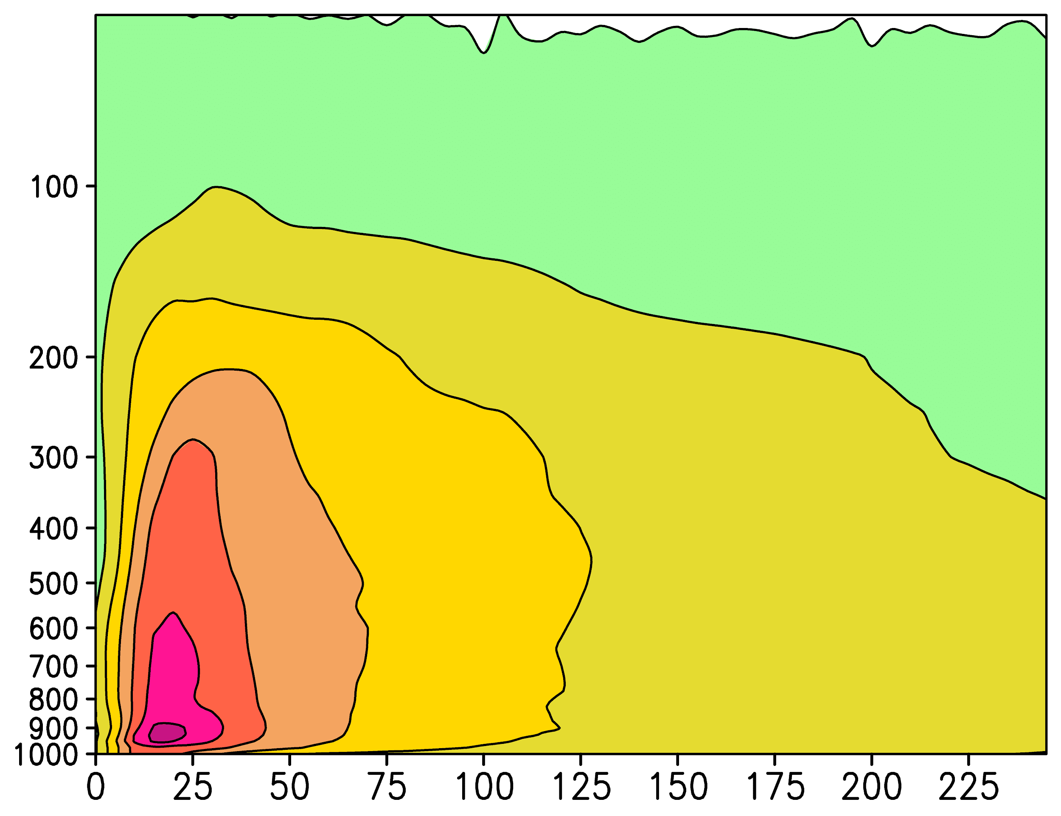
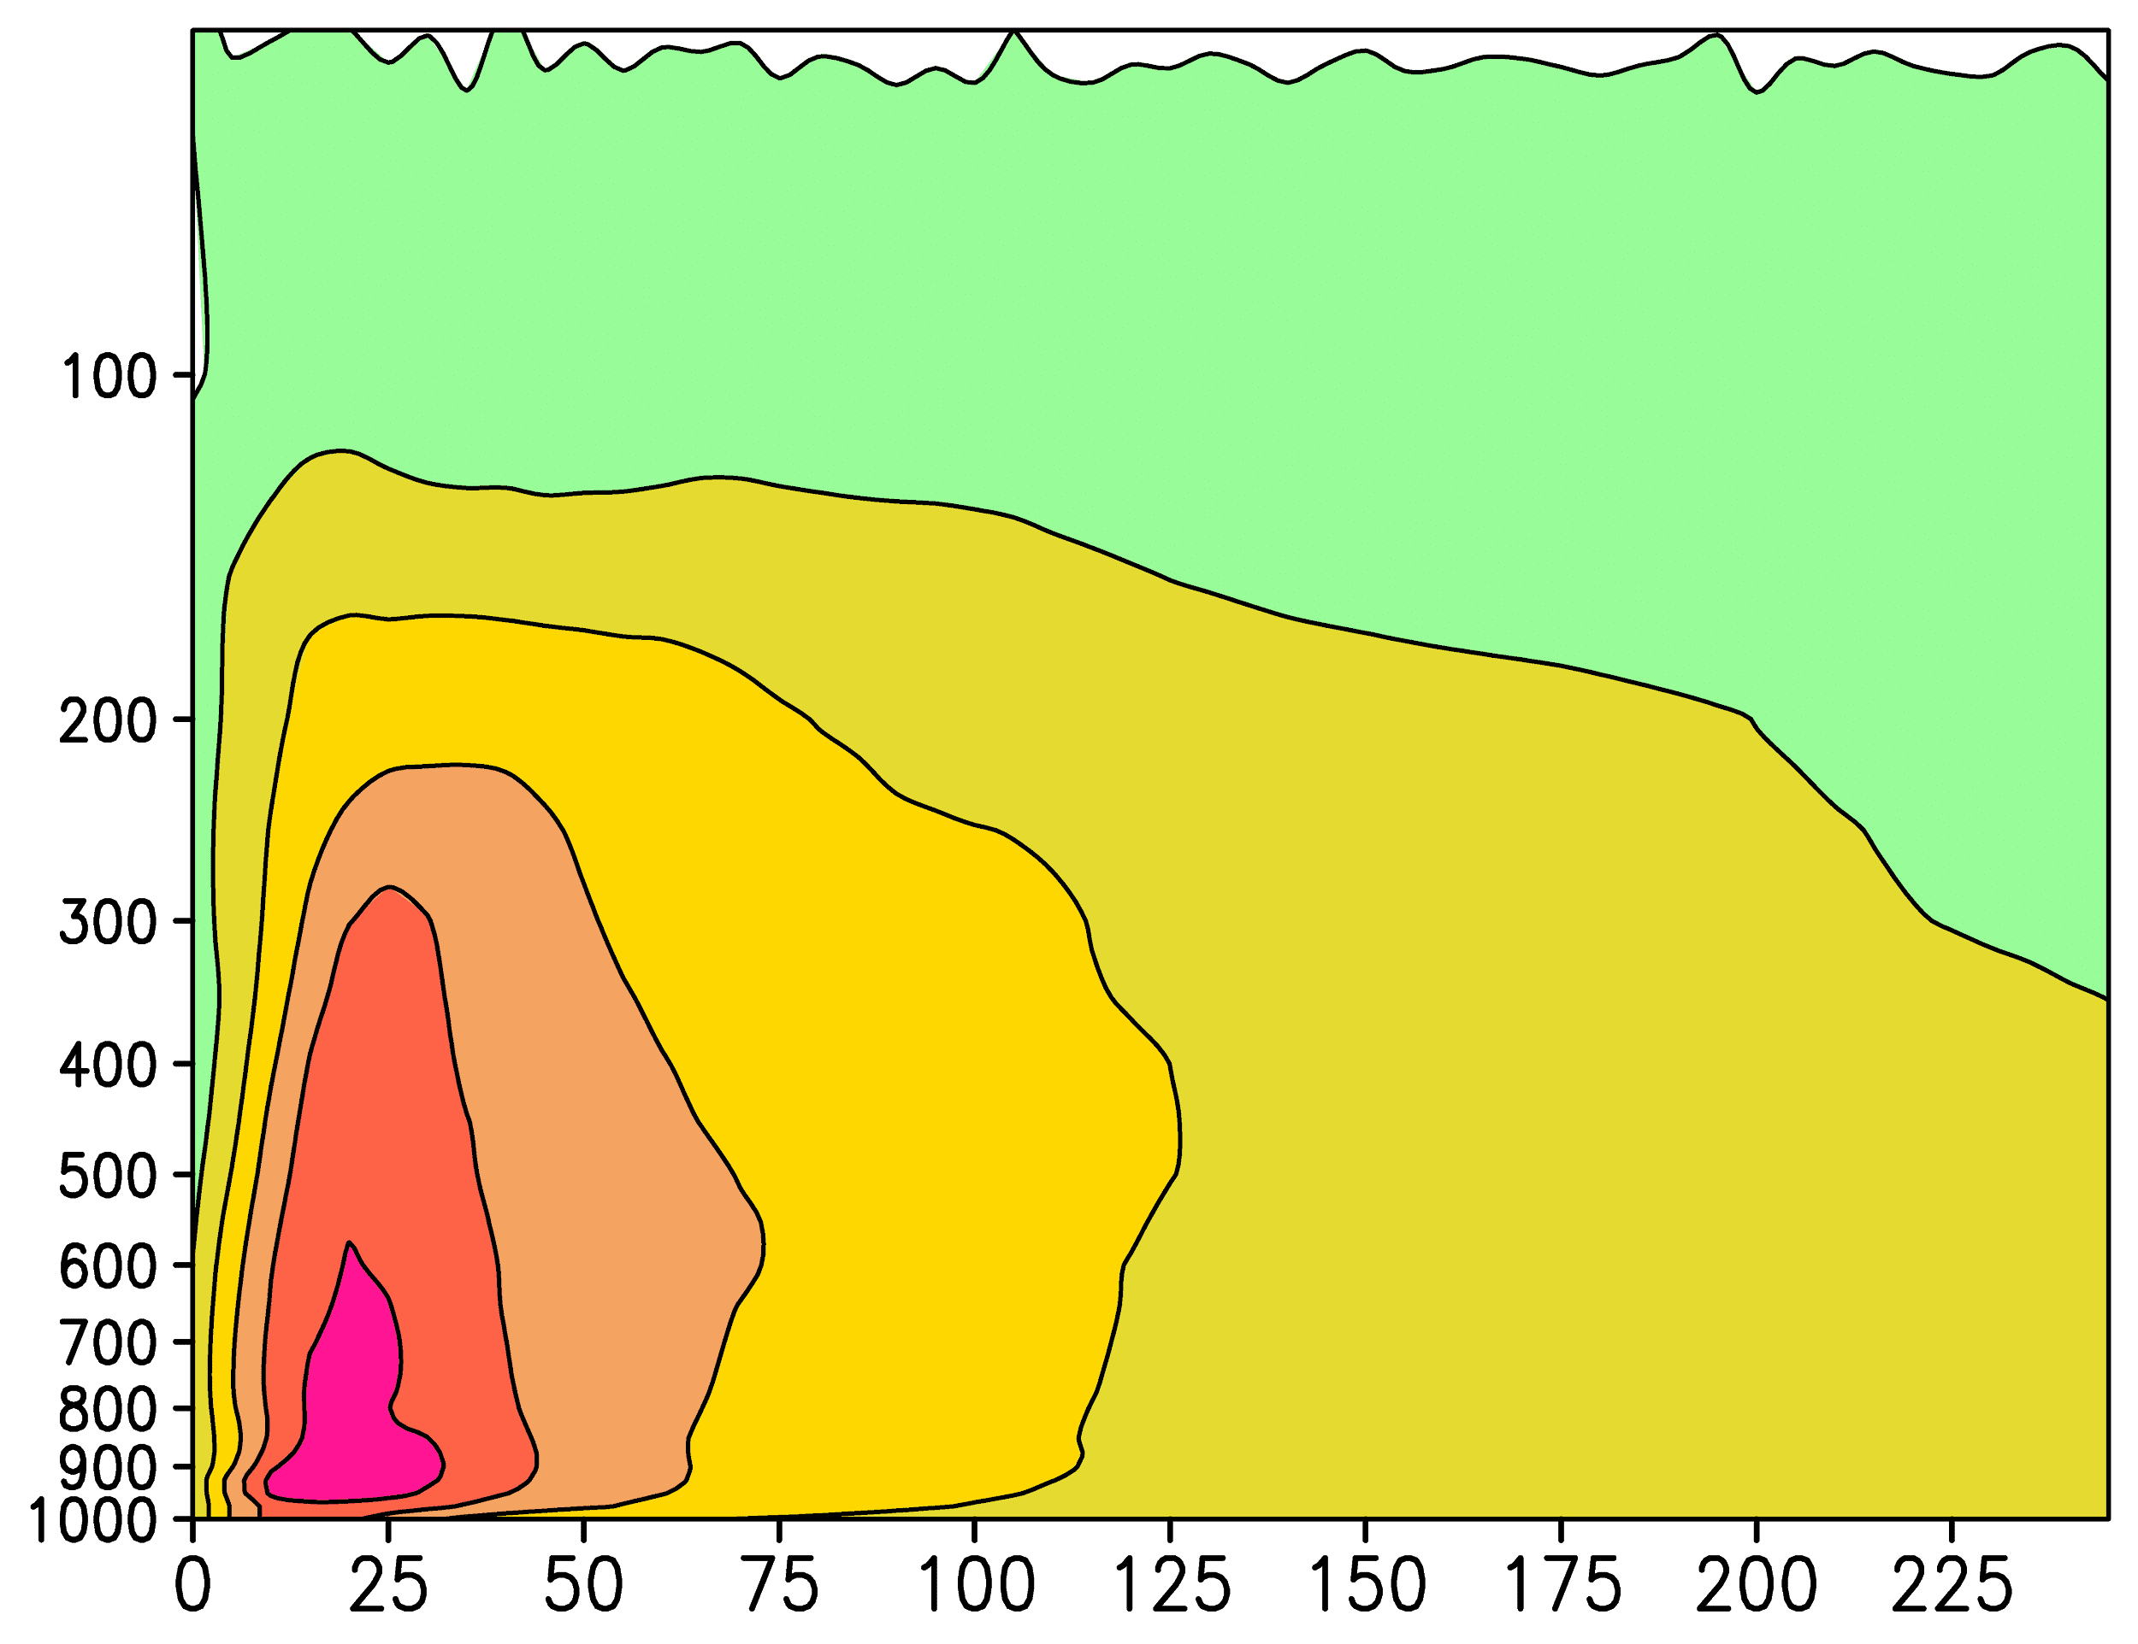
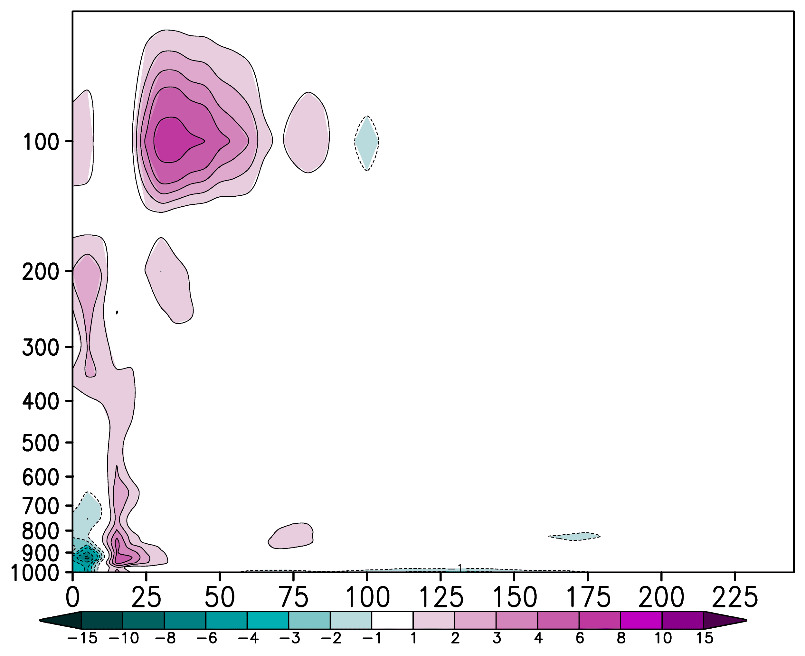
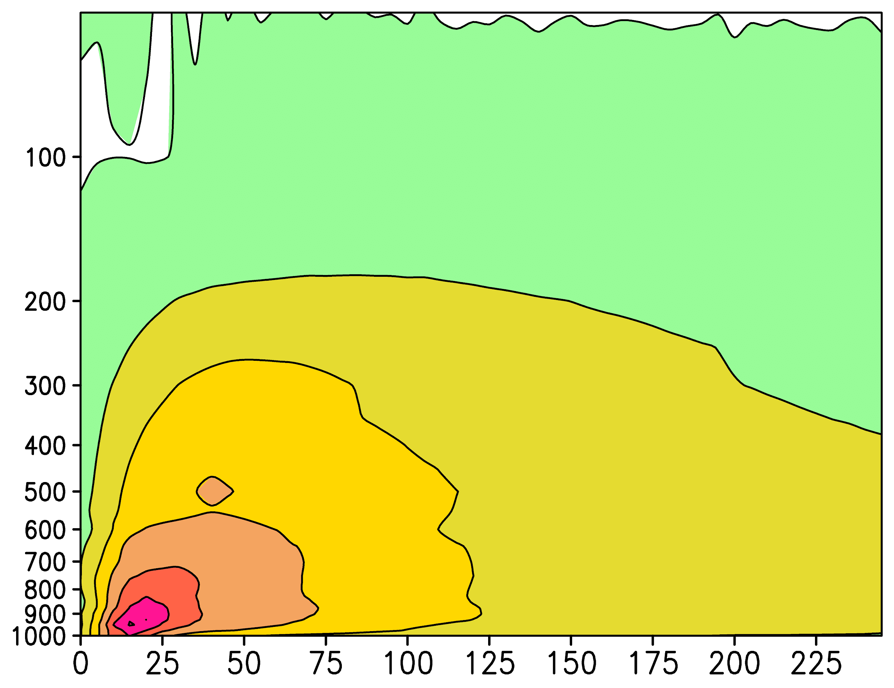
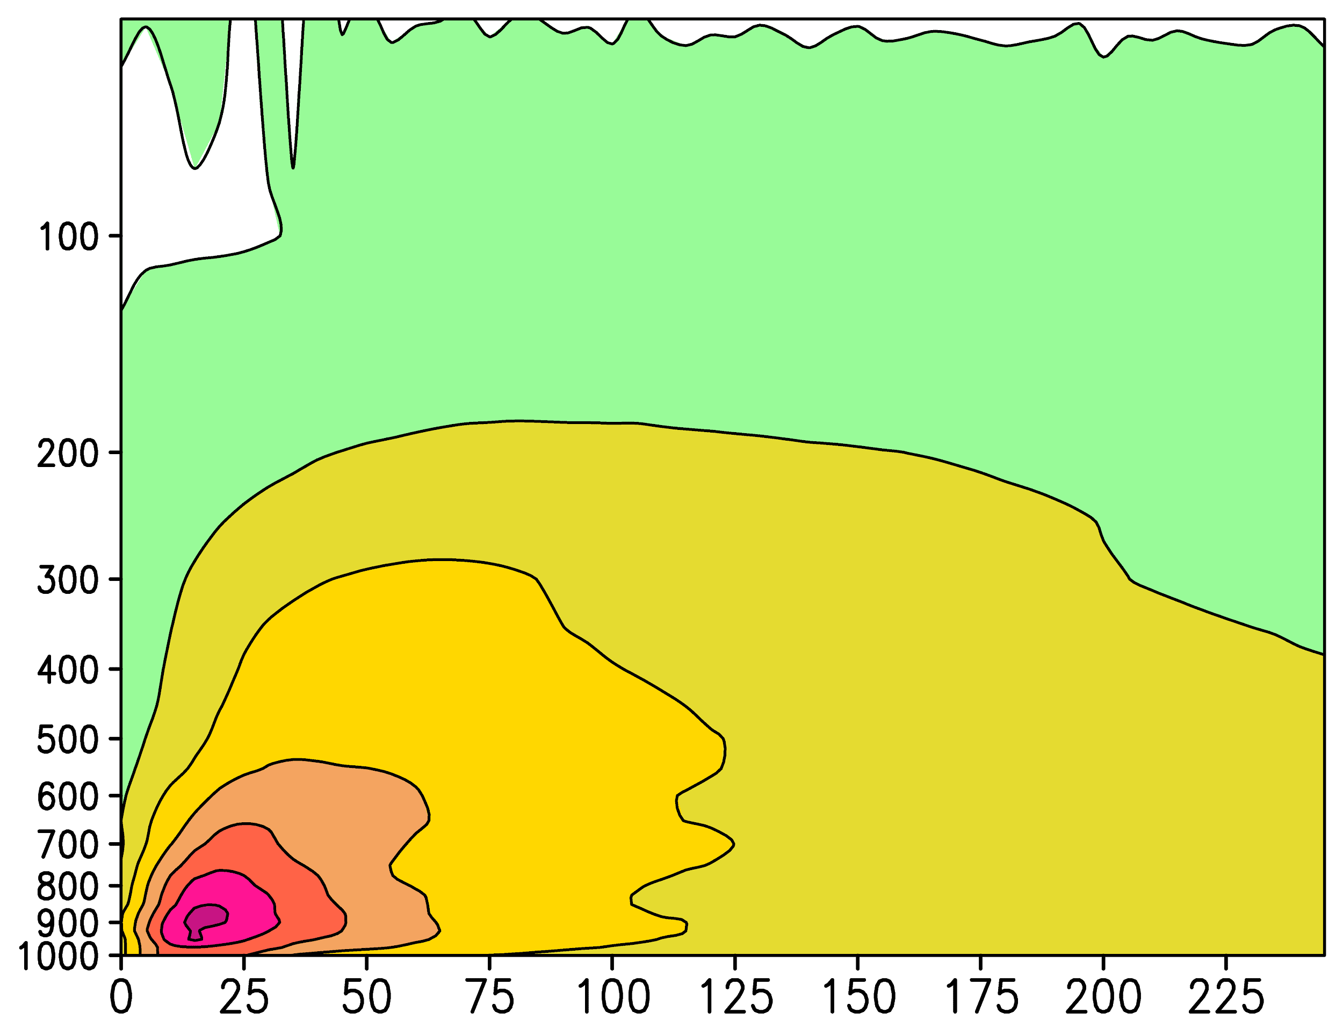
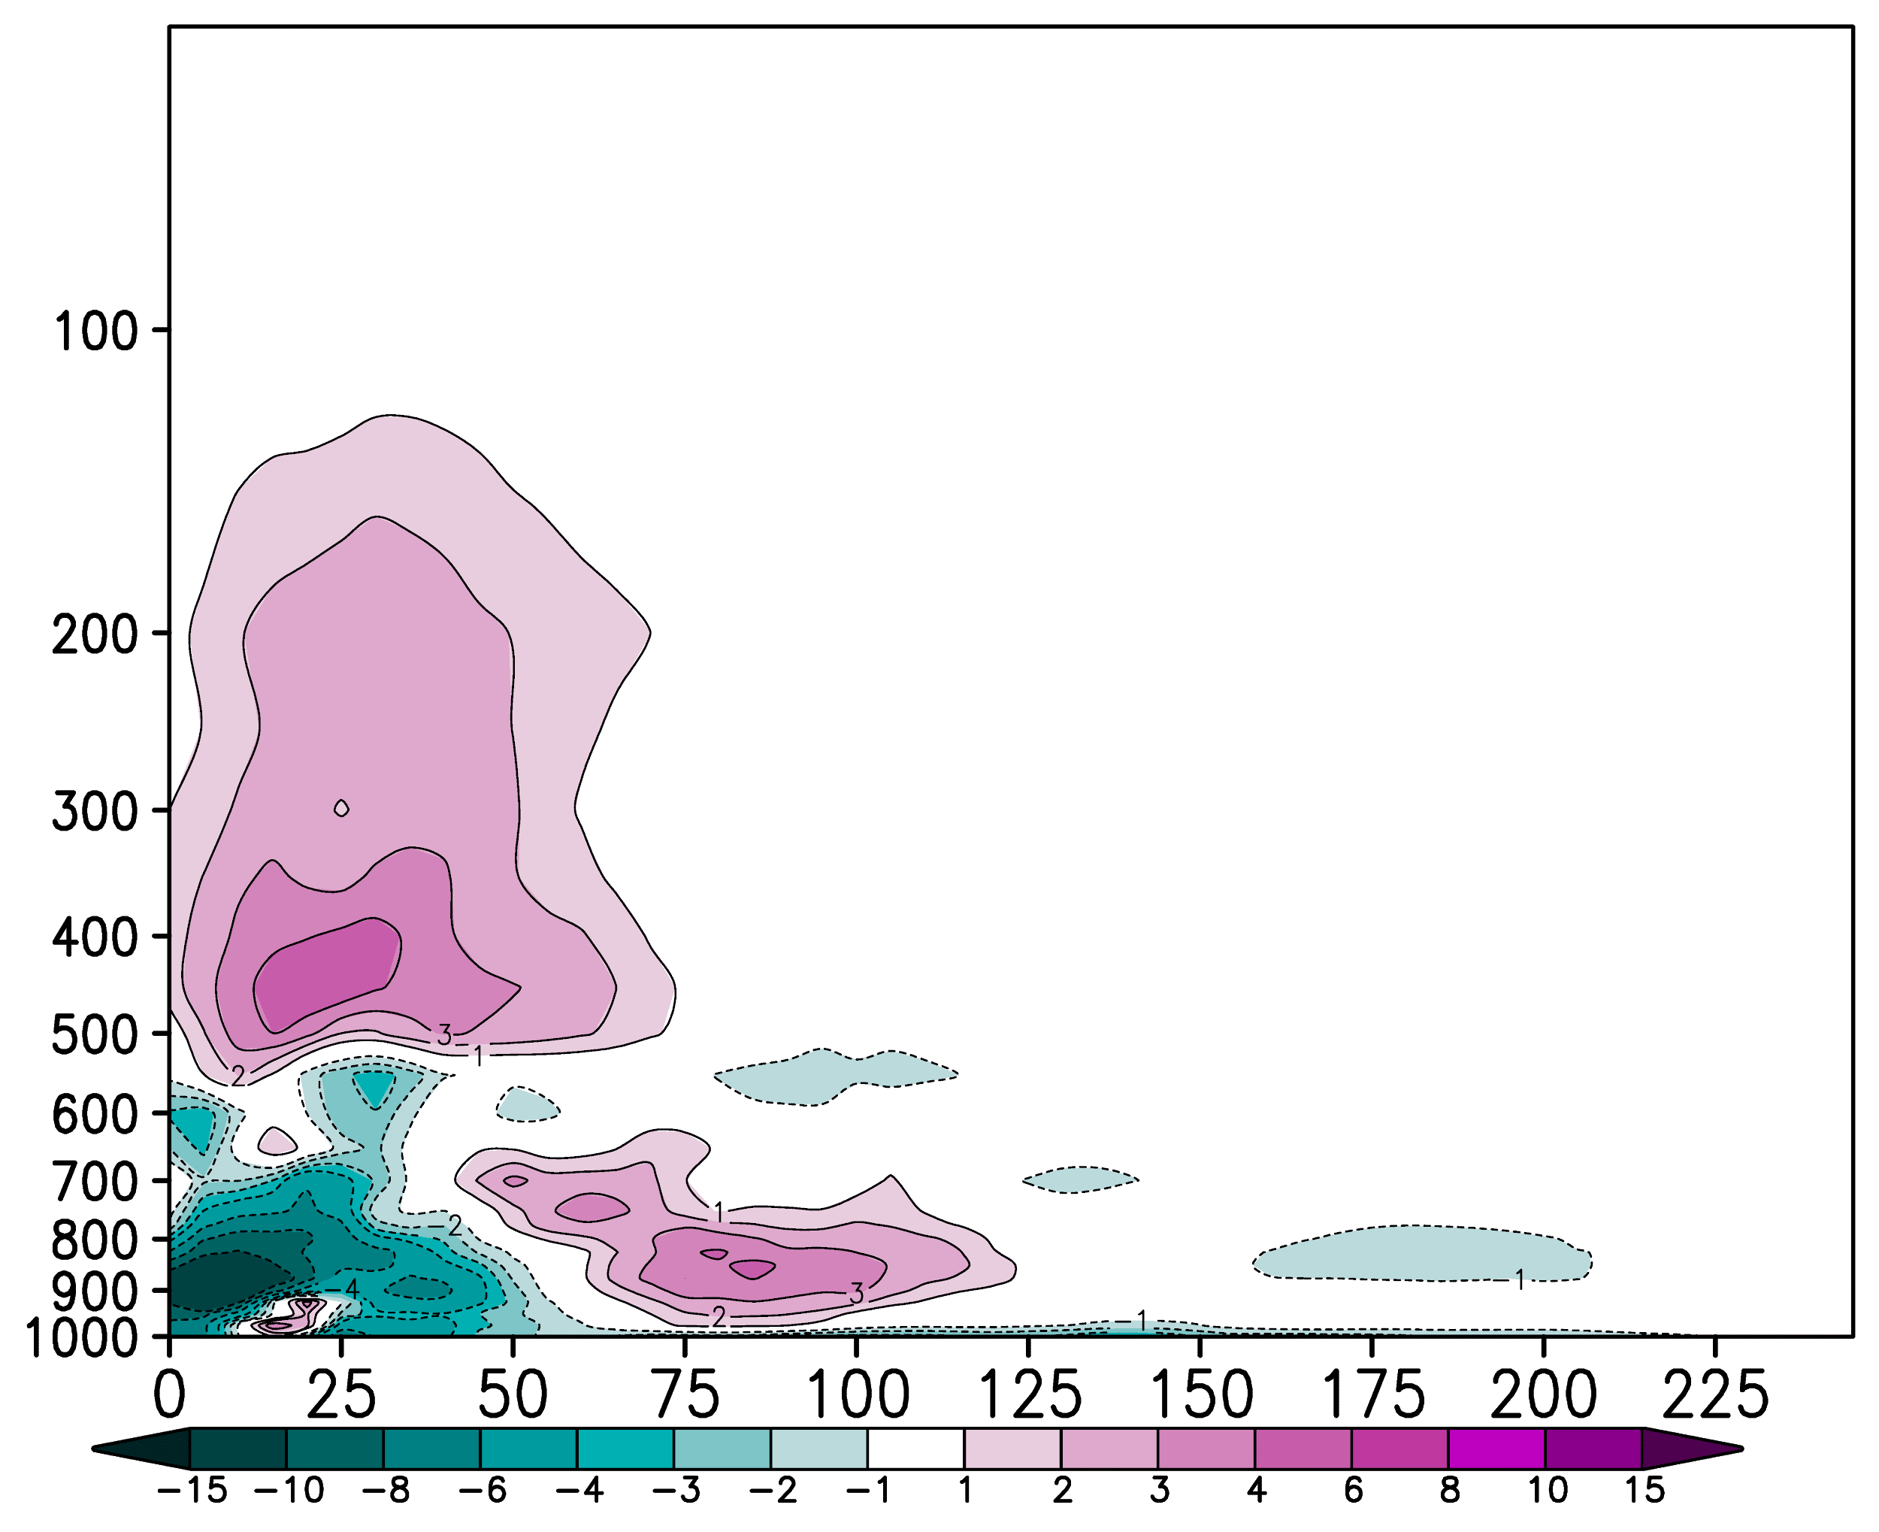
Assimilation of ADWL Observations Collected in Hurricane Lane (2018)
(a) All
(b) NoADWL
(c) All–NoADWL
(d) NoTDR
(e) NoTDR_NoADWL
(f) NoTDR–NoTDR_NoADWL
Assimilation of Airborne Doppler Wind Lidar Collected in Tropical Cyclones
November 18, 2020

Slide 14
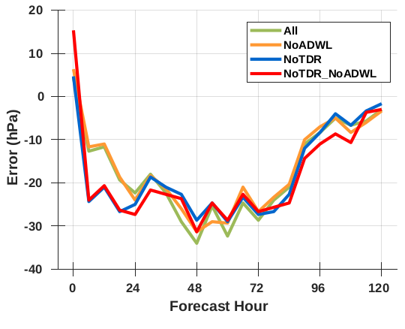
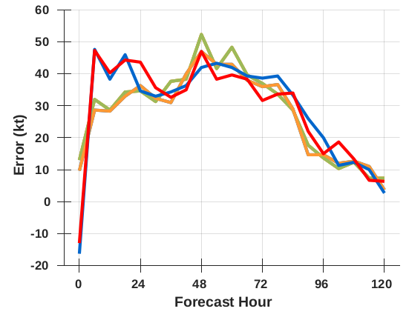
Assimilation of ADWL Observations Collected in Hurricane Lane (2018)
Averaged Minimum Central Pressure Error
Averaged Maximum 10m Wind Speed Error
“Spin down” common when initializing strong storms (Tong et. al. 2018)
Assimilation of Airborne Doppler Wind Lidar Collected in Tropical Cyclones
November 18, 2020
Notes:
- Here’s how the final analyses perform in the forecast, error statistics are averaged over all three cycles, and show the minimum central pressure error and the maximum 10m wind (intensity) error
- You can see a substantial spin down in the first 6 hours, this is common when initializing strong storms
- You can see when you have more wind observations (experiments with the TDR) that the spin is less dramatic
- The additional of the ADWL observations in these few cases did not mitigate the spin down

Slide 15
Assimilation of ADWL Observations Collected in Hurricane Lane (2018)
ADWL data adds information content in the boundary layer and near-storm environment
Potential to adjust radial extent of the storm wind field
Inconsistent results with and without TDR data suggest ADWL needs to be optimized
Vertical thinning/superobing
Additional quality control measures
Insufficient model grid spacing for small hurricane
Test more cases
Developing/asymmetric TCs (2016: Earl, Javier)
Assimilation of Airborne Doppler Wind Lidar Collected in Tropical Cyclones
November 18, 2020
Notes:
We found that the doppler wind lidar data adds observations in the boundary layer and extends the coverage radially from the center. With those additional observations, we see the data make modifications to the TC analyzed structure. But results are not consistent with and with radar data which suggest use of the ADWL by the DA system needs to be optimized. This could be through a variety of methods, though thinning and superobing come to mind. One other important “To Do” on my list is revisit the validation statistics for this case and redo the comparison-- maybe data is sneaking through and we need more quality control measures. So after some sensitivity tests, it would also be good to try a different storm.. Maybe something a little easier this time like one of the developing storms from our validation study.

Slide 16
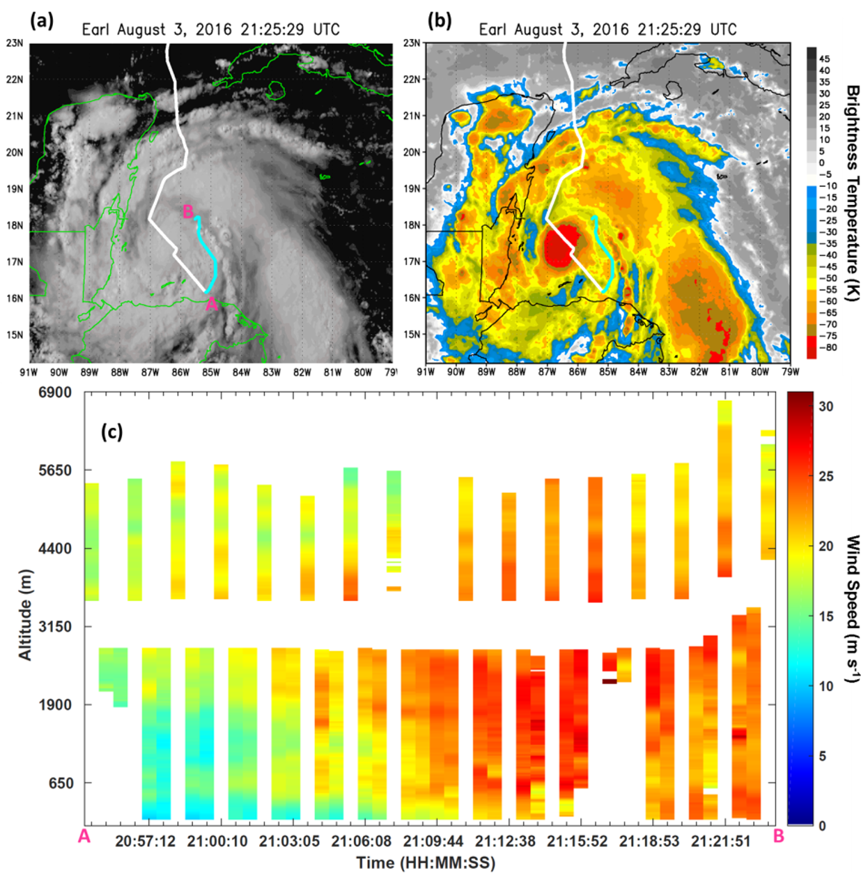
Airborne DWL in Tropical Cyclones Summary
Successful collection of wind profiles in 2015-2018 Atlantic hurricane seasons
ADWL winds are comparable to other wind measurements
ADWL captures wind measurements in some previously under-observed areas
Highly concentrated in boundary layer
Unexplored scientific uses
Processes in under-observed areas
Independent model/parameterization evaluation
Use validation for space-based DWLs
November 18, 2020

Slide 17
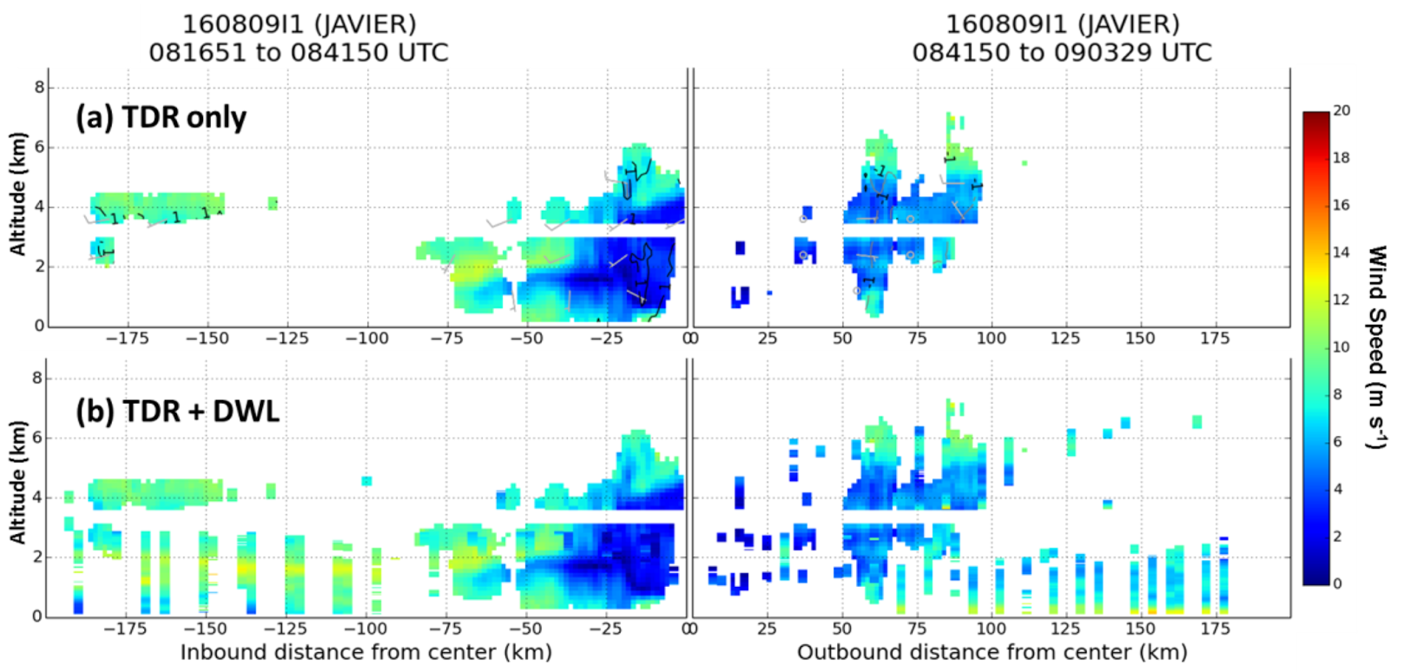
Potential DWL in Tropical Cyclones
Assimilation of Airborne Doppler Wind Lidar Collected in Tropical Cyclones
November 18, 2020
Notes:
When we compare the wind profiles collecting by the TDR and DWL, this is an example from the decaying tropical storm Javier. The top panel show just TDR data from a cross section through the center of the storm. The bottom overlays wind collected by the DWL. From this pass alone, 2900 new wind observations were collected with the DWL. So this instrument can collect data in previously unobserved regions- a result consistent through all flights.

Slide 18
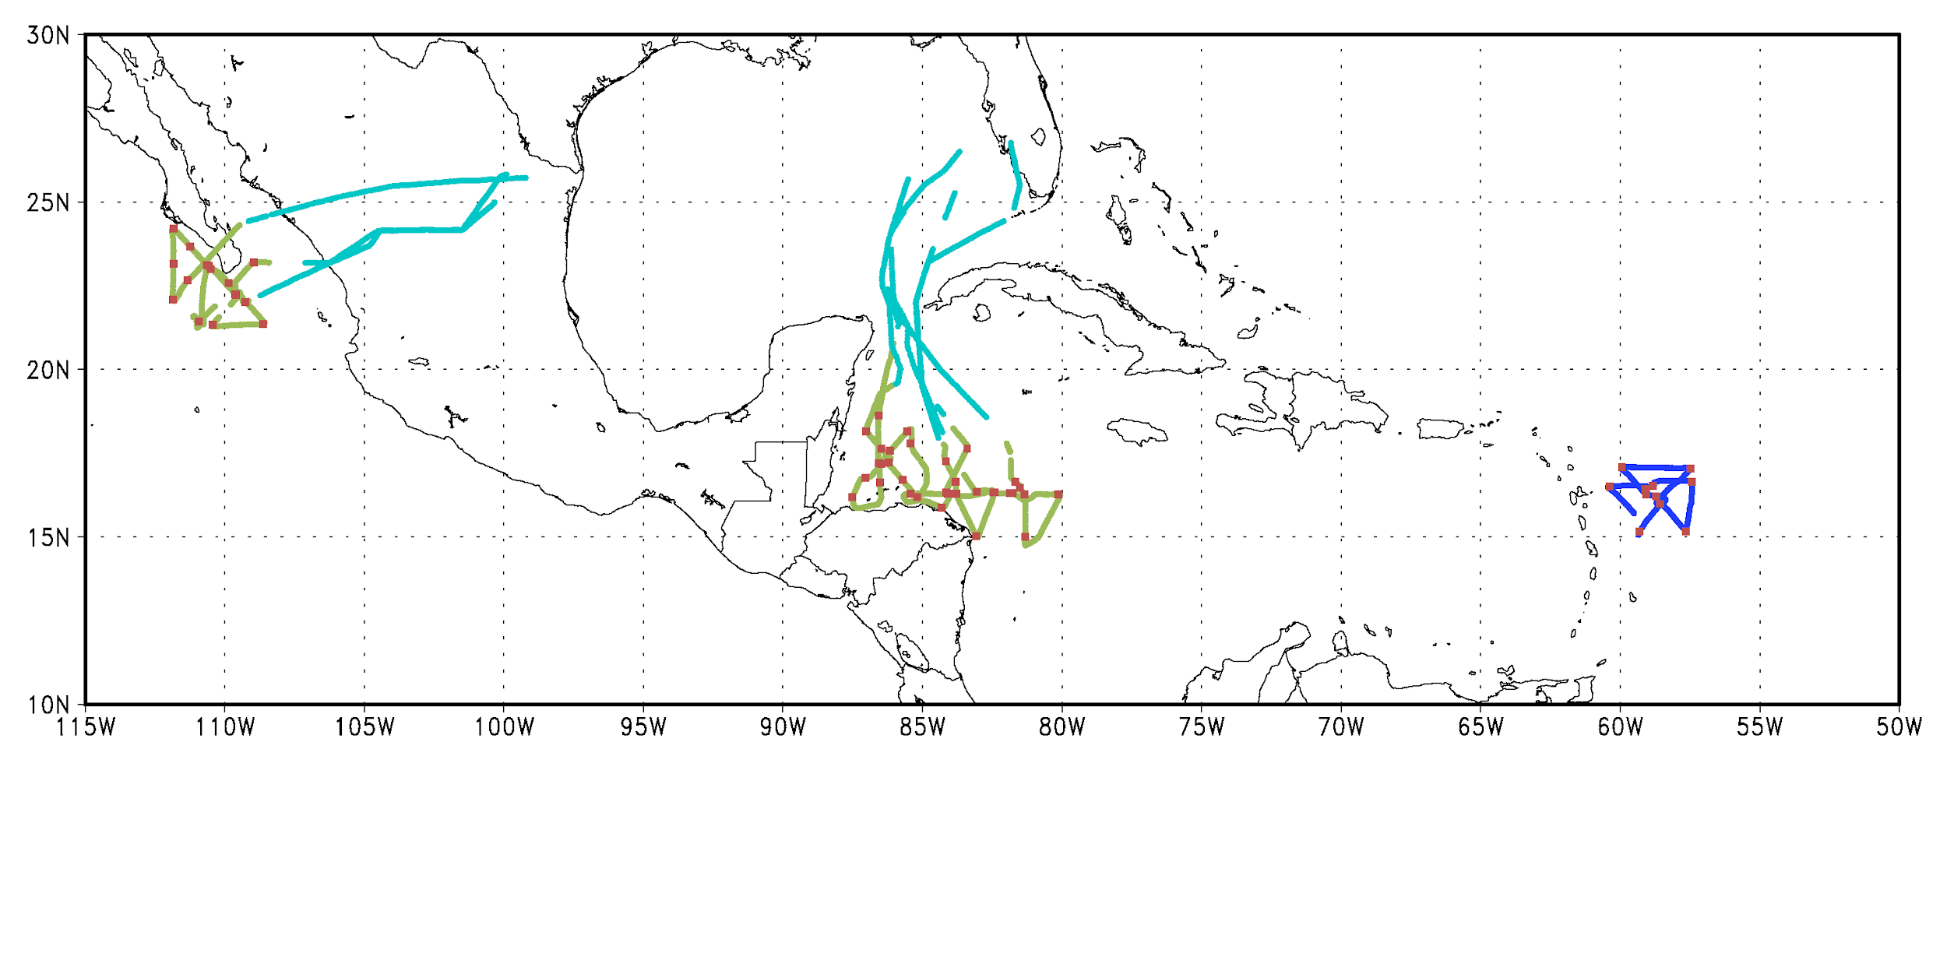
Validation of an Airborne DWL in Tropical Cyclones
Location of DWL Wind Profiles
2016 (In Storm): 1315 profiles 2016 (Transit): 899 profiles 2015: 364 profiles
Dropsondes: 62
TS Erika (1 flight), TS/Hurricane Earl (3 flights), TS Javier (2 flights)
Assimilation of Airborne Doppler Wind Lidar Collected in Tropical Cyclones
November 18, 2020

Slide 19
Validation of an Airborne DWL in Tropical Cyclones
ADWL (5+ LOS) versus Dropsondes
ADWL (5+ LOS) minus Dropsondes
Non-Center Comparisons
x
Wind Difference
RMS
Bias
D_{ADWL} = 0.9659(D_{DROP}) + 7.5271
corr=0.9858
Non-center
+
Center
Assimilation of Airborne Doppler Wind Lidar Collected in Tropical Cyclones
November 18, 2020
Notes:
Next we can validate the direction of the doppler wind lidar profiles, and starting with the right figure in a direct comparison between dropsondes and the DWL we see a large group of outliers. But the large majority of these outliers are associated with center dropsondes. So again, the doppler wind lidar is smoothing the wind shift associated with the center of the storm while the dropsonde does do that. When you remove center drops and redo the comparison, your line of best fit and correlation value are quite good. And with 5 LOS or more your bias stabilizes around 0.

Slide 20
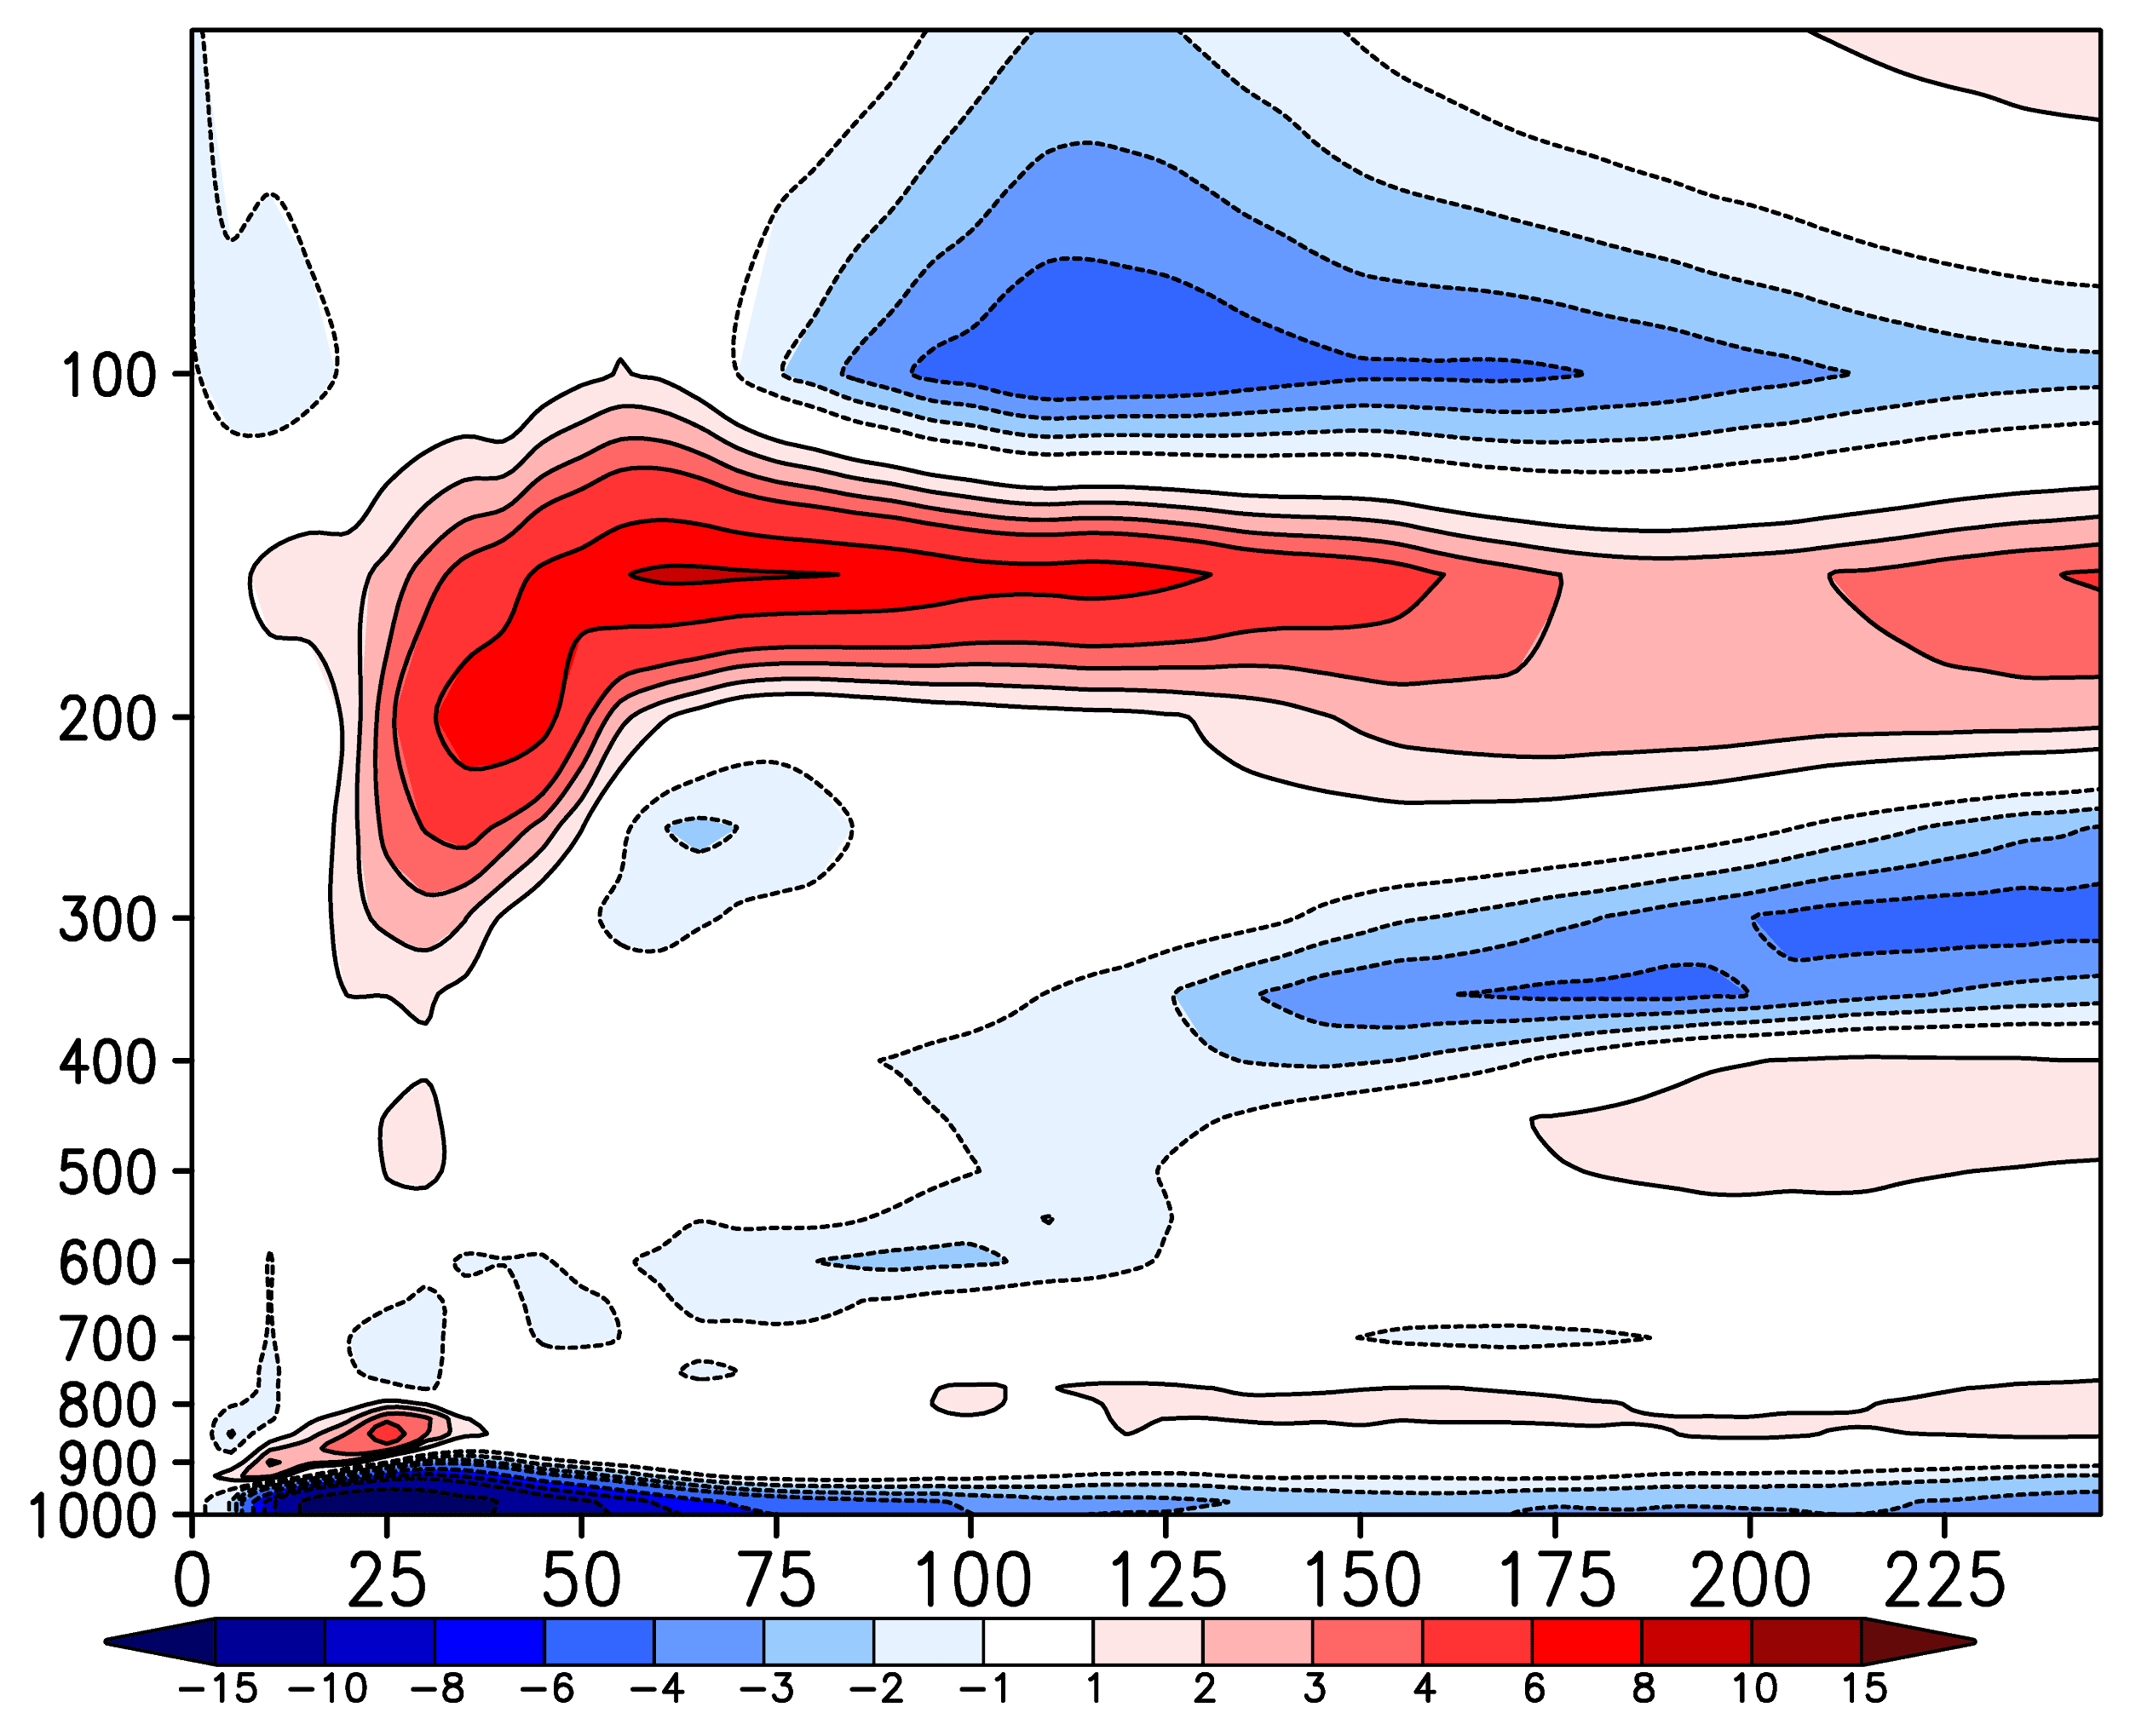
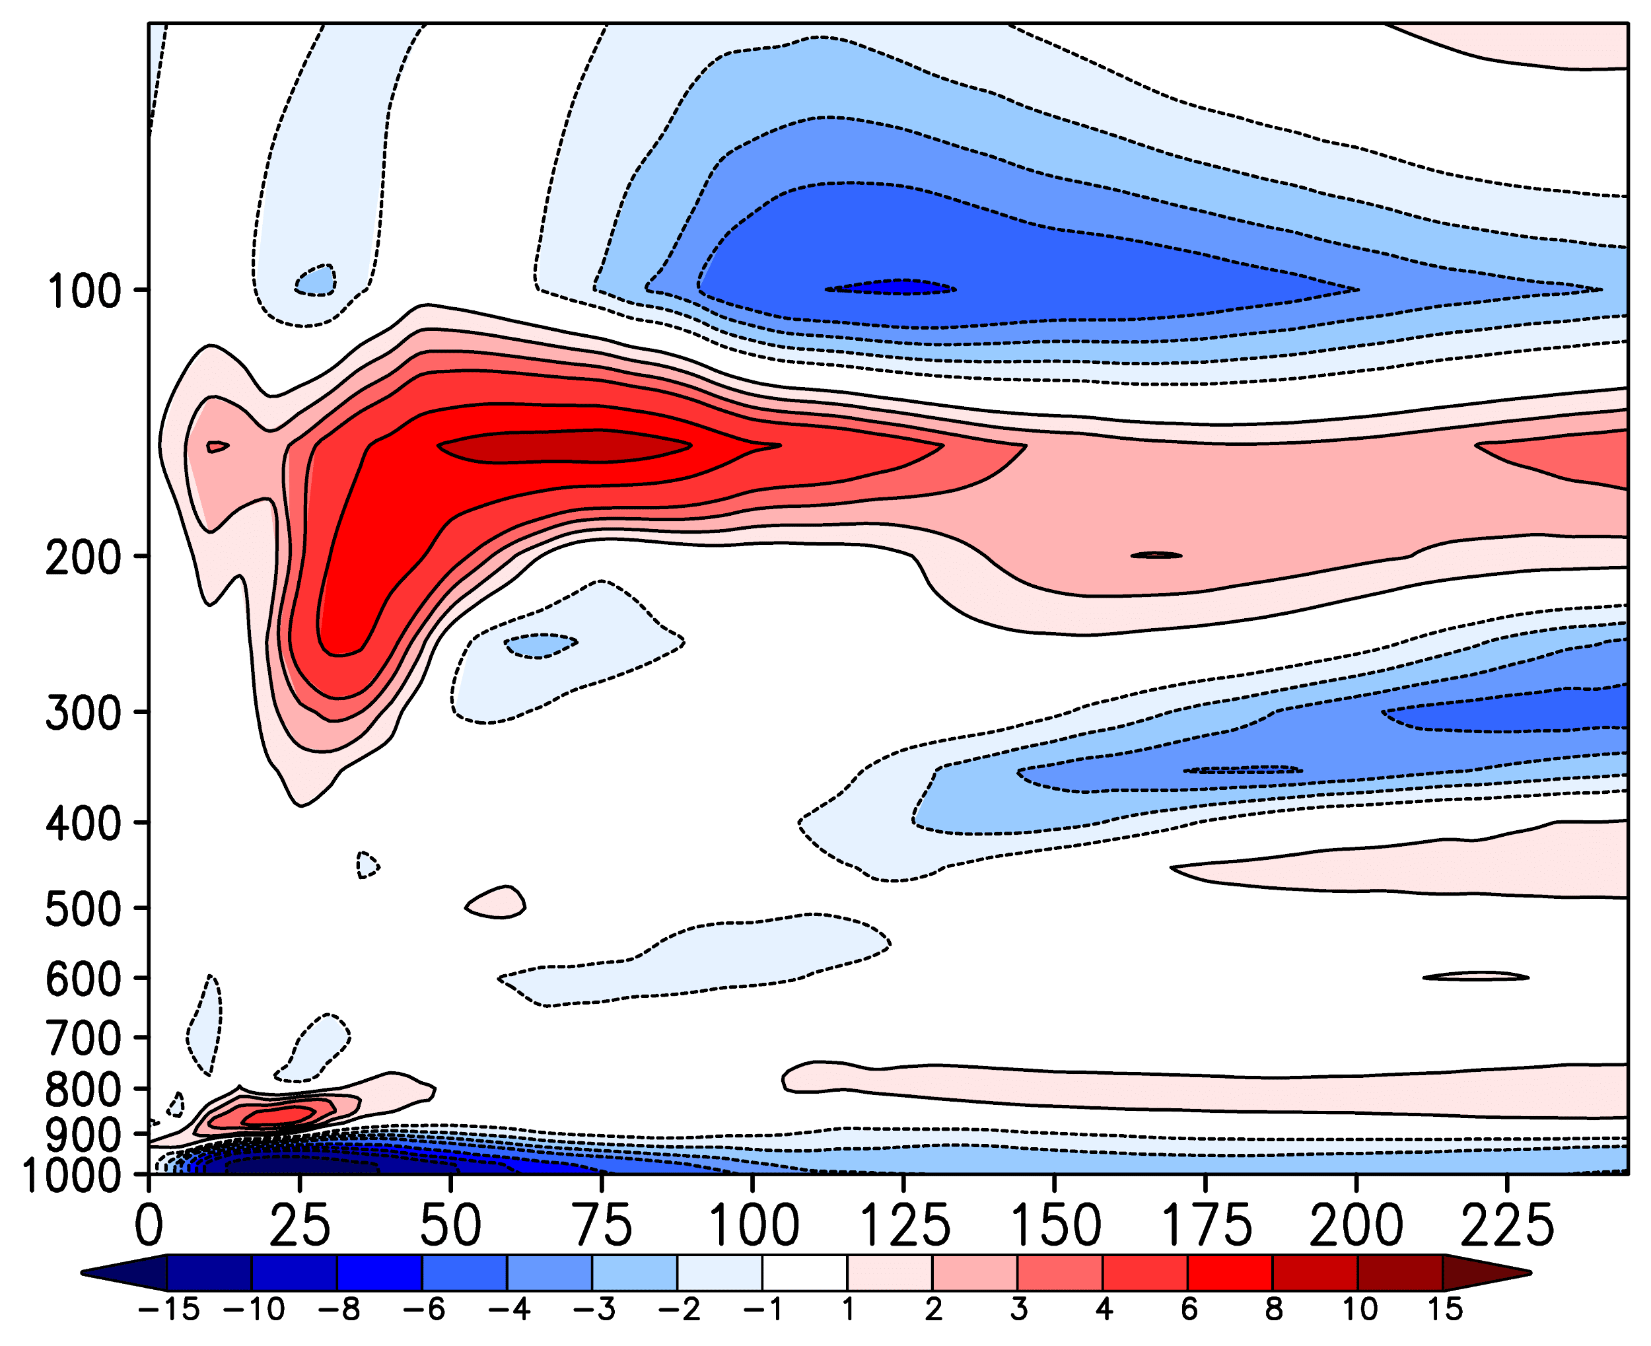
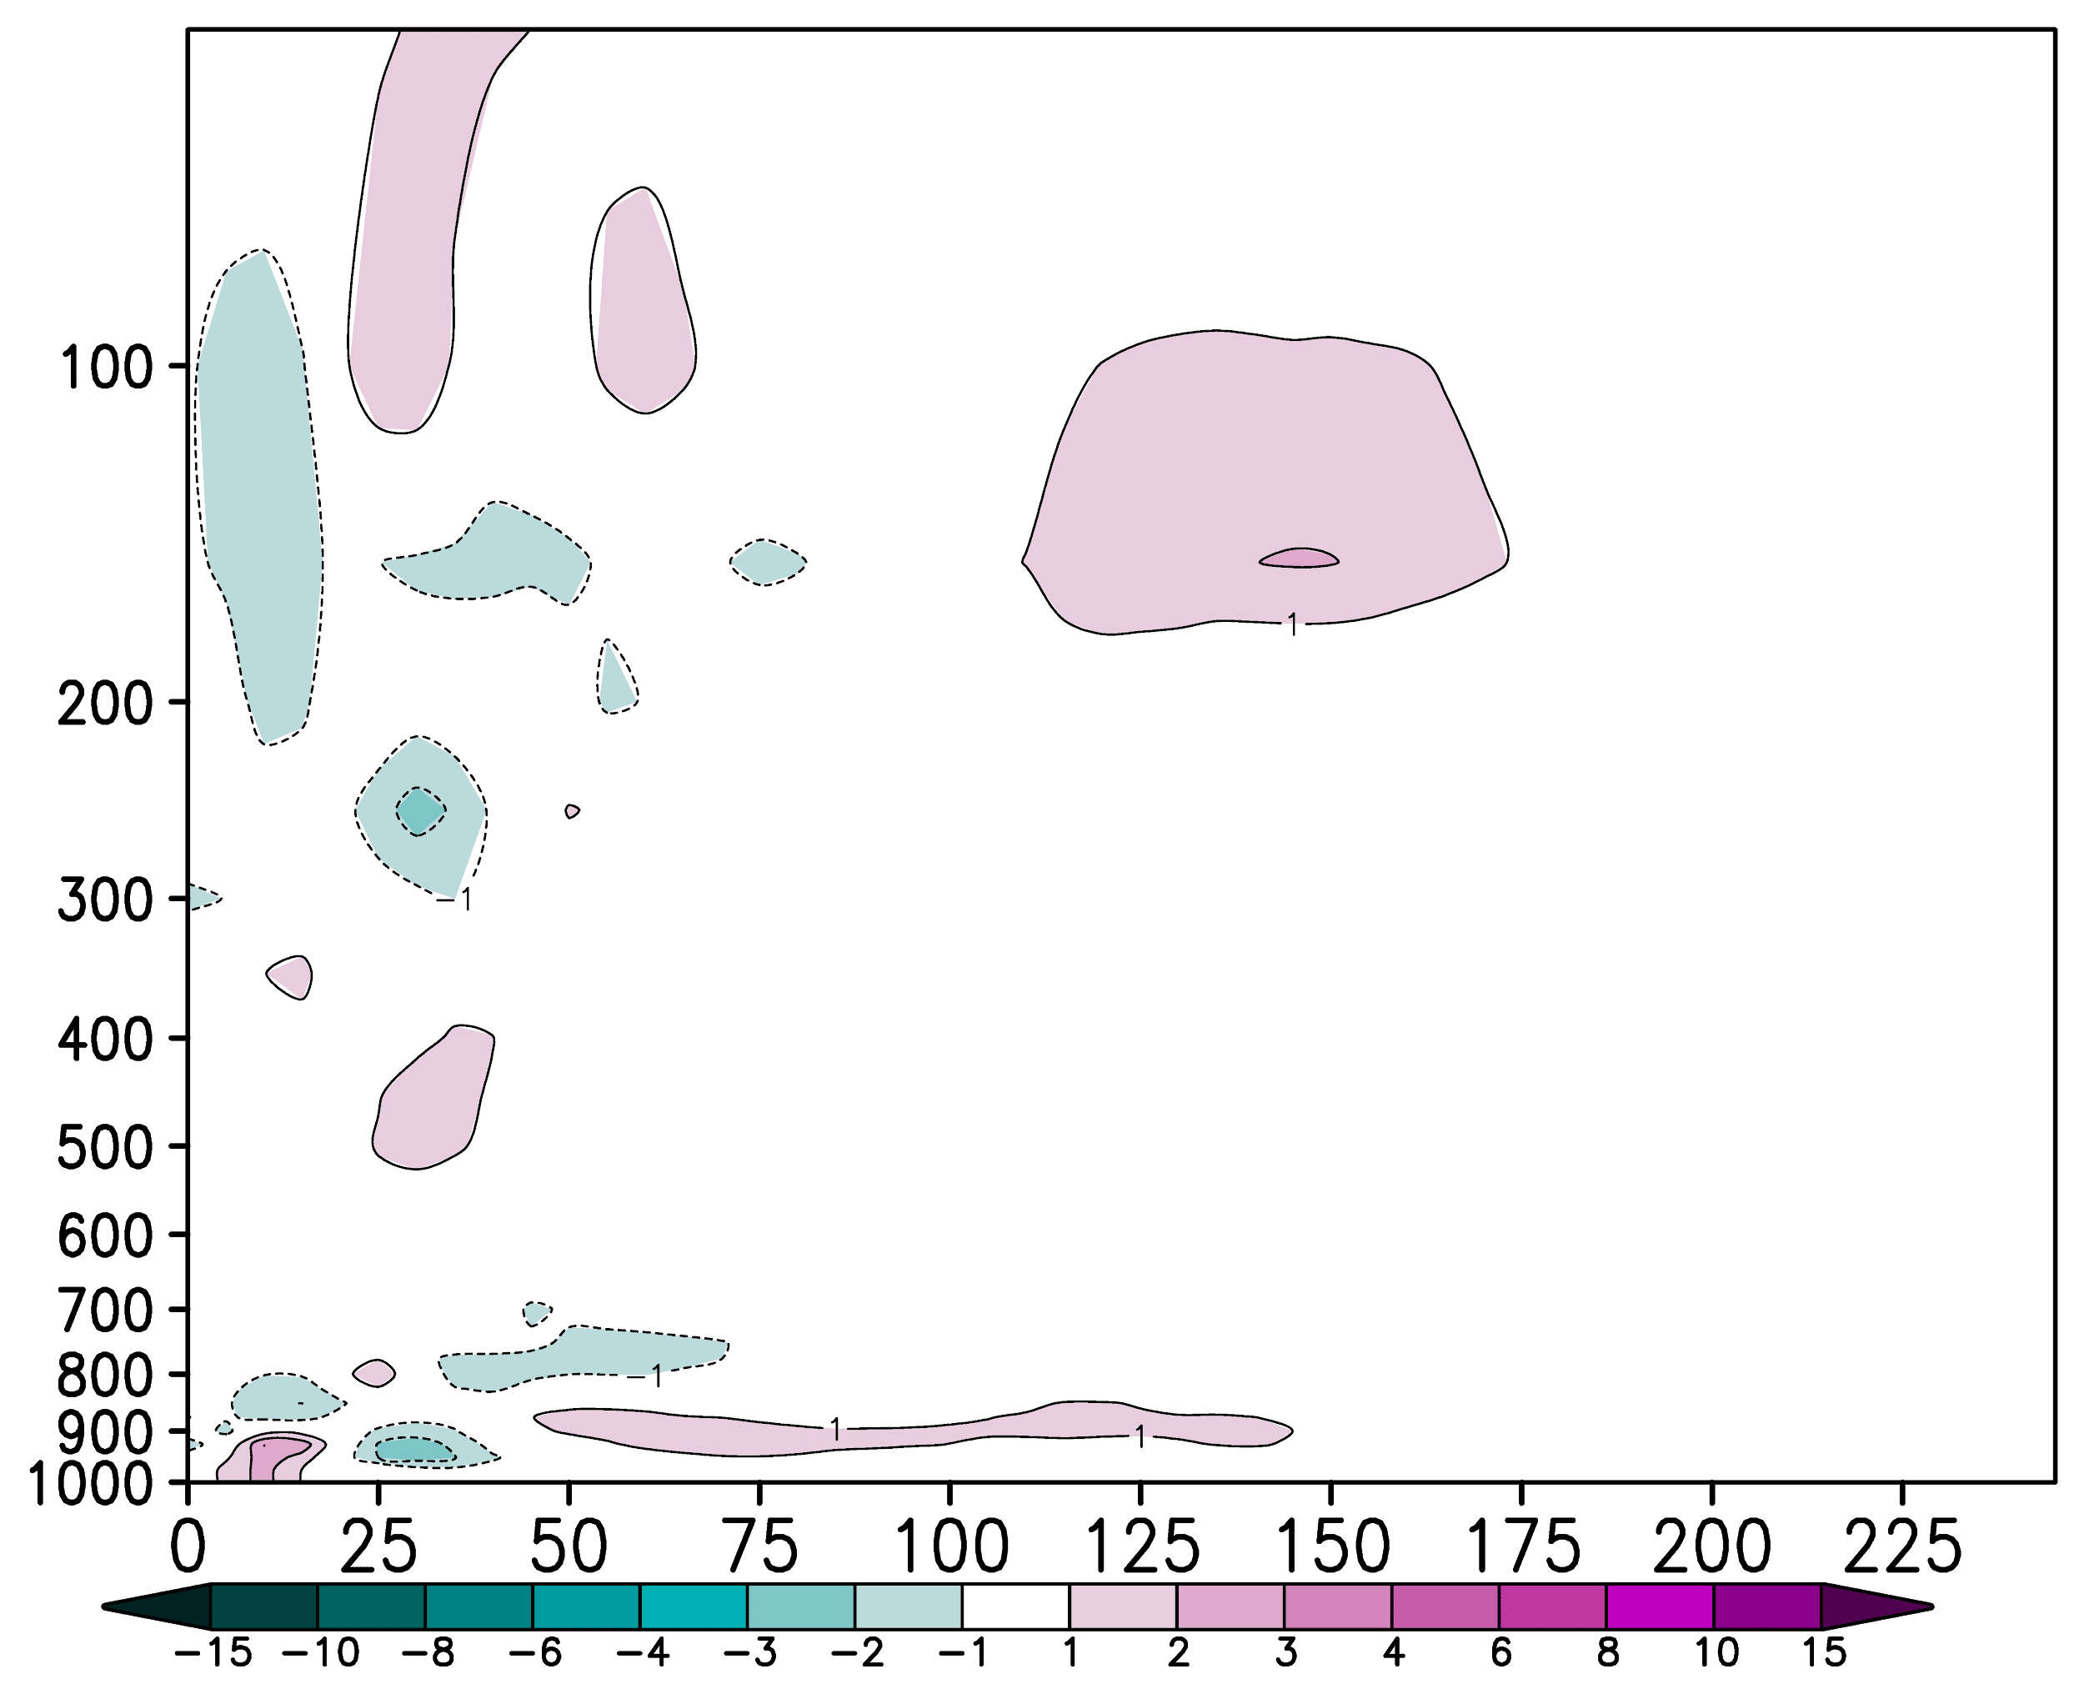
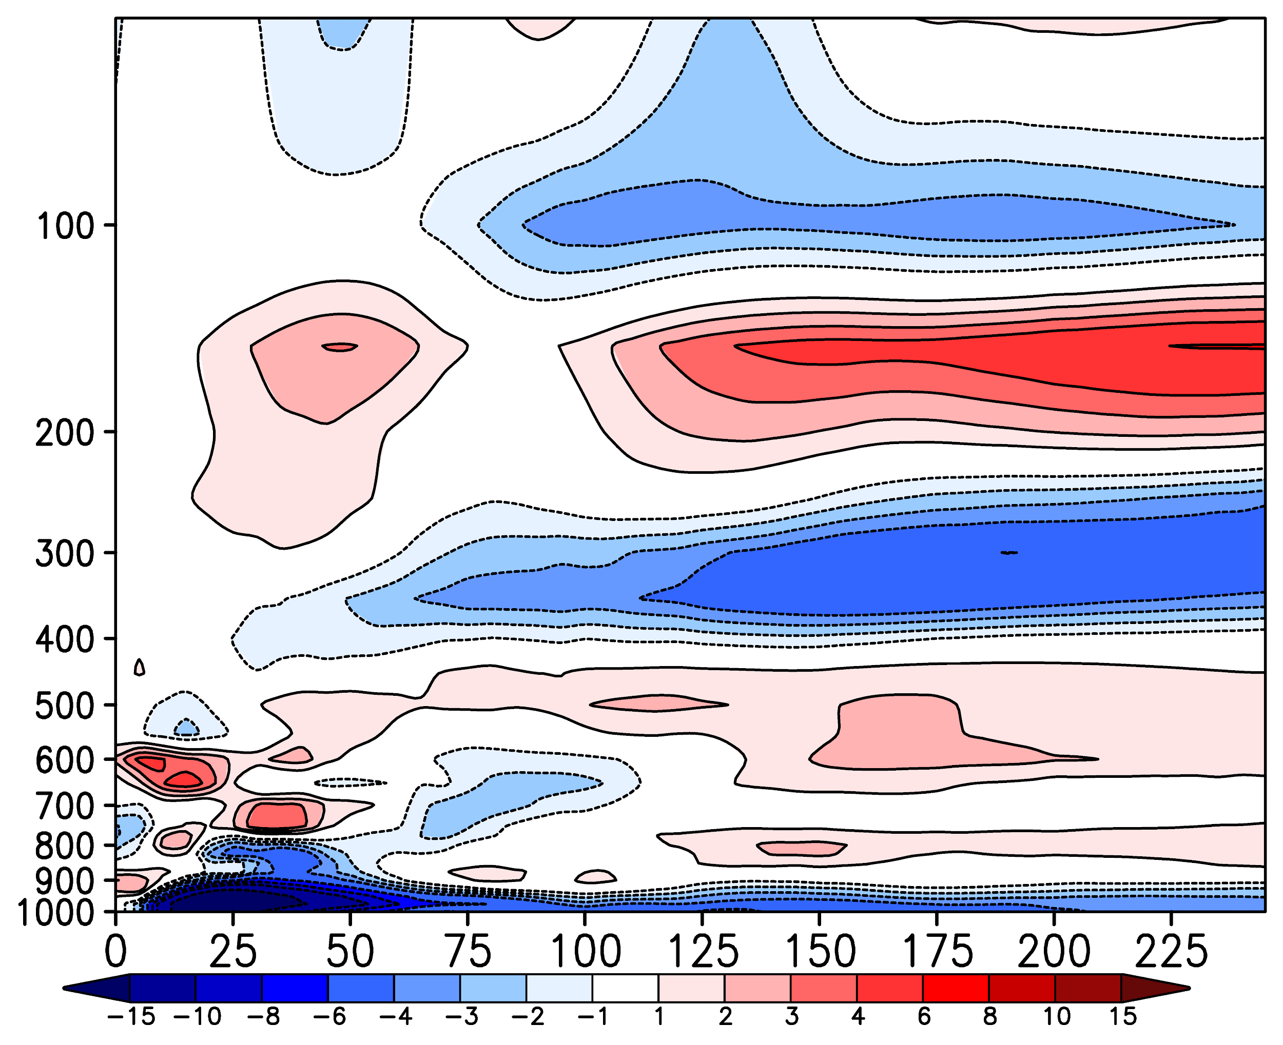
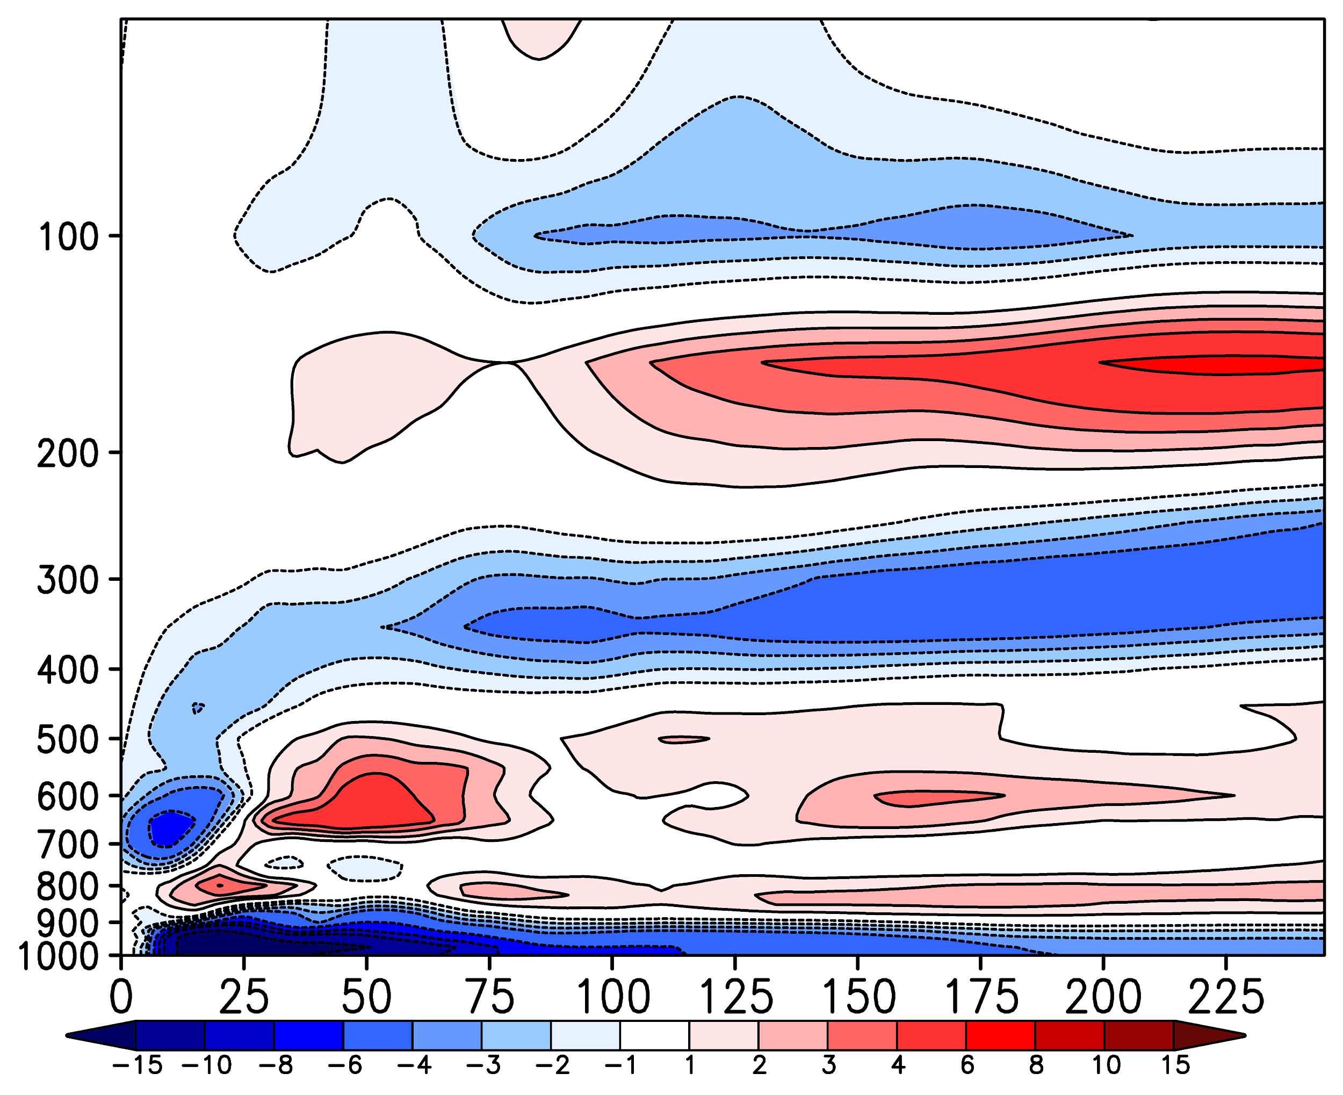
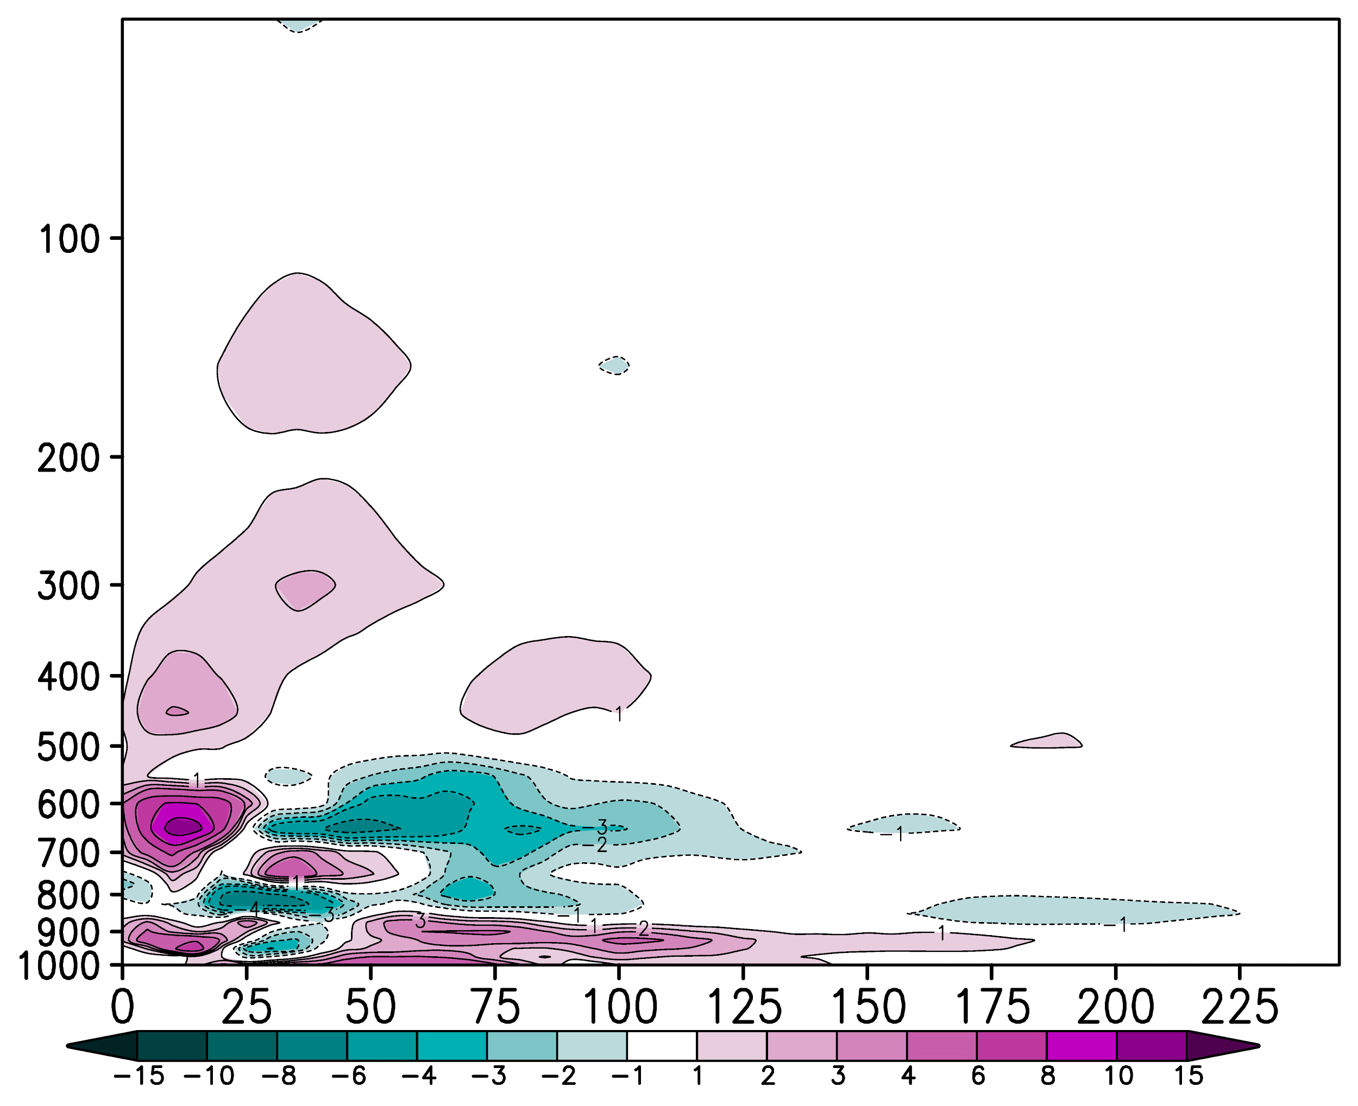
Assimilation of ADWL Observations Collected in Hurricane Lane (2018)
(a) All
(b) NoADWL
(c) All–NoADWL
Radial Wind (m s⁻¹)
(d) NoTDR
(e) NoTDR_NoADWL
(f) NoTDR–NoTDR_NoADWL
Assimilation of Airborne Doppler Wind Lidar Collected in Tropical Cyclones
November 18, 2020
Notes:
Decreases the magnitude of the boundary layer inflow. So combined with the previous slide, it is weakening the low-level vortex. So the ADWL is modifying the TC structure, but the result is not consistent between the two sets of experiments.

