Slide 1
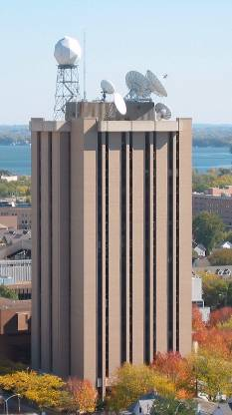
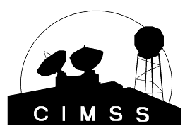
Applications of Hyperspectral Observations to Numerical Weather Prediction (NWP)
Robert M. Aune
Center for Satellite Applications and Research, NESDIS
Madison, Wisconsin
► What does a hyperspectral sounder bring to the numerical weather prediction?
► Quantitative assessment of the value of hyperspectral soundings
► Hyperspectral soundings for near-casting
► Future
UW-Madison

Slide 2
What does a hyperspectral sounder bring to numerical weather prediction?
► Vertical resolving power!
► Background independent inversion of temperature/moisture
► Cloud cleared temperature/moisture retrievals
► Above cloud temperature/moisture retrievals
► Additional tracers for motion vectors
► Improved height assignment for motion vectors
UW-Madison

Slide 3
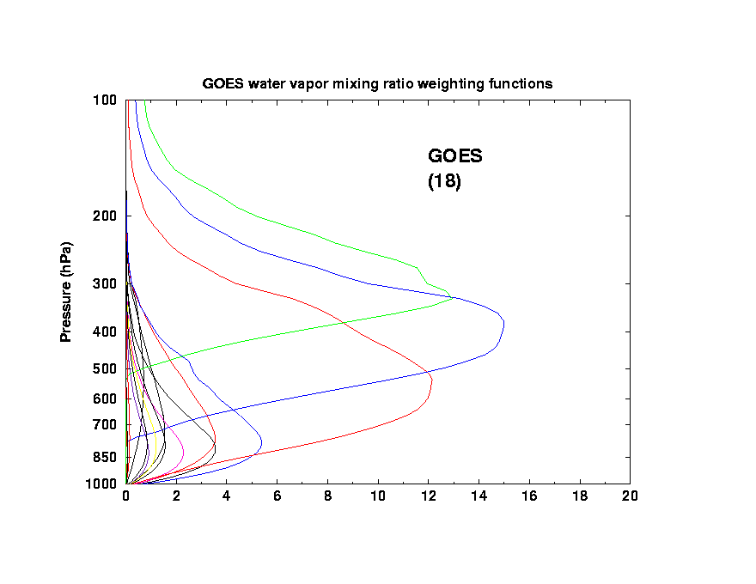
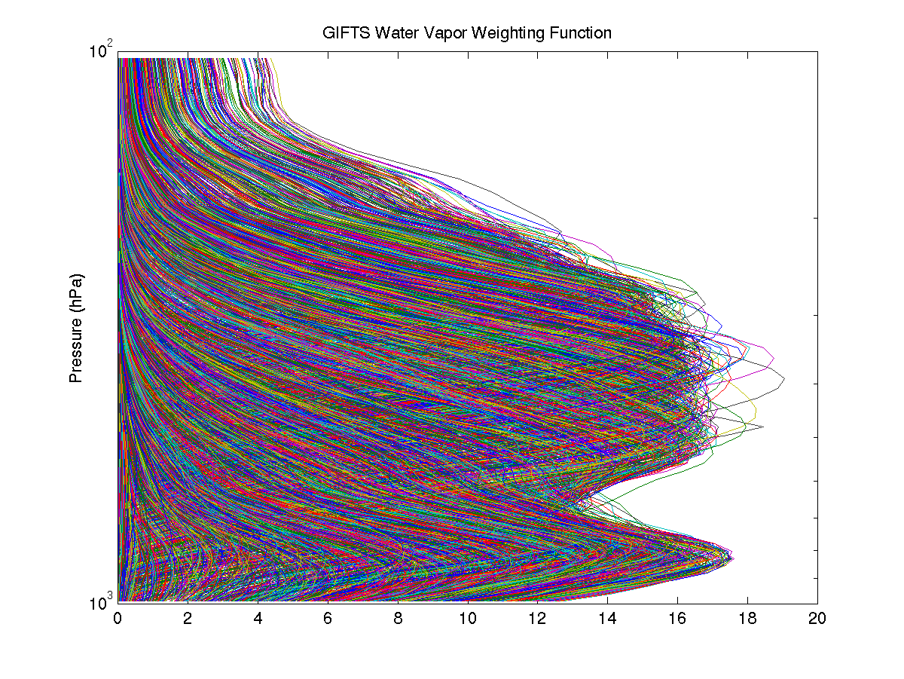
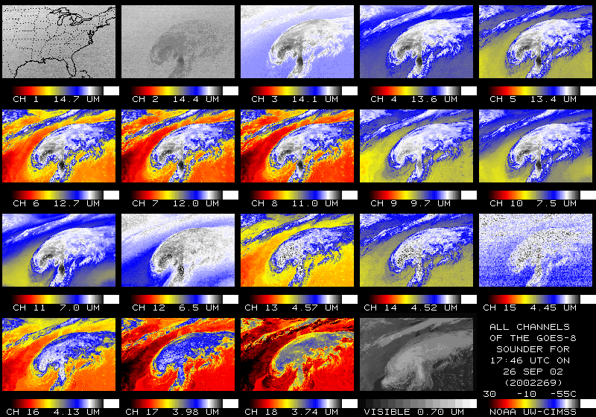
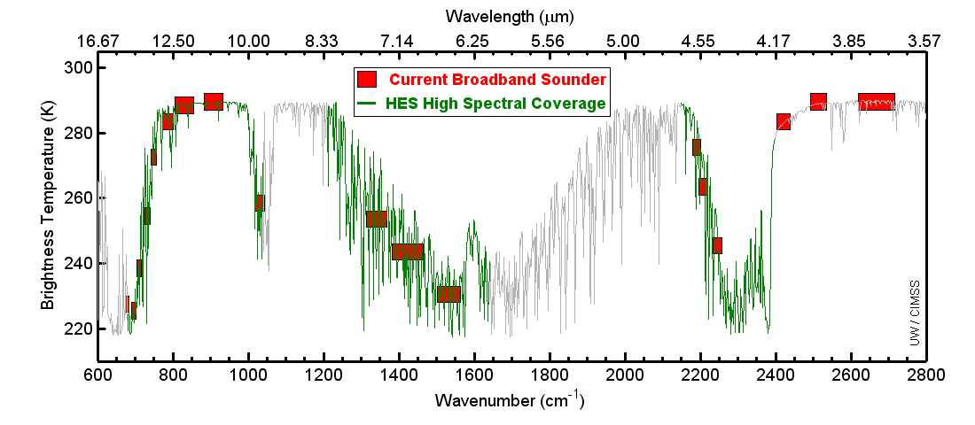
Stone Age Sounder Configuration
Hyperspectral Sounder Configuration
GOES-13 Weighting
Functions (18)
Hyper-spectral Sounder
Pressure (hPa)
Pressure (hPa)
18 IR + 1 Visible Channels
UW/CIMSS

Slide 4
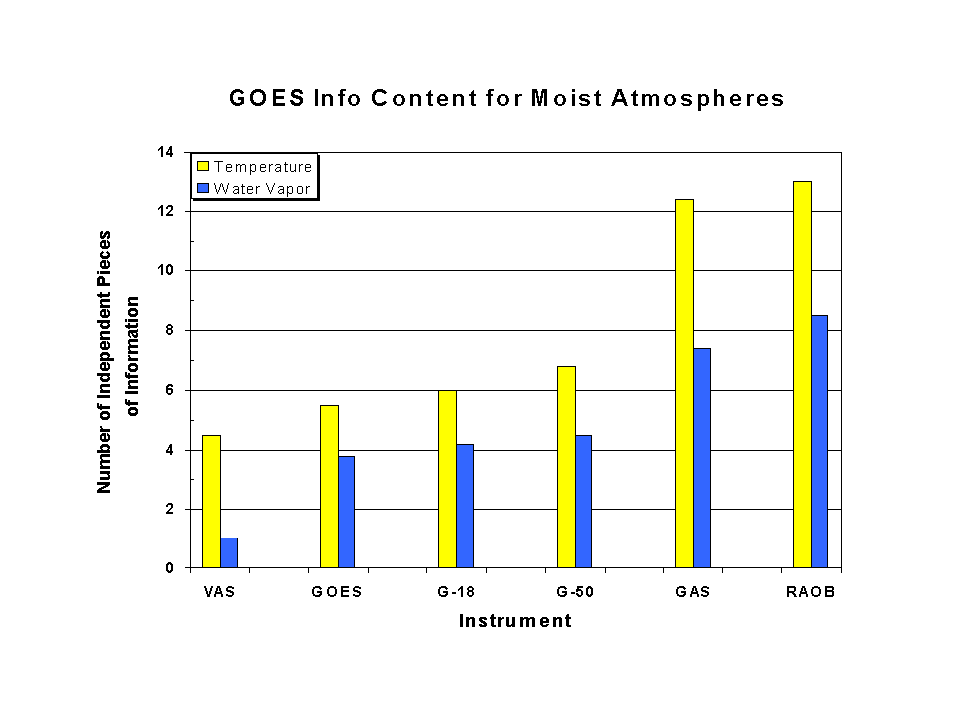
Satellite Assimilation Workshop, March 1999

Slide 5
Capability: Vertical Information
The relative vertical information is shown for radiosondes, a high-spectral infrared sounder, the current broad-band GOES Sounder and the ABI. The high-spectral sounder is much improved over the current sounder. This information content analysis does not account for any spatial or temporal differences.
Notes:
Plus, the ABI needs temperature information from NWP to compensate for only one co2 band.

Slide 6
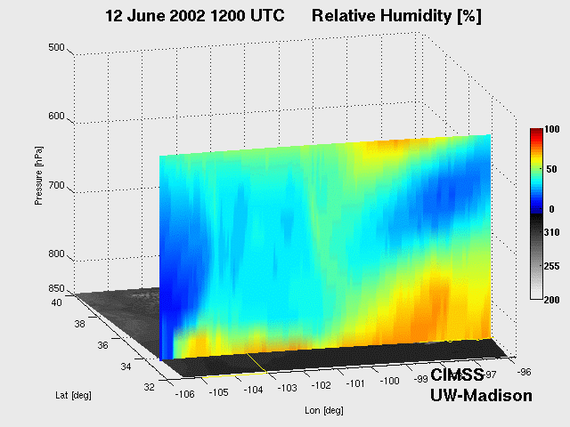
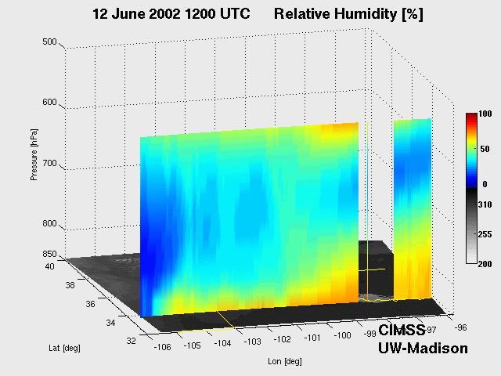
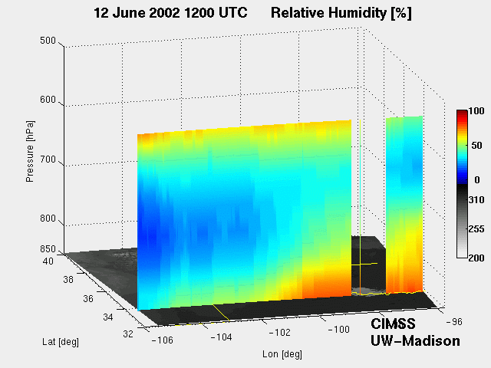
GEO
Advanced
Sounder
True
GOES-R
ABI

Slide 7
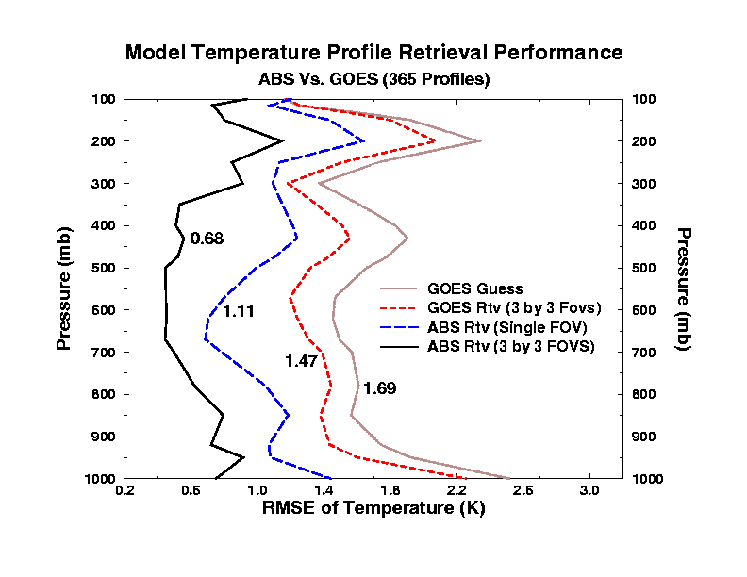
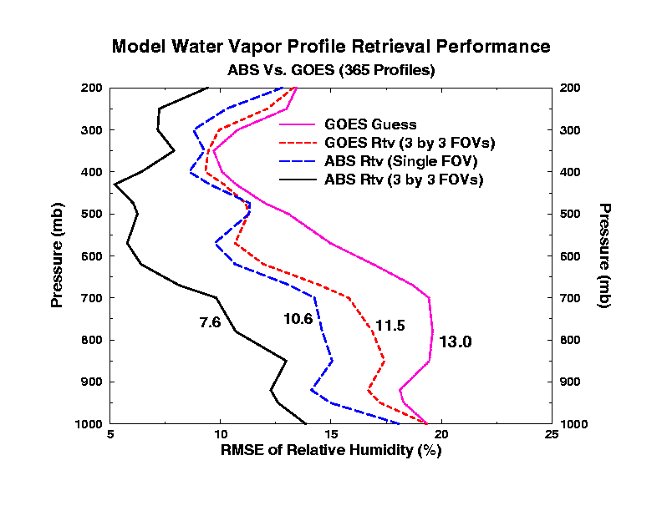
Improvements in Retrievals with Interferometers
Model background not required!
RH errors less than 10% are only available from high spectral resolution measurements
Temperature errors less than 1 degree are only available from high spectral resolution measurements
Compatible with modern assimilation techniques!

Slide 8
Capability: Vertical Profiling
Comparison of Vertical Profiling Capabilities.
Dropsonde is in an situ observation of the atmosphere from an aircraft (blue)
AIRS (green) and GOES (red) Relative Humidity (RH) retrievals.
High-spectral resolution instrument is in much better agreement with in situ measurement.
Pressure (mb)
The improved vertical resolution identifies unstable environments, which is critical for both nowcasting and NWP applications
Analysis courtesy of Jun Li, CIMSS.
Relative Humidity (%)
Notes:
Consider Dropsonde as the standard observation – like a radiosonde but dropped from a plane.
Should also not that being able to observe the moist (e.g 600-700 mb layer) and dry (e.g. 750-900 mb layer) is critical to improved weather forecasting.
The retrievals are independent of forecast models. The current broadband GOES can not capture the vertical moisture structure observed by the dropsonde.

Slide 9
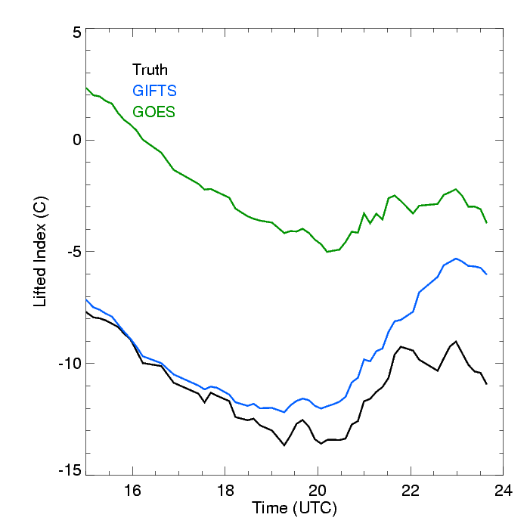
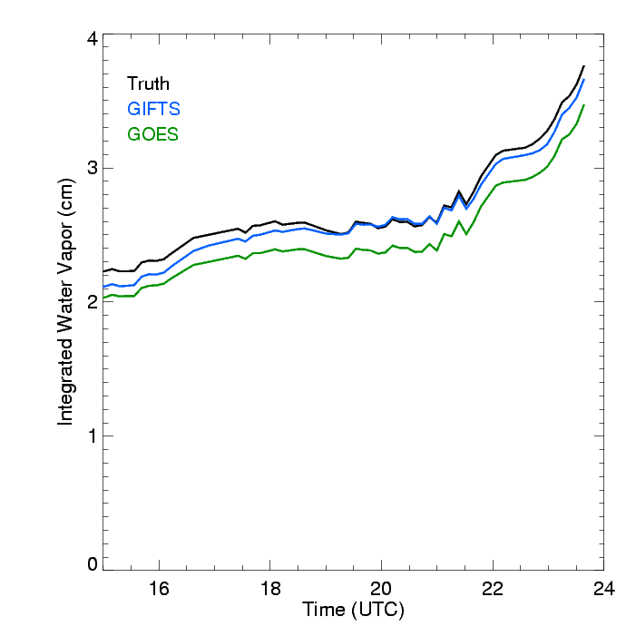
3 May 1999 -- Oklahoma/Kansas tornado outbreak
ARM / CART Site
All three solutions show rapid atmospheric destabilization (decreasing LI) between 14 and 20 UTC. GIFTS better depicts the absolute values and tendencies compared to GOES. The total precipitable water (TPW) increases through the period. Both current and future sounding measurements capture the correct trends.
UW-Madison/CIMSS

Slide 10
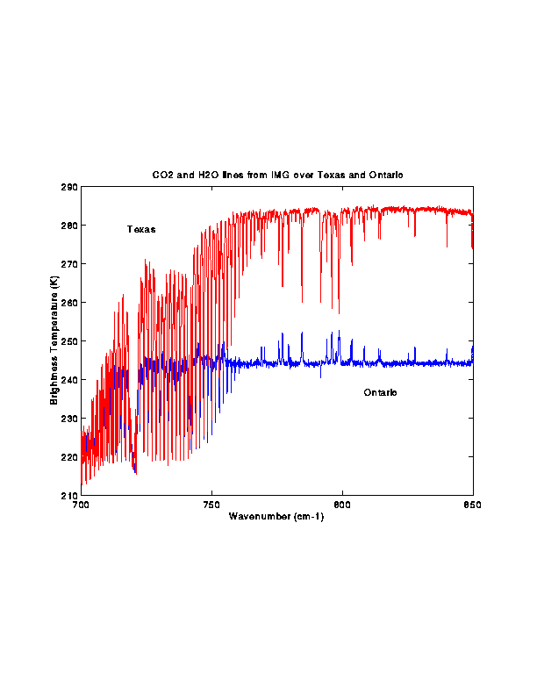
IMG demonstrates interferometer capability to detect low level inversions: example over Ontario with inversion (absorption line BTs warmer) and Texas without (abs line BTs colder)

Slide 11
The 1st Geo Sounder OSSE (1999)
Findings for the Geo-Interferometer Observing System Simulation Experiment (OSSE) at CIMSS
Aune, R. A., W. P. Menzel, J. Thom, G. Bayler, H.-L. Huang, and P. Antonelli, 2000: Preliminary Findings from the Geostationary Interferometer Observing System Simulation Experiments (OSSE). NOAA Technical Report NESDIS 95, U.S. Department of Commerce, Washington, DC, 18 pp.
Study impact of Geo Interferometer vs Geo Radiometer vs Leo Interferometer
Simulate products from “Nature” atmosphere:
Soundings (T, Td)
Winds (cloud drift / water vapor)
Aircraft Reports
Profiler Network
Conventional Data (sfc obs, raobs)
Use RUC as test model; assimilate obs for 12 hours;
generate 12 hr forecast using combinations of obs

Slide 12
Observing System Simulation Experiment (OSSE)
Validation / Calibration with Selected Observations
Nature Run
Simulated Observations
Compare and calibrate
Real Observations
Data Assimilation
Compare innovations
Data Assimilation
Forecasts “with”
Forecasts “without”
Forecasts “with”
Forecasts “without”
Simulated Impact
Compare and calibrate
Real Data Impact
Principal components of an Observing System Simulation Experiment (left) and their relationship with a Real Observation Sensitivity Experiment (right). (Provided by EMC)

Slide 13
GEO-R Sounding Locations
60 km spacing in clear skies

Slide 14
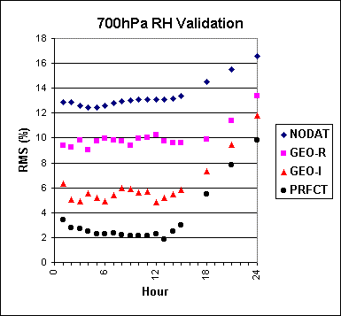
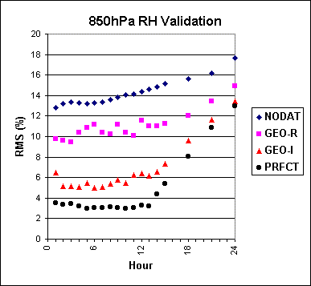
Significant Finding from Geo-Interferometer OSSE
Geo Interferometer penetrates Boundary Layer (BL) to provide
low level (850 RH) moisture information:
Geo Radiometer only offers information above BL (700 RH)

Slide 15
Findings from Geo-Hyperspectral Sounder OSSE
Geo-Increased Spectral Resolution Sounder (Geo-I) sees into Boundary Layer (BL) providing low level (850 RH) moisture information; Geo-Broadband Radiometer (Geo-R) only offers information above BL (700 RH)
Aune et al, 2000
OSSE 12 hr assimilation followed by 12 hr forecast
15
Notes:
15
This is seen again in the skill scores (indicative of how well the shape of the weather system is being forecast). The Geo-Interferometer improves the forecast by about 10 skill score points at both 700 and 850 hPa, the GOES-Sounder provides very little at 12 hours.

Slide 16
Findings from Geo-Hyperspectral Sounder OSSE
Two polar orbiting interferometers (Leo) do not provide the temporal coverage to sustain forecast improvement out to 12 hours. Only the hourly Geo-Increased Spectral Resolution Sounder (Geo-I) observations depict moisture changes well enough for forecast benefit.
Aune et al,
2000
OSSE 12 hr assimilation followed by 12 hr forecast
16
Notes:
16
This slide shows 850 RH using hourly Geo-I soundings and winds vs 6 hourly Leo-I soundings Conv (sfc obs, raobs, profiler, acars) vs Conv+Leo-I vs Conv+Geo-I vs Conv+Geo-Prfct (best = no noise). Two polar orbiting interferometers (Leo) do not provide the temporal coverage to sustain forecast improvement out to 12 hours. Only the hourly Geo-Interferometer (Geo-I) observations depict moisture changes well enough for forecast benefit.

Slide 17
Conclusions from 1st Geo Sounder OSSE
* RUC sensitive to moisture info at 50 km
* Geo-I has 2x temp/moisture info content than Geo-R
* Geo-R helps with 700 RH, but not with 850 RH
* Geo-I resolves boundary layer moisture; Geo-I halves 850 RH RMSE of conv obs (10% to 5%).
* Geo impact appears to be linear with noise
* Leo-I does not equal Geo-I moisture performance;
hourly observations critical for regional model

Slide 18
Simulating An Advanced Geo sounder using a
high-resolution forecast model
IHOP (2002) case has been used to simulate the GEO advanced IR sounding system as well as radar observations. High spatial and temporal resolution WRF model output is used as truth in the simulation. RUC forecast is also used in comparisons.
The GEO advanced IR sounder represents a dramatic new capability for earlier warnings of severe weather, 4 – 8 hours earlier than the radar observation, current GOES Sounder or the regional forecast model
UW-Madison
Notes:
18

Slide 19
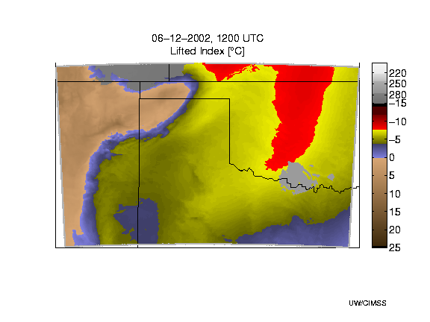
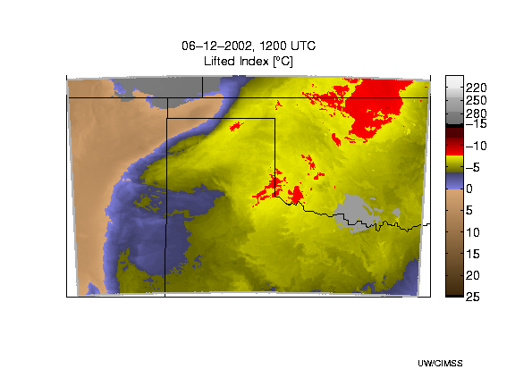
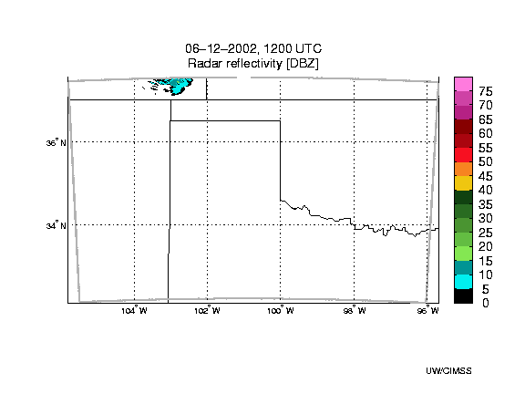
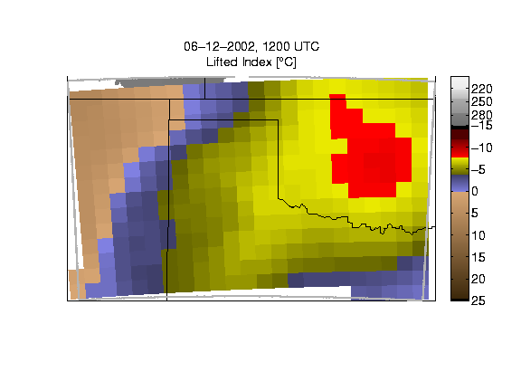
Demonstration of GEO hyperspectral sounder for storm nowcasting
True
GEO Hyp IR
Red = extreme instability
Simulated Radar
RUC forecast
RUC forecast
HES/IRS provides needed instability and warning information hours earlier than regional forecast (+3-4 hrs) and Radar (+8 hrs)
Jun Li, Jinlong Li, Jason Otkin, and Tim Schmit
Notes:
LI>0 stable, -3 to 0 moderately stable, -6 to -3 moderately unstable, -6 to -9 very unstable, -6 to -9 extreme instability

Slide 20
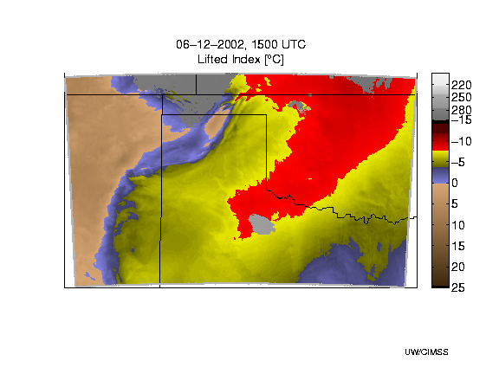
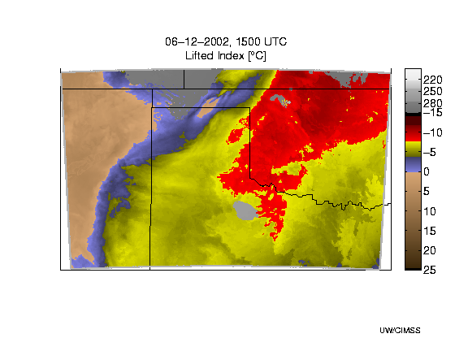
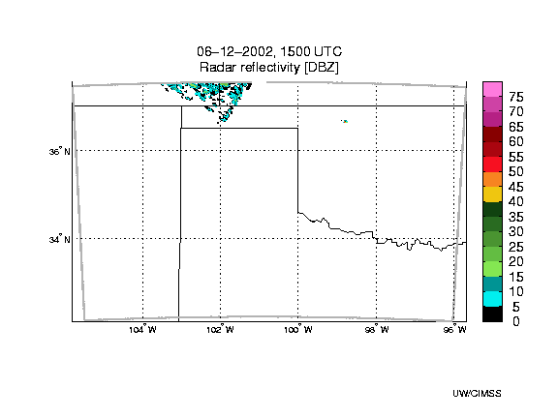
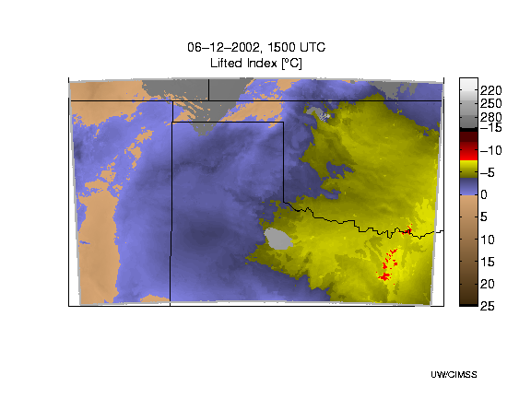
Comparing GEO hyperspectral IR sounder to GOES
True
GIFTS/HES/IRS
Simulated Radar
GOES Sounder like
20

Slide 21
Geo (hourly) high spectral (~1 cm-1) IR Sounder with spatial (4-10 km) & radiometric (~0.1 K) capabilities will
* depict water vapor as never before by identifying small scale features of moisture vertically and horizontally in the atmosphere
* track atmospheric motions much better by discriminating more levels of motion and assigning heights more accurately
* characterize life cycle of clouds (cradle to grave) and identify cloud particle sizes (useful for radiative effects of clouds)
* measure surface temperatures (land and sea) by accounting for emissivity effects (improved SSTs useful for sea level altimetry applications)
* distinguish volcanic ash (useful for aircraft routing), ozone, and possibly some trace gases (SO2, CH4, CO, …) with improved certainty.
21
Notes:
21

Slide 22
Hyperspectral observations are already
impacting NWP!
The top seven observing systems that contribute to ECMWF forecast error reduction (QJRMS, Oct, 2009):
1. AMSU-A (4 satellites) 17.2% 2. IASI (one satellite) 12.0% 3. AIRS (one satellite) 11.8% 4. AIRREP (aircraft temperature and winds) 9.3% 5. GPSRO (bending angles)-8.5% 6. TEMP (radiosonde winds, humidity, and temps)-7.9% 7. QuikSCAT (scatterometer surface winds)-5.2%
UW-Madison

Slide 23
Using the GOES Sounder to Nearcast Severe Weather
GOAL:
Generate useful short-range forecasts of the timing and locations
of severe thunderstorms
Fill the Gap
Between Nowcasting & NWP
Issues:
- Poor forecast accuracy in short-range NWP
- Lack of moisture observations over land (US)
Excessive smoothing of moisture in NWP
Time delay in delivering guidance products
Solution:
Develop an objective “nearcasting” tool that leverages information from the GOES Sounder to assist forecasters with identifying pre-convective environments 1-6 hours in advance
CIMSS collaborator: Ralph Petersen

Slide 24
Premise:
Sounder gives information on distinct layers in atmosphere at observation time
Use winds/height gradients move those slabs of moisture around
Question: Where does convective instability develop because of the moving slabs?
Very Dry Layer
Somewhat Moist Layer
Very Moist Layer
24

Slide 25
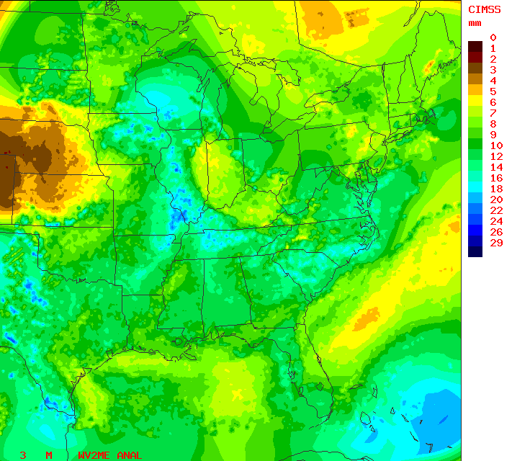
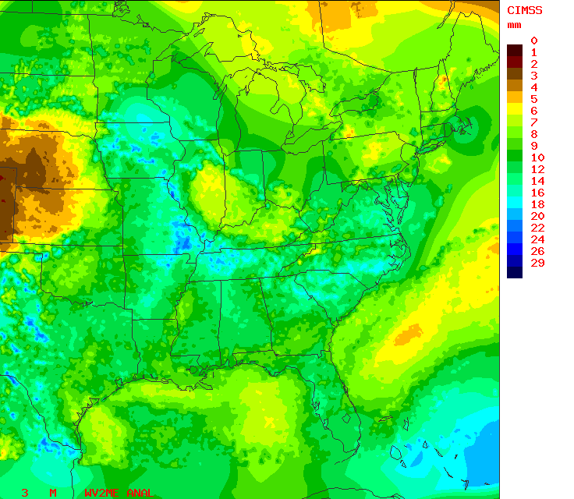
Lagrangian Nearcasting Approach
GOES-12 900-700 hPa precipitable water analysis valid
21 UTC 13 April 2006
GOES-12 900-700 hPa precipitable water retrievals valid 00 UTC 14 April 2006
0-hour Nearcast
Dry
Moist
3-hour Nearcast
Dry
Moist
O
O
Starting location
New location
How it works
NWP models use randomly spaced moisture observations interpolated on to a fixed grid, and use gridded wind data to advect the moisture information forward in time at fixed grid points. This process smooths horizontal gradients.
The Lagrangian approach interpolates wind data to each observation location (~10km spacing) which is then projected forward to a new location forced by dynamically changing wind forecasts. A relatively long time step (10 min) can be used. The new data locations are then transferred back to a regular grid.
25

Slide 26
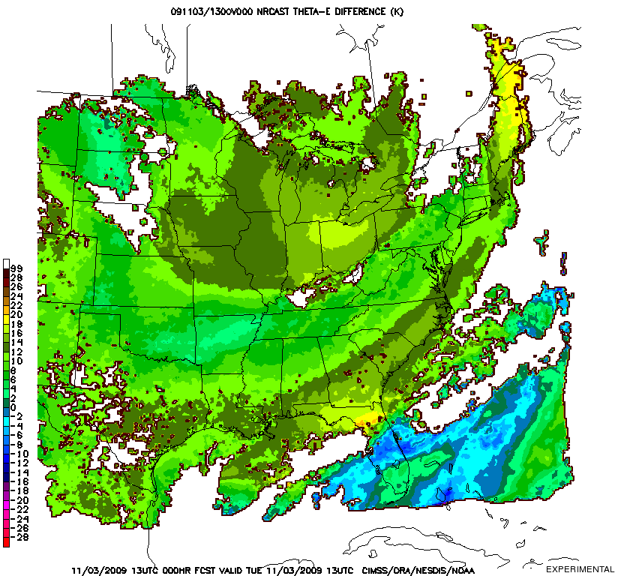
Real-time 6-hour nearcast of atmospheric de-stabilization, 2-layer thetaE from the GOES-12 sounder commencing 19UTC Novenber 3, 2009. Hourly loop is from T- 6 hours to T+ 6 hours.

Slide 27
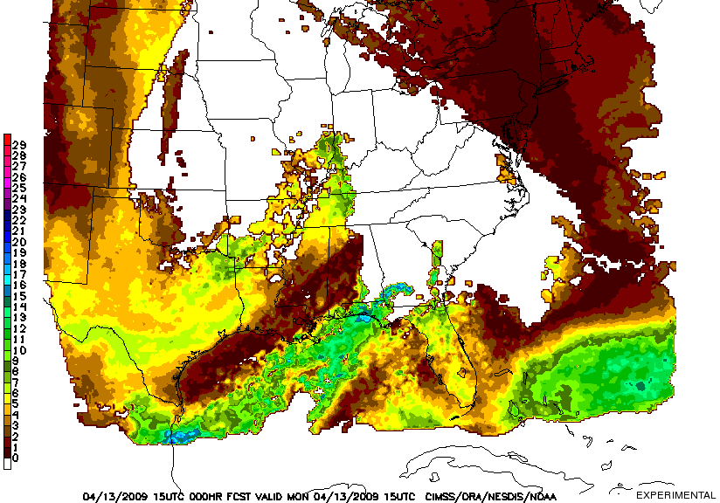
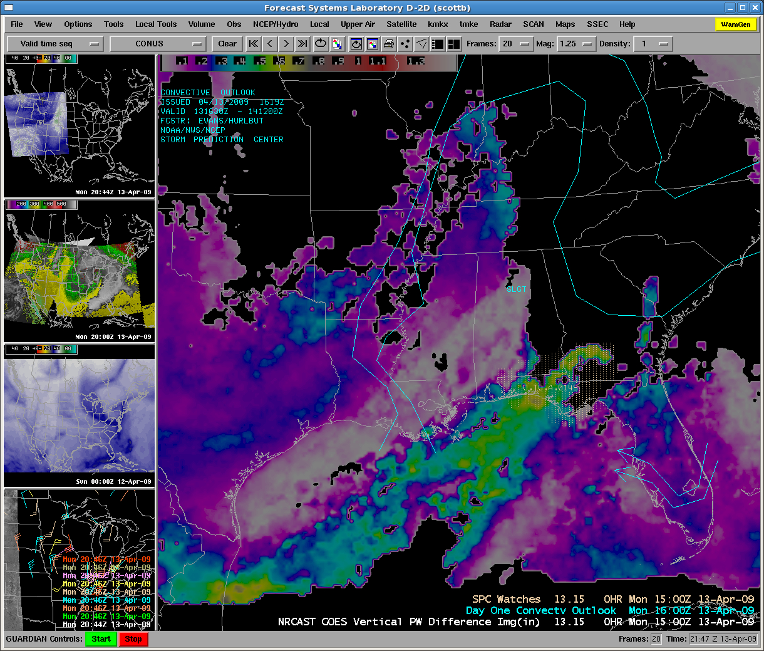
Evaluation by NWS Forecast Office, Sullivan, Wisconsin
NWS Milwaukee is evaluating the CIMSS precipitable water nearcasting product. The example below shows a good relationship between amount of convective clouds (or lack of them) and strong vertical gradients of PW.
CIMSS nearcast products are currently being inserted into the operational AWIPS data stream for NWS evaluation.
CIMSS precipitable water lapse rate product valid 15UTC April 13, 2009.
1-hour nearcast of vertical precipitable water differences (mm) valid 19 UTC, July 2, 2009.
Visible image for
19 UTC, July 2, 2009. Red indicates where convection is likely. Black indicates areas where convection is not likely.
Same CIMSS nearcast product displayed on an AWIPS workstation.
27

Slide 28
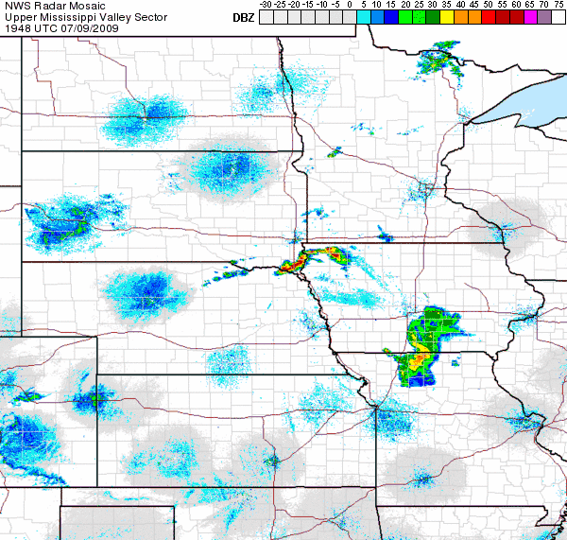
Using the GOES-12 Sounder to Nearcast Severe Weather
Robert Aune (NESDIS) and Ralph Petersen (CIMSS)
The CIMSS Near-casting Model uses hourly GOES Sounder retrievals of layered precipitable water (PW) and equivalent potential temperature (Theta-E) to predict severe weather outbreaks up to
6 hours in advance!
Hourly, multi-layered observations from the GOES Sounder are projected forward in time along Lagrangian trajectories forced by gradient winds. “Trajectory observations” from the previous six hours are retained in the analysis. Destabilization is indicated when theta-E decreases with height.
Limitations:
- Sounder channels support only two layers for near-casting
- Only useful for elevated convection – Sounder can’t detect low-level moisture
- Frequent false alarms – Sounder can’t detect inversions
One Example of a Successful Near-cast
Low-level Theta-E NearCasts shows warm moist air band moving into far NW Iowa by 2100 UTC.
Vertical Theta-E Differences predict complete convective instability by 2100 UTC.
Severe thunderstorms occurs as predicted!
6-hour NearCast for 2100 UTC
Low level Theta-E
6-hour NearCast for 2100 UTC
Low to Mid level Theta-E Differences
Rapid Development of Convection over NW Iowa between 2000 and 2100 UTC 9 July 2009
Notes:
Precipitation products from NWP models tend to show patterns that are quite board and much smoother than observed. In addition, the source of moisture for the precipitation is often misrepresented – i.e., the precipitation forms for the wrong reason and/or the precipitation patterns become driven by the convective parameterizations themselves, not by details in the observed local moisture and wind fields.
In the case shown, the rapid convection developed only in the area where the 6 hour NearCasts showed strong signatures of Convective Instability in far NW IA – a fact that was lost to forecasters using the NWP guidance lone. It should also be noted that no GOES observations were available here after the convection began, although the destabilization shown in the NearCasts proper predicted the subsequent movement of the MCS.
It should also be noted that NWP models typically ‘limit’ the amount of convective instability that can be present in the models. In fact, the role of the ‘convective parameterizations’ is not be produce realistic thunderstorms, but rather to remove excessive thermal instabilities and ‘vertically misplaced latent heating’ which could adversely affect the model during an extended prediction. For example, the ECMWF readily recognizes the it’s convective schemes cause rainfall to occur too early during daytime over land in the tropics (they detect instability and try to remove it to quickly) and that the rainfall is unrealistic in that it ‘starts and stops’ much to often during the afternoon (due to repeated cycles of stabilization, followed by surface heating and destabilization). In addition, once the convective parameterization has been active for a period of time (even if incorrectly), boundary layer flows produced as a result of the parameterization often become dominant in the area around the storms, leading to further forecast errors.

Slide 29
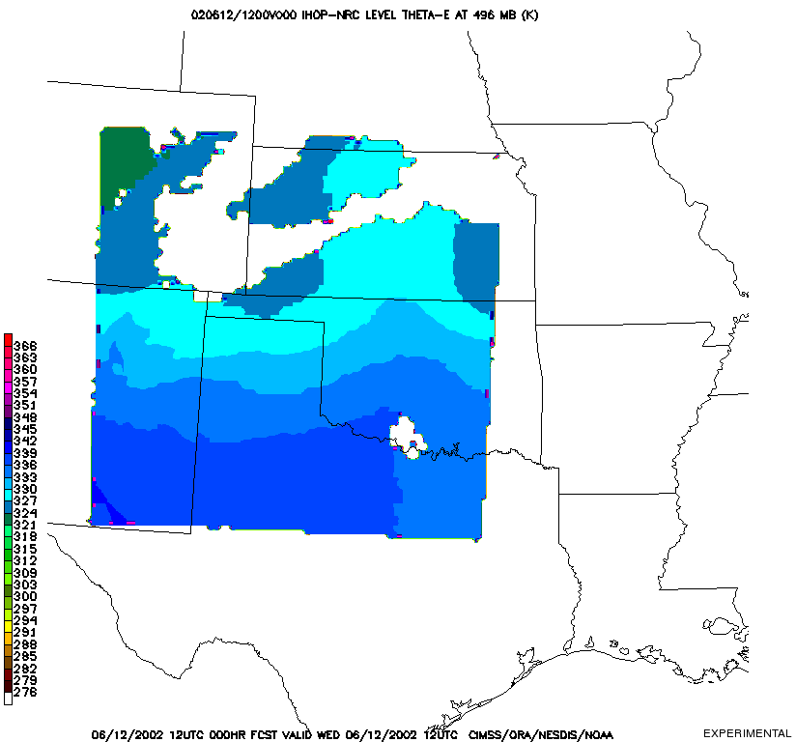
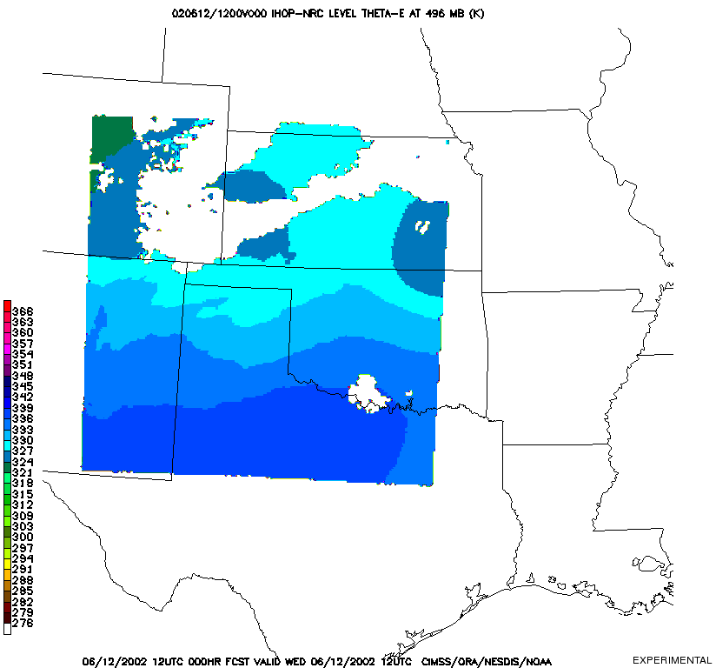
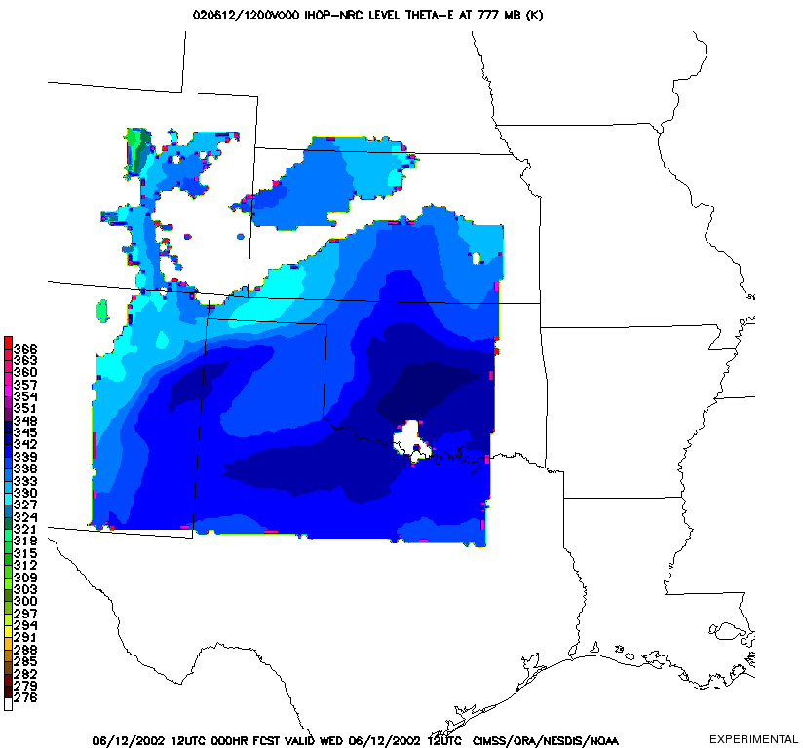
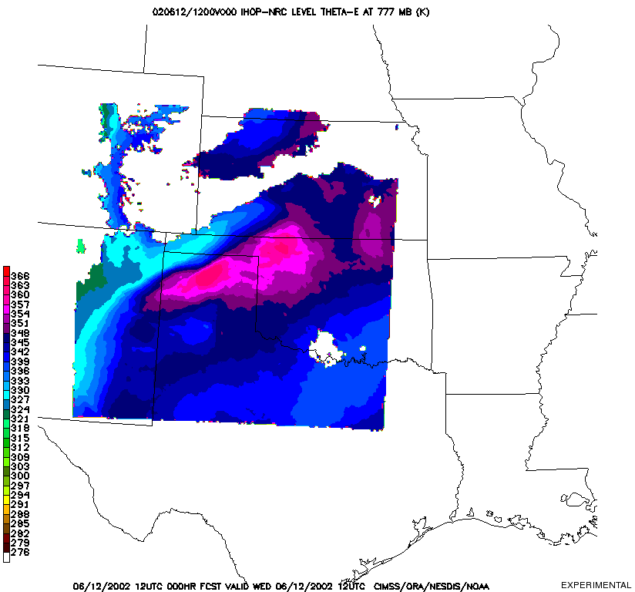
A Hyper-Spectral Geo-Sounder Will Near-cast Severe Weather An Observing System Simulation Experiment
ABI 450hPa θ_{e}
HES 450hPa θ_{e}
A WRF model simulation of the June 12, 2002 IHOP case was used to generate simulated radiances from a GOES-R Advanced Baseline Imager (ABI) and a geostationary Hyper-spectral Environmental Sounder (HES). Simulated radar reflectivity was also generated
Temperature and moisture profiles were retrieved from the simulated radiance datasets and assimilated by the CIMSS Near-casting Model and compared.
ABI 720hPa θ_{e}
HES 720hPa θ_{e}

Slide 30
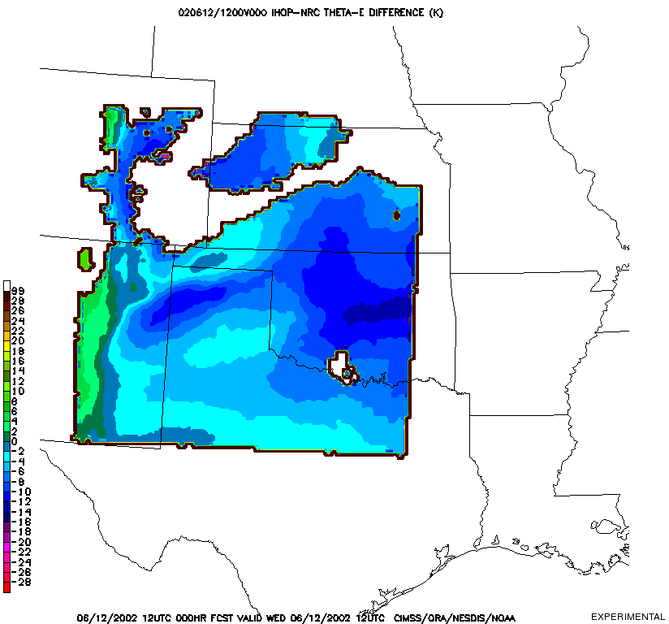
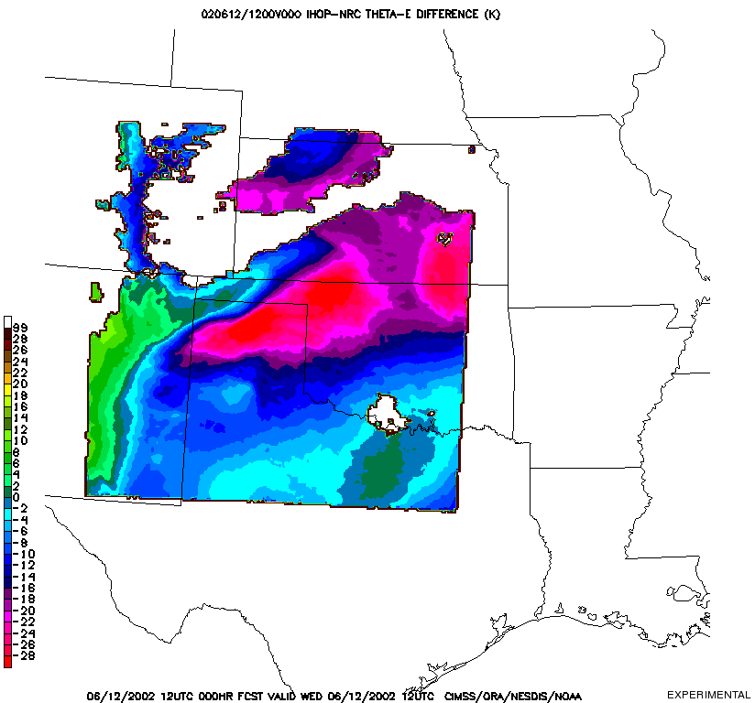
A Hyper-Spectral Geo-Sounder Will Near-cast Severe Weather An Observing System Simulation Experiment
720hPa ABI Δθ_{e}
720hPa HES Δθ_{e}

Slide 31
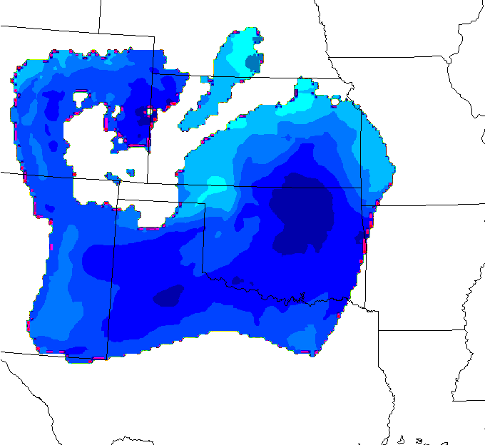
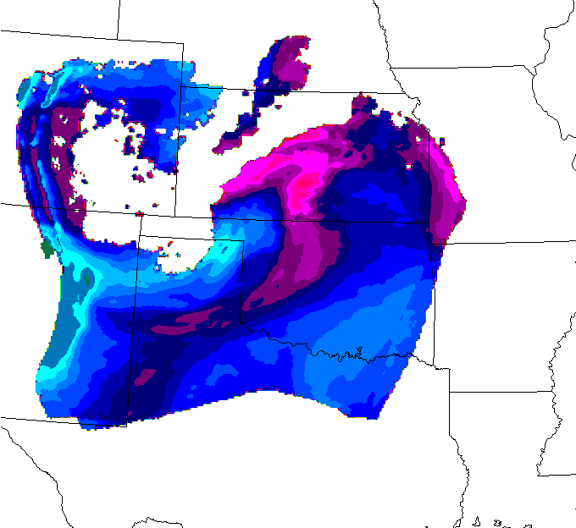
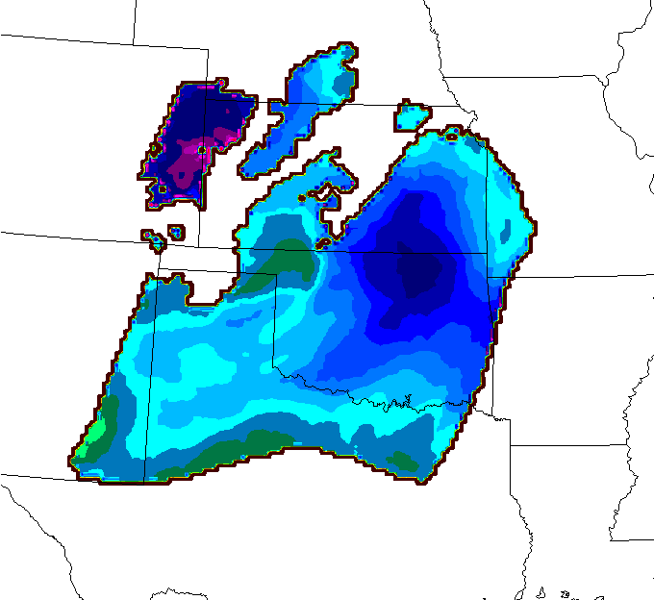
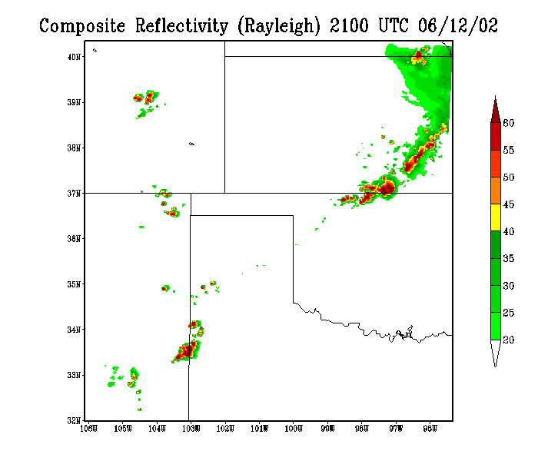
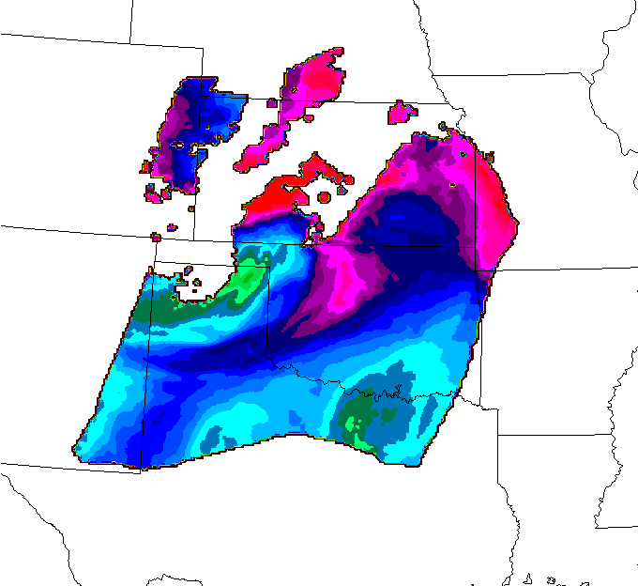
A Hyper-Spectral Geo-Sounder Will Near-cast Severe Weather An Observing System Simulation Experiment
Simulated ABI
Robert Aune (NESDIS)
Simulated HES
Weak gradients of low-level Theta-E are indicated by ABI which has only two water vapor channels.
A WRF model simulation of the June 12, 2002 IHOP case was used to generate simulated radiances from a GOES-R Advanced Baseline Imager (ABI) and a geostationary Hyper-spectral Environmental Sounder (HES). Simulated radar reflectivity was also generated
Temperature and moisture profiles were retrieved from the simulated radiance datasets and assimilated by the CIMSS Near-casting Model and compared.
Strong low-level Theta-E gradients are indicated by HES which has the ability to detect low-level moisture.
5-hour NearCast for 2000 UTC
Low level Theta-E
5-hour NearCast for 2000 UTC
Low level Theta-E
Negative vertical Theta-E differences indicate where convection is likely.
Negative vertical Theta-E differences indicate where convection is likely.
Simulated composite reflectivity indication the formation of convection.
5-hour NearCast for 2000 UTC
Low to Mid level Theta-E Differences
Rapid Development of Convection over Texas and Nebraska between 2000 and 2100 UTC 12 June 2002
5-hour NearCast for 2000 UTC
Low to Mid level Theta-E Differences
Notes:
Precipitation products from NWP models tend to show patterns that are quite board and much smoother than observed. In addition, the source of moisture for the precipitation is often misrepresented – i.e., the precipitation forms for the wrong reason and/or the precipitation patterns become driven by the convective parameterizations themselves, not by details in the observed local moisture and wind fields.
In the case shown, the rapid convection developed only in the area where the 6 hour NearCasts showed strong signatures of Convective Instability in far NW IA – a fact that was lost to forecasters using the NWP guidance lone. It should also be noted that no GOES observations were available here after the convection began, although the destabilization shown in the NearCasts proper predicted the subsequent movement of the MCS.
It should also be noted that NWP models typically ‘limit’ the amount of convective instability that can be present in the models. In fact, the role of the ‘convective parameterizations’ is not be produce realistic thunderstorms, but rather to remove excessive thermal instabilities and ‘vertically misplaced latent heating’ which could adversely affect the model during an extended prediction. For example, the ECMWF readily recognizes the it’s convective schemes cause rainfall to occur too early during daytime over land in the tropics (they detect instability and try to remove it to quickly) and that the rainfall is unrealistic in that it ‘starts and stops’ much to often during the afternoon (due to repeated cycles of stabilization, followed by surface heating and destabilization). In addition, once the convective parameterization has been active for a period of time (even if incorrectly), boundary layer flows produced as a result of the parameterization often become dominant in the area around the storms, leading to further forecast errors.

Slide 32
Prediction
A hyperspectral sounder (upstream of North America!) will provide the greatest improvement in 24-48 hour forecast accuracy in the history of operational mesoscale NWP at NCEP!
UW-Madison

