Slide 1
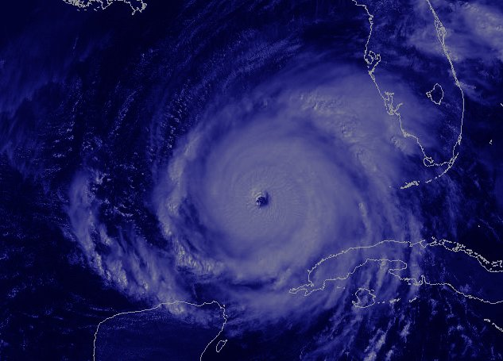
NATIONAL CENTERS FOR ENVIRONMENTAL PREDICTION
Use of hyperspectral sounders at the National Hurricane Center - Present and future
JACK BEVEN
NATIONAL HURRICANE CENTER
WHERE AMERICA’S CLIMATE AND WEATHER SERVICES BEGIN

Slide 2
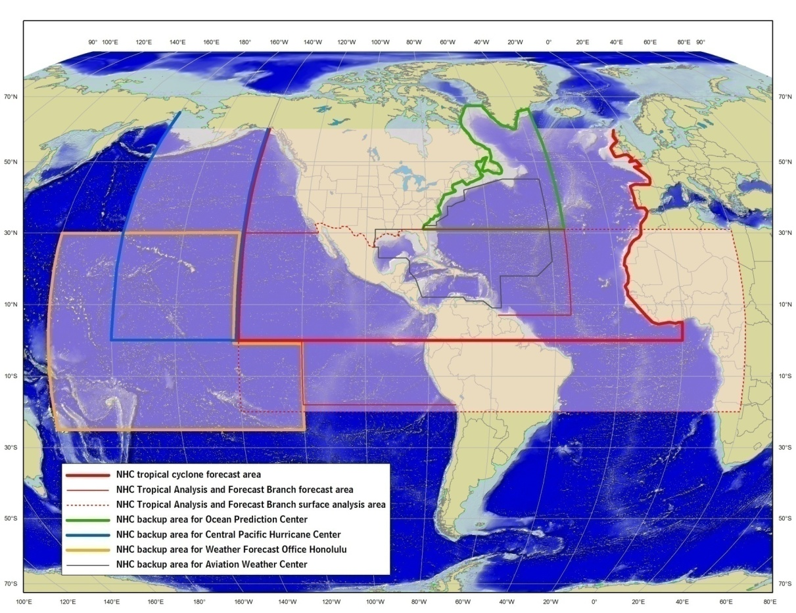
NHC Sounder Issues
The NHC does not directly use satellite sounding (IR or microwave) data in its operational data stream.
Microwave sounding data is used for tropical cyclone intensity estimates.
Note that the NHC performs a lot of data analysis outside the NWP framework.
NHC Area of Responsibility

Slide 3
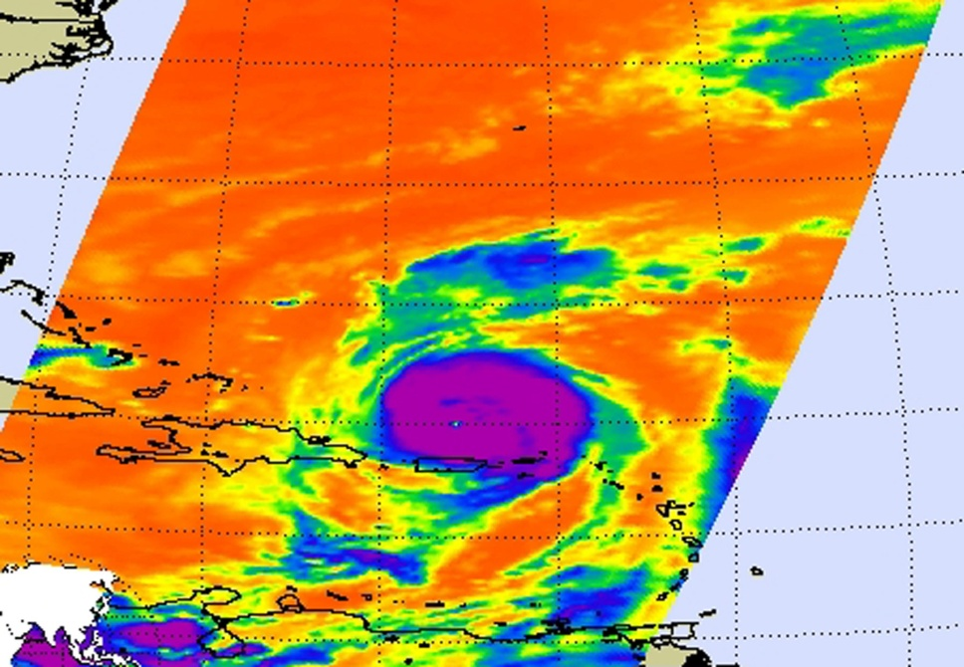
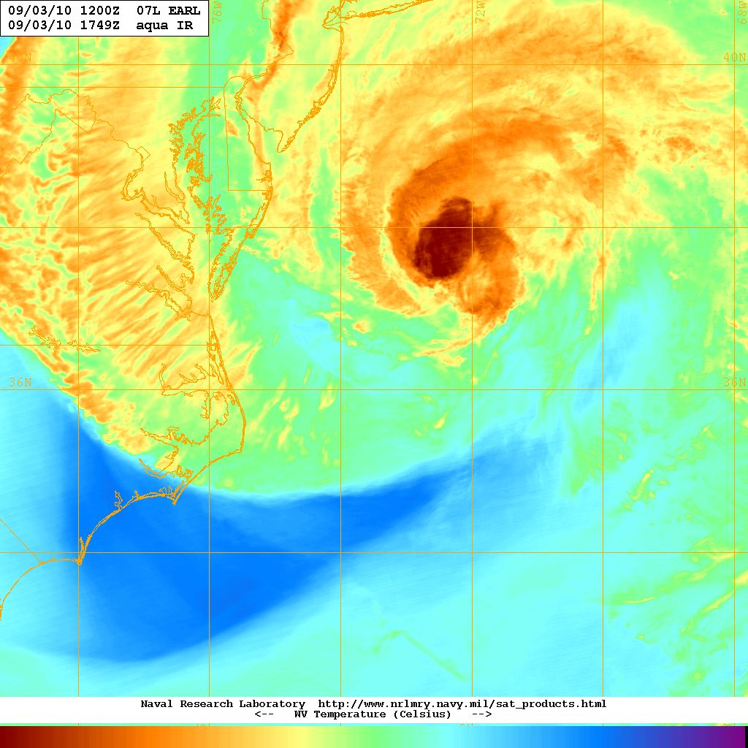
Hyperspectral sounders and tropical cyclones
Infrared-based hyperspectral sounders cannot sense underneath the cirrus canopy of a tropical cyclone.
Thin outflow moisture plumes could conceal important features underneath
Hyperspectral sounders currently fly on LEO satellites, which makes data timeliness an operational issue

Slide 4
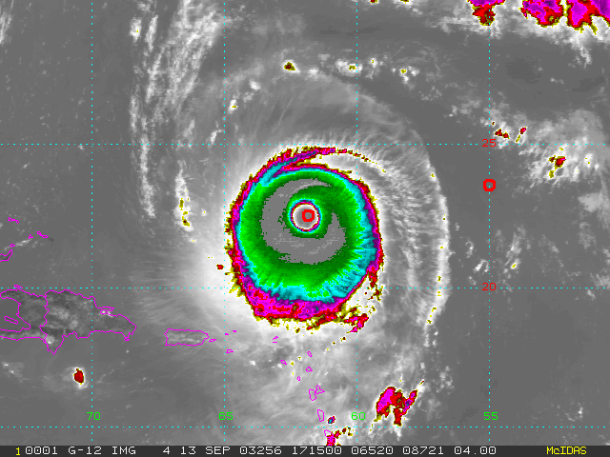
AIRS Sounding in Eye of Isabel
Eye - Environment
Temperature
Eye Sounding
Environment
Sounding
Integrate Hydrostatic Equation Downward from 100 hPa to Surface
Environment Sounding: P_{s} = 1012 hPa
Eye Sounding: P_{s} = 936 hPa
Aircraft Recon: P_{s} = 933 hPa
Hyperspectral sounders could aid in TC intensity analysis!
From Menzel, 2006 and DeMaria, CIRA, 2004

Slide 5
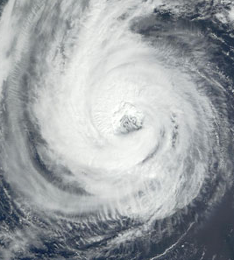
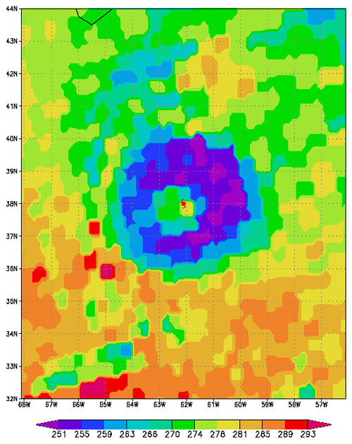
Ozone Detection
Strong convection can result in "a local maximum of total ozone in the core of hurricane, and a ring of low level of total ozone surrounding the hurricane.“ (NASA /FSU)
Hurricane Erin
September 2001
Could ozone be a tool to analyze and forecast TC intensity? Could we use a hyperspectral sounder, or would this need a more specialized instrument (e. g. TOMS)?
http://www.nasa.gov/vision/earth/environment/ozone_drop.html
Notes:
Strong convection near eyewall can reach lower stratosphere, bring lower troposphere air upward, and replace ozone rich atmosphere, which results in the reduction of total ozone in that region
Meanwhile, air tends to fall downward in the eye of a hurricane, bringing ozone-rich air into the lower troposphere and increasing the amount of ozone in the hurricane's core.
The result,"a local maximum of total ozone in the core of hurricane, and a ring of low level of total ozone surrounding the hurricane.“
http://www.nasa.gov/vision/earth/environment/ozone_drop.html
Ozone Levels Drop When Hurricanes Are Strengthening
06.08.05
Scientists are continually exploring different aspects of hurricanes to increase the understanding of how they behave. Recently, NASA-funded scientists from Florida State University looked at ozone around hurricanes and found that ozone levels drop as a hurricane is intensifying.

Slide 6
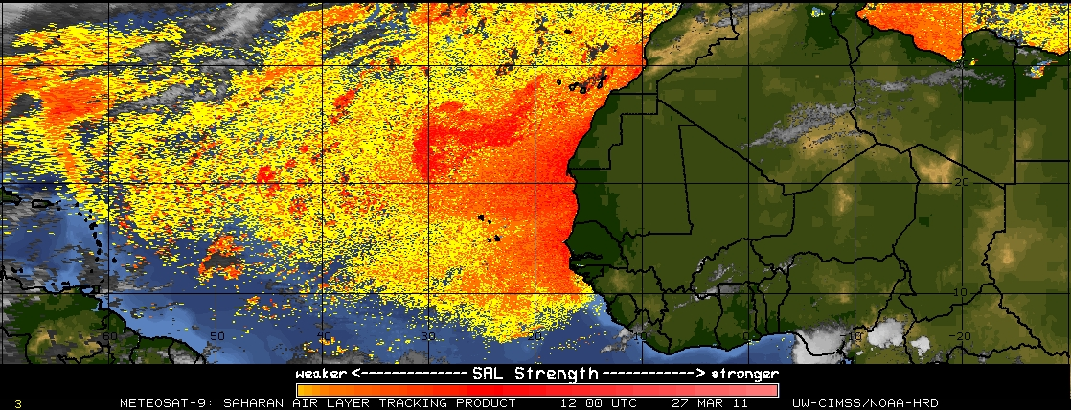
Hyperspectral data to diagnose the near-TC environment
Hyperspectral sounder data enhances operational analyses of temperature and moisture in the environment near a tropical cyclone. This helps with the detection of Saharan Air Layers and other dry air intrusions. It could also aid forecasts of tropical transition and extratropical transition.

Slide 7
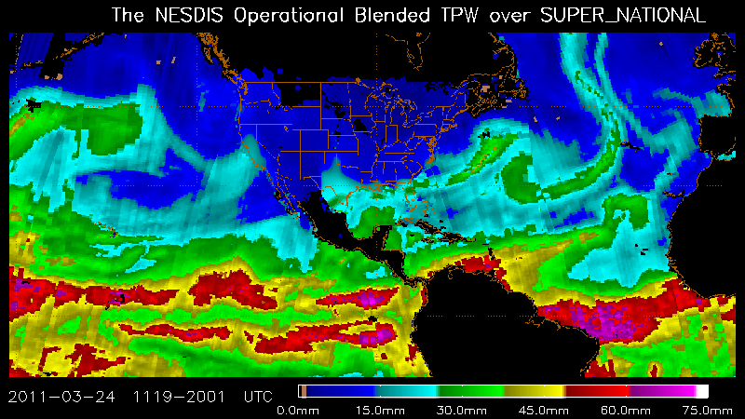
Total Precipitable Water Products
Hyperspectral sounder data (especially geostationary-based) could enhance the microwave-based TPW products, making it easier for the NHC to detect and track important moist and dry features.

Slide 8
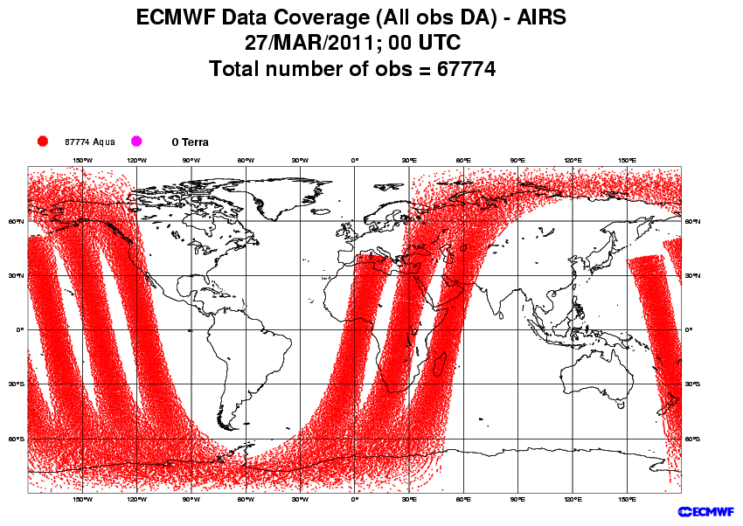
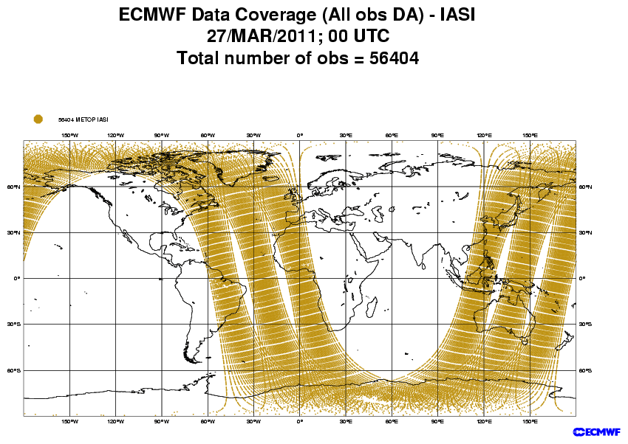
Hyperspectral sounder data for numerical weather prediction
Hyperspectral sounder data is used operationally in many NWP models, providing vertical temperature and moisture data where rawinsondes are not available.
This contributes to the NHC through improved global model track forecasts.
Future hyperspectral instruments, especially in geostationary orbit, should bring about additional improvements

Slide 9
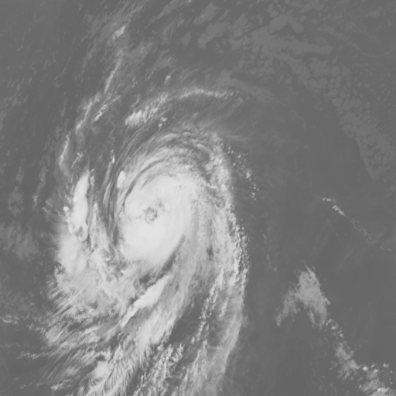
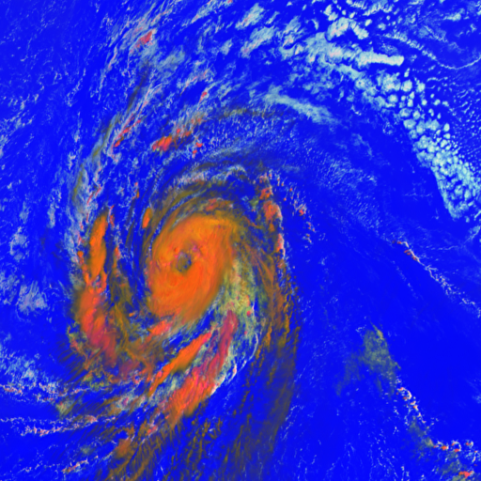
Hurricane Isabel
MSG-1, 7 September 2003, 11:45 UTC – slide courtesy of EUMETSAT
5
2
3
4
1
4
Channel 09 (IR10.8) RGB Composite VIS0.6-NIR1.6-IR10.8
1=large warm ice, 2=large cold ice, 3=small cold ice, 4=small cold water, 5=large warm water
Could hyperspectral data improve analyses of clouds and cloud microphysical properties? This could improve intensity estimates and NWP.

Slide 10
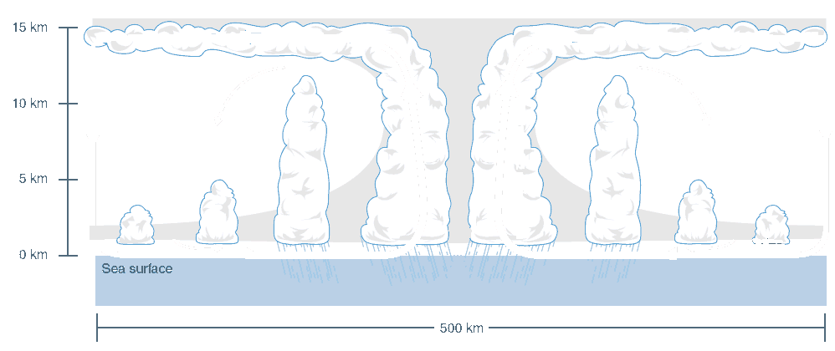
How can we analyze the structure of a TC with satellites?
Sounder – microwave/ infrared – thermal structure
Infrared – thin clouds
Solar – top of clouds Outflow winds
Submm – Ice Water Path
microwave – Liquid Water Path
microwave (Rad/P) - precipitation
Surface winds – scatterometer/microwave
Slide courtesy of Steve Ackerman
Notes:
I’ll work on this figure some more and add text.

