Slide 1
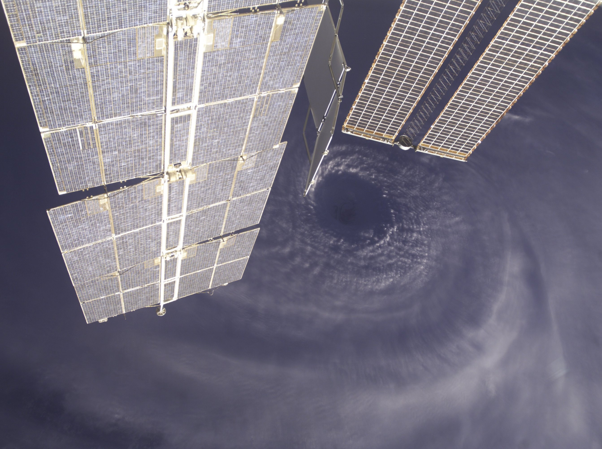
Tropical Cyclone Forecast Improvements Through Hyperspectral Soundings
Frank Marks
NOAA/AOML/Hurricane Research Division
29 March 2011
Notes:
Hurricane Earl 2 September 2010

Slide 2

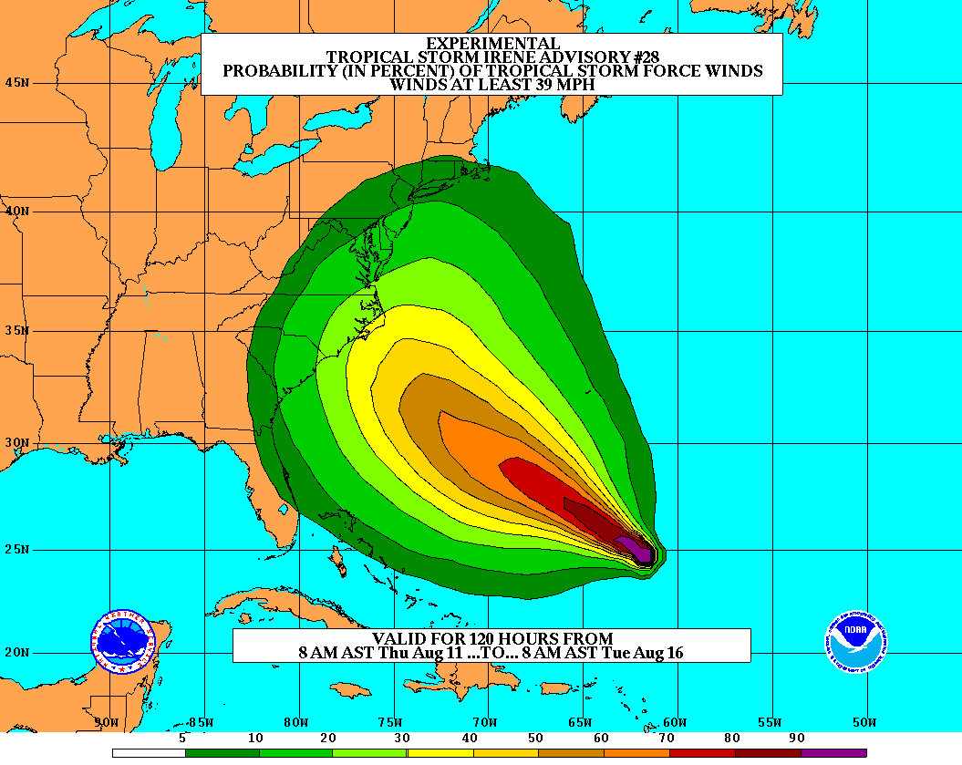
Goals
Improve Forecast Accuracy
  Hurricane impact areas (track) – 50%
  in 10 years
  Severity (intensity) – 50% in 10 years
  Storm surge impact locations
  and severity
Extend forecast reliability out to 7 days
Quantify, bound and reduce forecast uncertainty to enable risk management decisions
Notes:
http://www.nrc.noaa.gov/HFIPDraftPlan.html
HFIP Team
Frank Marks, research lead
Ed Rappaport, operations lead
Fred Toepfer, project manager
Robert Gall, development manager
Mark DeMaria
Chris Fairall
Jim McFadden
Scott Kiser
Daniel Melendez
Roger Pierce
HFIP executieve oversight board:
OAR DAA/Sandy MacDonald, co-chair
NWS AA/Jack Hayes, co-chair
NCEP/Louis Uccellini,
TPC/Bill Read,
NESDIS/Mark DeMaria,
NOS/Jesse Feyen,
AOML/Bob Atlas
PPI/Paul Doremus
NMFS/Bonnie Ponwith,
NOS/Liz Scheffler,
NMAO-PM Aircraft/Phil Kenul,
OFCM/Sam Williamson
Executive Secretariat: OAR/Joseph Bartosik and NWS/John Iacabucci

Slide 3
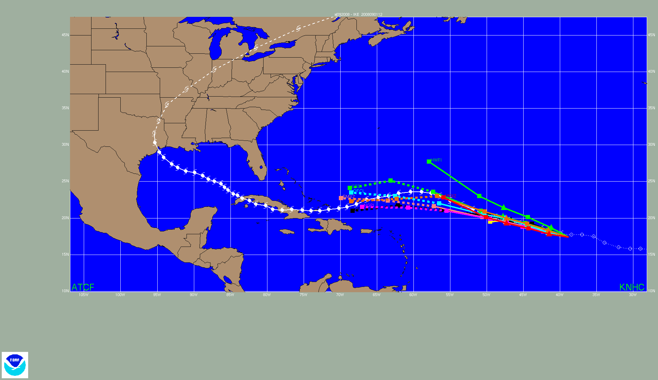
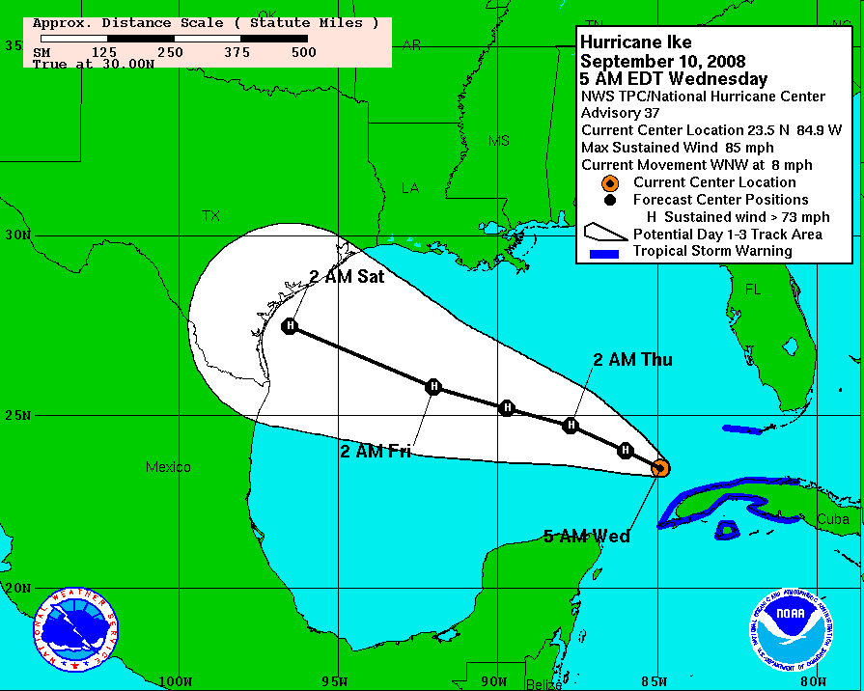
Current Capabilities:
Track models
Future increases in skill will likely be tied to increased use of satellite data!
The increasing skill of NHC track forecasts is due to the increasing skill in NWP models. Satellite data assimilated into NWP likely plays a large role in this.
Notes:
Animation of track guidance models for Hurricane Ike.

Slide 4
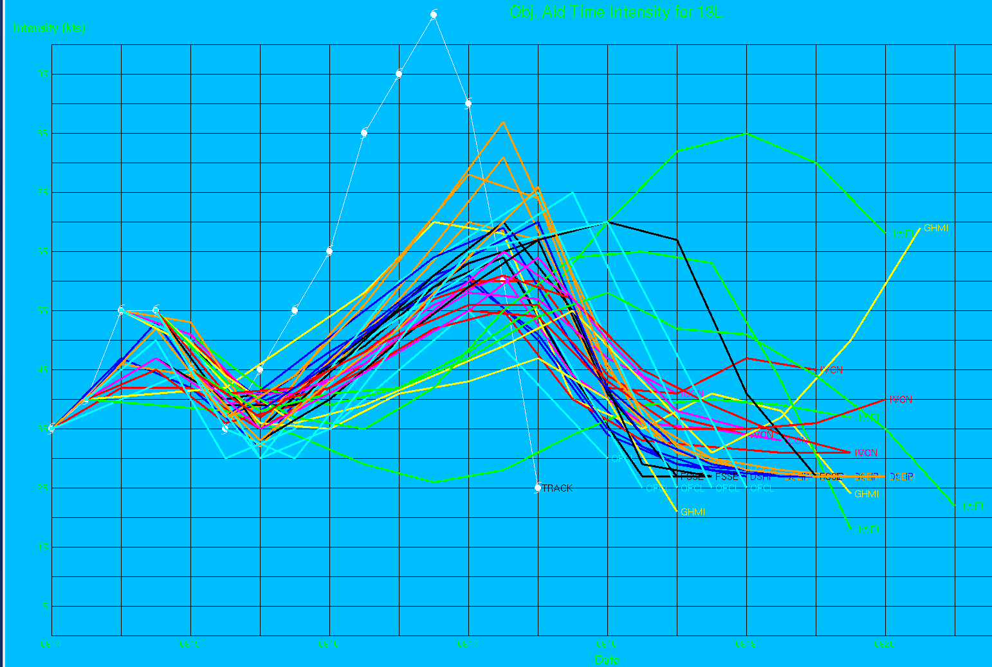
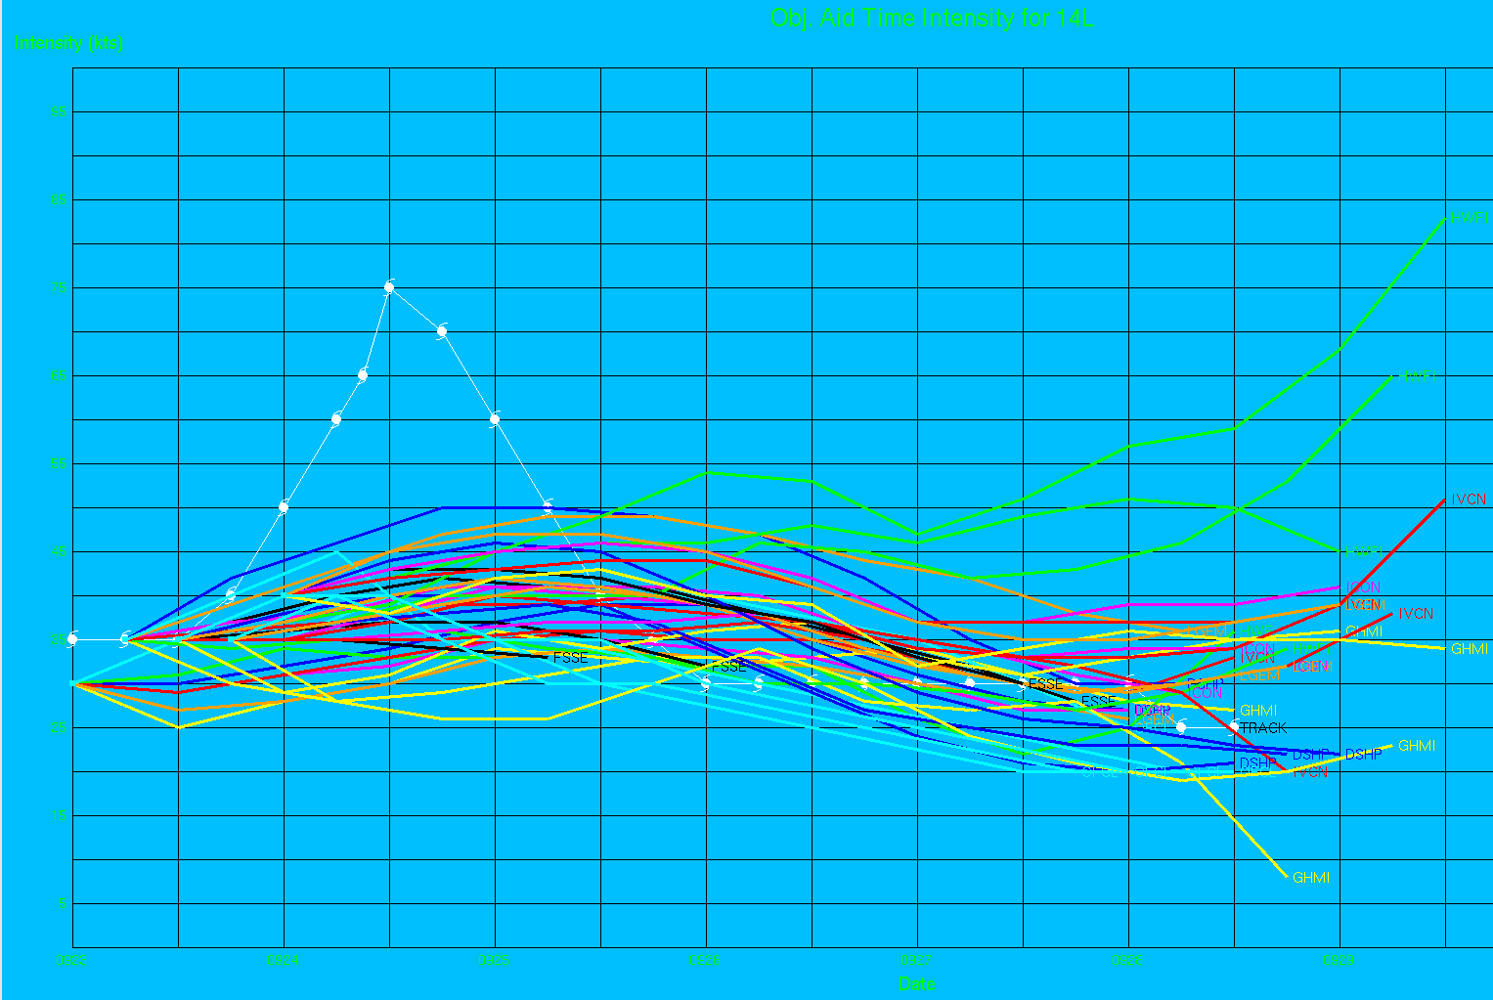
Current Capabilities:
Intensity
Intensity forecasts need a lot of improving, and not just when high-resolution aircraft data is available (which is 30% of the time or less in the NHC AOR). Satellite-based data and associated assimilation into NWP models are key parts of improving intensity forecasts.
Karl (had aircraft)
Lisa (did not have aircraft)

Slide 5
Issues effecting forecasts
Sensitive to environment beyond TC envelope (moisture analysis, dry air, shear, etc.)
Sensitive to upper and lower boundary and changes along track
Sensitive to inner core dynamics
Sampling limited by presence of rain & clouds
Issues include:
  poor data coverage in important areas,
  inability to cover necessary targets
  temporal and spatial resolution (≥24 h, horizontal ≥50 km, integrated or limited vertical resolution)

Slide 6
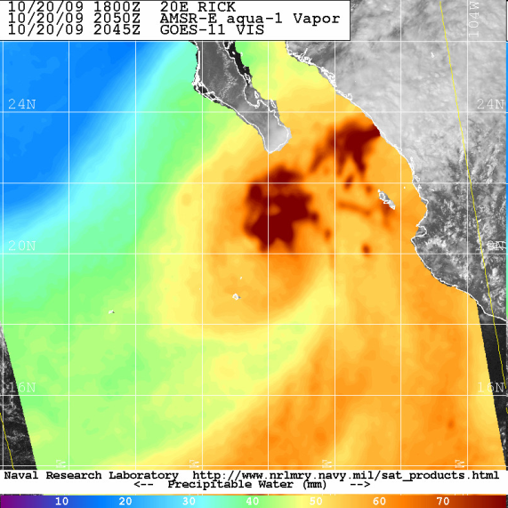
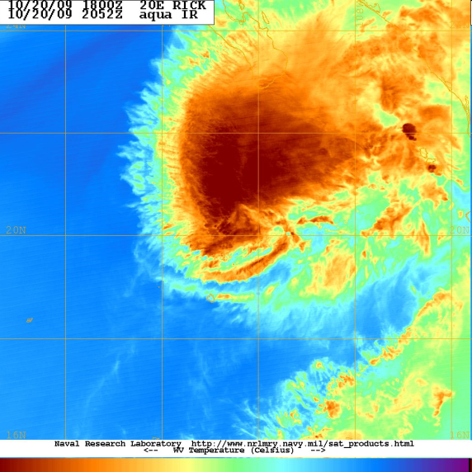
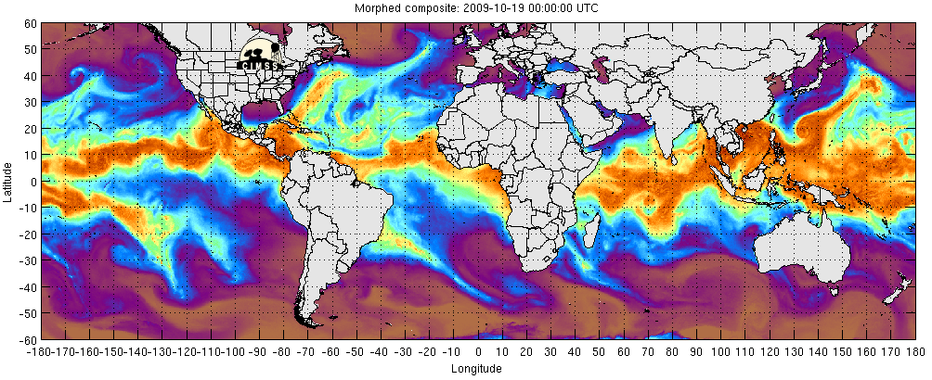
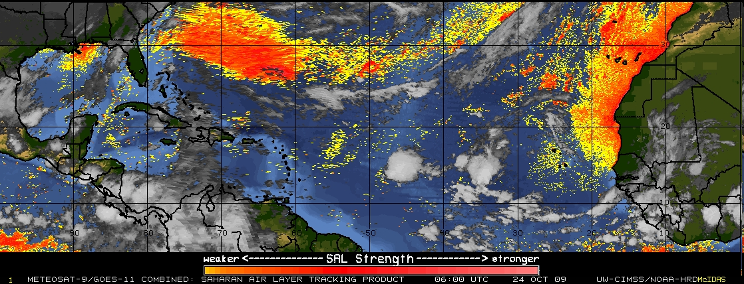
Moisture Analyses – Water Vapor Imagery, SAL Imagery, & TPW
Remotely-sensed atmospheric moisture helps diagnose environment in and near TCs both qualitatively and for NWP. Aids detection of dry air and extratropical transition.
Water vapor imagery depicts the mid/upper-level moisture.
Microwave sounders show total precipitable water (TPW) which is heavily weighted to boundary layer
Greatest limitation in TPW sensing is knowledge of depth and height of boundary layer

Slide 7
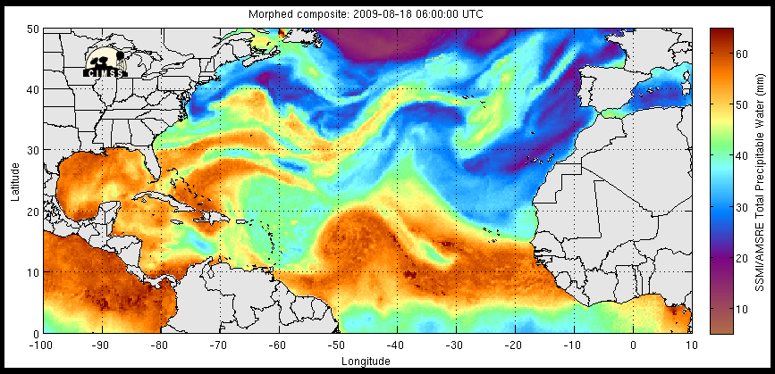
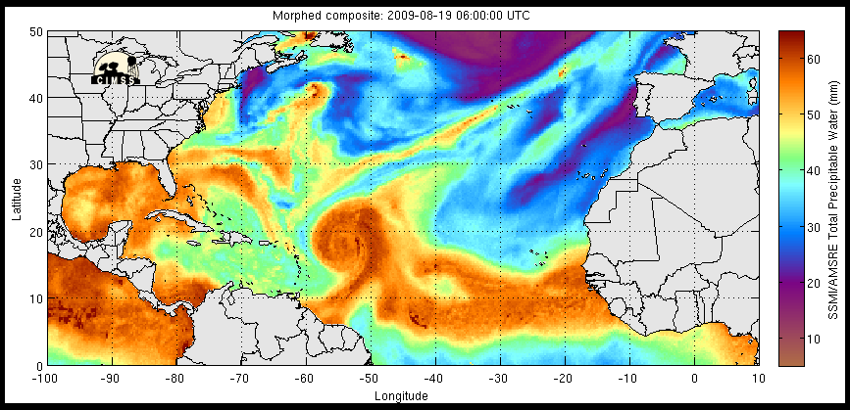
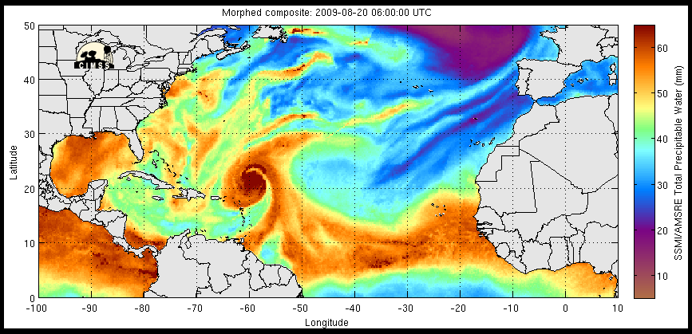
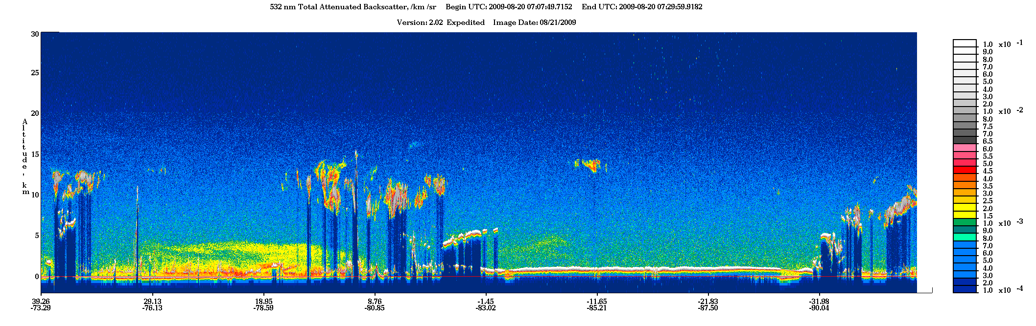
A
SAL &
mid-lat
subsid above
SAL
SAL &
mid-lat
subsid above
SAL
SAL &
mid-lat
subsid above
SAL
B
A
B
Saharan Dust
Notes:
Top: TPW showing large SAL outbreaks W and E of Bill. Note the large dry air intrusion wrapping around the storm at this time
Bottom: coincident CALIPSO overpass (A-B) showing that the dry air wrapping into the storm on the SW side was indeed a dusty SAL outbreak. Dust extends up to ~4.5-5 km in this outbreak…fairly typical for SAL outbreaks in the NATL

Slide 8
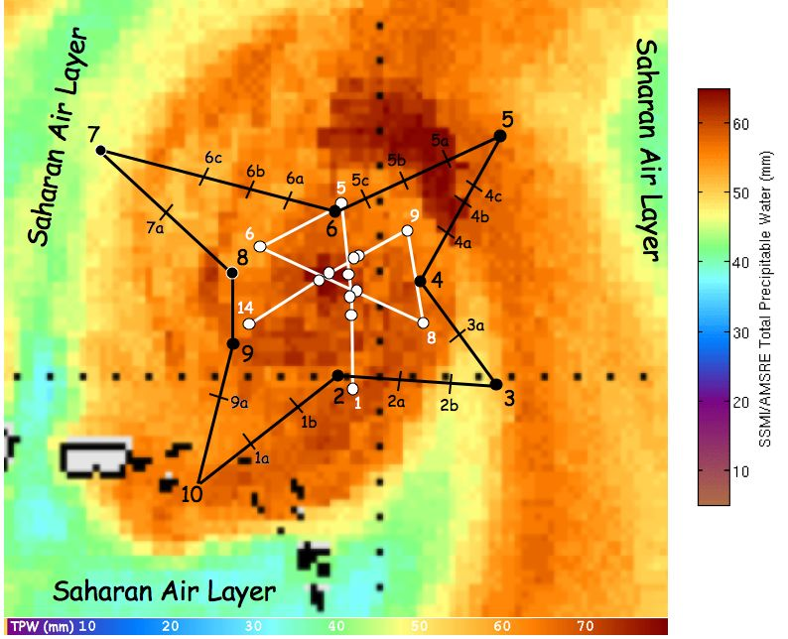
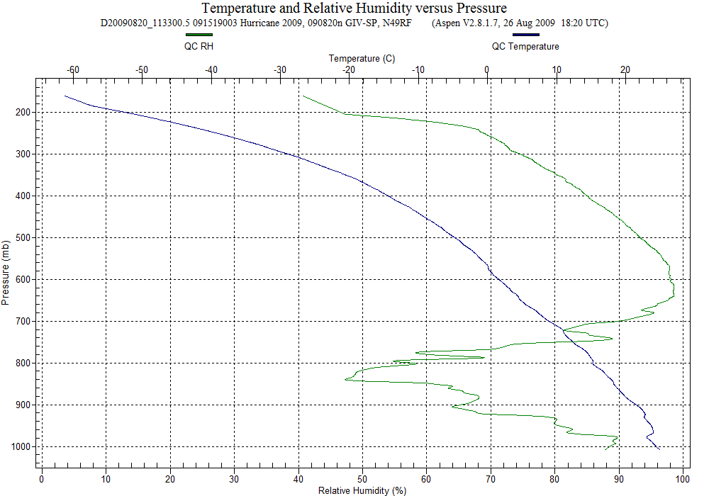
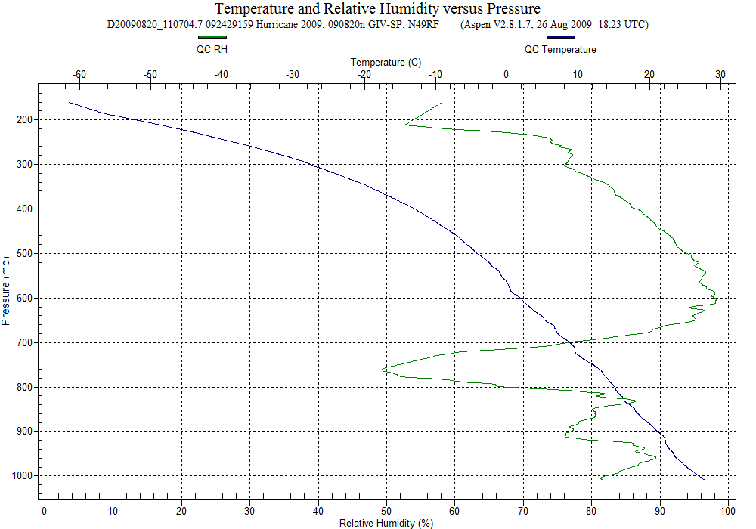
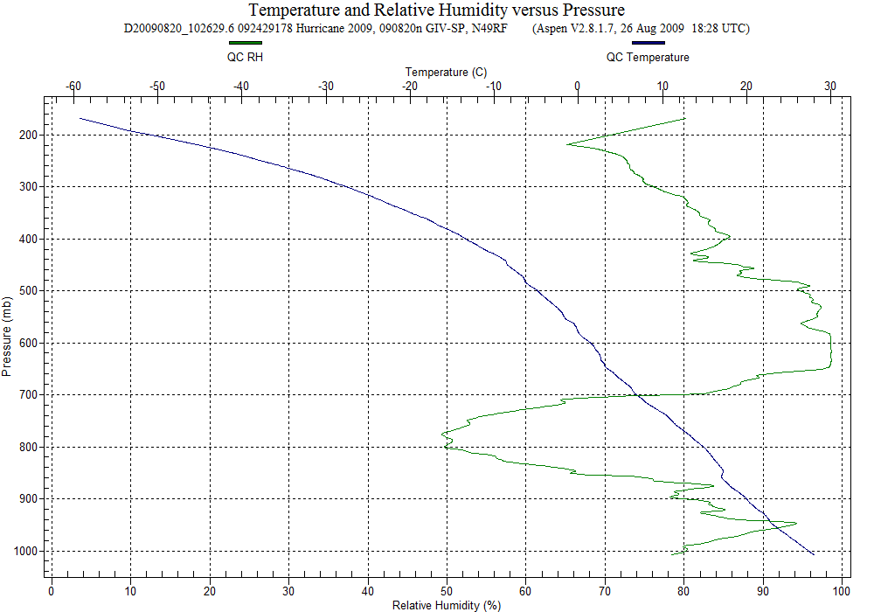
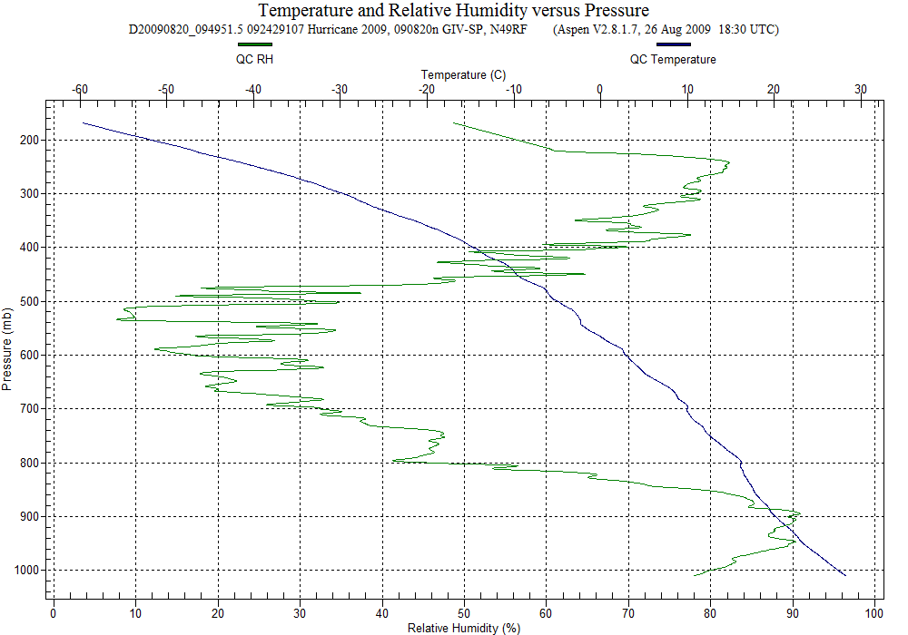
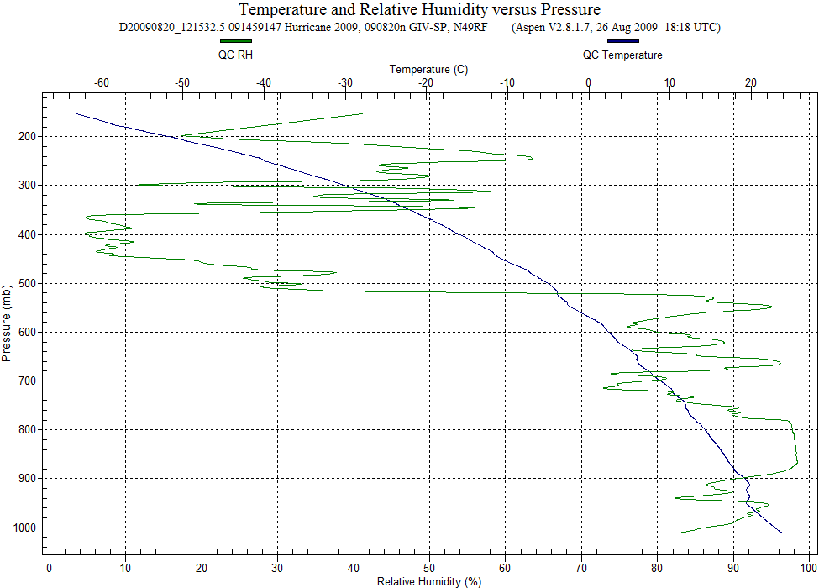
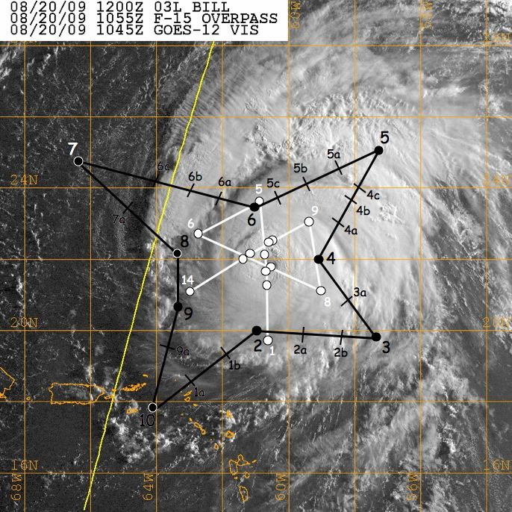
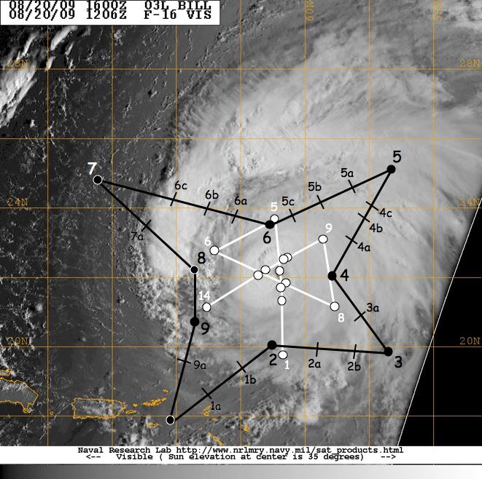
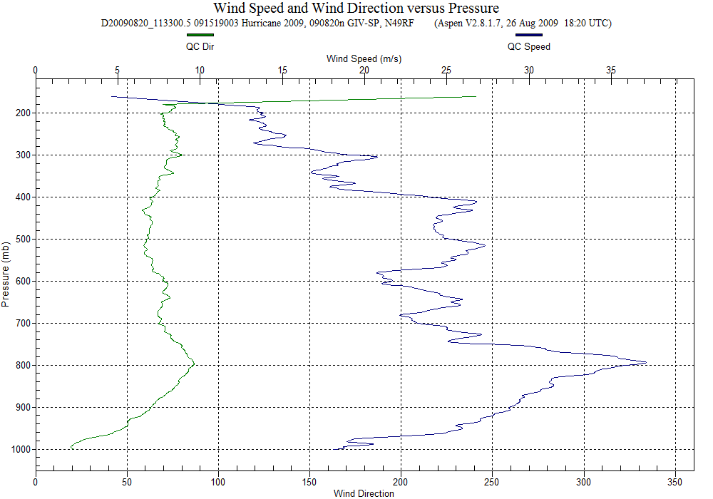
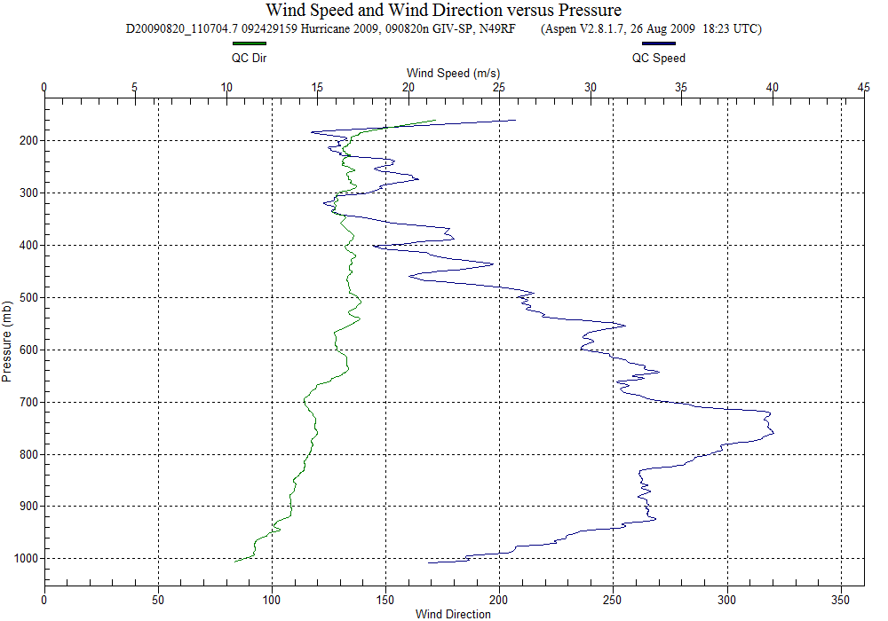
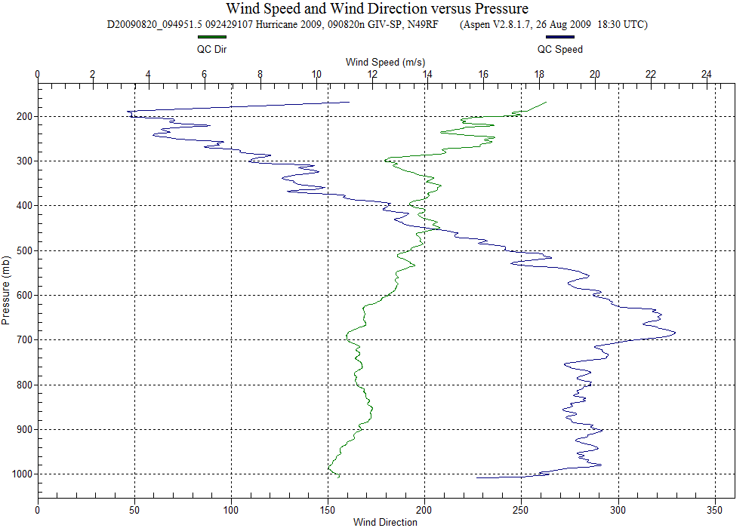
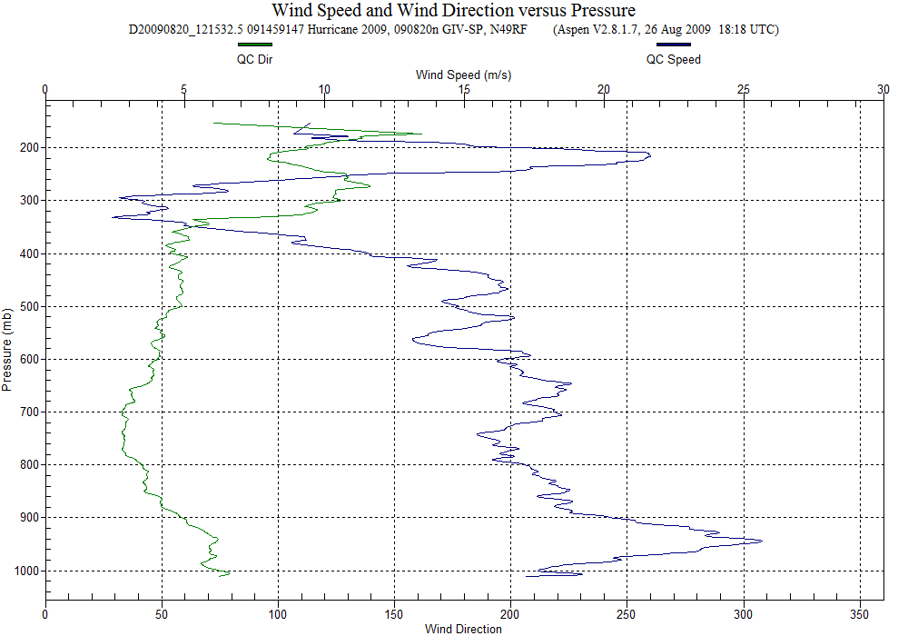
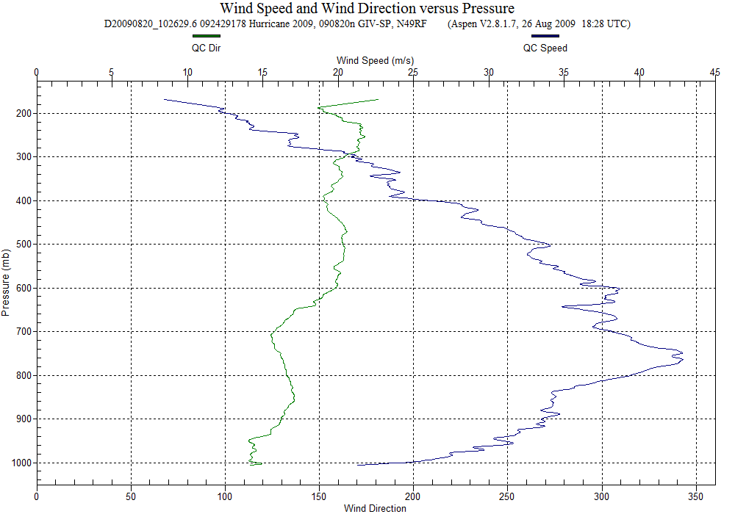
mid-latitude/subsidence
SAL intrusion
SAL intrusion?
(collocated with jet)
SAL intrusion
SAL intrusion >
Downdraft?
46 kt SSE jet
86 kt SE jet
80 kt ESE jet
76 kt ENE jet
52 kt ENE jet

Slide 9
How can Hyperspectral Soundings help?
  Provide data coverage in important areas surrounding TC for data assimilation into numerical models.
  Improved vertical structure of environment temperature and humidity, particularly near top of boundary layer to better determine enthalpy and impact of dry air
  Higher temporal resolution 12 h, horizontal resolution ≤25 km, vertical resolution <1 km.
  Accuracy to 1 K & ≤10% RH in vicinity of TC - large differences in storm intensity change for small changes in thermal structure

Slide 10

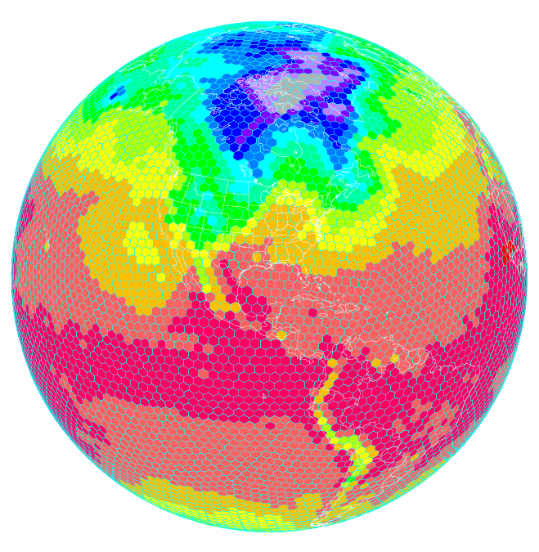
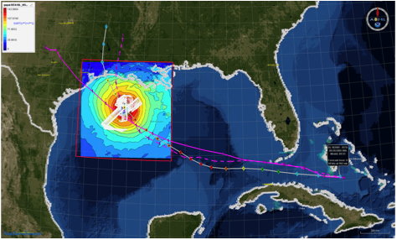
Moving Forward:
HFIP activities
Traditional Hurricane Research Activities:
Observations, analysis, database, & instrument R&D (IFEX)
Statistical-dynamical model development
Advances in operational models (Stream 1)
New HFIP Research Thrusts:
Experimental global and regional hurricane model development (Stream 2)
Data assimilation techniques and observing system strategy analysis development (Stream 1 & 2)
Model evaluation tool development
Socioeconomic research and development
D1
D2
Partnership: NCEP, AOC, AOML, ESRL, GFDL, DTC, USWRP, NESDIS/STAR
Notes:
Two Stream Approach to HFIP developments:
Stream 1– Operational Transition and Implementation
Stream 2 – Advanced Technology Demonstration
Unconstrained by near-term availability of operational computing
Uses both NOAA’s and computing resources from major supercomputing centers for testing and evaluation.
Emphasis is on high resolution global and regional models run as ensembles
Real-time or near real time runs during hurricane season
Stream 1.5 (JHT-like)
NHC Forecaster Defined.
Subset of Stream 2 that forecasters see as particularly promising or provides demonstrated capability
Will be configured to run in real-time and products made available to NHC.

Slide 11
Summary
Hyperspectral soundings can significantly impact TC forecasts and research through improved vertical and horizontal thermal structure in storm environment
Hyperspectral soundings do not need to provide data in core for major impact
Major advantages:
  better temporal & spatial (vertical & horizontal) thermal structure surrounding TC than possible with targeted obs
  higher vertical resolution useful near boundary layer inversion
  improved accuracy of humidity and temperature estimates
To take advantage should link to HFIP activities

Slide 12
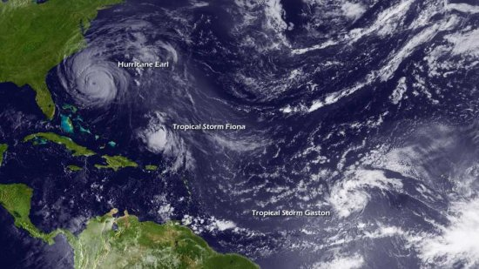
Questions?

