Slide 1




Tropical cyclone (TC) trajectory and storm precipitation forecast improvement using SFOV AIRS soundings
Jun Li@, Tim Schmit&, Hui Liu#, Jinlong Li@, Jing Zheng@, Bin Wang%, and Elisabeth Weisz@
&Center for Satellite Applications and Research, NOAA/NESDIS
@CIMSS/SSEC, University of Wisconsin-Madison
#National Center for Atmospheric Research
%Institute of Atmospheric Physics, Chinese Academy of Sciences
Satellite Hyperspectral Sensor Workshop
Miami, Florida
March 29 -31, 2011
Supported by NOAA JPSS and GOES-R programs

Slide 2
Objective
Help understand on assimilating the advanced IR water vapor information for NWP
Improve tropical cyclone track and intensity forecast by assimilating advanced IR soundings in regional NWP models; improve the severe storm forecast by assimilating advanced IR soundings in regional NWP models
Evaluate advanced IR soundings where in-situ measurements are rare (JPSS)
Prompt the application of advanced IR sounding products in regional forecast by impact studies (JPSS)
Use high-spectral resolution polar-orbiting information combined with high temporal information from GOES-R

Slide 3
Methodologies/technical approaches
Using advanced IR soundings (AIRS, next IASI and in future CrIS) in hurricane forecast through WRF/DART forecast/assimilation system.
  2-day assimilation followed by 4-day forecast for Hurricane Ike (2008)
  1-day assimilation followed by 2-day forecast for Typhoon Sinlaku (2008)
Using advanced IR soundings in hurricane forecast through WRF/3DVAR forecast/assimilation system
  48 hour forecast for Hurricane Ike (2008)
Assimilating advanced IR soundings in regional NWP models for storm forecast through AREM/4DVAR
  24 hour precipitation forecast

Slide 4
Assimilating advanced IR soundings with WRF/DART – hurricane/typhoon forecast experiments
~10 AIRS granules over the regional WRF domain
Full spatial resolution AIRS soundings (13.5 km at nadir) are derived using CIMSS hyperspectral infrared sounding retrieval (CHISR) algorithm
Clear sky only soundings are used
  Future work could include soundings in partial cloud cover
Ensemble assimilation of AIRS soundings followed by ensemble forecast (36 km resolution)
  CTL run: Assimilate radiosonde, satellite cloud winds, QuikSCAT winds, aircraft data, COSMIC GPS refractivity, ship, and land surface data.
  AIRS run: Same as CTL run plus AIRS full spatial resolution T and Q soundings

Slide 5
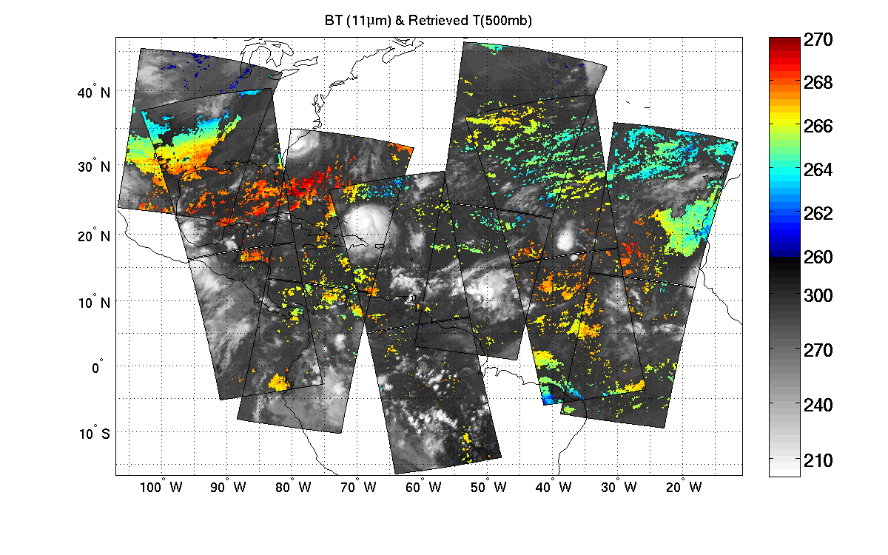
Hurricane Ike (2008): Retrieved 500 hPa temperature 2008.09.06 – Used in assimilation)
(K)
CIMSS/UW
Clear sky AIRS single field-of-view temperature retrievals at 500 hPa on 06 September 2008, each pixel provides vertical temperature and moisture soundings.

Slide 6
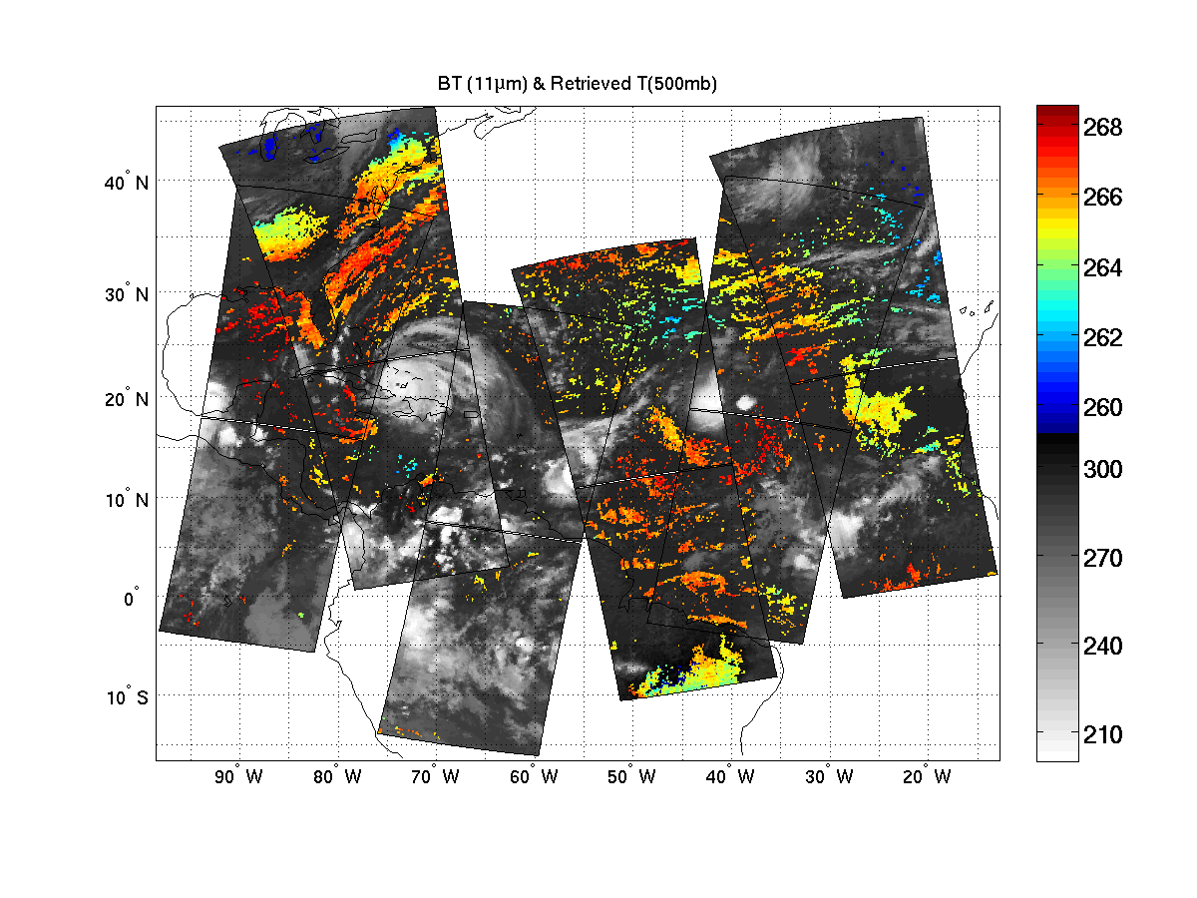
Hurricane Ike (2008): Retrieved 500 hPa temperature 2008.09.07 – Used in assimilation)
(K)
CIMSS/UW
Clear sky AIRS single field-of-view temperature retrievals at 500 hPa on 07 September 2008, each pixel provides vertical temperature and moisture soundings.

Slide 7
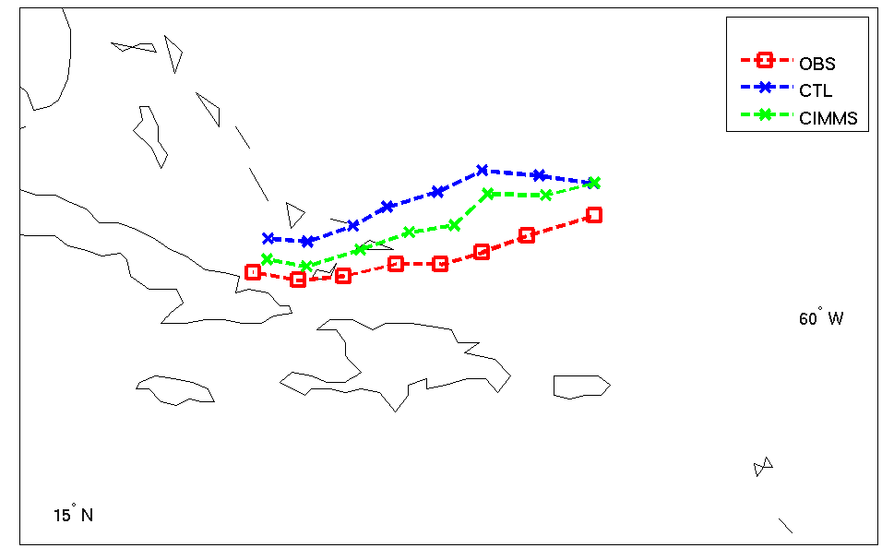
Tracks of ensemble mean analysis on Hurricane IKE
CTL run: Assimilate radiosonde, satellite cloud winds, aircraft data, and surface data.
AIRS
Analysis from 06 UTC 6 to 00UTC 8 September 2008

Slide 8
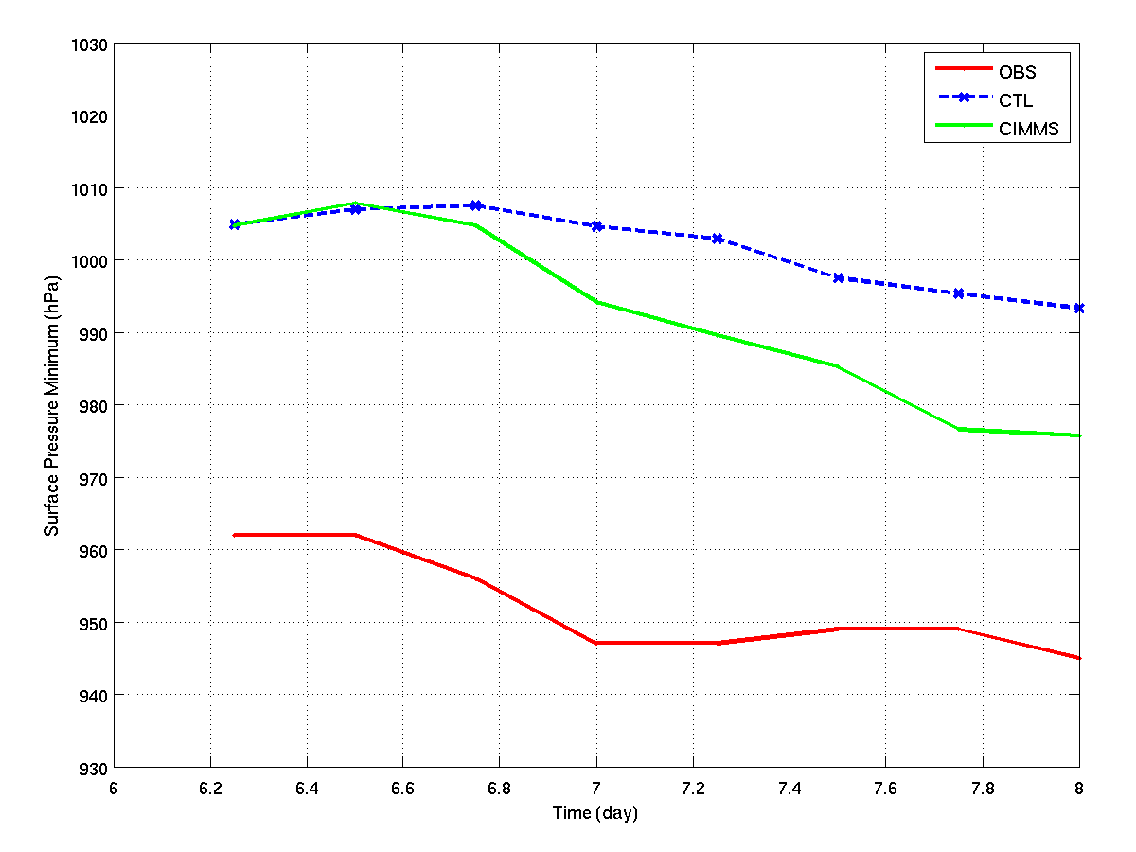
Sea Level Pressure of ensemble mean analysis on Hurricane IKE
AIRS
Analysis from 06 UTC 6 to 00UTC 8 September 2008

Slide 9
Forecast Experiments on Ike (2008)
4-day ensemble forecasts (16 members) from the analyses on 00UTC 8 September 2008.
Track trajectory and hurricane surface central pressure are compared (every 6-hourly in the plots).

Slide 10
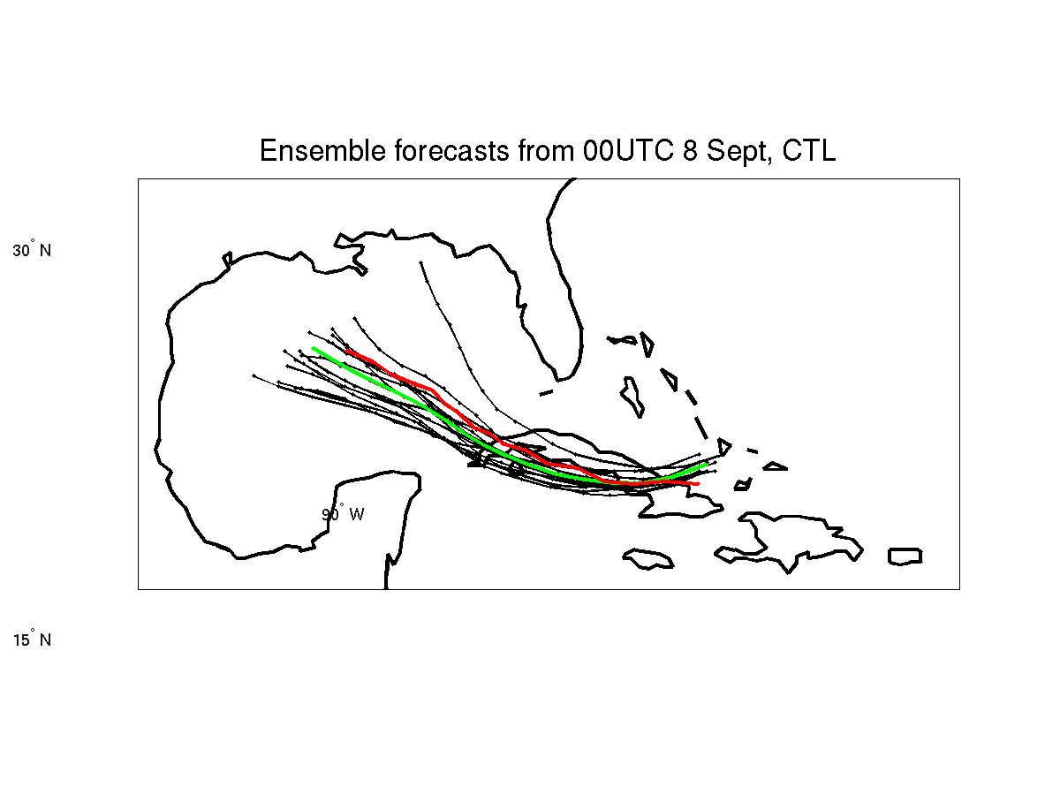
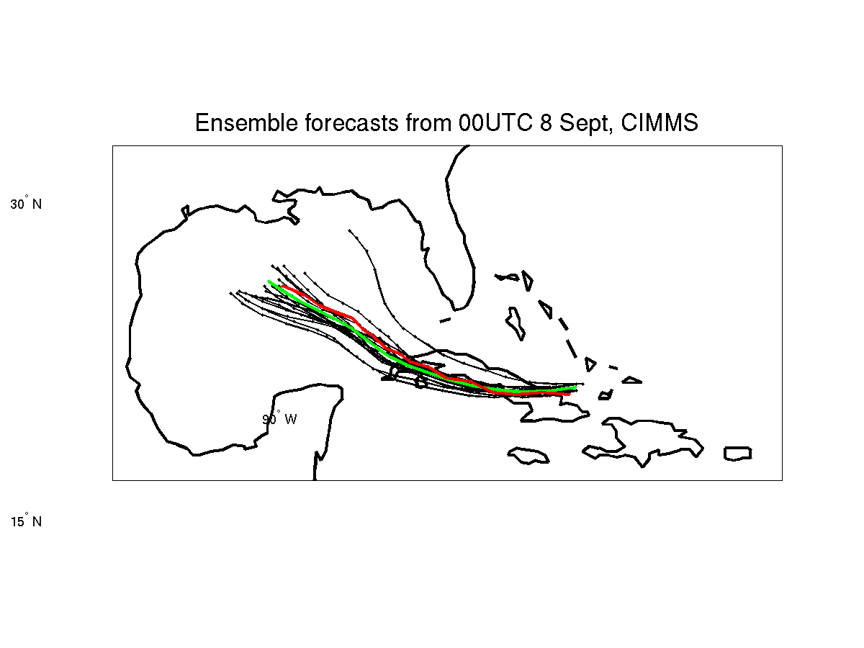
Tracks of 96h forecasts on Hurricane IKE
AIRS
CTRL run: Assimilate radiosonde, satellite cloud winds, aircraft data, and surface data.
No AIRS
With AIRS
Red is observation, green is forecast
Forecasts start at 00 UTC 8 September 2008

Slide 11
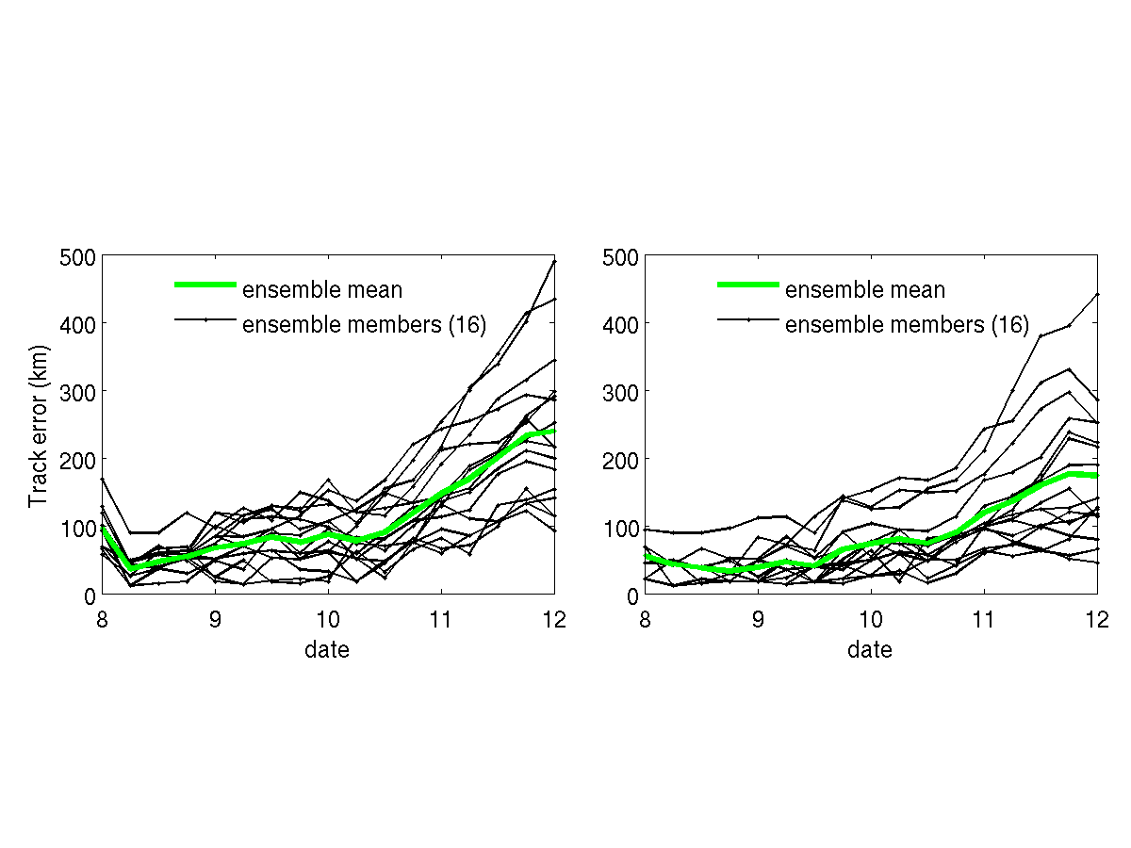
Without AIRS
With AIRS
Without AIRS
With AIRS
Track error (upper two panels) and sea level pressure from 96 hour forecasts (start at 00 UTC 8 September 2008)
Notes:
Track error (upper two panels) and sea level pressure (lower two panels) for 96 hour ensemble forecast.

Slide 12
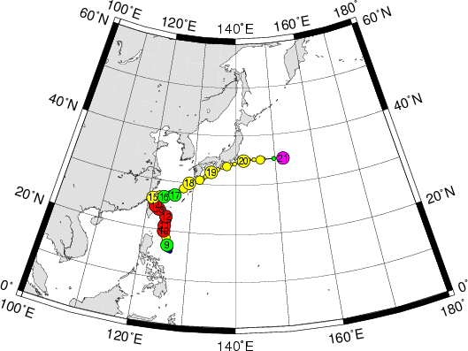
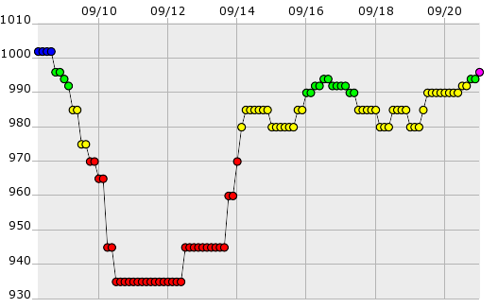
Typhoon Sinlaku (2008) Fact
Sinlaku Path
Sinlaku rapid intensification observed

Slide 13
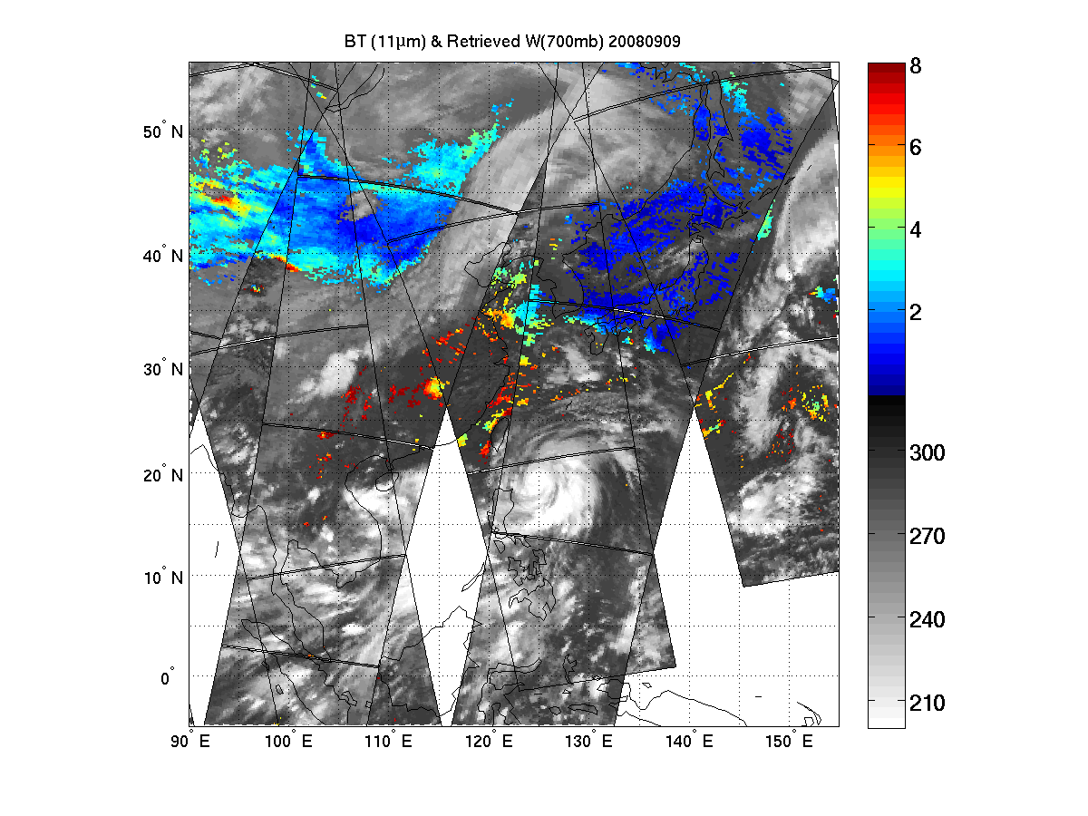
Typhoon Sinlaku (2008): Retrieved 700 hPa water vapor mixing ratio 2008.09.09 – Used in assimilation)
(g/kg)
(K)
700 hPa water vapor mixing ratio (g/kg) in clear skies (Sinlaku – 09 September 2008)

Slide 14
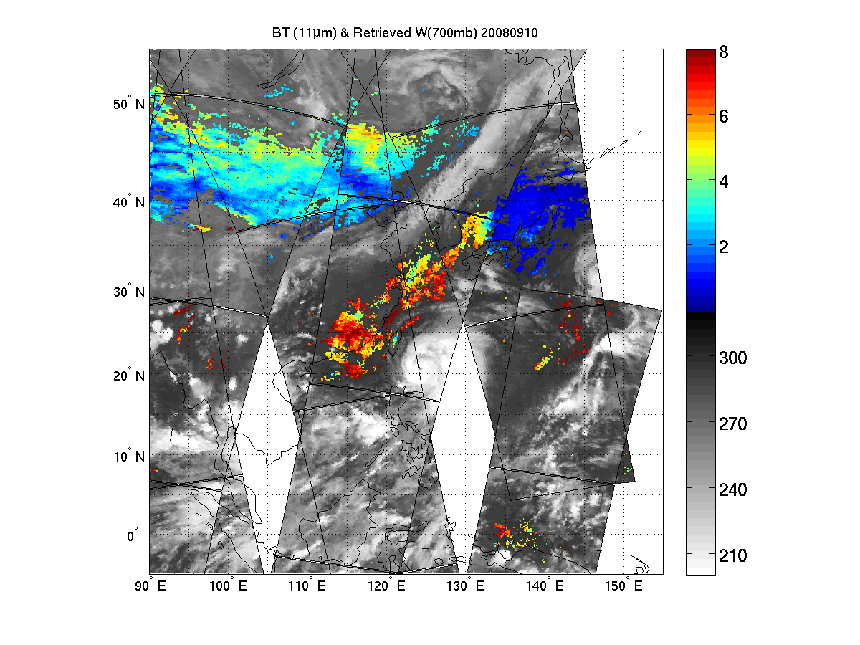
Typhoon Sinlaku (2008): Retrieved 700 hPa water vapor mixing ratio 2008.09.10 – Used in assimilation)
(g/kg)
(K)
700 hPa water vapor mixing ratio (g/kg) in clear skies (Sinlaku – 10 September 2008)

Slide 15
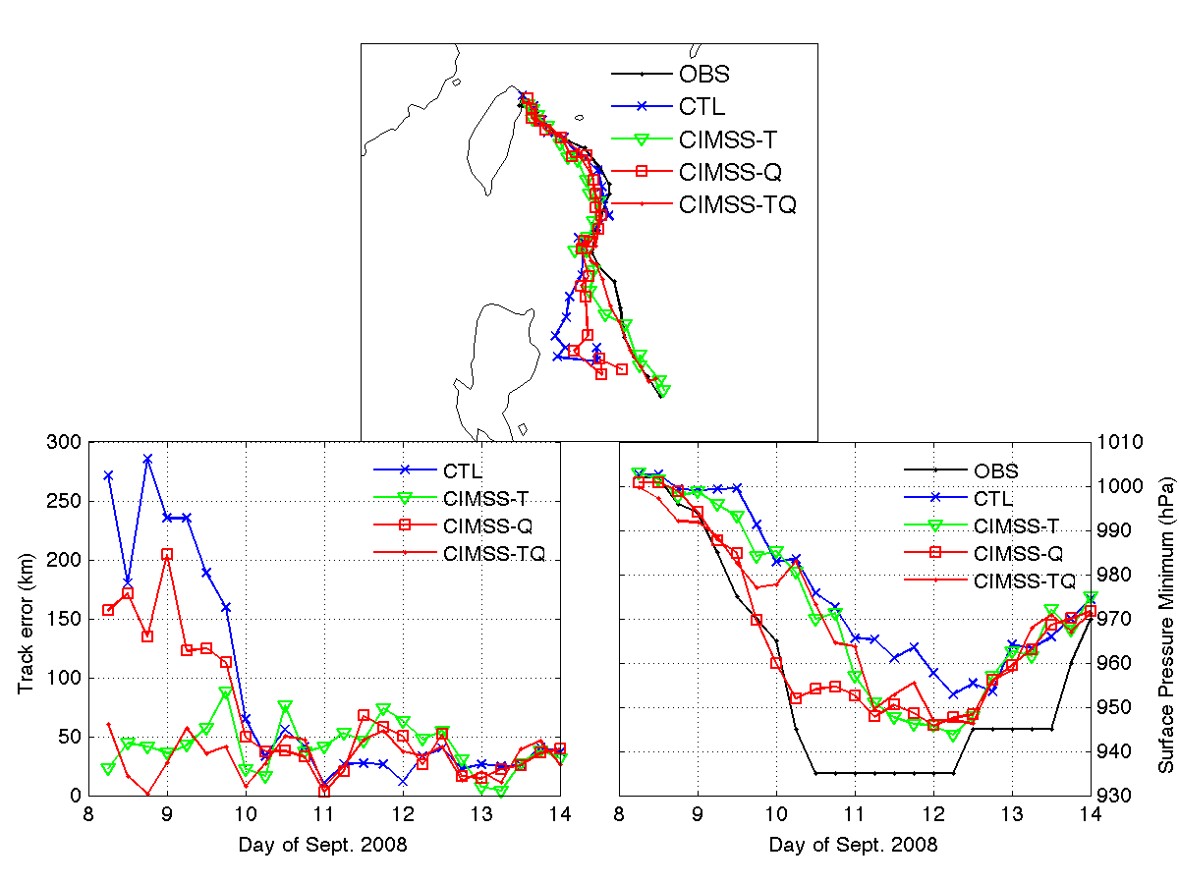
Track and Intensity Analyses for Sinlaku (2008)
Rapid intensification from 9 – 10 September 2011 – water vapor soundings are important!
CIMSS-T: AIRS SFOV temperature
CIMSS-Q: AIRS SFOV water vapor
CIMSS-TQ: AIRS SFOV temperature and water vapor

Slide 16
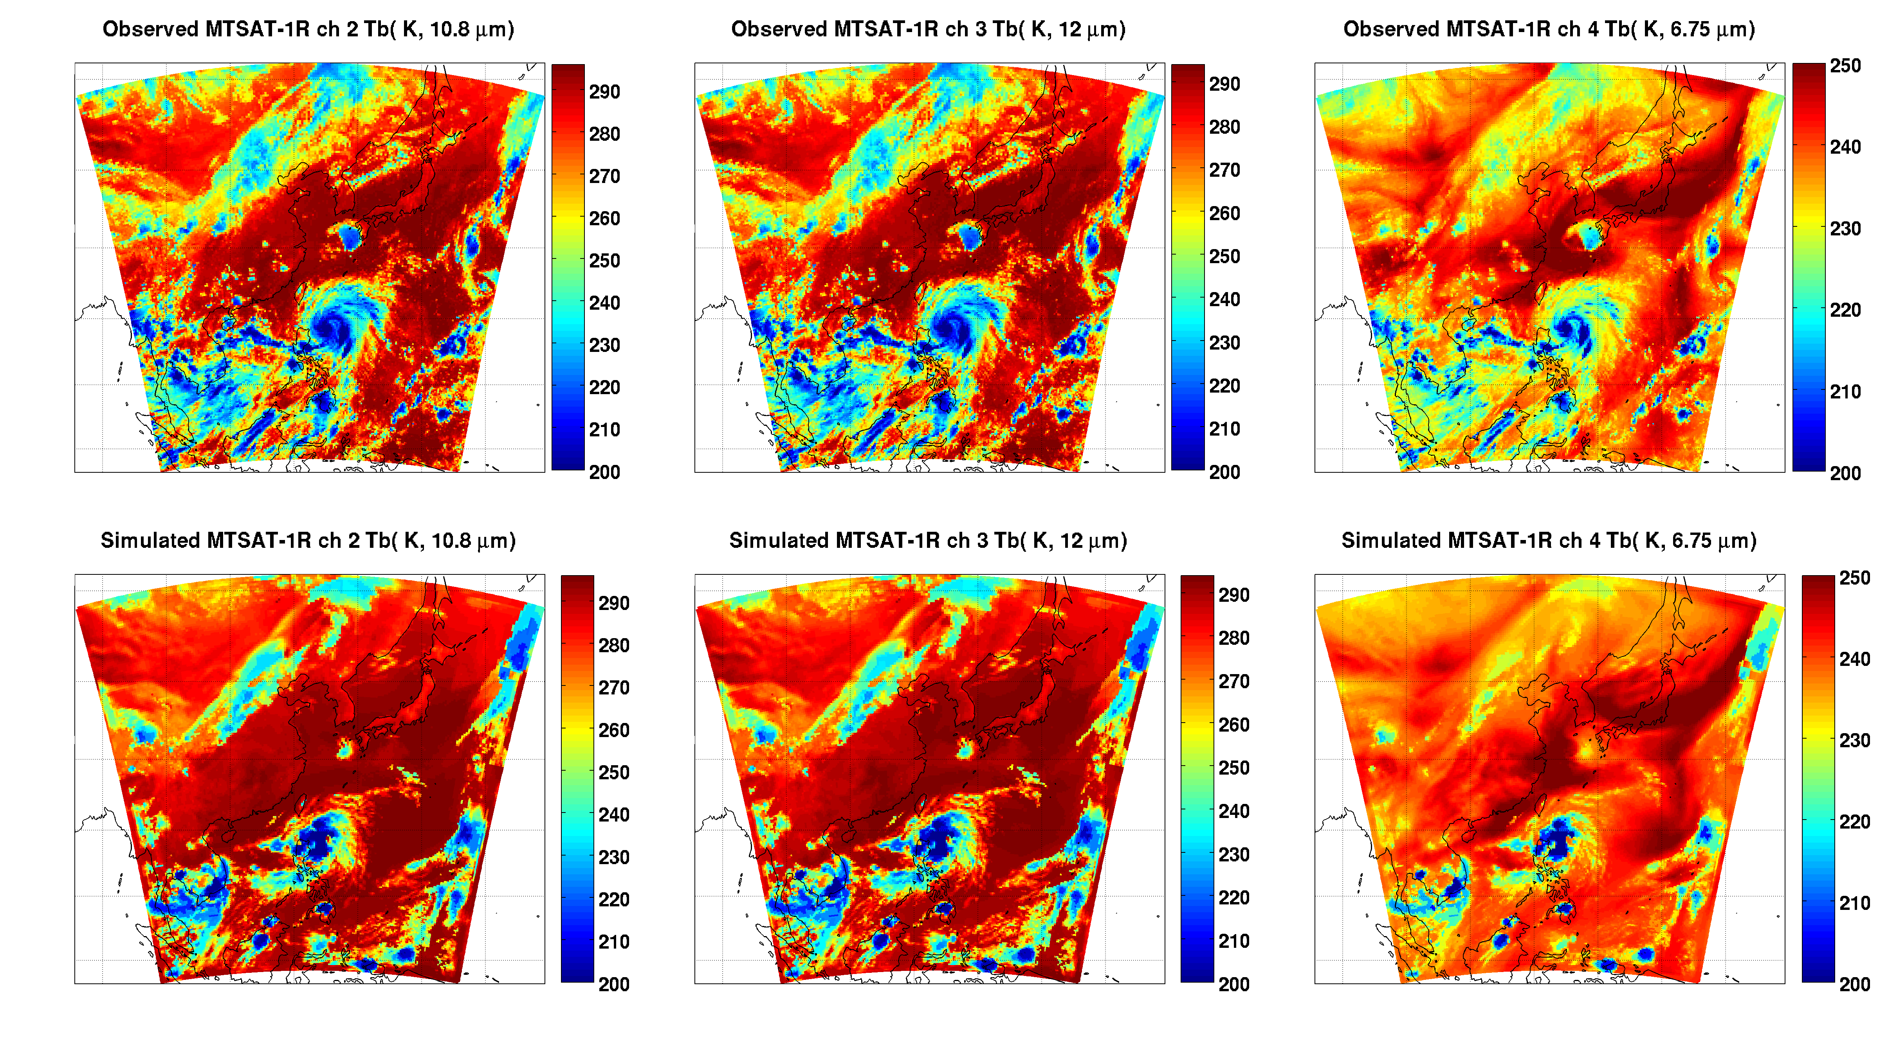
Verify forecast/analysis with geostationary IR images
Observed MTSAT IR Images
10.8 μm
6.75 μm
Simulated MTSAT IR Images

Slide 17
Assimilating advanced IR soundings with WRF/3DVAR - Hurricane forecast experiments
2008090606_WRF/3DVAR
CTRL run: use NCEP 6-hour final operational global analysis (1.0 x 1.0 degree grids; http://dss.ucar.edu/datasets/ds083.2/), including radiosondes, satellite winds, pilot report, GPS, ship, profiler, surface observations etc., starting at 06 UTC 06 September 2008
AIRS (Control + AIRS) run: use clear-skies from granules g066/067/068, but only assimilate 13 levels of AIRS SFOV temperature profiles between 500 and 800 hPa
Comparisons of Hurricane track for the next 48 hour forecast

Slide 18
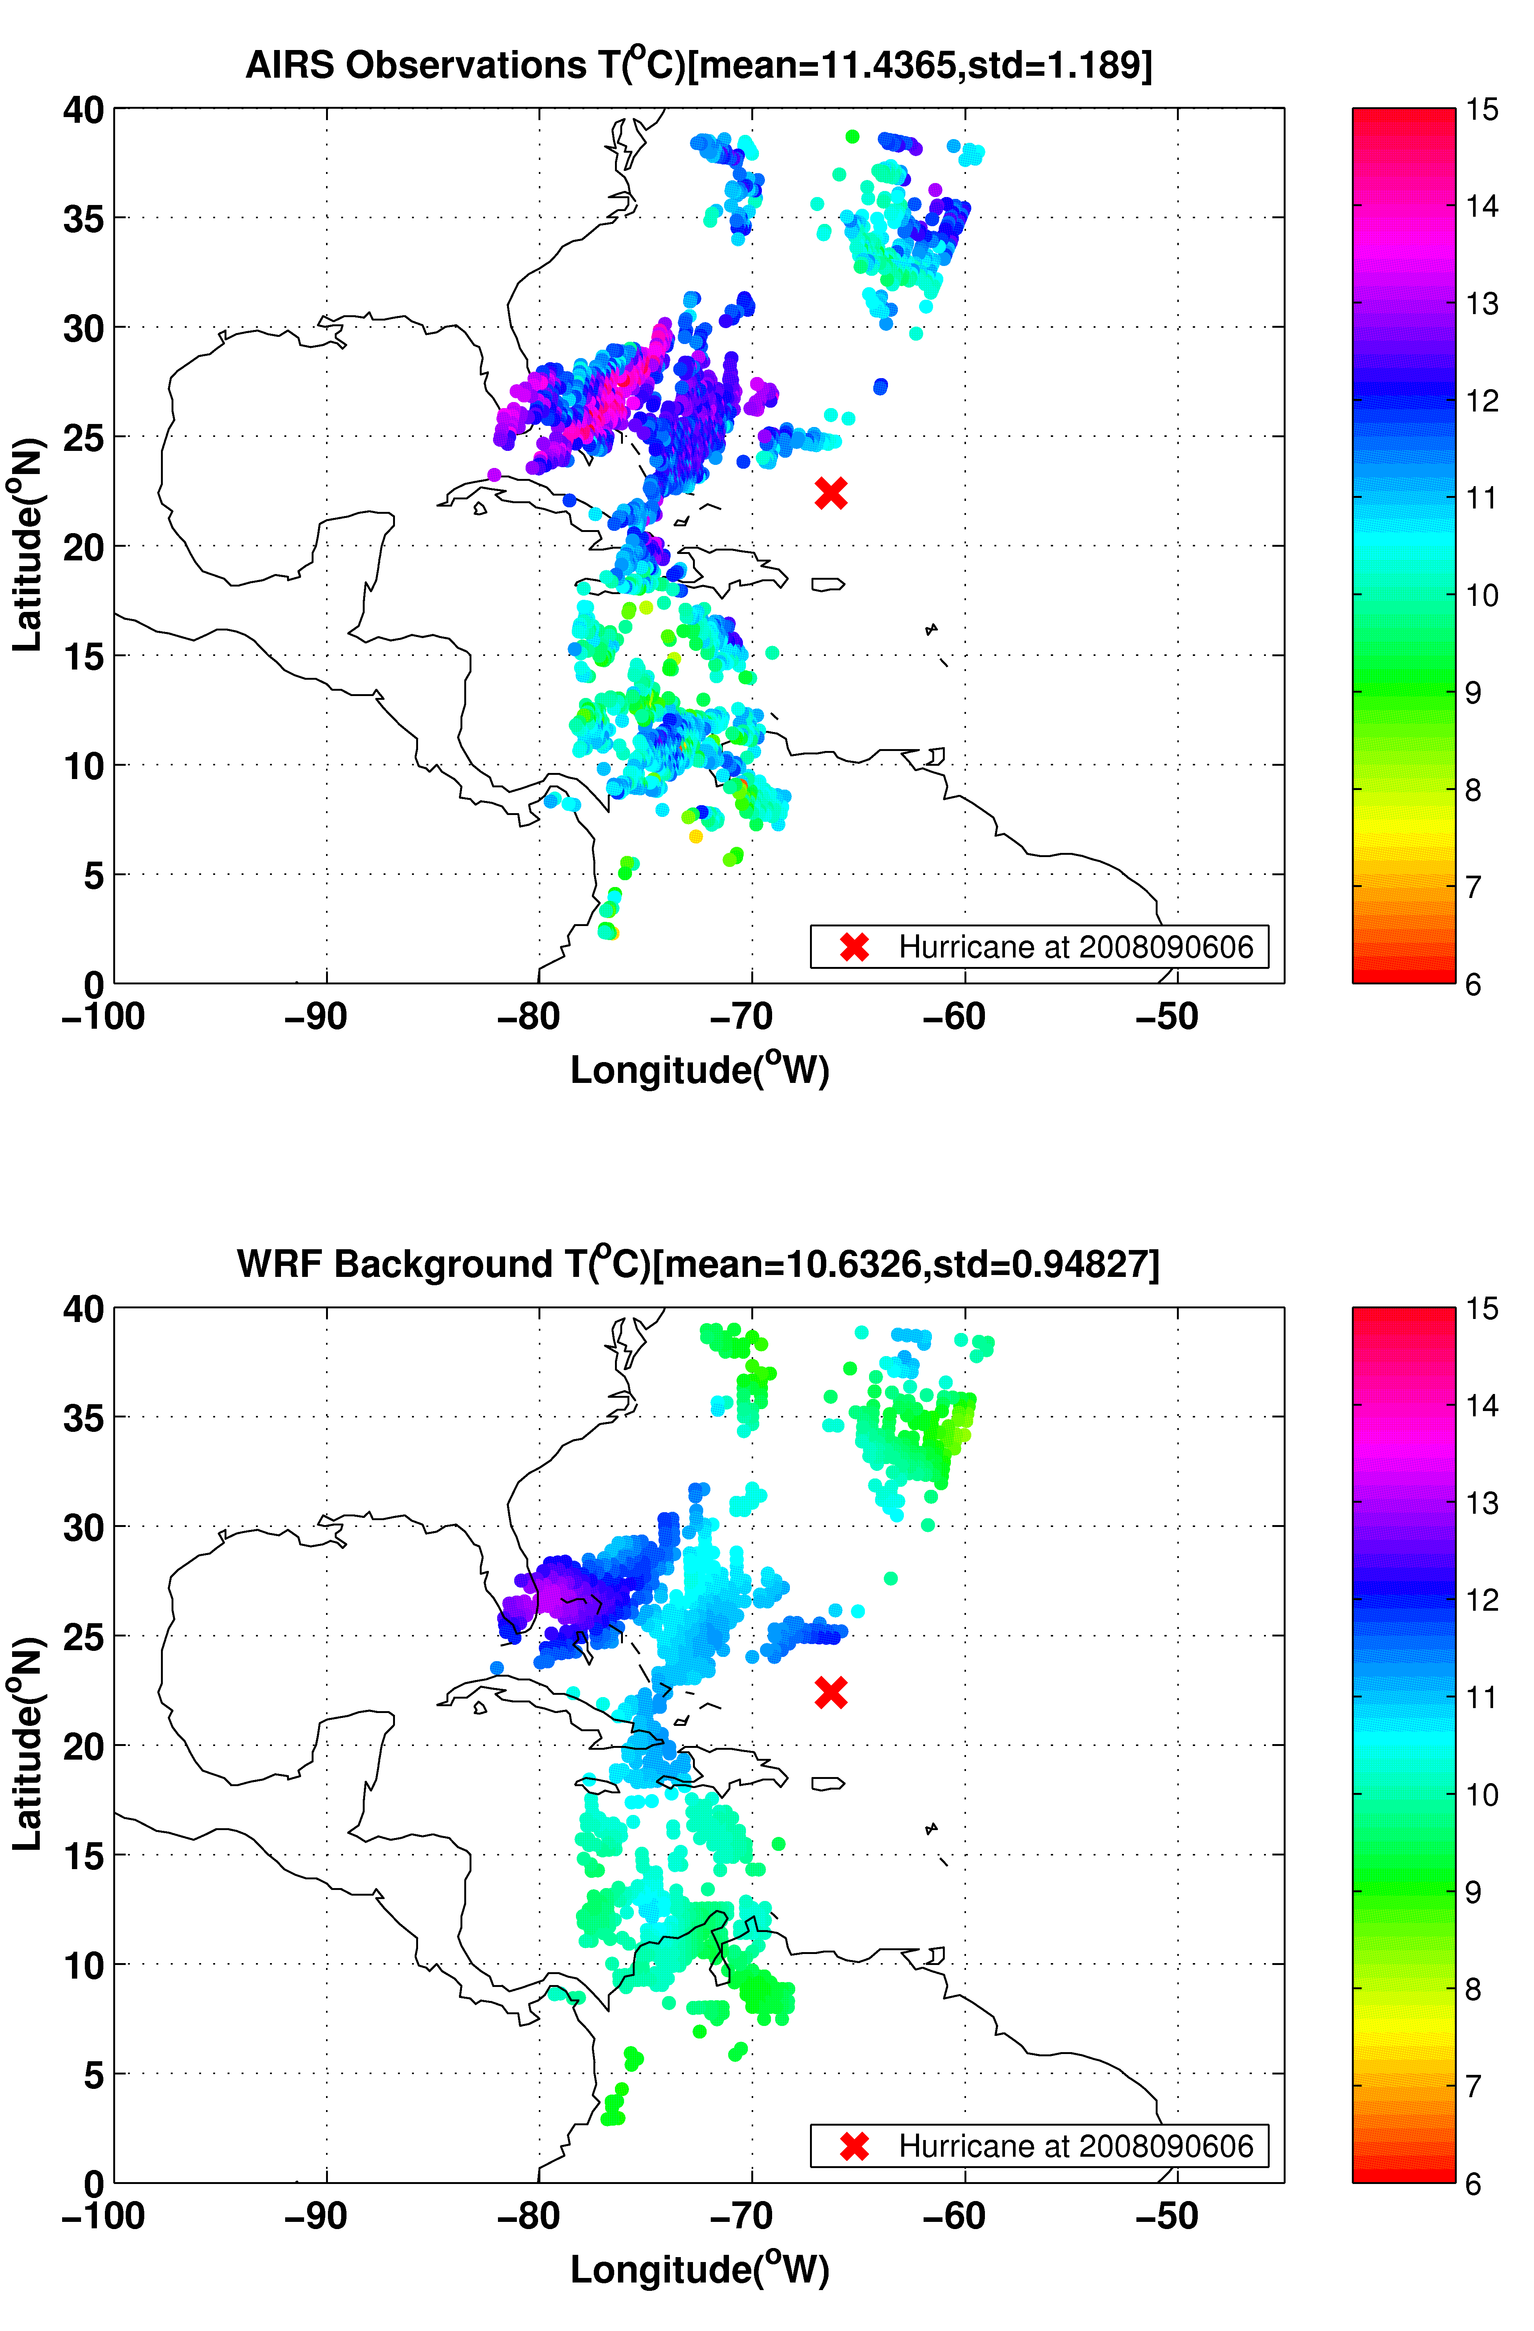
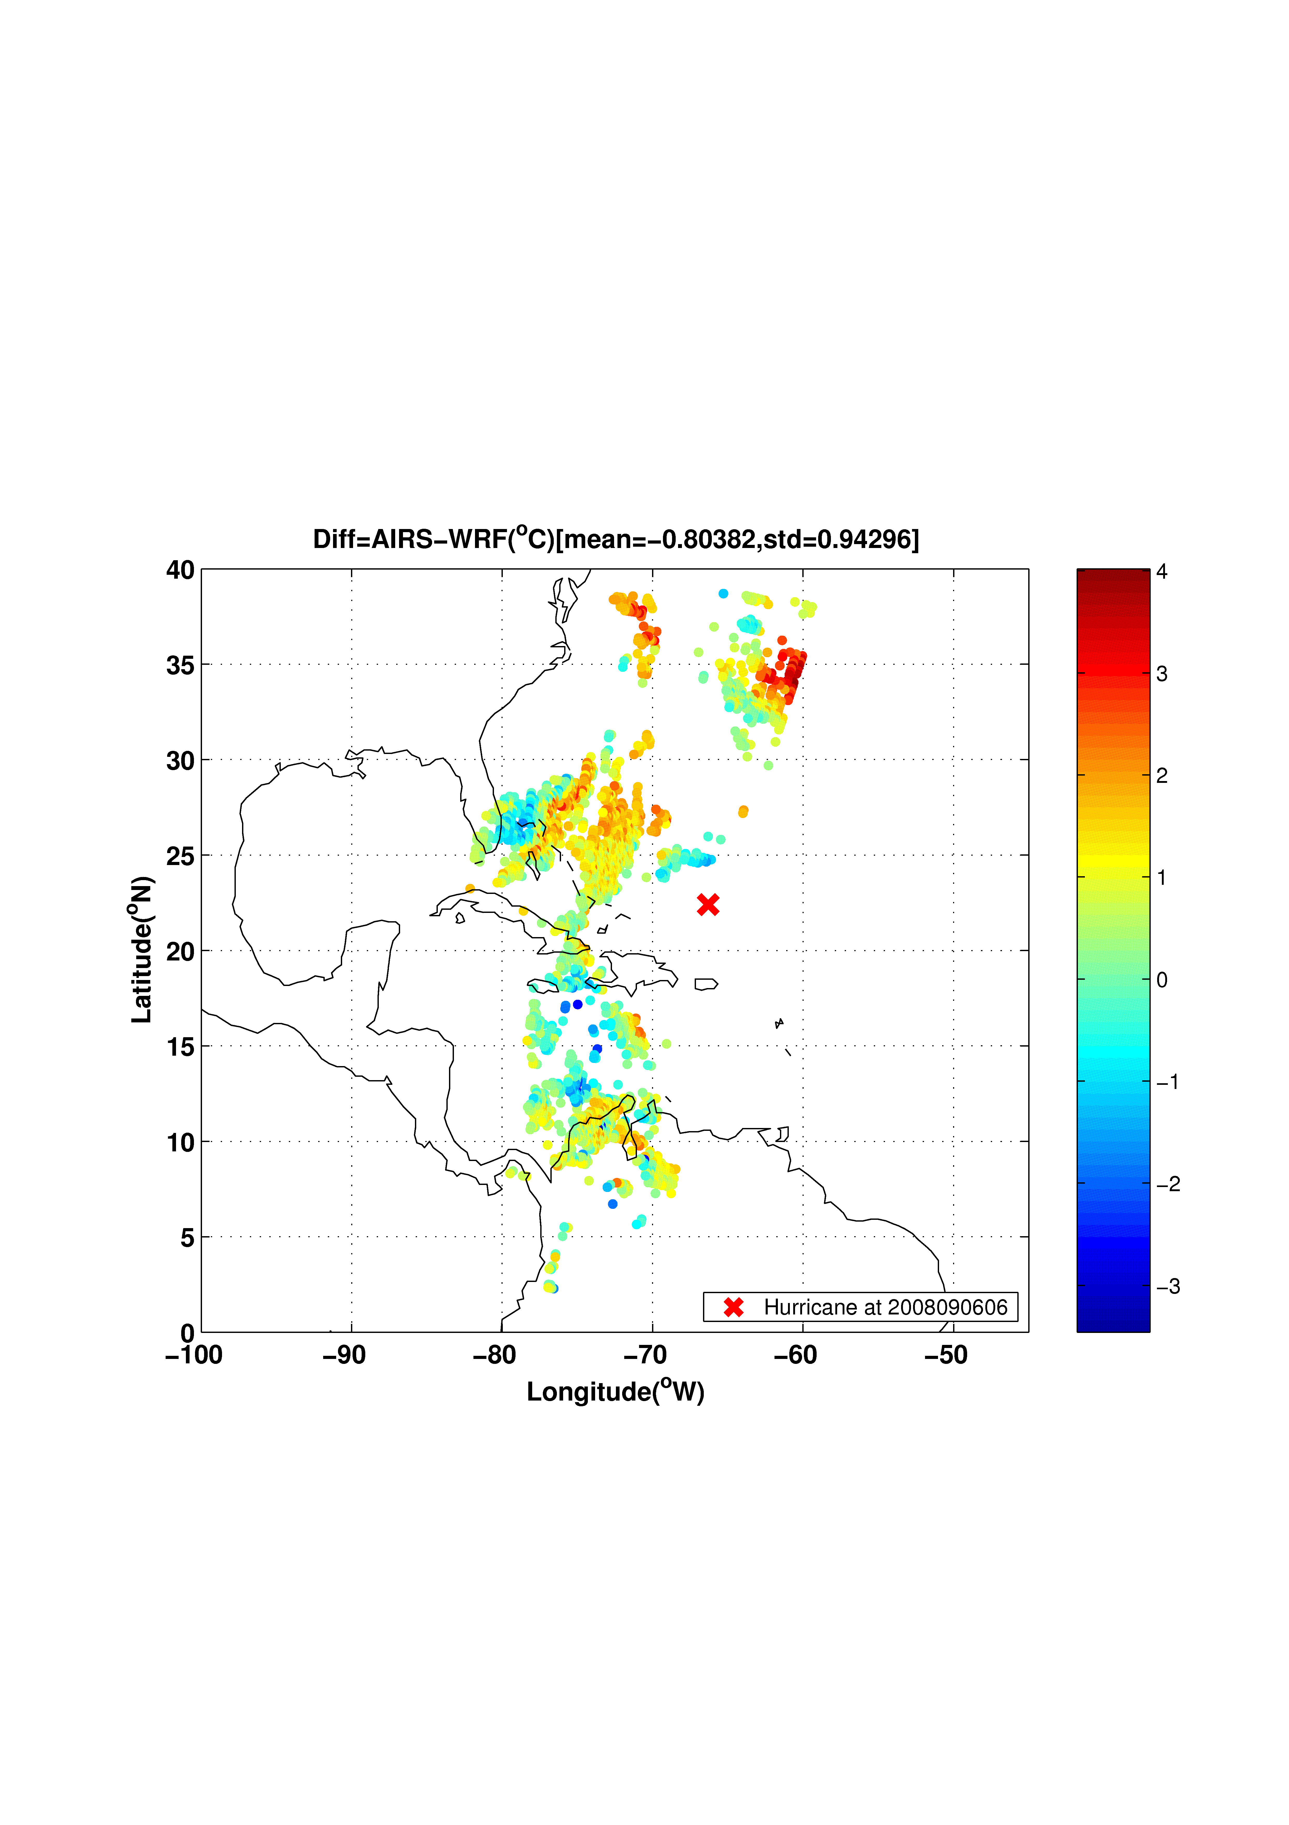
AIRS 2008090606_g066, g067, g068
AIRS 700 hPa temperature (upper left)
WRF 700 hPa background temperature (lower left panel)
The temperature difference between the AIRS and WRF background at 06 UTC on 06 September 2008 (lower right panel).

Slide 19
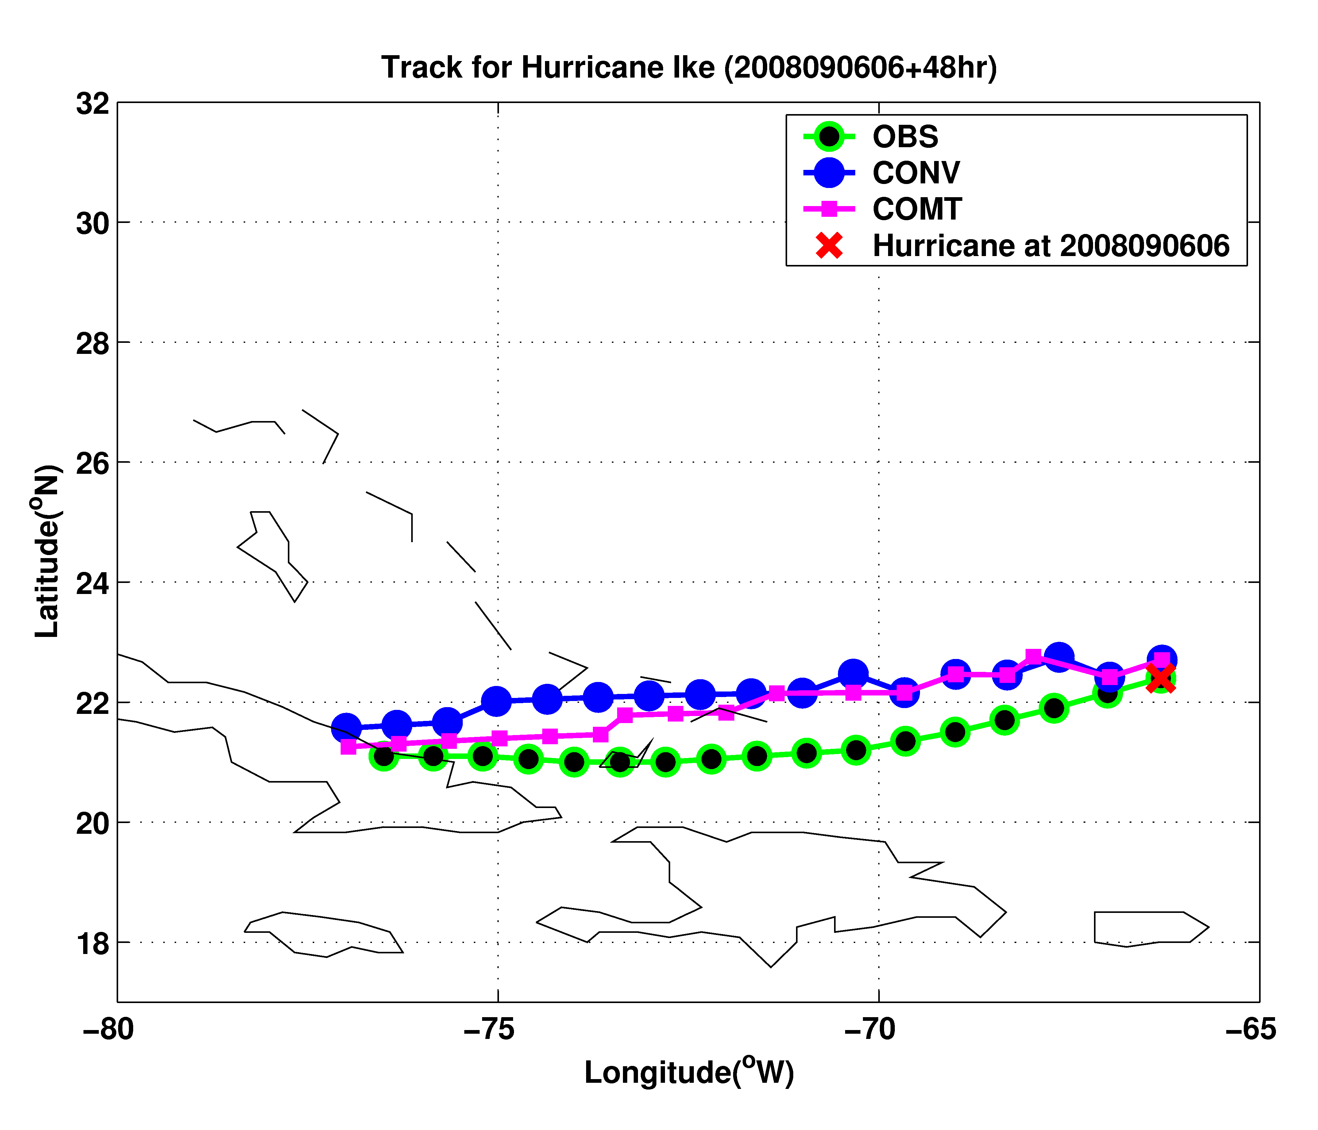
48 hour forecast starting at 06 UTC 06 September 2008
CTRL
AIRS
Control run with NCEP analysis, including radiosondes, satellite winds, pilot report, GPS, ship, profiler, surface observation, etc.
AIRS run

Slide 20
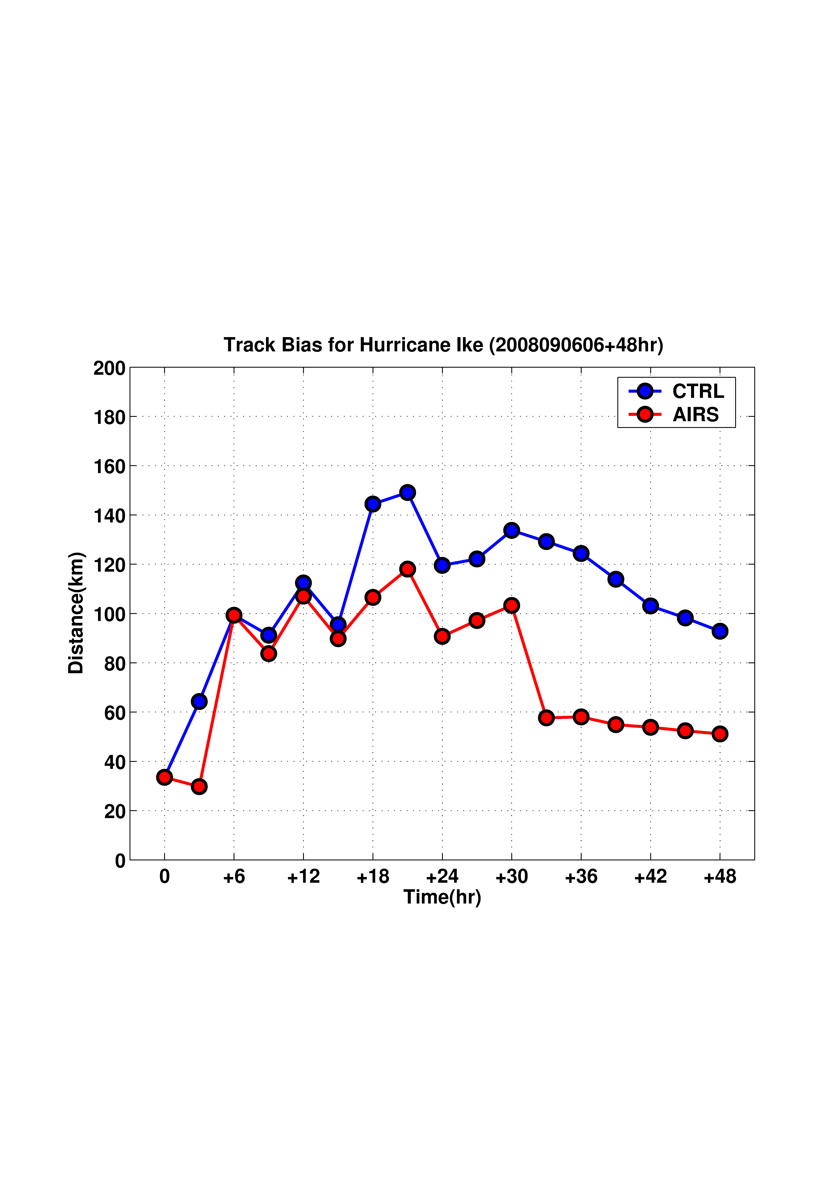
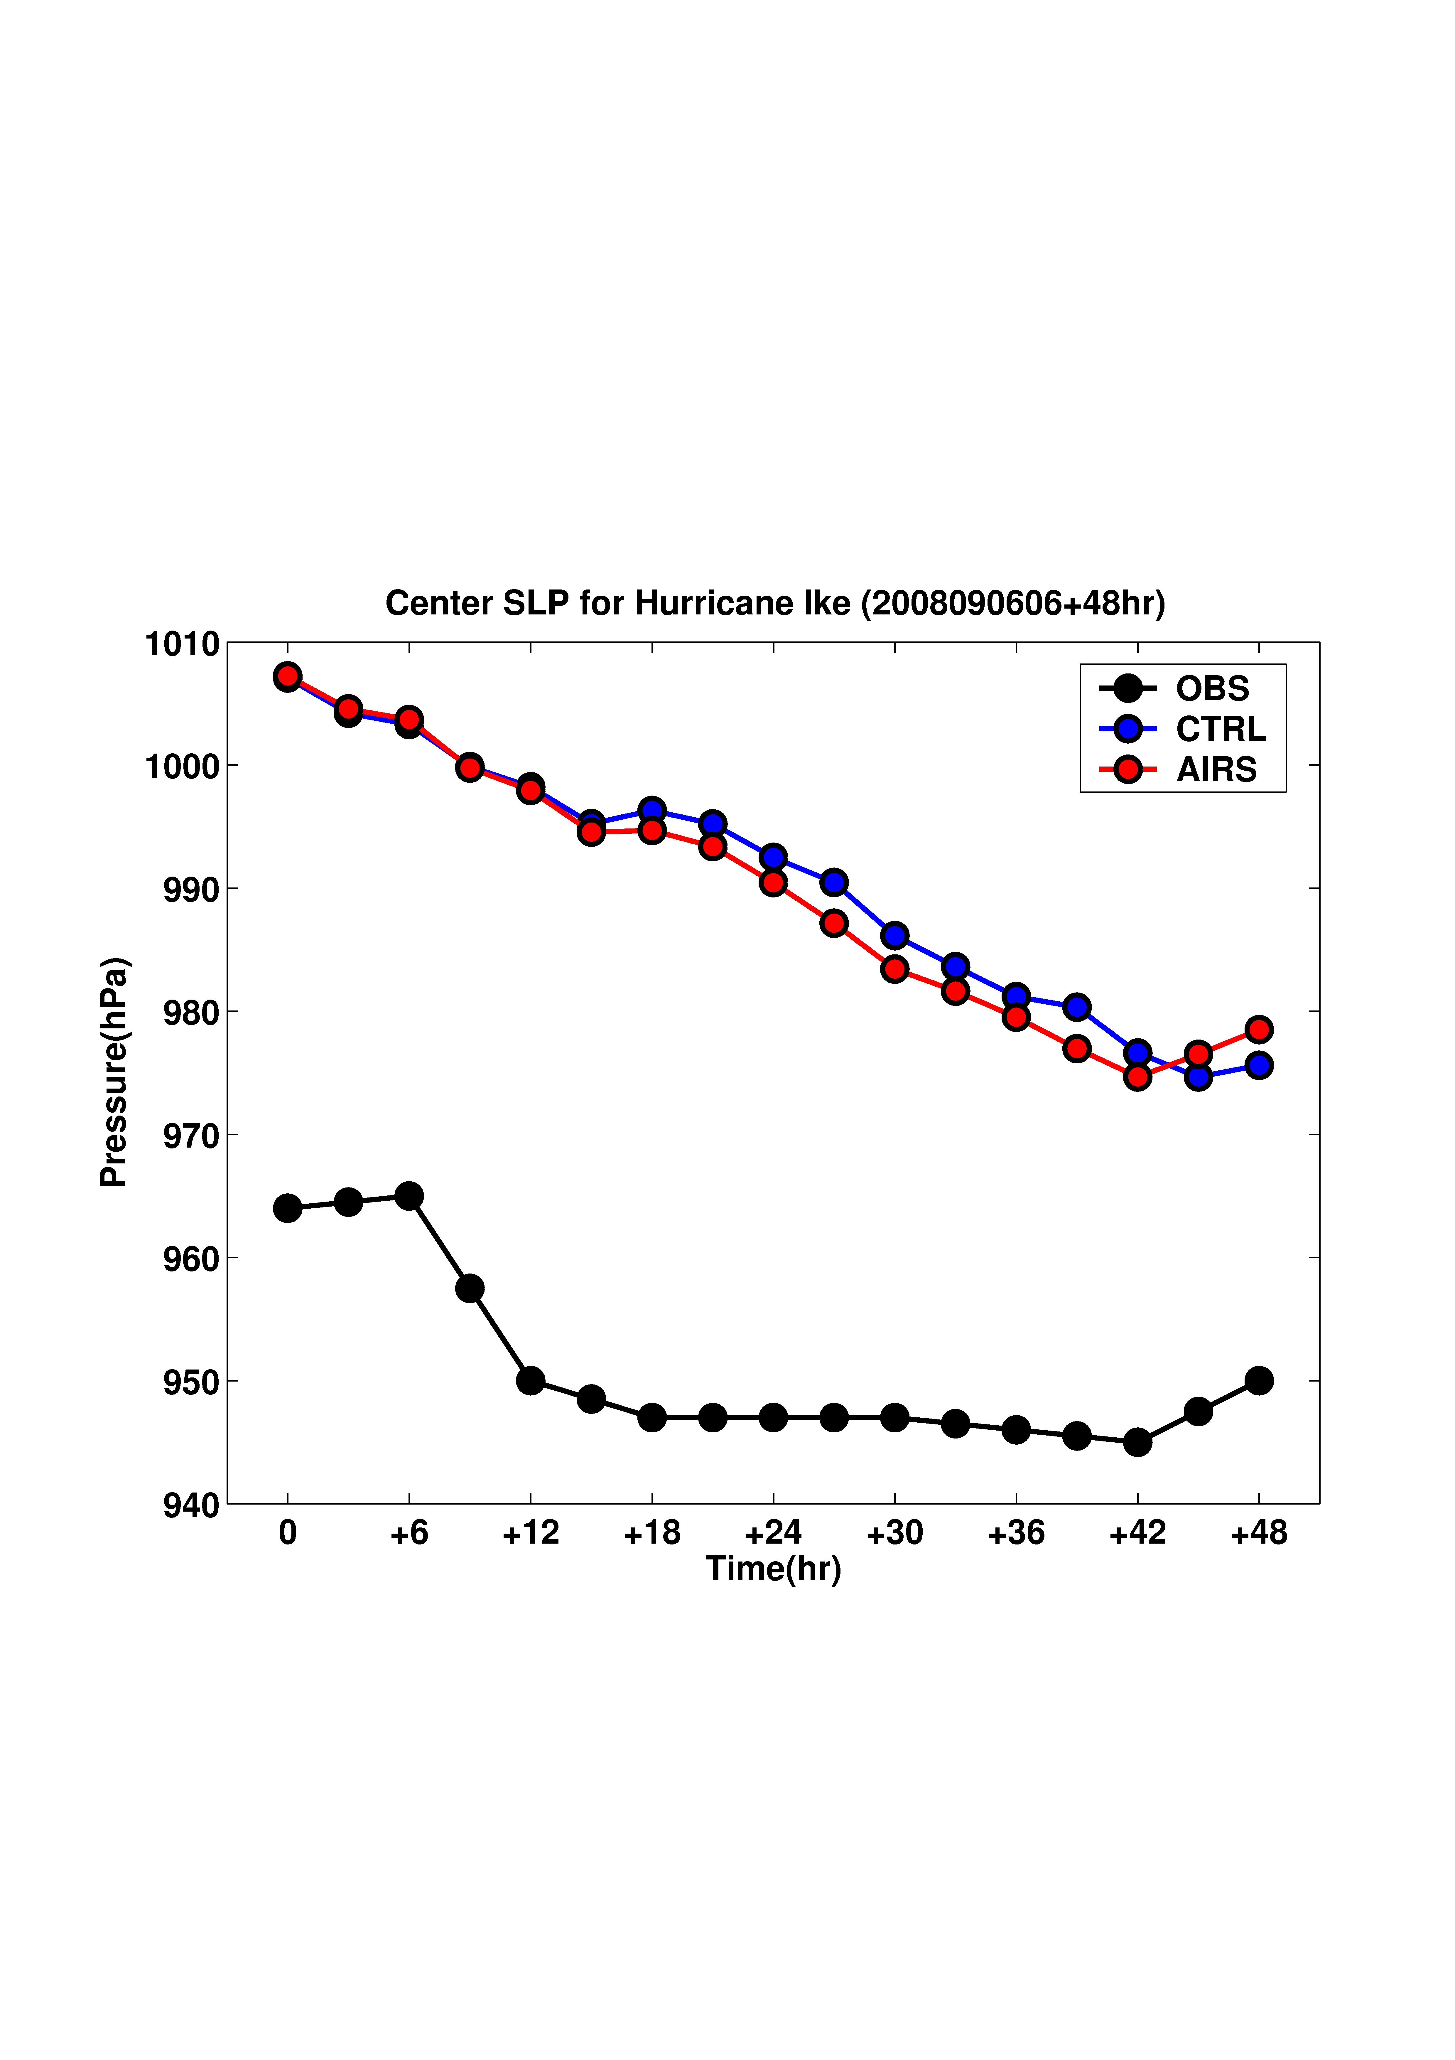
48 hour forecast track bias
(assimilate 500 – 800 hPa AIRS_T)
48 hour forecast SLP
(assimilate 500-800 hPa AIRS_T)
strongest

Slide 21
Assimilating advanced IR soundings with AREM/4DVAR – Storm precipitation forecast experiment
Control Run: NCEP-FNL analysis
AIRS Run 1:
  Assimilate AIRS T/Q at 2009072206
AIRS Run 2:
  Assimilate AIRS T/Q at 2009072206 and 2009072218
  Assimilating window: 00 – 06 UTC and 12 – 18 UTC
2009072206
300 hPa AIRS temperature
2009年7月22日～23日
2009072218
Notes:
AREM - Advanced Regional Eta-coordinate Model (AREM) (37 km spatial resolution)

Slide 22
OBS
CTRL
24-hour Precipitation Forecast
AIRS Run 1
AIRS Run 2

Slide 23
Summary
AIRS SFOV temperature and water vapor soundings improve both the track and intensity forecast for Hurricane Ike (2008) and Typhoon Sinlaku (2008) with both WRF/DART and WRF/3DVAR simulation and forecast systems.
AIRS SFOV moisture soundings significantly improve the definition of the typhoon vortex in the analysis and the forecast of the rapid intensification for Typhoon Sinlaku (2008).
AIRS SFOV temperature and moisture soundings improve 24 hour precipitation forecast with AREM/4DVAR.

Slide 24
Select References
Li, J., H. Liu, 2009: Improved hurricane track and intensity forecast using single field-of-view advanced IR sounding measurements, Geophysical Research Letters, 36, L11813, doi:10.1029/2009GL038285.
Liu, H., and J. Li, 2010: An improvement in forecast of rapid intensification of typhoon Sinlaku (2008) using clear sky full spatial resolution advanced IR soundings, Journal of Applied Meteorology and Climate, 49, 821 – 827.
Li, J., H. Liu, and T. Schmit, 2010: Advanced infrared water vapor measurements improve hurricane forecasts. SPIE, 012337/FAE9473B/000053. (http://spie.org/x42479.xml?highlight=x2420&ArticleID=x42479)
Wang, B., J. Liu, S. Wang, W. Cheng, J. Liu, C. Liu, Q. Xiao, and Y. Kuo, 2010: An Economical Approach to Four-dimensional Variational Data Assimilation. Adv. Atmos. Sci., 27, 715 - 727.
Weisz, E., J. Li, Jinlong Li, D. K. Zhou, H.-L. Huang, M. D. Goldberg, and P. Yang, 2007: Cloudy sounding and cloud-top height retrieval from AIRS alone single field-of-view radiance measurements, Geophysical Research Letters, 34, L12802, doi:10.1029/2007GL030219.

