Slide 1
IASI L2 products
Thomas AUGUST
Presented by Dieter Klaes
Tim Hultberg, Arlindo Arriaga, Anne O’Carroll, Xavier Calbet,
Dorothée Coppens, Marc Crapeau, Dieter Klaes, Rose Munro, Peter Schlüssel

Slide 2
Scope and background
IASI L2 PPF re-organised in 2009-2010 => v5.x, operational since 14th September 2010.
    > New algorithms > Software re-engineering
Presentation of the some of the most recent, on-going and foreseen activities to further improve and characterize the products

Slide 3

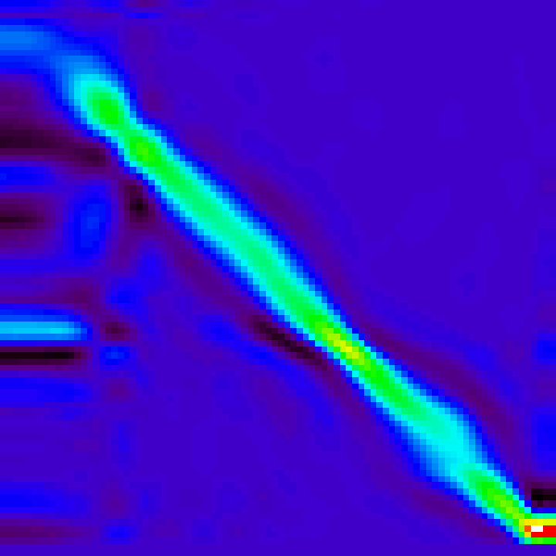

IASI L2 Processor
Input data pre-processing
Cloud detection and characterisation
Statistical retrievals: TWT, ε, trace gases
Optimal Estimation Method (OEM)
Validation of T, q sounding products
IASI L1C
EOF
ANN
cloud-free
OEM
NWP
Aux. meas.
IASI
L2
product
Conf. data
Static db
EOF cloudy

Slide 4
1. Preprocessing: static databases
Data type | Origin | Resolution
Land/Sea mask | AAPP | quadtree
Surface elevation | GTOPO 30 (US Geological Survey) | 30” x 30” (~1 km)
Emissivity Atlas | Global land surface IR emissivity database UW-Madison (Borbas et al., 2007) | 0.05° x 0.05° lat/lon 10 wavelengths Monthly means
Emissivity Atlas | Global land surface climatology from IASI measurements (Zhou et al., submitted to IEEE TGRS ) | 0.5°x0.5° Full spectrum (via PCs) Monthly means
Notes:
IR ems atlases replace the IGBP soil type + labo ems spectra

Slide 5
Plan
Input data pre-processing
Cloud detection and characterisation
Statistical retrievals: TWT, ε, trace gases
Optimal Estimation Method (OEM)
Validation of T, q sounding products
IASI L1C
NWP
Aux. meas.
IASI
L2
product
Conf. data
Static db

Slide 6
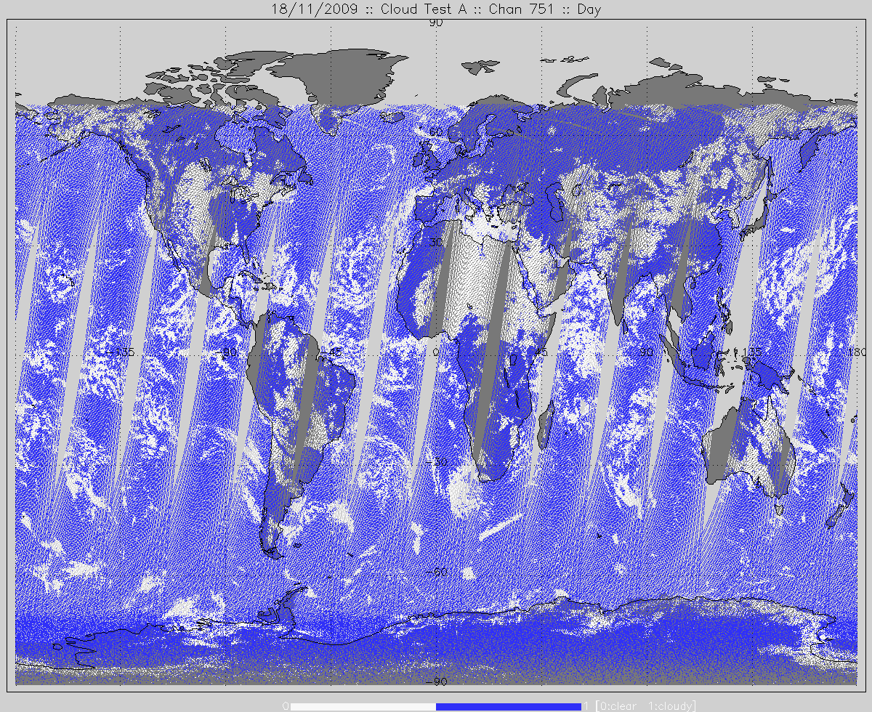
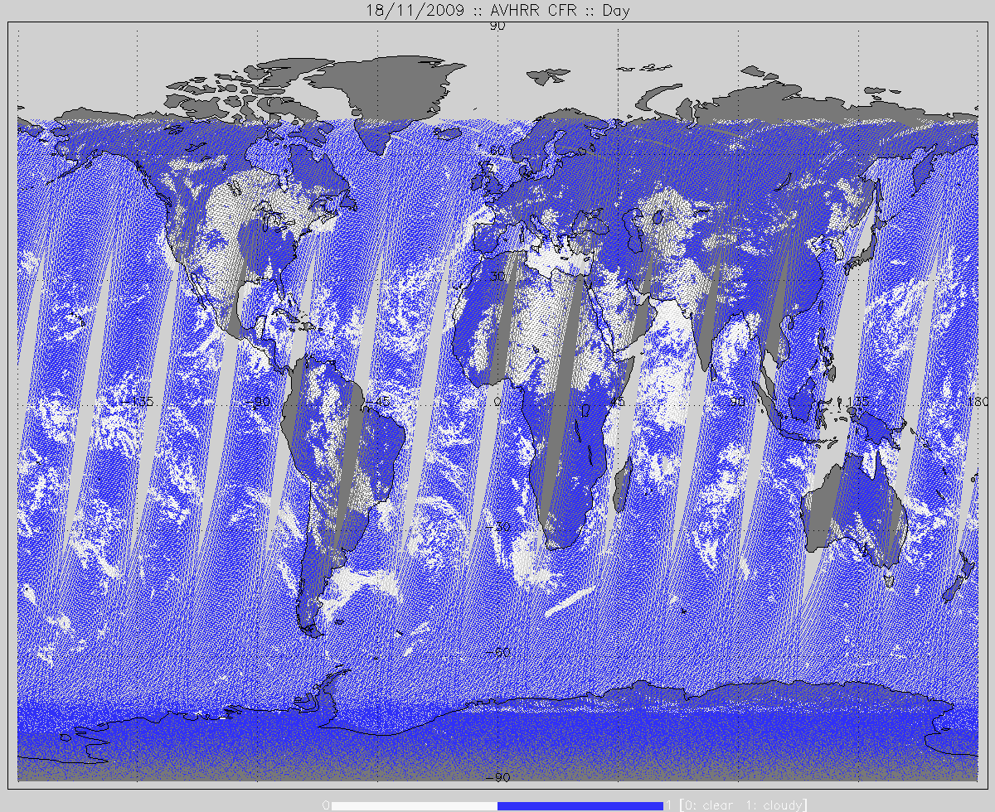
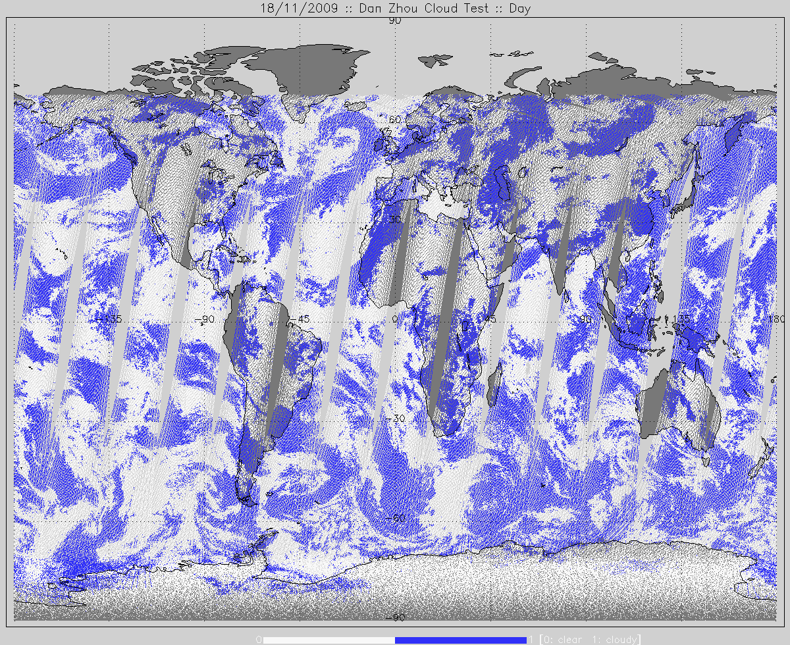
2. Cloud product: detection, operational tests
Opt. depth test
AVHRR test
NWP test
NWP cloud test
OBS – CALC(NWP, ems, … ) @ chans 751 & 1023
Cloudy if |OBS-CALC| > 1K
Relies on accurate forecasts and surface ems
AVHRR integrated cloud-fraction
IASI PSF weighted count of AVHRR cloudy pixels
Cloudy if CFR > 2%
Cloud optical depth test
EOF retrieval, D. Zhou et al., GRL 2005
Triggers final acceptance of cloudy retrievals
18/11/2009 White: clear

Slide 7
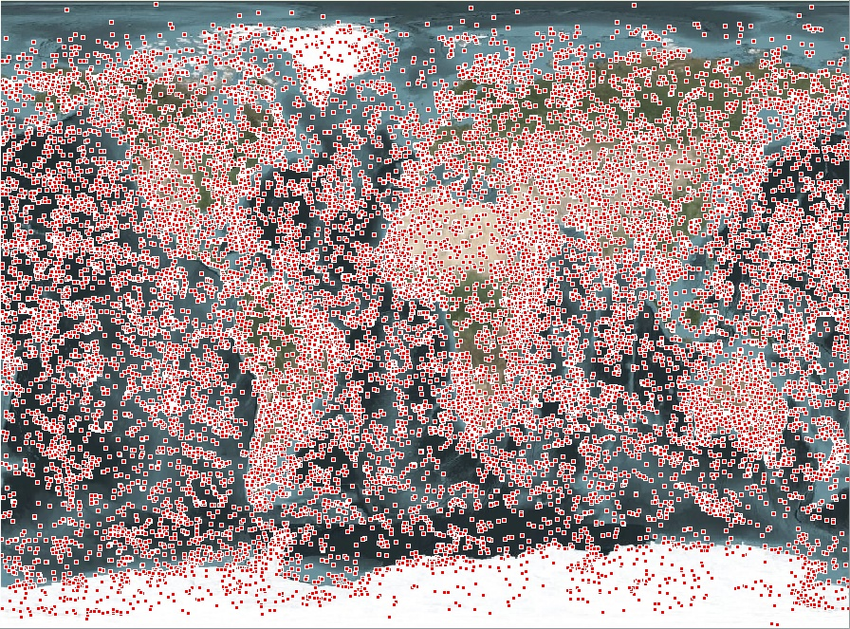
2. Cloud product: detection, a new test
Non-linear cloud detection
Based on artificial neural networks (ANN)
Result of external study (Brockman & Freie Universität Berlin)
~25 000 IFOVs classified by visual inspections of AVHRR images
Dedicated ANNs trained for land/sea & day/night config.
Performs better than NWP test on the training base:
accuracy ~90% vs 75% for NWP test capability ~85% vs 60% for NWP test
Notes:
Accuracy: evaluate misclassification of clear cases
Capability: evaluates misclassification of cloudy cases

Slide 8
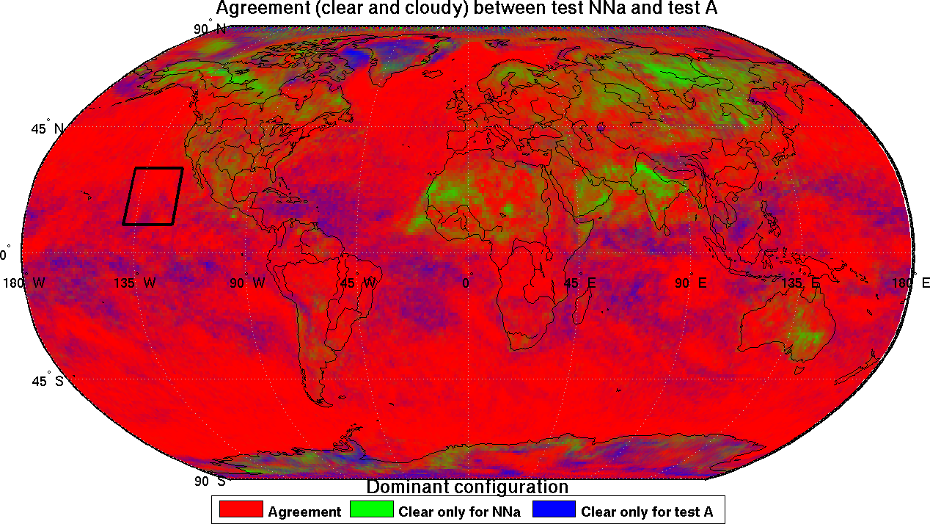
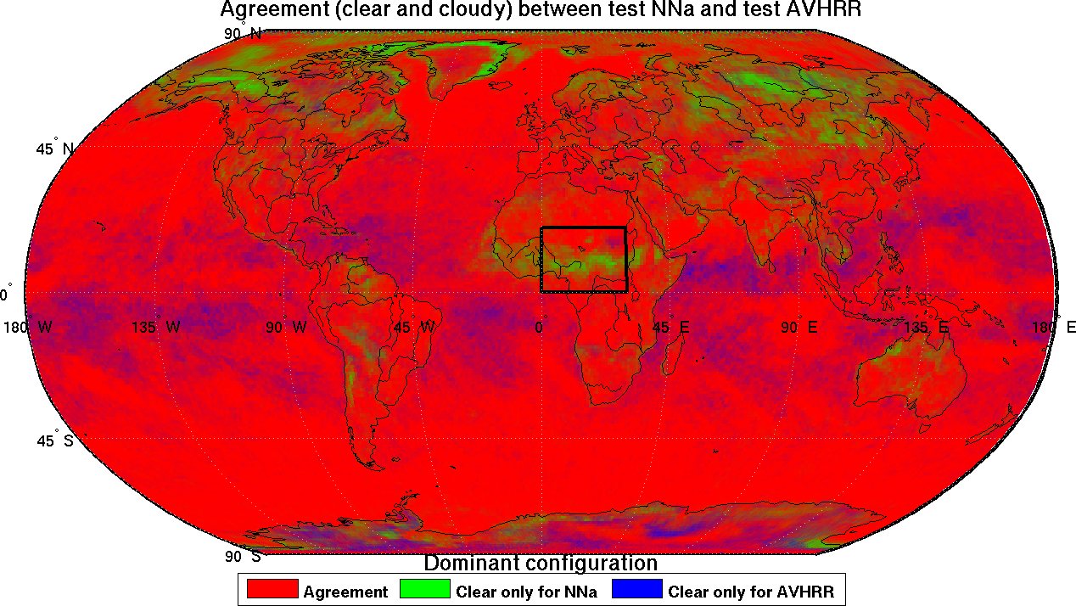
2. Cloud product: combining all cloud tests
19-24 March 2010 Agreement rate: ANN vs AVHRR
19-24 March 2010 Agreement rate: ANN vs NWP
snow, Ts, T&q profiles ?
ems, Tskin ?
q profiles ?
mineral dust
NWP test

Slide 9
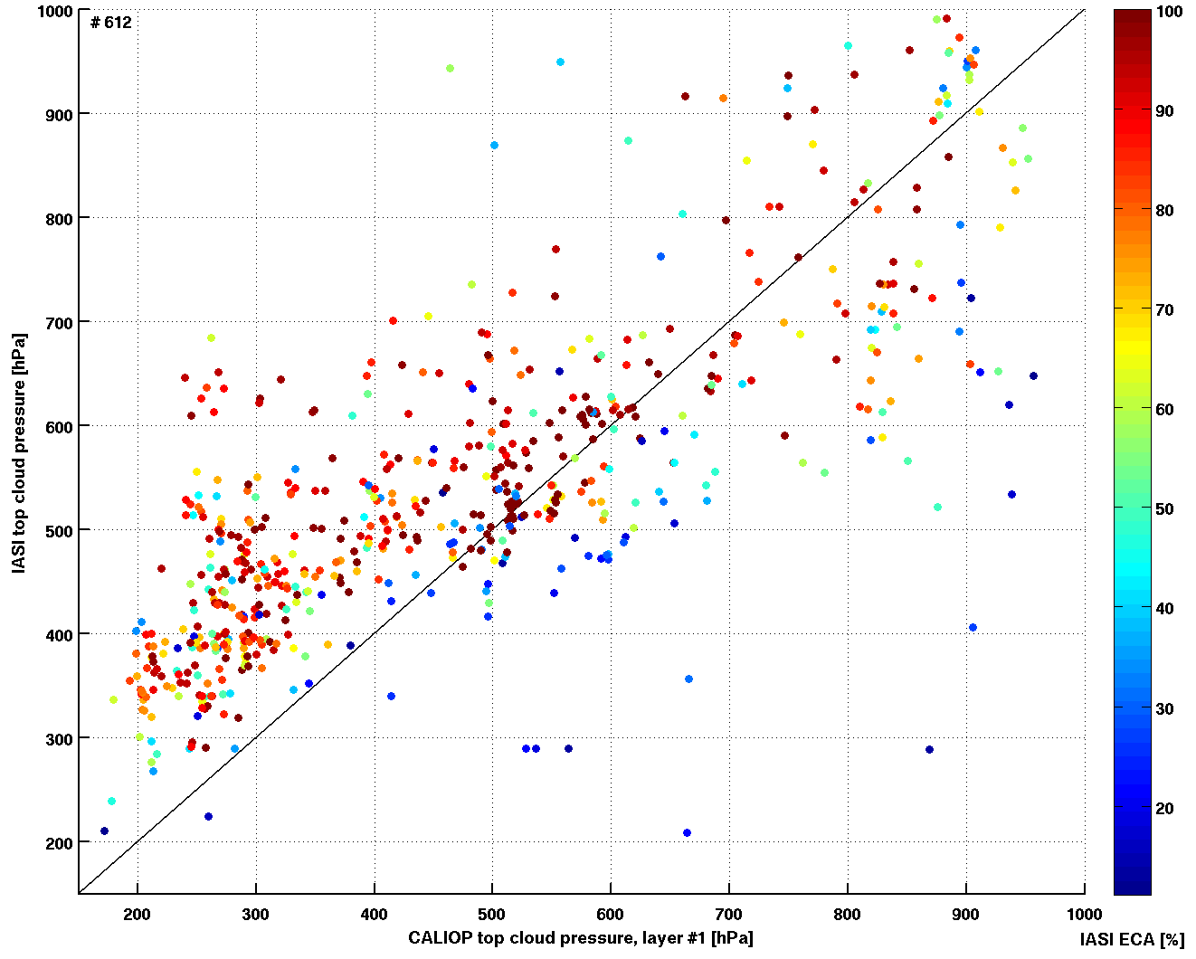
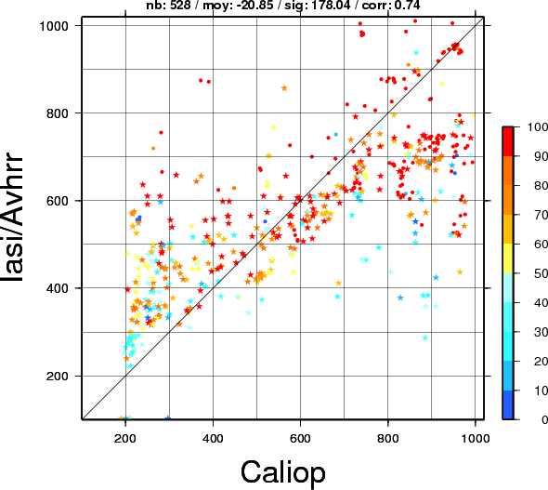
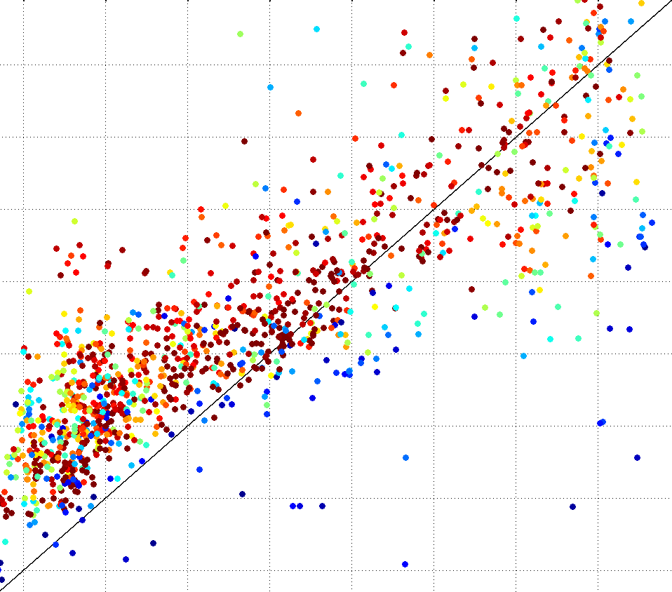
2. Cloud product: coverage and cloud-top pressure
On-going validation with CALIOP and ConcordIasi
Co-operation with L. Lavanant & F. Rabier (Meteo-France)
Support EPS Polar winds products
IASI CTP @ EUM
IASI/AVHRR CTP @ CMF
Credits: Lydie Lavanant
CALIOP CTP (hPa)
Notes:
Lydie also compared CTT (AVHRR/CALIOP): Agreement relatively OK but many CALIOP (CTP,CTT) points she cold not put on NWP forecasts T profiles. Come back to this in the T,q profs section

Slide 10
Plan
Input data pre-processing
Cloud detection and characterisation
Statistical retrievals: TWT, ε, trace gases
Optimal Estimation Method (OEM)
Validation of T, q sounding products
IASI L1C
EOF
ANN
cloud-free
NWP
Aux. meas.
IASI
L2
product
Conf. data
Static db
EOF cloudy

Slide 11
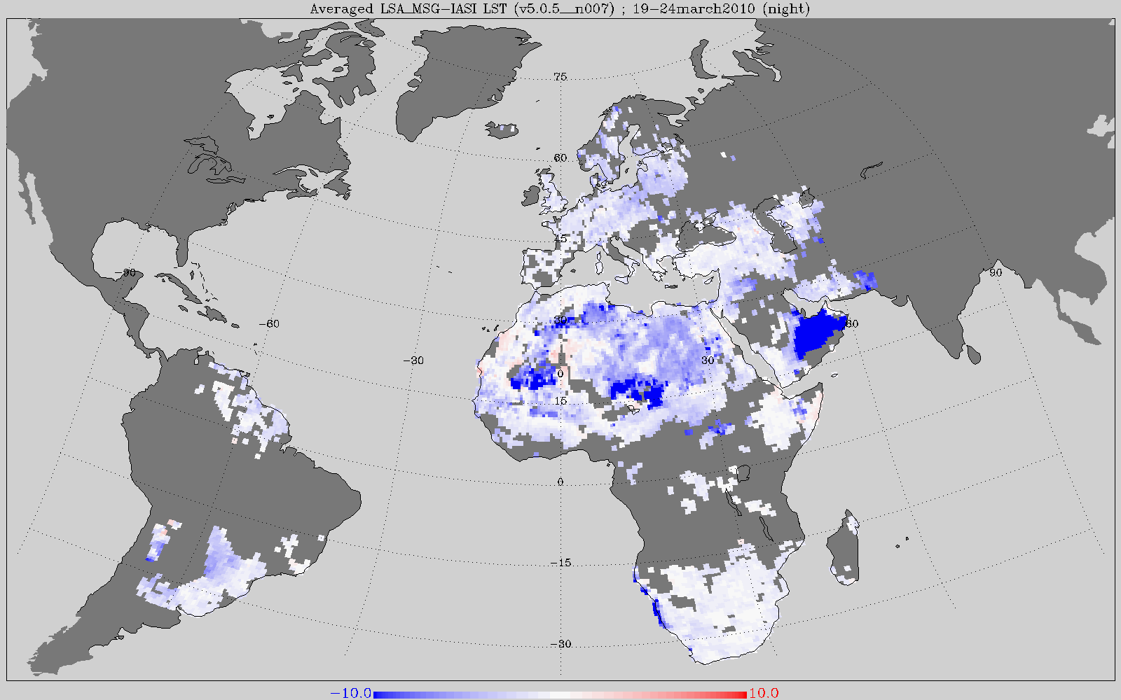
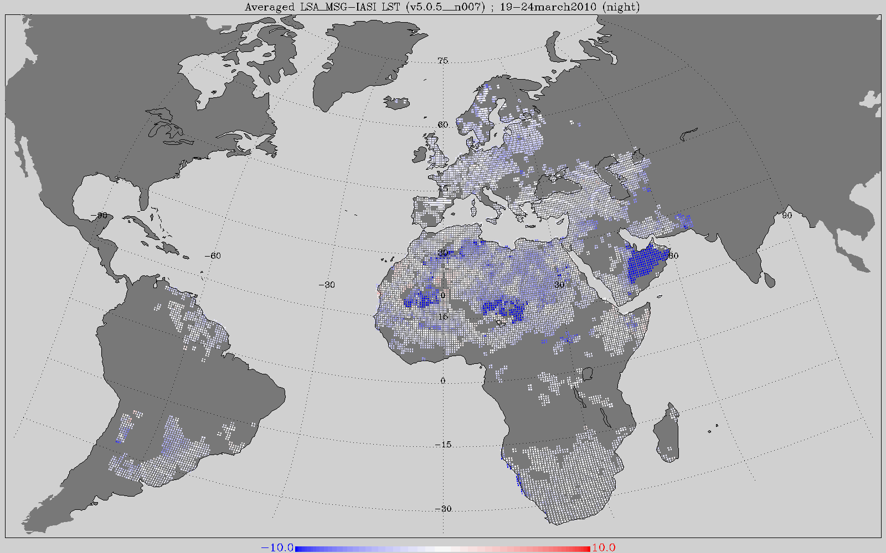
3. Statistical retrievals: Land Surface T & emissivity
19-24 March 2010
Night
EOF regression (D. Zhou et al., 2010)
Enters final IASI L2 products
Performance mostly assessed against SEVIRI LAND-SAF LST
Global figures: warm bias ~1K, stddev ~2K
Largest departures in deserts
Emissivities pre-operational and distributed since 30/11/2010
Alternative emissivity retrieval from external study (A.Chédin & V.Capelle, Laboratoire de Météorologie Dynamique)
Specific case studies initiated in Oman and Mauritania (with LMD and MetOffice data)
(LSA_MSG - IASI) LST [K]

Slide 12
3. Statistical retrievals: Land Surface T & emissivity
Mauritania
ARIES data, courtesy of
J. Taylor & S. Newman (MetOffice)
µm
Notes:
Variability from year to year could be explained by vegetation…
Differences between LMD and DZ retrievals not explained yet fully (possible dust contamination not filtered by LMD)

Slide 13
3. Statistical retrievals: T,q profiles
EOF retrieval (D. Zhou et al., 2005, GRL)
Regression with different coefficients for different viewing angles
Full profiles available under clear and partly cloudy conditions
Clear sky: first-guess in the final iterative retrieval
Clear sky: q profiles enters final L2 products
Cloudy IFOVs (partly): after users request, the partly cloudy T,q profiles retrievals were added to the final IASI L2 products.
Distributed since 02/12/2010.

Slide 14
3. Statistical retrievals: CO
ANN retrievals, total column
Typical errors ~ 8-15%, assessed at EUMETSAT and by LATMOS against MOPITT, ULB/IASI-CO...
Inter-pixel differences in IASI L1C (AR.11795) fixed with a new database: operational since 07/02/2011
IASI L2 CO available for all four pixels from 14th March 2011
Future developments:
Retrieval error estimate: OEM (LATMOS/ULB via O3SAF)
ANN (Aires et al., 2004)
Latest & on-going validation and scientific studies

Slide 15
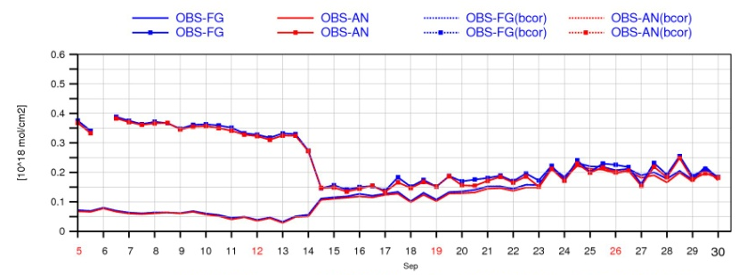
3. Statistical retrievals: CO
Monitoring @ MACC :: September 2010
IASI L2
PPFv5
EUMETSAT-CO
LATMOS/ULB-CO
Credits: A. Inness, ECMWF

Slide 16
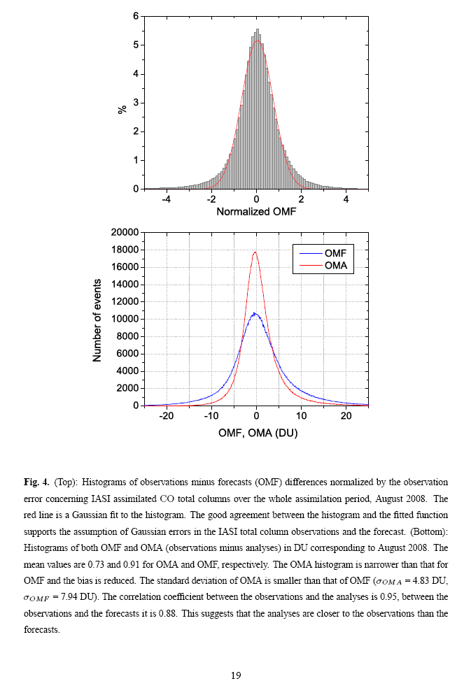
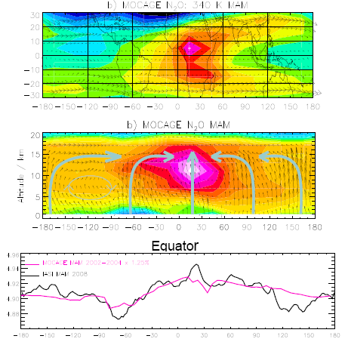
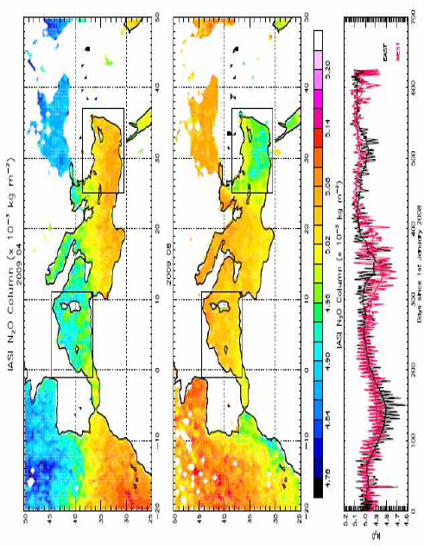
3. Statistical retrievals: CO, N₂O, CH₄, CO₂
Comparison and assimilation in MOCAGE, CTM @ Meteo-France
Assimilation of CO TC
error ~11%
L. El Amraoui, V-H. Peuch et al., ACP in preparation
N₂0 variability along the Equator
P. Ricaud, J-L Attié et al.,
2009, ACP
Chemistry Aerosol Mediterranean Experiment
(ChArMEx)
P. Ricaud, et al.,
2010, A-train conference

Slide 17
Plan
Input data pre-processing
Cloud detection and characterisation
Statistical retrievals: TWT, ε, trace gases
Optimal Estimation Method (OEM)
Validation of T, q sounding products
IASI L1C
EOF
ANN
cloud-free
OEM
NWP
Aux. meas.
IASI
L2
product
Conf. data
Static db
EOF cloudy

Slide 18
4. OEM retrievals: current settings
Follows standard Optimal Estimation Method after Rodgers:
Cost-function: a background and a measurement term, Marquardt-Levenberg minimisation (5 iterations max.)
Active parameters: T_{skin} and T, q & O₃ profiles
Background term computed in the EOF space of the atmospheric parameters: T -> 28 PCs, q -> 18 PCs, O₃ -> 9 PCs
One global a priori and covariance matrix: climatology
316 channels after Collard (Collard et al., QJRMS 2007)
Clear sky OBS-CALC: global radiance tuning and measurement error covariance matrix
Forward model: RTIASI-4 optimised for faster computations
First guess: statistical retrievals

Slide 19
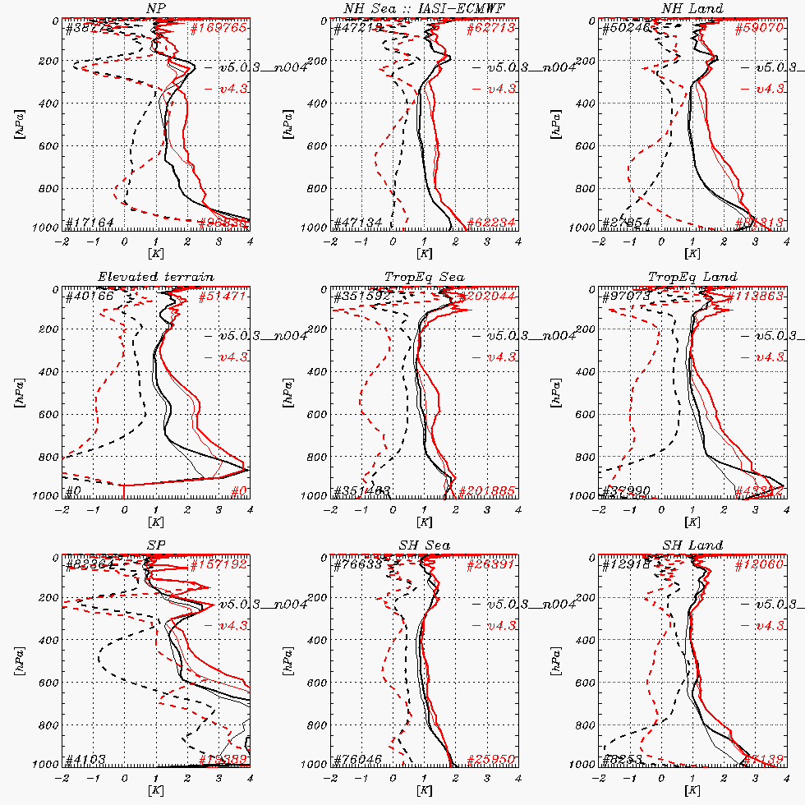


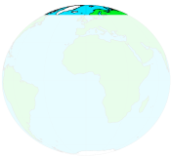
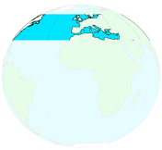
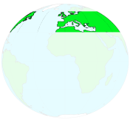


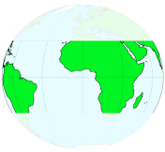

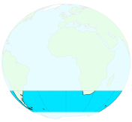
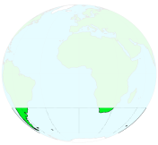
4. OEM retrievals: Performances
rms ~ 0.7 K !!!
rms ~ 0.7 K !!!
Courtesy F. Rabier (Meteo-France)
- v5
- v4

Slide 20
4. OEM retrievals: Performances
Errors previously assessed against ECMWF analyses
T errors < 1K in mid and upper troposphere
Larger departures in BDL and over land surfaces
Retrieved humidity profiles too constrained by BG, replaced by FG (EOF retrievals) in the final IASI L2 products
OEM(Tskin) not as good as EOF
Ozone TC validated in-house with GOME-2 products and in external study (LATMOS) against other instruments products and LATMOS/ULB IASI O3: bias < 2%, stddev ~ 3%
Latest and on-going validation: NPROVS, ConcordIasi, GlobVapour

Slide 21
Plan
Input data pre-processing
Cloud detection and characterisation
Statistical retrievals: TWT, ε, trace gases
Optimal Estimation Method (OEM)
Validation of T, q sounding products
IASI L1C
EOF
ANN
cloud-free
OEM
NWP
Aux. meas.
IASI
L2
product
Conf. data
Static db
EOF cloudy

Slide 22
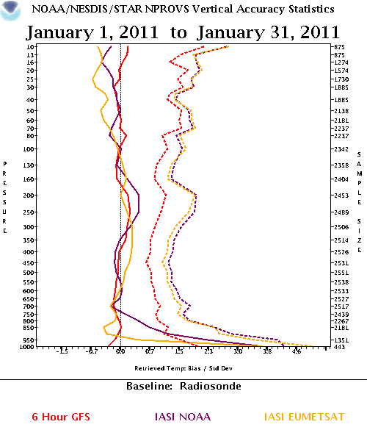
5. T & q profiles validation: T @ NOAA NPROVS
PPFv5
Credits: NOAA / NESDIS Center for
Satellite Applications and Research.

Slide 23
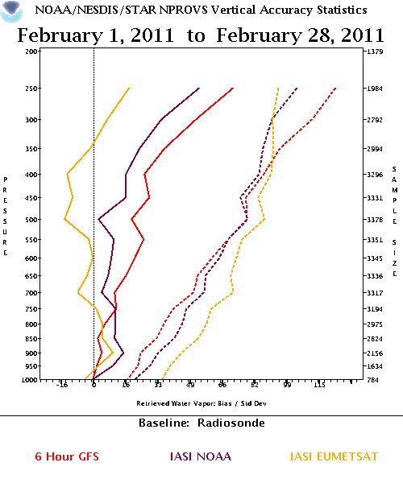
5. T & q profiles validation: W @ NOAA NPROVS
PPFv5
IASI EUM
IASI NOAA
Credits: NOAA / NESDIS Center for
Satellite Applications and Research.

Slide 24
Summary: PPFv5 status
Product | Algo | Retr. Errors | Status
Cloud detection | NWP, AVHRR | No | OP
CTP, CFR | CO₂-slicing | No | OP
T profiles | OEM | Yes (diag) | OP
W profiles | EOF | No | OP
SST / LST | EOF | No | OP
ems | EOF | No | Trial
O₃ | OEM | (Yes) | OP (TC)
CO | ANN | No | OP
N₂O, CH₄, CO₂ | ANN | No | Trial

Slide 25
Thank you for your attention !

