Slide 1

The Use of Current and Future Hyperspectral Trace Gas
Retrievals in Atmospheric Chemistry Research at NOAA
R. Bradley Pierce
NOAA/NESDIS/STAR
Collaborators:
Todd Schaack and Allen Lenzen (UW-Madison, SSEC)
Jay Al-Saadi and Murali Natarajan (NASA-LaRC)
Bill Smith (Hampton University)
Data Providers:
Steve Wofsy (Harvard), RuShan Gao, Ryan Spackman, David.W.Fahey (NOAA/ESRL), Chris Boone (University of Waterloo), Kevin Bowman, Nathaniel Livesey (NASA/JPL), Pawan Bartia (NASA/GSFC), Anne Thompson (PSU)

Slide 2
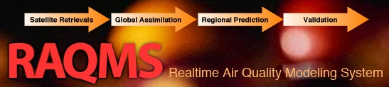

Question 13: What are the views of NOAA Research on the role of present, emerging, and future hyperspectral sensing from satellite for operational meteorology, atmospheric chemistry, and climate monitoring (in particular trace gases)?
Current: Assimilation of hyperspectral trace gas retrievals within global chemical data assimilation systems can be used to constrain background tropospheric ozone distributions and improve regional Air Quality (AQ) predictions.
- TES/OMI/MLS 2006 data denial studies during TEXAQS
Future: Assimilation of hyperspectral trace gas retrievals within global chemical data assimilation systems should be used to constrain radiatively active trace gas distributions and improve forward modeling for radiance assimilation.
- ACE/IASI 2010 GHG validation during HIPPO-3
Pierce, R. B., et al. (2007) Chemical data assimilation estimates of continental US ozone and nitrogen budgets during the Intercontinental Chemical Transport Experiment-North America. J. Geophys. Res. doi:10.1029/2006JD007722

Slide 3
Question 13: What are the views of NOAA Research on the role of present, emerging, and future hyperspectral sensing from satellite for operational meteorology, atmospheric chemistry, and climate monitoring (in particular trace gases)?
Current: Assimilation of hyperspectral trace gas retrievals within global chemical data assimilation systems can be used to constrain background tropospheric ozone distributions and improve regional Air Quality (AQ) predictions.
- TES/OMI/MLS 2006 data denial studies during TEXAQS
Future: Assimilation of hyperspectral trace gas retrievals within global chemical data assimilation systems should be used to constrain radiatively active trace gas distributions and improve forward modeling for radiance assimilation.
- ACE/IASI 2010 GHG validation during HIPPO-3
Pierce, R. B., et al. (2007) Chemical data assimilation estimates of continental US ozone and nitrogen budgets during the Intercontinental Chemical Transport Experiment-North America. J. Geophys. Res. doi:10.1029/2006JD007722

Slide 4
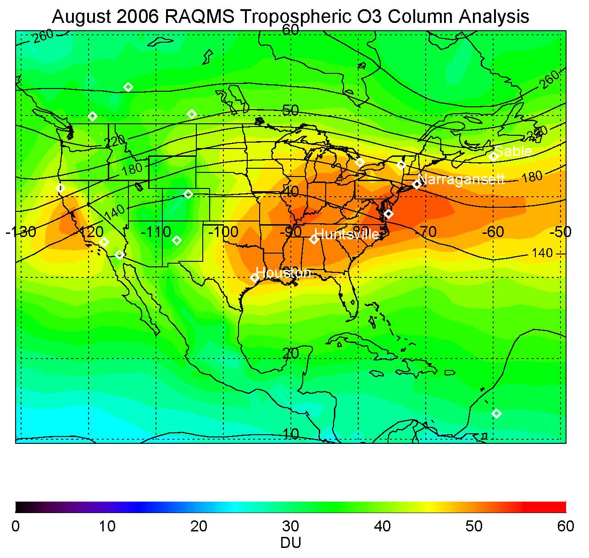
RAQMS 2006 Data Denial Study
Time period: August 2006
Initial Conditions: July 15th, 2006
(Baseline RAQMS OMI+TES ozone analysis)
Validation: 2006 IONS ozonesonde network (373 sondes)
Meteorological Analysis: GFS/GSI
Chemical Analysis:
Optimal Interpolation (IO) univariate (Pierce et al., 2007)
unified online troposphere/stratospheric chemistry for first guess
Procedure:
Compare RAQMS analyses with ozonesonde
No Assimilation
OMI (Cloud Cleared) only
TES (O3&CO) only
TES (O3&CO)+OMI (Cloud Cleared)
Notes:
4

Slide 5
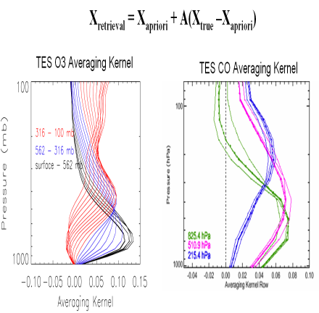
RAQMS (2x2) 2006 OMI/TES Reanalysis O3/CO Assimilation Procedure
NOAA GFS Global Met
RAQMS Global Met/Chem
Modeled O3/CO+ TES Obs Operator
Adjusted O3/CO
TES
Profile Assimilation Cycle
First Guess Profile
Local increment
Modeled O3+ OMI Obs Operator
Adjusted O3
OMI
Column Assimilation Cycle
First Guess Column
Column increment
Pierce, R. B., et al. (2007) Chemical data assimilation estimates of continental US ozone and nitrogen budgets during the Intercontinental Chemical Transport Experiment-North America. J. Geophys. Res. doi:10.1029/2006JD007722

Slide 6
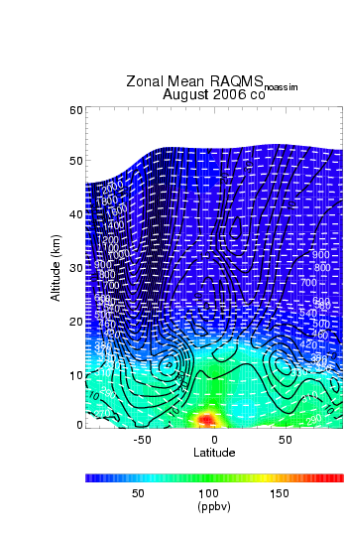
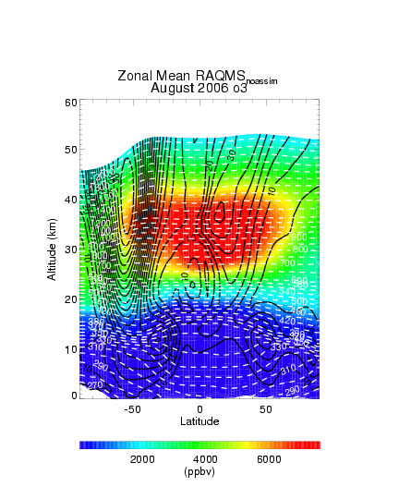
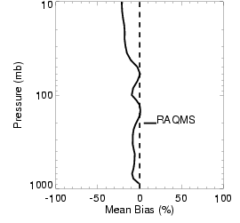
August 2006 NO ASSIM Zonal mean CO/O3
(July 15, 2006 OMI+TES IC)
RAQMS vs IONS
Notes:
6

Slide 7
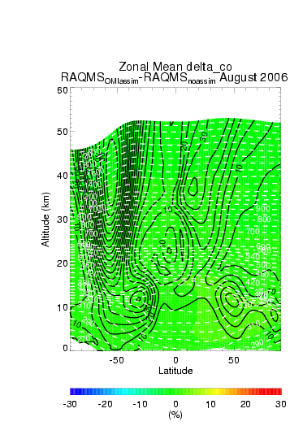
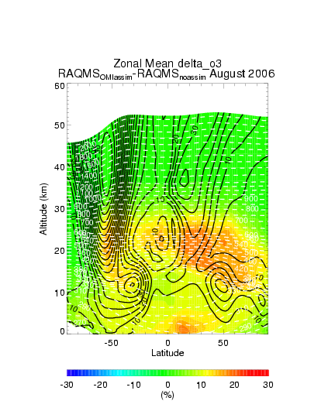
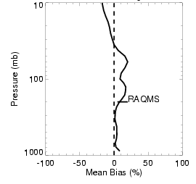
August 2006 OMI Assim-NO ASSIM Zonal mean Delta CO/O3
(July 15, 2006 OMI+TES IC)
Small (~2%) change in CO
RAQMS vs IONS
+15-20%
Notes:
7

Slide 8
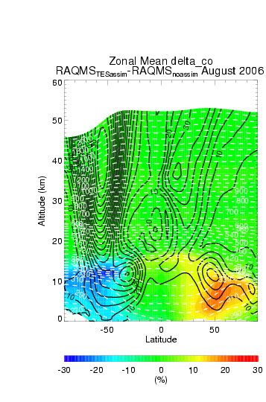
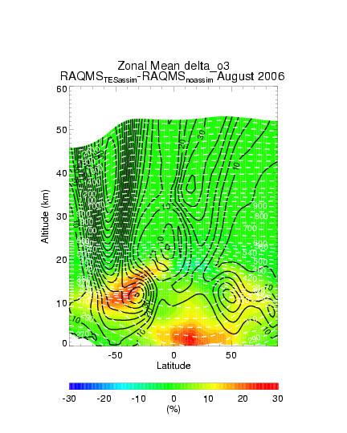
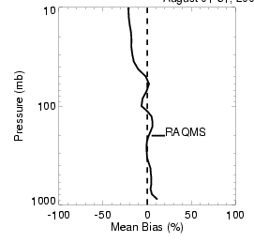
August 2006 TES Assim-NO ASSIM Zonal mean Delta CO/O3
(July 15, 2006 OMI+TES IC)
(+/-) 15-20% change in (NH/SH)
RAQMS vs IONS
+15-20%
Notes:
8

Slide 9
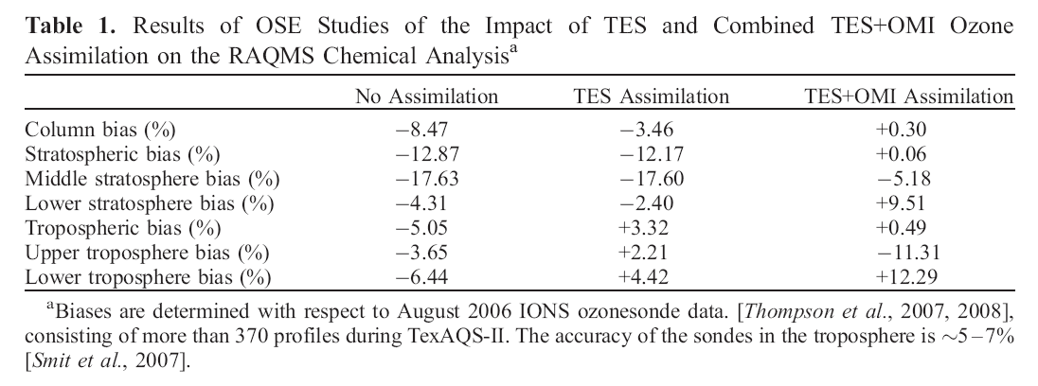
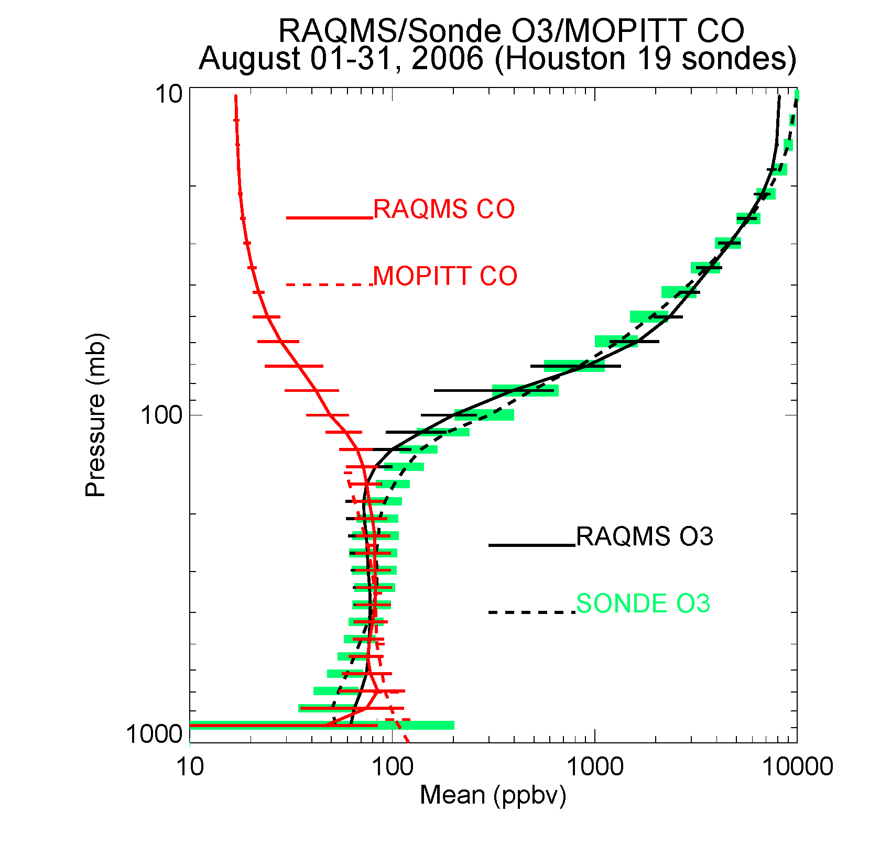
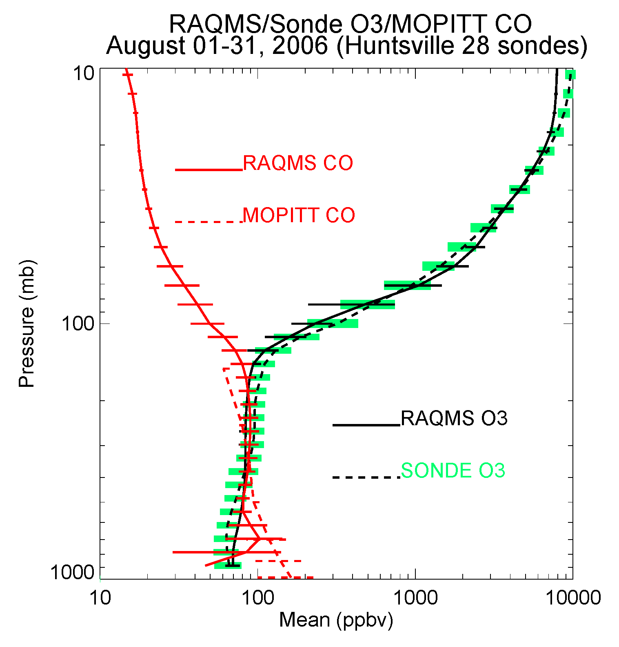
Pierce, R. B., et al., 2009 Impacts of background ozone production on Houston and Dallas, TX Air Quality during the TexAQS field mission, J. Geophys. Res., 114, D00F09, doi:10.1029/2008JD011337

Slide 10
Pierce, R. B., et al., 2009 Impacts of background ozone production on Houston and Dallas, TX Air Quality during the TexAQS field mission, J. Geophys. Res., 114, D00F09, doi:10.1029/2008JD011337

Slide 11
Pierce, R. B., et al., 2009 Impacts of background ozone production on Houston and Dallas, TX Air Quality during the TexAQS field mission, J. Geophys. Res., 114, D00F09, doi:10.1029/2008JD011337

Slide 12
Pierce, R. B., et al., 2009 Impacts of background ozone production on Houston and Dallas, TX Air Quality during the TexAQS field mission, J. Geophys. Res., 114, D00F09, doi:10.1029/2008JD011337

Slide 13
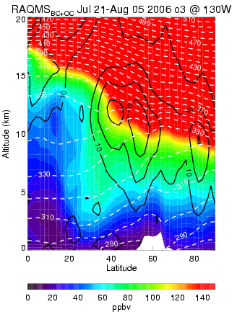
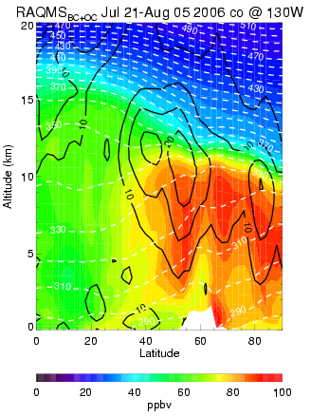
Impact of Global BC on regional AQ Prediction
Assessment using pre-operational NOAA/NWS NAM-CMAQ 12km forecast
(July 21-August 5, 2006)
RAQMS lateral Boundary Conditions lead to 10-15 ppbv reductions in off-shore surface ozone and 5-10 ppbv increases in surface ozone over mountain regions of the western US.
Analyzed Eastern Pacific O3
Analyzed Eastern Pacific CO
Mean O₃ Difference (ppbv)
(RAQMS-BC – Fixed-BC)
Comparison with EPA AIRNow surface ozone west of -115ºW shows improved slope and correlations but increased positive bias.
NAM-CMAQ vs AIRNOW
West of -115°W
S=0.804 R=0.691 MB=4.7 ppbv
S=0.914 R=0.703 MB=7.1 ppbv
Static BC
RAQMS BC
Mean O3 biases (ppbv)
Tang. Y., et al., (2008), The impact of chemical lateral boundary conditions on CMAQ predictions of tropospheric ozone over the continental United States, Environmental Fluid Mechanics, DOI: 0.1007/s10652-008-9092-5
Notes:
13
13

Slide 14
Question 13: What are the views of NOAA Research on the role of present, emerging, and future hyperspectral sensing from satellite for operational meteorology, atmospheric chemistry, and climate monitoring (in particular trace gases)?
Current: Assimilation of hyperspectral trace gas retrievals within global chemical data assimilation systems can be used to constrain background tropospheric ozone distributions and improve regional Air Quality (AQ) predictions.
- TES/OMI/MLS 2006 data denial studies during TEXAQS
Future: Assimilation of hyperspectral trace gas retrievals within global chemical data assimilation systems should be used to constrain radiatively active trace gas distributions and improve forward modeling for radiance assimilation.
- ACE/IASI 2010 GHG validation during HIPPO-3
Pierce, R. B., et al. (2007) Chemical data assimilation estimates of continental US ozone and nitrogen budgets during the Intercontinental Chemical Transport Experiment-North America. J. Geophys. Res. doi:10.1029/2006JD007722

Slide 15
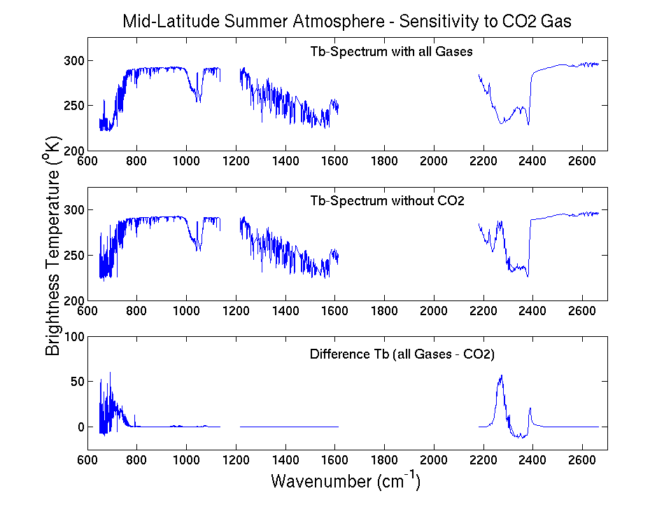
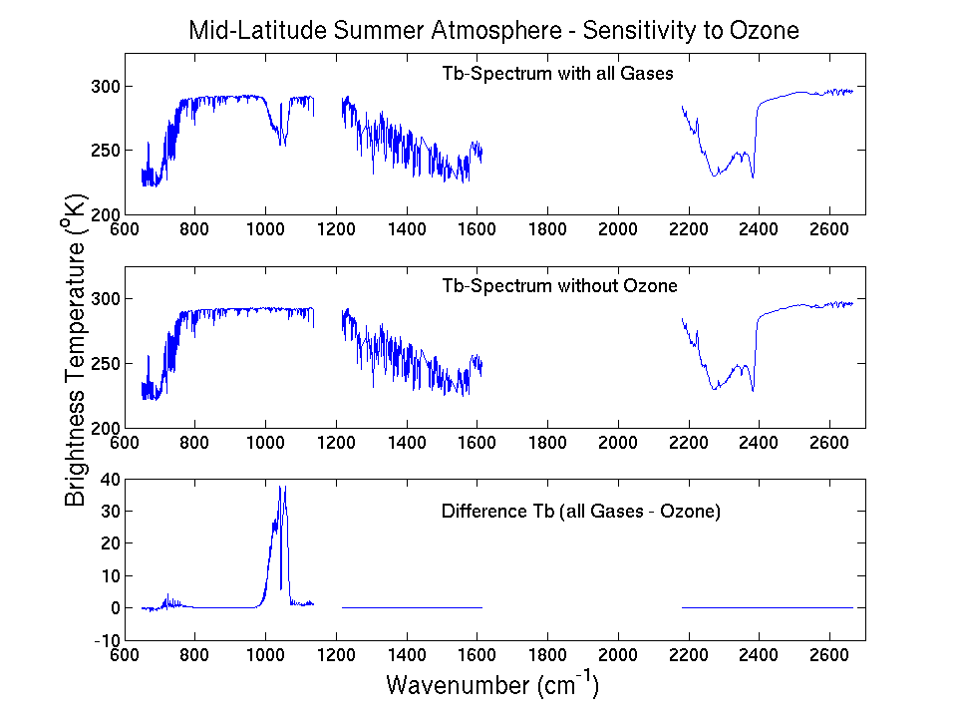
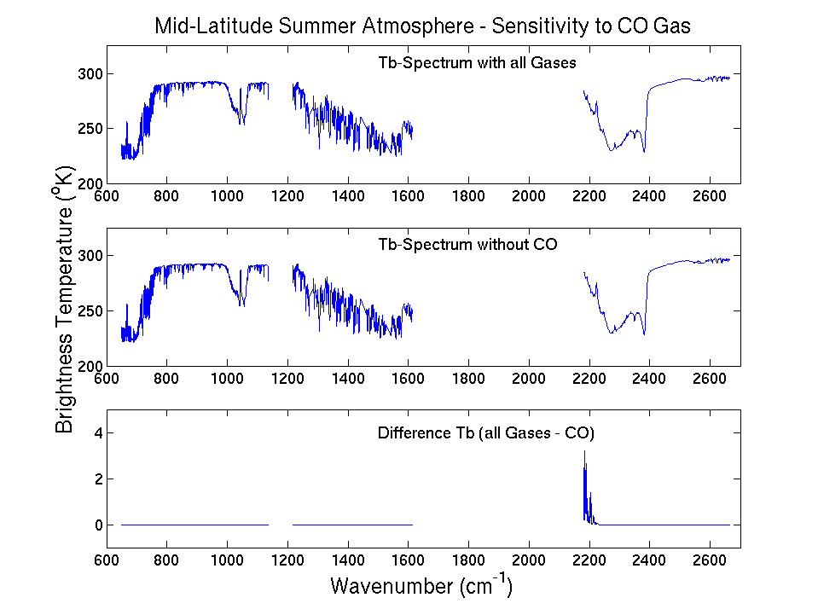
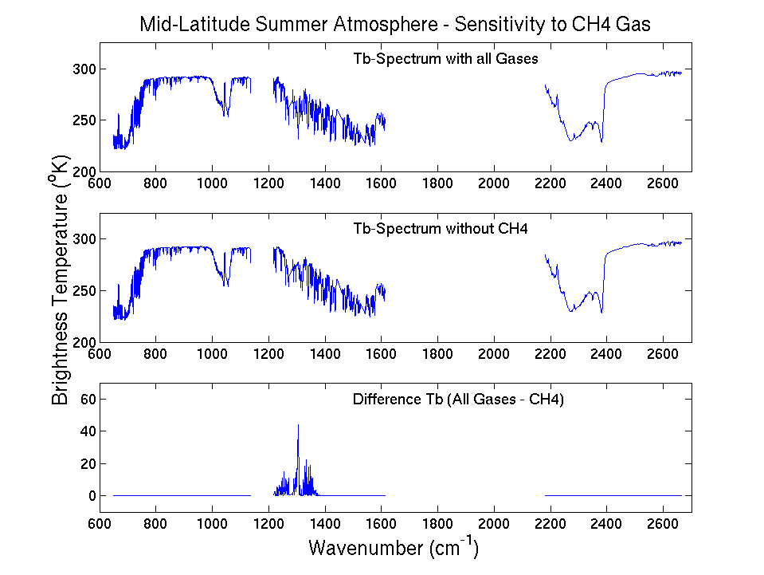
Radiative influences of Trace Gases
Radiative influences of Ozone, CO, CH4, CO2, N2O and other GHG are significant
Temporal/spatial variability should be accounted for in forward radiative transfer modeling
Figure provided by Tim Schmit, NESDIS/STAR

Slide 16
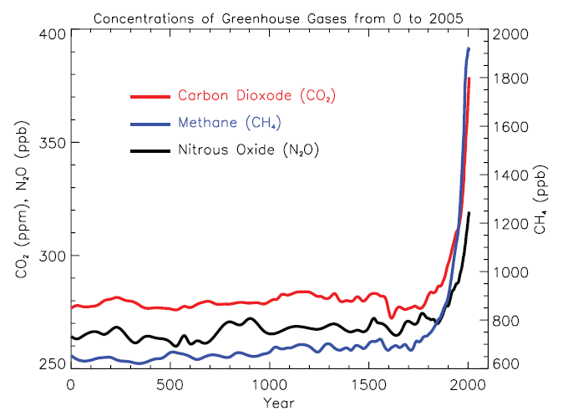
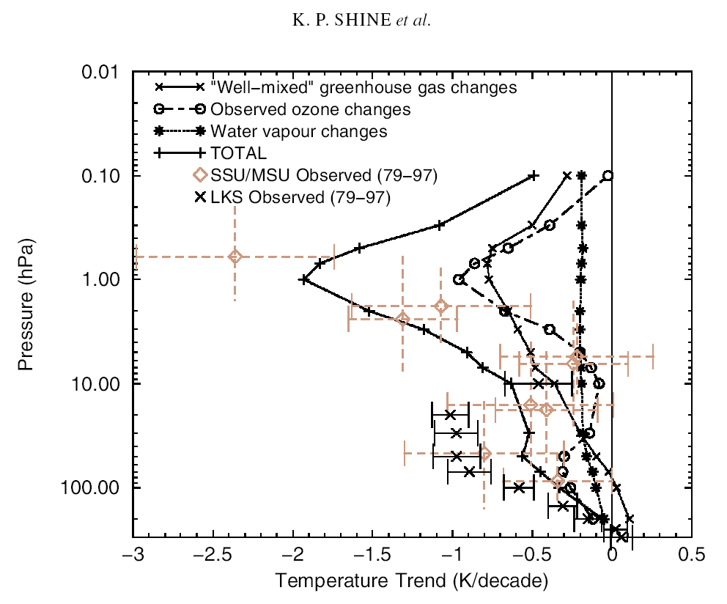
Radiative influences of Trace Gas Trends
From Forster, P., et al. 2007: Changes in Atmospheric Constituents and in Radiative Forcing. In: Climate Change 2007: The Physical Science Basis. Contribution of Working Group I to the Fourth Assessment Report of the Intergovernmental Panel on Climate Change
Trends in stratospheric Ozone and GHG concentrations largely account for observed stratospheric temperature trends
From Shine, K., et al., (2003), A comparison of model-simulated trends in stratospheric temperatures, Q. J. R. Meteorol. Soc. (2003), 129, pp. 1565–1588 doi: 10.1256/qj.02.186

Slide 17
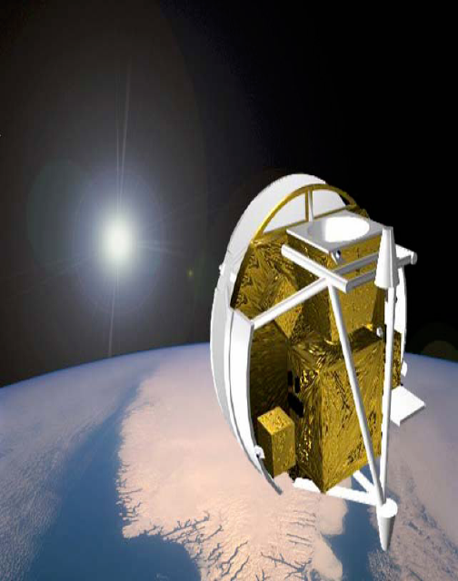
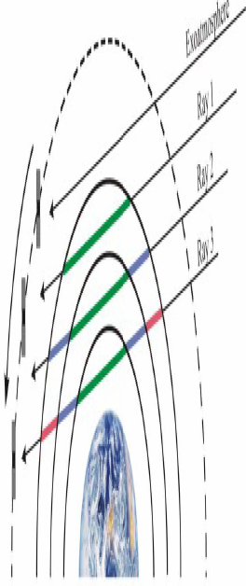
Atmospheric Chemistry Experiment (ACE)
PI Peter Bernath, University of Waterloo, Ontario Canada
Solar Occultation
Infrared Fourier Transform
Spectrometer
Using Version 2.2 data
FTS Species
MINOR GASES CO2, CO, H2O, O3, N2O, CH4
TRACE GASES
Nitrogen species NH3, NO, NO2, N2O5, HNO2, HNO3,HO2NO2, HCN
Hydrogen Species H2CO, H2CO2, HDO, H2
Halogens CCl3F (F11), CCl2F2 (F12), CH3CCl3,
CHClF2 (F22), CH3Cl, CCl4, SF6, HF,
HCl, CF2O, ClONO2, HOCl
Sulfur oxides OCS, SO2
Other species C2H2, C2H4, C2H6, CH3D
As well as aerosols and PSC IR spectra
ACE sampling pattern
Notes:
17

Slide 18
RAQMS (2x2) 2010 OMI/MLS Real-time O3 Assimilation Procedure
NOAA GFS Global Met
RAQMS Global Met/Chem
Modeled O3
Adjusted O3
MLS
Profile Assimilation Cycle
First Guess Profile
Local increment
Modeled O3+ OMI Obs Operator
Adjusted O3
OMI
Column Assimilation Cycle
First Guess Column
Column increment

Slide 19
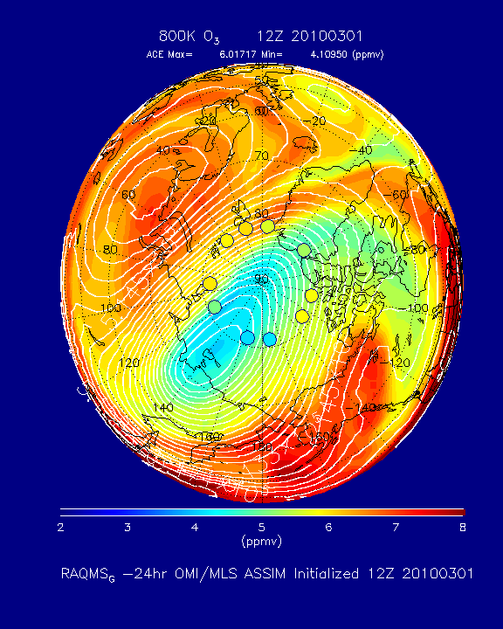
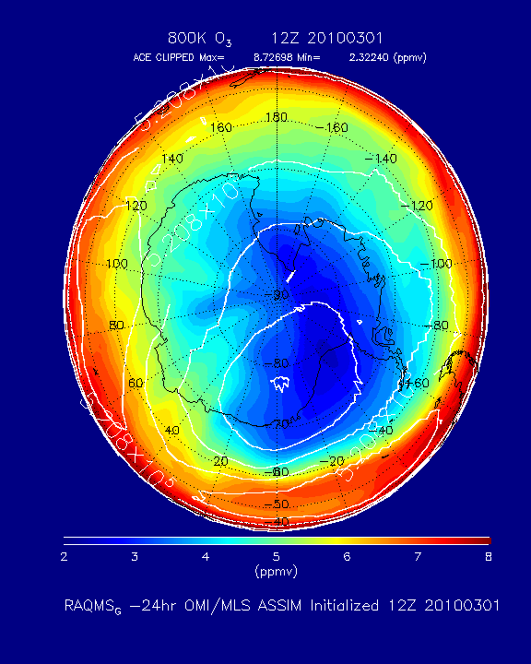
ACE/RAQMS 800K O3 March 01-April 04, 2010
Northern Hemisphere
Southern Hemisphere
Notes:
Currently not doing QC, will update with error<10% at 800K

Slide 20
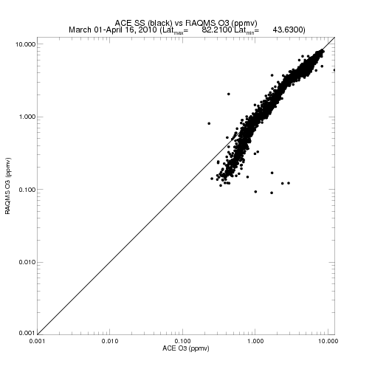
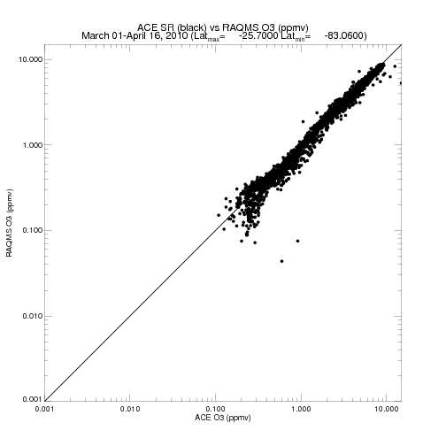
ACE vs RAQMS O3 March 01-April 04, 2010
Northern Hemisphere
Southern Hemisphere
ACE QC: error<10%
RAQMS shows
Low bias in NH
lower stratosphere
relative to ACE

Slide 21
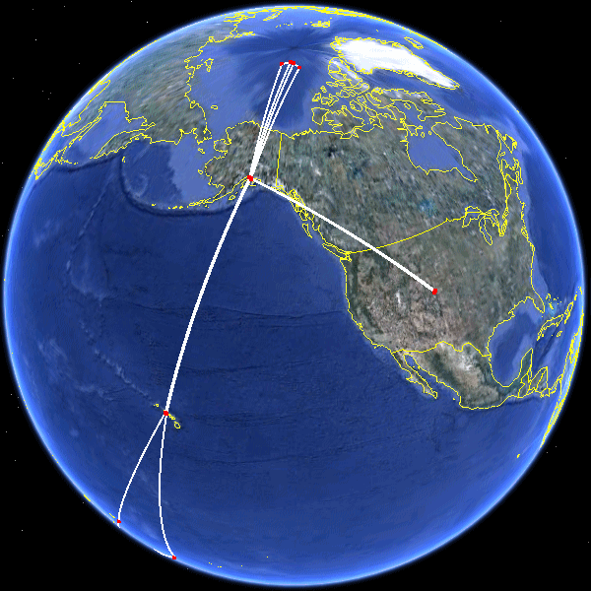
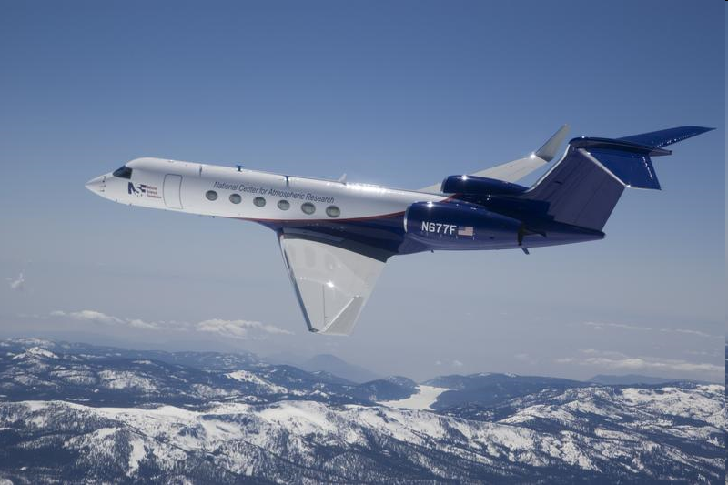
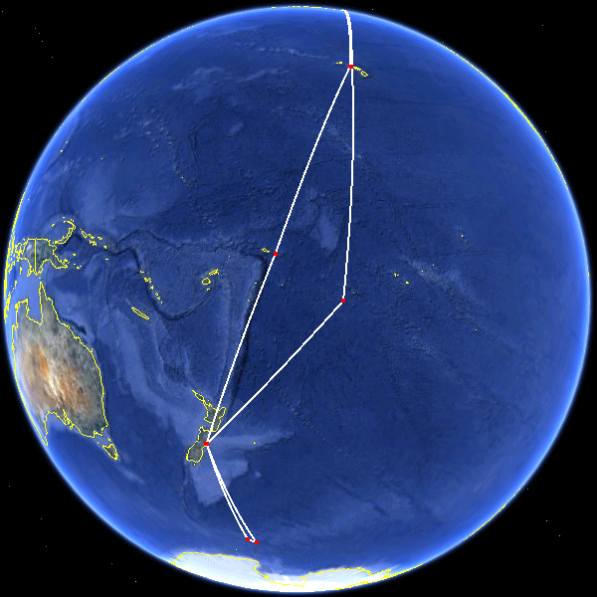
High-performance Instrumented Airborne Platform for Environmental Research (HIAPER), Pole-to-Pole Observation (HIPPO) III
PI: Steven C. Wofsy, Harvard University
NCAR G-V aircraft
March 20-April 20, 2010
National Science Foundation (NSF)-sponsored effort to study the distribution of greenhouse gases and black carbon in the atmosphere.
High-accuracy measurements of greenhouse gases and black carbon particles from the top of the troposphere to the earth's surface and pole-to-pole.
http://www.eol.ucar.edu/deployment/field-deployments/field-projects/hippo_global_3

Slide 22
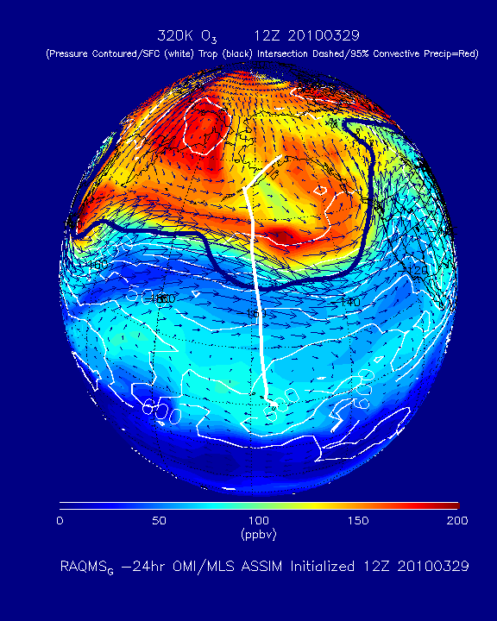
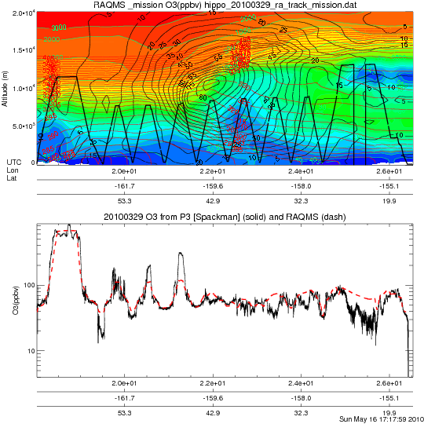
Anchorage to Hilo 03/29/2010
RAQMS 320K O3 with HIPPO 3 Flight Track
RAQMS O3 curtain with HIPPO 3 insitu O3 (Spackman, NOAA/ESRL)

Slide 23
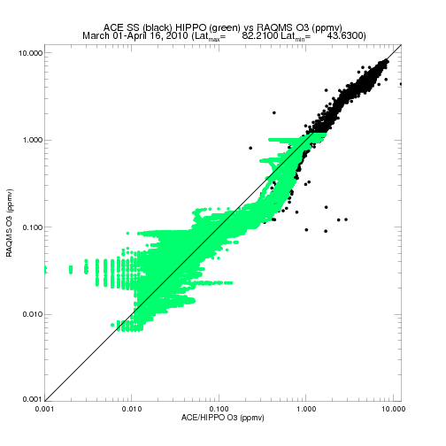
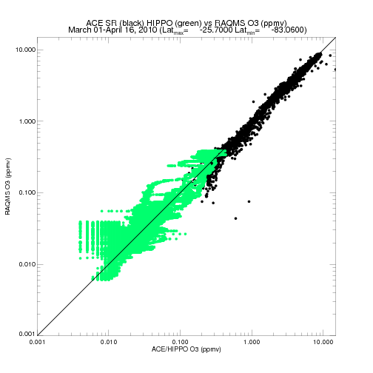
ACE/HIPPO
vs
RAQMS O3 March 01-April 16, 2010
Northern Hemisphere
Southern Hemisphere
RAQMS shows
high bias in tropical and
subtropical upper
troposphere relative
to HIPPO
RAQMS shows
high bias in tropical and
subtropical upper
troposphere relative
to HIPPO
RAQMS shows
Low bias in NH
lower stratosphere
relative to ACE &
HIPPO

Slide 24
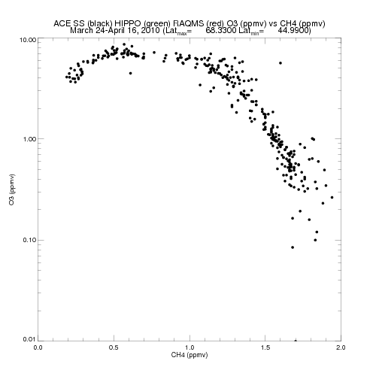
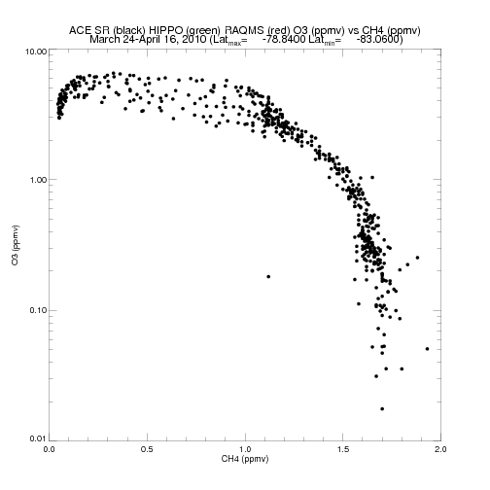
ACE O3 vs CH4
Pacific Sector (120E-120W)
March 24-April 16, 2010
Northern Hemisphere
Southern Hemisphere
QC: error<10%

Slide 25
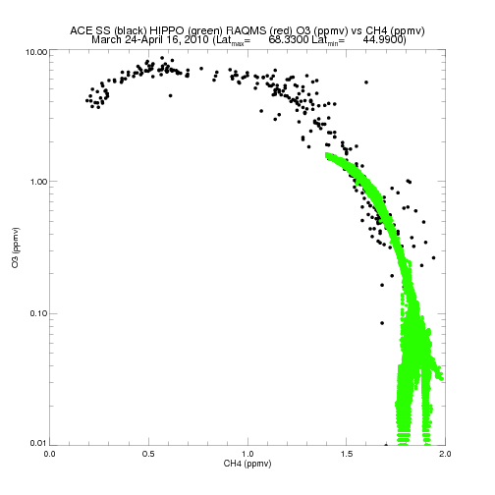
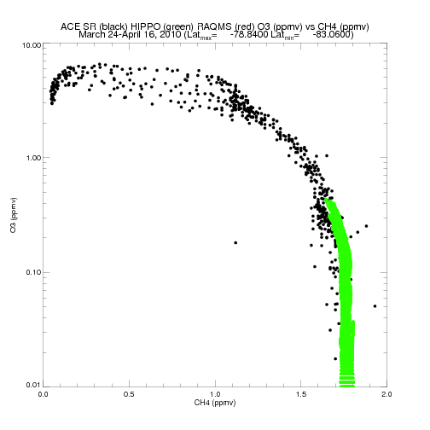
ACE & HIPPO O3 vs CH4
Pacific Sector (120E-120W)
March 24-April 16, 2010
Northern Hemisphere
Southern Hemisphere
Remarkable
Agreement with
HIPPO insitu
measurements!
QC: error<10%

Slide 26
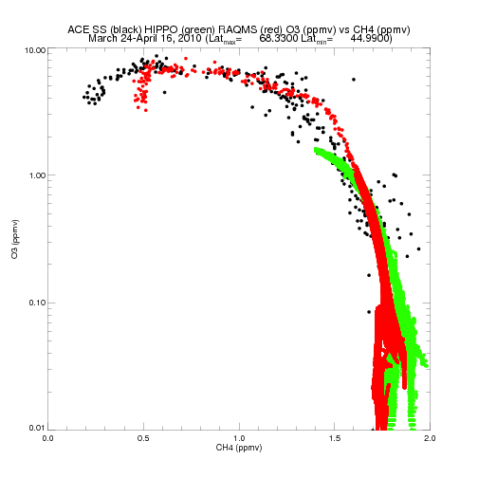
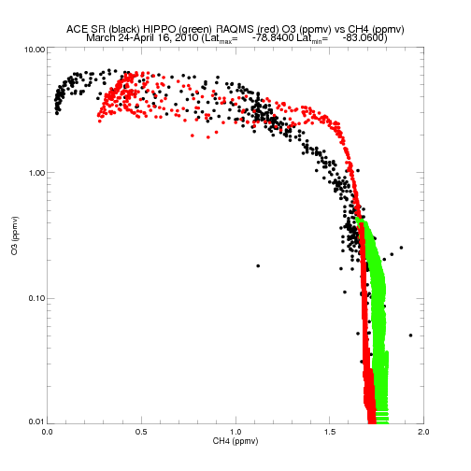
ACE & HIPPO & RAQMS O3 vs CH4
Pacific Sector (120E-120W)
March 24-April 16, 2010
Northern Hemisphere
Southern Hemisphere
Missing CH4/CO/CO2 photochemistry
Missing CH4/CO/CO2 photochemistry
Brewer Dobson Circulation
Brewer Dobson Circulation
Surface boundary condition
Surface boundary condition

Slide 27
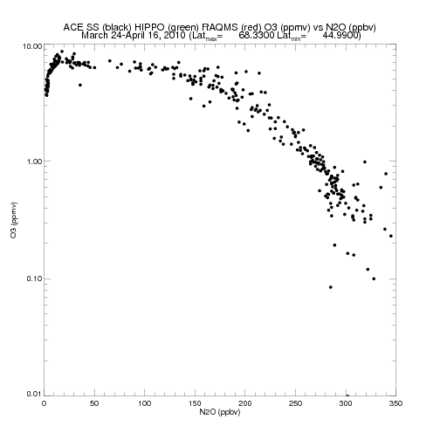
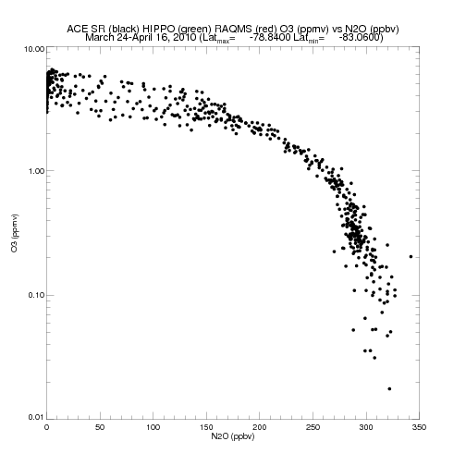
ACE O3 vs N2O
Pacific Sector (120E-120W)
March 24-April 16, 2010
Northern Hemisphere
Southern Hemisphere
QC: error<10%

Slide 28
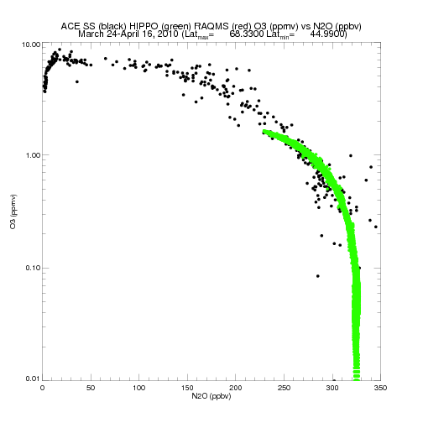
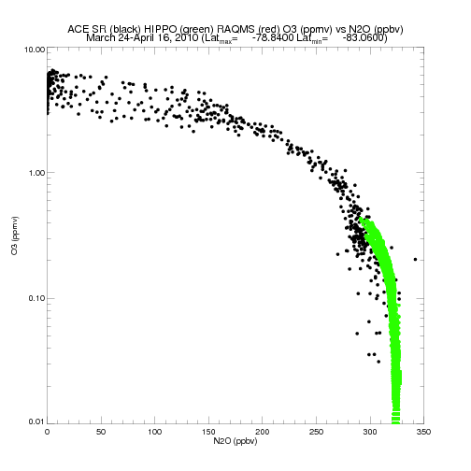
ACE & HIPPO O3 vs N2O
Pacific Sector (120E-120W)
March 24-April 16, 2010
Northern Hemisphere
Southern Hemisphere
Remarkable
Agreement with
HIPPO insitu
measurements!
QC: error<10%

Slide 29
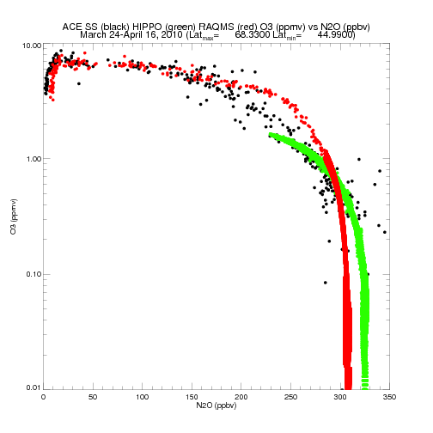
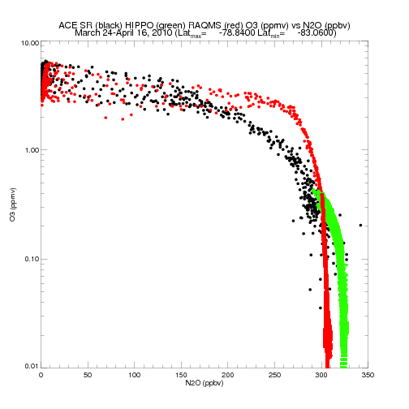
ACE & HIPPO & RAQMS O3 vs N2O
Pacific Sector (120E-120W)
March 24-April 16, 2010
Northern Hemisphere
Southern Hemisphere
Brewer Dobson Circulation
Brewer Dobson Circulation
Surface boundary condition
Surface boundary condition

Slide 30
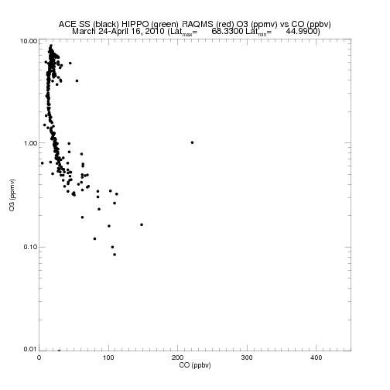
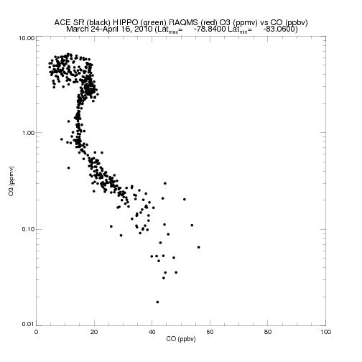
ACE O3 vs CO
Pacific Sector (120E-120W)
March 24-April 16, 2010
Northern Hemisphere
Southern Hemisphere
QC: error<10%

Slide 31


ACE & HIPPO O3 vs CO
Pacific Sector (120E-120W)
March 24-April 16, 2010
Northern Hemisphere
Southern Hemisphere
Remarkable
Agreement with
HIPPO insitu
measurements!
QC: error<10%

Slide 32


ACE & HIPPO & RAQMS O3 vs CO
Pacific Sector (120E-120W)
March 24-April 16, 2010
Northern Hemisphere
Southern Hemisphere
Brewer Dobson Circulation
Brewer Dobson Circulation
Overestimate in UT/LS
Good agreement in free troposphere

Slide 33


ACE & HIPPO & RAQMS & IASI O3 vs CO
Pacific Sector (120E-120W)
March 24-April 16, 2010
Northern Hemisphere
Southern Hemisphere
Retrieved O3 r= 0.962165
Median Bias= -0.00191106 ppmv
Retrieved CO
r= 0.0679334
Median Bias= -19.5601 ppbv
RAQMS CO
r= 0.0444996
Median Bias= -23.2552 ppbv
RAQMS at coincident ACE and IASI points along HIPPO flight Track

Slide 34

Anchorage to Hilo 03/29/2010
HIPPO 3 insitu vs RAQMS O3/CO
RAQMS O3 curtain with HIPPO 3 insitu O3 (Spackman, NOAA/ESRL)
RAQMS CO curtain with HIPPO 3 insitu CO (Wofsy, Harvard)

Slide 35


Anchorage to Hilo 03/29/2010
HIPPO 3 insitu vs IASI O3/CO
IASI (Smith, HU) O3 curtain with HIPPO 3 insitu O3 (Spackman, NOAA/ESRL)
IASI (Smith, HU) CO curtain with HIPPO 3 insitu CO (Wofsy, Harvard)

Slide 36
Summary:
Current: Assimilation of hyperspectral trace gas retrievals within global chemical data assimilation systems can be used to constrain background tropospheric ozone distributions and improve regional Air Quality (AQ) predictions.
Future: Assimilation of hyperspectral trace gas retrievals within global chemical data assimilation systems should be used to constrain radiatively active trace gas distributions and improve forward modeling for radiance assimilation.
But Operational models need to predict both tropospheric and stratospheric chemistry (e.g. GMES/MACC)!
And we need to downlink full resolution JPSS CrIS spectra for GHG retrieval!
Proposed next generation Hyperspectral Sounder (IASI NG, 2 x radiometric and 2 x spectral Resolution, 2018+) and Solar Limb Occultation (Solar Occultation for Atmospheric Research, SOAR, 3x vertical resolution, 2016+) would provide improved trace gas retrievals for Weather, Air Quality and Climate applications.

Slide 37


ACE & HIPPO & RAQMS & IASI O3 vs CH4
Pacific Sector (120E-120W)
March 24-April 16, 2010
Northern Hemisphere
Southern Hemisphere
RAQMS at coincident ACE and IASI points along HIPPO flight Track

Slide 38


ACE & HIPPO & RAQMS & IASI O3 vs N2O
Pacific Sector (120E-120W)
March 24-April 16, 2010
Northern Hemisphere
Southern Hemisphere
RAQMS at coincident ACE and IASI points along HIPPO flight Track
RAQMS at coincident ACE and IASI points along HIPPO flight Track

Slide 39
03/27 Final Stats with respect to HIPPO insitu measurements
Retrieved O3 r= 0.962165, Median Bias= -0.00191106
RAQMS O3 r= 0.971285, Median Bias= -0.00144393
Retrieved CO r= 0.0679334, Median Bias= -19.5601
RAQMS CO r= 0.0444996, Median Bias= -23.2552
Retrieved CH4 r= 0.136063, Median Bias= 0.0558940
RAQMS CH4 r= 0.108257, Median Bias= 0.0565929
Retrieved N2O r= 0.164484, Median Bias= 16.6093
RAQMS N2O r= 0.166612, Median Bias= 16.3700

