Slide 1
Next Generation Grating Spectrometer Sounders for LEO and GEO
Thomas S. Pagano
California Institute of Technology JPL
tpagano@jpl.nasa.gov
March 31, 2010
© 2011 California Institute of Technology. Government sponsorship acknowledged.

Slide 2
NASA Science Community Workshop on Polar Orbiting IR and MW Sounders
Top Recommendations
November 1,2, 2010, 140 People Registered
Top 3 Recommendations Common to Weather, Climate and Composition Breakout Groups:
  Recommendation I: The formation of a US based Sounding Science Team is required to identify the current and future needs of the weather, climate and atmospheric composition communities using data from the IR and MW sounders
  Recommendation II: The JPSS enable the full spectral resolution possible with the FM-1 CrIS on NPP as soon as possible.
  Recommendation III: NASA should begin development of an advanced IR sounder with high spatial resolution and improved spectral resolution to be ready to follow the current planned sounders expected to retire in the 2020 timeframe.
Draft Workshop Report Available by 4/15/11 at:
http://nasa-sounder-workshop.jpl.nasa.gov

Slide 3
Improved Spatial Resolution from LEO Needed to Initialize & Validate GCM’s
 | Global Models
1974 | 450 | Global GIIS 4dx5d
1976 | 250 | GISS
1980 | 300 | Spectral NML
1998 | 100 | GEOS-3
1999 | 50 | GEOS-4
2009 | 35 | NCEP
2004 | 25 | GEOS-4,5
2009 | 3.5 | GEOS-5 Limited Run
Observations of Temperature, Water Vapor, Clouds, etc. are used to initialize and validate forecast models

Slide 4
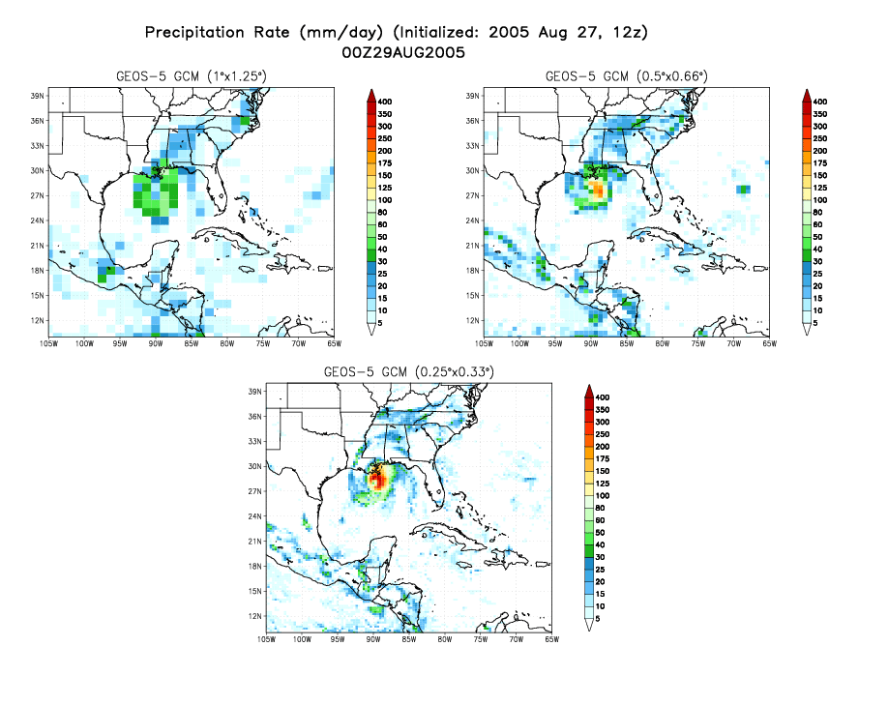
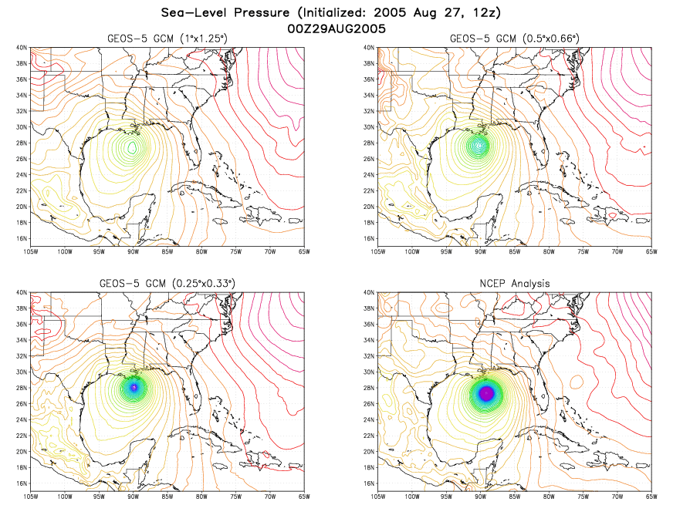
Forecast Accuracy Improves with
GCM Spatial Resolution
Increasing resolution improves realism of forecasts of the details in nature
2-day Katrina forecasts
Columbia allows high resolution and rapid time-to-solution
GMAO: M. Rienecker
Notes:
These figures show a comparison of the 2-day forecasts of Katrina. The GEOS-5 model was one of the earliest models to lock on to New Orleans landfall. Other models quickly followed. GEOS-5 was consistent with its landfall prediction.
The initial conditions for these forecasts were provided by NOAA/NCEP. AIRS data are included.
We are now in the process of improving the use of the AIRS data and evaluating their impact on forecasts.
One, 1/2 and 1/4 degree forecasts are shown. MAP05 forecasts were done at 1/4 degree and it is clear why. The 1/4 degree forecasts start to show much more realistic structures, showing clear rain bands associated with the hurricane.
The higher resolution also supports a much more intense pressure center.

Slide 5
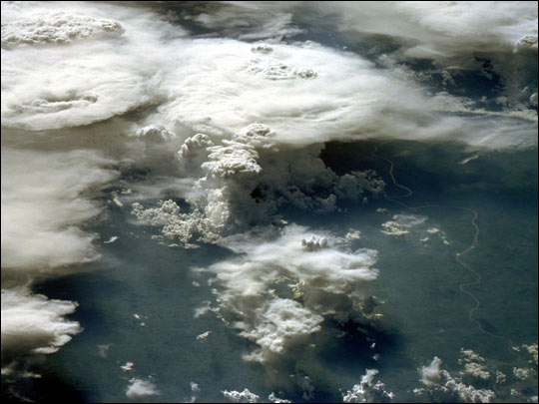
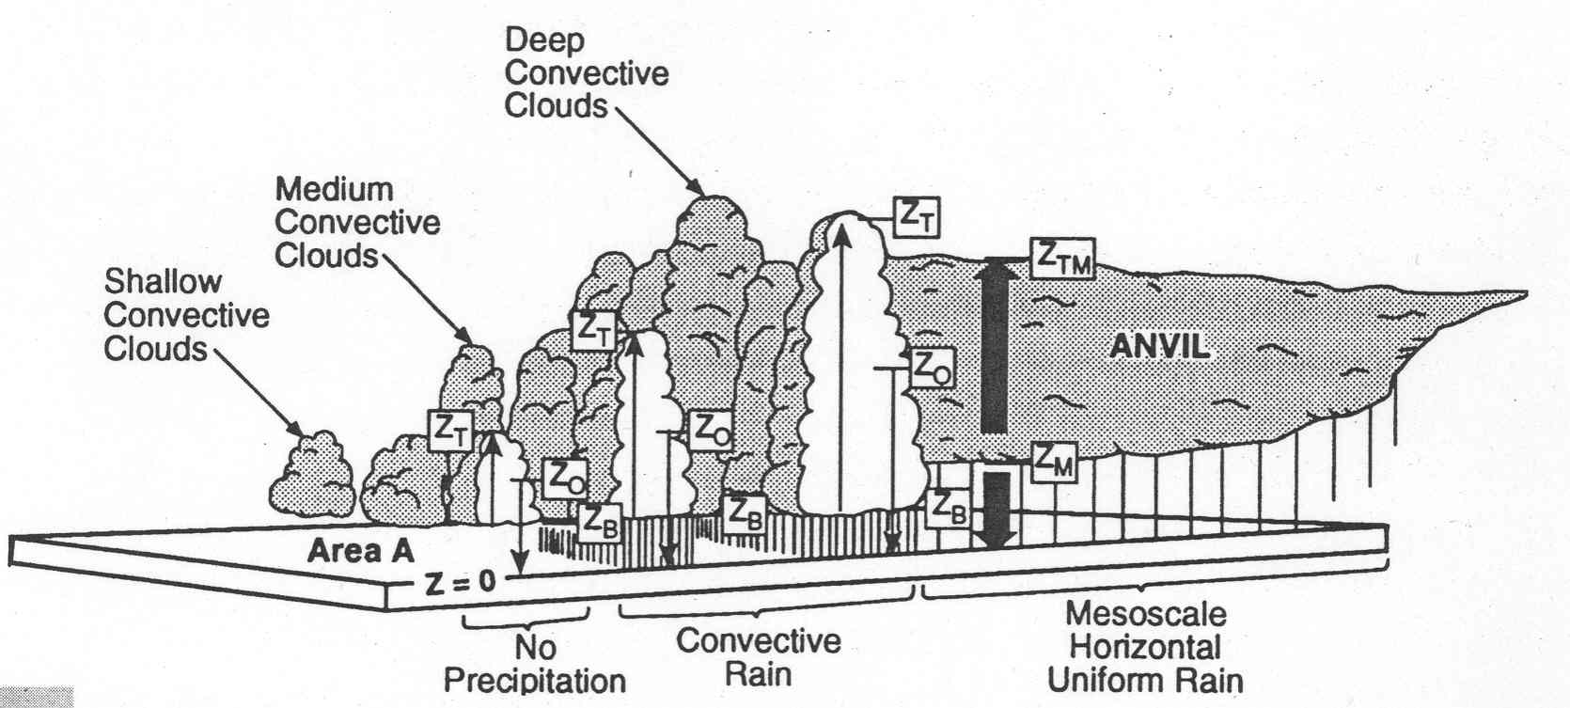
Higher Spatial Resolution Improves Ability to Sound in Presence of Clouds
More Clear Observations
Better Cloud Height Discrimination
Better Characterization of Cloud Scale Dependent Variability
Improved Boundary Layer Sensitivity
Adapted from Gettelman, 2006

Slide 6
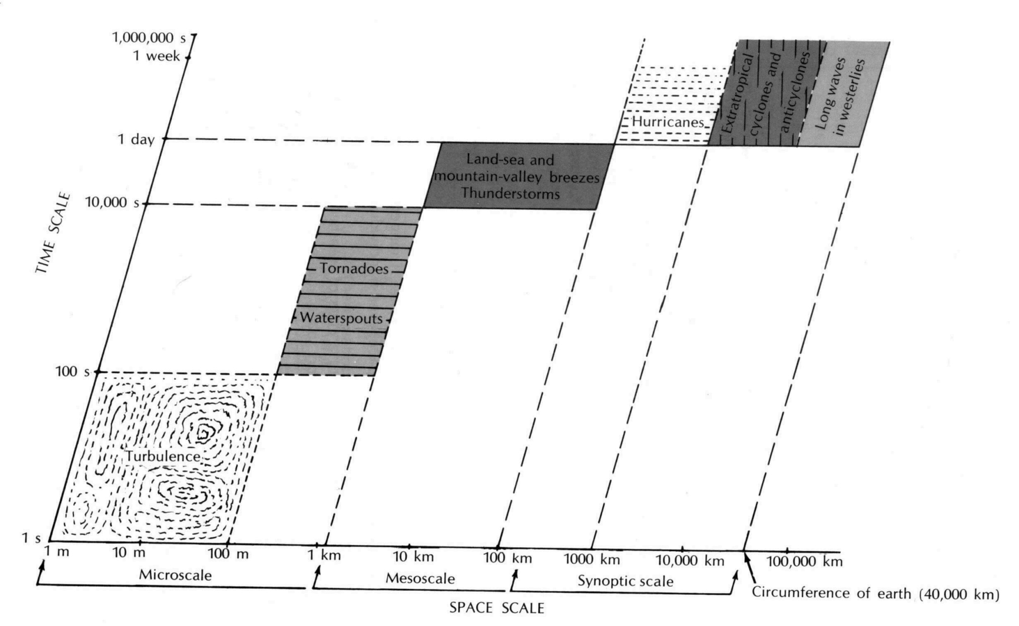
Improvements Needed in Resolution to Validate Cloud Microphysics Models
Regardless of Scale: Still need parameterizations for most things
Goal: get interactions right (Mesoscale). Also extreme events
1km AIRS
AIRS
Resolved Scales
HES
Global Models
Future Global Models
Cloud/Mesoscale/Turbulence Models
Adapted from Gettelman, 2006, Antes 1975

Slide 7

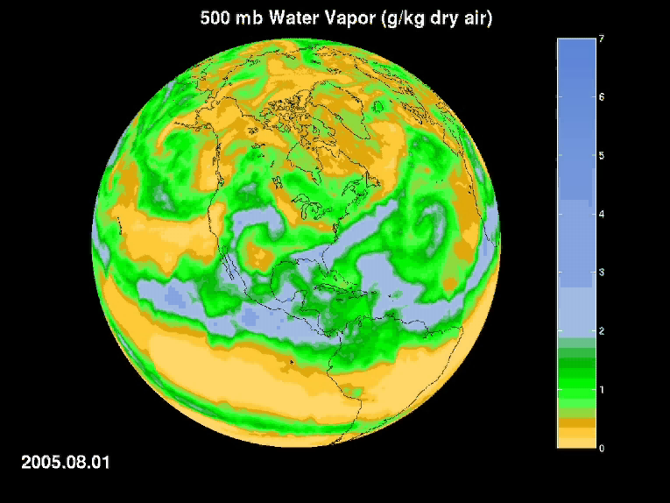
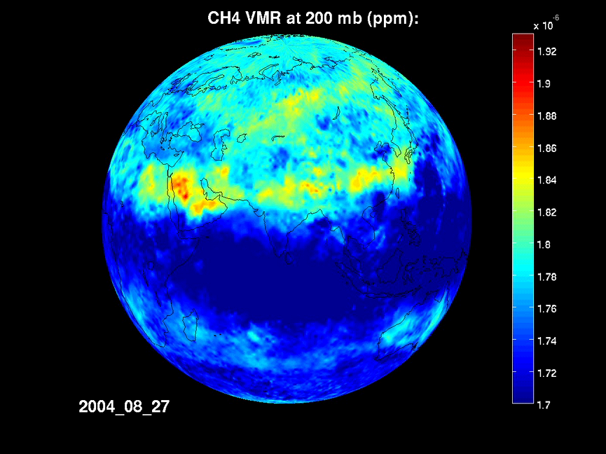
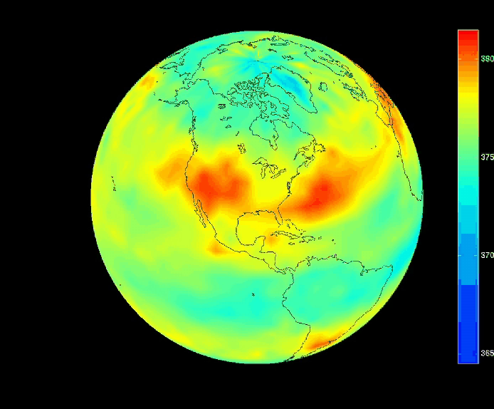
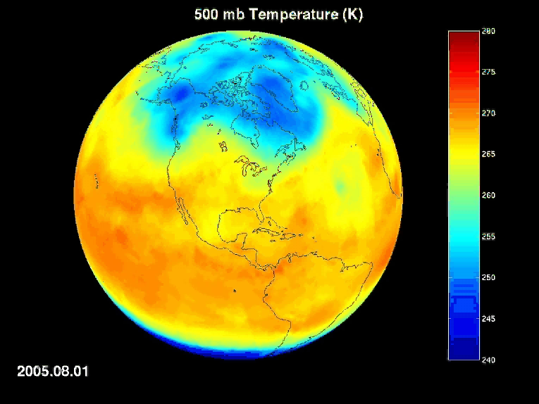
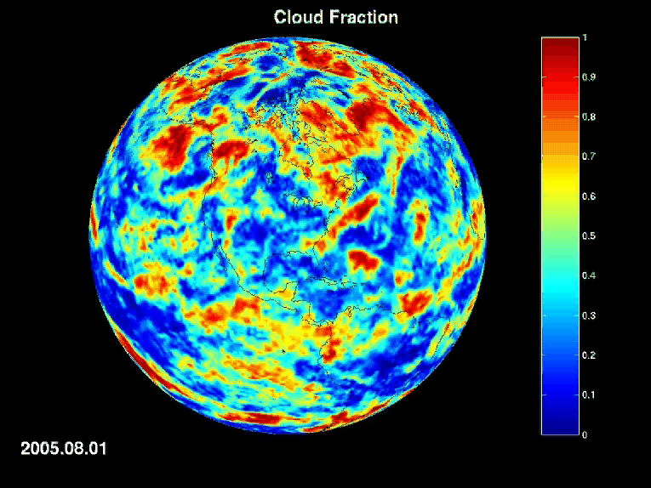
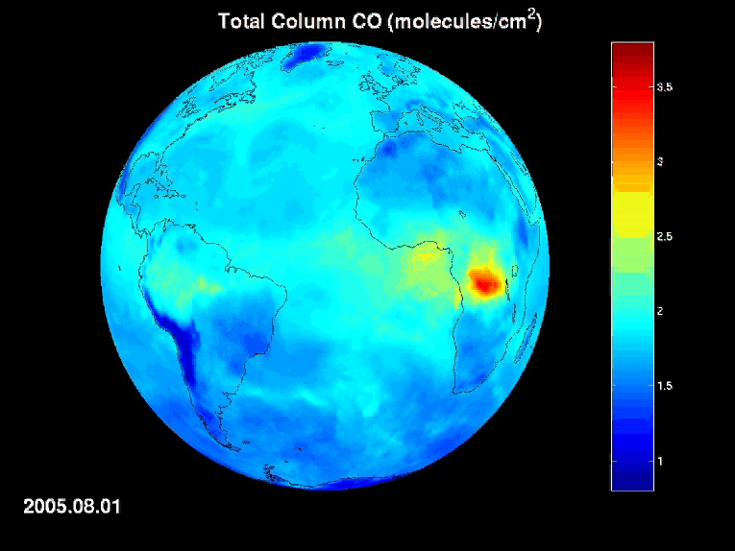
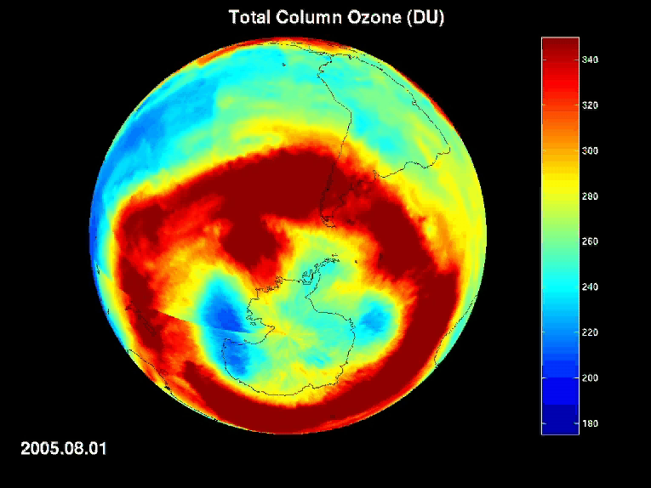
National Aeronautics and
Space Administration
Jet Propulsion Laboratory
California Institute of Technology
Pasadena, California
AIRS Greenhouse Gases
H₂O
CH₄
CO₂
Mid-Tropospheric CO₂ (ppm)
Other AIRS Atmospheric Climate Products
Pagano, JPL, 2009
Temperature
Clouds
CO
O₃

Slide 8
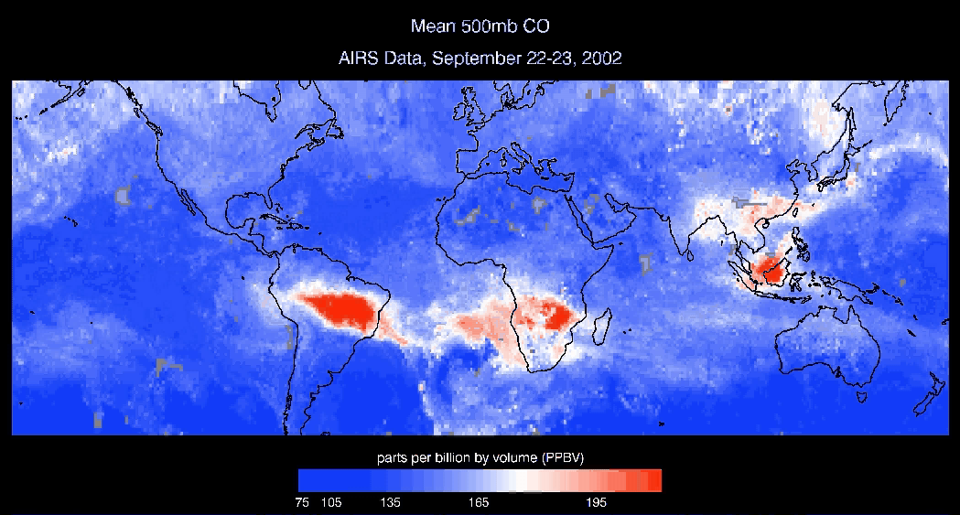
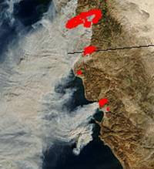
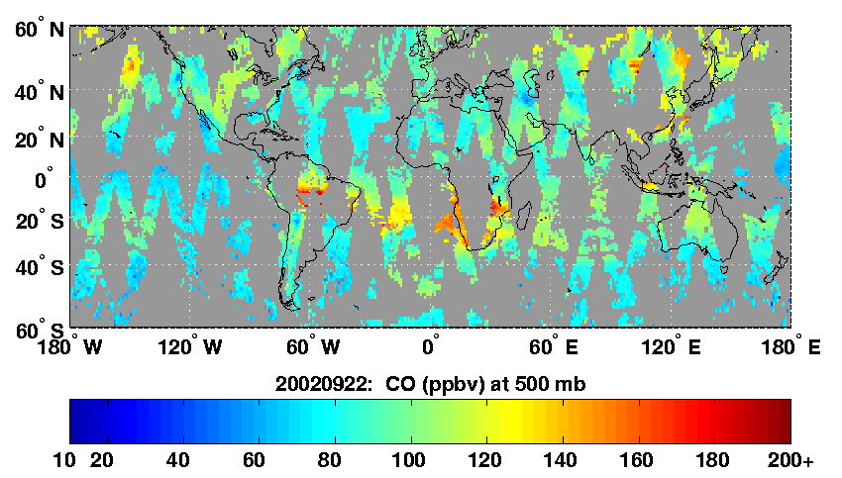
Higher Spatial Resolution Needed to Track Sources and Sinks of Trace Gases
Current: AIRS CO, Grating,
15 km IFOV
Daily Global Coverage
Higher Spatial Resolution + Global Coverage
CO, CO_{2,} CH₄
MOPITT CO
Gas Cell
22 km IFOV
Monthly Global
MODIS 1km
Daily Regional Coverage

Slide 9
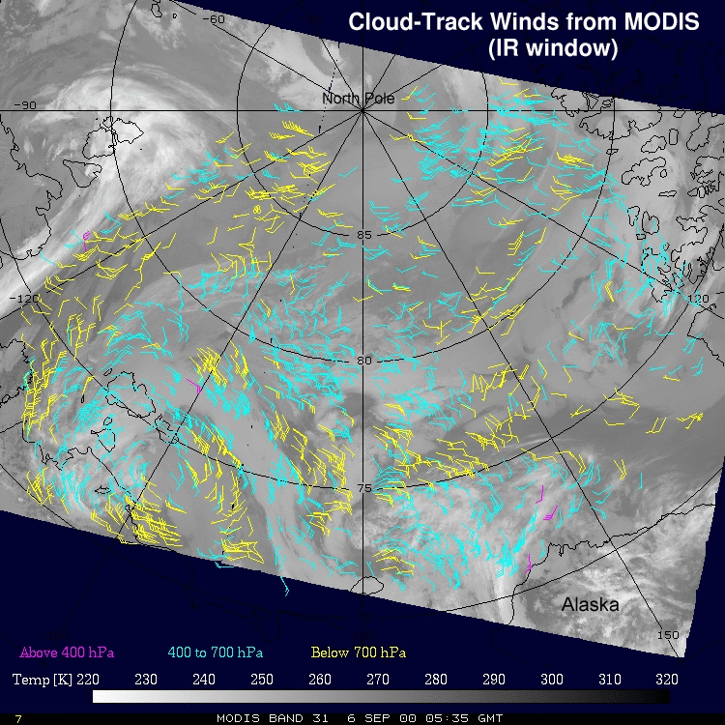
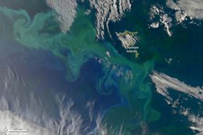
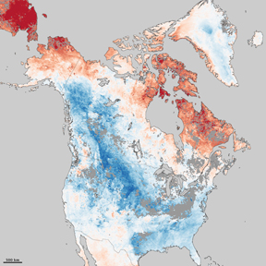
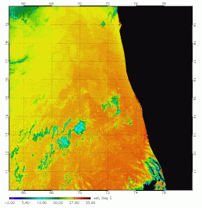
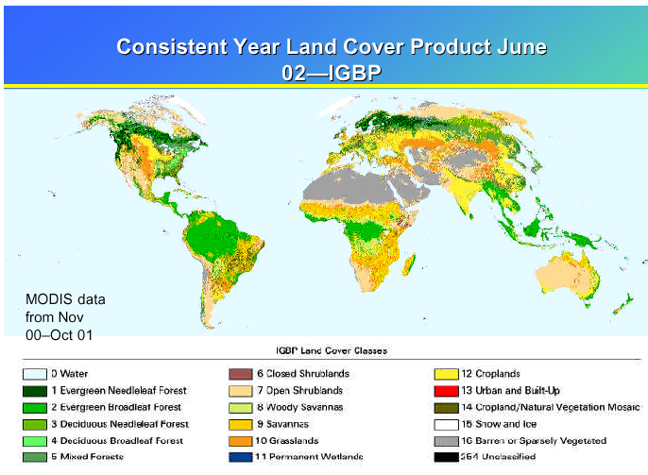
Imager Products Highly Synergistic with Sounder for Weather, Climate, GHG Flux
Aerosol
Polar Winds
Ocean Color
LST
SST
NDVI

Slide 10
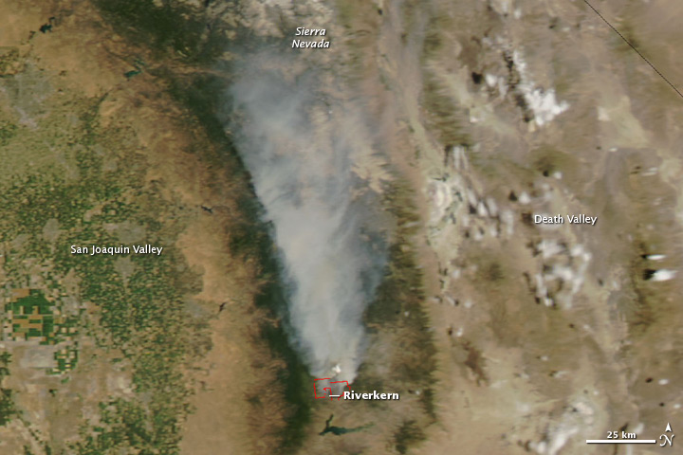
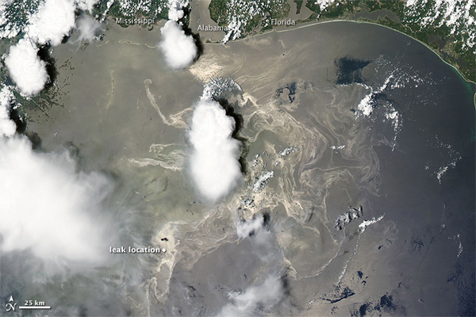
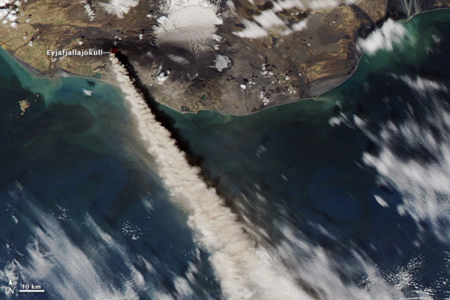
MODIS Widely Used for Operational Government and Civil Applications
Water Vapor Winds assimilated operationally at numerous NWP Centers
40 NWS Centers Regularly Use MODIS IMAPP Data
Forecast Support for Johnson Spaceflight Center Meteorology Group
Snow/ice/cloud discrimination
Fog detection
Sea Surface, Land, Lake Temperature
Aerosols used for EPA Air Quality
Disaster Monitoring: Volcanoes, Oil Spills, Fires, Hurricanes, Floods
Agriculture, Commercial Fishing
Military Operations
Over 40+ Products

Slide 11
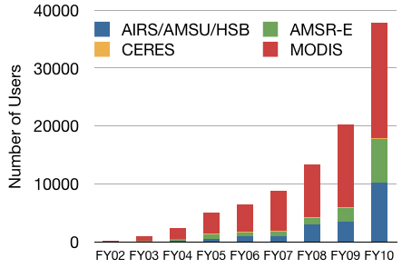
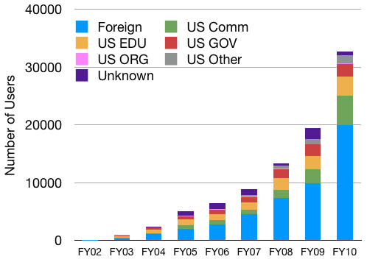
Almost 40,000 Users of Aqua Data
MODIS and AIRS have Most Users
Most Users Foreign
LEO Imagers and Sounders are Essential to Earth Science Investigations and Must be Priority for Advancement.
NASA NRC DS Assigned to NOAA
Courtesy of GES/DISC

Slide 12
Key Needs of Next Generation
Imagers and Sounders
Higher Spectral Resolution
  Improved Product Accuracy and Calibration
  Improved Sea Surface Temperature Accuracy
  Improved LST, and Surface Emissivity
  Improved Cloud and Aerosol Product Accuracy
  Improved boundary layer sensitivity
  Improved GHG observations: CH4, CO, CO₂
  Improved Water Vapor Transport: Higher H2O Vertical Resolution, HDO
Higher Spatial Resolution (on the order of 1km)
  Improved regional model initialization and characterization
  Improved yield in cloudy scenes; closer to cloud boundaries
  Improved characterization of cloud processes and variability
  Aviation Alerts: Volcanic Ash and SO2, Storms, etc.
  Improved Fire Detection
  Greenhouse Gas, CO and SO2 Emissions from Anthropogenic Sources
  Synergy with OCO-2, CarbonSat

Slide 13
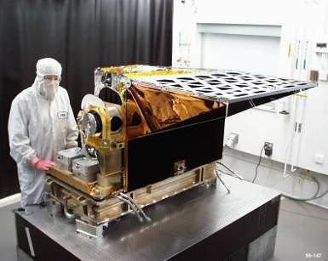
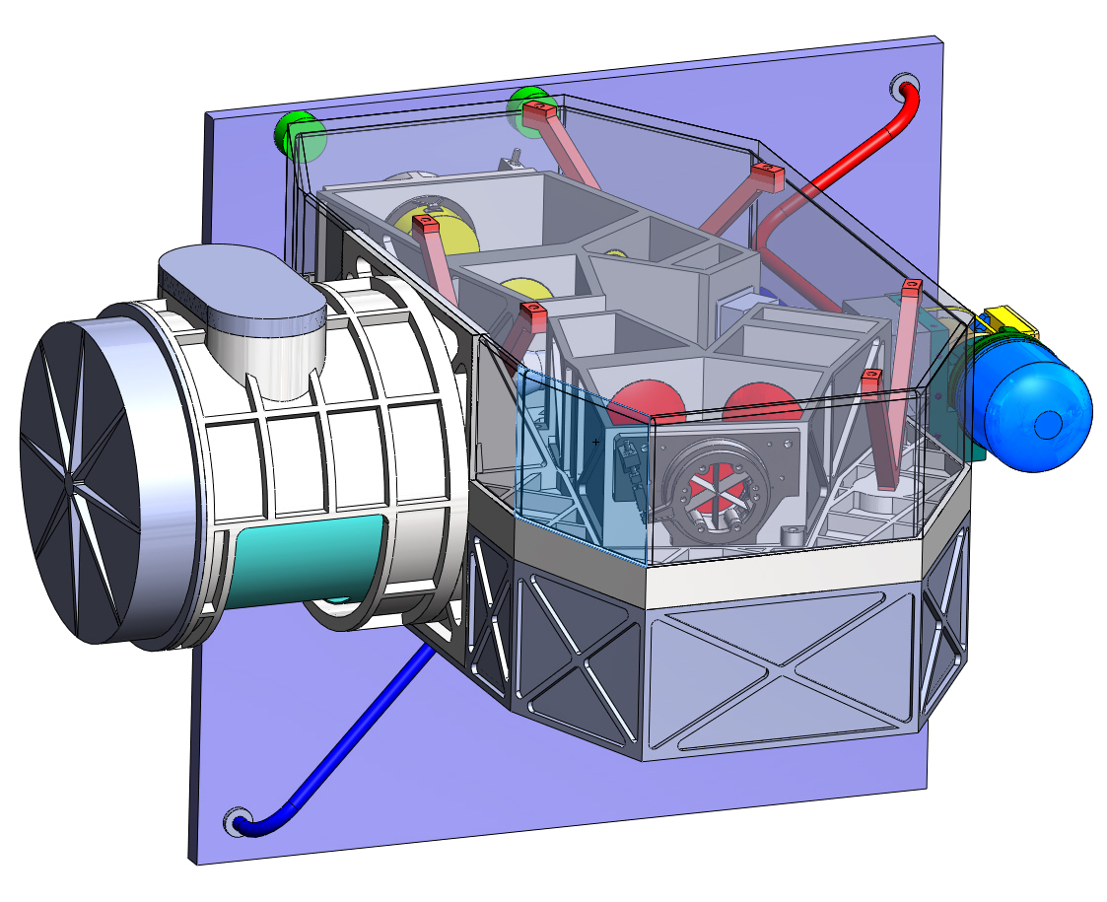
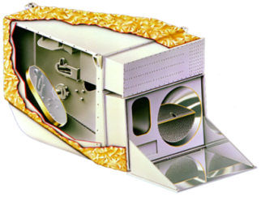
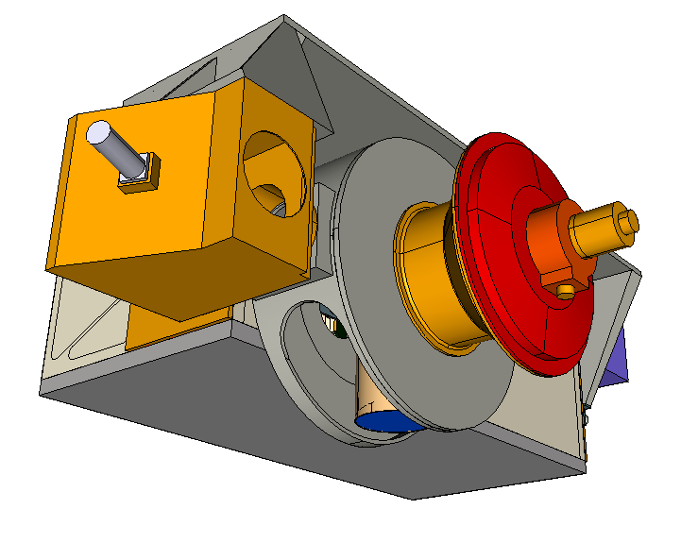
Evolving Requirements and Technology Lead to New Architecture
AIRS
ARIES (IR Only)
Atmospheric Remote-sensing Imaging Emission Sounder
AIRS on Aqua
14 km GSD, ±49.5°
2378 Channels
0.4-15.4 μm
177 kg, 256 W
0.9 m³, 1.3 Mbps
1 km GSD. ±55°
4096 Channels
3.3-15.4 μm
100 kg, 150 W
0.5 m³, 60 Mbps
Unplanned
AIRS and MODIS around till ~2020
ORCA+ (UV/VIS/NIR)
Ocean Radiometer for Carbon Assessment
MODIS
1 km GSD. ±58°
108 Channels
0.24-2.14 μm
140 kg, 130 W
0.5 m³, 13 Mbps
NASA Planned
(For PACE)
MODIS on Aqua
1 km GSD, ±55°
0.4-14.4 μm
220 kg, 160 W
1.5 m³, 11 Mbps
ARIES and ORCA Meet all Requirements of AIRS and MODIS + More!!!
T.S. Pagano, C.R. McClain, “Evolution of Satellite Imagers and Sounders for Low Earth Orbit and Technology Directions at NASA’, Proc. SPIE, 7807-20, San Diego, California, August 2010

Slide 14
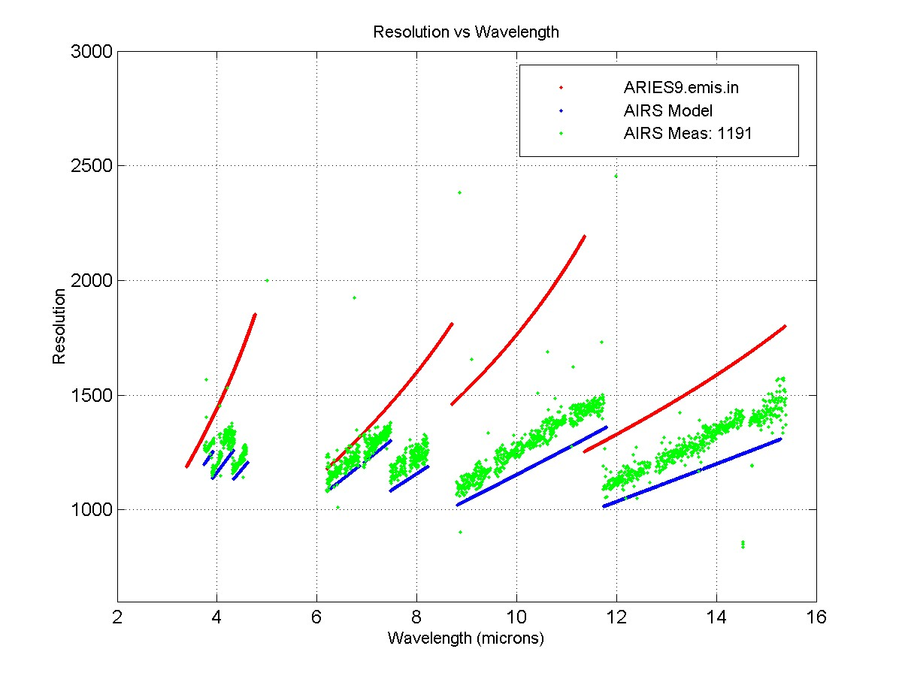
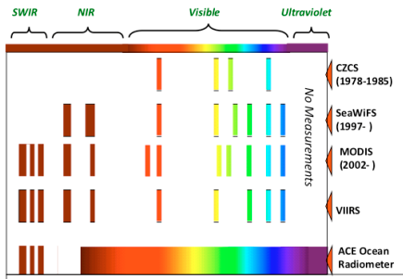
Next Gen Imaging Sounders Give
Hyperspectral UV through LWIR
ARIES
4096 Channels
~2x Better than AIRS
ORCA
108 UV/Vis/NIR Ch.
345-885 nm, Δλ = 5 nm
3 SWIR Channels
Band | Spectral Range | Spectral Resolution | No. Channels
MW1 | 2100 - 2950 cm⁻¹ | 1.6 cm⁻¹ | 1024
MW2 | 1150 - 1613 cm⁻¹ | 1.0 cm⁻¹ | 1024
LW1 | 880 - 1150 cm⁻¹ | 0.6 cm⁻¹ | 1024
LW2 | 650 - 880 cm⁻¹ | 0.5 cm⁻¹ | 1024
T.S. Pagano, C.R. McClain, “Evolution of Satellite Imagers and Sounders for Low Earth Orbit and Technology Directions at NASA’, Proc. SPIE, 7807-20, San Diego, California, August 2010

Slide 15
ARIES Enters New Domain of Earth Observation Spectral and Spatial Space

Slide 16
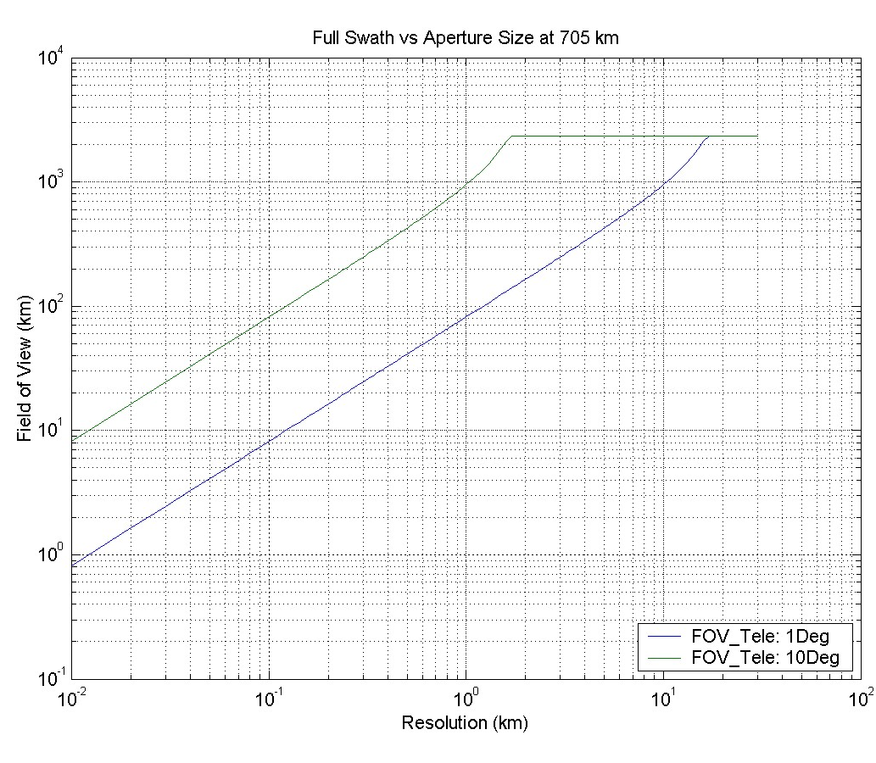
Wide Field Optics Improve Spatial Resolution and/or Coverage
Whiskbroom: Wide field slows scan, enabling higher spatial resolution
Pushbroom: Wide field directly extends E/W Swath
1km AIRS
AIRS
OCO-WF
Pushbroom
OCO-2
Wide Field Grating Spectrometer
Demonstrated on IIP 2001
Whiskbroom
Grating

Slide 17
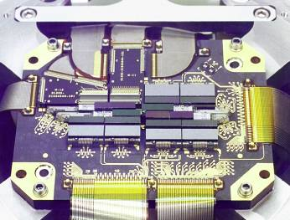
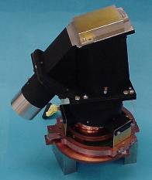
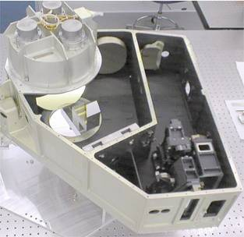
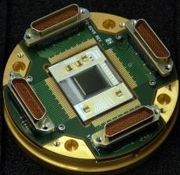
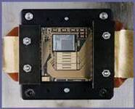
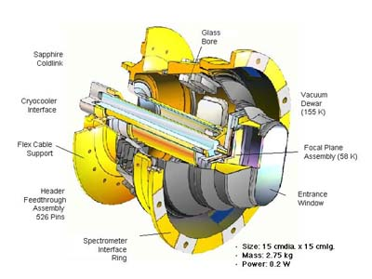
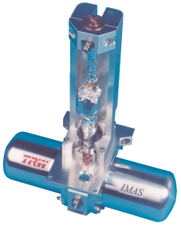
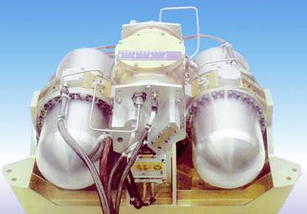
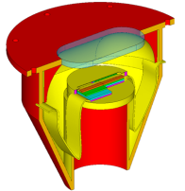
New Technologies Enable Compact Wide Field Grating Spectrometer Sounders
BAE Systems
HgCdTe
15 μm Cutoff
512 x 512
SIRAS IIP1
Refractive 16°
Grating Spectr
AIRS
Reflective 1.1°
Grating Spectr
AIRS
BAE Systems
PV/PC HgCdte
17 modules
2 x ~180
100 x 50 um
MODIS
Raytheon Vision
Systems
PV/PC HgCdTe
4 FPAs
10 x ~10
400 x 400 um
Next Generation
LEO or GEO
Sounder
TRL 5
AIRS
Large Dewar
NGST
Small Single
Pulse Tube
Cooler
AIRS
Large Dual Pulse
Tube Coolers
High Efficiency
Mini Dewars

Slide 18
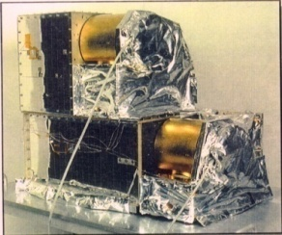
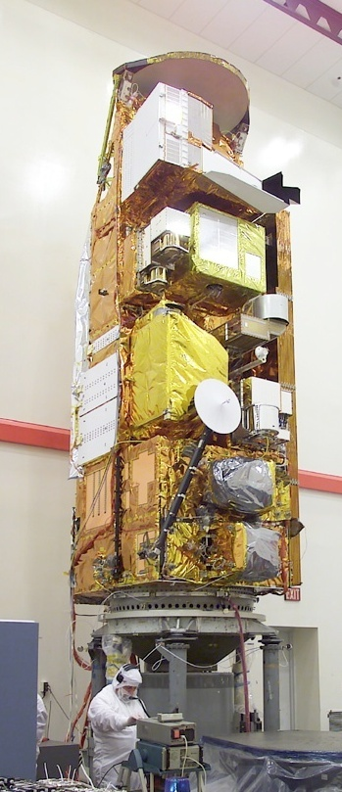
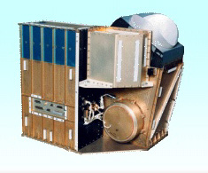
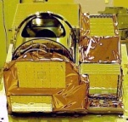
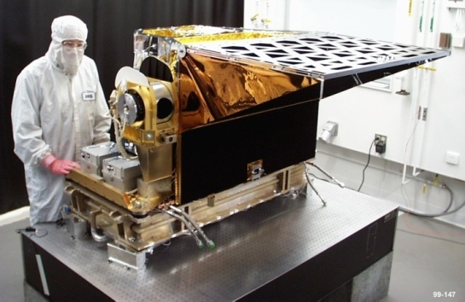
Modular Mini-Grating Spectrometers
Reduce Cost and Complexity
On Aqua, IR/MW frequencies distributed amongst 4 instruments. Single Retrieval
Mini-Spectrometer Instrument Modules
1 WF Grating Spectrometer / FPA per Module
Optics / FPA Tailored for Each Band
Commonality Reduces Cost. Low RE
Easier to accommodate
< 50 kg, < 50W, < 1 Mbps
TRL 5
Scanner
AMSU
Spectrometer / FPA
Nadir
Calibrator
Track
HSB
Electronics
Cryocooler
AIRS

Slide 19
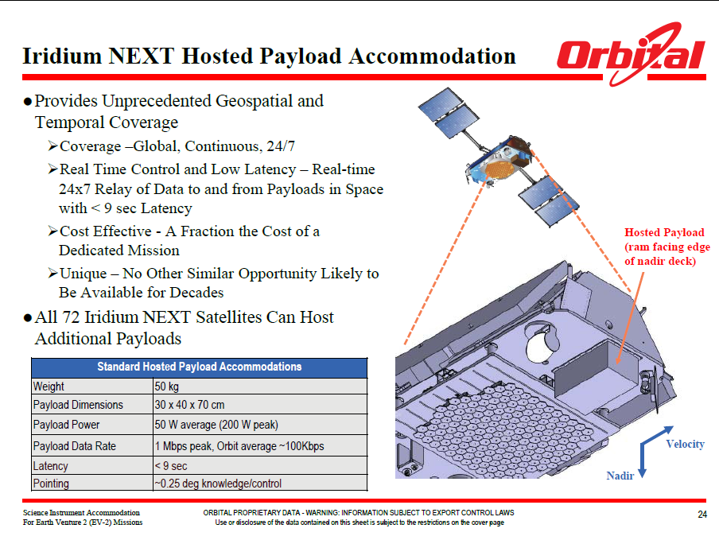
Mini Grating Spectrometers Compatible with Launch on Iridium Constellation
C. Schueler (OSC)

Slide 20
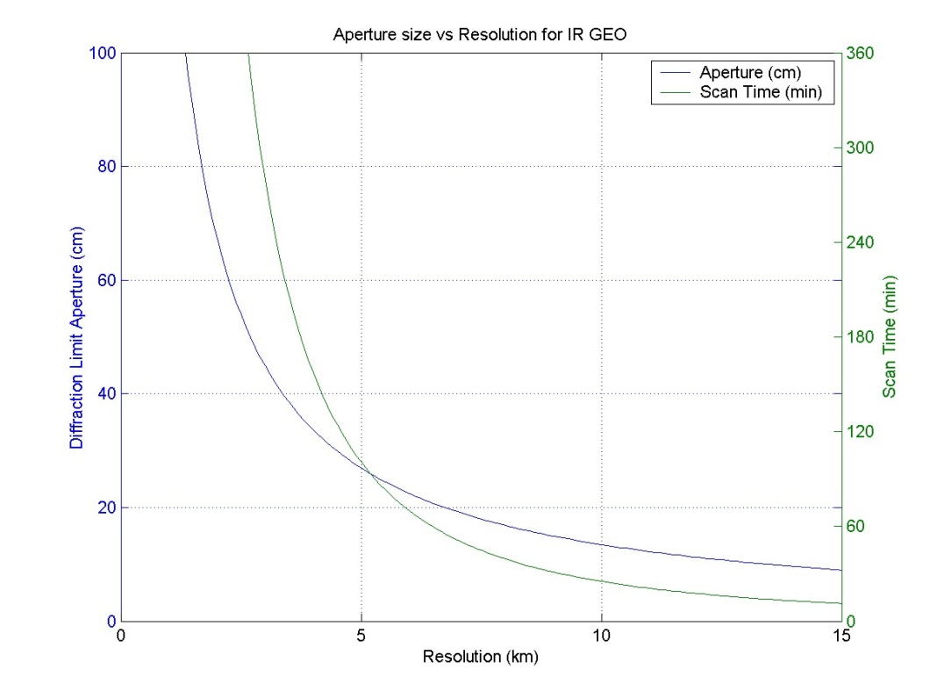
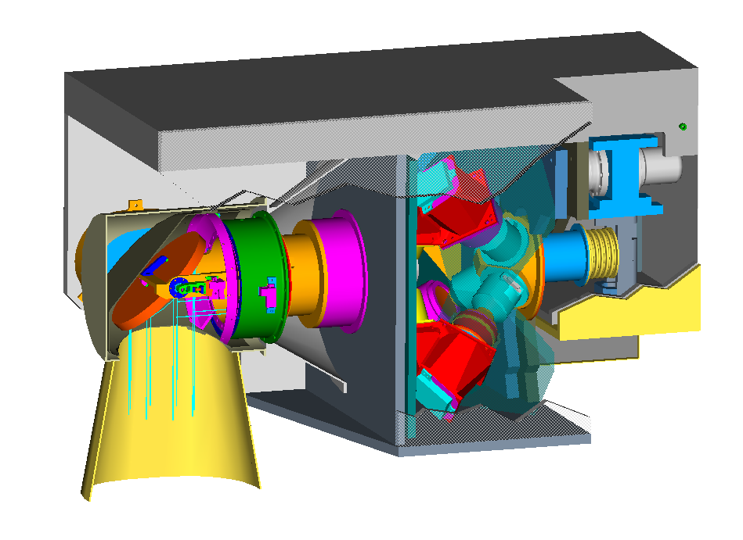
Key to Affordable GEO Instrument is Modest Set of Requirements
Gratings offer advantages for GEO
  High Reliability
  Low sensitivity to pointing
  Smaller Spectrometers (wide field allows high magnification)
  Low Power (Minimal signal processing)
  But: Fewer Channels than FTS
GEO sounder need not be big
  SIRAS-G, AIRS+ from GEO
  JPL NMP Concept Proposal 1998
  Spectrometers Same as LEO
  Compatible with Orbital STAR
Minimize Aperture
For Lowest Cost
SIRAS-G (NMP 1998)
GSD (km) 5.0
IFOV (km/µr) 10.0/280
Size (m) 0.7 x 0.5 x 0.4
Mass (kg) 100
Power (W) 150
Aperture (cm) 12.5
Integration (ms) 100
No. Channels 2400
Data Rate (kBps)) <300
Assumptions
Aperture:
D=2.44 λ/α
λ=15.4 µm
Scan Time
3000x4000 km Region
500 km Swath N/S
Same A_{o}Ω_{d}T_{int} as AIRS

Slide 21
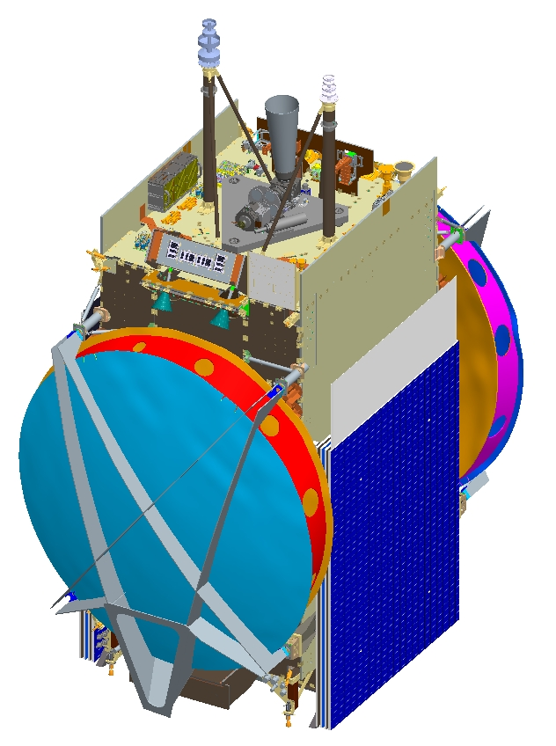

GEO Hosted Payloads
Remote Sensing
Payload
Orbital STAR™ Bus
Flight Proven with CHIRP Payload
Volume: 0.7 x 0.4 x 0.5 m
Mass: 80kg
Power: 275W
Data Rate: 70 Mbps
Commercially Hosted Infrared Payload (CHIRP), US Air Force experiment CY-2011
Gary Payton, USAF, Oct 2008 (Brinton): “The deal…was fantastic…a fourth-of-world view at GEO & a year…of data…for less than the cost of a launch vehicle.”
US DOC Office of Space Commercialization (http://www.space.commerce.gov/general/commercialpurchase/hostedpayloads.shtml): “Air Force expects…major cost savings... They estimate…$500M to launch a dedicated free flyer to satisfy 100% of technical questions...hosted payload ended up costing $65M & should satisfy 80% of technical questions.”
Commercially Hosted Infrared Payload (CHIRP)
U.S. Air Force
3rd Generation Missile Warning Technology Demonstration on
SES-2 Commercial GEO Communications Satellite
Launch Fall 2011
C. Schueler (OSC)

Slide 22
Summary
AIRS and MODIS Widely Used for Weather, Climate, Composition, Carbon Cycle, Cross-Calibration, and Applications
Community asking for new capability in the 2020 timeframe
  Hyperspectral UV to LWIR, High Spatial ≤1km IFOV
  Maximize Synergies of Solar Reflected and IR. Synergies with OCO-2.
Expect more users and applications of next gen LEO IR Sounder than GEO
  Weather, Climate, GHG Monitoring, Aviation, Disaster Response
New Direction for Imagers and Sounders
  Separate Vis/NIR/SWIR from MWIR/LWIR Instruments Reduces Technology Risk and Complexity
  Expect Costs to be lower than CrIS & VIIRS
Additional Ideas to Reduce Costs:
  Minimum Set of Requirements
  Mini-Grating Spectrometers. Supports Constellation for Higher Revisit
  New Technology to Reduce Instrument Size (Large Format FPA’s)
  Hosted Payloads

Slide 23
Issues and Recommendations
Issues
  Currently no plan to advance capability of LEO IR sounder at NASA or NOAA = No Study Funds
  NRC Decadal Survey did not make IR sounders a priority at NASA
  Currently no technology development program for LEO IR sounders at NASA or NOAA
Recommendations
  Initiate studies for advanced imager and sounders at NASA and NOAA
    OSSE’s, Requirements Analysis, Mission Studies, Instrument Studies
  Initiate a technology development program focused on retiring key risk areas for next generation LEO imager and sounder

Slide 24

Special Thanks to Mous Chahine for His Vision of ARIES
A Brilliant Scientist
A Great Visionary
A Gentle Mentor
A Good Friend

