Slide 1

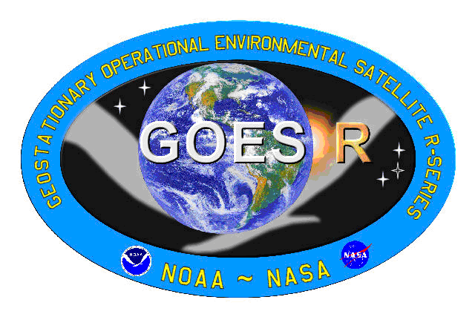
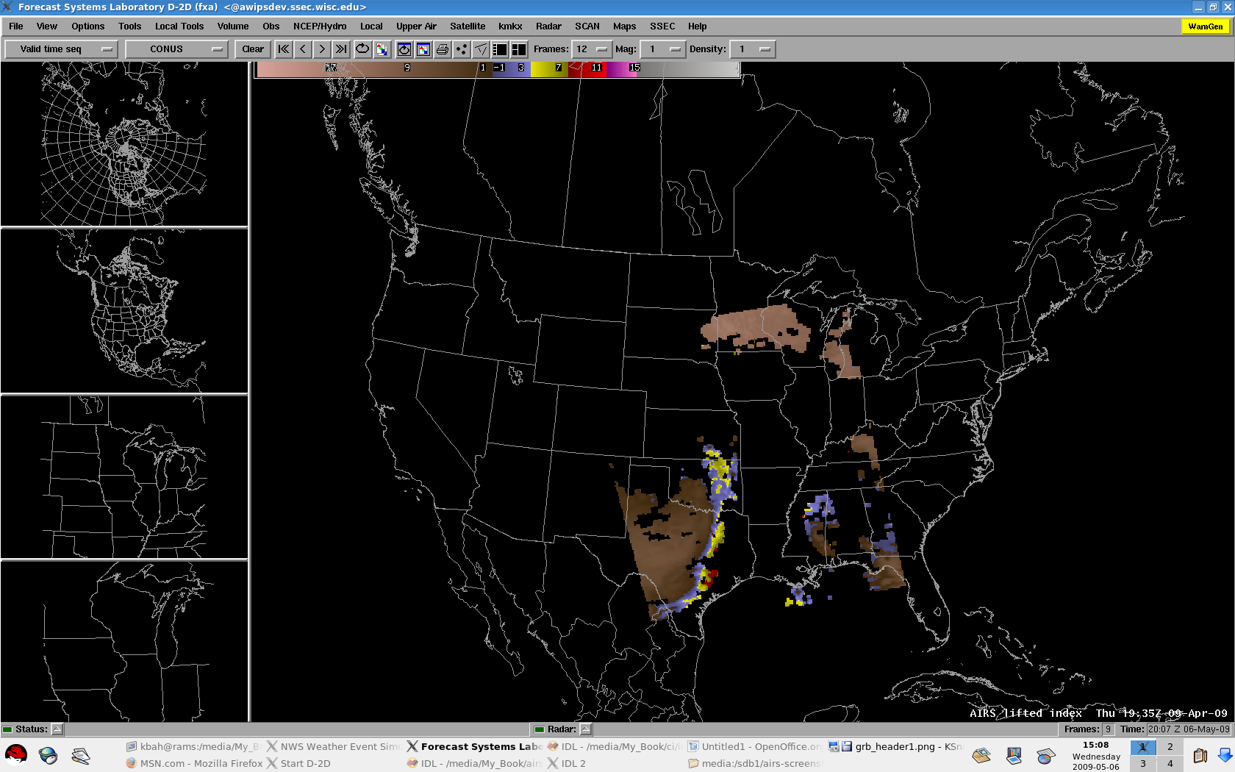
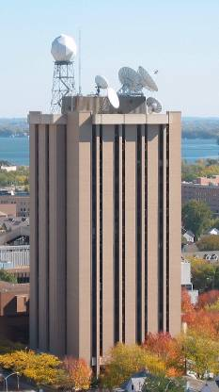

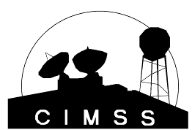
High-Spectral Resolution IR Observations for Weather-related Applications
  Timothy J. Schmit (tim.j.schmit@noaa.gov)
NOAA/NESDIS/Satellite Applications and Research
Advanced Satellite Products Branch (ASPB)
Jun Li, Justin Sieglaff , Mathew M. Gunshor, etc.
Workshop on Hyperspectral Sensor Greenhouse Gas (GHG), atmospheric chemistry, weather forecasting measurements from Environmental Satellites
Miami, FL
30-March-2011
UW-Madison

Slide 2
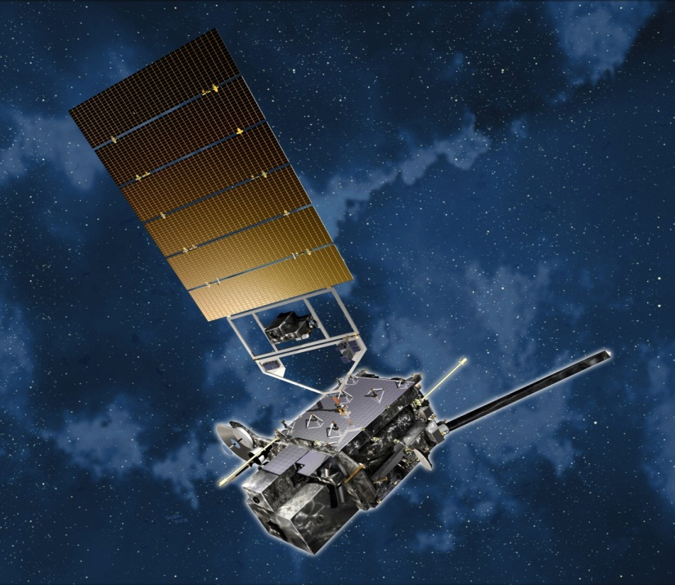
Overview
GOES-R Overview
  No dedicated Sounder
  Synergy with ABI
Current GOES Sounder
Select products
Sample applications
Summary
  More information
  References
Lockheed Martin

Slide 3
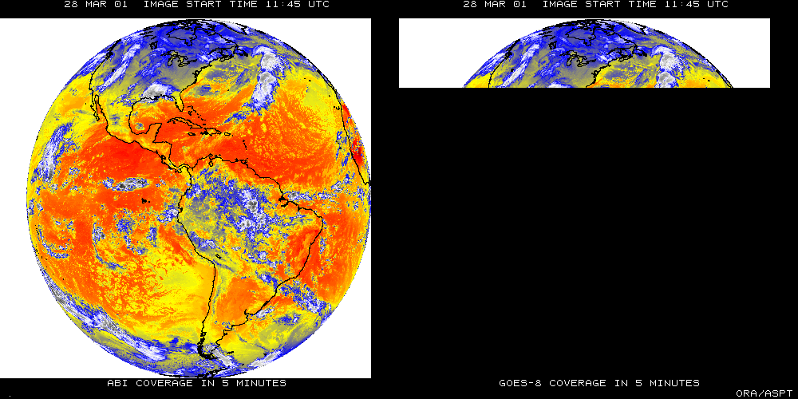
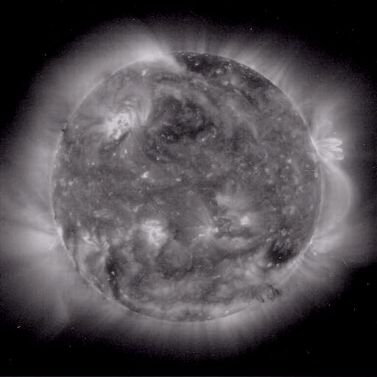
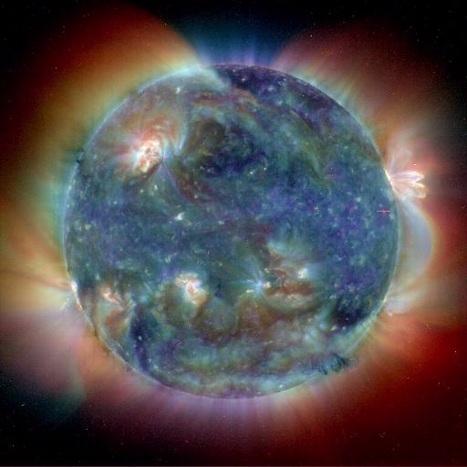
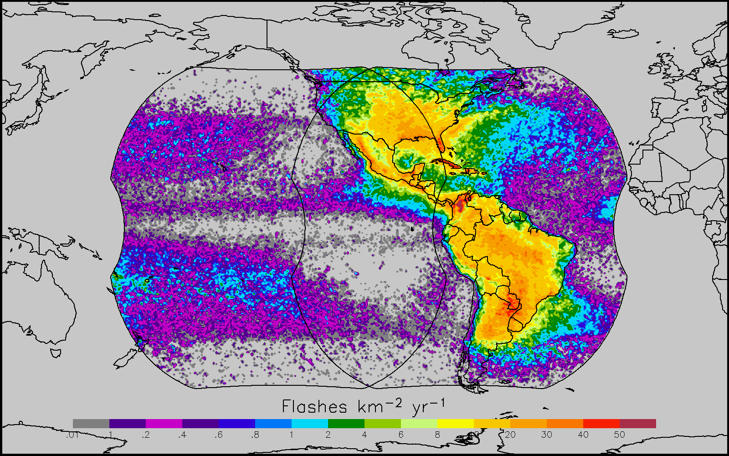
GOES-R main instruments
ABI – Advanced Baseline Imager
Space Weather/Solar
ABI covers the earth approximately five times faster than the current Imager.
Geostationary Lightning Mapper
Images courtesy of SOHO EIT, a joint NASA/ESA program

Slide 4
GOES-R Series Overview
No dedicated Sounder
Advanced Baseline Imager (ABI)
Geostationary Lightning Mapper (GLM)
Space Weather
  Space Environmental In-Situ Suite (SEISS)
  Solar Ultra Violet Imager (SUVI)
  Extreme Ultra Violet/X-Ray Irradiance Sensor (EXIS)
  Magnetometer
Communications
  GOES Rebroadcast (GRB)
  Low Rate Information Transmissions (LRIT)
  Emergency Managers Weather Information Network (EMWIN)
  Search and Rescue (SAR)
  Data Collection System (DCS)
Notes:
Advanced Baseline Imager (ABI) Earth-viewing
Geostationary Lightning Mapper (GLM) Earth-viewing
Solar Ultra-Violet Imager (SUVI) Sun-viewing
EUVS and XRS Irradiance Sensors (EXIS) Sun-viewing
Space Environment In-Situ Suite (SEISS) Space-viewing
Magnetometer (MAG) Space-viewing

Slide 5

Advanced Sounders
Timothy J. Schmit
NOAA/NESDIS/ORA
Advanced Satellite Products Team (ASPT)
in collaboration with
Cooperative Institute for Meteorological Satellite Studies
(CIMSS)
Madison, Wisconsin
[2001]
UW-Madison

Slide 6
Sounders, circa 2010
More than 5 years of high spectral measurements from polar orbits:
- AIRS (Atmospheric InfraRed Sounder)
- IASI (Infrared Atmospheric Sounding Interferometer)
- CrIS (Crosstrack Infrared Sounder)
Approximately 5 years of high spectral, spatial and temporal measurements from geostationary orbit:
- GIFTS (Geostationary Imaging Fourier Transform Spectrometer)
30 years of filter wheel technology in geostationary orbit:
- VAS and GOES Sounder
40 years since the first interferometer flown in space to study the weather: IRIS (Infrared Radiation Interferometer Spectrometer)
Forecast from 2001… with 67% accuracy!
The time is right to update the GOES sounder! The technology is mature. The need is documented.

Slide 7
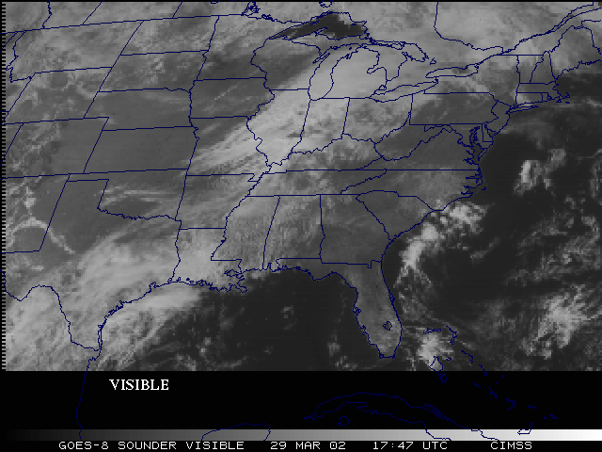
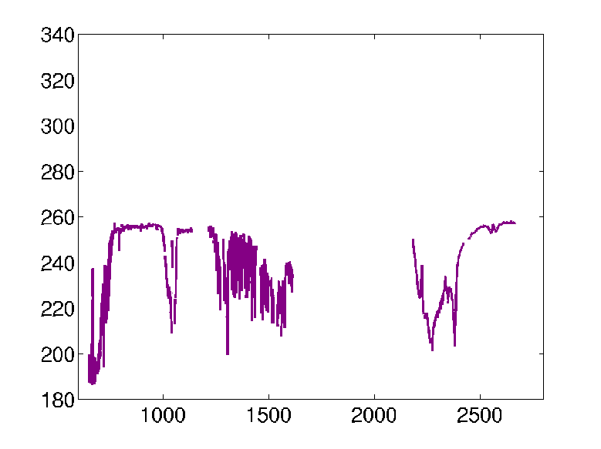
Improved products could be realized from combinations of ABI and HES (Hyperspectral Environmental Suite) data
Spatial
resolution
Temporal
resolution
Cloud
clearing
ABI
HES
Spectral
coverage
Surface
emissivity
Spectral resolution
cira 2004

Slide 8
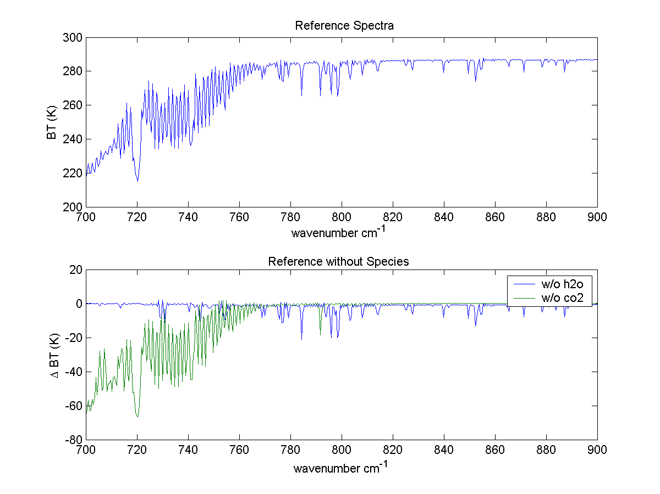
Why do we need a high spectral resolution sounder?
Analysis courtesy of Justin Sieglaff, CIMSS.
GOES-12 Sounder Bands
Smooth over required absorption lines
Compared to broadband sounders, observing absorption lines is mandatory to meeting requirements for temperature and moisture structure needed to improve weather forecasting
Many papers document science value of high spectral resolution sounder that support weather forecast needs. (Sieglaff et al.)
Notes:
These are calculated spectra, showing important features dealing with temperature and moisture are in the high-spectral data, but are smoothed over in the broad-band data. Figure courtesy of J. Sieglaff, CIMSS.
I’m not sure it is useful to show an entire spectrum. Rather I prefer to show the above and indicate that it is these little wiggles that make the HES so valuable and that the current GOES smears out.

Slide 9
High-Spectral, combined with High-Temporal Resolution is the key
Water Vapor and Carbon Dioxide absorption lines within the infrared window are sensitive to changes in the lower tropospheric thermodynamic state
Current GOES sounders are spectrally too broad to resolve these lines
High-time information obtained from a high spectral resolution IR GEO sounder would be very useful for monitoring pre-convective clear sky regions

Slide 10
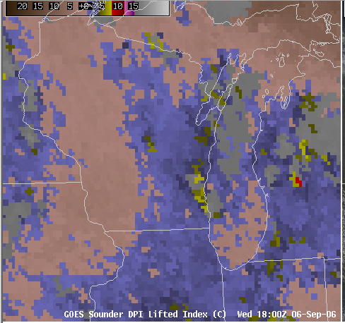
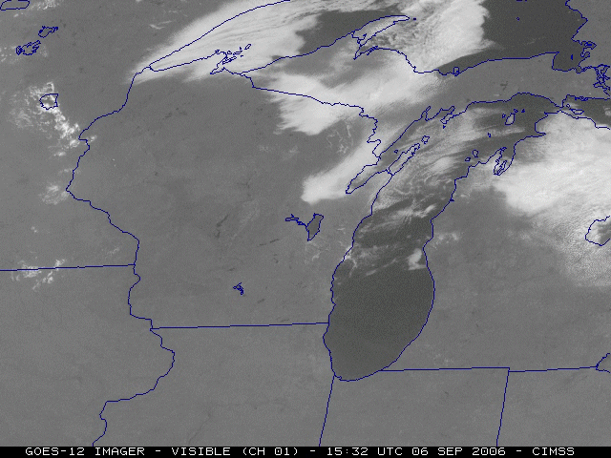
Need to monitor rapidly evolving situations

Slide 11
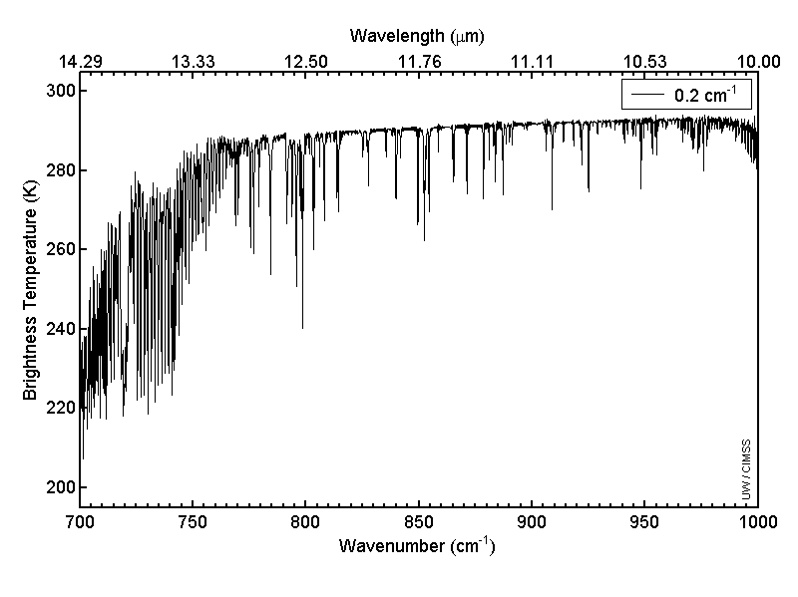
Allen Huang, CIMSS
On-line/off-line “signal”
Longwave window region

Slide 12
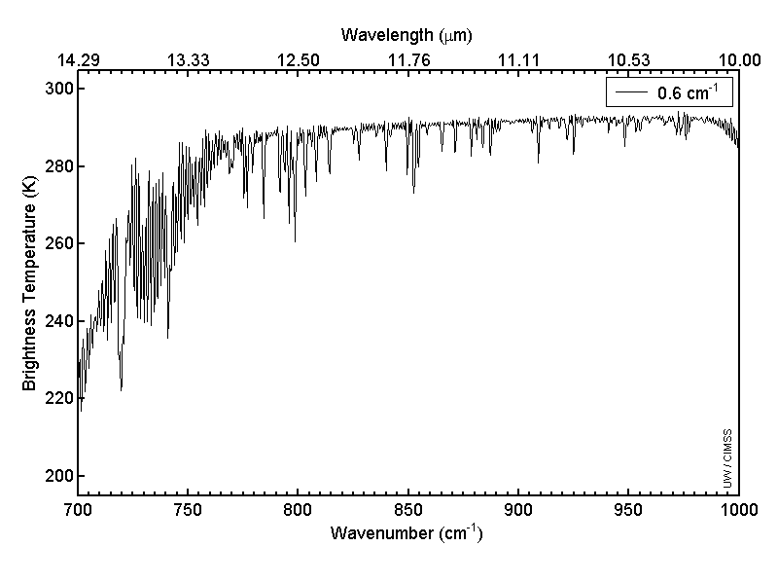
Allen Huang, CIMSS
“AIRS or IASI-like”
Longwave window region

Slide 13
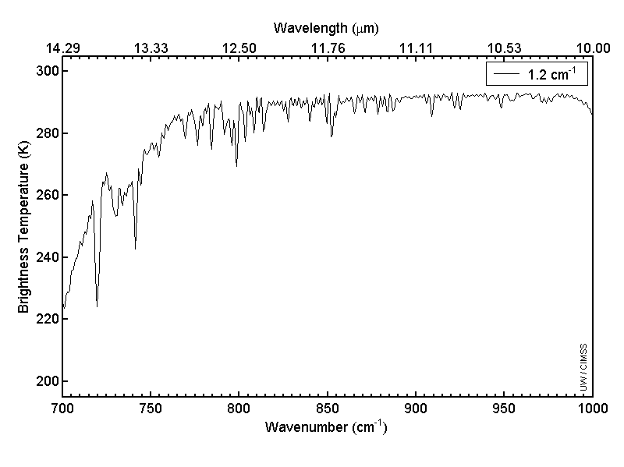
Allen Huang, CIMSS
Longwave window region

Slide 14
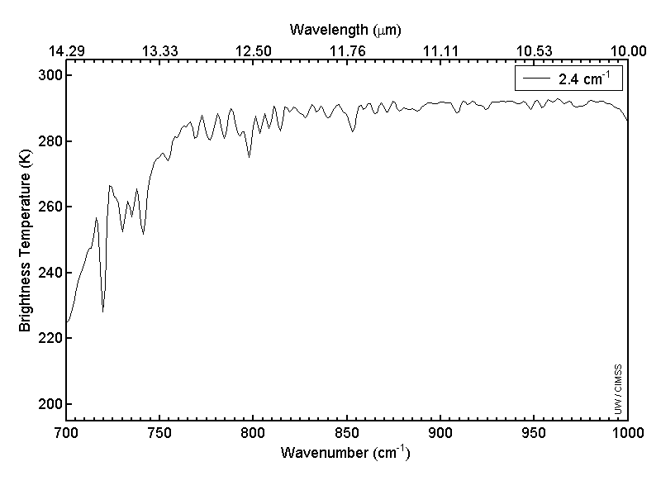
Allen Huang, CIMSS
Longwave window region

Slide 15
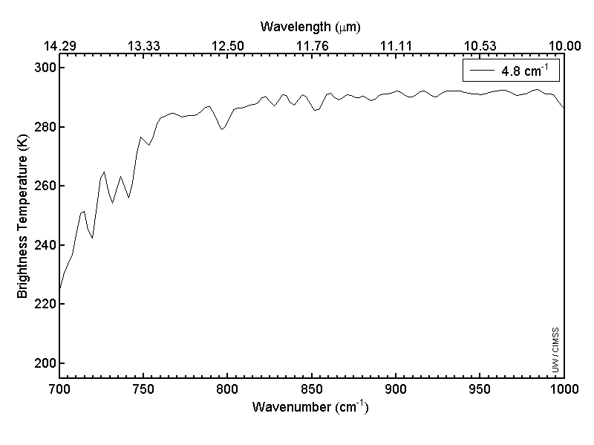
Allen Huang, CIMSS
Longwave window region

Slide 16
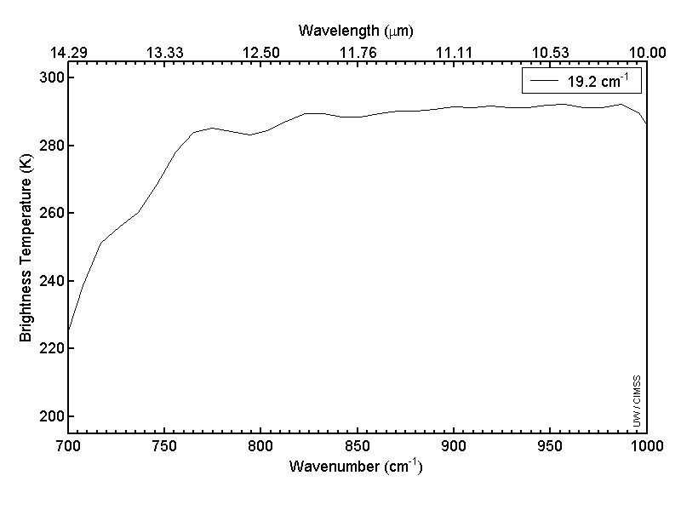
Allen Huang, CIMSS
Longwave window region

Slide 17

Allen Huang, CIMSS
“Current GOES-like”
Longwave window region

Slide 18
The relative vertical number of independent pieces of information is shown. Note that the moisture content is similar between the ABI and the current GOES Sounder. The Sounder does show more temperature information than the ABI. Caveat: Even if two systems have the same number of pieces of information, they may represent different vertical levels. This information content analysis does not account for any spatial or temporal differences.

Slide 19
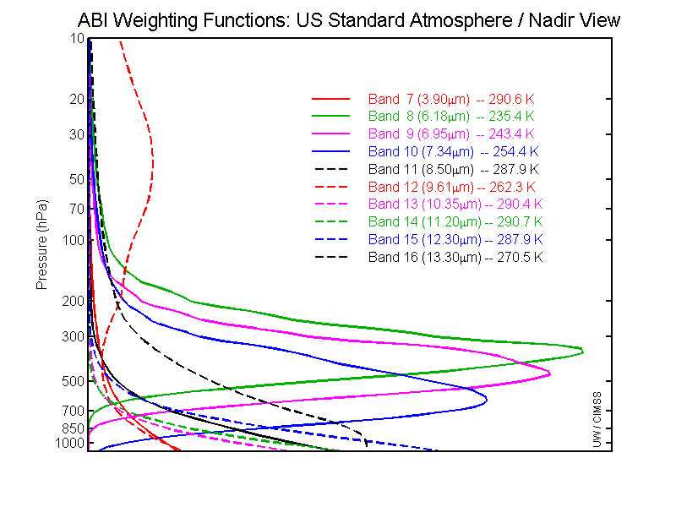
GOES-R ABI Weighting Functions
ABI has only 1 CO₂ band, so upper-level temperature will be degraded compared to the current sounder. Hence short-term NWP temperature information will be needed.

Slide 20
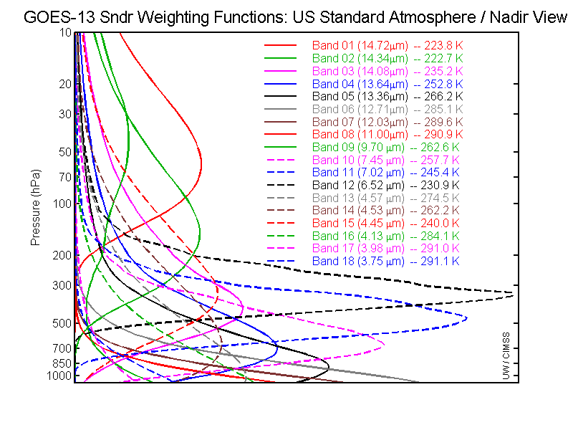
GOES-13 Sounder Weighting Functions
The current GOES sounders have 5 CO₂ bands, and more SW bands than ABI

Slide 21
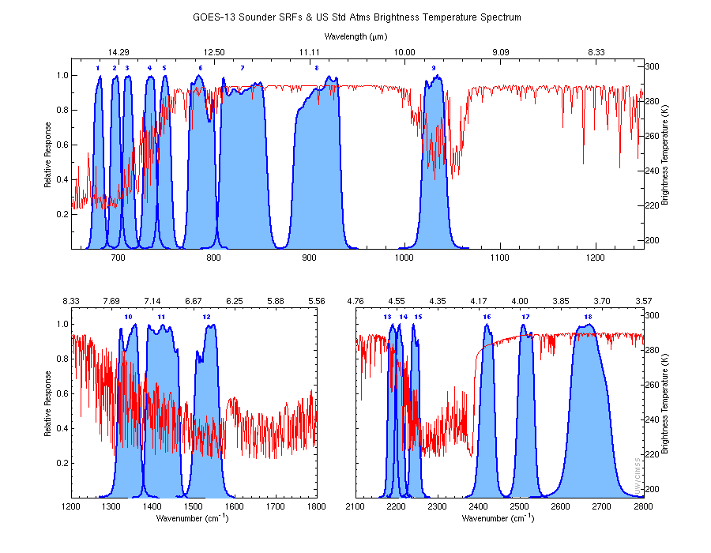
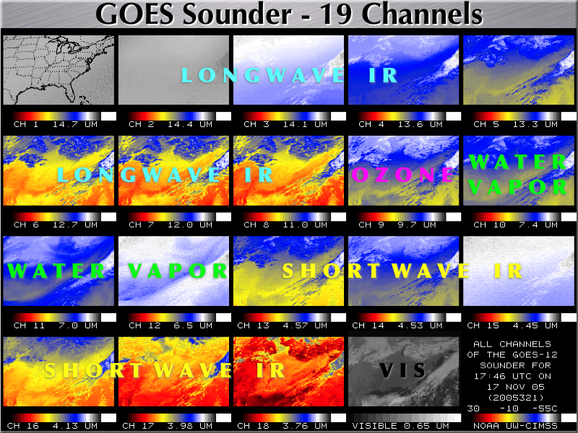
Overview
GOES-R Overview
  No dedicated Sounder
  Synergy with ABI
Current GOES Sounder
Select products
Sample applications
Summary
  More information
  References
http://cimss.ssec.wisc.edu/goes/rt/sounder-dpi.php

Slide 22
Current Sounder Operational Uses
GOES Sounder Product | Operational Use within the NWS
Clear-sky Radiances | Assimilation into NCEP operational regional & global NWP models over water
Layer & Total Precipitable Water | Assimilation into NCEP operational regional & global NWP models; display and animation within NWS AWIPS for use by forecasters at NWS WFOs & National Centers in forecasting precipitation and severe weather
Cloud-top retrievals (pressure, temperature, cloud amount) | Assimilation into NCEP operational regional NWP models; display and animation within NWS AWIPS for use by forecasters at NWS WFOs; supplement to NWS/ASOS cloud measurements for generation of total cloud cover product at NWS/ASOS sites
Surface skin temperature | Image display and animation within NWS AWIPS for use by forecasters at NWS WFOs
Profiles of temperature & moisture | Display (SKEW-Ts) within NWS AWIPS for use by forecasters at NWS WFOs in forecasting precipitation and severe weather
Atmospheric stability indices | Image display and animation within NWS AWIPS for use by forecasters at NWS WFOs in forecasting precipitation and severe weather
Water Vapor Winds | Image display and animation within NWS AWIPS for use by forecasters at NWS WFOs
Courtesy of J. Daniels, STAR
While there are limitations, the current GOES sounder is used today!
Notes:
Note the many operational uses of today’s sounder, even with its limited spatial and spectral attributes.

Slide 23
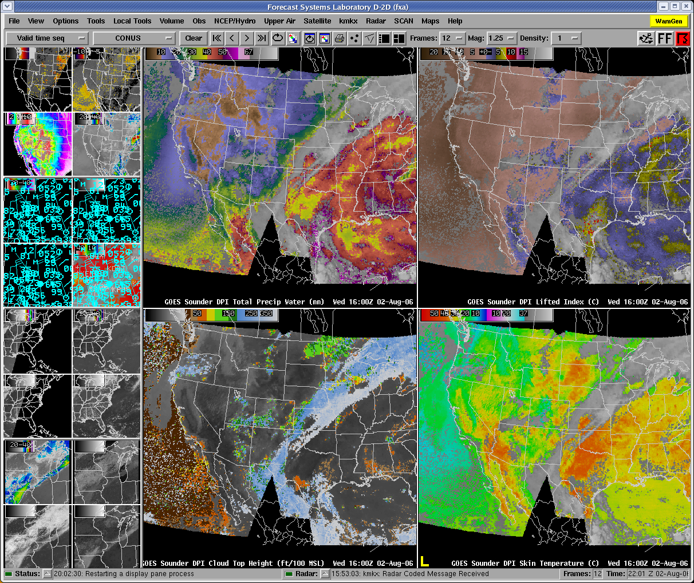
AWIPS Display
Lifted Index
Total Precipitable Water
Courtesy of J. Daniels, STAR
Cloud-Top Height
Surface Skin Temperature

Slide 24
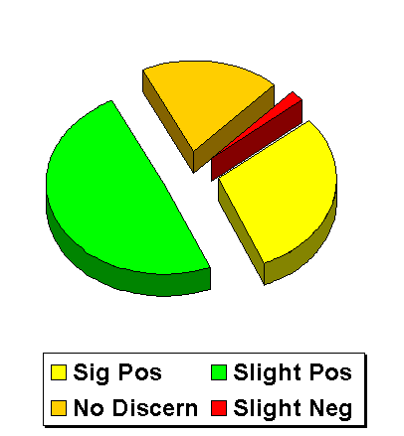
Forecasters value the current sounder
NWS Forecaster responses (Summer of 1999) to: "Rate the usefulness of LI, CAPE & CINH (changes in time/axes/gradients in the hourly product) for location/timing of thunderstorms."
There were 248 valid weather cases.
- Significant Positive Impact (30%)
- Slight Positive Impact (49%)
- No Discernible Impact (19%)
- Slight Negative Impact (2%)
- Significant Negative Impact (0)
National Weather Service, Office of Services
Notes:
This 1999 NWS survey was written up as part of a Schmit et al paper.
Note that almost 80% of the responses were positive in terms of forecasters support for satellite derived images from the existing GOES sounder.
Current NWS training programs (e.g. SHyMet) will hopefully increase the use and appreciation of new satellite data.
Main Objective of SHyMet (Satellite Hydrology and Meteorology) training program
To prepare National Oceanic and Atmospheric Administration (NOAA) and National Weather Service (NWS) users for the latest polar orbiting and geostationary satellite data and products in the warning and forecast programs with direct links to Government Performance Results Act (GPRA) goals.
Completes end-to-end program cycle for space-based remote sensing as part of NOAA's Strategic Plan for an Integrated Global Environmental Observation and Data Management System and Global Earth Observation System of Systems (GEOSS).

Slide 25
Forecasters need a better GEO sounder
Forecasters value the current GOES sounder products; however, the same forecasters also noted several limitations of the current sounder:
  retrievals limited to clear skies;
  the scanning rate is relatively slow, which limits coverage;
  the vertical resolution from the current generation GOES radiometers is limited.
Each of these limitations can be mitigated with an advanced sounder in the geostationary perspective.
Notes:
This is related to the pie chart of previous slide

Slide 26
Impact Study of RAOB, GOES, and POES data on Eta Data Assimilation System
RAOBs, GOES and POES all contribute unique information!
Zapotocny, T. H., W. P. Menzel, J. A. Jung, and J. P. Nelson III, 2005: A four season impact study of rawinsonde, GOES and POES data in the Eta Data Assimilation System. Part I: The total contribution. Wea. Forecasting, 20, 161-177.
Zapotocny, T. H., W. P. Menzel, J. A. Jung, and J. P. Nelson III, 2005: A four season impact study of rawinsonde, GOES and POES data in the Eta Data Assimilation System. Part II: Contribution of the components. Wea. Forecasting, 20, 178-198.
Zapotocny, T. H., W. P. Menzel, J. P. Nelson III, and J. A. Jung, 2002: Impact Study of Five Satellite Data Types in the Eta Data Assimilation System in Three Seasons. Weather and Forecasting, 17, 263-285.

Slide 27
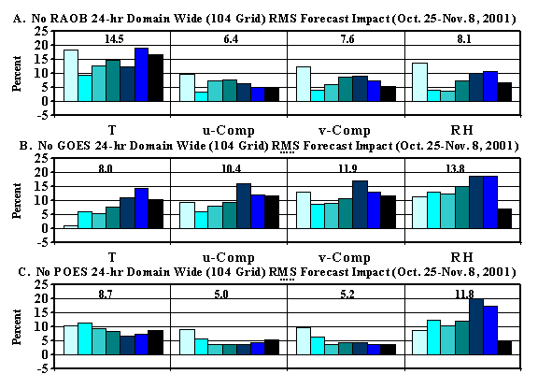
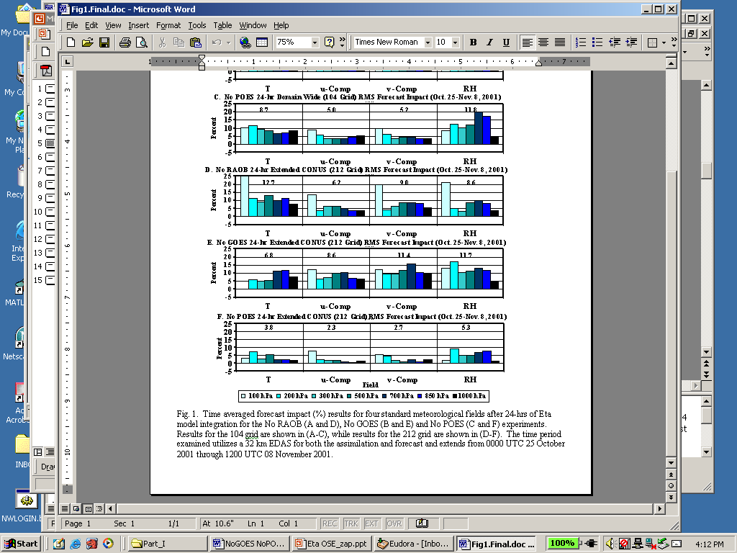
Oct 2001 forecast impact (%) for T, u, v, RH fields
after 24-hrs of Eta model integration
Zapotocny, 2005
Notes:
Time averaged forecast impact (%) results for four standard meteorological fields after 24-hrs of Eta model integration for the No RAOB (A), No GOES (B) and No POES (C) experiments. Results for the 104 grid are shown. The time period examined utilizes a 32 km EDAS for both the assimilation and forecast and extends from 0000 UTC 25 October 2001 through 1200 UTC 08 November 2001.
Raob impact decreases %5 in summer versus winter

Slide 28
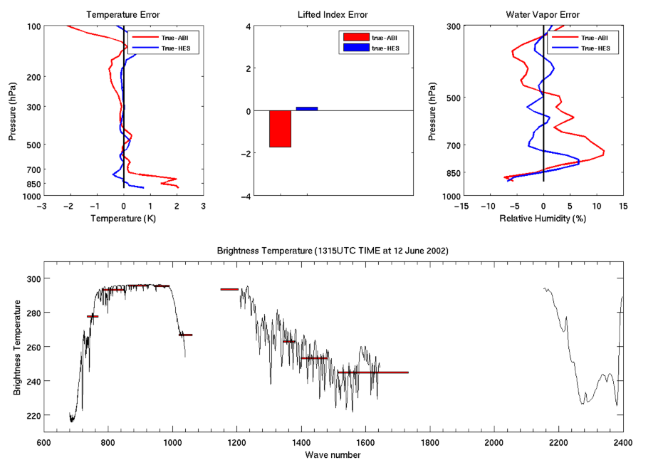
Overview
GOES-R Overview
  No dedicated Sounder
  Synergy with ABI
Current GOES Sounder
Select products
Sample applications
Summary
  More information
  References

Slide 29
Product Impacts and Requirements
With data from an advanced high-spectral sounder in the geostationary orbit, the following NOAA validated product requirements can be reinstated, improving now, short and long term forecasts :
Advanced Atmospheric vertical moisture profile;
Advanced Atmospheric vertical temperature profile;
Capping inversion information (height & strength);
Moisture flux;
Surface emissivity;
Cloud Base altitude;
Carbon monoxide concentration.
Plus, high spectral resolution IR data will help at least 17 other products.
Notes:
There are 6 products that will not meet requirements without a GEO high-spectral resolution sounder. This presentation focuses on T, Q vertical profiles, capping inversion and moisture flux.
Without an advanced high-spectral sounder on GOES, the following validated product requirements will either not be produced or will provide limited value added over numerical model guidance in the 2020 time frame

Slide 30
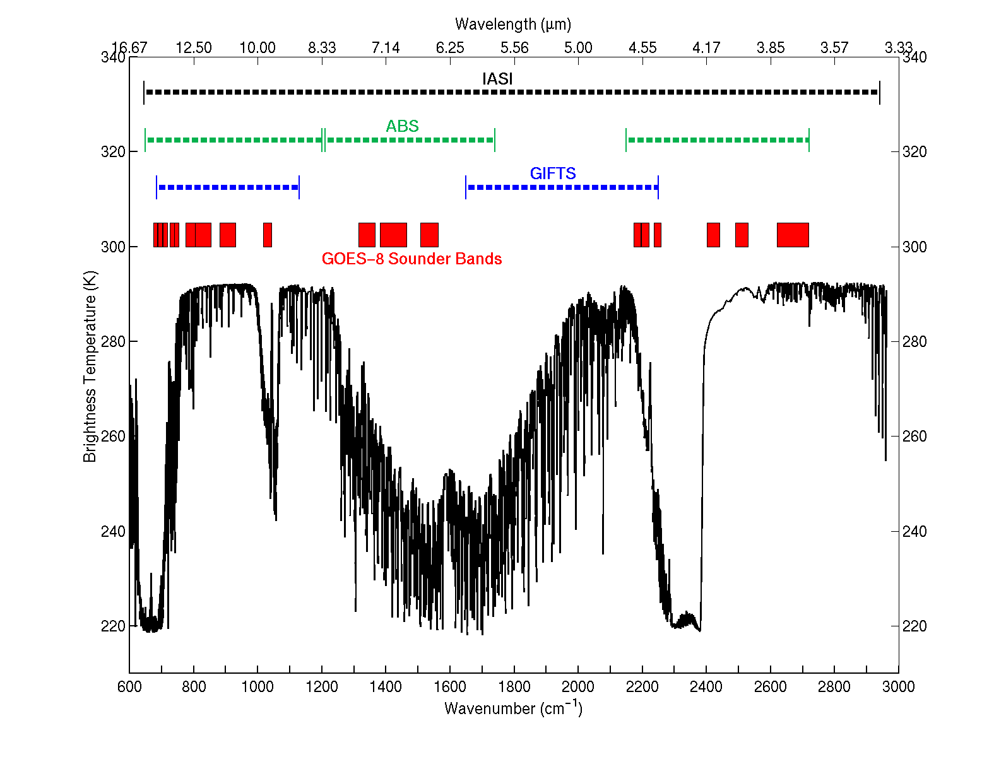
Spectral coverage of the ABS, GIFTS, IASI
and the current GOES radiometer sounder

Slide 31
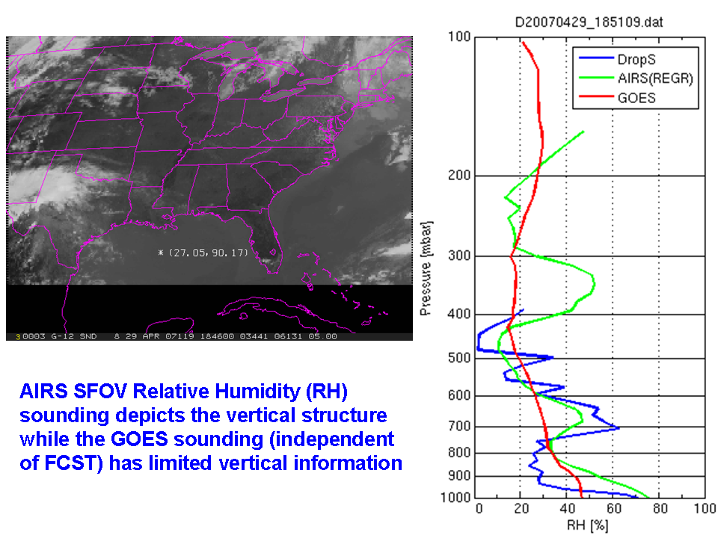

Slide 32
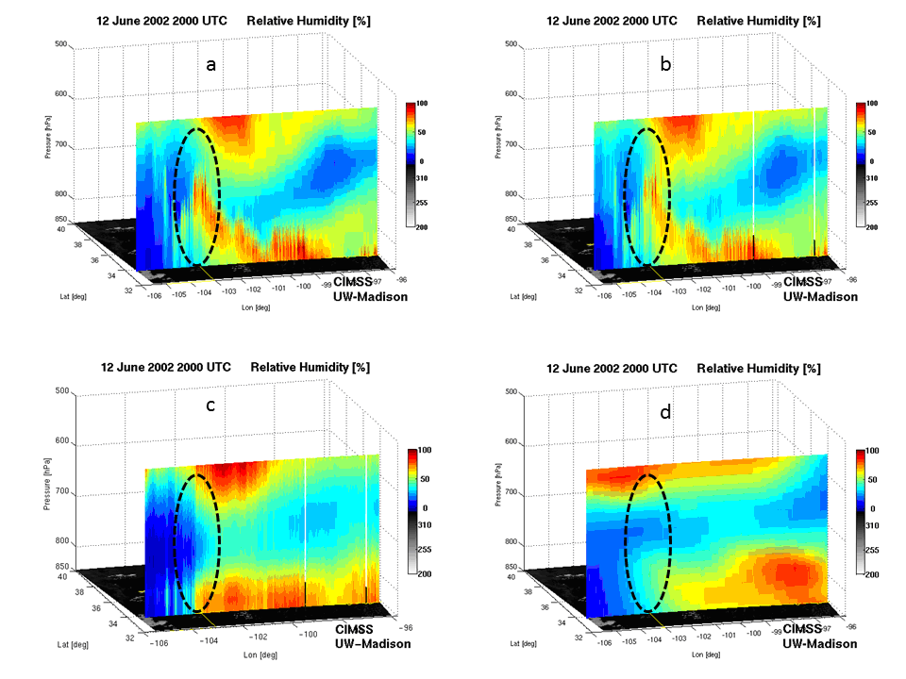
Evolution of the Vertical Moisture is the Key!
Simulated Relative humidity cross-section at 20 UTC 12 June 2002
“Truth”
“GEO advanced IR sounder ”
“ABI”
“RUC”
Li et. al.
Notes:
Warning information in pre-convection environment from geostationary advanced infrared sounding system – a simulation study using the IHOP case
Jun Li, Jinlong Li, Jason Otkin, Timothy J. Schmit, Chian-Yi, LiuJournal of Applied Meteorology and Climatology

Slide 33
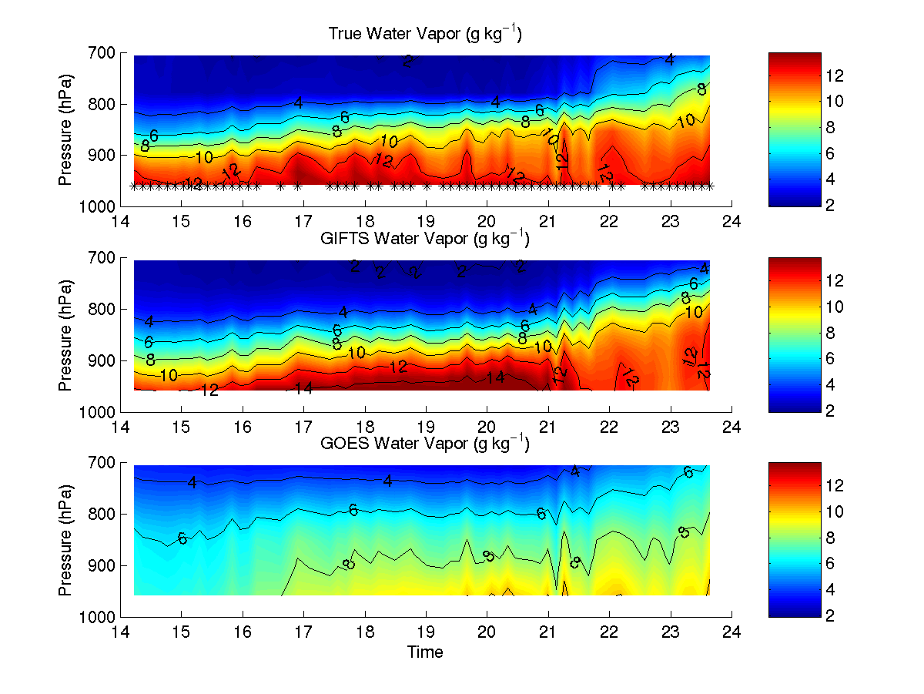
Time series of low-level vertical moisture structure during
9 hours prior to Oklahoma/Kansas tornadoes on 3 May 1999
Truth>
Geo-Adv. IR>
Note Geo-AI retains strong vertical gradients for monitoring convective instability
Current GOES>
GEO-AI
Analysis courtesy of W. Feltz, CIMSS.
Geo-Advanced IR traces moisture peaks & gradients with greatly reduced errors
Notes:
Here upward looking AERI high-spectral data are used for truth and the retrieved high-spectral (middle chart) and broad-spectral (lower chart) are shown.
GEO-I is for Increased spectral resolution.

Slide 34
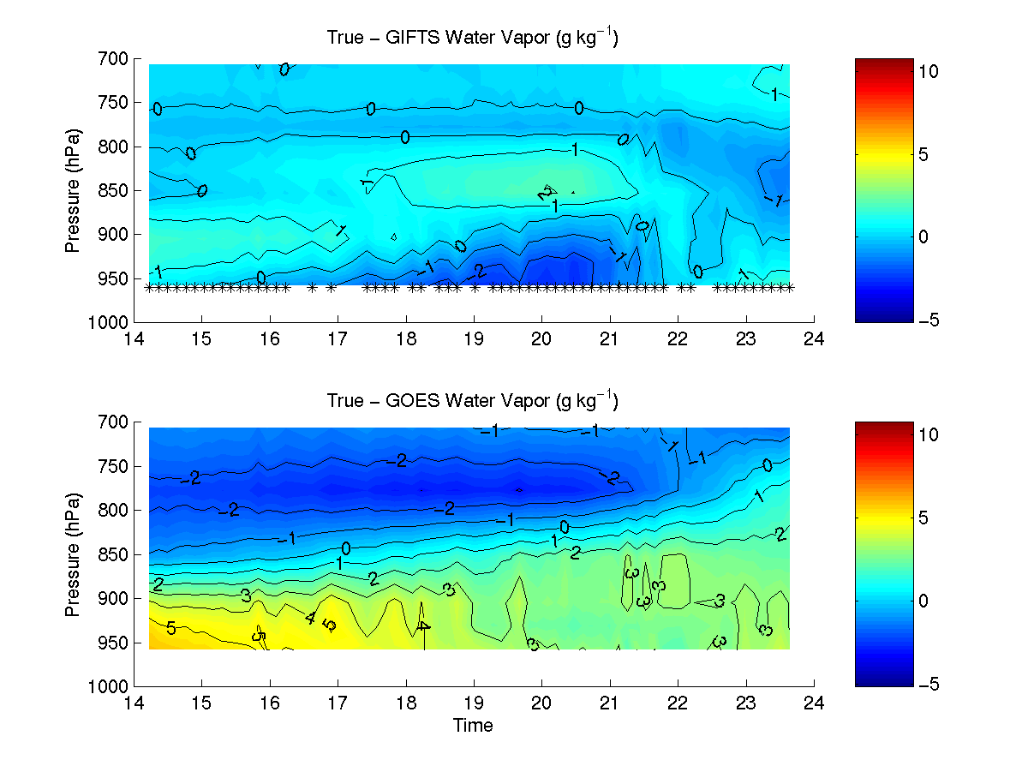
3 May 1999 – Oklahoma/Kansas tornado outbreak
GIFTS/GOES Retrieved-Moisture (g/kg) Errors
Truth>
Geo-Adv IR Errors>
Standard Dev. = 0.9 g/kg
Note Geo-I
reduces errors
and captures
low-level moisture peaks and vertical gradients
GOES Errors>
Standard Dev. = 2.4 g/kg
Analysis courtesy of W. Feltz, CIMSS.
Geo-Advanced IR correctly captures important vertical moisture variations
Notes:
Here upward looking AERI high-spectral data are used for truth and the retrieved high-spectral (middle chart) and broad-spectral (lower chart) are shown.
GEO-I is for Increased spectral resolution.

Slide 35
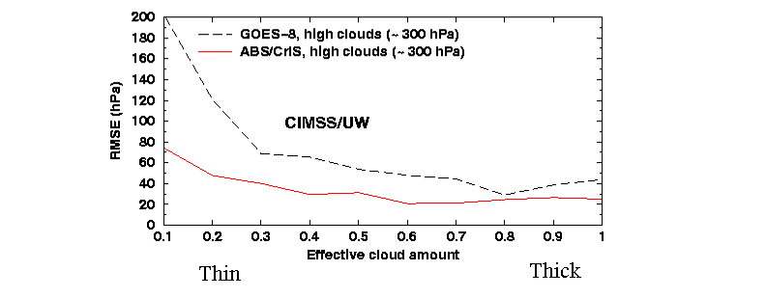
Better Observation of Cloud Properties
High spectral data allow a more accurate determination of high, thin clouds.
Notes:
Simulations. GOES-8 vs CrIS-type. 75 CONUS raob profiels. J. Li. 2001

Slide 36
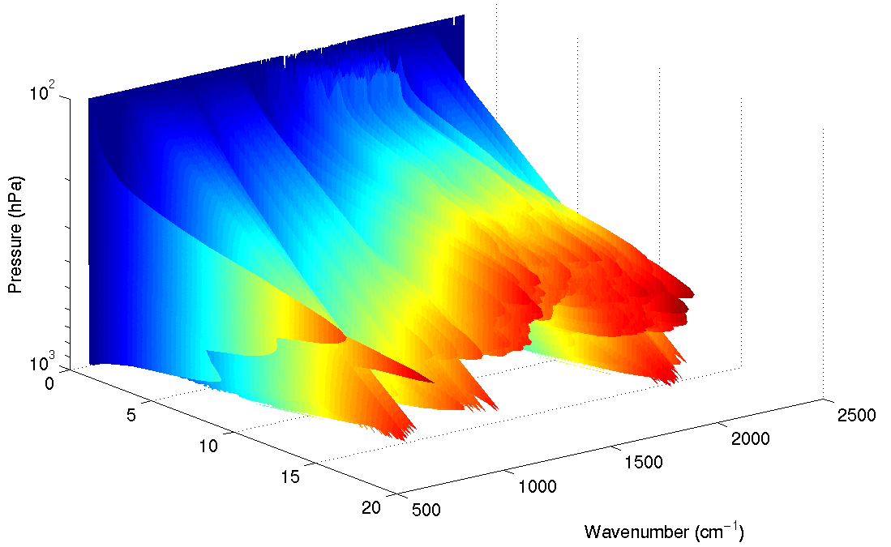
Overview
GOES-R Overview
  No dedicated Sounder
  Synergy with ABI
Current GOES Sounder
Select products
Sample applications
Summary
  More information
  References

Slide 37
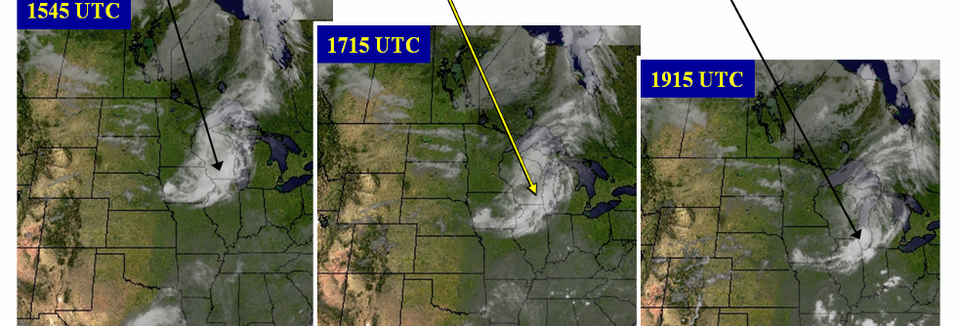
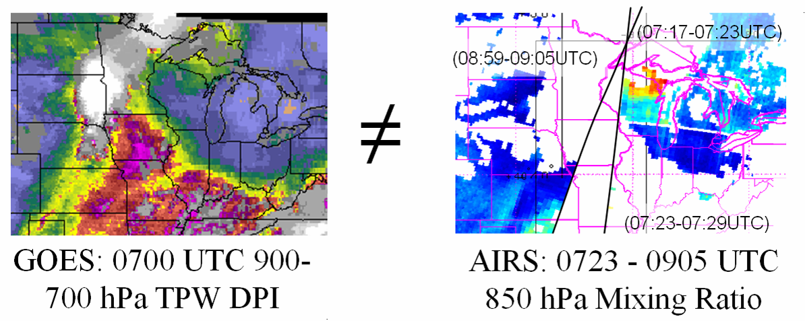
Example of Advantage of GOES over POES data for small-scale convection,
An un-forecast mesoscale Derecho which moved from MN across south-central WI, decayed and then re-intensified south of Chicago
Figure courtesy of R. Petersen, CIMSS.
Comparison of GOES (left) and AIRS (right) data coverage around 0700 UTC 20 July 2006.
Times and lateral limits of AIRS overpasses shown.
For GOES: Details of moisture maximum (warm colors) which was initially over Iowa and subsequently moved eastward to support convection over WI and IL are clearly identified in spatially continuous data.
For POES: No AIRS data were available over IA (indicated by white areas), due to combination of:
1) cloud obscurations (e.g., over MN and western IA in later 0900 UTC data), and
2) data gaps between successive orbital paths (e.g., central and eastern IA).
Note: Neither radiosonde nor aircraft moisture data would have been available around 0700 UTC for this area.
Notes:
From Ralph Petersen, now of CIMSS.

Slide 38
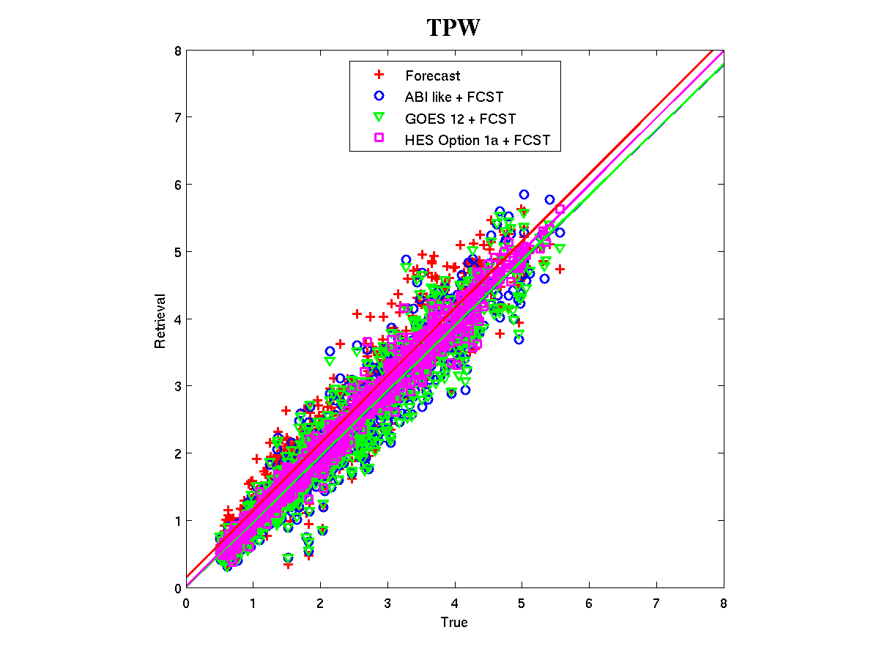
Benefits of high-spectral over broad-band measurements!
Root Mean Square Error
Forecast: 0.40
ABI like + fcst: 0.35
GOES 12 + fcst: 0.34
HES + fcst: 0.16
Experiments show that retrievals of Total Precipitable Water (TPW) from high-spectral (HES) data are much improved over current broadband (GOES-12+forecast).
Notes:
For TPW, the error is half from high-spectral data, compared to broad-band measurements.
Raob data are used for truth.
The ABI-like data are select sounder bands.
The GOES-12 case is GOES-12 sounder bands.
The HES (high-spectral) data are simulated.
The region is over CONUS.

Slide 39
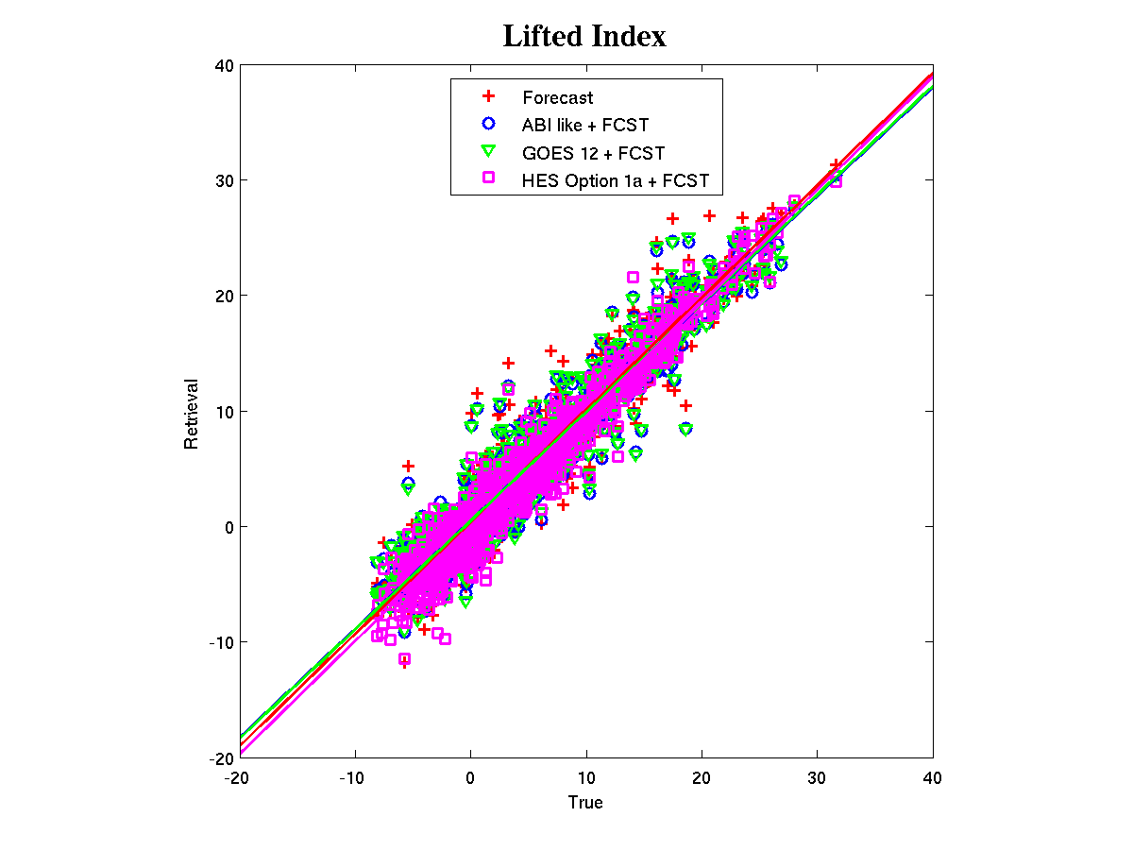
Benefits of high-spectral resolution over narrowband measurements!
Root Mean Square Error
Forecast: 2.27
ABI like + fcst: 2.20
GOES 12 + fcst: 2.18
HES + fcst: 1.79
Experiments show that retrievals of atmospheric instability from high-spectral (HES) data are much improved over current broadband (GOES-12+forecast).
Notes:
For LI, the error much less from high-spectral data, compared to broad-band measurements.
Raob data are used for truth.
The ABI-like data are select sounder bands.
The GOES-12 case is GOES-12 sounder bands.
The HES (high-spectral) data are simulated.
The region is over CONUS.

Slide 40
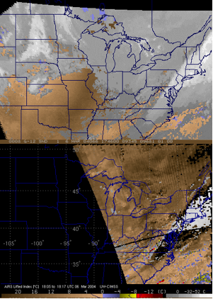
Derived Product Images of Lifted Index: GOES and AIRS
Current GOES Sounder showed a stable atmosphere.
No profiling via thin clouds.
Sample of AIRS (high-spectral IR) showed un-stable regions.
Retrievals generated through thin clouds.
Analysis courtesy of Jun Li, CIMSS.

Slide 41
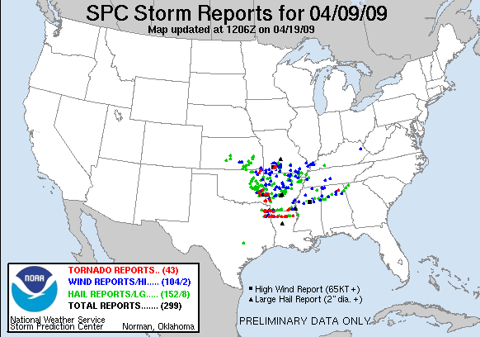
Sample AIRS (LI) in AWIPS
Might a polar Proving Ground reformat AIRS products in near realtime for AWIPS?

Slide 42
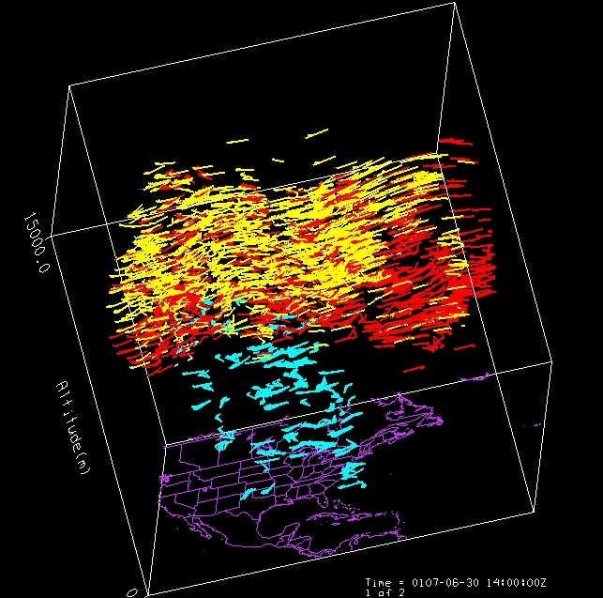
Atmospheric Motion Vectors from Sounder data
  Imager WV cloud tracked AMVs (yellow), Imager WV clear sky AMVs (red) and clear sky GOES Sounder AMVs (blue)
Much improved height-resolved winds from tracking features in retrieval fields from high spectral/temporal resolution rather than spectral images using broad band sounder
Iliana Genkova, Chris Velden, Steve Wanzong, Paul Menzel, CIMSS
Notes:
42
MM5 - Pennsylvania State University - National Center for Atmospheric Research Mesoscale Model.
GIFTS forward model retrievals from GIFTS water vapor channels. CIMSS retrievals of MM5 model run. Raw vectors. No winds beneath the clouds because of the cloud mask.
30 minute time steps at 50mb intervals. 1000mb – 350 mb. NASTI example compared well with LIDAR.
GIFTS - Geostationary Imaging Fourier Transform Spectrometer.

Slide 43
High spectral (HS) resolution IR data will help at least 17 other ABI-based products
GOES-R Observational Requirements:
Aerosol Detection (including Smoke and Dust)
Geomagnetic Field
Surface Albedo
Aerosol Particle Size
Probability of Rainfall
Surface Emissivity *
Suspended Matter / Optical Depth
Rainfall Potential
Vegetation Fraction: Green
Volcanic Ash *
Rainfall Rate/QPE
Vegetation Index
Aircraft Icing Threat
Legacy Atm. Vertical Moisture Profile *
Currents
Cloud Imagery: Coastal
Legacy Atm. Vertical Temperature Profile *
Sea & Lake Ice / Age
Cloud & Moisture Imagery
Derived Stability Indices *
Sea & Lake Ice / Concentration
Cloud Layers / Heights & Thickness *
Total Precipitable Water *
Sea & Lake Ice / Extent & Edge
Cloud Ice Water Path *
Total Water Content *
Sea & Lake Ice / Motion
Cloud Liquid Water
Clear Sky Masks
Ice Cover / Landlocked
Cloud Optical Depth
Radiances *
Snow Cover
Cloud Particle Size Distribution
Absorbed Shortwave Radiation: Surface
Snow Depth
Cloud Top Phase
Downward Longwave Radiation: Surface
Sea Surface Temps
Cloud Top Height *
Downward Solar Insolation: Surface
Energetic Heavy Ions
Cloud Top Pressure *
Reflected Solar Insolation: TOA
Mag Electrons & Protons: Low Energy
Cloud Top Temperature *
Upward Longwave Radiation *: Surface & TOA
Mag Electrons & Protons: Med & High Energy
Cloud Type
Ozone Total *
Solar & Galactic Protons
Convection Initiation
SO₂ Detection *
Solar Flux: EUV
Enhanced "V"/Overshooting Top Detection
Derived Motion Winds *
Solar Flux: X-Ray
Hurricane Intensity
Fire / Hot Spot Characterization
Solar Imagery: extreme UV/X-Ray
Low Cloud & Fog
Flood / Standing Water
Lightning Detection
Land Surface (Skin) Temperature *
Improved with HS
Turbulence
Visibility
* = Products degraded from original GOES-R (e.g.; now no HES)
ABI – Advanced Baseline Imager
Continuity of GOES Legacy Sounder Products from ABI
SEISS – Space Env. In-Situ Suite
EXIS – EUV and X-Ray Irradiance Sensors
GLM – Geostationary Lightning Mapper
Magnetometer
SUVI – Solar extreme UltraViolet Imager

Slide 44
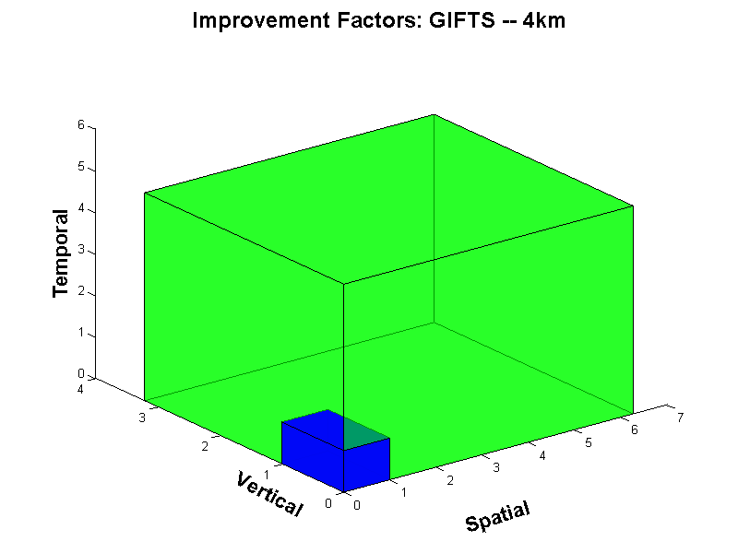
Overview
GOES-R Overview
  No dedicated Sounder
  Synergy with ABI
Current GOES Sounder
Select products
Sample applications
Summary
  More information
  References

Slide 45
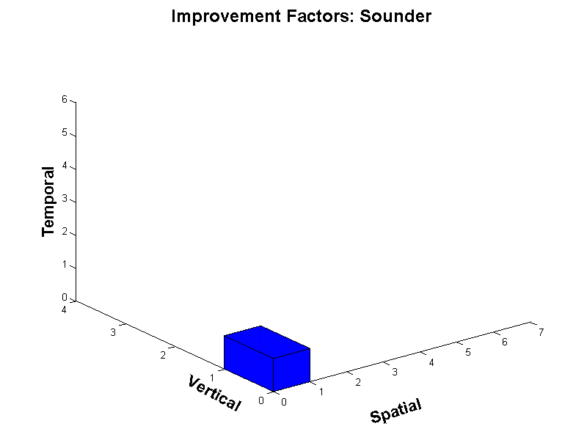
Current Sounder Data Volume
Current GOES Sounder
Horizontal
Notes:
Define current GOES sounder information volume to be 1 x 1 x 1 for the attributes.

Slide 46
Advanced High-Spectral IR Sounder
(GIFTS example)
Horizontal

Slide 47
Summary
An advanced geostationary sounder overcomes existing instrument limitations.
High-spectral IR observations needed for trace gas monitoring could also be used for a number of weather-related applications.
High-spectral resolution IR observations will resolve high temporal and vertical fluctuations of moisture that are not resolved by current in-situ or satellite measurements. High temporal resolution is unique aspect of GEO measurements.
Critical meteorological parameters (temperature, moisture, clouds, winds) with necessary temporal, spatial and vertical resolutions will improve monitoring of atmospheric conditions.
An advanced high-spectral sounder on GOES will fulfill requirements of several validated products.
Studies have estimated the economic and societal benefits of a high-spectral resolution sounder to be at least $4.2 B (Centrec study).

Slide 48
Conclusions on the need for advanced geostationary IR observations wrt weather applications
As stated in 2001…
  Technology is mature
  Meteorological need is documented.
  Time is right to update geostationary sounding instruments to provide required high spectral resolution measurements with high temporal refresh rates.

Slide 49
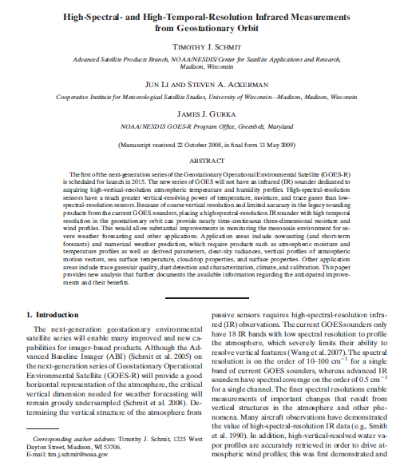
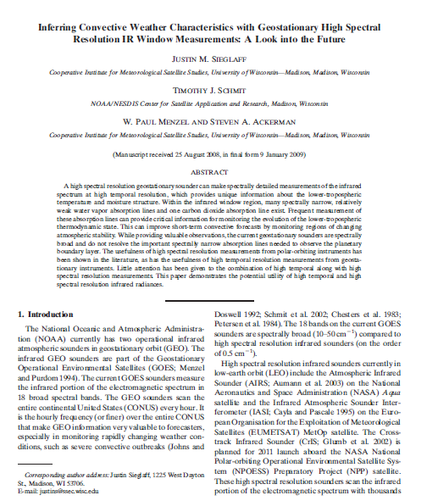
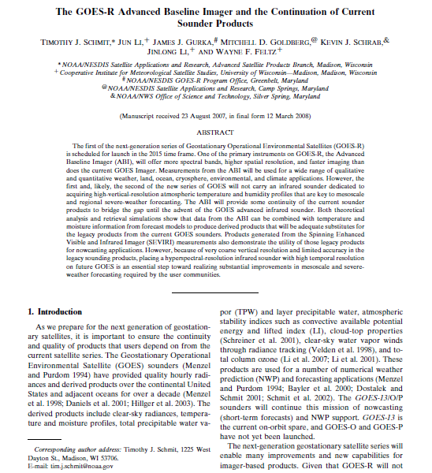
Select References
Schmit, T. J., J. Li, S. A. Ackerman, and J. J. Gurka, 2009: High spectral and temporal resolution infrared measurements from geostationary orbit, Journal of Atmospheric and Oceanic Technology, 26, 2273 - 2292.
(a.k.a., why we need an advanced geo-sounder)
Sieglaff, J., M., T. J. Schmit, W. P. Menzel, S. A. Ackerman, 2009: Inferring Convective Weather Characteristics with Geostationary High Spectral Resolution IR Window Measurements: A Look into the Future. J. Atmos. Oceanic Technol., 26, 1527–1541.
(a.k.a., potential now-casting applications)
Schmit, T. J., J. Li, J. J. Gurka, M. D. Goldberg, K. Schrab, J. Li, W. Feltz, 2008: The GOES-R ABI (Advanced Baseline Imager) and the continuation of current sounder products. J. of Appl. Meteor., 47, 2696–2711.
(a.k.a., the ABI isn’t an advanced sounder)

Slide 50
Back-up
No dedicated Sounder on GOES-R/S/T/U
Legacy products can be produced from the ABI.
ABI+forecast and GOES Sounder+forecast have similar precisions on temperature, moisture profiles, TPW, LI
Both GOES Sounder and ABI has significantly less temperature and moisture information than a hyper-spectral resolution IR sounder

Slide 51
Summary
High vertical resolution profiles of temperature and water vapor are fundamental for weather forecasting and climate monitoring.
  1 degree Celsius for temperature and 15 % water vapor can only be achieved with high spectral resolution measurements.
  Hemispheric Coverage
An advanced high-spectral sounder on GOES will fulfill requirements of the following validated products, which currently will either not be produced or will provide limited value added over numerical model guidance in the 2020 time frame:
  Advanced Atmospheric vertical moisture profile;
  Advanced Atmospheric vertical temperature profile;
  Capping inversion information;
  Moisture flux;
  Surface emissivity;
  Carbon monoxide concentration.
These requirements are not being met in GEO orbit
  Current GOES, GOES-R –S, -T, -U (present – 2028)
  LEO instruments and data processing have succeeded in showing how to make a revolutionary advance with low technical risk
    Atmospheric InfraRed Sounders (AIRS) 2002 – TBD
    Infrared Atmospheric Sounding Interferometer (IASI) 2006 -TBD
    Cross-track InfraRed Sounder (CrIS) 2011 – TBD

Slide 52
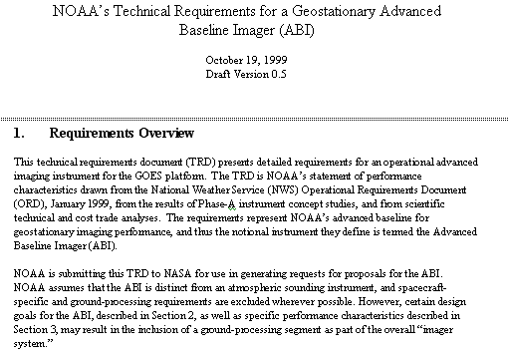
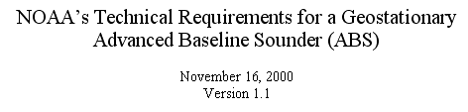
The early GOES-R series development included both the ABI and advanced geostationary sounder!
ABI was designed to co-exist with and advanced geostationary sounder. For example, so ABI could use the temperature and ozone information from the sounder.
ABI/ABS; circa 1999/2000

Slide 53
Geo advanced sounder – a history
Low-earth demonstration -- IRIS (1970)
Successful aircraft demonstrations (1980s and 1990s, etc.)
G-HIS was (briefly) slated to be on GOES-L (eg, GOES-11)
GOES-N/O/P were to be advanced instruments
  they turned out to be continuation instruments
The Advanced Baseline Sounder (ABS) was slated to be on GOES-Q, then -R
The ABI was designed assuming a companion high-spectral resolution sounder
Successful low-earth spectral resolution IR sounders demonstrated
  IMG, AIRS, IASI, etc.
HES was removed from GOES-R/S series (2006)
Strong support from the NRC Decadal study and others. Plans for operational geo sounders by EUMETSAT and China
ABI is not an advanced sounder, and hence cannot meet the original sounding or derived requirements
Notes:
The need for geo high-spectral resolution data have been demonstrated with aircraft and leo data.

Slide 54
GOES Related Benefit Reports
Geostationary Operational Environment Satellite System (GOES) GOES-R Sounder and Imager Cost/Benefit Analysis
An Investigation of the Economic and Social Value of Selected NOAA Data and Products for Geostationary Operational Environmental Satellites (GOES) (Centrec, 2007)
Existing reports document the economic and societal benefits gained from a high-spectral resolution sounder.
Improved GEO sounder data benefits is > $4.2 B
Notes:
Independent group studies have explored the economic and societal benefits of a high-spectral resolution sounder.
$4.2 B is from Centrec study, which includes areas from the earlier reports and is the total benefit thru the satellite lifetime.

Slide 55
Regional simulation using GOES-12 measurements
(update on 07 March 2007)
Using time/space collocated GOES-12 Sounder/RAOB/Forecast over CONUS
GOES-12 Sounder real retrieval
ABI-like from GOES-12 Sounder real retrieval (via channel selection)
HES retrieval is from simulated data
Retrievals are compared with RAOB
Soundings, Total precipitable water (TPW) and Lifted Index (LI) are used for performance analysis

Slide 56

RMS is based on the absolute difference between the retrieval and radiosondes

Slide 57

RMS is based on the absolute difference between the retrieval and radiosondes

Slide 58
Summary of Simulations
ABI alone temperature is degraded significantly from GOES Sounder alone, ABI alone moisture has comparable information of GOES Sounder alone
ABI+forecast and GOES Sounder+forecast have similar precisions on temperature, moisture profiles, TPW, LI
Both GOES Sounder and ABI has significant less temperature and moisture information than HES like hyperspectral IR sounder

Slide 59


Atmospheric winds are improved significantly with simulated High-spectral resolution data
Current GOES
High-spectral
C. Velden, CIMSS
Notes:
This is just a simulation to show the greater density of GOES-R Wind Vectors over central US (on right) as opposed to today (on left).

Slide 60


Atmospheric Motion Vectors from simulated Hyperspectral Sounder data
500 hPa
Noise Filtered Retrievals targets
Noise Filtered Retrievals wind vectors (no QI)
C. Velden, CIMSS
Notes:
60
MM5 - Pennsylvania State University - National Center for Atmospheric Research Mesoscale Model.
GIFTS forward model retrievals from GIFTS water vapor channels. CIMSS retrievals of MM5 model run. Raw vectors. No winds beneath the clouds because of the cloud mask.
30 minute time steps at 50mb intervals. 1000mb – 350 mb. NASTI example compared well with LIDAR.
GIFTS - Geostationary Imaging Fourier Transform Spectrometer.

Slide 61




Spectral resolution (0.3, 0.6, 1.2 cm**-1) impact on T/q retrieval
LW
MW

Slide 62
HES’
HES

Slide 63

Need: Monitor the lowest layers of the atmosphere
Analysis courtesy of Jun Li, CIMSS.
Resolving low level moisture is critical for forecasting convective development.
Notes:
Temperature and moisture structure of the

Slide 64

Example spectral coverage
Current GOES Sounder spectral coverage and that possible from an advanced high-spectral sounder. The broad-band nature of the current GOES limits the vertical resolution.

